Slide 1
FLUX ACADEMY · A SCHOOL FOR SEEING
MODULE 10 · PRACTICE & MASTERY
The Project as Engine & The Book as Proof
BY DANTE SISOFO

Slide 2
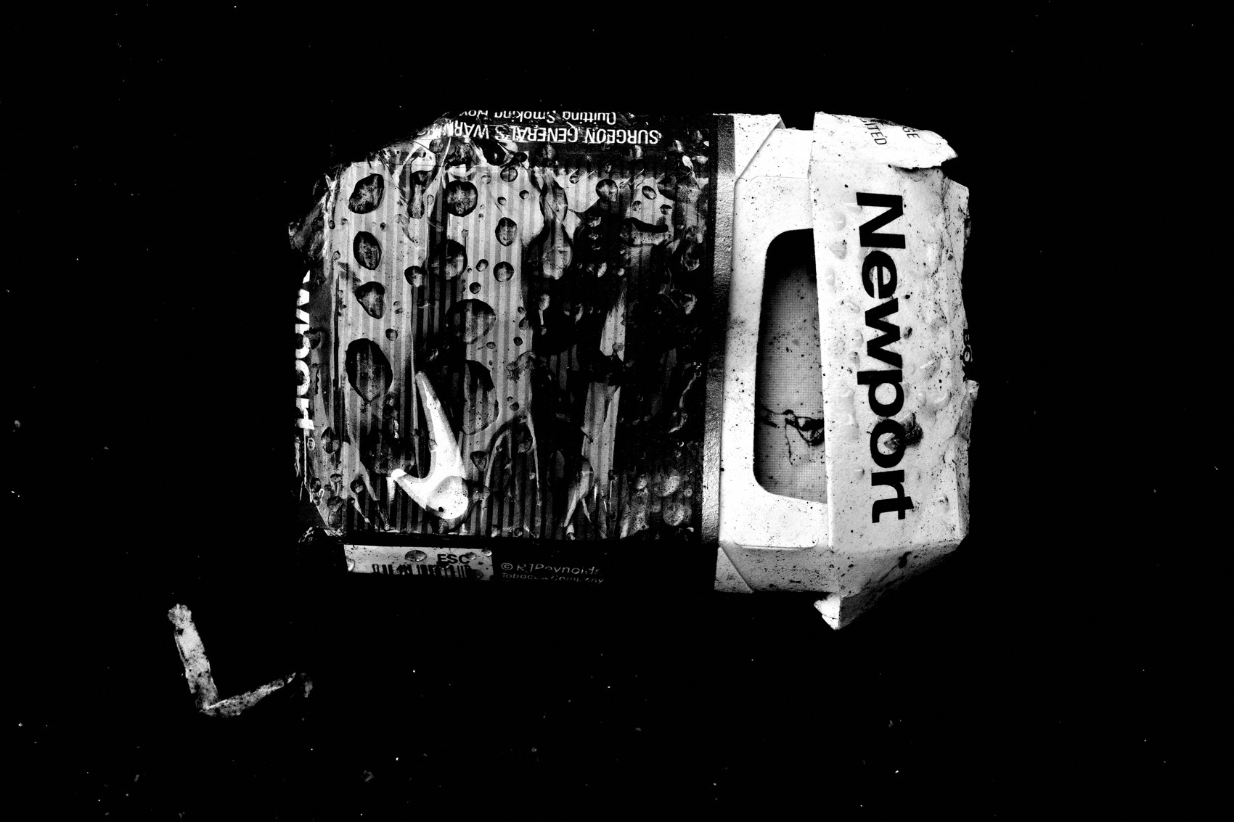
FLUX ACADEMY
BEAT 01 · CORE IDEA
The Project Is the Engine
— A project gives the work a spine
— The book is the proof it happened
— Structure turns walking into legacy
Notes:
What's popping, people — it's Dante. Today we're talking about the two things that separate a lifelong practice from a folder of random frames: the project and the book. A project is the engine — it gives every single walk a reason, a direction, a spine. The book is the proof. It says: this happened, it mattered, it's real. Without a project, you're just wandering. With one, you're building something.

Slide 3
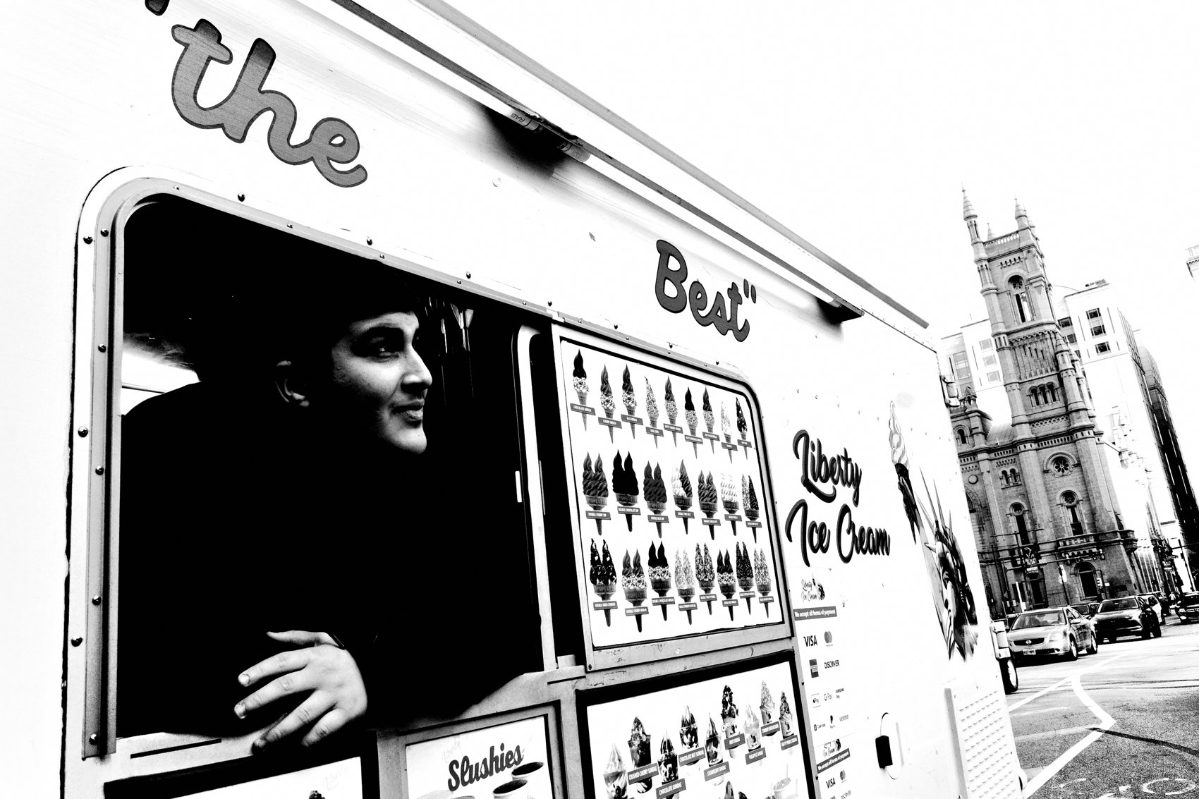
FLUX ACADEMY
BEAT 02 · LEARNING OBJECTIVE
What You'll Walk Away With
— How to build a project with real structure
— Why constraint unlocks more creativity than freedom
— How a zine or book closes the chapter and honors the work
Notes:
By the end of this lesson you'll know how to build a project that actually drives your daily practice — not just conceptually, but physically, with maps, archives, and tangible outputs. And you'll understand why making the thing — the zine, the book, the object — is not the finish line but the punctuation mark that keeps you going.

Slide 4
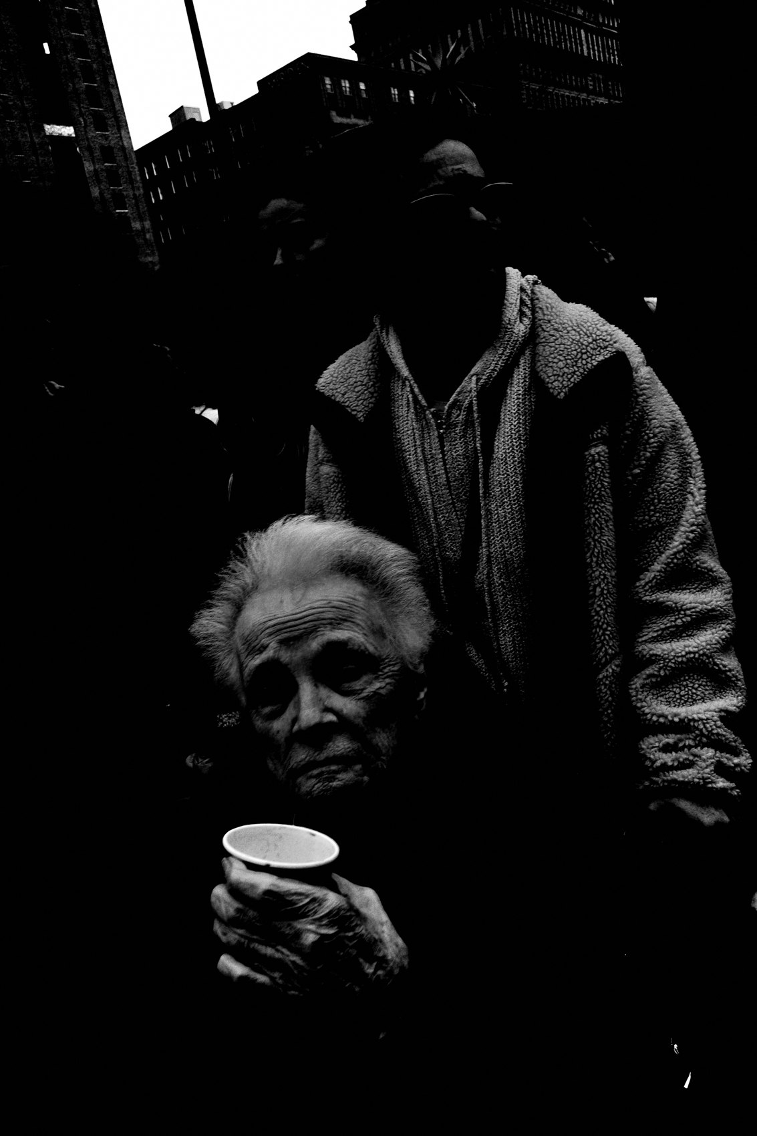
FLUX ACADEMY
BEAT 03 · WHY THIS MATTERS
Random Frames Don't Become an Archive
— Years of shooting without structure disappears into the hard drive
— No project = no throughline, no meaning
— The archive is only powerful if it coheres
Notes:
Here's the uncomfortable truth: if you shoot every day for a decade with no project holding it together, most of it evaporates. Files on a drive. Forgotten folders. Frames without context. A project changes that. It creates a throughline. It makes the archive cohere. Without structure, time doesn't build anything — it just accumulates.

Slide 5

FLUX ACADEMY
BEAT 04 · WHY THIS MATTERS
The Tangible Object Closes the Loop
— The physical object makes the work real
— Printing closes a chapter so a new one can open
— Sitting with the work teaches you what it means
Notes:
And here's what the digital-only world misses: the tangible object closes the loop. When you print the zine, sit down, and flip through it, you understand what you made in a way a screen never gives you. The chapter closes. You see the patterns. You learn what the work means. Then you start the next one. That rhythm — make, print, close, start — is how a practice compounds into a body of work.

Slide 6
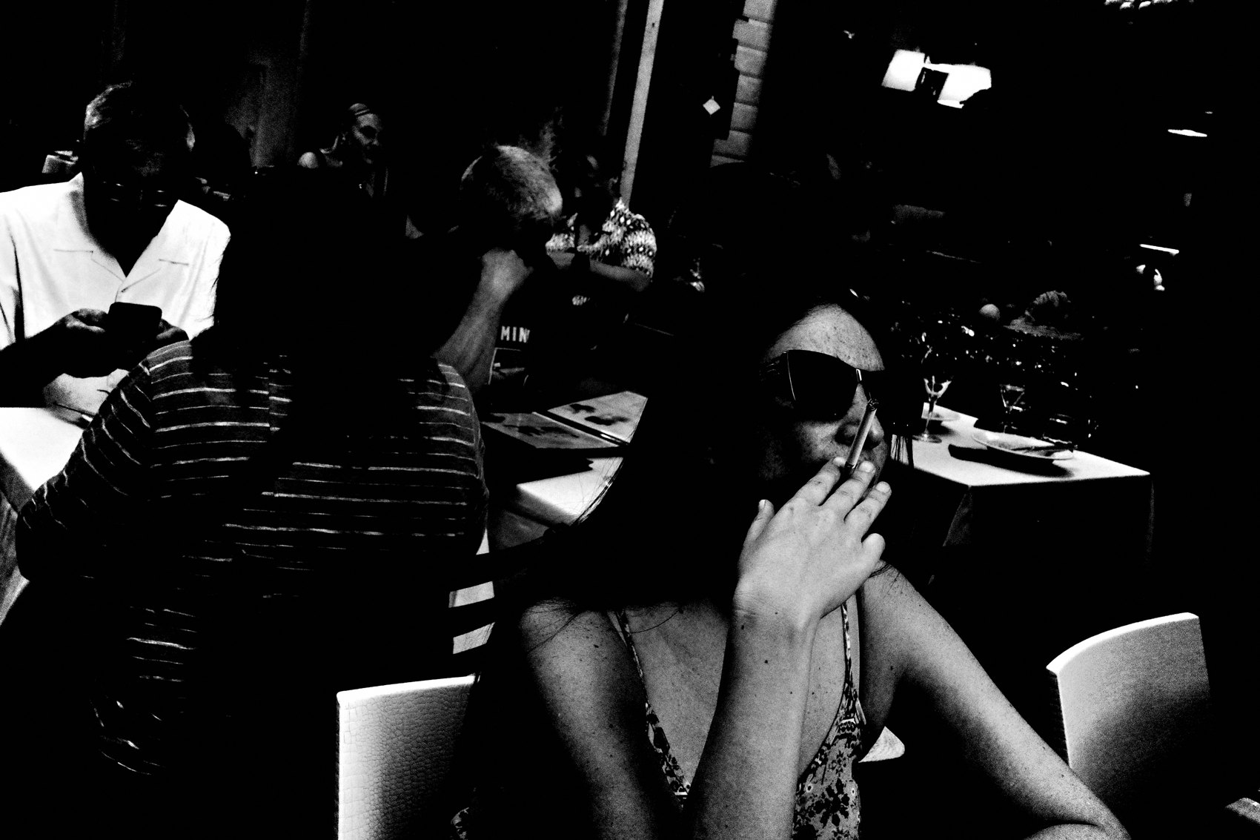
FLUX ACADEMY
BEAT 05 · MAIN TEACHING
The Survey Project as a Model
— Pick a place and commit to covering it, one street at a time
— Track the totals: streets, photographs, miles, hours
— Simple goal: document space and time
Notes:
The clearest model for a project is a survey. The goal couldn't be simpler: cover the entirety of a place — a city, a district, a neighborhood — one street at a time. You watch the totals climb: streets covered, photographs made, miles walked, hours logged. No fancy concept. No thesis statement. Just a map, a camera, and forward motion. The simplicity is the genius of it.

Slide 7

FLUX ACADEMY
BEAT 06 · MAIN TEACHING
The Map as Accountability Partner
— Build a literal map that tracks every street covered
— Progress becomes visible and satisfying
— Unlocking sections is like uncovering a video-game map
Notes:
I built a map that tracks every street I've covered — and watching it fill in is strangely powerful. It's not just organizational. It's motivational. Every walk reveals a new section. Every photograph adds another piece. Watching the numbers grow — streets covered, photographs made, miles walked — is almost like unlocking a map in a video game. The project gamifies showing up, and showing up is everything.

Slide 8
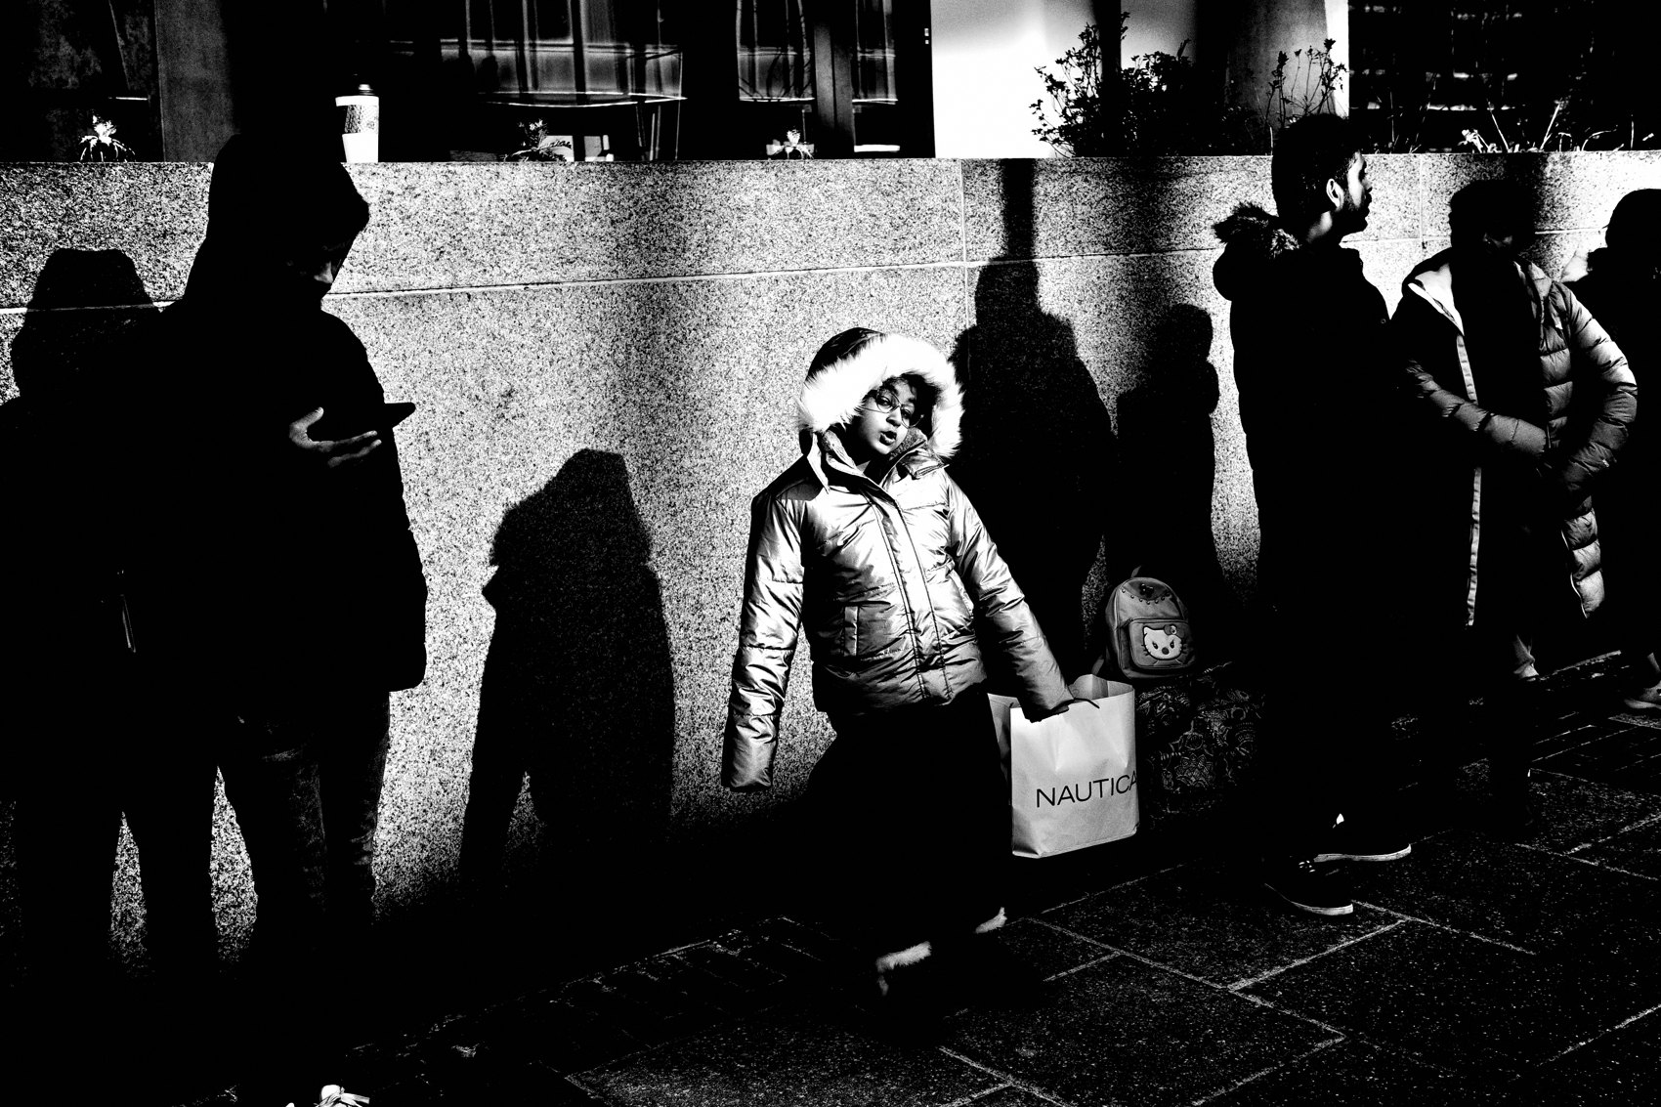
FLUX ACADEMY
BEAT 07 · MAIN TEACHING
Each Walk Is Its Own Closed Project
— One walk = a fixed count of photographs, a distance, a duration
— Metadata: time, date, location, GPS coordinates
— Granularity makes the archive searchable and alive
Notes:
Each individual walk becomes its own self-contained project — a fixed count of photographs, a distance covered, a span of hours. Every photograph is attached to a location on the map, so you can click any point and see the frame made at that exact spot. That granularity — time, date, GPS coordinates — transforms a collection of frames into a genuine archive. The data is part of the work.

Slide 9
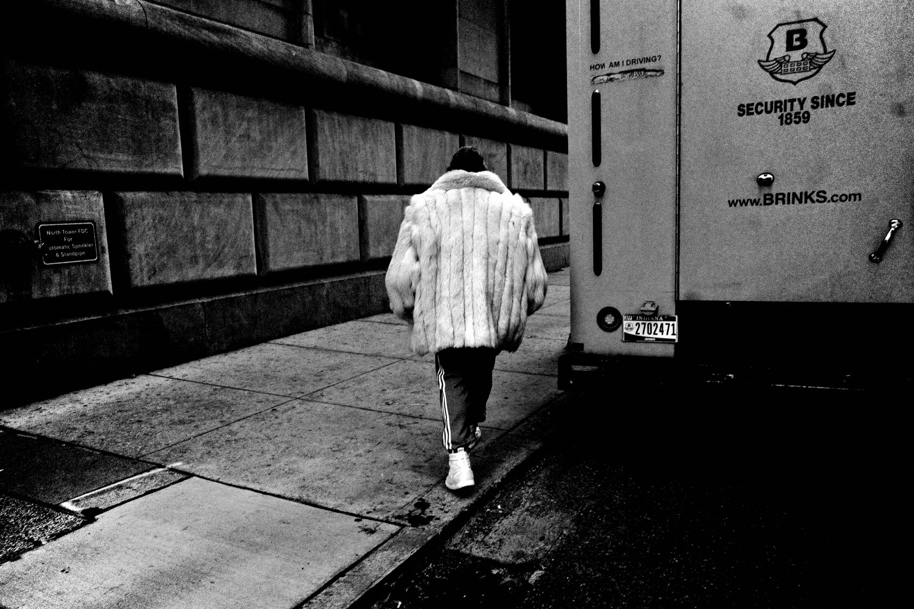
FLUX ACADEMY
BEAT 08 · MAIN TEACHING
The Archive Is the Artwork
— The archive itself is the primary output
— Individual great frames matter less than the whole document
— Space and time are the true subjects
Notes:
Here's the reframe that changed everything for me: the archive is the artwork. Not the individual great frame. Not the highlight reel. The archive. Inside a survey project, you're not trying to make great photographs — you're creating a document of space and time, preserving a place at a specific moment. That shift from photographer to archivist unlocks a completely different kind of freedom.

Slide 10

FLUX ACADEMY
BEAT 09 · MAIN TEACHING
The Daily Zine as a Closing Ritual
— 36 photographs per zine: time, date, location, GPS, contact sheet
— Printed on a cheap Brother LaserJet on copy paper
— The imperfections are part of the aesthetic
Notes:
Every day I come home and make a zine from the walk. Thirty-six photographs. Time, date, location, GPS coordinates on each image. A contact sheet on the back. A short manifest. A QR code linking to the digital archive. Printed on a cheap monochrome Brother LaserJet on ordinary copy paper. And honestly? I love it. The grain, the grit, the disposable quality of the paper — all of it feels aligned with the work. The imperfections are the aesthetic.

Slide 11

FLUX ACADEMY
BEAT 10 · MAIN TEACHING
Constraint Is the Creative Liberator
— A "boring" block: warehouses, junk cars, abandoned lots
— No obvious subject forces deeper looking
— The tighter the constraint, the more freely you see
Notes:
Here's a principle that runs through every project worth building: creative constraint is the liberator. Take a stretch that looks empty — warehouses, abandoned lots, random junk cars. On paper, nothing to photograph. But that's exactly why it becomes interesting. When there's no obvious subject, you look harder. Details beneath cars. Light falling across concrete. The geometry of a shadow. The texture of a wall. The constraint forces attention. And attention is everything.

Slide 12

FLUX ACADEMY
BEAT 11 · MAIN TEACHING
Thinking Like a Cartographer
— Less photographer, more cartographer or archivist
— Miles walked, timestamps, metadata — as important as the frames
— The project documents change as it happens
Notes:
I've started thinking less like a photographer and more like a cartographer. Walk a long avenue and you move through historic stone facades and old churches — then suddenly you're surrounded by abandoned buildings, faded signs, and new construction. The street transforms as you walk it. Architectural changes. Economic shifts. New developments. Decaying infrastructure. All existing simultaneously. The goal isn't to judge any of it. It's to preserve it.

Slide 13

FLUX ACADEMY
BEAT 12 · MAIN TEACHING
Unexpected Discoveries Are the Real Reward
— The best moments in a project are never in the plan
— Strangers open doors; conversations become history lessons
— The walk becomes part project, part human connection
Notes:
Some of the most powerful things a project gives you were never in the plan. Cover enough ground and you meet the people who live there — someone who invites you inside and tells you the history of the oldest house on the block, or a family member who points out the parks and corners where they played as a child. The walk becomes part photography project, part living history lesson. Those encounters are just as important as the photographs themselves.

Slide 14

FLUX ACADEMY
BEAT 13 · MAIN TEACHING
The Workflow Must Be Frictionless
— Ricoh GR: red filter, crop mode, double-tap shortcut
— Move between macro, 50mm crop, and 28mm almost instantly
— Tap. Tap. Click. Tap. Tap. — fluid, uninterrupted walking
Notes:
The workflow has to be frictionless or the project dies. With the Ricoh GR monochrome, I use the red filter and crop mode assigned to a shortcut. A quick double-tap switches me to a 50mm equivalent field of view. That means I can move between macro, crop mode, and 28mm almost instantly — most photographs made while walking. Tap. Tap. Click. Tap. Tap. Back to 28mm. The fluidity is everything. Covering ground quickly demands it.

Slide 15
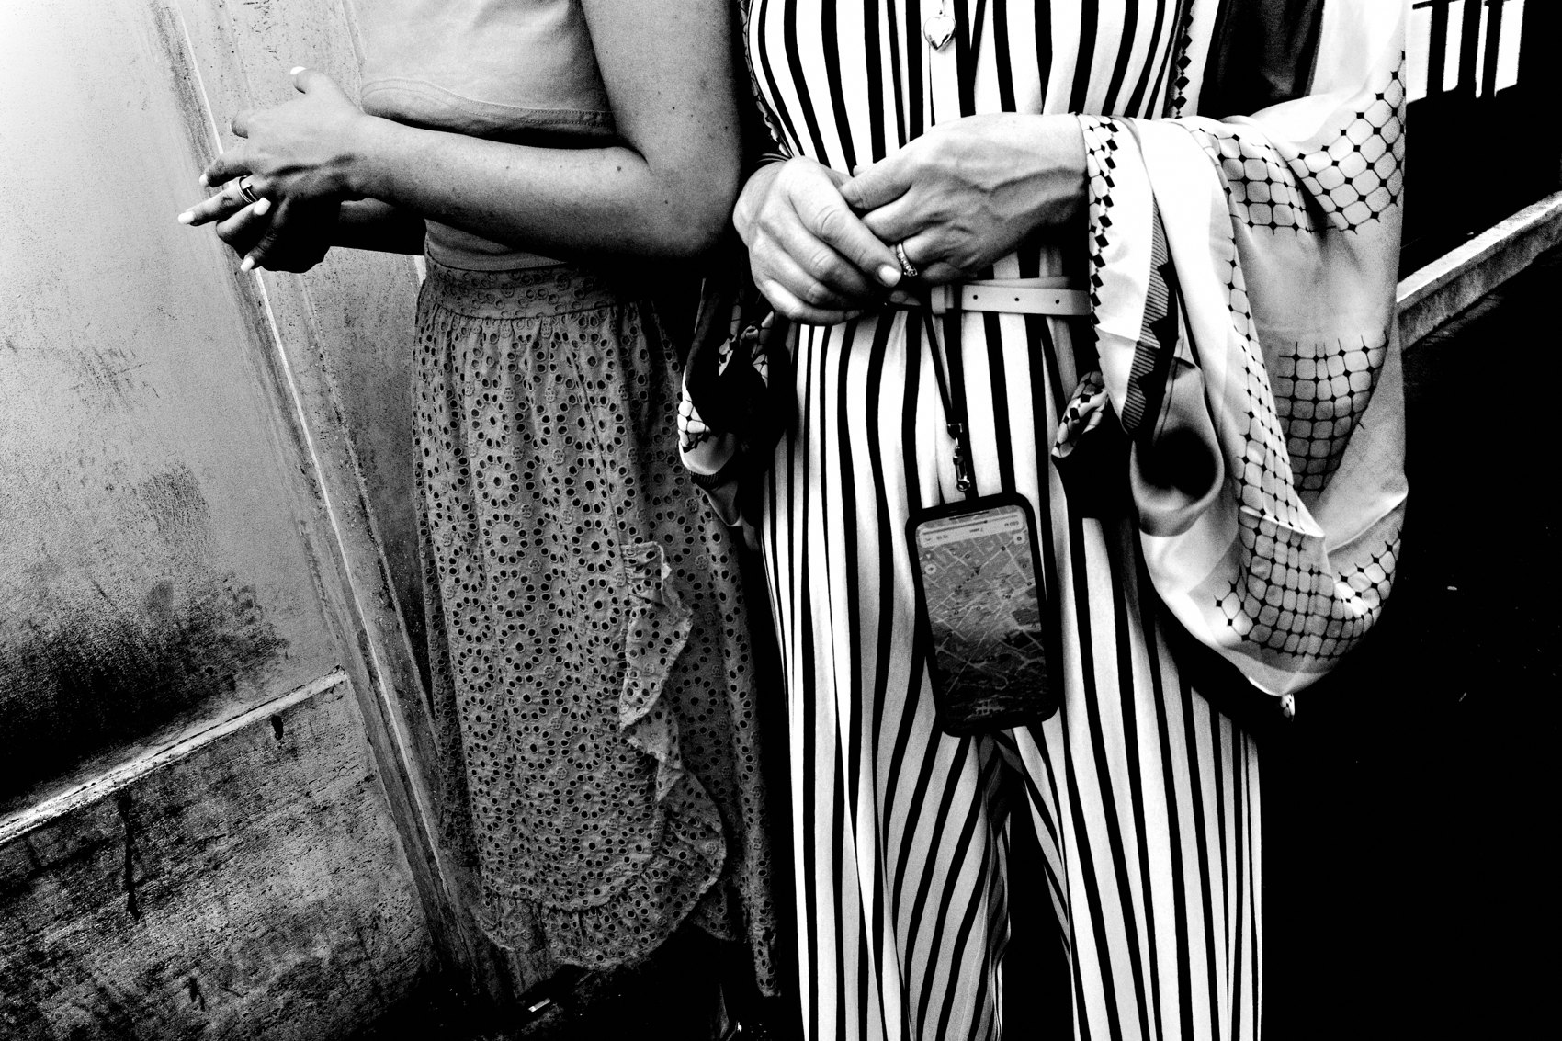
FLUX ACADEMY
BEAT 14 · MAIN TEACHING
Walk More to See More
— The more you walk, the more you see
— The more you see, the more you photograph
— Reorient the day around walking, not shooting
Notes:
There's a lesson this project keeps reinforcing: the more you walk, the more you see. The more you see, the more you photograph. So what if the ultimate goal wasn't to photograph more? What if it was simply to walk more? That's how I orient my days now. One street. One avenue. One creative constraint. The walking is the practice. The photographs are what the walking produces.

Slide 16
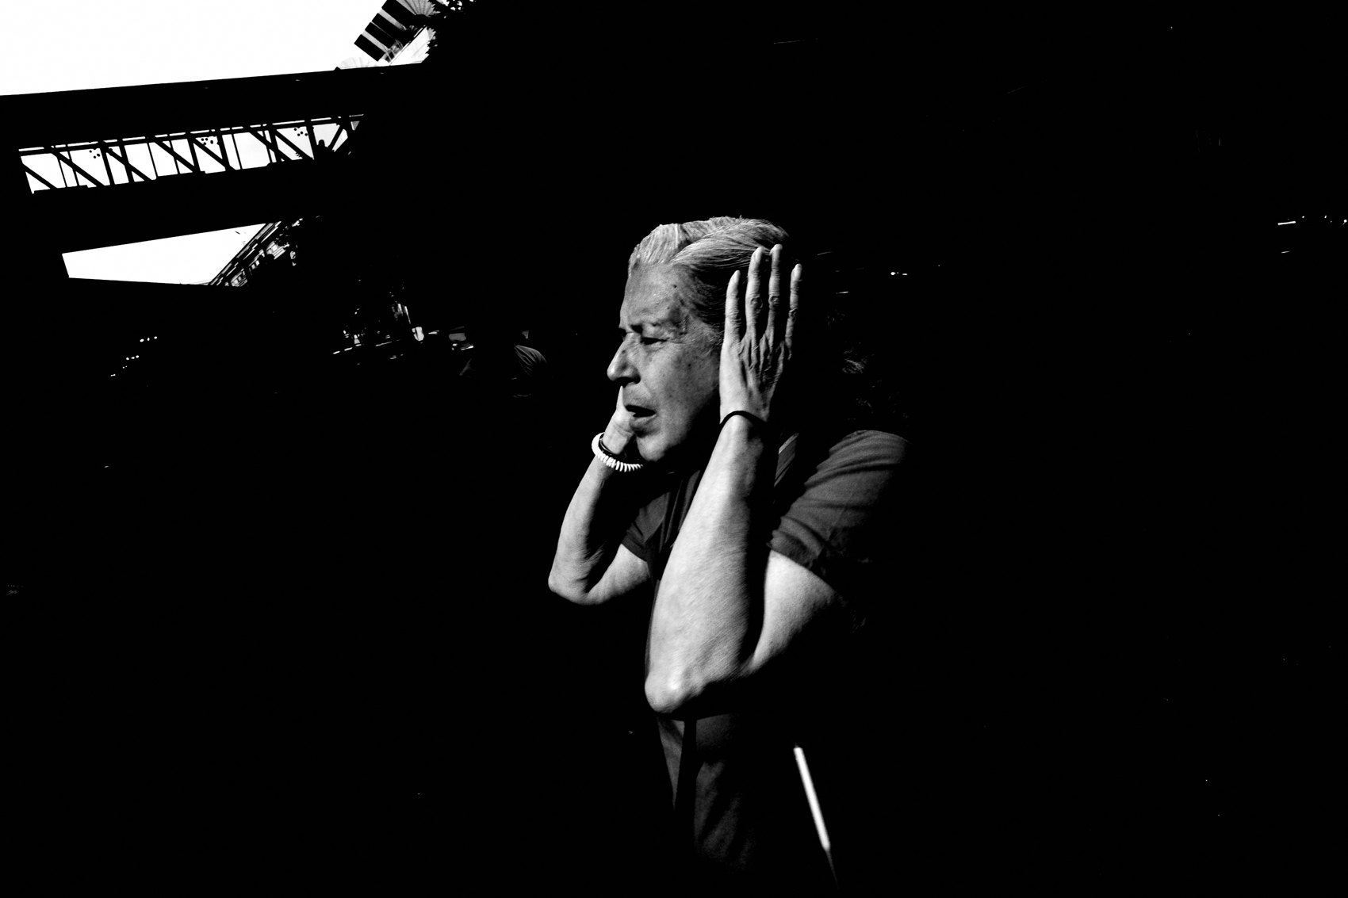
FLUX ACADEMY
BEAT 15 · MAIN TEACHING
The Accumulation Creates Satisfaction
— The map updates. The zine gets printed. The chapter closes.
— Seeing work accumulate is a distinct kind of fulfillment
— No urge to stop when the process itself rewards you
Notes:
One thing I've noticed about long-form project work: the satisfaction is in the accumulation. The map updates. The zine gets printed. The chapter closes. There is something incredibly rewarding about watching the work stack up day by day — streets covered, photographs cataloged, miles logged. I don't feel any urge to stop because the process itself is fulfilling. That's the secret. Build a project where the process rewards you and you'll never run out of reasons to show up.

Slide 17
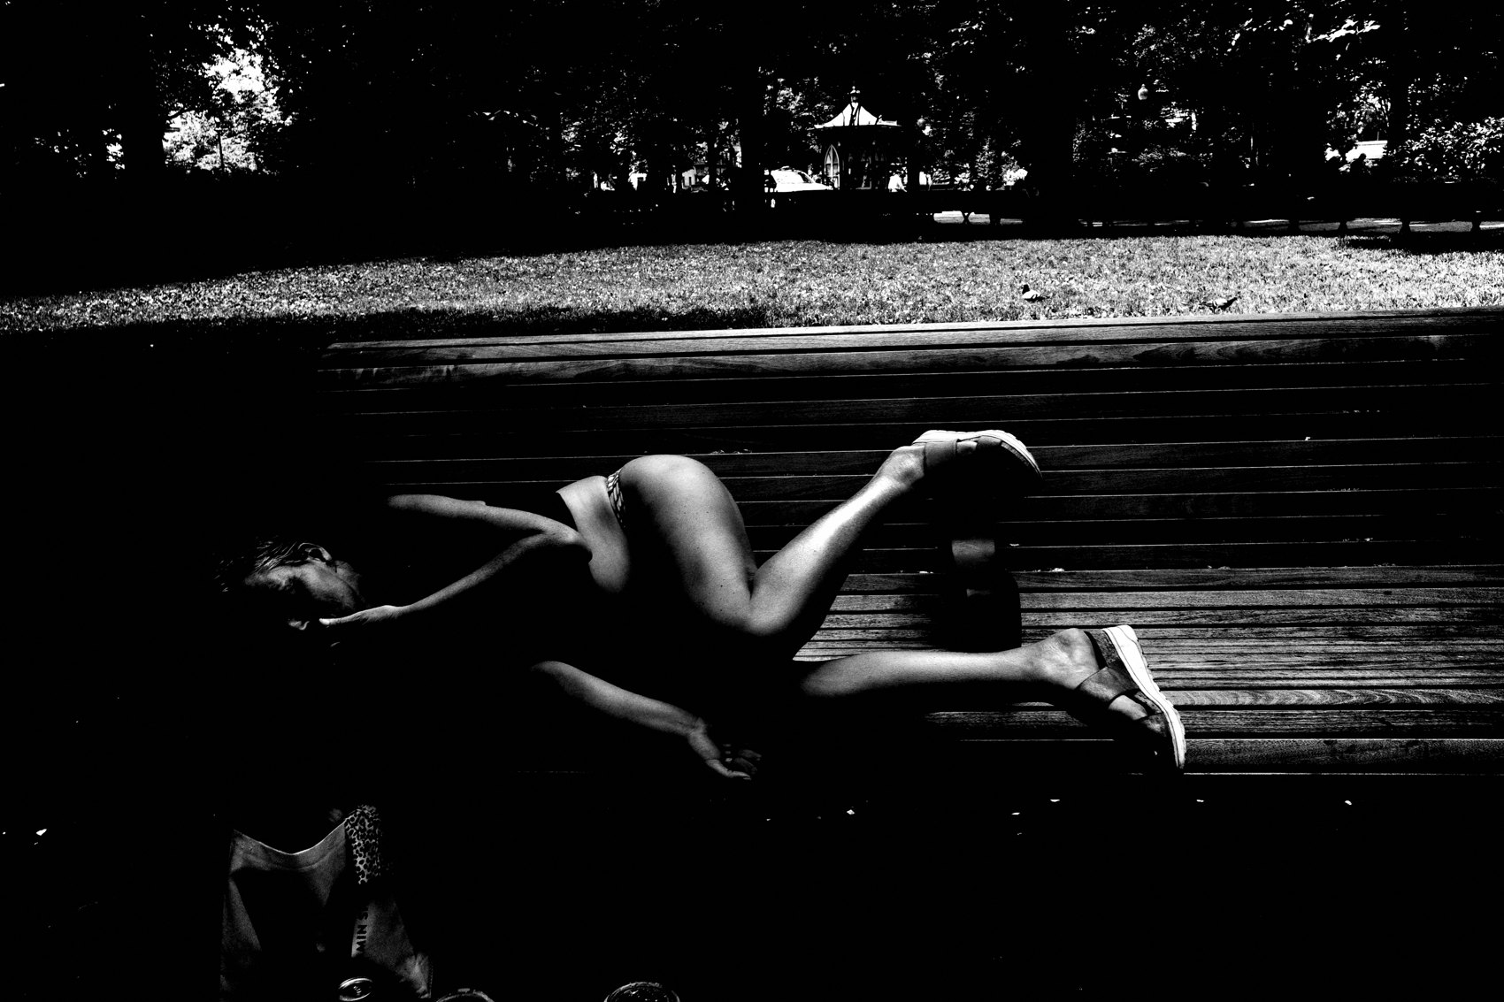
FLUX ACADEMY
BEAT 16 · MAIN TEACHING
Opening the Archive to Others
— A submission portal lets anyone upload their own mapped walk
— People in other countries document their own neighborhoods
— The archive grows into a collective document of the world
Notes:
A project becomes even more powerful when it opens up. Build a way for others to contribute — a portal where anyone can upload their own mapped walks — and people in other cities and countries start documenting their own neighborhoods alongside yours. Seeing others use the tool — adding their walks, their streets, their cities — is one of the most rewarding parts of the whole thing. The archive starts to grow into something bigger than one person. A collective document of the world.

Slide 18
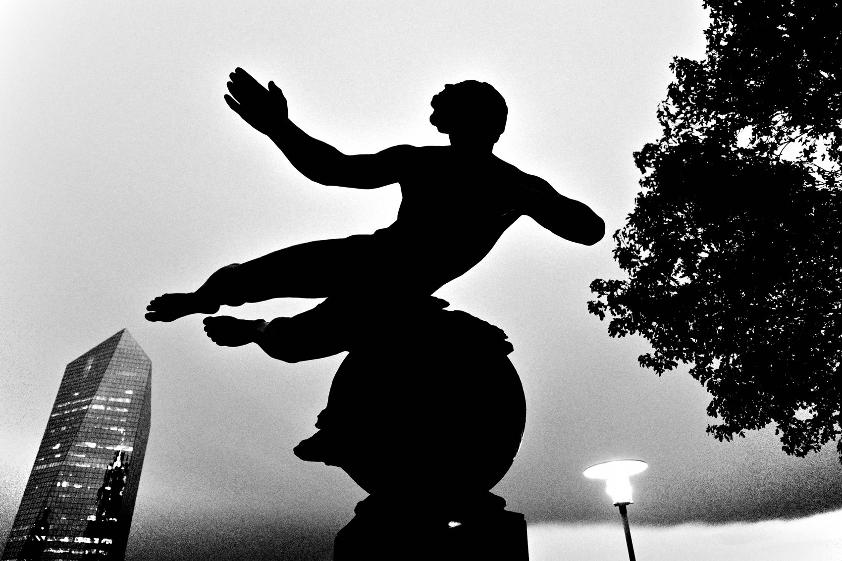
FLUX ACADEMY
BEAT 17 · PRACTICAL APPLICATION
Map Your Own City
— Pick one street, neighborhood, or city you care about
— Track every block covered — digital map or hand-drawn
— Let the map be the motivation to keep walking
Notes:
Your assignment: map something you care about. It doesn't have to be an entire city. One neighborhood. One avenue. One square mile. Pick it, commit to it, and start tracking every block you cover. The map becomes your accountability partner. Every uncovered section is an invitation. Watch how quickly the constraint transforms a familiar place into an inexhaustible subject.

Slide 19
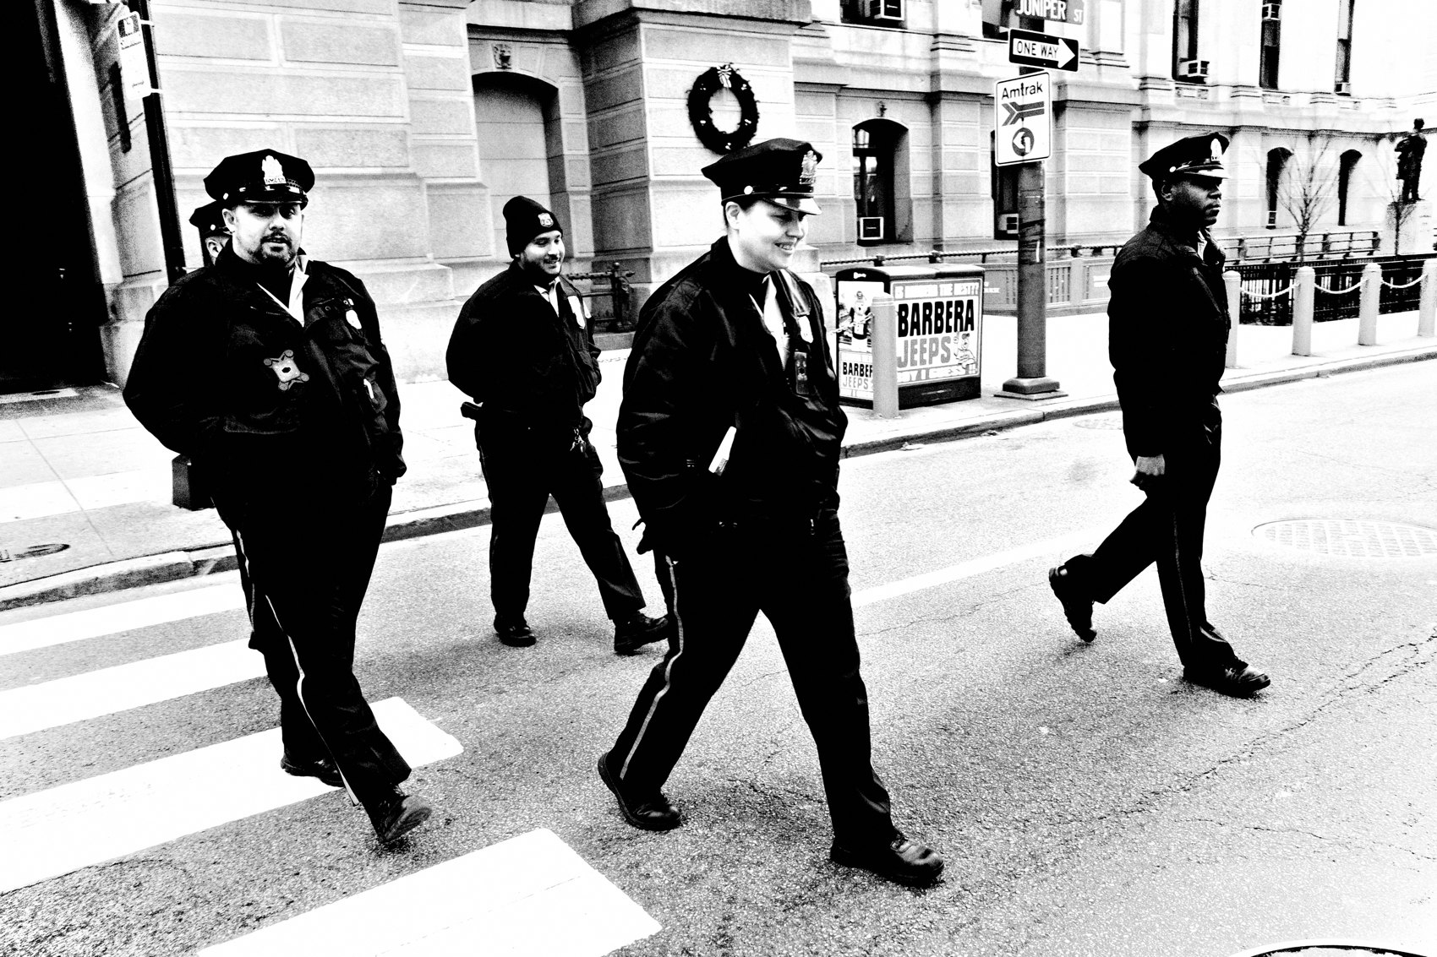
FLUX ACADEMY
BEAT 18 · PRACTICAL APPLICATION
Build the Daily Closing Ritual
— At end of each shoot, select 36 frames and make a zine
— Include time, date, location on every image
— Print it, hold it, flip through it — then start the next one
Notes:
Build the closing ritual. At the end of every walk, select your frames — thirty-six is a good number, it forces editing — and make something physical. A zine. A printed contact sheet. Even a PDF. Include the metadata: time, date, location. Print it. Hold it. Flip through it slowly. That act of sitting with the work teaches you things a screen never will. Then start the next one. The rhythm is the practice.

Slide 20
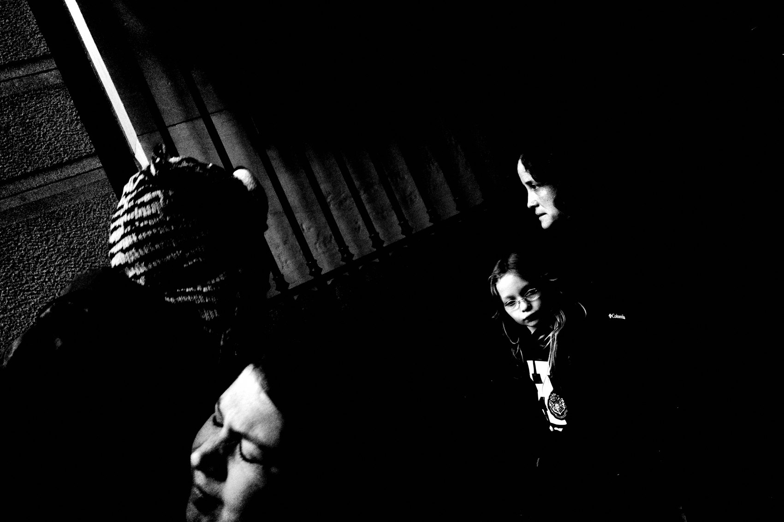
FLUX ACADEMY
BEAT 19 · PRACTICAL APPLICATION
Let the Archive Be the Primary Output
— Shift the goal from "great photograph" to "honest document"
— The archive grows whether or not any single frame is great
— Longevity beats highlight reels every time
Notes:
Shift your goal. Stop trying to make the great photograph on every walk. Start trying to build the honest document. The archive grows whether or not any single frame is extraordinary. And over time — over years of this — the archive becomes something no single great frame could ever be. A record. A life. A body of work. Longevity beats the highlight reel every time.

Slide 21
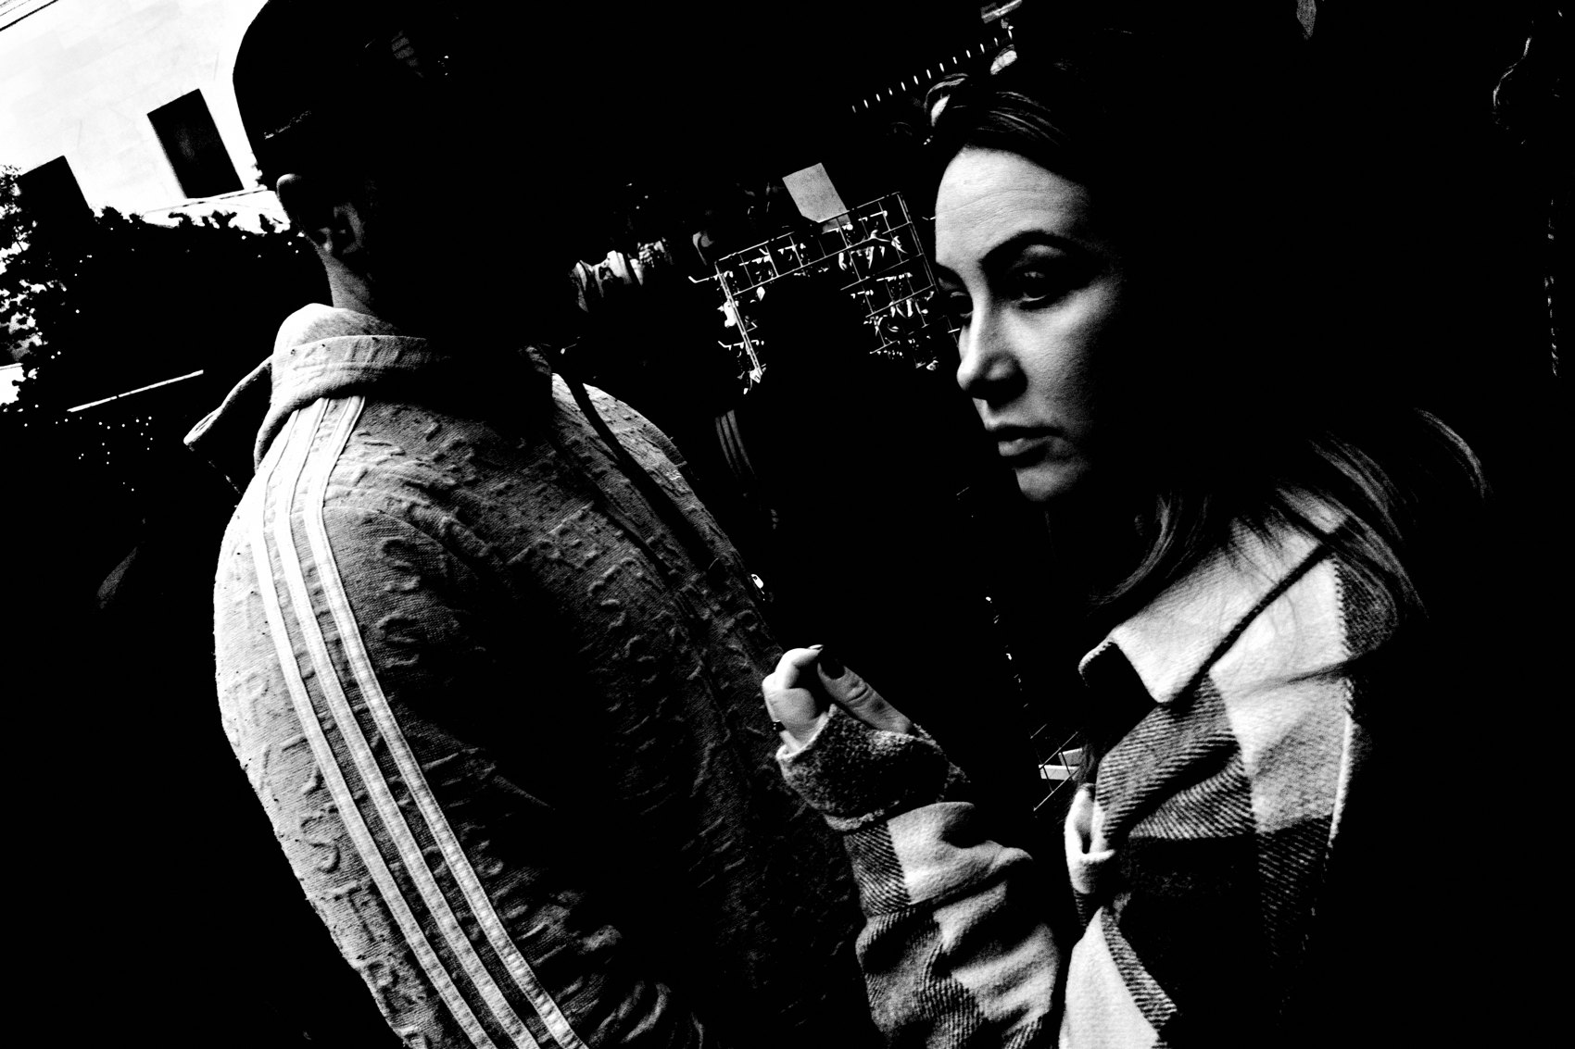
FLUX ACADEMY
BEAT 20 · COMMON MISTAKES
Waiting for the Perfect Project Concept
— "I'll start when I have a great idea" is the trap
— The project reveals itself through the walking, not before it
— Start simple, start local, start today
Notes:
The biggest mistake I see is waiting for the perfect concept before starting. I'll start when I have a great idea. I'll start when the timing is right. But the project doesn't reveal itself before you start — it reveals itself through the walking. The strongest survey projects aren't grand conceptual statements. They start from a simple goal: cover the place. Start simple. Start local. Start today. The concept emerges from the accumulation.

Slide 22
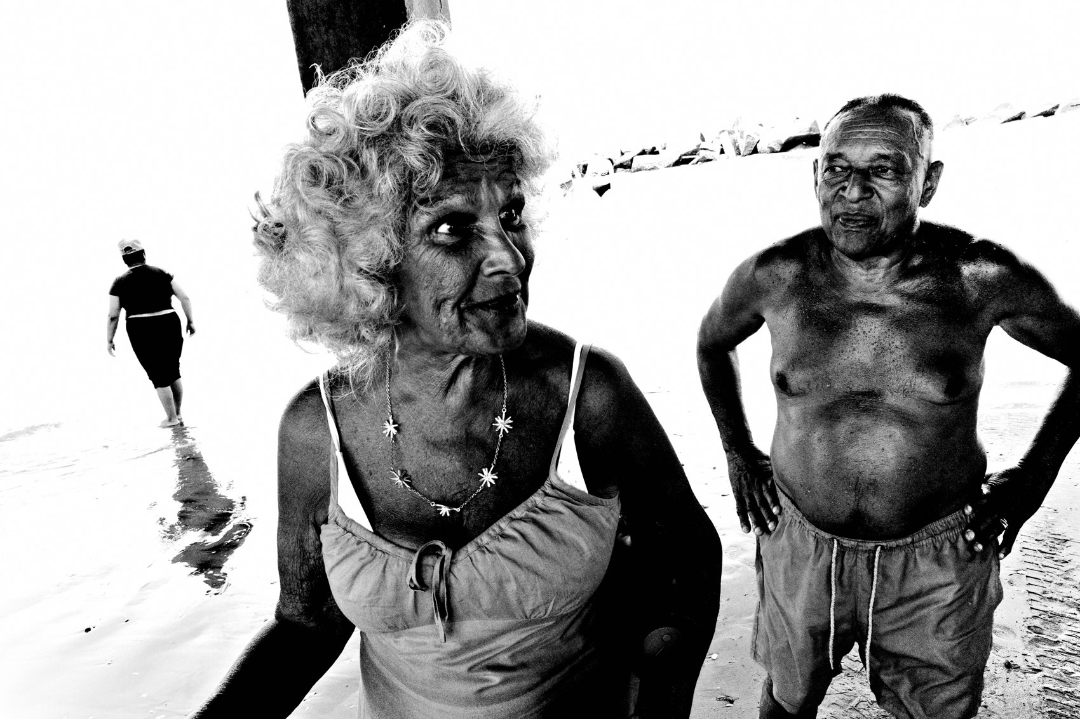
FLUX ACADEMY
BEAT 21 · COMMON MISTAKES
Making the Project Too Complicated to Sustain
— Complex workflows become reasons not to show up
— The simpler the system, the longer it lasts
— One camera, one constraint, one closing ritual — that's enough
Notes:
The other mistake is overengineering the project until it collapses under its own weight. Complex editing workflows. Elaborate filing systems. Gear decisions multiplying daily. Complexity becomes the reason not to show up. I use one camera, one focal length, baked-in JPEG, one constraint per walk, and one daily closing ritual. That's the whole system. The simpler it is, the longer it lasts. And longevity is the only metric that matters.

Slide 23
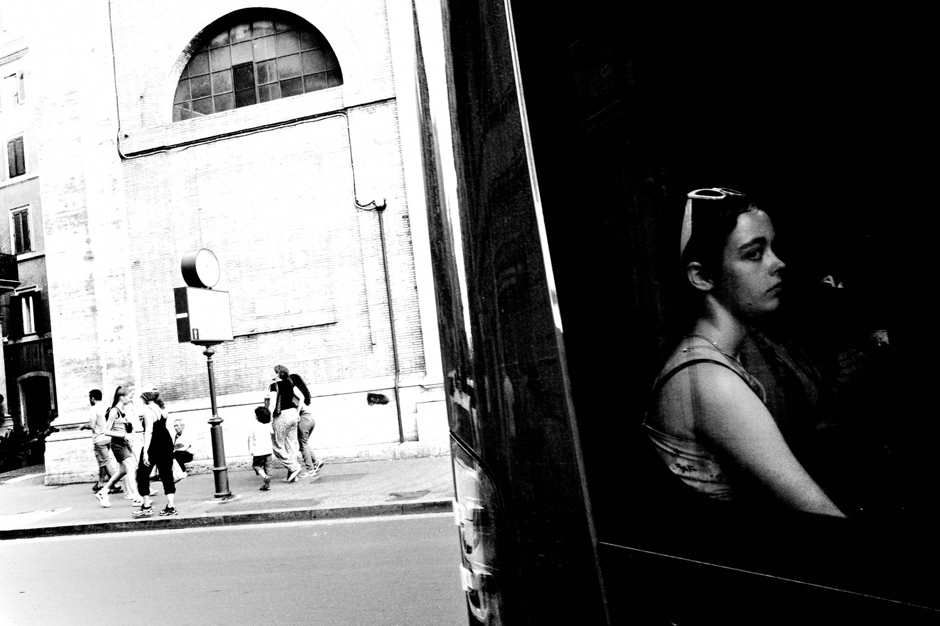
FLUX ACADEMY
BEAT 22 · RELATIONSHIP TO PREVIOUS
From Daily Practice to Long-Form Vision
— Lesson 051 established the daily habit and the flow state
— This lesson gives that daily habit a larger container
— The project is where daily practice becomes lasting work
Notes:
Lesson 051 built the daily habit — the flow state, the walk, the quiet commitment to showing up. This lesson gives that daily habit a larger container. The project is where the daily practice stops being just maintenance and starts becoming lasting work. One is the foundation; the other is the structure you build on top of it. You needed Lesson 051 before you could use this one.

Slide 24
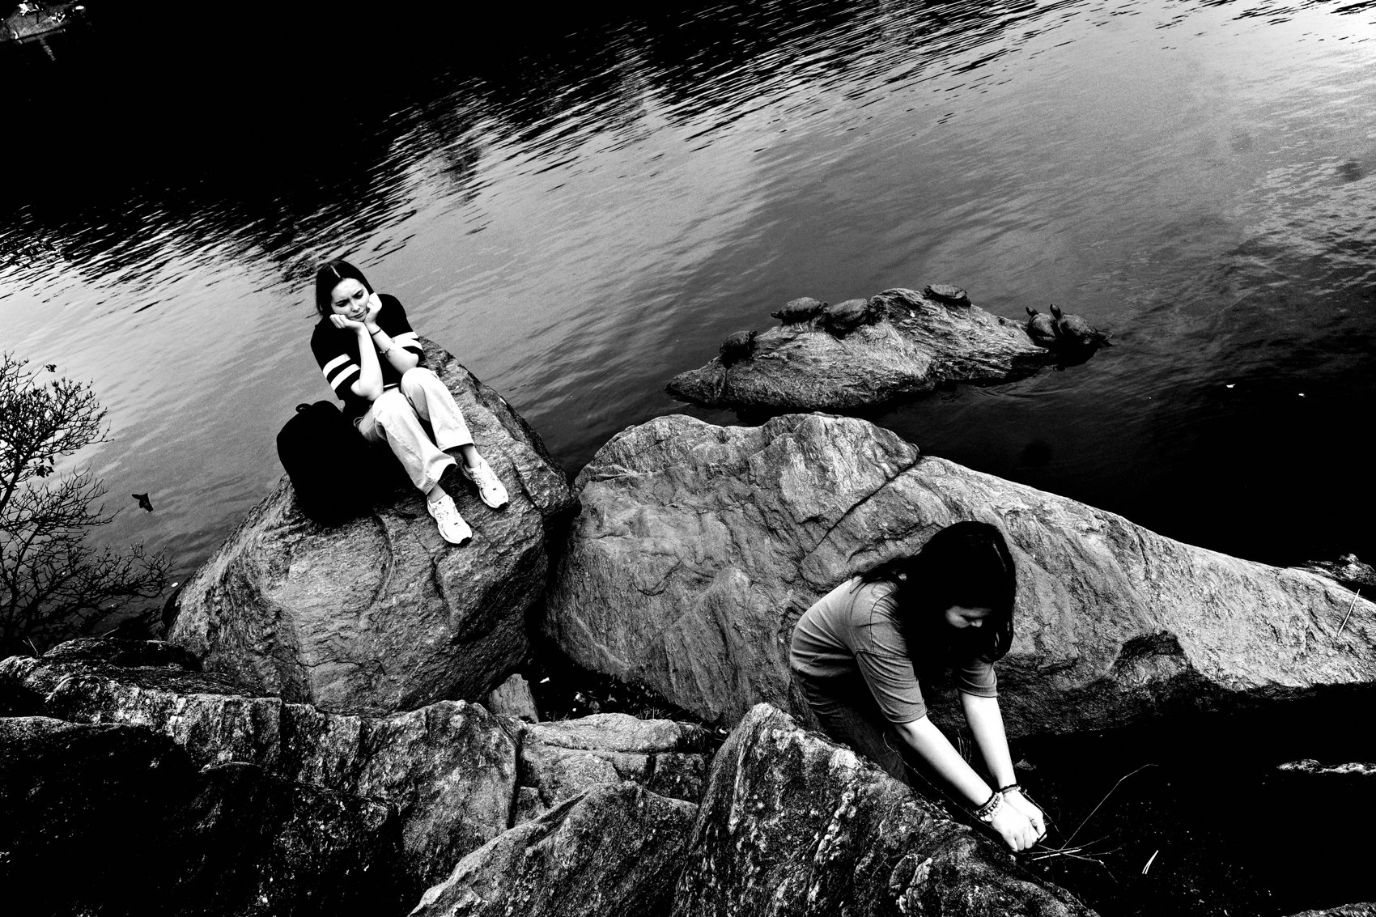
FLUX ACADEMY
BEAT 23 · SUMMARY / TAKEAWAY
Map It, Walk It, Print It, Repeat
— The project gives every walk a reason
— The book — the zine, the archive — makes it real
— Map it. Walk it. Print it. Repeat.
Notes:
Last thing. A project is the engine because it gives every single walk a reason — a direction, a constraint, a place on the map still waiting to be uncovered. The book, the zine, the printed archive — that's the proof. It says: this happened, it mattered, it's real. You don't need a grand concept. You need a simple goal, a system light enough to sustain, and the discipline to close each chapter before opening the next. Map it. Walk it. Print it. Repeat. Catch you in the next one. Peace.

