Slide 1
FLUX ACADEMY · A SCHOOL FOR SEEING
MODULE 10 · PRACTICE & MASTERY
A Decade of Lessons
BY DANTE SISOFO

Slide 2
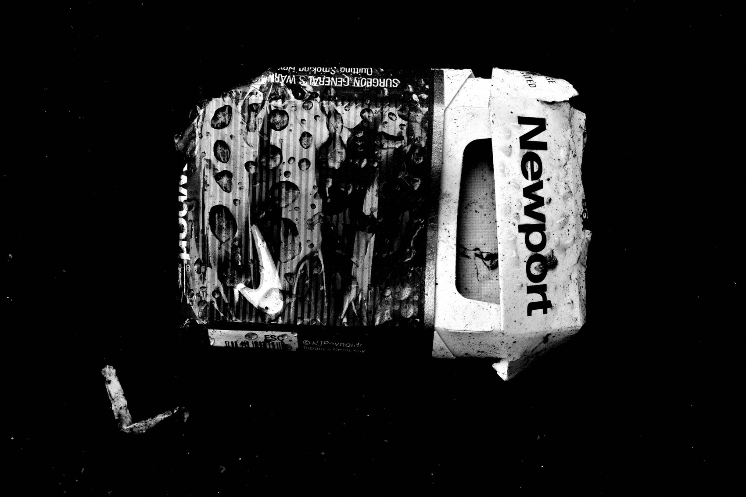
FLUX ACADEMY
BEAT 01 · CORE IDEA
Ten Years Teaches What Books Can't
— Ten years in, the lessons are lived — not learned
— Failure, persistence, and flow are the real curriculum
— What you wish you knew at the start changes everything now
Notes:
What's popping, people — it's Dante. Ten years. A decade of walking streets, pressing shutters, coming home with nothing, and coming back anyway. The lessons I'm about to share aren't from a book — they're from ten years of daily practice, failure, and the occasional frame that actually meant something. Let's get into it.

Slide 3
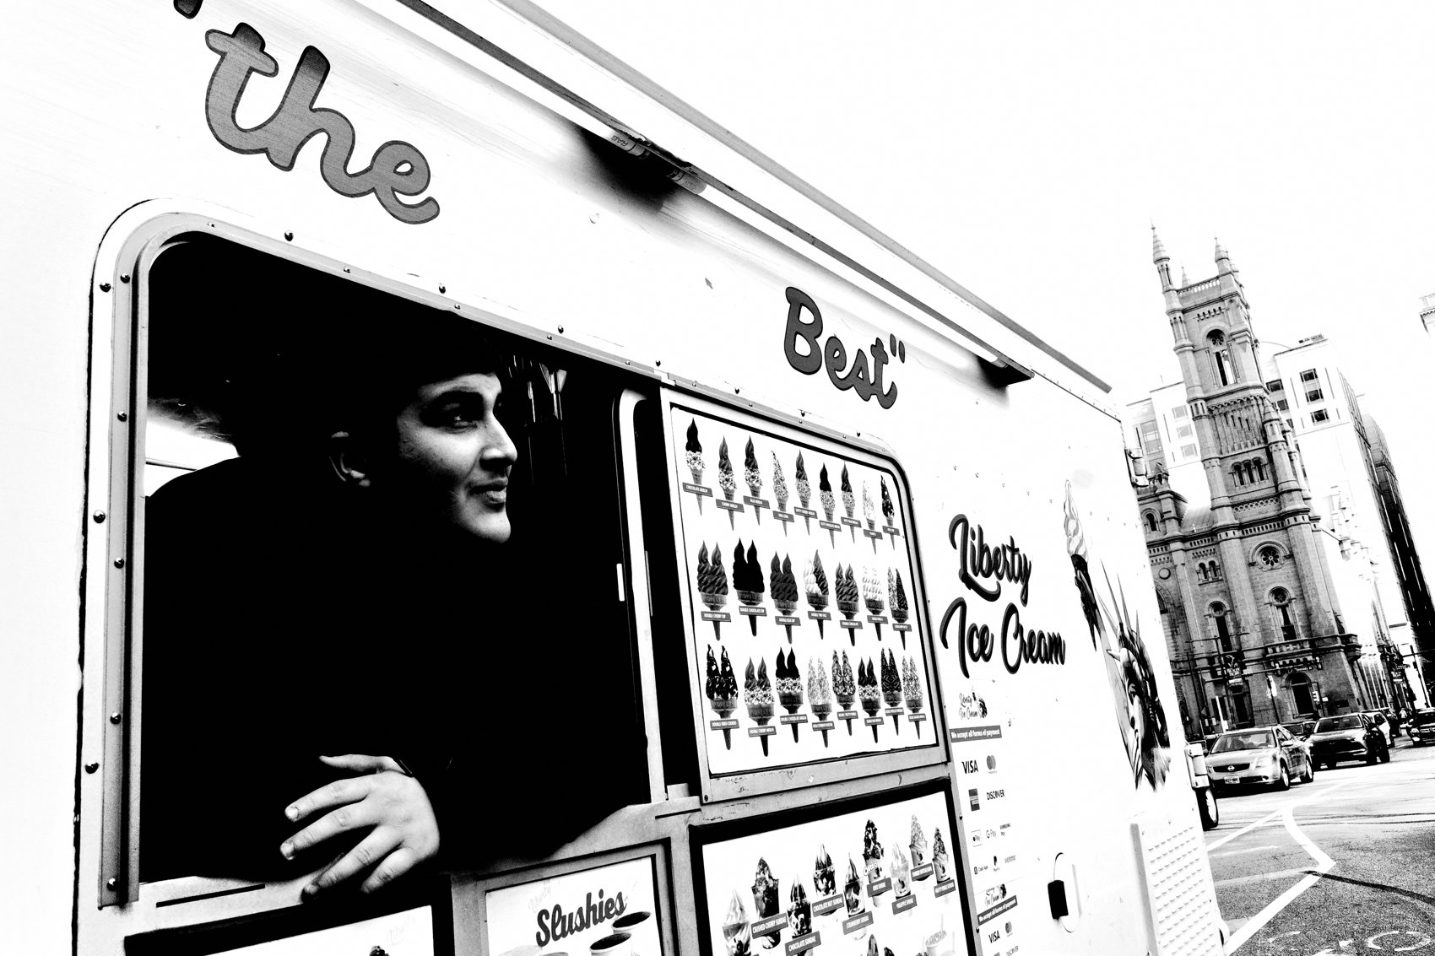
FLUX ACADEMY
BEAT 02 · LEARNING OBJECTIVE
What You'll Walk Away With
— The ten principles that shaped a decade of practice
— A realistic map of what mastery actually looks like
— Permission to fail — and keep going anyway
Notes:
By the end of this lesson, you'll have the ten hard-won principles that shaped my first decade of street photography. Not shortcuts. Not hacks. A real map of what it looks like to build a practice over time — and why failing every single day is part of the design.

Slide 4
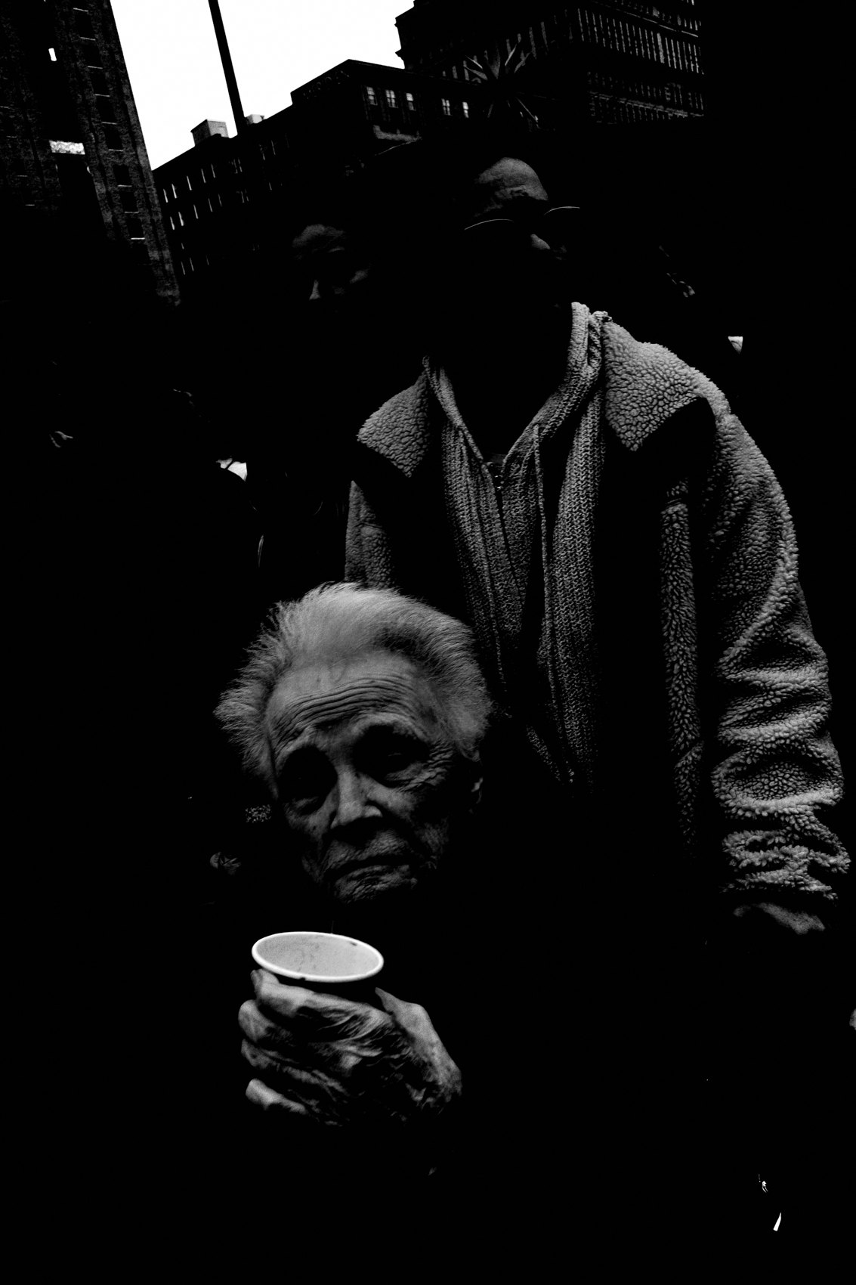
FLUX ACADEMY
BEAT 03 · WHY THIS MATTERS
Most People Quit Too Early
— Most photographers quit before the work deepens
— They expect results before they've paid the time
— A decade changes what you see, what you make, what you are
Notes:
Here's the brutal truth: most people quit before anything real happens. They expect the work to arrive quickly, and when it doesn't, they stop. A decade teaches you that the work doesn't arrive — you become it. The photographer who sticks around long enough gets something the quitter never does.

Slide 5

FLUX ACADEMY
BEAT 04 · WHY THIS MATTERS
Failure Is the Actual Curriculum
— 99.9% of shots won't be great — and that's normal
— Failure teaches what success never could
— Learning to love failure is the whole game
Notes:
Failure will bring you to success. That's not a motivational poster — that's ten years of evidence. Ninety-nine point nine percent of the shots you take won't be great. The photographers who last are the ones who learn to love that. Failure isn't the obstacle to mastery. It is the curriculum.

Slide 6

FLUX ACADEMY
BEAT 05 · MAIN TEACHING
Street Photography Is a Numbers Game
— Persistence is everything
— Detach from the outcome of each individual frame
— Find meaning in the process, not the result
Notes:
Lesson one from the decade: street photography is a numbers game. Persistence is everything. You have to detach from the outcome — stop obsessing over the results of each photograph. Instead, find meaning in the process. Enter a flow state where the act of making pictures matters more than what you come home with. Every single day for ten years, I've been making photographs. That's the job.

Slide 7

FLUX ACADEMY
BEAT 06 · MAIN TEACHING
Find Beauty in the Mundane
— Can you walk the same street every day and still find something?
— The simplest moments can become the most beautiful
— The magic is finding the extraordinary in the ordinary
Notes:
Lesson two: find beauty in the mundane. The real challenge isn't finding an exotic location — it's walking the same street every single day and still seeing something worth making. The simplest moments can become the most beautiful. No matter where you are — a busy city, a small market, a mountain path — there is always something to photograph. The eye is the variable. Not the street.

Slide 8

FLUX ACADEMY
BEAT 07 · MAIN TEACHING
One Camera, One Lens
— Limit your gear — it's the best technical advice there is
— Consistency builds muscle memory and positioning instinct
— Movement makes improvement
Notes:
Lesson three: one camera, one lens. This is the best piece of technical advice I can give after a decade. It doesn't matter which focal length or body you choose — what matters is sticking to it. Through consistency you build muscle memory. You learn how to position your body in relation to a scene. Photography is physical. Movement makes improvement. The more you walk, the more you see.

Slide 9

FLUX ACADEMY
BEAT 08 · MAIN TEACHING
Repetition Builds Mastery
— Find a busy street — go there every day, same time, same camera
— Patterns emerge: light, timing, rhythm
— You'll intuitively know where to stand and when to press
Notes:
Lesson four: repetition builds mastery. Find a busy street in your hometown. Go there every single day, at the same time, with the same camera, for a year. Patterns will emerge — the way the light falls at certain hours, the timing of people passing, the rhythm of daily life. Over time you'll intuitively know where to stand and exactly when to press the shutter. Through repetition, you build mastery.

Slide 10
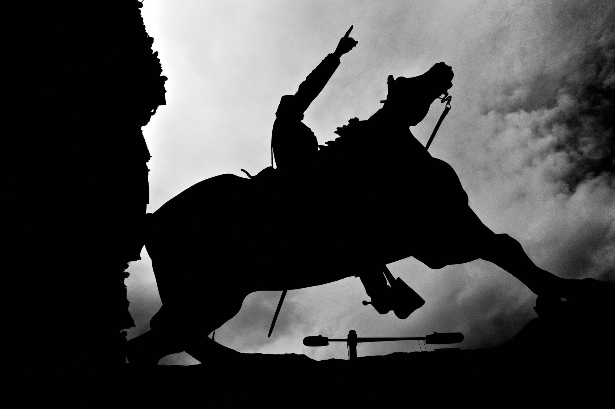
FLUX ACADEMY
BEAT 09 · MAIN TEACHING
Light and Composition Are the Foundations
— Photography is literally writing with light
— A bad photo can be saved by good light; great composition fails in bad light
— Think: foreground, middle ground, background — solve the visual puzzle
Notes:
Lesson five: light and composition are the foundations of everything. Photography is literally writing with light. A bad photograph can be saved with good light — but even a brilliant composition falls apart in bad lighting. Think of composing an image as solving a visual puzzle: foreground, middle ground, background. Most of my best photos are actually simple. The key is clarity — images that are easy to read but visually alive.

Slide 11
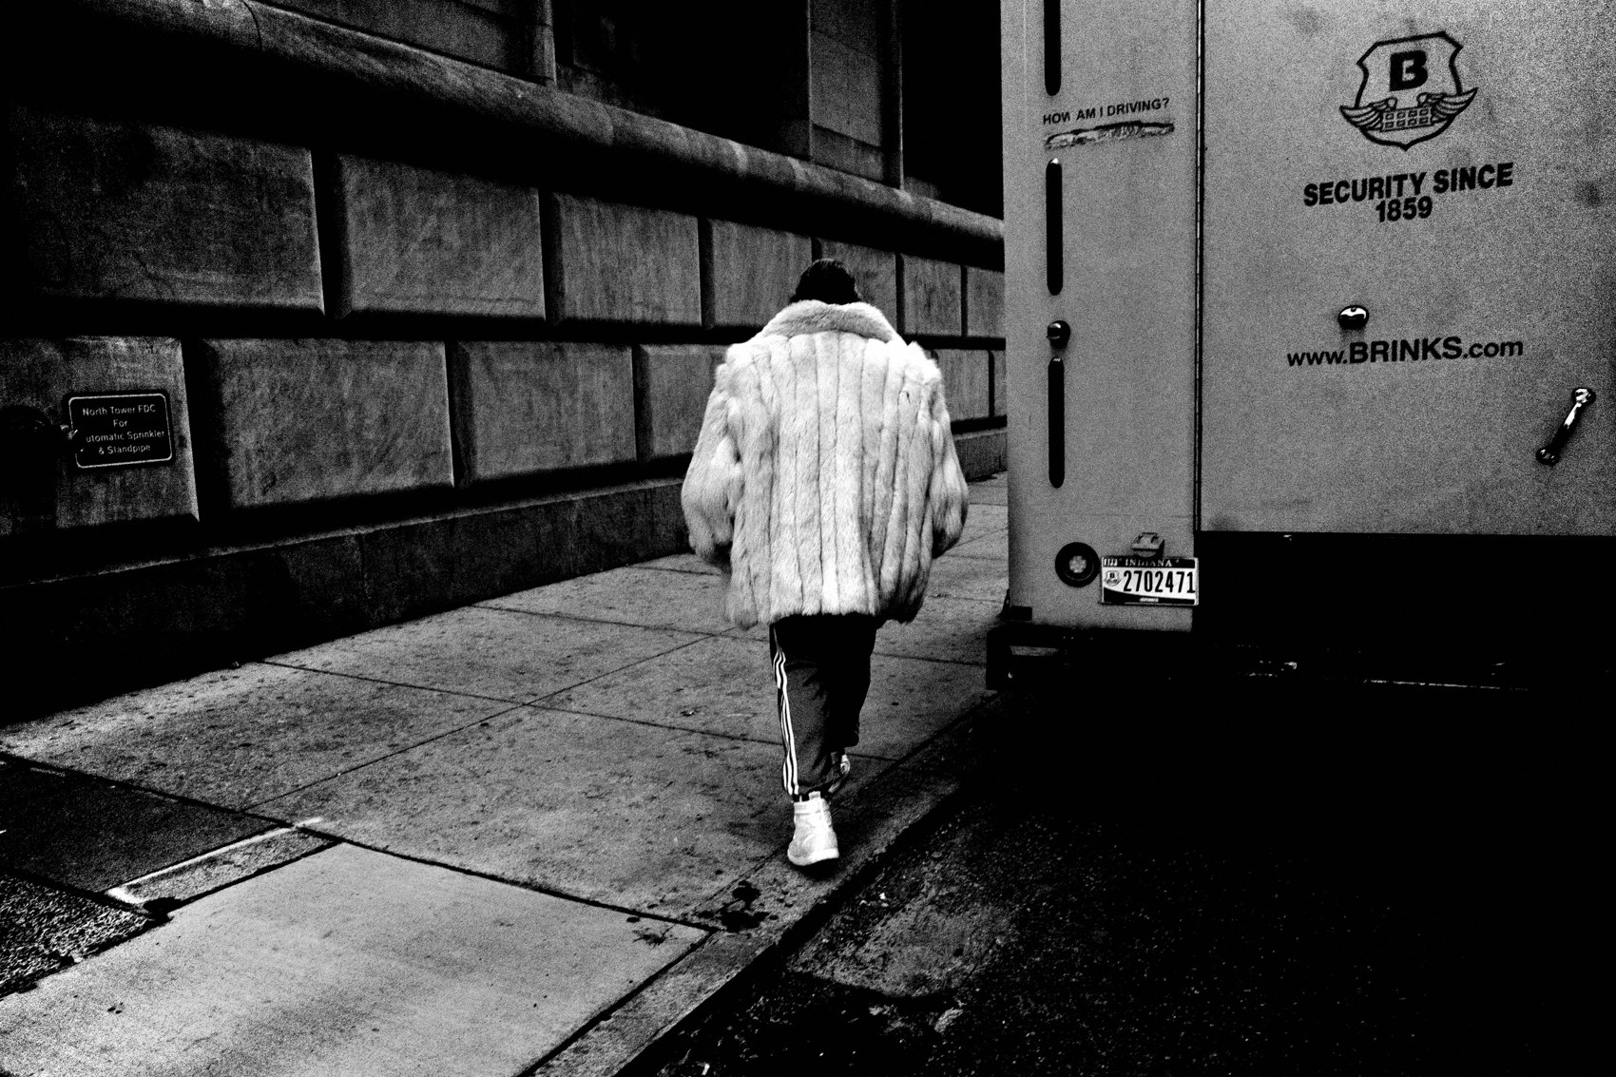
FLUX ACADEMY
BEAT 10 · MAIN TEACHING
Travel with Purpose
— Traveling teaches you to see differently
— Life is like an ultimate video game — step into the unknown
— New cities and cultures force presence; chaos fuels creativity
Notes:
Lesson six: travel with purpose. Don't limit yourself to your hometown. Traveling forces you to be present in a way the familiar never can. Life is like an ultimate video game — stepping into the unknown, new cities and cultures, pushes you into full presence. Some of the most formative experiences come from embracing the unknown: places of worship in an unfamiliar country, ceremonies you were never taught the rules to, landscapes that dwarf everything you know. Your camera is a passport. Use it.

Slide 12

FLUX ACADEMY
BEAT 11 · MAIN TEACHING
Champion Humanity in Your Frames
— Photography is about people — not just aesthetics
— Treat each person in your frame like a hero
— Respect, dignity, uplift — that's what separates good from great
Notes:
Lesson seven: champion humanity in your frames. Photography is about more than aesthetics — it's about people. Treat each person in your frame like a hero. Respect, dignity, and uplifting the human spirit — that's what separates a good photograph from a great one. When you look at a stranger and see a hero rather than a subject — someone with courage, defiance, tenderness worth honoring — the frame carries that reverence. That's the power photography can hold.

Slide 13

FLUX ACADEMY
BEAT 12 · MAIN TEACHING
Photography Takes Time
— A decade in and still learning — mastery requires long-term thinking
— You might make a handful of great photos per year — that's normal
— Let photos marinate; you have a lifetime, but the time is now
Notes:
Lesson eight: photography takes time. I'm a decade in and still learning. Mastery requires long-term thinking. You might only take a handful of truly great photos each year. That's completely normal. Let your photos marinate before judging them — a frame that excites you today might look entirely different in a year. You have a lifetime, but the time is now. Both things are true at once.

Slide 14

FLUX ACADEMY
BEAT 13 · MAIN TEACHING
Don't Take Yourself Too Seriously
— I treat the streets like my playground
— Photography is subjective — no universal good or bad
— Ignore contests, ignore trends, shoot for yourself
Notes:
Lesson nine: don't take yourself too seriously. I treat the streets like my playground. Don't overthink it. Don't put on your photojournalist hat. Approach photography with curiosity and joy. Photography is subjective — there is no universal good or bad. Ignore contests. Ignore trends. Shoot for yourself. The moment you make it a grim pursuit of status, the joy — which was the whole fuel — leaks out.

Slide 15

FLUX ACADEMY
BEAT 14 · MAIN TEACHING
Curiosity Is Everything
— Street photography is an ethos, a way of seeing
— Increase curiosity 1% every day and you'll never stop growing
— Forget the rules — make your own game
Notes:
Lesson ten, and the biggest one: curiosity is everything. Street photography is an ethos, a way of seeing — not a checklist, not a rulebook. If you increase your curiosity by one percent every day, you will never stop growing. Forget what people say street photography should be. Forget the rules. Make your own game. Curiosity is the engine that outlasts every other motivation.

Slide 16

FLUX ACADEMY
BEAT 15 · MAIN TEACHING
Follow Your Joy
— Photography fuels the lust for life — it's not about the perfect photo
— Move the body into the world, follow curiosity wherever it leads
— If you're having fun, you're winning
Notes:
Underneath all ten lessons is one principle that holds them together: follow your joy. For me, photography has never been about capturing the perfect photo. It's about fueling my lust for life, moving my body out into the world, following curiosity wherever it leads. Each morning I wake up ready to see, explore, and create. Photography brings me so much joy. And if you're having fun, you're winning. Full stop.

Slide 17

FLUX ACADEMY
BEAT 16 · MAIN TEACHING
Familiarity Reveals the Extraordinary
— Walk the same streets for years — same light, same rhythms
— Repetition breeds familiarity; familiarity reveals the extraordinary in the mundane
— The archive builds itself one rep at a time
Notes:
Here's what those lessons look like lived out. Walk the same streets for years — same corners, same hours — and you come to know how the light falls and the rhythms of the people. Repetition breeds familiarity, and familiarity lets you see the extraordinary hiding in the ordinary. The archive doesn't come from one great day. It comes from showing up every single day and walking.

Slide 18

FLUX ACADEMY
BEAT 17 · MAIN TEACHING
Kill Your Darlings
— Years of work distills down to a small handful that truly matter
— Kill your darlings — let go of what you thought was great
— Results take time; the cutting room floor is part of the process
Notes:
And here's the number that resets expectations: look back at years of work and you might find only a small handful of photographs you truly care about. That's it. That's normal. Kill your darlings. Let go of what you thought was great. Most photos end up on the cutting room floor — the real skill is recognizing the ones worth keeping. Results take time. That's not a flaw in the system. That is the system.

Slide 19
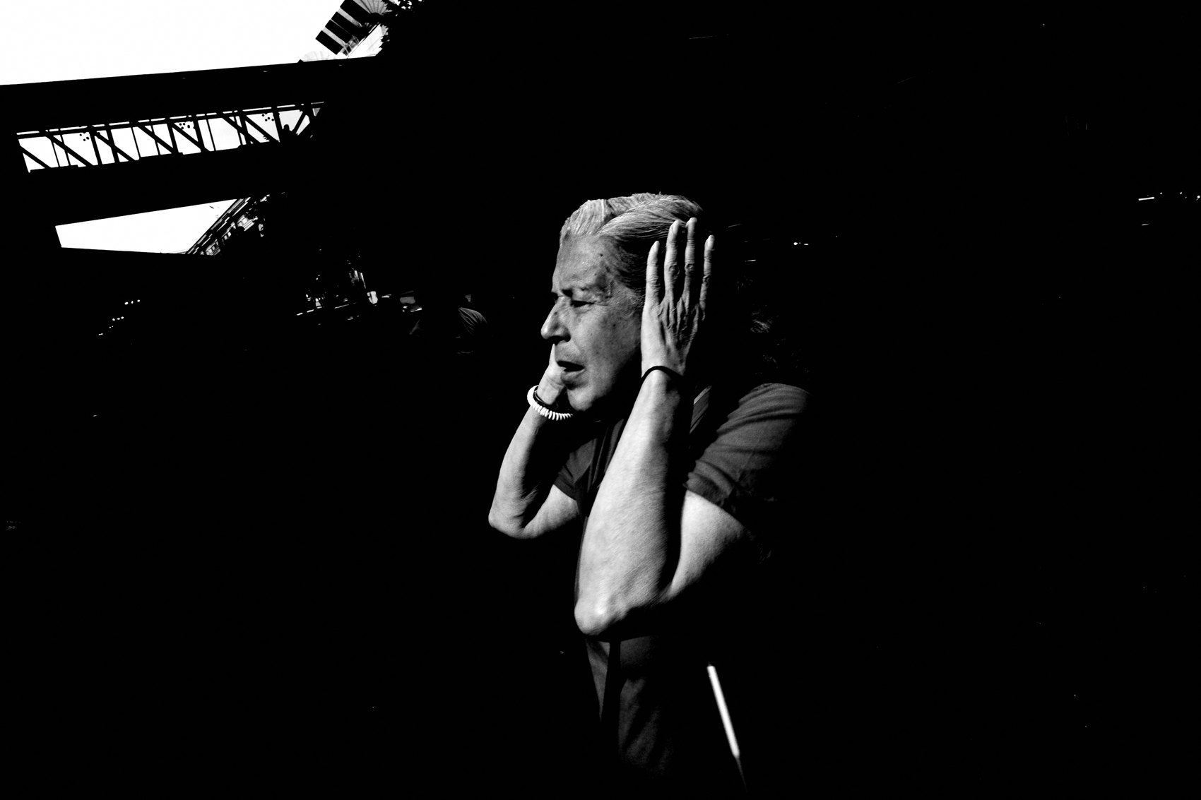
FLUX ACADEMY
BEAT 18 · MAIN TEACHING
Photographs as Instant Sketches
— Shoot high-contrast black-and-white JPEGs baked in-camera
— Treat photographs as instant sketches of life — light as the subject
— Letting go of perfection unlocks a more prolific period
Notes:
The third principle: treat your photographs as instant sketches of life. Shoot high-contrast black-and-white JPEGs with everything baked in-camera — light as the subject, no endless processing, what you capture is the final piece. Letting go of perfection and control lets you make more photographs than ever. This simplified workflow fits photography into everyday life. And that integration — that's the key the whole decade was building toward.

Slide 20

FLUX ACADEMY
BEAT 19 · PRACTICAL APPLICATION
Go Out Every Day for One Month
— Same street, same time, same camera — for thirty consecutive days
— Don't judge the frames; just build the rep count
— Notice what you start to know intuitively by week four
Notes:
Here's your assignment: pick one street. Same time. Same camera. Every day for the next thirty days. Don't judge the frames. Don't cull aggressively. Just build the reps. By week four, notice what you start to know without thinking — where to stand, when to wait, how the light moves. That's the decade starting to compress into a month.

Slide 21
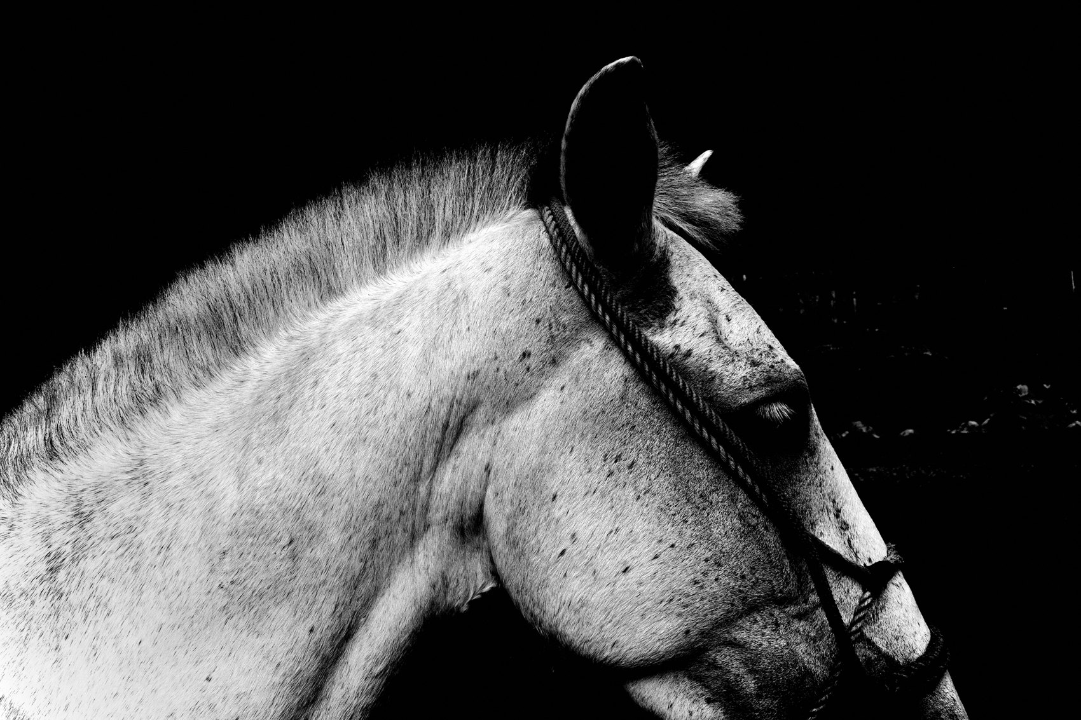
FLUX ACADEMY
BEAT 20 · PRACTICAL APPLICATION
Let Photos Marinate
— After a shoot, back up and walk away — don't judge immediately
— Return in a week, a month, a year
— What changes in the photo reveals what changed in you
Notes:
Practice delayed judgment. After your next shoot, back everything up and walk away. Don't open the folder for at least a week. When you return, notice which frames hold up and which ones you were just excited about in the moment. What changes in the photo reveals what changed in you. This is how the decade teaches — slowly, through return visits.

Slide 22
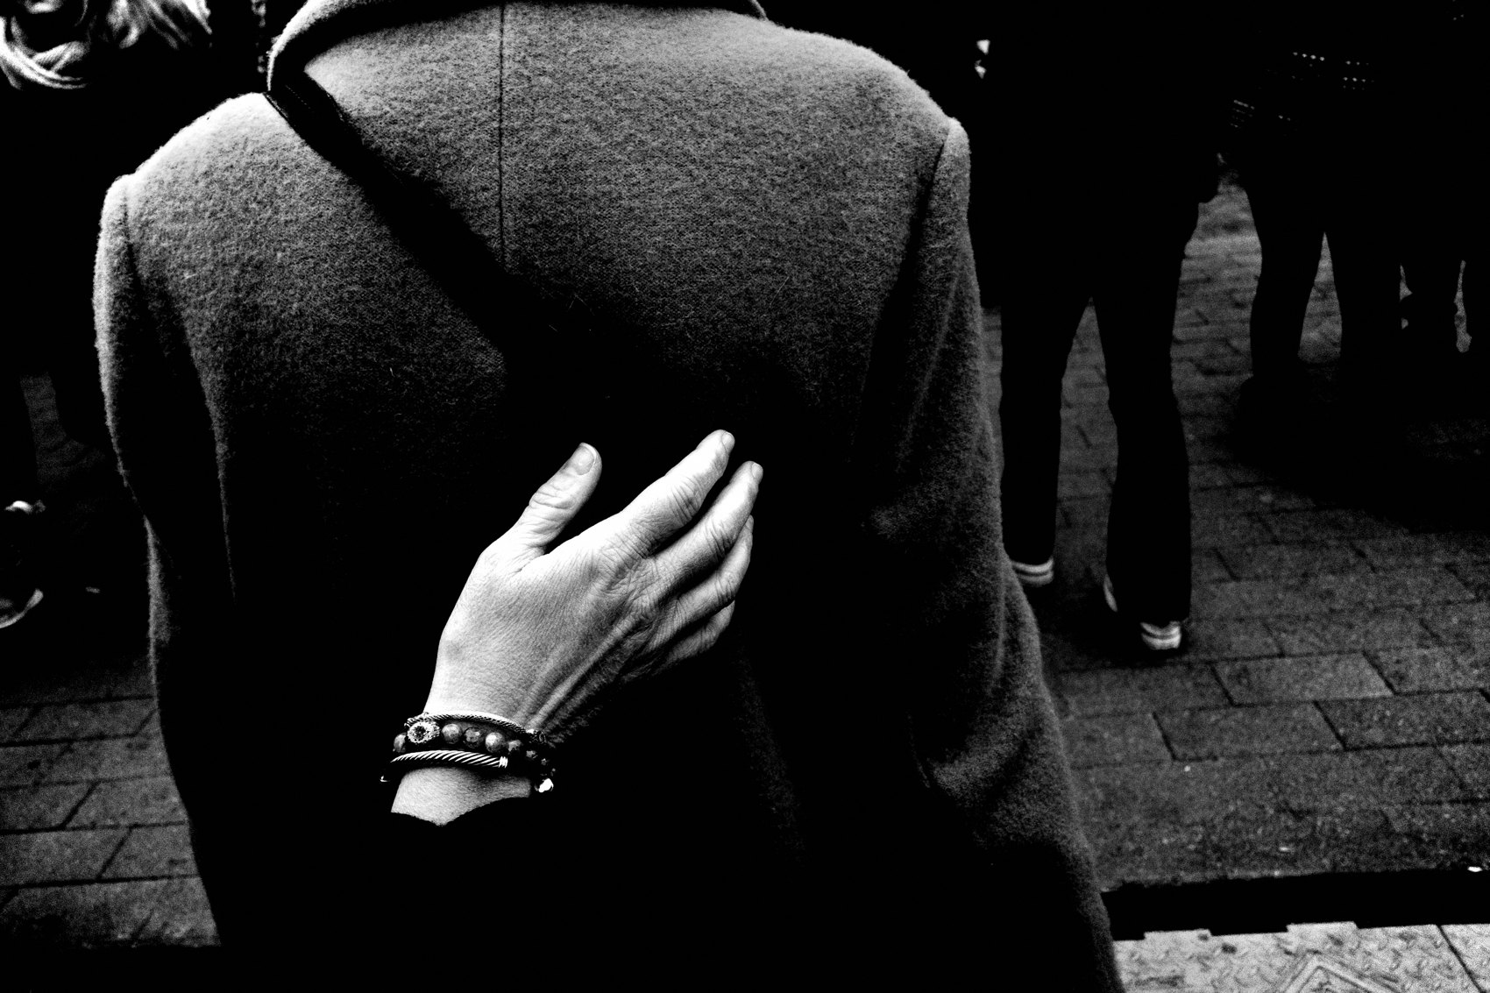
FLUX ACADEMY
BEAT 21 · COMMON MISTAKES
Expecting Results Before Paying the Time
— Wanting the archive before doing the years
— Comparing your year one to someone's year ten
— Impatience is the most common reason good photographers stop
Notes:
The most common mistake I see: expecting results before paying the time. Wanting the archive before doing the years. Comparing your year one to someone else's year ten. Social media makes it look like great work arrives fast — it doesn't. I still consider myself an amateur. Real work takes time not just to make but to understand what it means. Impatience is the most common reason good photographers stop. Don't be that photographer.

Slide 23

FLUX ACADEMY
BEAT 22 · RELATIONSHIP TO PREVIOUS
Built on the Long Game
— Lesson 050 established the long-game mindset
— This lesson fills that frame with ten specific, lived principles
— The decade of lessons is the long game made concrete
Notes:
Lesson 050 laid out the long-game mindset — why street photography is a practice measured in years, not sessions. This lesson fills that frame with ten specific principles drawn from a full decade of daily practice. The long game isn't an abstract idea anymore. It's these ten lessons, lived out, one day at a time.

Slide 24
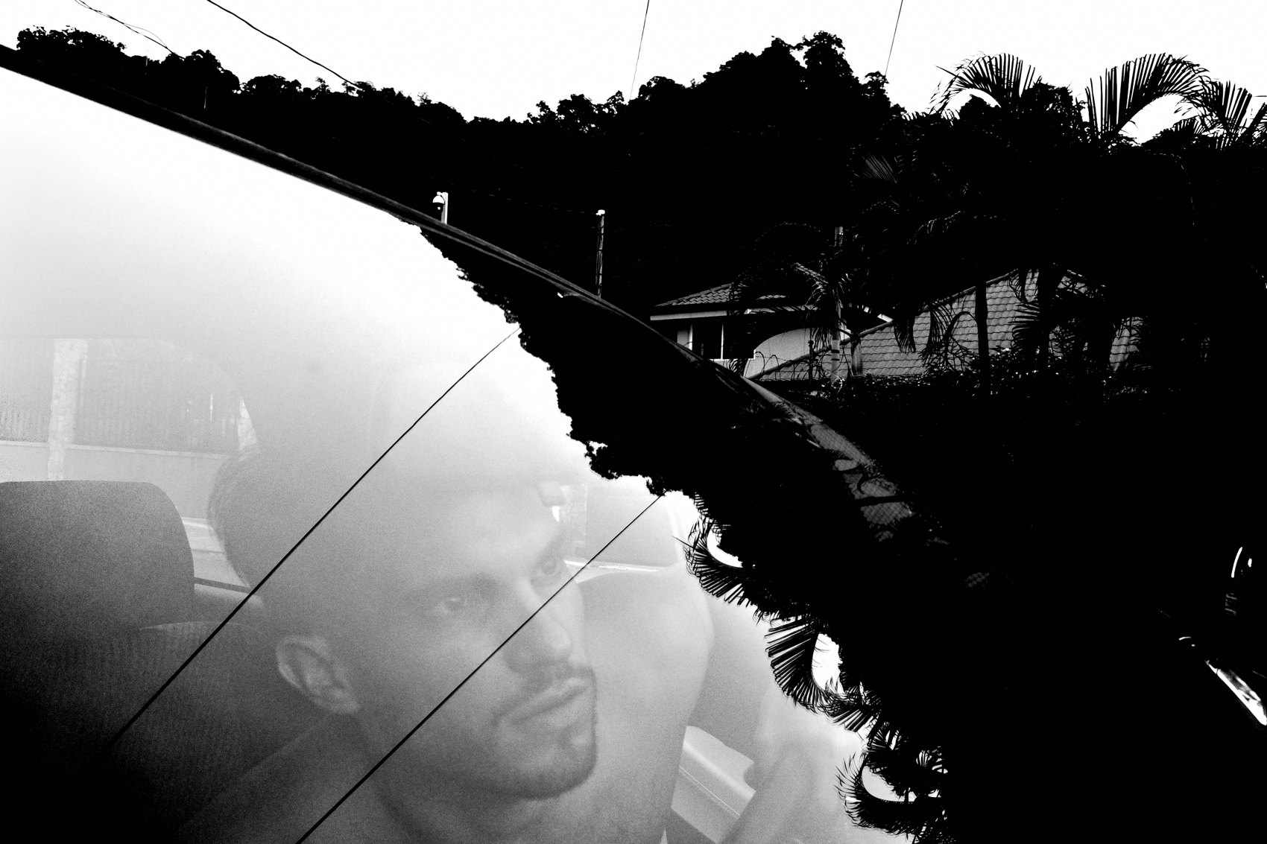
FLUX ACADEMY
BEAT 23 · SUMMARY / TAKEAWAY
Ten Years, One Direction
— Numbers game. Mundane beauty. One camera. Repetition. Light.
— Travel. Humanity. Time. Play. Curiosity.
— Follow your joy — that's the decade in a sentence
Notes:
Last thing. Ten lessons from ten years: street photography is a numbers game; find beauty in the mundane; one camera, one lens; repetition builds mastery; light and composition are the foundations; travel with purpose; champion humanity; photography takes time; don't take yourself too seriously; and curiosity is everything. Underneath all of it — follow your joy. That's the whole decade in a sentence. See you in Lesson 052.

