Slide 1
FLUX ACADEMY · A SCHOOL FOR SEEING
MODULE 10 · PRACTICE & MASTERY
Consistency & the Visual Diary
BY DANTE SISOFO

Slide 2
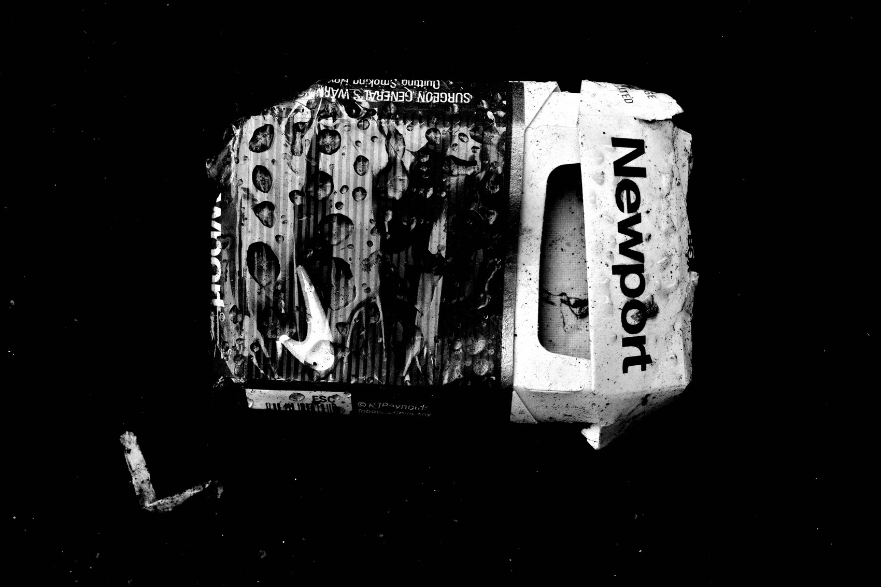
FLUX ACADEMY
BEAT 01 · CORE IDEA
Show Up or Fall Behind
— Consistency is the single biggest separator
— Not talent, not gear — just showing up
— He who walks the most shall win
Notes:
What's popping, people — it's Dante. Today we're getting into the one thing that separates photographers who grow from photographers who stall: consistency. Not your camera. Not your eye. Not some lucky trip to an exotic city. Just showing up, day after day, camera in hand, and letting the practice evolve. He who walks the most shall win — and that's not a metaphor, that's the whole game.

Slide 3

FLUX ACADEMY
BEAT 02 · LEARNING OBJECTIVE
What You'll Walk Away With
— Why consistency beats inspiration every time
— How to build a visual diary practice
— The mindset that makes showing up feel effortless
Notes:
By the end of this lesson you'll understand why consistency is the backbone of a real street photography practice, how to turn daily shooting into a living visual diary, and — most importantly — how to make showing up feel less like discipline and more like compulsion. That shift is everything.

Slide 4
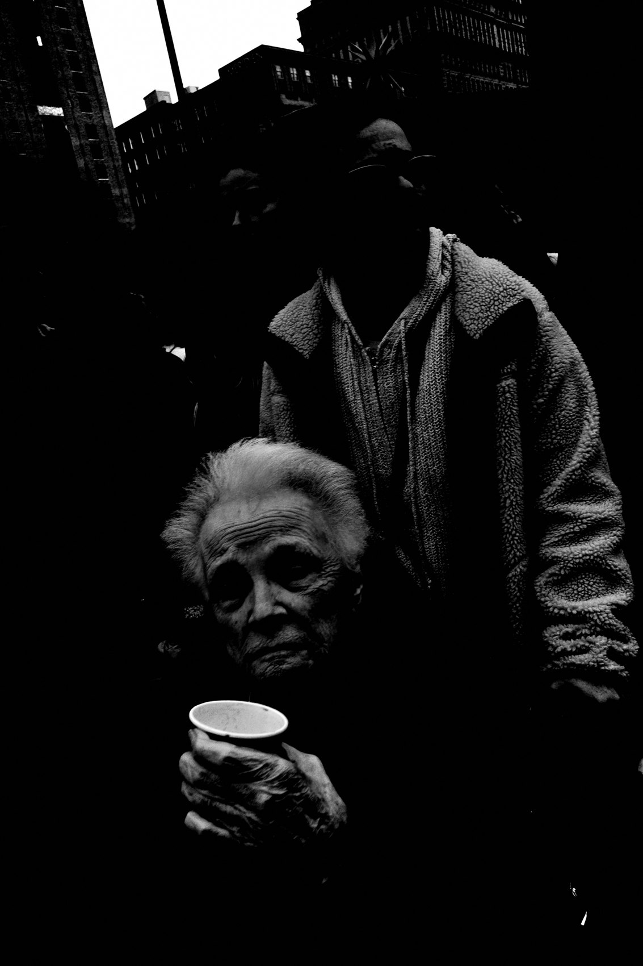
FLUX ACADEMY
BEAT 03 · WHY THIS MATTERS
Inspiration Is Unreliable
— Inspiration comes and goes — consistency stays
— Waiting for the "right" moment is a creativity killer
— Volume is the only path to voice
Notes:
Here's why this matters: inspiration is a terrible strategy. It shows up when it feels like it and disappears right when you need it most. Consistency doesn't care how you feel. It's the practice that builds your eye, your instinct, your voice — not the rare burst of motivation. If you're waiting to feel inspired before you shoot, you're going to wait a long time.

Slide 5

FLUX ACADEMY
BEAT 04 · WHY THIS MATTERS
The Practice Reveals Itself Over Time
— Patterns emerge only through repetition
— Your style isn't chosen — it's uncovered
— The diary builds meaning you can't force
Notes:
And here's the deeper truth: you cannot think your way into a style. You have to walk your way into it. Through repetition — returning to the same streets, at the same times, with the same camera — patterns emerge. The light starts to make sense. The moments start to find you. The visual diary writes itself, and what it reveals is you.

Slide 6

FLUX ACADEMY
BEAT 05 · MAIN TEACHING
Consistency Is a Compulsion, Not a Chore
— Don't force it — let it become involuntary
— Even on low-motivation days, just show up
— The act of showing up is the practice
Notes:
Here's how I think about consistency: it's not discipline in the strict sense. It's closer to a compulsion. I don't need to motivate myself to photograph the way some people have to motivate themselves to go to the gym. It's almost involuntary. But even on the days when that pull is quieter, I still show up. Because the act of showing up is the practice — not the frames you bring home.

Slide 7

FLUX ACADEMY
BEAT 06 · MAIN TEACHING
Walk More, See More, Photograph More
— Walking and photographing are inseparable
— Movement generates opportunity
— He who walks the most shall win
Notes:
There's a simple equation at the heart of this whole practice: walk more, see more, photograph more. It sounds almost too obvious to say — but most photographers aren't walking enough. They're planning shoots, editing, watching tutorials. Walking and photographing are inseparable. Get your legs moving and the photographs will follow. This is not metaphor. This is mechanics.

Slide 8
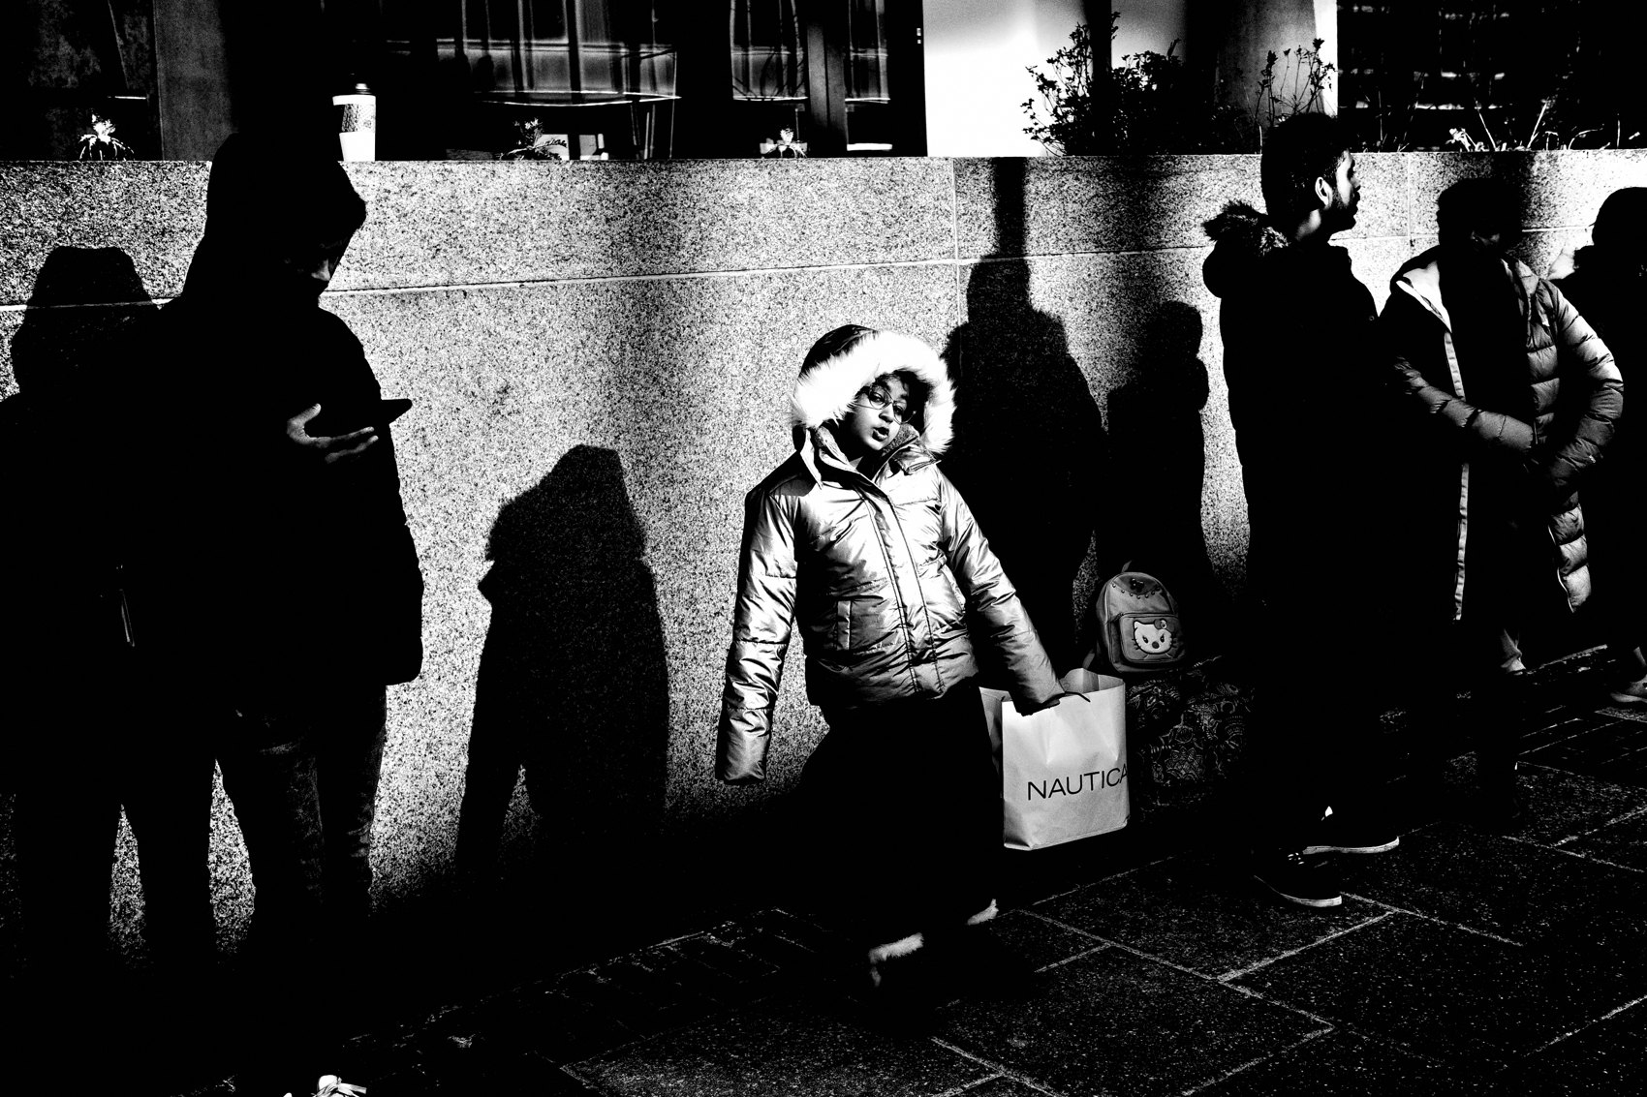
FLUX ACADEMY
BEAT 07 · MAIN TEACHING
The Visual Diary: No Theme, No Project, No Limits
— No theme, no project, no checklist
— Photograph your everyday life, for yourself
— The mundane becomes the subject
Notes:
The visual diary approach is this: no theme, no project, no predetermined outcome. You photograph your everyday life — for yourself, and yourself only. A quiet record of your days. What you ate, where you walked, who you saw, how the light fell on that wall on Tuesday morning. The mundane is the subject. When you stop hunting for the exceptional, the ordinary starts giving you everything.

Slide 9
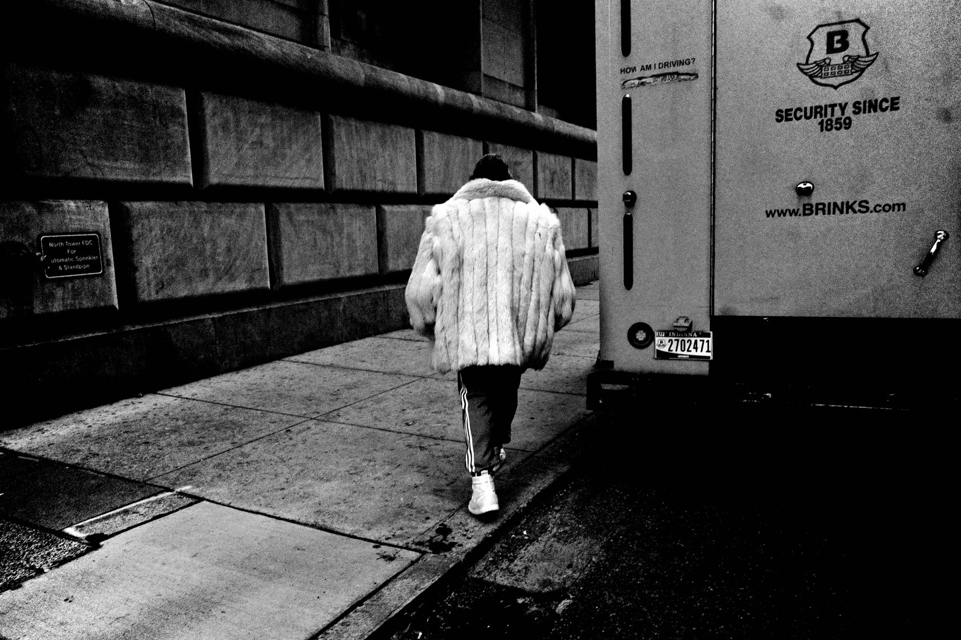
FLUX ACADEMY
BEAT 08 · MAIN TEACHING
Obsession Over Obligation
— Obsession feels effortless; obligation feels heavy
— Cultivate an insatiable love for the process
— Return to the same streets with new curiosity
Notes:
There's a difference between being obligated to shoot and being obsessed with shooting. Obligation is heavy — it creates friction, resentment, burnout. Obsession is light. It pulls you out the door before you've finished your coffee. My goal has always been to cultivate that insatiable love for the process — returning to the same streets with fresh eyes every single time, genuinely curious about what today will give me.

Slide 10

FLUX ACADEMY
BEAT 09 · MAIN TEACHING
Same Street, Different World
— The street changes every day — light, people, mood
— Repetition reveals what variety hides
— Go back. Go back. Go back.
Notes:
People ask me how I can walk the same streets over and over without getting bored. The answer is that the street is never the same. The light is different. The people are different. My mood is different. The world is always in flux — and that's the point. Repetition doesn't dull the street; it sharpens your ability to read it. Go back. Go back. Go back.

Slide 11

FLUX ACADEMY
BEAT 10 · MAIN TEACHING
One Camera, One Lens, No Excuses
— Eliminate gear decisions — remove friction
— The compact camera is always there
— No preparation ceremony, just shoot
Notes:
One of the biggest consistency killers is gear friction. When photographing requires preparation — packing a bag, choosing lenses, charging batteries — it creates a barrier between you and the street. My solution has always been the same: one compact camera, always in my pocket, always ready. No ceremony. No setup. Just life, and the camera riding along with it. Remove the friction and consistency becomes almost automatic.

Slide 12

FLUX ACADEMY
BEAT 11 · MAIN TEACHING
Flow State Is the Reward for Showing Up
— Flow isn't summoned — it's earned through repetition
— Muscle memory replaces decision-making
— The camera becomes an extension of the body
Notes:
The flow state — that place where you're not thinking, just doing — doesn't arrive by appointment. It's the reward for showing up consistently until the camera becomes an extension of your body. When you've walked the same streets enough times, you stop thinking about where to stand. When you've used the same camera long enough, you stop thinking about the controls. You're just reacting. That's where the real photographs live.

Slide 13

FLUX ACADEMY
BEAT 12 · MAIN TEACHING
Photography as Life Affirmation
— Every frame says yes to life
— Find meaning in mundane, overlooked moments
— The diary is a record of gratitude
Notes:
Here's an idea I keep coming back to: every photograph is me saying yes to life. Finding meaning in an ordinary, overlooked moment. The visual diary isn't just a record of what happened — it's an act of gratitude. This street. This light. This person. This moment. I was here. I was paying attention. The camera is how I say thank you to the day.

Slide 14

FLUX ACADEMY
BEAT 13 · MAIN TEACHING
The Street Rewards Regulars
— Walk the same street daily, camera always out
— Not hunting — just open and moving
— Consistency turns a street into a teacher
Notes:
Pick a street and walk it day after day — not hunting for anything specific, just open and moving — and it starts to teach you things. Where the light pools in the afternoon. Which corner always has activity at noon. Which wall turns gold at 5 PM. You can only learn that by showing up consistently. The street rewards regulars. It has no patience for tourists.

Slide 15

FLUX ACADEMY
BEAT 14 · MAIN TEACHING
Readiness Is Built, Not Summoned
— The best moments arrive while you're distracted
— Head on a swivel, ears open, body relaxed
— The frame arrives because the body was ready
Notes:
Here's how consistency pays off in a single frame. Imagine you're walking with a friend — talking, laughing, mid-conversation — and you're still moving, still listening with your whole body. A charged moment suddenly opens up in front of you. The camera is already in your hand. A flick of the wrist, the shutter clicks. That moment didn't wait for you to get ready. You were ready because you're always ready. That readiness only comes from daily practice.

Slide 16
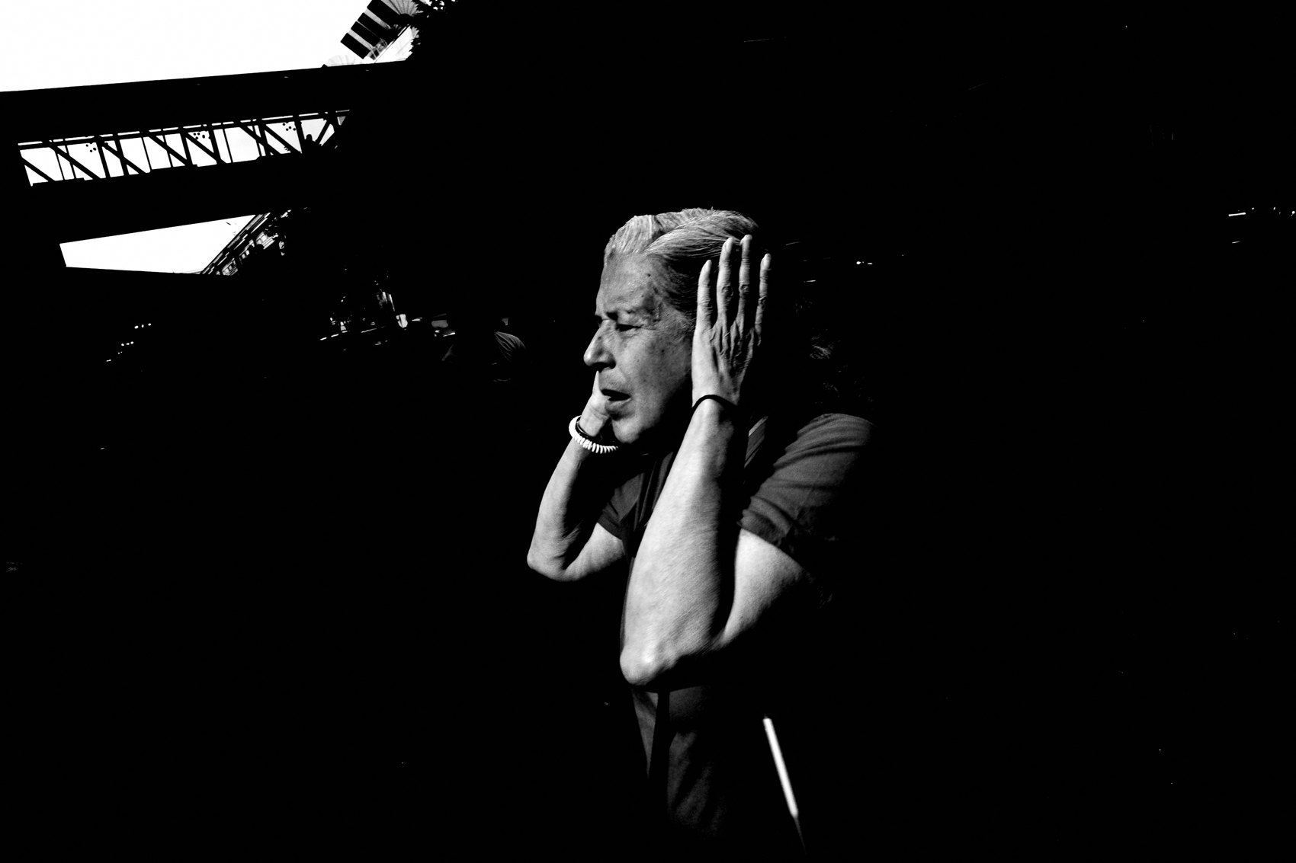
FLUX ACADEMY
BEAT 15 · MAIN TEACHING
Building the Body of Work
— Great images are rare — volume is the path
— A body of work built through daily effort
— Through sheer volume, you find your voice
Notes:
The visual diary isn't about any single great photograph. It's about the body of work that accumulates through daily effort. Great images are rare — maybe a handful a year, if that. That's normal. The volume is what makes them possible. Through sheer volume, you start to find your voice, your style, your unique way of seeing. You can't engineer that. You can only walk your way into it, one day at a time.

Slide 17

FLUX ACADEMY
BEAT 16 · MAIN TEACHING
Treat Every Day Like Day One
— Return to beginner's mind daily
— Think you've seen it all — and burnout follows
— Each day is a blank slate
Notes:
The enemy of consistency isn't laziness — it's thinking you've already seen everything. The moment you feel like you know what the street has to offer, curiosity shuts off and burnout follows. My practice is to return to day one every single morning. Blank slate. First day. Childlike eyes. Treat the street like you've never walked it before — even if you've walked it a thousand times. Especially then.

Slide 18
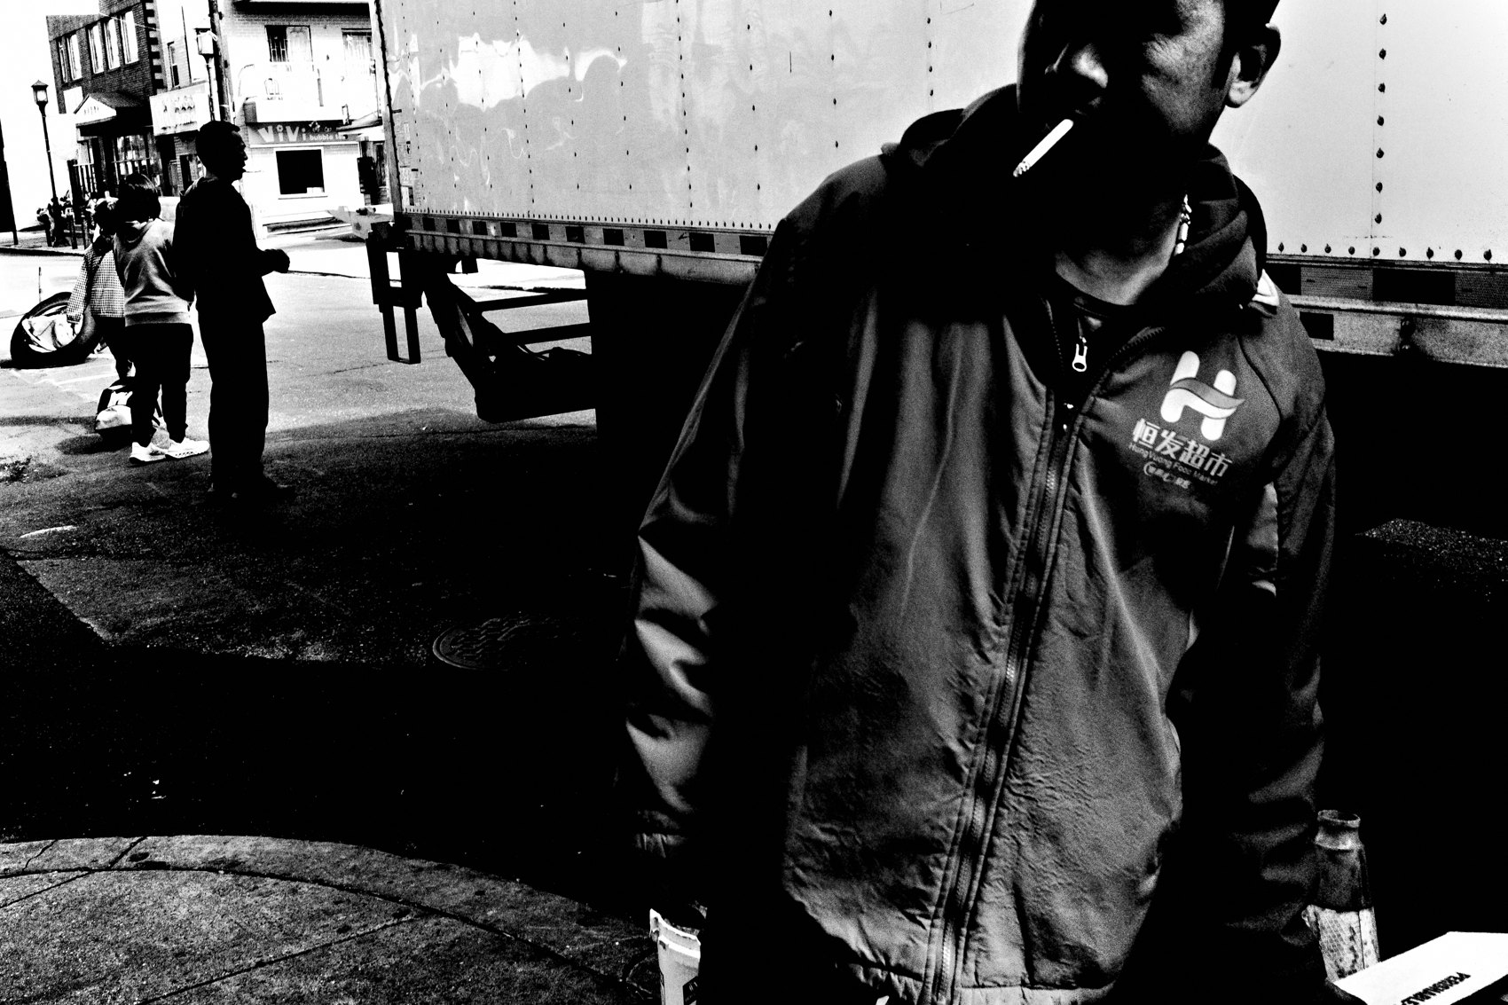
FLUX ACADEMY
BEAT 17 · PRACTICAL APPLICATION
The Daily Walk Assignment
— Pick one street, same time, every day this week
— One camera, one lens — no swapping
— No agenda, no theme, just show up
Notes:
Here's your assignment. Pick one street — ideally one you already know. Walk it at the same time every day this week with the same camera, same lens. No agenda, no theme, no hunting for a specific shot. Just show up and let the street show you what it has. By day four or five, notice what's changed in how you see it. That shift is consistency working.

Slide 19

FLUX ACADEMY
BEAT 18 · PRACTICAL APPLICATION
Build the Visual Diary Habit
— Photograph for yourself, not for an audience
— Don't curate as you go — just accumulate
— Review at the end of the week, not the end of the day
Notes:
Start a visual diary — literally a folder on your computer that nobody sees but you. Photograph for yourself, not for an audience. Don't curate as you go; just accumulate. At the end of the week — not the end of the day — sit with what you made. Let the images breathe. You'll start to see threads you didn't know you were pulling.

Slide 20
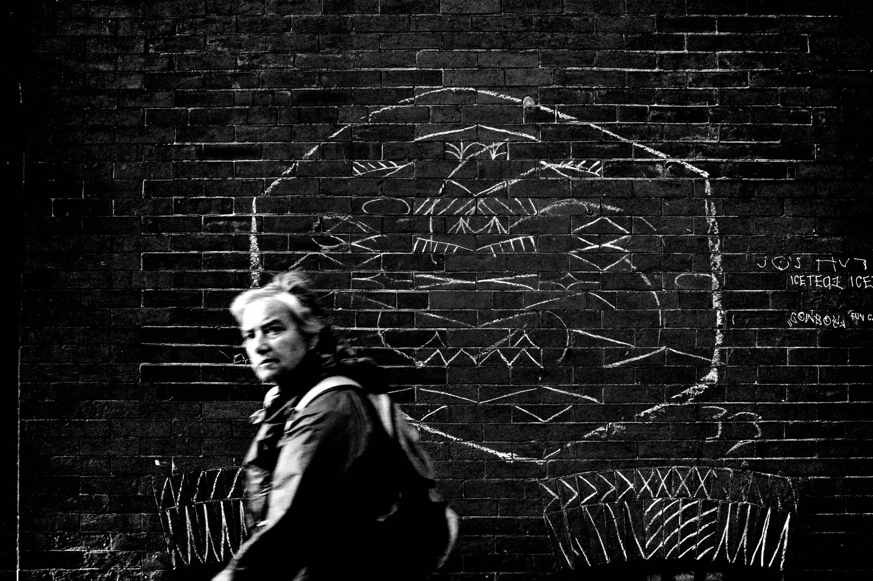
FLUX ACADEMY
BEAT 19 · COMMON MISTAKES
Limiting Yourself to Themes and Projects
— Strict themes narrow creative possibilities
— Projects create checklists — checklists create labor
— Open exploration leads to discovery
Notes:
The most common mistake I see is photographers locking themselves into strict themes and projects before they've even developed a consistent practice. Themes narrow you. Projects turn photography into a checklist, and checklists turn it into labor. When you're only looking for one type of shot, you miss everything else. Stay open. The visual diary has no theme — life is the theme.

Slide 21
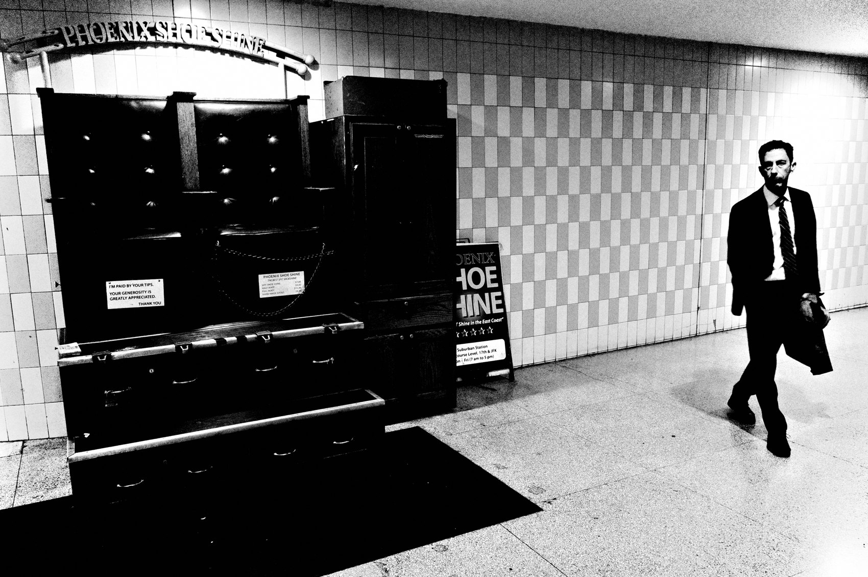
FLUX ACADEMY
BEAT 20 · COMMON MISTAKES
Judging While Shooting
— Grading frames in real time kills flow
— Stop the good/bad loop on the street
— Save evaluation for the edit — not the walk
Notes:
The other mistake: judging your frames while you're still on the street. You take a shot, you look at the screen, you decide it's bad, your confidence dips, you hesitate on the next moment, you miss it. That loop will destroy your consistency. The street is not the place for evaluation. Walk. Shoot. Keep moving. The edit comes later — much later. On the street, your only job is to keep going.

Slide 22
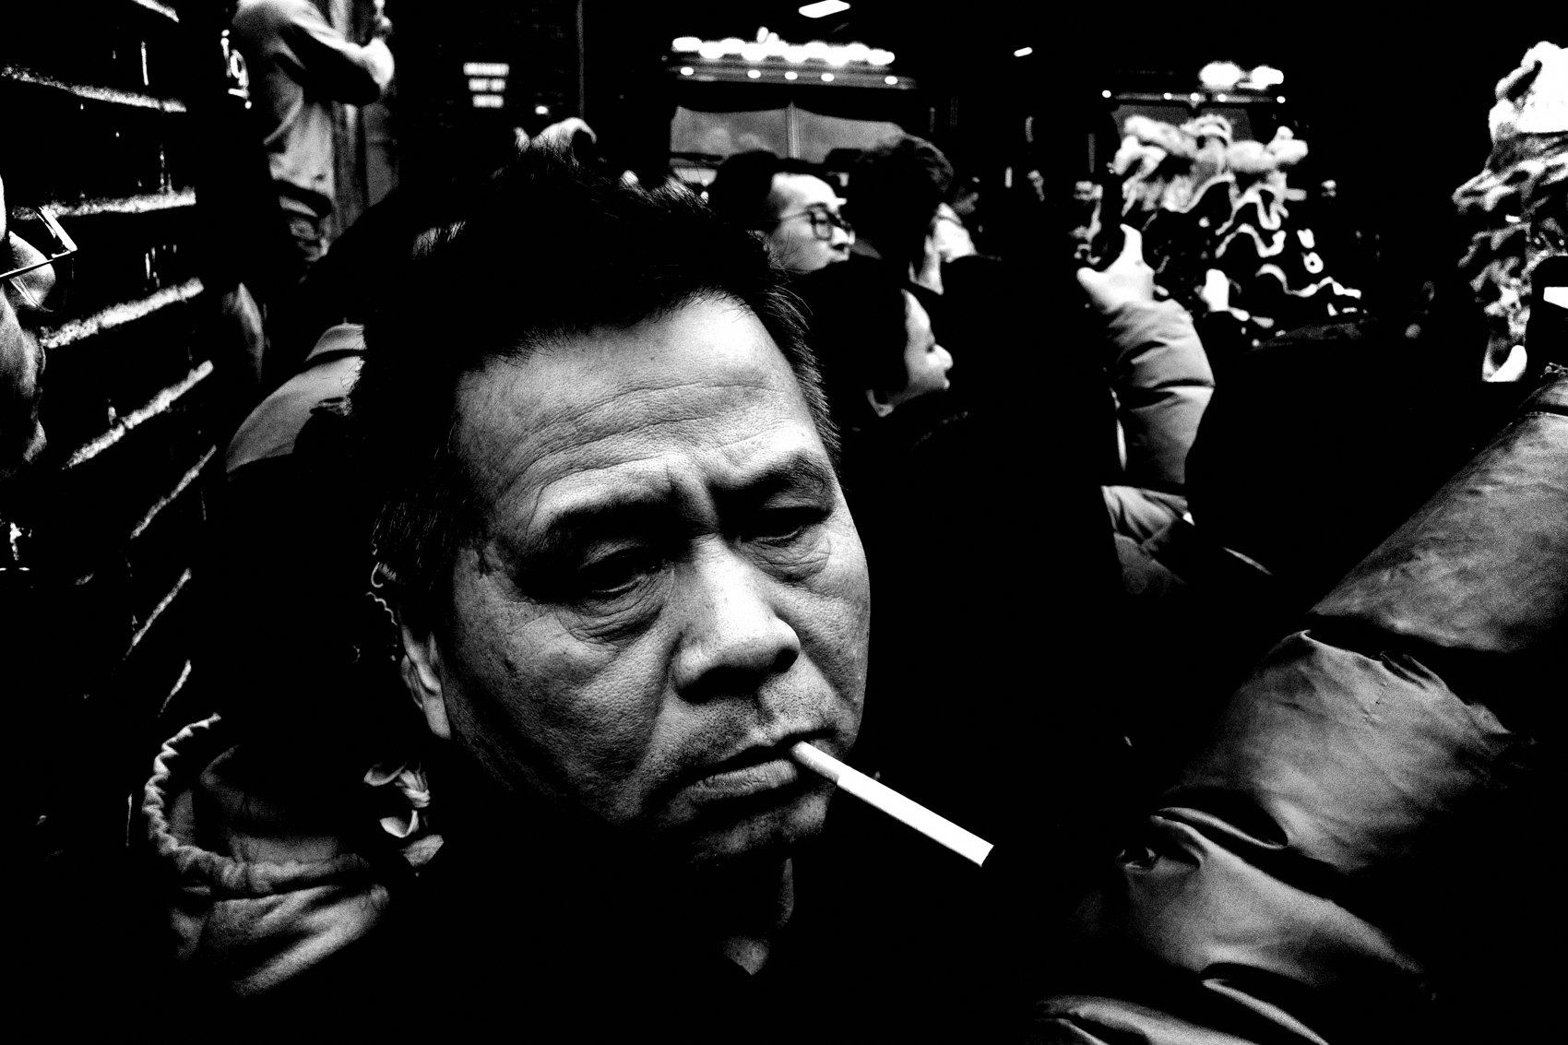
FLUX ACADEMY
BEAT 21 · RELATIONSHIP TO PREVIOUS
Building on What Lesson 049 Taught
— Lesson 049 laid the foundation this builds on
— Consistency is where that groundwork becomes practice
— The principles deepen when they're lived daily
Notes:
Lesson 049 gave us the foundation this lesson now puts into motion. Whatever principle or craft idea we landed on there — this is where it becomes real. Knowing something is one thing. Walking it out every day is another. Consistency is how the lessons stop being ideas and start being instincts. This is where the earlier work compounds.

Slide 23
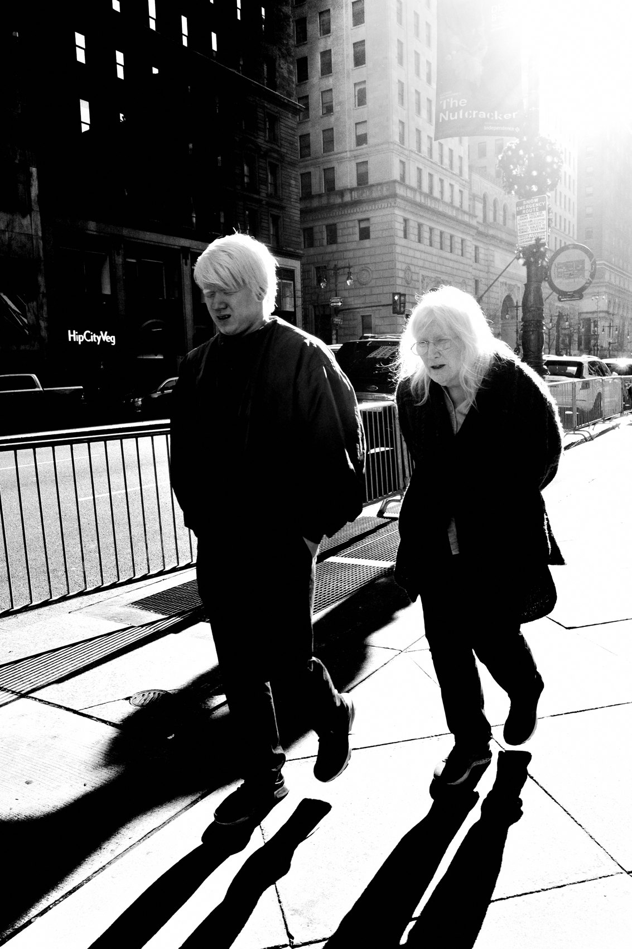
FLUX ACADEMY
BEAT 22 · RELATIONSHIP TO UPCOMING
Setting Up Lesson 051
— Lesson 051 takes the long-game further
— Consistency without evolution leads to stagnation
— Next: how the practice grows and changes over time
Notes:
And Lesson 051 is going to push this further — because consistency alone isn't enough. If you're showing up every day but making the same photographs, you've traded one stagnation for another. Next lesson, we get into how the practice evolves over time: how to keep the daily habit alive and keep growing inside it. Stay with me.

Slide 24
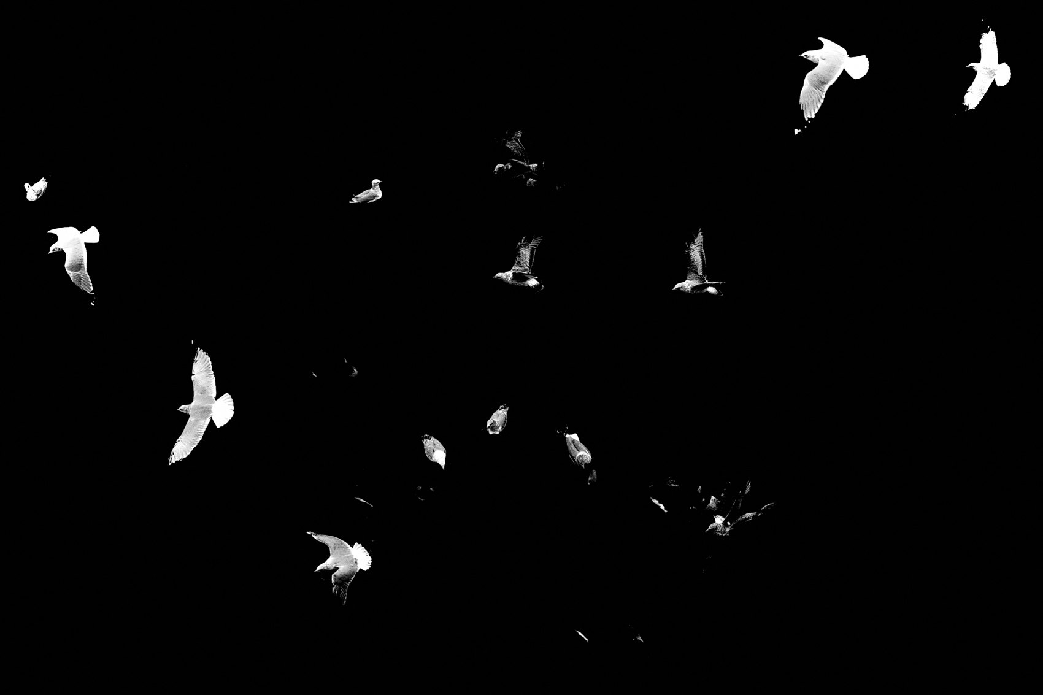
FLUX ACADEMY
BEAT 23 · SUMMARY / TAKEAWAY
Walk More. Judge Less. Keep the Diary.
— Consistency is the path — not talent, not gear
— The visual diary is a practice and a record
— Show up. Walk. Let the work accumulate.
Notes:
Last thing. The secret to this whole practice isn't talent and it isn't gear — it's showing up. Every day. Same street, same camera, no excuses, no checklist. Build the visual diary not for anyone else but yourself. Let the frames accumulate. Let the patterns emerge. Let the voice develop on its own terms. Walk more. Judge less. Keep the diary. He who walks the most shall win — go prove it. Catch you in the next one.

