Slide 1
FLUX ACADEMY · A SCHOOL FOR SEEING
MODULE 9 · AFTER THE SHOT
The Automated Archive & Publishing Pipeline
BY DANTE SISOFO

Slide 2
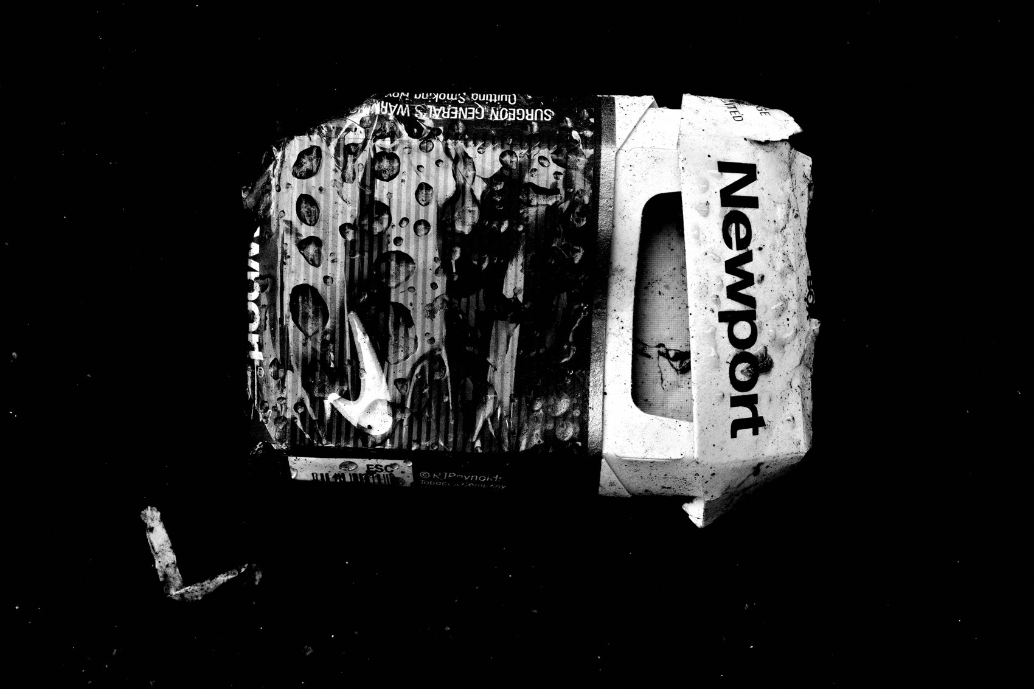
FLUX ACADEMY
BEAT 01 · CORE IDEA
One Pipeline, Zero Friction
— Capture → cull → archive → publish, all in one motion
— No desk required, no delay required
— The pipeline is the creative freedom
Notes:
What's popping, people — it's Dante. Today we're talking about the pipeline — the automated archive and publishing system that lets me shoot in the morning and have something published before lunch. This is not about gear obsession. It's about removing every single point of friction between the shutter click and the world seeing your work.

Slide 3
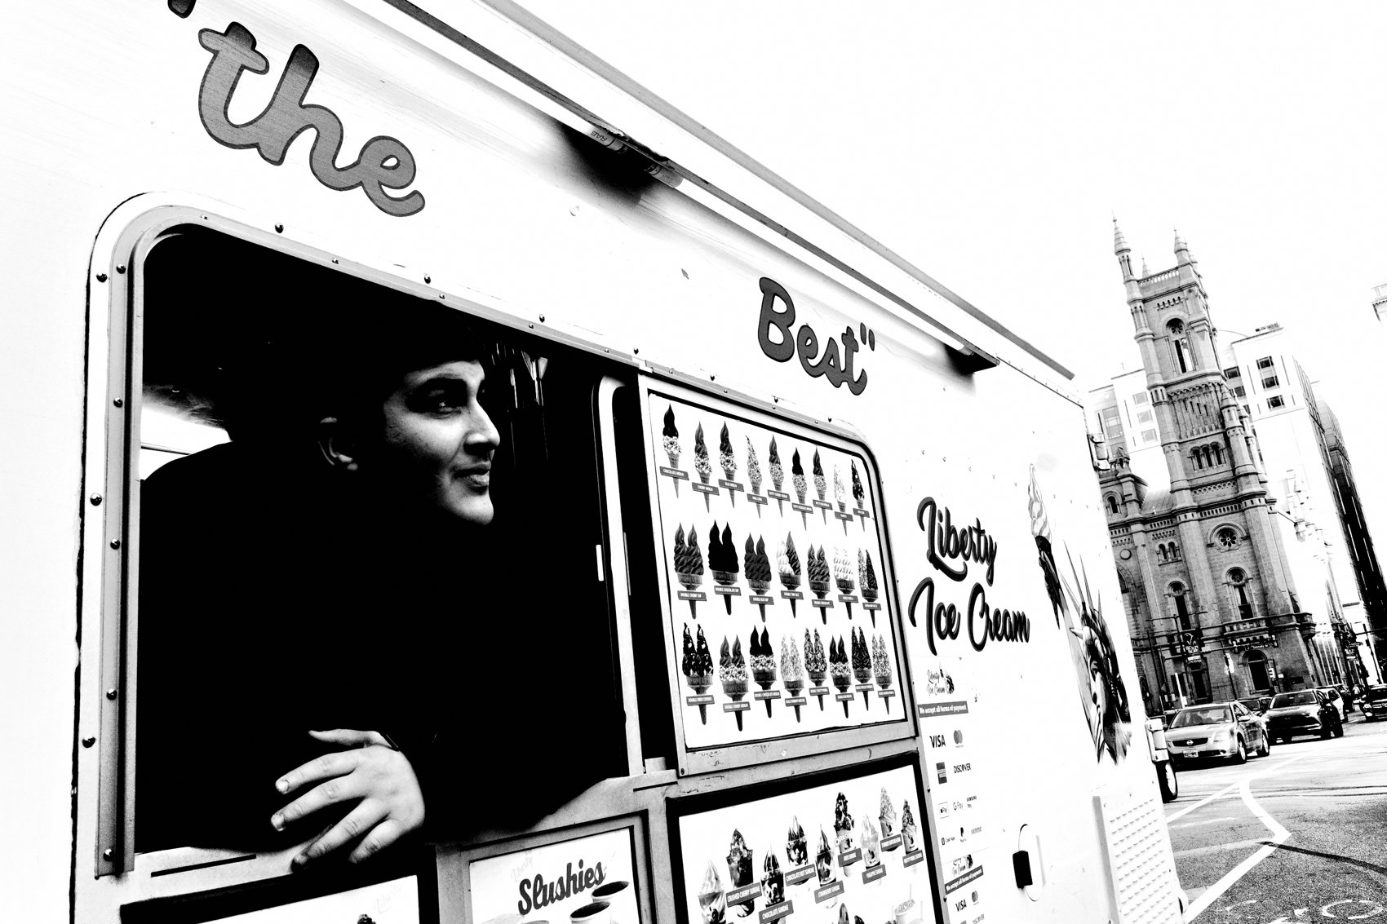
FLUX ACADEMY
BEAT 02 · LEARNING OBJECTIVE
What You'll Walk Away With
— A repeatable end-to-end workflow you can run daily
— Why speed and simplicity unlock more creative shooting
— The specific tools and sequence Dante uses every day
Notes:
By the end of this lesson you'll have a clear, repeatable pipeline — from import through archive to publish — built on tools you probably already own. More importantly, you'll understand why a fast, low-friction system makes you a better photographer, not just a faster one.

Slide 4
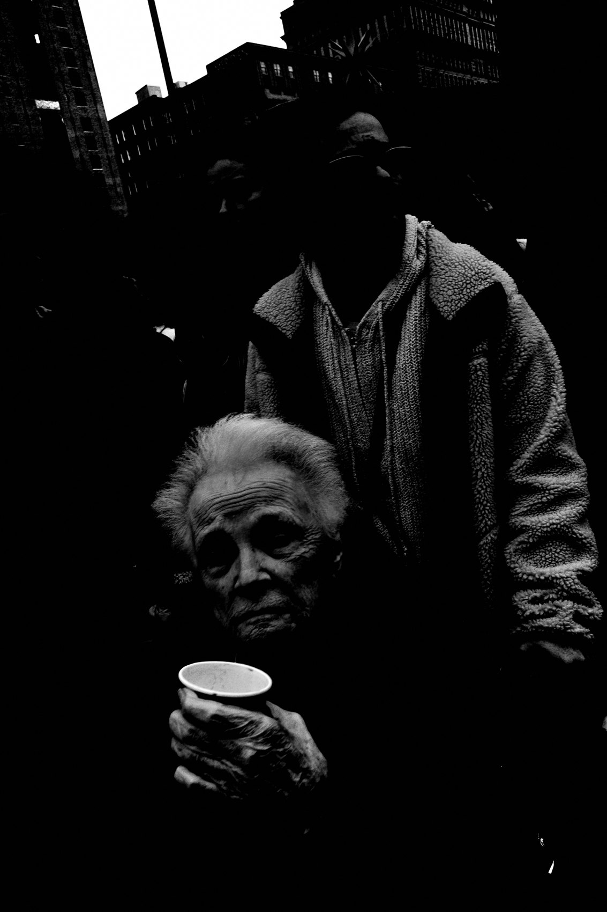
FLUX ACADEMY
BEAT 03 · WHY THIS MATTERS
Slow Workflows Kill Creative Momentum
— The old way: multiple lenses, hard drives, laptop culling
— Tedious systems bog you down mentally and practically
— Friction between shooting and sharing drains excitement
Notes:
Here's the honest truth about why this matters: a slow, complicated workflow quietly kills your creative momentum. There came a point where I realized my old system — a bulky camera body, multiple lenses, hard drives, laptop culling — was outdated and tedious. It bogged me down practically and mentally. The gap between shooting and sharing was so wide it drained the joy right out of it.

Slide 5

FLUX ACADEMY
BEAT 04 · WHY THIS MATTERS
Speed Creates Joy, Joy Creates Volume
— Through simplicity you work with speed
— Through speed you find joy
— Joy compounds into daily publishing for years
Notes:
The flip side is just as real: when the system is fast and simple, you find joy. And that joy compounds. It's the reason I've been able to publish every single day for over two and a half years. Speed isn't laziness — it's what keeps you excited to shoot again tomorrow.

Slide 6
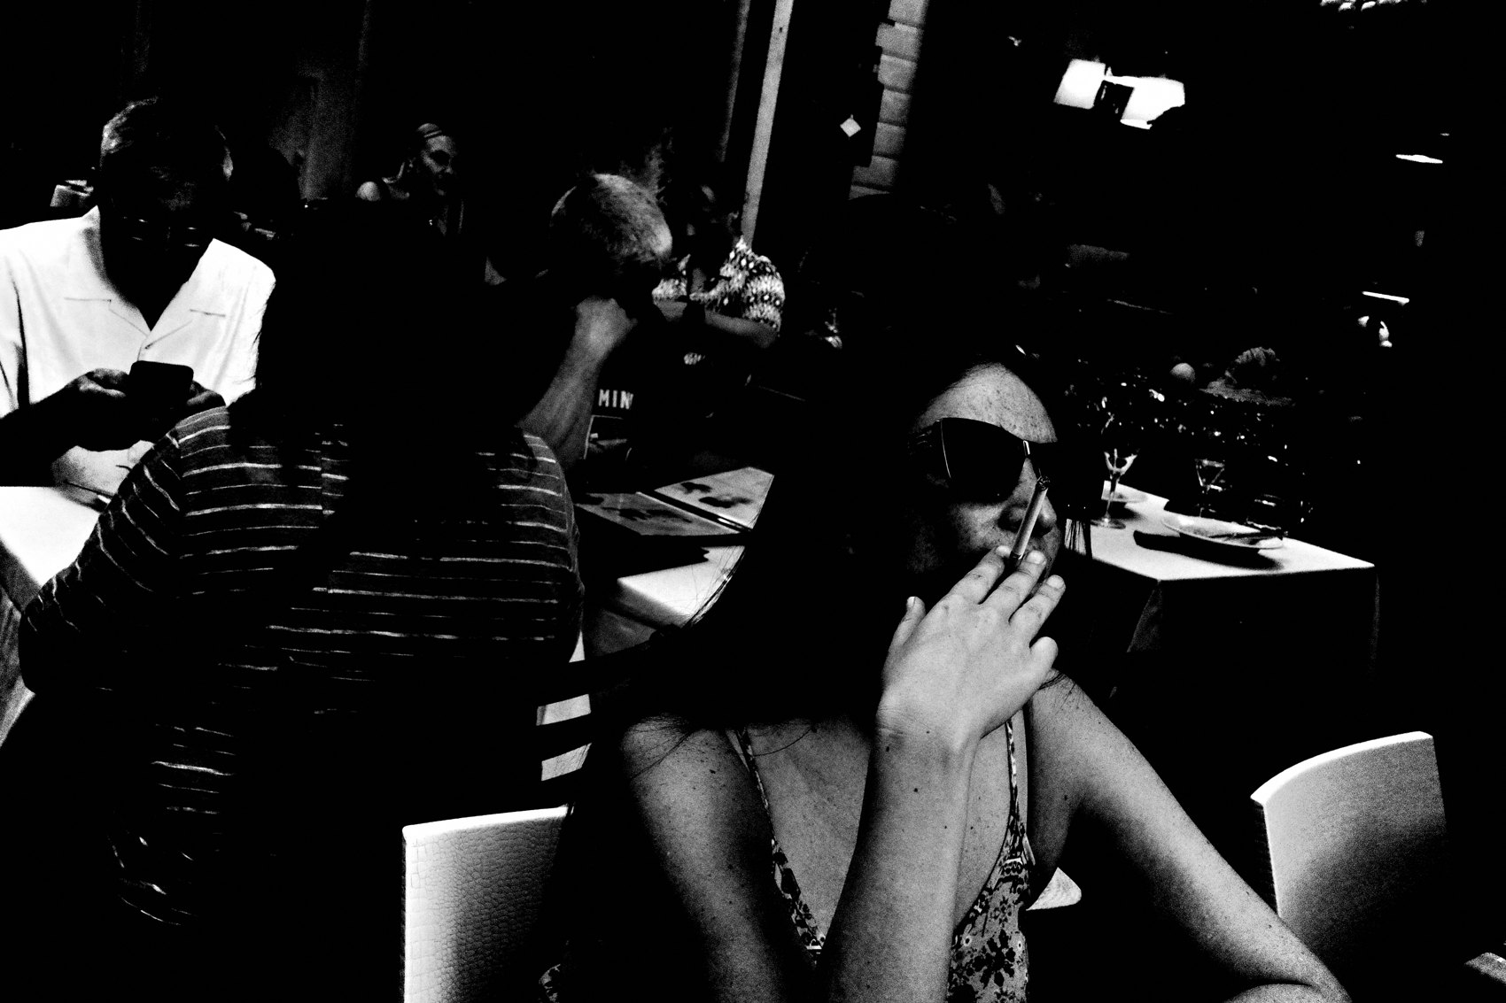
FLUX ACADEMY
BEAT 05 · MAIN TEACHING
Why the Old Workflow Had to Go
— Multiple lenses = decision fatigue
— Hard-drive backup = friction and delay
— Laptop culling = tethered to a desk
Notes:
The old workflow demanded a desk. Multiple lenses meant decision fatigue before you even raised the camera. Hard drives meant backup rituals that ate hours. Laptop culling meant you couldn't process anything until you got home. All of that is the enemy of a daily practice. So I sold the gear, picked up the Ricoh GR III, and rebuilt everything around the iPad Pro.

Slide 7

FLUX ACADEMY
BEAT 06 · MAIN TEACHING
The Core Rig: Ricoh GR + iPad Pro
— Ricoh GR III: compact, pocket-sized, always ready
— High-contrast black-and-white JPEGs straight out of camera
— iPad Pro: light, fast, and always with you anywhere
Notes:
The foundation is two devices. The Ricoh GR III — small, pocket-sized, shooting high-contrast black-and-white JPEGs — and the iPad Pro. Together they are, in one word, freedom. You can be in the forest, on the bus, in a café — your entire creative operation travels with you. No desk, no compromise.

Slide 8
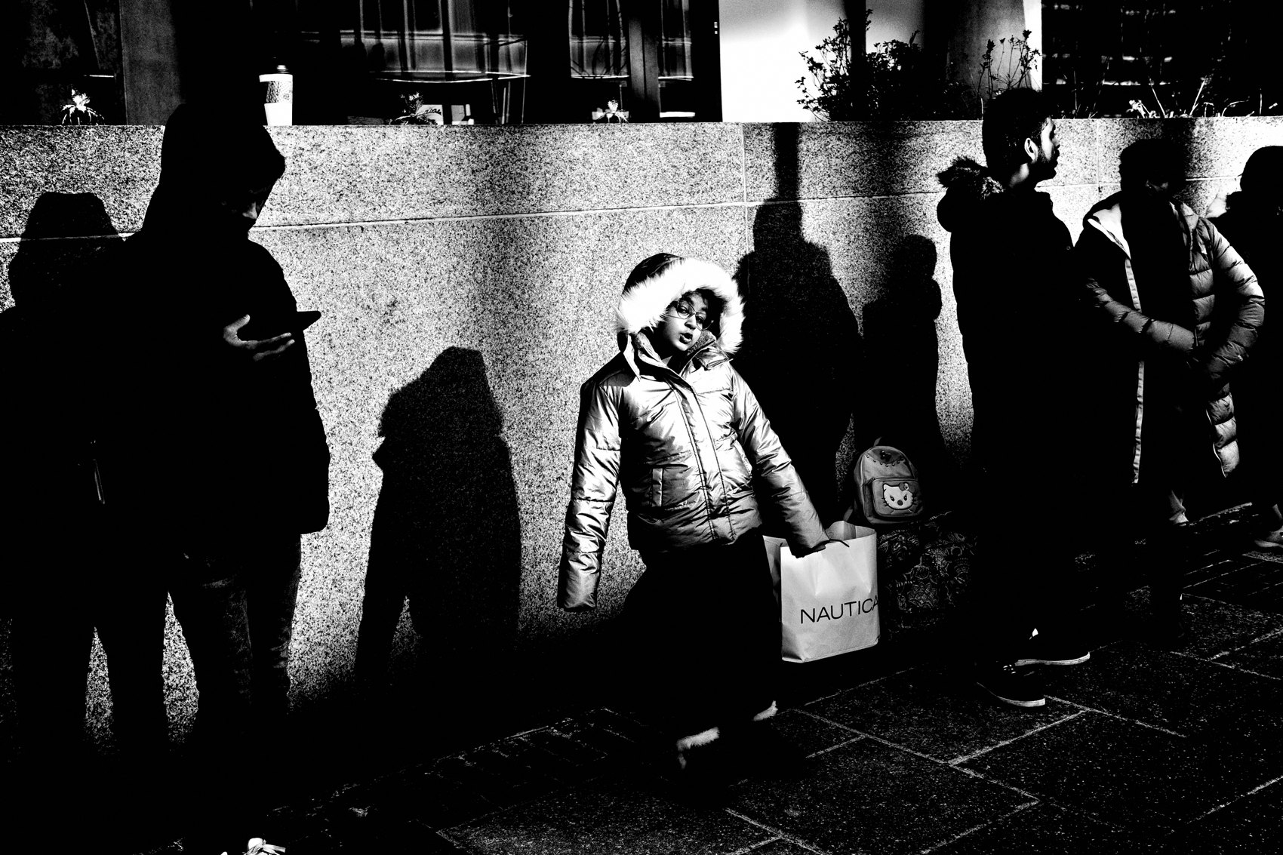
FLUX ACADEMY
BEAT 07 · MAIN TEACHING
Import: USB-C to SD, Straight In
— USB-C to SD card reader — plug and play
— Import directly into the Photos app, no Lightroom needed
— Shoot JPEGs and skip the RAW conversion entirely
Notes:
Import is the first link in the chain and it has to be instant. USB-C to SD card reader, straight into the Photos app. No Lightroom required if you're shooting JPEGs — and shooting JPEGs is itself a workflow decision. When you commit to JPEG, you're committing to speed. The heavy lifting happens in-camera, not on a screen.

Slide 9
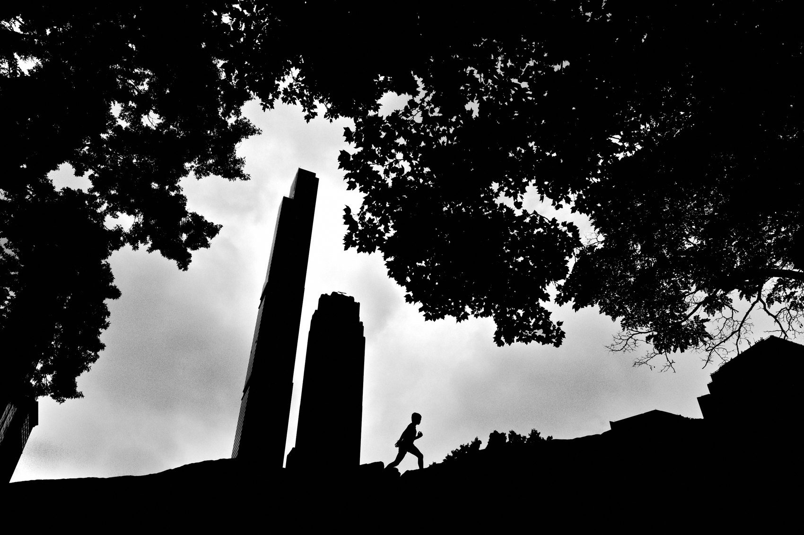
FLUX ACADEMY
BEAT 08 · MAIN TEACHING
Culling in the 3×3 Grid View
— Open Photos app, switch to 3×3 grid view
— Scroll fast — if it looks good small, it's probably a keeper
— Tap Favorite instantly on what hits; don't zoom, don't pixel-peep
Notes:
Culling is where most photographers slow down and overthink. My method is brutally simple: 3×3 grid view in the Photos app, scroll fast, and favorite whatever hits me. "If it looks good small, it's probably a keeper." I don't zoom in. I don't pixel-peep. I just feel. Intuition over intellect, every time.

Slide 10
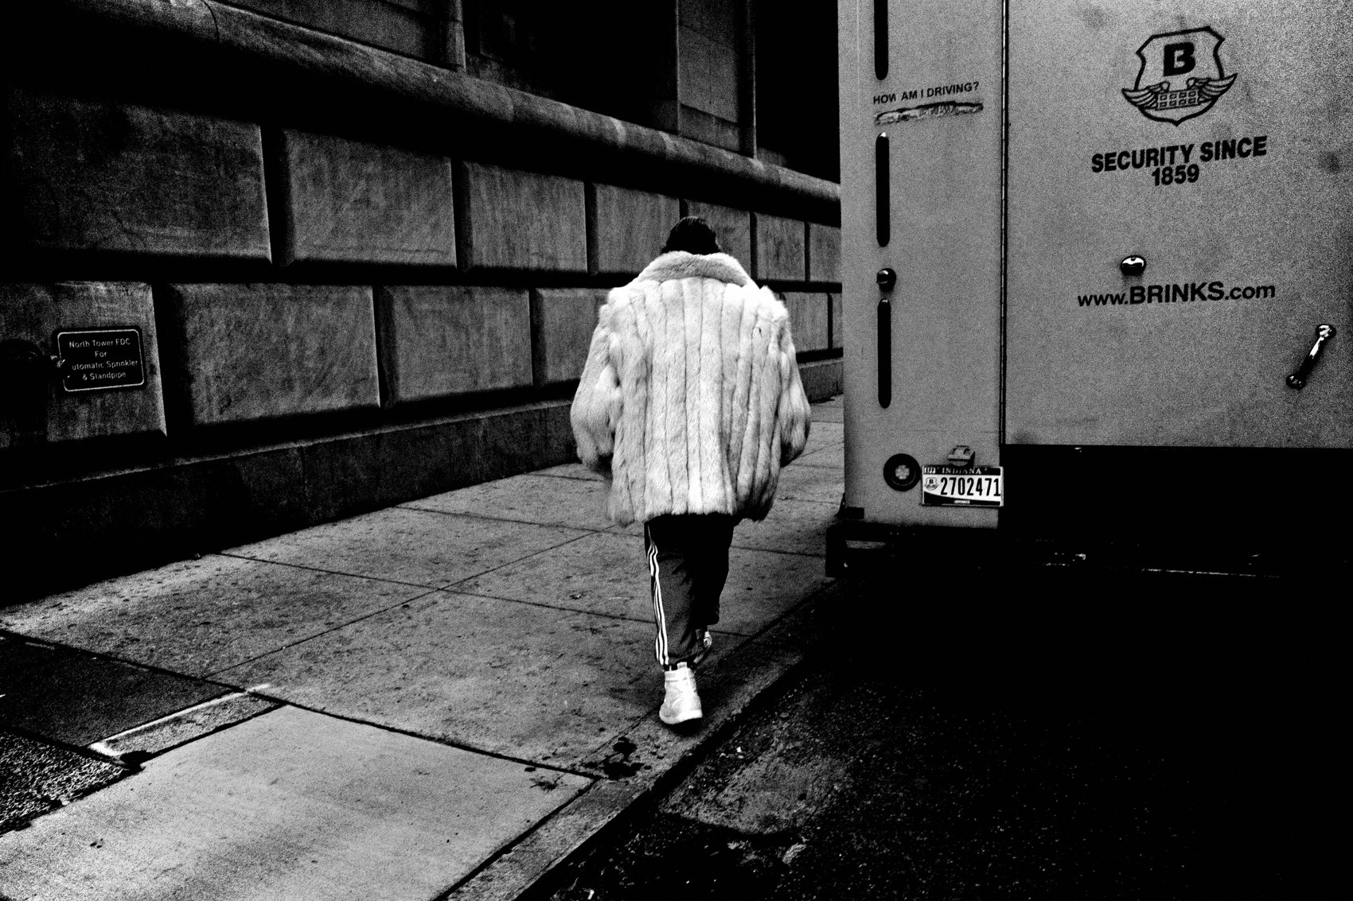
FLUX ACADEMY
BEAT 09 · MAIN TEACHING
Name the Album, Date It, Move On
— Name each album by date — e.g. April 12, 2024
— One folder per day, every day for three years
— The archive becomes a visual diary of how you live
Notes:
Every session gets a folder named by date — April 12, 2024, October 31, 2025, whatever the day is. I've been doing this every single day for three years. That stack of dated folders is the visual diary. It's a record of how I live my life. The photographs are just a reminder of where I was and what I was responding to.

Slide 11
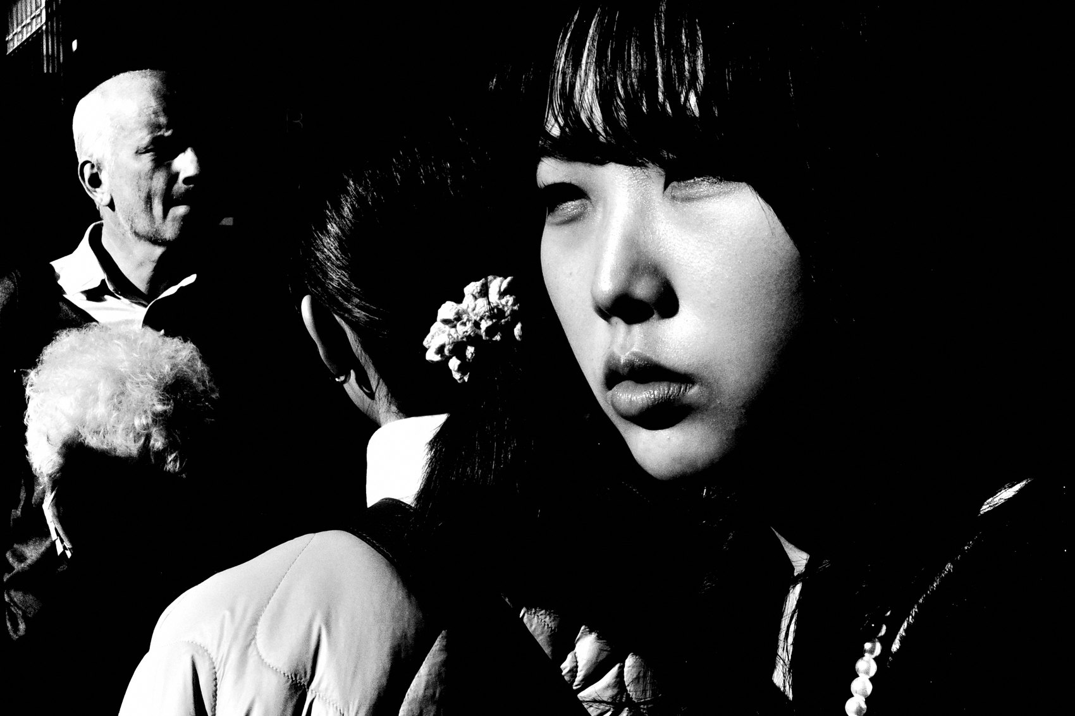
FLUX ACADEMY
BEAT 10 · MAIN TEACHING
The Three-Tier Selection System
— Tier 1 — Favorites: rapid tap on thumbnails that stand out
— Tier 2 — Selections: tighter edit pulled from favorites
— Tier 3 — Year Folder: the keepers that define the year
Notes:
Inside the archive, selections move through three tiers. First, Favorites — rapid tapping on anything that catches my eye during the initial scroll. Second, Selections — a tighter edit pulled from those favorites. Third, the Year Folder — the true keepers, the ones that define who I was as a photographer that year. Most days give you nothing for Tier 3. Every so often, one photograph feels alive.

Slide 12
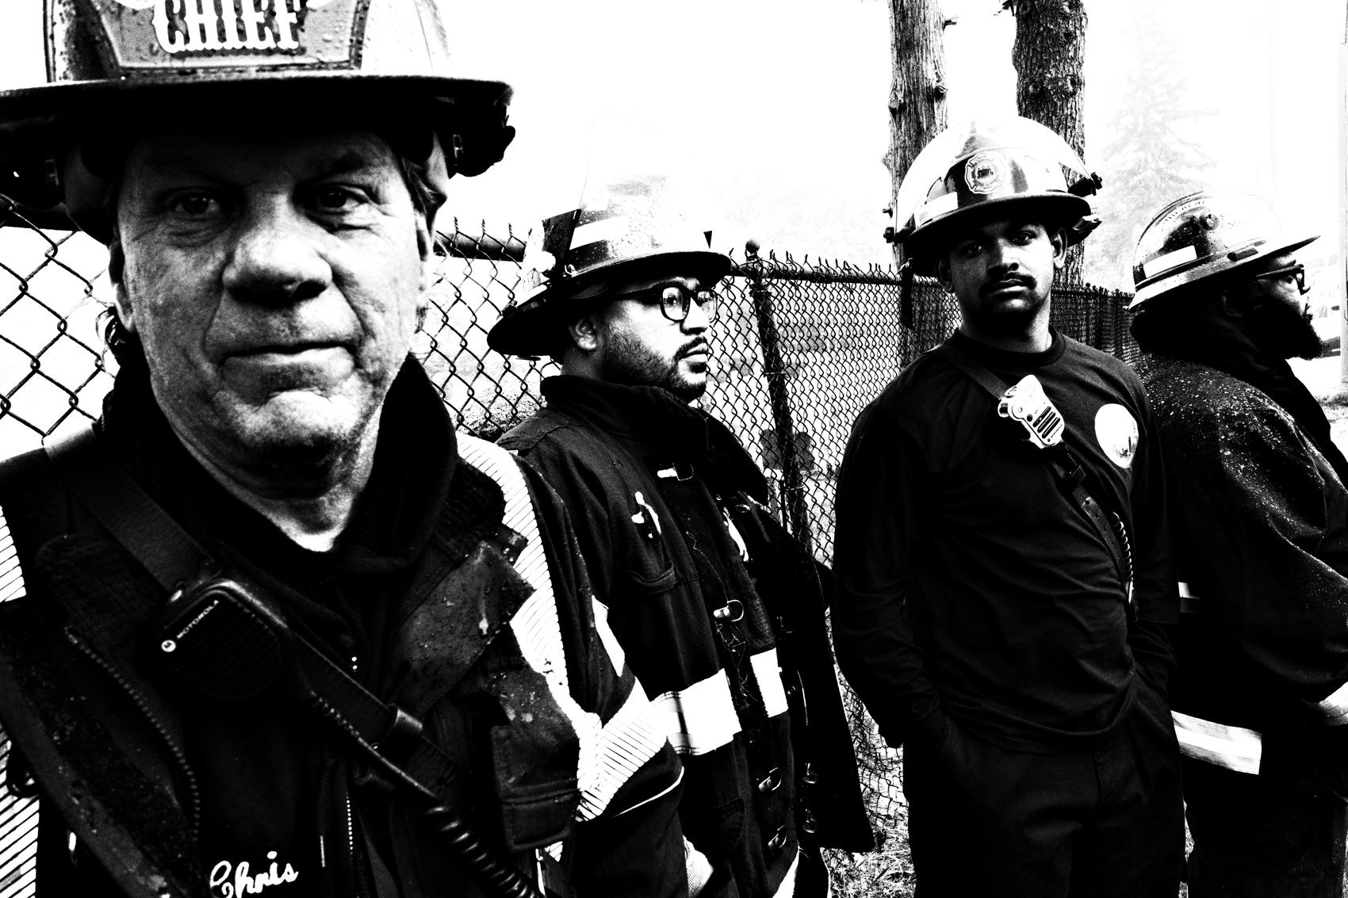
FLUX ACADEMY
BEAT 11 · MAIN TEACHING
The Cloud Backup Stack
— Google Photos: public, shareable, open-access archive
— Lightroom CC: legacy RAW files in the cloud
— AirDrop: instant device-to-device without cables
Notes:
Backup runs in parallel, not after. Google Photos for the public, shareable archive — anyone can browse it straight from my website. Lightroom CC for legacy RAW files. AirDrop for instant device-to-device transfer when I need something on my iMac. The beauty is access anywhere, anytime — across phone, iPad, or desktop — without thinking about it.

Slide 13

FLUX ACADEMY
BEAT 12 · MAIN TEACHING
The Pipeline Under Heavy Volume
— A big night can leave you with hundreds of frames
— The full session gets culled on the iPad in one fast pass
— Out of hundreds, one keeper rises above everything else
Notes:
This is the pipeline under load. A big, active night can leave you with hundreds of frames on the card. You cull the entire session on the iPad in one sitting — scrolling the 3×3 grid, tapping favorites, moving fast, never breaking flow. And out of hundreds, one frame rises above everything else, the one where light, composition, and moment all align. The volume doesn't matter when the system does the carrying.

Slide 14

FLUX ACADEMY
BEAT 13 · MAIN TEACHING
Cull on the Bus, Publish Before Work
— Shoot at sunrise, cull on the bus
— Publish a full photo essay by 9 AM
— Same-day publishing as a daily standard, not an exception
Notes:
The pipeline isn't theoretical — it's timed. You can shoot at sunrise, cull on the bus ride home, and publish a complete photo essay before work starts. That's not a boast; that's the design. Same-day publishing becomes your daily standard. The gap between experience and sharing collapses to almost nothing, which means your work stays honest, fresh, and alive.

Slide 15

FLUX ACADEMY
BEAT 14 · MAIN TEACHING
Writing on the Move with iA Writer
— iA Writer + voice dictation = blog posts without a keyboard
— Write standing up, walking through nature, even hiking
— Publish directly to WordPress from the Safari app
Notes:
The pipeline extends to writing. iA Writer plus voice dictation means I can write a full blog post without touching a keyboard — standing in the forest, walking a trail, dictating out loud. Then I publish directly to WordPress through the Safari app on the iPad. No laptop, no desk, no delay. "You don't need a mouse, a case, or accessories — just speak."

Slide 16

FLUX ACADEMY
BEAT 15 · MAIN TEACHING
Procreate and Keynote as Creative Extensions
— Procreate: gradient maps, AI selection, spontaneous collage
— Keynote: slideshows with fades and text, export as video or PDF
— Both publish directly from the iPad — no desktop required
Notes:
The pipeline doesn't stop at single images. Procreate lets me remix photographs into collages — gradient maps, layered elements, embracing imperfection and serendipity. Keynote turns photo sequences into slideshows with fades and text, exported as video or PDF and published straight to the blog or YouTube. Street collage is like Dada — serendipity, humor, lightheartedness. It's visual art, not just photography.

Slide 17
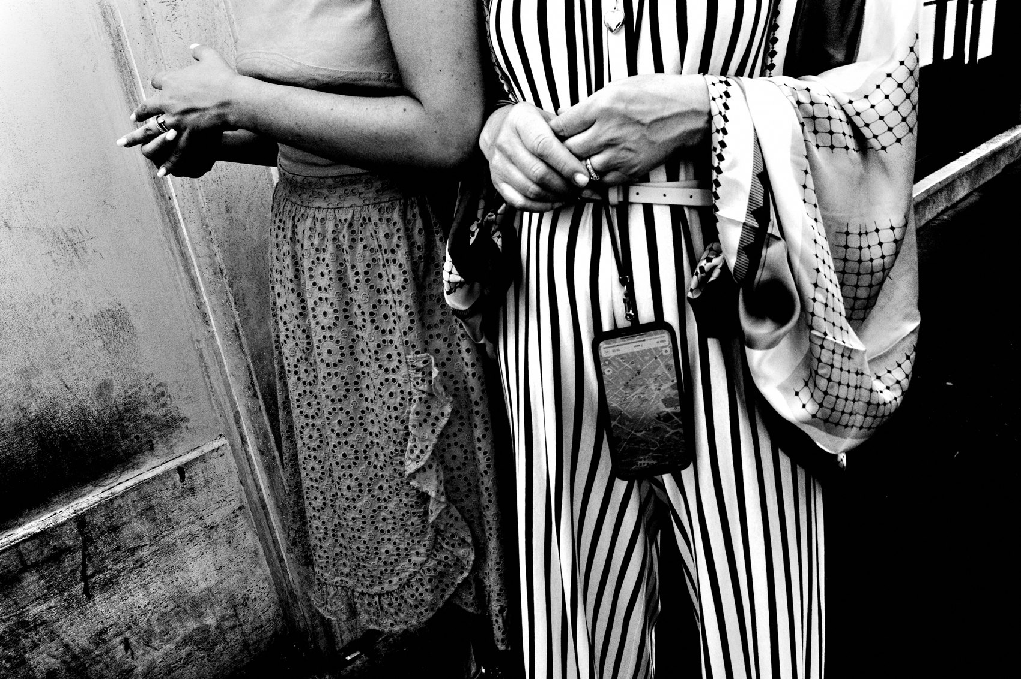
FLUX ACADEMY
BEAT 16 · MAIN TEACHING
Open-Source Publishing Philosophy
— Your own domain, WordPress, full creative control
— Google Photos as a public visual diary — open and downloadable
— Share freely; the examined life gains meaning through sharing
Notes:
Everything in this pipeline points outward — openly. My Google Photos archive is publicly browsable from my website. Everything is free, downloadable, remixable. I build on my own domain through WordPress — not Instagram, not a platform that owns my work. "To share is to give your life deeper meaning." The examined life is worth living, and sharing is how you examine it.

Slide 18
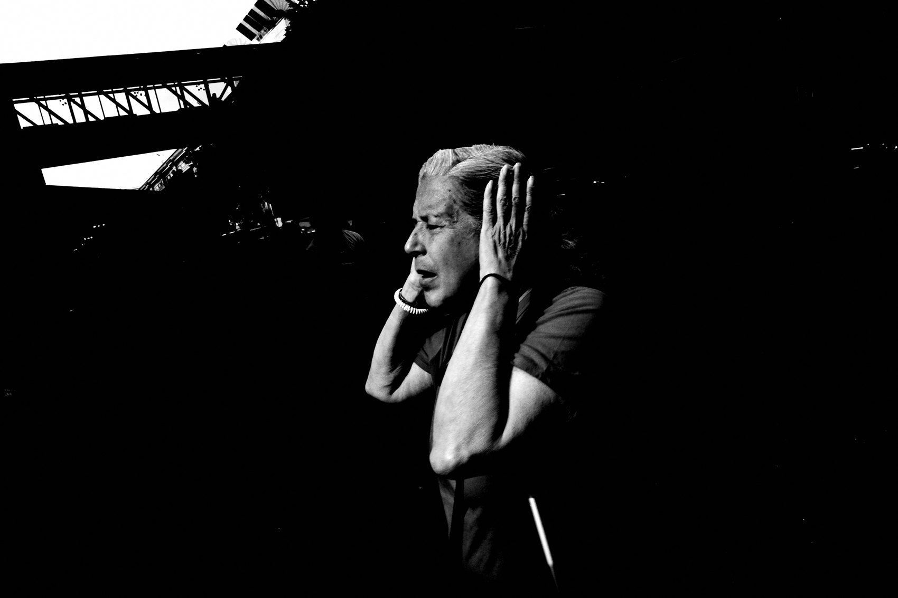
FLUX ACADEMY
BEAT 17 · PRACTICAL APPLICATION
Build Your Daily Pipeline Today
— Pick one device as your hub — iPad Pro or laptop, commit
— Shoot JPEG, import same day, date the folder, favorite fast
— Back up to one cloud service before you sleep
Notes:
Here's your assignment: build the pipeline today, not someday. Pick one device as your hub and commit. Shoot JPEG if you can. Import the same day you shoot. Date the folder. Favorite fast in the 3×3 grid. Back up to one cloud service before you sleep. That's the whole system. Run it once and it becomes automatic.

Slide 19
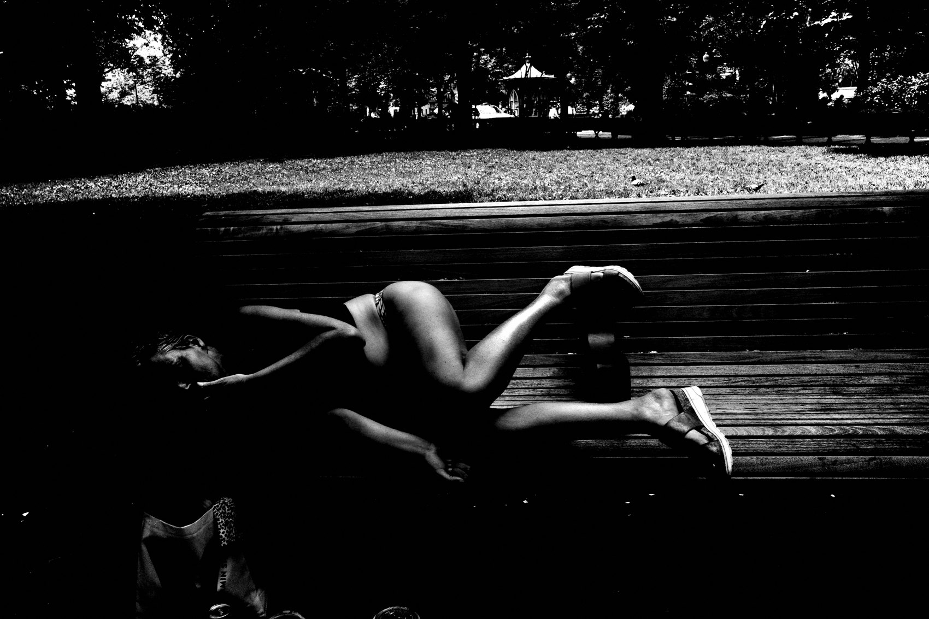
FLUX ACADEMY
BEAT 18 · PRACTICAL APPLICATION
Run a Same-Day Publish Challenge
— Shoot in the morning, publish something by end of day
— It doesn't have to be the best photo — it has to be out
— Repetition builds the reflex; the reflex builds the archive
Notes:
Then run a same-day publish challenge for one week. Shoot in the morning, have something published — a photo, a note, a short sequence — by end of day. It doesn't have to be your best work. It has to be out. Repetition builds the reflex, and the reflex builds the archive. "Publish, learn, evolve."

Slide 20
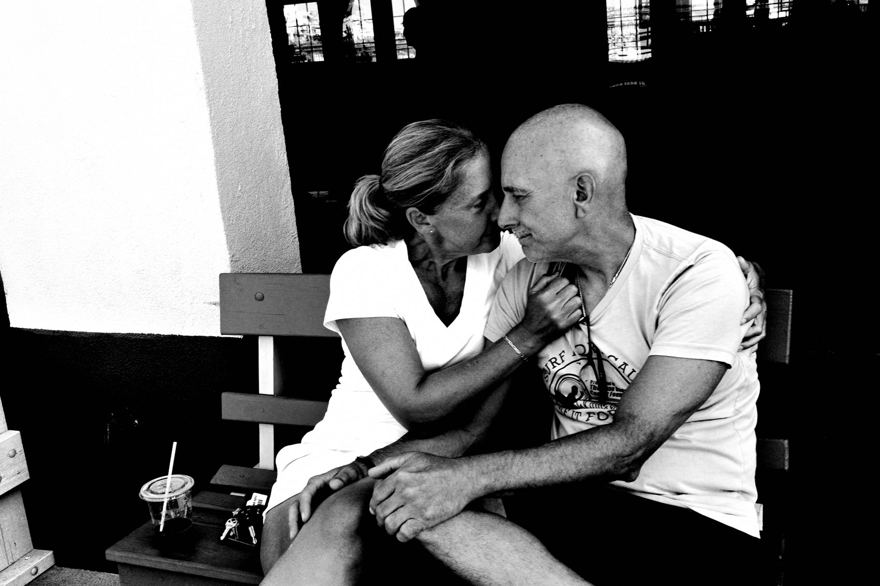
FLUX ACADEMY
BEAT 19 · COMMON MISTAKES
Over-Engineering the System
— More tools do not equal a better workflow
— Every added step is a point of friction
— Complexity is procrastination in disguise
Notes:
The most common mistake is over-engineering. Adding more tools, more software, more steps — believing that complexity equals quality. It doesn't. Every added step is a point of friction, and friction is procrastination in disguise. The best workflow is the one you'll actually run every single day without thinking. Keep it dumb simple.

Slide 21
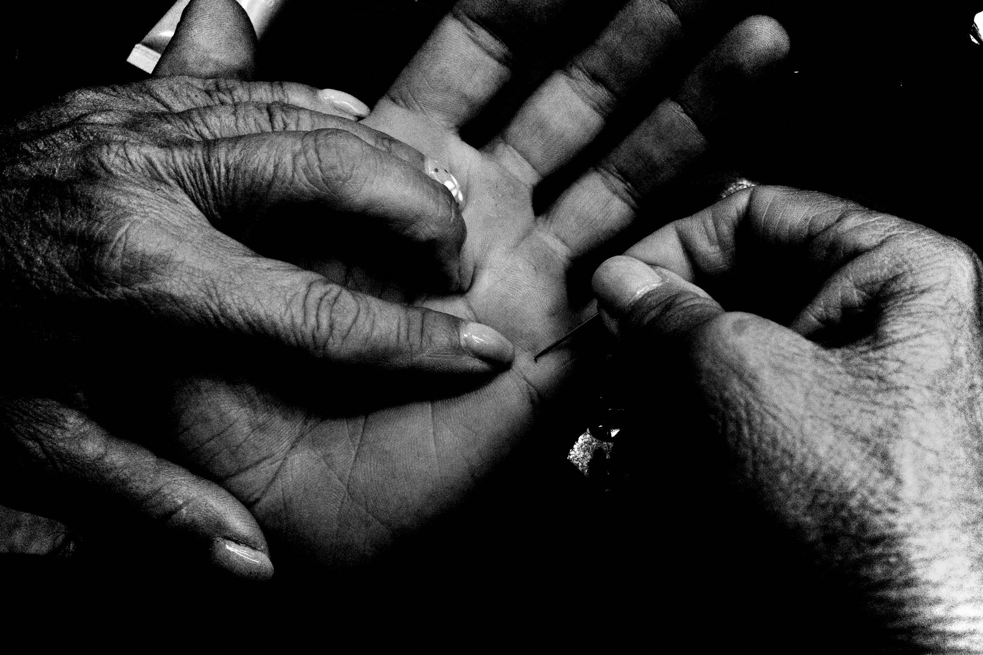
FLUX ACADEMY
BEAT 20 · COMMON MISTAKES
Holding Work Back for Perfection
— Waiting until it's "ready" means never publishing
— "Everything is a work in progress — publish, learn, evolve"
— Stagnation is sitting in front of the screen thinking
Notes:
The other mistake: holding work back until it's perfect. There is no perfect. "Everything is a work in progress — publish, learn, evolve." Stagnation is sitting in front of the screen thinking. Motivation is moving your body, clicking the shutter, and hitting publish. Send it. Move on. The next day's work is already waiting for you.

Slide 22
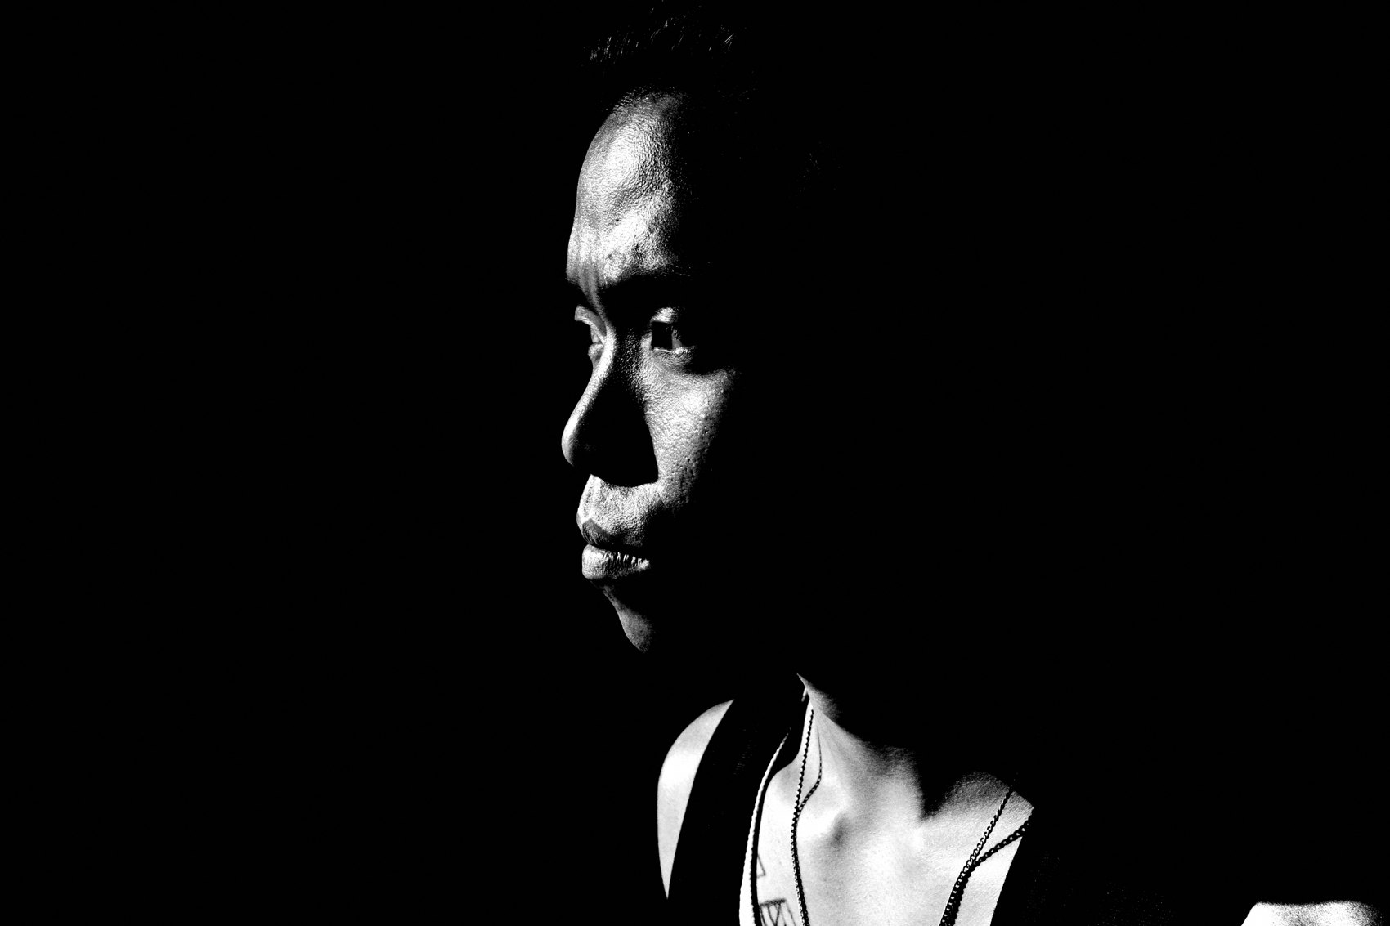
FLUX ACADEMY
BEAT 21 · RELATIONSHIP TO PREVIOUS
Building on the Speed Mindset
— Lesson 047 established the gear philosophy — less is more
— This lesson turns that philosophy into a daily operating system
— The pipeline is what makes minimal gear sustainable long-term
Notes:
Lesson 047 gave us the gear philosophy — that less is more, that the right tool is the one you actually carry. This lesson takes that philosophy and turns it into a daily operating system. The pipeline is what makes minimal gear sustainable over the long run. It's not enough to own the right camera; you need the right chain to move the work from camera to world.

Slide 23
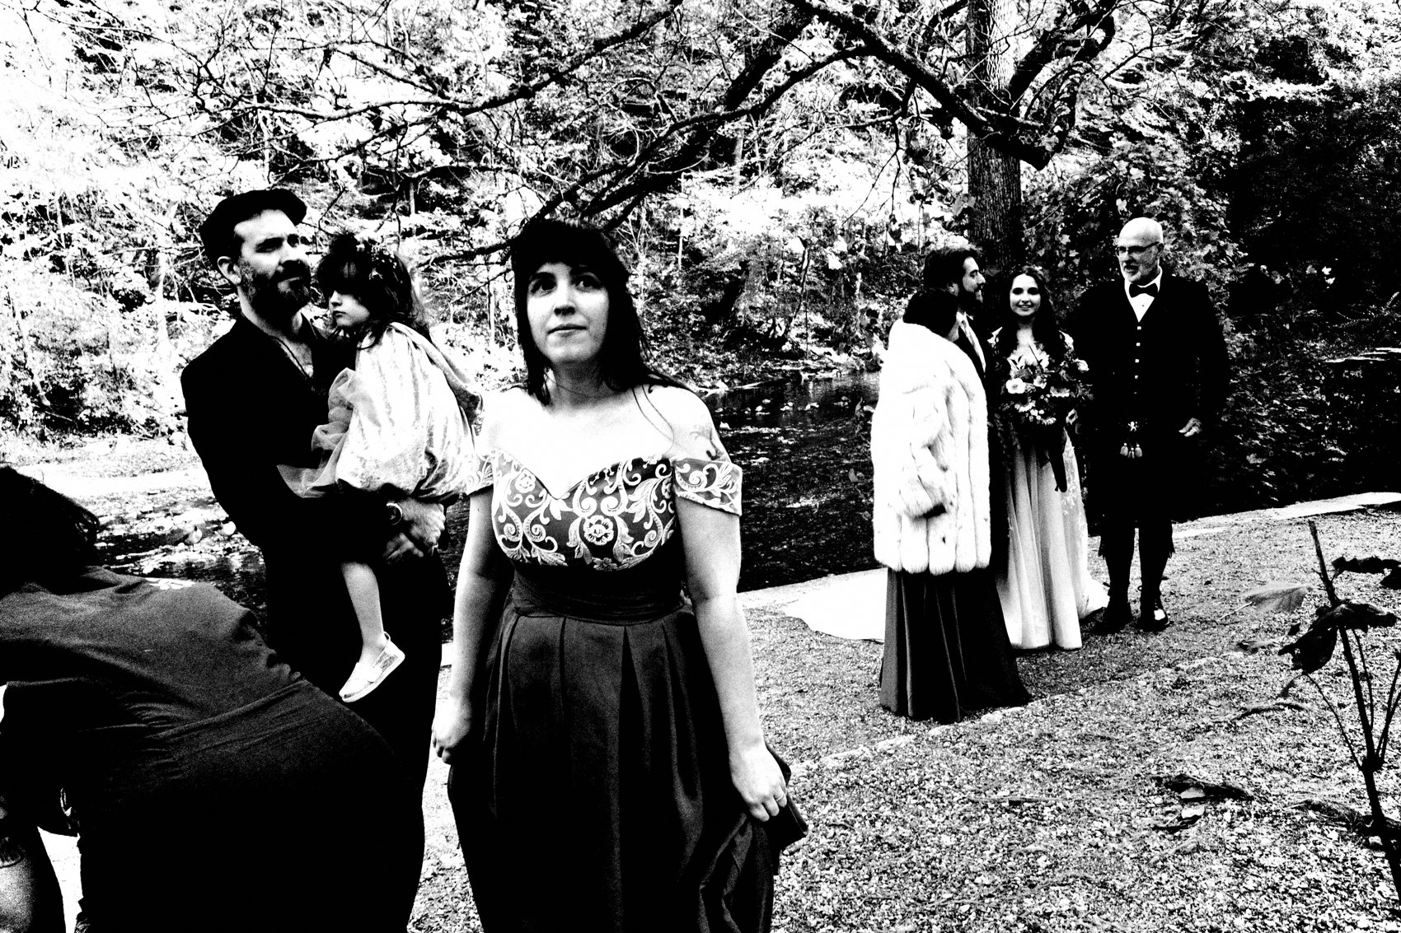
FLUX ACADEMY
BEAT 22 · RELATIONSHIP TO UPCOMING
From Pipeline to Longevity
— Lesson 049 addresses creative longevity and staying power
— The pipeline keeps you publishing; longevity keeps you going
— Systems sustain the practice; the next lesson sustains the person
Notes:
The pipeline keeps your work moving. But what keeps you moving? Lesson 049 takes on creative longevity — how to sustain a daily practice for years without burning out, losing the love, or running dry. The system we built today is the infrastructure; next lesson is about the fuel that runs through it.

Slide 24
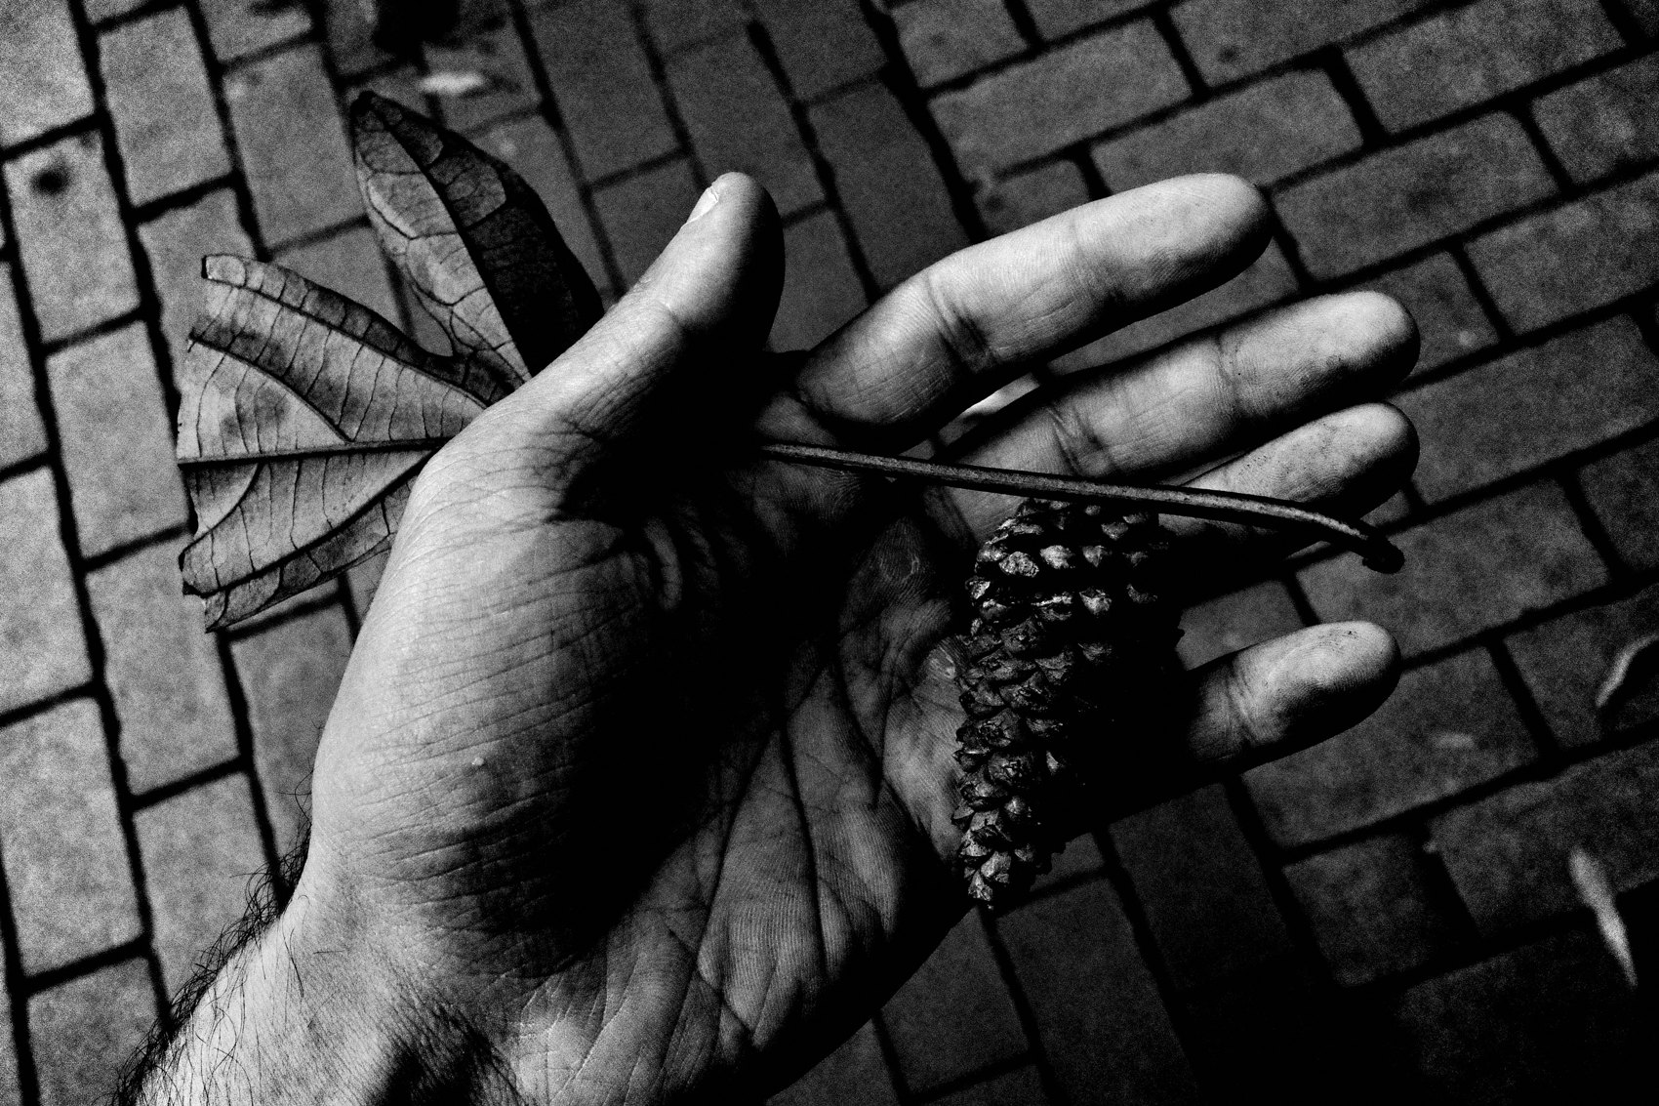
FLUX ACADEMY
BEAT 23 · SUMMARY / TAKEAWAY
Build the Chain, Free the Photographer
— Ricoh GR + iPad Pro = the whole operation in two pockets
— Capture → cull → archive → publish, same day, every day
— The pipeline isn't about efficiency — it's about freedom
Notes:
Last thing. The automated archive and publishing pipeline isn't a productivity hack — it's a freedom system. Ricoh GR in one pocket, iPad Pro in a bag, USB-C card reader, Photos app, Google Photos, your own WordPress site. Capture, cull, archive, publish — same day, every day. Remove the friction and what's left is the only thing that ever mattered: getting out there and making photographs. Build the chain. Free the photographer. Catch you in Lesson 049. Peace.

