Slide 1
FLUX ACADEMY · A SCHOOL FOR SEEING
MODULE 9 · AFTER THE SHOT
How I Choose My Best Shots
BY DANTE SISOFO

Slide 2

FLUX ACADEMY
BEAT 01 · CORE IDEA
The Keeper Reveals Itself
— Not every frame is equal — and that's fine
— The keeper is found, not forced
— Moment + form + feeling = the one
Notes:
What's popping, people — it's Dante. Today we're going inside my iPad, my archive, my actual process — and we're talking about how I choose the best shot from a day of shooting. This is the edit. This is the selection. And here's the thing: the keeper isn't decided by logic alone. It reveals itself when moment, form, and feeling all line up at once.

Slide 3

FLUX ACADEMY
BEAT 02 · LEARNING OBJECTIVE
What You'll Walk Away With
— A repeatable keeper formula
— How to compare similar frames objectively
— The instinct + eye balance that drives strong selection
Notes:
By the end of this lesson you'll have a real process for choosing your best shots — not a checklist that kills the feeling, but a framework that sharpens your eye over time. You'll know what to look for, what to let go, and how to trust the frame that breathes.

Slide 4

FLUX ACADEMY
BEAT 03 · WHY THIS MATTERS
Bad Selection Buries Great Work
— You can shoot brilliantly and edit poorly
— Weak selection = your worst work representing you
— The edit is the final creative act
Notes:
Here's why this matters: you can go out and shoot brilliantly and then bury your best work under a bad selection. The edit is a creative act in its own right — the final one. Get it wrong and your weakest frame becomes the face of your day. Get it right and the single keeper does all the talking.

Slide 5

FLUX ACADEMY
BEAT 04 · WHY THIS MATTERS
Comparison Sharpens the Eye
— Similar frames sharpen your ability to choose
— Patterns across sessions reveal your instincts
— The more you compare, the faster you see
Notes:
There's a second reason this matters: when you come home with similar frames — even from different years, different cities — and you put them side by side, your eye gets sharper. The comparison process itself is a training ground. You start to see what you were actually reaching for.

Slide 6

FLUX ACADEMY
BEAT 05 · MAIN TEACHING
The Three-Part Keeper Formula
— The Decisive Moment — what happened
— Clean Composition — how it's ordered
— Emotional Resonance — what it makes you feel
Notes:
Here's the formula I always come back to: the decisive moment, clean composition, and emotional resonance. The gesture gives life to the picture. The composition gives it order. The emotion gives it meaning. When all three are synthesized, the keeper reveals itself. Not before.

Slide 7

FLUX ACADEMY
BEAT 06 · MAIN TEACHING
Less Is More, Every Time
— Simple frames, simple moments
— More elements rarely means more power
— Clarity over complexity
Notes:
One principle runs through every selection I've ever made: less is more. Simple frames, simple moments. When I'm comparing two shots and one has more elements, more dynamics, more going on — that complexity almost always works against it. Clarity wins. Every time.

Slide 8

FLUX ACADEMY
BEAT 07 · MAIN TEACHING
The Breathing Frame Beats the Busy One
— Simple + clean + emotional reads stronger than more-going-on
— A chaotic background steals the eye from the subject
— The keeper breathes — simplicity + emotion + separation
Notes:
Line up two frames of the same subject where one is quiet and one is busy, and the pattern holds almost every time. The quiet frame — clean composition, a bit of foreground mystery, a face full of emotion — is the keeper. The busier frame has more elements, more dynamics, but a background that pulls the eye away and never lets it settle. The keeper breathes. The viewer's eye lands and rests. That ease is the signal.

Slide 9

FLUX ACADEMY
BEAT 08 · MAIN TEACHING
Separation Is the Tiebreaker
— Clean separation between elements reads as clarity
— More subjects and more dynamics can still lack compositional order
— Balance between moment and form beats busyness
Notes:
When two frames are close, separation usually breaks the tie. Picture a single strong subject set cleanly against its background, each element given room to stand on its own — that clarity wins over a competing frame packed with more subjects and more motion but no order. The cleaner frame holds because its moment and its form are in balance. When I'm on the fence, I always ask: which one has better separation? That answer almost never lies.

Slide 10
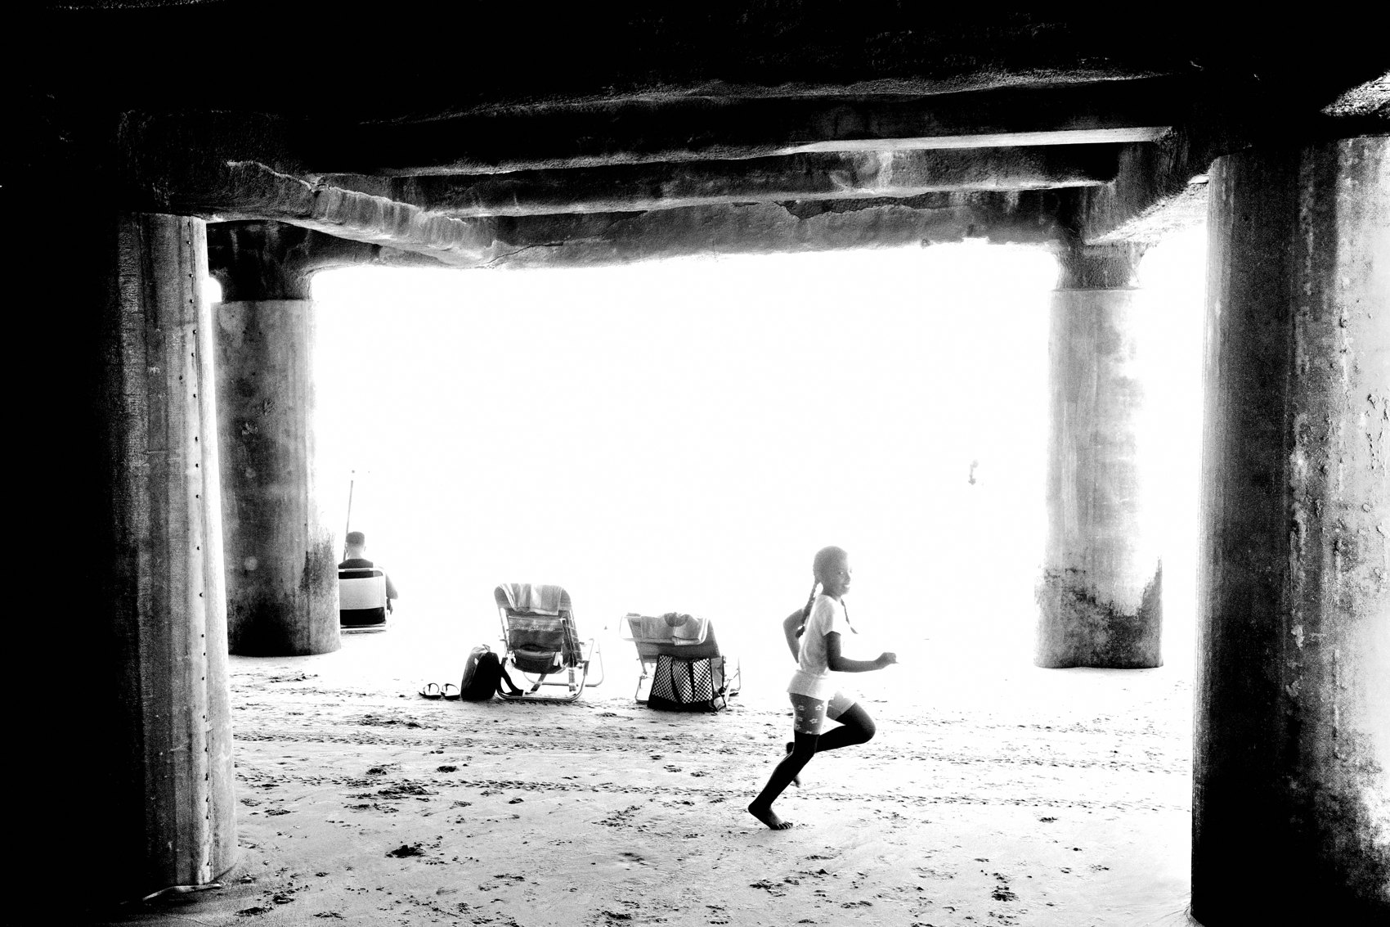
FLUX ACADEMY
BEAT 09 · MAIN TEACHING
Rhythm Across the Layers Earns the Keep
— Foreground interest draws the viewer in
— Repeated gestures create rhythm across the frame
— Better subject separation seals the decision
Notes:
When a scene is full of people and motion, look for rhythm. The winning frame usually has a piece of foreground interest that pulls you in, then a repeated gesture — the same hand shape, the same tilt of a body — echoing across different planes so the eye travels layer to layer. Add cleaner subject separation on top of that and the decision is made. When a frame has rhythm running through every layer, it earns the keep.

Slide 11
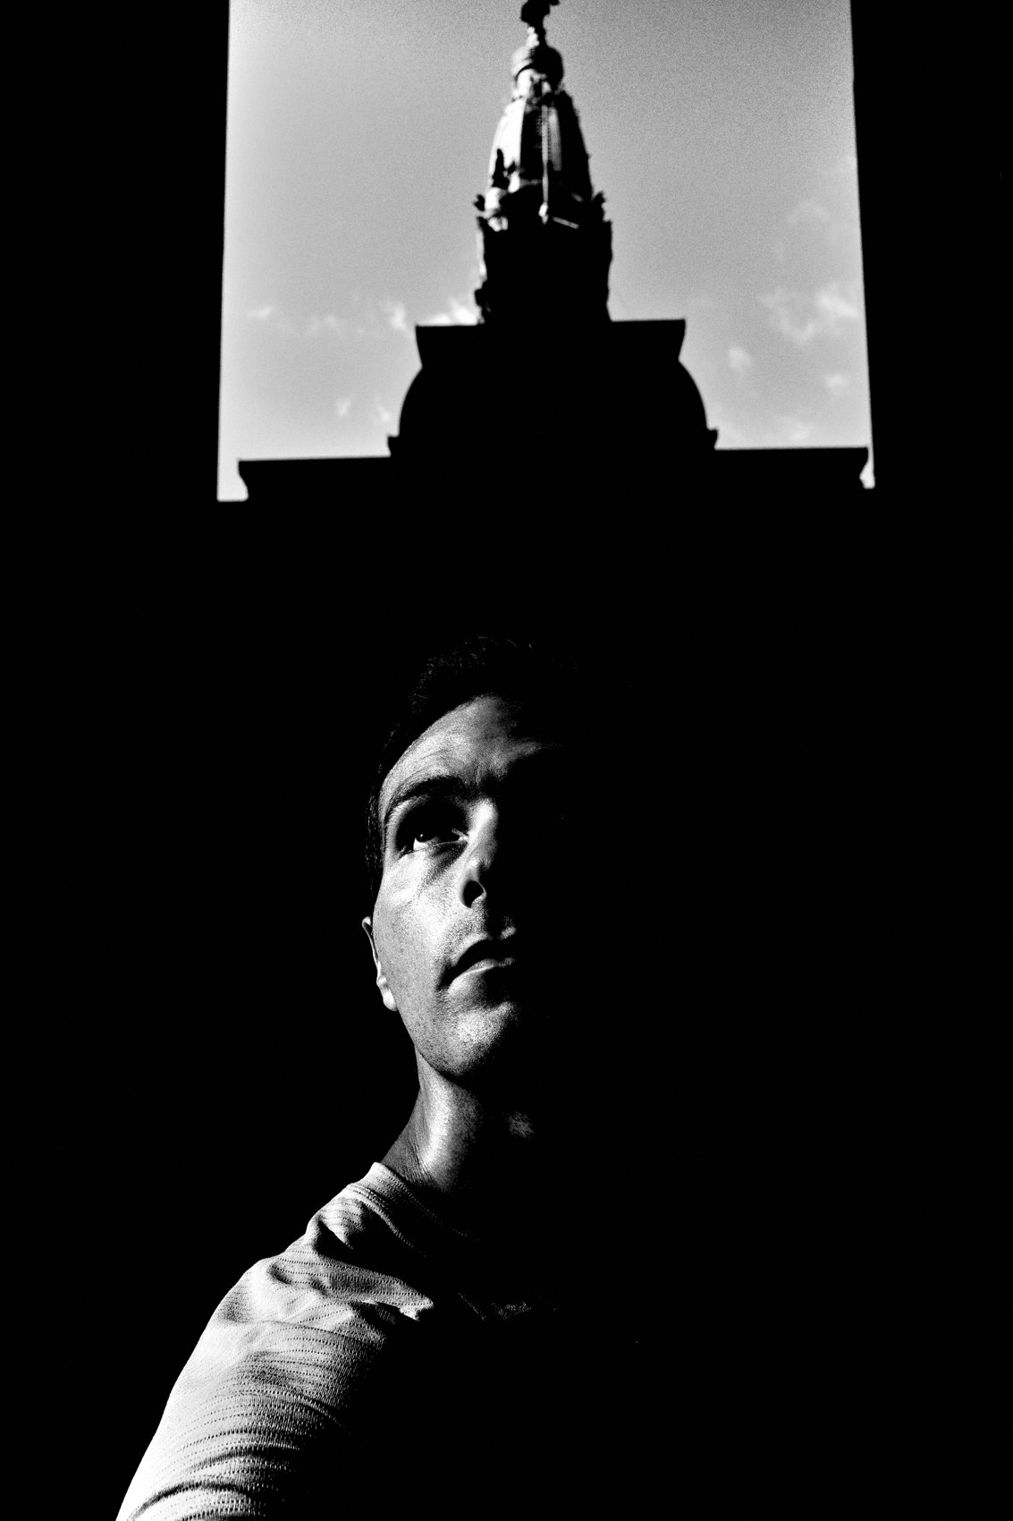
FLUX ACADEMY
BEAT 10 · MAIN TEACHING
Light Is an Element, Not an Afterthought
— Light becomes an element to be hyper-aware of
— Better light adds an extra layer of mystery
— Shadow adds depth — depth adds meaning
Notes:
This one shifted everything for me: light is not a condition, it's an element in the frame — one I have to be hyper-aware of and vigilant about. When you compare two frames with nearly identical compositions, the one with richer light and shadow wins, because that light adds an extra layer of mystery and depth. One frame is merely good. The other has atmosphere. The difference is almost always the light doing something.

Slide 12

FLUX ACADEMY
BEAT 11 · MAIN TEACHING
Layered Shadow Beats the Flat Open Scene
— Silhouette + light creates visual dynamism
— A subject's gaze can guide the eye through the frame
— Depth and layering beat an open, flatter scene
Notes:
Compare a frame built on shadow play against one that's wider and more open, and the layered one usually wins. Silhouettes interacting with light create dynamism; a subject's downward gaze guides the viewer's eye through the frame. The open scene may show more, but it reads flatter. The layered frame wins because shadow creates depth, and depth creates pull. Without that layering, the eye wanders and leaves.

Slide 13

FLUX ACADEMY
BEAT 12 · MAIN TEACHING
The Punctum: Invisible Energy
— The punctum — an invisible energy that draws you in
— Can't always be explained, only felt
— Look for the element that ties the soul of the frame together
Notes:
Here's the thing that separates a technically good frame from a keeper: the punctum. It's the invisible energy — the unseen gravitas that pulls the viewer inward and won't let them go. Often it's one small thing — a subtle gaze, a hand, a glance at the edge of the frame — that carries the whole feeling. The other frames may have good form. The keeper has soul. You can't chart it. You feel for it.

Slide 14

FLUX ACADEMY
BEAT 13 · MAIN TEACHING
Gesture Over Sterile Perfection
— The decisive gesture beats the clean but lifeless frame
— Raw, candid energy is the pulse of street photography
— Choose emotion over sterile perfection, always
Notes:
Picture two versions of the same encounter: one clean and simple, the other slightly messier but carrying the perfect decisive gesture — a hand passing something, a look exchanged. Choose the gesture. Always. Because street photography is the raw, candid, gritty pulse of life itself. A frame can be technically perfect and completely dead. Choose the one that's alive.

Slide 15

FLUX ACADEMY
BEAT 14 · MAIN TEACHING
The Timelessness Test
— Line up variations on the same motif and judge them together
— The winner: strong emotional element + simplified composition
— A frame with a timeless juxtaposition tends to announce itself
Notes:
When you've shot the same striking motif many times, in many places, the selection comes down to three things: a dynamic presence for that motif, a strong emotional element, and a simplified, impactful composition. The one that wins usually carries a juxtaposition with a timeless quality — an element of feeling set against an element of spectacle, stripped of clutter. Some frames just know they're the one, and they tend to be the ones that would still read a hundred years from now.

Slide 16

FLUX ACADEMY
BEAT 15 · MAIN TEACHING
Mystery Over Playfulness
— Toy guns: playful vs. tense reads very differently
— Mystery and tension elevate over pure playfulness
— Simple composition with impactful content wins
Notes:
When a scene carries an ambiguous or loaded object, the mistake is keeping the frame that reads as simply playful. The winner captures tension, mystery, a strong juxtaposition between the subject and the object. Playfulness without mystery is cute. Mystery without explanation is compelling. Simple composition, impactful content — that's the lesson.

Slide 17

FLUX ACADEMY
BEAT 16 · MAIN TEACHING
Trust Your Gut, Then Refine
— Objective truths exist in the frame — use them
— But interpretation is always subjective
— Feel it in your gut first, then verify with your eye
Notes:
Here's where I land on the head-versus-gut debate: there are objective truths when you look at a frame — better separation, stronger gesture, cleaner light. Use those. But your interpretation is always subjective. Feel it in your gut first. Then let the eye verify. When gut and eye agree, you have your keeper. When they fight, keep looking.

Slide 18

FLUX ACADEMY
BEAT 17 · PRACTICAL APPLICATION
Run the Three-Part Test
— Pull your last shoot: find two similar frames
— Score each on moment, composition, emotional resonance
— The one that wins all three — or carries the most feeling — is the keeper
Notes:
Go back to your last shoot and find two frames that feel similar. Run them through the three-part test: decisive moment, clean composition, emotional resonance. Not a rigid scorecard — a conversation with each frame. Ask which one breathes, which one has better separation, which one carries invisible energy. The answer will come. Trust it.

Slide 19

FLUX ACADEMY
BEAT 18 · PRACTICAL APPLICATION
Move Fast, Favor Intuition
— Cull in a 3×3 grid — fast, loose, intuitive
— Tap favorite on what catches you; don't zoom, don't pixel-peep
— Speed preserves the feeling; overthinking kills it
Notes:
Here's how I actually do it in practice: I scroll through thumbnails in a 3×3 grid on my iPad and tap favorite on whatever catches my attention. I don't zoom in. I don't pixel-peep. I move fast. If something strikes me emotionally, I click it. If not, I move on. Speed preserves the feeling. Overthinking kills it. Your first instinct is usually right.

Slide 20

FLUX ACADEMY
BEAT 19 · COMMON MISTAKES
Keeping the Busiest Frame
— More elements does not mean more power
— Chaos reads as chaos, not complexity
— The simple frame that breathes will always outlast the busy one
Notes:
The most common mistake I see — and I've made it myself — is keeping the busiest frame because it feels like more is happening. More elements, more dynamics, more action. But chaos reads as chaos. The viewer's eye has nowhere to land. The simple frame that breathes will always outlast the busy one. When in doubt, go simpler.

Slide 21
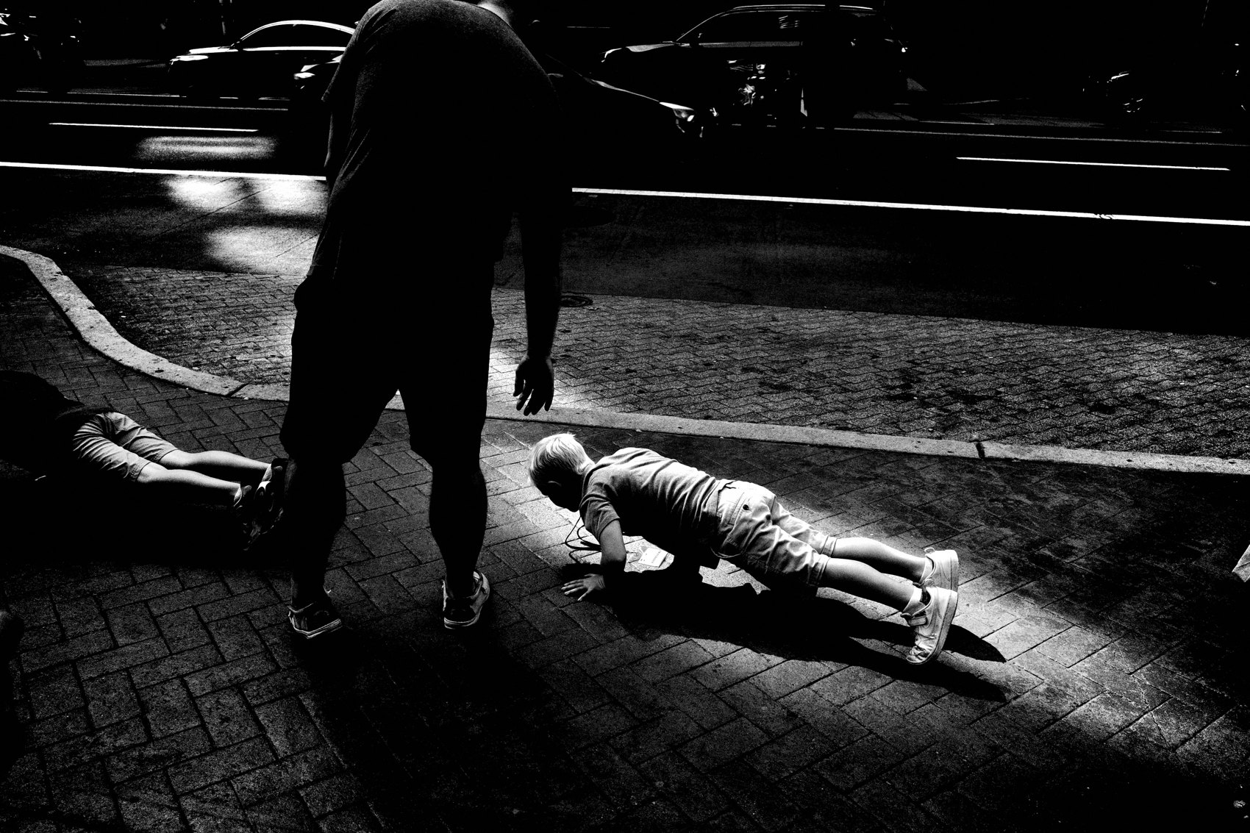
FLUX ACADEMY
BEAT 20 · COMMON MISTAKES
Choosing Technical Over Emotional
— Sharp, well-exposed, perfectly composed — but dead
— Emotion and gesture beat sterile technical perfection
— A keeper must carry energy, not just quality
Notes:
The other trap: choosing the frame that's technically sharpest, best-exposed, perfectly composed — but emotionally flat. I've seen people keep technically correct photographs that are completely dead inside. A keeper must carry energy. It must breathe. Sharpness is easy. Feeling is the whole game. Choose the one that's alive, even if it's slightly messier.

Slide 22

FLUX ACADEMY
BEAT 21 · RELATIONSHIP TO PREVIOUS
Building the Eye That Selects
— Lesson 045 built the eye that now does the selecting
— Seeing deeply is the prerequisite for choosing well
— You can only select what your vision has already trained
Notes:
Lesson 045 was about training the eye — seeing deeply, cultivating visual instinct on the street. That work feeds directly into this one. You can only select what your eye has already learned to value. The stronger your vision in the field, the clearer the keeper becomes on the screen. Selection is just seeing, one more time.

Slide 23

FLUX ACADEMY
BEAT 22 · RELATIONSHIP TO UPCOMING
From Choosing to Presenting
— Lesson 047 takes the keepers and builds a body of work
— Selection is one frame; sequencing is many
— The edit becomes the story
Notes:
Once you can reliably find the keeper, the next question is: what do you do with a collection of them? Lesson 047 takes this further — building a body of work, sequencing frames, letting the edits become a story. Selection is the singular act. Sequencing is where the vision becomes a world.

Slide 24

FLUX ACADEMY
BEAT 23 · SUMMARY / TAKEAWAY
Moment, Form, Feeling
— The keeper formula: decisive moment + clean composition + emotional resonance
— Less is more; simplicity breathes; the punctum pulls
— Trust gut, verify with eye — the right frame reveals itself
Notes:
Last thing. The keeper isn't the busiest frame or the sharpest file — it's the one where moment, form, and feeling all arrive at once. Less is more. The simple frame breathes. The one with the punctum pulls. Trust your gut first, then let your eye verify. When they agree, you've found it. That's the process. That's the whole game. Catch you next lesson.

