Slide 1
FLUX ACADEMY · A SCHOOL FOR SEEING
MODULE 8 · THE SYSTEM — RICOH GR
The Frictionless Daily System
BY DANTE SISOFO

Slide 2
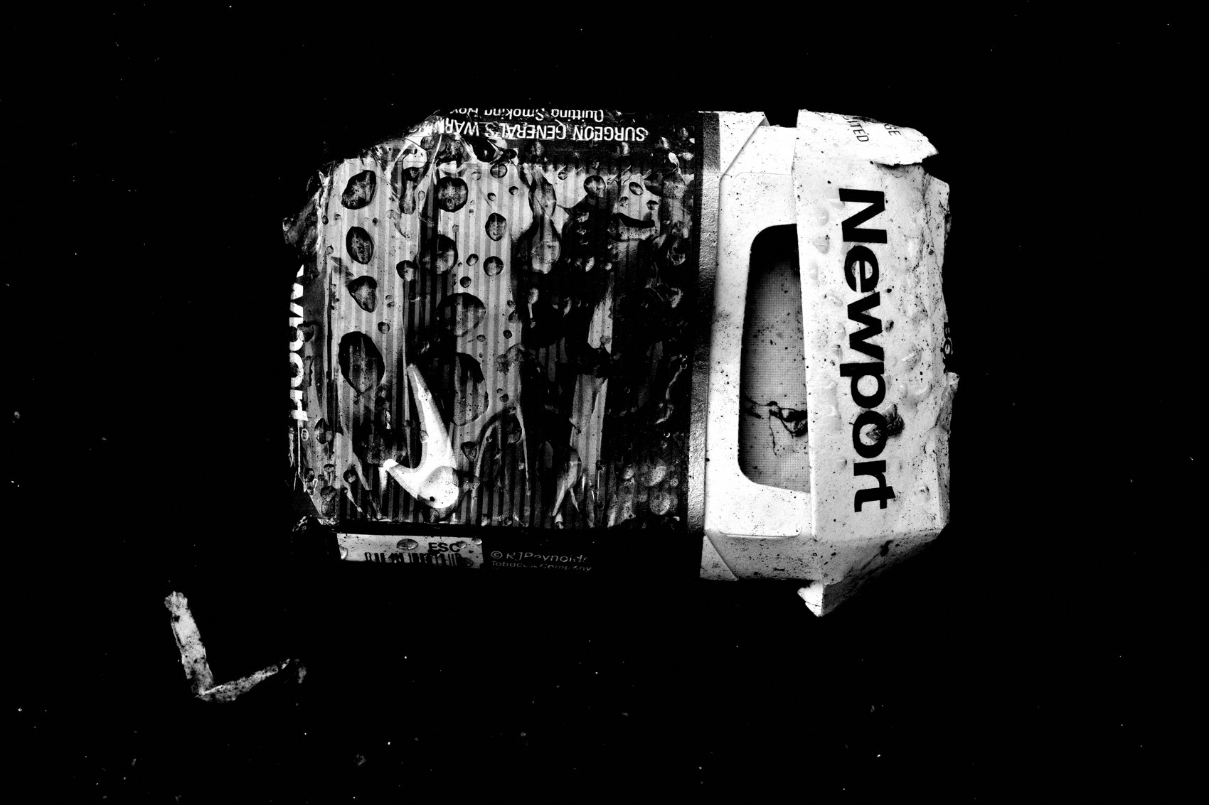
FLUX ACADEMY
BEAT 01 · CORE IDEA
One System, Zero Friction
— The real enemy isn't skill — it's friction
— One camera, one aesthetic, one workflow
— The system only works if fully installed
Notes:
What's popping, people — it's Dante. Here's the truth nobody tells you: the thing killing your photography isn't your eye, your gear, or your city — it's friction. Every extra decision, every extra lens, every RAW backlog piling up is friction. This lesson is about eliminating all of it with one installed, automatic, non-negotiable system.

Slide 3
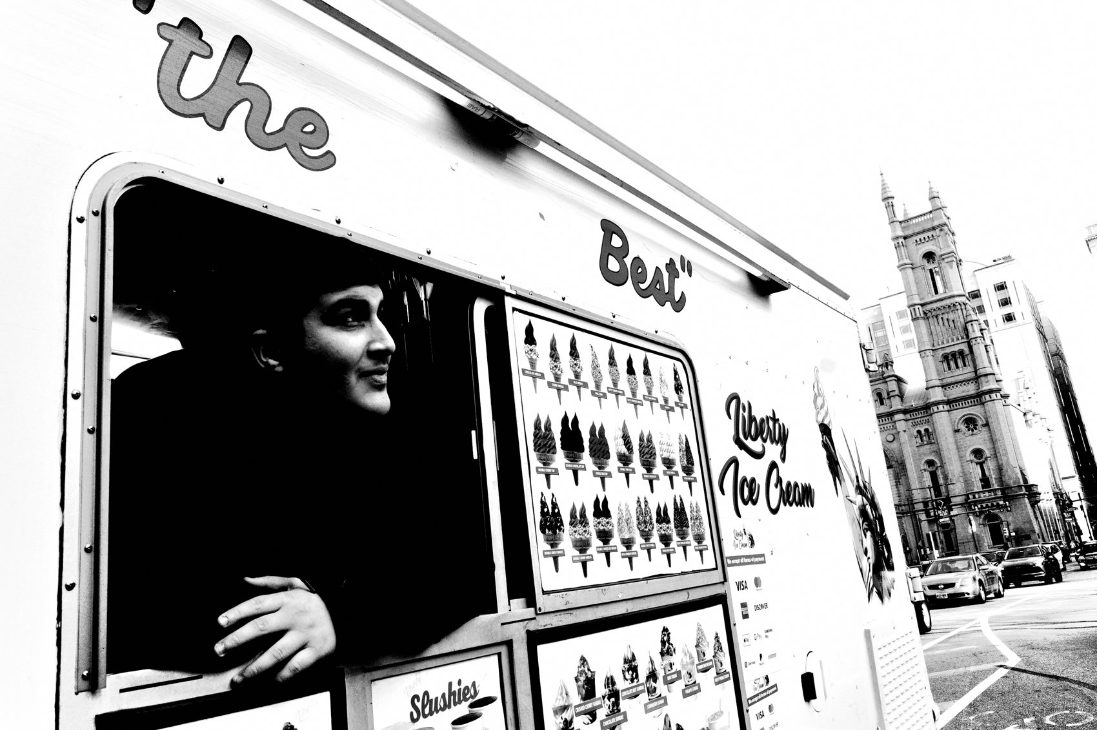
FLUX ACADEMY
BEAT 02 · LEARNING OBJECTIVE
What You'll Walk Away With
— What a fully frictionless daily system looks like
— How to install it inside 24 hours
— Why partial adoption produces partial results
Notes:
By the end of this lesson you'll understand exactly what the FLUX daily system is, why it works, and how to install it completely — not partially, not with tweaks, but fully. The system is binary: it's in or it's out. Install it and watch the friction disappear.

Slide 4
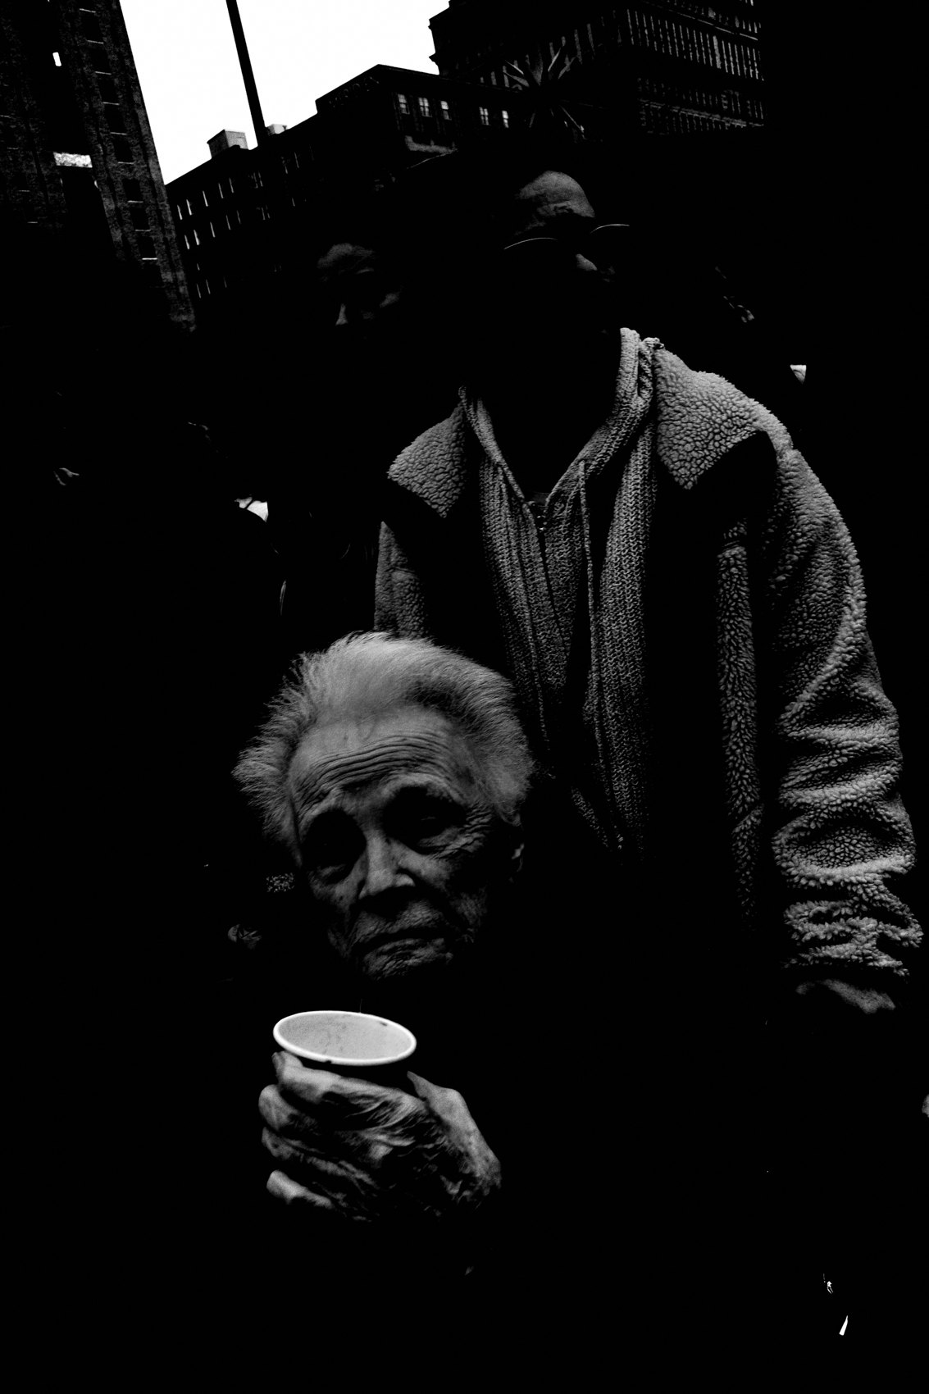
FLUX ACADEMY
BEAT 03 · WHY THIS MATTERS
Friction Is the Silent Killer
— Multiple lenses = multiple decisions = paralysis
— RAW backlogs pile up and never get touched
— Waiting for "interesting" kills momentum
Notes:
Here's why this matters so much. Most photographers aren't failing because of bad technique — they're failing because of friction. Multiple lenses. RAW files nobody edits. Hunting for rare moments that never arrive. Waiting for free time that never comes. Friction compounds into burnout. Remove the friction and the whole game changes.

Slide 5

FLUX ACADEMY
BEAT 04 · WHY THIS MATTERS
Partial Adoption Breaks the System
— Remove one non-negotiable and the system weakens
— You can't negotiate with the install
— All in, or the results are partial
Notes:
And here's the thing about this system specifically: it only works if you adopt it completely. Every time I see someone getting partial results, it traces back to partial adoption. They kept the second lens. They kept shooting RAW. They kept waiting. The system is designed as a whole — remove one piece and the whole thing weakens. Trust the install.

Slide 6
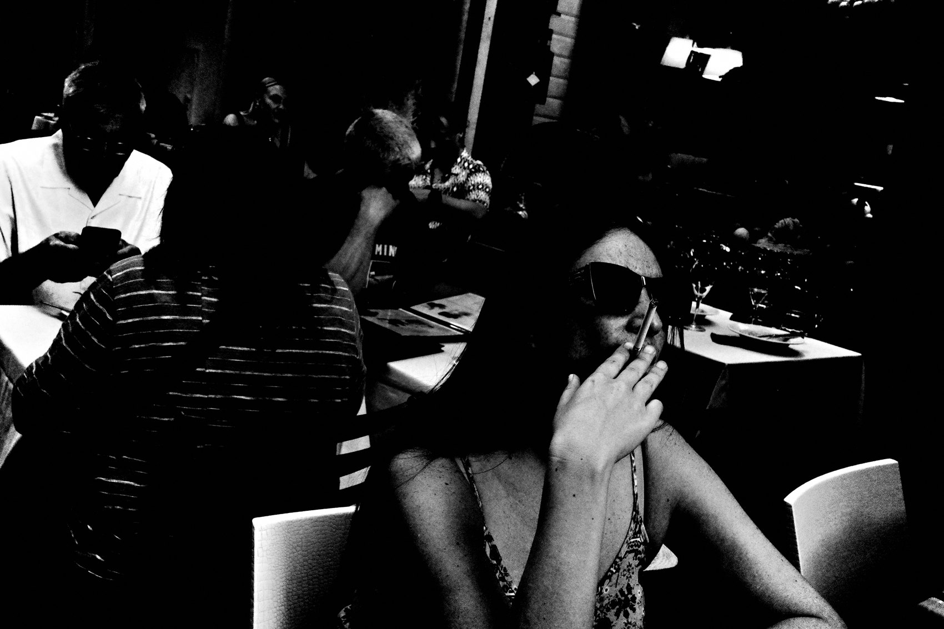
FLUX ACADEMY
BEAT 05 · MAIN TEACHING
What the System Is
— One camera — Ricoh GR, pocket-sized
— One aesthetic — high contrast black and white
— One file type — small JPEG, no RAW
Notes:
So what exactly is the system? One camera — the Ricoh GR, small enough to live in your front right pocket. One aesthetic — high contrast black and white, baked into the camera profile. One file type — small JPEG. No RAW, no backlog, no editing paralysis. That's the whole machine. Simple, total, and installed once.

Slide 7

FLUX ACADEMY
BEAT 06 · MAIN TEACHING
Snap Focus and Automatic Mode
— Snap Focus locked at 1 meter
— f/16, multi-segment metering, automatic mode
— Settings done — raise, point, shoot
Notes:
The camera settings are equally non-negotiable. Snap Focus locked at 1 meter. f/16. Multi-segment metering. Automatic mode. Exposure compensation ready. That's it. Settings are installed once and left alone. Now every time you raise the camera, the machine is already ready. Your only job is to raise it, point it, and press the shutter.

Slide 8
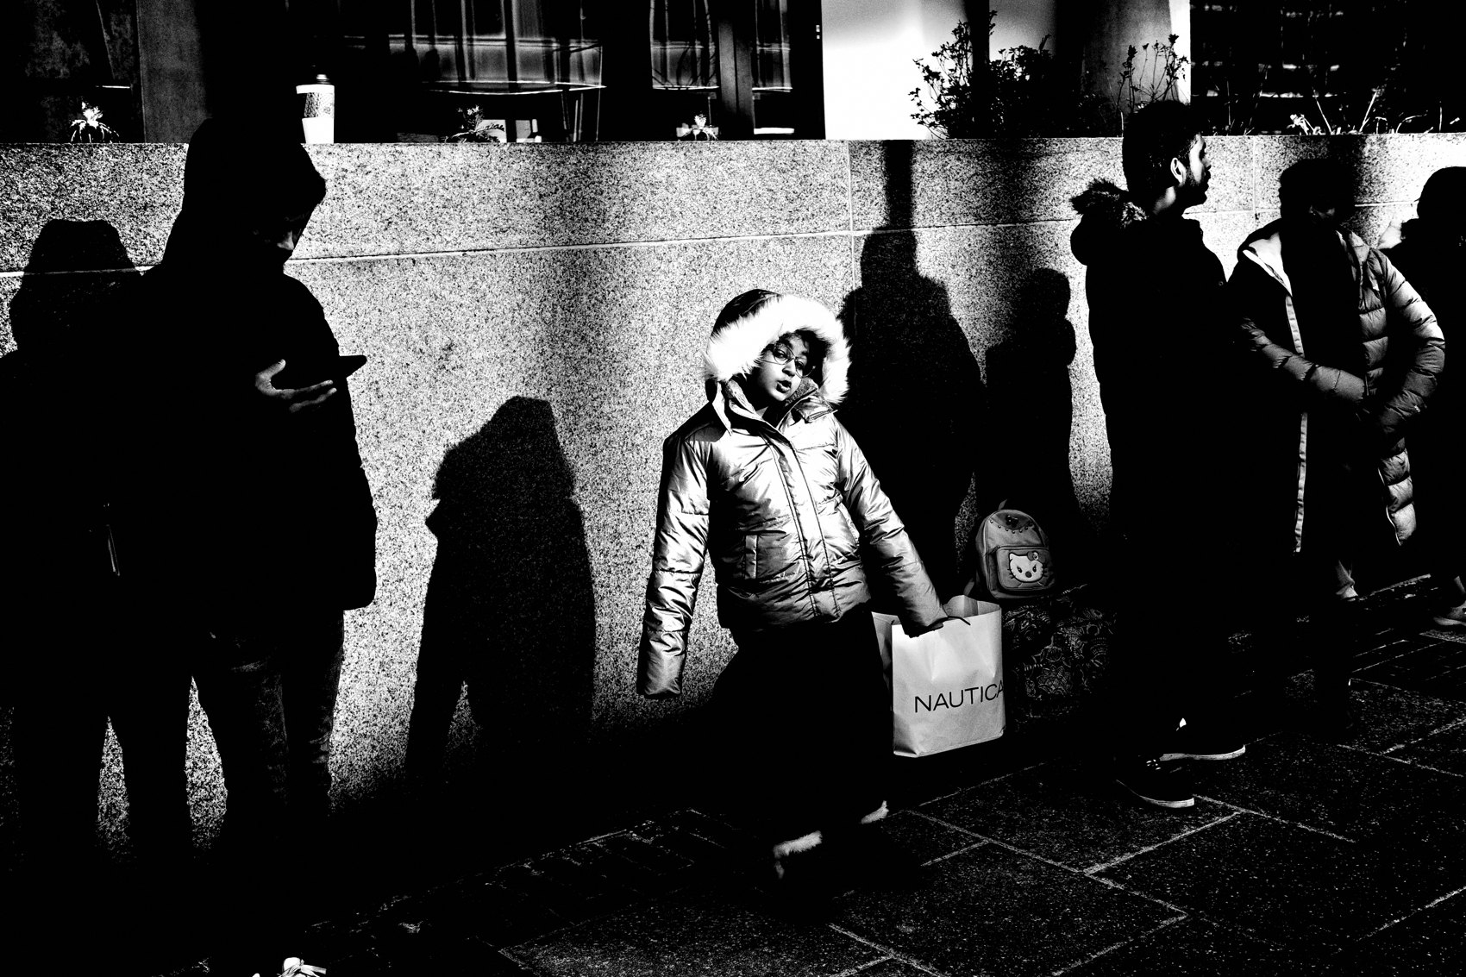
FLUX ACADEMY
BEAT 07 · MAIN TEACHING
The Camera Lives in Your Pocket
— Front right pocket — always
— No bag, no strap, no ceremony
— The camera is a constant companion
Notes:
The physical protocol is just as important as the settings. The camera lives in your front right pocket — not in a bag, not on a strap, not on the shelf. In the pocket. Always. This single habit removes the most common excuse: "I didn't have it with me." The camera is small enough that this is no longer a valid reason. It goes where you go.

Slide 9
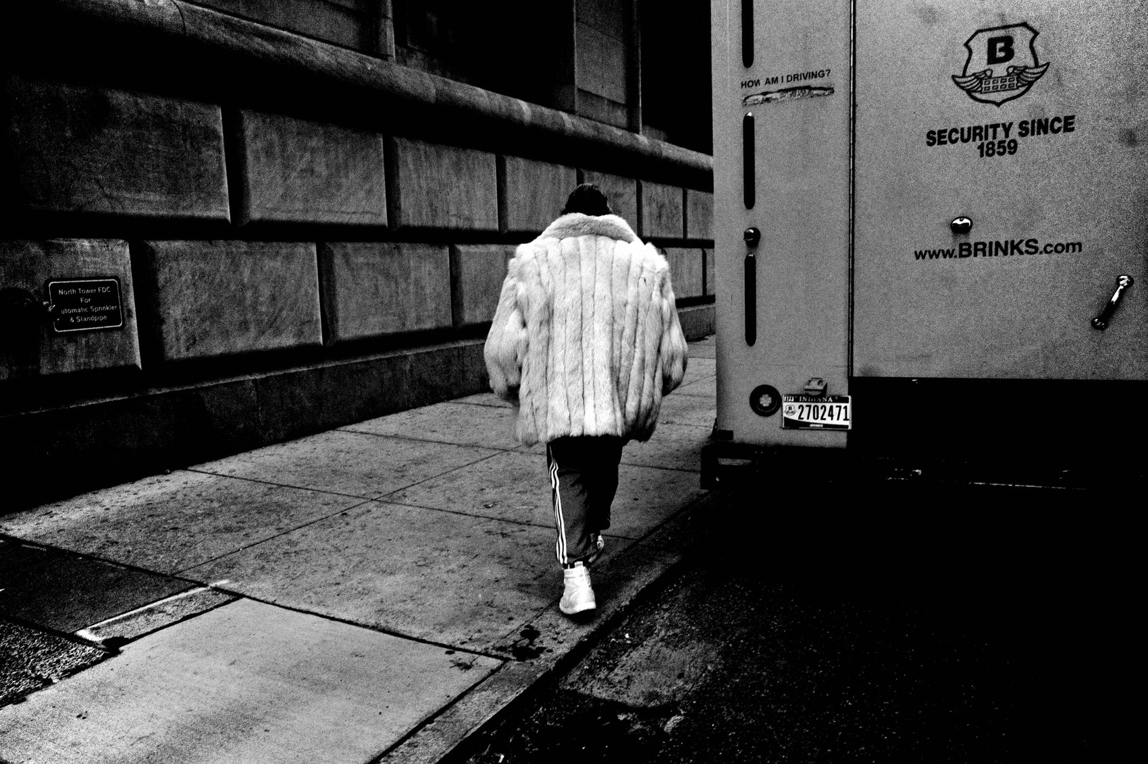
FLUX ACADEMY
BEAT 08 · MAIN TEACHING
Photography Becomes Inseparable from Life
— You don't "go shooting" — you live and shoot through it
— No performance, no photo mindset, no ceremony
— Life is the subject
Notes:
Here's the philosophical shift the system creates: you stop "going out to shoot." You stop waiting for free time. You live — and you photograph through the living. Morning commute, lunch break, errands, walks, everything. No ceremony. No special photo mindset. Your life is the subject, and the camera in your pocket captures it without interruption.

Slide 10
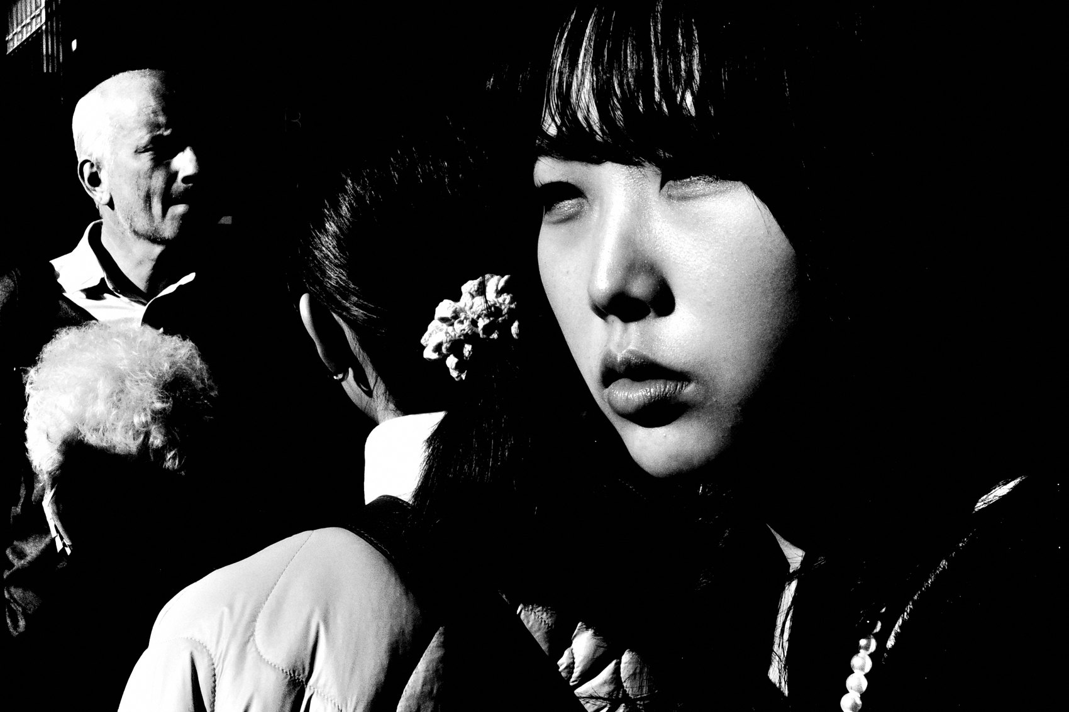
FLUX ACADEMY
BEAT 09 · MAIN TEACHING
The Daily Rhythm
— Photograph every single day
— At least 20 frames — consistency over volume
— Rhythm is the goal, not output
Notes:
The daily target is deliberately small: at least 20 photographs per day. Not because 20 is a magic number, but because the goal isn't volume — the goal is rhythm. Consistency. Showing up every day with the camera. An eye that practices daily sharpens in ways that weekend sessions never produce. Twenty frames a day is a commitment to showing up.

Slide 11

FLUX ACADEMY
BEAT 10 · MAIN TEACHING
The Morning Trigger
— Wake up, shoot immediately
— Never miss another sunrise
— The morning becomes the automatic trigger
— Walk the same route daily
Notes:
Build the morning into the protocol. Wake up and shoot — immediately. Walk the same route every day and photograph it. Never miss another sunrise. The repetition isn't boring; it's how your eye learns to see differently in the same place. The morning walk becomes the trigger that fires the whole system for the day.

Slide 12

FLUX ACADEMY
BEAT 11 · MAIN TEACHING
Import Same Day, Publish Same Day
— iPad import — immediate, no backlog
— Cull same day, publish same day
— The archive builds itself chronologically
Notes:
The workflow has to be as frictionless as the shooting. Import to iPad the same day. Cull the same day. Publish chronologically, the same day. No backlogs. No hard drives full of unedited work. When you shoot on Monday, Monday's photographs are done by Monday night. The archive builds itself and you stay free to just photograph tomorrow.

Slide 13

FLUX ACADEMY
BEAT 12 · MAIN TEACHING
The Visual Diary
— Each frame is a diary entry, not a masterpiece
— Photograph documents life lived
— Look back and relive the week
Notes:
When you publish chronologically and shoot daily, something happens: your photographs become a visual diary. Not event documentation, not portfolio curation — a genuine record of life lived. At the end of a week, you select ten photographs, sequence them, and look back at the week through images. That's the power. You're not collecting pictures; you're preserving your life.

Slide 14

FLUX ACADEMY
BEAT 13 · MAIN TEACHING
He Who Walks the Most Shall Win
— Walk more than anyone else
— Volume builds instinct
— This is not motivation — it's rhythm
Notes:
There's a principle underneath all of this: he who walks the most shall win. It's not poetic — it's mechanical. More walking means more frames. More frames mean more instinct. More instinct means the camera eventually disappears and you simply respond. This is not motivation, it's rhythm. Lace up and walk.

Slide 15
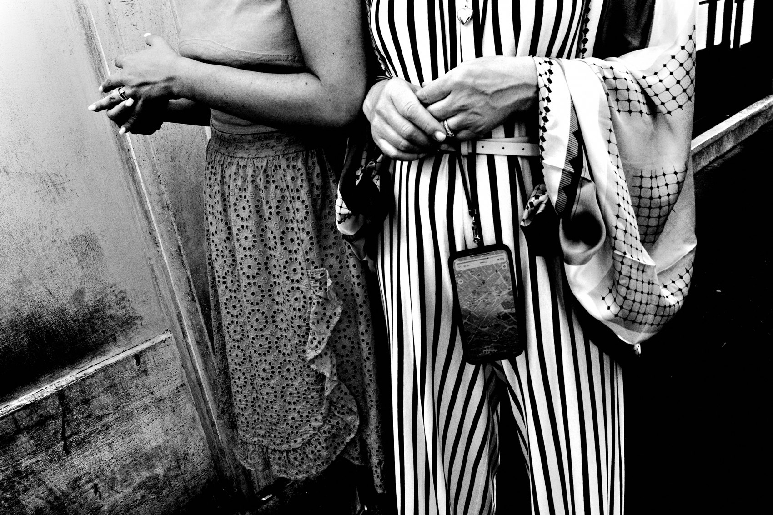
FLUX ACADEMY
BEAT 14 · MAIN TEACHING
The System Under Pressure
— No preparation, no special conditions
— Camera in pocket, settings locked, flow immediate
— Shoot in the hundreds — chaos becomes material
Notes:
Here's what the system looks like under real pressure: an unfamiliar place, no preparation, no special conditions — dense crowds, noise, constant movement. The system doesn't change — Snap Focus, f/16, high contrast, small JPEG. You shoot in the hundreds across a hard day or two. Import same day, cull same day, publish same day. Chaos becomes material when the system is already installed. When the tool demands nothing from you, all your attention goes to the moment.

Slide 16
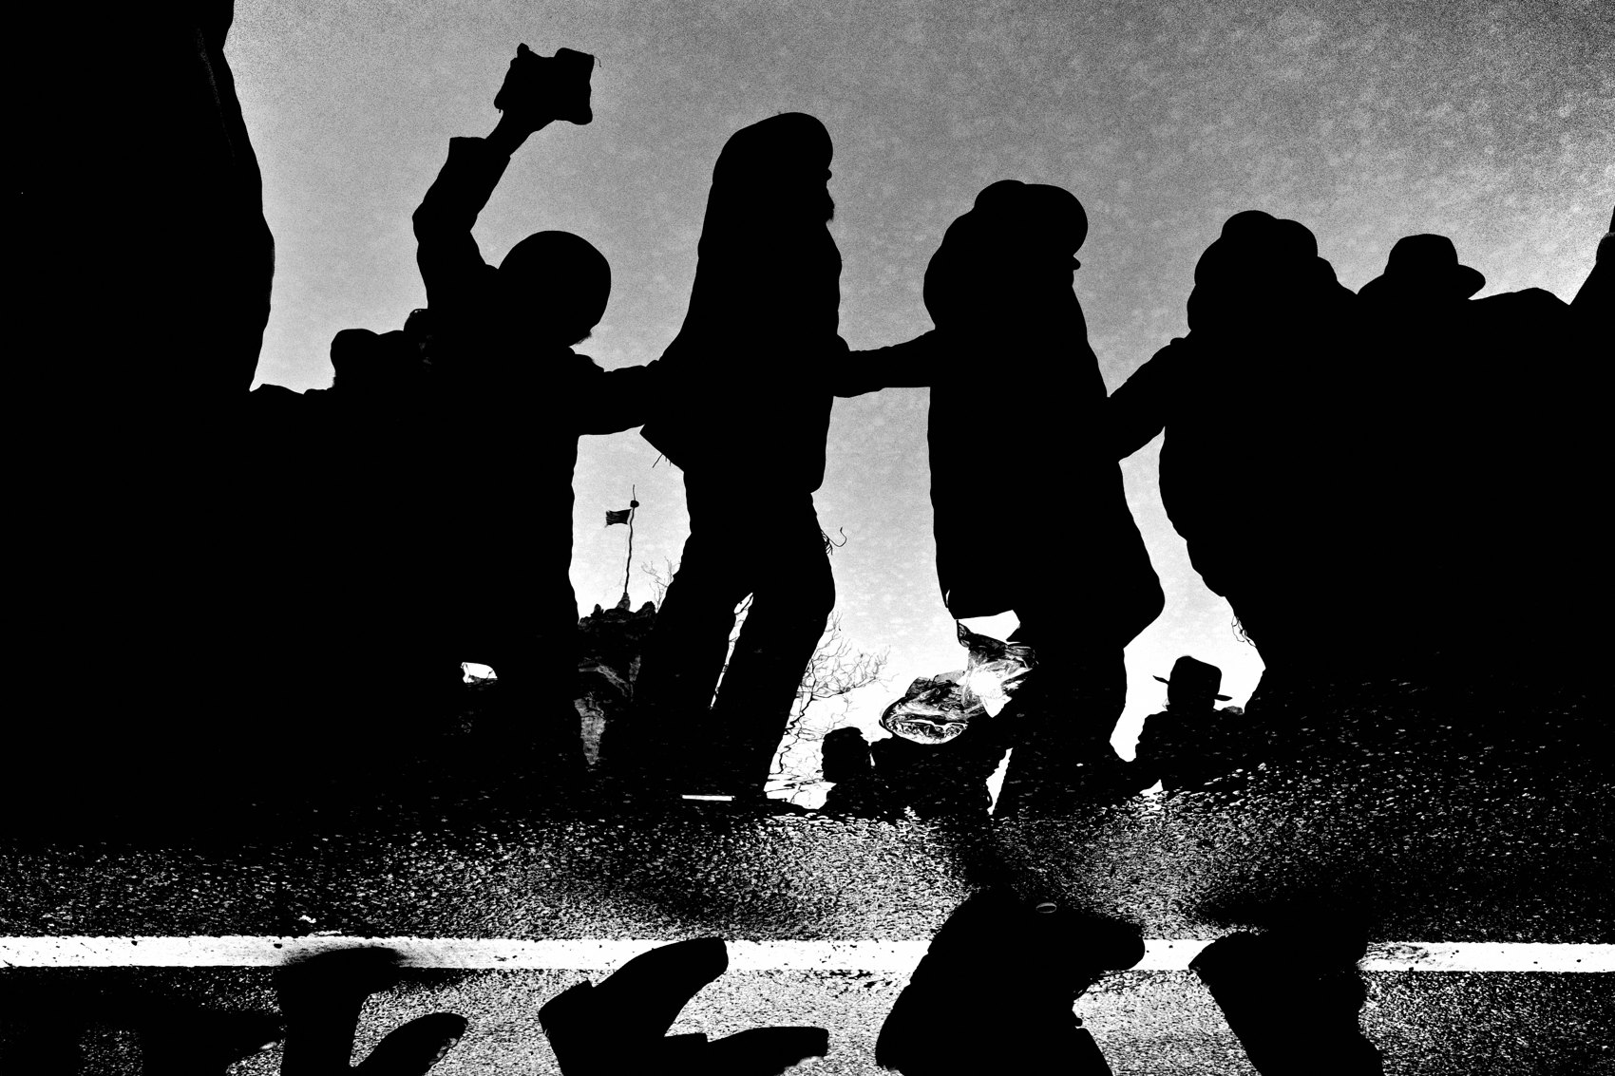
FLUX ACADEMY
BEAT 15 · MAIN TEACHING
Constraint Is the Solution to Chaos
— 50mm crop to isolate in chaos
— Underexpose -2, expose for highlights, crush shadows
— Gesture over spectacle — a hand, a gaze, a face
Notes:
When chaos increases, the constraint tightens, not loosens. Switch to 50mm crop to isolate. Underexpose minus-two. Expose for highlights. Crush the shadows. Look for gesture over spectacle — a hand, a gaze, a single face caught in light. The crowd becomes the context and the human moment becomes the subject. Constraint is the solution to chaos, not the casualty of it.

Slide 17
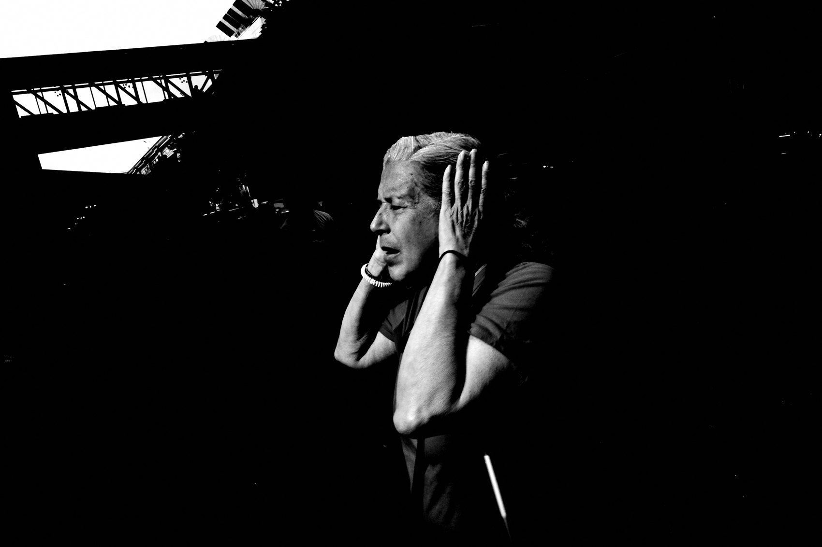
FLUX ACADEMY
BEAT 16 · MAIN TEACHING
The One-Full-Day Stress Test
— Sunrise to sunset — dedicate the full day
— 400 frames minimum — instinct takes over
— Stop thinking, simply respond
Notes:
The stress test is one completely free day, sunrise to sunset, somewhere with movement and energy. Target at least 400 frames. Leave the phone at home. Walk, observe, respond, shoot. Something real happens around frame 200 — you stop thinking. The camera disappears. You simply respond to life as it unfolds. That's when the system is fully installed in the body, not just the camera.

Slide 18
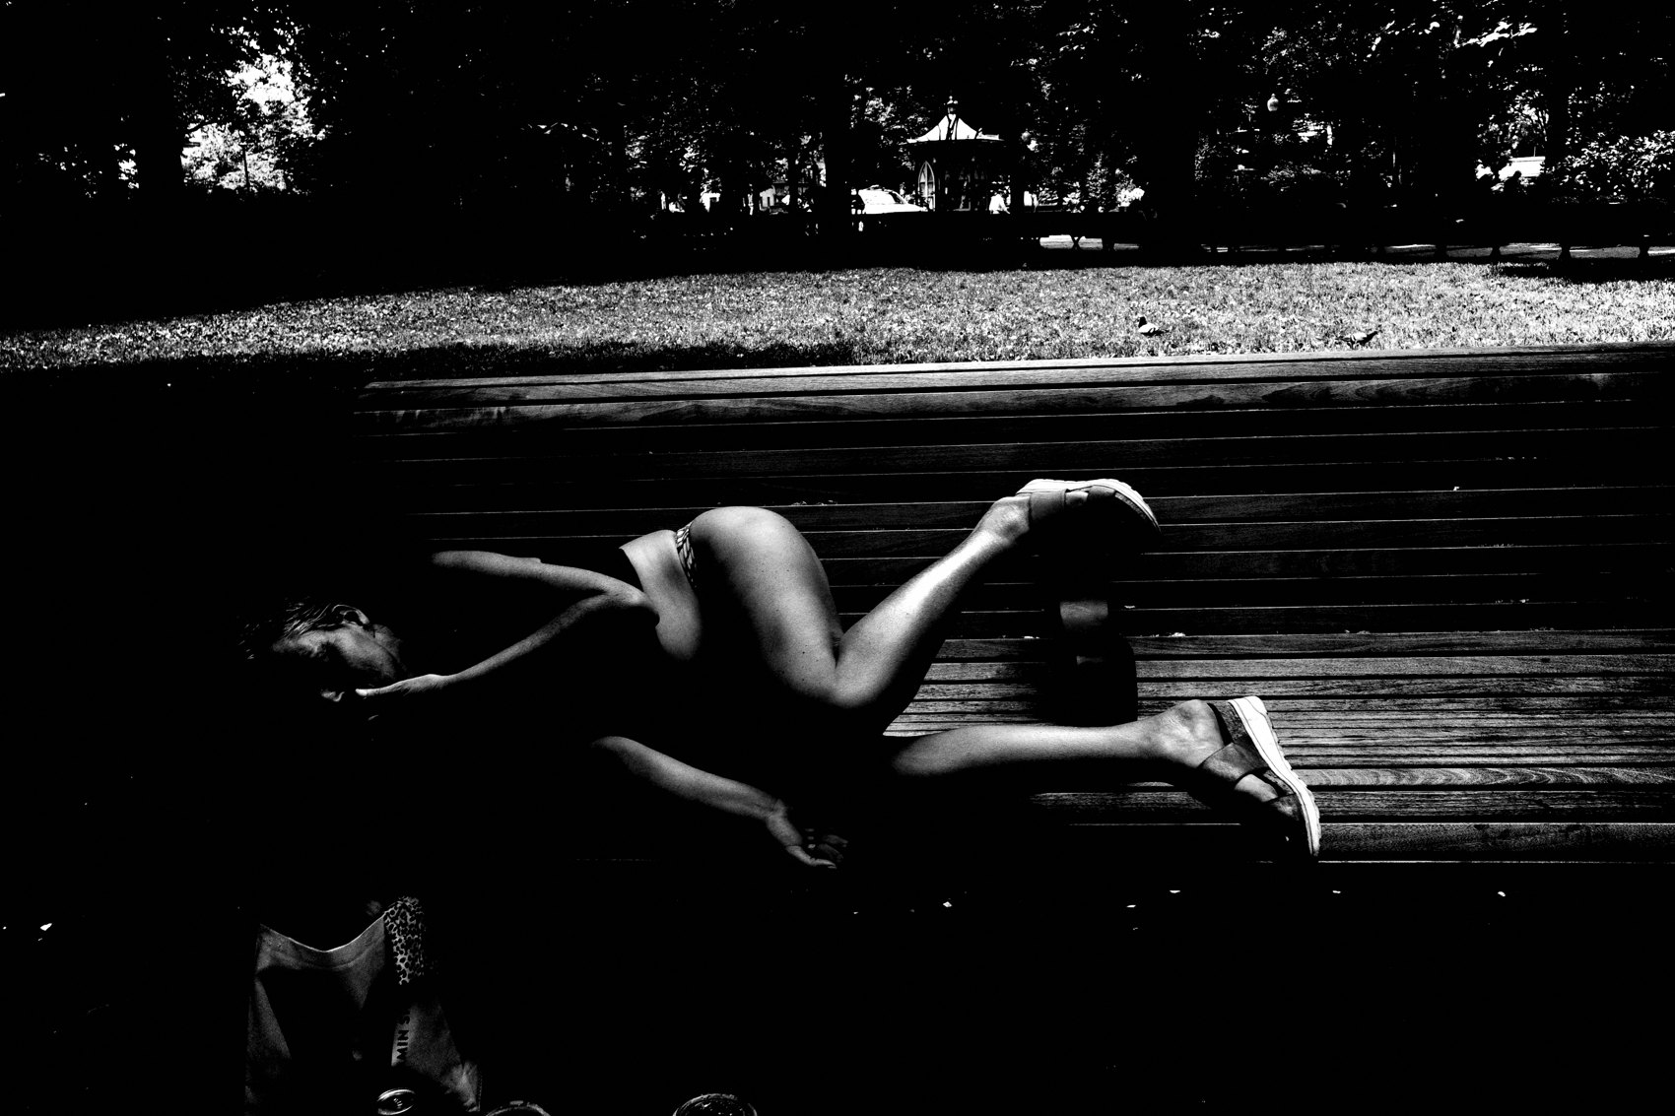
FLUX ACADEMY
BEAT 17 · PRACTICAL APPLICATION
Install It Completely, Today
— Set the camera up exactly as shown — no customization
— Install the high contrast black and white profile
— Do not tweak — trust the process
Notes:
Your first job is the install. Set the Ricoh GR up exactly as shown — every setting, exactly as specified. High contrast black and white. Small JPEG. Snap Focus. Automatic mode. Do not customize. Do not negotiate. The system is designed as a complete unit. Install it exactly, then go outside and make your first 100 photographs. The only goal is comfort with the physical machine.

Slide 19
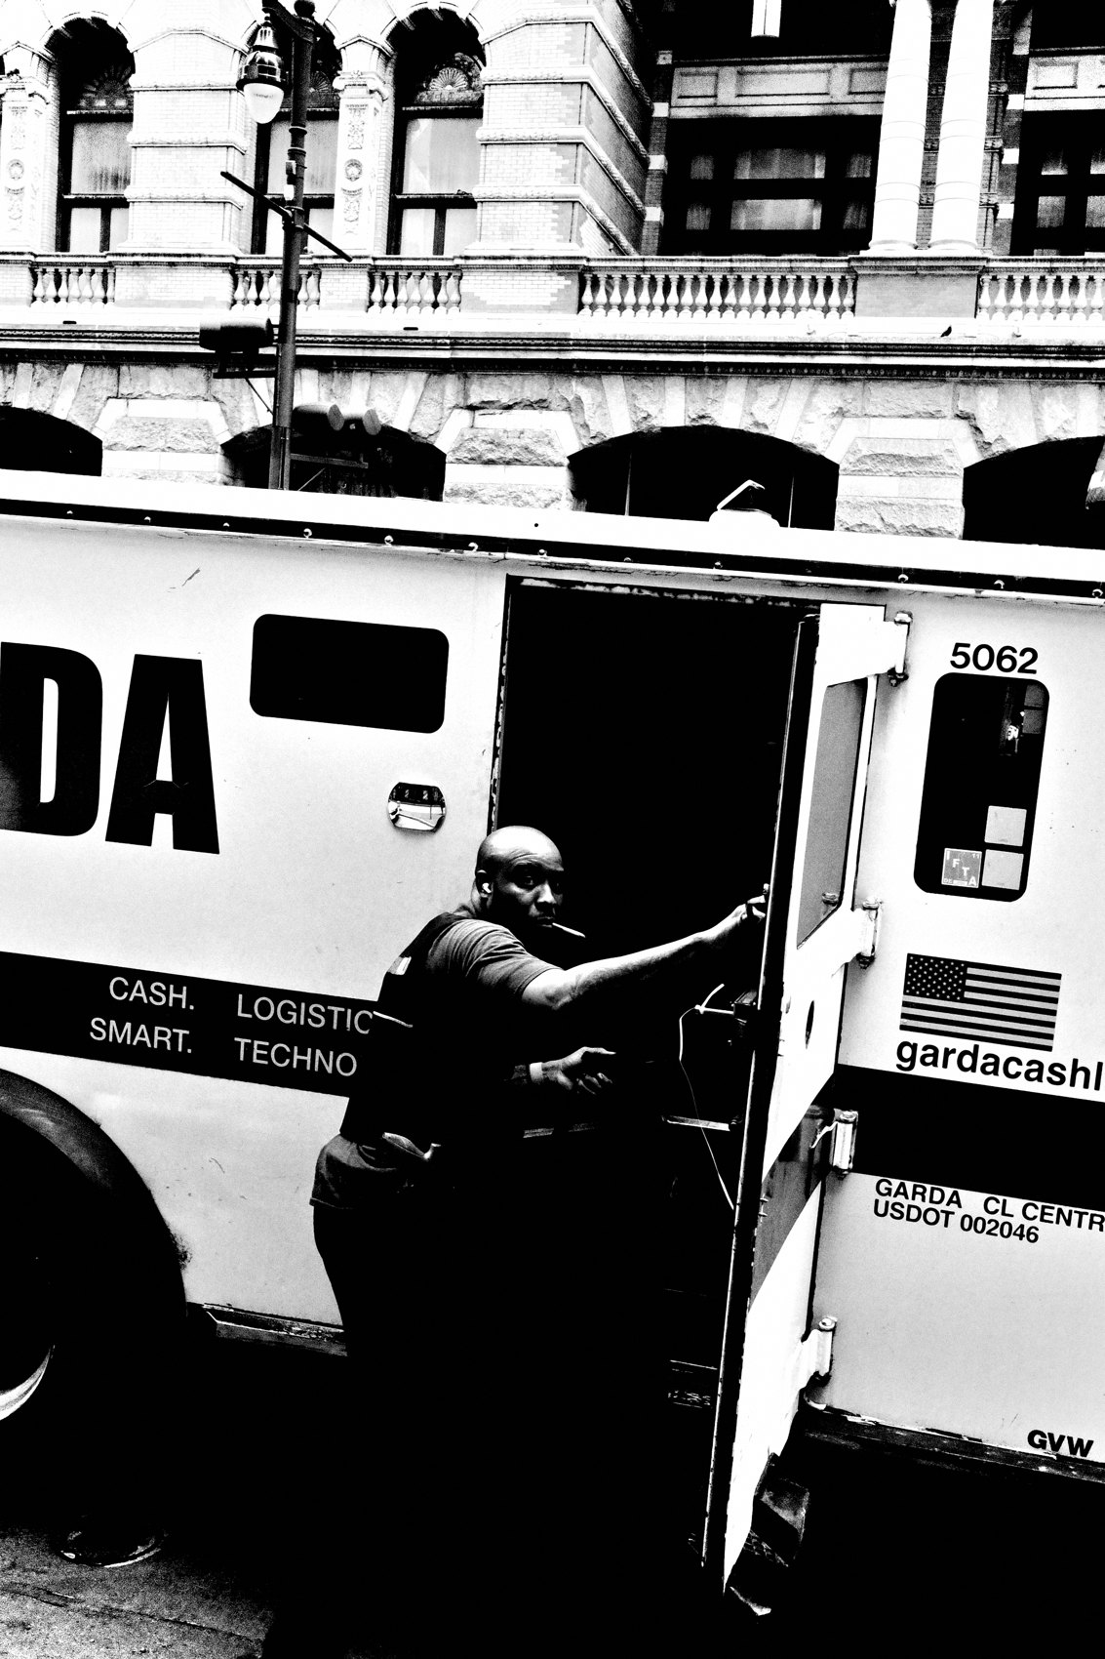
FLUX ACADEMY
BEAT 18 · PRACTICAL APPLICATION
Build the 7-Day Rhythm
— Carry the camera every day for 7 days
— Photograph morning walks, commutes, errands, anything
— End of week: select 10 images, sequence chronologically
Notes:
Then run the 7-day rhythm install. For one week, carry the camera everywhere — front right pocket, no exceptions. Photograph your morning walk, your commute, your lunch break, your errands. At least 20 frames a day. At the end of the week, select 10 photographs and sequence them chronologically. Look at the visual diary you just built. That's your life. That's the power.

Slide 20
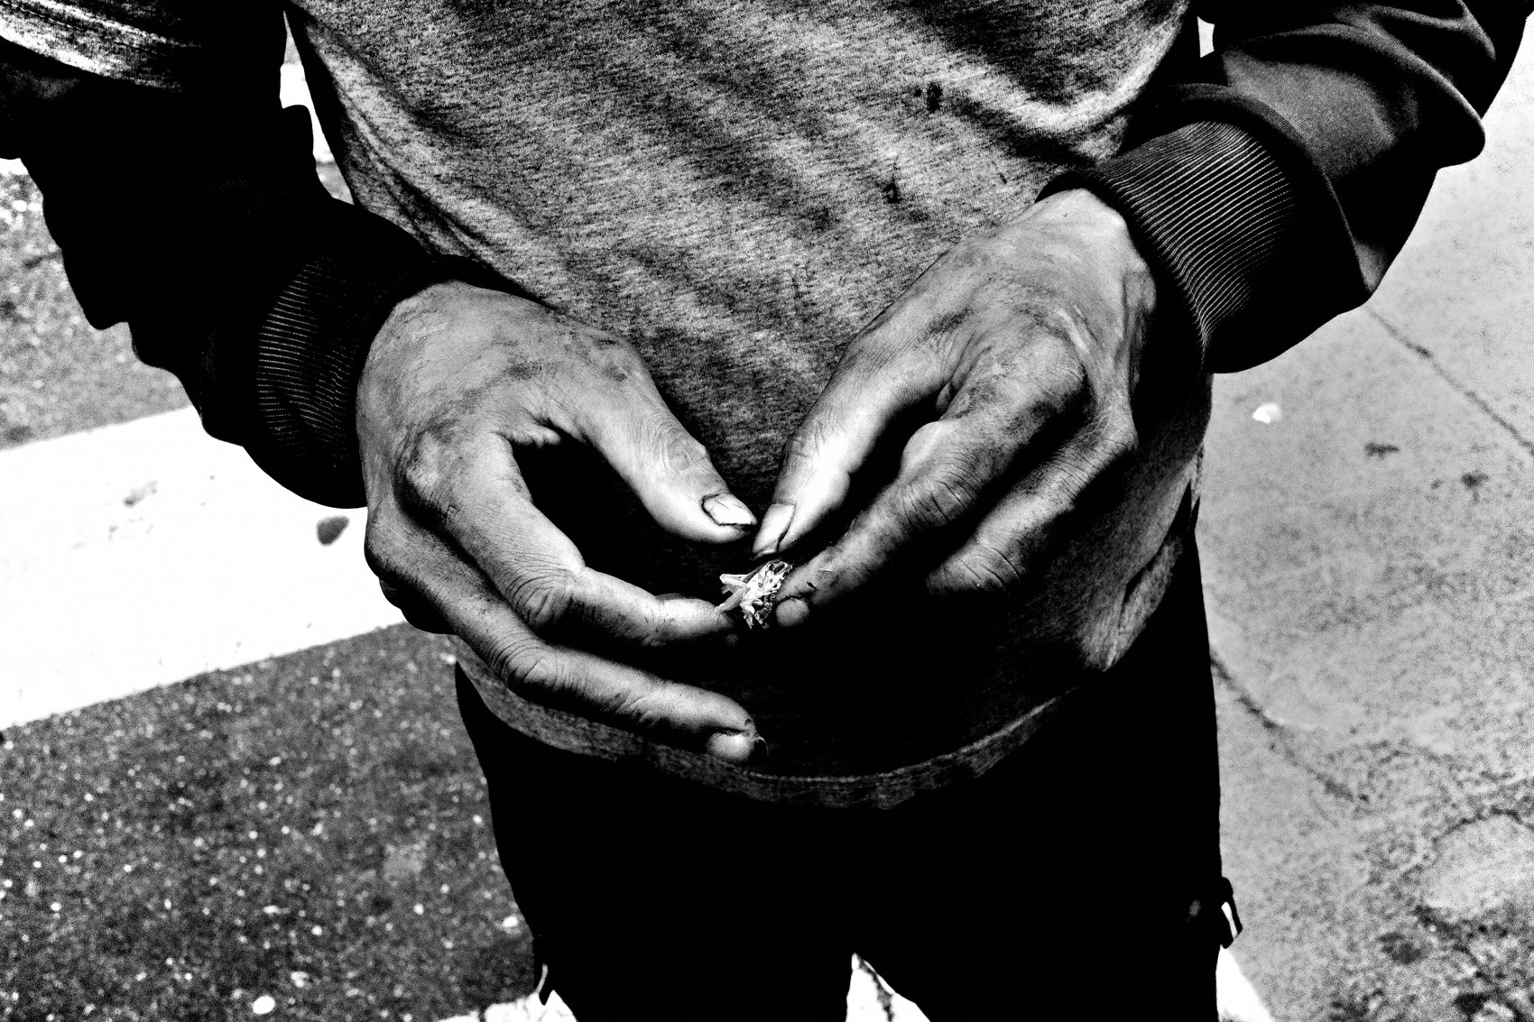
FLUX ACADEMY
BEAT 19 · COMMON MISTAKES
Customizing the System During Install
— "I'll just keep the wide angle too"
— Partial adoption = partial results
— The negotiation starts small and erodes everything
Notes:
The most common mistake is negotiating with the system during the install. "I'll just keep the wide angle for certain situations." "I'll shoot RAW for important days." It sounds reasonable and it breaks everything. Partial adoption creates partial results — every single time. Install it completely first. You can reconsider after six months of full commitment. Not before.

Slide 21
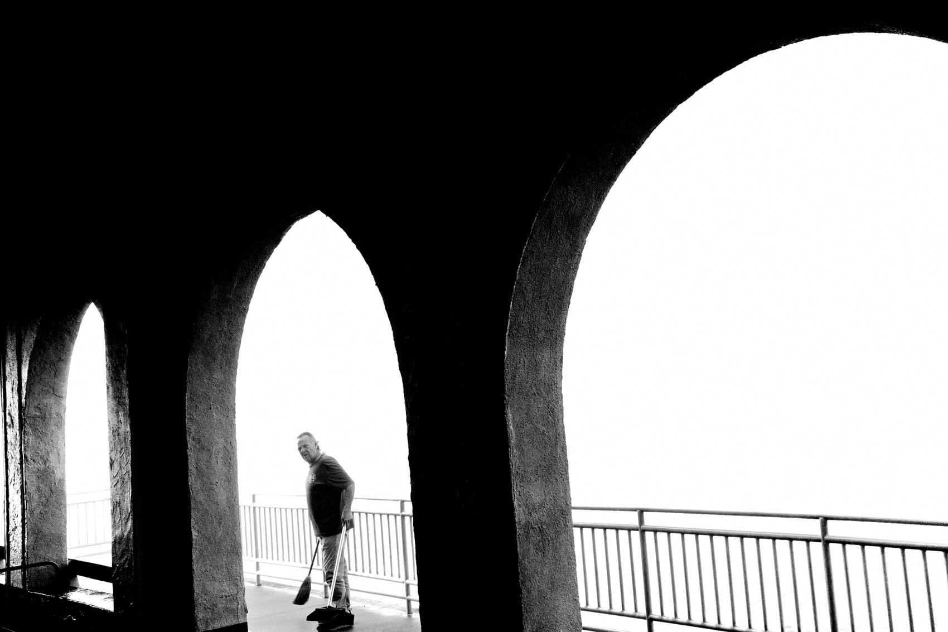
FLUX ACADEMY
BEAT 20 · COMMON MISTAKES
Treating the System as a Grind
— Ceremony and gear-obsession re-introduce friction
— The system is designed to disappear
— If it feels like labor, you've over-complicated it
Notes:
The other mistake is making the system feel like work — treating the camera pull as ceremony, reviewing every frame on the LCD after you shoot it, making the import a production. The whole design of this system is that it disappears. Camera in pocket, shoot, import same day, done. If it feels heavy or laborious, you've added something back in. Strip it back down.

Slide 22
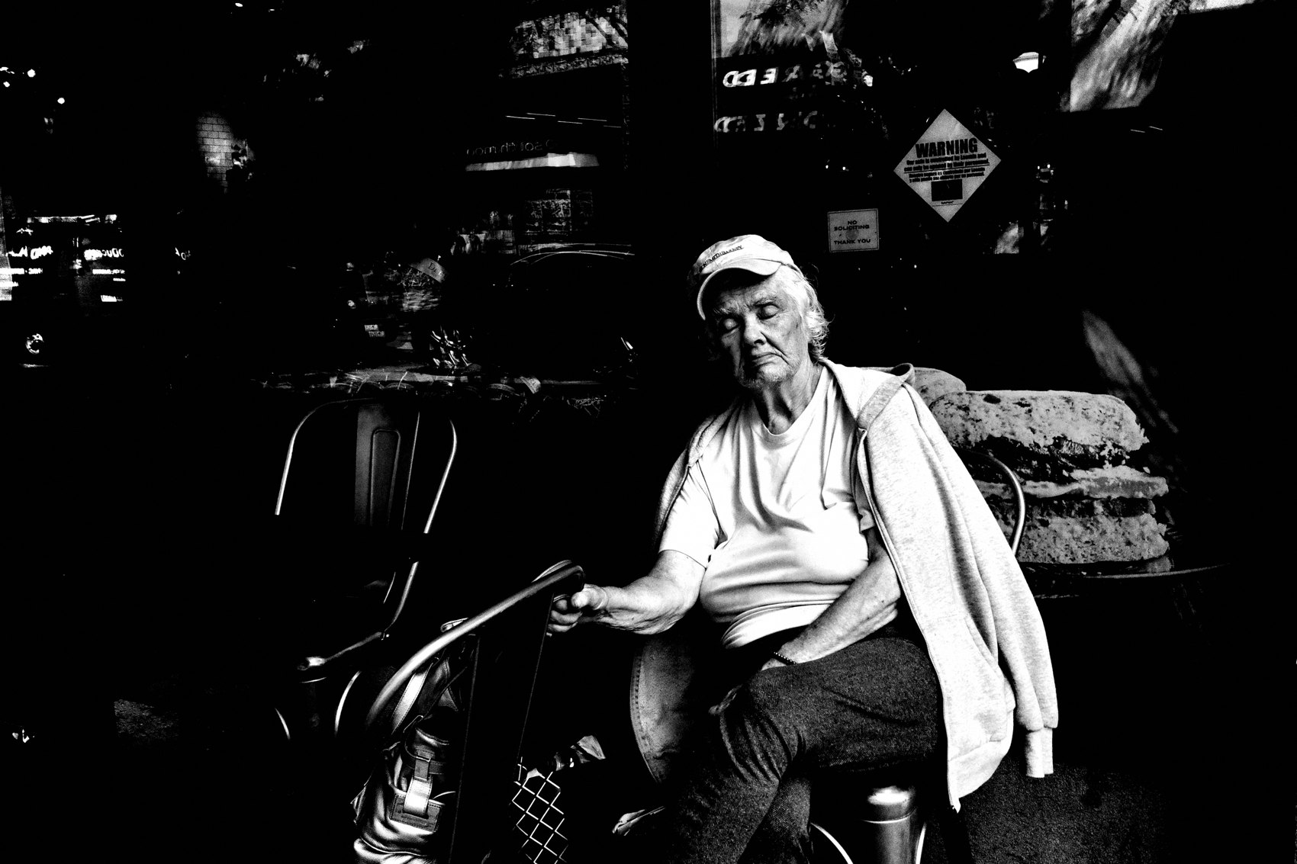
FLUX ACADEMY
BEAT 21 · RELATIONSHIP TO PREVIOUS
Building on What Came Before
— Lesson 043 laid the foundation for daily consistency
— This lesson operationalizes it as a complete installed system
— The why becomes the how
Notes:
Lesson 043 built the case for daily consistency and the photographer's rhythm. This lesson is where that philosophy gets operationalized — every principle becomes a specific, non-negotiable element of an installed machine. The why we established before now has an exact how. One camera. One aesthetic. One workflow. Running every day.

Slide 23
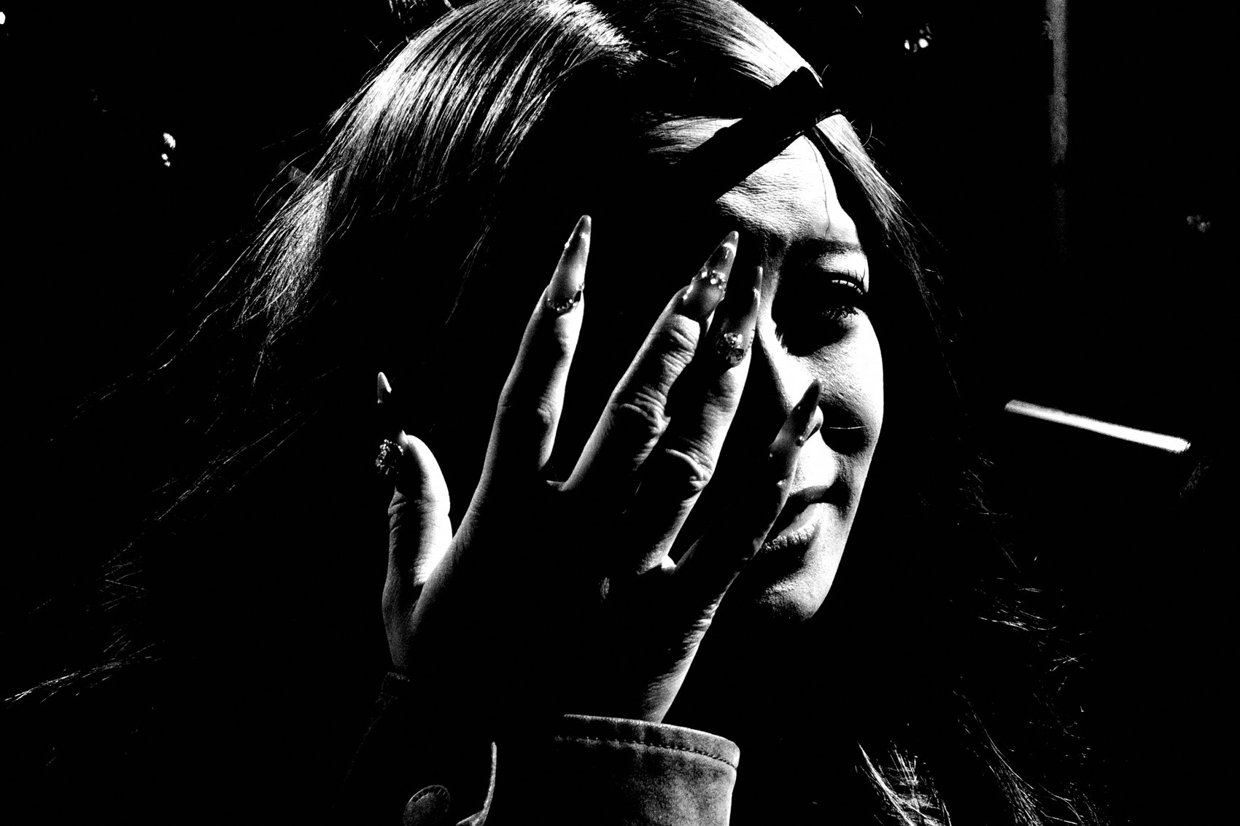
FLUX ACADEMY
BEAT 22 · RELATIONSHIP TO UPCOMING
Where We Go From Here
— Lesson 045 stress-tests the system in real conditions
— Chaos becomes the proving ground
— The installed system meets the unpredictable world
Notes:
With the system fully installed, Lesson 045 takes it somewhere it has to prove itself — real chaos, real conditions, no preparation. Everything we've built gets stress-tested in the wild. The system doesn't change when the environment does. That's the whole point. Next lesson, we find out if it's truly installed.

Slide 24
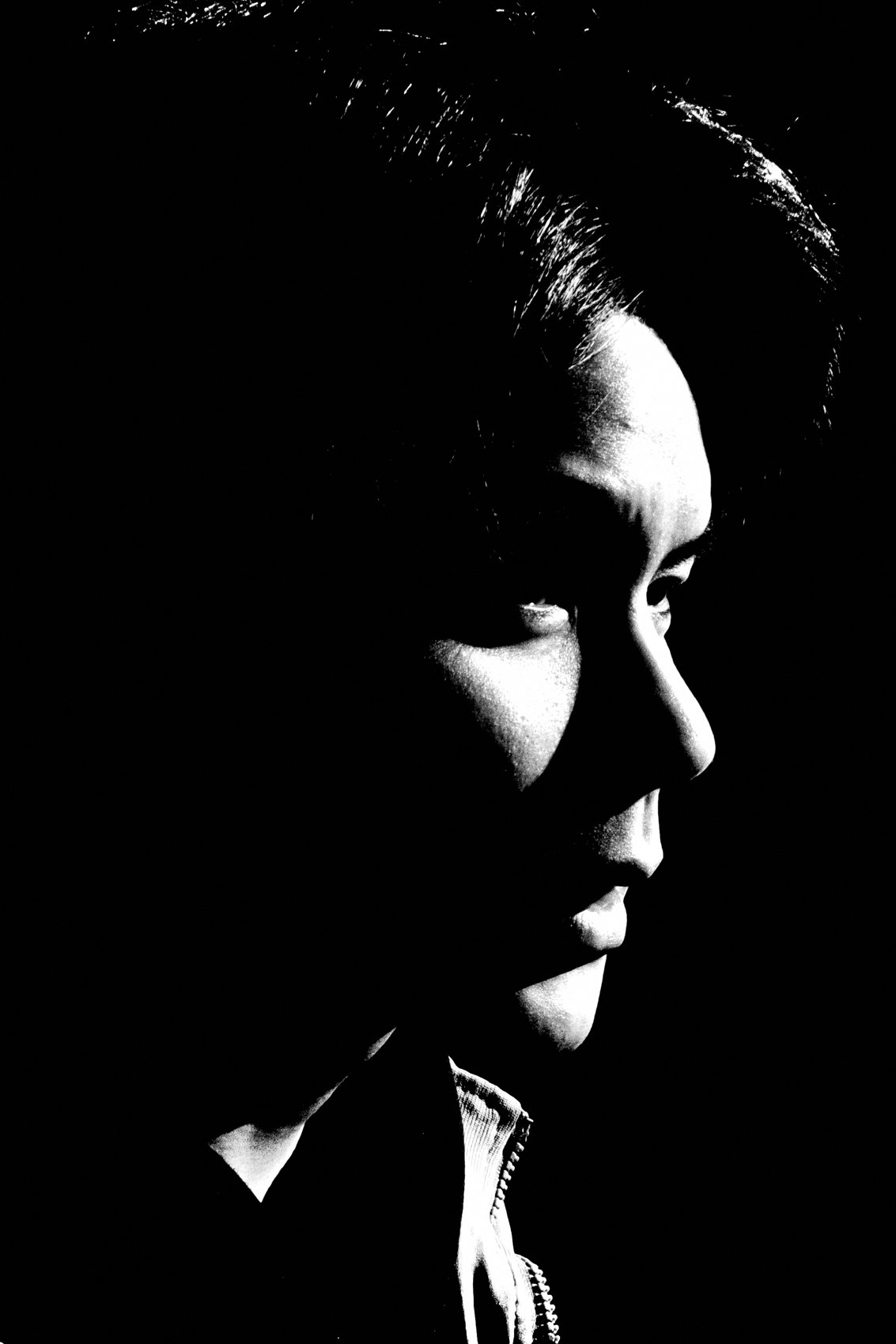
FLUX ACADEMY
BEAT 23 · SUMMARY / TAKEAWAY
Install It. Trust It. Live Through It.
— The enemy is friction — the system removes it completely
— One camera, one aesthetic, one workflow, one daily rhythm
— Install it fully. Trust it. Go live.
Notes:
Last thing. The frictionless daily system isn't a set of suggestions — it's an operating system, and it only runs when fully installed. One camera in one pocket. One aesthetic baked in. Small JPEGs flowing same day. Twenty frames minimum, every day, from the life you're already living. Remove the friction and photography stops being something you do and starts being how you move. Install it. Trust it. Go live. Catch you in Lesson 045.

