Slide 1
FLUX ACADEMY · A SCHOOL FOR SEEING
MODULE 8 · THE SYSTEM — RICOH GR
Setting Up the Ricoh GR
BY DANTE SISOFO

Slide 2
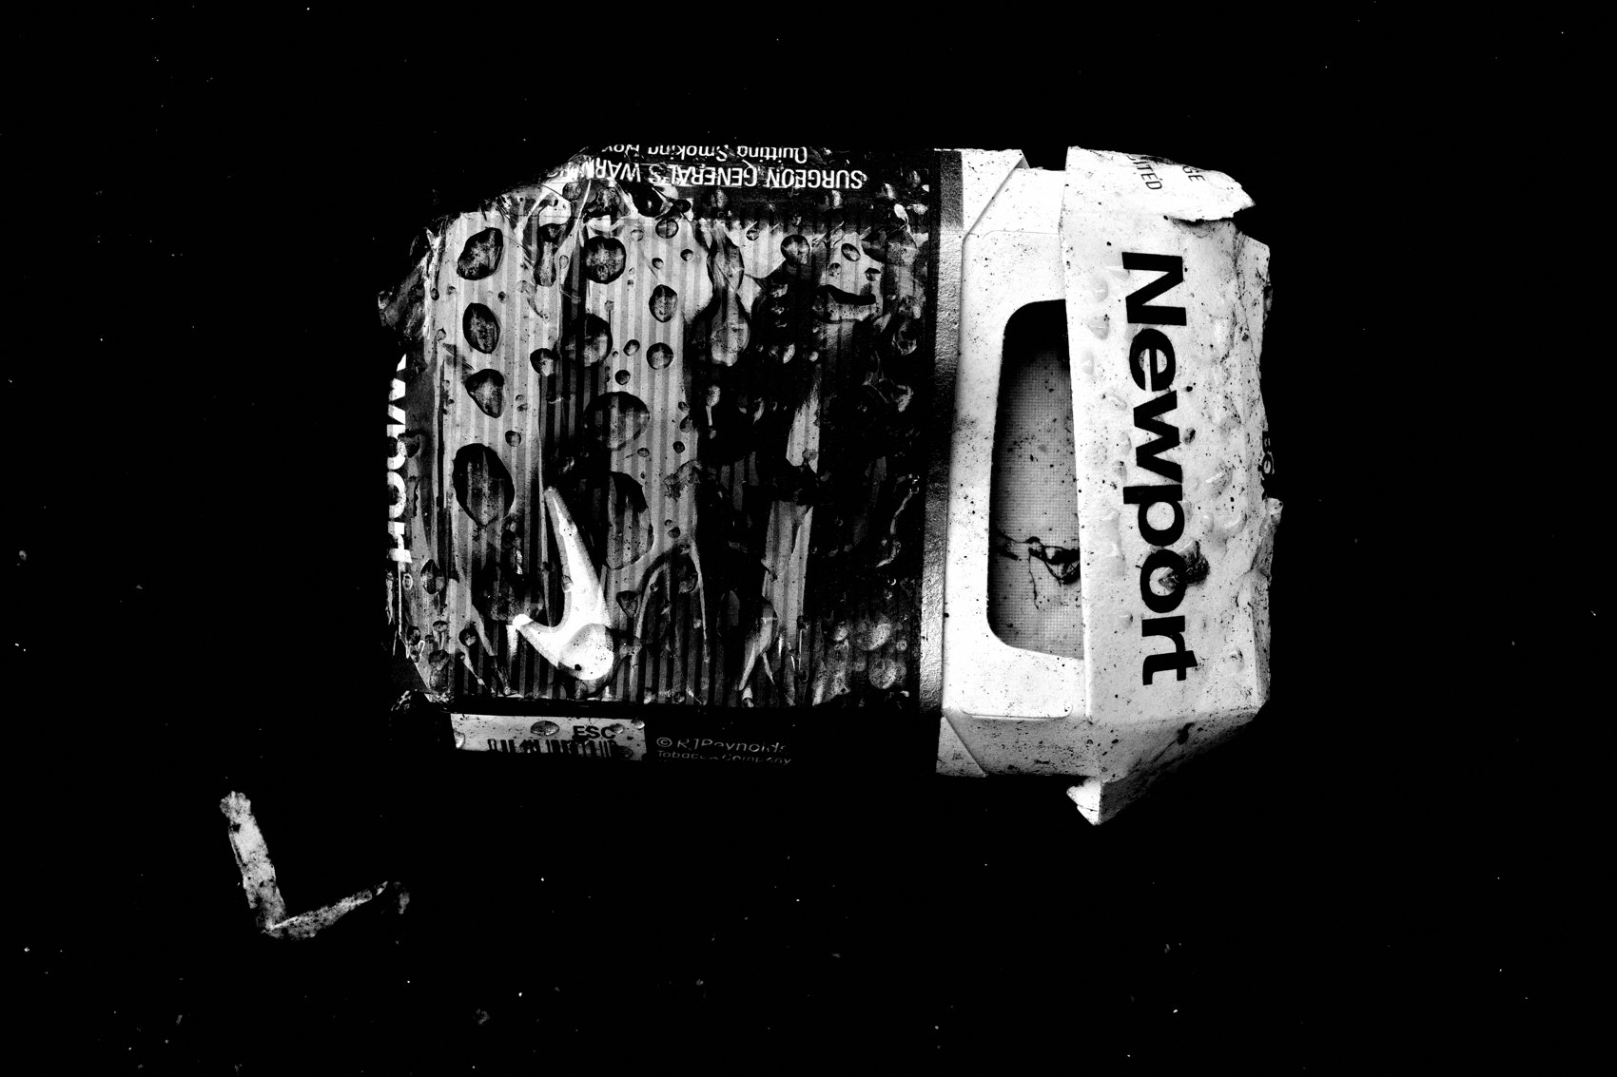
FLUX ACADEMY
BEAT 01 · CORE IDEA
One Setup. Locked. Forever.
— One configuration — do not negotiate
— Set it once, forget it forever
— The system frees you; tinkering traps you
Notes:
What's popping, people — it's Dante. Today we are locking down your Ricoh GR — one time, completely, non-negotiably. This is not a menu you revisit on the street. This is not a starting point you "customize later." You set it exactly the way I'm about to show you, and then you never touch it again. The setup is the freedom.

Slide 3
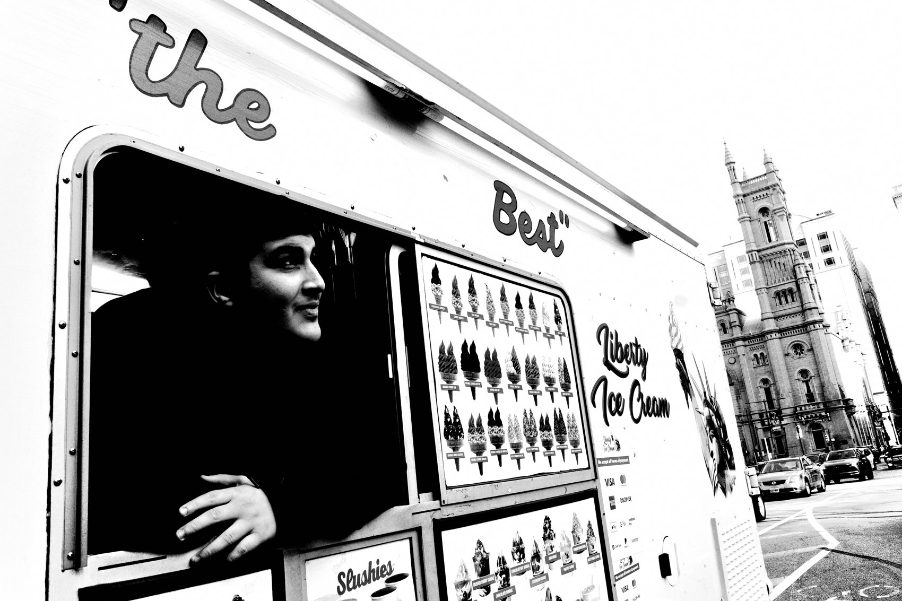
FLUX ACADEMY
BEAT 02 · LEARNING OBJECTIVE
What You'll Walk Away With
— Exact settings installed, nothing improvised
— Understand why each choice was made
— Ready to raise the camera and shoot immediately
Notes:
By the end of this lesson your camera will be a fully installed machine — mode, focus, exposure, file format, image control, buttons, and display all locked in. You won't wonder what to change. You won't tweak on the street. You'll understand the reasoning behind every decision, and you'll be ready to walk out the door and shoot.

Slide 4
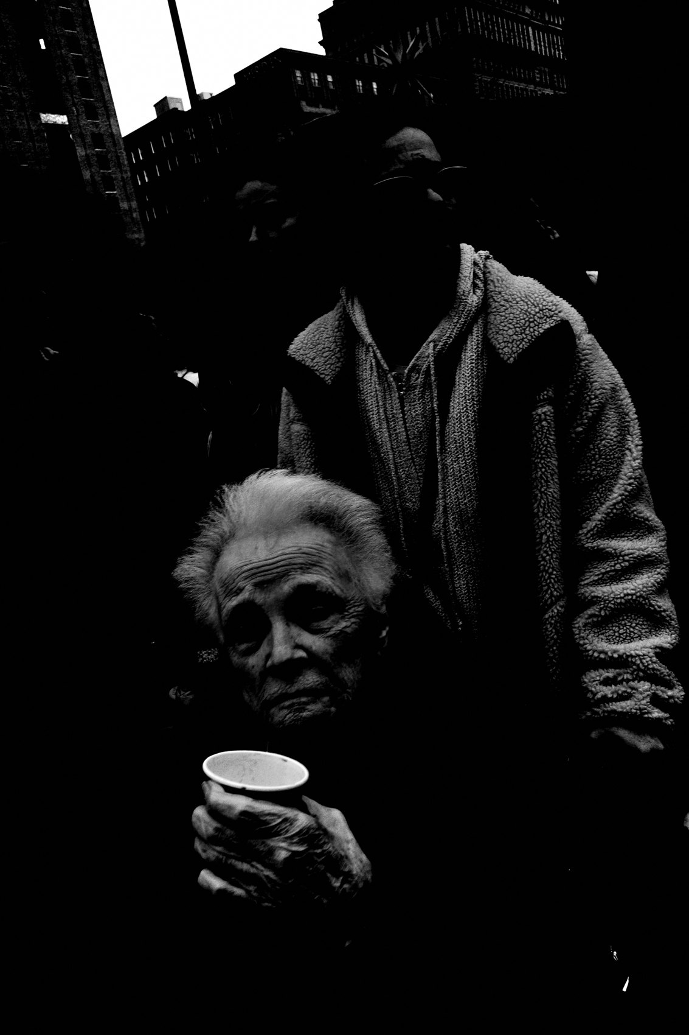
FLUX ACADEMY
BEAT 03 · WHY THIS MATTERS
Menus Are the Enemy of Flow
— Every menu dive breaks presence
— Tinkering on the street kills the frame
— A locked system keeps you in the world
Notes:
Here's why this matters more than you think: every time you dive into a menu on the street, you leave the world. You stop seeing. You miss the frame. The whole point of the FLUX system is to keep you present and moving — and that only happens when the camera is already set up before you leave home.

Slide 5

FLUX ACADEMY
BEAT 04 · WHY THIS MATTERS
Constraint Is the Engine
— Fewer controls = faster decisions
— The constraint compounds over time
— Less camera, more photograph
Notes:
There's a deeper principle here too: constraint is the engine of this practice. The less you have to decide about the camera, the more you can give to the photograph. Remove the variables and what's left is instinct — which is exactly where you want to be operating.

Slide 6
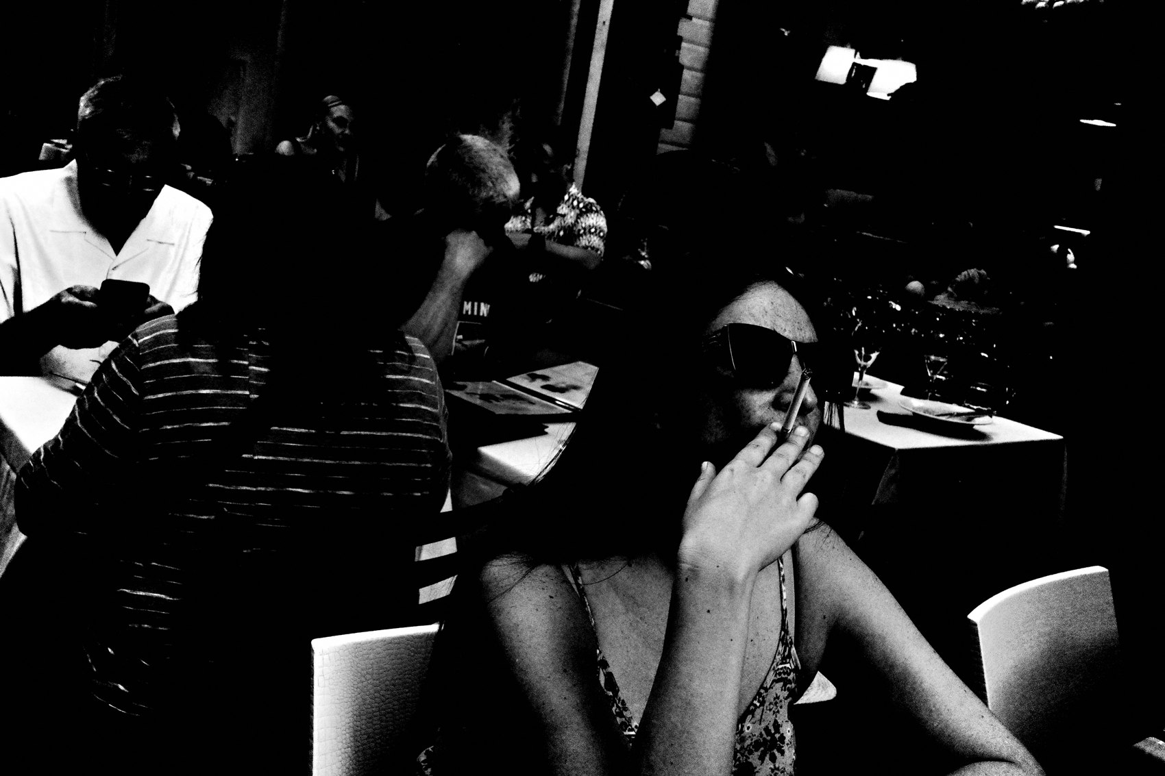
FLUX ACADEMY
BEAT 05 · MAIN TEACHING
Shooting Mode: AV at f/8
— Mode: AV — Aperture Priority
— Aperture: f/8 — the locked setting
— Let the camera handle the rest
Notes:
Start with your shooting mode. Set it to AV — Aperture Priority — and set your aperture to f/8. That's where it lives. Ninety percent of the time you are in AV mode. You can use P mode occasionally, but f/8 is the default and you do not move it. We are letting the camera do the exposure work so your brain can do the seeing work.

Slide 7

FLUX ACADEMY
BEAT 06 · MAIN TEACHING
Focus: Snap at 2 Meters
— Focus Mode: Single Point / Select AF
— Snap Focus Distance: 2 meters
— Fn button toggles between the two
Notes:
Focus next. Set your Focus Mode to Single Point — Select AF. Set your Snap Focus distance to 2 meters. Full Press Snap: Off. AF Assist Light: Off. Then assign your Fn button to Snap. Now you can toggle instantly between Single Point AF and Snap Focus. In Snap at 2 meters, roughly one meter to infinity is in focus — raise it, point it, it's sharp. GRIIIx users: use f/9 and 3.5 meters snap distance.

Slide 8
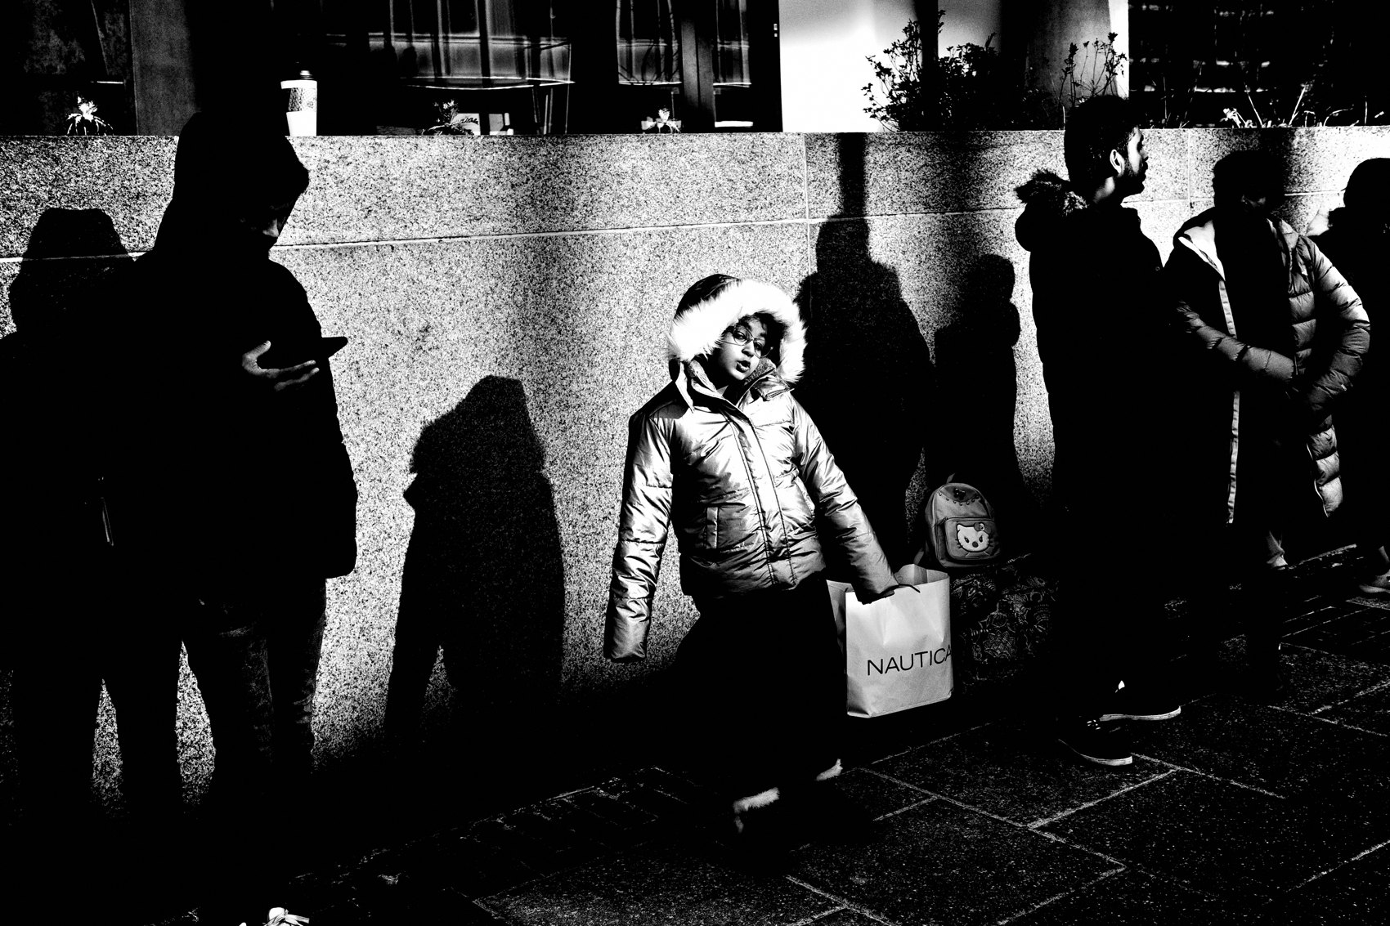
FLUX ACADEMY
BEAT 07 · MAIN TEACHING
Exposure: Auto ISO, Fixed Shutter Floor
— Metering: Multi-segment
— ISO: Auto — 160 lower, 25,600 upper
— Minimum shutter speed: 1/500
Notes:
Exposure. Set metering to Multi-segment. ISO goes to Auto — lower limit 160, upper limit 25,600. Minimum shutter speed: 1/500. That floor keeps your frames sharp while you move. And here's the only control you will actually touch on the street: the Exposure Compensation dial. Not the shutter. Not the ISO. Not the aperture. Just exposure comp. If you want deeper shadows, underexpose. That's it.

Slide 9
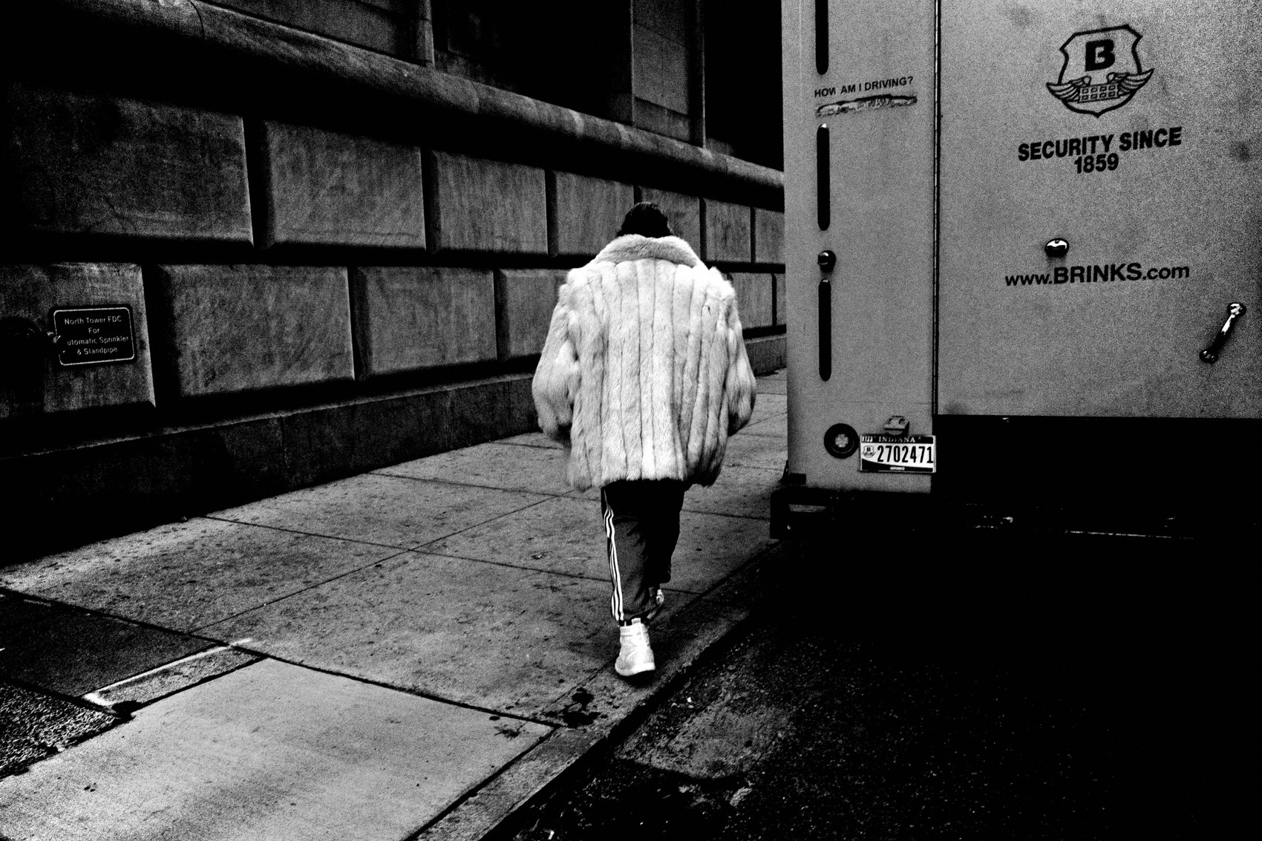
FLUX ACADEMY
BEAT 08 · MAIN TEACHING
File Format: JPEG Only, Small, 3:2
— File Type: JPEG only — not RAW, not RAW+JPEG
— Aspect Ratio: 3:2
— Small file size — speed creates rhythm
Notes:
File format. JPEG only. Do not shoot RAW. Do not shoot RAW plus JPEG. The aspect ratio is 3:2. Small JPEG — approximately 3504 by 2336 pixels. Small files create speed. Speed creates rhythm. RAW creates backlog. And backlog kills the practice. Commit to JPEG. What you see is what you get. Everything is baked in.

Slide 10
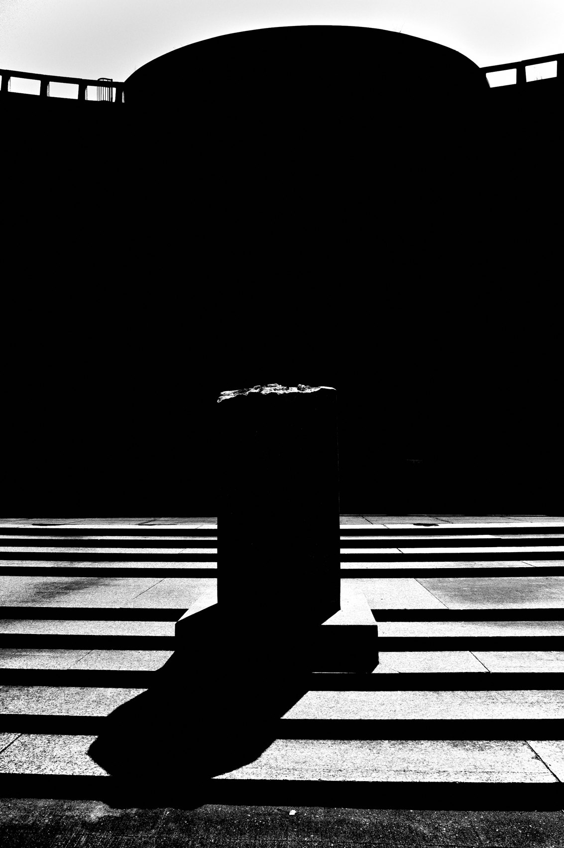
FLUX ACADEMY
BEAT 09 · MAIN TEACHING
Image Control: High Contrast B&W Baked In
— Image Control: High Contrast B W
— Specific values — enter them exactly, do not round
— Grain on, size 2 — the look is locked
Notes:
Now the image control — this is where the look lives. Set Image Control to High Contrast B W. Enter these exact values: High/Low Key minus 2, Contrast plus 4, Highlight Contrast minus 4, Shadow Contrast 0, Sharpness plus 4, Shading plus 4, Clarity plus 4. Grain: On, Size 2. Toning: Off. Every frame baked. No fixing in post. Set it once and never touch it again.

Slide 11
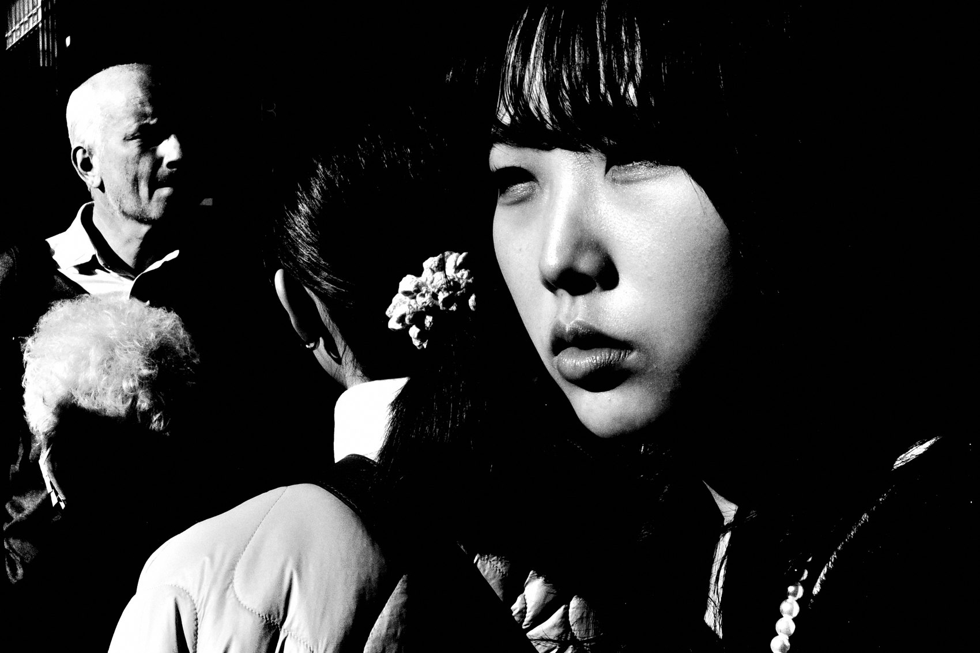
FLUX ACADEMY
BEAT 10 · MAIN TEACHING
Button Layout: Strip It Down
— Fn button: Snap
— Custom Settings 2–5: Off
— Movie button: Crop mode only
Notes:
Buttons. Fn button is Snap — that's it. Display Custom Setting 1 is Snap Focus Distance. Custom Settings 2 through 5: all Off. Movie Button becomes Crop Mode. Touch AF: Off. You are removing every shortcut that isn't essential. The buttons should only do the two things you actually need on the street — toggle snap and switch crop. Everything else is noise.

Slide 12

FLUX ACADEMY
BEAT 11 · MAIN TEACHING
Display: Minimum Information, Maximum Presence
— Shooting Info Display: Simplified
— Playback Info Display: nothing selected
— Grid: 4×4 — the only overlay you keep
Notes:
Display settings. Shooting Info Display: Simplified. Playback Info Display: nothing selected. Grid: 4×4. Guide Display: Off. Power Button Lamp: Off. Auto Power Off: Off. Sleep Mode: Off. Your LCD should show shutter speed, aperture, ISO, exposure compensation, and the grid. Nothing else. Remove all visual clutter. The less your screen pulls your eye, the more the world does.

Slide 13

FLUX ACADEMY
BEAT 12 · MAIN TEACHING
The Final Checklist
— AV mode · f/8 · Snap Focus 2m
— Auto ISO · JPEG only · High Contrast B W baked
— Exposure comp is your only street control
Notes:
Here's your final check before you walk out the door: AV mode, f/8, Snap Focus at 2 meters, Auto ISO with floor at 160 and ceiling at 25,600, minimum shutter 1/500, JPEG only, High Contrast B W baked in, minimal screen, Fn button set to Snap. Raise camera. Point. Shoot. The only things you will touch on the street are exposure compensation and the Fn button. That's the whole system.

Slide 14
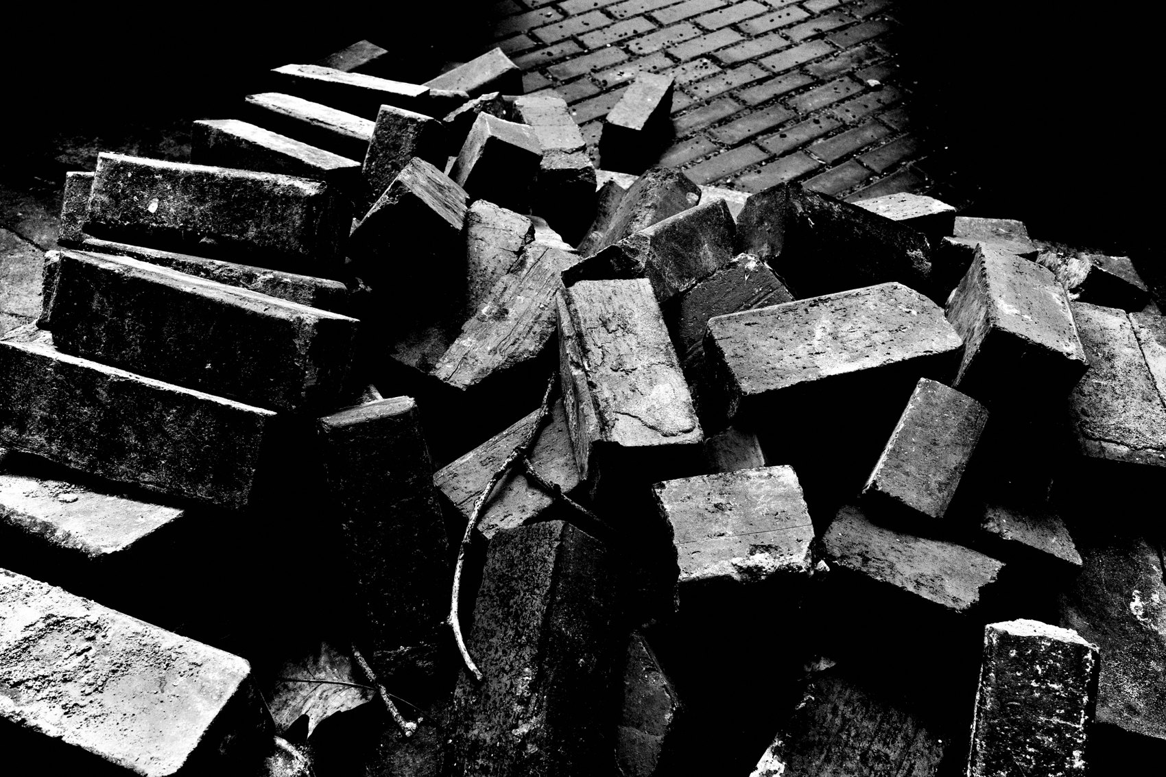
FLUX ACADEMY
BEAT 13 · MAIN TEACHING
The System Holds When Chaos Increases
— The environment changes — the system stays identical
— 50mm crop, underexpose minus 2
— Expose for highlights, crush the shadows
Notes:
Here's the system working under real pressure. Drop yourself into pure chaos — a dense crowd, noise, constant movement, a festival at full tilt. The solution does not change: Snap Focus at 1 meter, f/16, Multi-segment metering, exposure comp ready, High Contrast B W, small JPEG. When the chaos increases, you tighten rather than fiddle — reach for the 50mm crop, underexpose to minus 2, expose for the highlights, crush the shadows. The environment changes. The system stays the same. That's the whole point of locking it.

Slide 15

FLUX ACADEMY
BEAT 14 · MAIN TEACHING
Volume Creates Instinct
— Hundreds or thousands of frames on a hard day — no backlog
— Import same day, cull same day
— Volume is not waste — it is instinct training
Notes:
Volume is part of the system. Give the installed machine a couple of hard days with no preparation and no special conditions, and you'll shoot in the hundreds — even the thousands. Because the settings are locked and the files are small, there's no backlog — import same day, cull same day, publish same day. Shoot more, think less. Volume increases instinct. That's what the small-JPEG workflow makes possible.

Slide 16

FLUX ACADEMY
BEAT 15 · MAIN TEACHING
The Same System Builds a Body of Work
— Same settings, same workflow, day after day
— Walk → photograph → cull → repeat
— Weeks of that rhythm produce a complete book, because the system is frictionless
Notes:
The same setup that holds up in pure chaos also holds up over the long, quiet stretch of daily street walking. Same camera. Same settings. Same workflow: walk your route, photograph daily, cull the same night, repeat the next morning. A frictionless system means no decisions pile up. Run that rhythm for a couple of weeks and you don't just have frames — you have a complete, sequenced body of work, even a book. Not because the place was special. Because the system was installed.

Slide 17
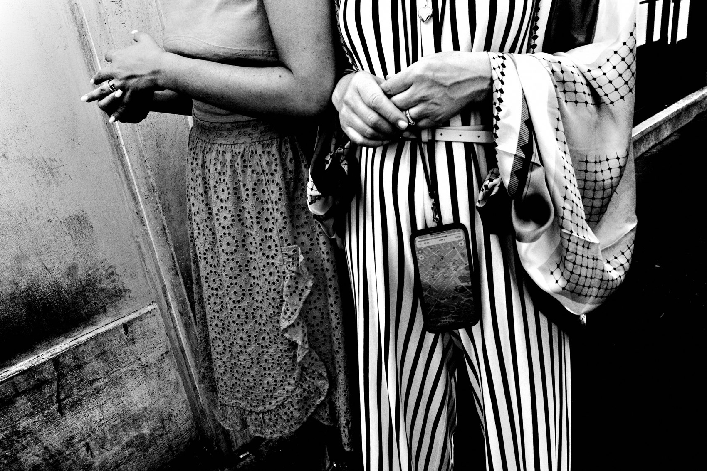
FLUX ACADEMY
BEAT 16 · MAIN TEACHING
Do Not Customize. Trust the Process.
— The temptation to tweak is real — resist it
— Every customization is a small leak in the system
— Trust compounds; tinkering compounds too
Notes:
I know the temptation. You read through these settings and your brain starts negotiating — "maybe I'll try f/5.6 just to see" or "I'll add one more custom button." Resist it completely. Every tweak is a small leak. The power of this system is its totality — when every variable is locked, the only thing left is you and the world. Trust the process. Install it exactly as given.

Slide 18
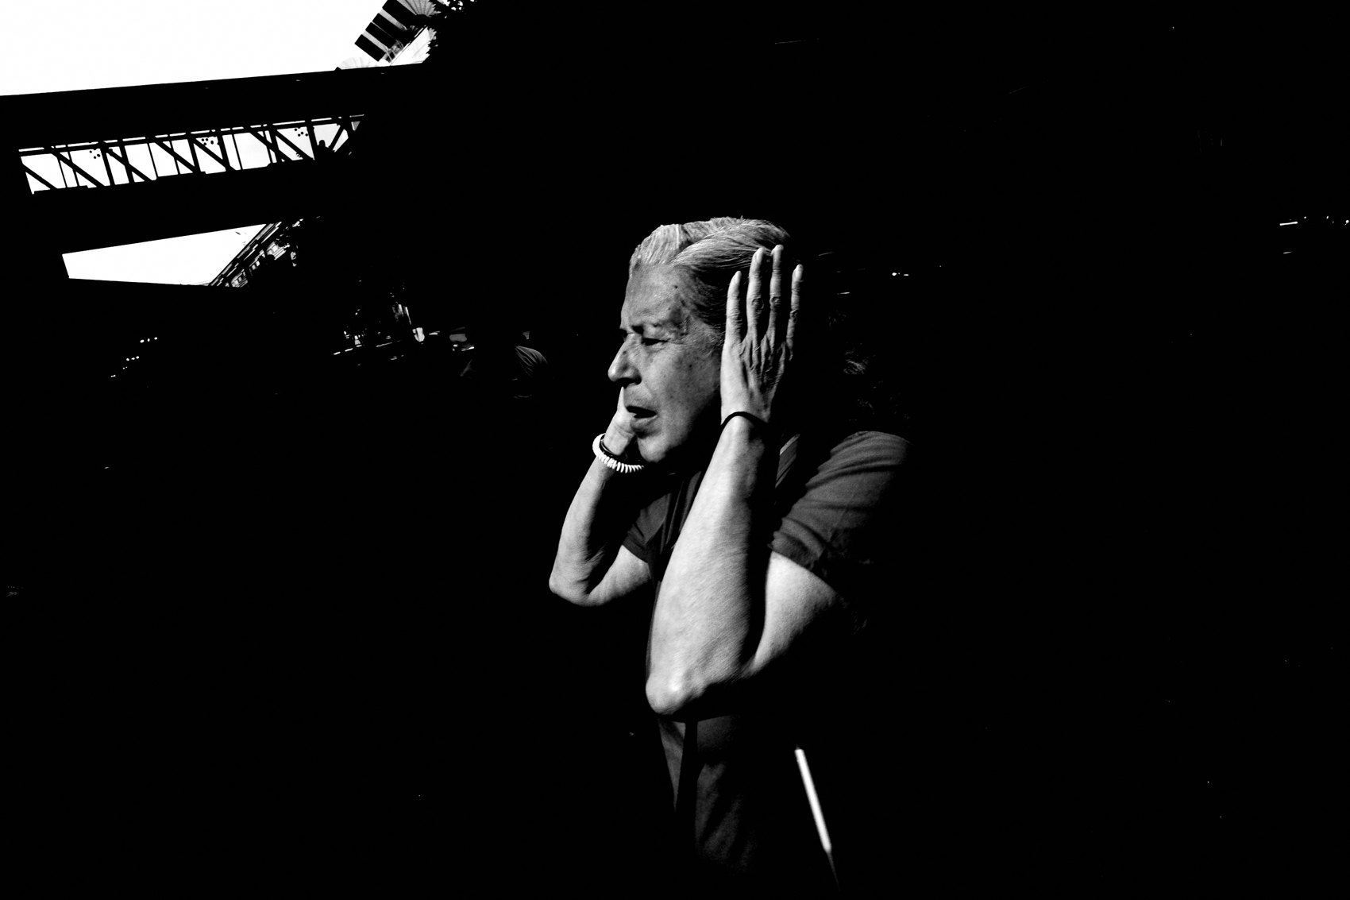
FLUX ACADEMY
BEAT 17 · PRACTICAL APPLICATION
Install Before You Leave Home
— Set every parameter tonight — not on the street
— Confirm: AV, f/8, Snap 2m, JPEG, High Contrast B W
— Walk out tomorrow with a fully installed machine
Notes:
Your move right now: sit down with your Ricoh tonight — not on the street tomorrow morning, tonight — and install every single setting from this lesson. Walk through the checklist. Confirm AV mode, f/8, Snap Focus at 2 meters, Auto ISO, JPEG, High Contrast B W baked. Close the menus. Put the camera in your pocket. Walk out tomorrow with a machine that is already done.

Slide 19
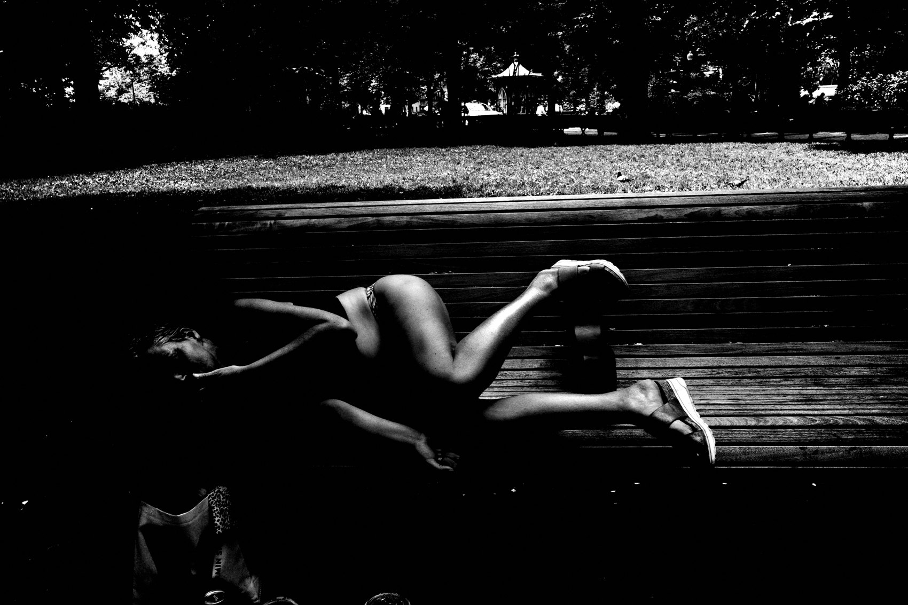
FLUX ACADEMY
BEAT 18 · PRACTICAL APPLICATION
First Walk: 100 Frames, Zero Judgment
— Goal: 100 photographs on your first walk
— Do not review on the LCD mid-walk
— Raise, point, shoot — get comfortable with the motion
Notes:
Once the system is installed, go for your first walk with one goal: make at least 100 photographs. Not 100 good photographs — 100 photographs, full stop. Do not review every frame on the LCD while you're out. The camera is set up. All you have to do is raise it, point it, and shoot. Get comfortable with the physical rhythm — wrist strap, shutter press, moving through the world. That's the whole assignment.

Slide 20
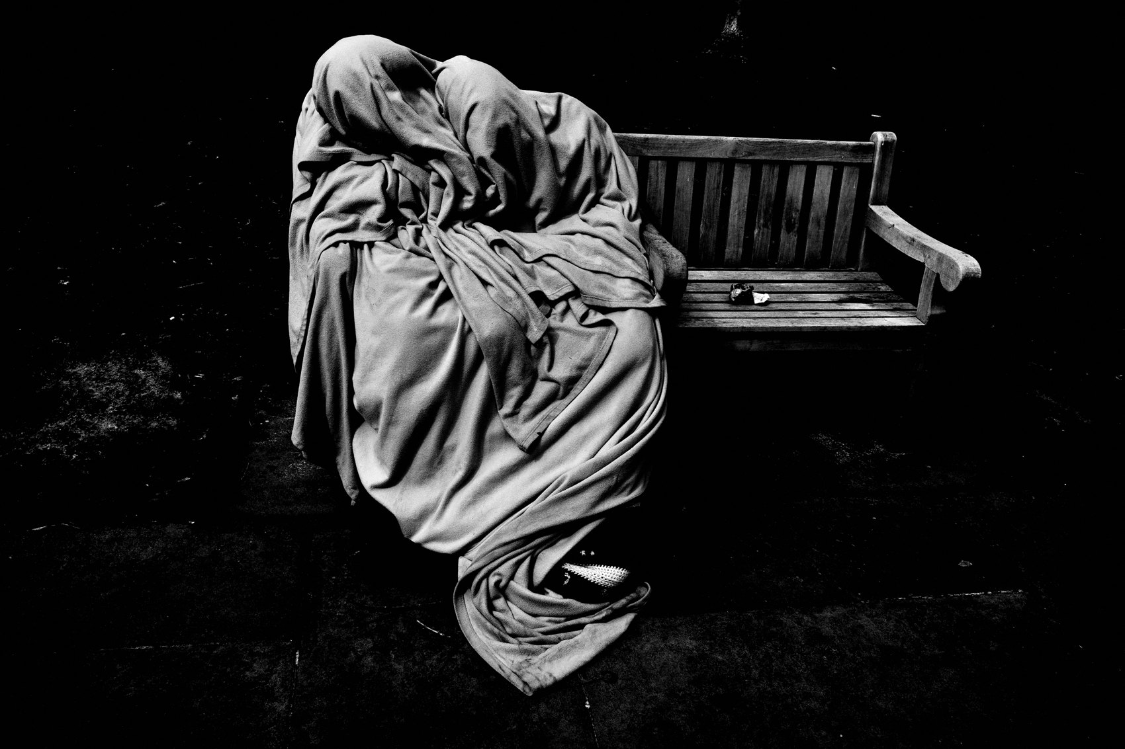
FLUX ACADEMY
BEAT 19 · COMMON MISTAKES
Tweaking Settings Mid-Walk
— Diving into menus on the street kills presence
— "Just a quick adjustment" is a full disconnection
— Set it at home — never adjust it outside
Notes:
The most common mistake is diving into the menus on the street. It feels productive — "I'll just quickly adjust the shadow contrast" — but every second you spend in a menu is a second you're not in the world. You miss the frame. You break the flow. You step out of presence and into management. Set it at home. Do not touch it outside. The discipline here is what makes everything else work.

Slide 21
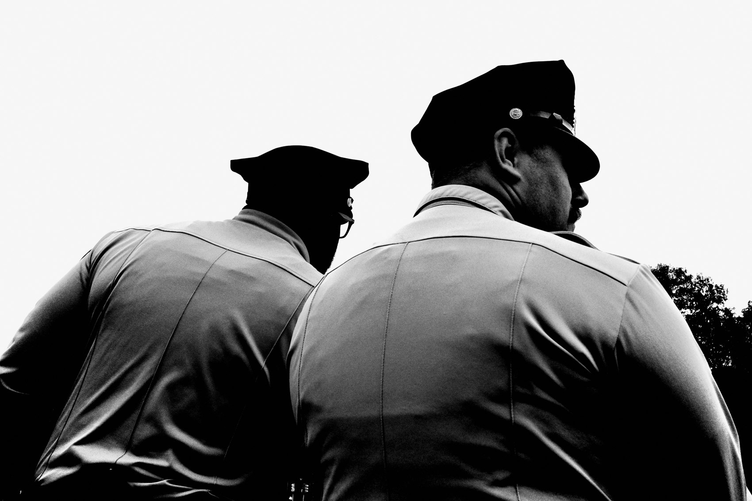
FLUX ACADEMY
BEAT 20 · COMMON MISTAKES
Shooting RAW "Just in Case"
— RAW creates backlog — backlog stops the practice
— "Just in case" is anxiety, not craft
— JPEG baked is a commitment to the moment
Notes:
The other mistake: shooting RAW "just in case" you want to fix something later. That safety net sounds reasonable and it will quietly kill the practice. RAW creates backlog. Backlog creates hesitation about culling. Hesitation stops the daily rhythm. JPEG only is not a limitation — it is a commitment to the image you made in the moment. Commit to the frame. Not the fix.

Slide 22
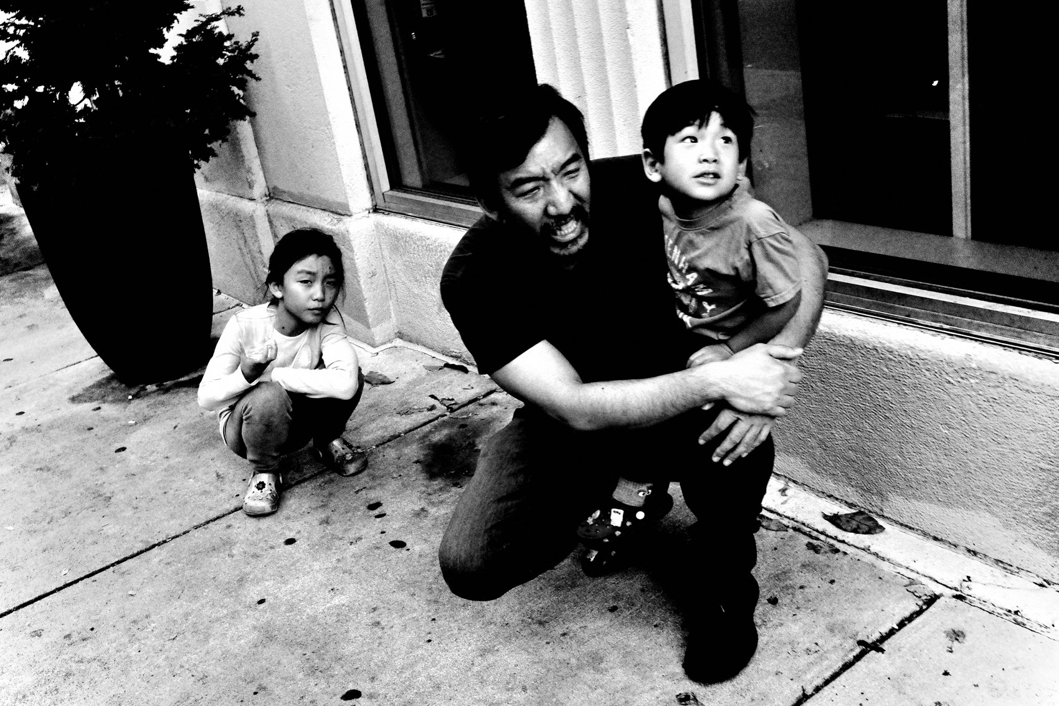
FLUX ACADEMY
BEAT 21 · RELATIONSHIP TO PREVIOUS
Built on What Came Before
— Lesson 042 established the FLUX camera philosophy
— This lesson is the physical installation of that philosophy
— Theory becomes hardware
Notes:
Lesson 042 laid out the philosophical case for why the FLUX system works — why constraint, simplicity, and a single committed workflow compound into real results. This lesson is where that philosophy becomes hardware. Everything discussed before about removing decisions and trusting the system now lives in your actual camera. Theory installed.

Slide 23
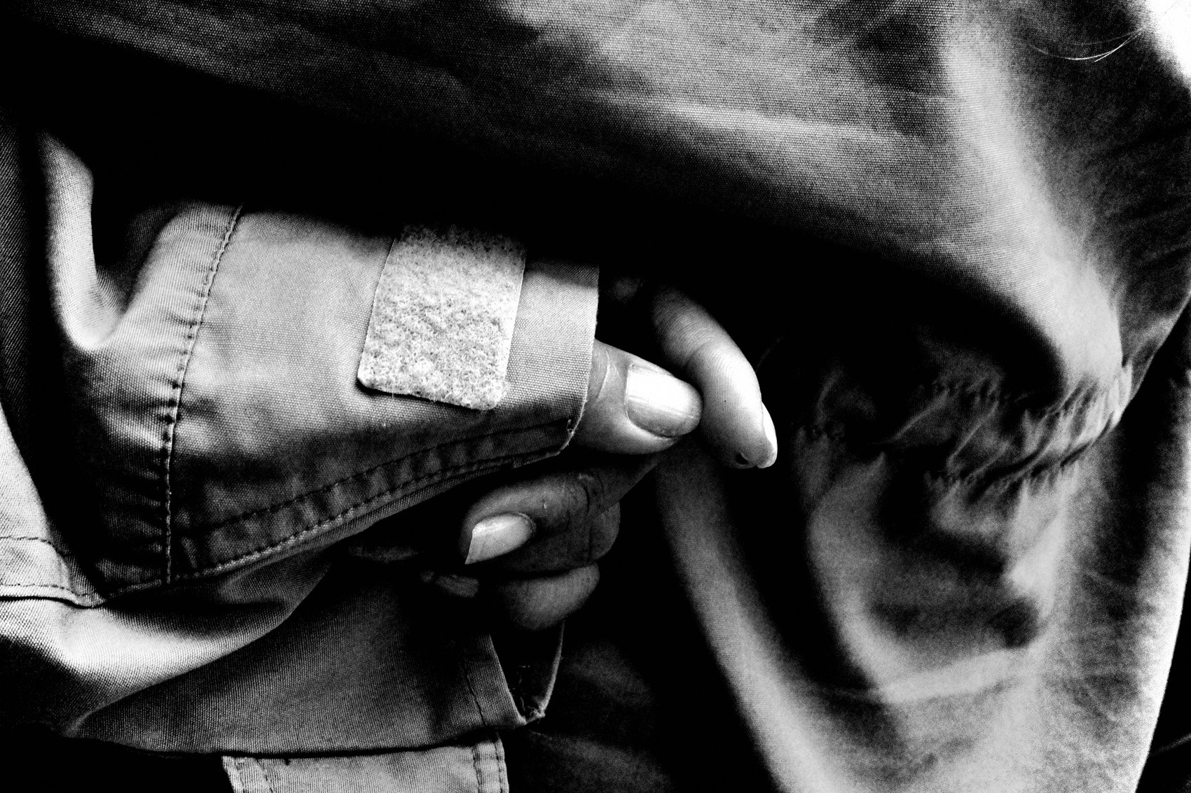
FLUX ACADEMY
BEAT 22 · RELATIONSHIP TO UPCOMING
What Comes Next
— Lesson 044 takes the installed system into motion
— Settings locked — now the operating mode changes
— From setup to street execution
Notes:
Lesson 044 takes this installed machine into actual street conditions — how to operate it, how instinct replaces analysis, how the system moves with your body. The settings are done. What comes next is execution: how to move, how to trust, how to let the installed machine disappear so that what remains is just you and the photograph.

Slide 24
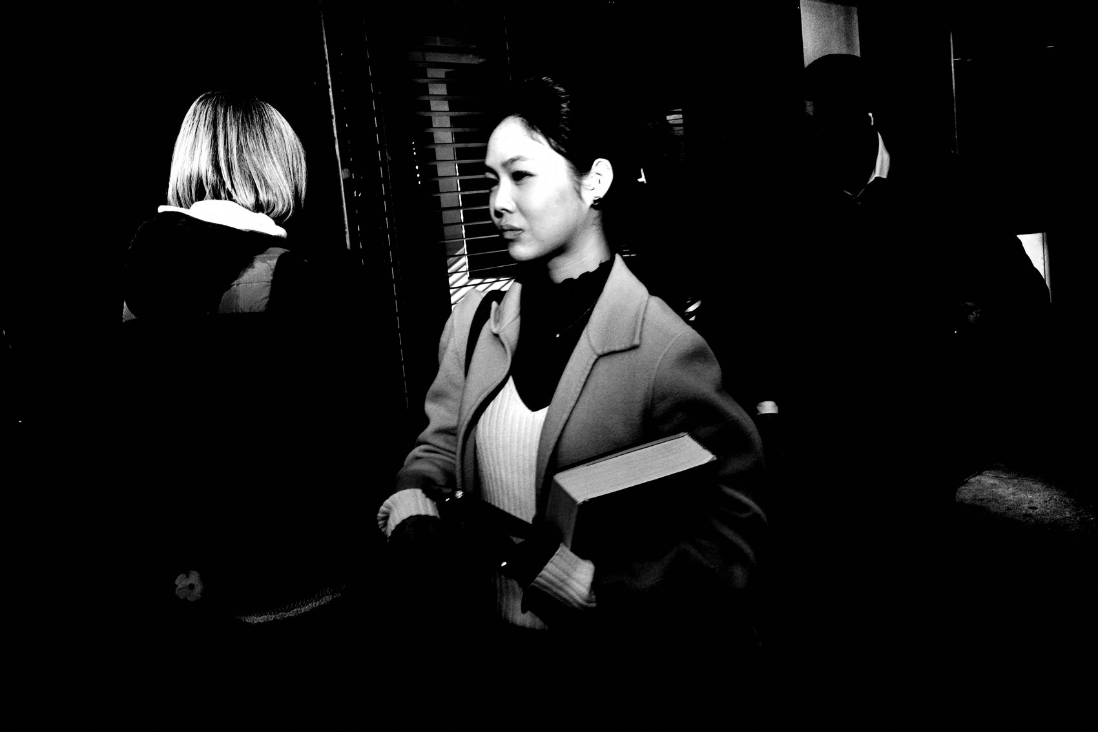
FLUX ACADEMY
BEAT 23 · SUMMARY / TAKEAWAY
Set It. Lock It. Go Shoot.
— AV · f/8 · Snap 2m · Auto ISO · JPEG · High Contrast B W
— One exposure compensation dial — your only street control
— Set it once, forget it forever, go make photographs
Notes:
Here's everything you need to carry out the door. AV mode. f/8. Snap Focus at 2 meters. Auto ISO, floor 160, ceiling 25,600, minimum shutter 1/500. JPEG only. High Contrast B W baked in. Buttons stripped. Display simplified. Exposure compensation is your one and only street control. Set it once. Lock it down. Never touch it again. The system is the freedom — now go use it. Catch you in Lesson 044.

