Slide 1
FLUX ACADEMY · A SCHOOL FOR SEEING
MODULE 7 · THE STREET
Breakdown V — A Full Walk, Explained
BY DANTE SISOFO

Slide 2
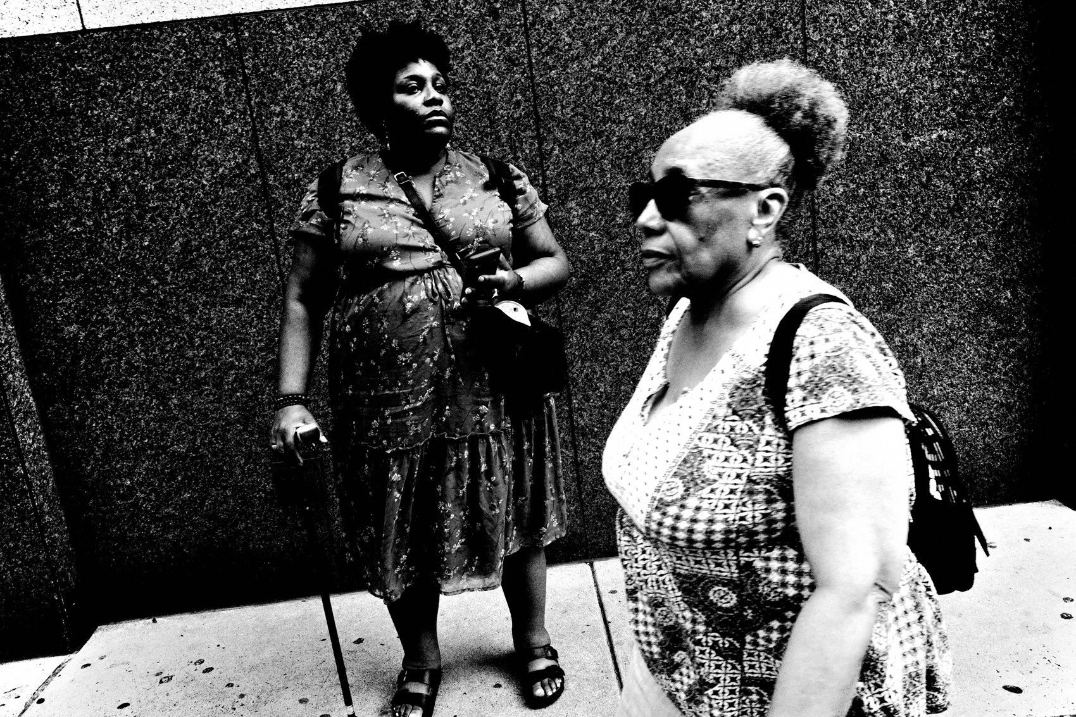
FLUX ACADEMY
BEAT 01 · CORE IDEA
The Walk Is the Method
— The walk itself is not a warm-up — it is the work
— Every decision on a full walk follows a logic
— Presence, curiosity, and physical movement united in one session
Notes:
What's popping, people — it's Dante. We've spent a lot of time on individual skills — composition here, the decisive moment there. Today we go bigger. We lay out the full arc of a shooting walk, start to finish, and I explain the logic behind every stage — how you arrive, how you read a place, when you set up and wait, when you react, when you stay, when you go. The walk isn't a vehicle to get to the photography. The walk is the photography.

Slide 3
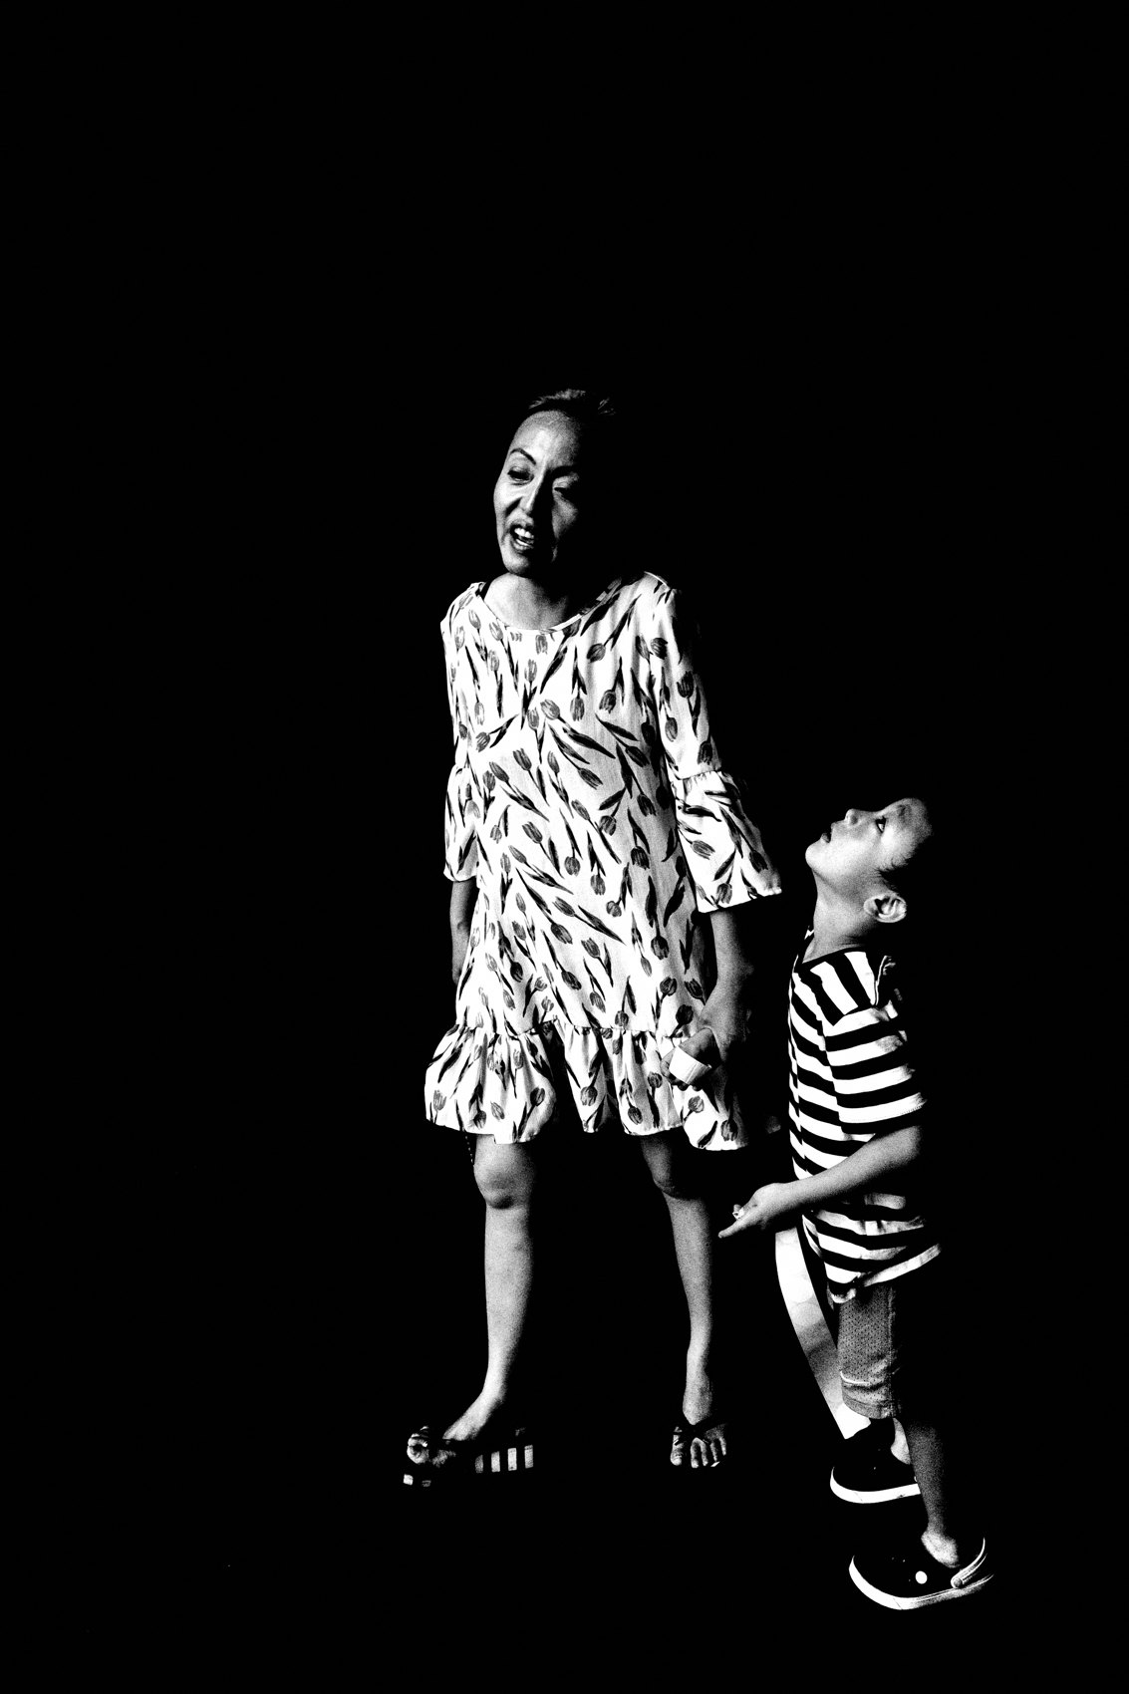
FLUX ACADEMY
BEAT 02 · LEARNING OBJECTIVE
What You'll Walk Away With
— How a full walk unfolds from arrival to last frame
— The decision-making that happens in real time
— How to read a scene, commit, and move on
Notes:
By the end of this lesson you'll have a blueprint for a full street photography session — not a checklist, but a living, breathing method. You'll see how curiosity, composition, physical positioning, and patience connect into one continuous flow from the moment you step outside to the moment you head home.

Slide 4
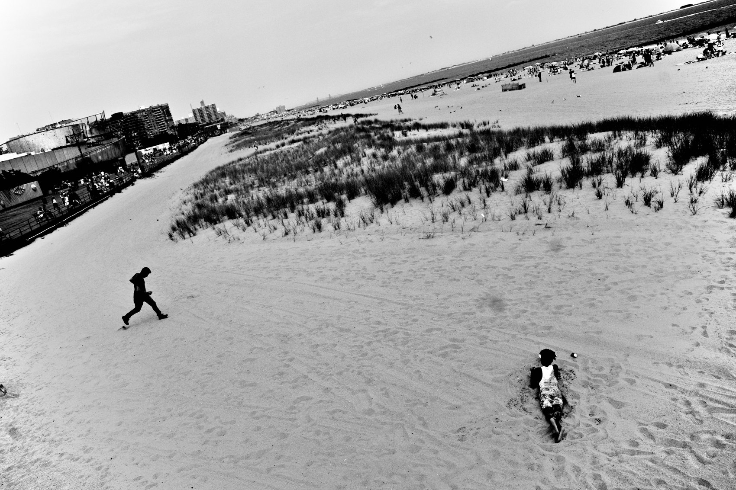
FLUX ACADEMY
BEAT 03 · WHY THIS MATTERS
Technique Without Flow Is Useless
— Knowing techniques in isolation doesn't help on the street
— The street doesn't pause so you can think
— You need a rhythm, not a rulebook
Notes:
Here's the problem with learning technique in fragments: the street doesn't give you time to consult a mental rulebook. You need rhythm. You need a way of moving that's so internalized it happens automatically. Seeing a full walk explained — decision by decision — gives you that rhythm to borrow until you build your own.

Slide 5
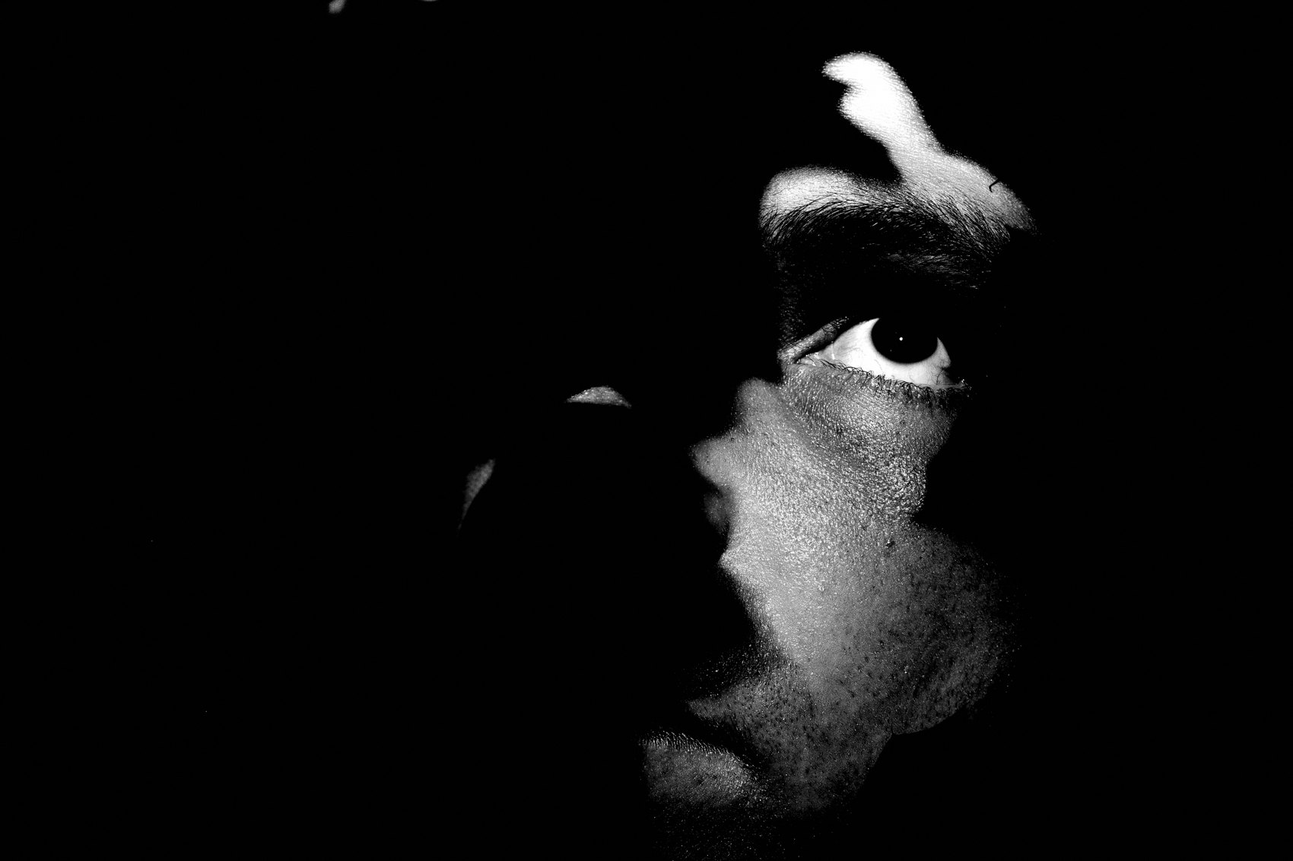
FLUX ACADEMY
BEAT 04 · WHY THIS MATTERS
The Walk Teaches You to Read Life
— Life on the street has patterns — the walk reveals them
— Foreground, middle ground, background: always in motion
— The more you walk, the more you see
Notes:
The street is a visual puzzle that's constantly reshuffling itself. A full walk teaches you to read that puzzle in motion — to notice when the foreground element, the middle figure, and the background detail are about to align into something real. That reading skill only sharpens through accumulated walks, explained and understood.

Slide 6
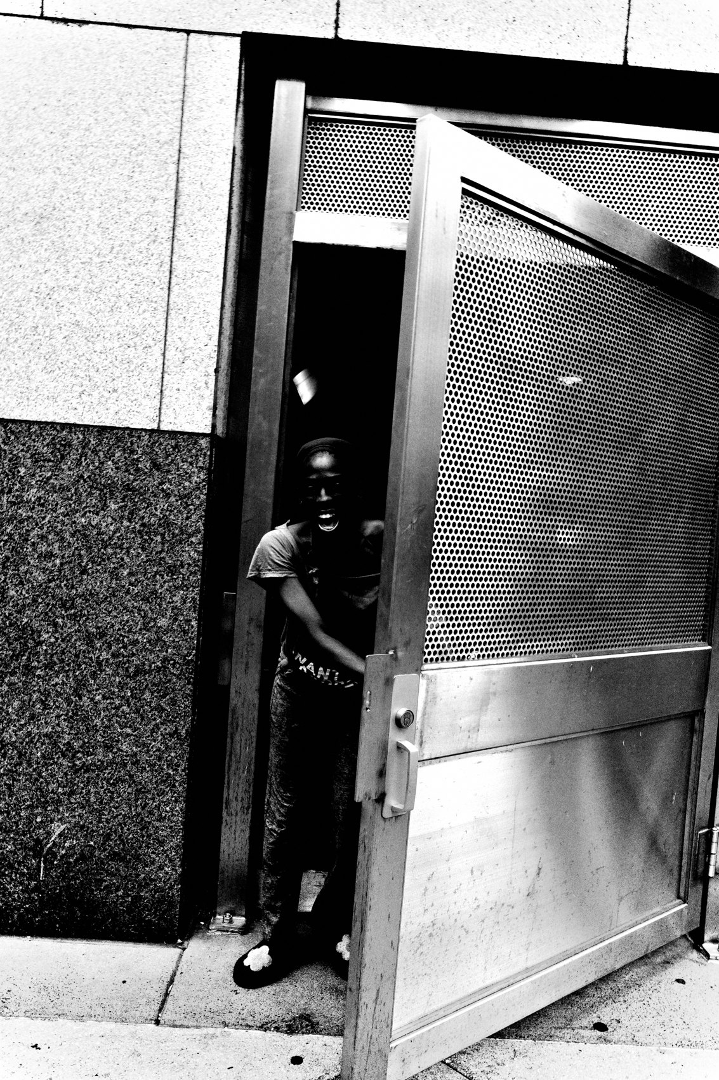
FLUX ACADEMY
BEAT 05 · MAIN TEACHING
Arriving Without Preconceptions
— Set your body in motion with no fixed agenda
— Go without preconceived notions of what you will find
— Arrival is an act of openness, not a hunt
Notes:
Every good walk starts the same way: you arrive without a fixed agenda. Not without intention — you're alert, curious, switched on — but without a predetermined image in your head. I've said it before: set your body in motion without preconceived notions of what you will find. Go out and explore. The scene you imagined will almost never be the scene that matters.

Slide 7
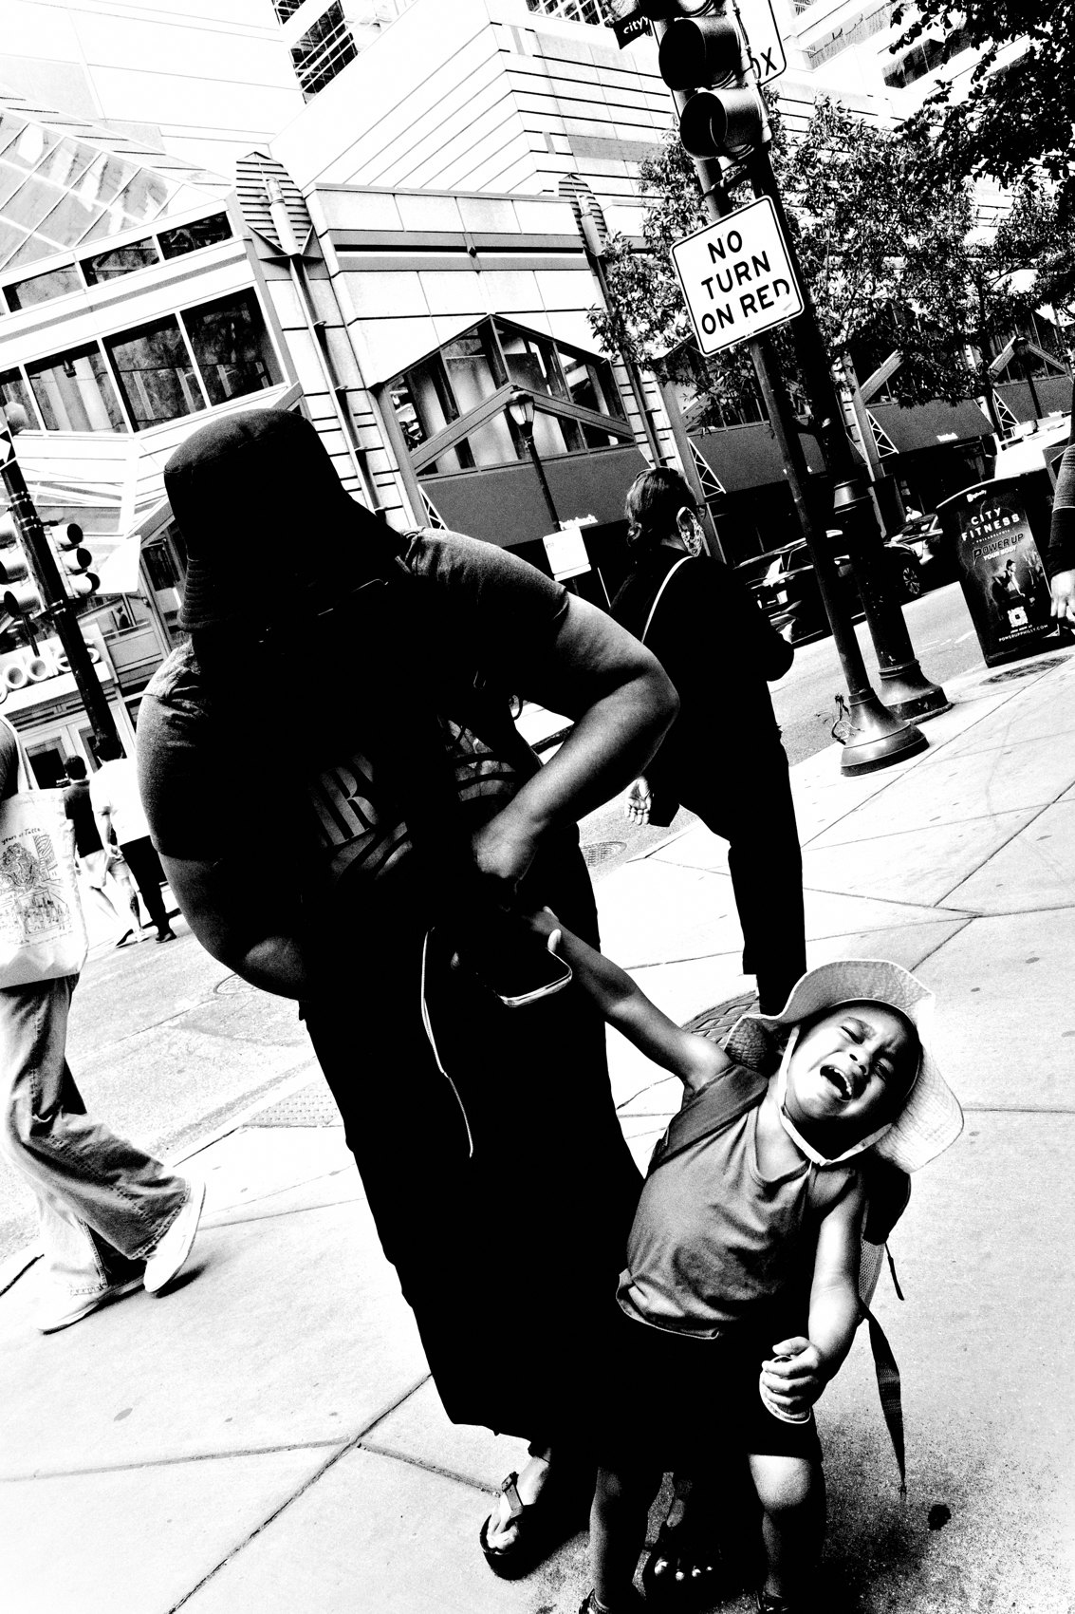
FLUX ACADEMY
BEAT 06 · MAIN TEACHING
Reading the Environment on Entry
— Immediately read the light — where is it, what does it offer?
— Find the choke points: doorways, corners, narrow alleys
— Note the background options before anything happens in front of them
Notes:
First thing I do when I arrive anywhere — any city, any block — I read the light. Where is it falling? What does it illuminate and what does it hide? Then I find the choke points: the narrow alleys, the stairways, the corners where life is funneled. I'm building a mental map before I even raise the camera.

Slide 8
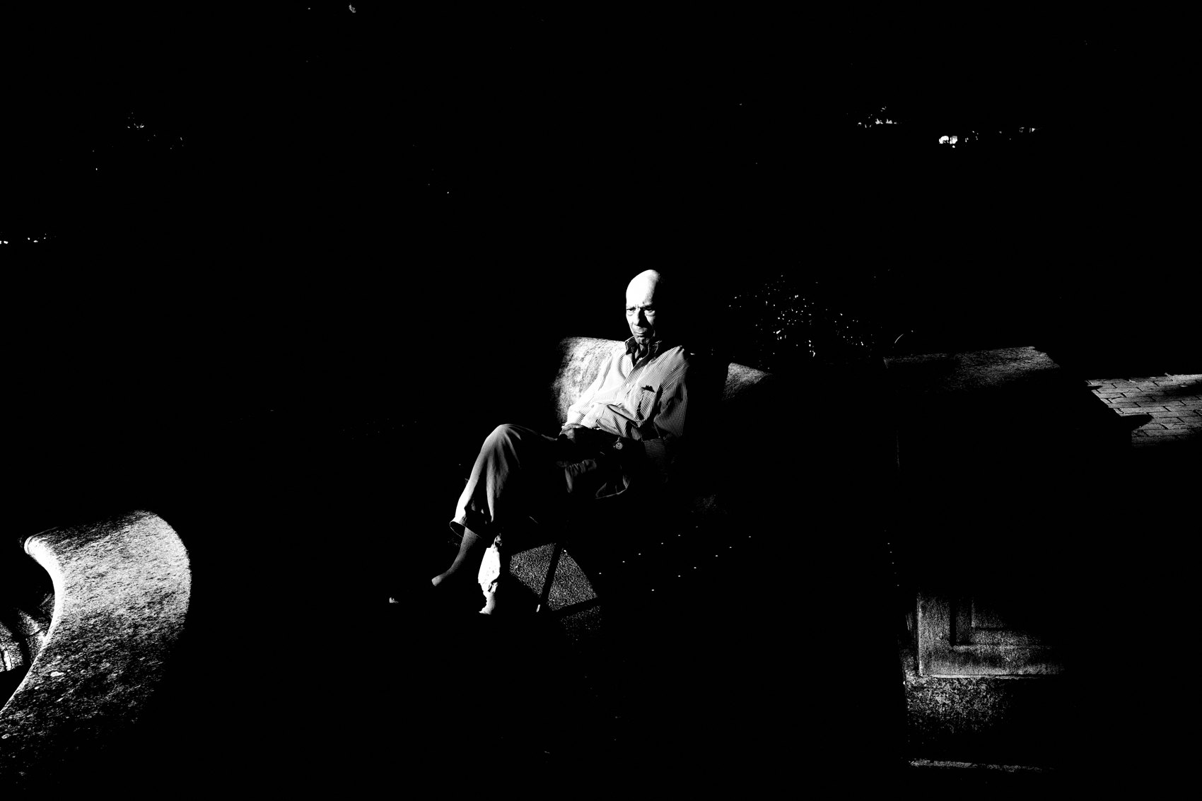
FLUX ACADEMY
BEAT 07 · MAIN TEACHING
Choosing Fishing or Hunting
— Fishing: find a strong scene, set up, wait for the element
— Hunting: see something happen, react instantly
— Know which mode the moment calls for — and switch freely
Notes:
Once I have the lay of the land I make a call: fish or hunt? Fishing means I've found a scene with strong bones — good light, clean background, natural flow of people — and I set up and wait for the right element to walk into the frame. Hunting means something is already happening and I move to it fast. A good walk uses both. The key is knowing which one the moment is asking for.

Slide 9
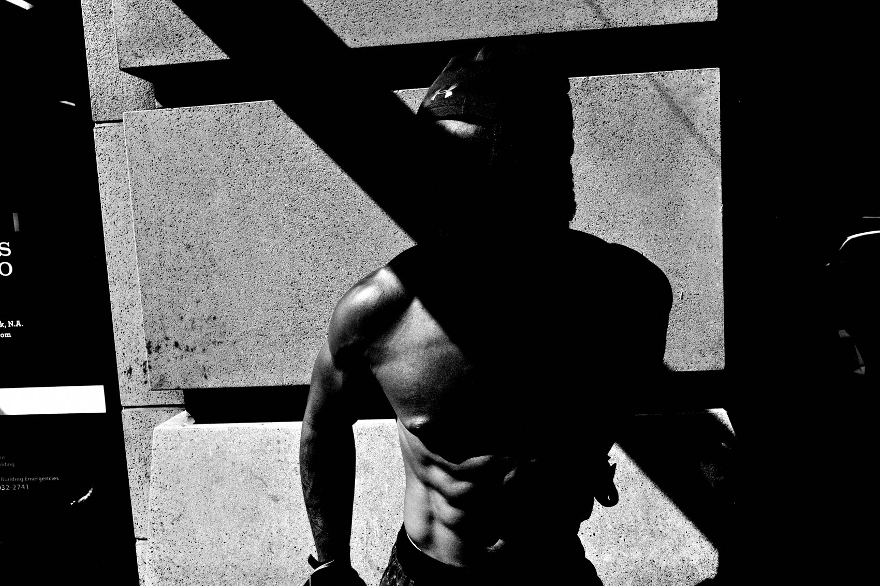
FLUX ACADEMY
BEAT 08 · MAIN TEACHING
Fishing: Set the Stage, Then Let Life Fill It
— Choose a location with strong bones — good light, clean geometry, natural traffic
— Lock the composition first, then hold your ground and wait
— The layers arrive on their own timing — foreground, middle, background
Notes:
Here's how fishing actually works on a walk. You find a spot with real bones — beautiful light, clear geometry, a natural flow of people passing through. You don't force anything. You set your stage: decide your frame, your edges, your angle. Then you hold your ground and wait. Something enters the foreground. Something happens in the middle. Something anchors the back. Three layers, one frame — and it feels like luck, but it isn't. It's patience meeting preparation. You did the reading before the moment ever arrived, so when it arrives you're ready.

Slide 10

FLUX ACADEMY
BEAT 09 · MAIN TEACHING
Moving the Body to Solve the Puzzle
— Photography is a physical medium — your body is the tool
— Drop low, shift sideways, lean in — until the pieces click
— You move the frame by moving yourself
Notes:
Here's something people forget: photography is physical. You solve the visual puzzle not just in your eye but with your feet. Often you'll sense that a scene is almost there — the elements are present but the composition hasn't resolved. That's your cue to move. Drop lower. Step to the side. Lean in until a reflection lines up, until an echo between two shapes reveals itself, until the background clears. You don't wait for the picture to arrange itself. You reposition your body until it does. The picture doesn't come to you. You go to it.

Slide 11

FLUX ACADEMY
BEAT 10 · MAIN TEACHING
Ordering Chaos in a Crowded Scene
— In a busy, chaotic place your goal is always the same: put order to the chaos
— Use a strong dividing element — a pole, an edge, a band of light and shadow — to structure the frame
— The best frames synthesize content and form in a single instant
Notes:
Drop into a chaotic, crowded place and the goal is always the same: put order to the chaos. Articulate the unknown. You look for a structuring element — a dividing pole, a doorway edge, a band of light against deep shadow — something that gives the frame a spine. Then you find the human gesture inside it: a hand, a bent head, a body in motion. And when it works, it's because everything lands at once — the gaze or gesture that carries the emotion, and the composition and light that carry the form, synthesized in the same fraction of a second you press the shutter. Content and form, together, or the frame doesn't breathe.

Slide 12
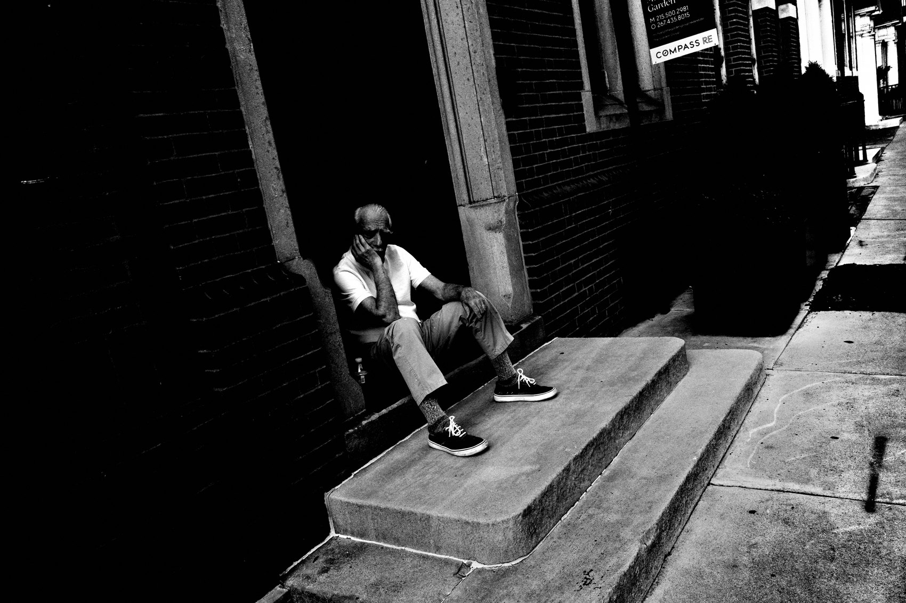
FLUX ACADEMY
BEAT 11 · MAIN TEACHING
Engaging, Not Just Observing
— How you engage with the world reflects in your photographs
— Talk to people — curiosity opens access
— Spending time earns you frames you could never force
Notes:
Observation alone isn't enough. How you engage with the world is what reflects back in the photographs you make. On a walk I'm talking, asking, spending time. When you hang out with someone for hours instead of grabbing a quick shot, the frame changes completely — you get inside their world, and the small telling details start to surface: the object in their hand, the writing on the wall behind them, the way they hold themselves when they've forgotten the camera. That kind of access, that kind of layered detail, only comes from genuine engagement. The camera is the last step, not the first.

Slide 13
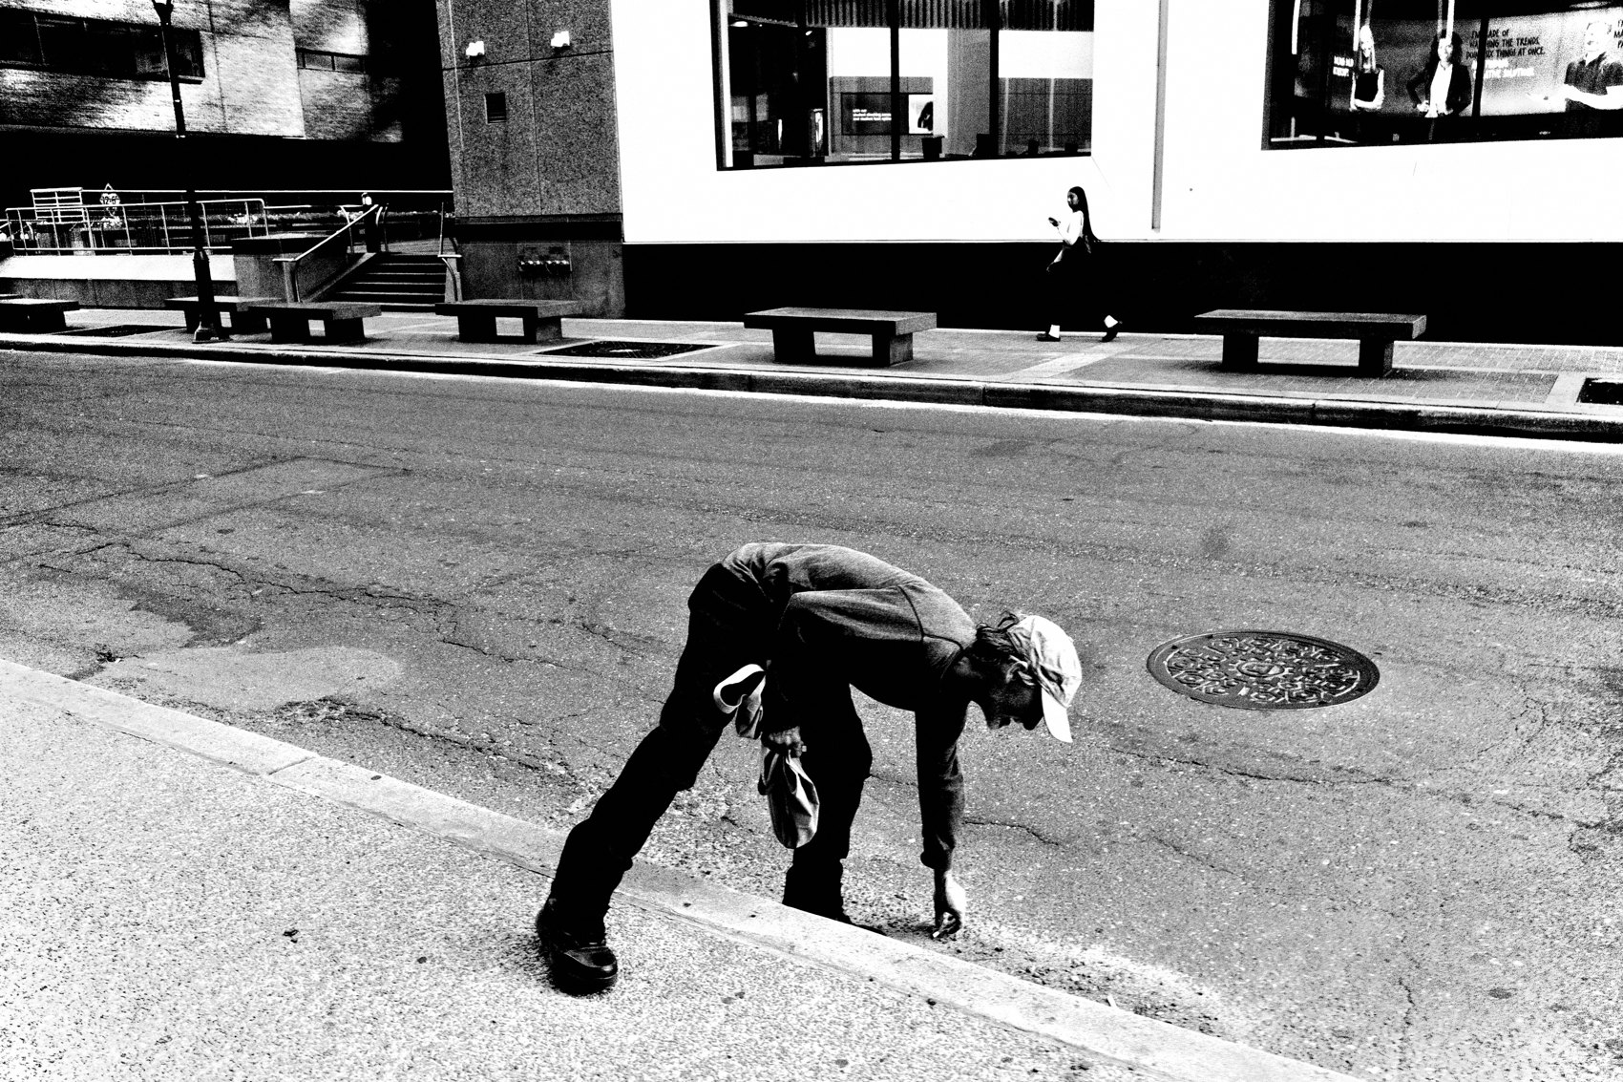
FLUX ACADEMY
BEAT 12 · MAIN TEACHING
Dropping Low and Getting Level
— Drop to the subject's level — it elevates them in the frame
— Low angles clean the background by using sky
— The physical choice of angle is a philosophical statement
Notes:
One move I return to constantly across every walk: drop low. If I'm photographing children, I drop to their level — to elevate them in the frame and give them a stage against the sky. It works anywhere, on any street, because it's not about the place — it's about the geometry and the respect. The physical act of dropping low is also a philosophical act: you're saying the subject matters, you're meeting them where they are, you're removing the noise that clutters the background.

Slide 14
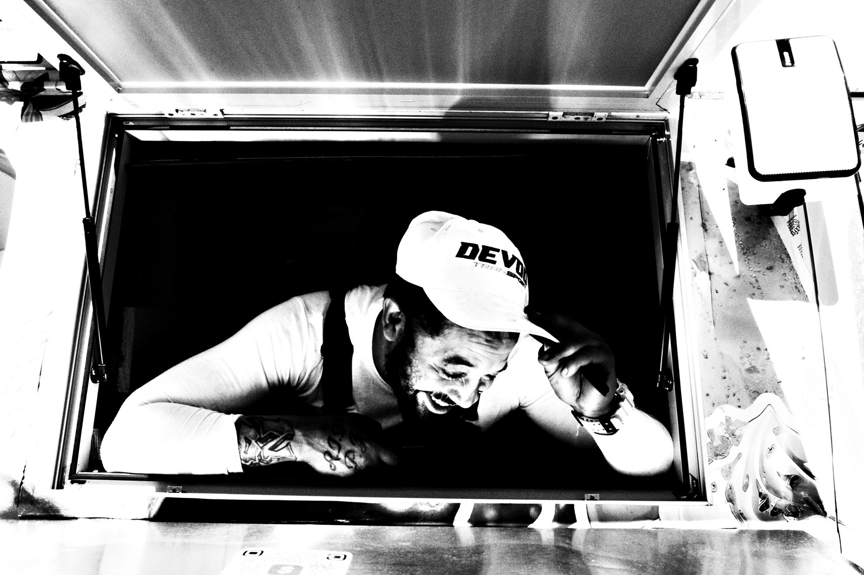
FLUX ACADEMY
BEAT 13 · MAIN TEACHING
Shoot From a State of Play
— Your own energy transfers directly into the frame
— Drop low, respond to movement, let shadows become part of the composition
— Don't direct the scene — join it, and let the joy show up on its own
Notes:
Here's a principle that sounds soft but is completely practical: the energy you bring transfers straight into the frame. When you photograph play — kids running, people laughing, bodies in motion — you can't do it from the outside as an observer. You have to be in the state yourself. Drop low. Move with the energy. Let the shadows dancing across the ground become part of the composition, let a clean sky or a simple backdrop hold it all together. You're not directing anyone. You're playing alongside them, and the camera catches the overflow. If you're in a state of play, your images will reflect that energy. That's not philosophy — that's what the frame shows.

Slide 15
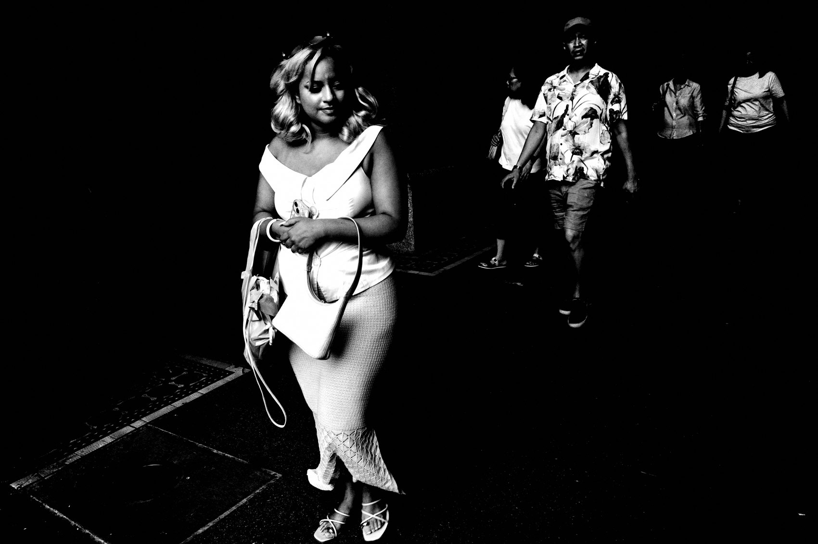
FLUX ACADEMY
BEAT 14 · MAIN TEACHING
Staying at the Scene
— Don't leave the scene until the scene leaves you
— Repetition builds familiarity; familiarity reveals patterns
— The best frame often comes after the obvious one
Notes:
The hardest discipline on a full walk is staying. The temptation is always to move on — to chase the next thing. But I've learned: don't leave the scene until the scene leaves you. The strongest moments almost always arrive after the obvious opportunities have passed — after you've stopped performing the act of shooting and just settled into the place, present, unhurried, part of the furniture. That's when the real moment surfaces: the quiet gesture, the embrace, the exchange nobody would have offered up to a photographer in a rush. That frame only exists because you stayed.

Slide 16
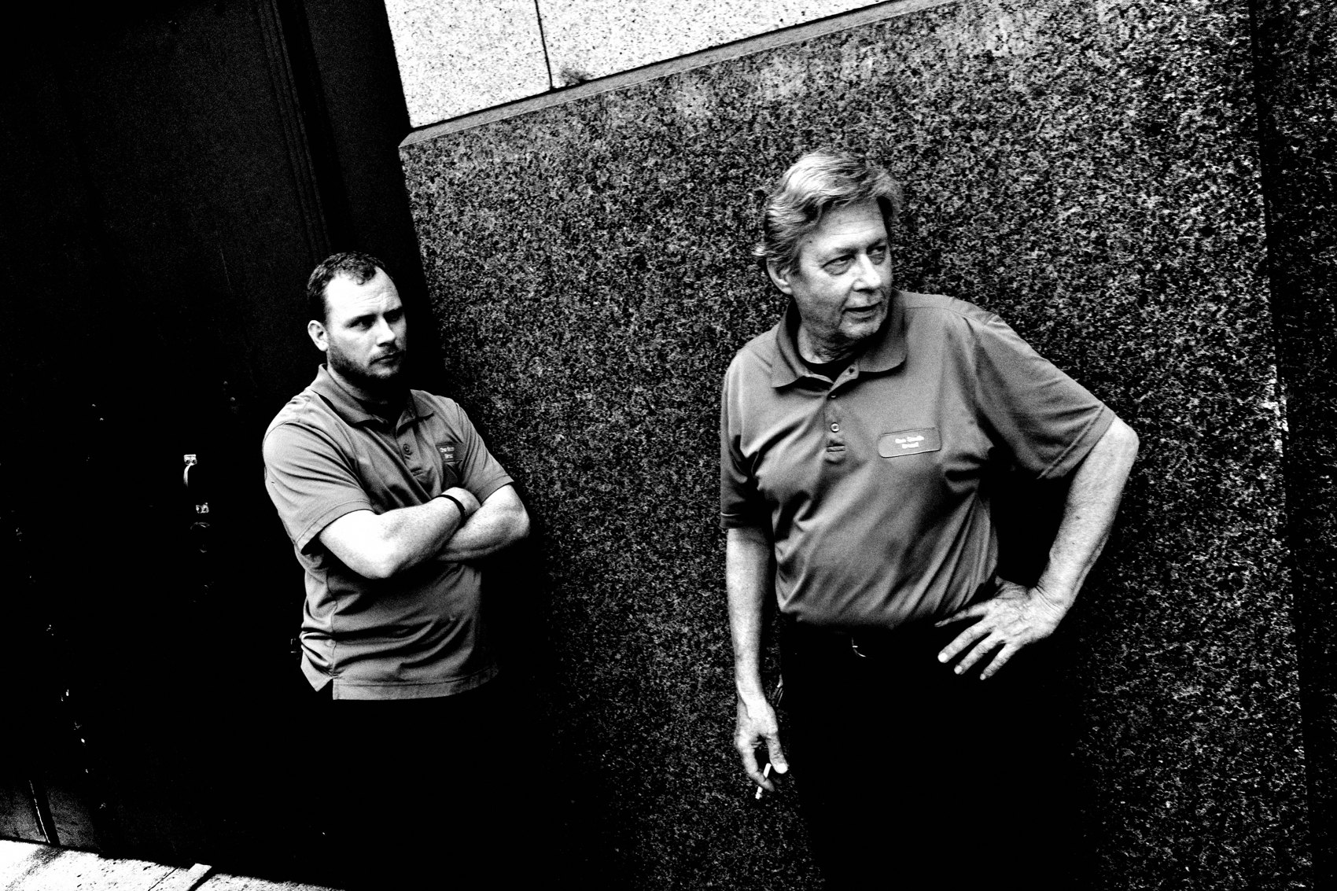
FLUX ACADEMY
BEAT 15 · MAIN TEACHING
Noticing the Small Details
— The background, the small unnoticed detail — these add weight
— Photography reveals what the eye alone cannot
— Train yourself to scan the whole frame, not just the subject
Notes:
The camera sees what your eye misses. Again and again you'll press the shutter on one thing and discover later that the frame held a second thing you never consciously registered — a shape in the background echoing a shape in front, a piece of text that comments on the subject, a small gesture at the edge that changes the whole read. On a walk, you have to train yourself to scan everything: the backdrop, the corners, the unexpected rhymes between elements. A photograph is not about one thing. It's about everything working together, including what you only half-saw.

Slide 17
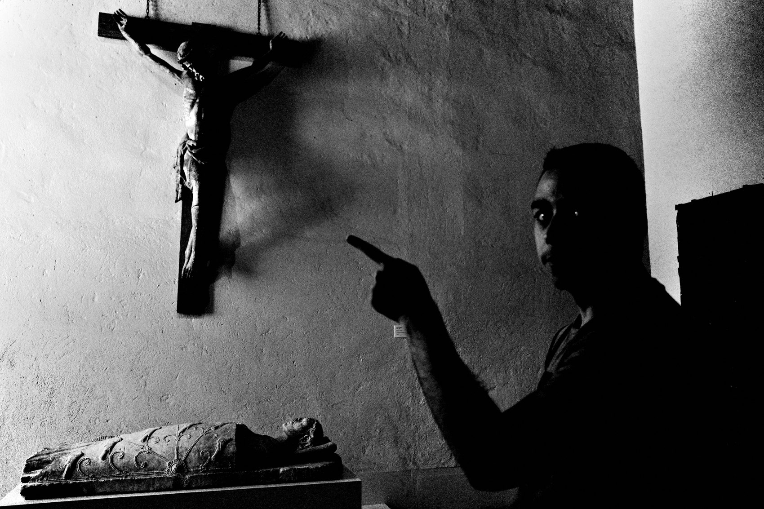
FLUX ACADEMY
BEAT 16 · MAIN TEACHING
Knowing When to Move On
— Not every location yields — read when the scene is spent
— Stay curious about what's around the corner
— The walk is a series of arrivals and departures
Notes:
And the flip side of staying: knowing when to go. Every scene has a shelf life. When the light has moved, the moment has passed, and you've worked every angle — move. Don't hover out of habit. Go to the outskirts, the side streets, the places that aren't obvious. Some of the strongest images come from exactly those edges — a construction site, a back road, a quiet block off the main drag — not from the busiest corner in the market. The obvious spot is where everyone else is pointing their camera.

Slide 18
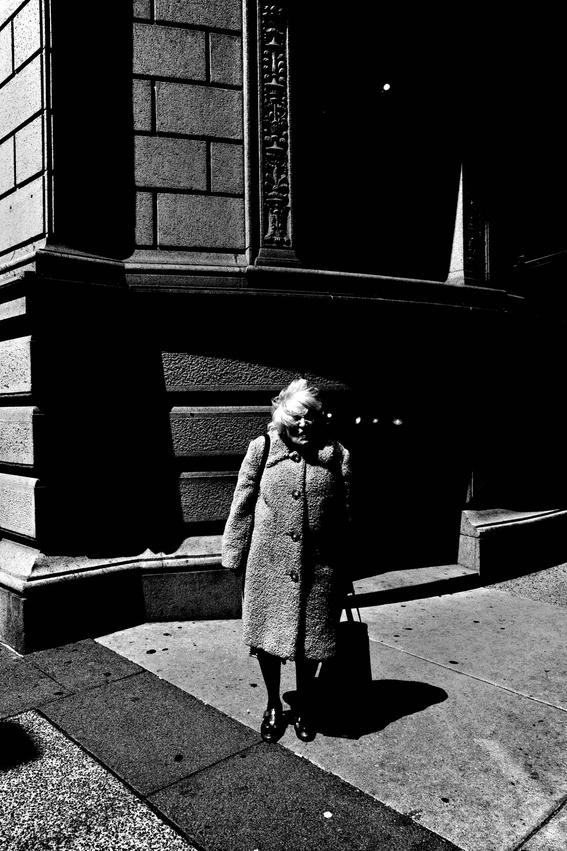
FLUX ACADEMY
BEAT 17 · PRACTICAL APPLICATION
Do the Full Walk Assignment
— Choose one familiar location — spend a minimum of two hours
— Practice both fishing and hunting within the same session
— Debrief afterward: write down three decisions you made and why
Notes:
Here's your assignment. Pick a location you know well — your neighborhood, your local market, your usual park. Spend at minimum two hours there. In the first hour, fish: set up at one strong scene and wait. In the second hour, hunt: move and react. When you get home, write down three specific decisions you made — an angle change, a moment you stayed for, a conversation you had. Make the walk conscious.

Slide 19

FLUX ACADEMY
BEAT 18 · PRACTICAL APPLICATION
Return to the Same Place Three Days Running
— Repetition builds familiarity; familiarity reveals patterns; patterns lead to moments
— The regulars, the rhythms, the recurring characters only reveal themselves on return visits
— Go back before you move on
Notes:
And then go back. Same place, three days in a row. Repetition builds familiarity. Familiarity reveals patterns. Patterns lead to moments. Every location has its regulars, its rhythms, its recurring characters — the vendor who sets up at the same hour, the kids who skate the same ledge, the light that hits the same wall at the same time. None of that is visible on a first pass. The first visit is reconnaissance. The second is practice. The third is when the real frames arrive.

Slide 20
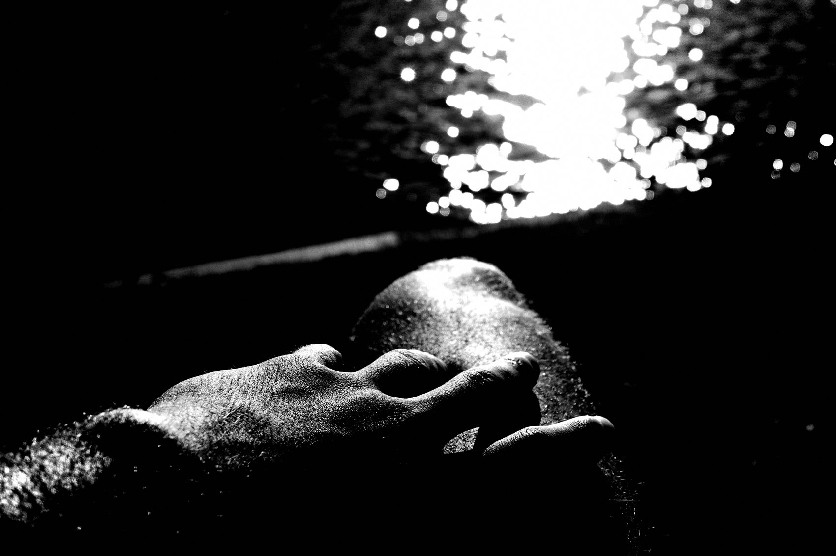
FLUX ACADEMY
BEAT 19 · COMMON MISTAKES
Moving Too Fast, Seeing Too Little
— Speed kills awareness — you miss the layers when you rush
— Slow down enough to read foreground, middle, background
— The street rewards patience more than pace
Notes:
The most common mistake on a full walk: moving too fast. You cover ground, you see lots of things, you come home with nothing. Speed kills awareness. When you rush you can only see the obvious subject — you miss the foreground element, the background detail, the small echo that makes the frame. Slow down. Let your eyes work all three planes. The street rewards patience more than pace.

Slide 21
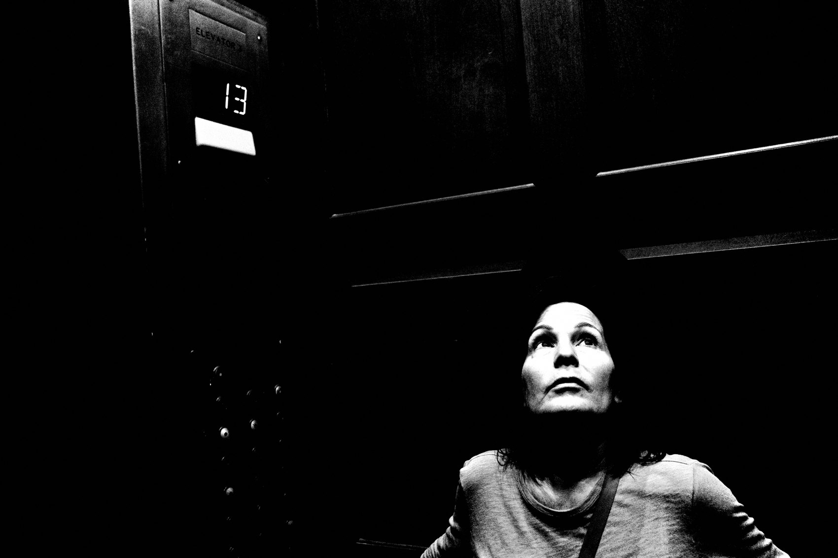
FLUX ACADEMY
BEAT 20 · COMMON MISTAKES
Shooting the First Version of a Scene
— The first frame you see is usually the most obvious
— Work around the scene — there's a better angle somewhere
— Move your body before you decide you've got it
Notes:
The other mistake: pressing the shutter the moment you see something and moving on. That first frame is almost always the most obvious version of the scene. Move around it. Drop lower. Step to the side. Let someone enter the background. The more times you physically reposition, the deeper you go into the frame — and that's where the real photograph lives.

Slide 22
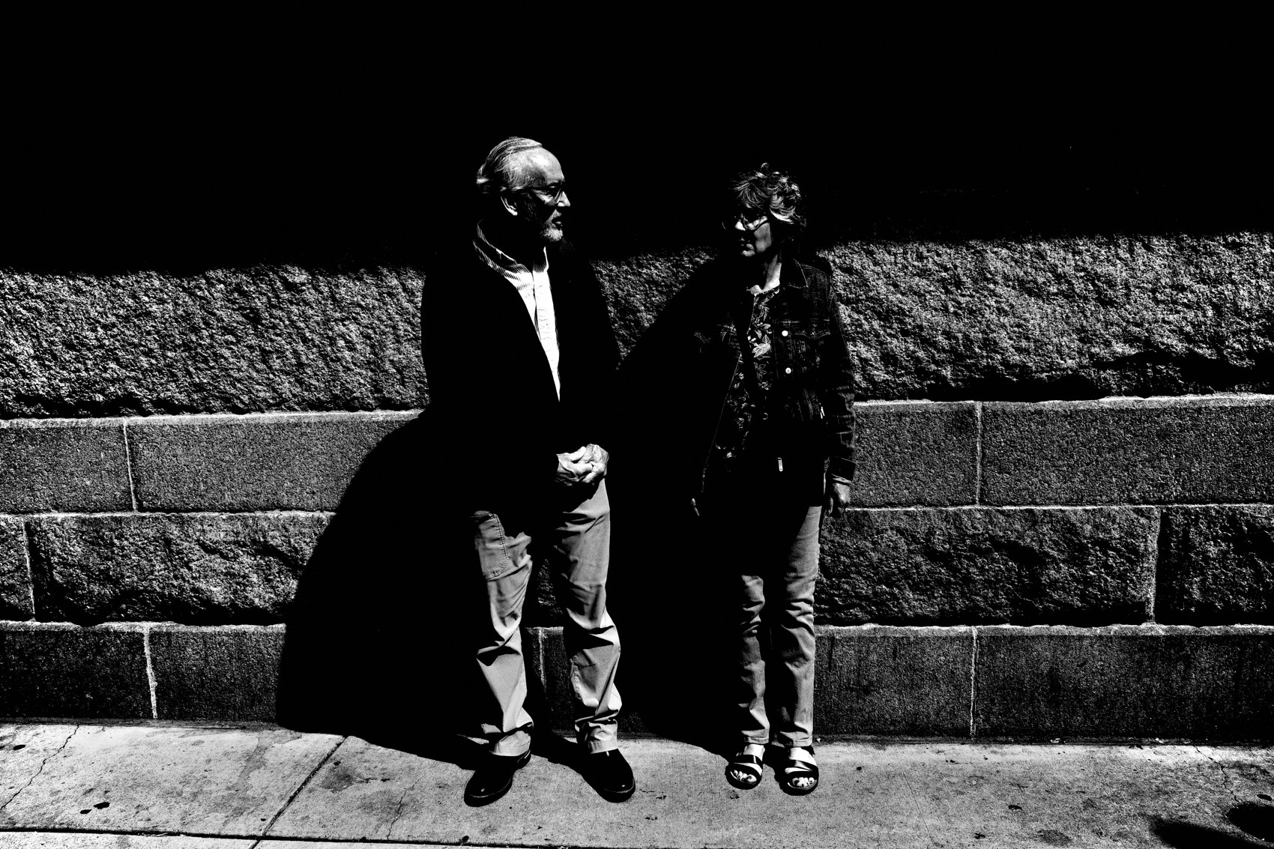
FLUX ACADEMY
BEAT 21 · RELATIONSHIP TO PREVIOUS
Building on the Series
— Lesson 040 established individual breakdown techniques
— This lesson extends those techniques across a full session
— Single moments now become a continuous, living practice
Notes:
Lesson 040 put individual photographs under the microscope — technique, composition, the decisive moment in isolation. This lesson takes everything that came before and strings it into a complete, living session. The full walk is where isolated skills become a unified practice. Every instinct we've discussed now has to work in real time, back to back, for hours.

Slide 23
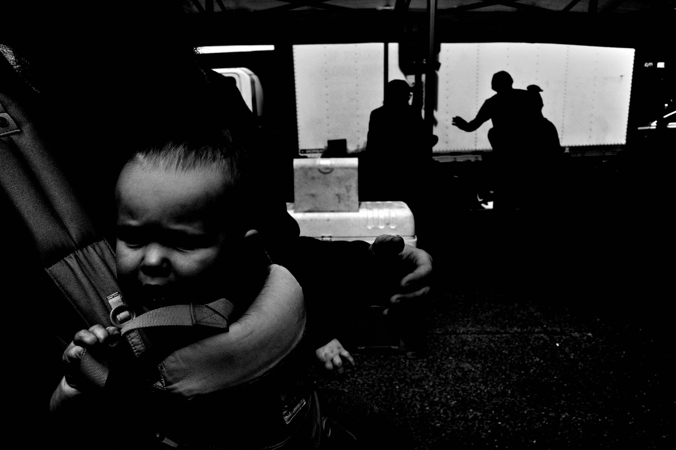
FLUX ACADEMY
BEAT 22 · RELATIONSHIP TO UPCOMING
Where We Go From Here
— Lesson 042 turns the walk outward — engaging communities and building access
— The full walk skills carry directly into longer-term projects
— From one session to sustained presence in a place
Notes:
In Lesson 042 we take the full walk further — from a single session into sustained presence, into communities, into the kind of long-form engagement that earns you frames no single afternoon walk can produce. The skills from today — reading scenes, engaging people, staying patient — are exactly what you'll need when the work becomes weeks and months, not hours.

Slide 24
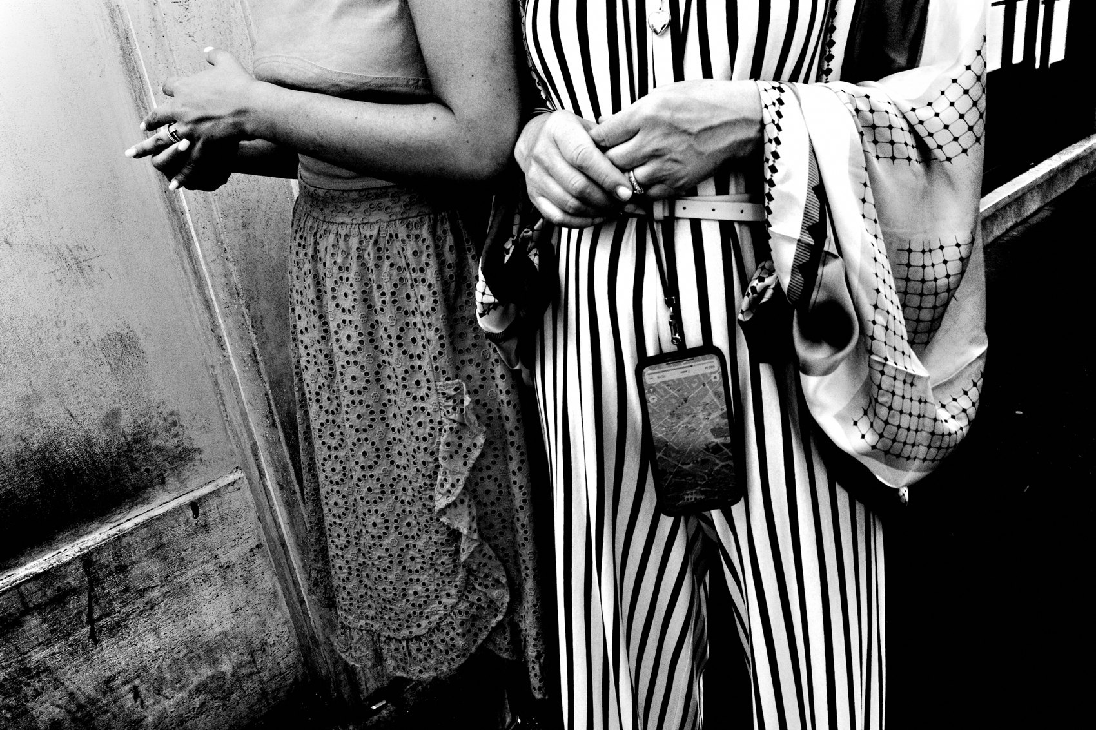
FLUX ACADEMY
BEAT 23 · SUMMARY / TAKEAWAY
Walk, Read, Move, Stay, Return
— Arrive open; read the light and the scene before raising the camera
— Move your body — fishing and hunting, staying and departing
— Return. Repetition is where the real frames live.
Notes:
Last thing. A full walk is not a collection of random moments — it's a method. Arrive without preconceptions. Read the light. Find the choke points. Fish when the scene is strong; hunt when life demands it. Move your body physically to solve the puzzle. Stay longer than you think you need to. Engage the people in front of your lens. And then go back. The walk doesn't end when you go home — it continues every time you return to the same street with fresh eyes. Walk. Read. Move. Stay. Return. That's the FLUX method, in motion.

