Slide 1
FLUX ACADEMY · A SCHOOL FOR SEEING
MODULE 7 · THE STREET
Always Carry a Camera
BY DANTE SISOFO

Slide 2
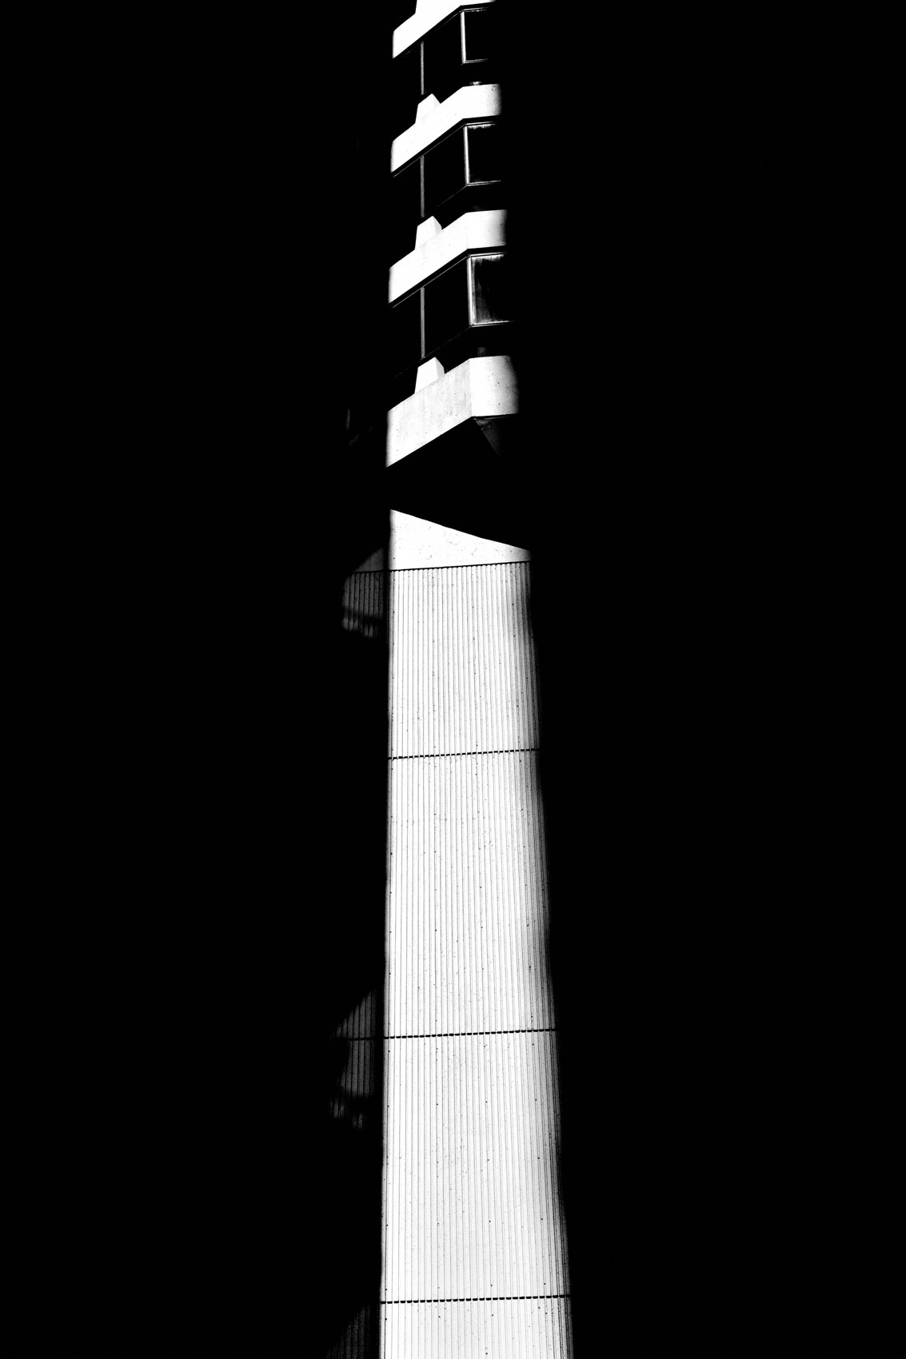
FLUX ACADEMY
BEAT 01 · CORE IDEA
The Camera That's Always There
— The best camera is the one you have with you
— Always carry it — no exceptions, no excuses
— Life doesn't wait for you to go get your gear
Notes:
What's popping, people — it's Dante. Here's the simplest rule I live by: always carry a camera. Not when the light is good. Not when you're heading somewhere interesting. Always. Because the moments that matter most never announce themselves, and the camera that's in your bag at home is worth exactly nothing.

Slide 3
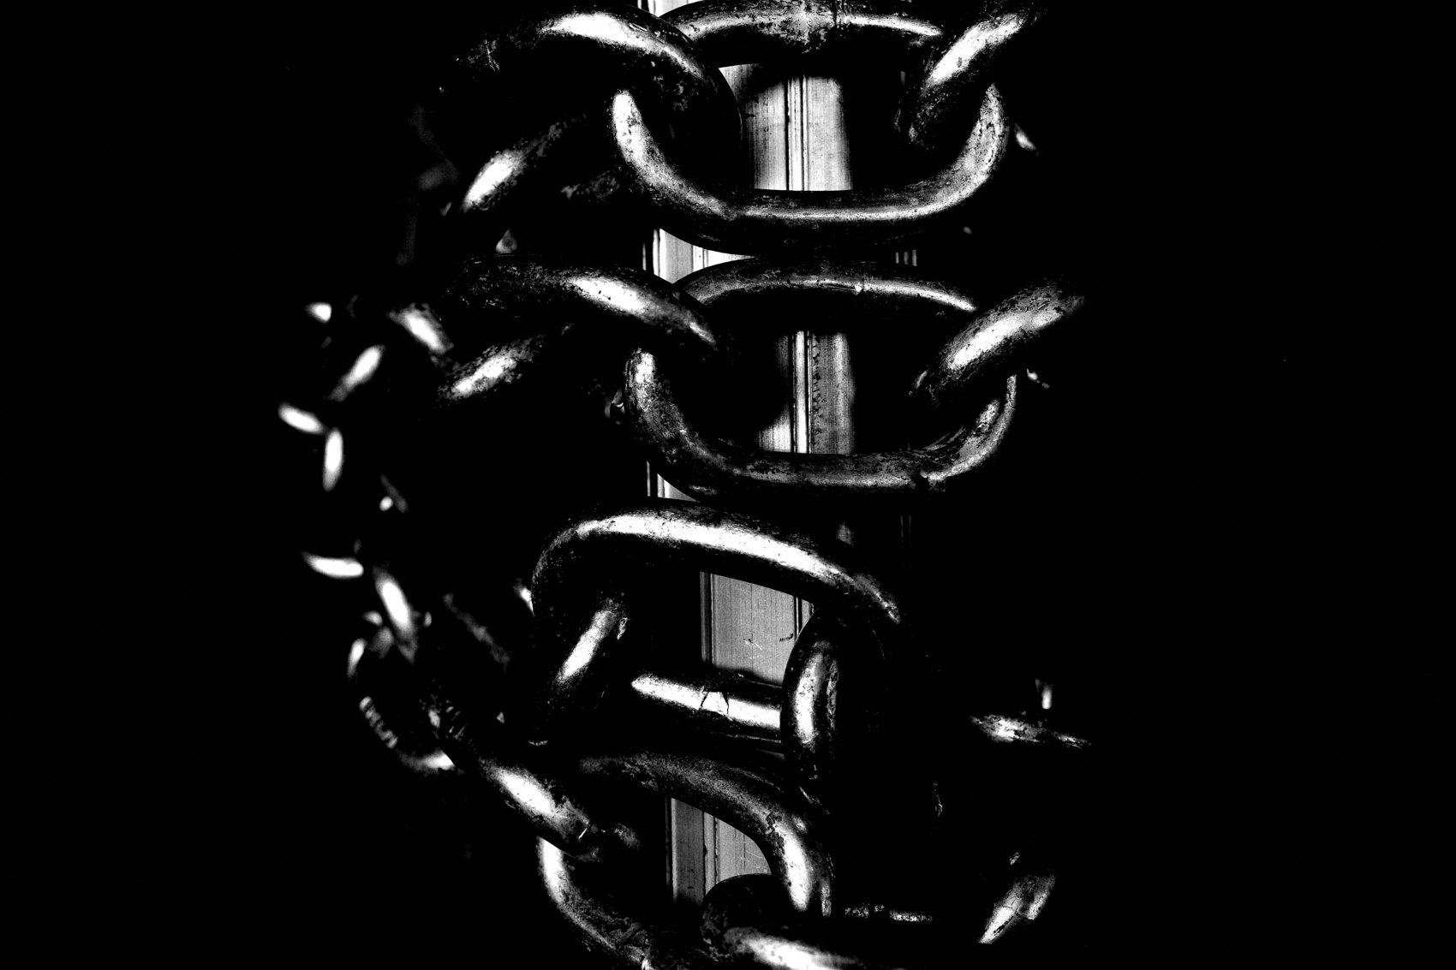
FLUX ACADEMY
BEAT 02 · LEARNING OBJECTIVE
What You'll Walk Away With
— Why always carrying a camera changes everything
— How to make it frictionless and sustainable
— The mindset shift from hunting to living
Notes:
By the end of this lesson you'll understand why always having a camera on you isn't just a habit — it's a philosophy. You'll know how to make it effortless, why it transforms your relationship with everyday life, and how it feeds the kind of curiosity that keeps this practice alive for decades.

Slide 4

FLUX ACADEMY
BEAT 03 · WHY THIS MATTERS
You Can't Make the Same Photograph Twice
— Every moment is singular and unrepeatable
— Light, people, chance — always shifting
— Miss it once and it's gone forever
Notes:
Here's the truth: you cannot make the same photograph twice. The way light falls on a surface, the way a person moves through a frame — it's always changing, always nuanced, always new. Miss it because your camera was somewhere else and that version of reality is gone. You can't go back. The only answer is to always be ready.

Slide 5
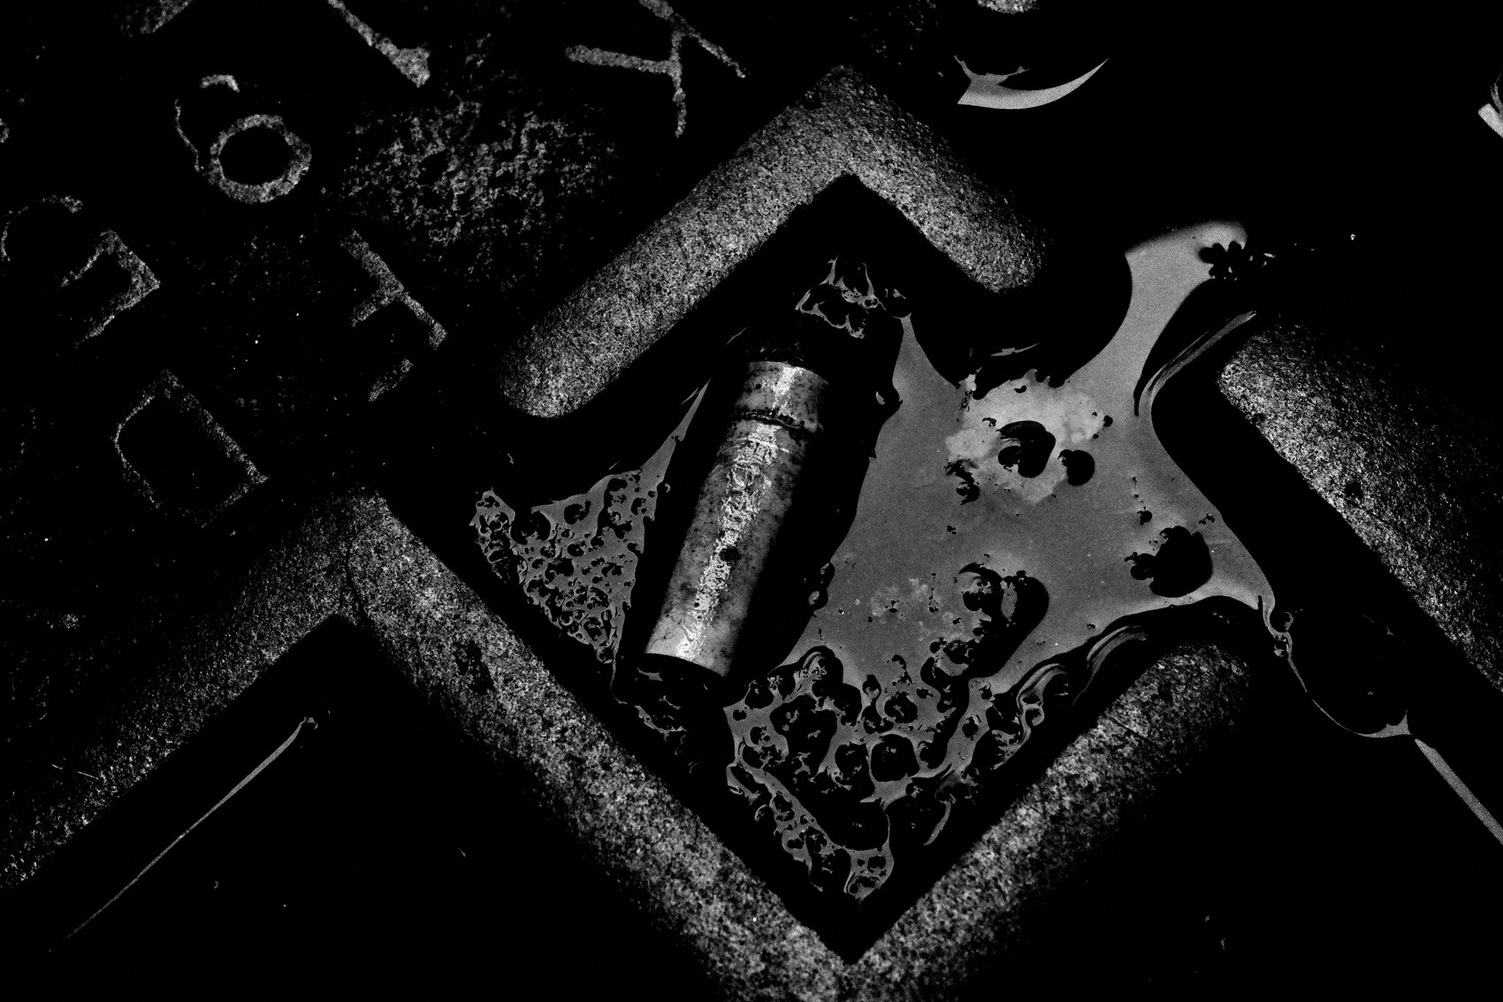
FLUX ACADEMY
BEAT 04 · WHY THIS MATTERS
Life Is the Source Material
— Your daily life is full of photographic potential
— The mundane is not the enemy — it's the raw material
— You don't need to travel somewhere special to find it
Notes:
And here's what I've learned after years of doing this: the richest source material isn't some exotic destination — it's your everyday life. Your commute. Your lunch break. Your friends. Your neighborhood. The moment you stop treating ordinary life as the place you wait between photo trips, everything opens up.

Slide 6
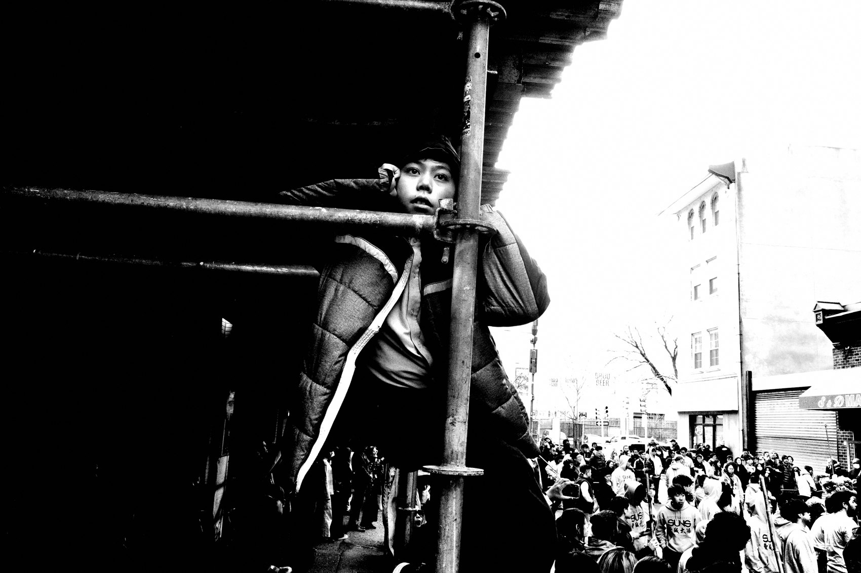
FLUX ACADEMY
BEAT 05 · MAIN TEACHING
The Compact Camera as a Way of Life
— One compact camera in your front right pocket
— No setup, no friction, no decisions
— The simpler the tool, the more present you are
Notes:
My answer to always carrying a camera is simple: the Ricoh GR lives in my front right pocket. All day, every day. I go to work — it's there. I grab coffee with friends — it's there. I walk to the store — it's there. A compact camera removes every excuse. No setup. No bag. No decision. Just a tool that's always ready when life is.

Slide 7
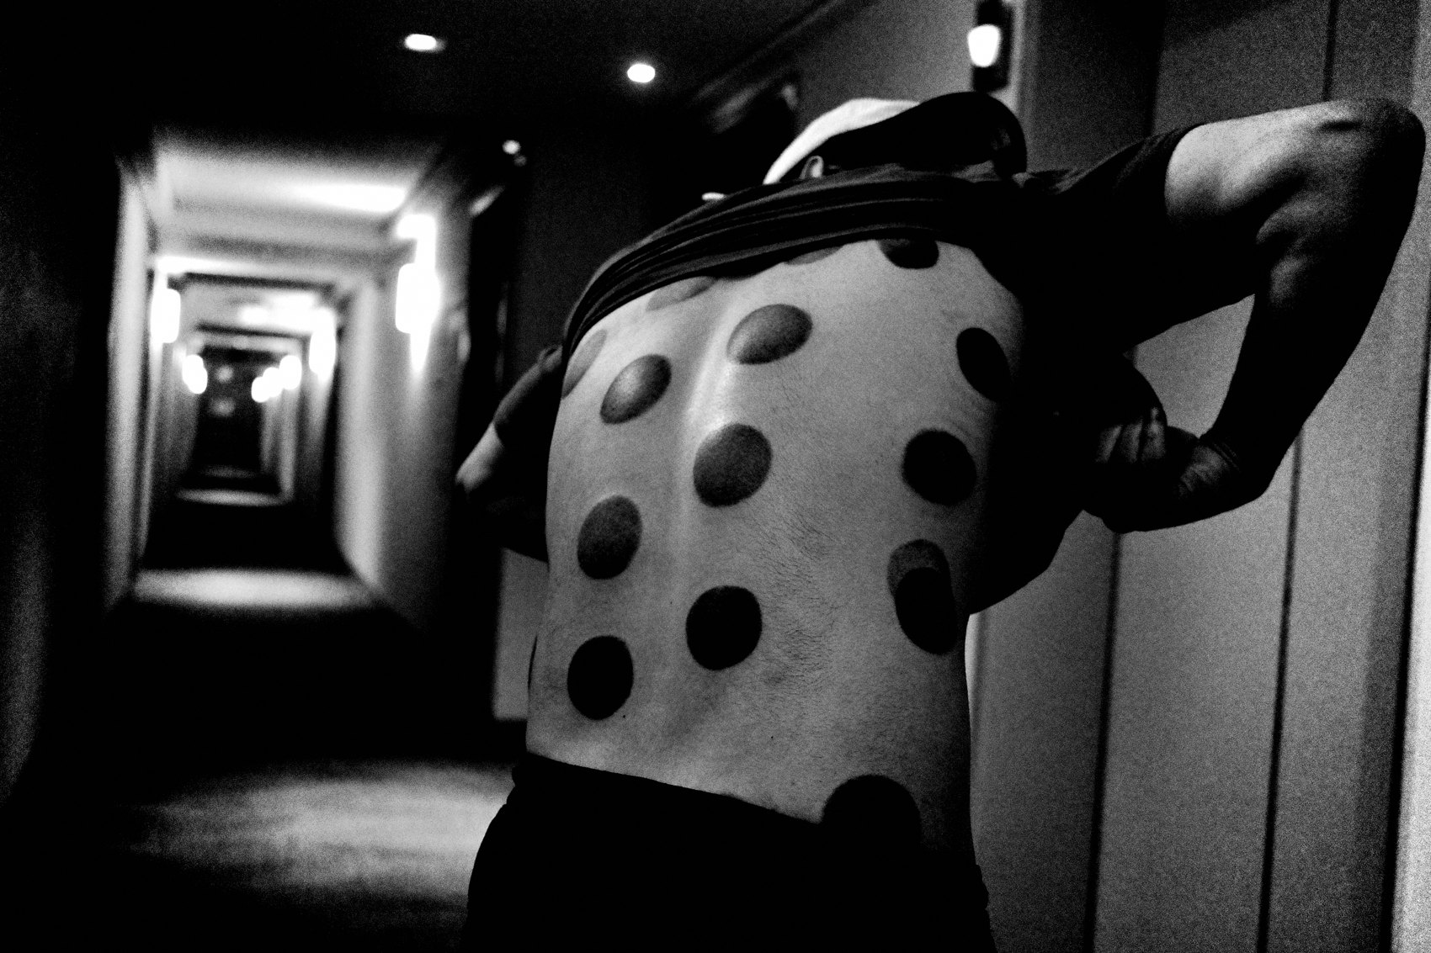
FLUX ACADEMY
BEAT 06 · MAIN TEACHING
Remove Every Barrier to Shooting
— Automatic settings eliminate technical hesitation
— Program mode or aperture priority — let the camera work
— Adjust exposure compensation and nothing else
Notes:
I run the camera on automatic. Program mode or aperture priority. I adjust one thing: exposure compensation. That's it. Everything else — focus, shutter speed — handled. By stripping out every technical decision, I can give my full attention to the world in front of me. The camera works for me. I don't work for the camera.

Slide 8
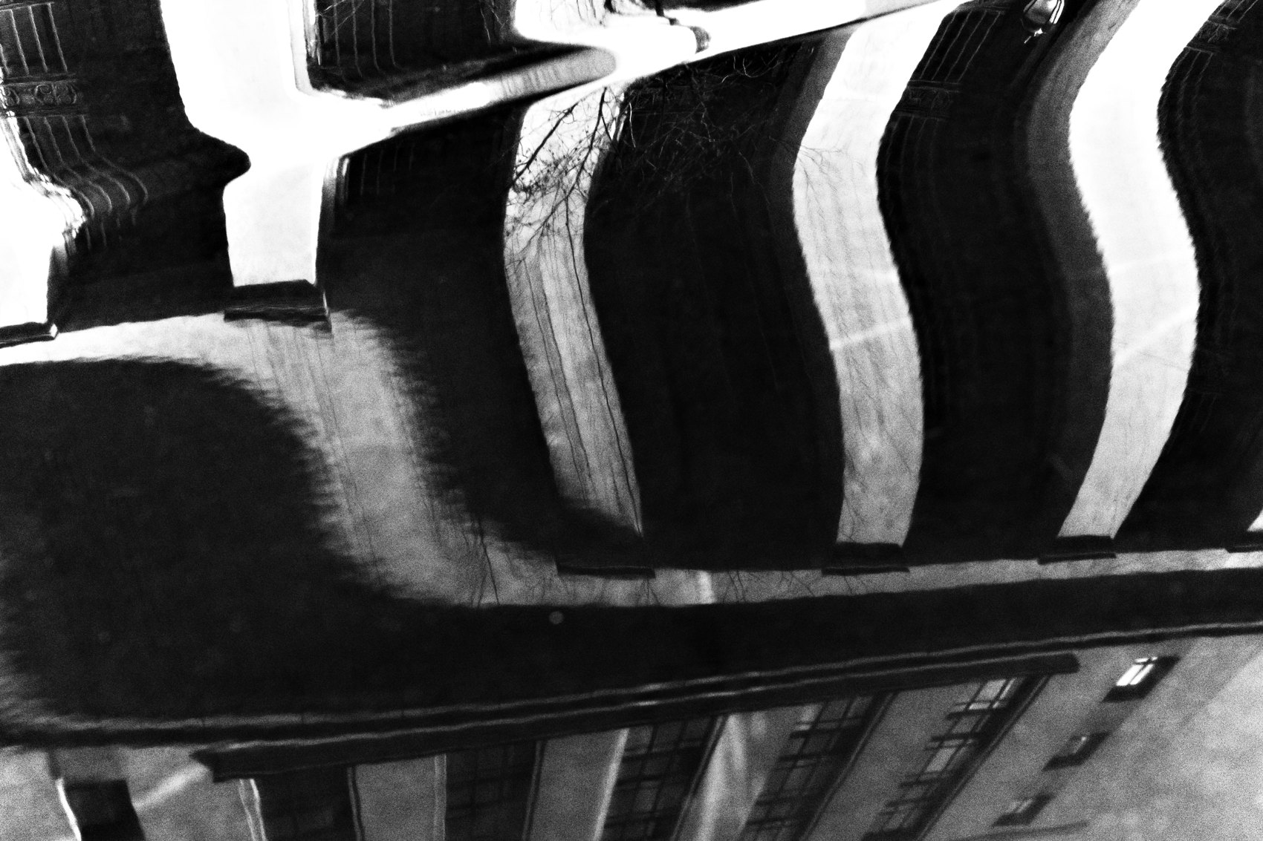
FLUX ACADEMY
BEAT 07 · MAIN TEACHING
Snapshot as the Purest Form
— The snapshot isn't lesser — it's the most honest form
— Democratic, immediate, unposed
— Imperfection is where authenticity lives
Notes:
The snapshot gets dismissed as amateur — but I'd argue it's the purest form of street photography. It's democratic. It's honest. It doesn't require technical mastery or formal planning. By snapshotting through everyday life, I'm not performing photography — I'm living it. The looseness, the imperfection — that's not a bug. That's the whole point.

Slide 9
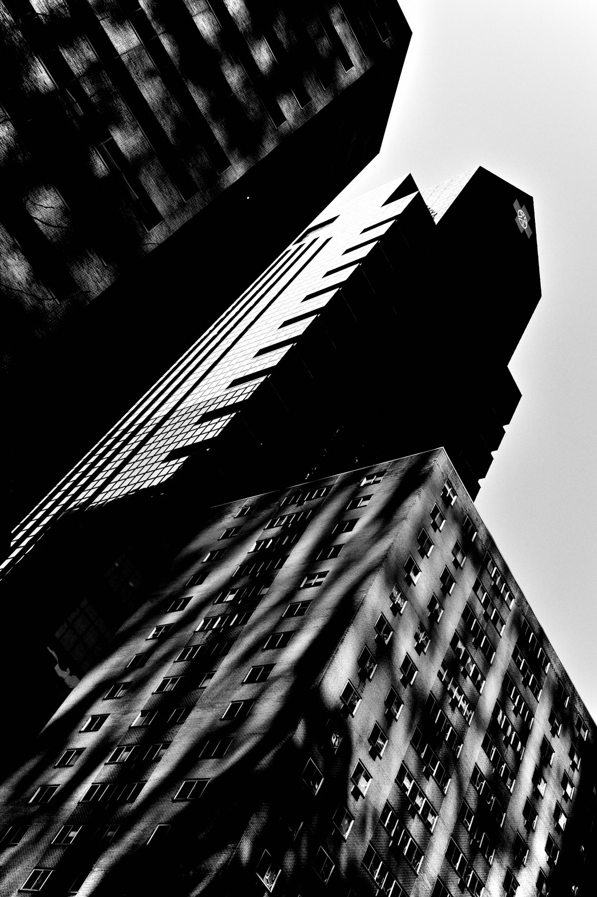
FLUX ACADEMY
BEAT 08 · MAIN TEACHING
Stop Hunting, Start Living
— Years of hunting left me chasing, not experiencing
— The shift: bring the camera for the ride
— Live first, photograph second
Notes:
For years I went out hunting — searching for my next best photo, chasing locations, straining to find something worth capturing. And then I made a shift. I stopped hunting. I started living my life and simply bringing the camera for the ride. That single change transformed my practice more than any technique I've ever learned.

Slide 10
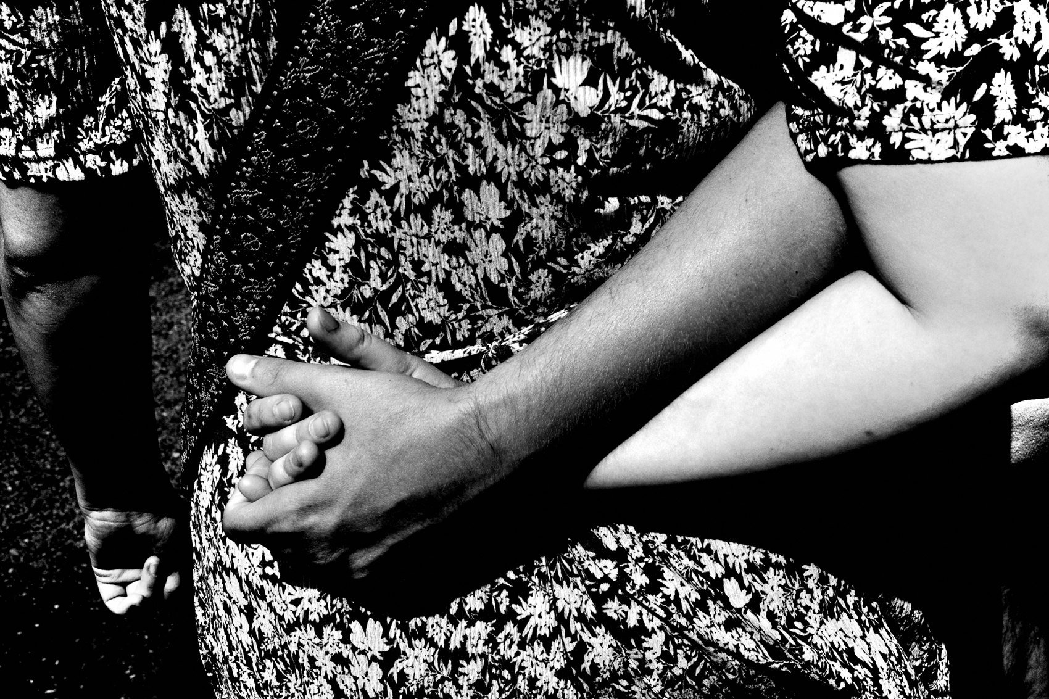
FLUX ACADEMY
BEAT 09 · MAIN TEACHING
The Moments You'd Never Set Out to Make
— The best candid moments are ones you'd never plan to shoot
— A friend's gesture, an ordinary exchange — gone in a second
— You don't hunt these; you're simply ready when they arrive
Notes:
Some of the best photographs are the ones you'd never have set out to make. A friend points at something. A stranger laughs. An ordinary exchange lights up for half a second. In hunting mode you walk right past it — it wasn't what you were looking for. But when the camera is already in your pocket, you don't have to go looking for these moments. You just have to be ready when they arrive. That readiness is the whole difference between missing a moment and keeping it.

Slide 11
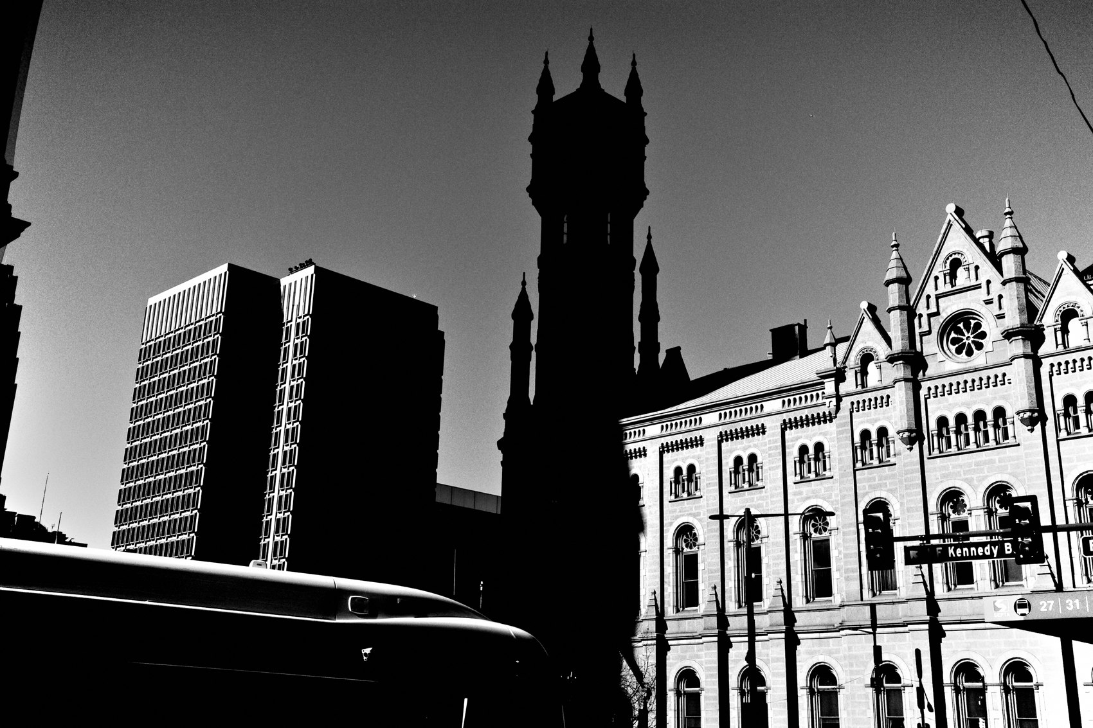
FLUX ACADEMY
BEAT 10 · MAIN TEACHING
The Camera as Passport
— The camera grants you access to life
— Not just images — experiences, connection, presence
— It's the excuse to engage with the world
Notes:
The camera isn't just a tool for making images — it's a passport. It gives you permission to engage with life more deeply, to walk into places you'd otherwise pass by, to talk to strangers you'd otherwise ignore. Carry one long enough and it opens doors all over the world — into homes, ceremonies, and communities you'd never otherwise enter. The camera is the reason you end up on the inside instead of walking past.

Slide 12
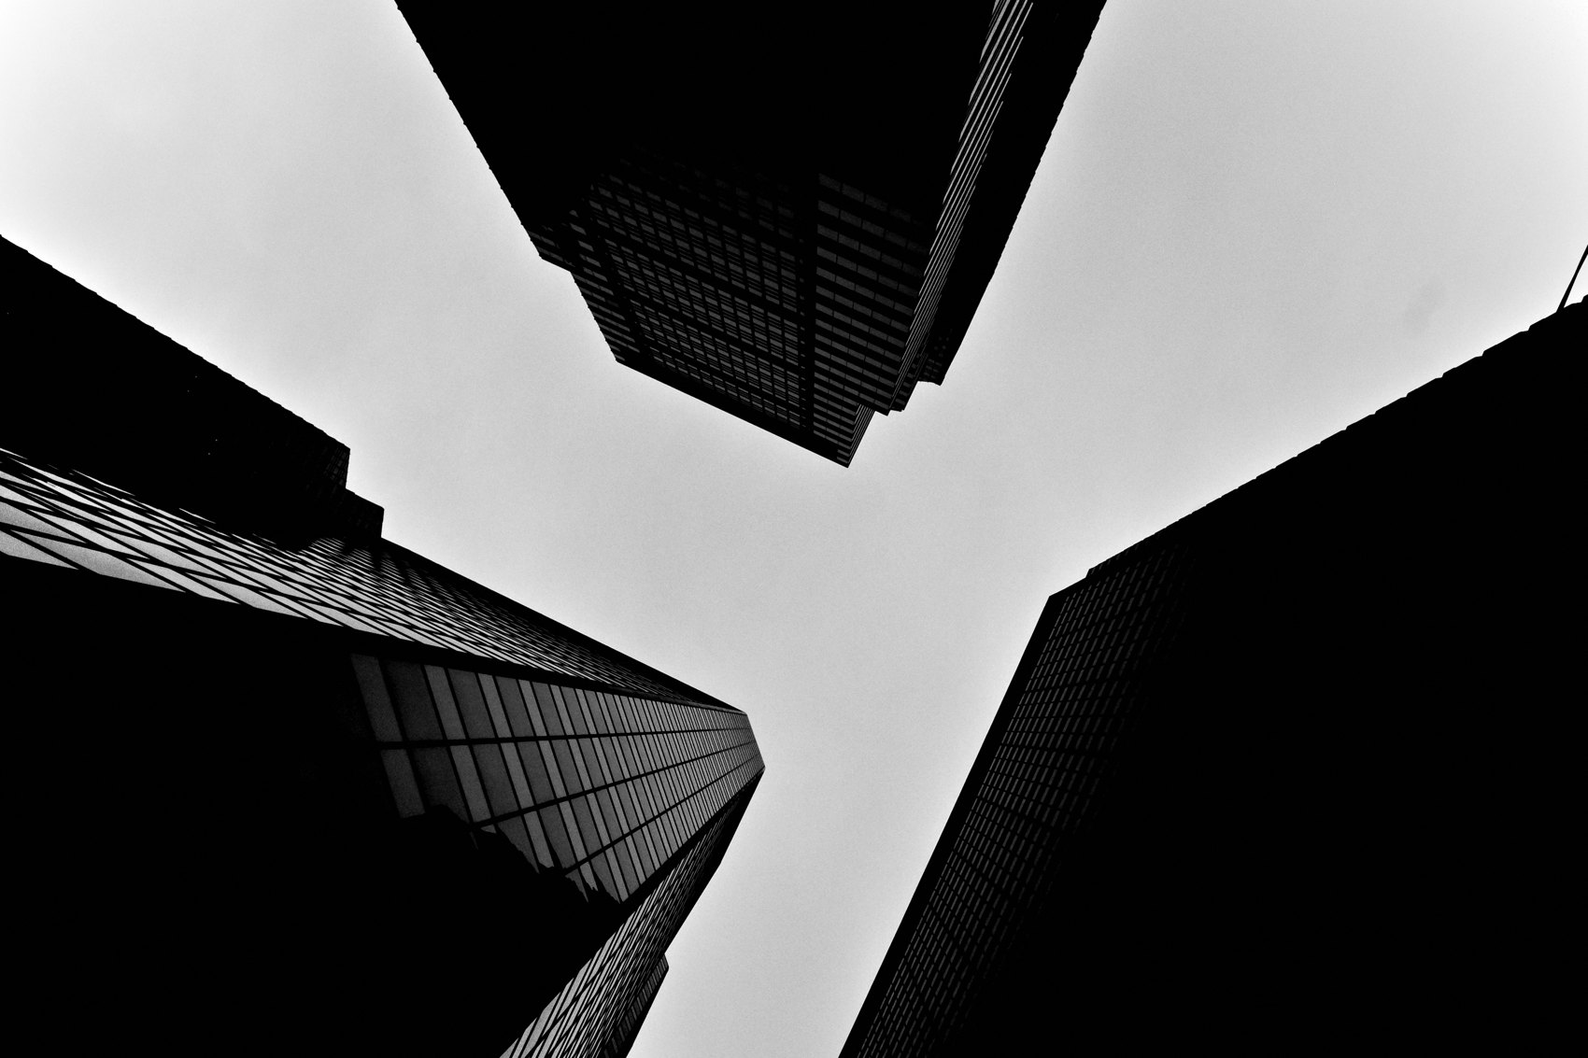
FLUX ACADEMY
BEAT 11 · MAIN TEACHING
There's No Separation Between Life and Work
— No divide between "photographer mode" and everyday life
— The camera integrates — it doesn't interrupt
— Photography becomes a way of being, not a scheduled activity
Notes:
Here's the mindset shift that matters most: there is no separation between being a photographer and being a human. The camera in my pocket doesn't switch me into photographer mode — it's just part of who I am, all day. I don't schedule photography. I live, and the camera comes along. When you close that gap, the whole practice gets lighter and more sustainable.

Slide 13
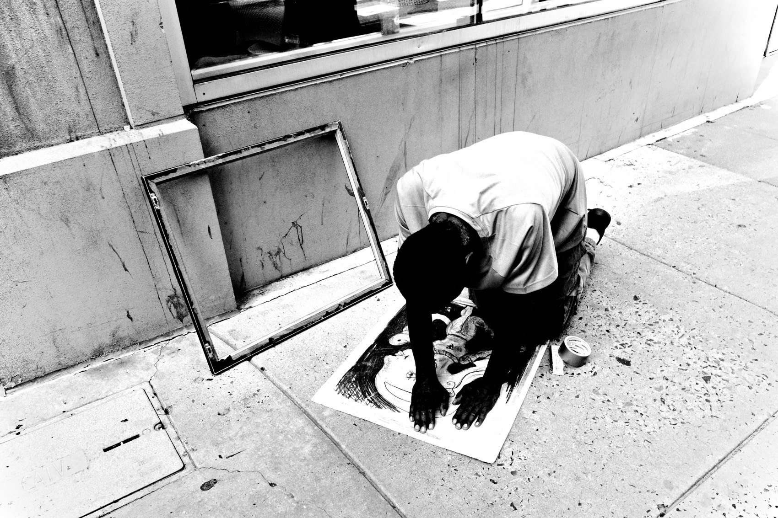
FLUX ACADEMY
BEAT 12 · MAIN TEACHING
The Mundane Becomes Infinite
— Challenge yourself: can this ordinary lane yield something?
— The smallest overlooked details become photographs
— Infinite potential in what others walk past
Notes:
I challenge myself constantly: can I walk the same mundane lane every single day and still find something worth photographing? And the answer is always yes — because the world is always shifting, light is always moving, and my eyes are always capable of seeing something new. Always carrying a camera forces you to keep looking. And the more you look, the more you find.

Slide 14
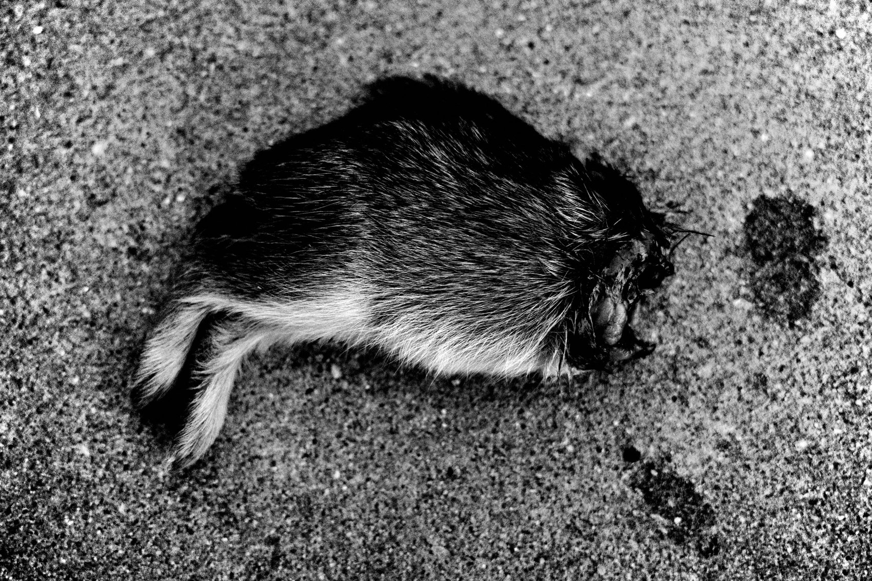
FLUX ACADEMY
BEAT 13 · MAIN TEACHING
Patience Lets the Ordinary Transform
— An unremarkable scene can transform if you stay with it
— Light shifts, a gesture emerges, someone steps into place
— The reward goes to whoever is still there, camera ready
Notes:
Here's what patience buys you: an ordinary scene can become extraordinary if you stay with it long enough. Someone taking a selfie by a fountain is nothing — until the light shifts, or a gesture emerges, or a passerby steps into exactly the right spot. These transformations happen constantly, but they only reward the person who is still there, camera in hand, present enough to notice. You can't plan the moment a scene comes alive. You can only be ready for it.

Slide 15
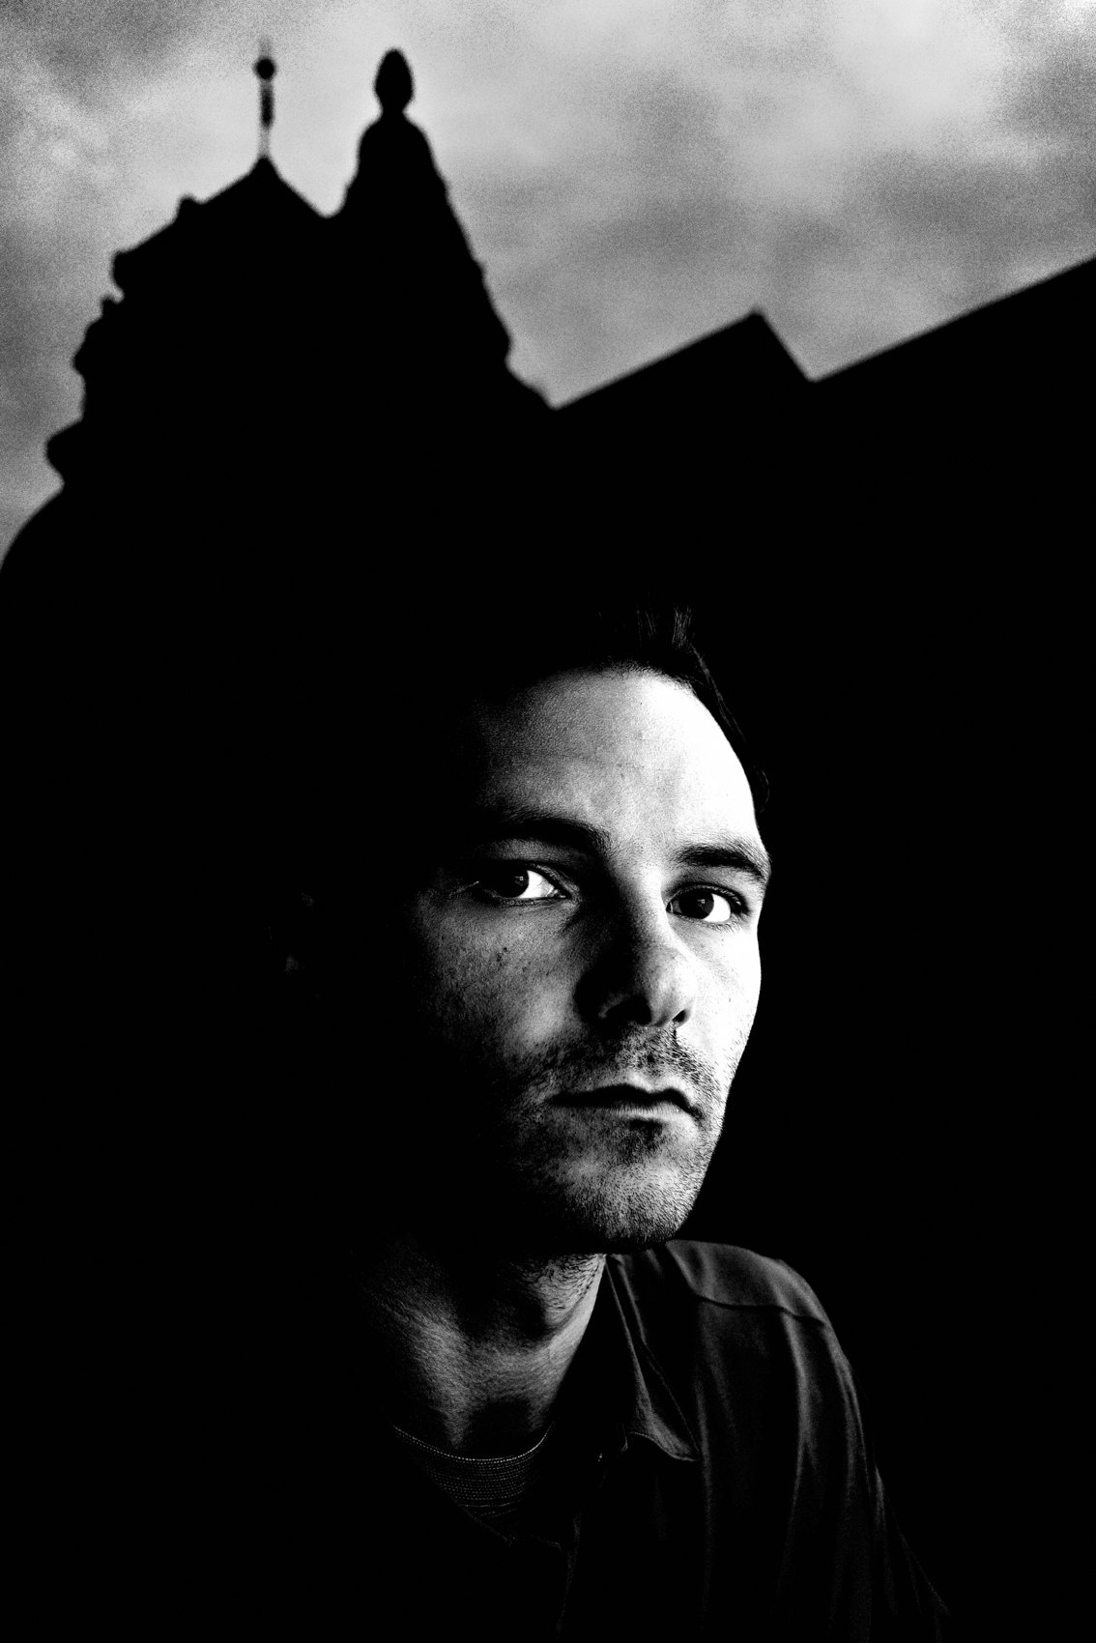
FLUX ACADEMY
BEAT 14 · MAIN TEACHING
Travel Light to See More
— One backpack, one camera, one lens — eliminate friction
— Decision fatigue kills your flow and your seeing
— The simpler the setup, the more awake you are to life
Notes:
The same logic applies when I travel. I carry a single Peak Design 45L backpack and my Ricoh GR. That's it. No what-if lenses. No backup bodies beyond a second Ricoh. Travel is about eliminating friction — and the fewer decisions you make about gear, the more attention you have for the world. Simplify everything. Slip the camera in your pocket and walk.

Slide 16
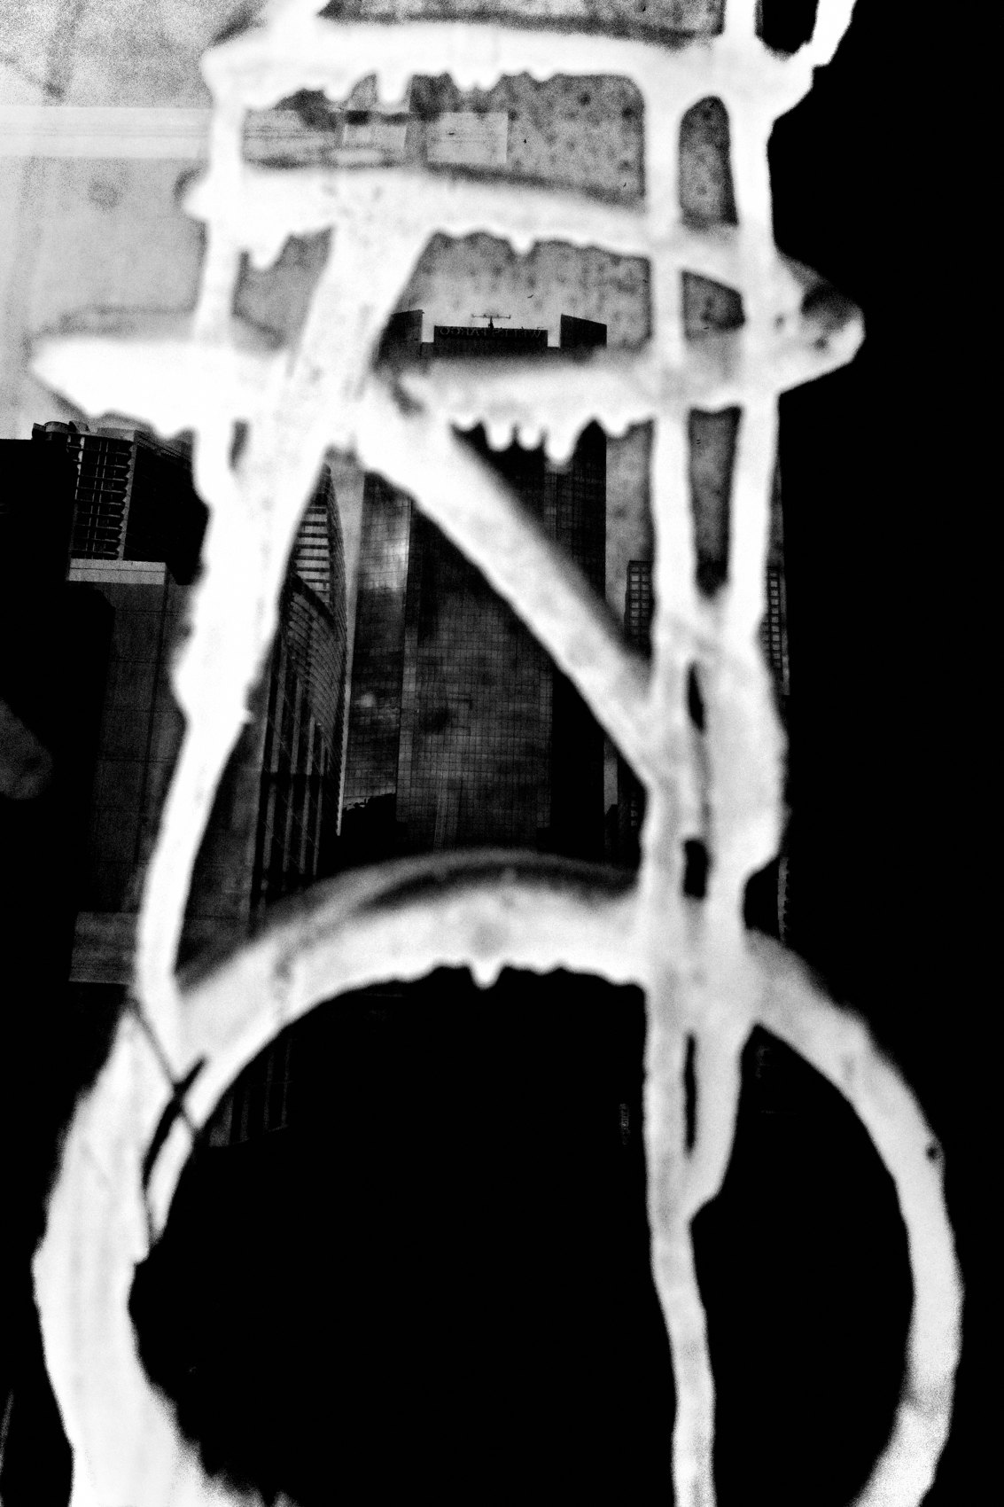
FLUX ACADEMY
BEAT 15 · MAIN TEACHING
Curiosity as the Engine
— Curiosity is what keeps the camera coming out of your pocket
— Not ambition, not discipline — curiosity
— Wake up every day wanting to see what's there
Notes:
What actually makes always carrying a camera work is not discipline — it's curiosity. If you're genuinely curious about the world, the camera comes out naturally. You don't have to force it. The question I carry with me every day is simple: what will reality manifest as a photograph today? That question keeps me looking, keeps me present, keeps the camera in my hand.

Slide 17
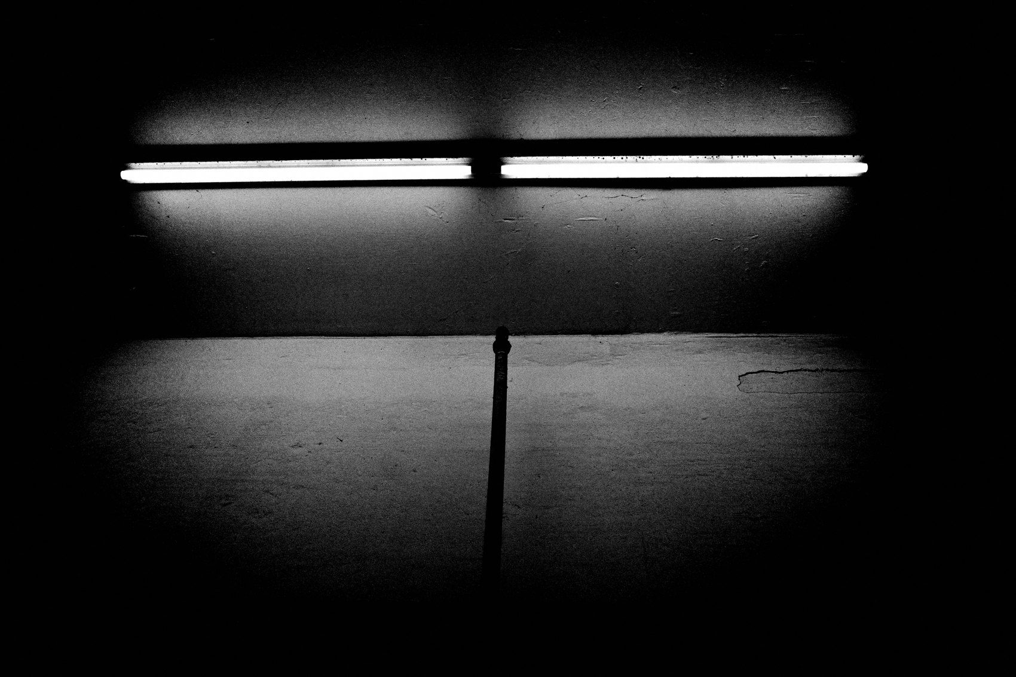
FLUX ACADEMY
BEAT 16 · MAIN TEACHING
Photograph as Visual Diary
— The camera documents your becoming, not just your best moments
— Inner world, outer world — both recorded
— A visual diary of curiosity and change
Notes:
I treat photography like a visual diary. Not a portfolio of greatest hits — a record of my inner world, my curiosity, my becoming. When the camera is always with me, every day gets documented: the unremarkable lunch, the unexpected light, the friend who said something that made me laugh. It's all data. It's all life. It's all worth keeping.

Slide 18
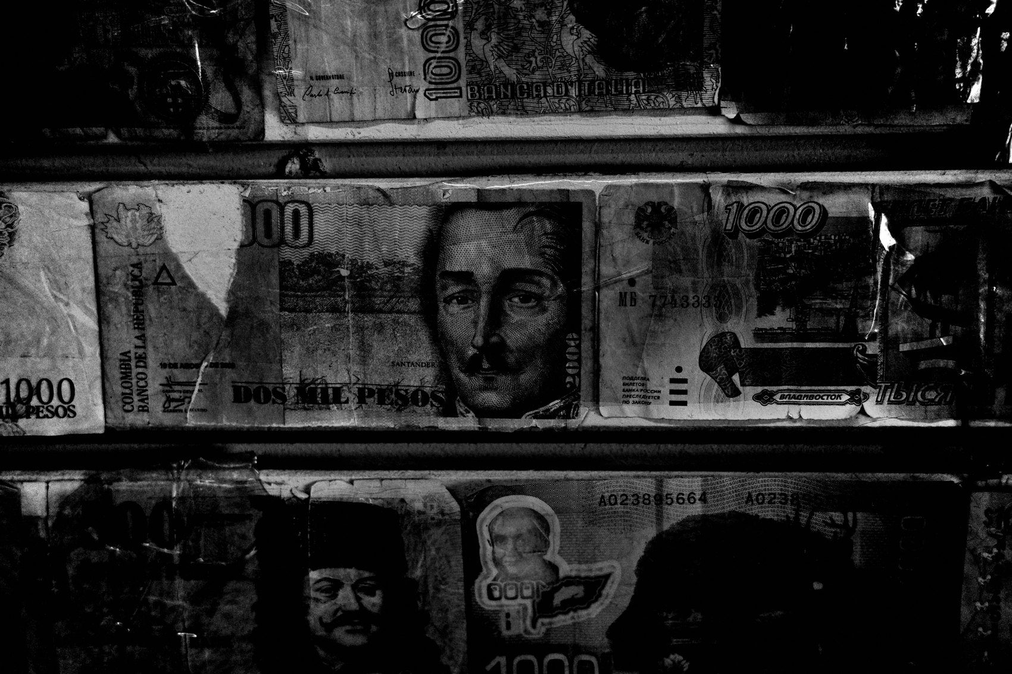
FLUX ACADEMY
BEAT 17 · PRACTICAL APPLICATION
The Pocket Camera Commitment
— Choose your most compact camera and keep it on your body
— Not in a bag — on your body, accessible in seconds
— Commit to one week of never leaving home without it
Notes:
Here's the practice: choose your most compact camera — whatever it is — and for the next seven days, keep it on your body at all times. Not in a bag you might leave behind. On your body, in a pocket. Every single day. Don't change your routine. Just add the camera. At the end of the week, look at what you made. I guarantee you'll surprise yourself.

Slide 19
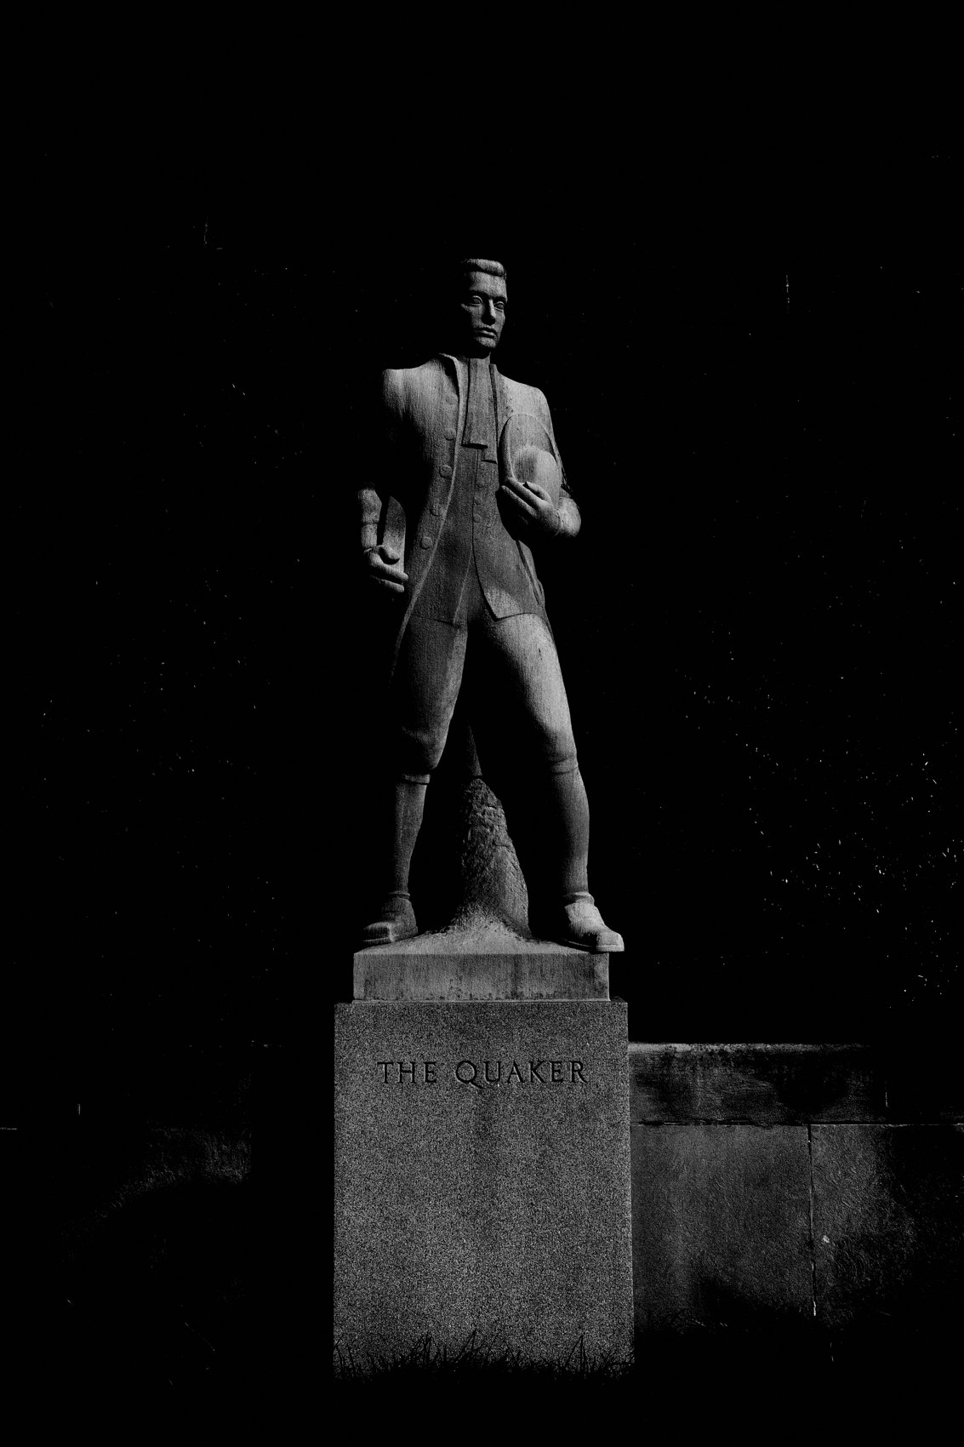
FLUX ACADEMY
BEAT 18 · PRACTICAL APPLICATION
Photograph the In-Between Moments
— Specifically target the moments you'd normally skip
— Commute, errands, waiting, transitions
— These "nothing" moments are the richest material
Notes:
Go further: actively look for the in-between moments — the ones you'd normally dismiss as not worth photographing. Your commute. A waiting room. An errand. The twenty minutes before the thing you were actually going to do. Those transitions are full of life. Point the camera there. The snapshot doesn't need a stage. It just needs your eyes and your presence.

Slide 20
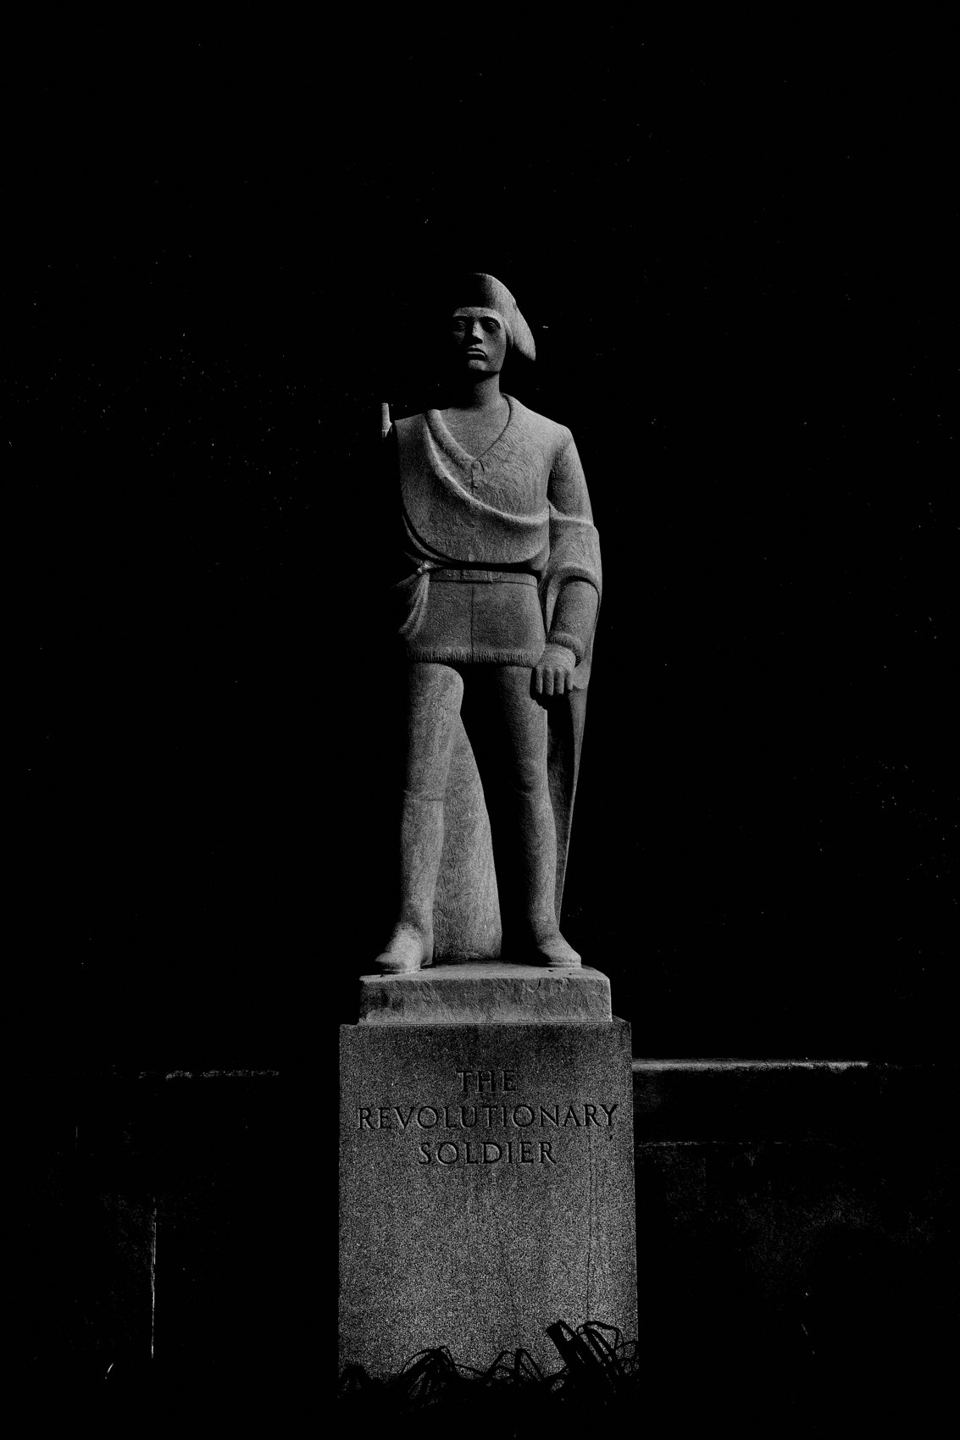
FLUX ACADEMY
BEAT 19 · COMMON MISTAKES
Saving the Camera for Special Occasions
— The "good camera for good moments" trap
— You miss everything that happens between the big events
— Ordinary life is where the real work lives
Notes:
The most common mistake I see is saving the camera for special occasions. You pull it out for the holiday, the trip, the event — and put it away for everything else. But that means you're missing the ninety percent of life that happens in between. The interesting photographs don't live at the big moments. They live in the quiet, unremarkable in-between. That's where you need to be ready.

Slide 21

FLUX ACADEMY
BEAT 20 · COMMON MISTAKES
Overthinking the Setup
— Gear fussing is a form of procrastination
— The perfect kit is the one you'll actually carry
— Don't let preparation become an obstacle to showing up
Notes:
The other mistake: overthinking the setup. Agonizing over which lens, which camera body, which bag — until the moment passes and you haven't shot anything. Gear fussing is procrastination dressed up as preparation. The perfect kit is the one you will actually carry every single day without thinking about it. Simple always wins.

Slide 22
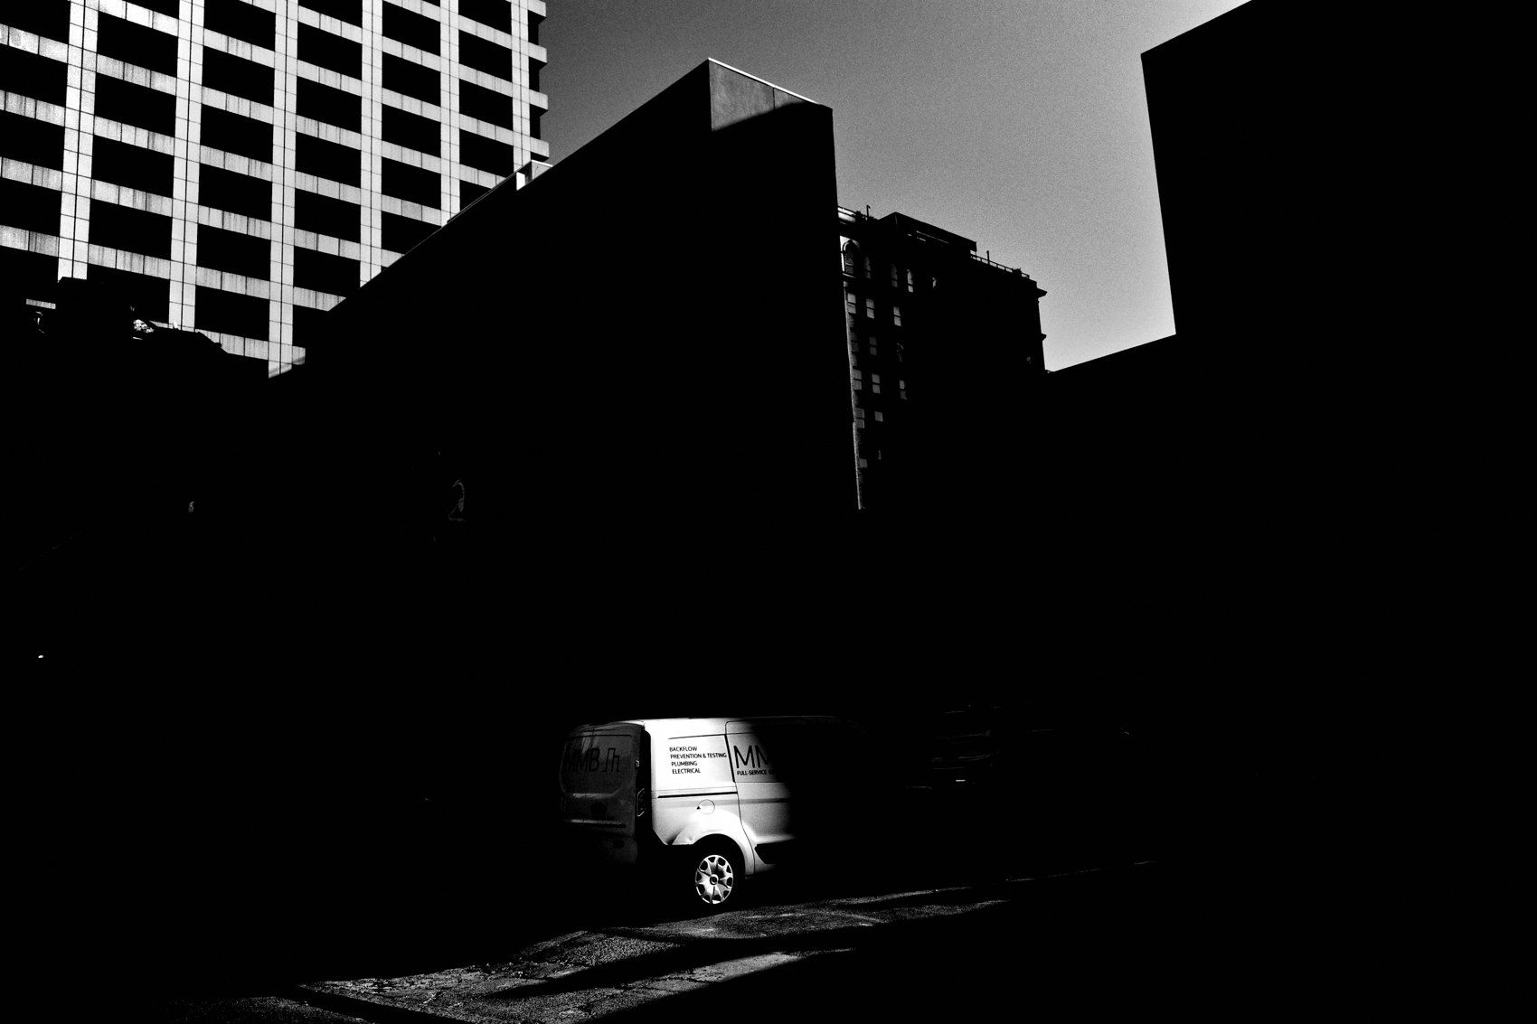
FLUX ACADEMY
BEAT 21 · RELATIONSHIP TO PREVIOUS
Building on Daily Practice
— Lesson 039 established the rhythm of daily practice
— Always carrying a camera is how that rhythm becomes automatic
— The habit of showing up, extended into every hour of every day
Notes:
Lesson 039 built the case for a daily practice — showing up with your camera as a consistent, repeatable commitment. This lesson takes that one step further: always carrying a camera is how that daily practice stops being a scheduled block and becomes a way of living. The rhythm becomes automatic. The camera becomes part of you.

Slide 23
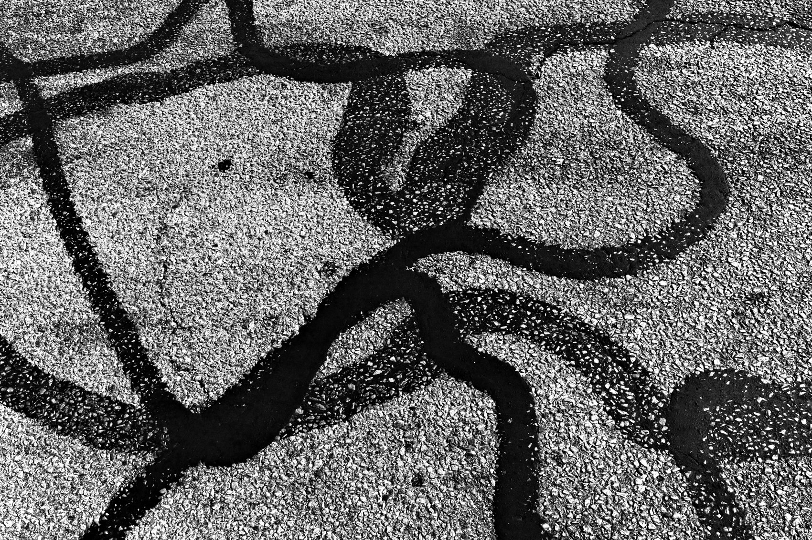
FLUX ACADEMY
BEAT 22 · RELATIONSHIP TO UPCOMING
What Readiness Makes Possible
— Always being ready opens the door to the decisive moment
— Lesson 041 takes readiness into instinct and reaction
— You can't respond instinctively to what you're not equipped for
Notes:
Always carrying a camera is what makes the next step possible. Lesson 041 moves into instinct — reacting without thinking, pressing the shutter in a fraction of a second. But instinctive reaction only works if the camera is already in your hand. Today we built the foundation. Next lesson, we build the reflex.

Slide 24

FLUX ACADEMY
BEAT 23 · SUMMARY / TAKEAWAY
Always Ready, Always Alive
— Always carry a camera — no exceptions, no excuses
— Life doesn't wait; the moments are happening right now
— Live first, camera along for the ride — and never miss again
Notes:
Last thing. Always carrying a camera isn't a photography tip — it's a life philosophy. It means deciding that your everyday life is worth documenting, that the mundane is full of potential, and that you are always ready to say yes to whatever reality puts in front of you. Live first. Camera along for the ride. Never miss another moment. Peace.

