Slide 1
FLUX ACADEMY · A SCHOOL FOR SEEING
MODULE 7 · THE STREET
Zone & Snap Focus + Settings
BY DANTE SISOFO

Slide 2
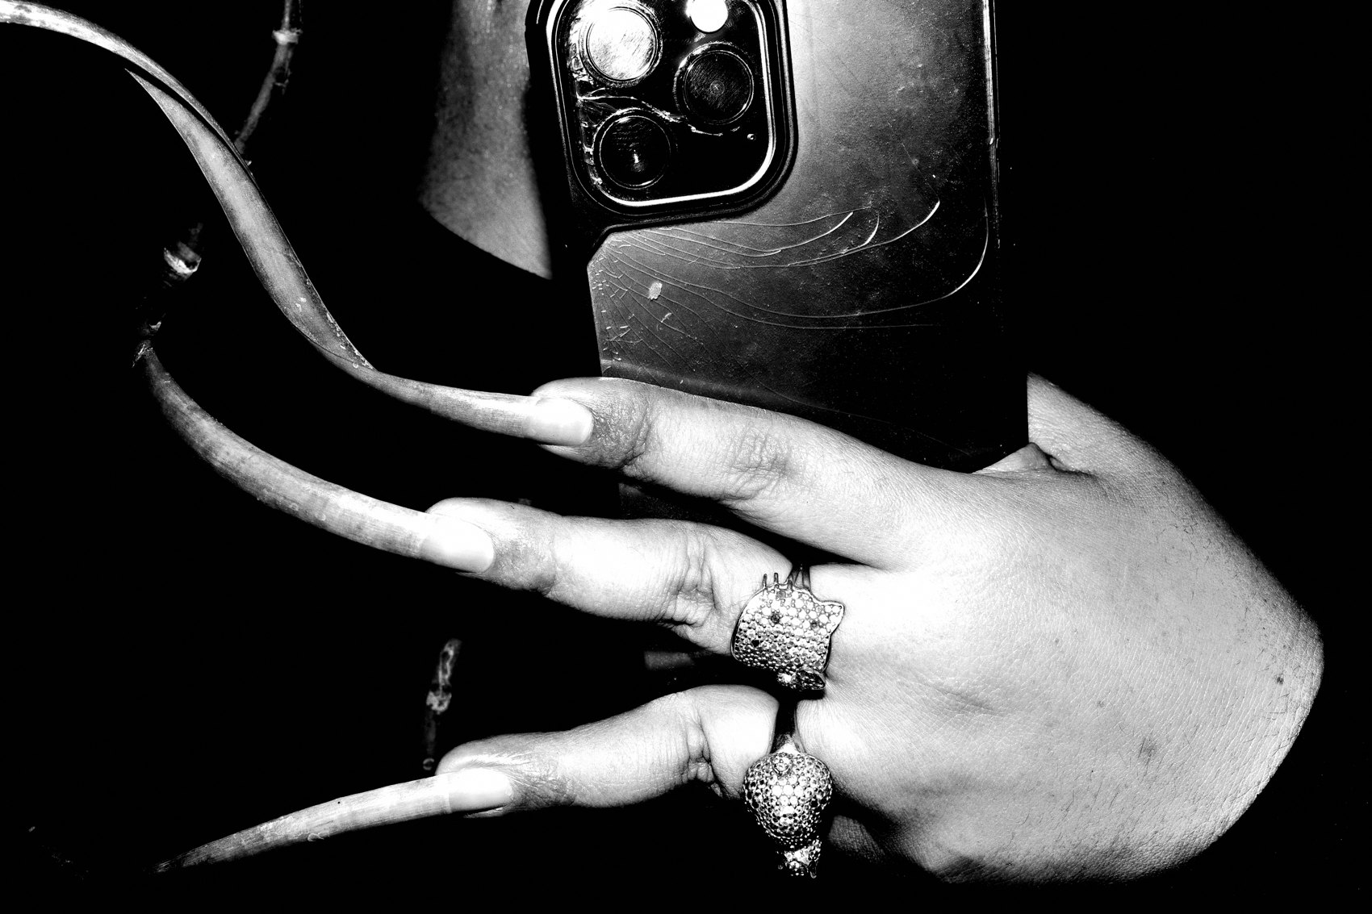
FLUX ACADEMY
BEAT 01 · CORE IDEA
Focus Less, See More
— Zone focus and snap focus eliminate the focus barrier
— Technical friction is the enemy of presence
— Set it and forget it — so you can see
Notes:
What's popping, people — it's Dante. Here's the thing about focus: the camera shouldn't be thinking when you are. Zone focus and snap focus exist for one reason — to get the technical decision out of the way so you can stay locked into the moment. Set it. Forget it. Photograph.

Slide 3
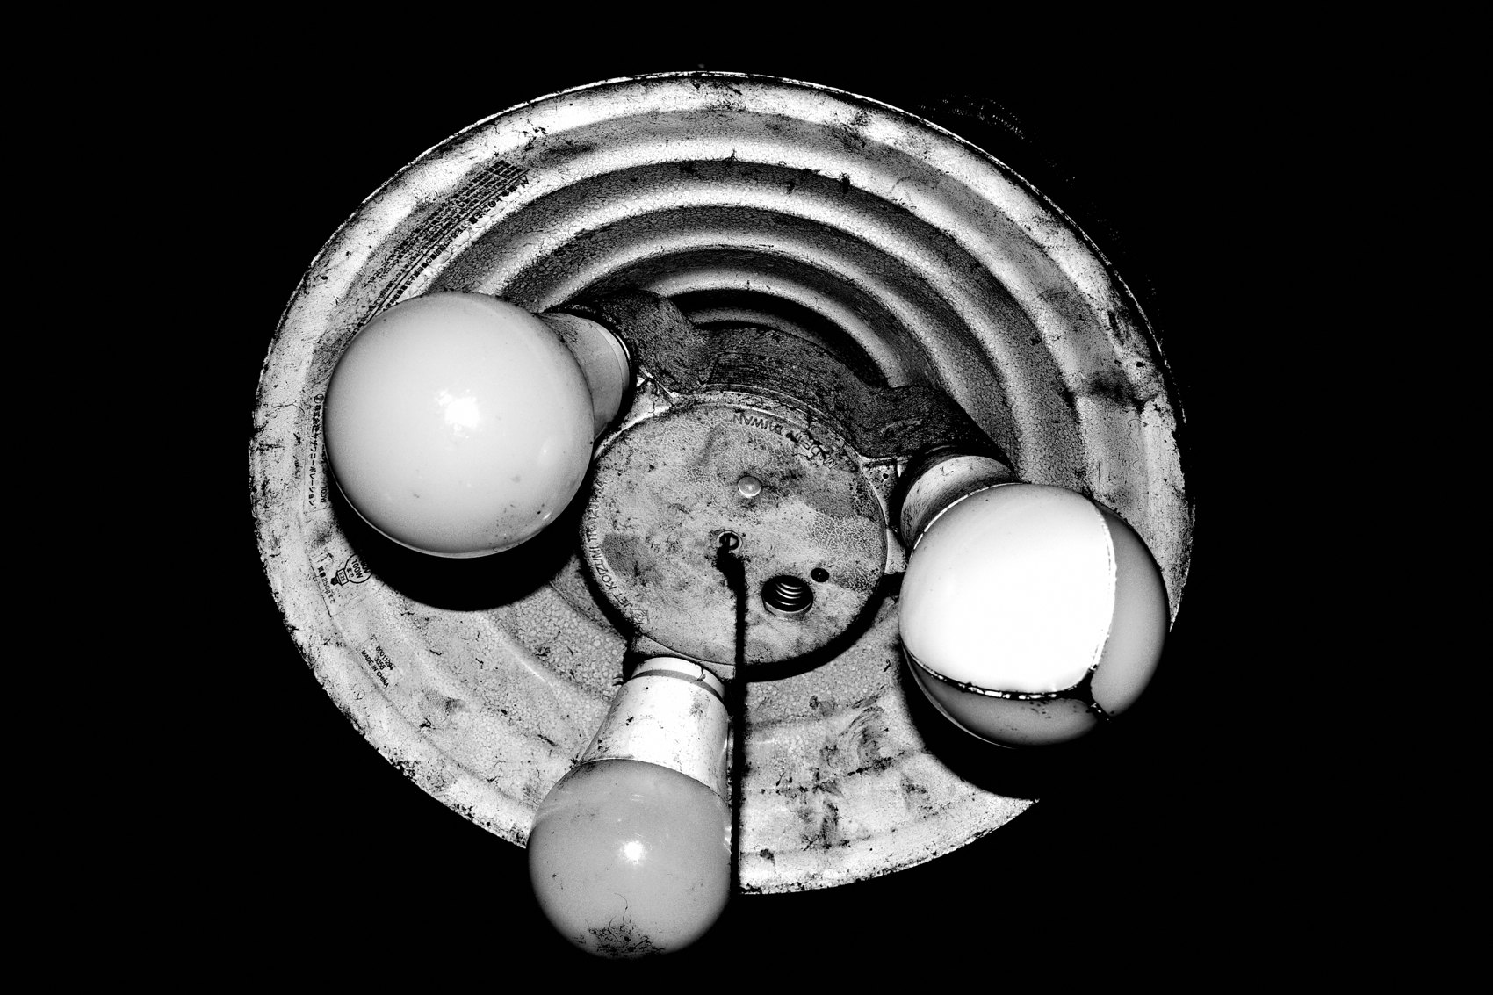
FLUX ACADEMY
BEAT 02 · LEARNING OBJECTIVE
What You'll Walk Away With
— Understand zone focus and snap focus as presence tools
— Know Dante's actual settings on the Ricoh GR
— Walk away with a system you can set up today
Notes:
By the end of this lesson you'll know exactly how zone focus and snap focus work, why they matter for street photography, and the precise settings Dante uses on the Ricoh GR so you can replicate the system and stop thinking about focus entirely.

Slide 4
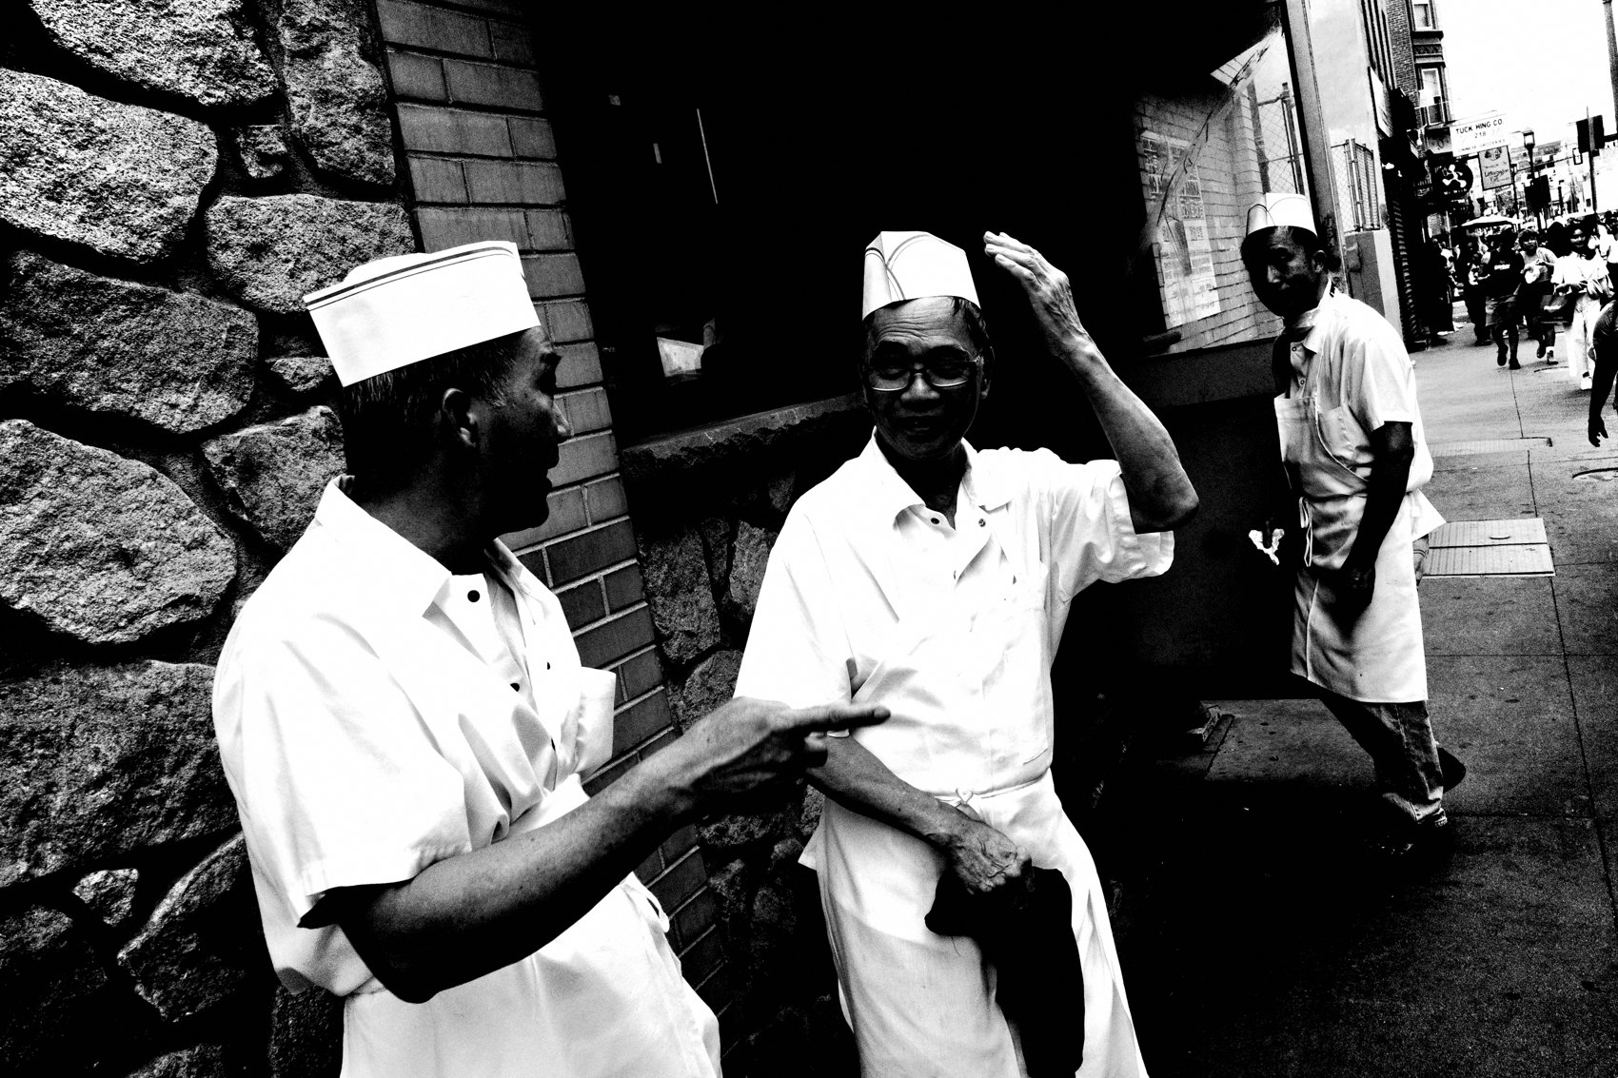
FLUX ACADEMY
BEAT 03 · WHY THIS MATTERS
Technical Friction Kills the Moment
— Autofocus hunting = lost moments
— Every second the camera thinks, the moment moves
— Friction between seeing and shooting costs you everything
Notes:
Here's the cold truth: while your camera is hunting for focus, the moment is gone. In street photography, the gap between seeing and shooting has to be zero. Any technical friction — any delay, any hunting, any half-press — is a tax on your presence. Zone and snap focus eliminate the tax.

Slide 5
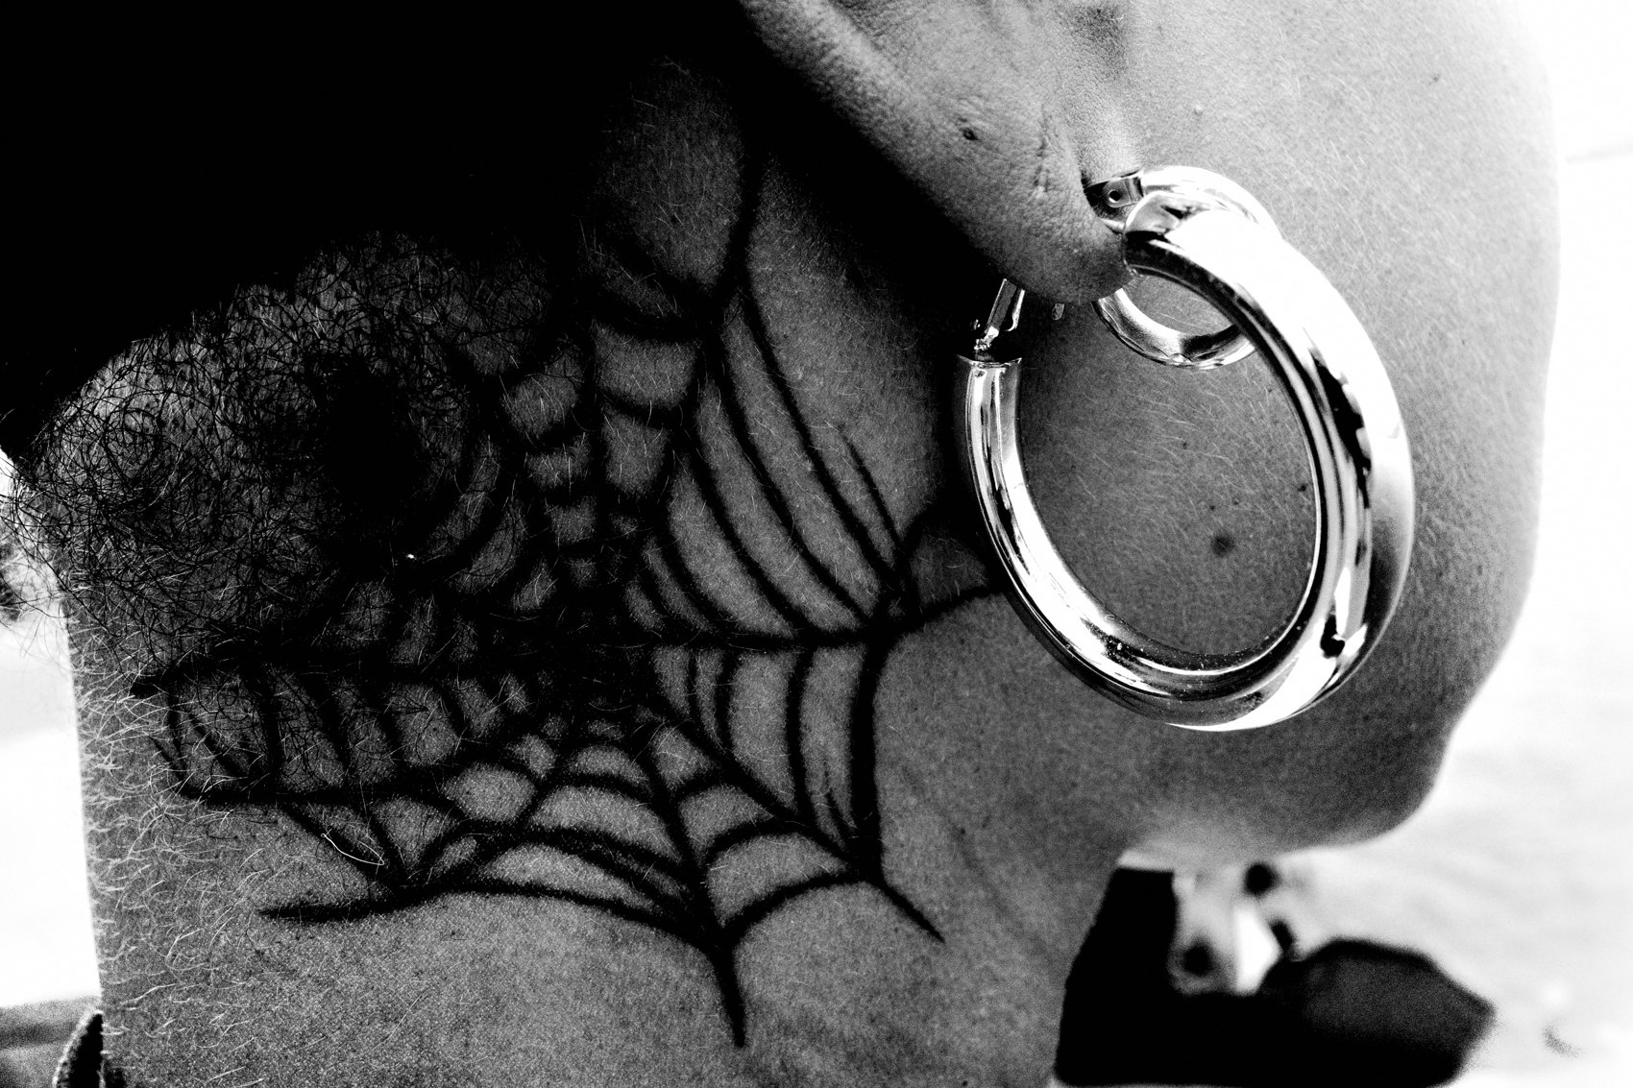
FLUX ACADEMY
BEAT 04 · WHY THIS MATTERS
Freedom to Live First, Photograph Second
— The snapshot approach means camera in life, not above it
— No separation between being human and being a photographer
— Settings that disappear let presence expand
Notes:
The snapshot approach is about integrating the camera into your life so seamlessly that there's no separation between living and photographing. That only works if the camera is invisible in your hands. The right focus system makes the camera disappear — and that's when real photographs happen.

Slide 6
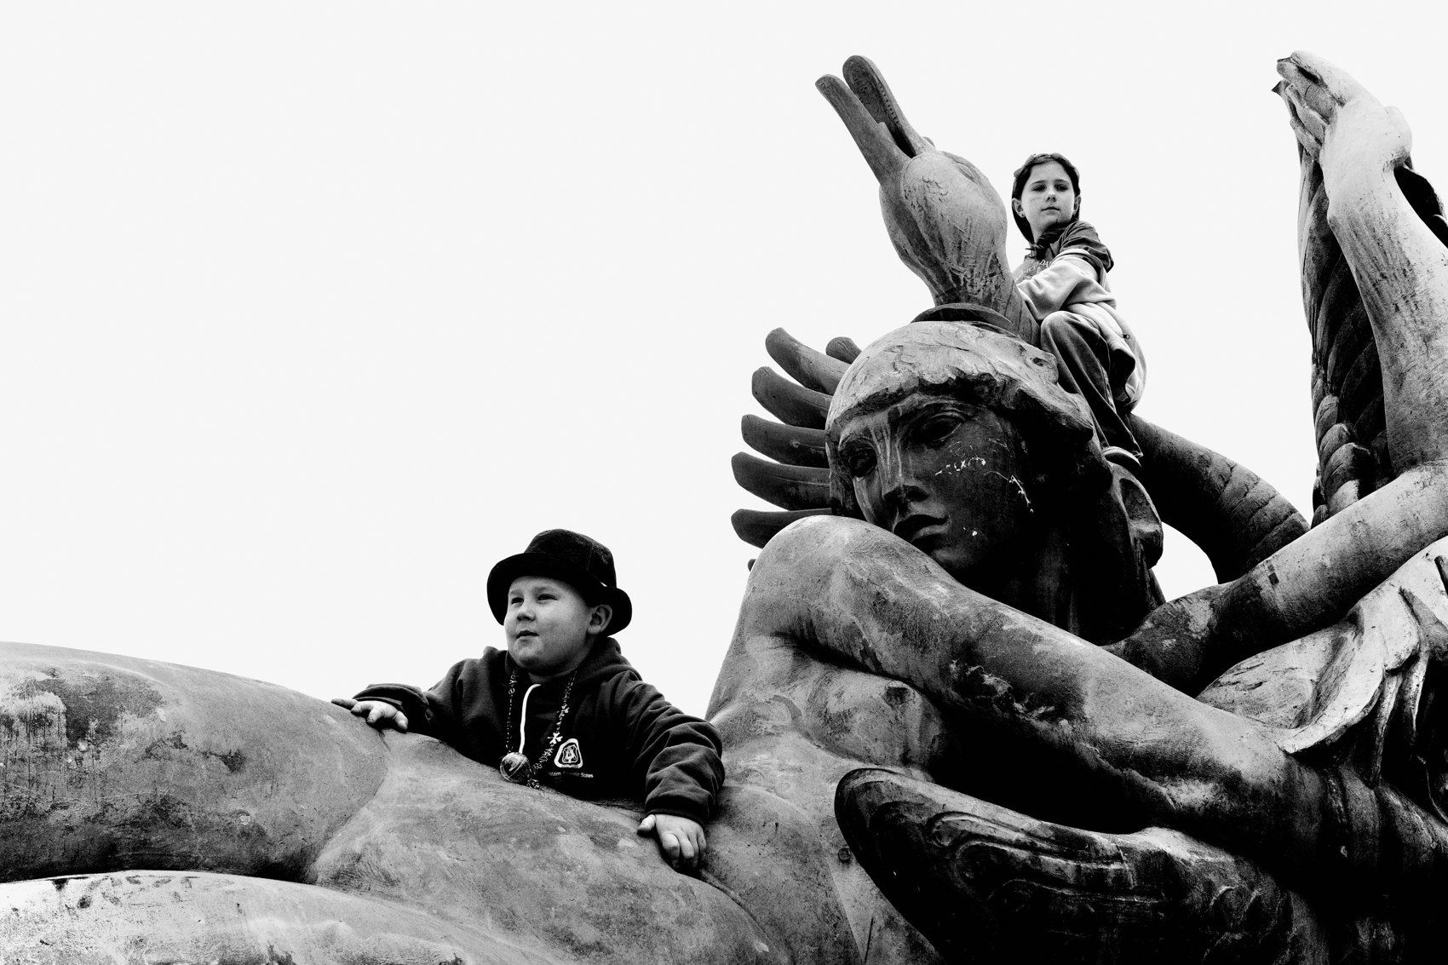
FLUX ACADEMY
BEAT 05 · MAIN TEACHING
What Zone Focus Actually Is
— Pre-focus to a set distance — say, two meters
— Everything within your depth-of-field range is sharp
— No shutter lag, no hunting, no hesitation
Notes:
Zone focus is simple: you pre-focus the camera to a specific distance — Dante uses two meters — and anything within the depth-of-field zone at that distance is acceptably sharp. You're not focusing on anything when you shoot. You're already focused. Raise the camera. Press. Done.

Slide 7

FLUX ACADEMY
BEAT 06 · MAIN TEACHING
What Snap Focus Actually Is
— Snap focus is the Ricoh GR's instant jump to a preset distance
— One button press = camera locks to your chosen distance
— Purpose-built for street, purpose-built for speed
Notes:
Snap focus is the Ricoh GR's version of zone focus on demand. You assign it to a button, set your target distance — say two meters — and a single press snaps the focus there instantly. No hunting. No half-press. The camera is always ready before you decide to shoot.

Slide 8
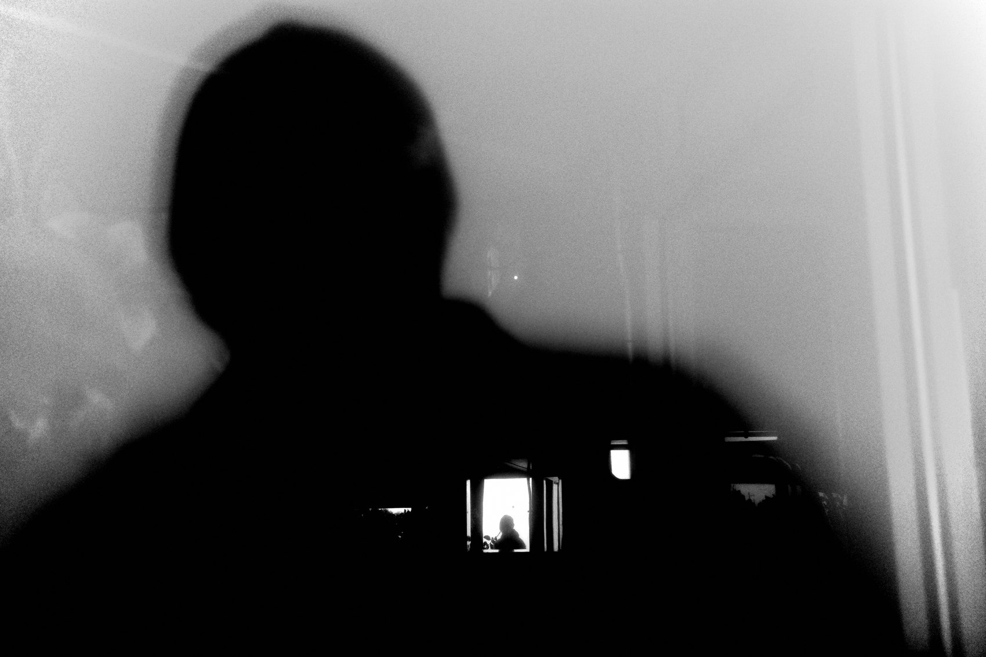
FLUX ACADEMY
BEAT 07 · MAIN TEACHING
Dante's Core Settings
— Ricoh GR · Program mode or Aperture Priority
— Snap focus set to two meters
— High-contrast black-and-white JPEG · small file size
Notes:
Here's the actual setup: Ricoh GR, program mode or aperture priority, snap focus locked to two meters. High-contrast black-and-white JPEGs cranked directly into the file — crushed shadows, highlight-weighted metering. One thing adjusted manually: exposure compensation. Everything else? Automatic. The system is built to remove every obstacle between seeing and shooting.

Slide 9
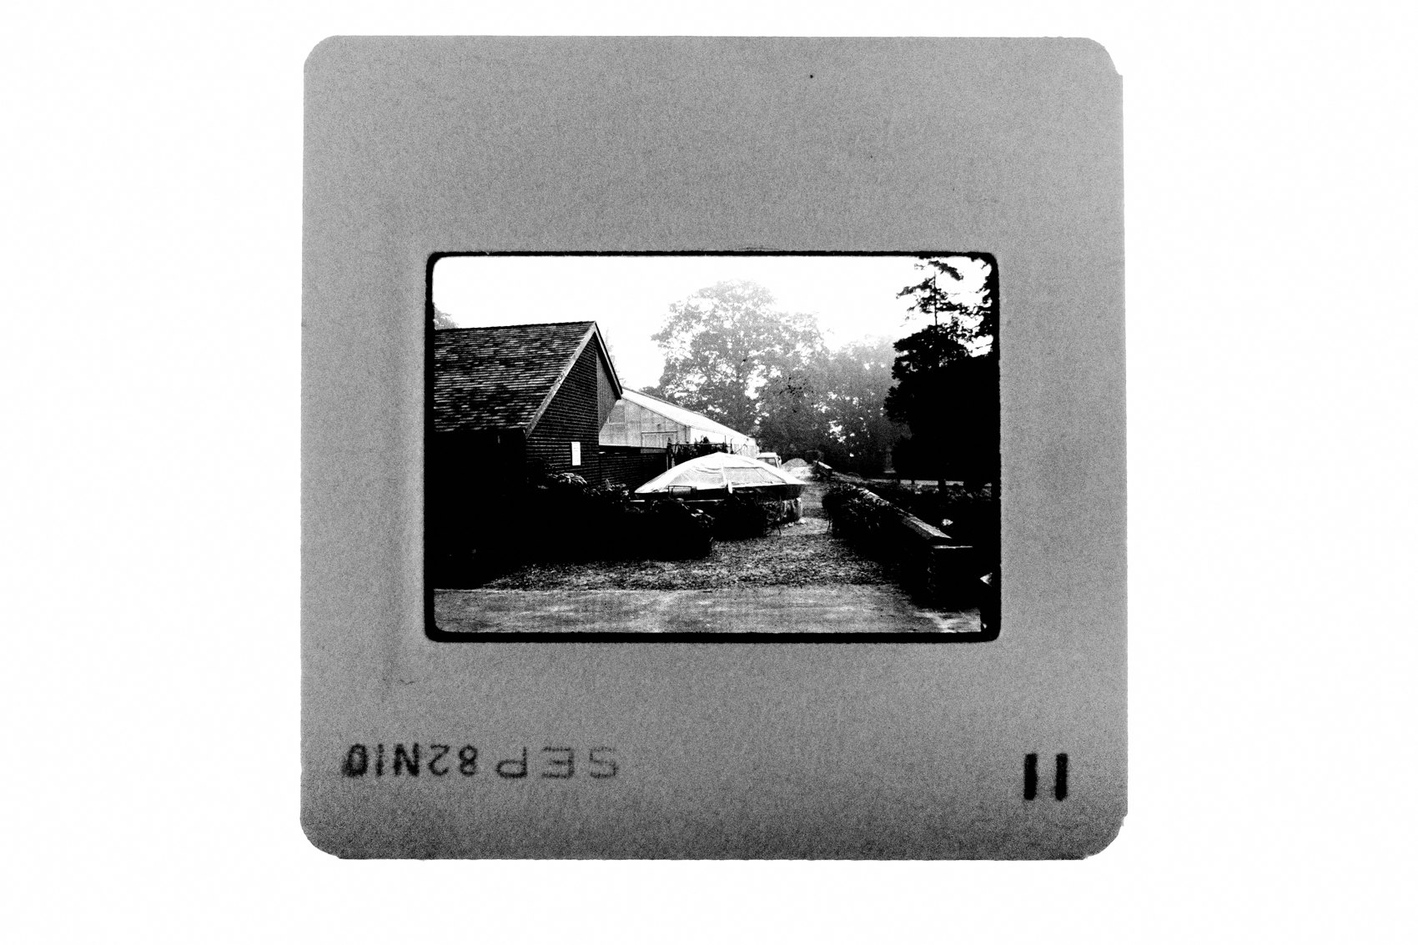
FLUX ACADEMY
BEAT 08 · MAIN TEACHING
Why Two Meters?
— Two meters keeps subjects close — intimate, not distant
— Close enough for gesture and expression to read
— Far enough to stay out of confrontation range
Notes:
Two meters is the sweet spot. Close enough that gesture, expression, and human detail read clearly in the frame. Far enough that you're not in anyone's face. At a small aperture, the depth-of-field at two meters covers enough ground that you don't have to be surgical about your position. Just get close and shoot.

Slide 10
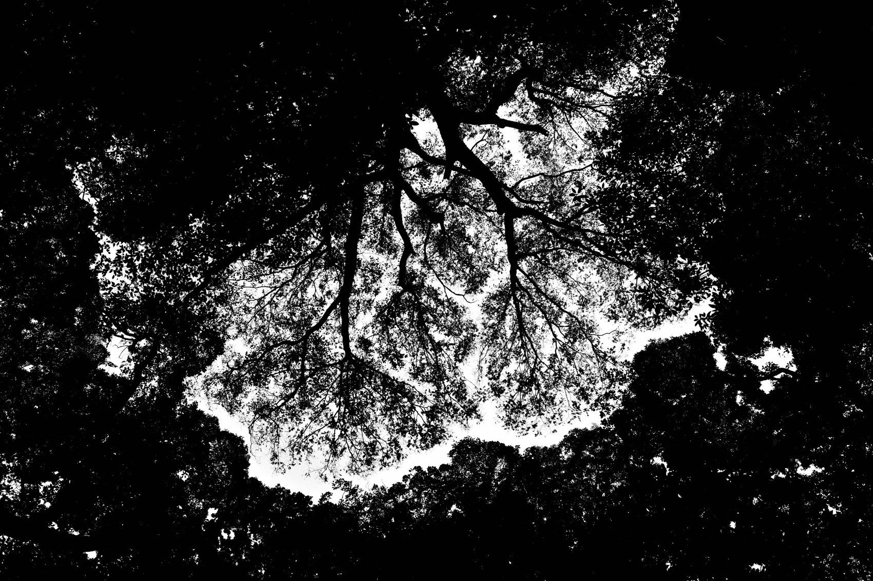
FLUX ACADEMY
BEAT 09 · MAIN TEACHING
Exposure Compensation Is the One Control
— Everything else is automatic — EC is the single dial
— Blow out bright backgrounds to reveal faces and gesture
— Against snow or any bright field: push positive to expose for the subject, not the white
Notes:
When everything else is automatic, exposure compensation becomes your one creative lever. Against a bright field — snow, a white wall, a blown-out sky — push exposure compensation positive, around +1.7, so the background blows clean and the faces and gestures in the foreground pop. The bright field becomes a clean stage the subject stands out against. One adjustment. Maximum impact. That's the whole game.

Slide 11

FLUX ACADEMY
BEAT 10 · MAIN TEACHING
Snap Focus to Infinity for Landscapes and Abstraction
— Snap focus to infinity for open scenes and abstraction
— River trails, open roads, skylines — no subject at two meters
— Switch modes fluidly as the scene demands
Notes:
Snap focus isn't locked to two meters forever. When there's no subject up close — an open trail toward the horizon, a river, a distant skyline, a field of texture and light — switch snap focus to infinity. Wide, open, abstract scenes need a different setting than intimate street portraits. The system is fluid. Read the scene, adjust the preset, keep moving.

Slide 12
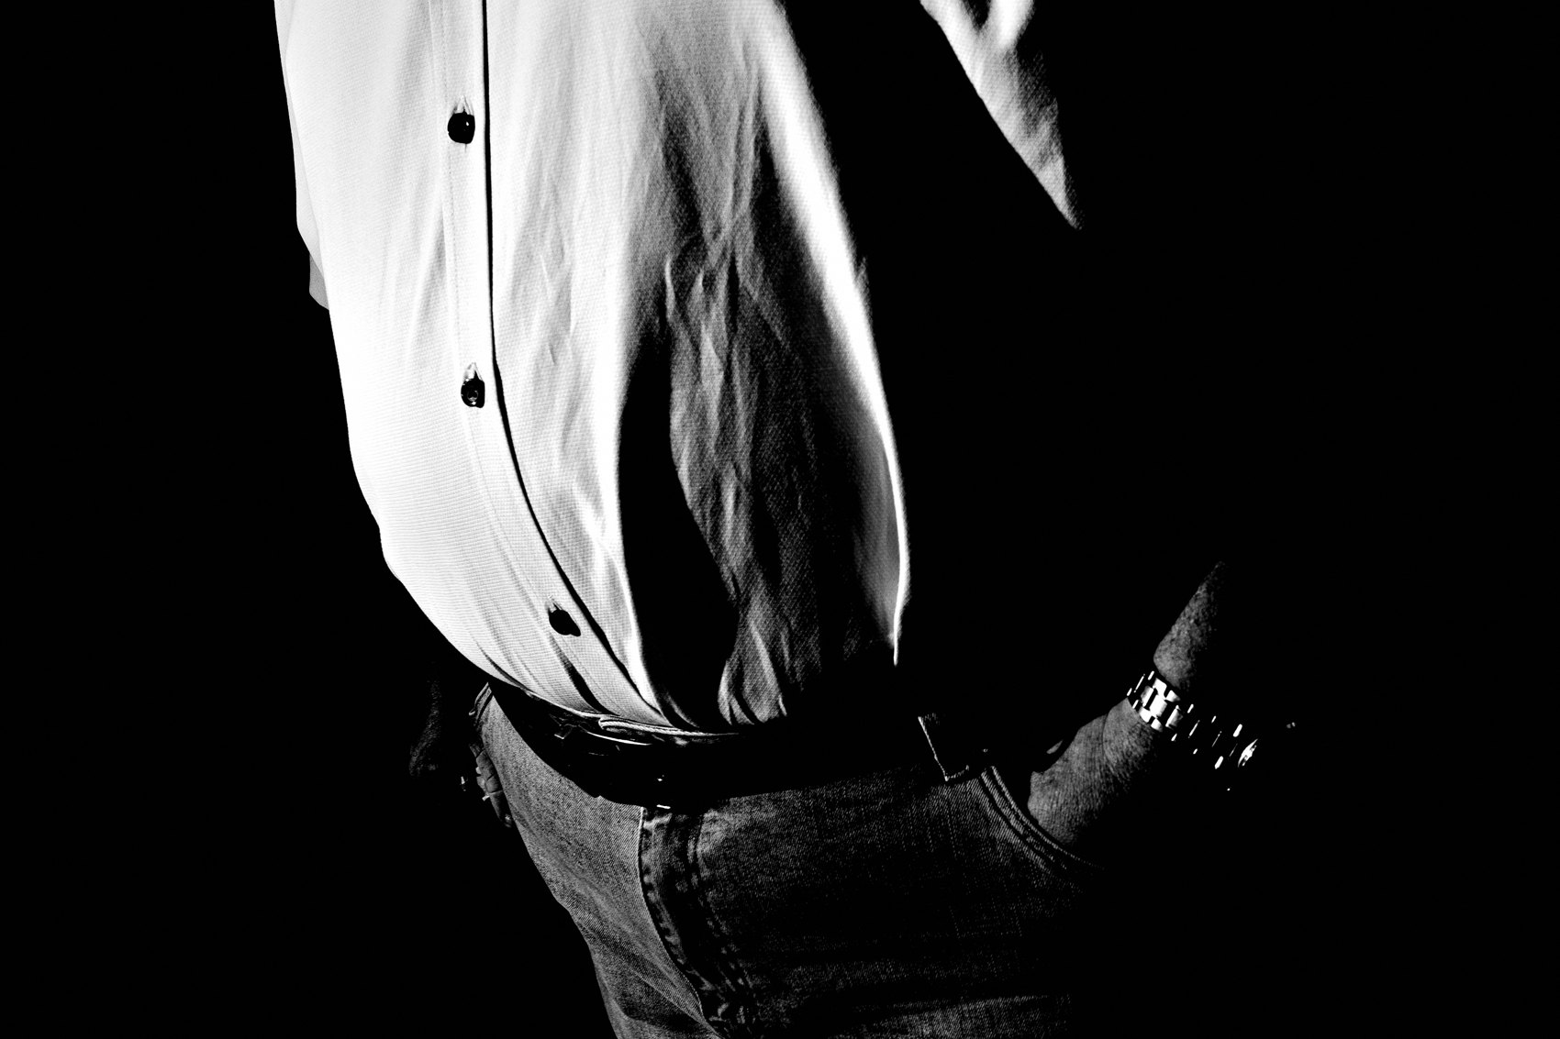
FLUX ACADEMY
BEAT 11 · MAIN TEACHING
JPEG, Not RAW: Committing In-Camera
— Shoot JPEG: the image is decided at the moment of capture
— High contrast cranked in-camera — no fixing it later
— Commitment forces presence and sharpens instinct
Notes:
Shooting small JPEGs in high-contrast black and white is a commitment — what you get is what you made. There's no RAW file to rescue later. That constraint is the point. When you know the image is final at the moment of capture, you start paying more attention before you press the shutter. The limitation sharpens your instinct.

Slide 13

FLUX ACADEMY
BEAT 12 · MAIN TEACHING
Highlight-Weighted Metering
— Highlight-weighted metering protects the brights
— Shadows crush naturally — adds drama and graphic quality
— Pairs with high-contrast JPEG for maximum punch
Notes:
Highlight-weighted metering tells the camera: protect the bright areas, let the shadows go. Combined with high-contrast JPEG processing, the result is deep blacks, clean highlights, and a graphic quality that makes images read immediately. You're not correcting in post — you're designing the tonal range at the moment of capture.

Slide 14

FLUX ACADEMY
BEAT 13 · MAIN TEACHING
Pre-Set Settings Free You to Respond on Instinct
— When a fast, high-energy moment erupts, there's no time to think about settings
— Snap focus at two meters, program mode — dialed in before you left home
— Your only job is to see it and respond; the camera does the rest
Notes:
Picture the kind of moment that arrives without warning — someone bursting into motion, jumping, arms flailing, pure energy, gone in a second. There is no time to adjust anything. This is exactly why the settings are locked before you leave home: snap focus at two meters, program mode, no hesitation. When the energy explodes in front of you, your only job is to see it and respond. The camera does the rest. That's the entire reason the system exists.

Slide 15

FLUX ACADEMY
BEAT 14 · MAIN TEACHING
Isolate One Subject From a Crowd With Exposure
— AV mode · snap focus at two meters · push EC positive
— Blow the busy background out to isolate a single subject
— Exposure as a tool to sculpt emotion from chaos
Notes:
When you're surrounded by hundreds of people and you want one face, one gesture to rise out of the noise, exposure is your scalpel. Switch to aperture priority, keep snap focus at two meters, and push exposure compensation up toward +1.7 — the cluttered background blows to white and the subject emerges clean. In a chaotic, crowded scene, exposure becomes a tool for isolating a single moment of emotion inside the disorder.

Slide 16
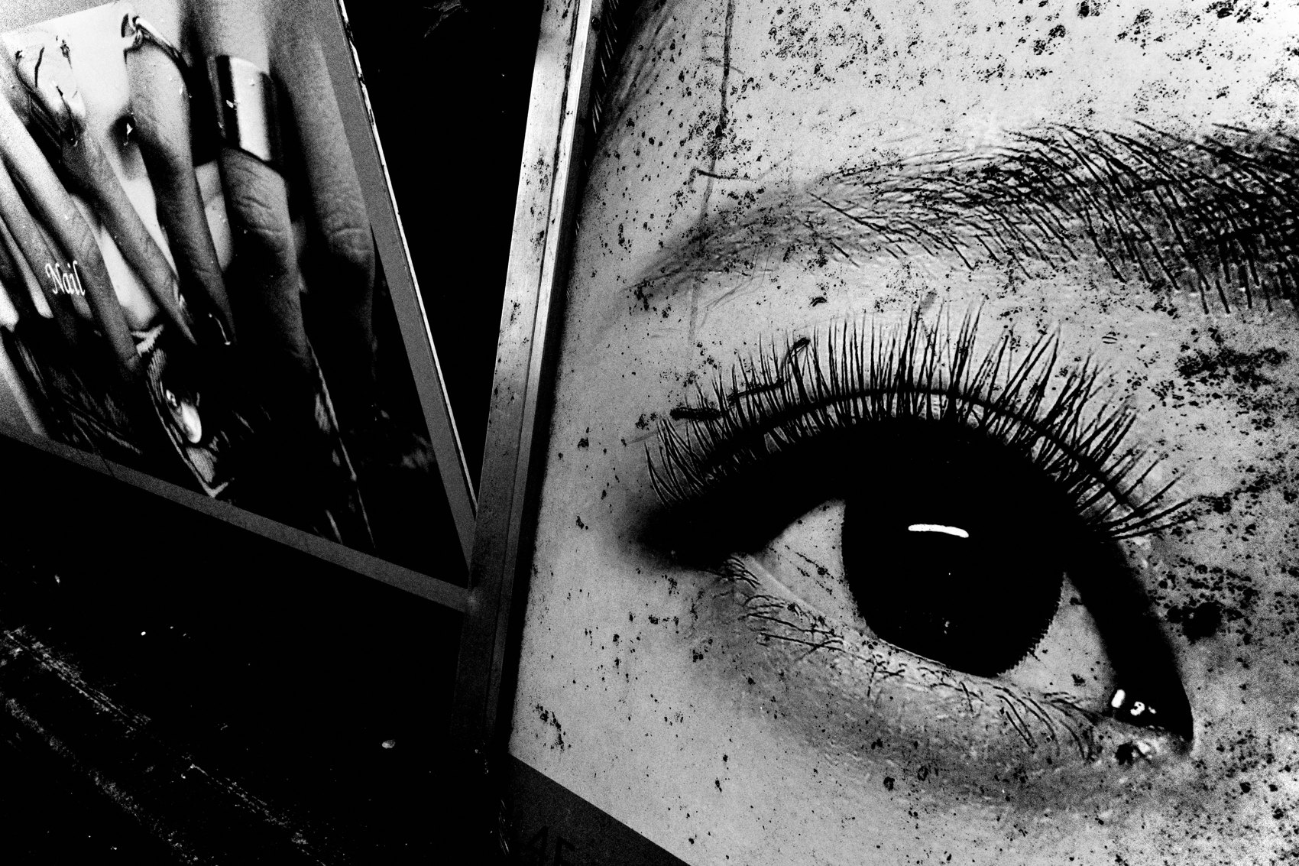
FLUX ACADEMY
BEAT 15 · MAIN TEACHING
Macro Mode and the Divinity of Detail
— Ricoh GR macro mode — trash becomes sculpture
— Snap focus still applies; the tool adapts
— Details become divine when you get close
Notes:
The Ricoh's macro mode is where the mundane becomes extraordinary. Trash on the street, a door knocker, the texture of bark — get close enough and the everyday transforms. Snap focus still underpins the approach: the goal is always to remove friction so you can respond to what's in front of you. God is in the details — but only if you get close enough to see them.

Slide 17
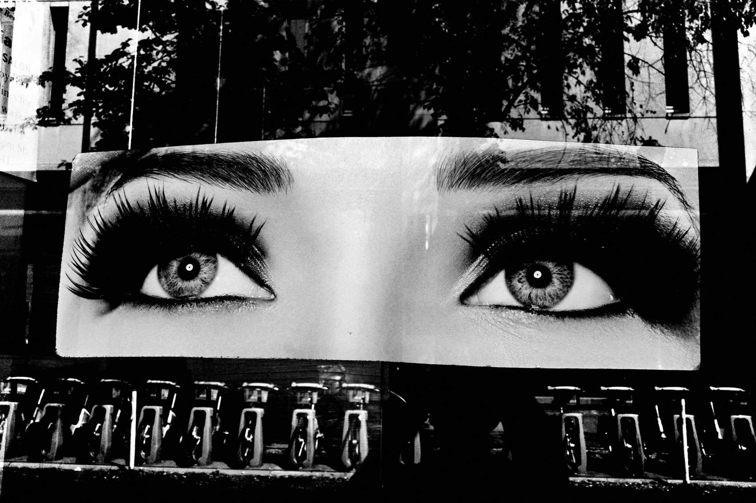
FLUX ACADEMY
BEAT 16 · PRACTICAL APPLICATION
Set Up Your Focus System Before You Leave
— Configure snap focus to two meters tonight
— Set metering, JPEG mode, and EC before you go out
— Leave the house with zero decisions left to make
Notes:
Here's the practice: before you leave the house, the camera is already configured. Snap focus set. Metering dialed. JPEG mode on. High contrast enabled. When you step out the door, every technical decision is already made. Your only job on the street is to see. Walk out ready. The moment you have to fiddle with settings is the moment you miss the frame.

Slide 18

FLUX ACADEMY
BEAT 17 · PRACTICAL APPLICATION
Work One Distance for a Full Session
— Commit to two meters for an entire outing
— Constraint forces you to move your body to the right distance
— Your feet become the focus system
Notes:
For your next session, commit to one snap focus distance — two meters — for the entire outing. Don't touch it. If the subject is too far, you move. Your feet are your zoom lens, and now your feet are also your focus adjustment. The constraint teaches you how to position your body relative to the scene. That's a lesson no menu setting can teach you.

Slide 19
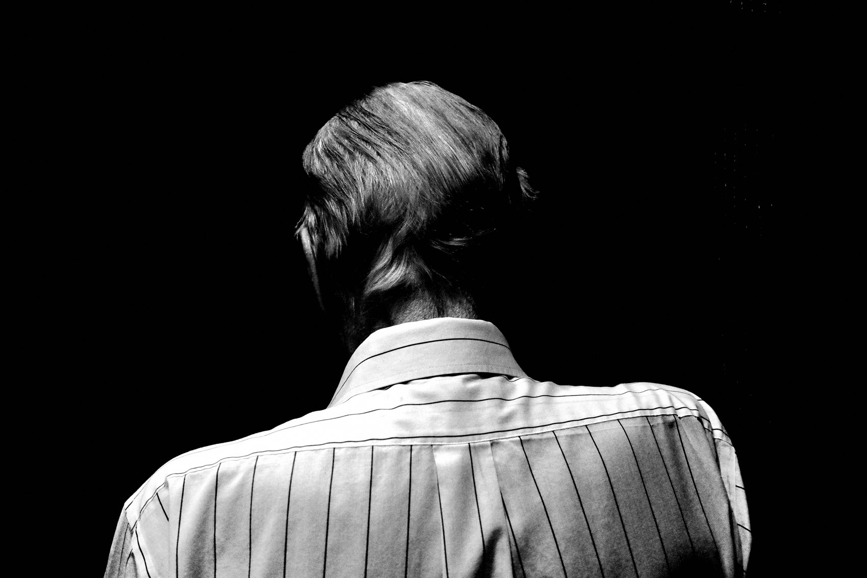
FLUX ACADEMY
BEAT 18 · PRACTICAL APPLICATION
Shoot JPEG for One Month
— One month: JPEG only, no RAW
— Every image is final at the moment of capture
— The constraint accelerates intuition
Notes:
Take the full commitment: JPEG only for one month. High contrast, black and white, cranked in-camera. No RAW safety net. Watch what happens to your attention before you press the shutter. When the image is final at capture, you start deciding more clearly. The constraint doesn't limit you — it accelerates you.

Slide 20
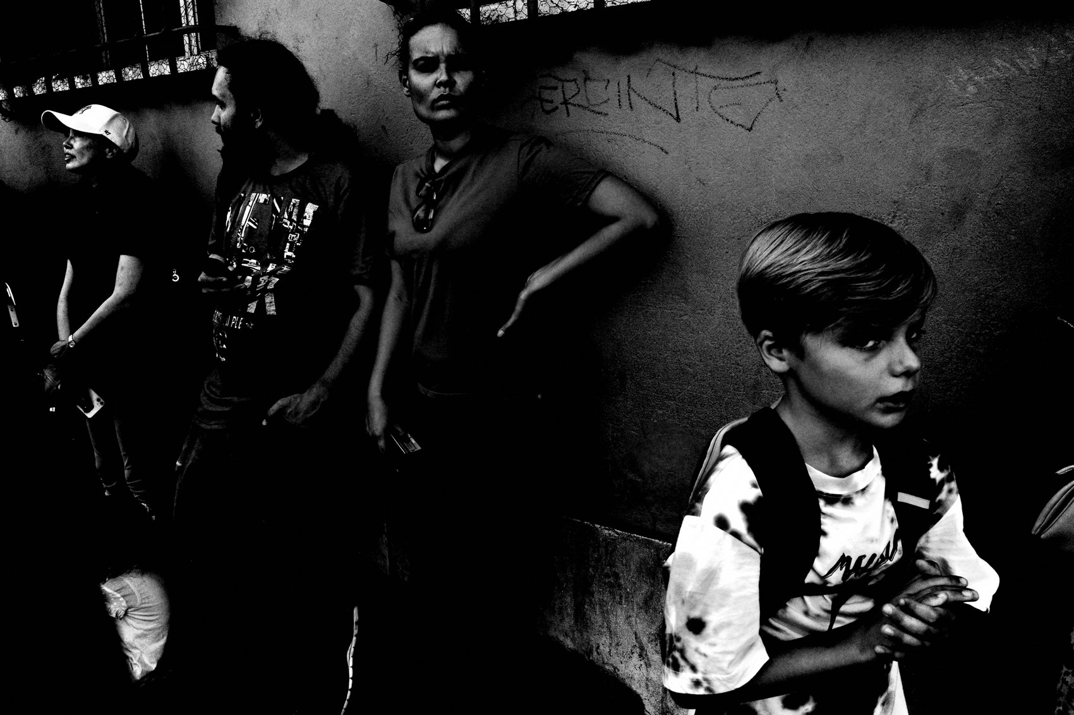
FLUX ACADEMY
BEAT 19 · COMMON MISTAKES
Over-Relying on Autofocus in Fast Scenes
— Autofocus hunts in low light, chaos, and fast movement
— The camera thinking is the moment leaving
— Zone and snap focus exist precisely for these conditions
Notes:
The most common mistake is defaulting back to standard autofocus when things get chaotic — exactly the conditions where it fails you most. Low light, fast movement, crowds — autofocus hunts. Zone and snap focus exist for these moments. Trust the preset distance. Stay present. The system is built for chaos; let it do its job.

Slide 21
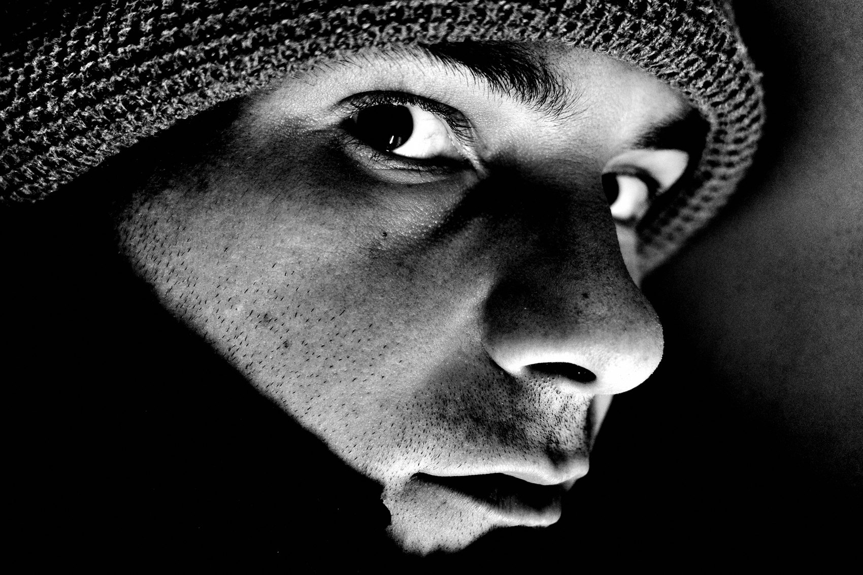
FLUX ACADEMY
BEAT 20 · COMMON MISTAKES
Changing Settings Mid-Session
— Changing settings mid-session breaks the flow state
— Every menu dive is a moment of disconnection
— Lock it in before you go; don't touch it until you're home
Notes:
Another mistake: adjusting settings mid-session. Every time you dive into the menu, you break the flow state. You stop being a photographer and become a camera operator. Lock your settings before you leave. The only thing worth adjusting on the street is exposure compensation — one dial, done. Everything else waits until you're home.

Slide 22
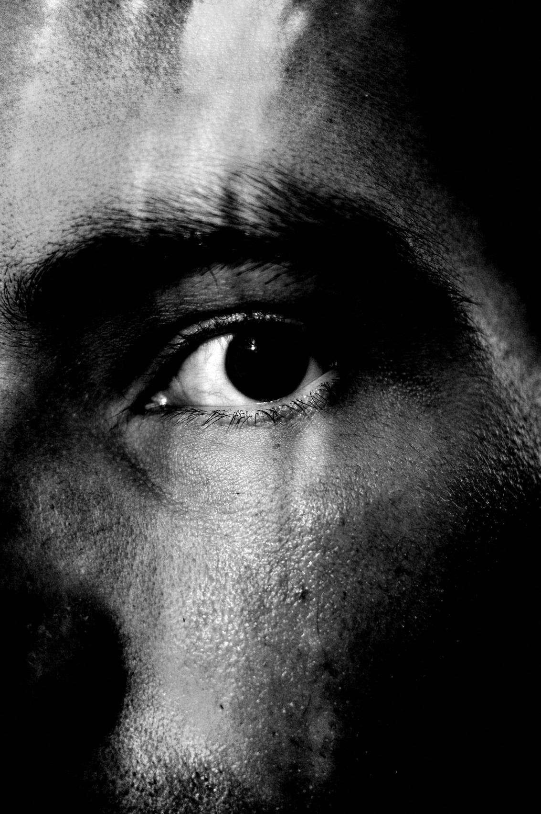
FLUX ACADEMY
BEAT 21 · RELATIONSHIP TO PREVIOUS
Building on Lesson 038
— Lesson 038 established the camera as an extension of self
— This lesson makes that extension frictionless
— Technique serves presence — not the other way around
Notes:
Lesson 038 established the idea that the camera should feel like an extension of who you are. Zone and snap focus are what make that extension frictionless. Once the camera is configured to disappear in your hands, you stop being someone operating a device and start being someone moving through the world with their eyes fully open.

Slide 23
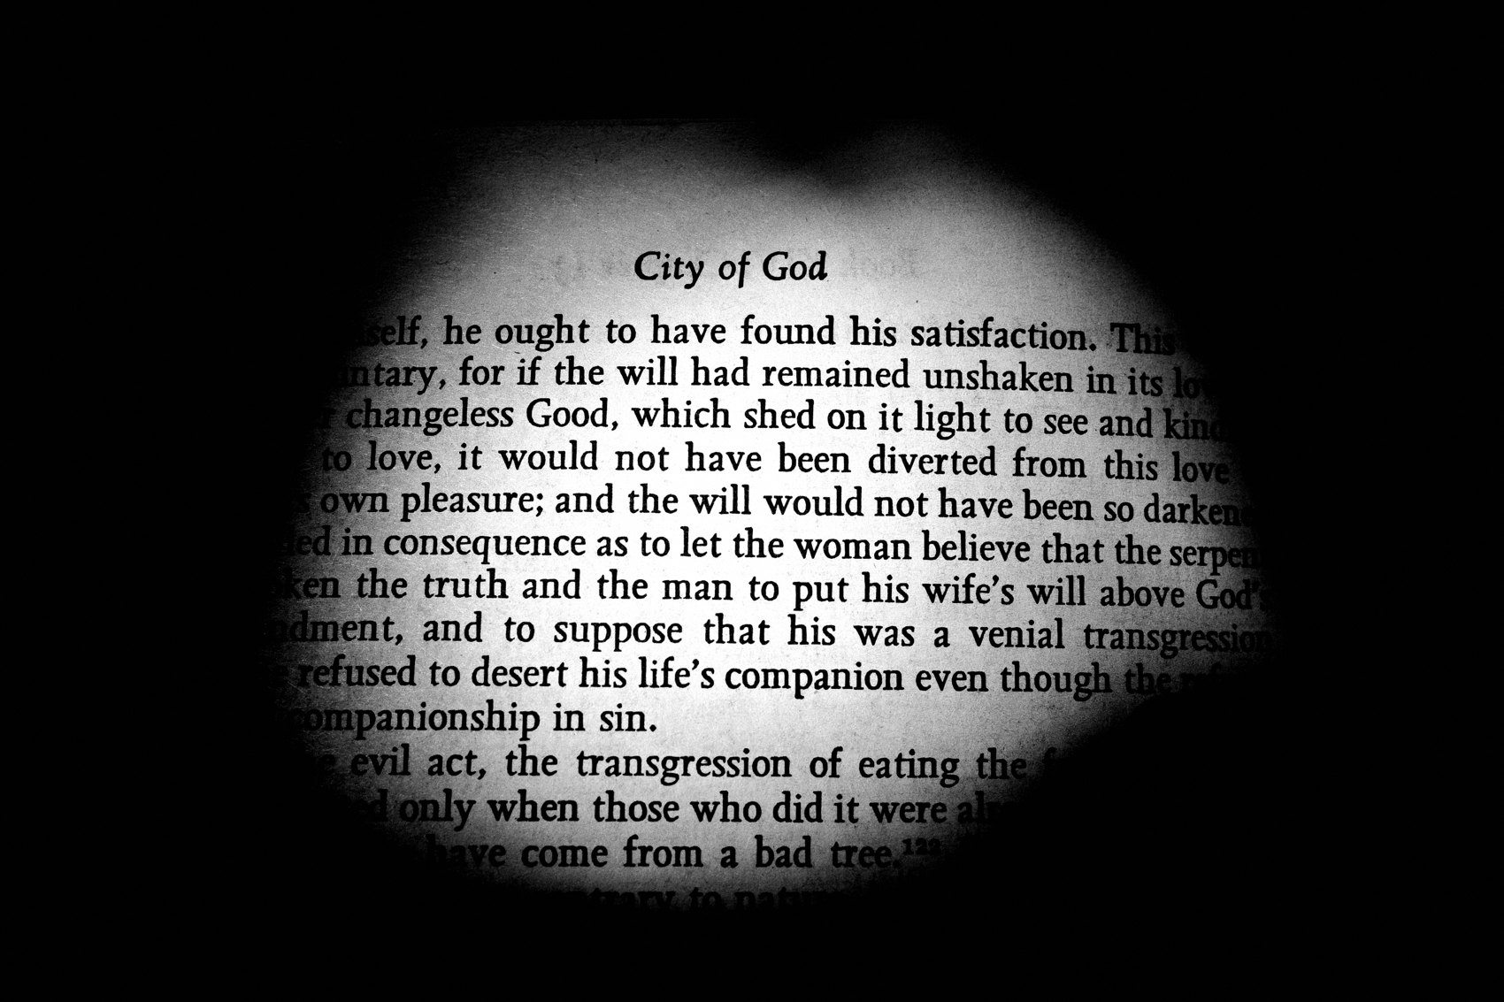
FLUX ACADEMY
BEAT 22 · RELATIONSHIP TO UPCOMING
Setting Up Lesson 040
— Lesson 040 takes on reading and chasing light
— Technical mastery here enables you to respond to light instantly
— The settings become the platform for the next level of seeing
Notes:
With focus and exposure dialed in automatically, you're ready for Lesson 040 — reading and chasing light. Once you're not thinking about settings, you can give your full attention to what light is doing on surfaces, in shadows, across faces. The technical foundation built here is what makes the next layer of seeing possible.

Slide 24
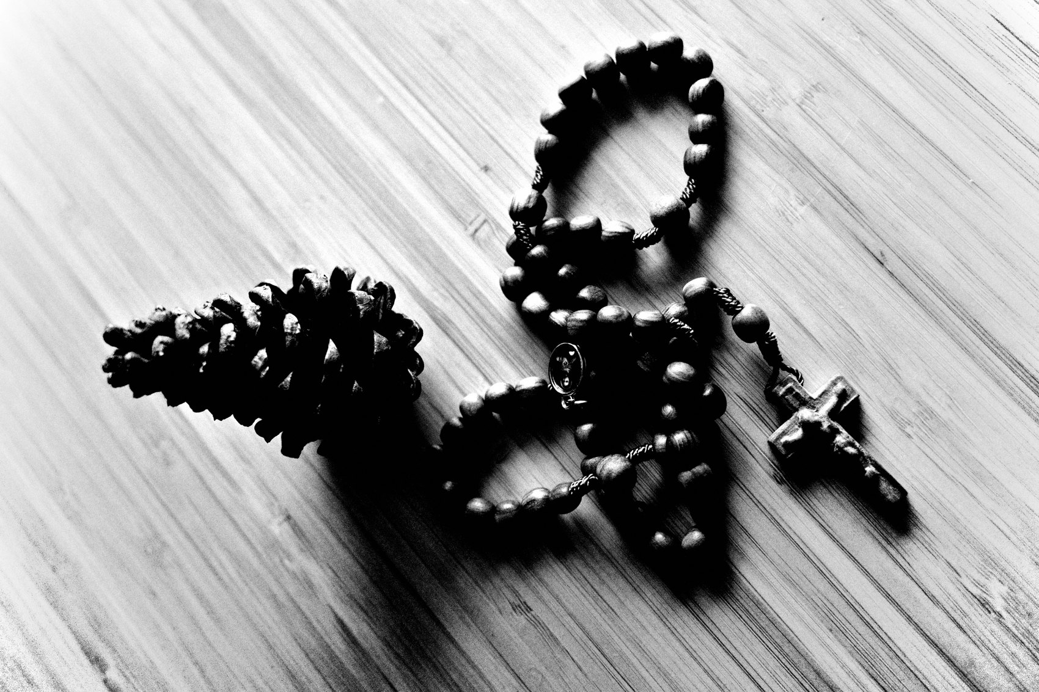
FLUX ACADEMY
BEAT 23 · SUMMARY / TAKEAWAY
Set It, Forget It, See Everything
— Zone and snap focus remove friction between seeing and shooting
— Dante's system: Ricoh GR · snap focus 2m · high-contrast JPEG · EC only
— Commit to the setup. Trust the system. Go photograph.
Notes:
Last thing. Zone focus and snap focus aren't just technical tricks — they're a philosophy. Remove every obstacle between seeing and shooting. Dante's system is simple: Ricoh GR, snap focus at two meters, high-contrast JPEG, highlight-weighted metering, and exposure compensation as the one dial. Set it. Forget it. See everything. That's the whole lesson — catch you in the next one.

