Slide 1
FLUX ACADEMY · A SCHOOL FOR SEEING
MODULE 7 · THE STREET
Champion Humanity
BY DANTE SISOFO

Slide 2
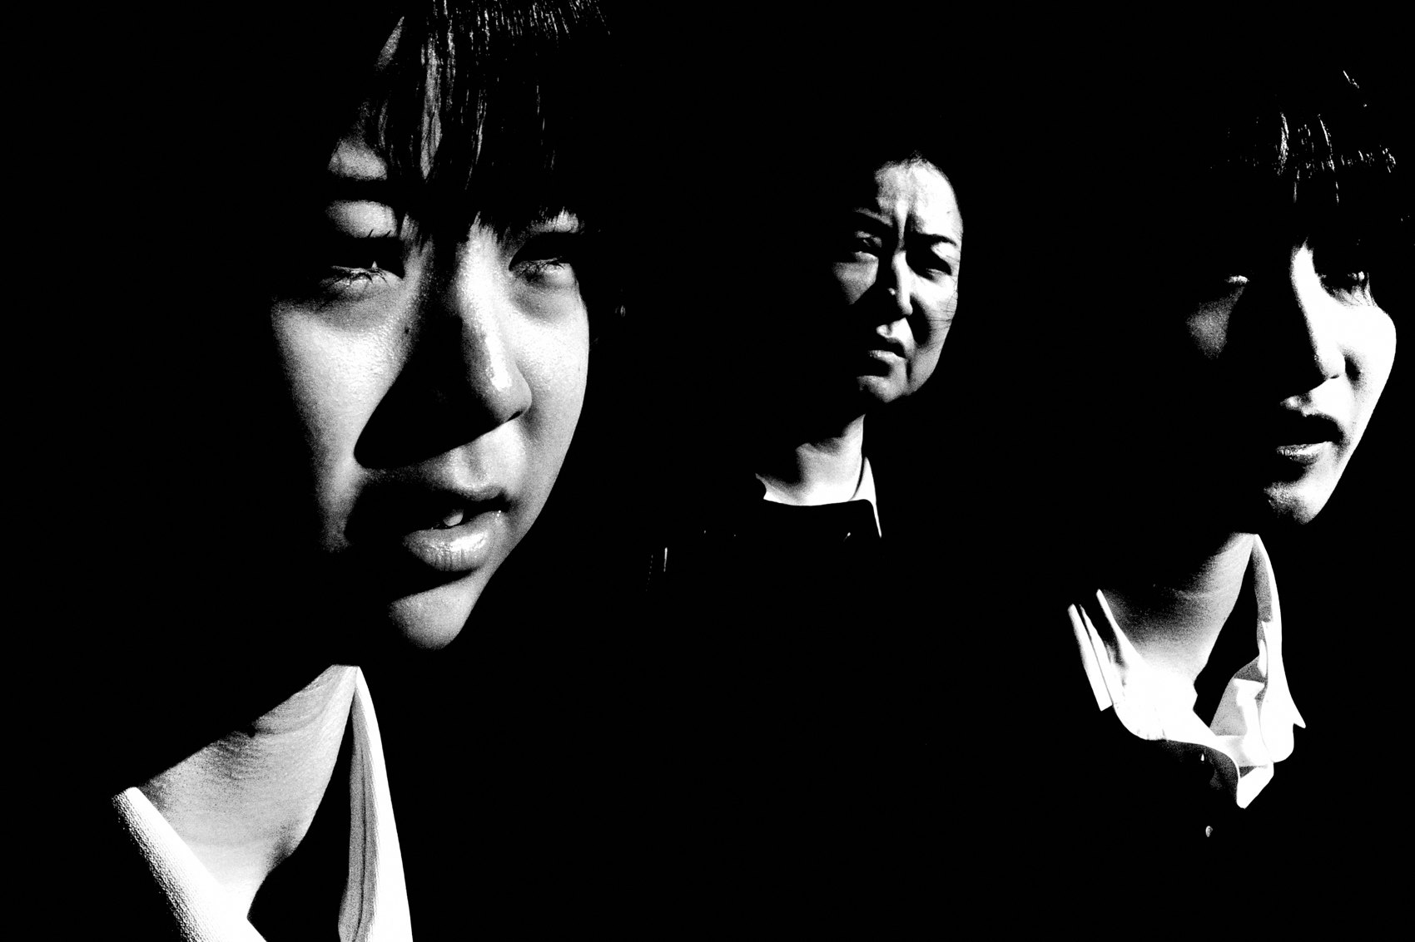
FLUX ACADEMY
BEAT 01 · CORE IDEA
Every Person Is a Hero
— Street photography is an act of championing humanity
— Every person on the street is a hero in their own story
— Your lens is a tool for honor, not observation alone
Notes:
What's popping, people — it's Dante. Today we're going into something that sits at the absolute heart of why I pick up a camera: the idea that street photography is an act of championing humanity. Not documenting it. Not studying it. Championing it — holding it up high and saying, this matters, you matter.

Slide 3

FLUX ACADEMY
BEAT 02 · LEARNING OBJECTIVE
What You'll Walk Away With
— Why every subject deserves reverence, not just a frame
— How a shift in mindset transforms what your camera finds
— The philosophy that turns street photography into a gift
Notes:
By the end of this lesson you'll carry a different relationship to every person you photograph. Not stranger, not subject — hero. That single shift changes how you see, how you move, and what your photographs ultimately mean.

Slide 4
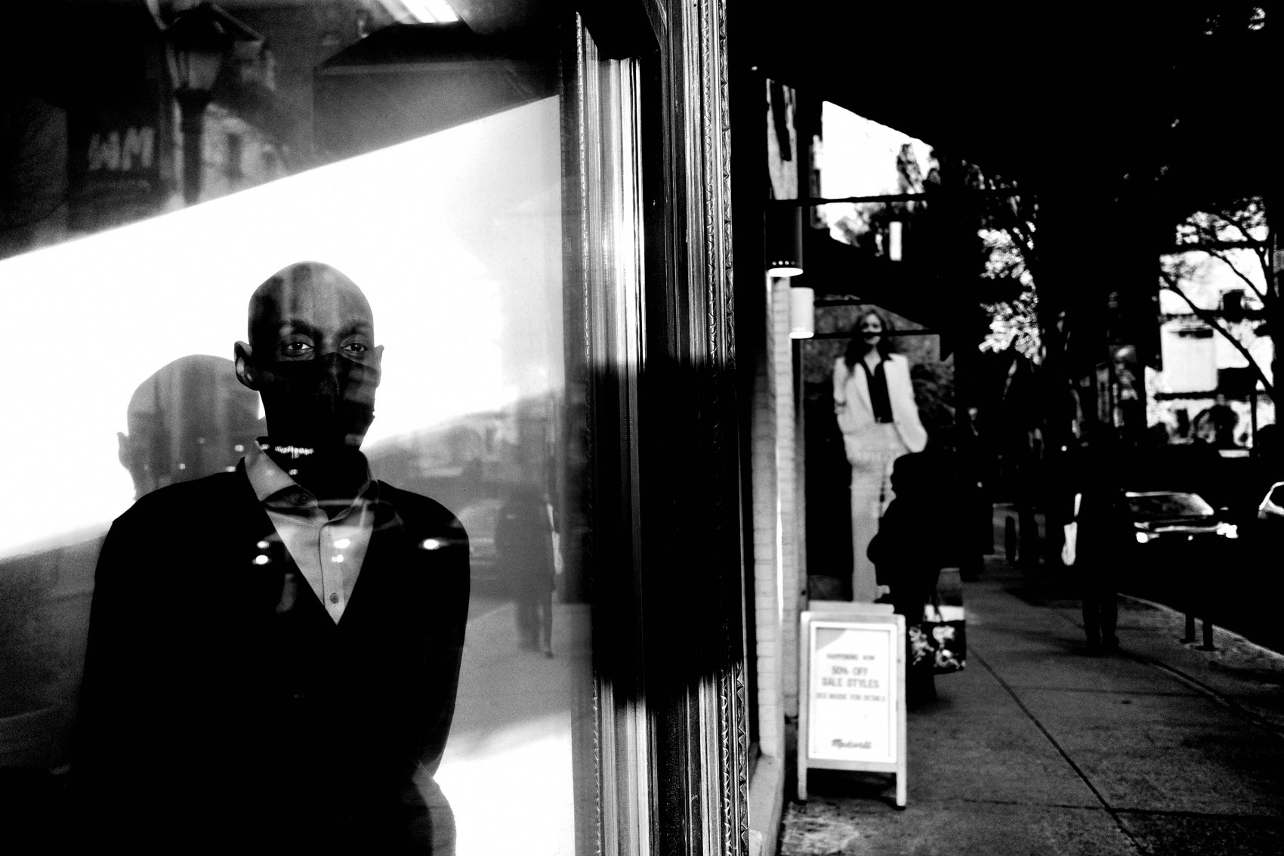
FLUX ACADEMY
BEAT 03 · WHY THIS MATTERS
Photography Can Uplift or Diminish
— How you see people determines what the frame says about them
— Photographs reflect the photographer's inner state
— Every image is either an act of honor or an act of indifference
Notes:
Here's why this matters: every photograph you make carries an implicit attitude toward its subject. You can diminish a person by treating them as scenery, or you can elevate them by seeing them as the hero of their own life. The camera doesn't decide which one it is — you do.

Slide 5
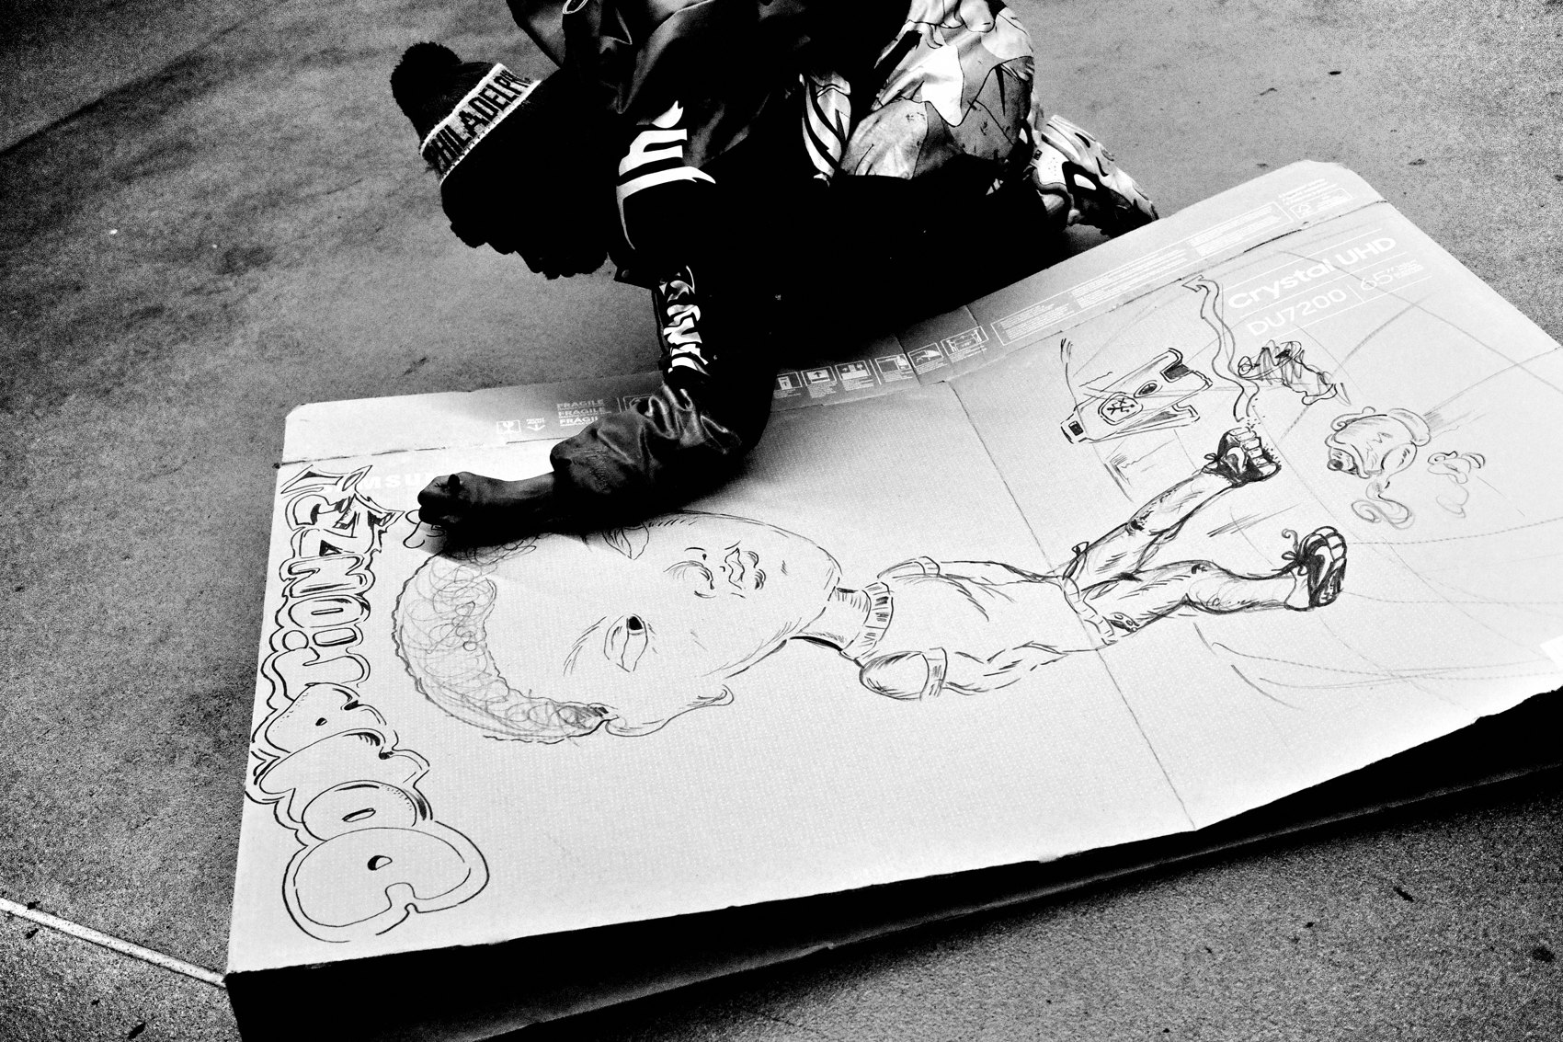
FLUX ACADEMY
BEAT 04 · WHY THIS MATTERS
The World Needs This Vision
— Shared humanity is what connects us across difference
— Street photography can remind people of their own dignity
— Uplifting the beauty of everyday existence is a radical act
Notes:
We live in a world that's quick to reduce people to types, categories, strangers. Street photography done with intention pushes back against that. When you photograph life and hold it up high, you remind the world — and the person in the frame — that their story is worth seeing.

Slide 6
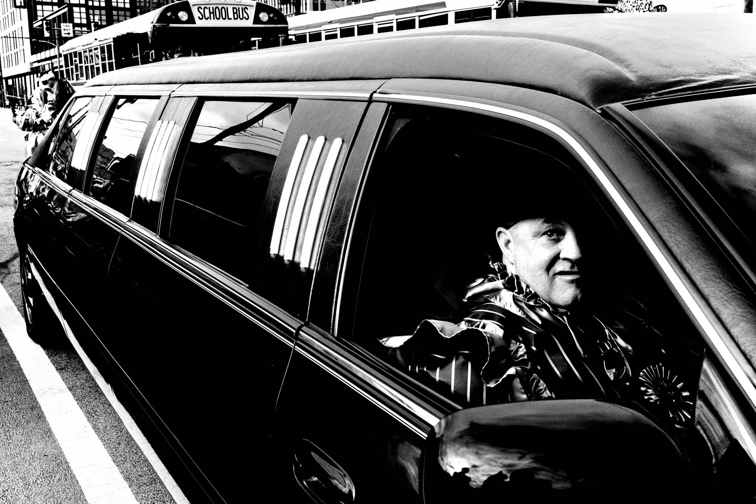
FLUX ACADEMY
BEAT 05 · MAIN TEACHING
See People as Heroes
— Look at strangers as heroes in their own lives
— Every person has their own struggles and triumphs
— Frame with care and reverence, not detachment
Notes:
The first move is purely mental: stop seeing strangers and start seeing heroes. Every person walking past you has a whole world inside them — struggles, triumphs, love, loss. When you carry that awareness into the street, your camera starts finding something entirely different. Not faces. Journeys.

Slide 7

FLUX ACADEMY
BEAT 06 · MAIN TEACHING
Photograph with Compassion and Curiosity
— Compassion and curiosity are the two eyes of great street photography
— See the world with compassion and curiosity — Dante
— Uplift what's overlooked; make the invisible visible
Notes:
Dante says it plainly: to champion humanity is to see the world with compassion and curiosity. Those two qualities working together — compassion so you care about the person, curiosity so you stay open to what they reveal — that combination is what separates images that hit from images that just exist.

Slide 8

FLUX ACADEMY
BEAT 07 · MAIN TEACHING
Be Human First, Photographer Second
— The camera follows your humanity, it doesn't replace it
— Photography has everything to do with how you engage with humanity
— Connection comes before the shutter
Notes:
I say this constantly and I'll say it again: be human first, photographer second. The camera is just coming along for the ride. When you walk up to someone with genuine curiosity and warmth, you get something a telephoto from across the street can never give you — trust. And trust shows in the frame.

Slide 9

FLUX ACADEMY
BEAT 08 · MAIN TEACHING
Courage Is Heart (cor)
— The Latin root of courage — cor — means heart
— Photographing with courage means photographing with compassion
— Get physically and emotionally closer
Notes:
There's a word I love for this: courage. And the Latin root cor literally means heart. To photograph with courage isn't about being bold or fearless in some aggressive way — it's about showing up with your heart open. That's what lets you get close. Not just physically close, but emotionally close.

Slide 10
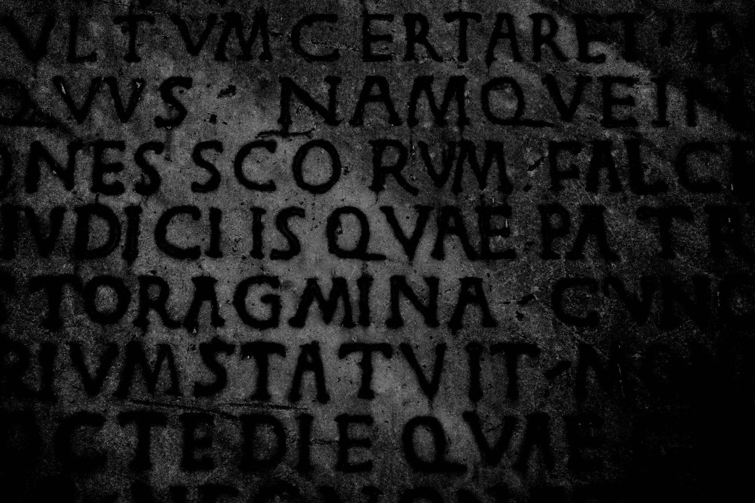
FLUX ACADEMY
BEAT 09 · MAIN TEACHING
The Frame Is Born From the Conversation
— When something intrigues you, walk up and ask instead of shooting from a distance
— A genuine conversation earns intimacy the lens can't fake
— The strongest human frames come from the connection, not despite it
Notes:
Here's how it works in practice. When you notice someone doing something that intrigues you — a gesture, a ritual, a small act of care — the instinct of most photographers is to shoot from a distance and move on. Do the opposite. Walk up and ask what they're doing. Let a real conversation unfold — minutes, not seconds. When you finally raise the camera, you're photographing from inside a relationship, not outside it. The most intimate, emotionally full frames come from that connection. They could not exist without it.

Slide 11
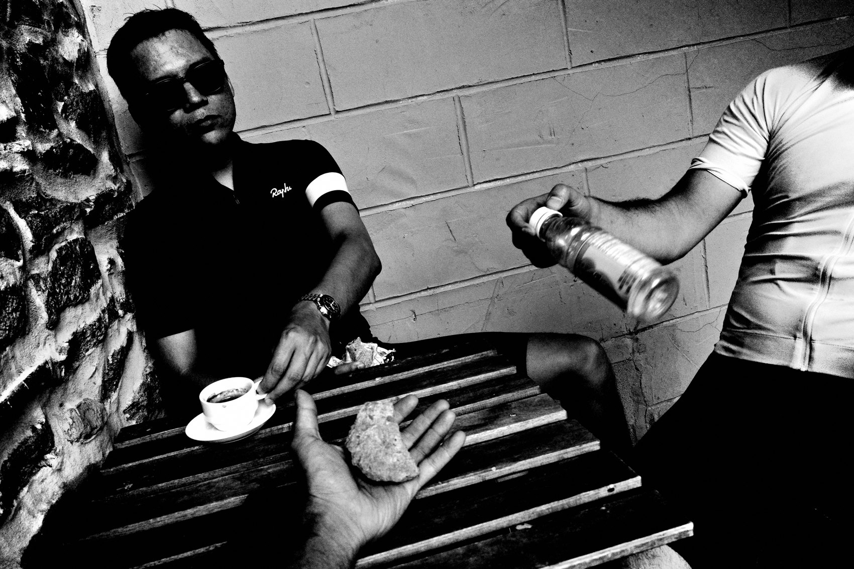
FLUX ACADEMY
BEAT 10 · MAIN TEACHING
Simple Gestures Carry Big Meaning
— Smiles, quiet reflections, simple gestures tell stories of resilience
— The small is the monumental
— Each of these moments tells a story of resilience and hope
Notes:
You don't need dramatic scenes to champion humanity. A hand reaching out. Someone lost in thought. A gesture of care between two people. These small, quiet moments carry the full weight of what it means to be human — resilience, hope, connection. Your job is to recognize them and honor them with the frame.

Slide 12

FLUX ACADEMY
BEAT 11 · MAIN TEACHING
Elevate, Don't Just Capture
— When you photograph life, hold it up high — Dante
— Elevation is an act of interpretation, not documentation
— The photograph adds dignity the casual eye might miss
Notes:
There's a line I keep coming back to: when you photograph life, hold it up high and elevate the experience of what it means to be human. That word — elevate — is the whole assignment. You're not just capturing what's there. You're lifting it. Presenting it as the extraordinary thing it actually is.

Slide 13
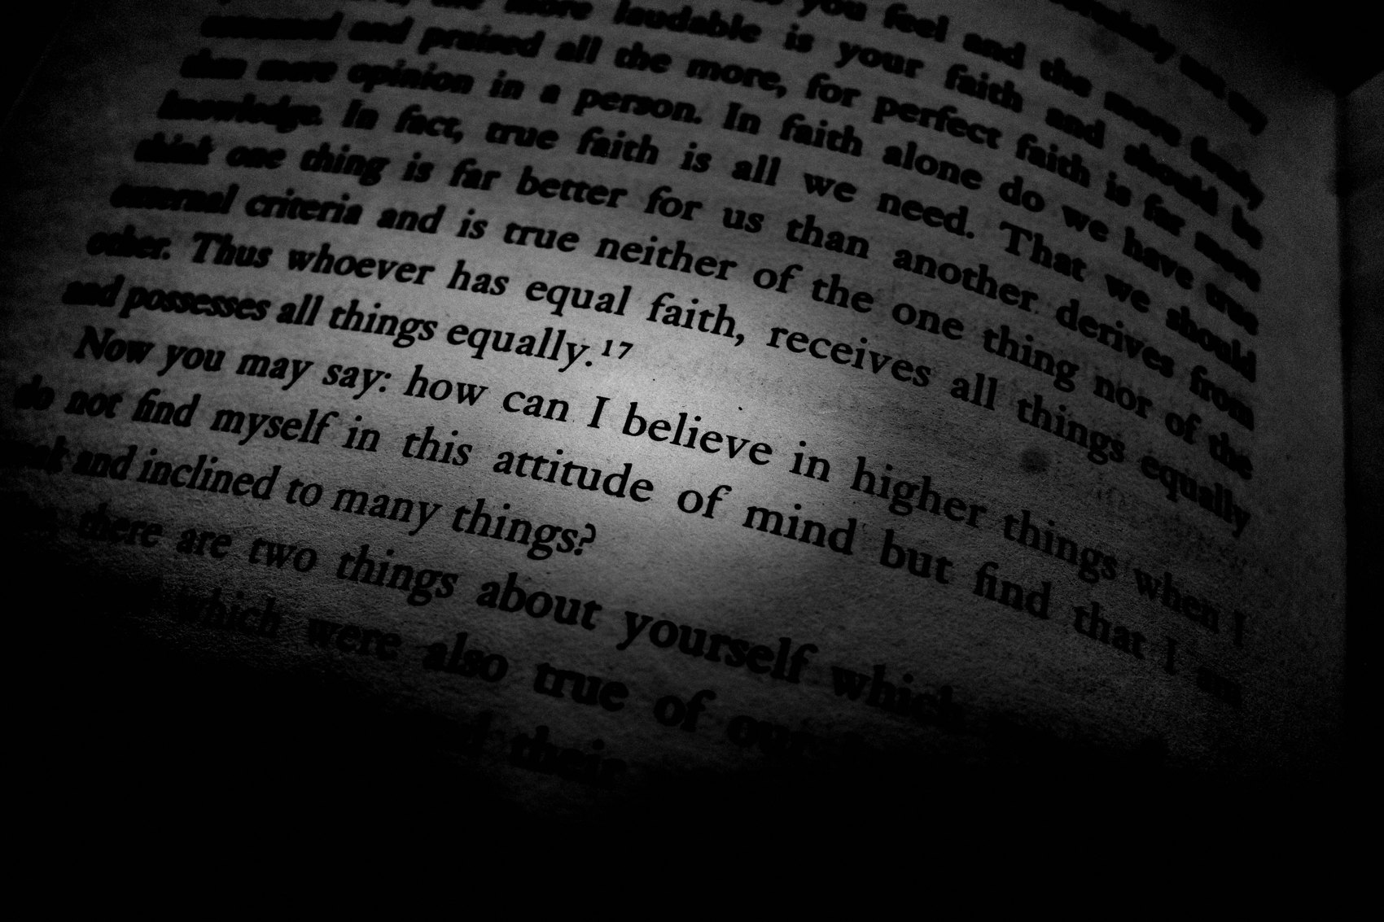
FLUX ACADEMY
BEAT 12 · MAIN TEACHING
The Extraordinary in the Ordinary
— Most of life is people moving from A to B — and that's enough
— Beauty hides in simplicity; your eye has to be trained to find it
— The mundane is the canvas for championing humanity
Notes:
Most of life is ordinary. People walking. Waiting. Working. And that's exactly the canvas. When you walk the streets with the mindset that every ordinary person is a hero, the mundane stops being an obstacle and starts being the whole point. You don't need something special to happen — you need to see what's already there.

Slide 14

FLUX ACADEMY
BEAT 13 · MAIN TEACHING
Join the Joy Before You Photograph It
— When you find people in a moment of joy, join it rather than observe it
— Talk, laugh, dance — become part of the energy
— Frames full of gesture and emotion come from play and presence, not pursuit
Notes:
Here's another way in. Sometimes a day feels quiet, nothing obviously happening — and then you stumble on people lost in a moment of pure joy, dancing, laughing, alive. The temptation is to snipe it from the edge. Don't. Approach. Talk. Laugh. Dance with them. Become part of the energy instead of an observer of it. It's from inside that state of play and genuine connection that you make frames full of gesture and emotion. Those images are a testament to human joy — and they only exist because you showed up as a human being first.

Slide 15
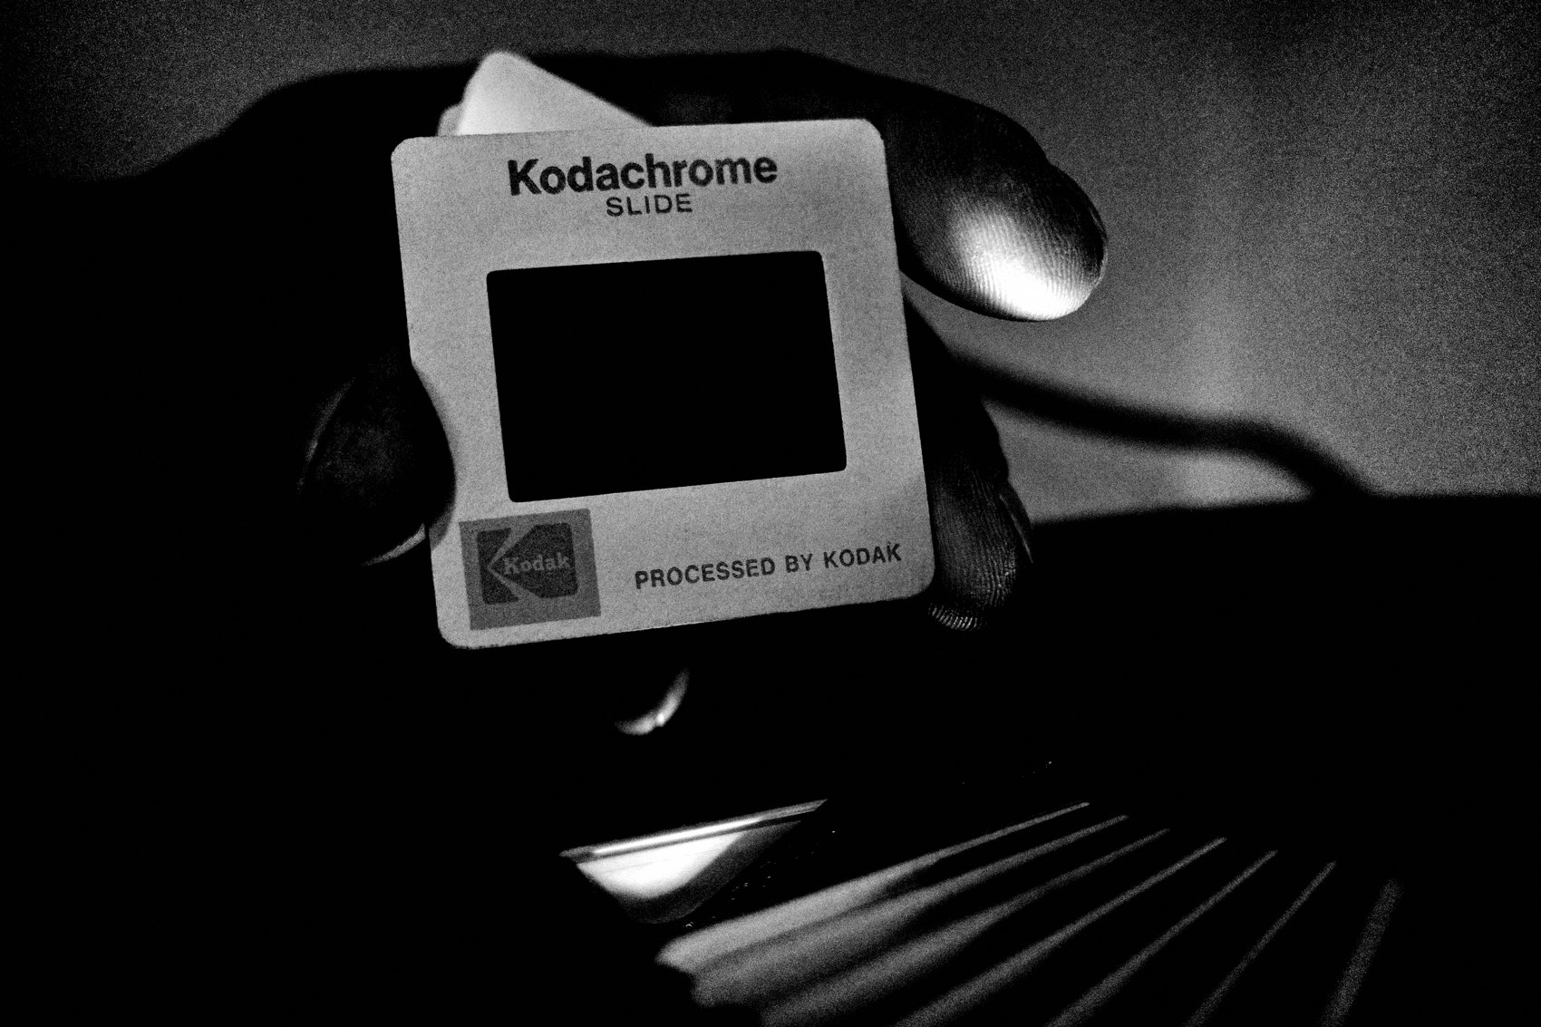
FLUX ACADEMY
BEAT 14 · MAIN TEACHING
The Instax as a Tool for Connection
— Gifting Instax prints opens doors and builds trust
— Elders, children, strangers — a print says you matter
— Connection enables deeper, more intimate photographs
Notes:
One of the most practical tools I use to champion humanity on the street is an Instax camera. When you gift a print to a stranger — an elder, a child, anyone — you're giving them something that says: I see you, and I think you're worth holding onto. That act of gifting opens doors that no amount of technical skill ever could.

Slide 16

FLUX ACADEMY
BEAT 15 · MAIN TEACHING
Golden Light Turns Ordinary People Into Myth
— Put yourself in the great light and stay long enough to be there when it peaks
— Ordinary people caught in golden hour take on the weight of legend
— The goal: elevate the everyday, turn real people into myths
Notes:
One more principle. Chase the great light and be willing to work for your position — climb, crouch, wade in, get where the light is doing its most dramatic work. When golden hour hits and ordinary people are moving through it — leaping, running, alive — they stop looking ordinary. A body launching through low, warm light can look like a Greek demigod. That's the goal in a single frame: elevate the everyday. Catch real people in the right light and reveal the myths they already are.

Slide 17

FLUX ACADEMY
BEAT 16 · MAIN TEACHING
A Shared Journey, Reflected Back
— Photography captures the shared human experience
— Reminding others to see the beauty in every face, every interaction
— Your images become a testament — to resilience, dignity, connection
Notes:
Ultimately, the photographs we make become a kind of testament. Not just to the individuals in the frame, but to the shared journey we're all on. When someone looks at your image and sees their own humanity reflected back — something they recognize in a stranger's face or gesture — that's the work succeeding at the deepest level.

Slide 18

FLUX ACADEMY
BEAT 17 · PRACTICAL APPLICATION
Approach One Stranger Today
— Go out today with the single intention of connecting before shooting
— Ask one stranger a question — what they're doing, where they're going
— Let the photograph emerge from the conversation
Notes:
Here's your assignment: go out today and approach one person before you photograph them. Ask a question — what are you doing, what is this place to you? Talk for a few minutes. Then, if it feels right, photograph. Notice what the image contains that your usual frames don't. That is what championing humanity feels like in practice.

Slide 19
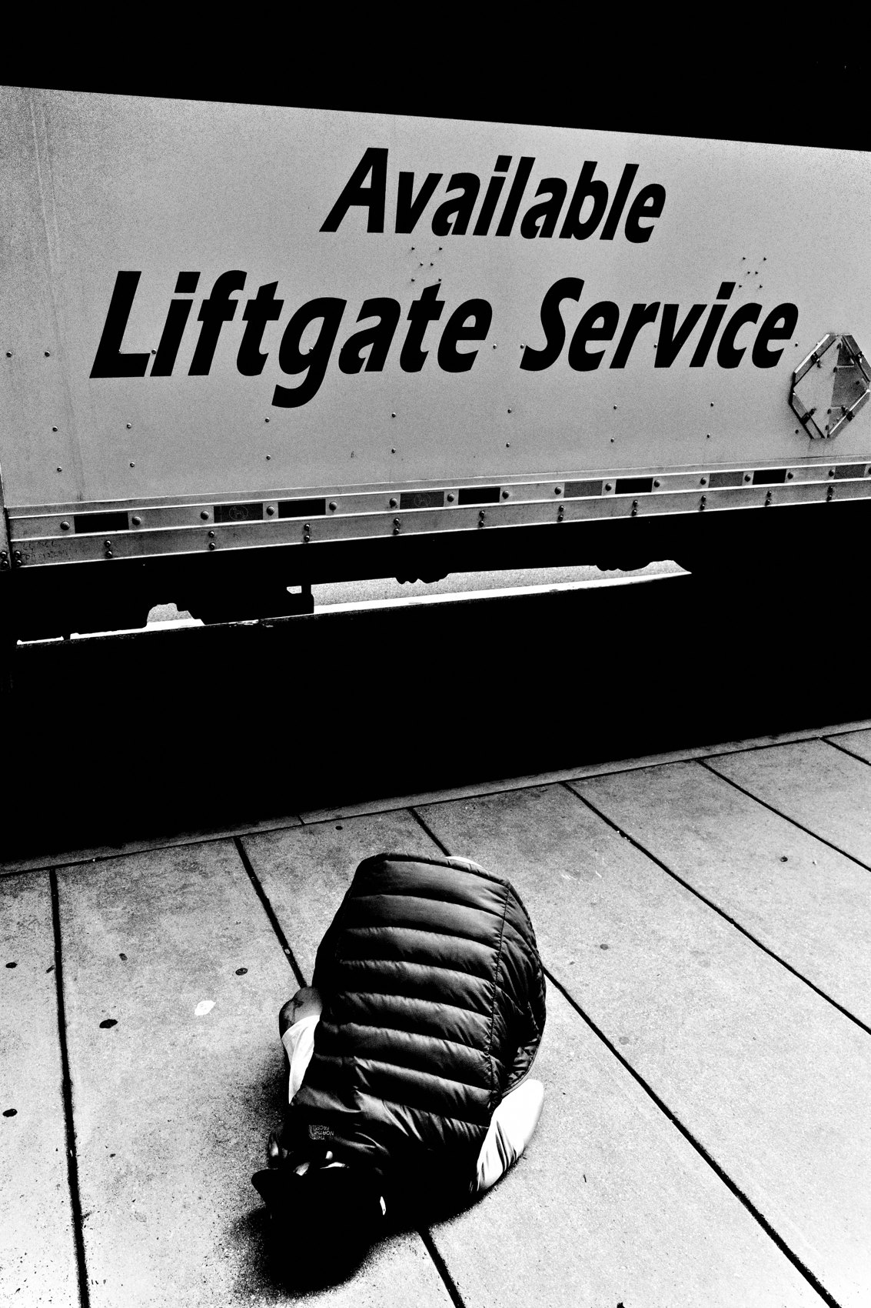
FLUX ACADEMY
BEAT 18 · PRACTICAL APPLICATION
The Hero Reframe
— Before raising the camera, silently say: this person is a hero
— Let that thought change how you frame, how close you get, how long you stay
— Build this as a pre-shoot ritual
Notes:
Build a simple ritual: before you raise the camera to anyone, take one breath and remind yourself — this person is a hero in their own story. Feel what that does to your posture, your proximity, your patience. It's a tiny mental shift with enormous photographic consequences.

Slide 20

FLUX ACADEMY
BEAT 19 · COMMON MISTAKES
Using People as Props
— Treating subjects as compositional elements rather than human beings
— The frame looks clever but feels empty — no soul, no connection
— Ask: does this image honor the person in it?
Notes:
The most common mistake when it comes to humanity in street photography is treating people as compositional props — elements in your geometry rather than the whole point. You end up with technically interesting frames that feel cold. Ask yourself honestly: does this image honor the person in it? If the answer is no, you've got composition without soul.

Slide 21
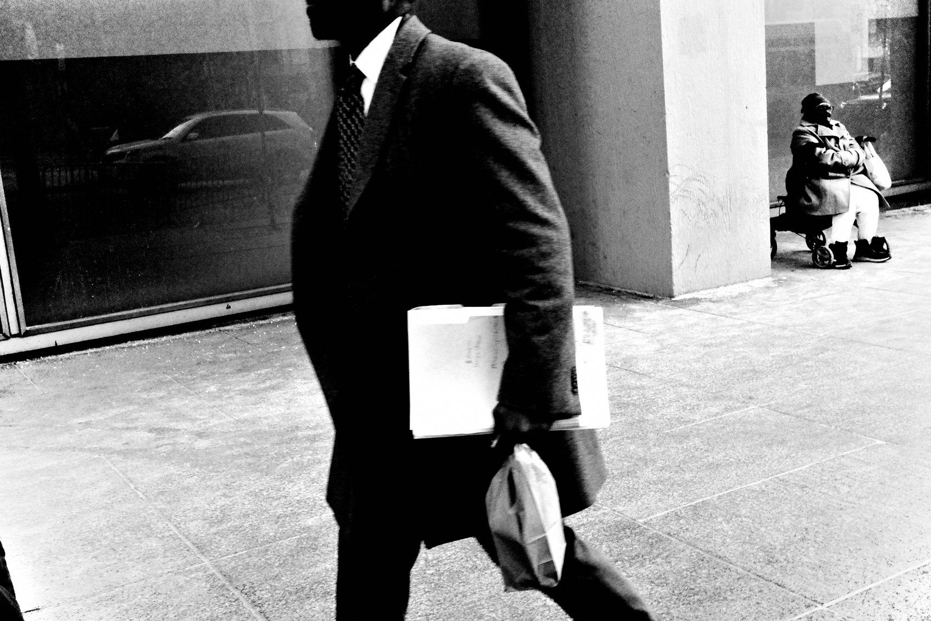
FLUX ACADEMY
BEAT 20 · COMMON MISTAKES
Shooting from Fear, Not Love
— Staying far away out of fear produces distant, impersonal images
— Fear of rejection keeps you from the frames that matter most
— Courage — heart — is the antidote
Notes:
The other mistake is shooting from fear — keeping your distance, staying invisible, never engaging. I understand the impulse, but it costs you everything. The images feel it. There's a coldness to a photograph made from behind the safety of distance. Courage — cor, heart — is what closes that gap and lets the real photograph through.

Slide 22
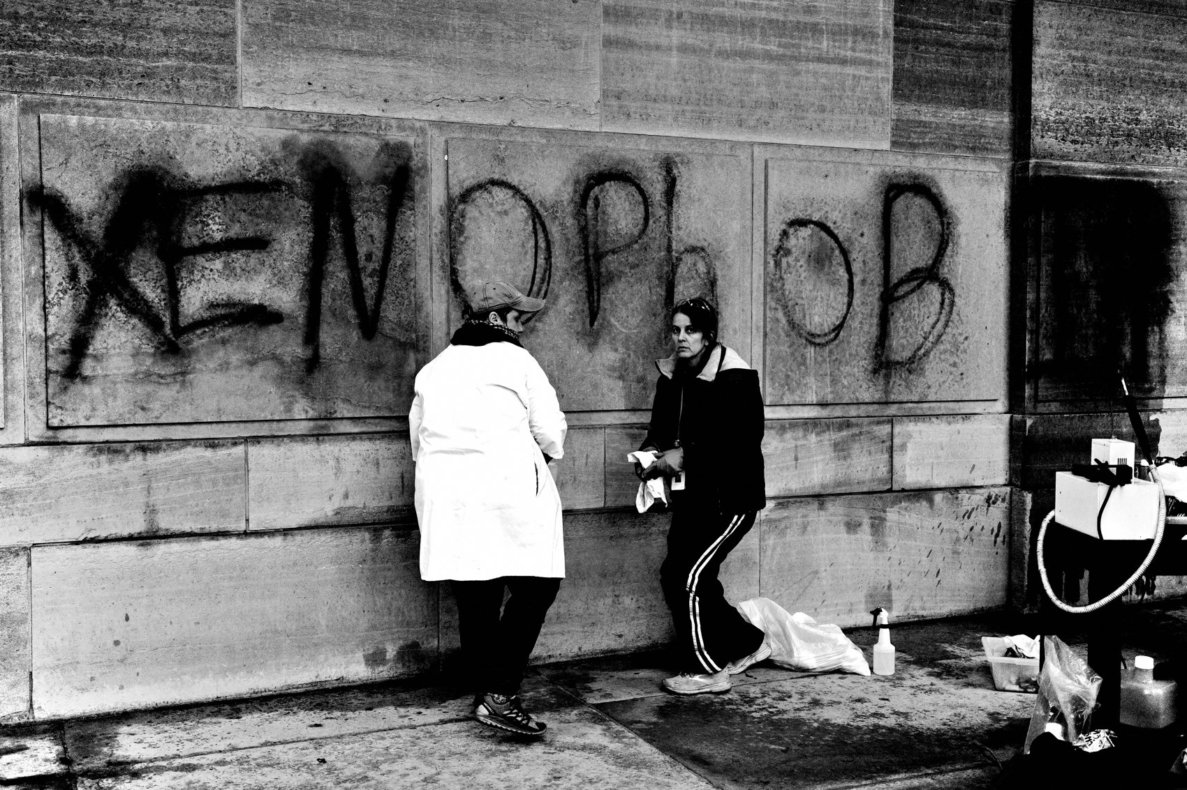
FLUX ACADEMY
BEAT 21 · RELATIONSHIP TO PREVIOUS
Building on How You See People
— Lesson 037 established how you look at people and moments
— This lesson deepens that into why — the philosophy of honoring your subjects
— Seeing leads to championing
Notes:
Lesson 037 laid the groundwork for how we look — the observational practice, the attentiveness to people and moments. This lesson takes that looking and gives it a why. It's not enough to see clearly; you have to see with reverence. Championing humanity is the purpose that makes all that careful observation meaningful.

Slide 23

FLUX ACADEMY
BEAT 22 · RELATIONSHIP TO UPCOMING
From Championing to Storytelling
— Lesson 039 extends this into the deeper territory of storytelling
— Once you see people as heroes, you naturally start asking: what is their story?
— Championing is the foundation; storytelling is the next floor
Notes:
Once you start seeing every person as a hero worth honoring, the natural next question is: what is their story? Lesson 039 takes us into that territory — how to build narrative depth into your street work. Championing humanity is the foundation. Storytelling is what gets built on top of it.

Slide 24

FLUX ACADEMY
BEAT 23 · SUMMARY / TAKEAWAY
Hold Life Up High
— Every person on the street is a hero in their own story
— When you photograph life, hold it up high — Dante
— See with compassion and curiosity. Connect before you shoot. Elevate.
Notes:
Last thing. The goal of street photography isn't to collect interesting frames — it's to champion humanity. Every person you pass is a hero with a story worth honoring. See them with compassion and curiosity. Be human first. Get close with your heart. And when you raise that camera, hold life up high. That's what this whole practice is for. Catch you in the next one — peace.

