Slide 1
FLUX ACADEMY · A SCHOOL FOR SEEING
MODULE 6 · LIGHT & BLACK-AND-WHITE
Breakdown IV — Light
BY DANTE SISOFO

Slide 2

FLUX ACADEMY
BEAT 01 · CORE IDEA
Light Is the First Instinct
— Light is the first thing to gravitate toward
— Not just pretty — it structures the entire frame
— The move that begins every strong frame: see the light, go to it
Notes:
What's popping, people — it's Dante. Today we're going deep on light — not as a technical setting on your camera, but as the first instinct that pulls you toward a scene. Before you think about subject, before you think about composition, one thing should move your feet: you see the light, and you go to it. That's where every strong frame begins.

Slide 3
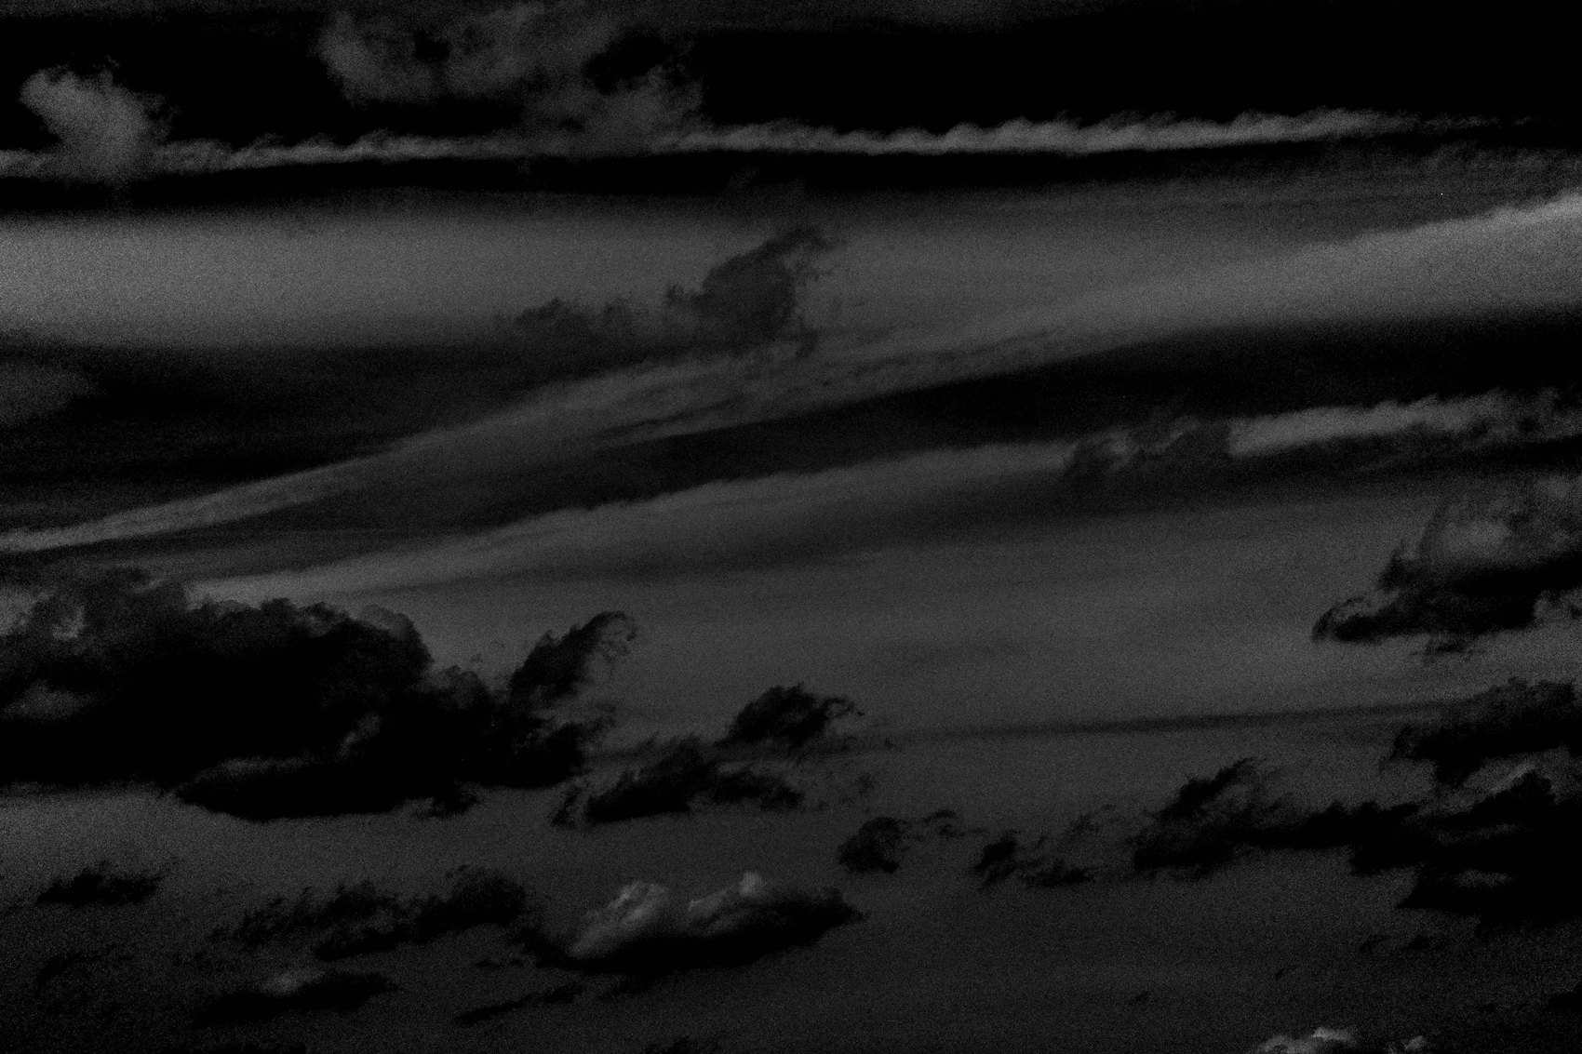
FLUX ACADEMY
BEAT 02 · LEARNING OBJECTIVE
What You'll Walk Away With
— How to read light before anything else
— Why golden hour is a reliable anchor for your practice
— How to let light structure foreground, middle ground, and background
Notes:
By the end of this lesson you'll understand how light functions as both the trigger and the structure of a photograph. You'll know how to use it to find your stage, separate your subjects, and create layered complexity — and you'll have a clear practice you can apply every time you step outside.

Slide 4
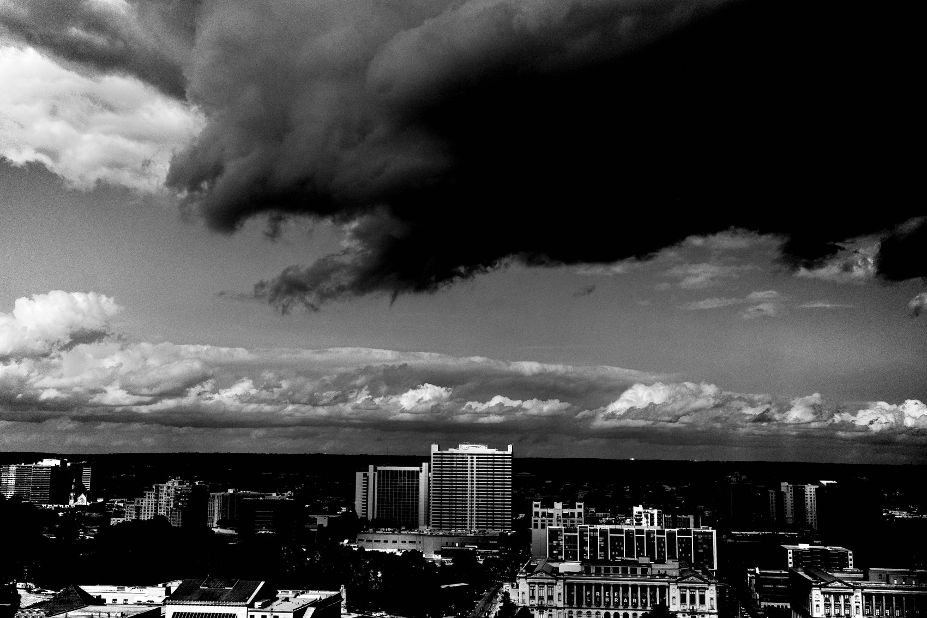
FLUX ACADEMY
BEAT 03 · WHY THIS MATTERS
Bad Light Doesn't Mean No Photo
— Don't only shoot golden hour
— Rain, fog, shade, and overcast all carry power
— Light conditions shape mood — all of them
Notes:
Here's why this matters: most people only shoot when the light is "perfect." But some of my most powerful photographs came from fog, rain, and stormy skies. Light isn't just sunshine — it's atmosphere, mood, and energy. Learn to read all of it, and you never have a reason to stay home.

Slide 5
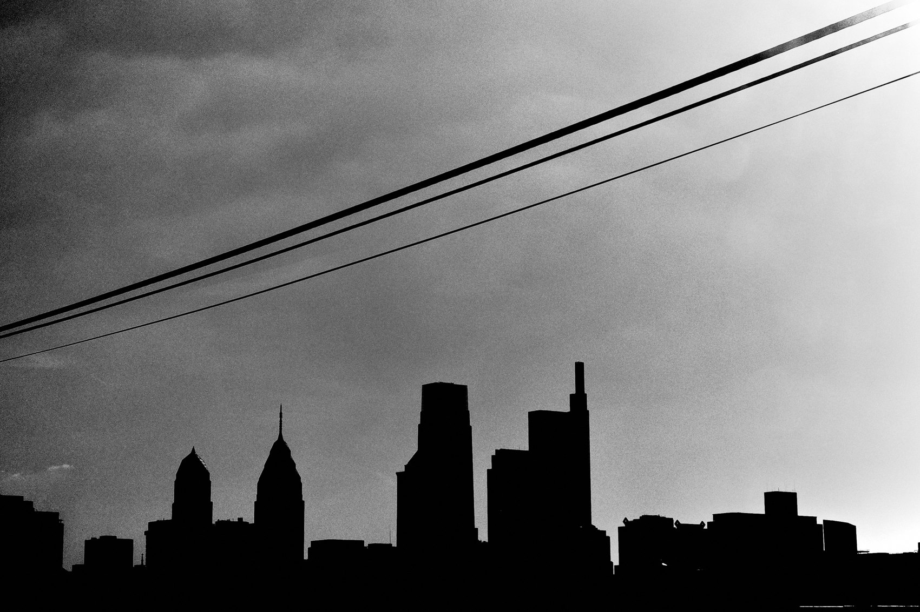
FLUX ACADEMY
BEAT 04 · WHY THIS MATTERS
Light Tells You Where to Stand
— Light reveals your stage
— It tells you where to plant your body
— The frame builds itself once you find the source
Notes:
And here's the deeper reason this matters: light doesn't just look good — it tells you exactly where to stand. When I find a beam, a shadow, a golden patch on a wall, that's the stage. I plant myself there and wait for life to walk in. Light is your co-director.

Slide 6
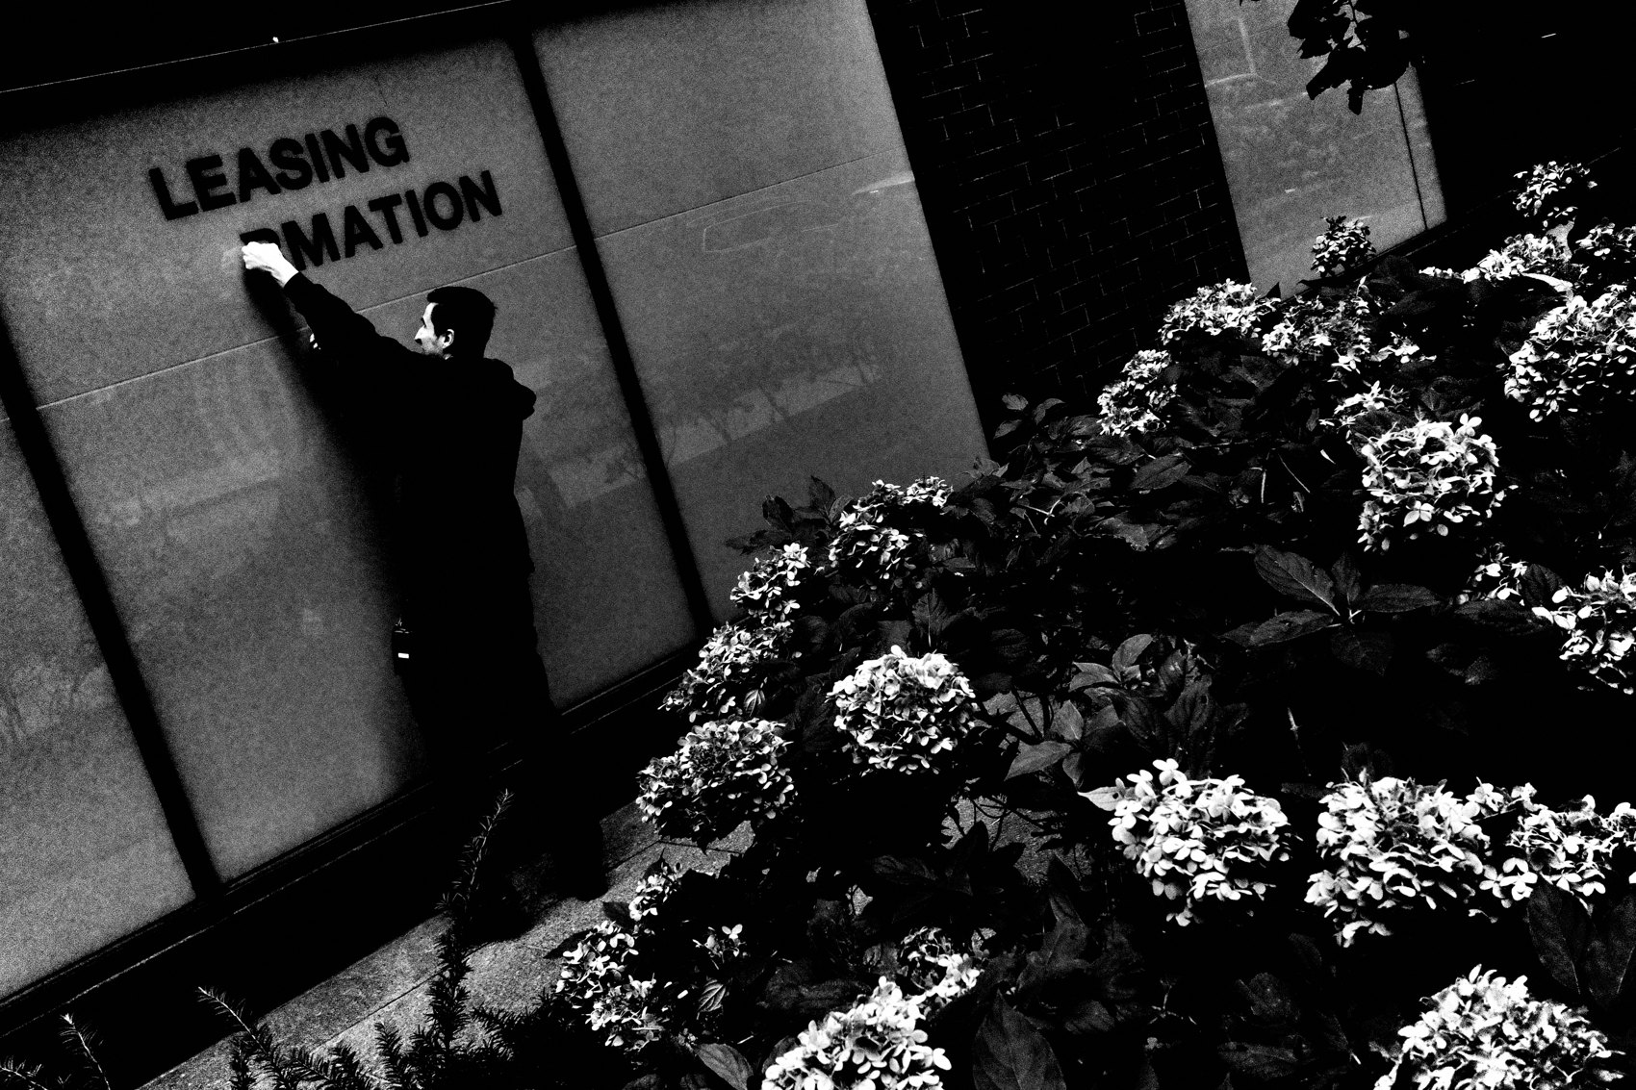
FLUX ACADEMY
BEAT 05 · MAIN TEACHING
Golden Hour Is a Ready-Made Stage
— The low, warm light of the golden hour turns ordinary surfaces alive
— A lit wall with shadows moving across it is a stage before anyone acts on it
— Follow the light to the surface first, then let the scene fill it
Notes:
The hour after sunrise and the hour before sunset are a gift, because the light comes in low and warm and turns ordinary surfaces alive. A flat wall becomes a glowing backdrop. Long shadows stretch across the ground and start moving as people pass. When you find a surface like that catching golden light, you've found a stage — and it's a stage before anyone even steps onto it. So don't plan the composition first. Follow the light to that surface, plant yourself, and let the scene fill in. That's always the first move.

Slide 7

FLUX ACADEMY
BEAT 06 · MAIN TEACHING
Light Pulls You In, Humanity Fills It Out
— Once the light hands you a stage, close the physical distance
— Approach openly and honestly — being a student is a real reason to ask
— Emotional proximity mirrors physical proximity
Notes:
The light gives you the stage, but people give you the photograph — so once you've found the light, close the distance. Approach openly. Tell them honestly what you're doing; being a student, being curious, being sincere is reason enough to ask. That openness is what lets you get close, and physical proximity carries emotional proximity — the nearer you stand, the more the viewer feels they're inside the moment with you. You can even let your own shadow fall into the frame as a foreground element. Light pulls you in; humanity fills it out.

Slide 8

FLUX ACADEMY
BEAT 07 · MAIN TEACHING
Gravitate Toward Where the Light Lives
— Choose locations for their light, not for their subject
— Some places simply glow at certain hours — an open sky, water, a west-facing wall
— Trust the light to show you something; don't arrive with a shot in mind
Notes:
Here's a habit worth building: pick where you shoot by the light, not by the subject. Some places just glow at certain hours — an open western sky, water throwing the sun back at you, a wall that catches the last warm hour. When you know a spot lights up like that, keep going back to it. Don't arrive with a specific shot in your head. Follow the light and trust that it will hand you something worth photographing. Show up where the light lives, again and again, and it will.

Slide 9

FLUX ACADEMY
BEAT 08 · MAIN TEACHING
Light Separates the Layers For You
— A clean, glowing sky is a backdrop that makes everything in front of it read
— Place your near subject low; let the lit sky hold the upper frame
— When the light is right, foreground, middle, and back all stay readable at once
Notes:
When the light is right, it does the hardest compositional job for you — it separates your layers. A clean, glowing sky is the simplest example: place a near subject low in the frame and let that lit sky hold the upper half, and suddenly the front element sits crisply against an uncluttered background. Add a second subject deeper in and the light keeps them apart too — each plane readable because the light is doing the separating. You're not fighting a busy background anymore. Get the light right and the layers hold themselves.

Slide 10
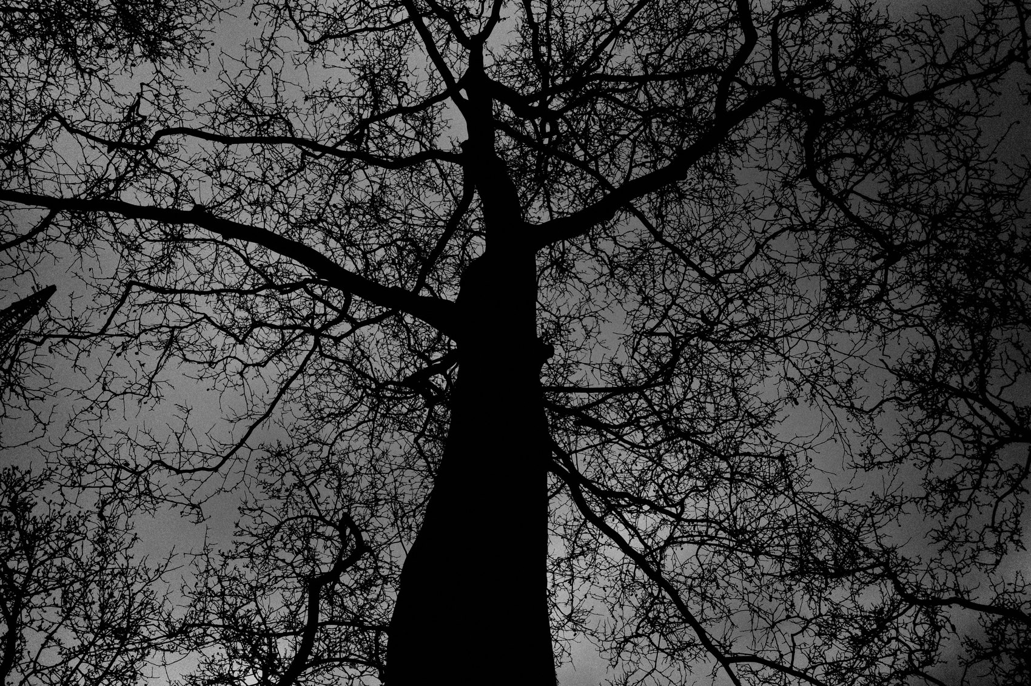
FLUX ACADEMY
BEAT 09 · MAIN TEACHING
Atmospheric Light Sets Mood
— Not all light is golden — fog and mist are light too
— Mist scatters light, softens the background, and drips everything in mood
— When the atmosphere is doing the work, compose back to front and let it breathe
Notes:
Not all light is golden, and some of the most atmospheric light shows up when the weather turns. Fog and mist are light — they scatter it, soften it, and wrap a scene in mood. Distant lights bloom and reflect off wet surfaces; the background falls away into a soft wash that isolates whatever's near you. When the atmosphere is doing that much work, your job is to stay out of its way: compose back to front, anchor on a strong distant shape, and let the mist do what it does. Mood and atmosphere become the whole photograph.

Slide 11
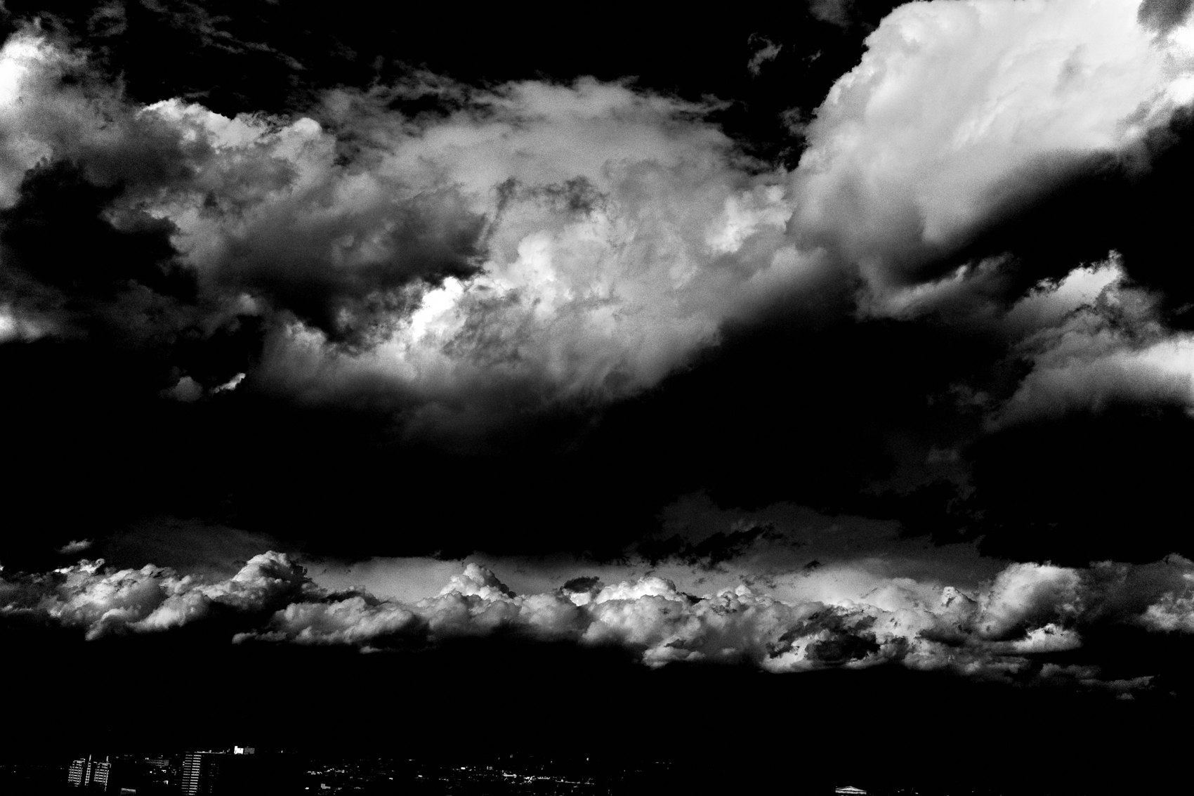
FLUX ACADEMY
BEAT 10 · MAIN TEACHING
Follow Your Inner Desire
— Go to the places you genuinely love — you'll be there when the light turns
— Curiosity and desire put you in position; you can't schedule magic
— The magic finds people who keep showing up
Notes:
Here's the lesson inside the lesson: go where you love. The best light rarely arrives on a schedule you can plan for — the unexpected fog, the freak storm sky, the one evening the whole street lights up. You can't manufacture those moments. But you can be standing there when they happen, and you'll be standing there if you keep returning to the places that genuinely pull at you. Follow your inner curiosity, follow your inner desire, put yourself in position — and the magic finds you.

Slide 12
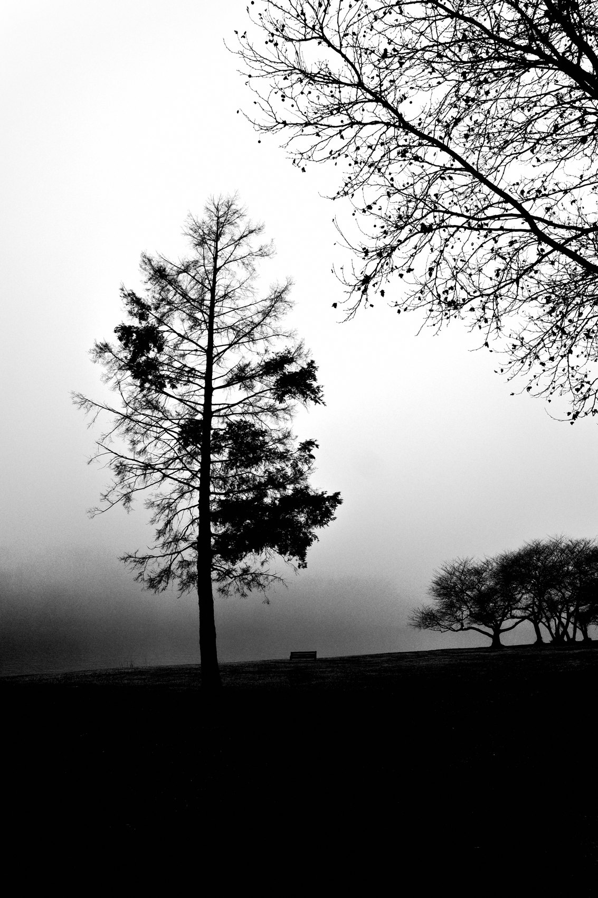
FLUX ACADEMY
BEAT 11 · MAIN TEACHING
Shoot Every Condition
— Rain isn't a problem to wait out — it's atmosphere and drama
— Wet streets throw reflections; people huddle and cluster under cover
— Being out in bad weather forces tight, layered compositions you'd never plan
Notes:
Rain is not a reason to stay home — it's atmosphere handed to you for free. Wet pavement turns into a mirror, throwing color and light back up into the frame. People cluster and huddle under shelter, which packs a scene with gesture and emotion. And when you're squeezed under an awning yourself, that tight space forces compositions you'd never construct on a dry, easy day — leading lines pulling back into the street, figures pressed close, texture everywhere. You don't need perfect light. You need to be out there, in every condition, ready.

Slide 13

FLUX ACADEMY
BEAT 12 · MAIN TEACHING
The Choke Point Strategy
— Find where reflected light pools — glass and towers bounce golden hour into the street
— Lock your backdrop at a choke point and wait for people to enter it
— Half a face in light, half in shadow is a decisive moment worth waiting for
Notes:
In a dense city, golden hour doesn't only come straight from the sun — it bounces off glass towers and reflective facades and pools in the street below. Find where that reflected light lands, place yourself at a choke point where people funnel through, lock in your backdrop, and wait. The payoff is the split-light moment: a subject enters and one side of the face catches the light while the other drops into shadow. That contrast is the photograph. Light plus patience equals layers — you build the stage, the light dresses it, and the moment walks in.

Slide 14
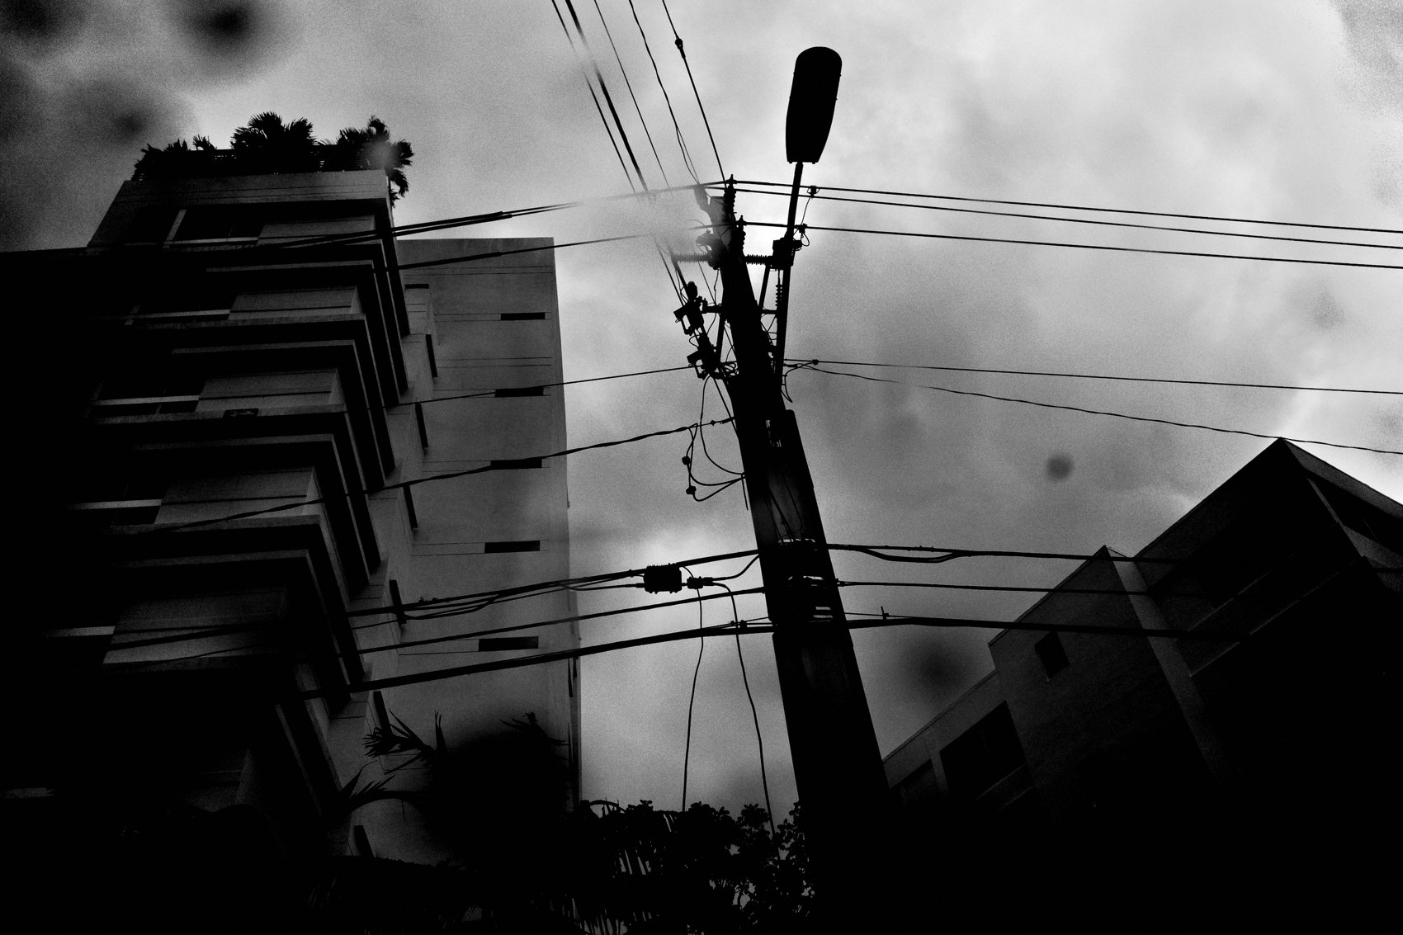
FLUX ACADEMY
BEAT 13 · MAIN TEACHING
Shadow as the First Instinct
— Look for the shadow before you look for the subject
— Shadow is a compositional element — it draws lines, hides, reveals
— Small position shifts let light reveal exactly the detail you want
Notes:
Train yourself to see the shadow before you see the subject. Light and shadow should be the first thing your eye lands on, because shadow is a compositional element in its own right — it draws lines across the ground, it hides what you want hidden, and it reveals the one detail you want revealed. And it's precise: a shift of a step or a drop of a few inches changes what the light picks out. Move until the light catches exactly the thing that matters — an eye, a hand, a face — and lets the rest fall dark. You don't always plan these alignments; intuition puts you in the right spot, and the light makes them visible.

Slide 15
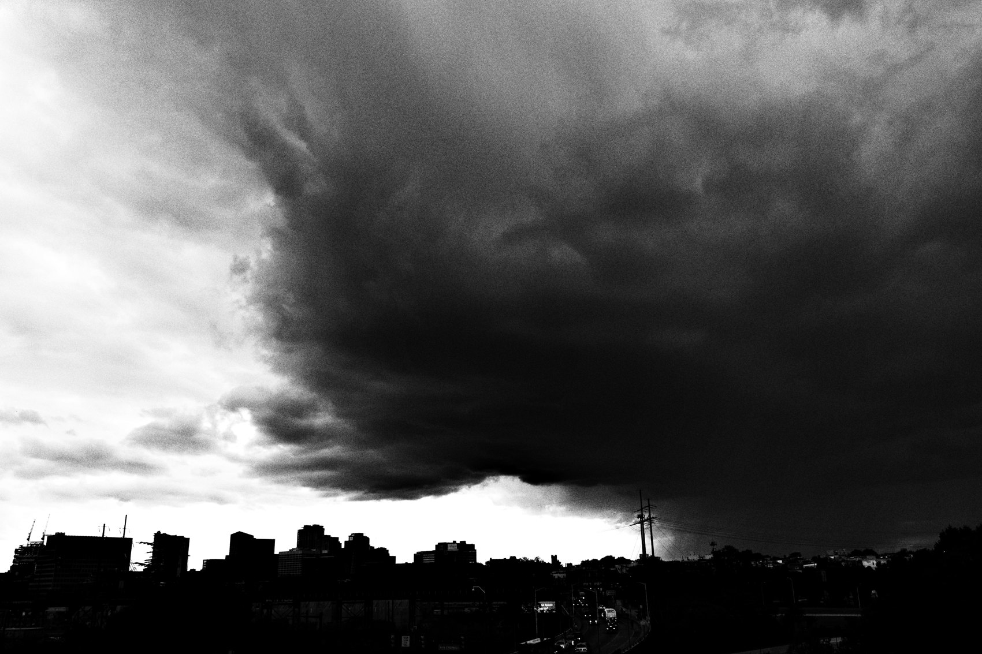
FLUX ACADEMY
BEAT 14 · MAIN TEACHING
A Dramatic Sky Is a Stage
— Stormy, dramatic light overhead turns a whole scene into a set you can't walk past
— Once the light hands you the stage, move until foreground and background align
— Line a near subject up inside a background shape — a bullseye you find only by repositioning
Notes:
Sometimes the light is overhead — a stormy, dramatic sky that turns an entire scene into a set you can't walk past. When that light hands you a stage, the work becomes alignment: recognizing the possibility and then moving your body until the pieces lock. Watch for the bullseye — a moment when a near subject lines up perfectly inside a shape further back, a head sitting inside a circle, a figure framed by an arch. You can't find that standing still; you find it by physically repositioning inch by inch. Recognize the light, recognize the stage, then move until it clicks.

Slide 16
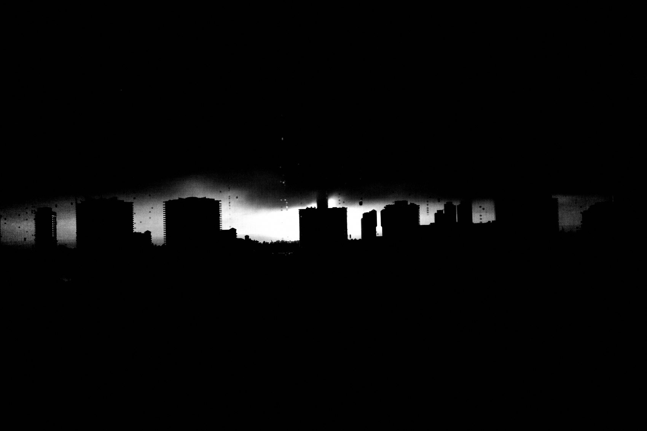
FLUX ACADEMY
BEAT 15 · MAIN TEACHING
Light Demands Physical Response
— Photography is physical: drop lower, shift position, align the pieces
— Light shows you the possibility; your body finds the frame
— Moving to the light is the whole practice condensed
Notes:
Here's the thread running through everything so far: light shows you the possibility, but your body finds the frame. Seeing the light is only half the work. Drop lower. Shift left. Step closer. Move until the light separates your subjects, clears your background, and the composition locks. Light is not passive and neither are you — it demands a physical response every single time. The photographers who get the frame are the ones who keep moving after they've seen it.

Slide 17

FLUX ACADEMY
BEAT 16 · MAIN TEACHING
Return to the Same Location
— Return to the same place over and over — light is learnable
— Comfort leads to access; access leads to closer, better moments
— Each visit you chip away, get more comfortable, get more anticipatory
Notes:
One of the most practical things you can do is return to the same location again and again. The first visit you're a stranger fumbling with the light. By the fifth, people recognize you, they let you get closer, and — most importantly — you know exactly how the light moves across that place hour by hour. You can anticipate it. You can be standing in the right spot before it even arrives. You learn a location's light by spending time there, not by showing up once. Pick a few spots and wear them in.

Slide 18
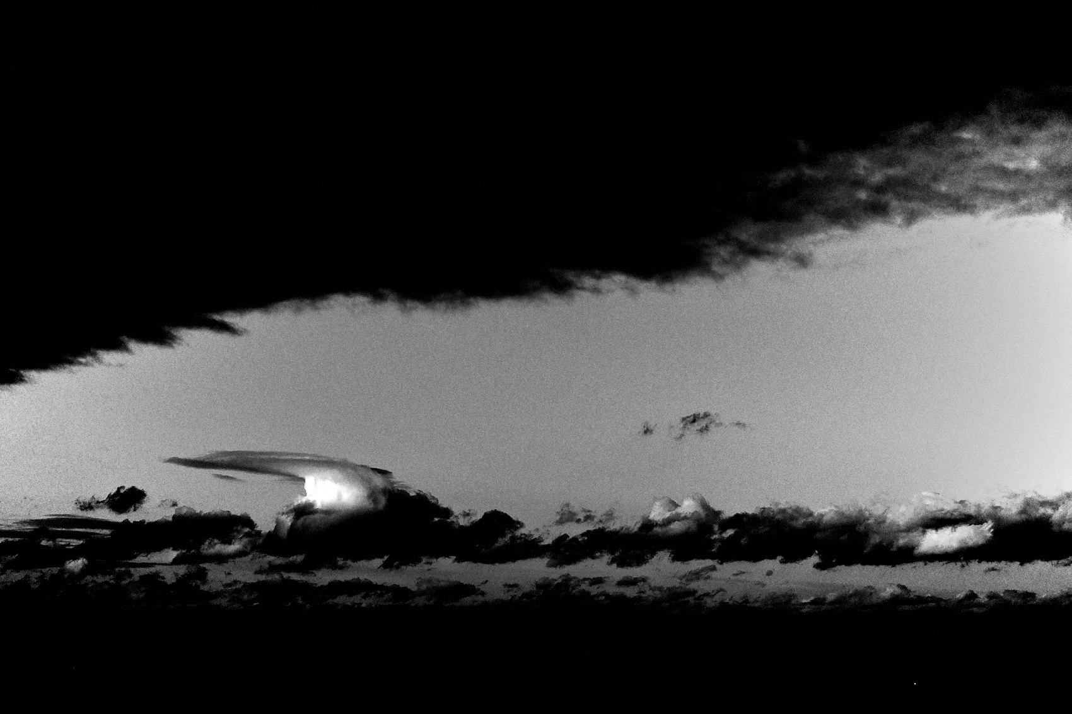
FLUX ACADEMY
BEAT 17 · PRACTICAL APPLICATION
Chase Golden Hour With Intention
— Pick one location you love and go at golden hour three days running
— Study how the light changes your stage each day
— Let the light tell you where to plant your feet
Notes:
Your first assignment: pick one location — somewhere you already love — and go at golden hour three days in a row. Don't force a photo. Study how the light falls differently each day. Where does it hit the wall? Where does it create shadow? Let the light show you the stage. By day three, you'll know exactly where to stand.

Slide 19
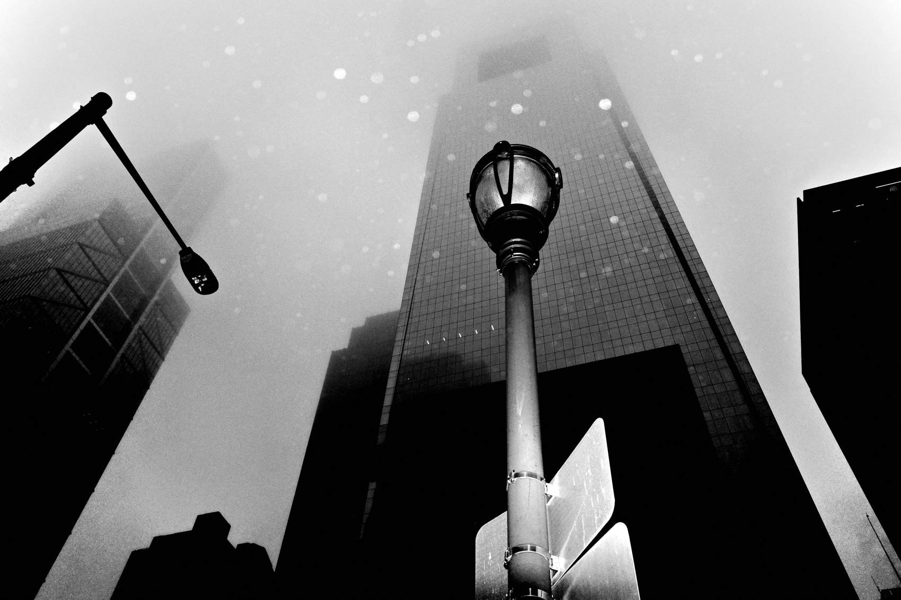
FLUX ACADEMY
BEAT 18 · PRACTICAL APPLICATION
Shoot One Challenging Condition
— Go out in rain, fog, or heavy overcast this week
— No excuses about imperfect light
— Mood and atmosphere replace golden tones — use them
Notes:
Second assignment: this week, go out in one condition you'd normally skip. Rain. Fog. Deep overcast. Leave the house anyway. Notice how the mood shifts — the reflections on the wet pavement, the way fog flattens the background and isolates your subject. Challenging light doesn't ruin photographs. It changes what kind of photograph you make. That's the whole lesson.

Slide 20
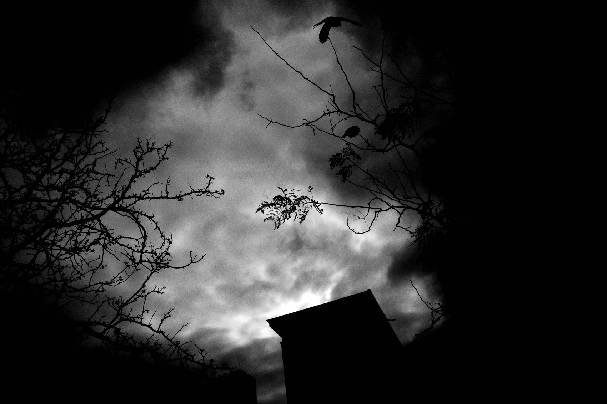
FLUX ACADEMY
BEAT 19 · COMMON MISTAKES
Waiting for Perfect Light
— Most people stay home when the light isn't golden
— Fog, rain, shade, and even harsh midday sun all have photographic power
— "You don't need perfect light to make a great photo"
Notes:
The most common mistake I see: waiting for perfect light. People only leave the house at golden hour, and only when the sky cooperates. But fog, rain, flat overcast, even harsh midday sun — all of it has power. I've made some of my strongest photographs in the rain with no umbrella. Be out there. The light you're waiting for is never as important as the moment you'd miss by staying home.

Slide 21
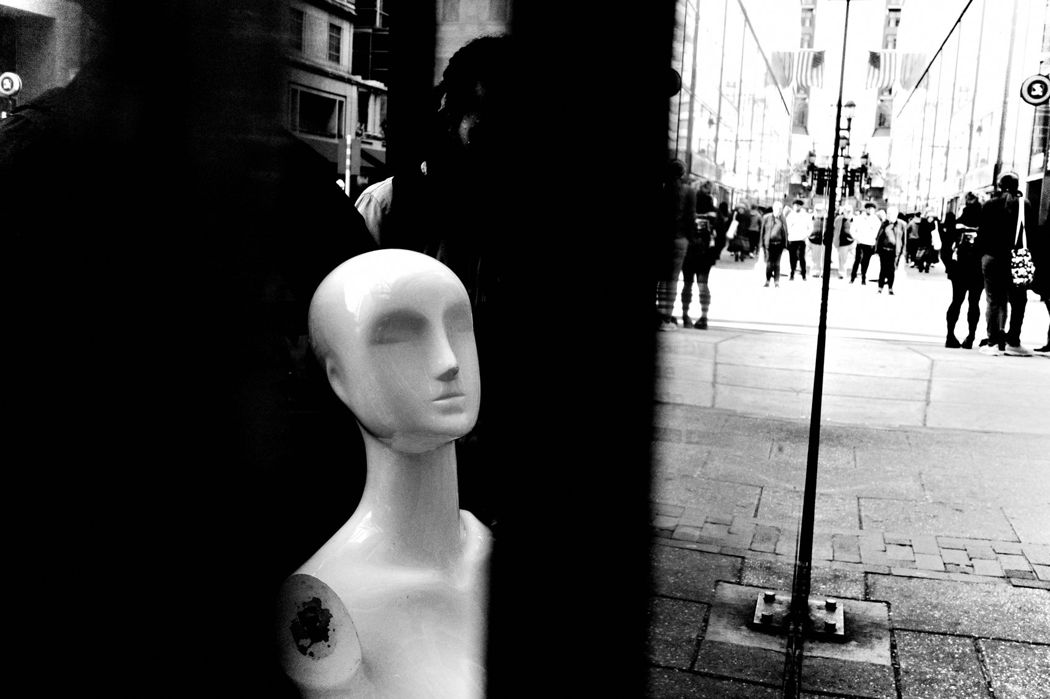
FLUX ACADEMY
BEAT 20 · COMMON MISTAKES
Seeing Light but Not Moving
— Noticing light isn't enough — you have to physically respond
— Most photographers stop too soon
— One more step, one lower angle, one shift left can save the frame
Notes:
The second mistake: you see the light but you don't move. You notice a beautiful fall of shadow or a golden patch on a wall, you raise the camera — and you shoot from exactly where you're standing. That's half the work. The other half is moving your body until the light does exactly what you need it to do. One more step. One lower angle. Don't stop until the frame locks.

Slide 22
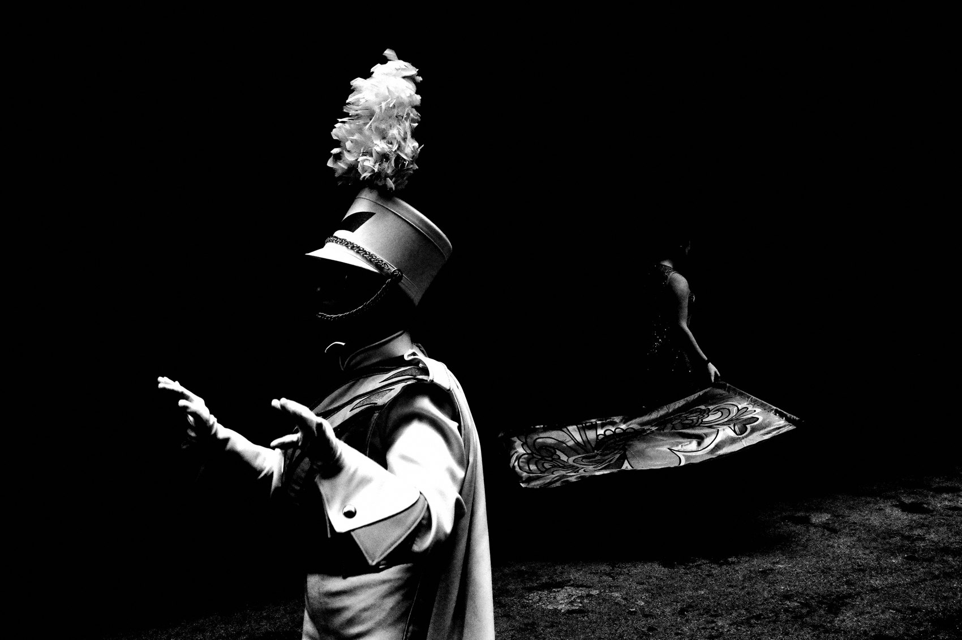
FLUX ACADEMY
BEAT 21 · RELATIONSHIP TO PREVIOUS
Building on Gesture and Timing
— Lesson 034 covered gesture and timing as the core of the decisive moment
— Now light becomes the stage that holds the gesture
— This lesson adds the environmental layer underneath everything before it
Notes:
In Lesson 034 we went deep on gesture and timing — how to read a body in motion and press the shutter at the right moment. Now we're adding the layer underneath all of that: light is the stage that makes the gesture readable. A great gesture in flat, dead light disappears. Put it in golden hour, or fog, or dramatic shadow — and it lives. These two ideas work together.

Slide 23
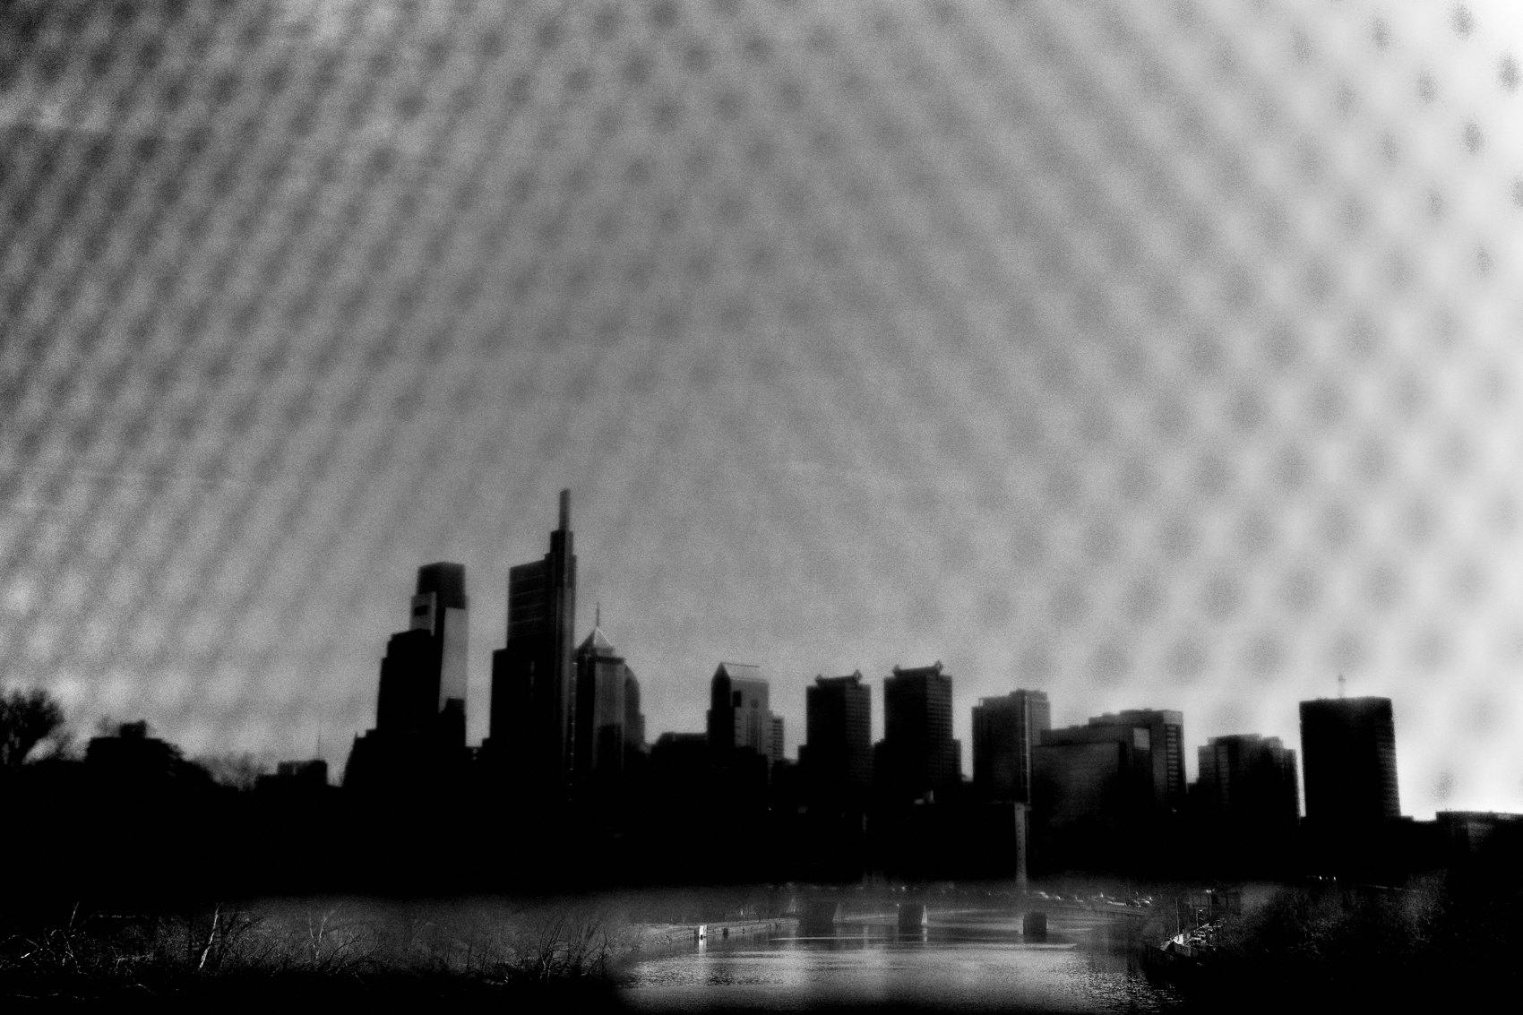
FLUX ACADEMY
BEAT 22 · RELATIONSHIP TO UPCOMING
Setting Up Composition and Layering
— Lesson 036 takes on composition and layering — the full visual architecture
— Light separates planes; composition organizes them
— The next lesson builds that architecture on the foundation laid here
Notes:
In Lesson 036 we take on the full architecture of composition — foreground, middle ground, background all working together in a single frame. Today's light work sets that up perfectly: light is what separates the planes and makes each layer readable. Next lesson we learn how to organize what the light reveals. Stay with it — the full picture is coming together.

Slide 24

FLUX ACADEMY
BEAT 23 · SUMMARY / TAKEAWAY
Follow the Light, Then Move
— Light is the first instinct — follow it before anything else
— It structures your stage, separates your subjects, creates your mood
— Follow the light, plant your body, wait for life to walk in
Notes:
Last thing. It all starts the same way: you see the light, and you move toward it. Not toward a subject, not toward a composition — toward the light. It shows you the stage. Then you plant your feet, adjust your body, and wait for life to walk in. That's the whole practice condensed. Follow the light. Move until the frame locks. Then press the shutter. Catch you in the next one — peace.

