Slide 1
FLUX ACADEMY · A SCHOOL FOR SEEING
MODULE 6 · LIGHT & BLACK-AND-WHITE
Light-Led Composition
BY DANTE SISOFO

Slide 2

FLUX ACADEMY
BEAT 01 · CORE IDEA
Light Leads, You Follow
— Light doesn't just illuminate — it composes
— The frame begins with light, not with subjects
— Follow the light; the photograph finds itself
Notes:
What's popping, people — it's Dante. Today we're talking about light-led composition — one of the most powerful ideas I've ever brought into my own shooting. Here's the core of it: light isn't just what you expose for, it's what you compose with. Before you think about subjects, gestures, or layers — find the light. The photograph grows from there.

Slide 3

FLUX ACADEMY
BEAT 02 · LEARNING OBJECTIVE
What You'll Walk Away With
— Understand light as the primary compositional force
— Learn to position your body in relation to light, not subjects
— Walk away with a repeatable light-first approach for any city, any time
Notes:
By the end of this lesson you'll have a complete framework for building compositions around light — not chasing subjects, not waiting for decisive moments, but reading the light first and letting everything else fall into place. This is a repeatable, portable approach that works in your home city, a foreign capital, or wherever the streets take you.

Slide 4

FLUX ACADEMY
BEAT 03 · WHY THIS MATTERS
Most Photographers Miss the Frame Before the Moment
— Most photographers wait for action — and miss the light already there
— Great light is temporary; a great subject can appear inside it
— Reordering your priorities changes what you see
Notes:
Here's the problem: most street photographers are waiting for something to happen. They want the decisive moment, the gesture, the expression. And meanwhile, a stunning beam of light is sitting right there — empty, temporary, waiting. Flip your priority. Find the light first. Then wait. The moment will come to you.

Slide 5
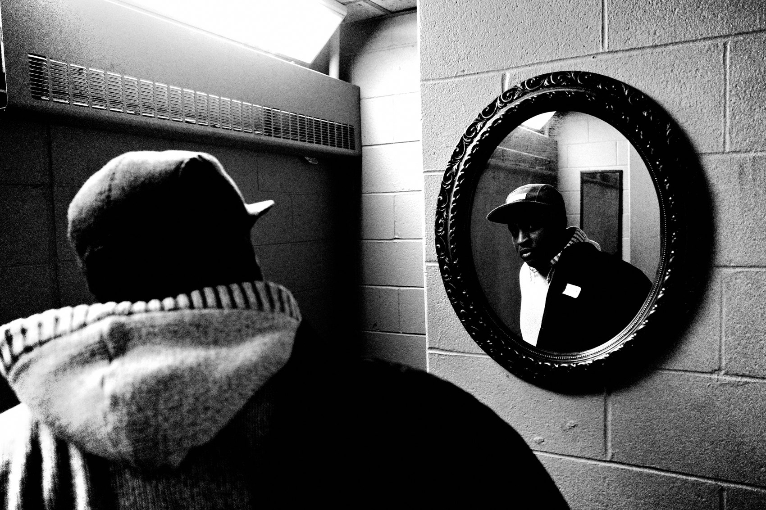
FLUX ACADEMY
BEAT 04 · WHY THIS MATTERS
Light Defines How You See and Compose
— Light gives shape and form to surfaces, people, and places
— Without light reading, composition is guesswork
— Visual understanding of light strengthens every frame you ever make
Notes:
And here's the deeper reason this matters: light defines how we see and compose a scene. It isn't separate from the composition — it is the composition. Having a visual understanding of how light interacts with a scene will enhance your ability to create stronger photographs every single time you raise the camera.

Slide 6

FLUX ACADEMY
BEAT 05 · MAIN TEACHING
The Three-Element Puzzle
— First element: a beam of light on a foreground object
— Second element: a silhouette anchoring the mid-ground
— Third element: a face stepping into light, adding emotional impact
Notes:
Think of it as a puzzle. Say you're working an ordinary spot — a bus stop, a corner where people wait and move. The first thing that draws you in is the light, not the people. You observe the interplay of light and shadow and you start solving: a beam on a pole in the foreground, a silhouetted figure in the mid-ground, someone entering the frame with their face lit — boom. Three elements, one light source, one frame. Treat it like a visual puzzle and the composition assembles itself.

Slide 7
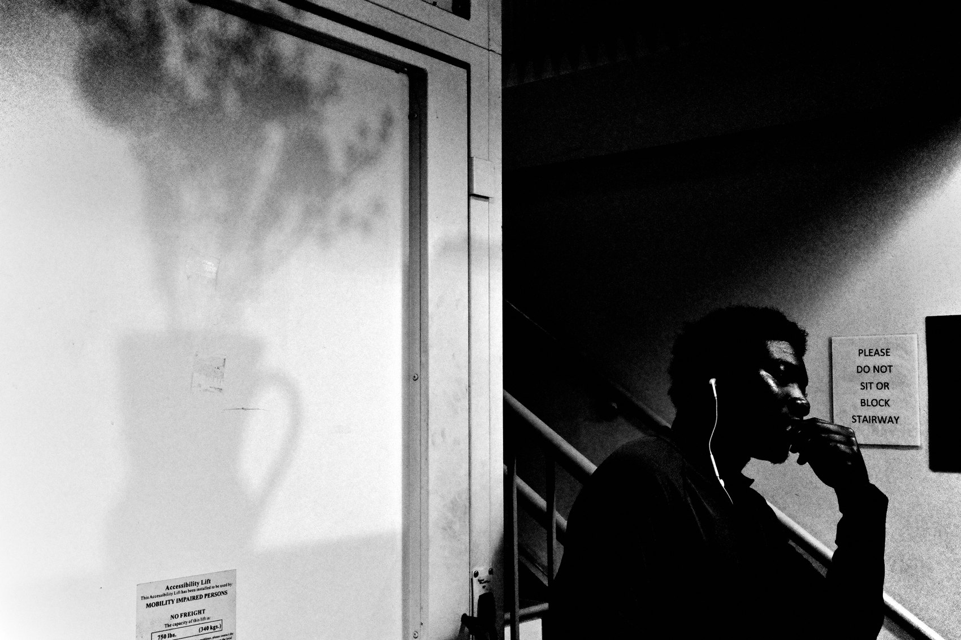
FLUX ACADEMY
BEAT 06 · MAIN TEACHING
Find a Choke Point and Stand Still
— A choke point concentrates people through the light
— Stand still; let the world move through your frame
— Snap focus, one meter — wait for the fish to swim in
Notes:
Find a busy choke point — a major station entrance, a crossing where crowds funnel through. Instead of wandering, stand still and let the world move around you. Snap focus locked at one meter. High contrast black and white cranked. Highlight-weighted metering crushing everything except the light. All you have to do is wait until someone steps from shadow into that one patch of sunlight — and click. Simple. Present. Deadly effective.

Slide 8
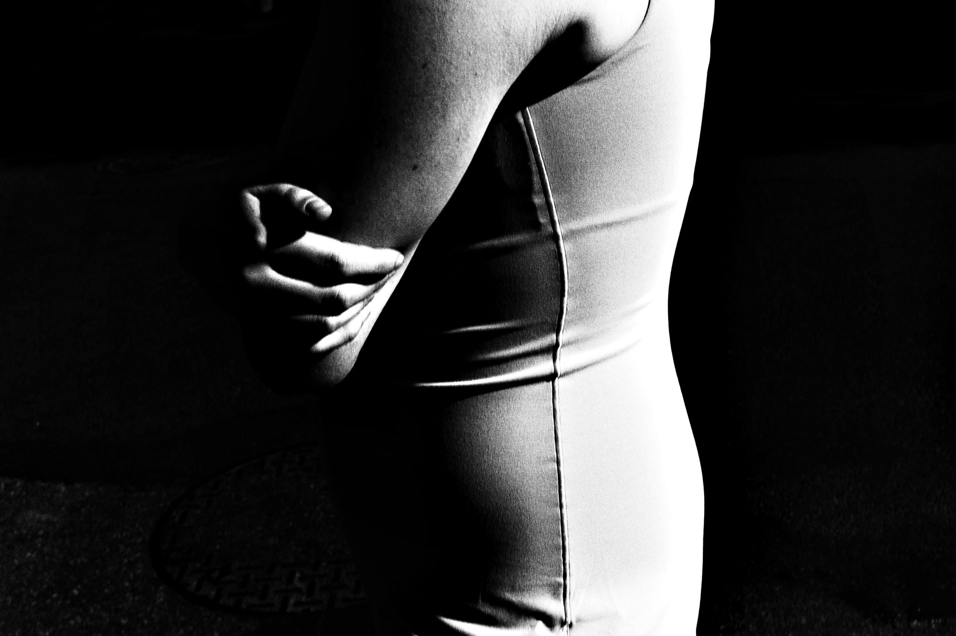
FLUX ACADEMY
BEAT 07 · MAIN TEACHING
You Only Control Three Things
— Where you stand
— When you click
— Where the subject is in relation to you
Notes:
Here's the liberating truth: in street photography, you only control three things — where you stand, when you click, and where the subject is relative to you. That's it. Light, movement, expressions, clothing — all out of your hands. So make the one decision you can make: position yourself so people step from shadow into light, and let the chaos do the rest.

Slide 9

FLUX ACADEMY
BEAT 08 · MAIN TEACHING
Let Light Reveal What You Can't Plan
— The camera sees what the eye misses
— Underexpose; let shadows crush; let light speak alone
— Mystery and drama come from what's not shown
Notes:
This is the part that still gets me every time. When someone walks into a narrow beam, the light can slice across just their lips — only the lips — the rest of the face swallowed by shadow. You could not have planned that. Light reveals things we don't consciously see in the moment. Most of the frame goes black, intentionally, maybe a second face barely lit in the background. That's the direction — more darkness, more mystery, more drama, more mood.

Slide 10

FLUX ACADEMY
BEAT 09 · MAIN TEACHING
Layering Light for Depth
— Foreground in shadow, mid-ground lit, background bright
— Layering adds depth and energy — the image feels alive
— Layers come from positioning, not complexity
Notes:
Layering isn't about cramming elements into a frame — it's about standing in the right place. Picture movement running through a scene: foreground in shadow, mid-ground subject lit, background glowing. That three-layer structure comes entirely from where you stand. Position yourself correctly and the layers appear on their own. You don't manufacture depth — you find it.

Slide 11
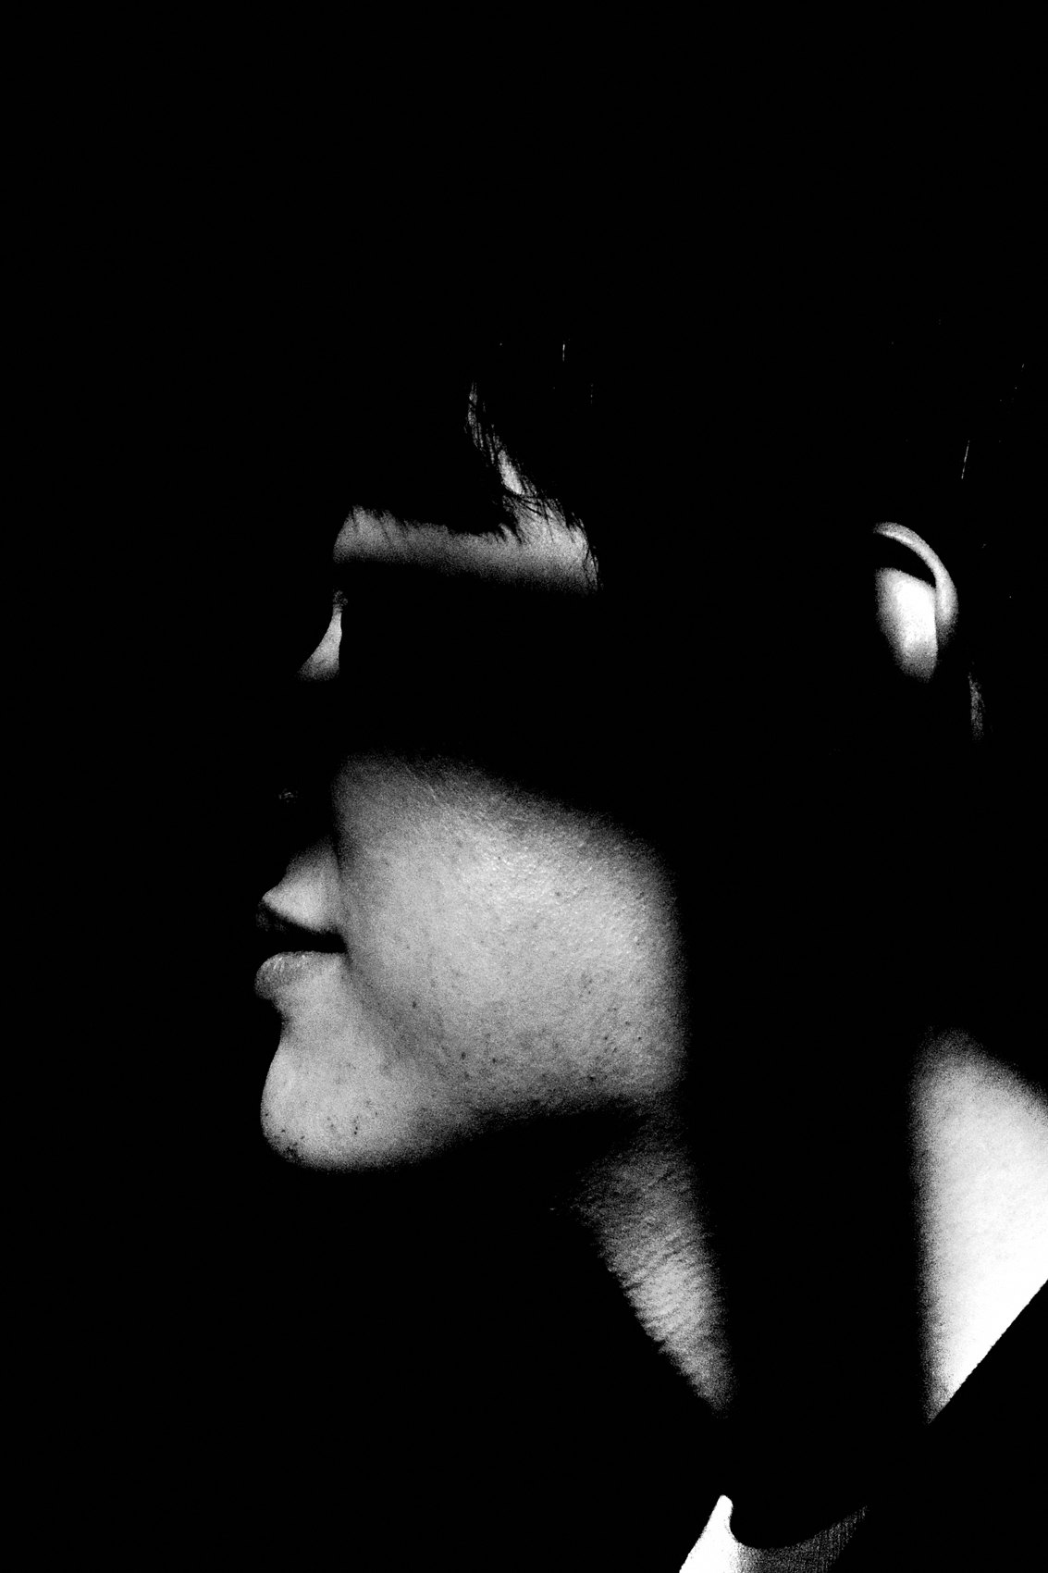
FLUX ACADEMY
BEAT 10 · MAIN TEACHING
High-Key vs. Low-Key Light
— High-key: bright, vibrant, evokes joy and innocence
— Low-key: deep shadows, cinematic feel, adds mystery and depth
— Both are valid — know which mood the light is already giving you
Notes:
Soft and harsh light both have their place — you just have to read which one you're standing in. High-key light, like people playing in bright open sun — vibrant, joyful, warm. Low-key light, where shadows go so deep that a single lit detail pops like it was painted — cinematic, mysterious. The light is already setting the mood. Your job is to recognize it and work with it, not against it.

Slide 12
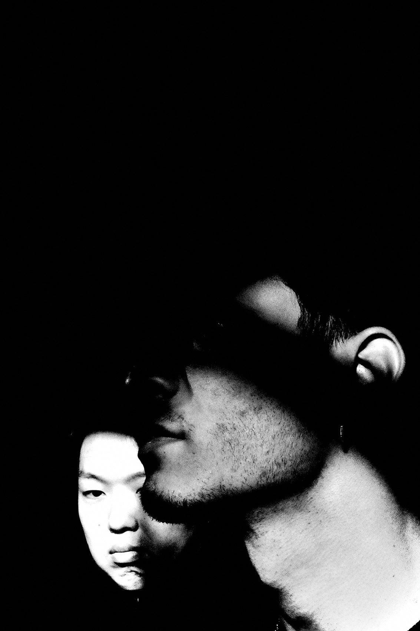
FLUX ACADEMY
BEAT 11 · MAIN TEACHING
Expose for the Highlights, Crush the Shadows
— Expose for highlights — let shadows go to black
— Underexpose by one stop to crush unnecessary detail
— Isolation through shadow is a compositional choice
Notes:
My go-to technical move: expose for the highlights and let the shadows crush. Underexpose by one stop and watch the unnecessary details disappear into black. What's left is exactly what you want the viewer to see. In black and white, this creates a chiaroscuro effect — like Caravaggio painting with a street corner. High contrast metering, highlight-weighted — the camera does the heavy lifting. By exposing for the highlights and isolating subjects in high contrast areas, we create cleaner, stronger compositions.

Slide 13

FLUX ACADEMY
BEAT 12 · MAIN TEACHING
Light Guides the Viewer's Eye
— Bright areas attract attention first
— Shadows create negative space, emphasizing the subject
— High contrast leads the eye through the scene in one clean path
Notes:
Picture a bustling market — noise everywhere — and one person turning back toward you, their gesture picked out by the contrast between deep shadow and bright highlight. Light guides the viewer's eye straight to that moment. No need for a complex composition. The light does the directing. Shadows create negative space; brightness pulls focus. That's light-led composition at its most direct.

Slide 14

FLUX ACADEMY
BEAT 13 · MAIN TEACHING
The Sun as a Theatre Spotlight
— Hard midday sun can spotlight the mid-ground while the foreground stays shadowed
— Simple light-play creates visual and emotional tension
— No action needed — light alone generates the drama
Notes:
Watch for the moments when hard sun casts a spotlight on the middle ground while the foreground stays shadowed. That's it. That's the whole composition. No extraordinary moment, no wild gesture — just the sun acting like a theatre spotlight on one patch of pavement. You position yourself, wait, and when a figure crosses into that light, the frame is already built. Light does the architecture; you just show up on time.

Slide 15
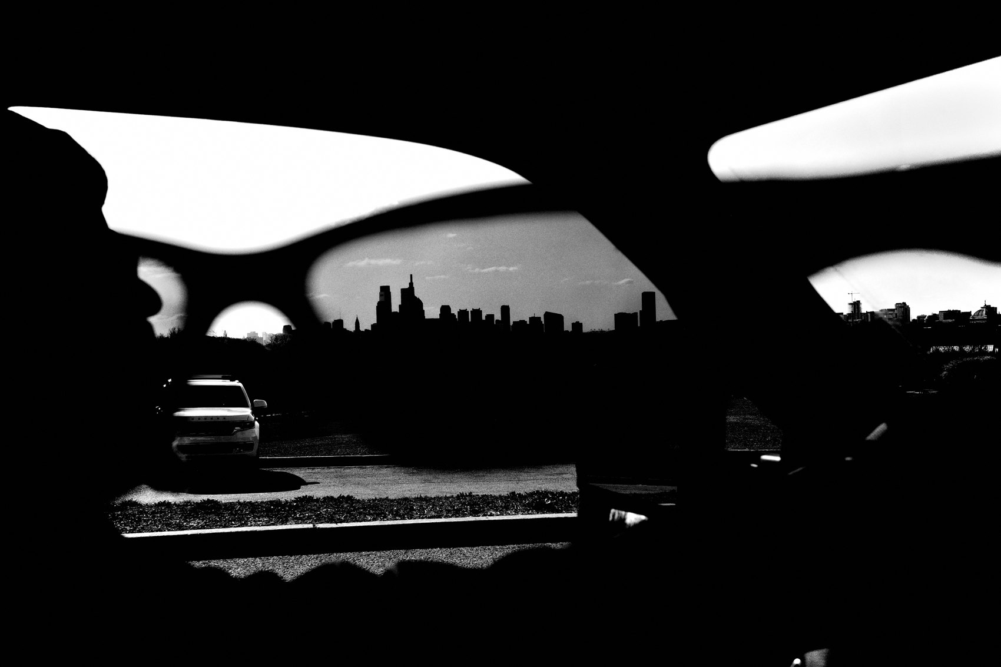
FLUX ACADEMY
BEAT 14 · MAIN TEACHING
Set Up on the Light, Not the Subject
— Let light on a wall or surface be what draws you, not a person
— Build on that light first; wait for someone to enter naturally
— Light creates the narrative before the person arrives
Notes:
Sometimes what intrigues you is simply how light falls on a wall — a painted surface, a texture, a stretch of color. Set up on that light. Don't wait for any particular person; wait for the light to do its work. Then someone walks into the frame naturally. The light alone told the story; the person completed it. This is the sequence: find the light, build around it, let life walk in. The narrative is already there. You just hold the door open.

Slide 16

FLUX ACADEMY
BEAT 15 · MAIN TEACHING
A Reflection Is Already a Composition
— A reflection of light in glass, water, or a discarded mirror can be the whole frame
— Wait with the camera ready; let a subject enter the reflection
— Light creates the composition; the subject seals the story
Notes:
Here's one worth training your eye for. A reflection of light — in a shop window, a puddle, even a broken mirror left in the trash — is already a composition before anyone is in it. So you wait, camera ready, and let a subject walk into that reflected light. The light created the narrative before the subject arrived. Follow the light, be curious about the light, let light guide your photography. The subject is the final ingredient, not the first.

Slide 17

FLUX ACADEMY
BEAT 16 · MAIN TEACHING
Reflections Amplify and Redirect
— Light bounces off glass, metal, water, windows
— Reflections create complex, layered compositions
— Use them to redirect and amplify light you've already found
Notes:
Light doesn't just illuminate — it bounces. Reflections off glass, metal, water, and windows can amplify and redirect light, making compositions more complex and interesting without you adding a single element. When you start reading the city for light, you start reading it for reflections too — every shop window, every puddle, every polished surface becomes a second light source you can compose through.

Slide 18
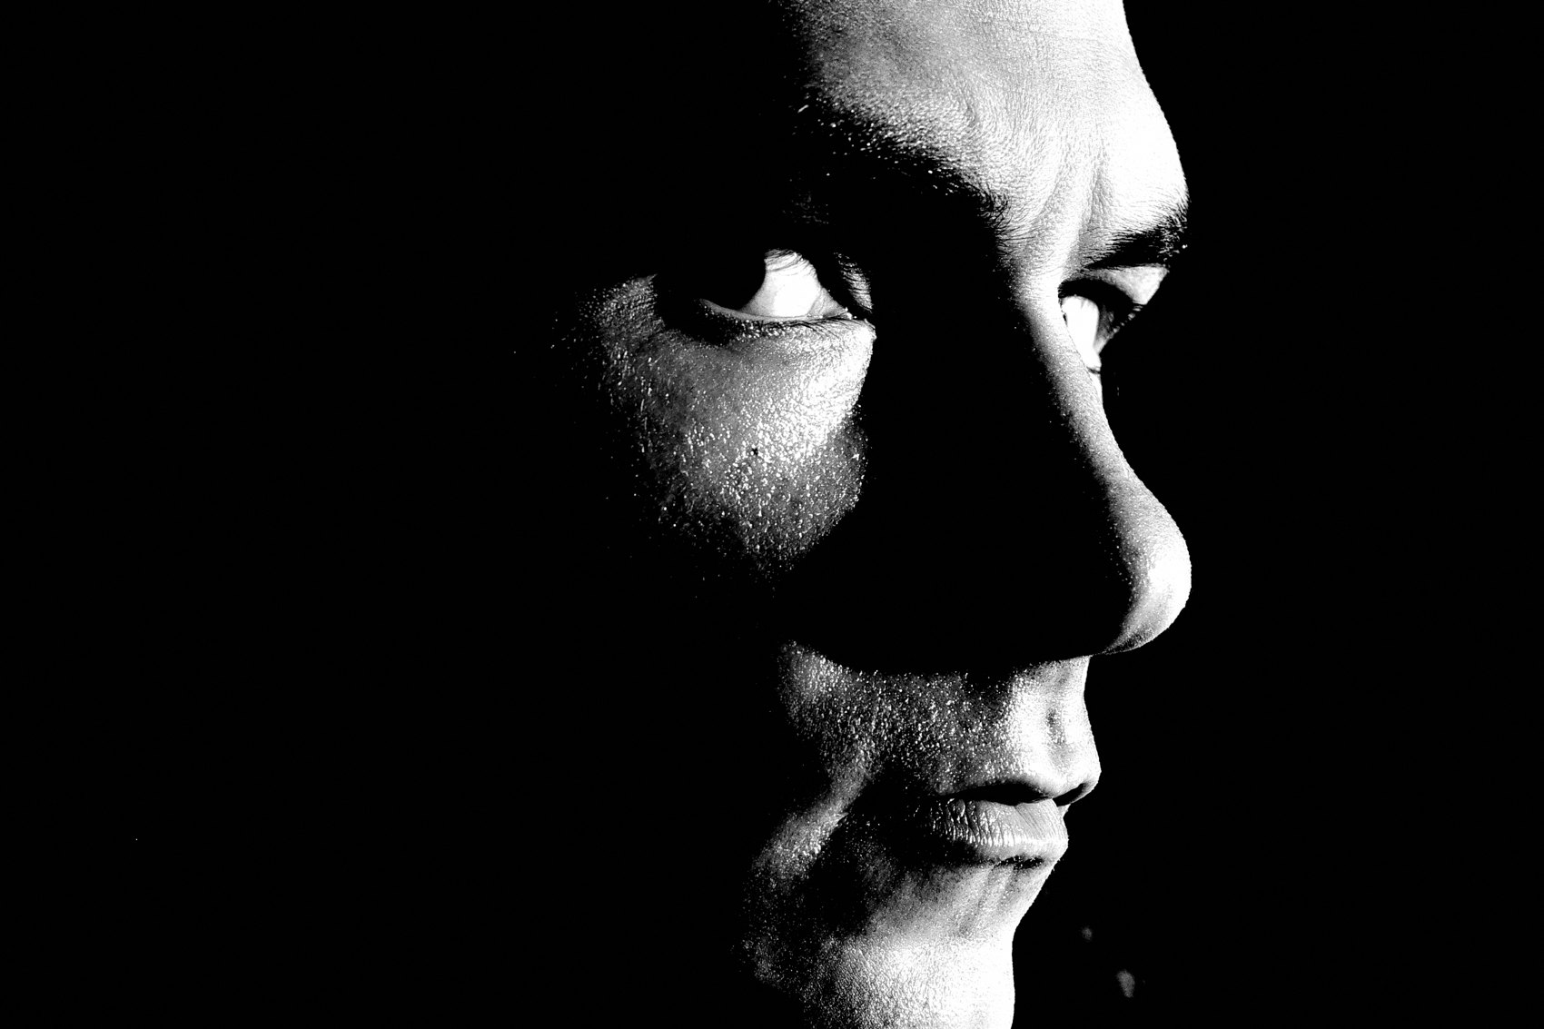
FLUX ACADEMY
BEAT 17 · PRACTICAL APPLICATION
The Landmark Exercise
— Pick one landmark in your city
— Photograph it at different times of day across multiple sessions
— See how light transforms the same subject into something new each time
Notes:
Here's your assignment. Pick a landmark in your city — a tower, a monument, a familiar building. Go photograph it at different times of day: golden hour, blue hour, harsh midday, overcast. Experiment with different angles and lighting conditions. See how light transforms the same subject over time. By repeating this process, you sharpen your ability to see and interpret light. A mundane tower can become extraordinary when approached with fresh eyes and an open morning.

Slide 19
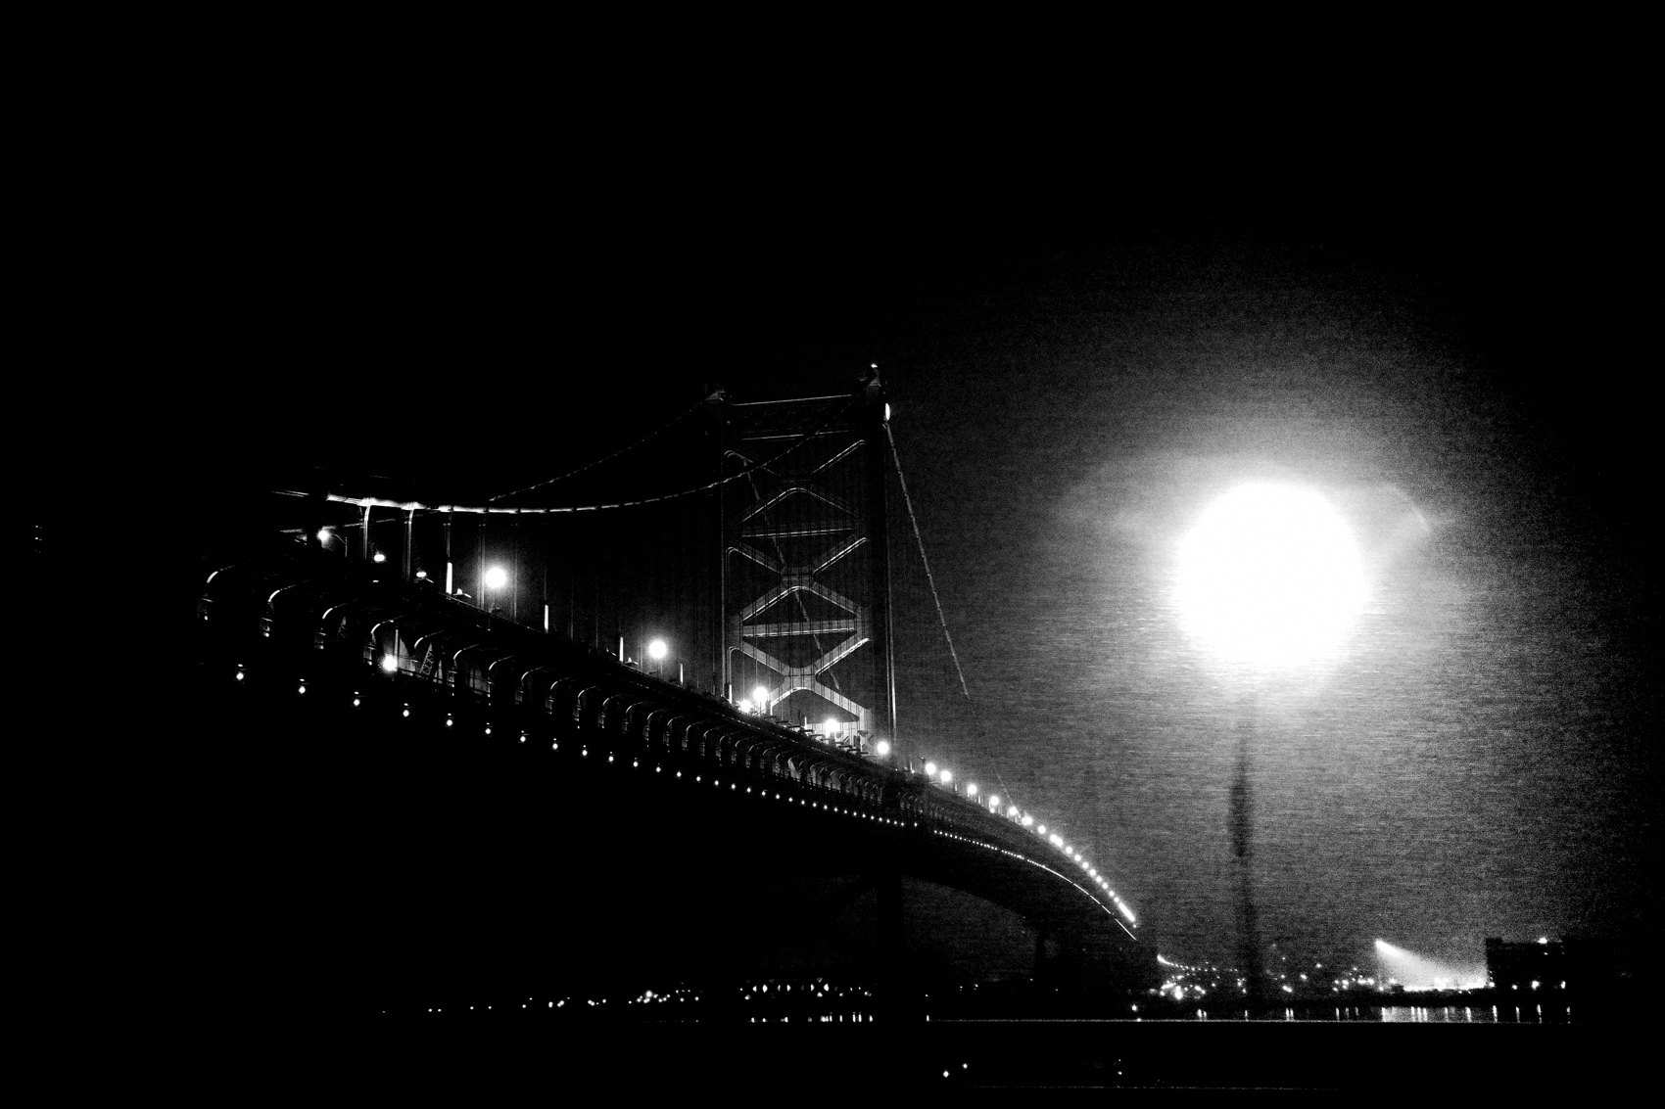
FLUX ACADEMY
BEAT 18 · PRACTICAL APPLICATION
The Choke-Point Stand
— Find a choke point in your city with strong directional light
— Lock snap focus, underexpose one stop, hold your position
— Shoot for 30 minutes without moving — just let people swim through
Notes:
Second assignment: find your choke point. A high-traffic entry point with strong directional light hitting it at a predictable angle. Set snap focus, lock your exposure, underexpose slightly, and stand there for thirty minutes without moving. Let people walk from shadow into light. Click when they hit the beam. You'll leave with more strong frames from thirty still minutes than from two hours of wandering. Simplicity. Presence. Timing.

Slide 20
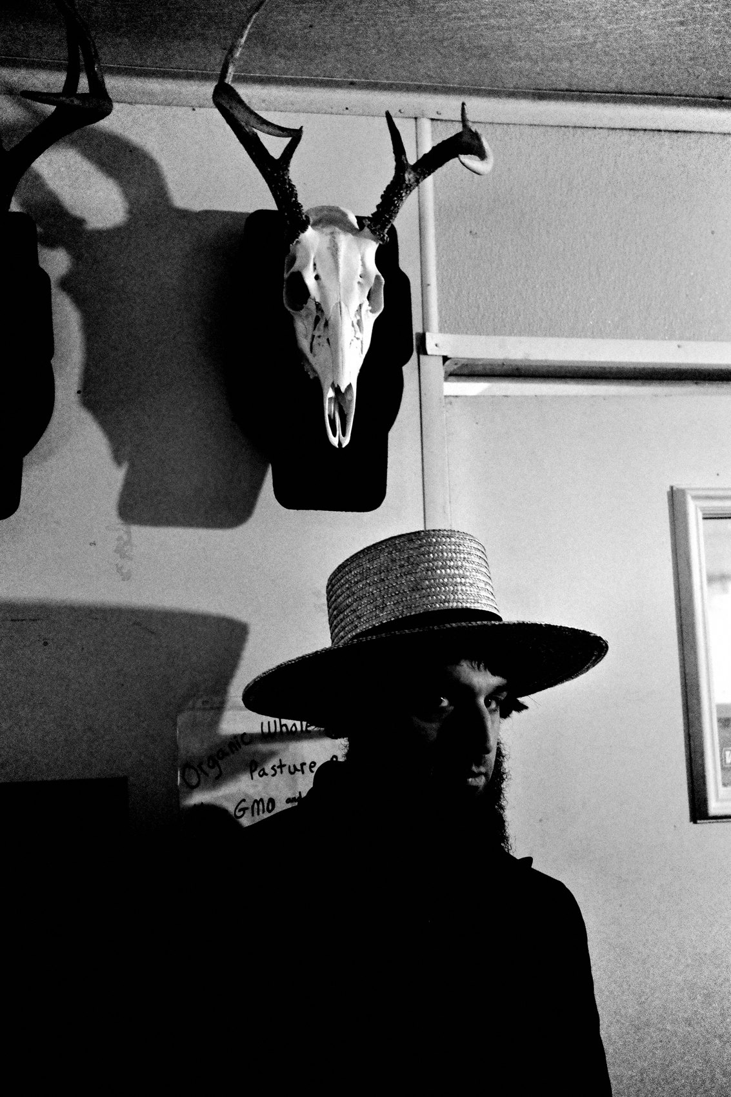
FLUX ACADEMY
BEAT 19 · COMMON MISTAKES
Chasing Subjects Instead of Light
— Chasing subjects produces flat, confused frames
— Without a light anchor, compositions have no structure
— Find the light first — subjects are secondary
Notes:
The most common mistake in street photography: chasing subjects instead of light. You see something interesting and you run toward it — and you end up with a flat, directionless frame because the light wasn't there. Light is the structure. Without it, even a compelling subject lands weak. Flip the sequence: find the light, build the frame around it, then wait for life to enter. Chase the light, not the subject.

Slide 21
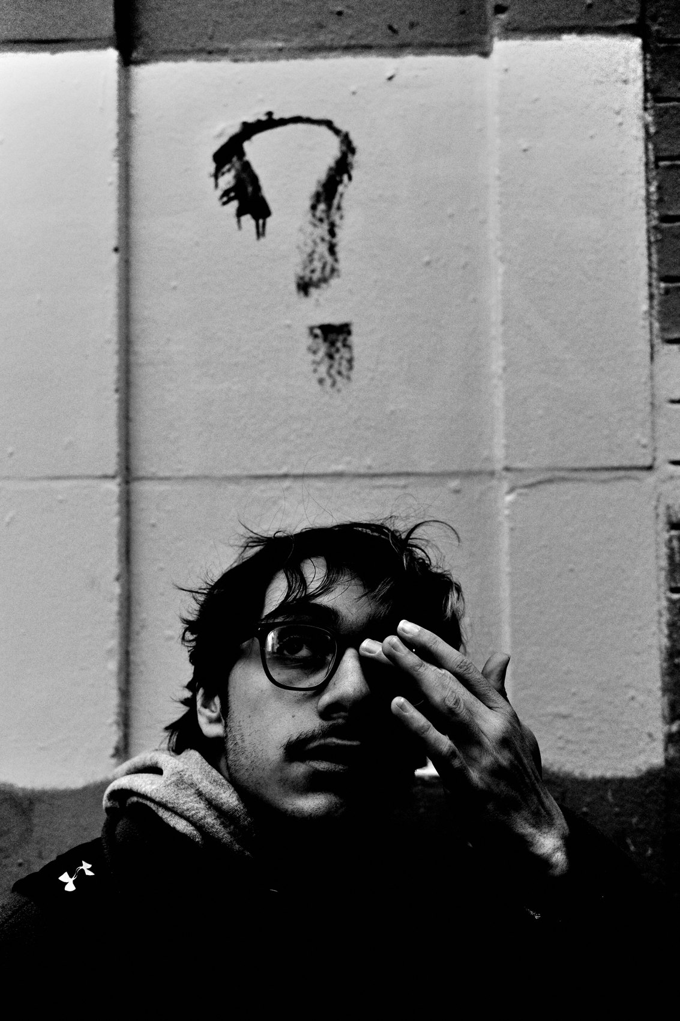
FLUX ACADEMY
BEAT 20 · COMMON MISTAKES
Fighting the Light You're Given
— Harsh midday light isn't bad — it's a different tool
— Overcast isn't boring — it's soft and layered
— Learn each quality of light rather than waiting for "perfect" conditions
Notes:
The other mistake: treating any lighting condition as a problem. Harsh midday light? That's tension and drama — use it. Overcast? That's soft, even light, perfect for layering subjects. Rain? Reflections everywhere. There's no bad light — only unread light. Shoot in all conditions. Understand each quality of light. The photographer who can work in any light is the one who's always dangerous on the street.

Slide 22
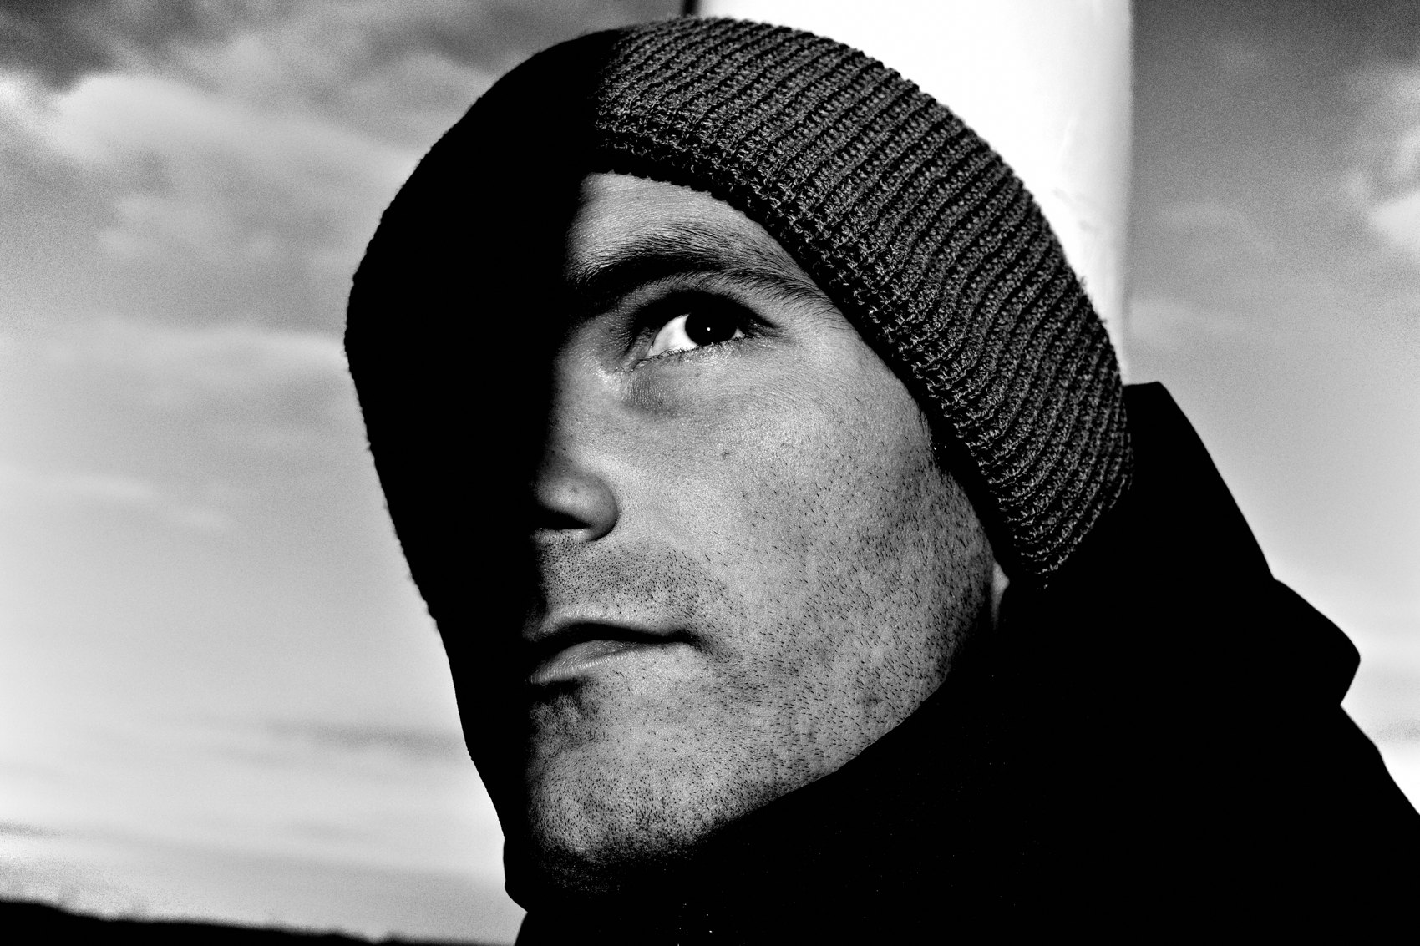
FLUX ACADEMY
BEAT 21 · RELATIONSHIP TO PREVIOUS
Building on Direction and Position
— Lesson 032 established where and how to position within a scene
— This lesson takes that positioning and ties it directly to light
— Now you're not just placing yourself — you're placing yourself in the light
Notes:
In Lesson 032, we built the vocabulary for positioning — how to stand, where to anchor, how to let the scene come to you. This lesson takes that same logic and binds it to light specifically. Positioning for composition becomes positioning for light. Every spatial decision you learned there now gets a new filter: where is the light, and how do I put myself in relationship to it?

Slide 23
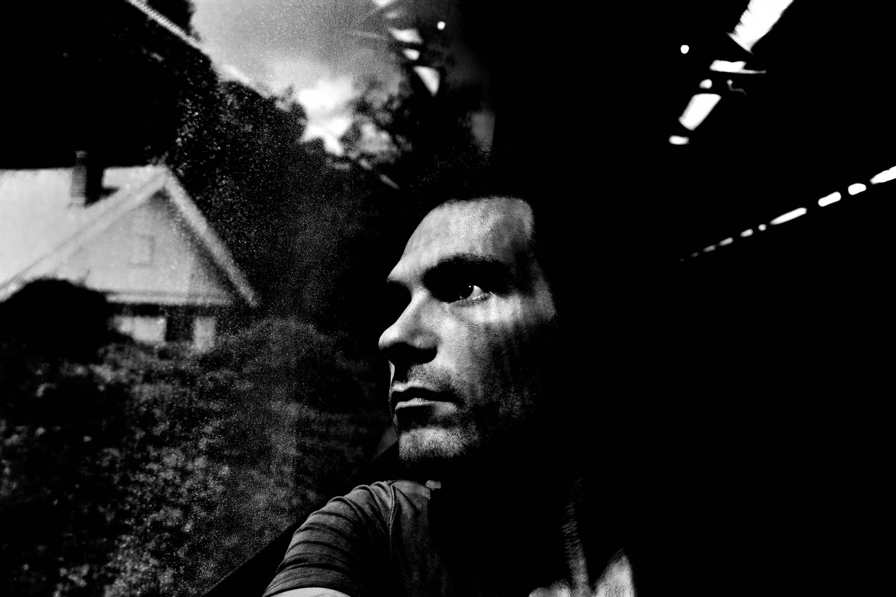
FLUX ACADEMY
BEAT 22 · RELATIONSHIP TO UPCOMING
What Happens When You Add a Subject
— Lesson 034 brings the human element inside the light-led frame
— Gesture, expression, and emotion layer on top of the light structure
— The frame is already built — the subject becomes the final piece of the puzzle
Notes:
In Lesson 034, we bring the full human element into the light-led frame. You've built the composition around light — now we talk about how gesture, expression, and the decisive human moment complete it. Think of it this way: after today, you know how to build the room. Lesson 034 teaches you how to let the right person walk through the door at the right time.

Slide 24
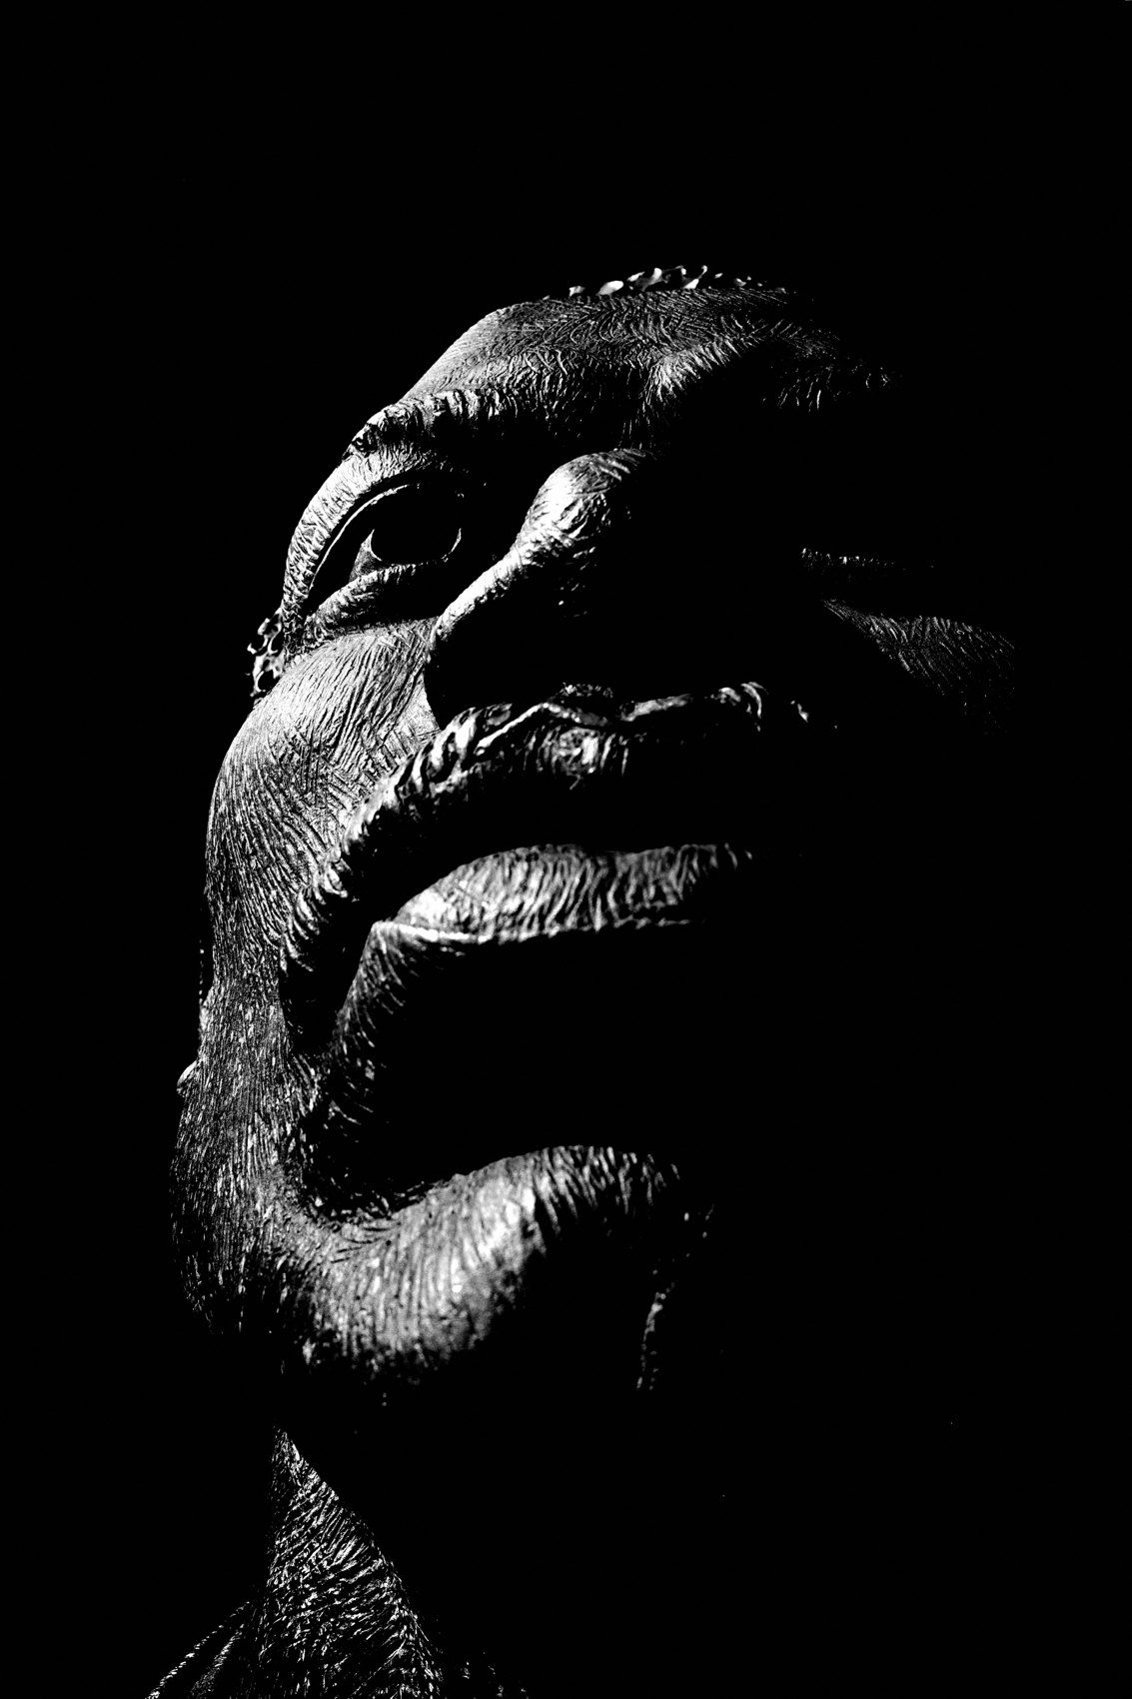
FLUX ACADEMY
BEAT 23 · SUMMARY / TAKEAWAY
Find the Light, Build the Frame, Let Life Walk In
— Light is the first compositional decision — always
— Position yourself in relation to light, not subjects
— Find the light. Build the frame. Let life walk in.
Notes:
Last thing. Light-led composition is a three-step practice: find the light, build the frame around it, and wait for life to walk in. You don't chase subjects. You don't force moments. You read the light — its intensity, direction, and quality — and you let it do the architectural work. Then you hold your position, stay patient, stay curious, and trust that the world will deliver something worth clicking. Find the light. Build the frame. Let life walk in. Catch you in Lesson 034. Peace.

