Slide 1
FLUX ACADEMY · A SCHOOL FOR SEEING
MODULE 5 · LAYERING
Complex Scenes: Multiple Subjects
BY DANTE SISOFO

Slide 2
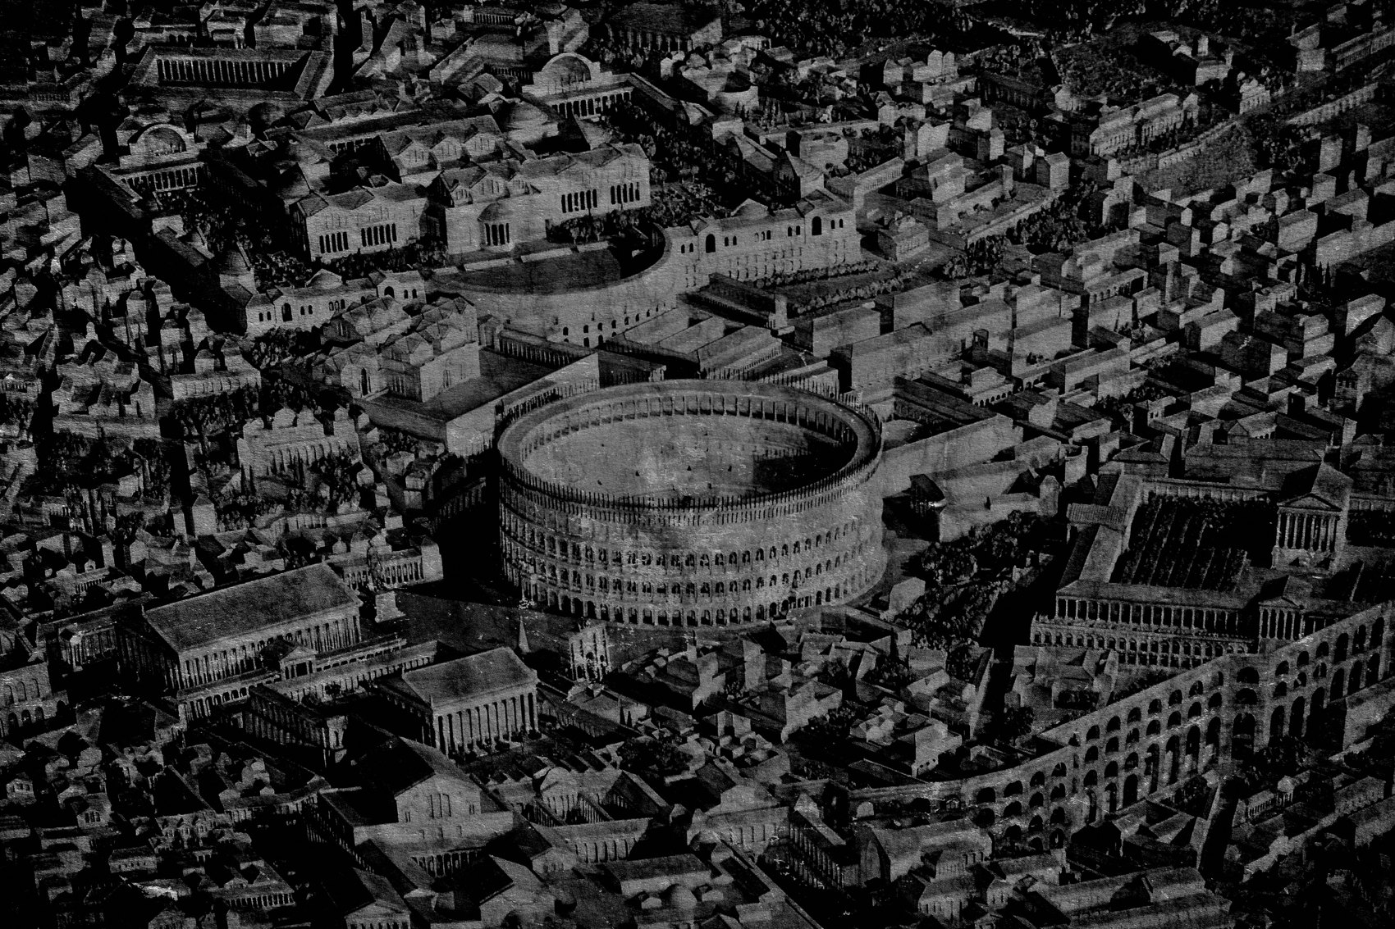
FLUX ACADEMY
BEAT 01 · CORE IDEA
Structure Tames Many Subjects
— Multiple subjects don't have to mean chaos
— Structure is what separates complexity from confusion
— The frame can hold many — when you build it right
Notes:
What's popping, people — it's Dante. Today we go deep into one of the hardest situations on the street: multiple subjects in the same frame. Most people panic. They either back up to fit everything in, or they freeze and miss it entirely. Here's the truth — a complex scene with many subjects is still just a layering problem. And layering is always about structure, not spectacle.

Slide 3
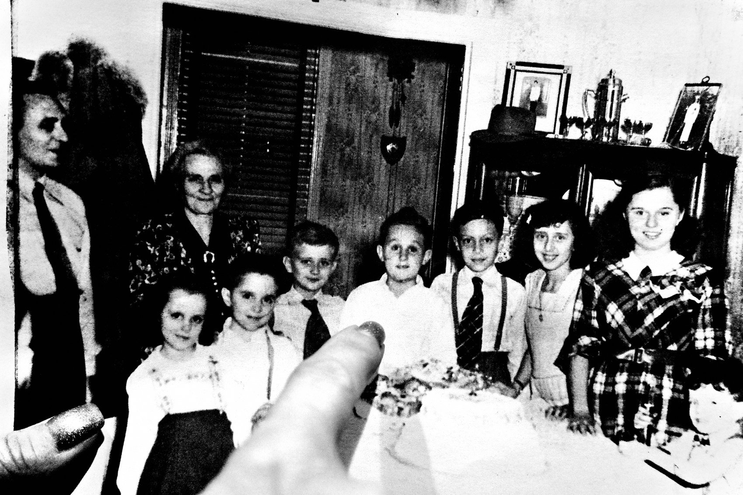
FLUX ACADEMY
BEAT 02 · LEARNING OBJECTIVE
What You'll Walk Away With
— How to read complex scenes without freezing
— Tools for organizing multiple subjects into one coherent frame
— Confidence to stay in a chaotic scene and let it resolve
Notes:
By the end of this lesson you'll have a repeatable process for approaching scenes with multiple subjects — how to read them, how to anchor them, and how to wait for the moment when everything lands. Complexity stops being the enemy and starts being the material.

Slide 4

FLUX ACADEMY
BEAT 03 · WHY THIS MATTERS
Complexity Is Everywhere
— The street is always full of more than one thing
— Avoiding complex scenes means missing most of life
— The photographers who thrive are the ones who can read density
Notes:
Here's why this matters: the street is almost never simple. There are almost always multiple people, multiple movements, multiple layers of information happening at once. If you can only work clean, quiet scenes you're cutting yourself off from the majority of what's out there. Complex scenes are where the most alive photographs live.

Slide 5
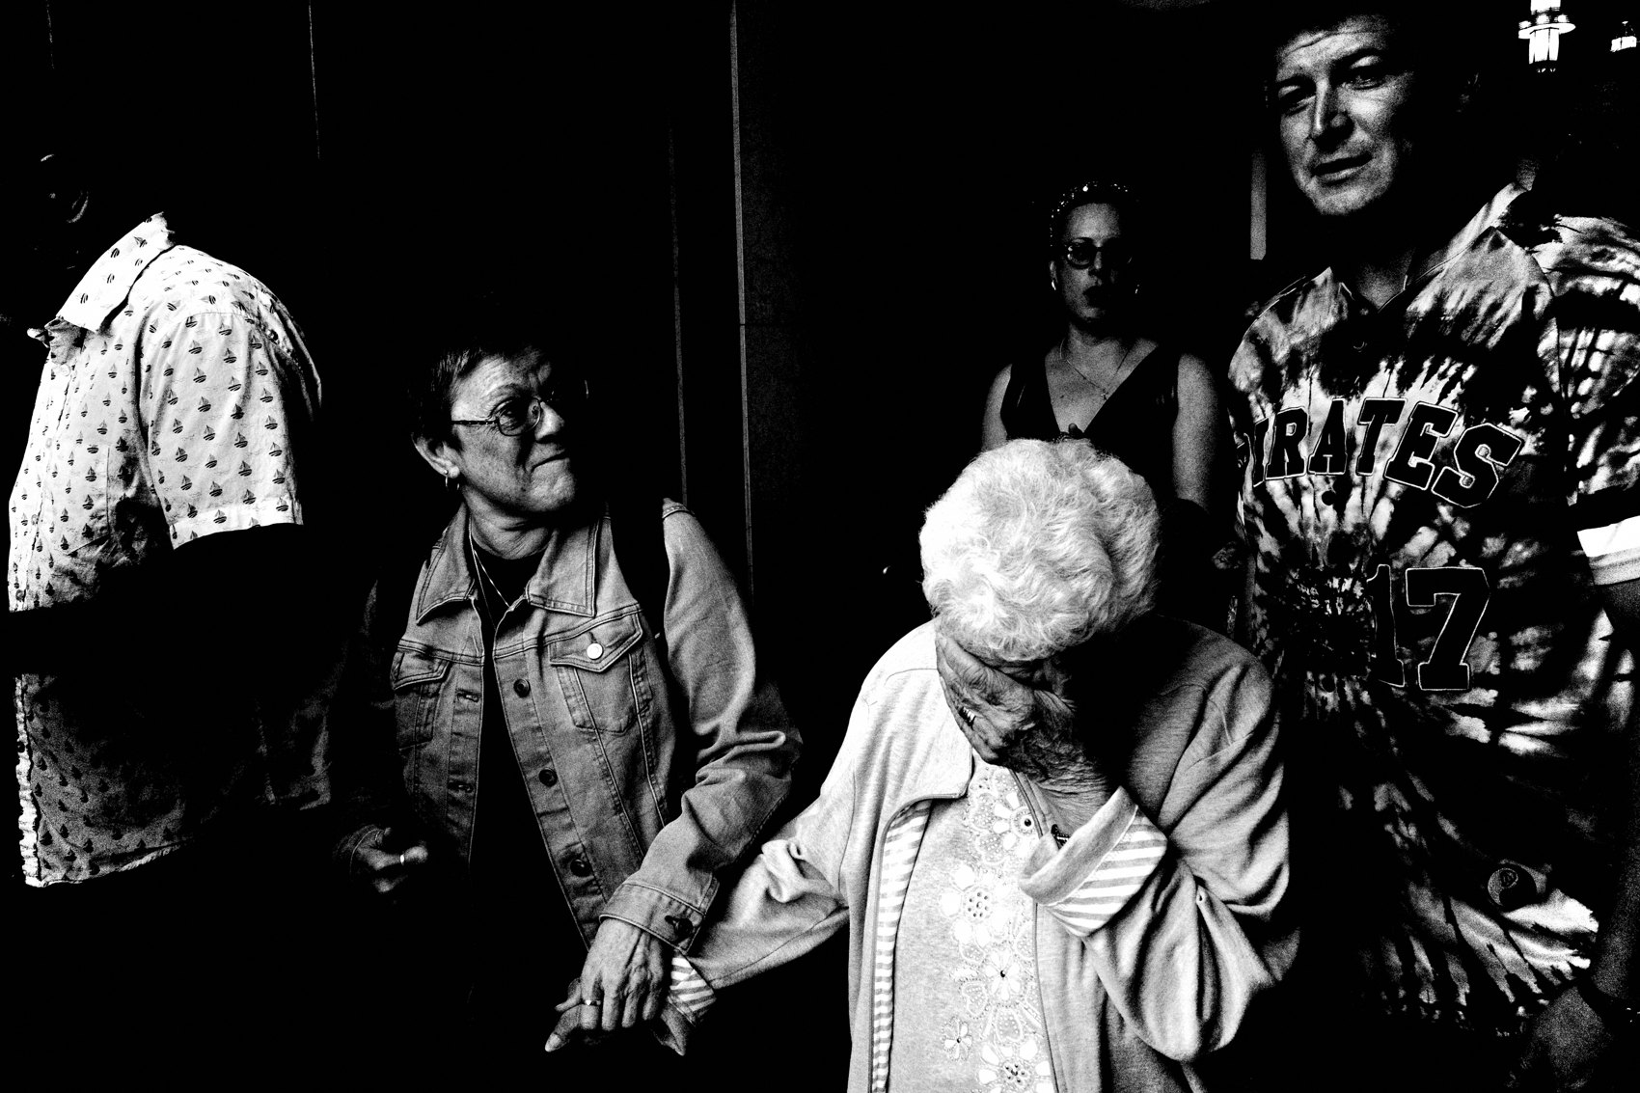
FLUX ACADEMY
BEAT 04 · WHY THIS MATTERS
More Subjects Means More Relationships
— It's not about subjects — it's about how they relate
— Relationships between elements create meaning
— More subjects = more potential for layered meaning
Notes:
And here's the reframe that changes everything: when you're dealing with multiple subjects, stop counting them. Start reading the relationships between them. That's where the photograph lives — not in any single face or gesture, but in what one person does in relation to another, and what both of them do in relation to the environment. Relationships are the content.

Slide 6

FLUX ACADEMY
BEAT 05 · MAIN TEACHING
Commit to the Background First
— Set the stage before the actors arrive
— Background commitment is the first decision
— Everything else moves through the frame you've already built
Notes:
The rule I come back to every single time: commit to the background first. Take a choke point like a bus stop on a busy street — you lock the background, the strong color and graphic presence of a wall or panel, before anyone enters the frame. The stage is already set. Then you wait. People move through naturally, and the photograph reveals itself. The shutter doesn't create the image — it confirms it.

Slide 7

FLUX ACADEMY
BEAT 06 · MAIN TEACHING
Foreground Anchors the Chaos
— One strong foreground organizes everything behind it
— Without an anchor the eye floats
— Commit close — don't retreat
Notes:
Once the background is set, the next decision is foreground. And here's what I've learned: one strong foreground element does more work than ten subjects scattered across the middle of the frame. It gives the viewer a place to enter. It establishes depth instantly. It turns an observational image into a participatory one. Don't retreat when scenes get dense — move closer and commit to one anchor.

Slide 8

FLUX ACADEMY
BEAT 07 · MAIN TEACHING
One Near Element Transforms the Image
— A hand entering the frame transforms the image
— Foreground creates immediacy and depth simultaneously
— The rest of the chaos finds its place once the anchor exists
Notes:
Picture a scene that already has energy — people, movement, light, activity all at once. It becomes immersive the moment a single near element enters at the foreground edge, like a hand reaching into the frame. That element creates depth, pulls the viewer inside, and anchors all the chaos behind it. Nothing else has to change. The foreground does all the heavy lifting so everything else can stay simple.

Slide 9

FLUX ACADEMY
BEAT 08 · MAIN TEACHING
Geometry Holds Multiple Subjects Together
— Cities are already full of structure — find it, don't force it
— Vertical and horizontal elements separate layers cleanly
— Geometry gives every subject its own space to exist
Notes:
When multiple subjects start filling the frame, what keeps it from collapsing into noise is geometry. The good news: geometry is already there. Walls, doorways, windows, shadows, architectural planes — the city is a pre-built structure. Your job is to recognize it and position yourself so the layers sit inside it cleanly. A wall with a window cutout, an object centered in that rectangle, a figure in the foreground — an arrangement like that works because geometry gives every element its own address in the frame.

Slide 10

FLUX ACADEMY
BEAT 09 · MAIN TEACHING
Frames Within Frames Separate Subjects
— A window or doorway isolates one subject from the rest
— The inner frame creates hierarchy inside a complex scene
— One rectangle of light does most of the work
Notes:
One of the most reliable tools in a complex scene: frames within frames. A window, a doorway, an arch — any architectural opening becomes a way to isolate one subject from all the others. The rectangle of a window can hold a background subject in place so the foreground can breathe. You don't need complex geometry. You need one clean shape doing its job quietly.

Slide 11
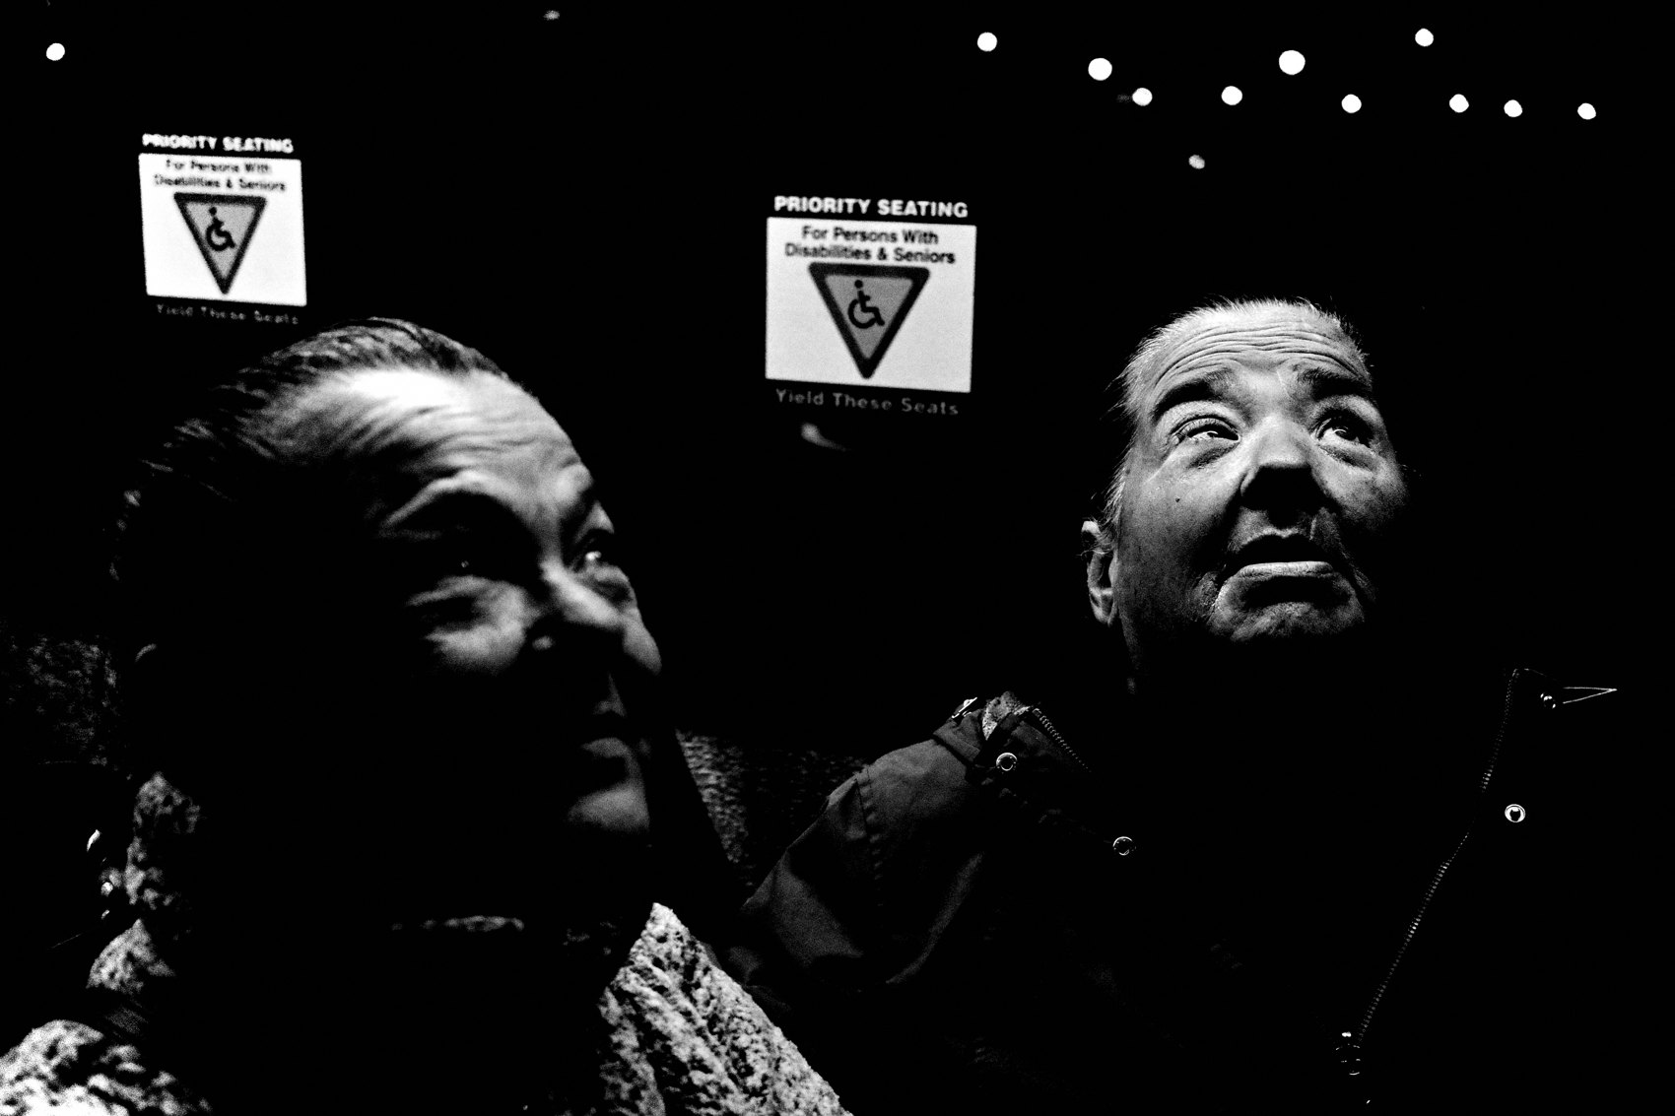
FLUX ACADEMY
BEAT 10 · MAIN TEACHING
Scan in Planes, Not People
— Stop looking for people — start scanning planes
— Ask: what's the background? What could foreground? How do they connect?
— Shift from reaction to construction
Notes:
Here's a perceptual shift that accelerates everything: stop looking for people and start scanning planes. Background plane first — what could be a strong stage? Foreground plane next — what could anchor it? Middle ground — what's moving through? When you scan in spatial layers instead of individual subjects, complex scenes become readable problems instead of overwhelming chaos. You move from reaction to construction.

Slide 12
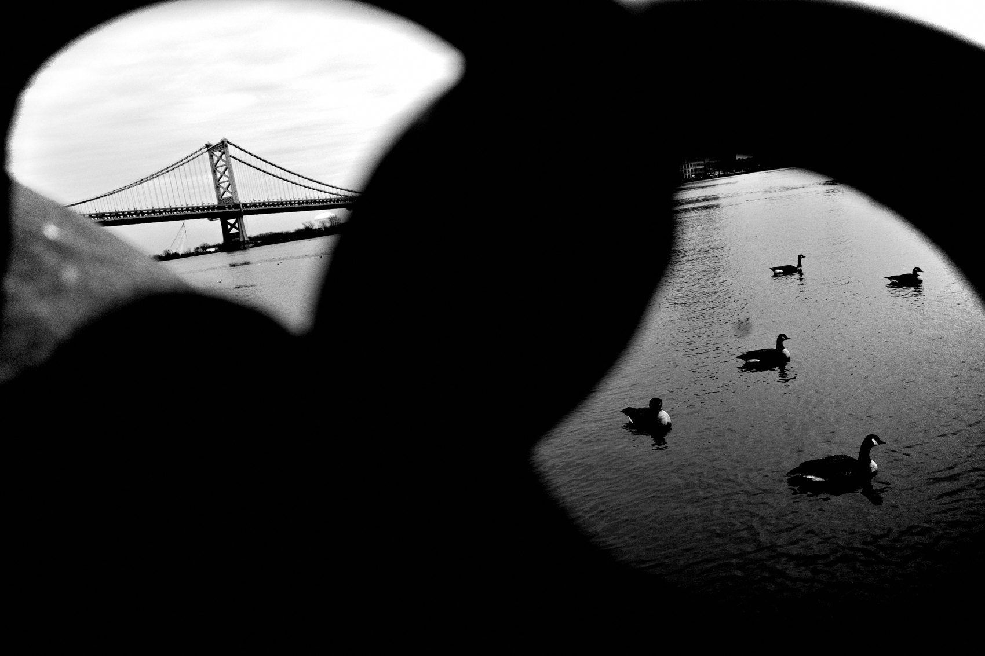
FLUX ACADEMY
BEAT 11 · MAIN TEACHING
Reflections Double the Scene Without Adding Clutter
— Reflections multiply subjects without multiplying chaos
— A second version of reality adds depth and ambiguity
— Positioning is everything — small moves change the whole image
Notes:
Reflections are one of the most elegant solutions to a complex scene. They let you add apparent subjects — duplicate them, layer them — without adding a single new element to the physical space. A reflective surface — a window, a puddle, a car panel — can create a second version of the scene: subjects exist in two spaces at once, real and reflected, and the tension between those two realities makes the image compelling. You gain complexity for free. But positioning is everything — tiny movements radically change what you're working with.

Slide 13
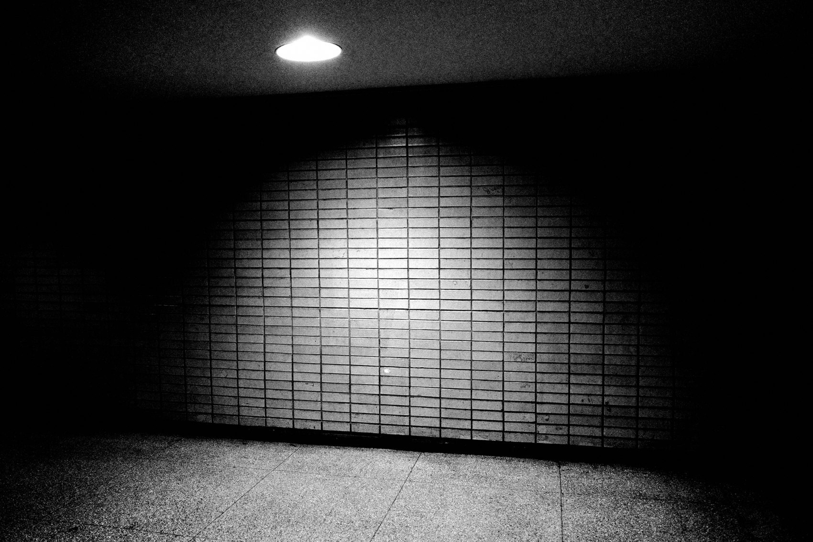
FLUX ACADEMY
BEAT 12 · MAIN TEACHING
Light Creates Hierarchy Among Many Subjects
— Bright areas pull the eye; dark areas recede
— Light solves subject hierarchy without cropping anything out
— Let light decide what matters — don't force it with composition alone
Notes:
When there are multiple subjects and you can't isolate them spatially, use light to establish hierarchy. Bright areas pull attention. Shadow recedes. You don't have to crop out a competing subject — you let light crush it into the background while the illuminated element leads. Strong separation between foreground, middle ground, and background often comes from nothing more than light versus shadow. Light is doing composition for you.

Slide 14
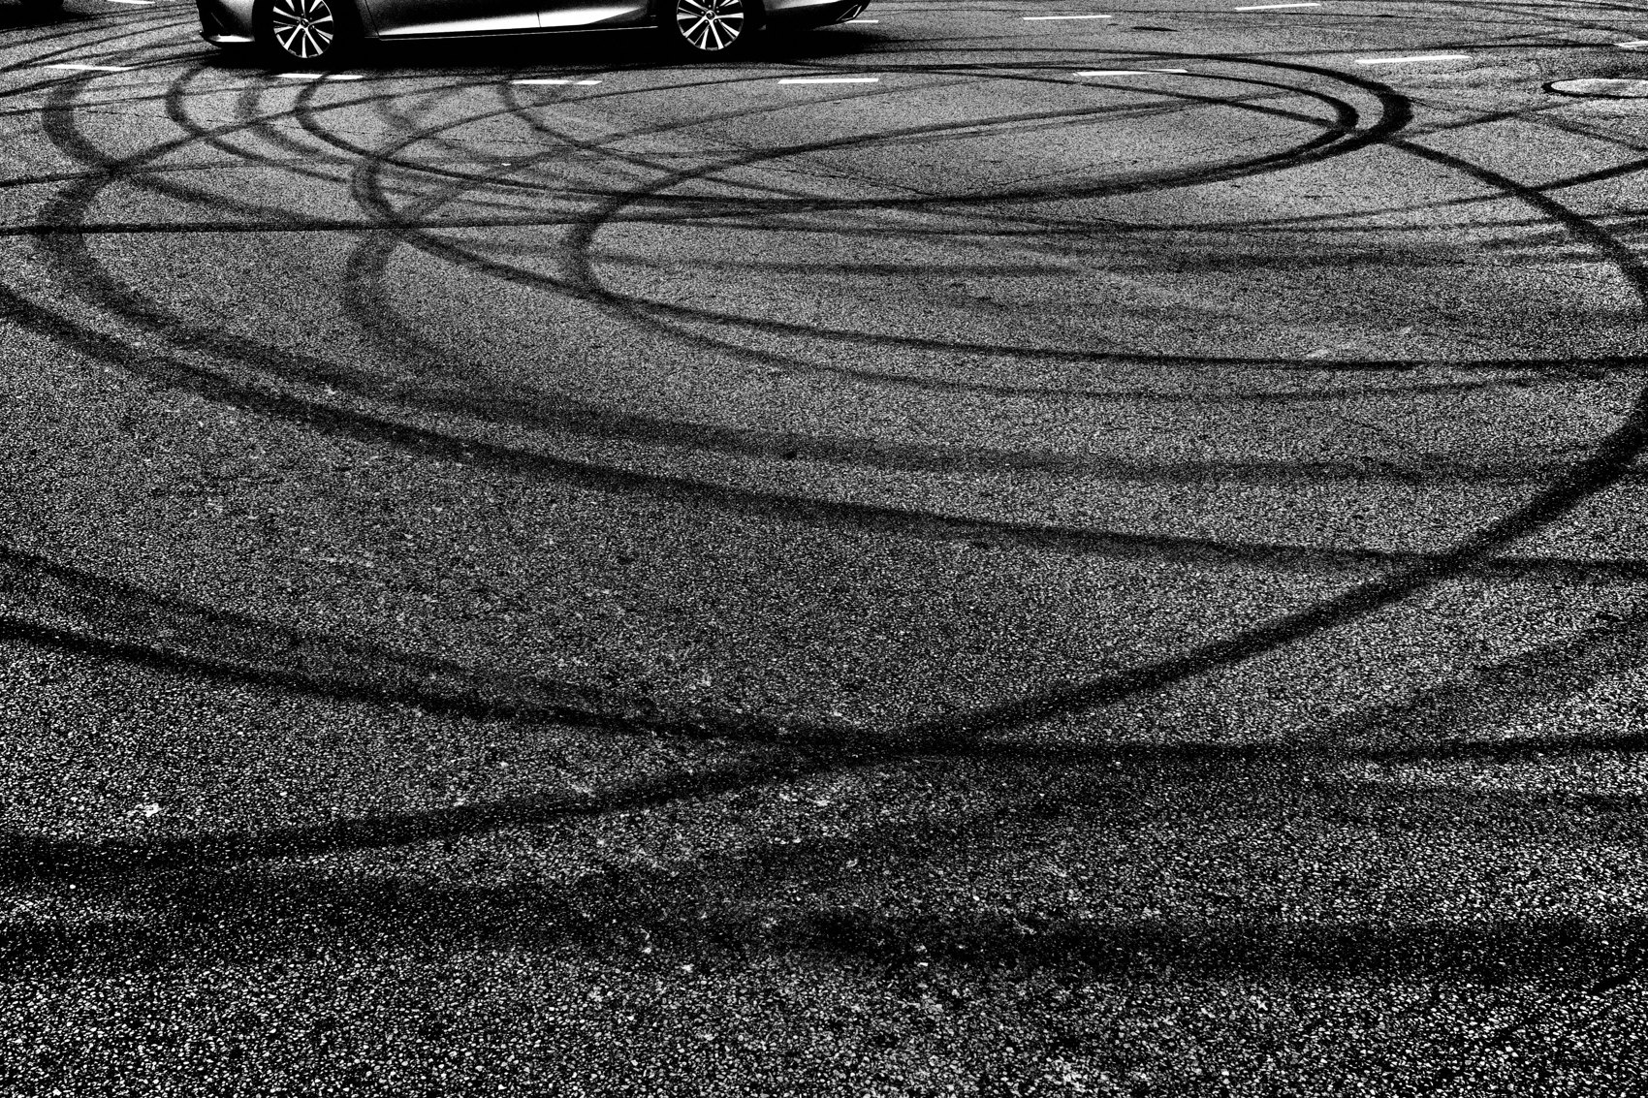
FLUX ACADEMY
BEAT 13 · MAIN TEACHING
Structure Over Spectacle
— A still, tired figure set against a glowing spectacle
— Stillness against movement; exhaustion against energy
— No drama forced — structure creates the emotional weight
Notes:
Structure over spectacle — always. Imagine a scene where nothing dramatic is happening on the surface: a tired figure at rest, a hand resting against a face, and behind them something glowing with color and energy. By structuring the frame — stillness against movement, exhaustion against spectacle, quiet against chaos — the image carries real emotional weight. Multiple subjects, multiple layers, zero forced drama. The layering does the work.

Slide 15

FLUX ACADEMY
BEAT 14 · MAIN TEACHING
Patience Is the Non-Negotiable
— Layers collapse when you rush
— Stay until the scene leaves you — not the other way around
— Many frames, letting life reveal itself layer by layer
Notes:
I want to be direct about this one: in complex scenes, patience isn't optional — it's the whole strategy. Layers collapse when you rush. I often watch a scene evolve and I don't leave until the scene leaves me. I make many frames, letting life reveal itself layer by layer. The mistake most photographers make is treating a complex scene like a single moment to catch. It's not. It's an unfolding. Stay in it.

Slide 16

FLUX ACADEMY
BEAT 15 · MAIN TEACHING
One Strong Element Beats Many Weak Ones
— Resist the urge to include everything
— One dominant element gives the frame a spine
— Hierarchy makes complex scenes feel intentional
Notes:
There's an instinct when a scene gets complex to include as much as possible — like more subjects means more photograph. It's the opposite. More subjects with no hierarchy means no photograph. When a scene overwhelms you, stay close to one object and let it dominate the foreground. That one decision — one committed dominant element — anchors the frame, gives the viewer an entry point, and allows all the surrounding chaos to exist without competing. One strong element beats many weak ones, every time.

Slide 17

FLUX ACADEMY
BEAT 16 · MAIN TEACHING
Move Until It Clicks
— Small physical moves create or destroy layers
— You move until alignment happens — then you hold
— The frame reveals itself through your body
Notes:
Composition in complex scenes is a physical act. You move — slowly, deliberately — until lines align, shapes separate, and layers settle into place. A frame like a figure, a wall, and a window only works once you find the position where all three align without overlap or clutter. It isn't thought into existence — it's moved into existence. Trust your body. Move until it clicks, then hold that position and wait.

Slide 18

FLUX ACADEMY
BEAT 17 · PRACTICAL APPLICATION
Build the Background First, Every Time
— Before raising the camera, commit to the background
— Ask: what is the stage here?
— Set the frame, then let subjects move through it
Notes:
Your first assignment is a single-session discipline: before you raise the camera on any scene today, ask yourself — what is the background? Lock it. Commit to it. Then wait for the foreground to arrive. Do this ten times in one outing and you'll feel the shift — you stop chasing and start building. The scene starts coming to you instead of running away from you.

Slide 19
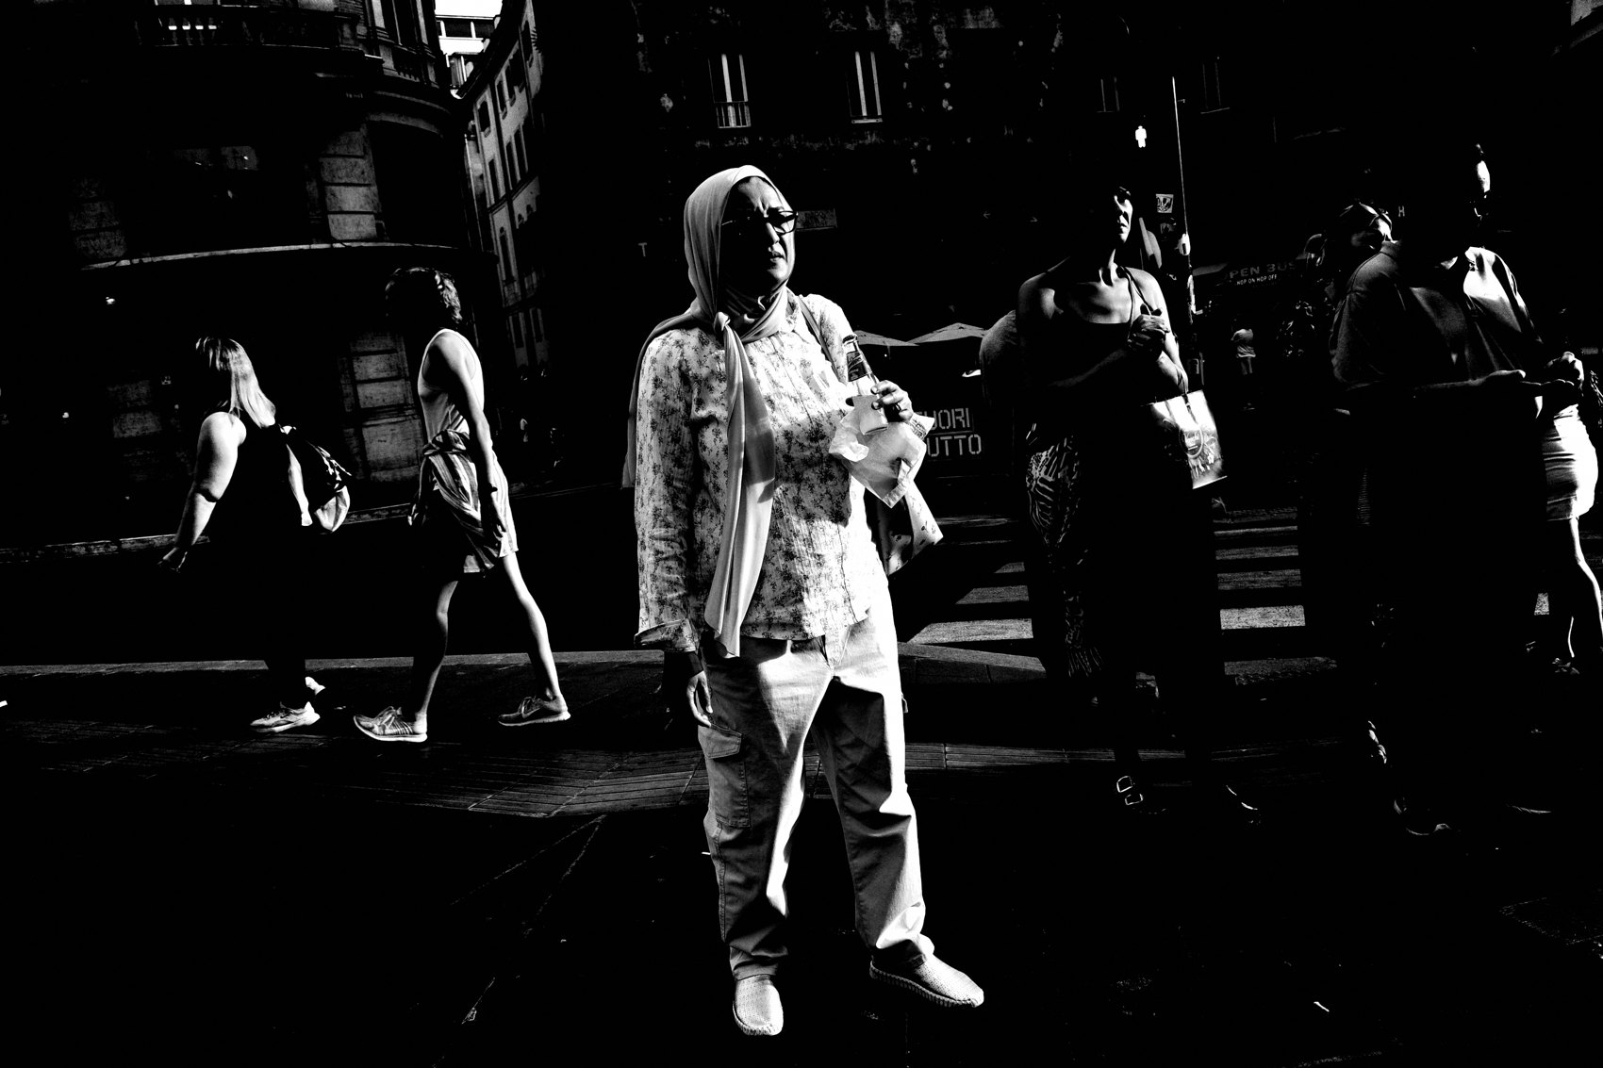
FLUX ACADEMY
BEAT 18 · PRACTICAL APPLICATION
Scan in Planes at a Busy Location
— Go somewhere dense — market, transit hub, crowded street
— Practice scanning planes: background first, foreground second, middle third
— No camera required at first — just the trained eye
Notes:
Second assignment: go somewhere genuinely complex. A market, a transit hub, a crowded intersection. Leave the camera in the bag for the first ten minutes and just scan. Background plane — what's there? Foreground possibilities — where could you anchor? Middle ground — what's moving through? Train the eye before the camera confirms it. When you're ready, the frame will already be built in your mind.

Slide 20
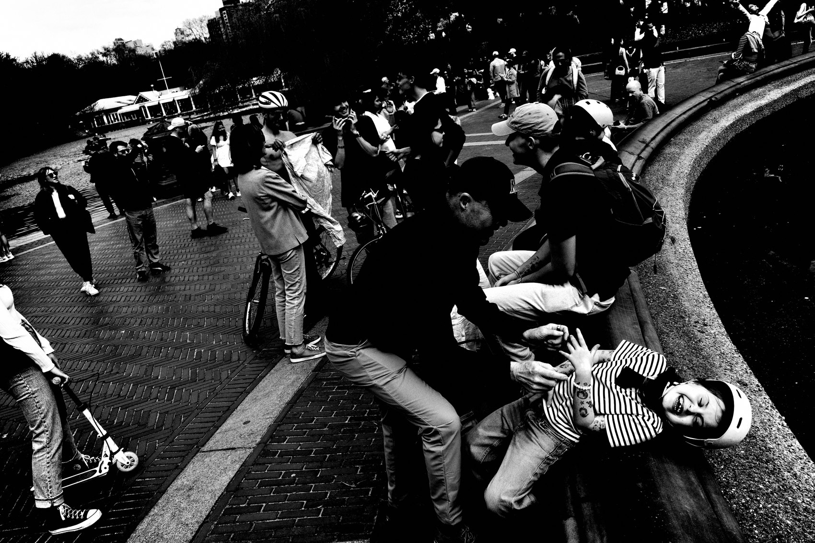
FLUX ACADEMY
BEAT 19 · PRACTICAL APPLICATION
Stay Longer Than Feels Comfortable
— Pick one scene and refuse to leave it for 20 minutes
— Make many frames as layers evolve
— Notice how the scene changes when you stop rushing
Notes:
Third assignment: pick one scene and commit to it for a minimum of twenty minutes. This is the patience drill. Make frames throughout — early, middle, late. Study what changed. Notice how subjects entered and exited, how the layers shifted, how the frame evolved. Almost always, the strongest image comes after you would normally have walked away. Train yourself to stay.

Slide 21

FLUX ACADEMY
BEAT 20 · COMMON MISTAKES
Including Everything, Organizing Nothing
— More subjects ≠ more photograph
— Without hierarchy the eye has nowhere to go
— Complexity without structure is just noise
Notes:
The most common mistake in complex scenes: including everything and organizing nothing. You see a lot happening and you try to get it all — wide angle, back up, pull in every subject. The result is a frame full of stuff and empty of meaning. There's no hierarchy, no anchor, no entry point. The eye has nowhere to go. Complexity without structure is just noise dressed up as ambition.

Slide 22

FLUX ACADEMY
BEAT 21 · COMMON MISTAKES
Retreating Instead of Committing
— Stepping back feels safe but it collapses depth
— The answer to complexity is almost always to move closer
— Commitment creates the foreground that anchors everything
Notes:
The second mistake — and I see it constantly — is retreating when scenes get complex. Stepping back feels like control. It isn't. Backing up collapses depth, flattens layers, and removes the foreground that was doing all the structural work. When a scene gets complex, the answer is almost always to move closer — commit to one dominant foreground element and let it anchor everything behind it. Forward, not back.

Slide 23
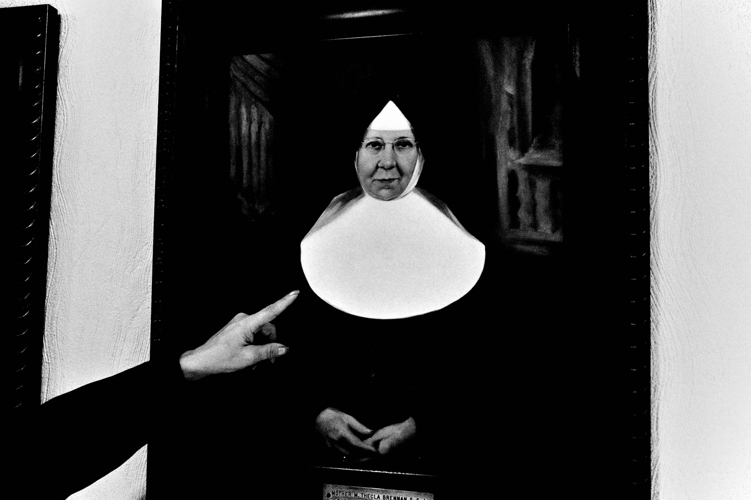
FLUX ACADEMY
BEAT 22 · RELATIONSHIP TO PREVIOUS
Built on What Light Already Taught Us
— Lesson 027 established light as the foundation of all layering
— Today we apply that light logic to scenes with multiple subjects
— Light is still leading — now we add human complexity on top
Notes:
Everything today stands on what Lesson 027 established: light comes first, always. Light creates separation. Light builds hierarchy. Light defines the stage before anything enters it. Today we took that foundation and loaded it with human complexity — multiple subjects, multiple planes, multiple relationships. The tools don't change when scenes get harder. They just have more material to work with.

Slide 24
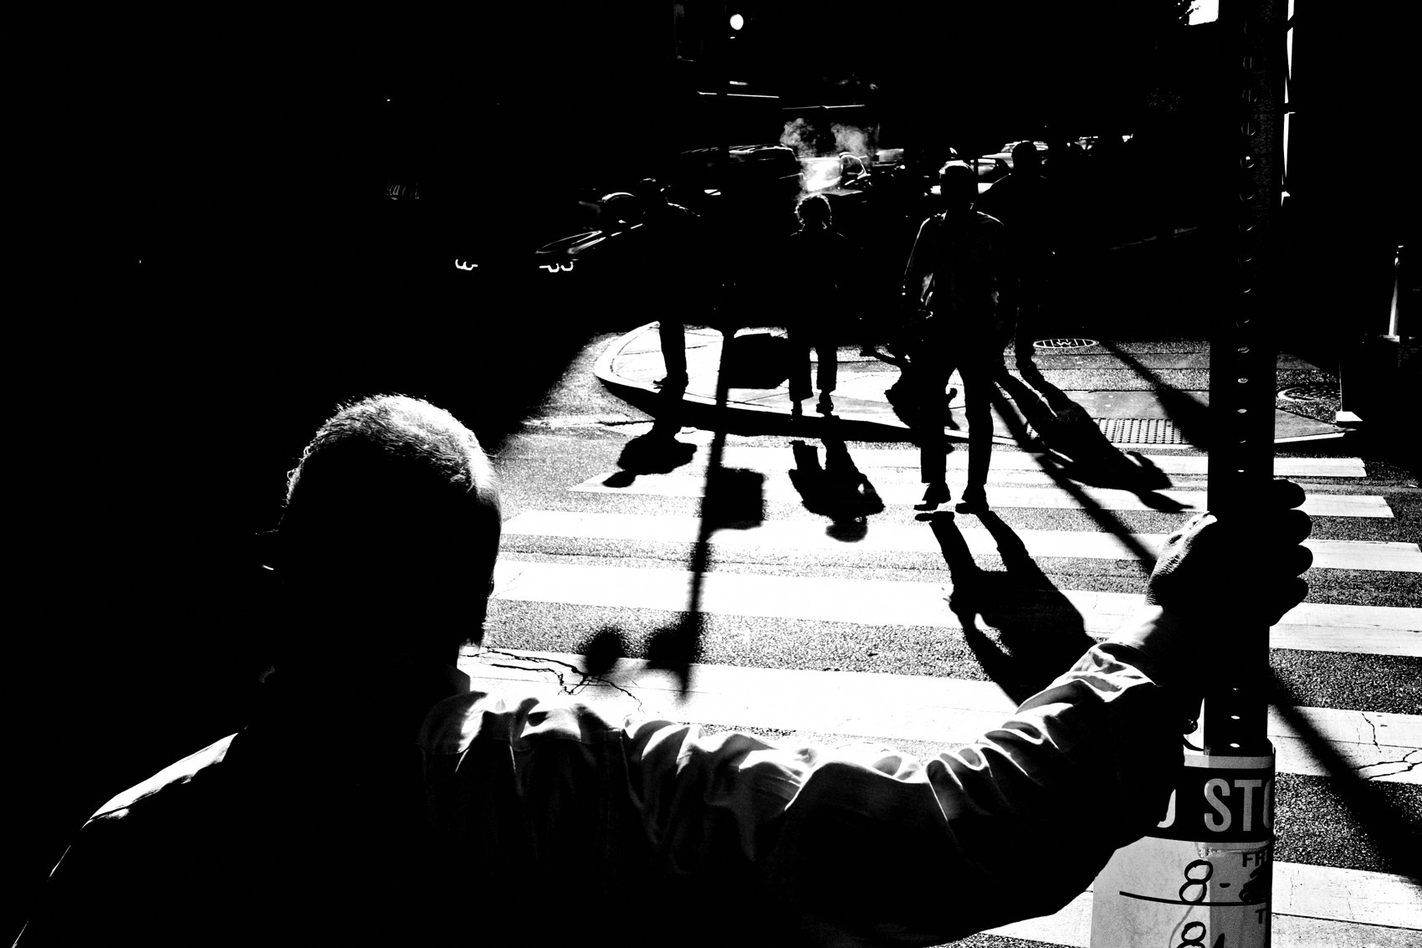
FLUX ACADEMY
BEAT 23 · SUMMARY / TAKEAWAY
Structure Is the Answer, Every Time
— Background first. One strong foreground. Geometry as scaffold.
— Scan planes, not people. Use light for hierarchy. Stay longer.
— Complexity is just a layering problem — and you know how to layer
Notes:
Last thing. Complex scenes with multiple subjects are not a different problem — they're the same problem with more material. Background first, always. One strong foreground to anchor it. Geometry to hold the layers apart. Light to establish hierarchy. Reflections to add depth without clutter. And patience — real patience — to let the scene finish itself. Don't retreat from complexity. Build structure inside it. That's the job. Catch you in Lesson 029.

