Slide 1
FLUX ACADEMY · A SCHOOL FOR SEEING
MODULE 5 · LAYERING
Foreground, Middle Ground, Background
BY DANTE SISOFO

Slide 2
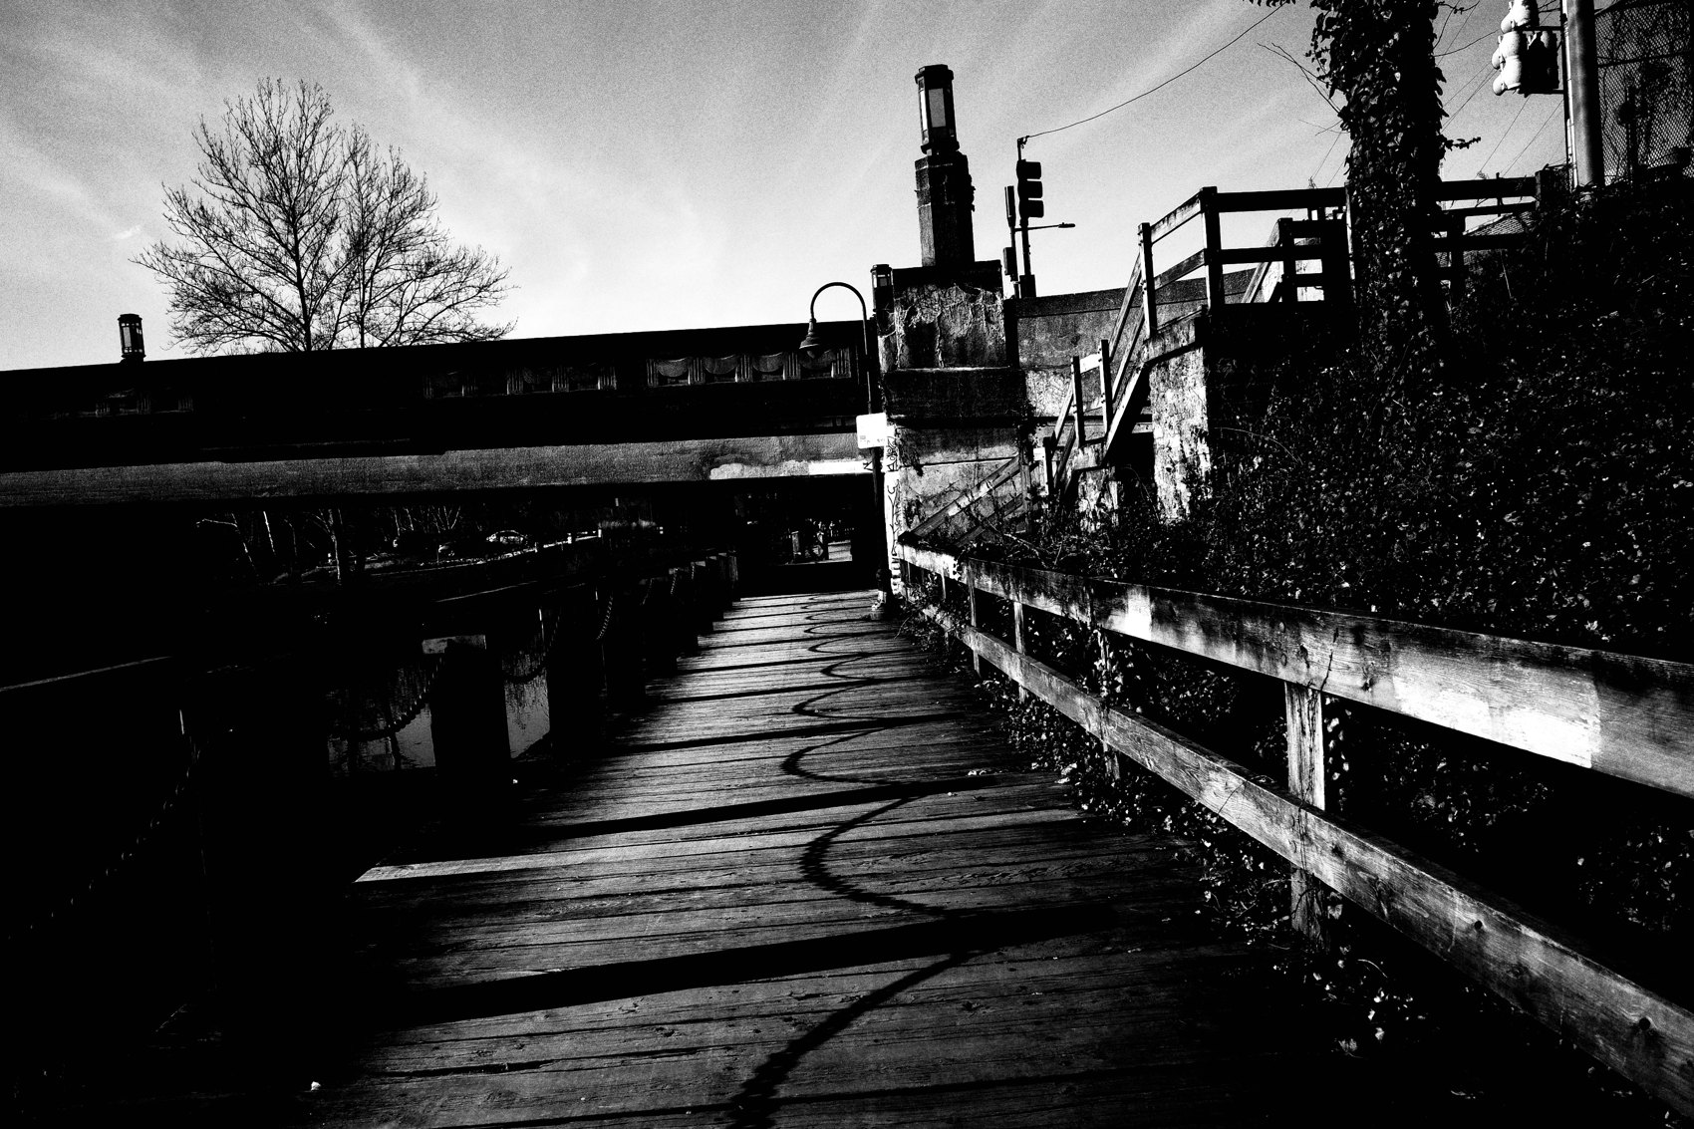
FLUX ACADEMY
BEAT 01 · CORE IDEA
Three Zones, One Frame
— Most strong photos = three spatial zones
— Background, middle ground, foreground
— Not theory — tools for order
Notes:
What's popping, people — it's Dante. Today we get spatial. Almost every strong photograph is built from three simple zones: background, middle ground, and foreground. These aren't academic terms — I never think of them as theory on the street. They're practical tools that put order to chaos and give the viewer a clear path through the frame.

Slide 3
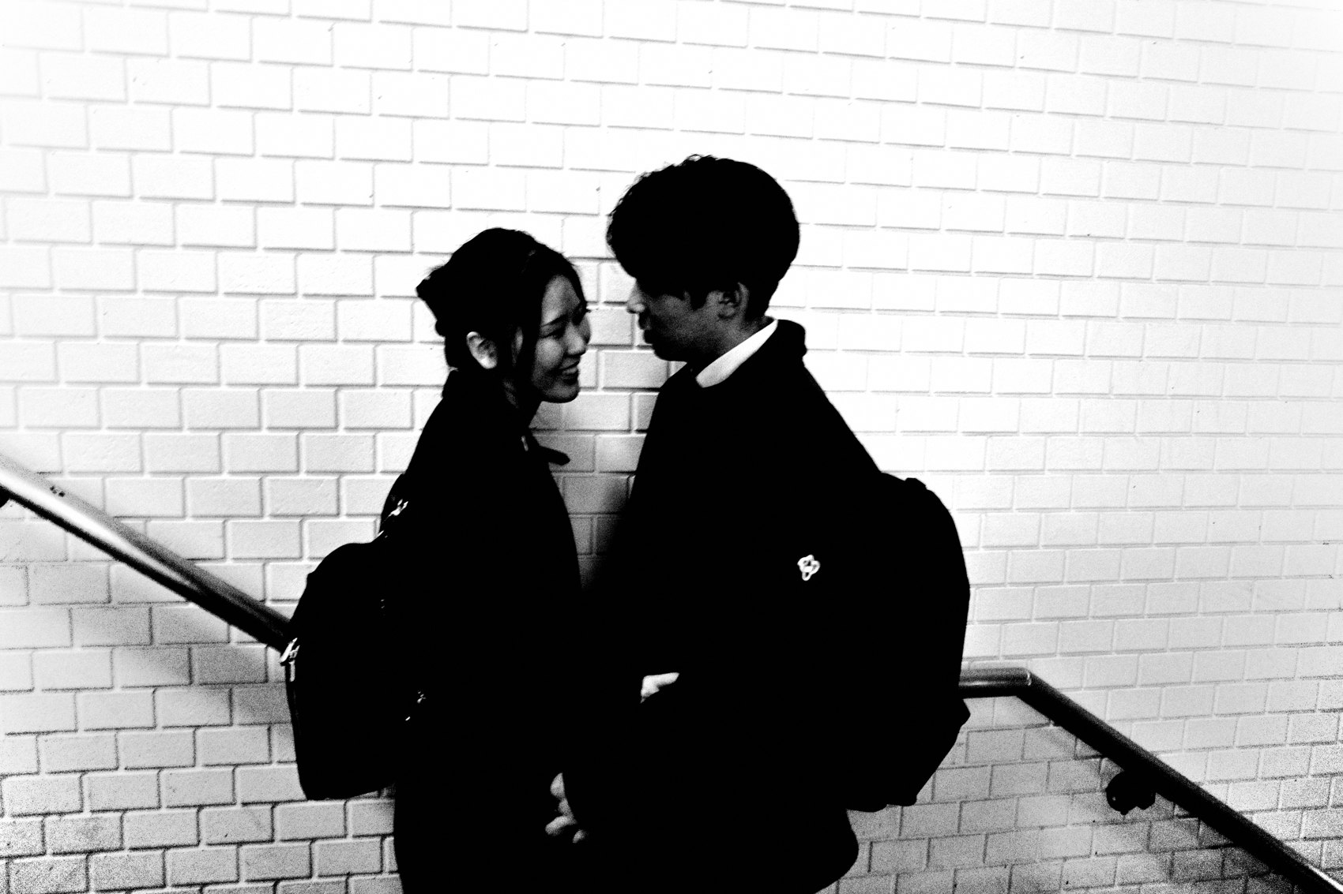
FLUX ACADEMY
BEAT 02 · LEARNING OBJECTIVE
What You'll Be Able to Do
— See a scene in planes, back to front
— Know what each zone is for
— Build depth on purpose, not by luck
Notes:
By the end of this lesson you'll be able to break a scene apart into planes and rebuild it with intention. You'll know what the background does, what the middle ground carries, and what a foreground adds — and you'll start controlling depth with your body instead of hoping it shows up by accident.

Slide 4
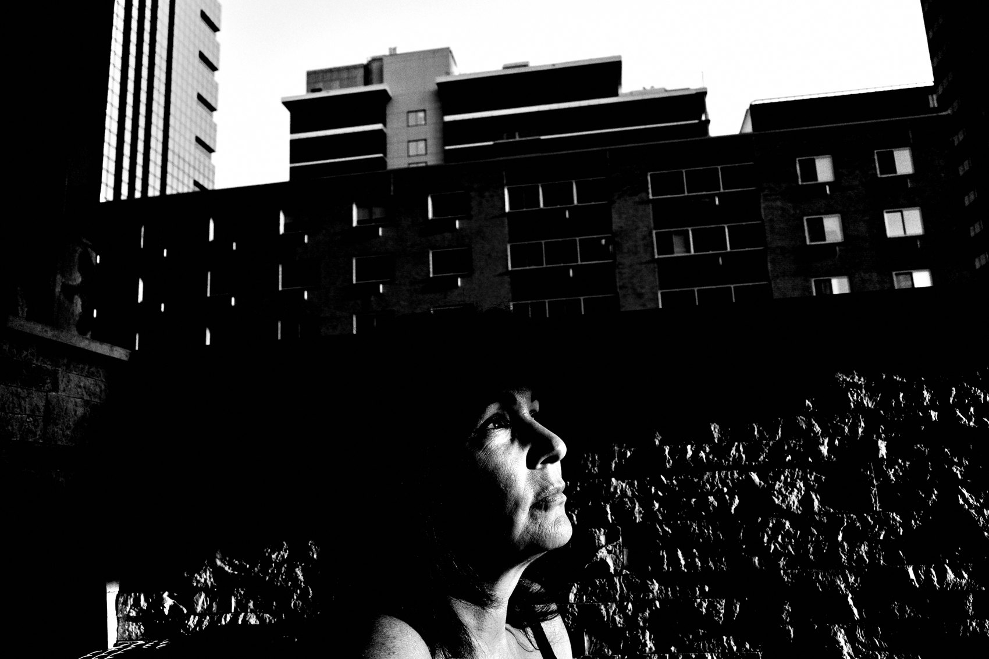
FLUX ACADEMY
BEAT 03 · WHY THIS MATTERS
Structure Before Subject
— An interesting subject won't save weak structure
— Stop chasing people — start building stages
— Structure first, content second
Notes:
Here's why this matters. Most photographers chase a subject — a face, a gesture — then try to force composition around it. With layering that approach collapses fast. An interesting subject will not save a weak background. Strong layering comes from structure first, content second. Stop chasing people. Start building stages.

Slide 5
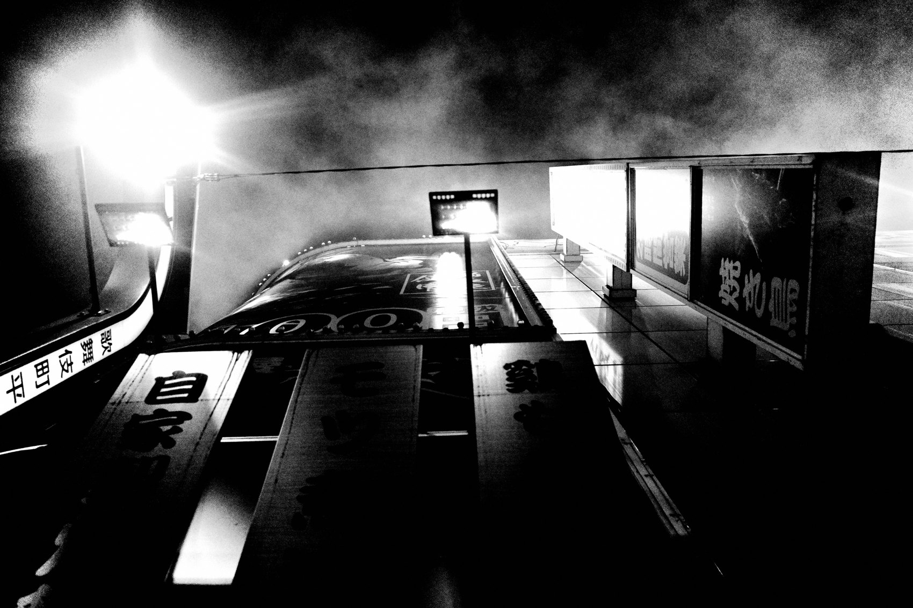
FLUX ACADEMY
BEAT 04 · WHY THIS MATTERS
Clarity, Not Complexity
— The goal isn't more — it's clearer
— These are options, not rules
— Sometimes two zones, sometimes one
Notes:
And this is the part people get wrong: the goal is never complexity. It's clarity. You don't need all three zones in every frame. Sometimes a photograph works with two; sometimes one layer carries the whole image. These spatial zones are options, not obligations. They're about seeing clearly, not adding more.

Slide 6
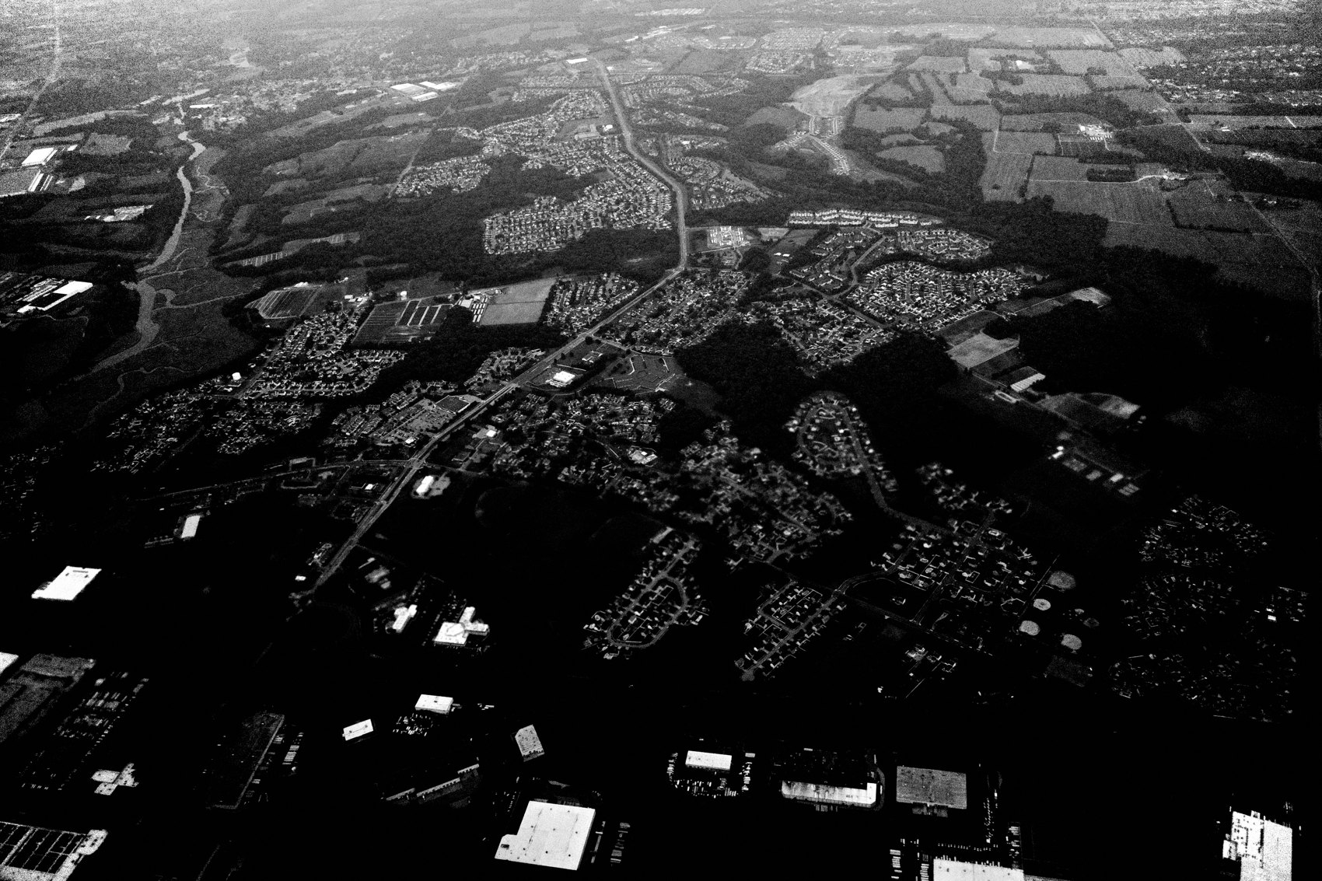
FLUX ACADEMY
BEAT 05 · MAIN TEACHING
The Background Is the Stage
— Background sets mood, structure, light, readability
— A wall, doorway, shadow, beam, horizon
— These are stages, not backdrops
Notes:
Let's start where I start — the background. For me it's almost always the foundation. The background sets the mood, the structure, the light, and how readable the whole photograph will be. It might be a wall, a doorway, a shadow, a beam of light, a horizon line. Don't treat it as a backdrop. Treat it as a stage.

Slide 7
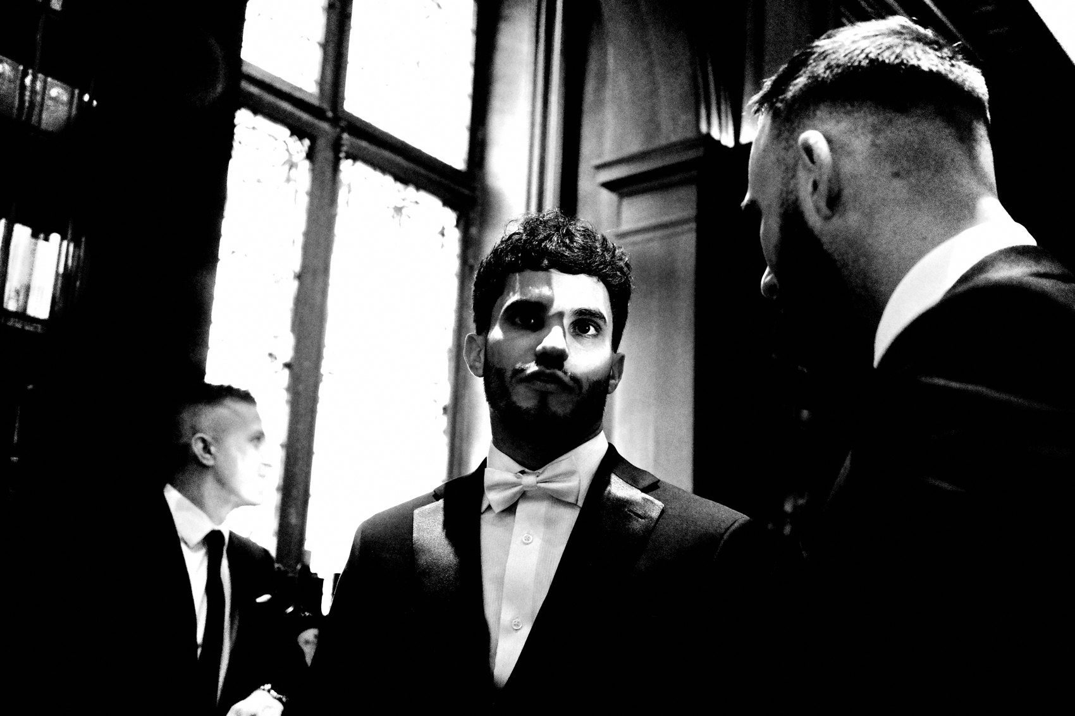
FLUX ACADEMY
BEAT 06 · MAIN TEACHING
Find the Background First
— First question: "What is my background?"
— Draw four invisible corners around a space
— Inside matters; outside is irrelevant
Notes:
So the very first question I ask on the street is simple: what is my background? When I choose one, I'm drawing four invisible corners around a space. Everything inside those corners matters. Everything outside is irrelevant. That single decision is how you begin to put order to the spontaneous, uncontrollable nature of life.

Slide 8
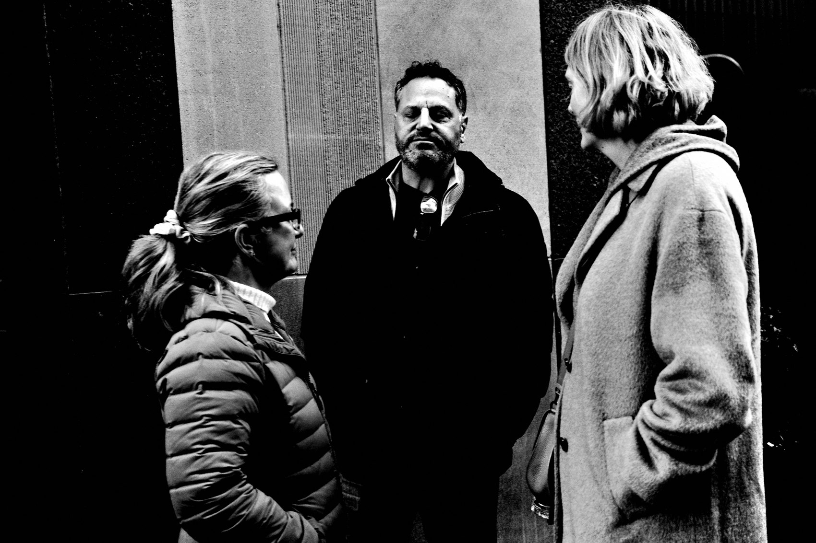
FLUX ACADEMY
BEAT 07 · MAIN TEACHING
Commitment Creates Control
— Choose a position, a height, a frame — and stay
— Don't hover, don't panic, don't reframe
— Commit, and anticipation becomes possible
Notes:
Finding the background first requires commitment. You choose a position, a height, a frame — and then you stay. You don't hover, you don't panic, you don't constantly reframe. You commit or you move on. Once you commit, anticipation becomes possible. Patterns reveal themselves. Gestures get predictable. That's where control comes from.

Slide 9
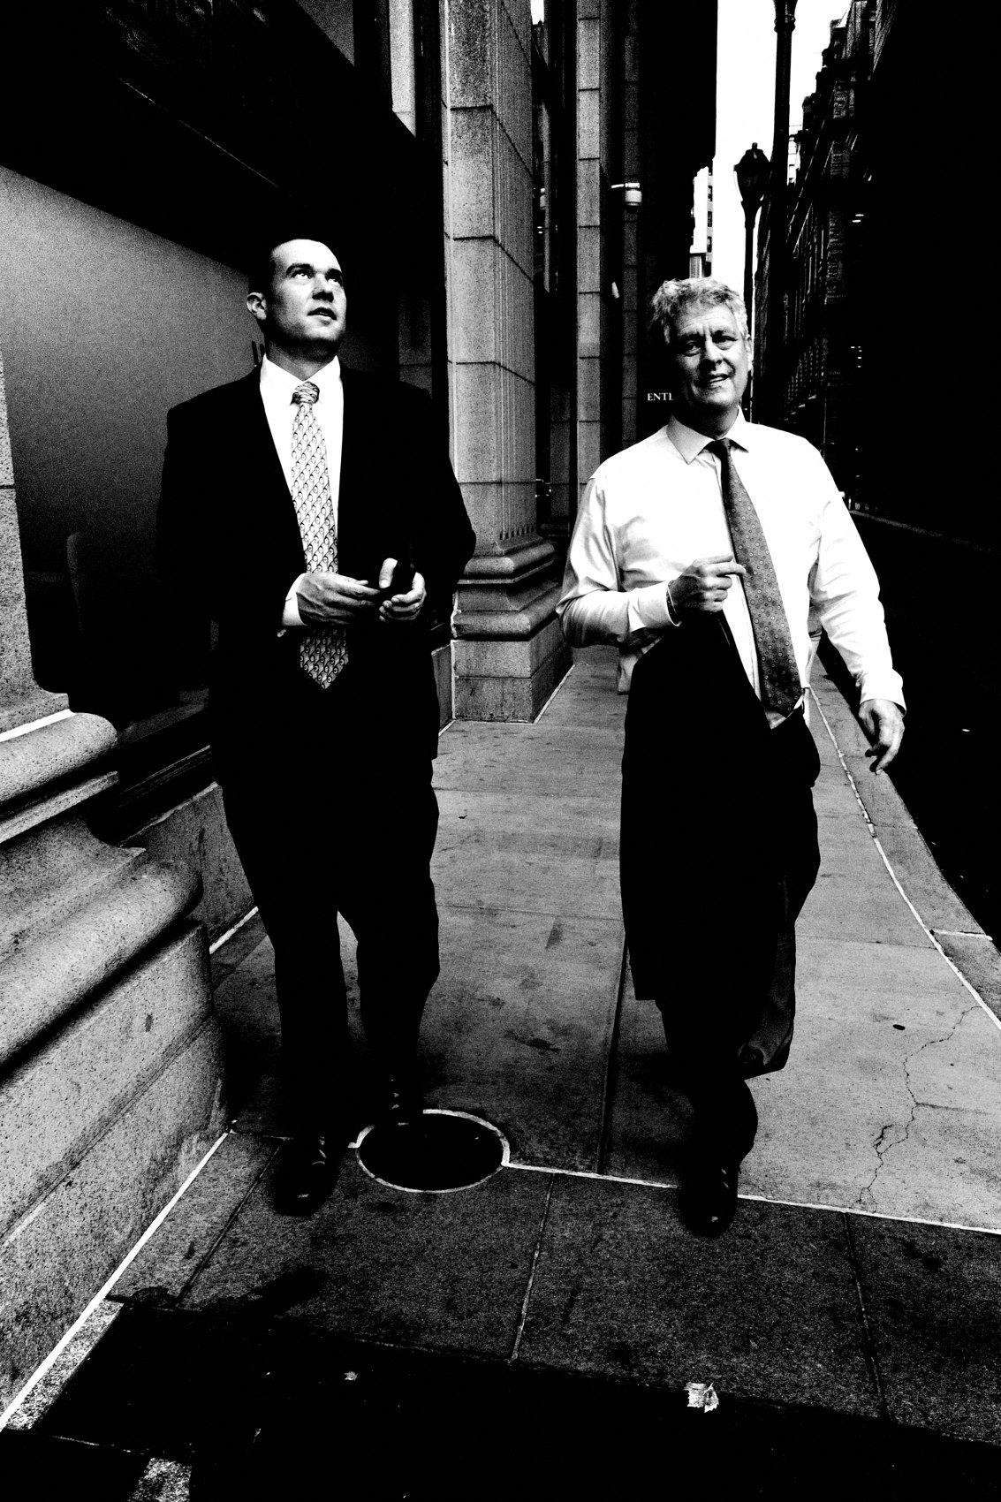
FLUX ACADEMY
BEAT 08 · MAIN TEACHING
The Middle Ground Carries Meaning
— Middle ground = where the story lives
— A person, a gesture, an interaction
— If the background's strong, it can stay quiet
Notes:
The middle ground is usually where the story lives — a person, a gesture, a moment of interaction, a human presence. It doesn't need to be dramatic. It just needs to belong in the space you've built. And here's the gift: if your background is strong, the middle ground can be quiet and still feel powerful. Structure does the heavy lifting.

Slide 10
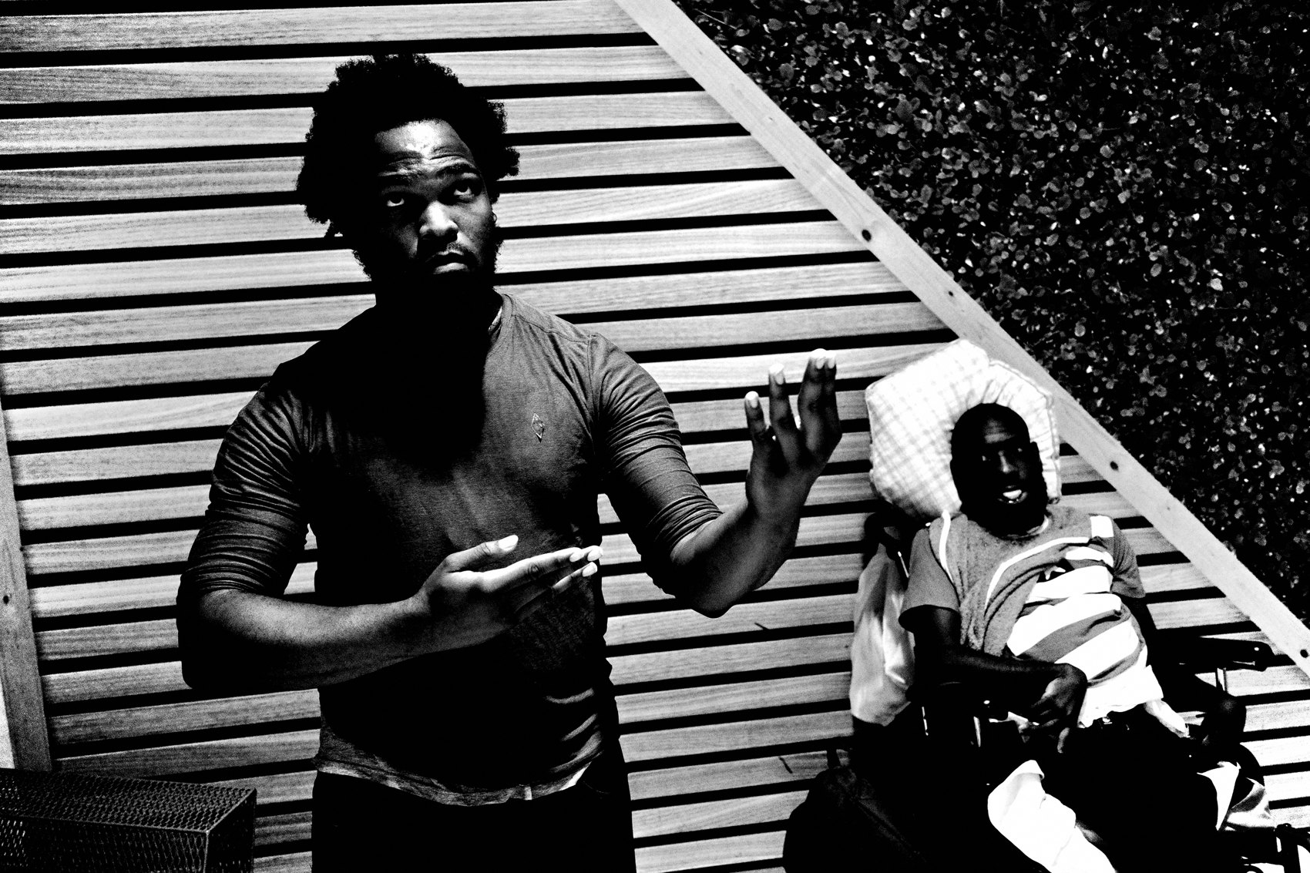
FLUX ACADEMY
BEAT 09 · MAIN TEACHING
The Foreground Creates Depth
— Foreground pulls the viewer into the photo
— A hand, silhouette, passerby, shadow, object
— Frames, separates, scales, guides inward
Notes:
The foreground is what pulls the viewer into the photograph — a hand, a silhouette, a passerby, a shadow, an object close to the lens. A weak foreground clutters the frame; a strong one anchors it. It works best when it frames the scene, adds separation, creates scale, and guides the eye inward. Never decoration — always a job.

Slide 11

FLUX ACADEMY
BEAT 10 · MAIN TEACHING
Foreground Is Physical
— Foreground = proximity; get close
— Clear separation, distinct shape or tone
— Small position shifts make or break it
Notes:
Foreground is about proximity. It usually means being close to something — a hand, an eye, a silhouette. That closeness adds intimacy and scale, but only if it's controlled. A good foreground is clearly separated from the middle ground, has a distinct shape or tone, and feels deliberate. Composition is physical. One step changes everything.

Slide 12

FLUX ACADEMY
BEAT 11 · MAIN TEACHING
These Are Relationships, Not Pieces
— Background gives structure
— Middle ground gives meaning
— Foreground gives depth
Notes:
Don't think of these as three separate pieces. Think of them as relationships. The background provides structure, the middle ground provides meaning, the foreground provides depth. When those relationships align, the photograph feels complete. One missing? The image can still work. All three together? The frame gains weight and presence.

Slide 13

FLUX ACADEMY
BEAT 12 · MAIN TEACHING
A Moment Is Not Yet a Photograph
— Something grabs you — but the frame doesn't exist yet
— Solve the puzzle: drop low to separate the planes
— Middle-ground subject, aligned foreground, clean structure
Notes:
Here's a pattern that repeats everywhere. Something grabs you first — a figure, a gesture, strong shadow play against a wall. But the moment is not yet a photograph. You have to solve the puzzle. Often that means dropping to a low angle to separate the tree, the bushes, the building, and the sky into distinct planes. The subject becomes your middle ground; a shape close to the lens in the foreground aligns with a vertical line behind it. The moment is the spark, but clean structure is what makes it a frame.

Slide 14

FLUX ACADEMY
BEAT 13 · MAIN TEACHING
Anchor on the Stage, Then Anticipate
— Anchor on the background, not on the moving subject
— Commit your position, then wait
— The subject completes a frame you already prepared
Notes:
The stronger move is to stop chasing the moving subject and anchor on the stage instead. Say you notice an open doorway — a clean geometric shape against blue sky. That doorway becomes the background, and you fix your body to it and commit. Now the space starts revealing its patterns: a figure in a window, people passing through the foreground, birds cutting through the opening again and again. It stops being luck and becomes anticipation. When the decisive element finally moves through, it completes a frame you had already prepared.

Slide 15

FLUX ACADEMY
BEAT 14 · MAIN TEACHING
When the Background Is Strong, Stay Still
— A strong background already does most of the work
— Don't chase action — plant your body and wait
— The person doesn't compete with the stage; they activate it
Notes:
When you find a background that's already strong — a wall with graphic shape, bold color, and good light — most of the work is done. The mistake now is chasing constant action and pulling yourself away from it. Instead, plant your body and stay still. Wait as someone moves through the space, from light into shadow, until a shape in the foreground lines up with the shapes on the wall behind. The person doesn't compete with the stage. They activate it. A strong background rewards patience, not motion.

Slide 16
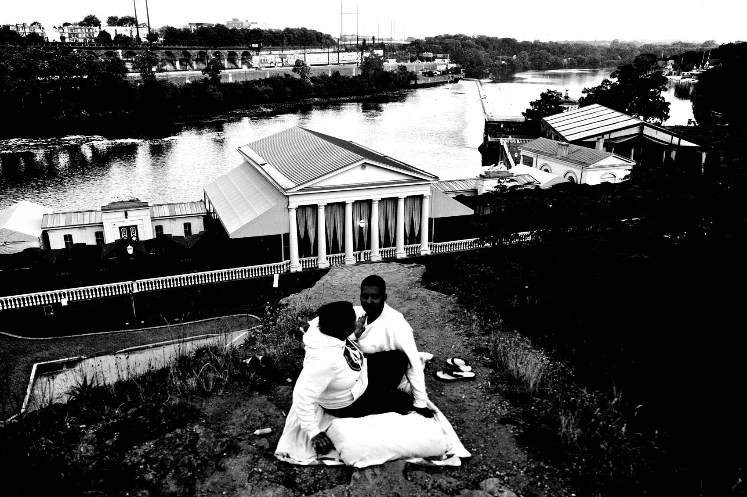
FLUX ACADEMY
BEAT 15 · MAIN TEACHING
Balance: Let One Layer Lead
— Every frame needs a dominant layer
— One leads, one supports, one holds it together
— Separate by light, space, tone — or simplify
Notes:
Balancing the three isn't about equal weight. In most strong photographs one layer leads, one supports, and one quietly holds everything together — the mistake is not choosing. Balance also needs separation: when layers bleed into each other it collapses, so separate them by light, space, tone, or timing. And when a frame feels heavy, don't add — remove. Simplify, and balance usually returns immediately.

Slide 17
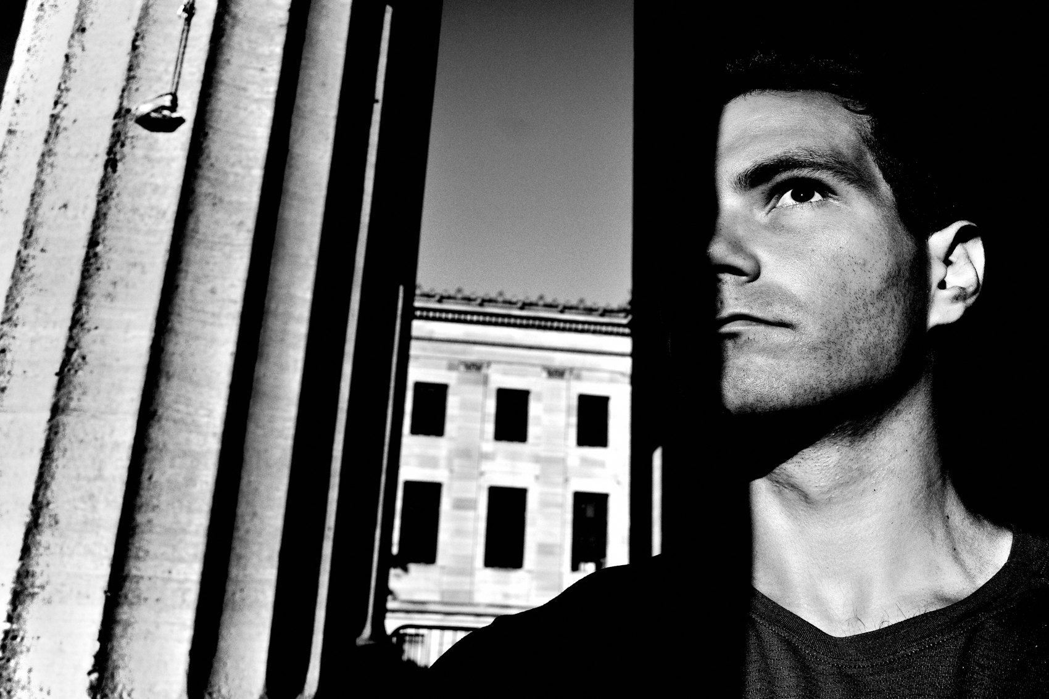
FLUX ACADEMY
BEAT 16 · PRACTICAL APPLICATION
Analyze Back to Front
— Set the background
— Place the subject
— Decide if a foreground helps
Notes:
Here's the method, and it's the same everywhere. Analyze the scene back to front. One: set the background — does this space work on its own? Two: place the subject — where could a moment live? Three: decide if a foreground helps or distracts. That's it. This slows you down in the right way. You stop reacting and start building.

Slide 18
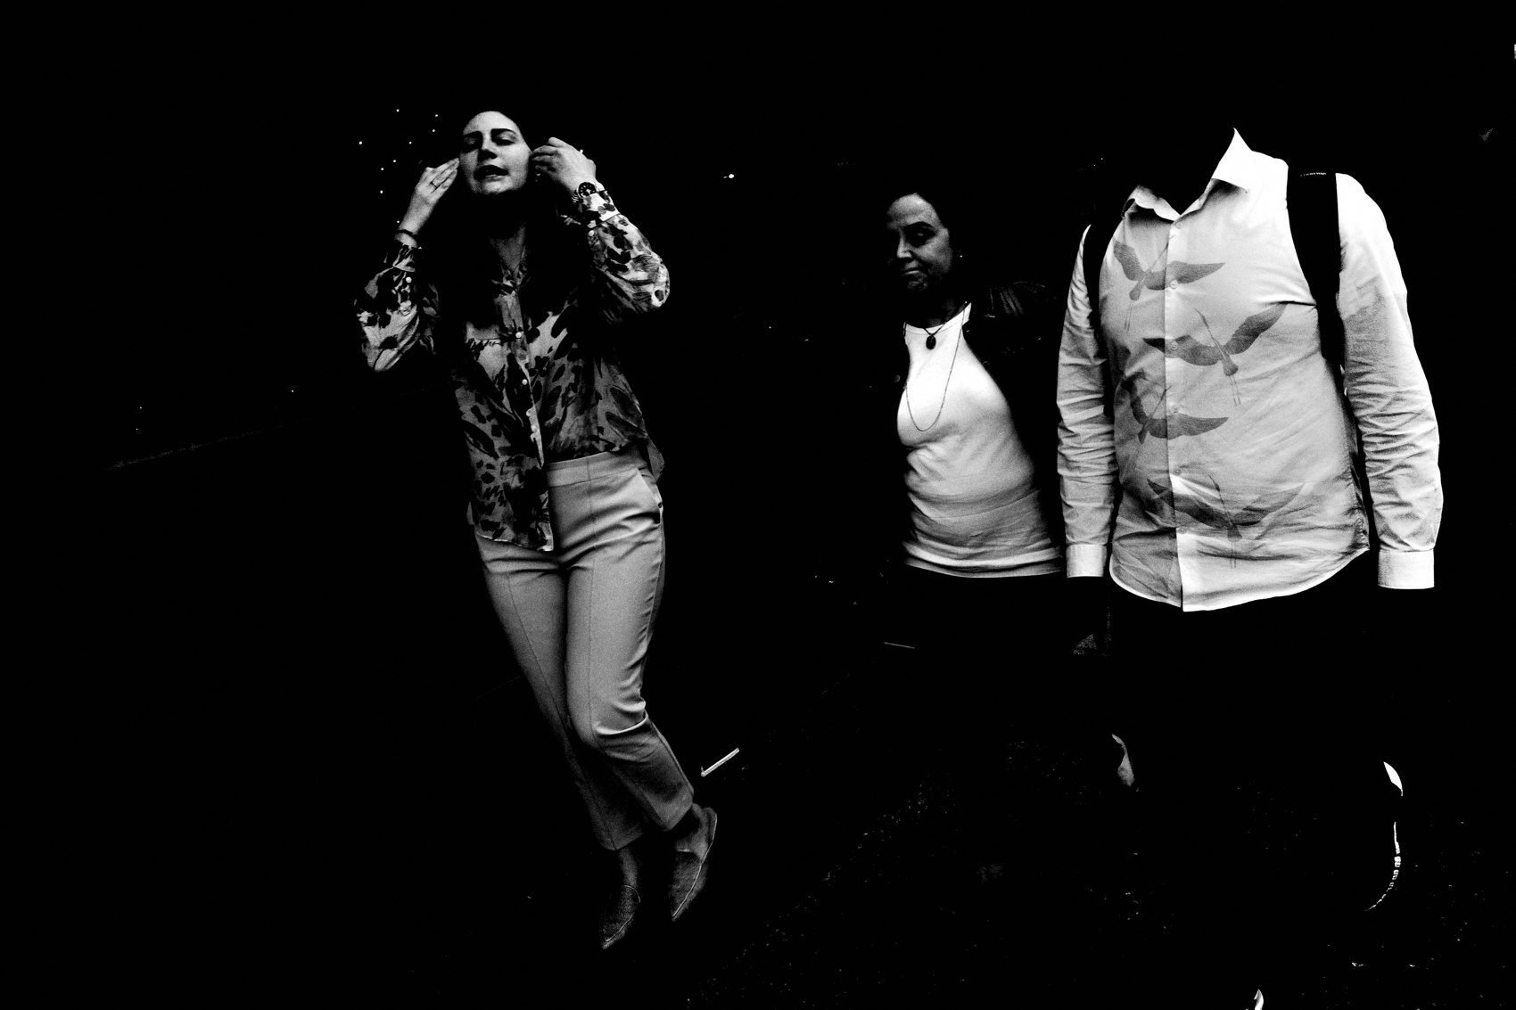
FLUX ACADEMY
BEAT 18 · PRACTICAL APPLICATION
Stand on One Stage
— Pick one strong background, hold position
— Let people enter and activate it
— One stage can give many photographs
Notes:
Your drill: find one strong background and commit. Hold position for ten, twenty minutes, longer. Let people come to you. A strong stage can produce many photographs — the background stays constant, the variables change. That's how layering becomes repeatable instead of lucky. And when the space goes quiet, move on intentionally — never out of boredom.

Slide 19
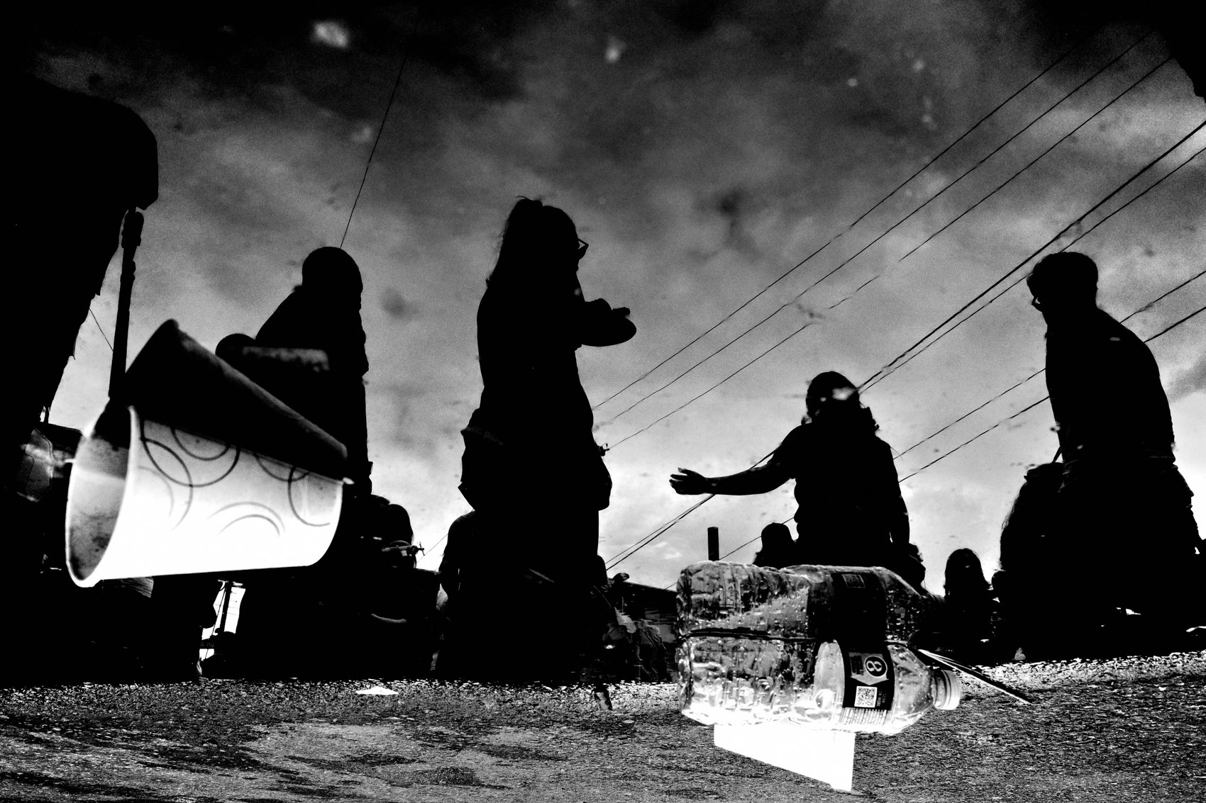
FLUX ACADEMY
BEAT 19 · PRACTICAL APPLICATION
Anchor With One Strong Foreground
— A hand entering the frame creates instant depth
— In chaos, get close and let one element dominate
— One strong element beats many weak ones
Notes:
Try the foreground move too. When a hand enters at the near edge of a frame, it creates instant depth — the image goes from observational to participatory in a single beat. In a scene full of chaos, get close and let one element dominate the foreground, anchoring everything behind it. One dominant element beats many weak ones. Don't look for more. Look for one strong foreground and let it do the work.

Slide 20
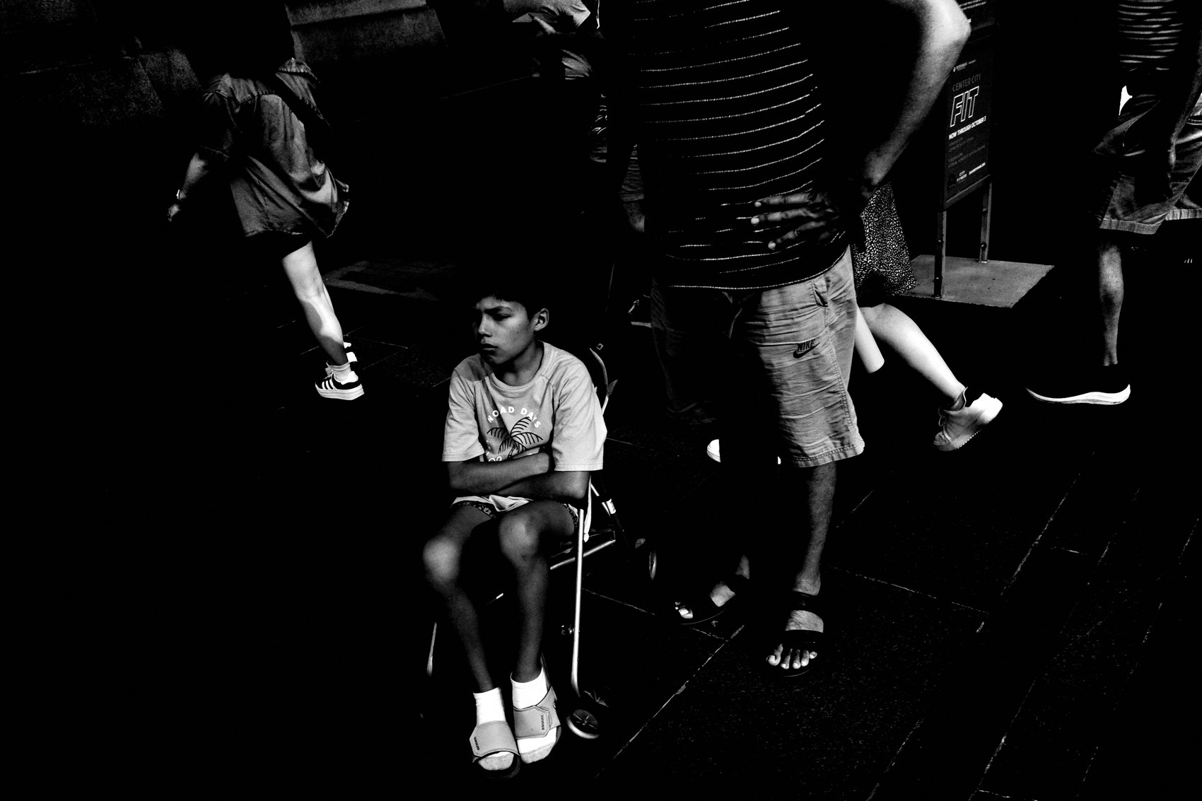
FLUX ACADEMY
BEAT 20 · COMMON MISTAKES
Forcing a Foreground
— Adding foreground doesn't auto-improve a photo
— Careless foreground = visual noise
— Knowing when NOT to add one is mastery
Notes:
The number-one mistake: thinking any foreground makes a photo better. A careless foreground is the fastest way to ruin a strong frame — it becomes visual noise, clutters the eye, weakens everything. If a foreground doesn't create depth, anchor, frame, or guide the eye, it doesn't belong. Knowing when not to add one is part of mastery. Less foreground is often better.

Slide 21
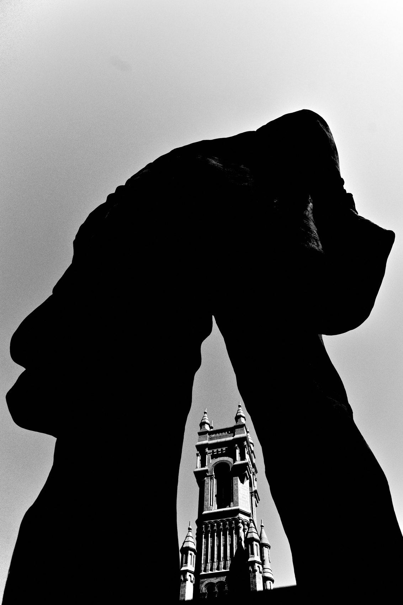
FLUX ACADEMY
BEAT 21 · COMMON MISTAKES
Treating It as a Checklist
— Don't force all three layers every time
— Overlap without separation kills hierarchy
— Messy foreground = positioning, not timing
Notes:
Mistake two: turning layering into a checklist — forcing a foreground, a middle ground, and a background into every frame. Many images fail exactly because the photographer insisted. And when a foreground feels messy, it's usually a positioning problem, not a timing problem. Take one step. Lower the camera. Wait. Clarity over complexity, always.

Slide 22
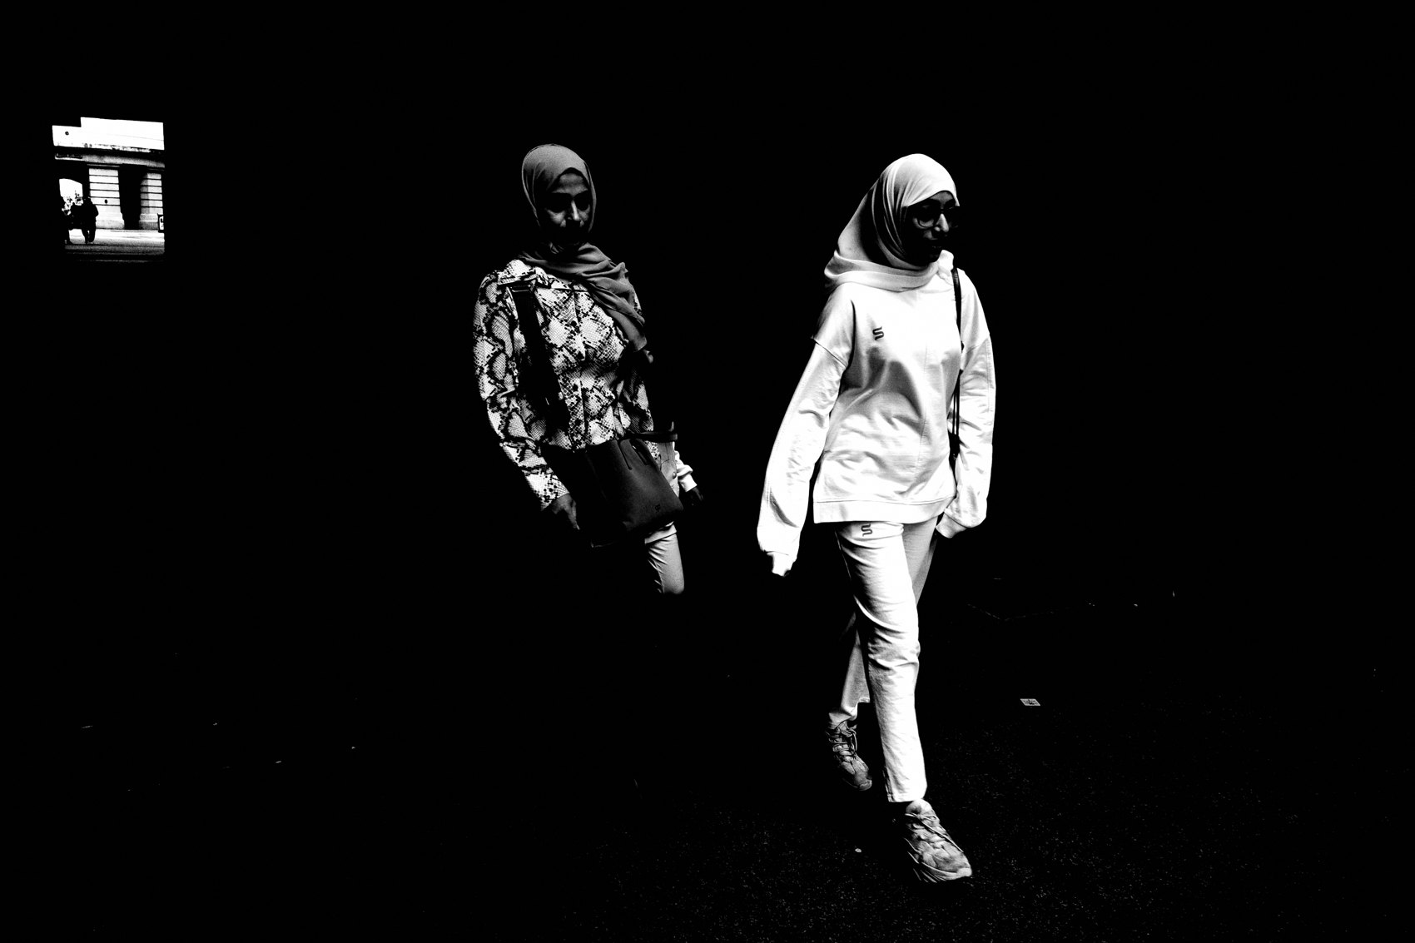
FLUX ACADEMY
BEAT 22 · RELATIONSHIP TO PREVIOUS
From Layering to Its Anatomy
— Lesson 023 defined layering as structure
— This lesson names its three parts
— Relationships, not subjects — now made spatial
Notes:
In Lesson 023 we defined layering itself — structure, relationships not subjects, putting order to chaos. Today we opened that idea up and named its three parts: background, middle ground, foreground. This is the anatomy of everything we introduced. You learned what layering is; now you know the planes it's actually built from.

Slide 23

FLUX ACADEMY
BEAT 23 · RELATIONSHIP TO UPCOMING
Toward Building Depth
— Next: Building Depth (Lesson 025)
— Overlap, scale, and separation across planes
— Take three zones → real dimensional space
Notes:
Up next, Lesson 025 — Building Depth. Once you can see three planes, the question becomes how to make them feel truly dimensional: overlap, scale, leading lines, and separation pulling the eye front to back. We've laid the zones down. Next we give them space between them. Last thing — the takeaway. Foreground, middle ground, and background aren't about adding more; they're about seeing clearly. Find the background first, commit your position, let the middle ground arrive, and add a foreground only when it earns its place. Build stages, not snapshots. See, hold, and let life perform inside the frame. Catch you next lesson.

