Slide 1
FLUX ACADEMY · A SCHOOL FOR SEEING
MODULE 4 · COMPOSITION
Breakdown II — Composition
BY DANTE SISOFO

Slide 2
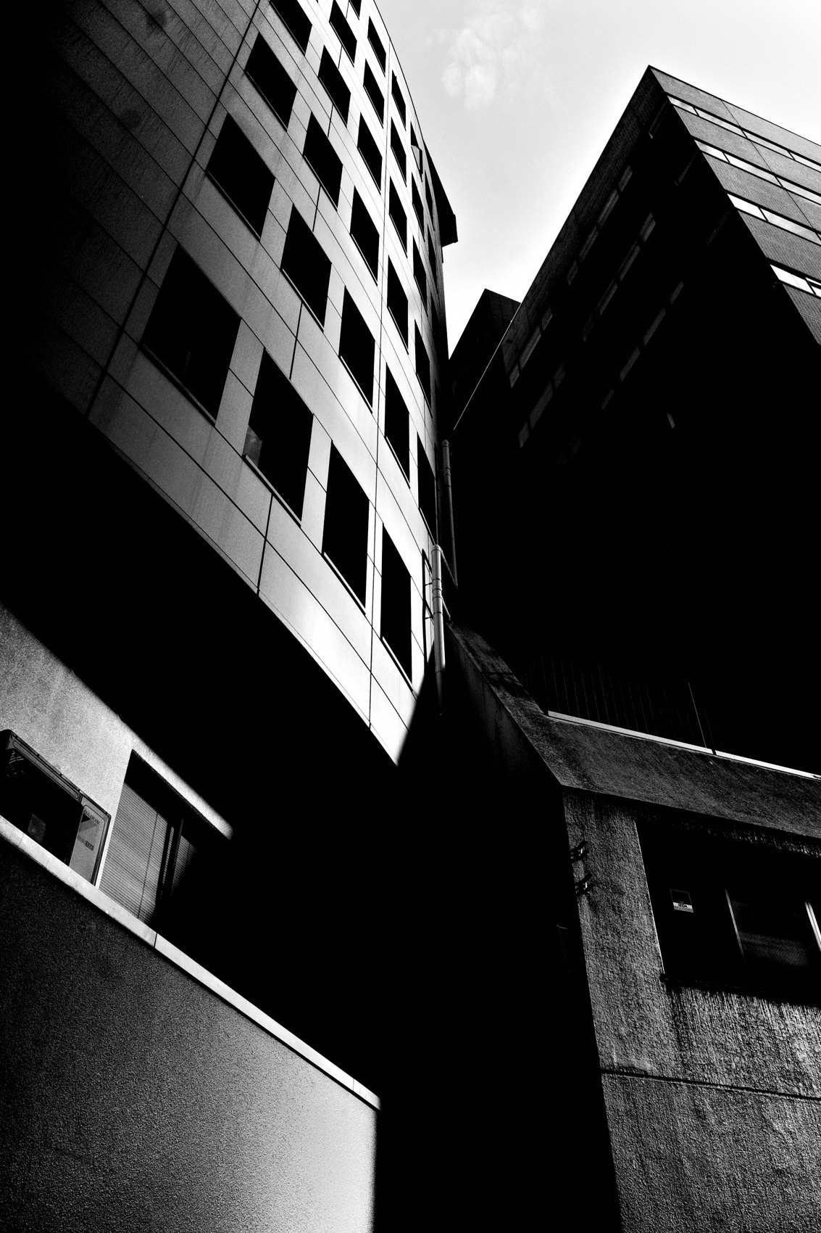
FLUX ACADEMY
BEAT 01 · CORE IDEA
Composition Is a Set of Decisions
— A frame is built from decisions
— The problem → the move → the resolve
— Composition is physical, not theory
Notes:
What's popping, people — it's Dante. Today we get practical about composition. We're going to look at the decisions inside a frame — the geometry, the balance, the framing, where the gesture sits. Because composition isn't a grid you memorize and lay over the world. It's a series of physical choices you make on the street, in the moment, and we're going to make those choices visible so you can make them on purpose.

Slide 3
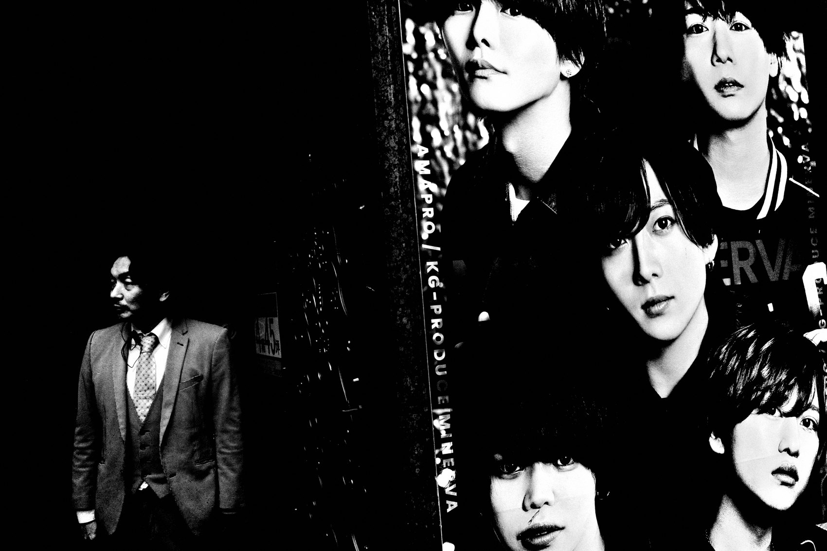
FLUX ACADEMY
BEAT 02 · LEARNING OBJECTIVE
Read the Decisions in a Frame
— See the problem a scene hands you
— Name the move that resolves it
— Understand why the move works
Notes:
By the end of this lesson you'll be able to look at any street scene and reverse-engineer the composition — spot the problem the scene is handing you, identify the decision that resolves it, and understand why it works. That's the skill you turn back on your own contact sheets, so your best frames stop being accidents and start being repeatable.

Slide 4
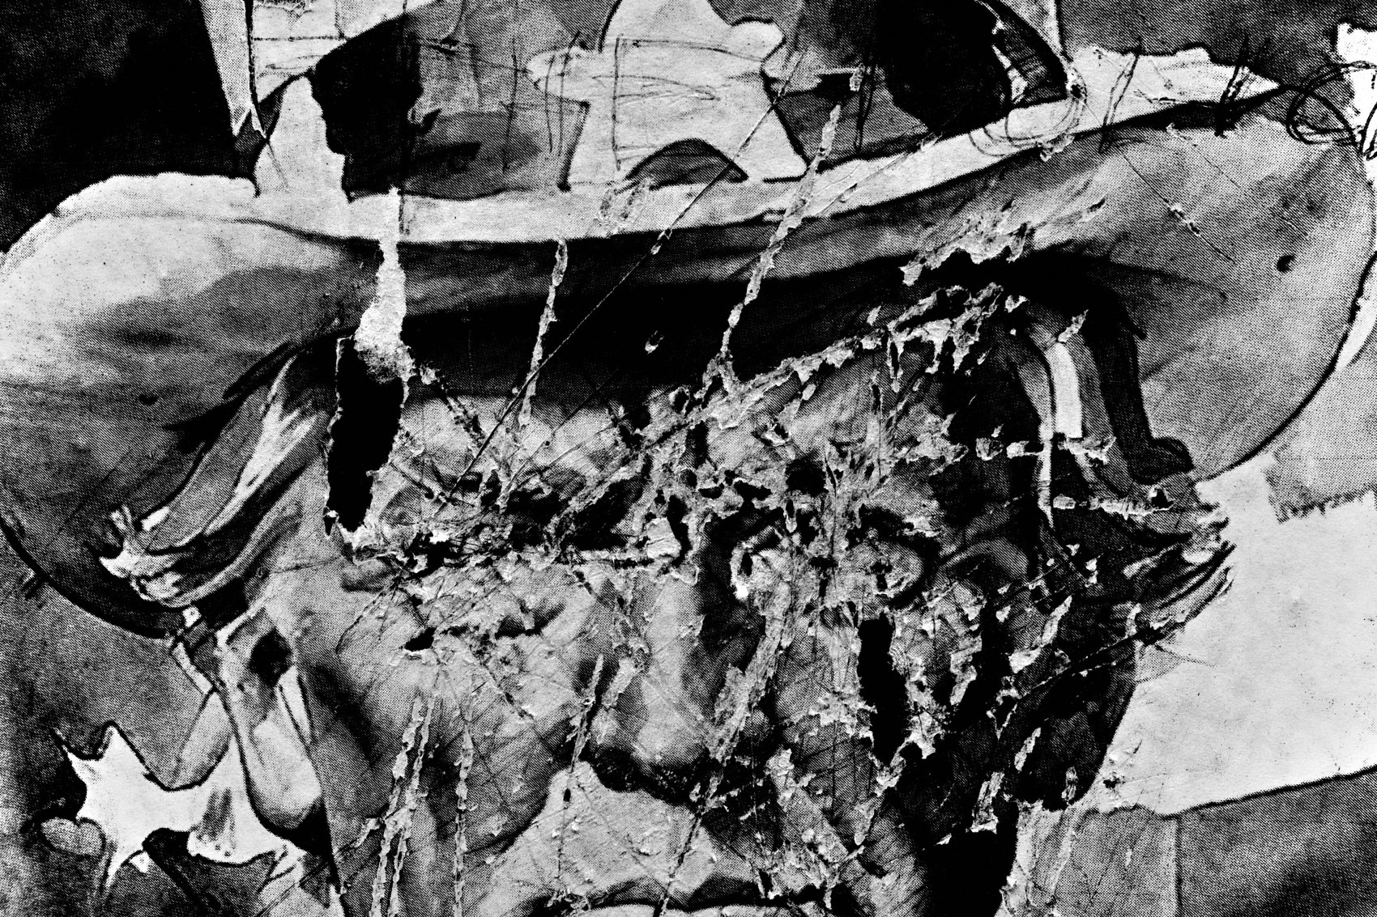
FLUX ACADEMY
BEAT 03 · WHY THIS MATTERS
Order Out of Chaos
— The street hands you chaos
— Composition is how you order it
— Decisions, not luck, make frames
Notes:
Here's why this matters. Out there, things happen fast — there's chaos everywhere. Our whole job is to put order to that chaos. The frames that work aren't lucky; they're the result of small physical decisions made in a split second. Composition is where those invisible decisions become visible, and where luck gets replaced by intention.

Slide 5

FLUX ACADEMY
BEAT 04 · MAIN TEACHING
The Three Questions
— What is the compositional problem?
— What decision resolves it?
— Why does that decision work?
Notes:
So here's the frame to run every scene through — three questions. What is the compositional problem the scene is giving me? What decision will resolve it? And why does that resolution actually work? Problem, move, payoff. Hold those three in your head and any scene — any photograph, yours or anyone's — starts teaching you something.

Slide 6
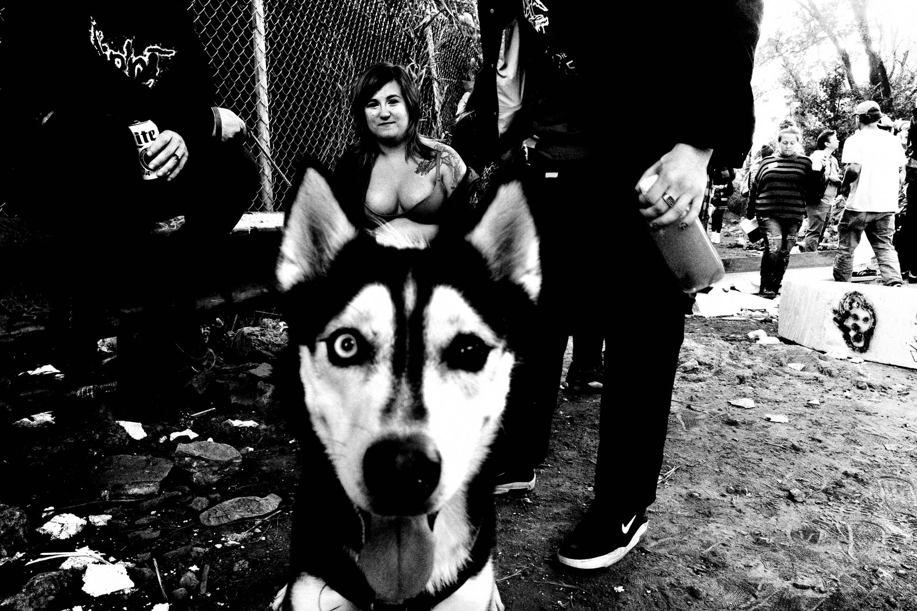
FLUX ACADEMY
BEAT 05 · MAIN TEACHING
Composition Is Physical
— A photographer positions their body
— Composition derives from your legs
— Move your feet, not your lens
Notes:
Before anything else, the one law underneath it all: a photographer is responsible for where they position their physical body in relationship to the subject and the background. Composition derives from your legs. Every "decision" we're about to make is really you moving your body to a better spot. When you feel a frame isn't working, the answer is almost always in your feet.

Slide 7
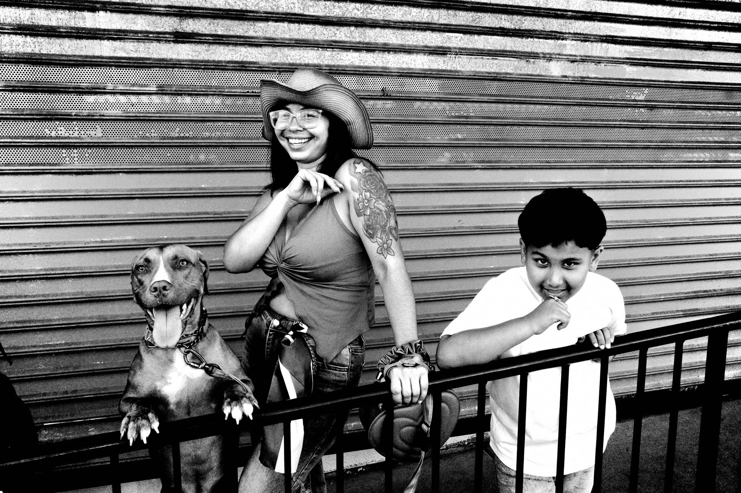
FLUX ACADEMY
BEAT 06 · MAIN TEACHING
Uplifting a Simple Subject
— The problem: a quiet, simple subject
— On its own it doesn't sing
— How do you make it resonate?
Notes:
First problem to solve: a subject that's simple. A single person in a doorway, a quiet gesture, one clean figure. On its own, it's just that — plain, static, easy to walk past. The compositional problem is how to uplift a simple subject into something that resonates. You don't fix this by finding a "better" subject. You fix it by finding what that subject can be related to.

Slide 8
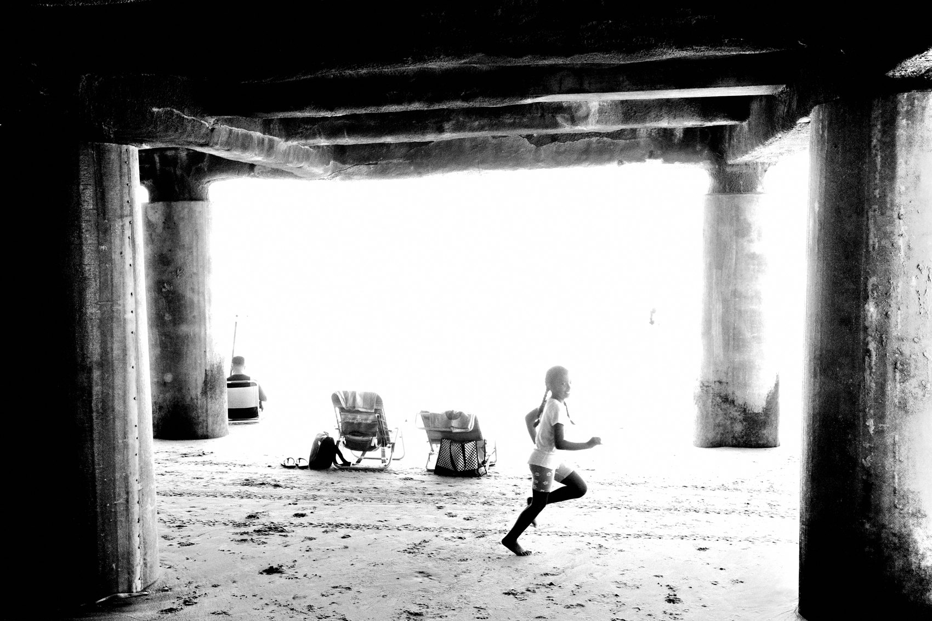
FLUX ACADEMY
BEAT 07 · MAIN TEACHING
The Decision: Let It Echo
— Compose the relationship, not the subject
— Find a shape or gesture that mirrors it
— Wait for the rhyme to line up
Notes:
The decision is to compose the relationship — not the thing, but the echo. Look for a shape nearby that repeats the shape of your subject: a frame that mirrors a frame, a gesture that mirrors a gesture, a face that answers another face. You press the shutter for the rhyme between elements, not for either one alone. That's how a quiet subject stops being alone in the frame.

Slide 9
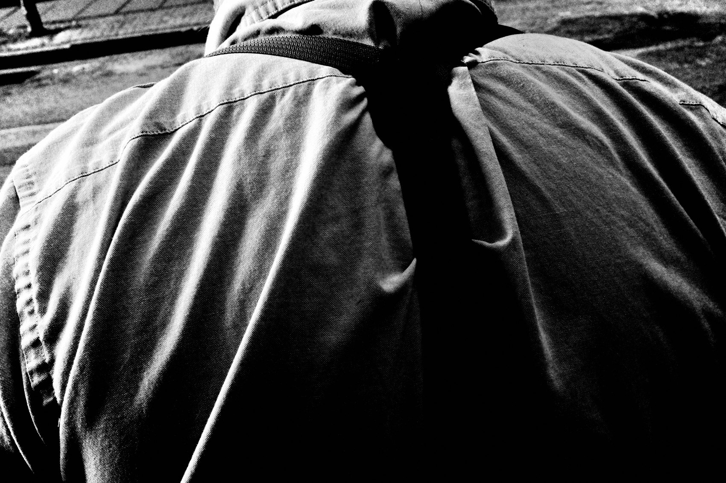
FLUX ACADEMY
BEAT 08 · MAIN TEACHING
Why It Works: The Rhyme
— Repetition gives the eye rhythm
— Frame-within-a-frame contains the subject
— A simple gesture goes a long way
Notes:
Why does it resolve? Because repetition gives the eye a rhythm to travel — shape to shape, hand to hand, face to face. A frame-within-a-frame contains your subject and points the viewer straight at them. Two echoing forms turn a quiet scene into a structured one. Sometimes a simple gesture can go a long way — you just have to give it something to rhyme with.

Slide 10
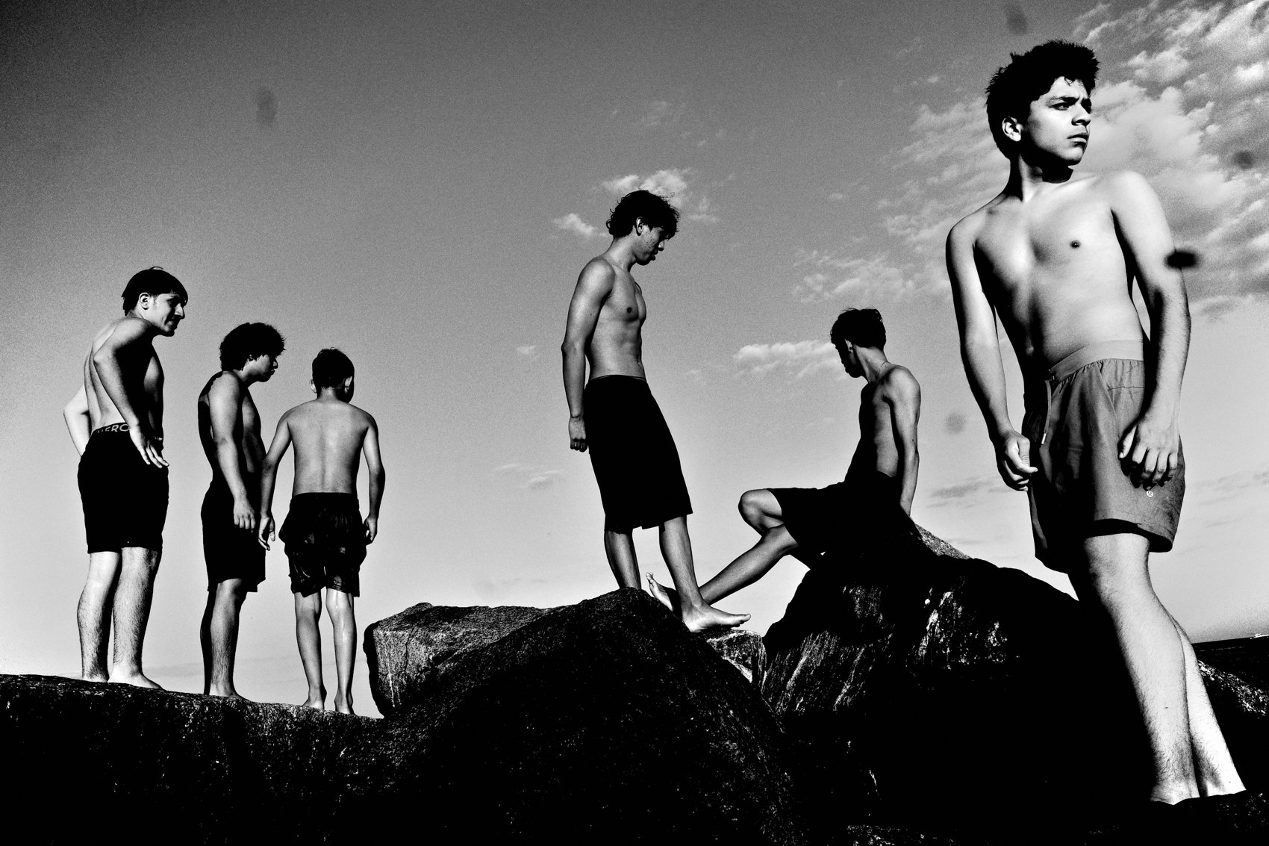
FLUX ACADEMY
BEAT 09 · MAIN TEACHING
Ordering a Chaotic Scene
— The problem: too much going on
— A subject lost in background clutter
— No separation, no read
Notes:
Now the opposite problem: too much. A scene packed with movement, gesture, atmosphere — real chaos. There's energy everywhere, but the subject you want in the center is getting swallowed by the clutter behind them. Their head merges into the background, there's no separation, and the eye has nowhere to land. The problem isn't that the scene is busy. It's that nothing is holding it together.

Slide 11
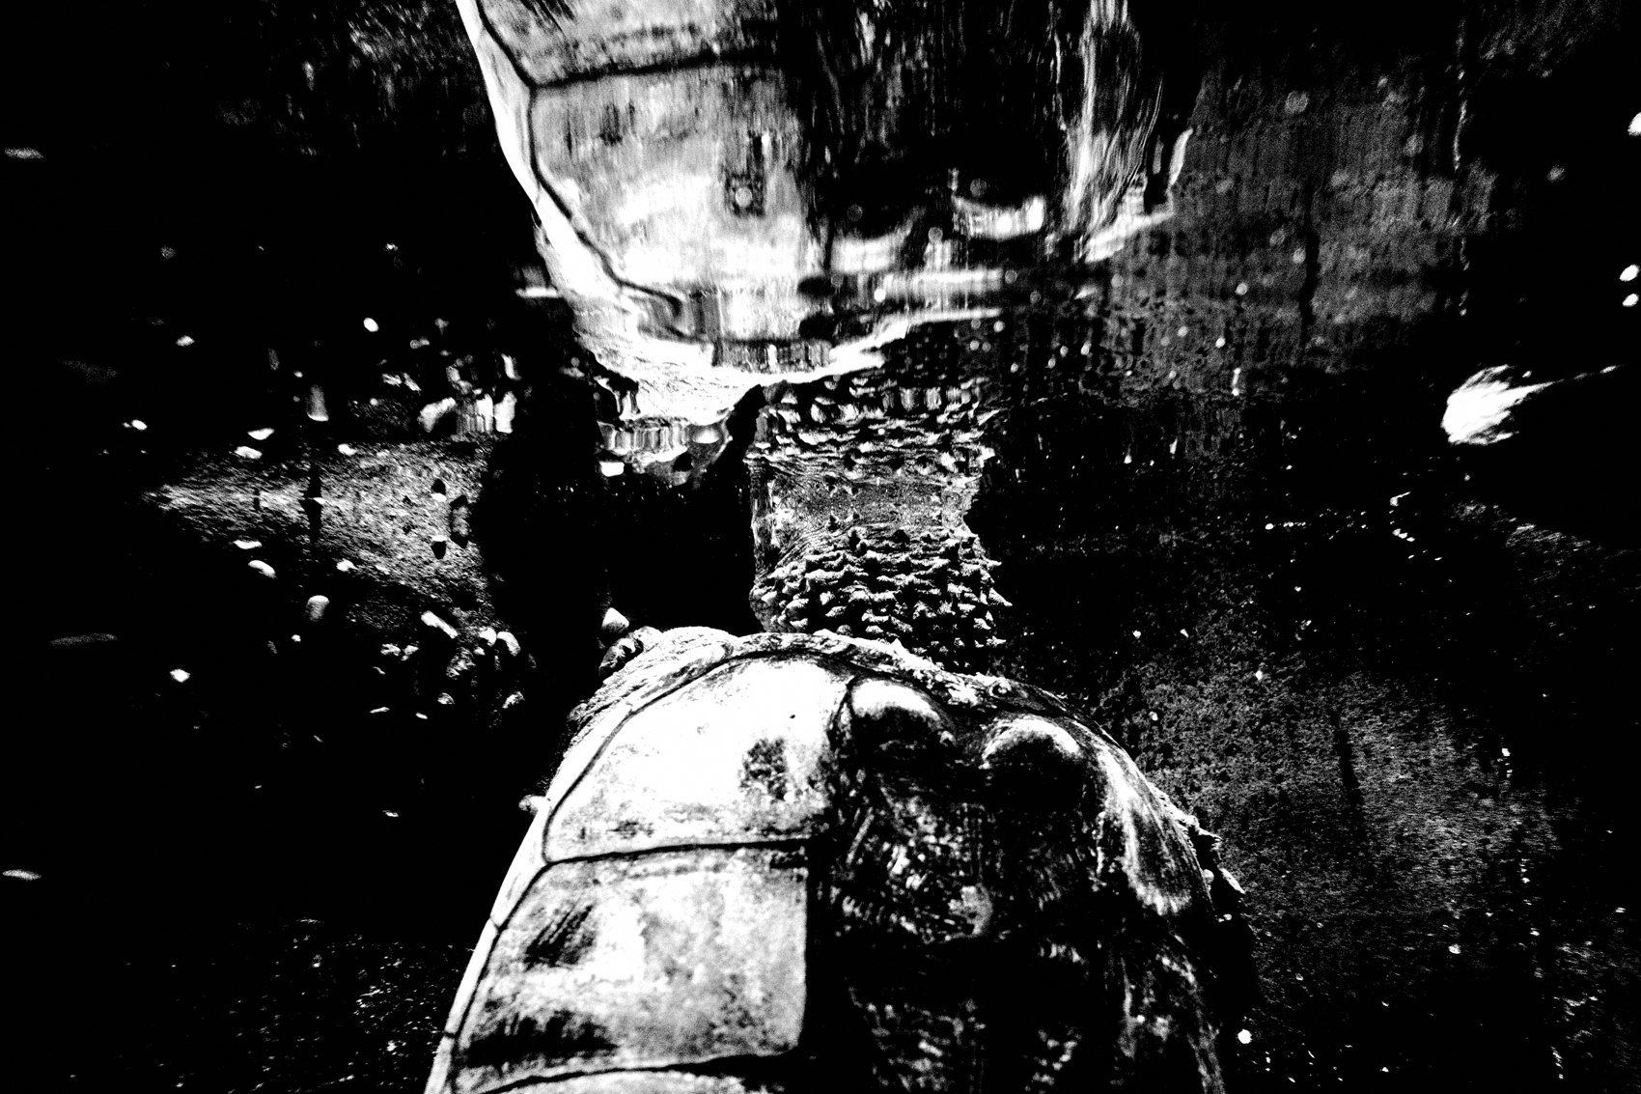
FLUX ACADEMY
BEAT 10 · MAIN TEACHING
The Decision: Drop and Separate
— Lower your body to change the backdrop
— Separate the subject from the clutter
— Anchor one strong figure in front
Notes:
The decision here is physical and exact: change your vantage point to separate the subject's head from the background. Often that means dropping low, so your subject sits clean against open sky instead of clutter. You anchor one strong figure in the foreground and let the vantage point do the work. A single hand or partial figure at the edge can add mystery — but the move that matters is getting the angle that gives you separation.

Slide 12
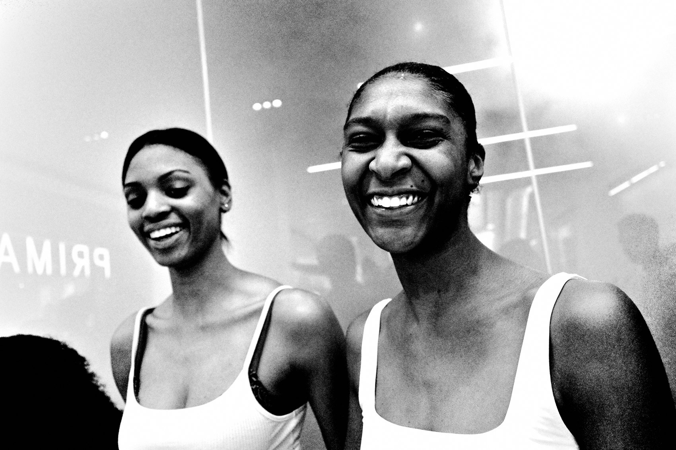
FLUX ACADEMY
BEAT 11 · MAIN TEACHING
Why It Works: A Clean Read
— One clean subject orders the chaos
— Open space = negative space, breathing room
— A successful composition is easy to read
Notes:
Why does it resolve? Because that clean separation — one subject isolated against open space — gives the eye a single anchor to grab in a frame full of grit. The open sky or wall becomes negative space, breathing room around the chaos. A successful composition is easy to read. You don't remove the chaos; you give it a center. The angle does all the work, and suddenly a mess becomes a picture.

Slide 13
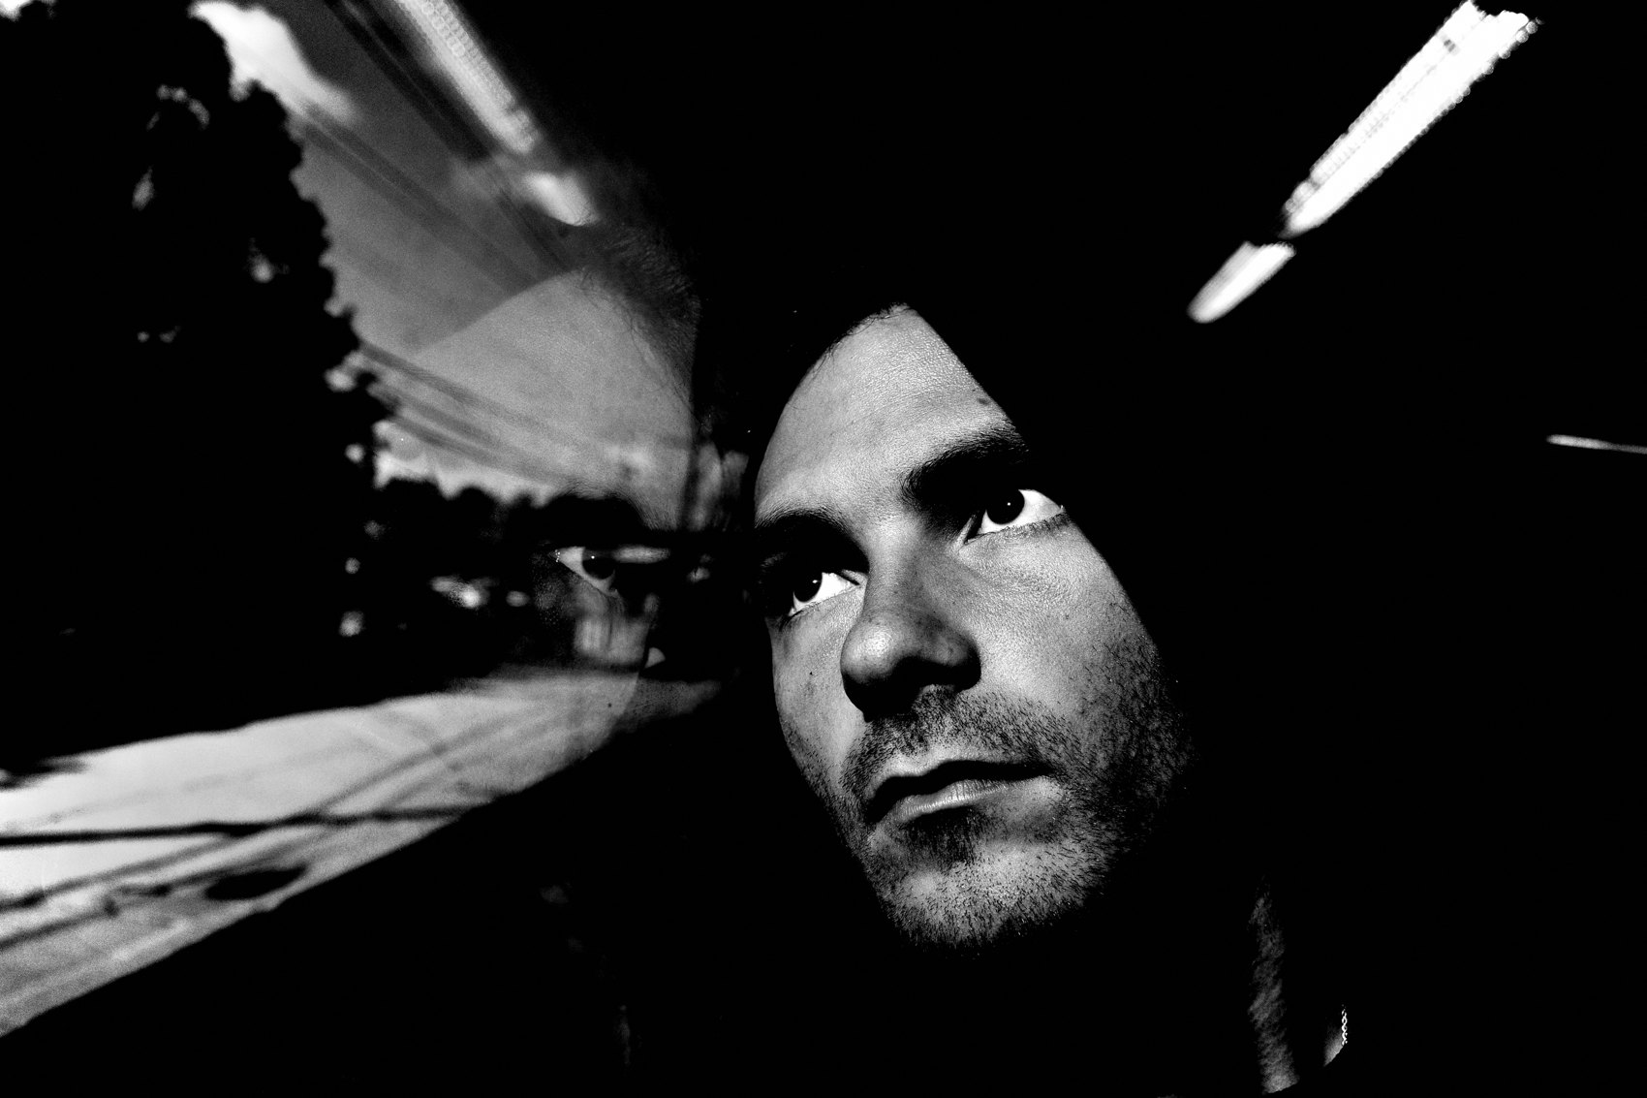
FLUX ACADEMY
BEAT 12 · MAIN TEACHING
Framing to Exclude
— The problem: a scene that could turn busy
— Use an opening as a natural frame
— Choose what to leave out
Notes:
Now a subtler problem: a moment that's fine right now but could easily turn busy and distracting if you let the whole scene in. The decision is to contain it. Use a natural opening — a window, a doorway, an archway — as a frame that crops the world down to only what you want. Framing isn't just decoration; it's how you exclude. You're choosing what to leave out as much as what to keep.

Slide 14
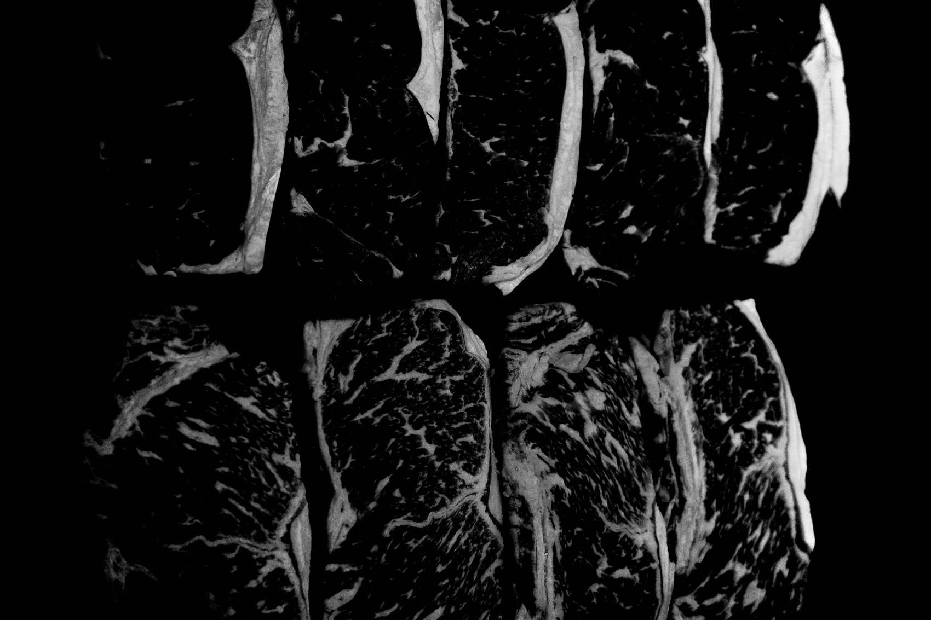
FLUX ACADEMY
BEAT 13 · MAIN TEACHING
The Decision: Frame and Balance
— Place your subject cleanly on one side
— Add a counterweight on the other
— Keep the background simple and ambiguous
Notes:
Inside that frame, you balance. Set your subject cleanly to one side, then add a second element — a smaller figure, a shape — on the opposite side as a counterweight, so the frame doesn't tip. Keep the background clean and ambiguous, giving nothing away. It's simple, but it's a real decision: subject on the right, counterweight on the left, quiet space behind. Nothing fighting for attention.

Slide 15

FLUX ACADEMY
BEAT 14 · MAIN TEACHING
Why It Works: Simplicity
— What you exclude matters as much
— Balance left–right so the eye rests
— Simplicity creates timelessness
Notes:
Why does it resolve? Because what you exclude from the frame is just as important as what you include. The opening contains your subject; the counterweight steadies it; the empty, ambiguous background gives the whole thing room to breathe. Left–right balance lets the eye rest instead of scrambling. Simplicity creates timelessness — strip a frame down and it stops belonging to one year, one trend, one moment.

Slide 16
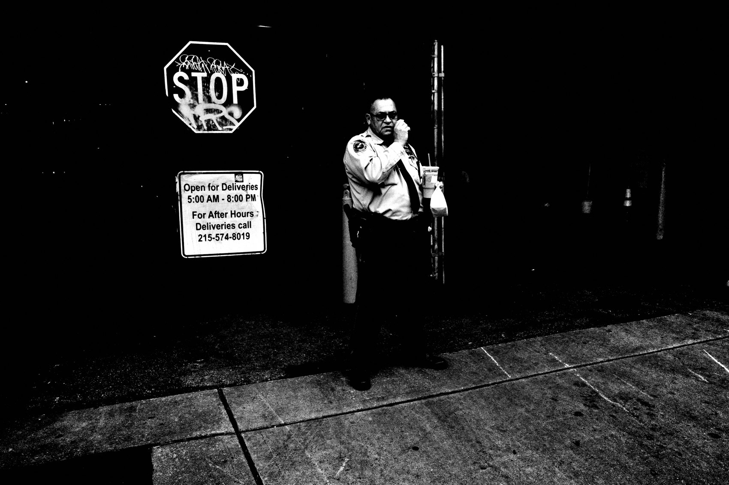
FLUX ACADEMY
BEAT 15 · MAIN TEACHING
Diagonal Tension
— Anchor opposite corners of the frame
— One element upper-left, another lower-right
— Contrast separates the figures
Notes:
Here's a pure geometry move: diagonal tension. Anchor one element in an upper corner and another in the opposite lower corner, and you create a line of tension that runs across the whole frame, corner to corner. It pulls the eye through the picture instead of letting it sit still. Pair that diagonal with tonal contrast — dark against light — so every figure separates cleanly. Geometry plus contrast is a reliable way to order even a crowded scene.

Slide 17
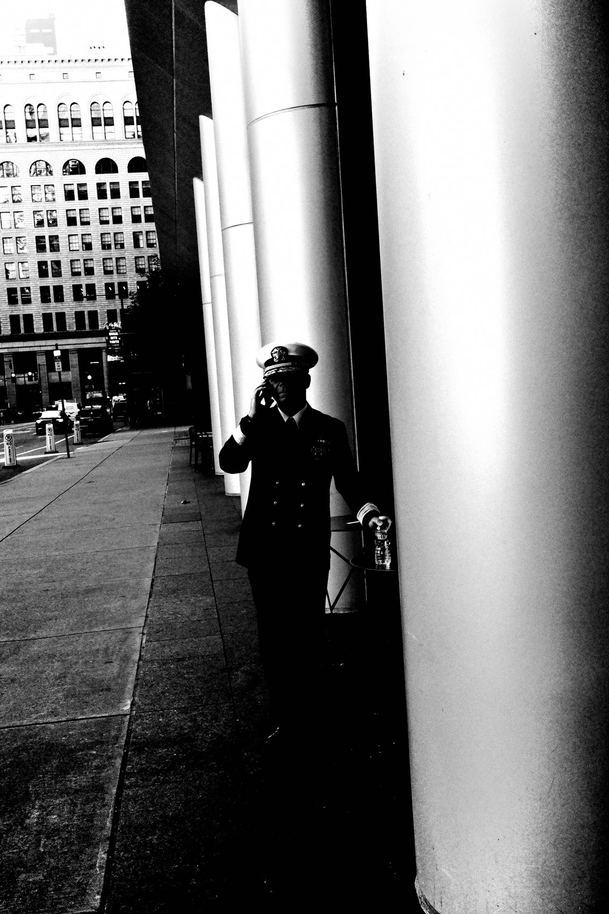
FLUX ACADEMY
BEAT 16 · MAIN TEACHING
Work Back to Front
— Anchor the background first
— Wait for the foreground to fill in
— Set your stage, plug in the pieces
Notes:
Notice the through-line: you rarely build a frame front-to-back. Plug in the background first, then wait for the moment. Anchor a strong background element — a figure in a window, a frame within a frame — and then wait for the foreground to fill with color, gesture, movement, maybe a bird cutting through. Set your stage, then plug in the puzzle pieces. The background is a decision you make early and hold.

Slide 18
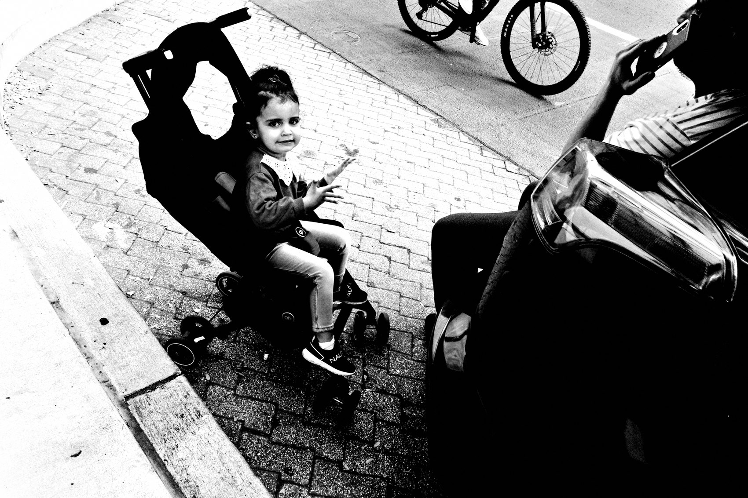
FLUX ACADEMY
BEAT 17 · MAIN TEACHING
Gesture Placement Is a Decision
— Find the gesture that draws you
— Position it close to the camera
— Then build structure around it
Notes:
And watch where the gesture lands. Mirrored hands, a cropping hand at the edge, a figure held inside a frame — gesture placement is a compositional decision, not an accident. Find what draws you in, and position it as close to the camera as possible — then build the geometry around it so it has somewhere to live. The gesture is the heartbeat; the structure is what lets it be felt.

Slide 19
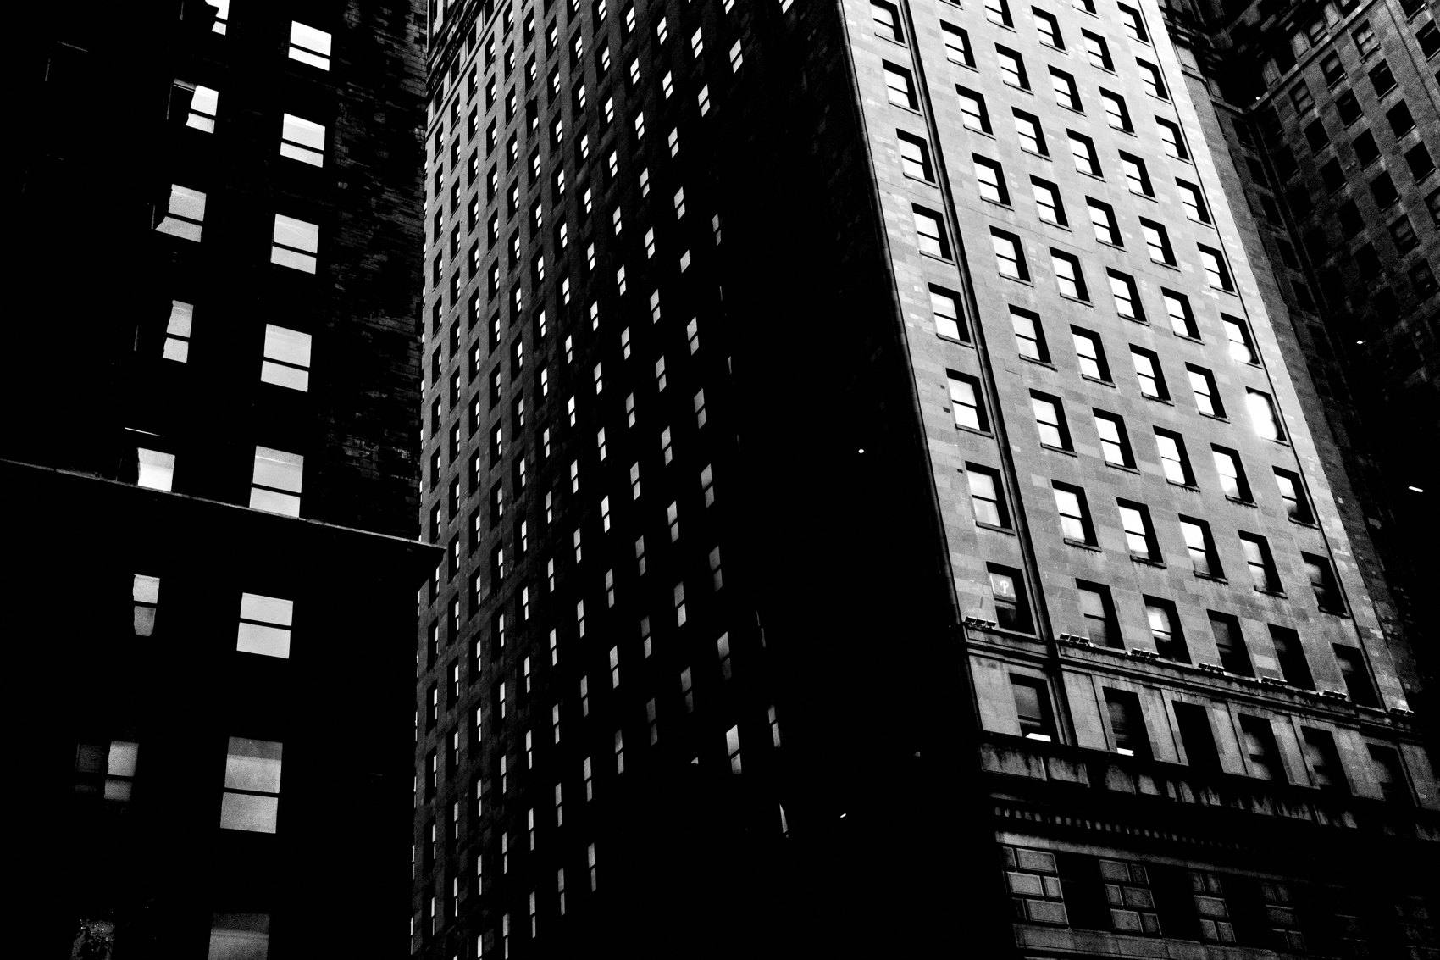
FLUX ACADEMY
BEAT 18 · PRACTICAL APPLICATION
Run Your Own Breakdown
— Pick three of your own frames
— For each: problem, decision, payoff
— Write the sentence out loud
Notes:
Here's your assignment. Pull three of your own frames — ideally from a contact sheet so you can see the misses too. For each one, answer the three questions in a full sentence: what was the compositional problem, what decision resolved it, why does it work? Saying it out loud is how the intuition becomes something you can repeat.

Slide 20
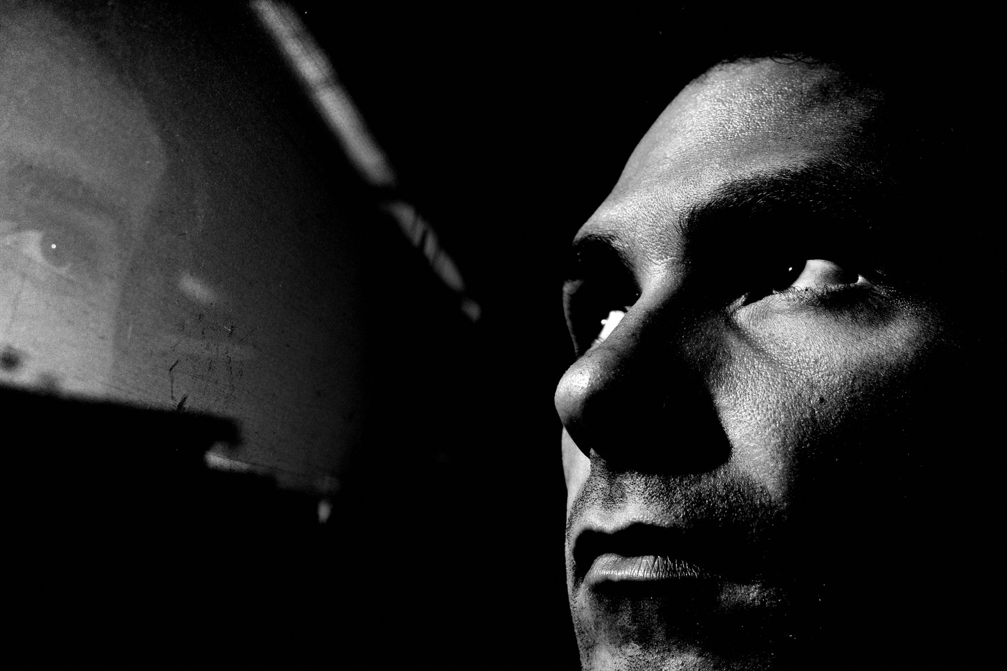
FLUX ACADEMY
BEAT 19 · PRACTICAL APPLICATION
Test the Counterfactual
— Ask: what if I hadn't dropped low?
— What if I'd cut the counterweight?
— The "what-if" reveals the decision
Notes:
Then test the counterfactual. For each frame ask: what if I hadn't changed my angle? What if I'd cropped out the balancing figure? What if the background weren't clean? When you imagine the frame without the decision, you finally see what that decision was doing. Removing it in your mind is the fastest way to understand it. That's the whole skill.

Slide 21
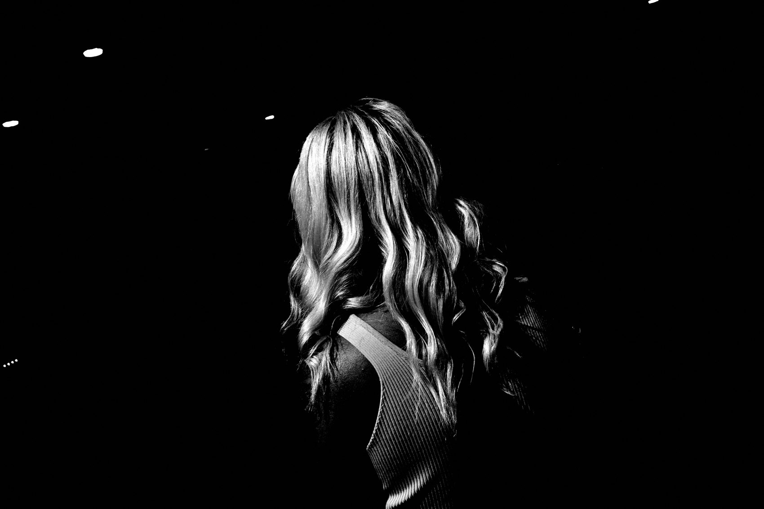
FLUX ACADEMY
BEAT 20 · COMMON MISTAKES
Crediting Luck, Not Choices
— "I got lucky" hides the decision
— Cropping later isn't composing
— Move your feet, not your lens
Notes:
The biggest mistake in reading your own work is crediting luck. "I just got lucky." No — you dropped low, you anchored a background, you waited. And the cousin of that mistake: trying to fix composition by cropping later. Cropping is not a solution. Move your feet, not your lens. Composition is a decision you make at the scene, not at the desk.

Slide 22
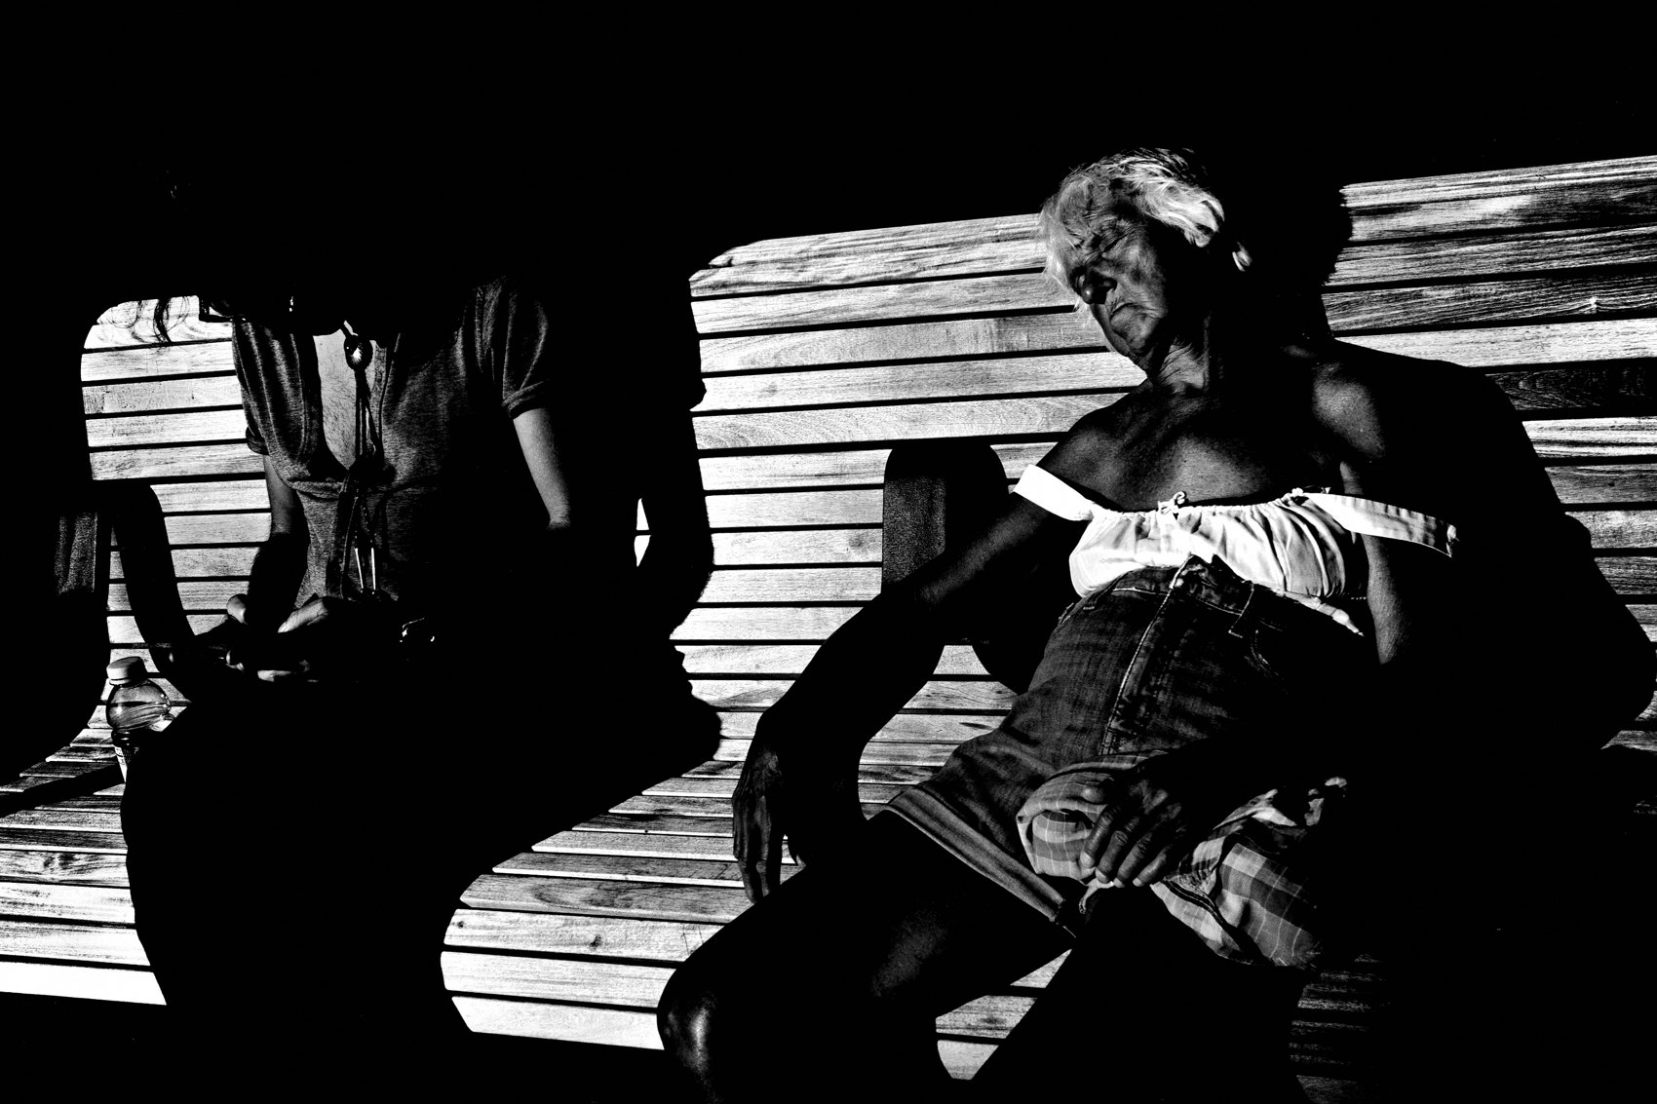
FLUX ACADEMY
BEAT 21 · RELATIONSHIP TO PREVIOUS
From Working to Reading
— Lesson 021 taught working the scene
— This lesson reads the result
— Working and reading feed each other
Notes:
In Lesson 021 we learned to work the scene — to stay, move, and refine until the frame comes together. This lesson is the other half of that loop: learning to read the result so you understand which of those moves actually paid off. Working makes the frame; reading teaches you why it worked, so next time you do it on purpose instead of by feel.

Slide 23
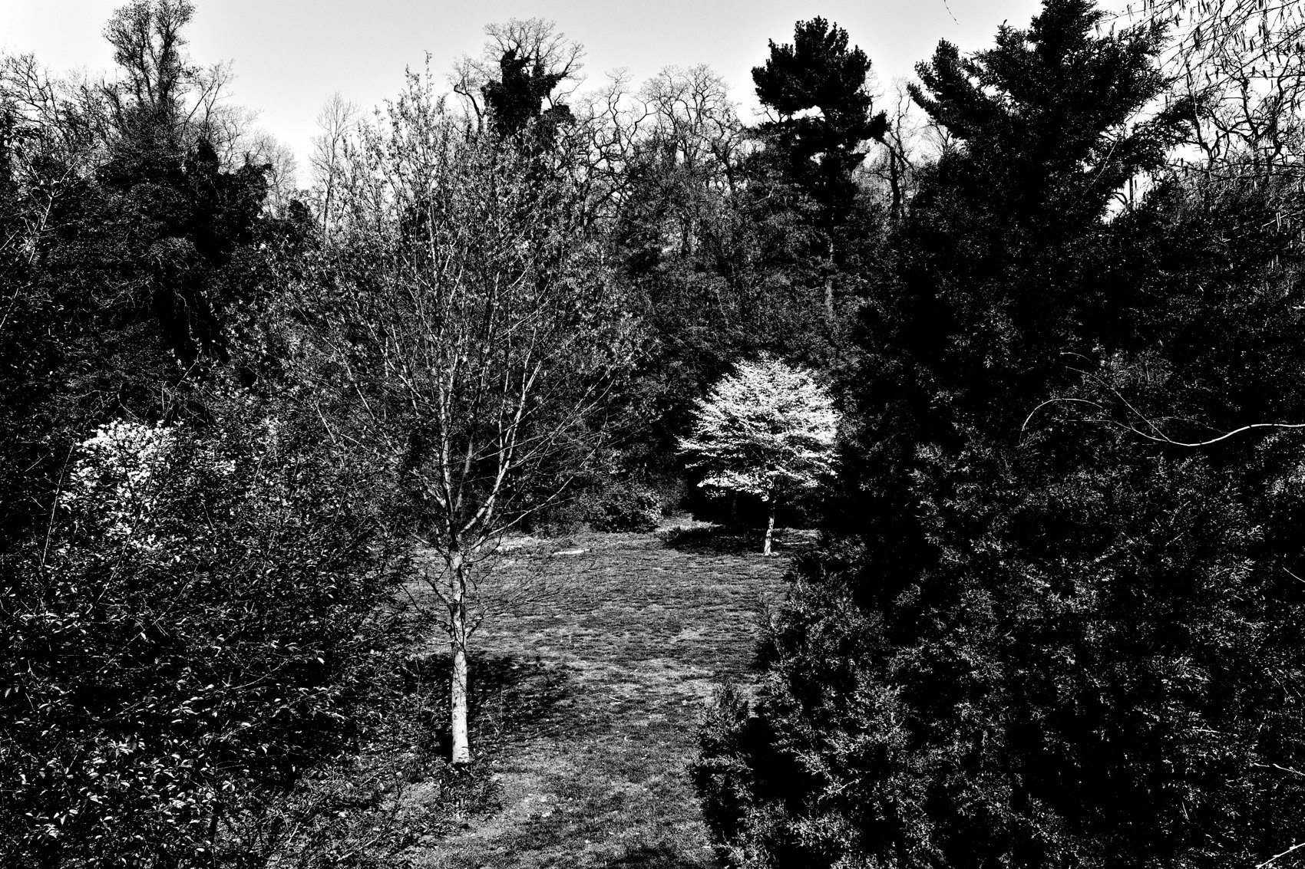
FLUX ACADEMY
BEAT 22 · RELATIONSHIP TO UPCOMING
Toward Layering
— Notice how many moves relied on layers
— Next: Introduction to Layering (Lesson 023)
— Foreground, middle ground, background
Notes:
And did you notice how many of these decisions lived on layers — a foreground anchor, a middle-ground moment, a background stage? That's no accident. Next up is Lesson 023, Introduction to Layering, where we go deep on stacking foreground, middle ground, and background into a single readable frame. Everything today was the setup; layering is the system.

Slide 24
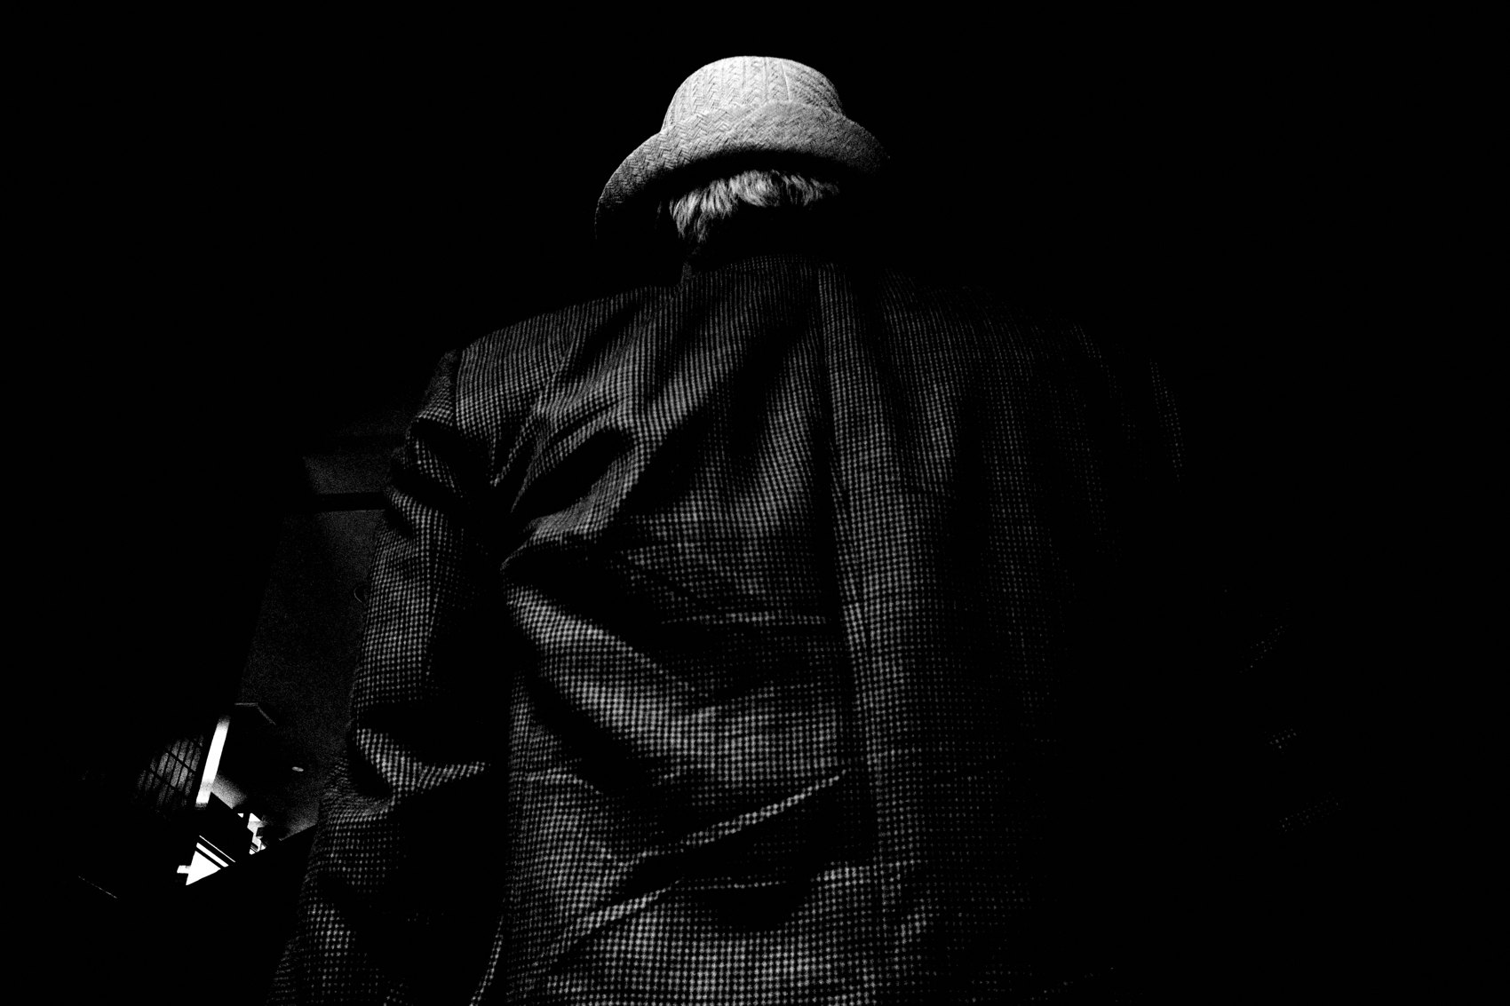
FLUX ACADEMY
BEAT 23 · SUMMARY / TAKEAWAY
Problem, Decision, Payoff
— Every strong frame solved a problem
— The decision was usually physical
— Problem. Decision. Payoff.
Notes:
Last thing. Every strong photograph is a problem the street handed you and a decision you made with your body to resolve it. The echo that lifts a simple subject, the low drop that clears a chaotic one, the opening that frames and excludes — problem, decision, payoff. Learn to read that in your own work and you stop hoping for good frames and start building them. Catch you next lesson.

