Slide 1
FLUX ACADEMY · A SCHOOL FOR SEEING
MODULE 4 · COMPOSITION
Working the Scene
BY DANTE SISOFO

Slide 2
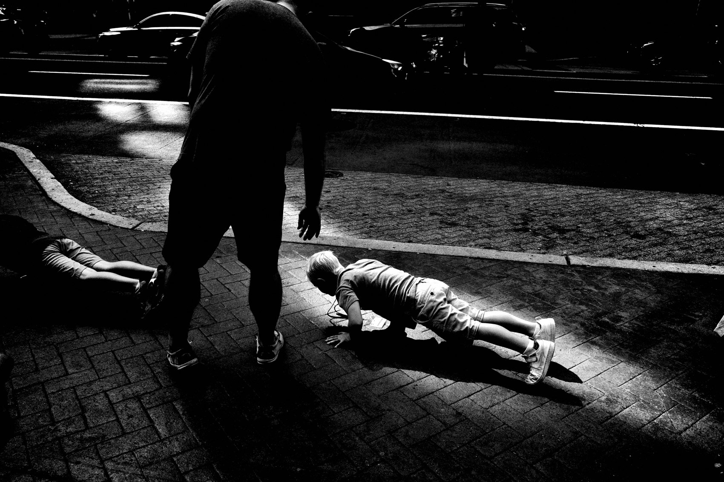
FLUX ACADEMY
BEAT 01 · CORE IDEA
Build the Frame, Don't Grab It
— A strong photo is built, not snatched
— Lots of clicks, lots of time
— Don't leave until the scene leaves you
Notes:
What's popping, people — it's Dante. Today we get our hands dirty with the actual mechanics of working a scene. Not the theory — the moves. A lot of my photographs came with lots of clicks, lots of shutter presses, a lot of time spent. You don't grab a great frame on the run. You build it. And you don't leave the scene until the scene leaves you.

Slide 3
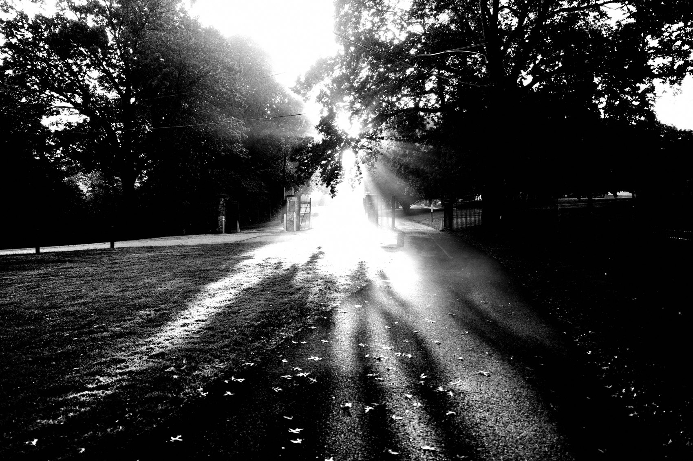
FLUX ACADEMY
BEAT 02 · LEARNING OBJECTIVE
Work a Scene Like a Craftsman
— Stay, position, and refine on the spot
— Use your body as the composition tool
— Build a frame in passes, not one press
Notes:
By the end of this lesson you'll know the hands-on craft of working a scene: how to stay, how to move your body, how to refine the composition press by press, and how to make multiple passes until the frame is right. This is the how — the physical, repeatable mechanics behind every photograph I'm proud of.

Slide 4
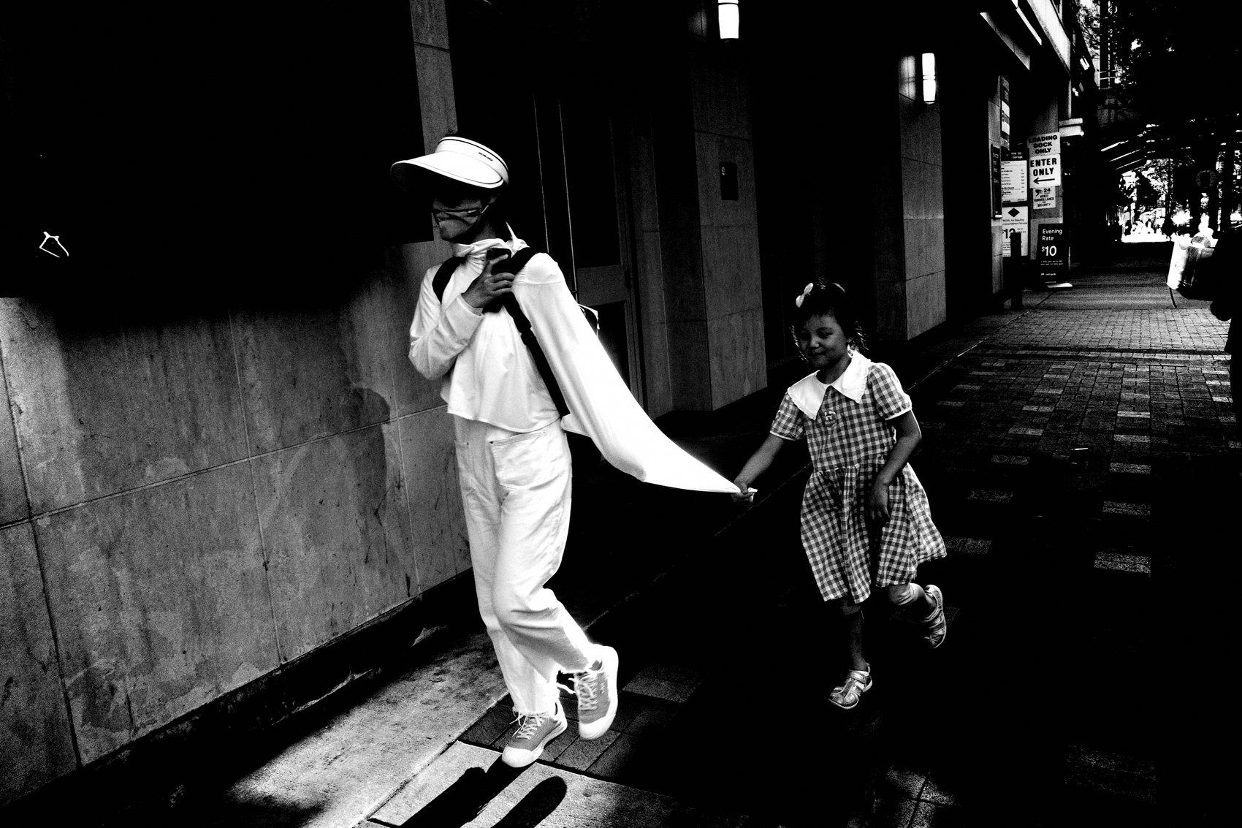
FLUX ACADEMY
BEAT 03 · WHY THIS MATTERS
One Click Leaves the Photo Behind
— The single-click habit kills good frames
— The real photo is a few steps and clicks away
— Mechanics are what close the gap
Notes:
Here's why this matters: there are real misconceptions about the decisive moment — people think you click once and glide away. I'm here to dispel that myth. Believe it and you'll walk off right before the frame comes together. The photograph you came for is usually a few steps and a few more presses away — and the craft is what gets you there.

Slide 5
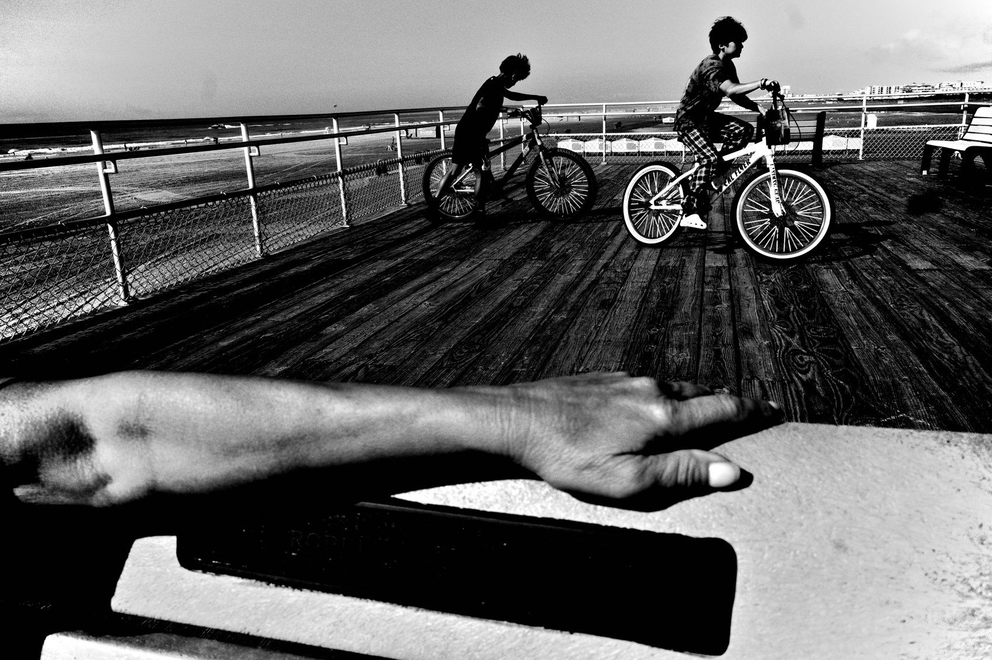
FLUX ACADEMY
BEAT 04 · WHY THIS MATTERS
The Work Happens Between Clicks
— The magic isn't in one shutter press
— It's in the moving and refining between them
— Craft is repeatable; luck isn't
Notes:
And this is the whole point of learning the mechanics: the magic isn't in the single press of the shutter — it's in everything you do between the clicks. The repositioning, the waiting, the adjusting. Luck you can't repeat. Craft you can. Master the moves and you stop hoping for the photograph and start manufacturing your shot at it.

Slide 6
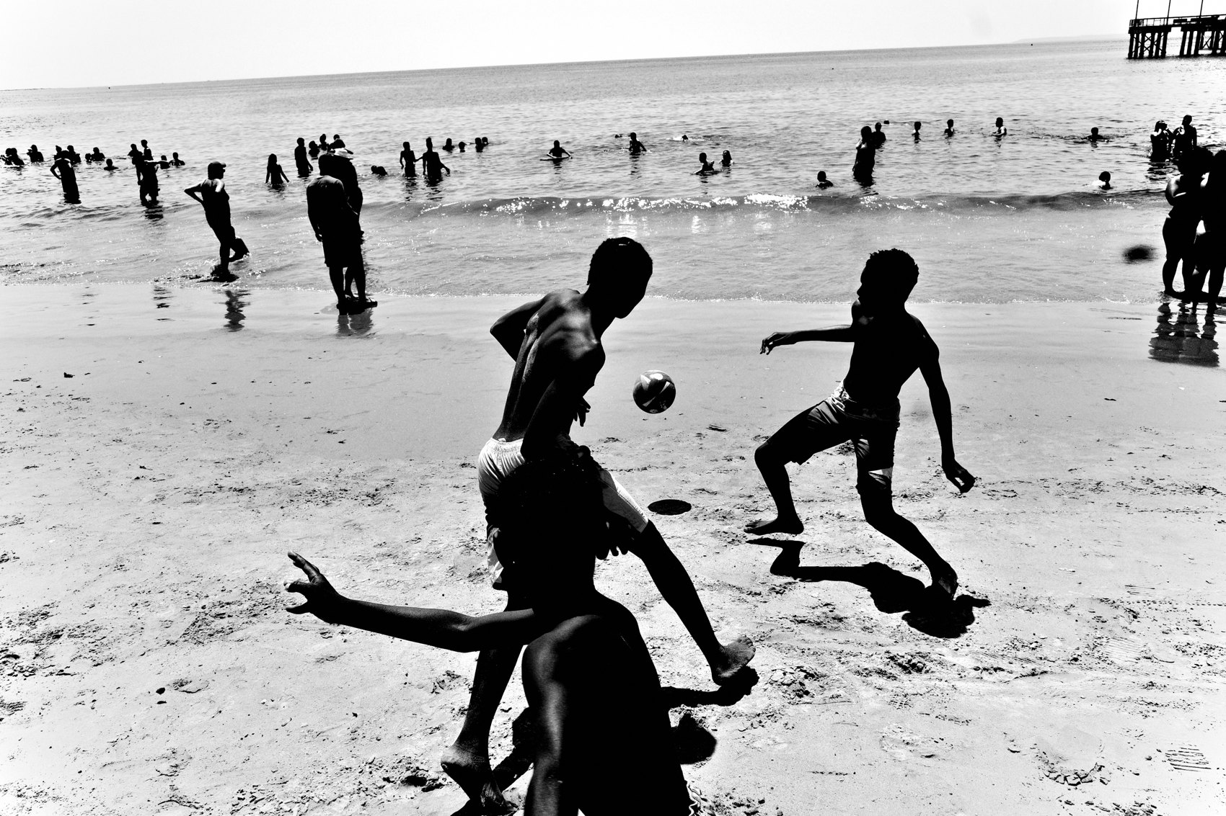
FLUX ACADEMY
BEAT 05 · MAIN TEACHING
Stay: Don't Leave Till It Leaves You
— Don't leave the scene until the scene leaves you
— Exhaust the possibilities before you walk
— Leave when the energy dies, not when you're nervous
Notes:
First mechanic: stay. Don't leave the scene until the scene leaves you. A lot of my strongest frames came with lots of time spent on one spot. You hold your ground and keep working until the possibilities are genuinely exhausted — not until you get bored, not until you get nervous. The amateur leaves early. The craftsman stays until the scene is done with him.

Slide 7
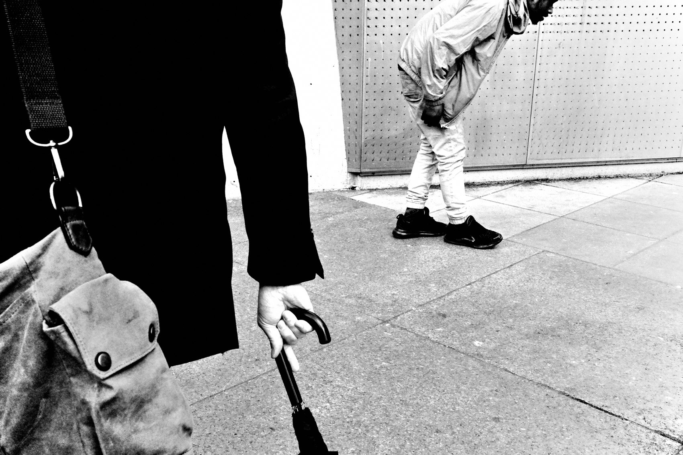
FLUX ACADEMY
BEAT 06 · MAIN TEACHING
Patience: Let the Moment Arrive
— Sometimes you simply wait
— Set up, then let the scene come to you
— The picture doesn't run on your schedule
Notes:
Second mechanic: patience. Sometimes you just have to wait for the right moment. You find your spot, you frame it up, and you let the scene come to you. The picture doesn't arrive on your schedule — so you hold the position, you keep the camera ready, and you wait for the instant the elements finally line up. Patience is an active skill, not standing around.

Slide 8
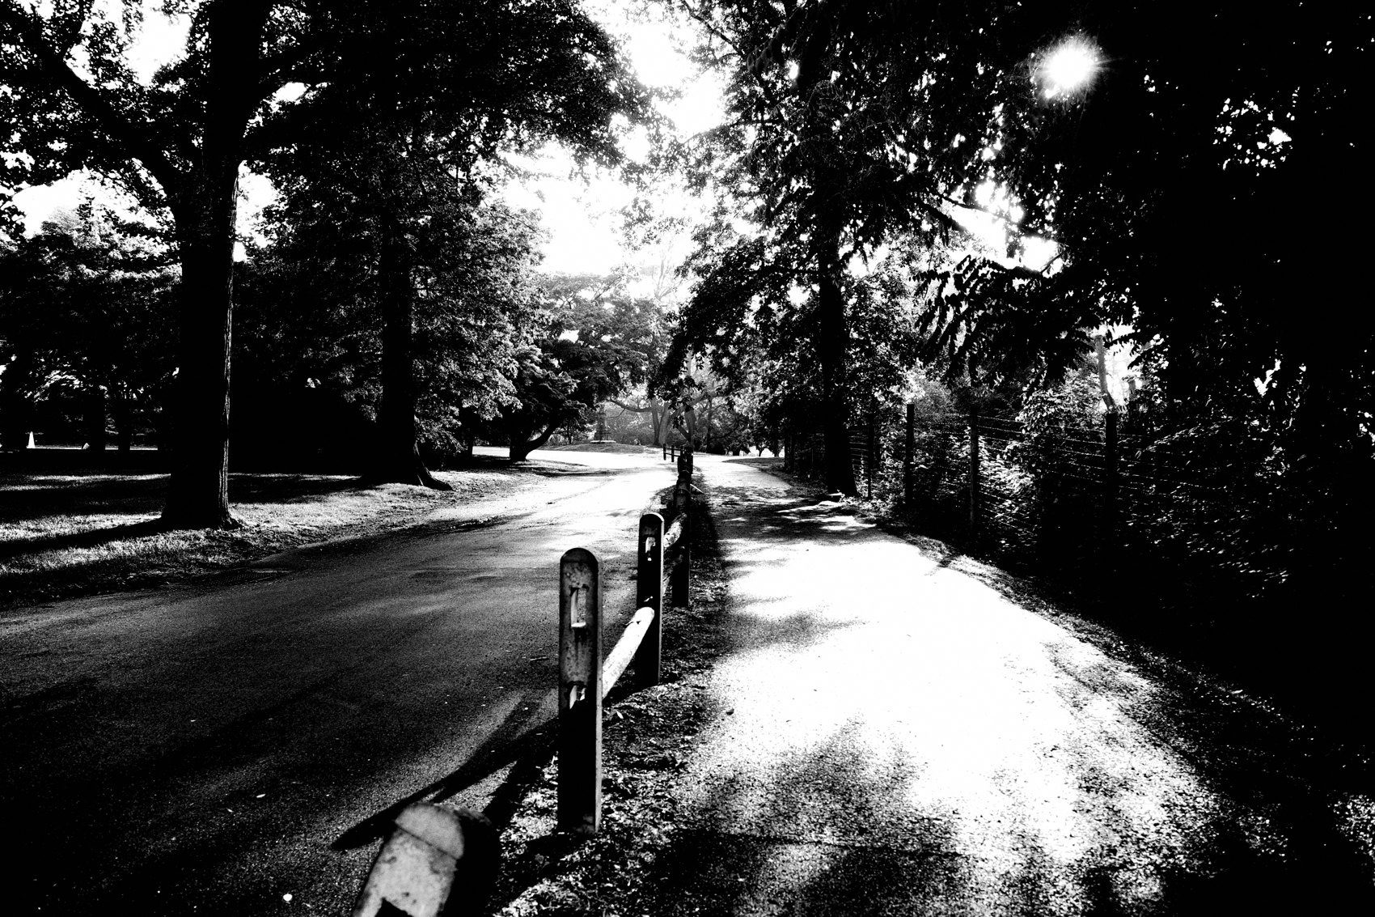
FLUX ACADEMY
BEAT 07 · MAIN TEACHING
Positioning: Your Body Is the Tool
— Your physical relationship to the scene matters
— A few steps changes the whole composition
— The frame is often two steps to the side
Notes:
Third mechanic, and the big one: positioning. Your physical relationship to the scene is everything. Photography is physical. Every small movement of your body changes the composition drastically. The frame you want is often two steps to the left of where you're standing — so don't shoot flat-footed. Move, and let your feet do the composing.

Slide 9
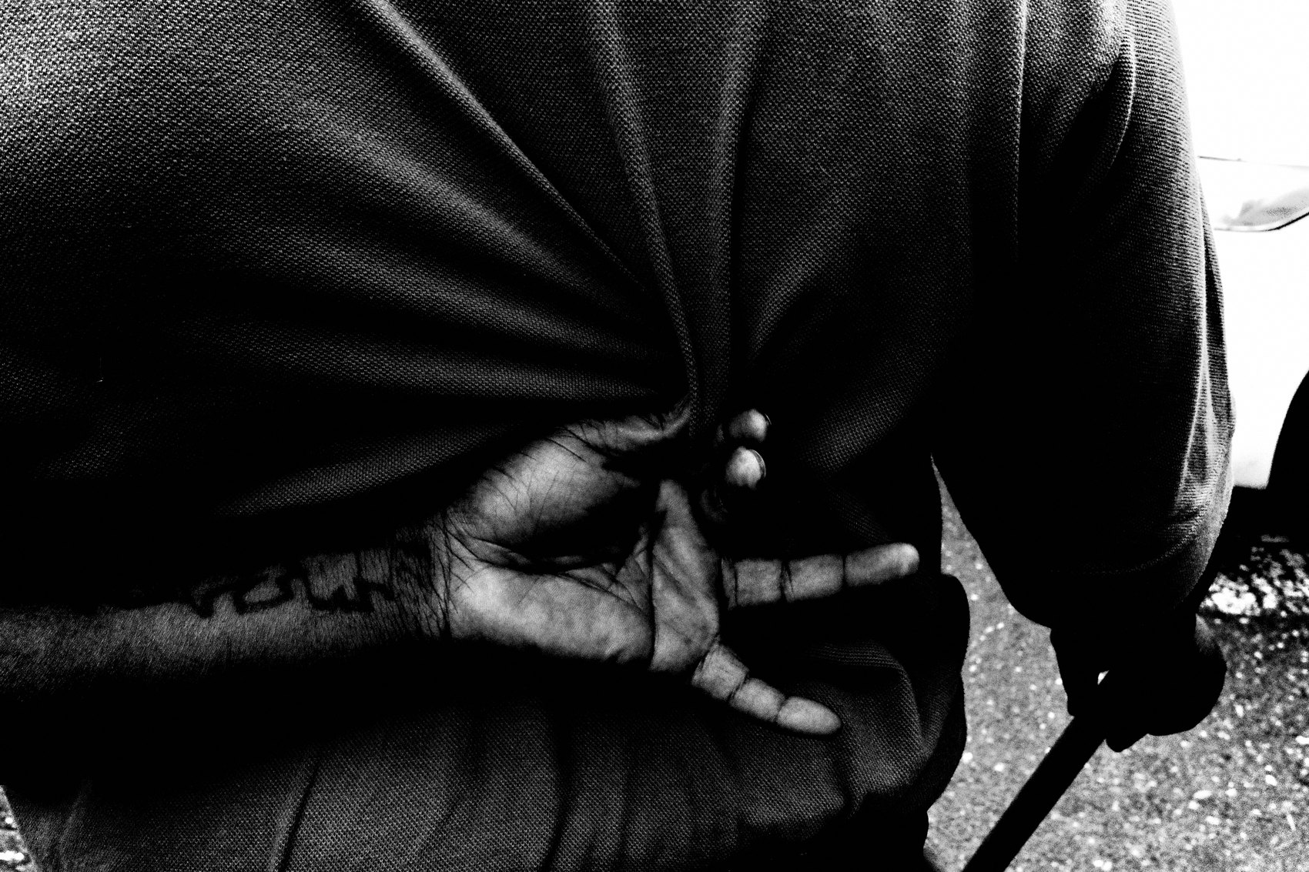
FLUX ACADEMY
BEAT 08 · MAIN TEACHING
Drop Low, Step Back, Change Angle
— Drop low, step back, shift right
— Each move re-stacks the elements
— Reposition constantly, observe, react
Notes:
Let's get specific about positioning. Drop low and the subject gets bigger, the background changes, the whole mood shifts. Step back and you let the surroundings into the story. Shift right and a distracting pole disappears. Reposition yourself constantly — anticipate the movement, observe, and react. You're not finding angles, you're trying them, one after another.

Slide 10

FLUX ACADEMY
BEAT 09 · MAIN TEACHING
Persistence: Keep Shooting, Keep Refining
— Keep shooting, keep adjusting, keep refining
— Don't take one shot and move on
— Sometimes you return week after week
Notes:
Fourth mechanic: persistence. Keep shooting, keep adjusting, keep refining. Don't take one shot and move on — work the scene and find the best way to make the composition. And persistence isn't only within one session. Sometimes you come back to the same spot week after week until it finally gives you what you came for. The frame rewards the photographer who refuses to settle.

Slide 11
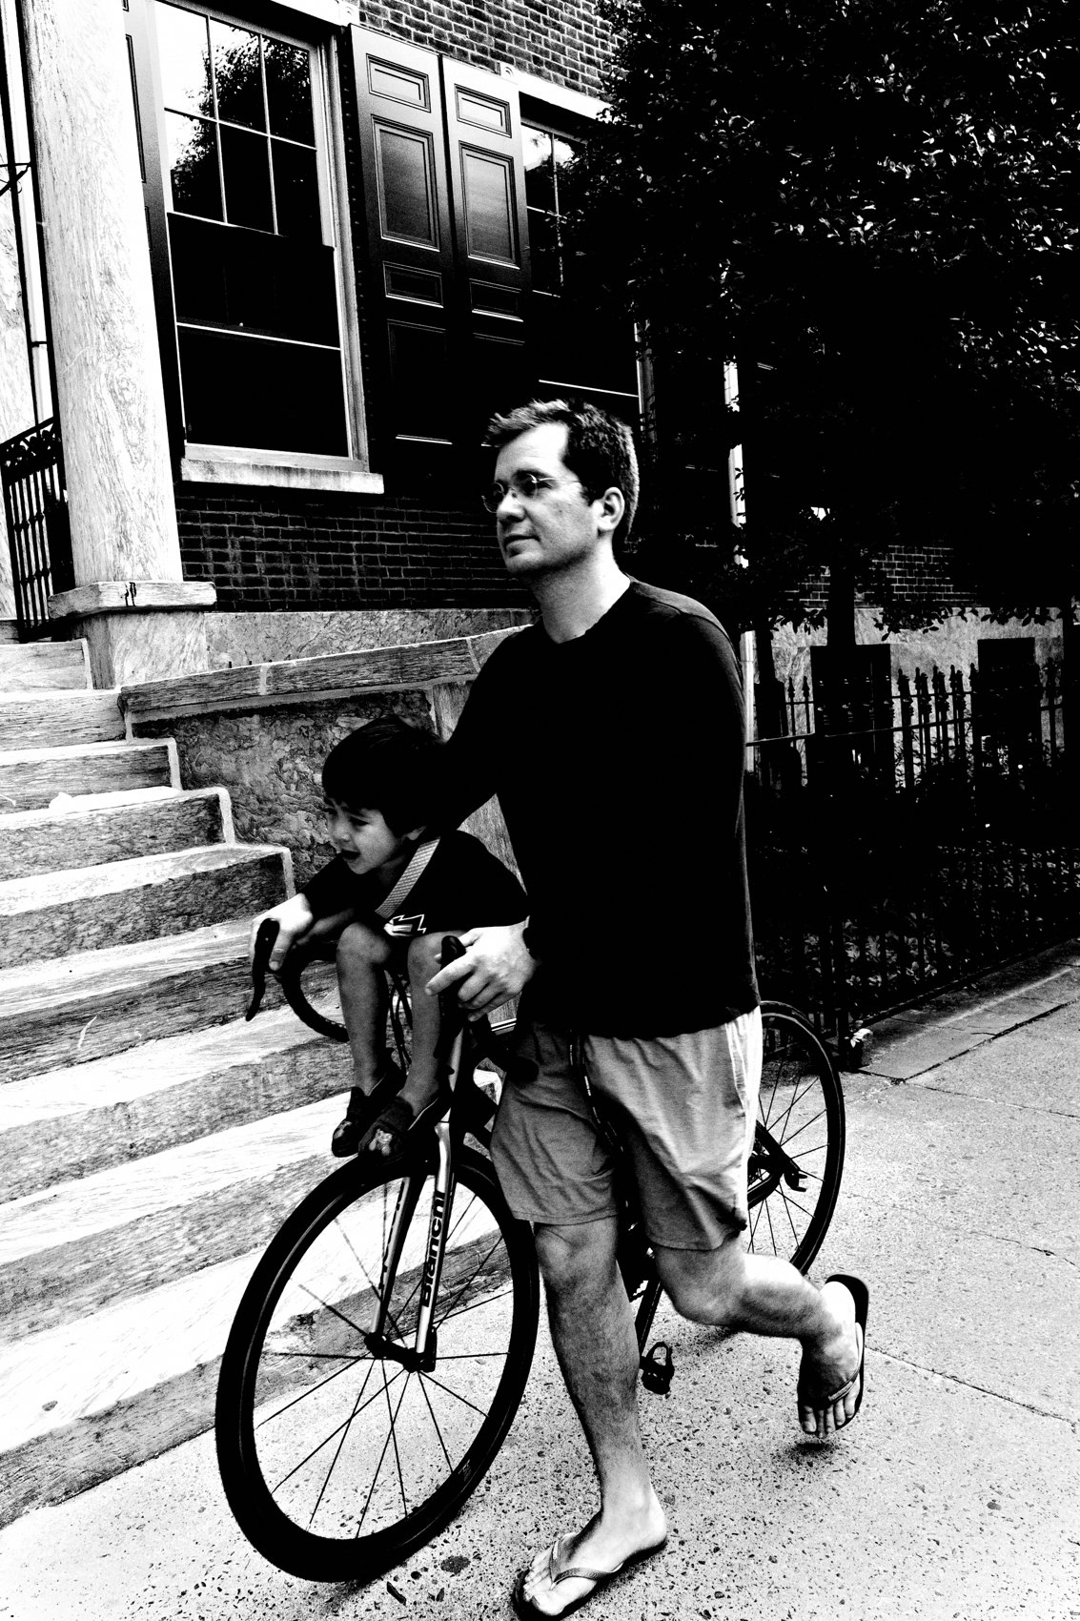
FLUX ACADEMY
BEAT 10 · MAIN TEACHING
Make Multiple Passes
— Each pass tests a new position or moment
— Compare passes; let the best one rise
— Volume on one scene, not scattered
Notes:
Here's the mechanic that ties it together: make multiple passes. One pass for the wide context, one dropped low, one stepped in close, one waiting on a gesture. Each pass is an experiment. You're not spraying frames randomly — you're systematically testing positions and moments on the same scene, then letting the strongest pass rise to the top later.

Slide 12
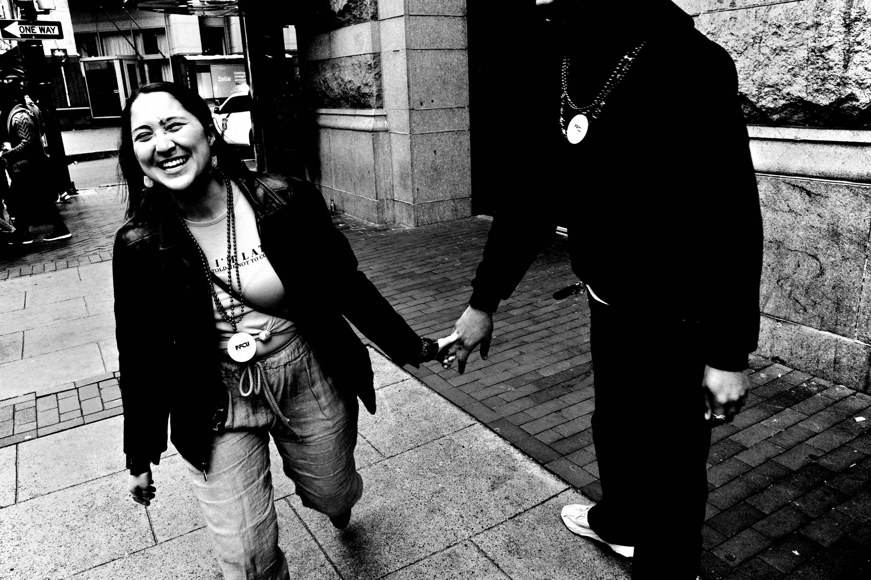
FLUX ACADEMY
BEAT 11 · MAIN TEACHING
Solve the Visual Puzzle
— Photography is a visual puzzle
— Find the pieces, fit them together
— Arrange yourself until they lock
Notes:
Think of it as a visual puzzle. Your job is to find the pieces and put them together. The light, a gesture, a shape, a clean background — they're all scattered in front of you. Working the scene is the physical act of arranging yourself until those pieces lock into one frame. You don't move the world; you move your body until the world composes itself.

Slide 13
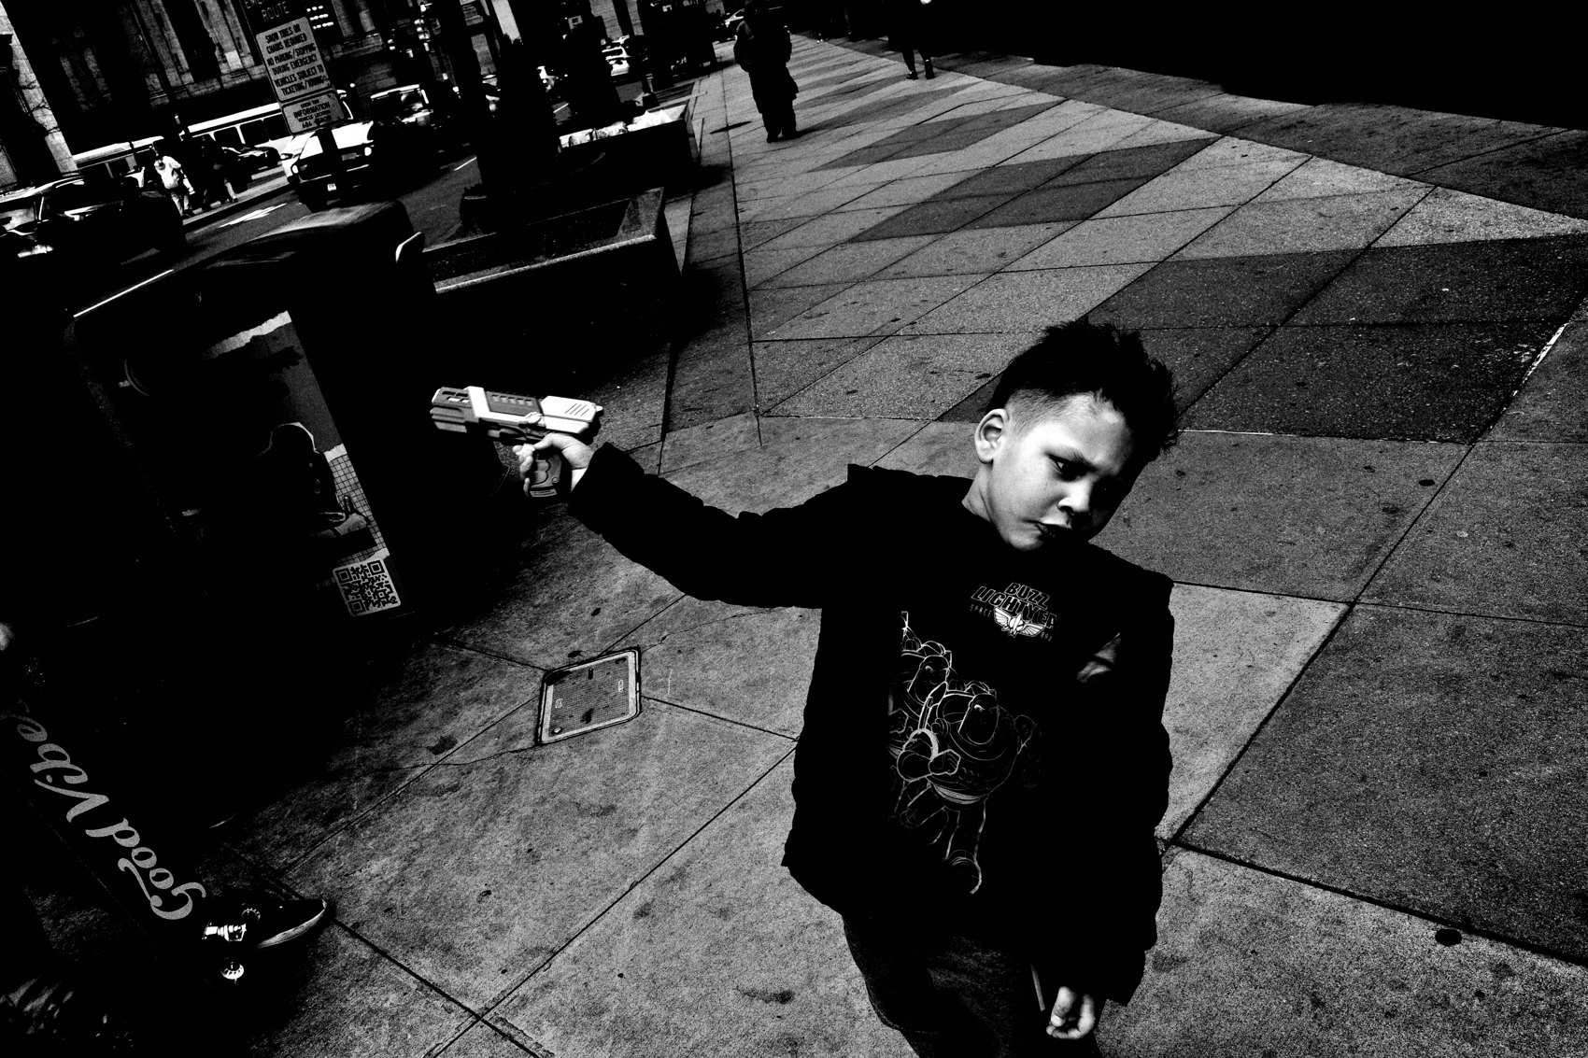
FLUX ACADEMY
BEAT 12 · MAIN TEACHING
Return Until the Scene Delivers
— Some scenes take many returns
— Most visits give you nothing
— The frame is built, not grabbed
Notes:
Some scenes only pay off if you keep coming back. You return to a spot time and time again — and most of the time nothing happens. Empty, quiet, nothing to shoot. Then, one visit, the moment finally arrives. A frame like that is made through courage, repetition, and persistence. It's built over many returns, not grabbed in a single passing instant. That's the mechanics paying off.

Slide 14
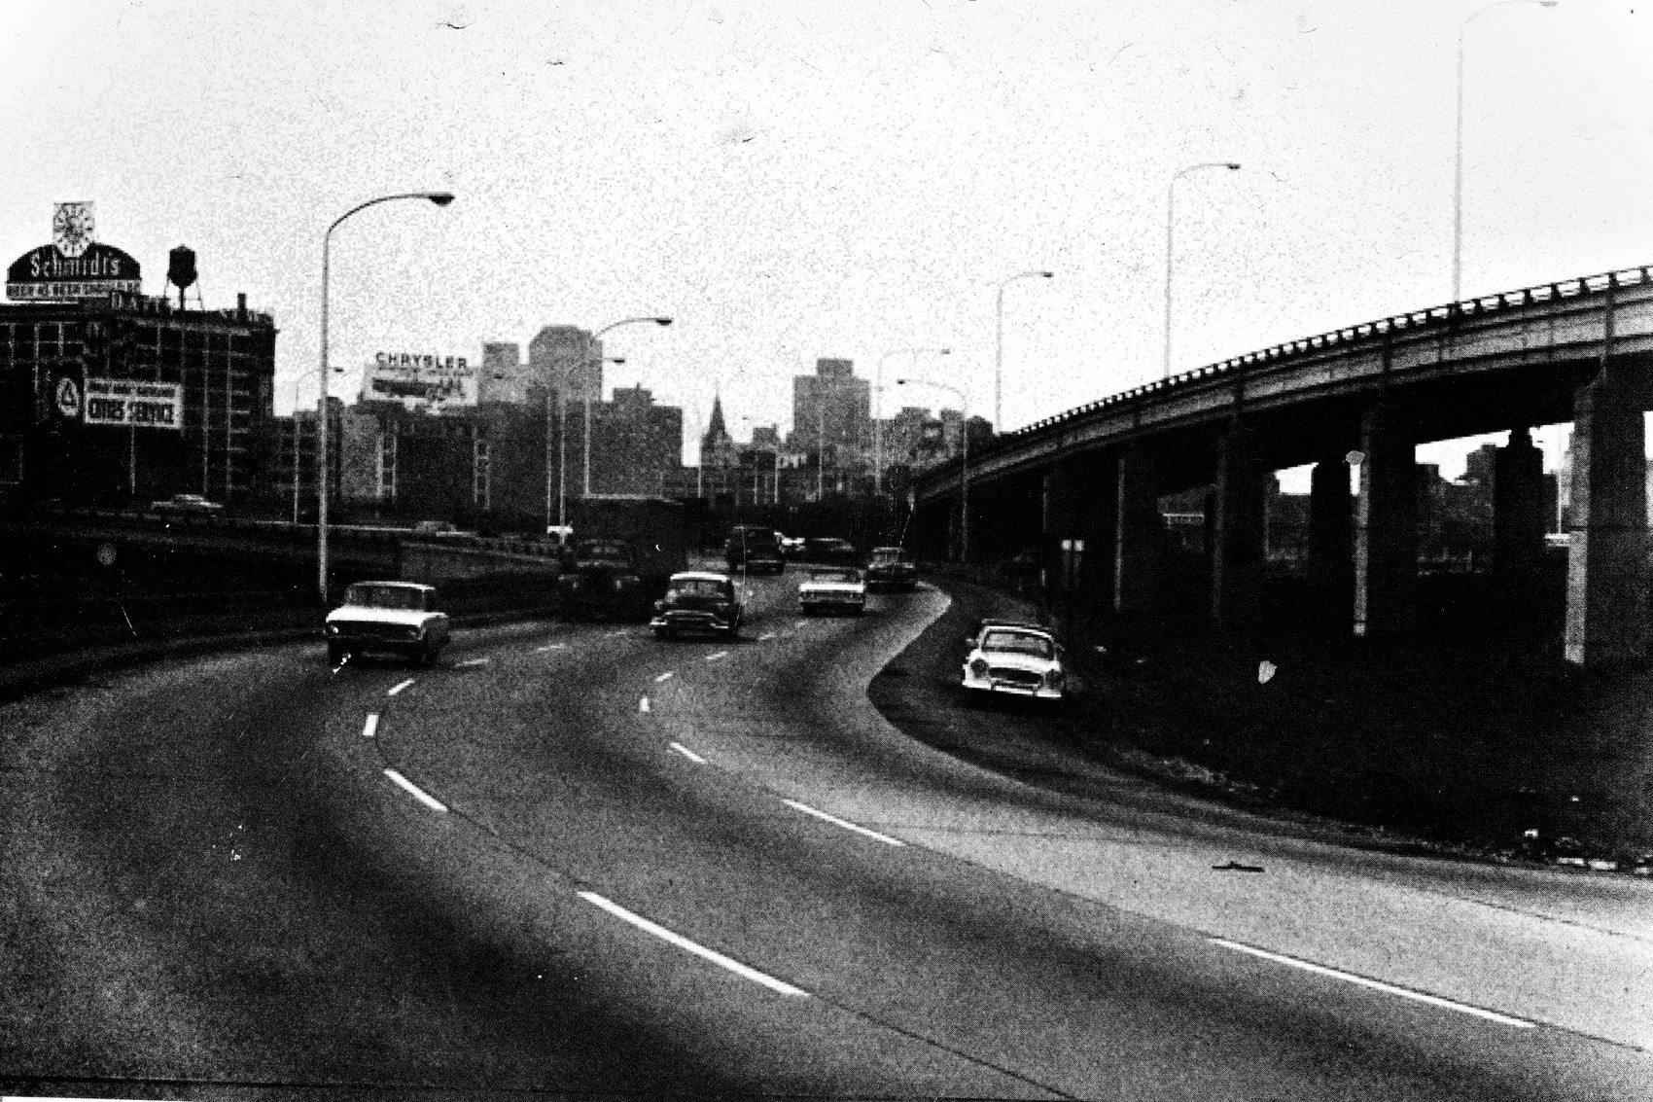
FLUX ACADEMY
BEAT 13 · MAIN TEACHING
The Contact Sheet Shows the Build
— First frames fall flat
— Reposition — a step to the side
— Structure and shadow snap into impact
Notes:
A contact sheet shows the build happen in real time. The early exploratory frames. The moment you sense potential in a scene. The first shots fall flat — so you move a step to the right, change your perspective, and suddenly a strong shape and a shadow create a far stronger image. By repositioning your body you turn a flat attempt into a photograph with real impact.

Slide 15
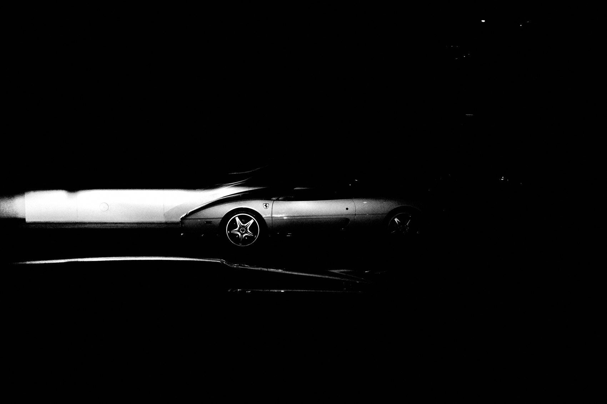
FLUX ACADEMY
BEAT 14 · MAIN TEACHING
Position First, Then Wait
— Notice a pop of color and striking light
— Position carefully before anything happens
— Wait for the gesture that completes it
Notes:
Here's the sequence, all mechanics. You notice a beautiful pop of color and striking light and you sense a photograph is possible. So you position yourself carefully first, and then you wait for the decisive moment — a vendor's gesture, a joyous smile framed perfectly by light and shadow. Position, then patience — that's the puzzle solved.

Slide 16
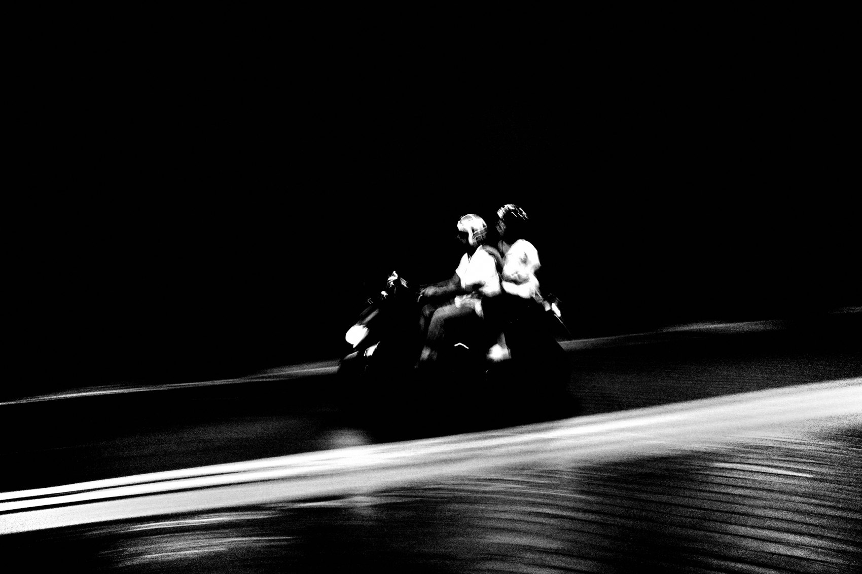
FLUX ACADEMY
BEAT 15 · MAIN TEACHING
Drop Low to Emphasize Emotion
— Read the dust, the light, the gestures
— Drop to a low angle deliberately
— Observe, anticipate, react
Notes:
One more on positioning. In a charged, emotional scene, you read the environment — the dust rising from the ground, the light, the gestures of the people in front of you. Then you make the key move: drop to a low angle to emphasize an expression. That single physical decision is what fills the frame with emotion and depth. Observe, anticipate, react — and let your body answer.

Slide 17
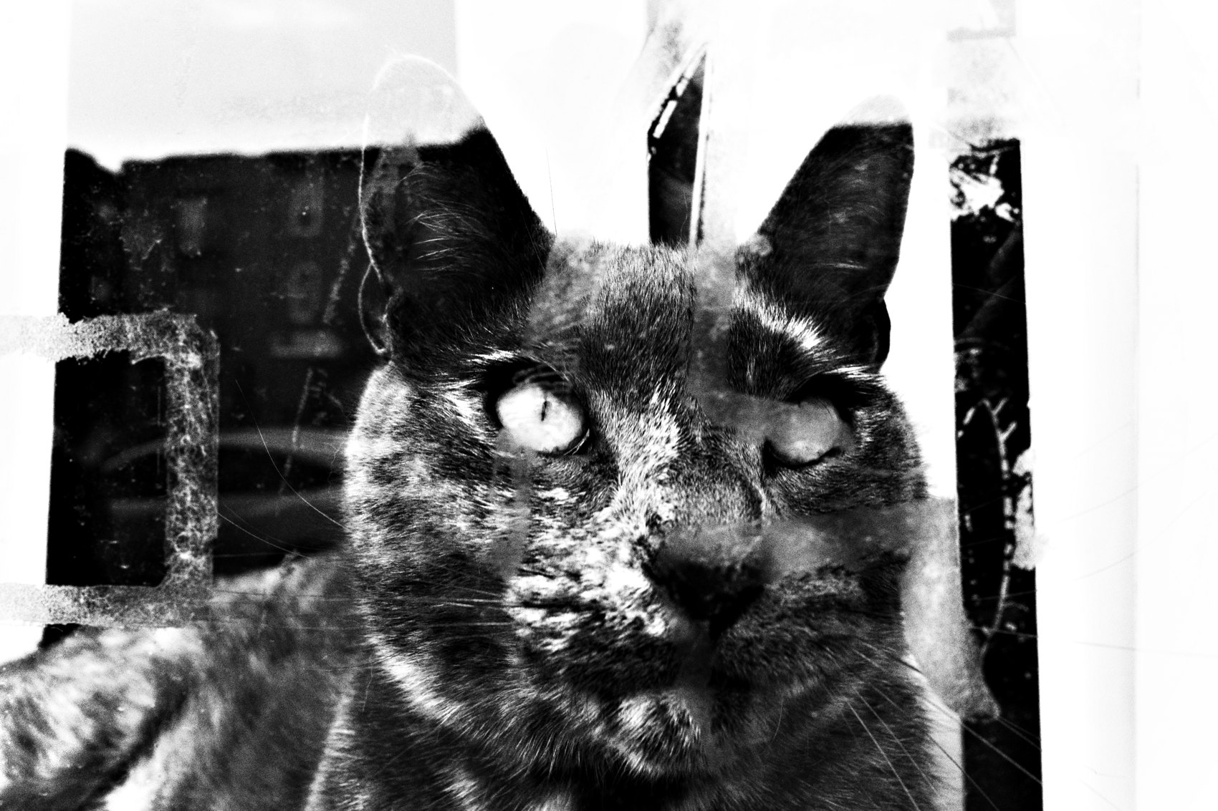
FLUX ACADEMY
BEAT 16 · MAIN TEACHING
Get Physically Close
— Position your body as close as possible
— Closeness fills the frame with impact
— Use the rule of thirds to balance it
Notes:
Working the scene often means closing the distance. Position your body as physically close to the action as you can, use the rule of thirds to balance the composition, and fill the frame with emotion. Even in a tense or fast-moving situation the tactic is the same: move in for thirty seconds, get the shot, move back. The mechanics still hold — position, frame, press.

Slide 18
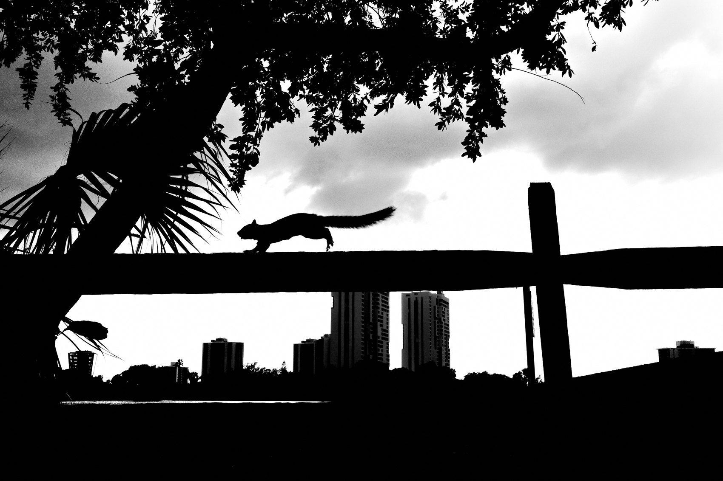
FLUX ACADEMY
BEAT 17 · MAIN TEACHING
Know When to Move On
— The energy dies, the light shifts
— Don't overstay a dead scene
— Trust your gut, then go find the next
Notes:
The flip side of staying is knowing when to leave. Sometimes the energy of a scene dies down, the light shifts, the moment passes. Trust your gut. Don't cling to a dead scene out of stubbornness once you've worked it fully. Staying and moving on are the same skill — you exhaust a scene, then you carry the same hunger to the next one.

Slide 19
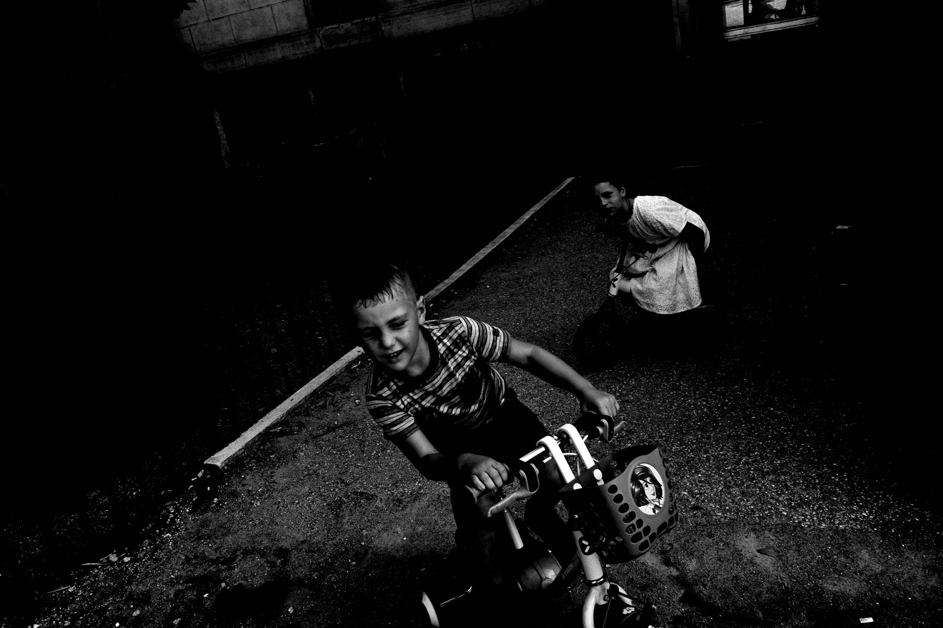
FLUX ACADEMY
BEAT 18 · PRACTICAL APPLICATION
Shoot One Scene Fifteen Ways
— Pick one scene with potential
— Make 15–20 frames, moving for each
— Compare: which position made it?
Notes:
Here's your drill, pure mechanics. Next time something catches your eye, do not take one shot and walk. Stay and make fifteen, twenty frames — and move your body for every single one. Step left, drop low, get closer, shift right, wait for a gesture. Later, lay them side by side and find which position made the photograph. That comparison is the lesson.

Slide 20
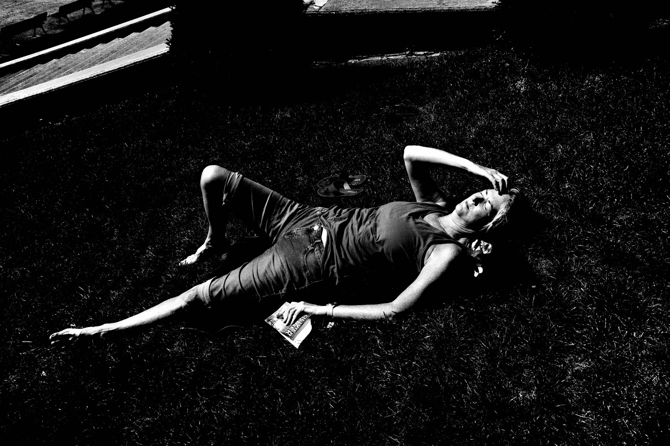
FLUX ACADEMY
BEAT 19 · PRACTICAL APPLICATION
Read Your Own Contact Sheet
— Review the whole run, not just the keeper
— Watch how each move strengthened it
— Learn the build so you do it faster
Notes:
Then study it the way I study mine. Look at the full run, not just the keeper. Watch the scene get stronger frame by frame — the flat early shots, the reposition, the moment it clicks into place. Reading your own contact sheet teaches you how your moves built the photograph, so next time you're on a scene, you get to the strong frame faster.

Slide 21

FLUX ACADEMY
BEAT 20 · COMMON MISTAKES
One Click, Flat-Footed
— Taking one shot and walking away
— Shooting head-on from one position
— Forgetting photography is physical
Notes:
The number-one mistake is the one-click habit: you snap a quick grab shot and move on, leaving the real photograph two minutes and three steps behind you. Its twin is shooting flat-footed — standing in one spot, head-on, never moving your feet. You forget photography is physical. If your first frames fall flat and you don't reposition, you've decided to settle.

Slide 22
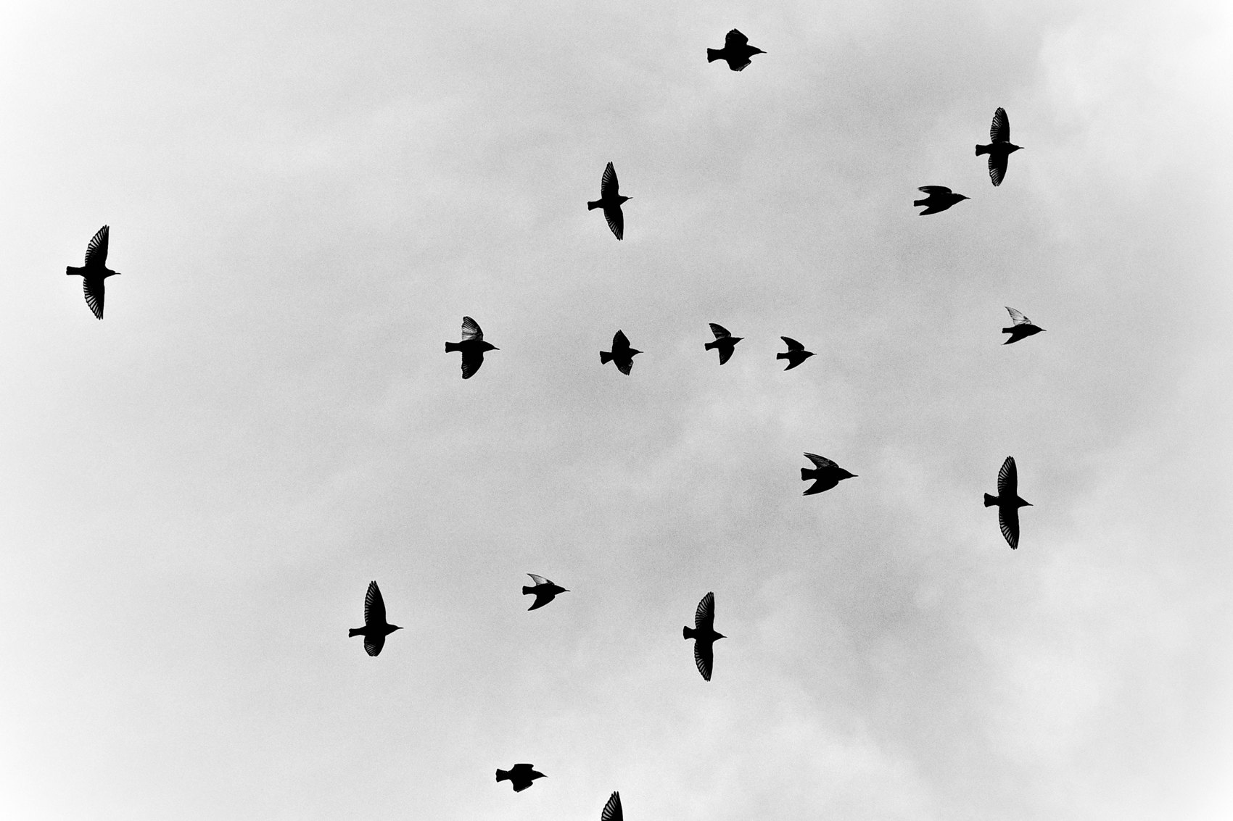
FLUX ACADEMY
BEAT 21 · RELATIONSHIP TO PREVIOUS
From Breaking Rules to Building Frames
— Lesson 020 freed you to break the rules
— This lesson is the disciplined work after
— Freedom plus mechanics makes the frame
Notes:
Last lesson — Lesson 020, Breaking the Rules — gave you permission to throw out the rulebook when the frame demands it. Keep that freedom. But freedom without craft is just chaos. This lesson is the disciplined other half: once you know you can break a rule, working the scene is the patient, physical work of building the frame that earns it.

Slide 23

FLUX ACADEMY
BEAT 22 · RELATIONSHIP TO UPCOMING
Next: We Break One Down
— Next: Breakdown II — Composition (Lesson 022)
— We deconstruct a worked scene step by step
— See the mechanics inside a finished photo
Notes:
Quick look ahead. In Lesson 022, Breakdown II — Composition, we take everything from this whole module and put a single photograph under the microscope. You'll see the positioning, the patience, and the passes living inside a finished frame — the mechanics of working the scene, reverse-engineered from the result. Theory becomes evidence.

Slide 24
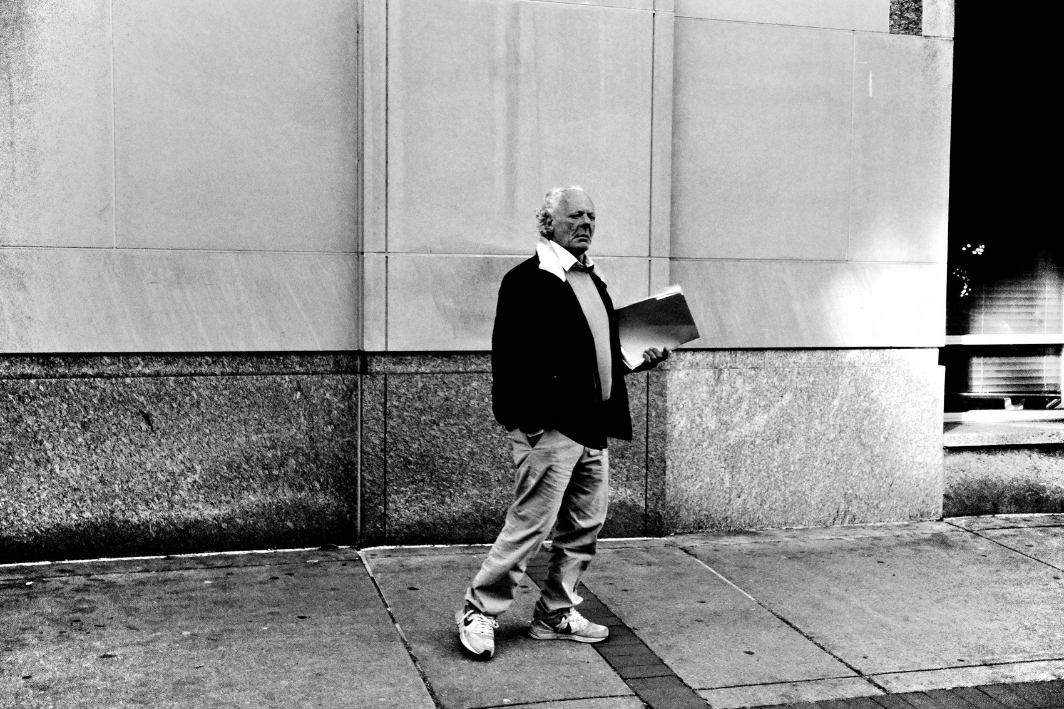
FLUX ACADEMY
BEAT 23 · SUMMARY / TAKEAWAY
Stay, Move, Refine, Repeat
— Build the frame — stay, position, refine
— Make multiple passes; read the contact sheet
— Don't leave the scene until the scene leaves you
Notes:
Last thing. A strong photograph is built, not grabbed — through staying, moving your body, refining the composition, and making pass after pass until the puzzle locks. Drop low, step back, get close, wait for it. Then read your contact sheet and learn how you did it. And never forget the line that runs through all of it: don't leave the scene until the scene leaves you. Catch you next lesson.

