Slide 1
FLUX ACADEMY · A SCHOOL FOR SEEING
MODULE 4 · COMPOSITION
Breaking the Rules
BY DANTE SISOFO

Slide 2
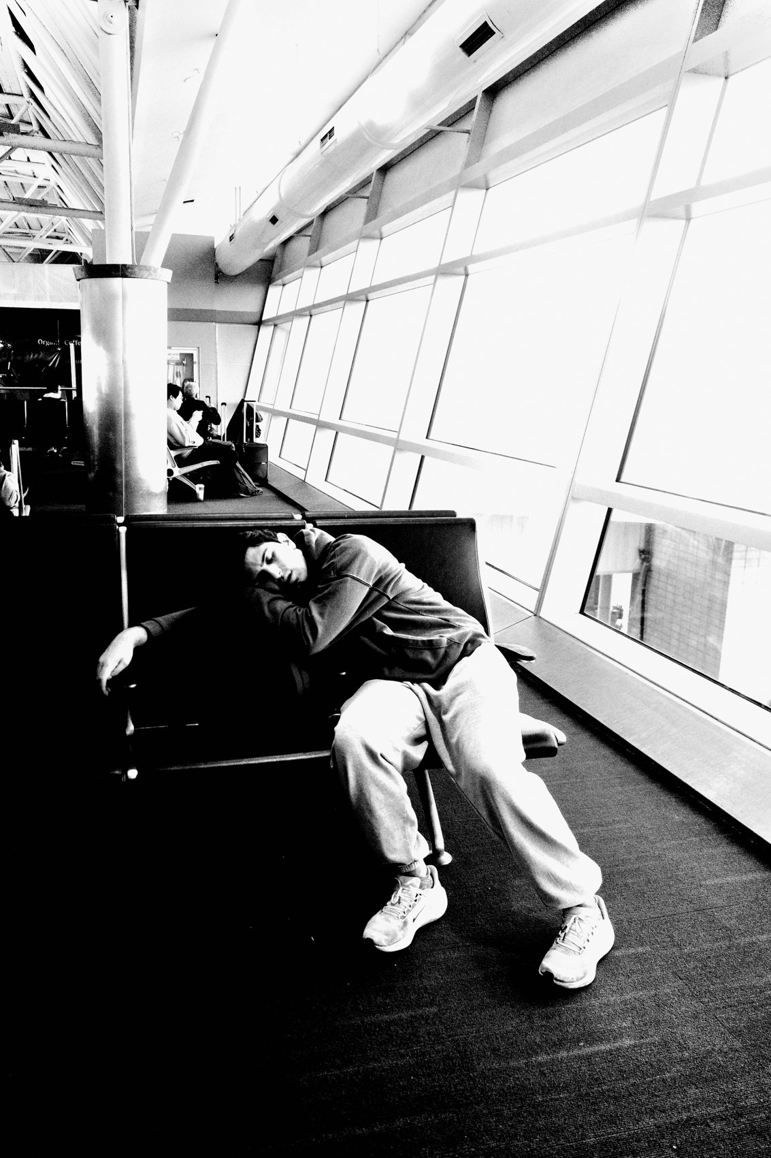
FLUX ACADEMY
BEAT 01 · CORE IDEA
Rules Are Guides, Not Laws
— The rule of thirds isn't a law
— It's a guide you outgrow
— Intuition overrules the grid
Notes:
What's popping, people — it's Dante. Today we break the rules. Here's the truth I keep coming back to: the rule of thirds isn't a law — it's a guide. Every "rule" of composition is just training wheels. Once your gut can see, you're allowed — you're expected — to break them.

Slide 3
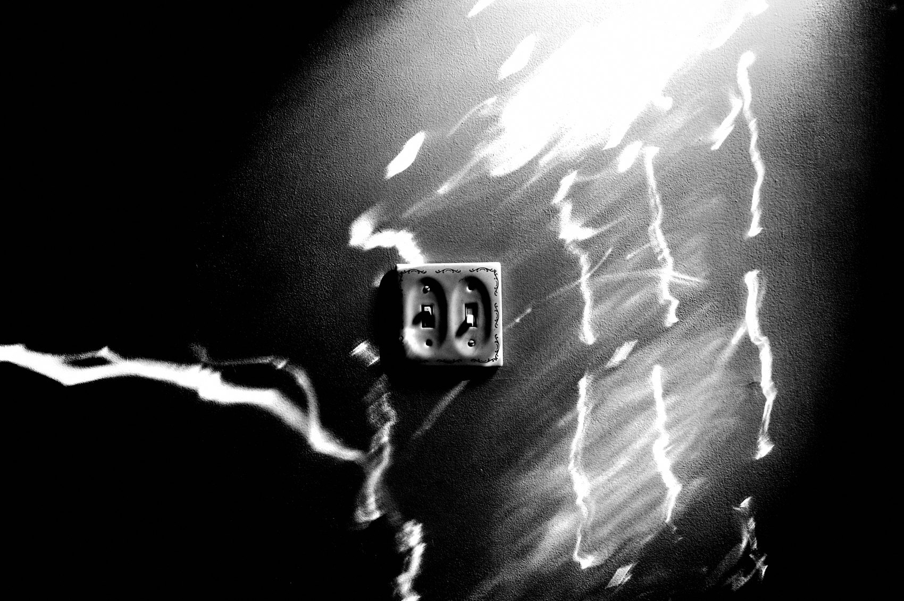
FLUX ACADEMY
BEAT 02 · LEARNING OBJECTIVE
Know When to Break Them
— Learn which rules to bend, and when
— Replace the grid with intuition
— Use tension on purpose
Notes:
By the end of this lesson you'll know how to break a compositional rule on purpose — not by accident, not from ignorance, but because your gut tells you the broken frame is stronger. That's the whole leap: from following rules to feeling them.

Slide 4

FLUX ACADEMY
BEAT 03 · WHY THIS MATTERS
The Grid Can Cage You
— Rules followed blindly make dead frames
— Overthinking kills the moment
— Life won't wait for your grid
Notes:
Here's why this matters: out there, life is chaotic, fast, unpredictable. If you're standing on the corner sorting every scene into leading lines and rule-of-thirds grids, the moment's already gone. The rules were built to free you. Followed blindly, they cage you.

Slide 5

FLUX ACADEMY
BEAT 04 · WHY THIS MATTERS
Synthesize Content With Form
— Content is the moment; form is the order
— A rule that kills the content fails
— Serve the moment first
Notes:
And the deeper stake: we shoot to synthesize content with form. The moment, the emotion, the gesture — that's content. Composition is the form we wrap around it. When a rule starts strangling the content, you break the rule. The moment always wins.

Slide 6

FLUX ACADEMY
BEAT 05 · MAIN TEACHING
Composition Comes From Intuition
— Composition derives from intuition
— The gut at the moment of the shutter
— Not a checklist you run
Notes:
Foundation first. Composition derives from intuition — that gut instinct when you press the shutter. I'm not walking the street consciously hunting leading lines. I'm responding. The frame is the result of instinct, not a checklist I run. Rules are what you internalize so deeply you can finally forget them.

Slide 7

FLUX ACADEMY
BEAT 06 · MAIN TEACHING
Look With Your Eyes, Not the Grid
— Use your two eyes, respond with your gut
— Don't read life as a grid
— React, don't analyze
Notes:
When I'm out there, I'm looking at life — not at a grid laid over it. Don't walk around with the camera to your eye — use your two eyes and respond with your gut. You're not seeking leading lines consciously. You respond to the world as it unfolds, ready to move your body and your frame.

Slide 8

FLUX ACADEMY
BEAT 07 · MAIN TEACHING
Center When Centering Is Stronger
— Off-center isn't always right
— Centering can be just as powerful
— Let symmetry earn the middle
Notes:
First rule to break: the thirds. Centering a subject can be just as powerful as offsetting it. When the scene is symmetrical — hands, hair, wheels echoing each other — the center is the strongest spot. The rule says push it to the side; your eye says hold it dead center. Trust the eye.

Slide 9

FLUX ACADEMY
BEAT 08 · MAIN TEACHING
Feel the Thirds, Don't Count Them
— The grid is felt, not measured
— It's a guide, not a law
— Internalize it, then forget it
Notes:
Here's the nuance: even when I do land on the thirds, I didn't count to get there. I felt it. The rule of thirds works best the moment you stop obeying it and start sensing it. Break the rule by absorbing it — until placement becomes instinct, not arithmetic.

Slide 10
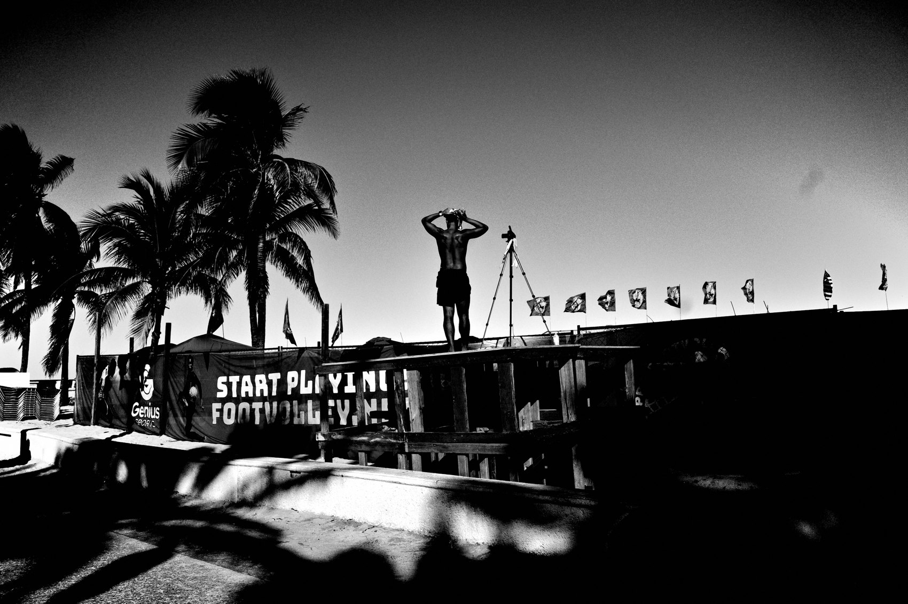
FLUX ACADEMY
BEAT 09 · MAIN TEACHING
Put Order to the Chaos
— Our job: put order to the chaos
— Rules are one tool for that order
— But order can be broken too
Notes:
Our whole job as photographers is to put order to the chaos of the world. Rules are one way to find that order. But sometimes a little disorder is the order — a tilt, a near-collision of elements, an imbalance that holds tension. Order isn't always tidy. Sometimes it's a controlled mess.

Slide 11

FLUX ACADEMY
BEAT 10 · MAIN TEACHING
Tension Over Tidiness
— A "perfect" frame can feel dead
— Imbalance creates energy
— Let elements push against each other
Notes:
A frame that follows every rule can come out lifeless — balanced to the point of boring. Tension is what wakes a photo up. Let elements lean, crowd, almost collide. The discomfort is the point. A little imbalance pulls the viewer in and won't let them rest. Tension over tidiness.

Slide 12

FLUX ACADEMY
BEAT 11 · MAIN TEACHING
Position Your Body to Break or Keep
— You're responsible for where you stand
— Drop low, shift, change the rule
— The break is physical
Notes:
Remember: the photographer is responsible for where they position their physical body in relationship to the moment and the background. Breaking a rule is physical. Drop to a low angle and the whole geometry changes. The rule you keep or break is decided by your two feet, not by theory.

Slide 13

FLUX ACADEMY
BEAT 12 · MAIN TEACHING
Break Your Default Angle
— Eye level blends the subject in — flat
— Break the angle: drop low
— Subject pops against the sky
Notes:
Take a moving subject against a busy backdrop. Shoot it at eye level and the figure blends right into the background. Dead. So break your own default: drop low, separate the subject from the skyline, throw a limb or an outstretched gesture up against open sky. Same moment, broken angle, alive. The rule you break here is your own habit.

Slide 14
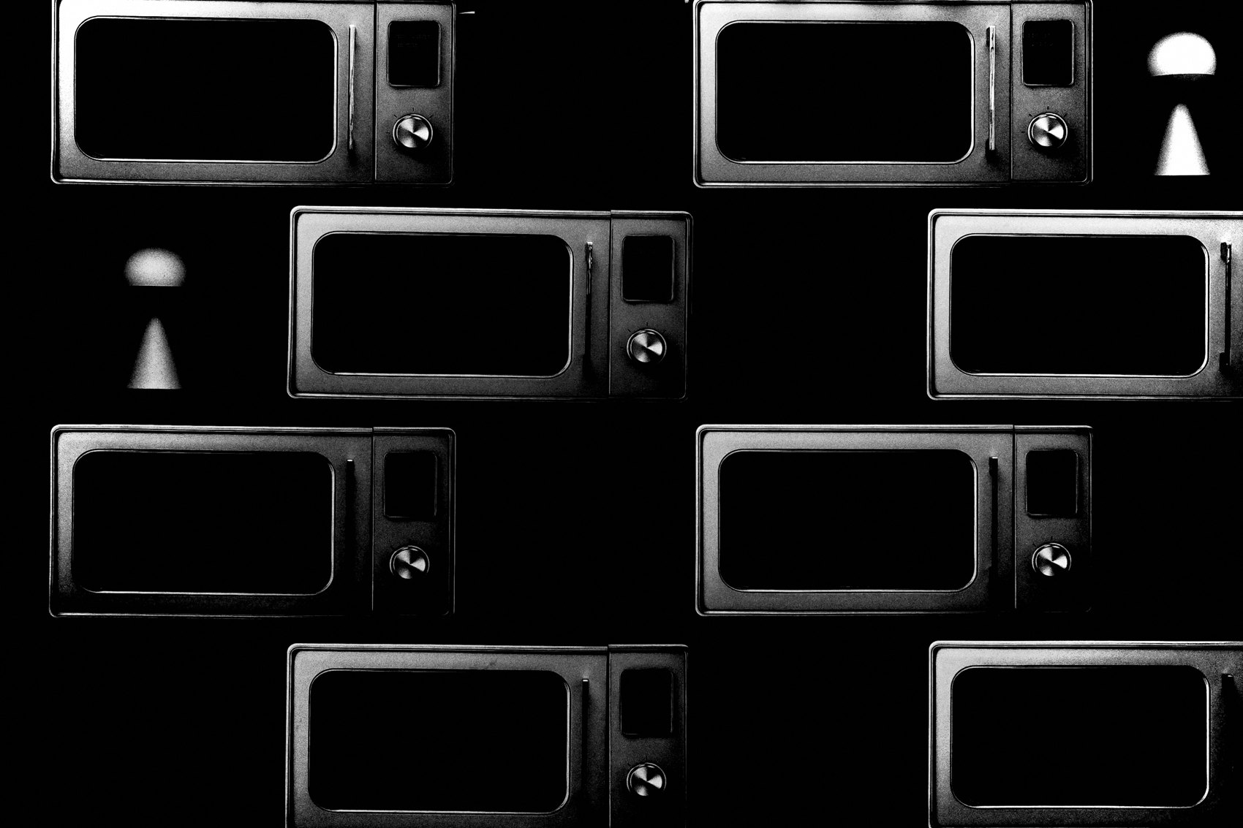
FLUX ACADEMY
BEAT 13 · MAIN TEACHING
Move Off the Flat-On Angle
— Flat-on framing goes dead flat
— Move the body, find a new angle
— Leading lines and shadow appear
Notes:
Picture a subject in front of a large wall or flat surface. Shoot it straight-on, relating people flatly to the wall, and it goes too flat. So work the scene and move. A new angle appears — leading lines come alive, a shadow is revealed, and the frame turns mysterious and impactful. Breaking the flat-on rule is nothing more than refusing to shoot from the obvious spot.

Slide 15
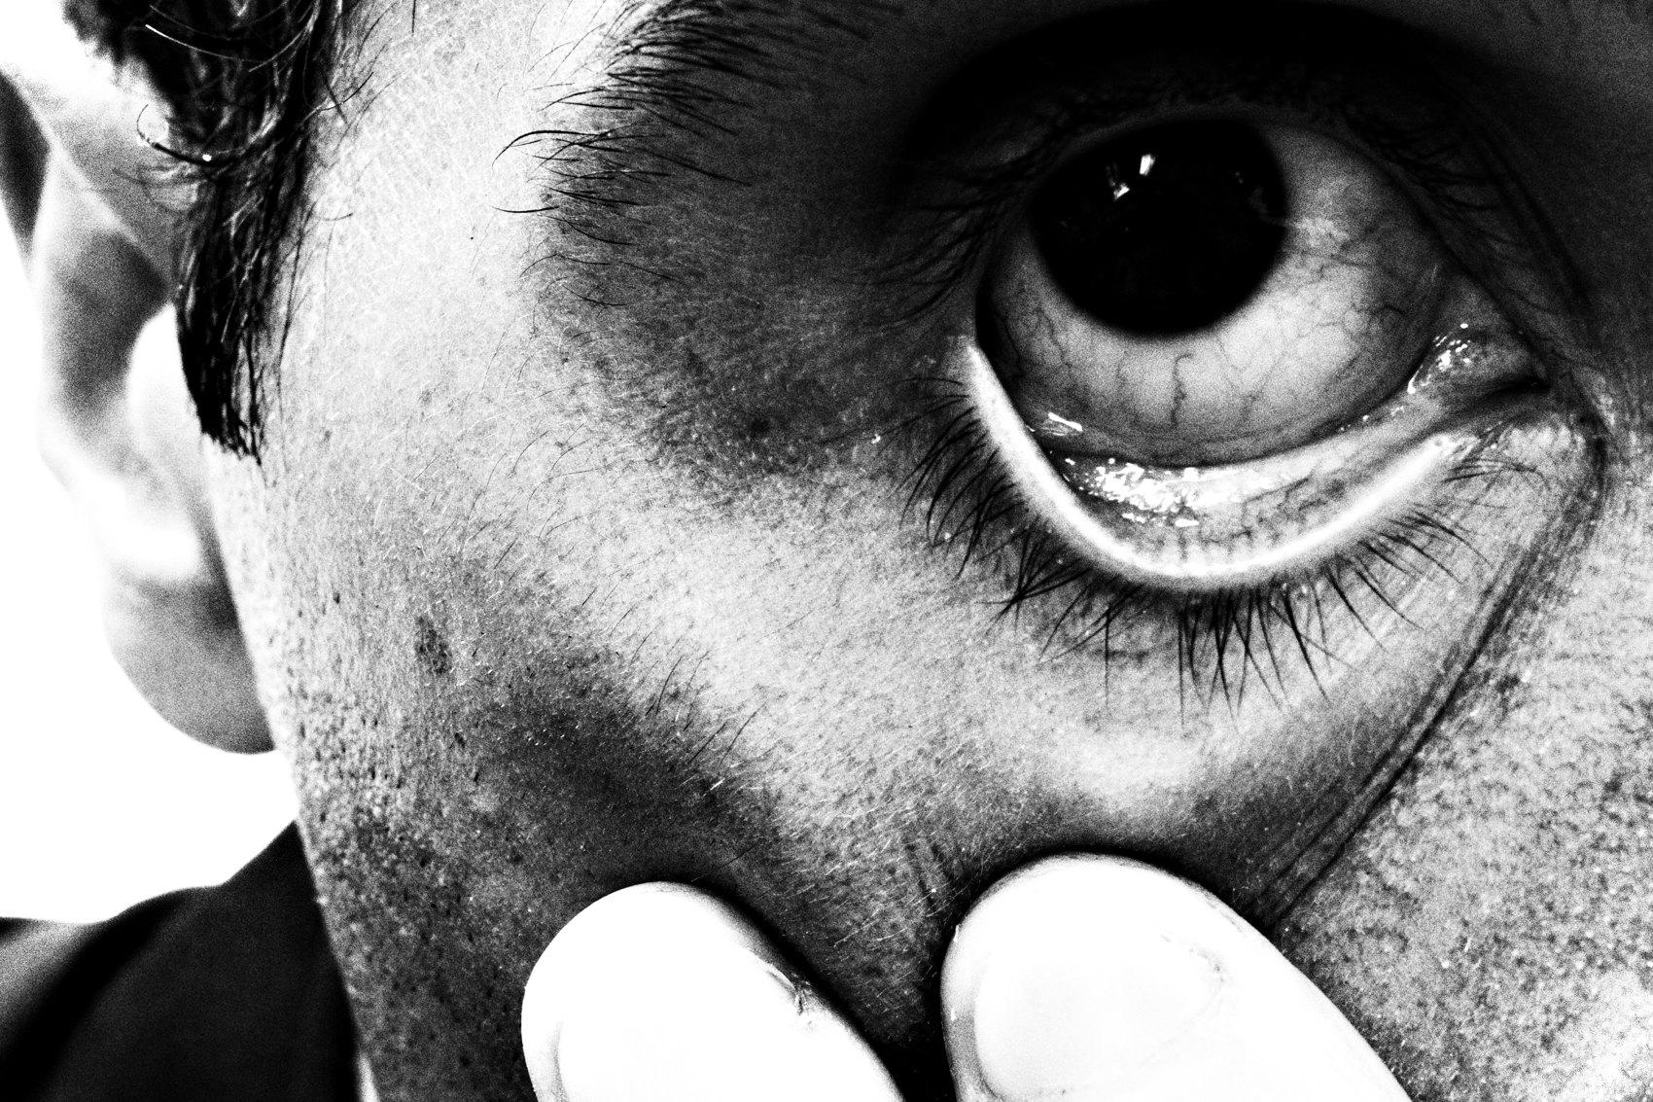
FLUX ACADEMY
BEAT 14 · MAIN TEACHING
Choose the Unorthodox Angle
— Skip the "normal" eye-level shot
— Go top-down; anchor a subject center
— Let a color lead the eye through
Notes:
Say you find people gathered around something by the water. Don't shoot it the "normal" way. Go top-down, anchor a central subject dead center, and use an open surface like water as a clean stage. Let a single bold color draw a flowing path through the frame. Unorthodox angle, intentional break, visual feast — you broke the eye-level habit on purpose.

Slide 16

FLUX ACADEMY
BEAT 15 · MAIN TEACHING
Break From Mastery, Not Laziness
— Learn the rule before you break it
— Mastery earns the break
— Ignorance isn't intuition
Notes:
One honesty check: break from mastery, not laziness. A tilted, off-balance frame from someone who knows the rules is bold. The same frame from someone who never learned them is just a mistake. Earn the break. A decade of repetition is what lets me trust the gut over the grid.

Slide 17
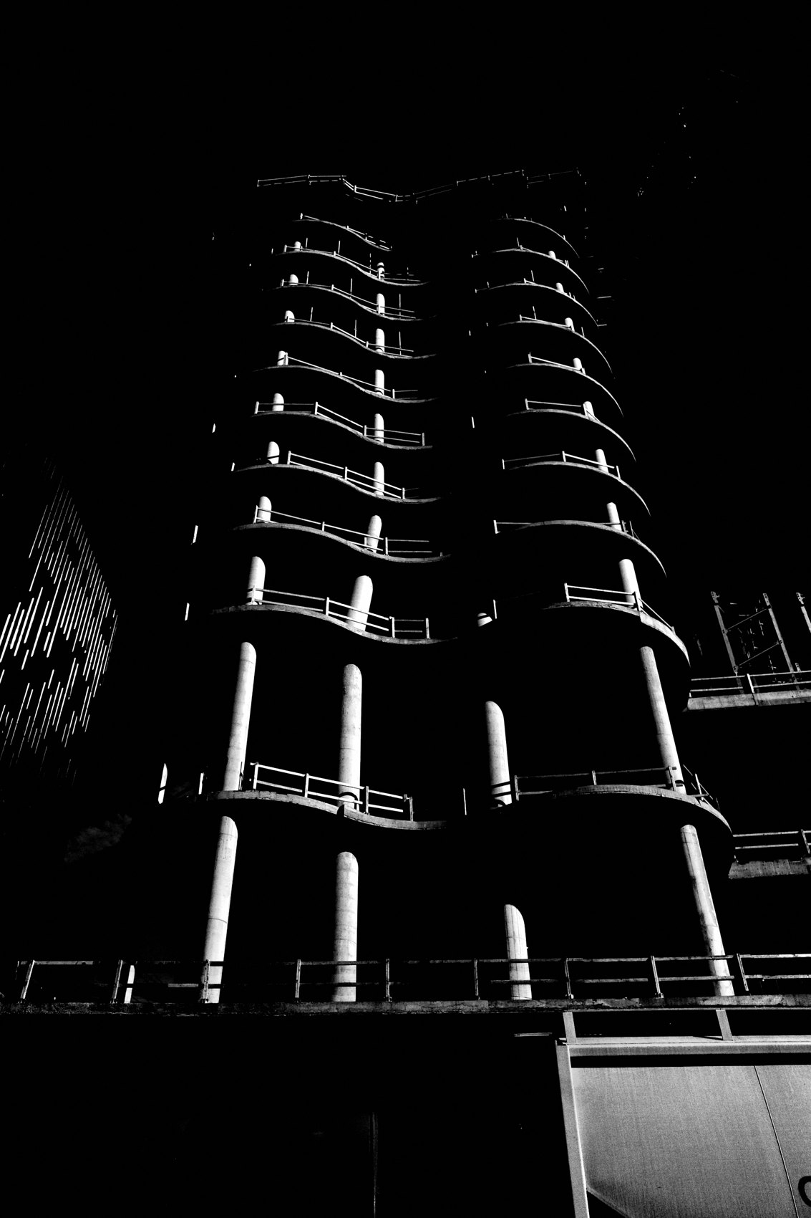
FLUX ACADEMY
BEAT 16 · MAIN TEACHING
Playfulness Lets You Break
— Don't take yourself too seriously
— Play loosens the grip of rules
— Respond, don't overanalyze
Notes:
And here's the secret ingredient: play. I don't take myself too seriously when I'm shooting — I respond intuitively. A playful attitude is what frees you from the rulebook. Overanalyze and you obey. Play and you experiment. The rule-breaker is just the photographer having more fun.

Slide 18
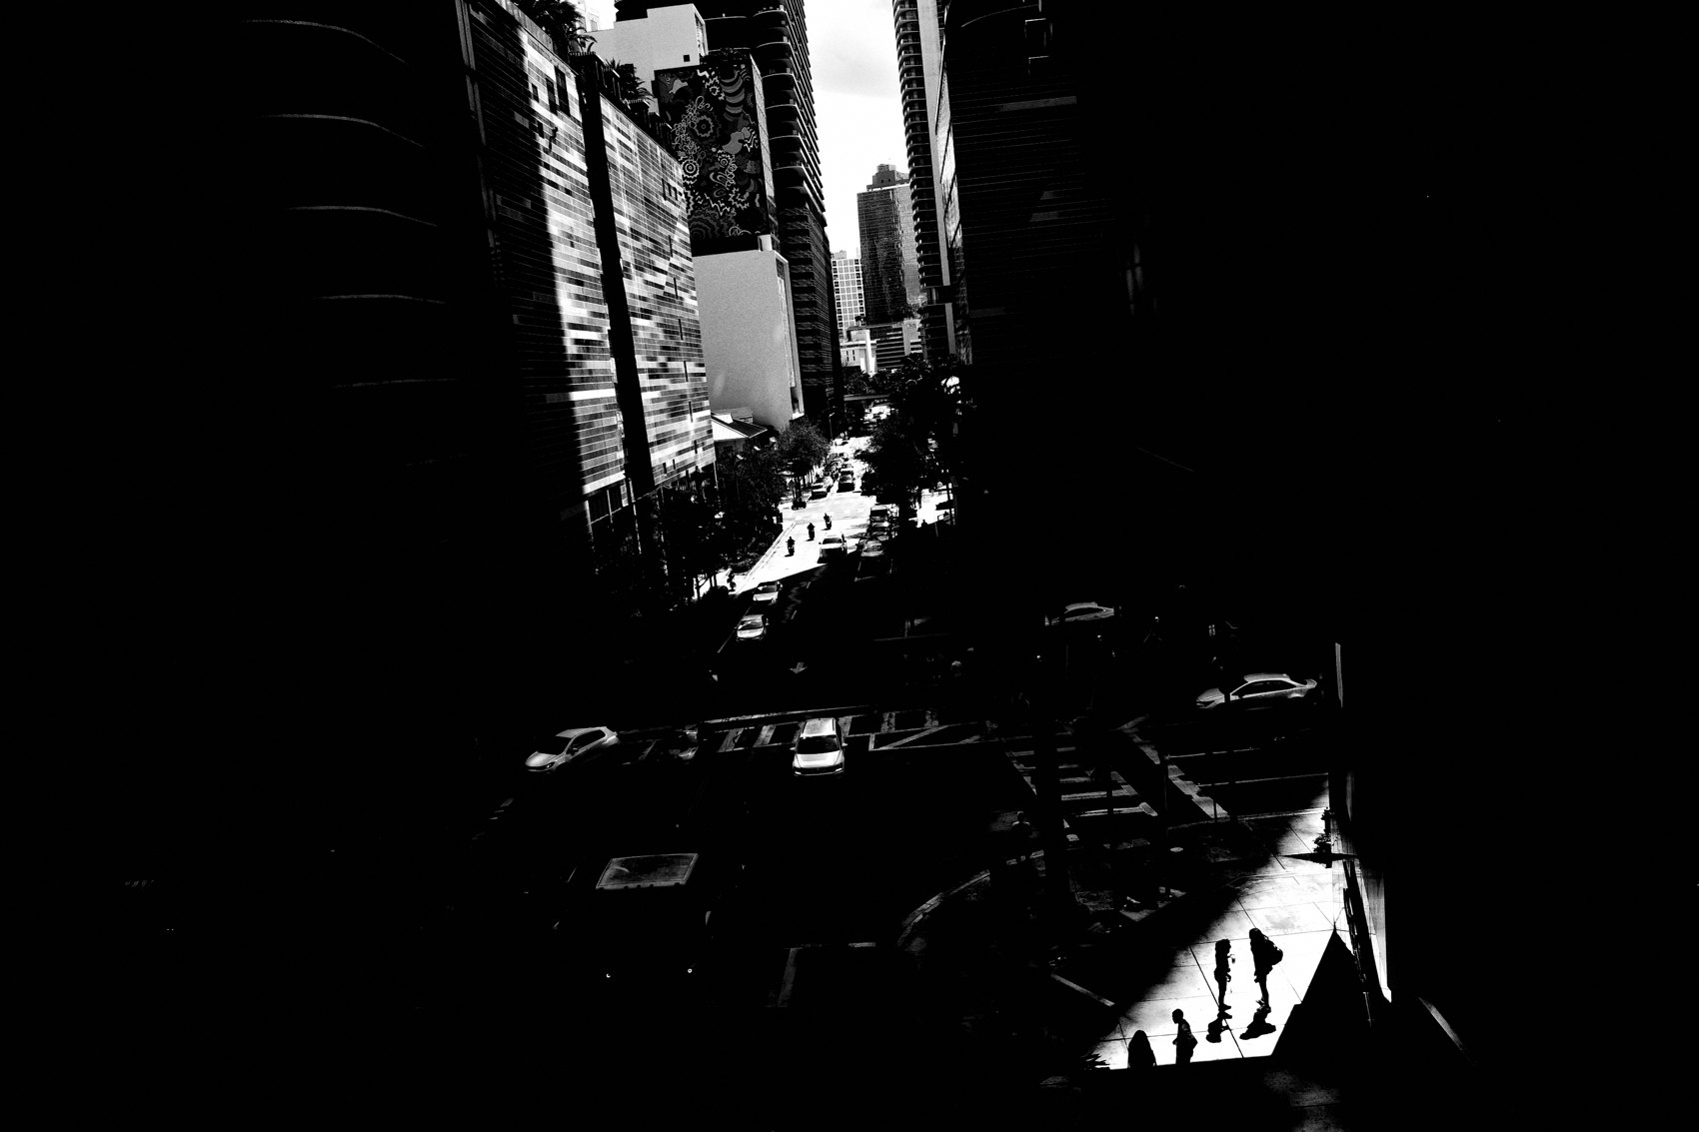
FLUX ACADEMY
BEAT 17 · PRACTICAL APPLICATION
The No-Grid Walk
— One walk: zero rule-checking
— Shoot only on gut
— Notice what your instinct chooses
Notes:
Drill one — the no-grid walk. Go out and shoot a whole session without checking a single rule. No thirds, no leading-line hunting. Just your two eyes and your gut. Press the shutter on instinct alone. Then look back and notice the order your intuition built on its own.

Slide 19

FLUX ACADEMY
BEAT 18 · PRACTICAL APPLICATION
Center It On Purpose
— Find a symmetrical scene
— Place the subject dead center
— Feel when center beats thirds
Notes:
Drill two — break the thirds on purpose. Find a symmetrical scene and slam the subject dead center. Live with how it feels. You're training the instinct to know when center beats offset. Breaking a rule once, deliberately, teaches you more than following it a hundred times.

Slide 20

FLUX ACADEMY
BEAT 19 · PRACTICAL APPLICATION
Shoot for Tension
— Make one frame intentionally uneasy
— Crowd or tilt the elements
— Keep what holds energy
Notes:
Drill three — shoot for tension. Make a frame that feels slightly wrong — tilted, crowded, off-balance — and chase the energy in that discomfort. Don't fix it into tidiness. The goal is a photo that won't let the eye settle. Keep the ones that hum.

Slide 21

FLUX ACADEMY
BEAT 20 · COMMON MISTAKES
Breaking Without Knowing
— Random isn't the same as broken
— Ignorance reads as sloppiness
— Know the rule first
Notes:
Biggest mistake: confusing breaking a rule with not knowing it. A random, sloppy frame isn't bold — it's just sloppy. The break only works when the viewer feels you chose it. Learn the grid cold first; then the deviation reads as intention, not accident.

Slide 22
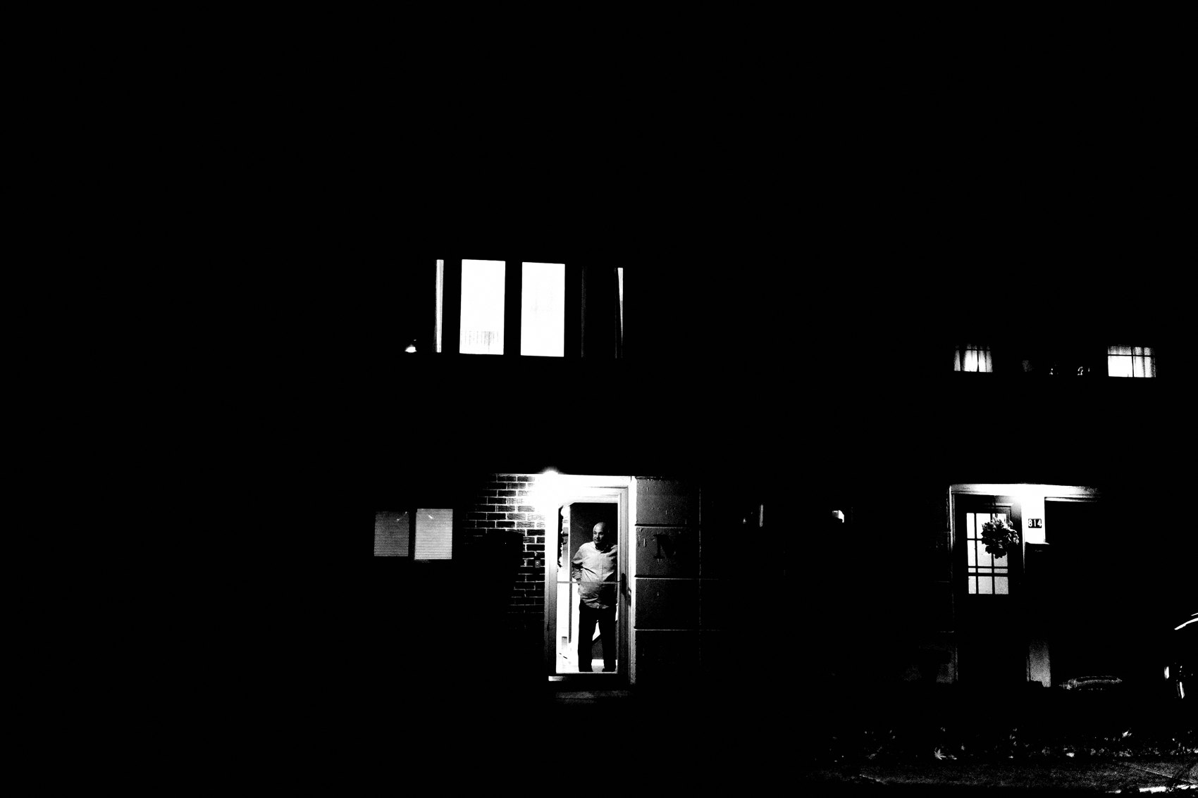
FLUX ACADEMY
BEAT 21 · COMMON MISTAKES
Rule-Worship Paralysis
— Don't freeze sorting lines and grids
— Overthinking loses the moment
— Trust the gut, move fast
Notes:
The other mistake: rule-worship. Standing frozen, sorting every scene into lines and thirds while life walks right past you. Don't overthink it. The rules live in your gut now — let them. Move fast, respond with your whole body, and let the composition come through you, not from a checklist.

Slide 23
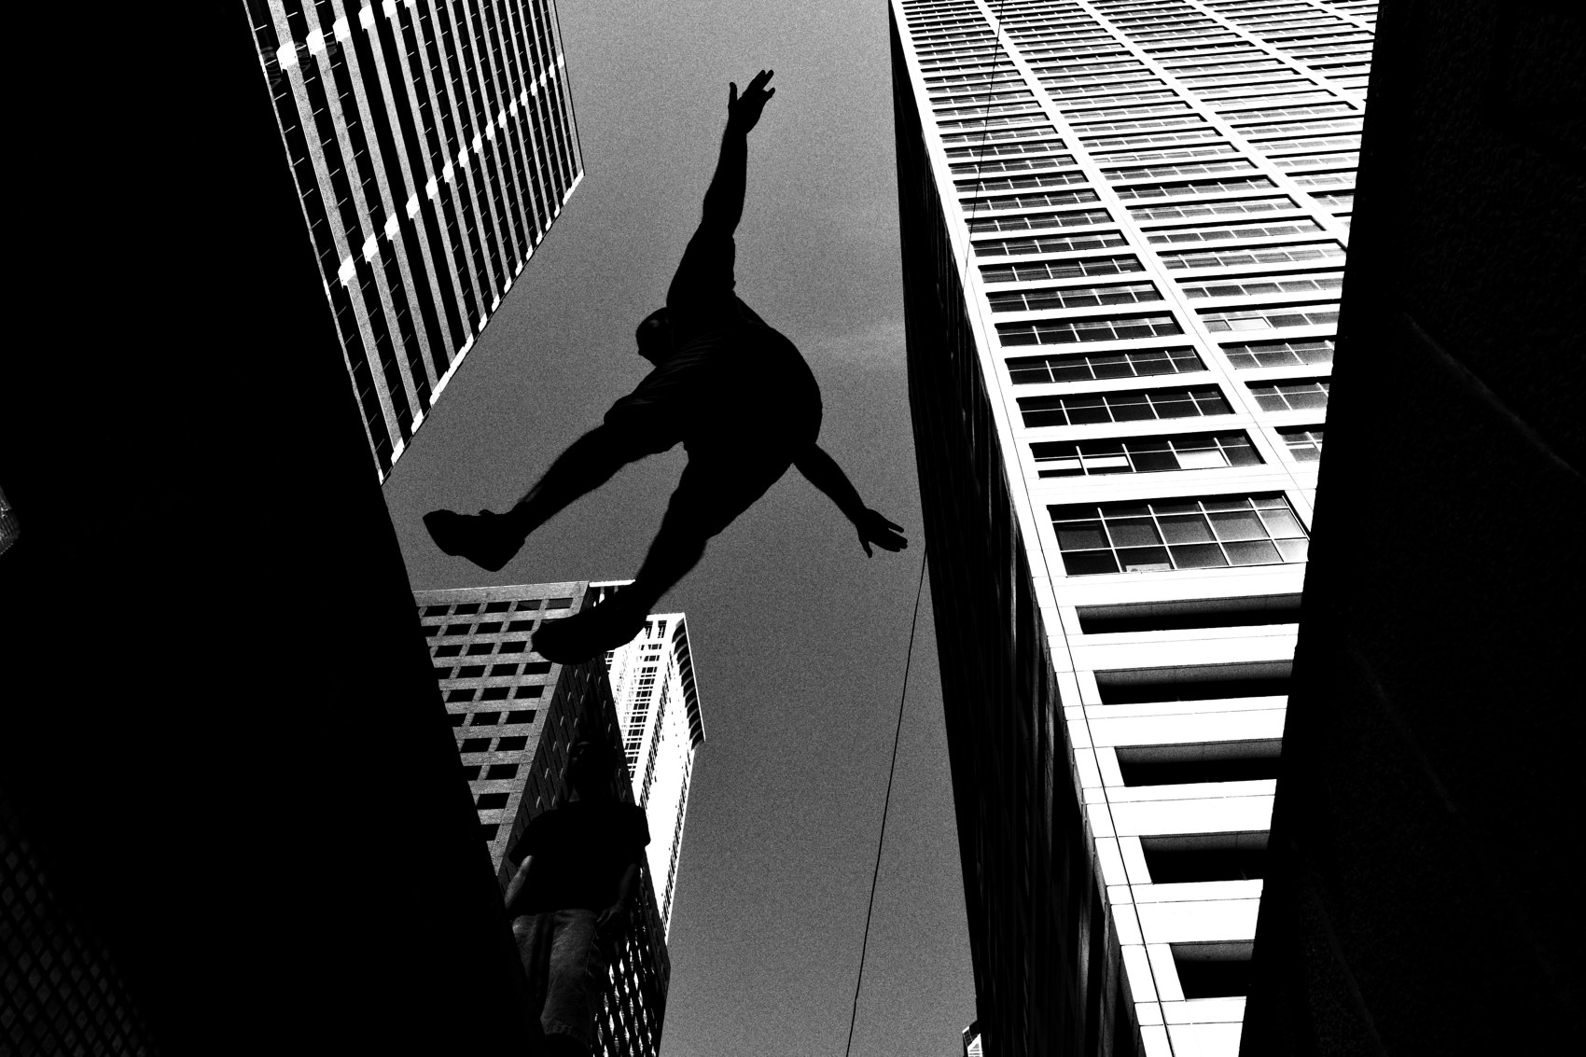
FLUX ACADEMY
BEAT 22 · RELATIONSHIP TO PREVIOUS
From Gesture to Breaking Form
— Lesson 019 read the human gesture
— Sometimes the gesture won't fit the grid
— Break the form to keep the moment
Notes:
This builds straight on Lesson 019, Gesture & Body Language. Once you're locked onto a real human gesture, you'll find the moment doesn't always fit a tidy grid. That's exactly when you break form to keep the content. Lesson 019 taught you what to protect; today taught you what to bend to protect it.

Slide 24
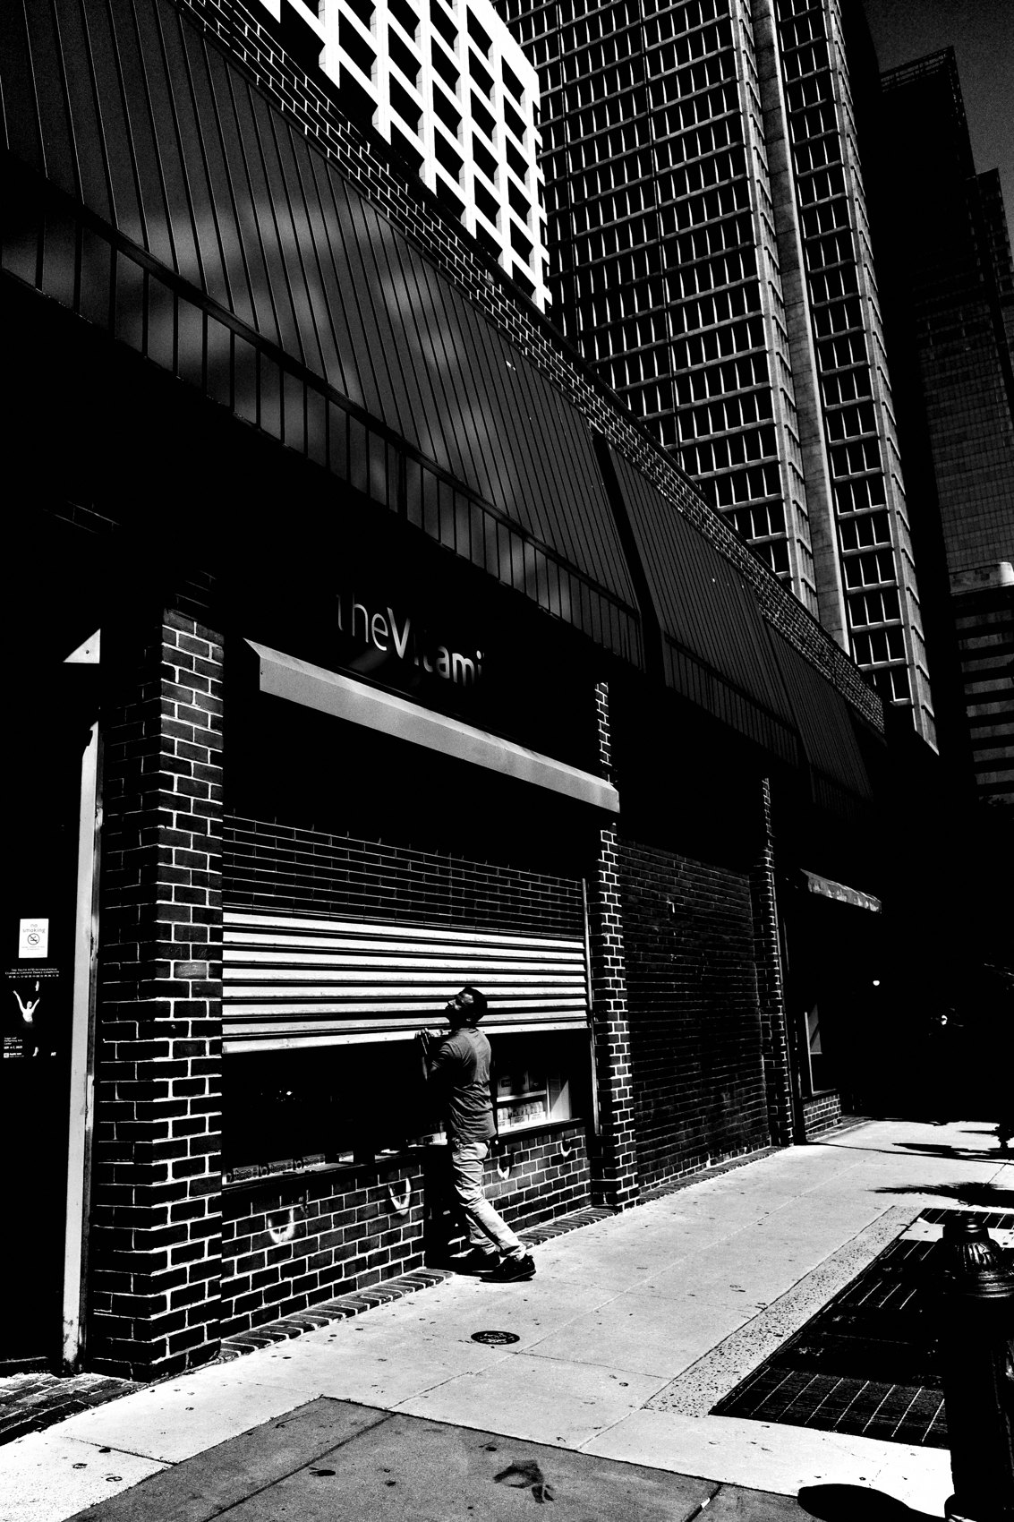
FLUX ACADEMY
BEAT 23 · SUMMARY / TAKEAWAY
Earn It, Then Break It
— Rules are guides; intuition is the law
— Break from mastery, for tension and truth
— Next: Lesson 021, Working the Scene
Notes:
Last thing. Composition rules are guides, never laws — and once your gut can see, you're free to break them for tension, for truth, for the moment. Earn the rule, then break it. Next up, Lesson 021, Working the Scene — how I stay until the photo comes. Earn it, then break it. Catch you next lesson.

