Slide 1
FLUX ACADEMY · A SCHOOL FOR SEEING
MODULE 4 · COMPOSITION
Gesture & Body Language
BY DANTE SISOFO

Slide 2
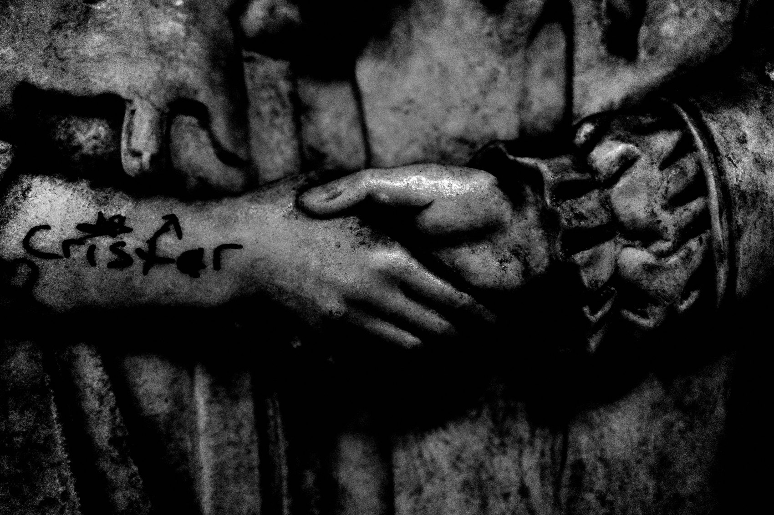
FLUX ACADEMY
BEAT 01 · CORE IDEA
Gesture Is the Anchor
— Hands, movement, the way bodies interact
— Gesture creates rhythm and energy
— The simplest thing to look for, the most powerful
Notes:
What's popping, people — it's Dante. Today we're talking gesture and body language — the simplest thing to look for on the street, and one of the most powerful. People walking from A to B can feel mundane. But hone in on a hand, a reach, a shift of the body, and the whole frame comes alive. Gesture creates rhythm. Gesture creates energy.

Slide 3
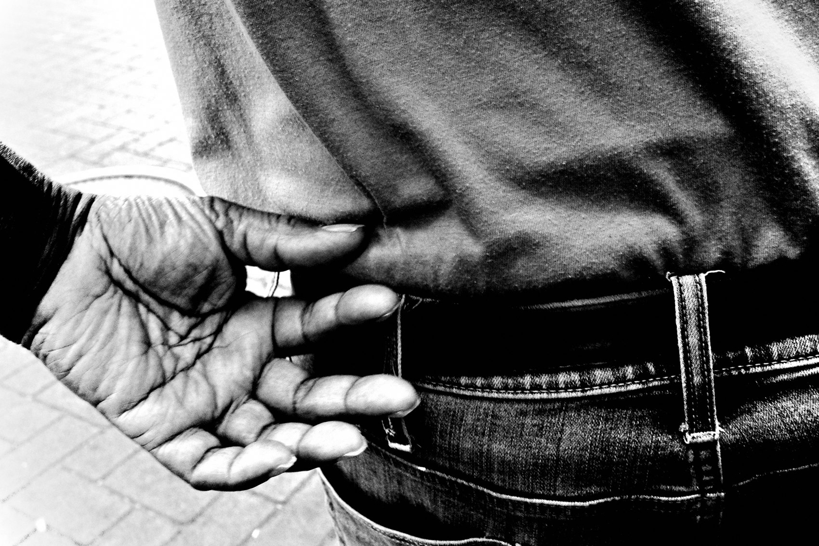
FLUX ACADEMY
BEAT 02 · LEARNING OBJECTIVE
What You'll Walk Away With
— See and time gesture instinctively
— Carry yourself with confident presence
— Turn a dull street into energy
Notes:
By the end of this lesson you'll know how to hunt for gesture — hands, feet, the way bodies respond to one another — and how to carry your own body so you can be there when it happens. You'll learn to turn a walking-from-work-to-home street into a frame full of interaction and emotion.

Slide 4

FLUX ACADEMY
BEAT 03 · WHY THIS MATTERS
The Street Feels Mundane Until You See It
— Most of the street is just people moving
— Gesture is what you anchor to
— It triggers you to shoot instinctively
Notes:
Here's why this matters. So much of the street is just people moving — point A to point B. It can feel hard to find anything to photograph. Gesture is the anchor. The moment you start watching hands and movement, the street stops being background noise and starts triggering you to make photographs.

Slide 5
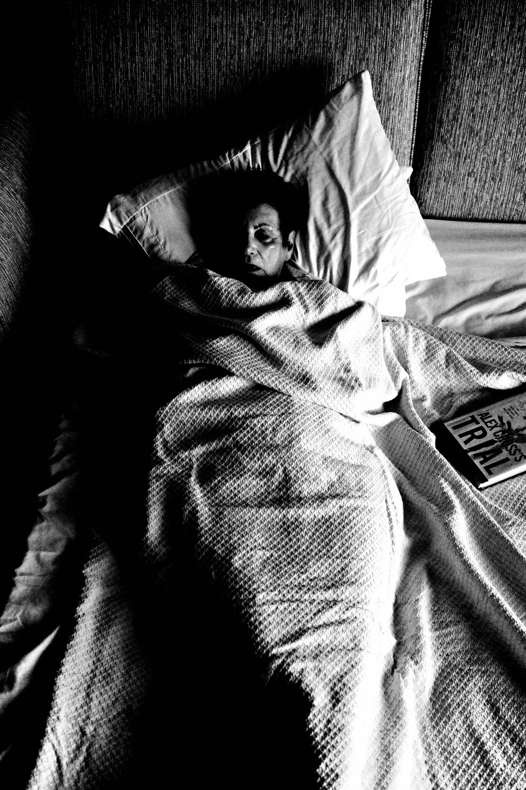
FLUX ACADEMY
BEAT 04 · WHY THIS MATTERS
Presence Is the Real Skill
— Street photography demands presence
— Laser-focus on what's unfolding
— See it, respond, shoot — no thinking
Notes:
And the deeper reason: gesture forces presence, and presence is the real skill. Being present means being laser-focused on what's unfolding in front of you so you can respond intuitively — fast. When I see a moment, I don't think. I shoot. Gesture trains that reflex better than anything.

Slide 6
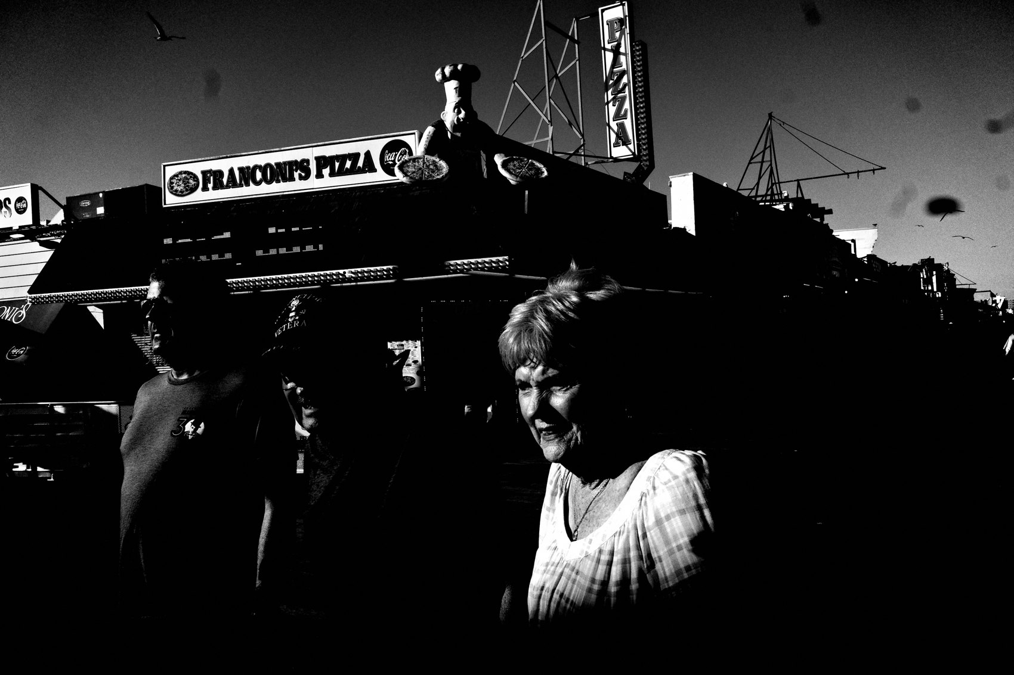
FLUX ACADEMY
BEAT 05 · MAIN TEACHING
Look for Hands
— Watch hands first
— Watch feet and how they move
— Watch bodies responding to one another
Notes:
Let's get specific. The simplest way to anchor yourself visually is to hone in on gesture. Look for hands. Look for movement. Look for the way people interact in public spaces. Watch how feet move across space, how hands meet objects, how one body answers another. That's your raw material.

Slide 7
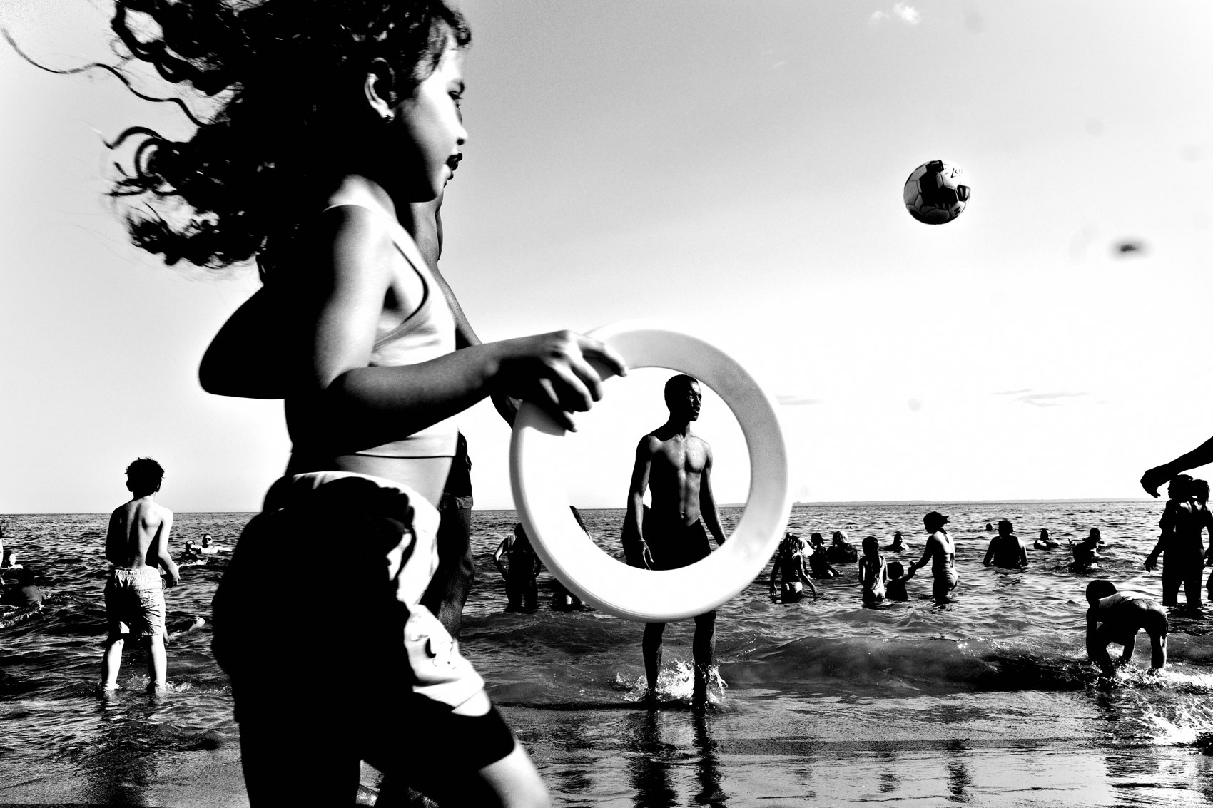
FLUX ACADEMY
BEAT 06 · MAIN TEACHING
Gesture Creates Rhythm
— Gesture = rhythm, energy, beat
— You tune into the street's pulse
— Patterns of behavior start to appear
Notes:
When you start watching hands and gestures, you become more in tune with the rhythm and the beat of the street. You begin to notice patterns in human behavior — the repeated shuffles, the reaches, the little dances people don't know they're doing. Gesture creates rhythm, and rhythm is what you're really photographing.

Slide 8
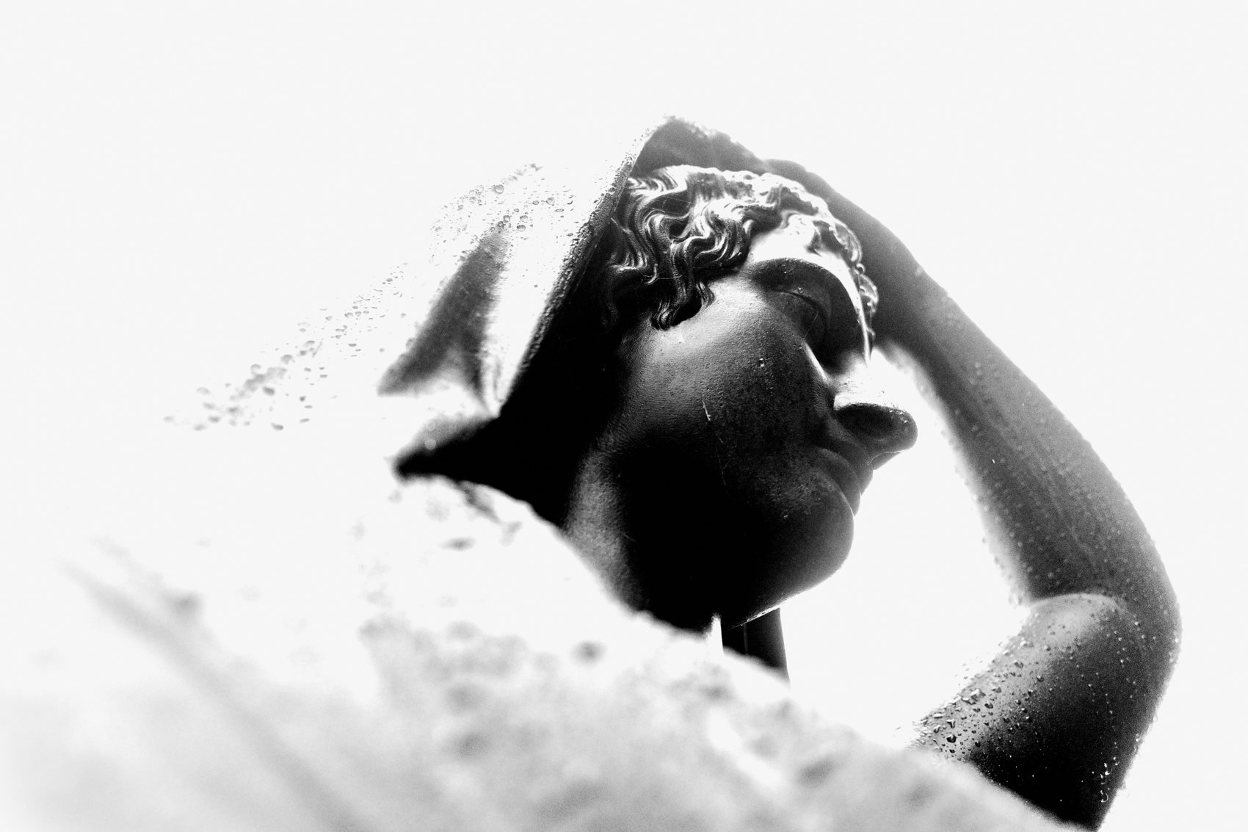
FLUX ACADEMY
BEAT 07 · MAIN TEACHING
Connect One Gesture to Another
— A crowd in motion is raw material
— Shoot a reflection to add a layer
— Wait for gestures to answer each other
Notes:
Think about how gestures connect. A crowd celebrating can, on its own, be just another moment. But notice a puddle on the ground and shoot the reflection, and you add a layer. Then wait — for the hands raised in the air — and connect that to another body leaping, feet lifted into the top of the frame. The relationship between those gestures is what transforms an ordinary scene into a photograph.

Slide 9
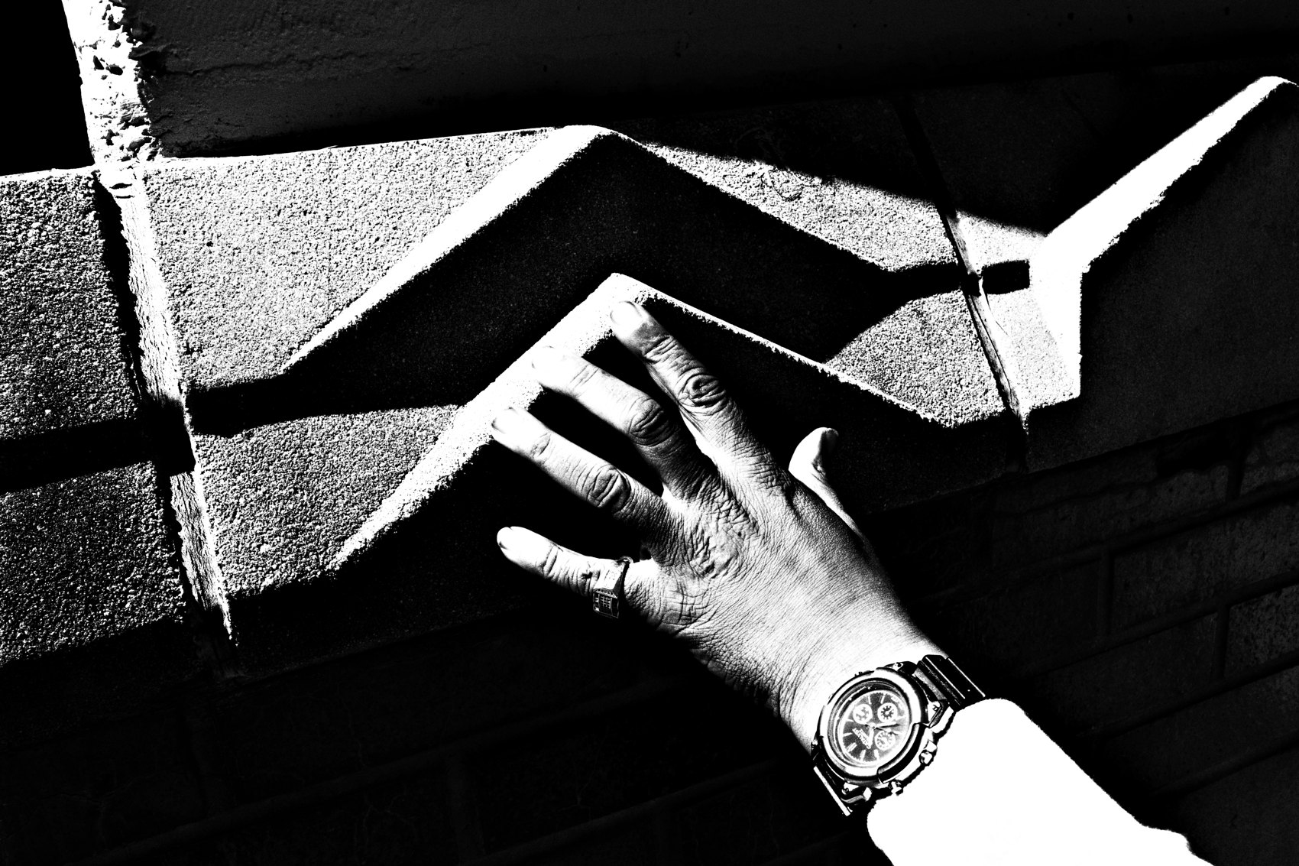
FLUX ACADEMY
BEAT 08 · MAIN TEACHING
Gestures Are the Rails the Eye Runs On
— The eye travels on gestures
— Light shapes the decisive moment
— Gesture does the work of composition
Notes:
Think about how a viewer's eye moves through a frame full of activity — people at play, bodies in motion. The eye travels through the whole picture, guided by their gestures and by the way light gives shape to the decisive moment. The gestures aren't decoration; they're the rails your eye runs on. That's gesture doing the work of composition.

Slide 10
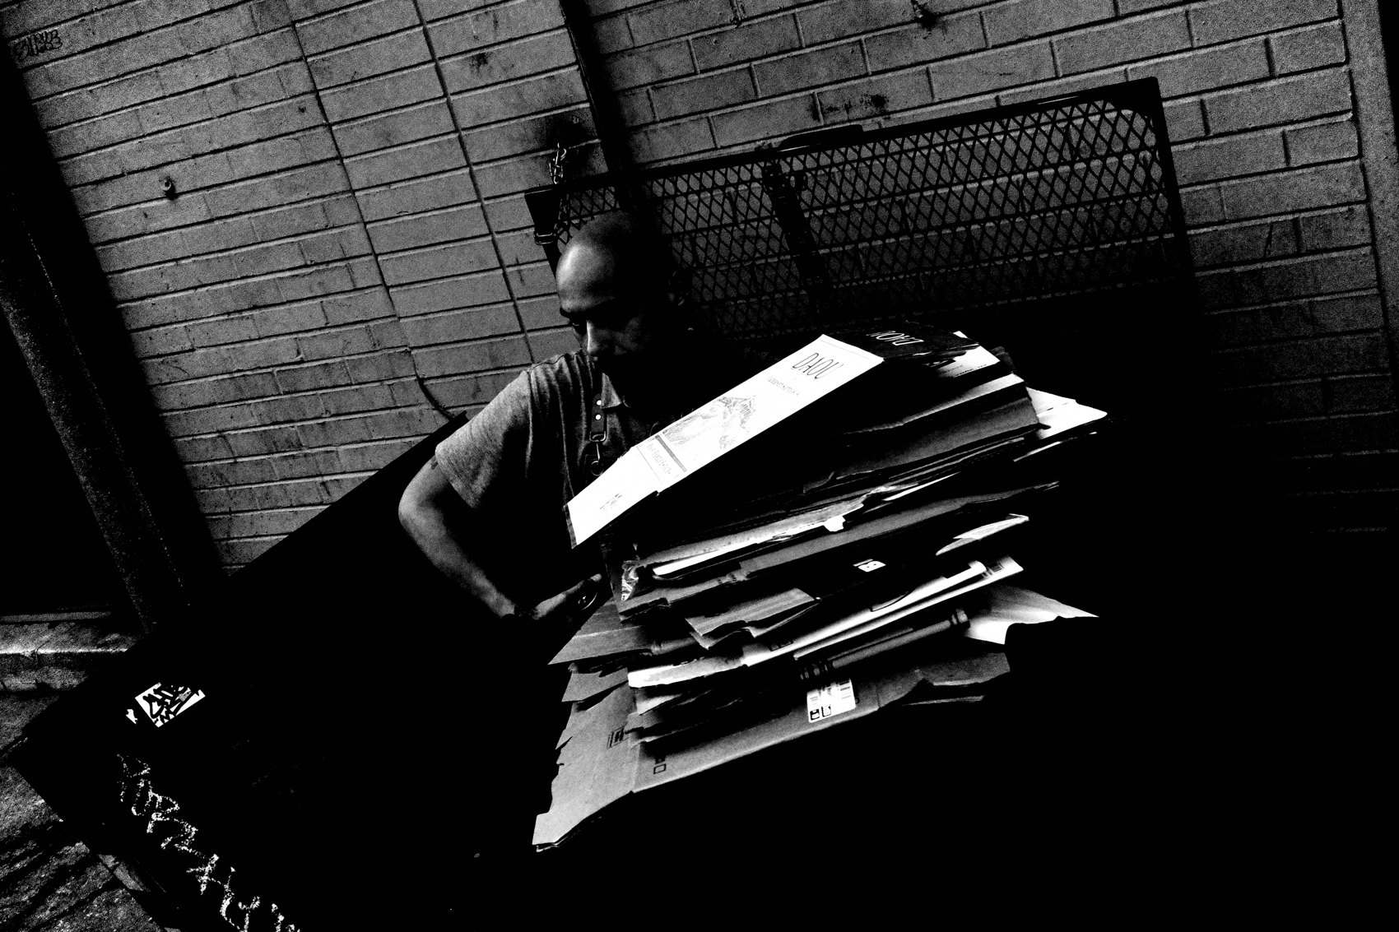
FLUX ACADEMY
BEAT 09 · MAIN TEACHING
Gesture Beyond People
— Even objects carry gesture
— Sculptures come alive against the sky
— Your physical position elevates them
Notes:
Gesture isn't limited to people. Even inanimate objects can carry gesture. A sculpture can come alive through gesture — framed against a dramatic sky, elevated by where you choose to stand. A statue's frozen reach can read as movement. Once you're tuned to gesture, you see it everywhere.

Slide 11
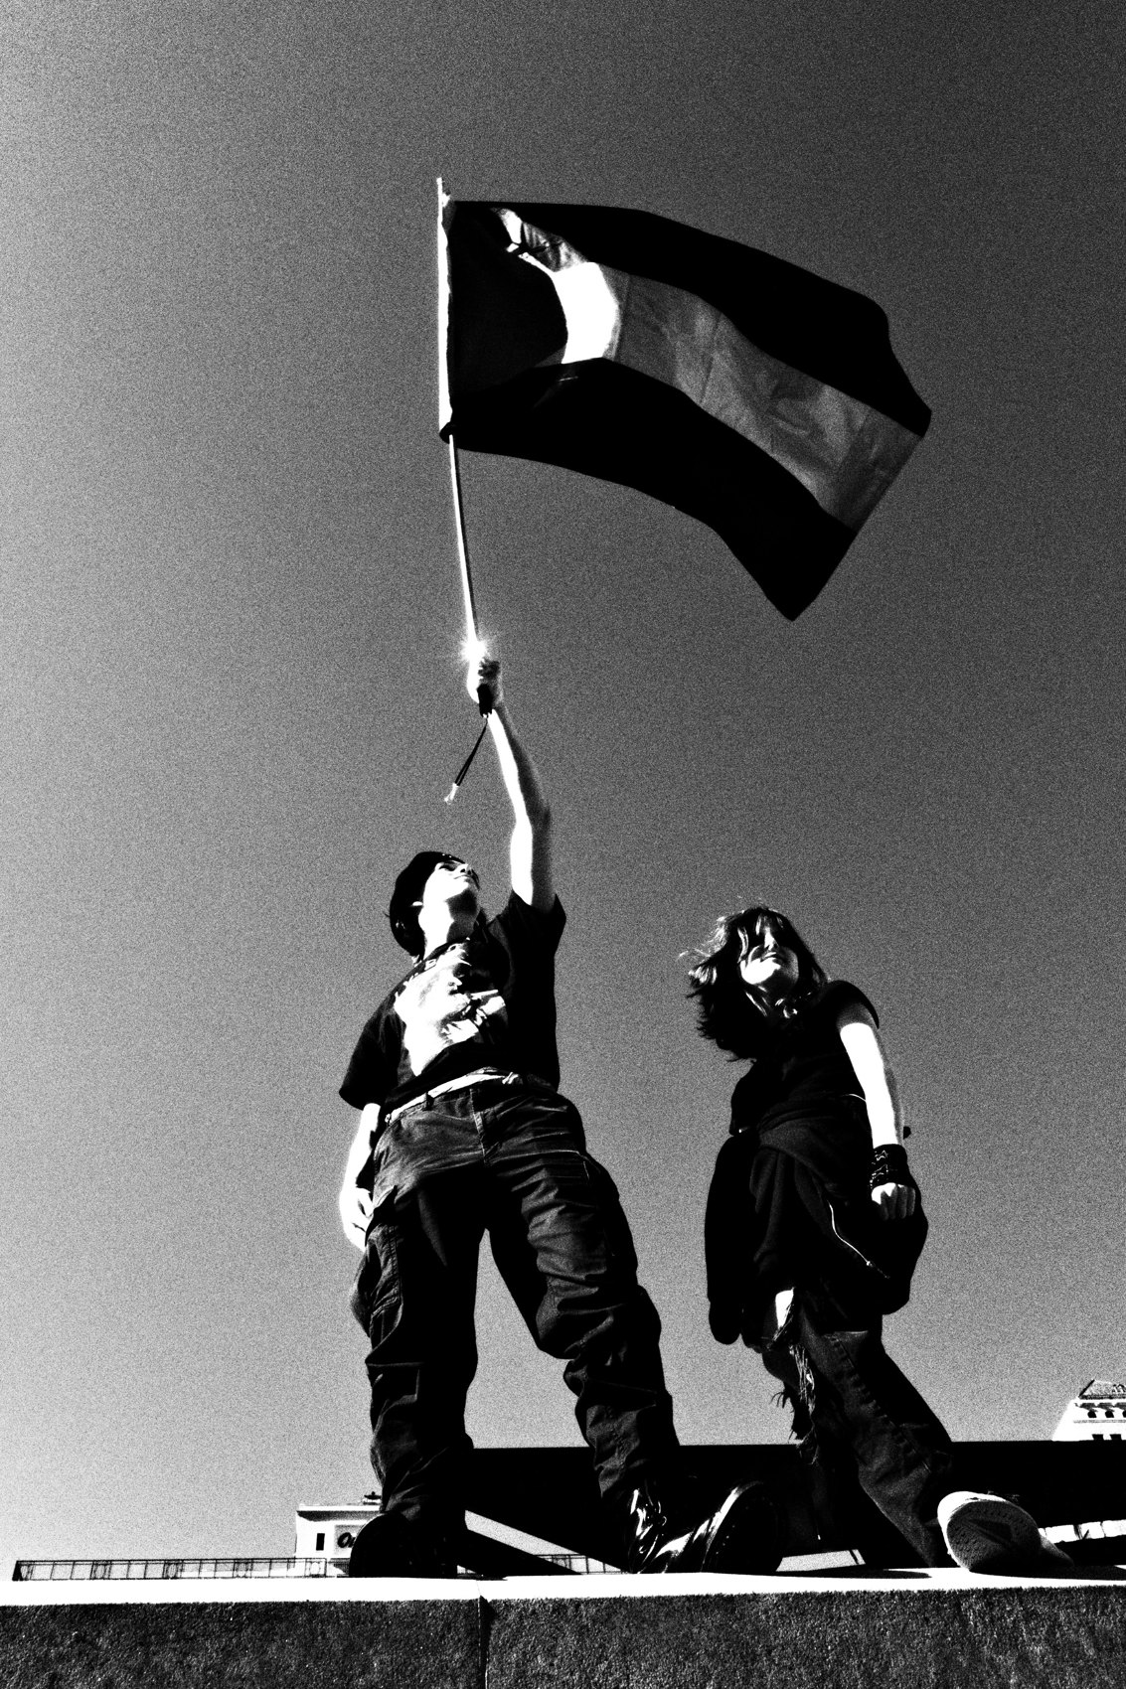
FLUX ACADEMY
BEAT 10 · MAIN TEACHING
Physical Position Shapes the Photo
— Looking up. Moving left. Moving right.
— Your body changes the picture
— Awareness of position elevates an image
Notes:
Where you stand matters. Looking up, moving left, moving right — these shifts in physical position directly change the photograph you make. Recognize your body's relationship to the subject. That awareness alone can elevate an image, before you even think about the moment.

Slide 12
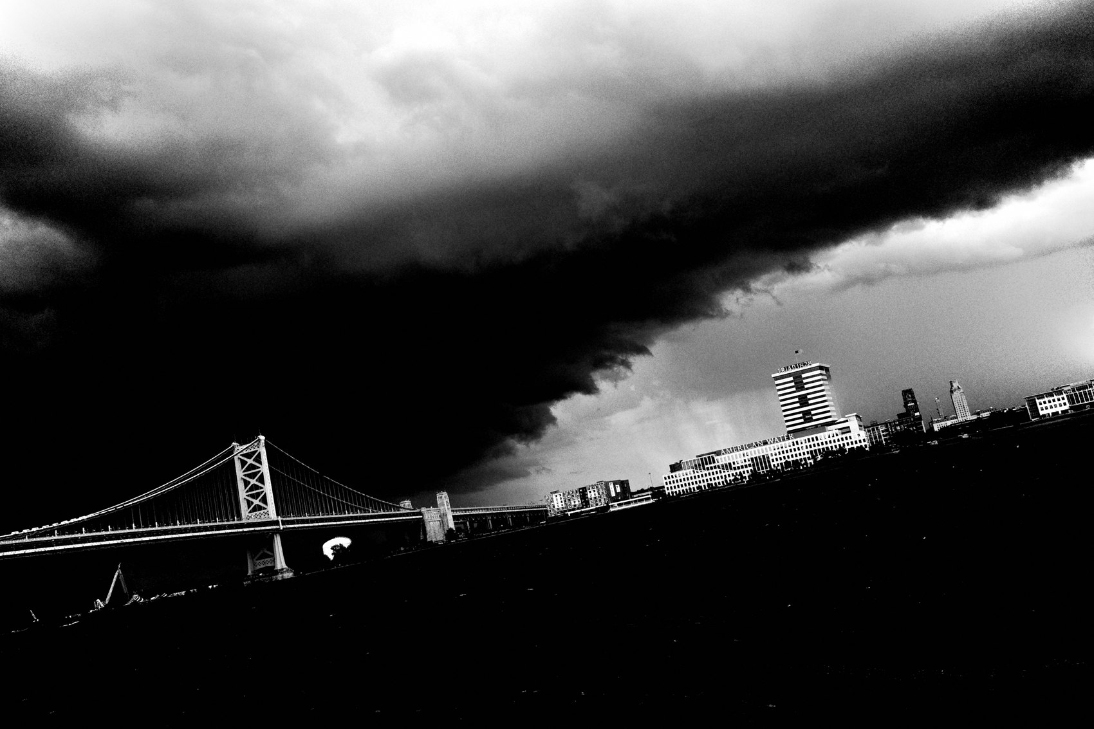
FLUX ACADEMY
BEAT 11 · MAIN TEACHING
Close Isn't Just Distance
— A close shot of hands carries impact
— Closeness is emotional, not just physical
— Be there when you press the shutter
Notes:
Getting close is powerful — a close photograph of hands can carry serious impact. But closeness isn't only about distance. It's about emotional presence. You don't need to throw your camera into someone's space. You need to be there when you press the shutter, fully in the moment.

Slide 13
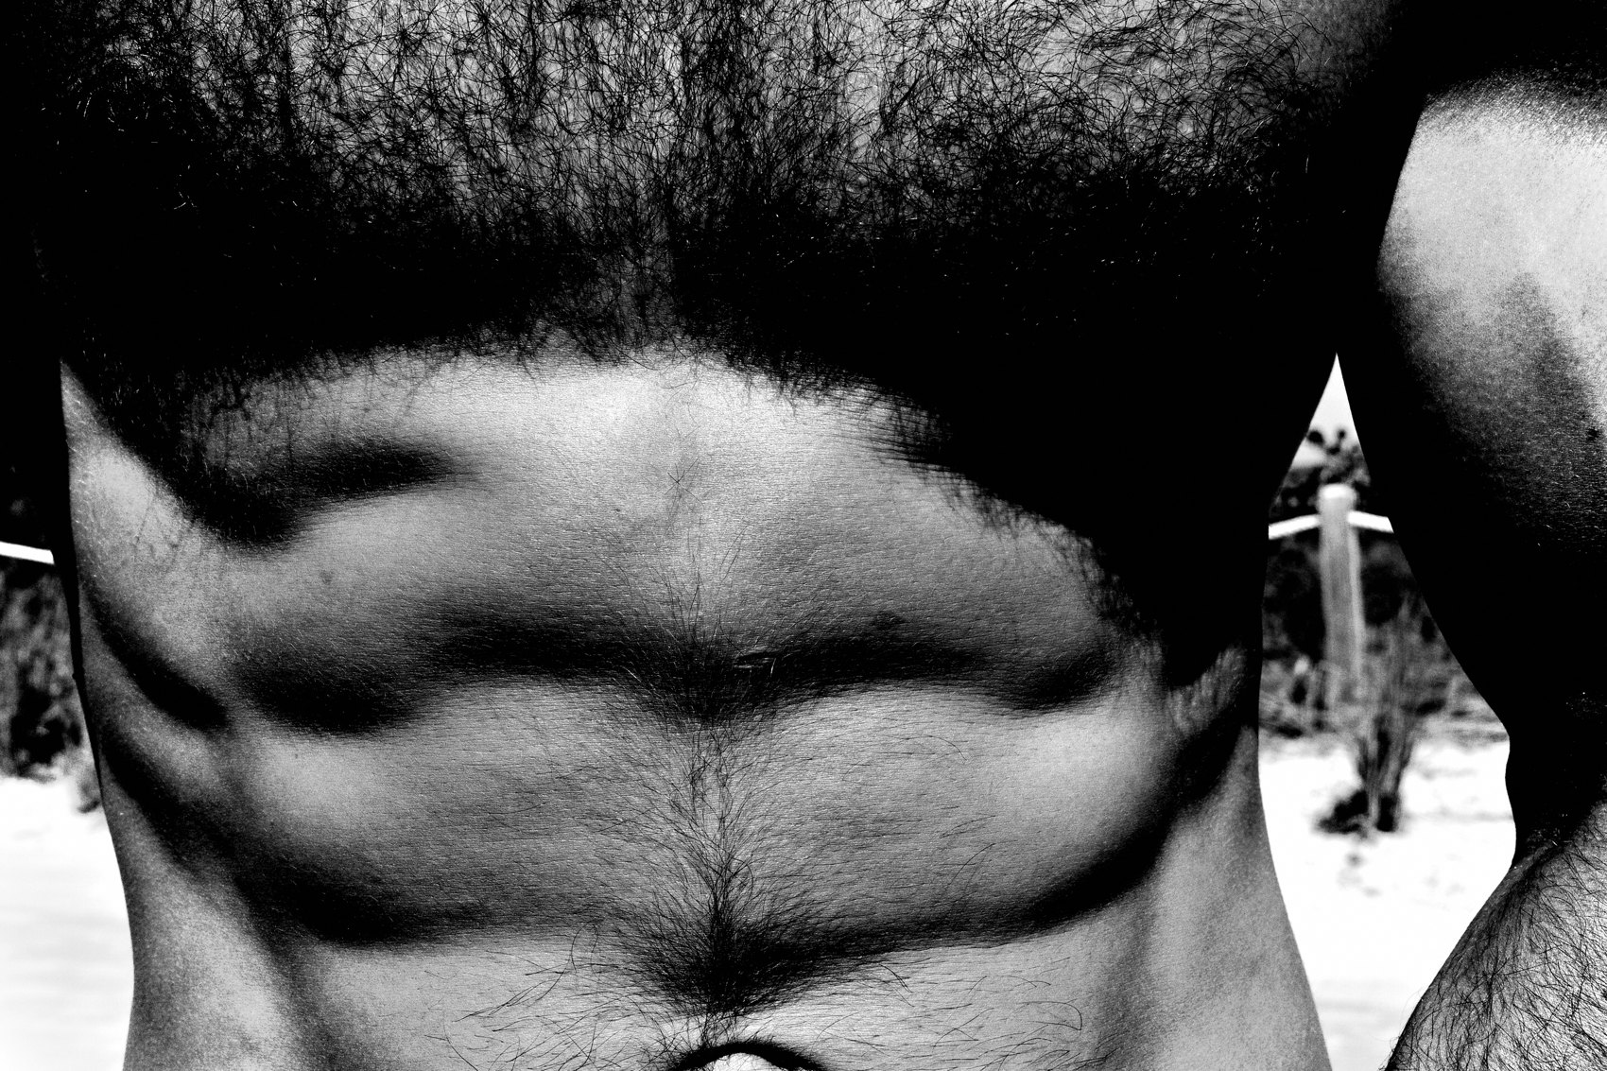
FLUX ACADEMY
BEAT 12 · MAIN TEACHING
Stay With the Scene
— Don't leave until the scene leaves you
— Work it; let life unfold
— Repetition and awareness, every day
Notes:
So work the scene. Stay with it. Don't leave until the scene leaves you. Allow life to unfold naturally in front of the lens. Street photography is a game of repetition and awareness — the more you stay present, the more the gestures come to you.

Slide 14
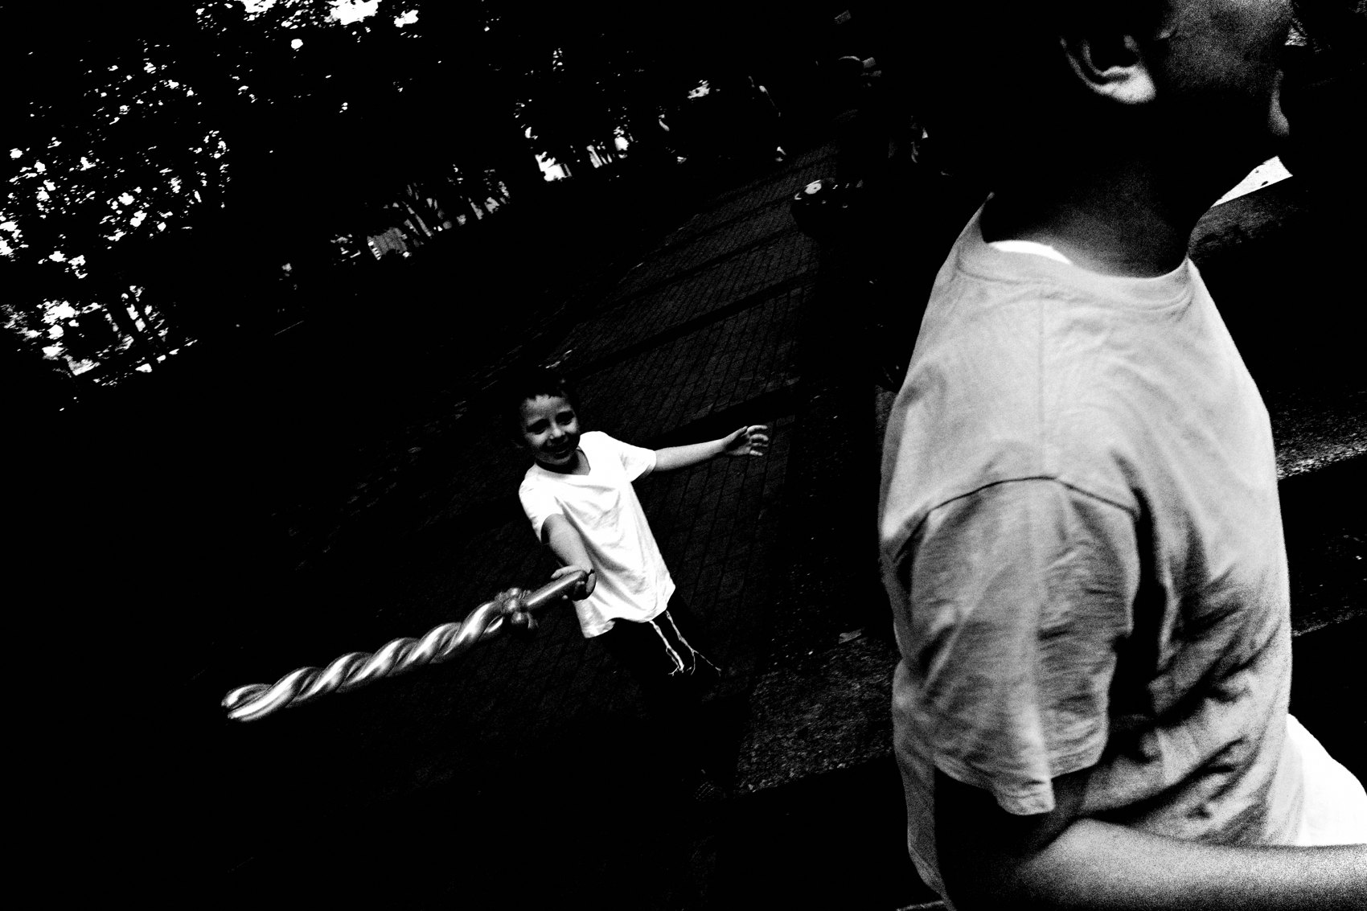
FLUX ACADEMY
BEAT 13 · MAIN TEACHING
Own the Street With Your Body
— Head up, shoulders back, chest open
— Walk with purpose; you belong here
— Avoid the modern phone slouch
Notes:
Now flip the camera around — onto you. The way you carry yourself can make or break your approach. Head up, shoulders back, chest open. Confidence is key. Walk with purpose and exude a presence that says you belong. Too many people hunch over their phones. As a street photographer, rise above the slouch — stay alert and present.

Slide 15
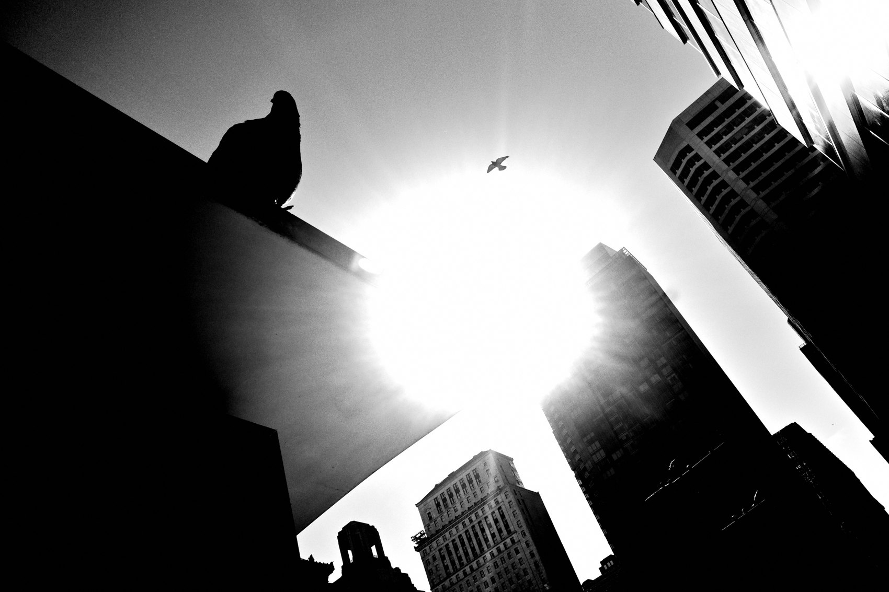
FLUX ACADEMY
BEAT 14 · MAIN TEACHING
Carry the Camera With Intent
— Discreet but confident
— Don't face subjects head-on
— Turn shoulders away, stay loose
Notes:
How you hold the camera shapes your street presence. Be discreet but confident. Don't face your subjects directly — turn your shoulders slightly away and keep your movements loose. Avoid locking eyes; you want the scene to stay natural, unbothered, real.

Slide 16
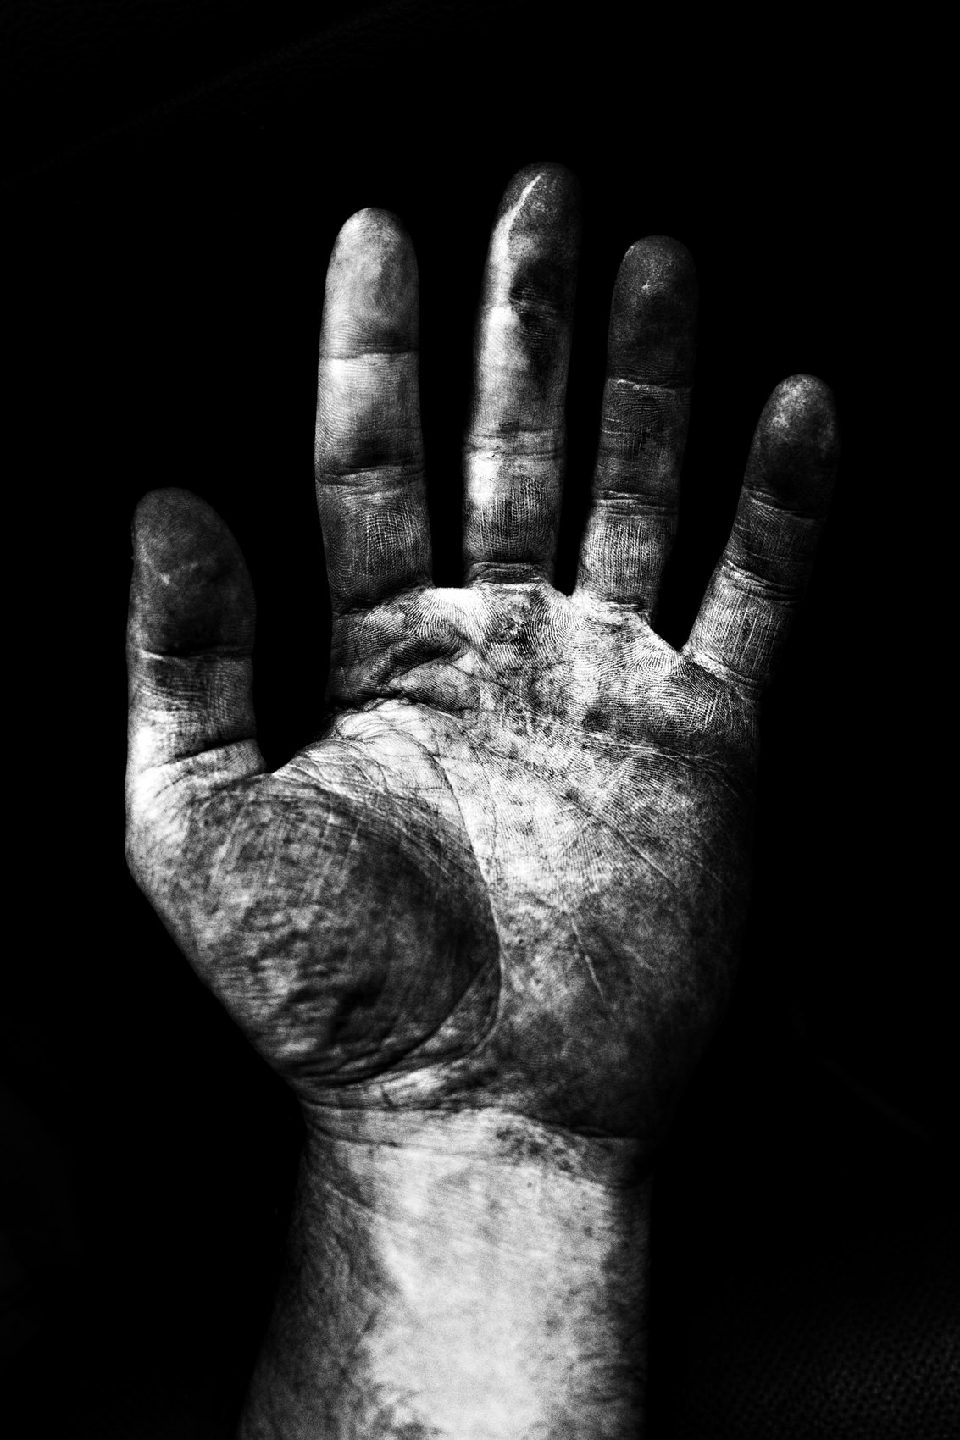
FLUX ACADEMY
BEAT 15 · MAIN TEACHING
The Art of Distraction
— Pretend to shoot above or behind you
— Use the tourist technique
— Fluid micro-movements with the camera
Notes:
Use subtle misdirection. Pretend to shoot above or behind you — the tourist technique throws off attention. Keep your movements fluid so you can glide between vertical and horizontal. As I like to say: I wave the wand, moving the camera around in micro-movements. It's all about fluidity and being one with your surroundings.

Slide 17
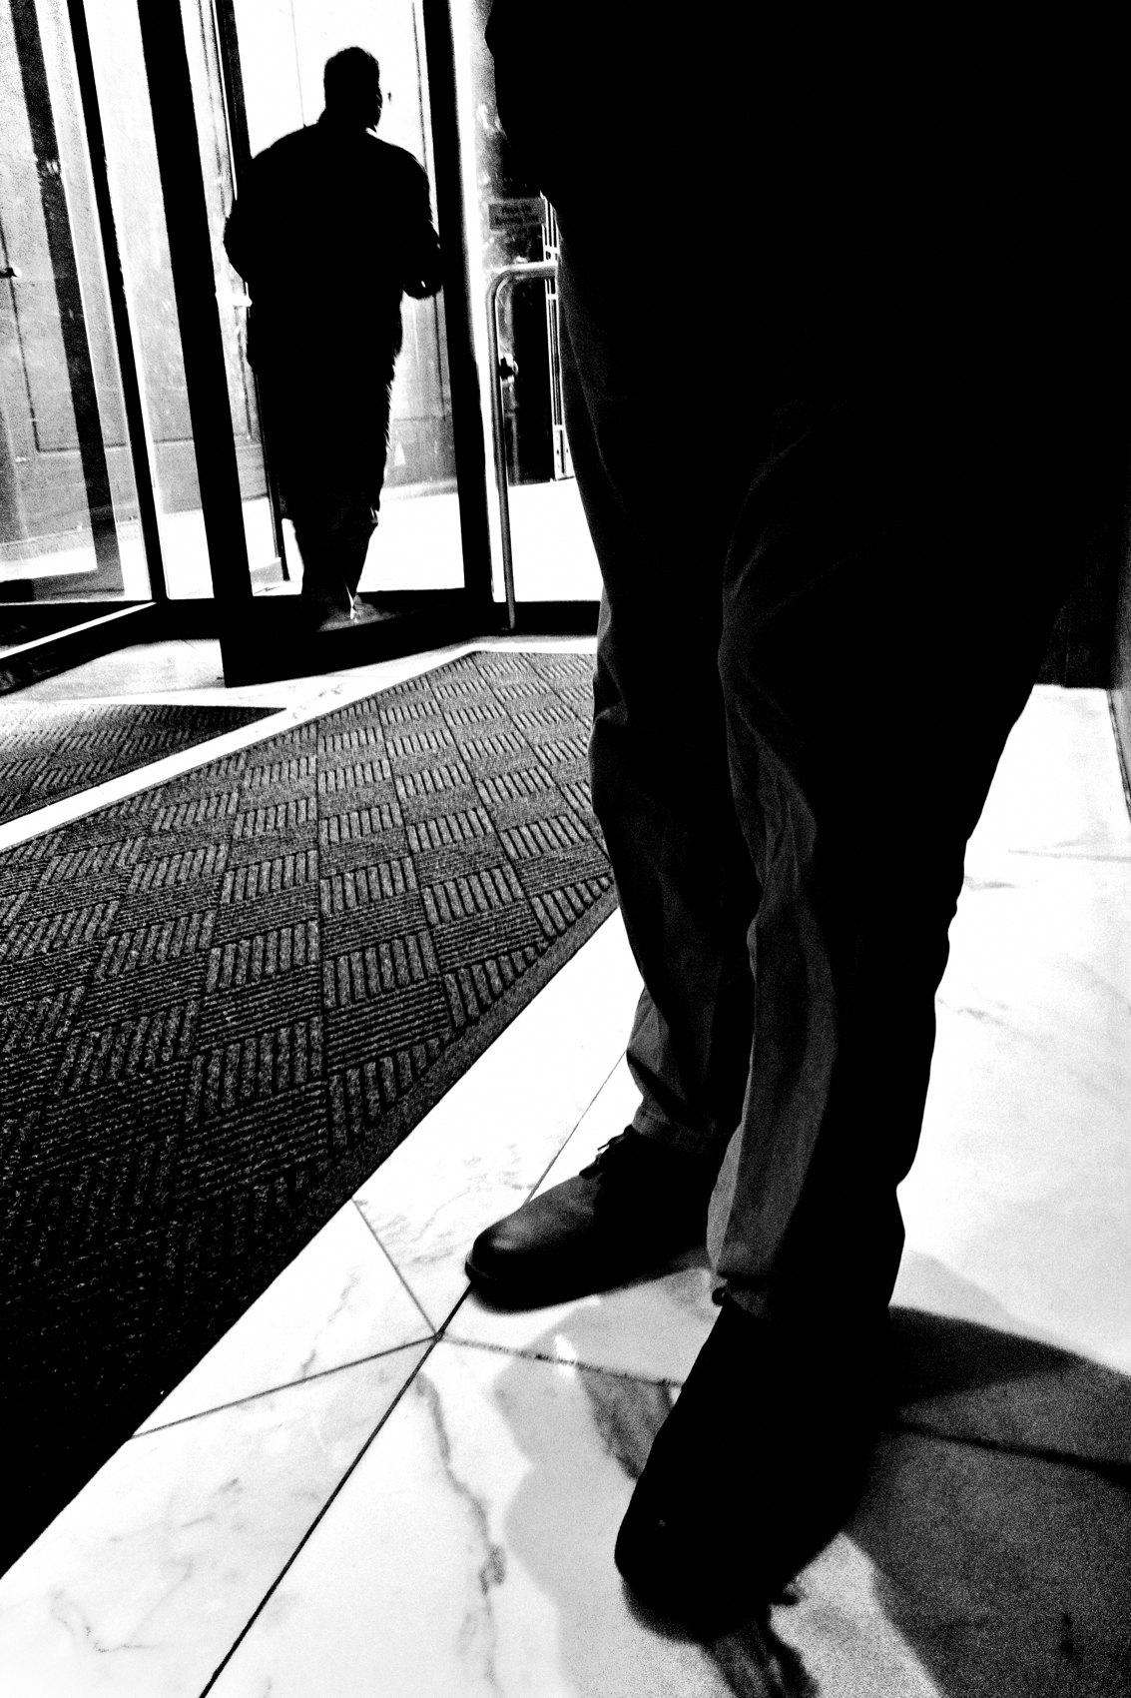
FLUX ACADEMY
BEAT 16 · MAIN TEACHING
Timing and Repetition
— Master the instinctive shot
— Pull up, snap, no hesitation
— Repetition builds your rhythm
Notes:
Then there's timing. Master the instinctive shot — practice pulling the camera up quickly and snapping without hesitation. Repetition builds rhythm. The more you shoot, the better your intuition gets, until reading and catching a gesture is second nature.

Slide 18
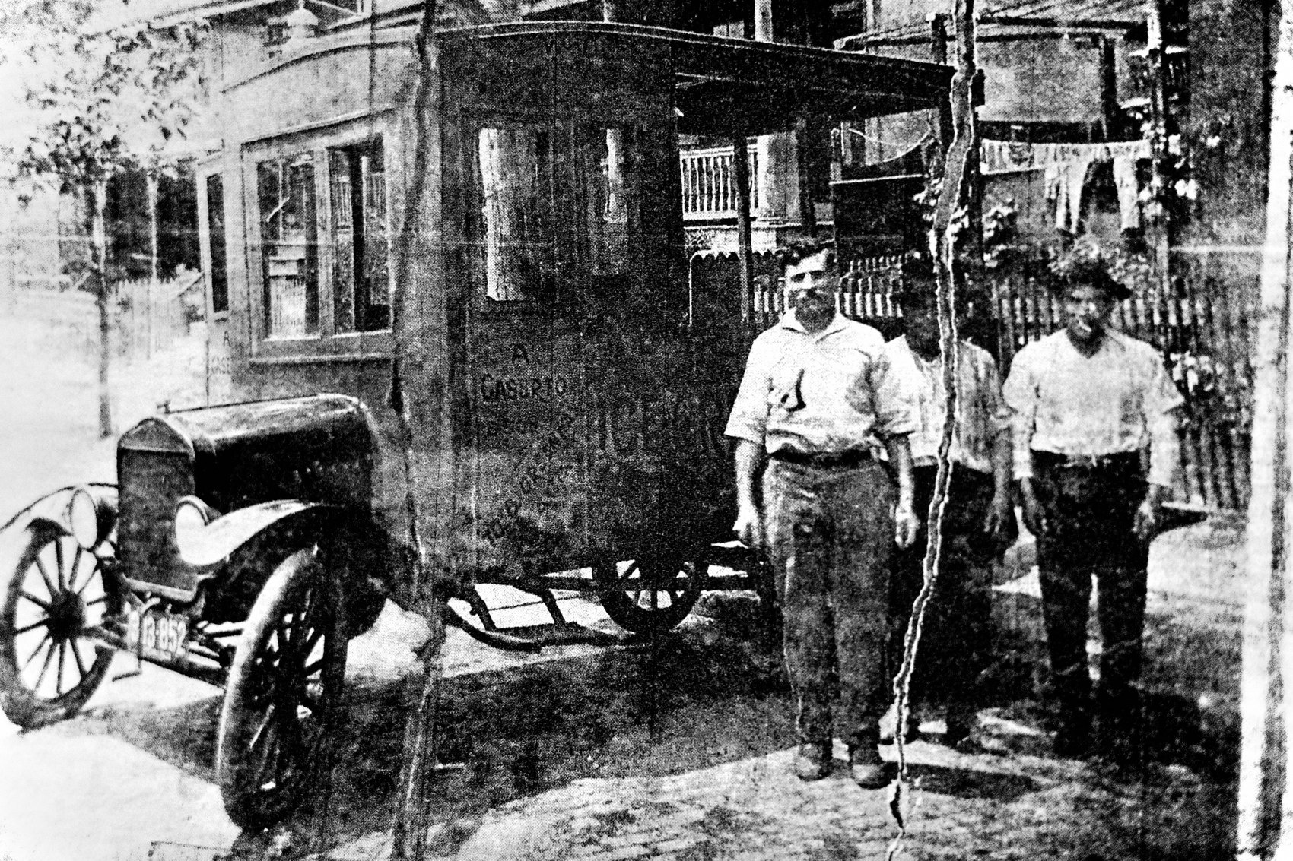
FLUX ACADEMY
BEAT 17 · PRACTICAL APPLICATION
The Hands-Only Walk
— One walk, photograph only hands
— Train the eye onto a single trigger
— Notice how much more you see
Notes:
Here's a drill. Go out for one walk and photograph only hands. Hands holding, reaching, gesturing, resting. Restricting yourself to a single trigger trains your eye hard and fast — and you'll be shocked how much more of the street's energy you suddenly notice.

Slide 19
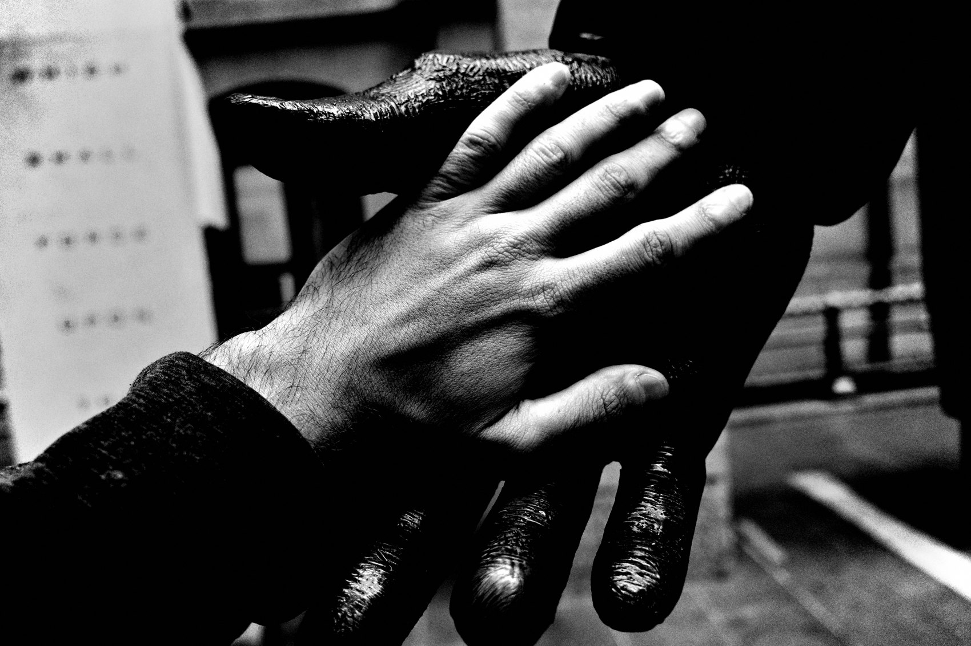
FLUX ACADEMY
BEAT 18 · PRACTICAL APPLICATION
Work One Scene
— Pick a spot with movement
— Stay, watch the rhythm, anticipate
— Let the gestures repeat into a photo
Notes:
Second drill: pick one spot where bodies are moving and stay. Watch the rhythm. Notice how feet shuffle, how hands repeat. Anticipate the gesture before it lands, and let the scene give you the photo. Don't leave until the scene leaves you.

Slide 20
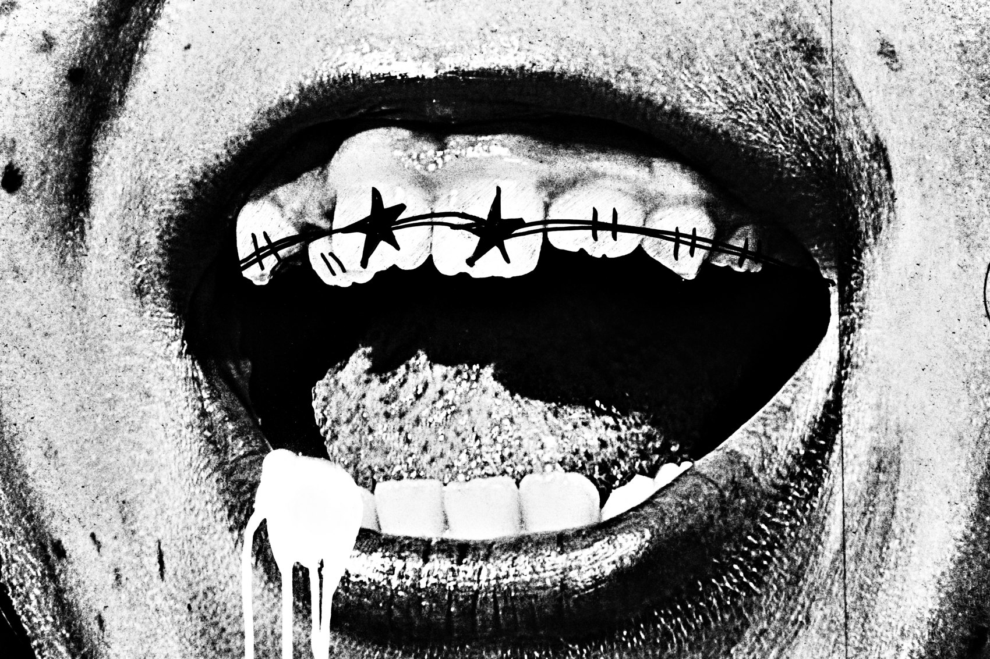
FLUX ACADEMY
BEAT 19 · PRACTICAL APPLICATION
Posture Check
— Reset: head up, shoulders back
— Loose grip, shoulders turned
— Presence first, then the shot
Notes:
Third, run a posture check before you shoot. Head up, shoulders back, chest open, grip loose, shoulders turned slightly off your subject. Get your own body language right first — relaxed and confident — and the candid gestures around you stay relaxed too.

Slide 21
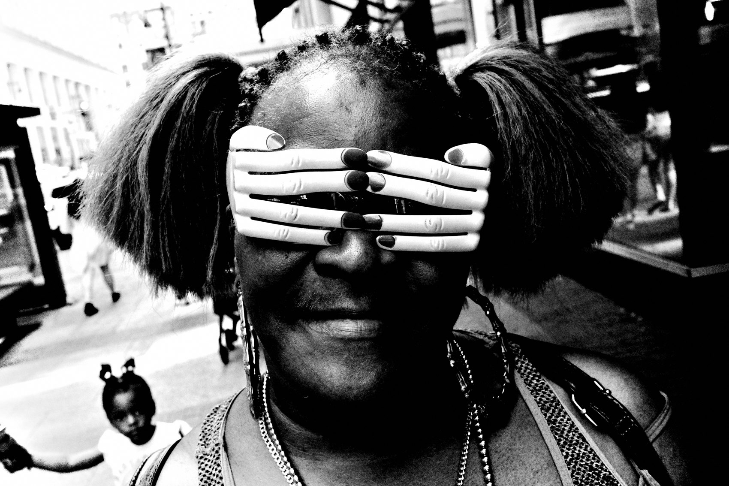
FLUX ACADEMY
BEAT 20 · COMMON MISTAKES
Stiff, Obvious, Head-On
— Slouching or freezing up
— Facing subjects dead-on, locking eyes
— Hesitating until the gesture is gone
Notes:
Now the mistakes. The slouch, the freeze, the dead-on stare — all of it telegraphs you and kills the candid moment. Hesitate and the gesture is gone; the hands drop, the leap lands, the rhythm breaks. Tension in your body becomes tension in the frame.

Slide 22
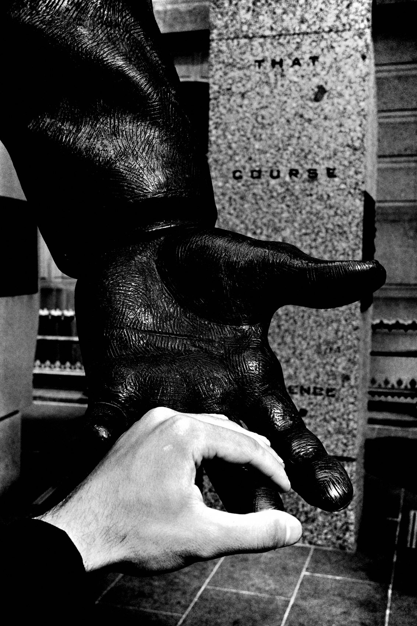
FLUX ACADEMY
BEAT 21 · RELATIONSHIP TO PREVIOUS
From Empty Space to Human Energy
— Lesson 018 stripped the frame down
— Now we fill it with gesture
— Simplicity plus a decisive body
Notes:
This builds straight on Lesson 018, Simplicity, Abstraction & Negative Space. There we stripped the frame down to the essentials so emotion could shine — and as I've said, even a single hand gesture can carry that clean frame. Now we put the human energy into that simplicity: the decisive body inside the negative space.

Slide 23
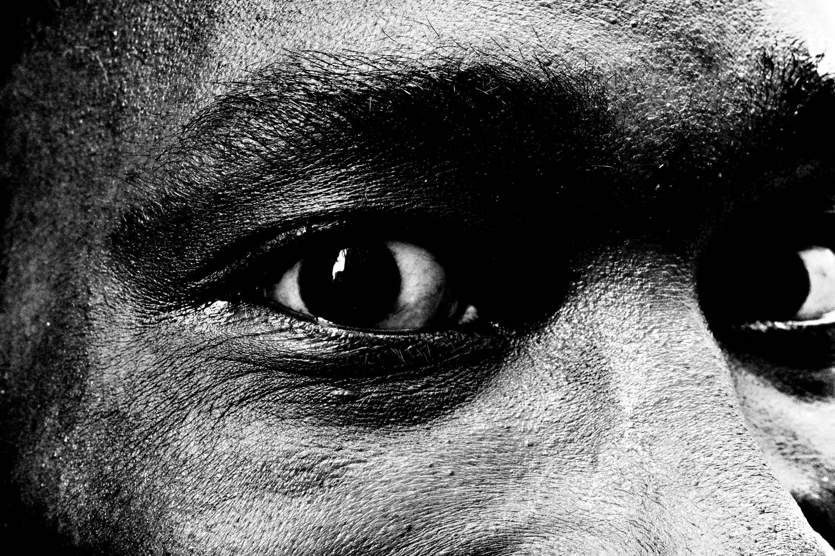
FLUX ACADEMY
BEAT 22 · RELATIONSHIP TO UPCOMING
Toward Breaking the Rules
— Next: Breaking the Rules (Lesson 020)
— Gesture trains instinct over formula
— Trust the body, then bend the rules
Notes:
Next up is Lesson 020, Breaking the Rules. Everything we did today is instinct over formula — responding to a body in a split second, not following a grid. That trained instinct is exactly what lets you break composition rules with intention. Master the gesture, then learn when to break the frame.

Slide 24
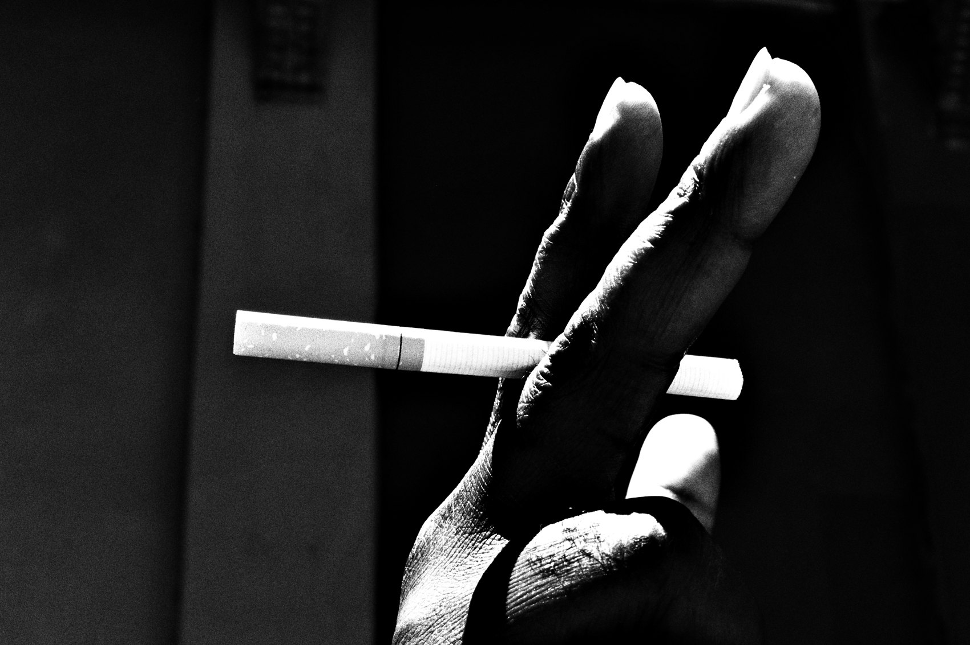
FLUX ACADEMY
BEAT 23 · SUMMARY / TAKEAWAY
Watch Hands, Stay Present
— Gesture is the simplest, strongest anchor
— Carry yourself open, loose, confident
— See it, don't think, shoot
Notes:
Last thing. Gesture — hands, movement, the way bodies answer each other — is the simplest thing to look for and one of the most powerful. Stay open, loose, and confident in your own body, get present, and when the moment comes, don't think — shoot. Watch the hands, feel the rhythm, and the street gives you everything. Catch you next lesson.

