Slide 1
FLUX ACADEMY · A SCHOOL FOR SEEING
MODULE 4 · COMPOSITION
Composition Is Physical
BY DANTE SISOFO

Slide 2
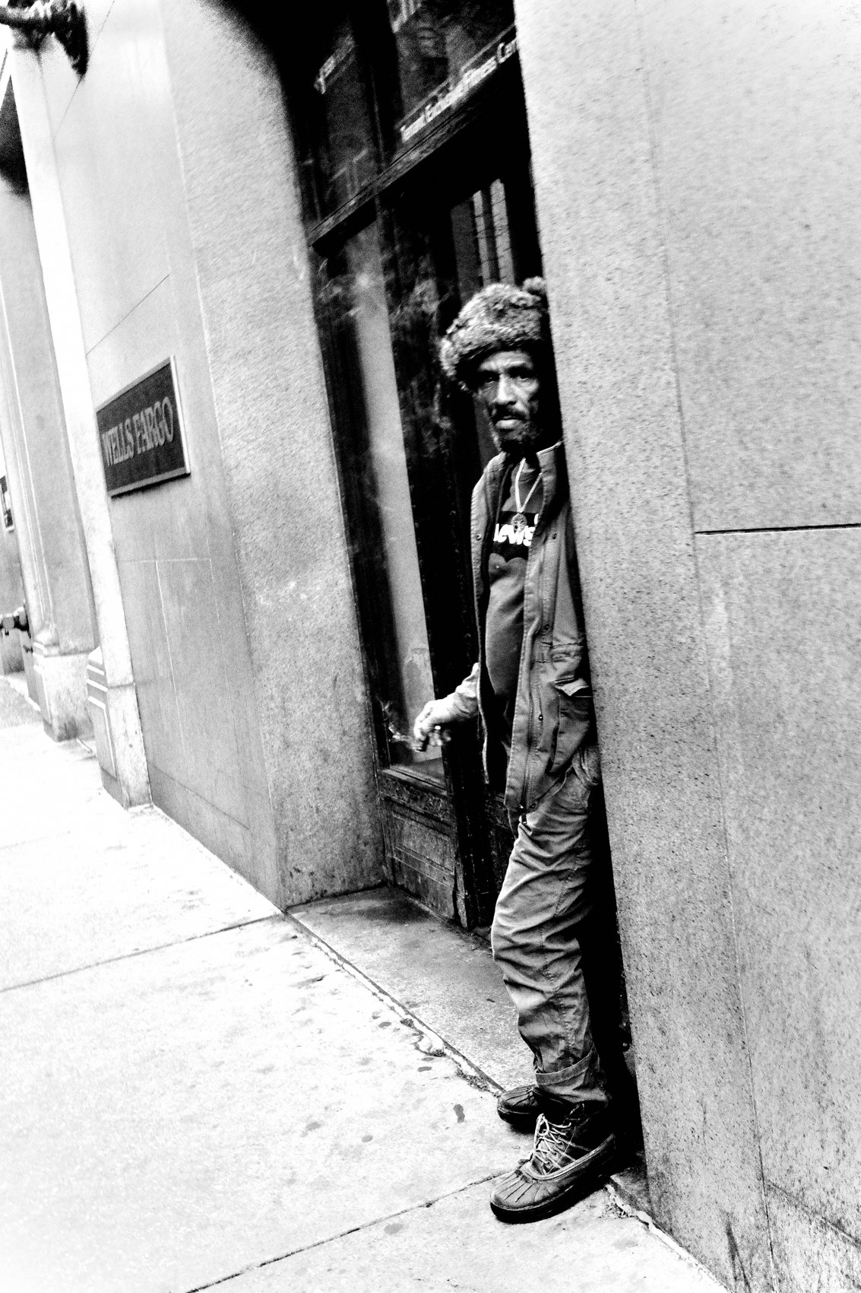
FLUX ACADEMY
BEAT 01 · CORE IDEA
Composition Is Physical
— Composition isn't an abstract idea
— It's your body, in space, in time
— You compose with your legs, not theory
Notes:
What's popping, people — it's Dante, out walking and thinking about composition. And here's the thought that hits me hard: composition is physical. It's not some academic thing you do in your head. It's real, lived practice — you out in the world, using your whole body to see.

Slide 3
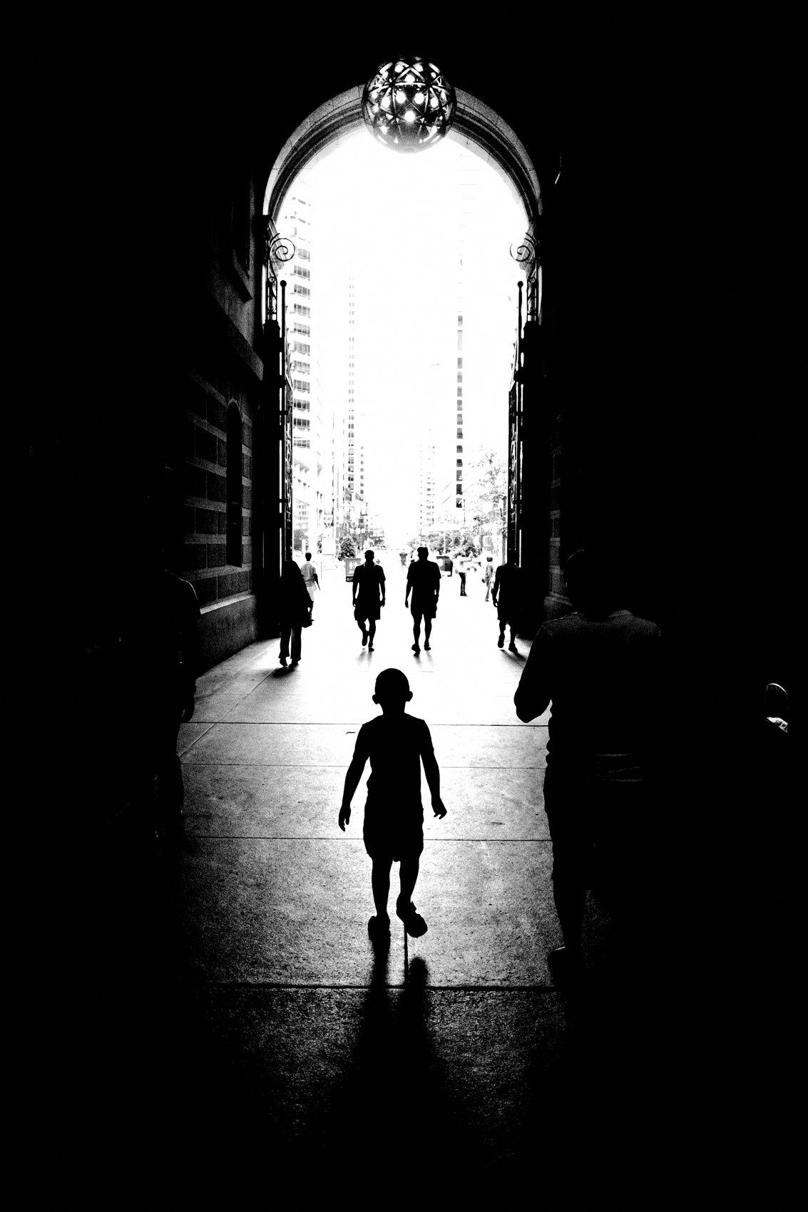
FLUX ACADEMY
BEAT 02 · LEARNING OBJECTIVE
What You'll Walk Away With
— Compose by moving your body
— Read foreground, middle ground, background
— Trust the gut over the rulebook
Notes:
By the end of this lesson you'll stop thinking of composition as a checklist and start feeling it. You'll learn to move — drop low, step left, raise the camera — to separate your layers and find the sweet spot. The goal is simple: compose with your body and your instinct, not a diagram.

Slide 4
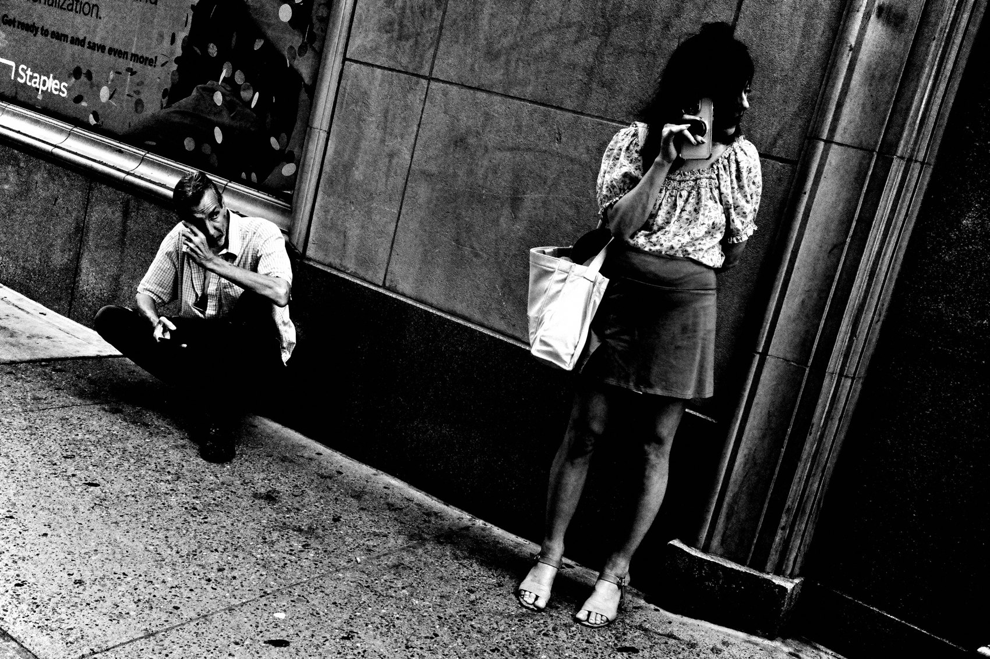
FLUX ACADEMY
BEAT 03 · WHY THIS MATTERS
Order Out of Chaos
— The street is fast and chaotic
— Our job: put order to the chaos
— Form turns a moment into a photo
Notes:
Here's why this matters. Out there, things are happening fast — chaos everywhere. Our whole job as photographers is to put order to that chaos. The content might be electric — a gesture, a glance — but without form it falls flat. Composition is how you take the mess of life and make it read.

Slide 5
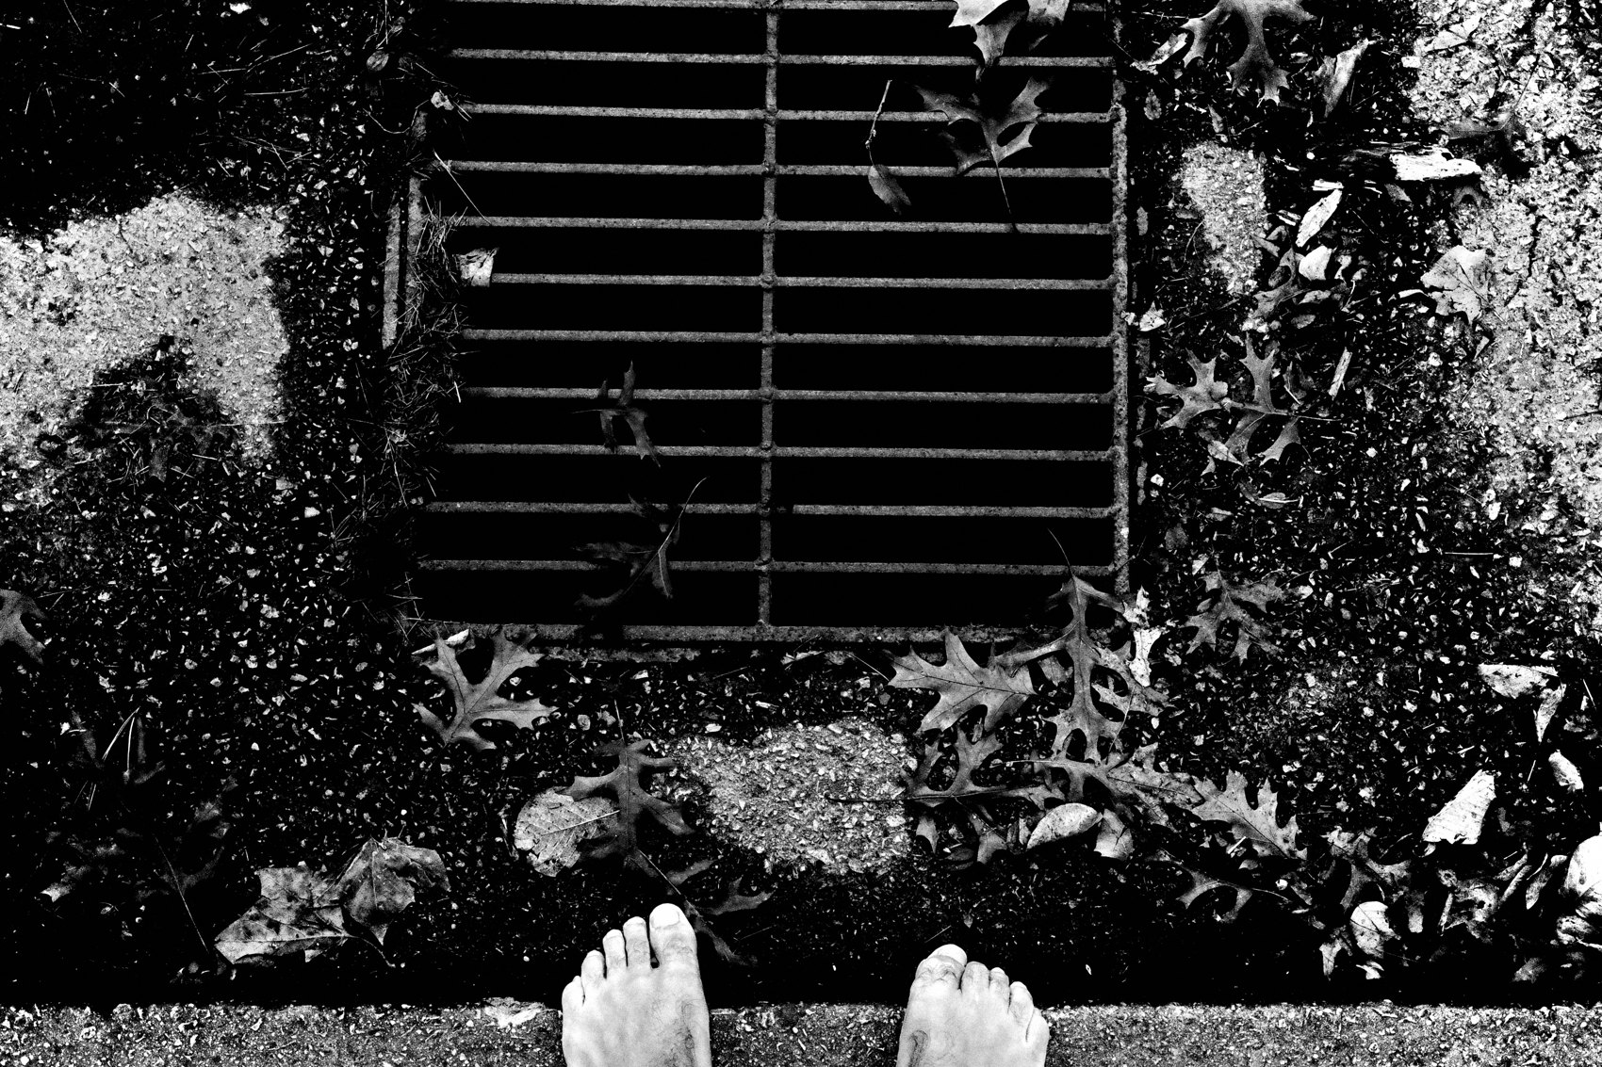
FLUX ACADEMY
BEAT 04 · WHY THIS MATTERS
Theory Won't Save You
— You can't think your way to a photo
— Diagrams are fluff until you walk
— Praxis beats philosophy
Notes:
And here's the stakes: you can read every tip, watch every video, study every diagram — and it's all just fluff until you get out and move your damn body. Philosophy is one thing; praxis is another. The photograph doesn't come from logic. It comes from being there, physically, responding to life.

Slide 6
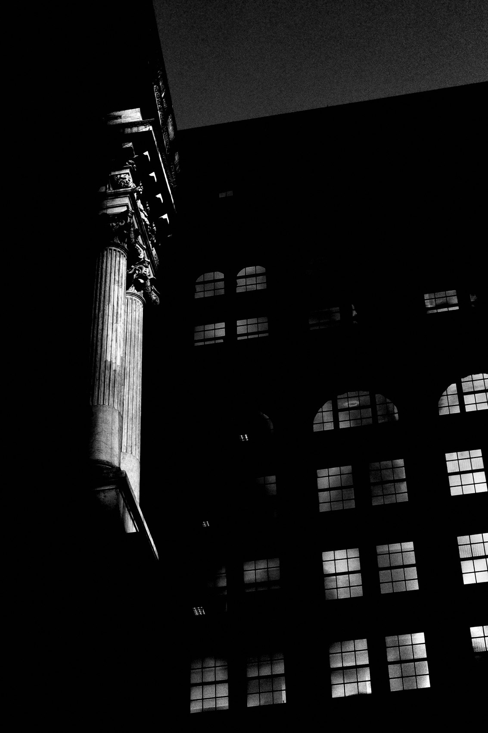
FLUX ACADEMY
BEAT 05 · MAIN TEACHING
Com = Together, Position = To Place
— The word means "to place together"
— You place yourself against the scene
— Subject, background, light, moment
Notes:
Let's go to the root of the word. Com means together, position means to place — composition is literally placing things together. And on the street, the thing you're placing is you. You're constantly positioning your body in relationship to the subject, the background, the light, the moment. That's the whole game.

Slide 7
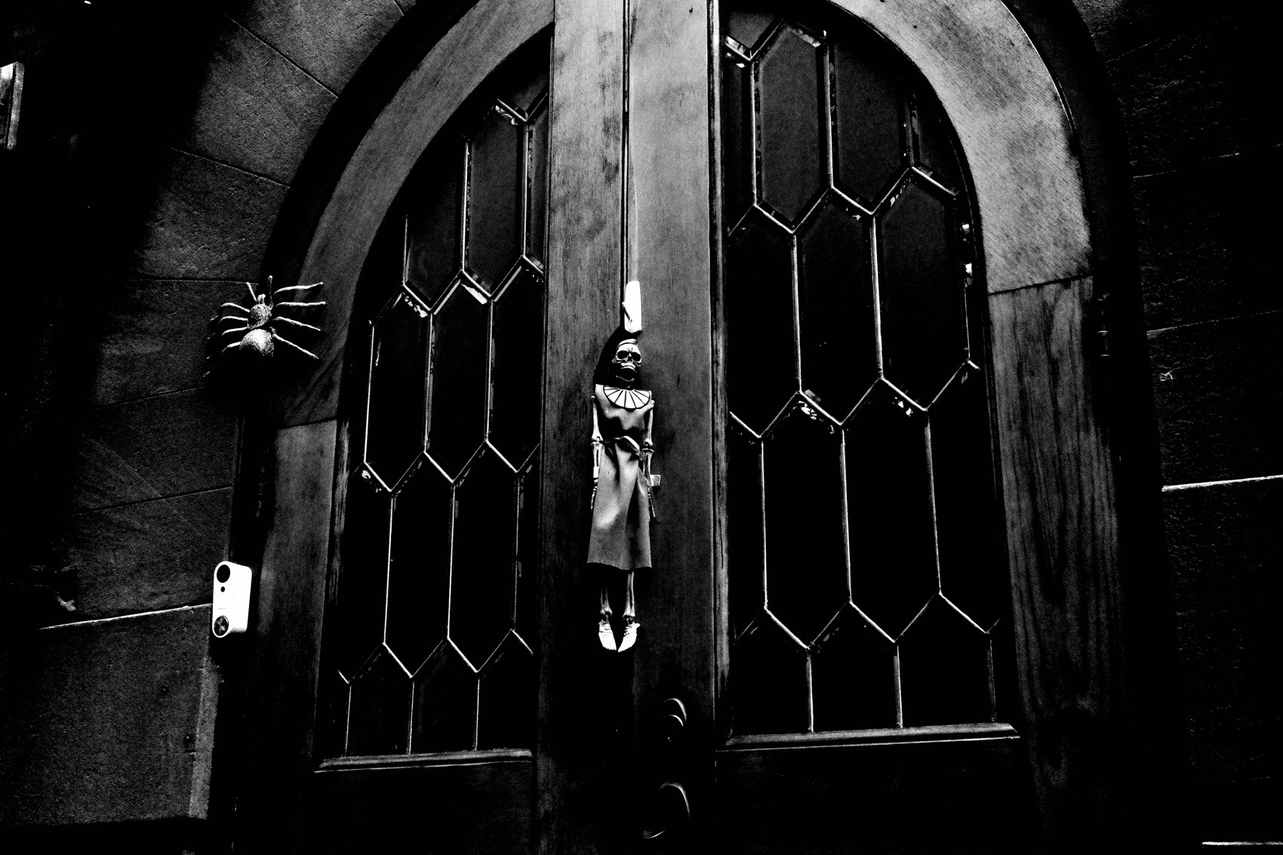
FLUX ACADEMY
BEAT 06 · MAIN TEACHING
You See With Your Body
— Not a brush, not a pencil — your feet
— Drop low, step left, slide right, raise up
— It's a dance, not a calculation
Notes:
Painters sit back with a brush. You don't. You're working in embodied, physical reality — and you see with your body. Drop low. Step left. Slide right. Raise your arm. Wait for the subject to enter the frame. The whole thing is a dance. You scan with your eye and you respond with your body.

Slide 8
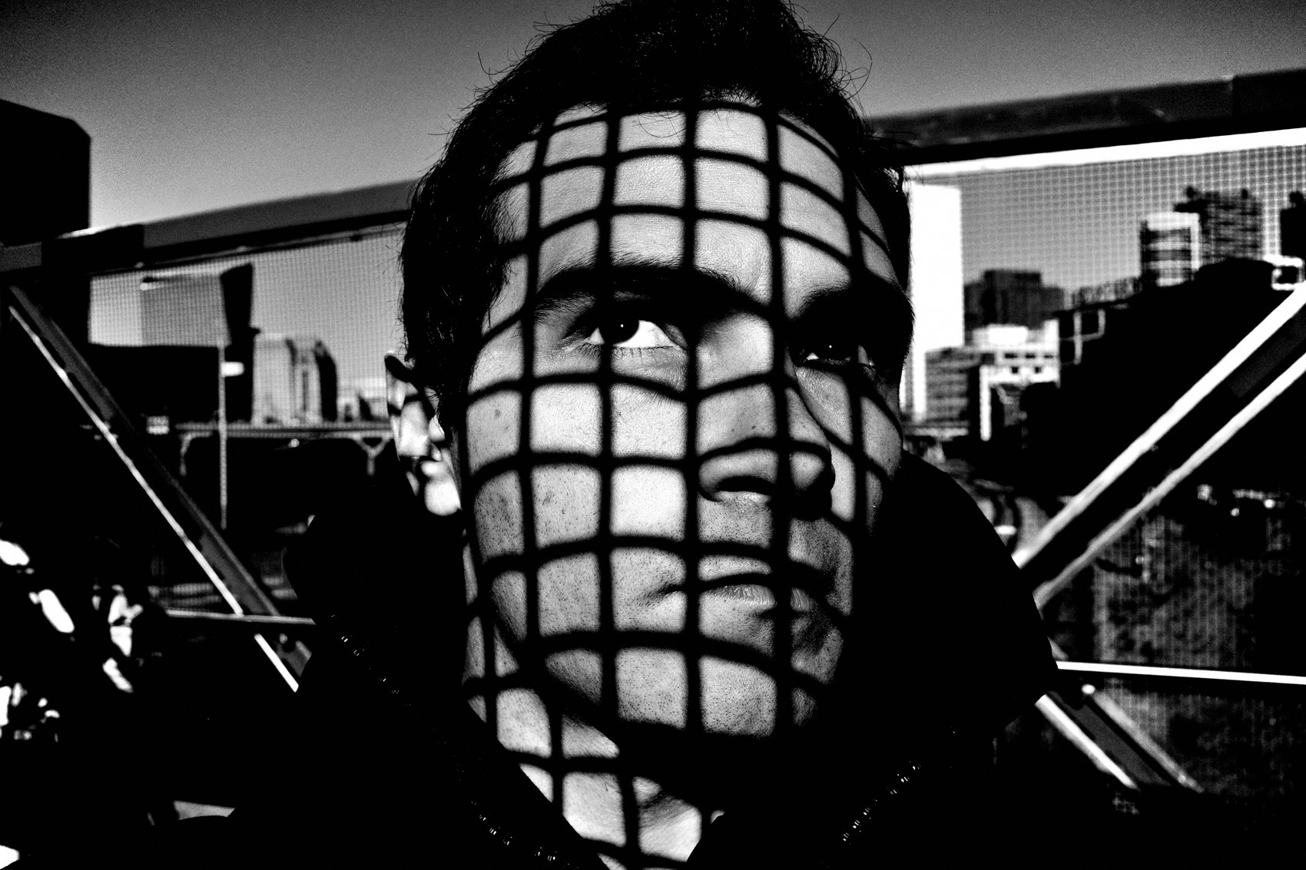
FLUX ACADEMY
BEAT 07 · MAIN TEACHING
Instinct, Not Intellect
— You're not hunting vanishing points
— The shutter press comes from the gut
— Two eyes open, camera down
Notes:
When I'm shooting I'm not in my head going, "hmm, where's my vanishing point?" I'm reacting to the world. The moment you press the shutter derives from your gut. Don't walk around with the camera glued to your eye — use your two eyes, read life directly, and let instinct pull the trigger.

Slide 9
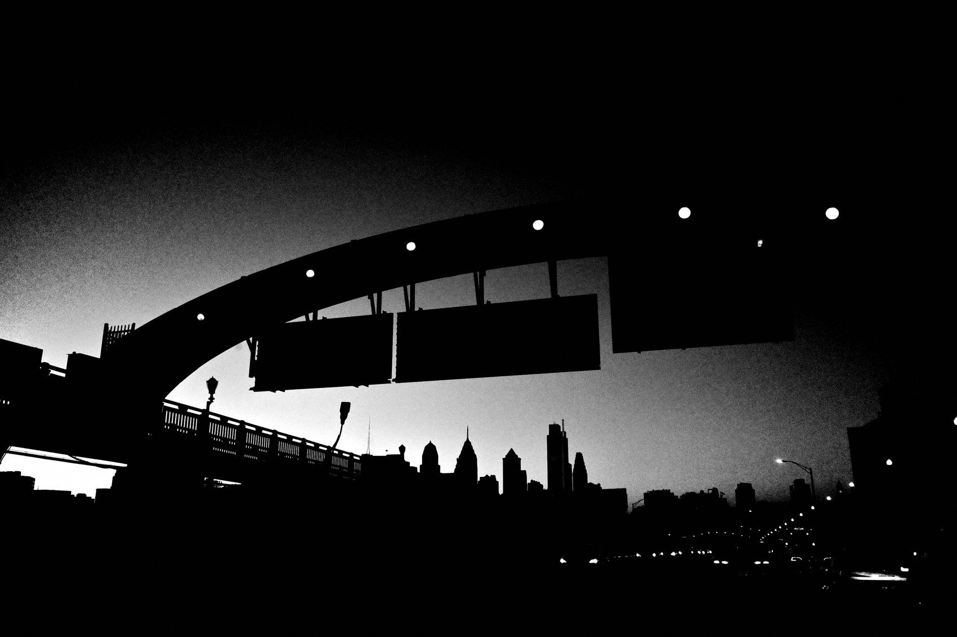
FLUX ACADEMY
BEAT 08 · MAIN TEACHING
Layering Is the Natural Outcome
— Layering isn't a trick — it's positioning
— Foreground, middle ground, background
— Don't force complexity; feel simplicity
Notes:
People overcomplicate layering. To me it's just the natural outcome of putting your body in the right spot to see foreground, middle ground, and background. You don't force complexity — you feel the simplicity. Position yourself well and the layers fall into place on their own. That's all layering really is.

Slide 10
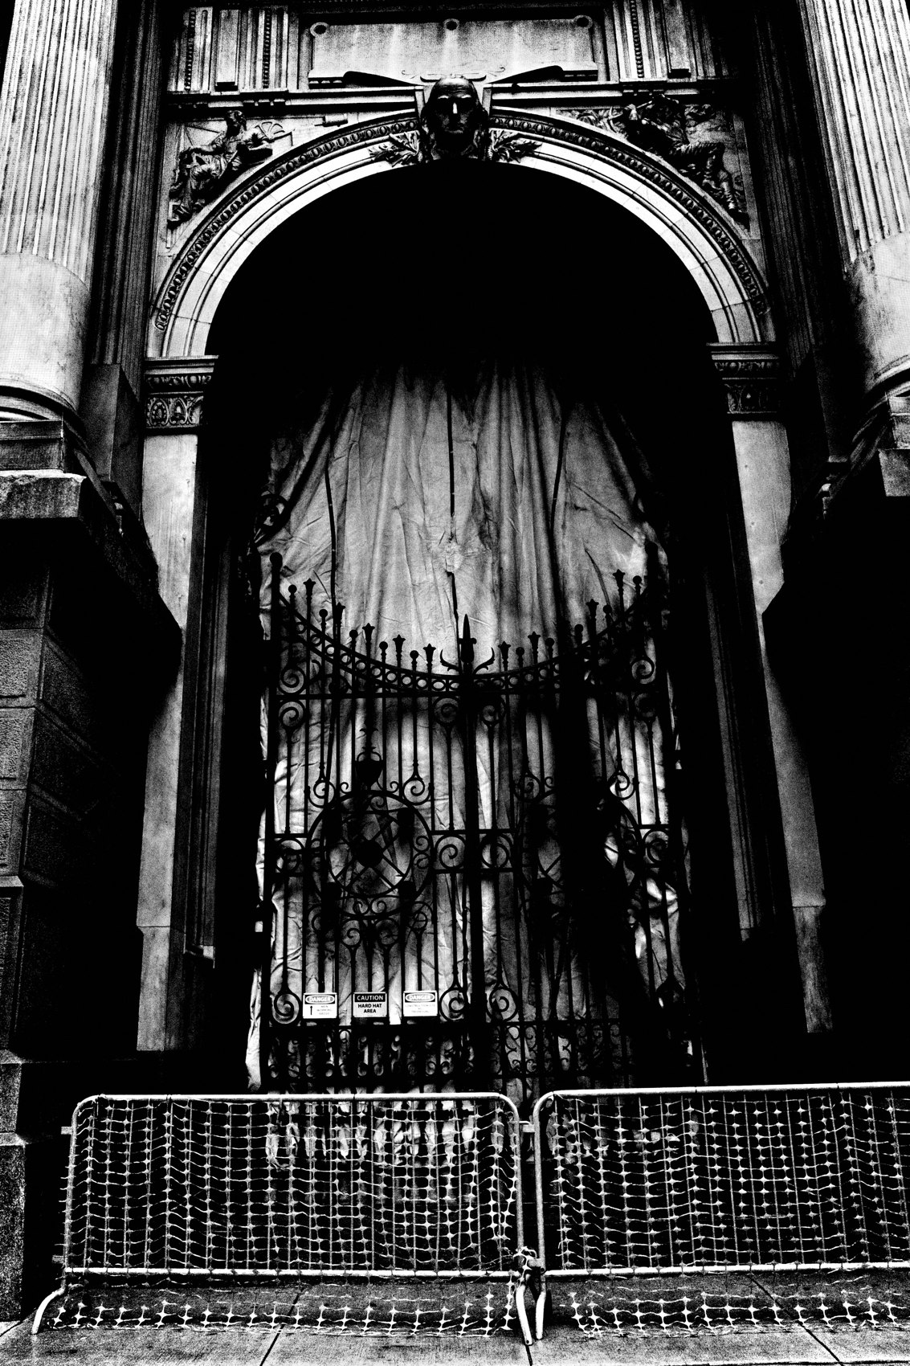
FLUX ACADEMY
BEAT 09 · MAIN TEACHING
Separating the Planes With Your Body
— Three planes: near, middle, far
— Eye level flattens them into one wash
— Raise or drop to pop the silhouettes
Notes:
Picture any scene with three planes — someone near, something in the middle distance, a backdrop behind. Shot flat from eye level, it all melts together into one busy wash. But drop low or raise the camera and you separate those layers, outline the shapes against a cleaner background, and make the scene read. That is composition — the same three elements, locked apart by where you put your body.

Slide 11
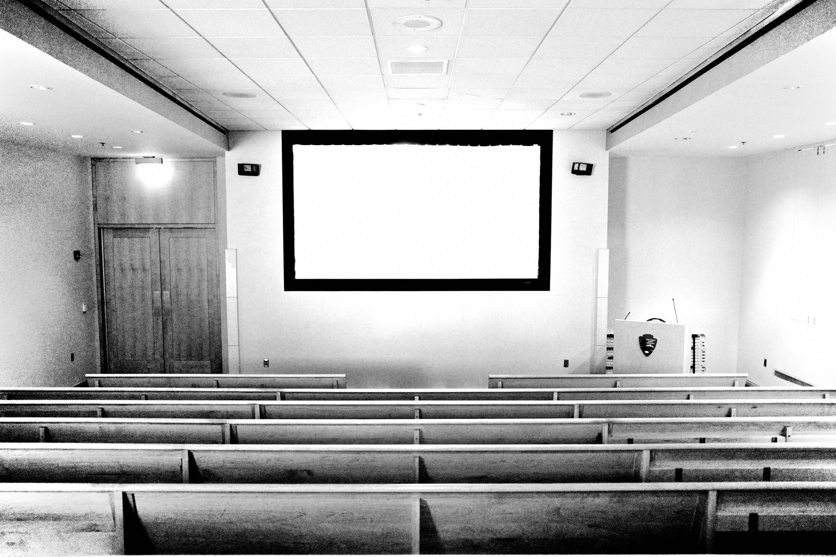
FLUX ACADEMY
BEAT 10 · MAIN TEACHING
Every Scene Has a Sweet Spot
— The sweet spot is always there
— It's rarely obvious
— You find it by practice, not theory
Notes:
Every scene has a sweet spot. It's not always obvious, but it's there, waiting for you to find it — not through theory, not through overthinking, but through practice. Over a decade of shooting rain or shine, I've built a rhythm where I can drop into any scene and feel that sweet spot, almost without thinking.

Slide 12

FLUX ACADEMY
BEAT 11 · MAIN TEACHING
A Visual Puzzle You Solve With Your Body
— Foreground, subject, background float free
— You lock them in — not in Photoshop
— With your legs, eyes, gut, timing
Notes:
Look at the world like a puzzle. Each piece — foreground, subject, background — is floating around, waiting to be locked into place. And you're the one who locks it in. Not with Photoshop — with your legs, your eyes, your gut, your timing. You solve the visual problem by where you put your body.

Slide 13

FLUX ACADEMY
BEAT 12 · MAIN TEACHING
Bring the Draw Right Up to the Camera
— Find the thing that draws you in
— Get close, place it against the camera
— Closeness builds depth and locks the frame
Notes:
When a gesture pulls you in — a hand raised to a forehead, a glance, a shape — get close and place that element right up against the camera. Find what draws you in and position it as close as you can. With a strong foreground detail up front and the wider world laid out behind it, that closeness builds depth and locks the frame. Proximity is a composition tool, not just a distance.

Slide 14

FLUX ACADEMY
BEAT 13 · MAIN TEACHING
Get Low to Feel the Energy
— Drop to the subject's own level
— A near figure fills the foreground
— Low angle pulls the viewer in
Notes:
When there's energy in front of you — people moving, playing, alive in good light — get low, down to their level, to feel that energy from the inside instead of looking down on it. A figure moving toward you fills the foreground and pulls the viewer in. Foreground, middle ground, background — positioning your body in relationship to the scene is everything.

Slide 15
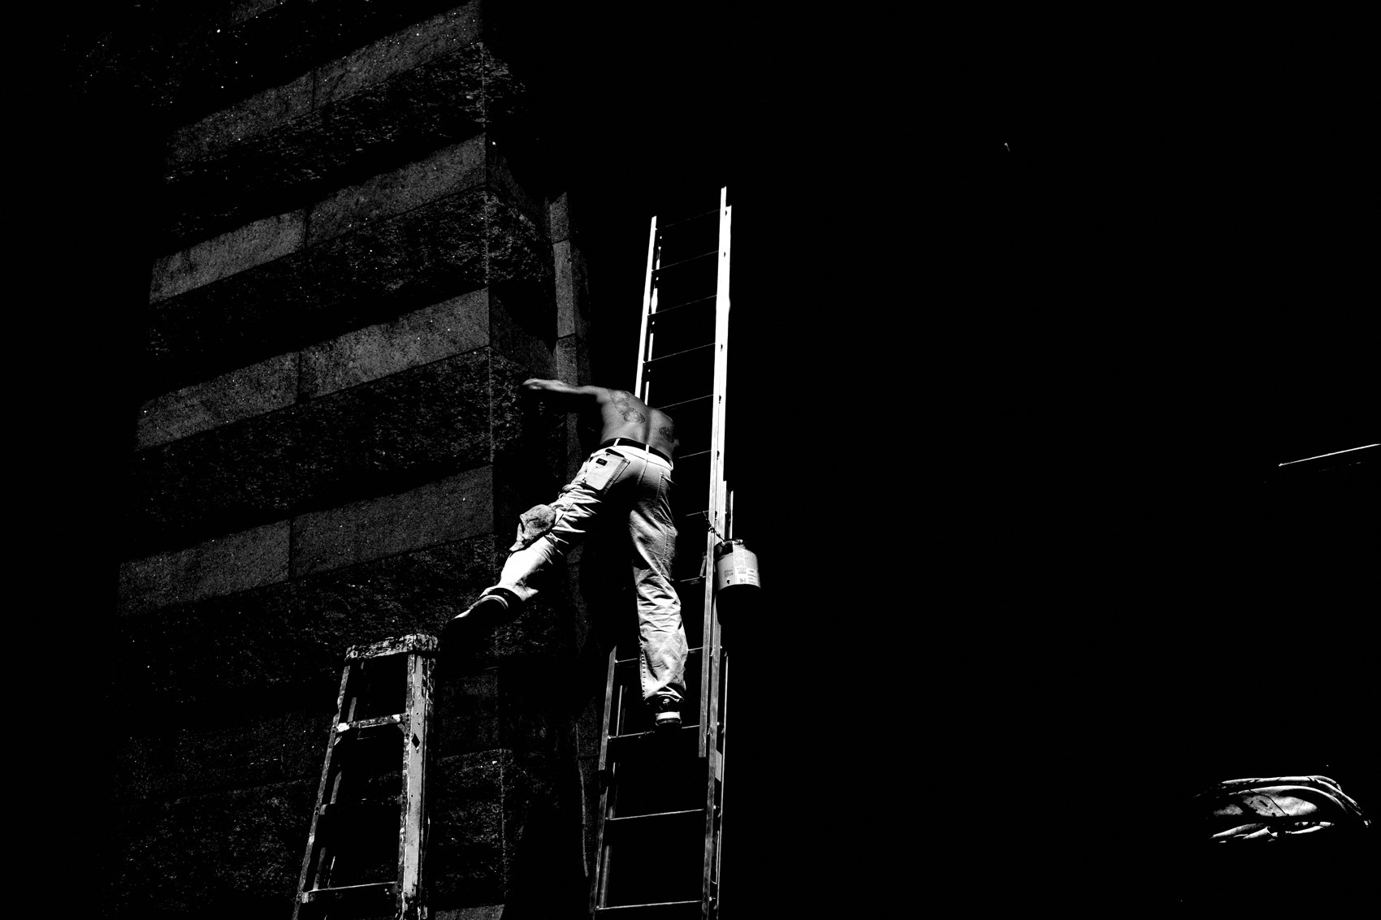
FLUX ACADEMY
BEAT 14 · MAIN TEACHING
Working Back to Front
— Sometimes set the stage, then wait
— A sign or shape anchors the frame first
— Wait for a subject to complete it
Notes:
There are two ways to work the puzzle: plug a foreground element in instinctually, or work back to front — set the stage and wait. Often a patch of light and shadow pulls you in, but it's a graphic anchor — a circular sign, a doorway, a strong shape off to one side — that locks the frame. That first decision dictates everything; you commit to it, then wait for someone to walk into the light, and press.

Slide 16
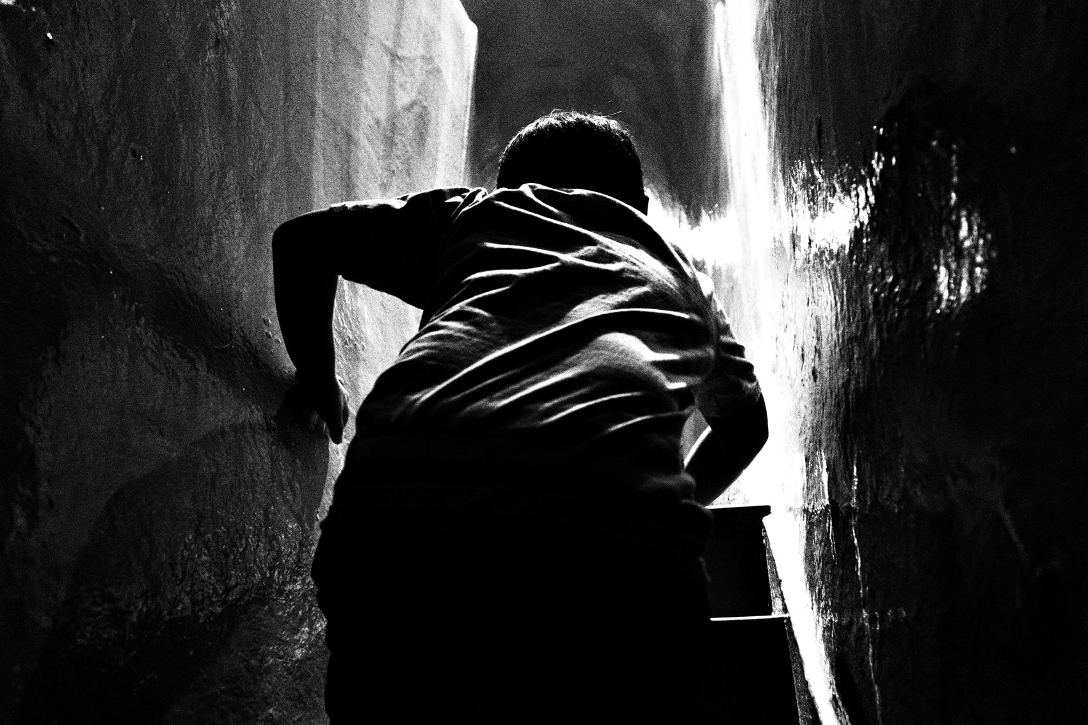
FLUX ACADEMY
BEAT 15 · MAIN TEACHING
Position and Perspective Decide Everything
— You own where your body stands
— A low angle clarifies form and gesture
— One step changes the whole picture
Notes:
Position and perspective determine the result of the photograph — and you are responsible for both. You decide where your physical body sits in relationship to the moment and the background. Dropping to a low angle can make form and gesture suddenly clear, can lift a subject off a busy background. One small move transforms a flat moment into an elevated frame.

Slide 17
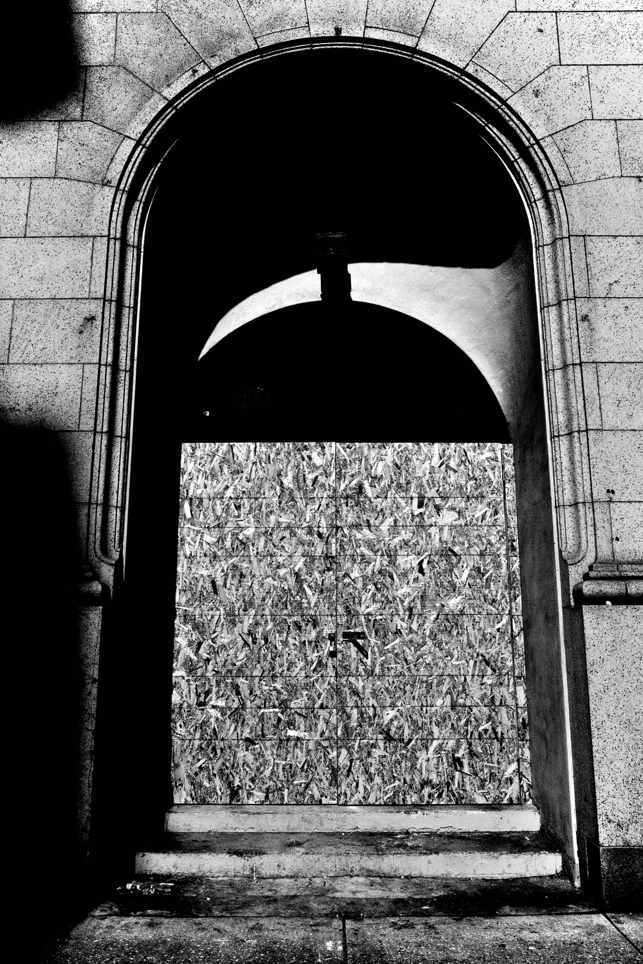
FLUX ACADEMY
BEAT 16 · MAIN TEACHING
Let Go of the Noise, Keep It Raw
— You don't need thirds or Fibonacci spirals
— The frame reflects your body and gut
— Let life bleed in — alive beats sterile
Notes:
Now let me free you from something. You don't need the rule of thirds, leading lines, Fibonacci spirals — any of that overhyped brain junk food. Use them intuitively if they help, never worship them. The photograph is just a reflection of your body in space and your gut in time. So don't sterilize it — get a little sloppy, let life bleed into the frame. The best compositions aren't clean and dead; they're alive.

Slide 18
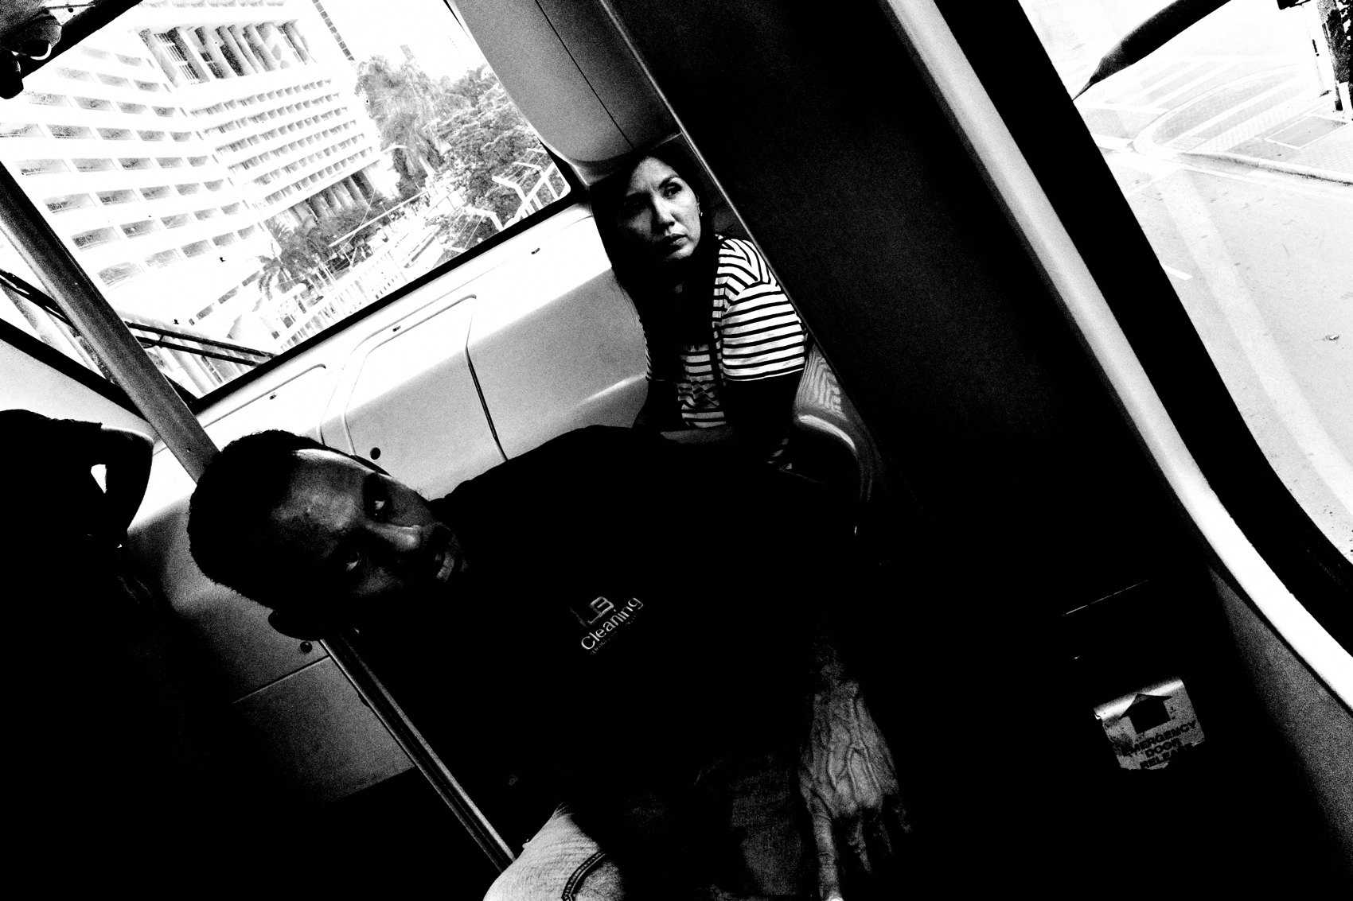
FLUX ACADEMY
BEAT 17 · PRACTICAL APPLICATION
The Two-Eyes Drill
— Walk with the camera down
— Read life with both eyes first
— Move your feet before you raise it
Notes:
Here's your drill. Tomorrow, walk with the camera down. Read the street with both eyes, not through the viewfinder. When something pulls you, move your feet first — drop, step, raise — find the position, then lift the camera. You'll be shocked how much faster and cleaner your compositions get when your body leads.

Slide 19
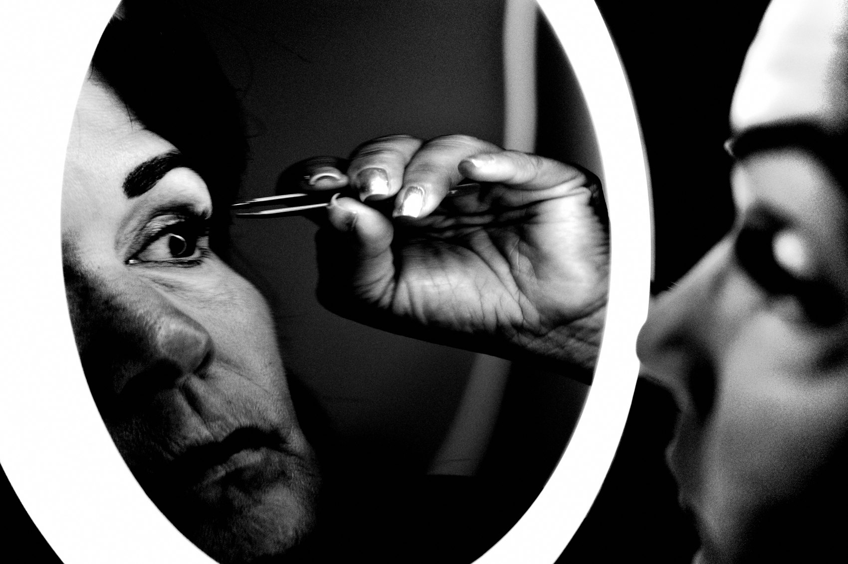
FLUX ACADEMY
BEAT 18 · PRACTICAL APPLICATION
Work One Sweet Spot
— Pick one scene, stay with it
— Shoot it from low, high, left, right
— Compare frames — feel the sweet spot
Notes:
Second drill: pick one scene and work it. Don't fire once and leave. Shoot it from low, from high, from the left, from the right. Then compare your frames and feel where it locked — where the layers separated and it finally read. That comparison is how you train your gut to find the sweet spot on instinct.

Slide 20

FLUX ACADEMY
BEAT 19 · COMMON MISTAKES
Shooting From Eye Level
— Eye level flattens everything together
— The subject melts into the background
— The fix is always: move your body
Notes:
The number-one mistake: shooting everything from eye level. A subject blends right into the background until you drop low and separate them against the sky. Eye level flattens your planes into mush. The fix is never a setting — it's your body. When a frame feels flat, move before you blame the scene.

Slide 21
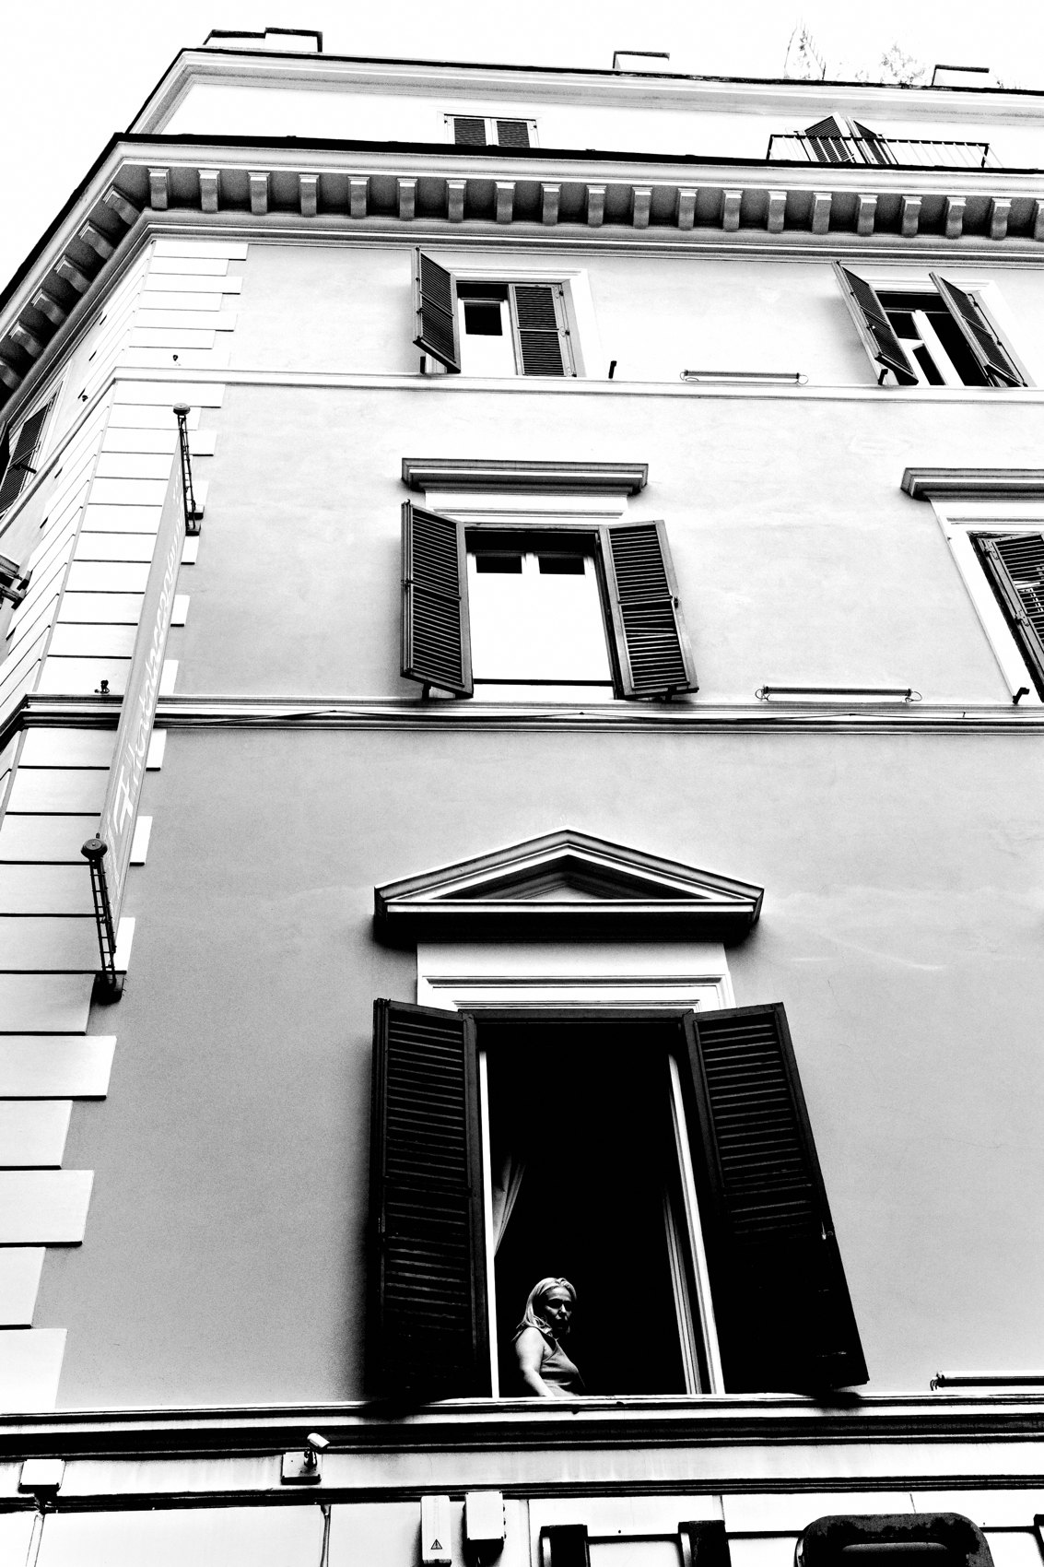
FLUX ACADEMY
BEAT 20 · COMMON MISTAKES
Composing in Your Head (or in the Crop)
— Don't overanalyze thirds and lines
— Don't "fix it later" by cropping
— Move your feet, compose in-camera
Notes:
Two more traps. First, freezing up overanalyzing thirds and vanishing points while the moment dies. Second, getting lazy and telling yourself you'll crop it later. Cropping is not composing. Move your feet, fill the frame in-camera, and let the decision come from your gut in the moment — not from your head, and not from the edit.

Slide 22

FLUX ACADEMY
BEAT 22 · RELATIONSHIP TO PREVIOUS
From Seeing to Placing
— Lesson 016 was about seeing the scene
— This lesson is about placing yourself in it
— Seeing finds it; the body locks it in
Notes:
This builds straight on Lesson 016, our first breakdown on seeing. There we trained the eye to spot the moment in the chaos. Now we take the next step: once you see it, you have to place yourself — move your body to lock those pieces together. Seeing finds the picture; the body composes it.

Slide 23

FLUX ACADEMY
BEAT 23 · RELATIONSHIP TO UPCOMING
Toward Simplicity
— Next: Simplicity, Abstraction & Negative Space (Lesson 018)
— Same physical instinct, stripped down
— Use the body to subtract, not just stack
Notes:
Next up is Lesson 018 — Simplicity, Abstraction & Negative Space. Same physical practice, pointed the other way: instead of stacking layers, we use light, shadow, and position to strip down to one clean subject. We carry the body-led instinct forward, but now we move to subtract. See you there — peace.

Slide 24

FLUX ACADEMY
BEAT 24 · SUMMARY / TAKEAWAY
Move. Trust. Click.
— Composition is physical, not theoretical
— Solve the puzzle with legs, eyes, gut, timing
— Don't overthink it — move your body, trust your gut
Notes:
Last thing. Composition isn't a textbook — it's physical. Every scene is a puzzle, and you lock the pieces in with your legs, your eyes, your gut, your timing. So don't overthink it. Move your body. Trust your gut. Photography is simple, composition is physical, and intuition is the trigger. Catch you next lesson — peace.

