Slide 1
FLUX ACADEMY · A SCHOOL FOR SEEING
MODULE 3 · LEARNING TO SEE
Be a Tourist at Home
BY DANTE SISOFO

Slide 2
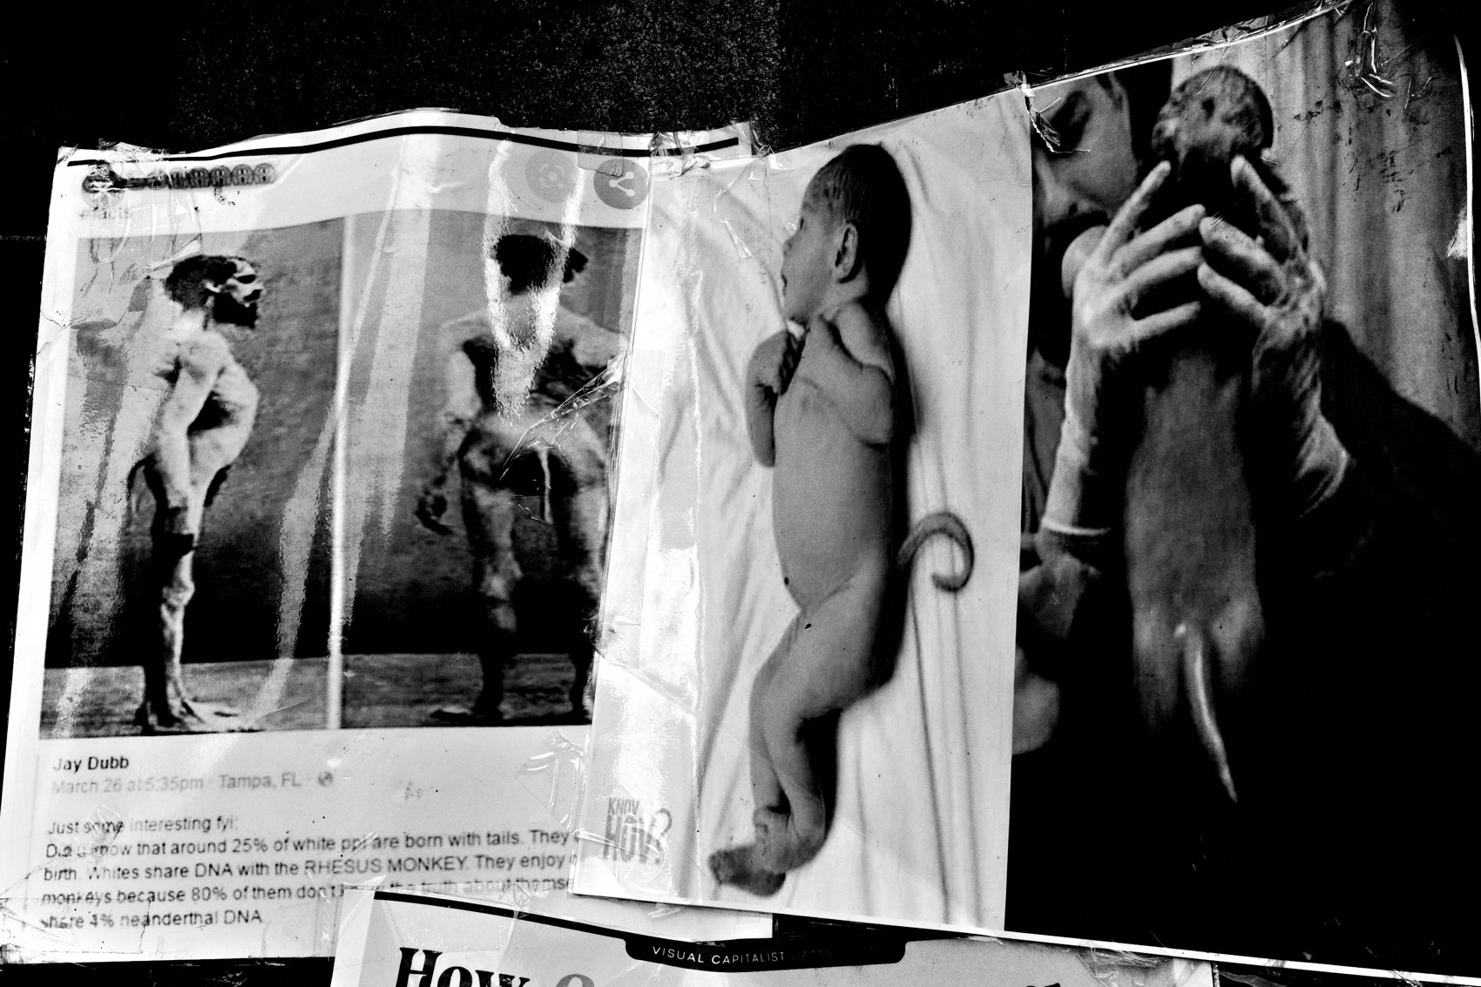
FLUX ACADEMY
BEAT 01 · CORE IDEA
Archive Where You're From
— Be the archivist of your own hometown
— The ordinary place is the assignment
— Tourist eyes, on streets you know
Notes:
What's popping, people — it's Dante. Today's idea is simple and it'll change how you walk out your front door: be the person who creates the archive of your hometown. You don't need to fly anywhere. The place you walk every single day is the assignment — you just have to start seeing it like a tourist.

Slide 3
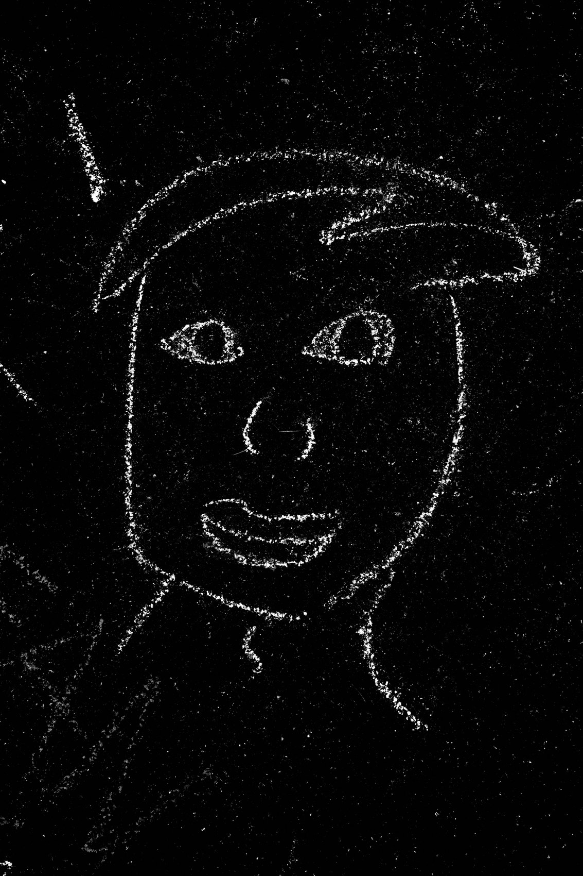
FLUX ACADEMY
BEAT 02 · LEARNING OBJECTIVE
What You'll Be Able To Do
— Shoot your home turf with fresh eyes
— Treat your camera as a tool of preservation
— Turn daily walks into an archive
Notes:
By the end of this lesson you'll know how to look at your own block like you've never seen it before — to treat the camera as a tool of preservation and turn your ordinary, everyday walks into something with real weight: an archive of where you're from.

Slide 4

FLUX ACADEMY
BEAT 03 · WHY THIS MATTERS
Familiarity Makes You Blind
— We stop seeing what we see daily
— Tourists notice what locals ignore
— Fresh eyes are a choice
Notes:
Here's the problem: the more familiar a place is, the more invisible it becomes. You stop seeing your own neighborhood. A tourist gets off the train and notices everything you walk past blind. This lesson is about reclaiming that wide-open tourist gaze — on home ground.

Slide 5
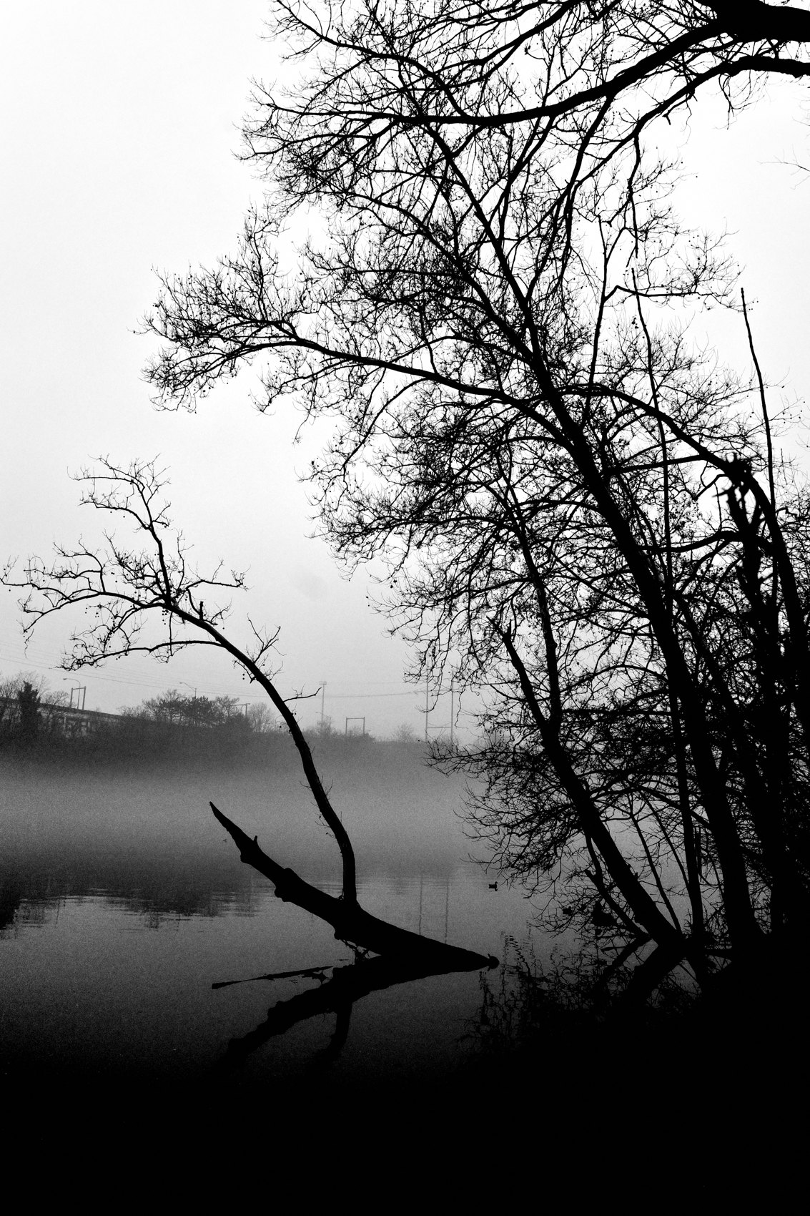
FLUX ACADEMY
BEAT 04 · WHY THIS MATTERS
It Gives Your Life Meaning
— It'll give your life more meaning
— A service for people to look back on
— Your town deserves a witness
Notes:
And why bother? Because, in Dante's words, it'll give your life more meaning — it'll provide a service for people to look back on in the future. Your town deserves a witness. Be that person. Whether anyone notices now doesn't matter; you're building something that outlasts the moment.

Slide 6
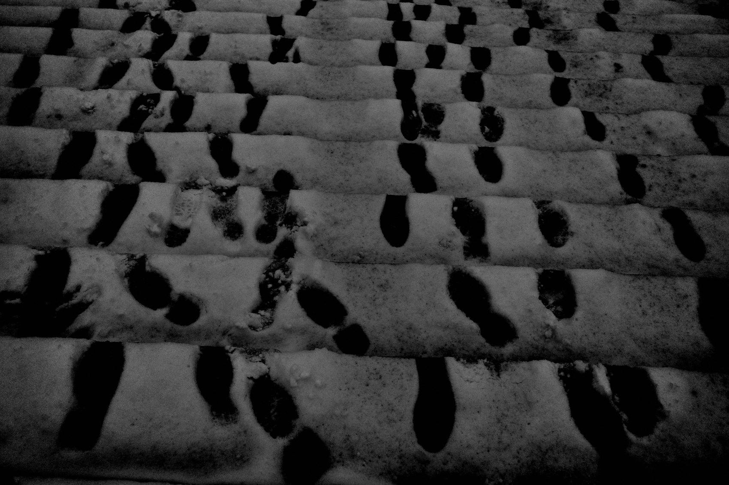
FLUX ACADEMY
BEAT 05 · MAIN TEACHING
Be the Archivist
— Be the person who archives where you're from
— City or rural — every place counts
— Take responsibility for the record
Notes:
So here's the heart of it: be the person who creates the archive of your hometown. Bustling city — Philadelphia, New York, Chicago, LA — or a small rural town, doesn't matter. Approach it as though you are responsible for archiving that part of the world. That responsibility changes everything.

Slide 7
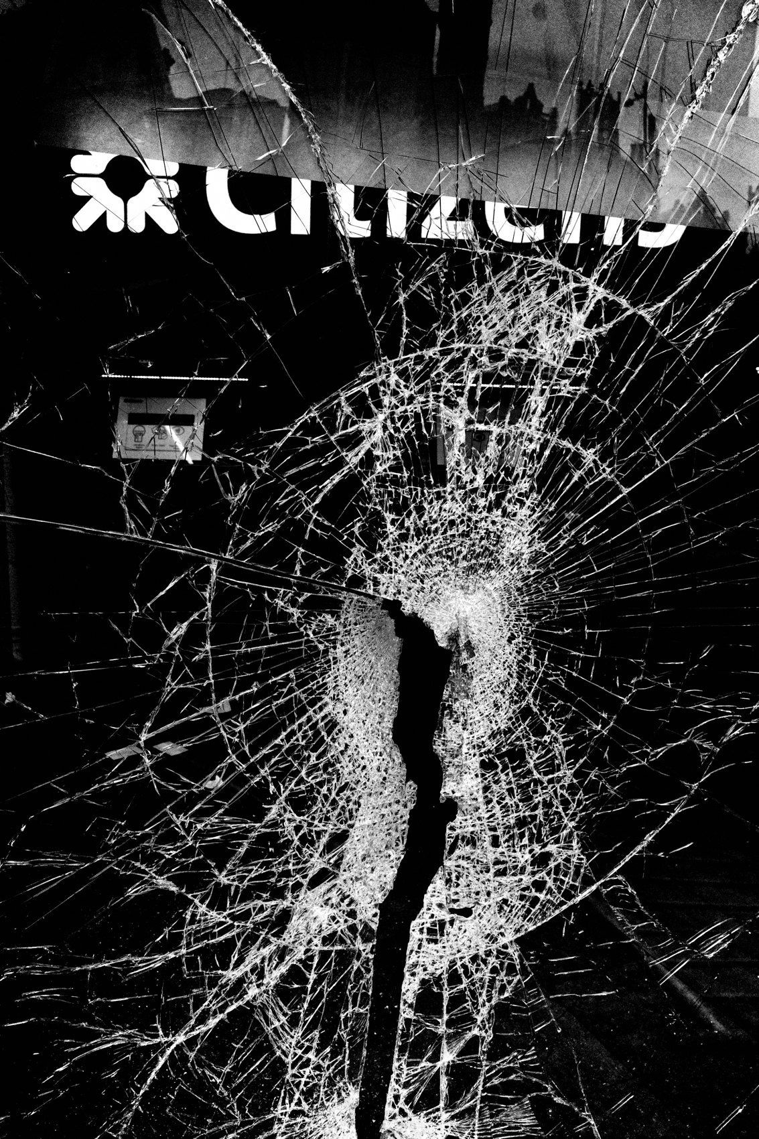
FLUX ACADEMY
BEAT 06 · MAIN TEACHING
Photograph Everything
— Sculptures, lampposts, benches, trees
— Rivers, architecture, construction sites
— Vehicles, people, fashion, fleeting moments
Notes:
What do you shoot? Everything. Sculptures, lampposts, benches, trees. Rivers, natural elements, architecture. Construction sites and new structures. Vehicles, buses, trains, planes. People, fashion, fleeting moments. When you're archiving, nothing is too small to document — it all belongs in the record.

Slide 8
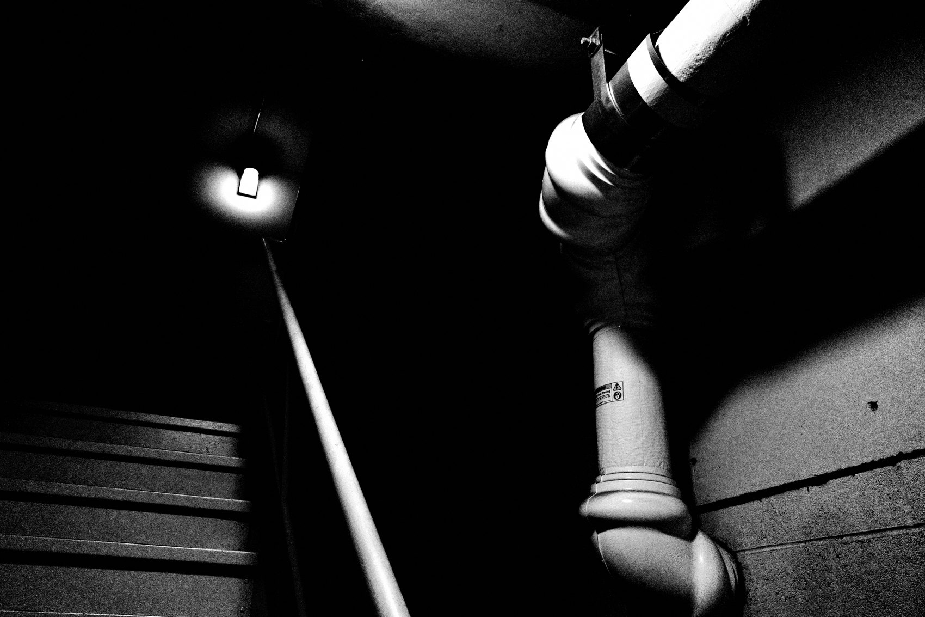
FLUX ACADEMY
BEAT 07 · MAIN TEACHING
Archiving Kills Decision Fatigue
— No more "what should I shoot?"
— The archive answers the question
— Just go out and photograph
Notes:
Here's the secret gift of this mindset: it eliminates decision fatigue. No more standing on a corner asking what should I photograph? When should I photograph? The archive already answered you. The answer is simple — just go out there and photograph. Over time you'll build something remarkable.

Slide 9

FLUX ACADEMY
BEAT 08 · MAIN TEACHING
The Mundane Becomes Endless
— Find beauty in the ordinary
— The mundane becomes endless fascination
— Don't wait for extraordinary moments
Notes:
When you walk with no preconceived notions, the mundane becomes a source of endless fascination. Don't wait for extraordinary moments — learn to find beauty in the ordinary. The bench you ignore, the lamppost you pass, the light on a parked bus: that's your material, and there's no end to it.

Slide 10
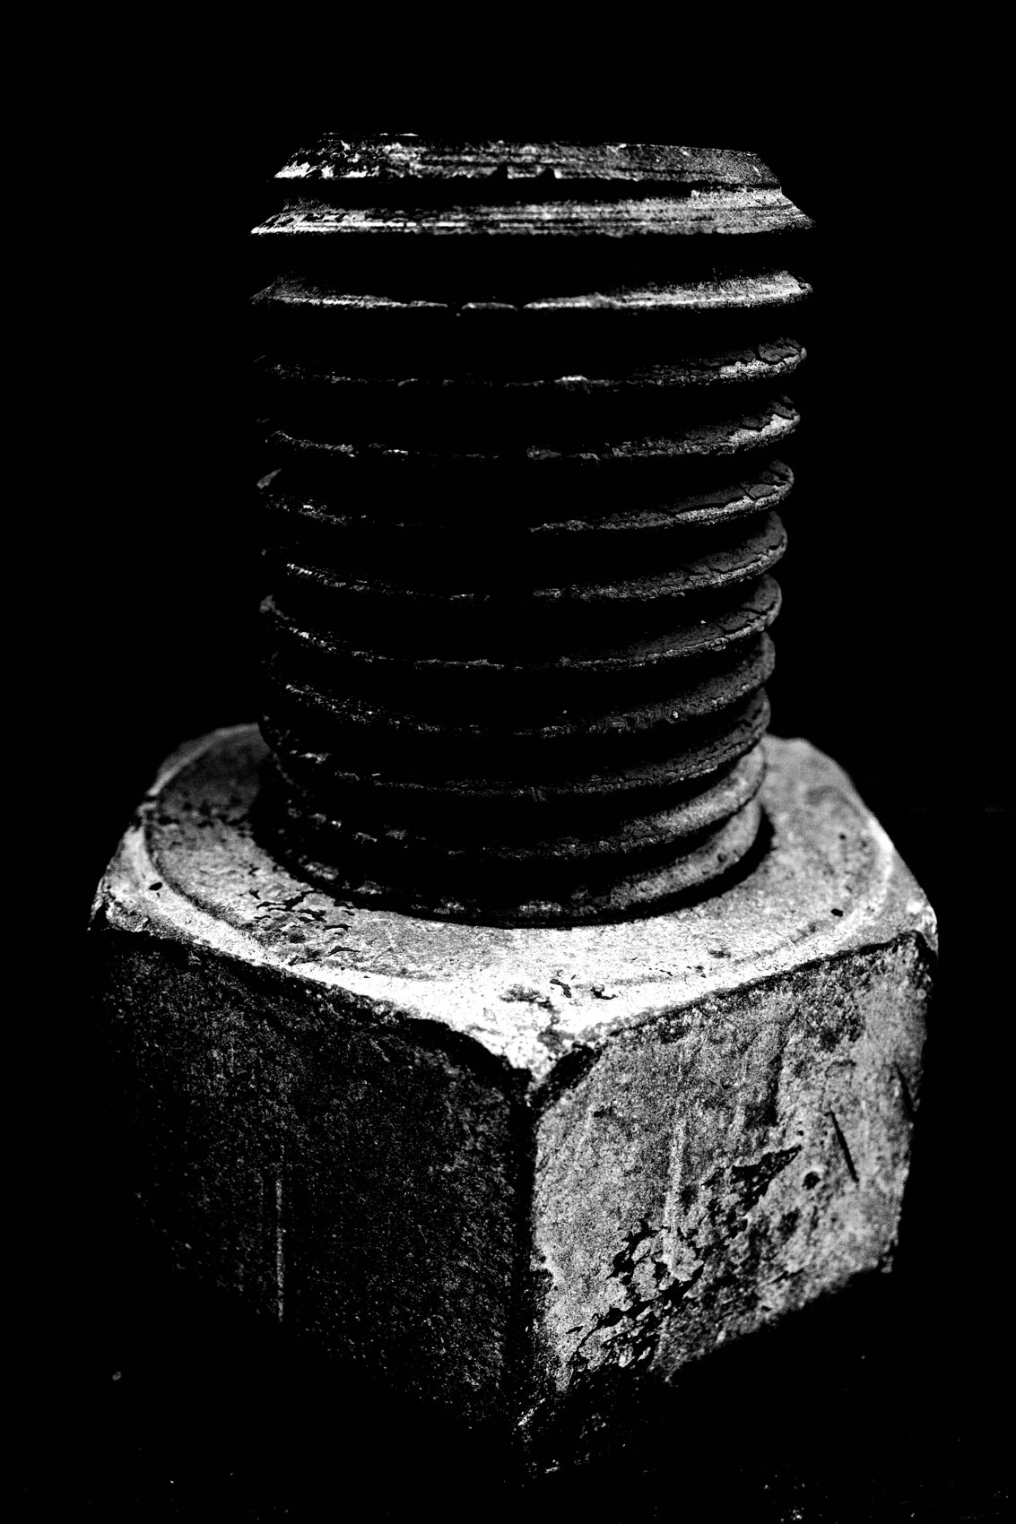
FLUX ACADEMY
BEAT 09 · MAIN TEACHING
Treat Your Camera as Preservation
— The camera is a tool of preservation
— You're saving this moment of your town
— Document it before it changes
Notes:
Reframe what the camera is. It's not a toy for impressive pictures — it's a tool of preservation. Cities change fast: that construction site becomes a tower, that storefront disappears. You are saving this version of your town before it's gone. That's a serious, beautiful job.

Slide 11

FLUX ACADEMY
BEAT 10 · MAIN TEACHING
Aim for the Archive, Not the Trophy
— Not a project, book, zine, or gallery
— The goal is the archive itself
— Who cares about fame or praise now?
Notes:
Notice what the goal is not. For Dante it's not to make a project, a book, a zine, or even a gallery — the goal is to create an archive. And: who cares if the photos gain fame or praise now? Drop the trophy-hunting. Build the record. The meaning is in the doing, not the applause.

Slide 12
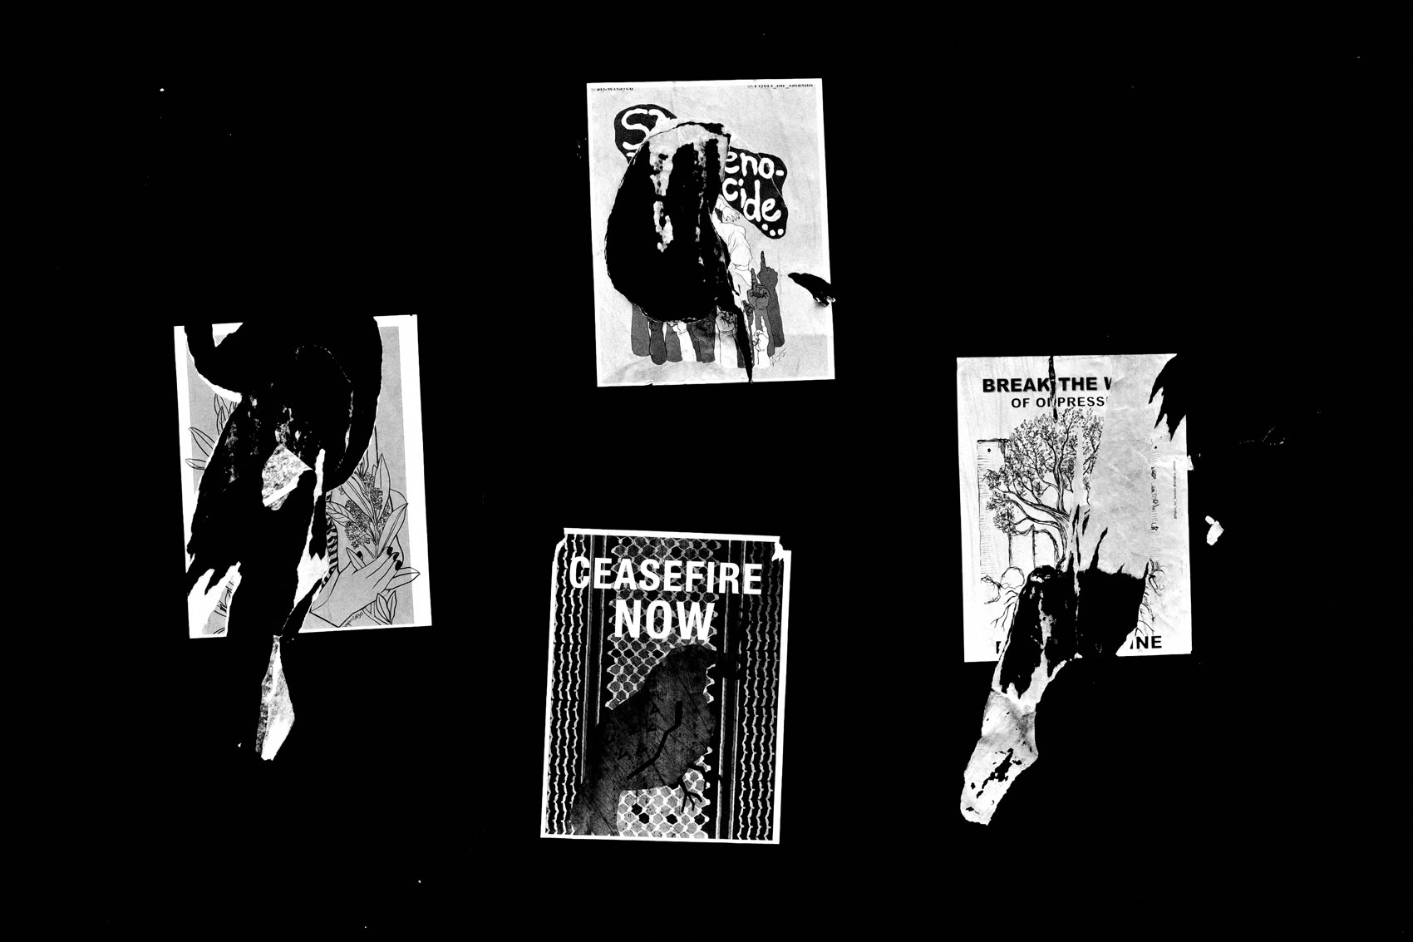
FLUX ACADEMY
BEAT 11 · MAIN TEACHING
Make It Audacious
— Pick a goal that's bold and grand
— I'm creating the archive of my city
— A big vision pulls you out the door
Notes:
Let your goal be audacious. Dante's is unapologetically grand: "I'm photographing to create an archive of the birthplace of the United States" — Philadelphia. If you want one bold, audacious goal, that's it: create the archive. A vision that big gets you out the door on the gray days.

Slide 13
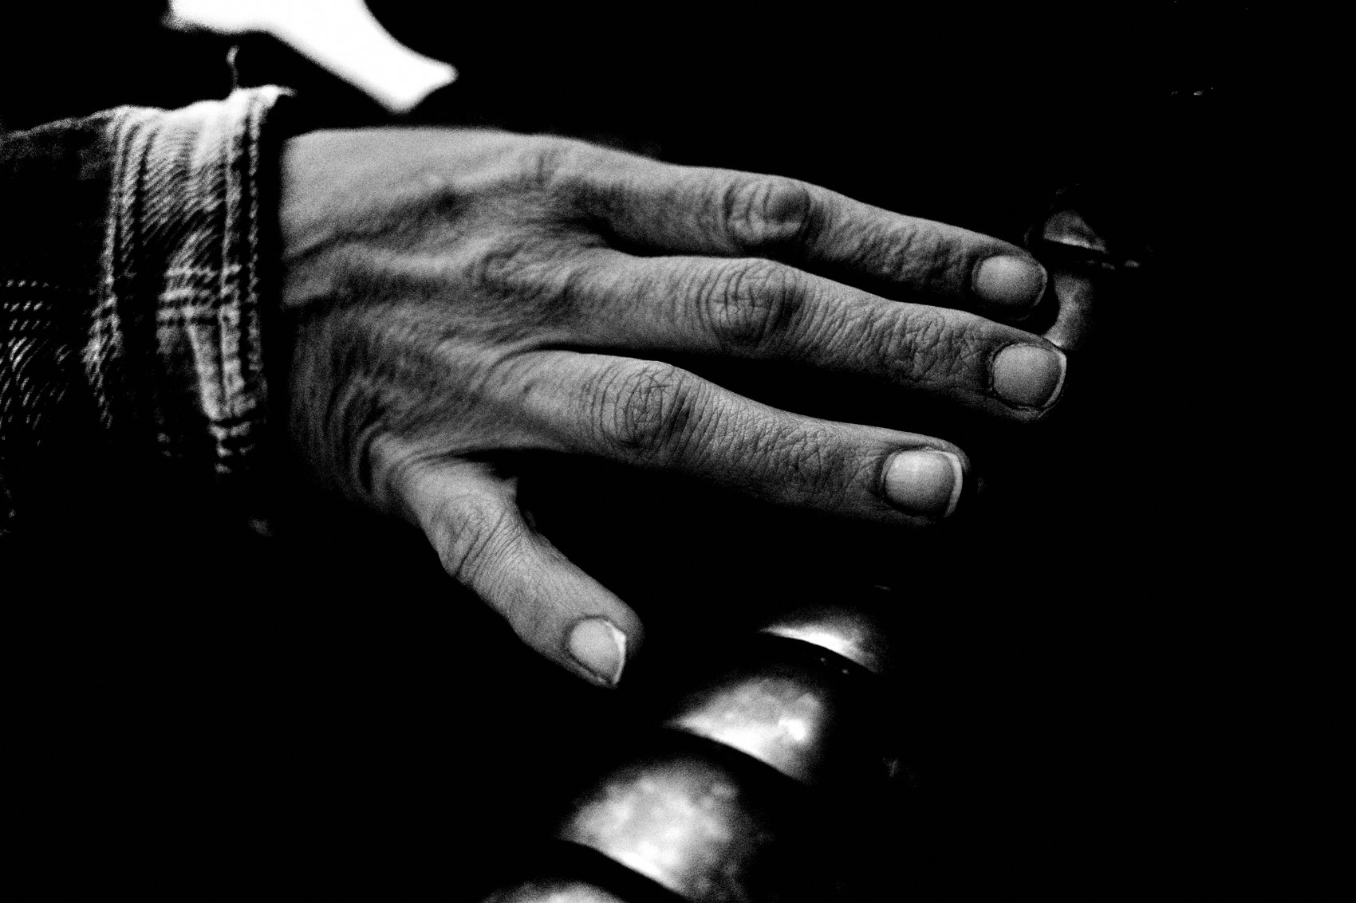
FLUX ACADEMY
BEAT 12 · MAIN TEACHING
Work the Path You Know
— Walk a familiar local trail or route
— Photograph the sculptures, the river, the details
— A familiar path, archived with care
Notes:
Here's what it looks like. Take a path near you that locals jog right past without a glance — a river trail, a park route, a walk through the old part of town. On archive duty, you slow down and work it: the statues, the water, the small landmarks nobody looks at anymore. Familiar ground, fresh attention. That's the whole shift.

Slide 14

FLUX ACADEMY
BEAT 13 · MAIN TEACHING
The Rural Town Counts Too
— Few photos exist of small places
— That scarcity makes your work valuable
— The only record might be yours
Notes:
And don't think this is only for big cities. If you're in a rural area where few documents or photos exist, your work holds incredible value — maybe more. Nobody's archiving that town. You could be the only record. That little main street, that grain silo, that empty road: photograph it like it matters, because it does.

Slide 15
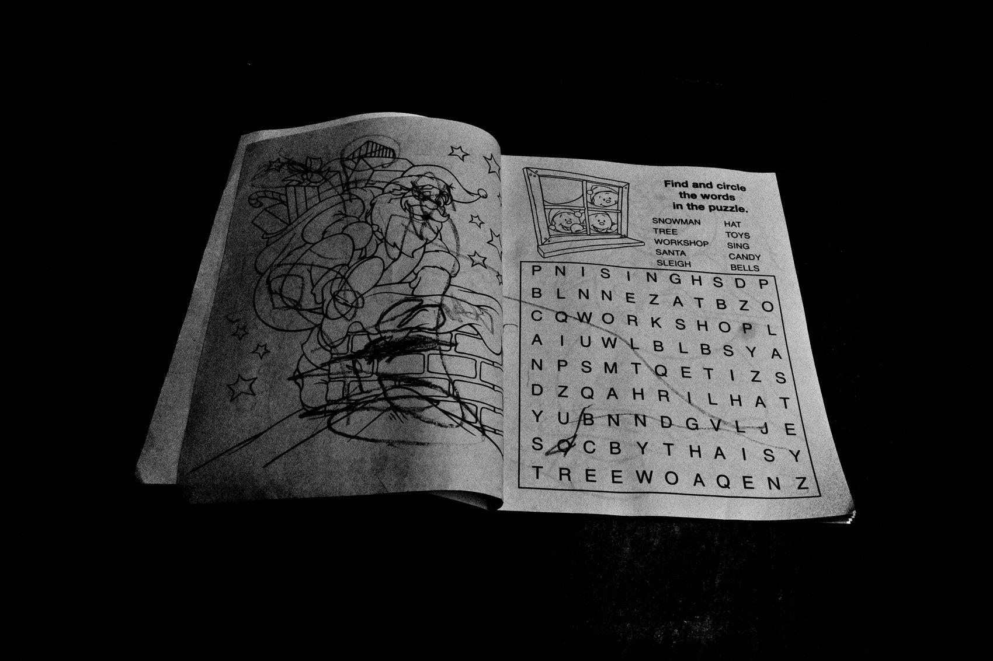
FLUX ACADEMY
BEAT 14 · MAIN TEACHING
Camera on Errands
— Carry the camera on every errand
— Make it as natural as breathing
— The archive grows on ordinary days
Notes:
One more, the most ordinary of all: the errand walk. Carry your camera to the store, to work, on the dog walk. Make photography part of your daily routine — as natural as breathing. The archive doesn't grow on special trips; it grows on a Tuesday, between chores, on the streets you already had to walk.

Slide 16

FLUX ACADEMY
BEAT 15 · MAIN TEACHING
Share It, Build the Record
— Start publishing your photographs
— Build a website, share the images
— A meaningful, ongoing project
Notes:
Then do something with it. Start publishing your photographs, build a website, share your images. This can be a deeply meaningful project. The archive isn't a hard drive full of files nobody sees — it's a living record you put out into the world for people to look back on.

Slide 17
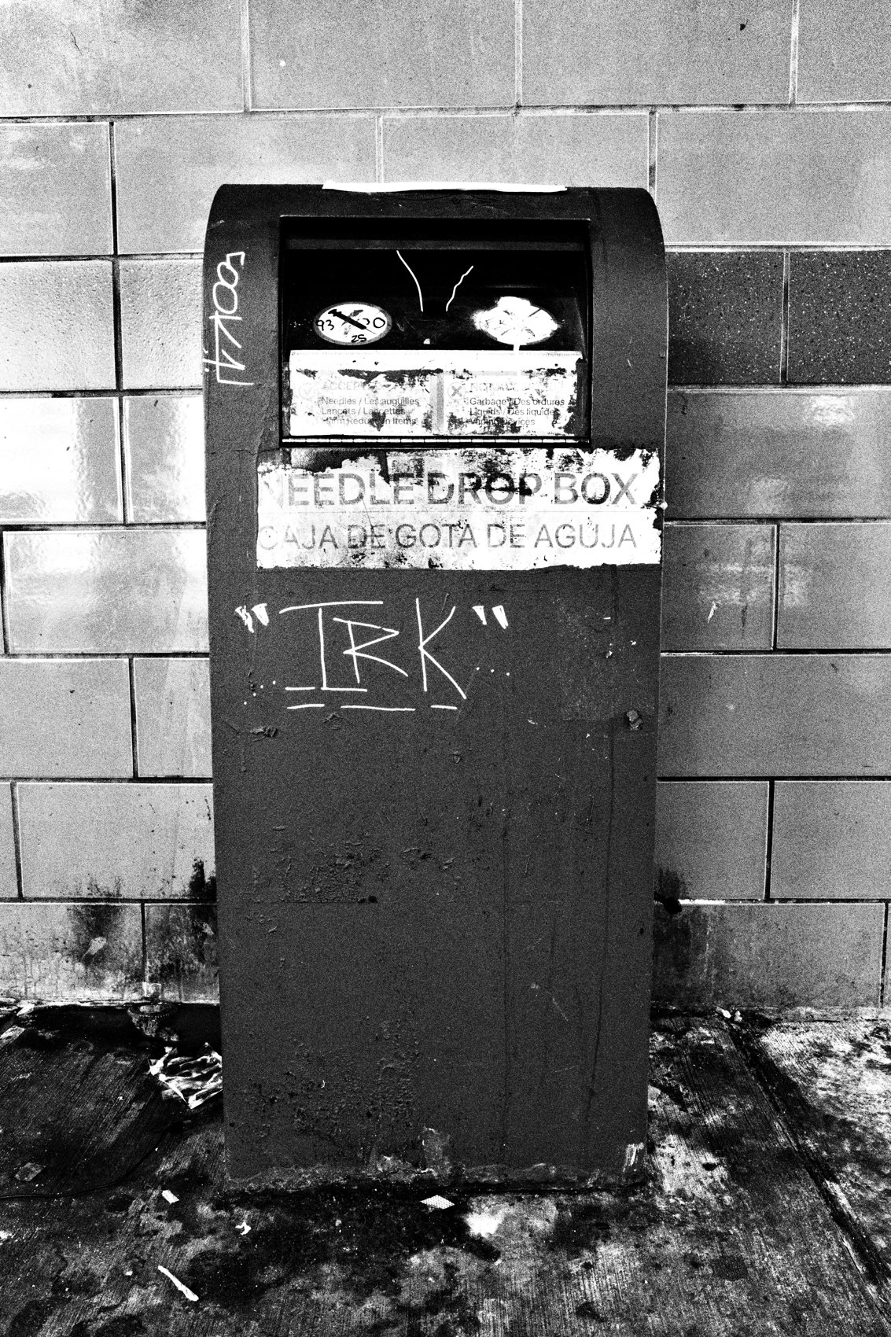
FLUX ACADEMY
BEAT 16 · MAIN TEACHING
Become the Camera
— Become the camera
— Move through home wide awake
— Preservation as a way of being
Notes:
And here's the line to carry: become the camera. Don't just carry one — be one. Move through your hometown wide awake, recording, present, taking on the job of preserving your surroundings. When archiving becomes who you are, the tourist eyes never switch off.

Slide 18
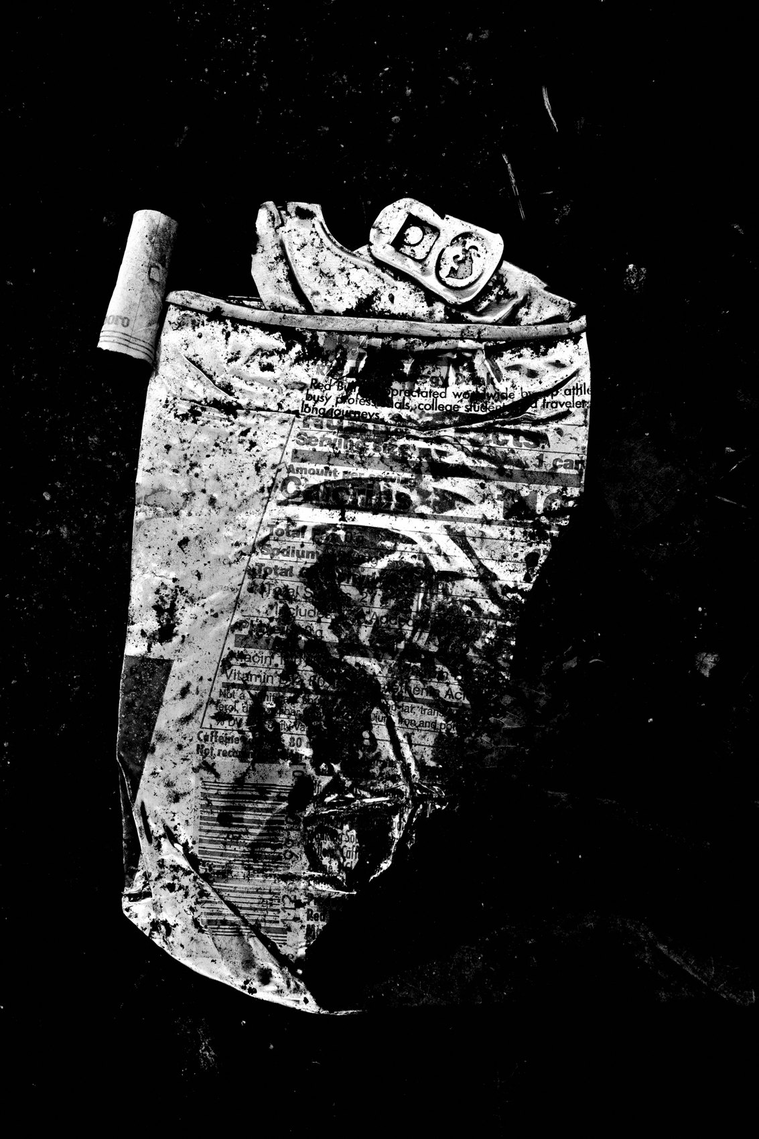
FLUX ACADEMY
BEAT 17 · PRACTICAL APPLICATION
The Tourist Walk
— Walk your block like a first-time visitor
— Photograph what a tourist would
— Notice what you usually ignore
Notes:
Your drill: take a walk you've taken a hundred times — and walk it like a tourist who just arrived. Photograph what a visitor would stop for: the architecture, the signs, the small weird details. Pay attention to everything you normally tune out. Same street, brand-new eyes.

Slide 19
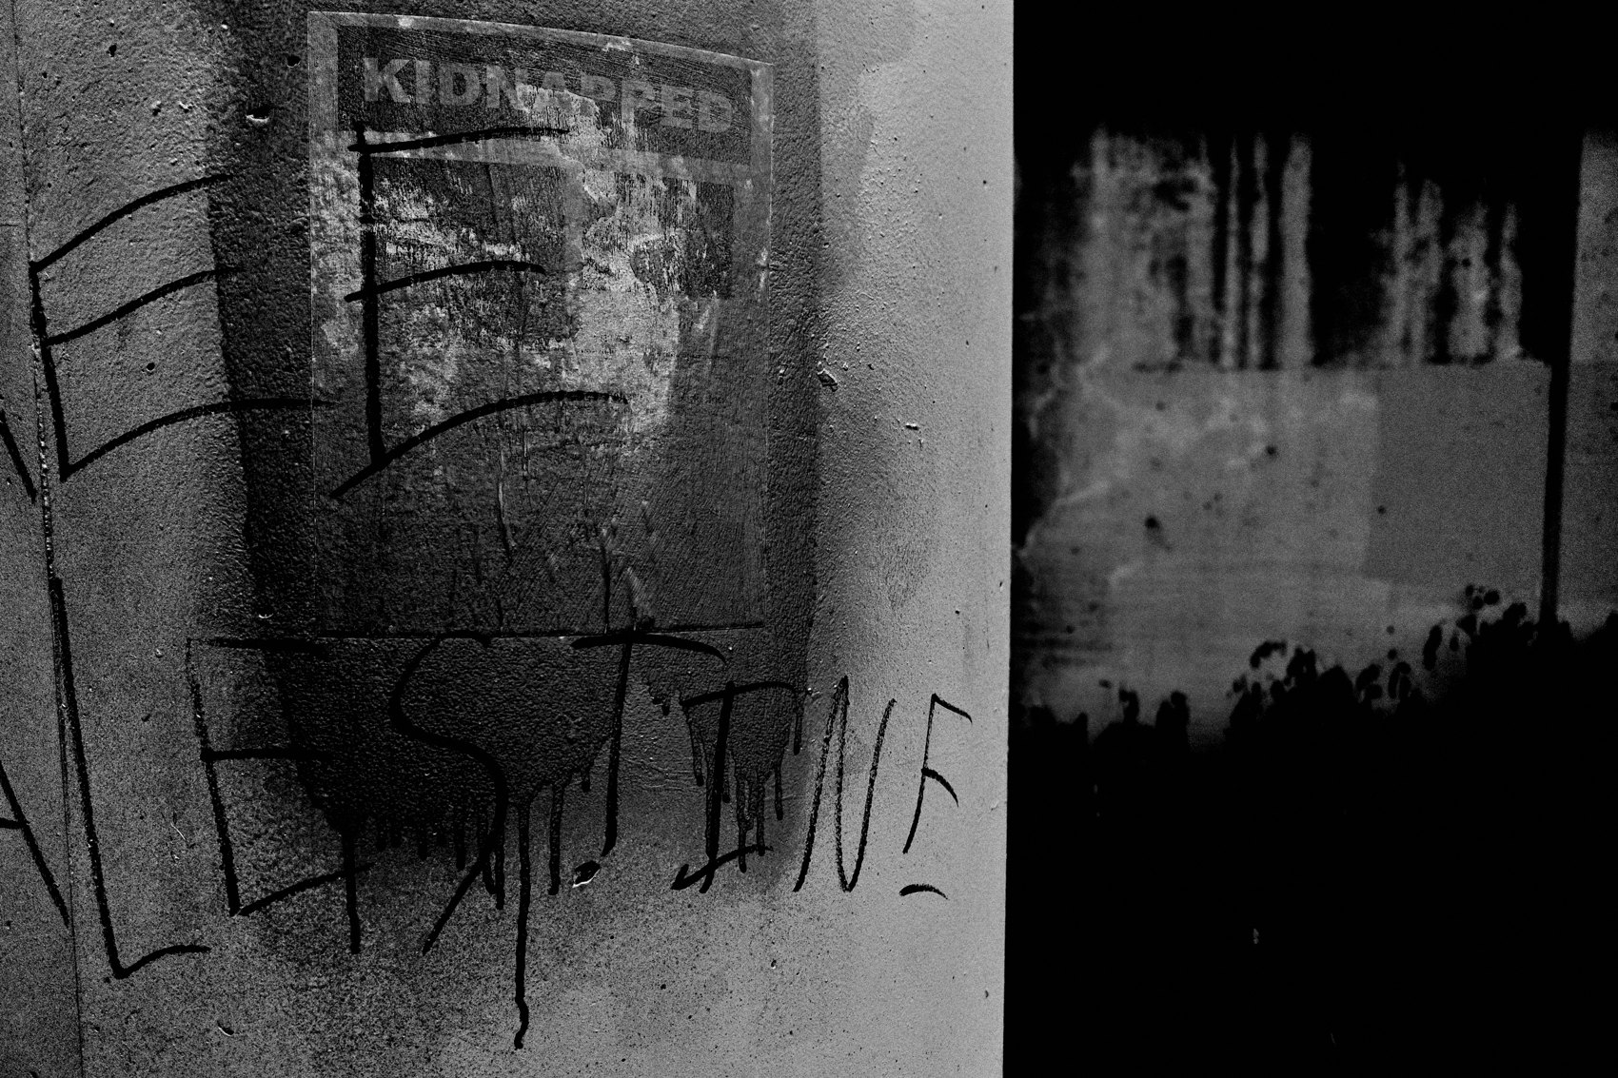
FLUX ACADEMY
BEAT 18 · PRACTICAL APPLICATION
Pick Your Archive
— Name what you're archiving — your town, river, block
— Let that goal end the daily debate
— Show up and add to it
Notes:
Then commit to an archive. Name it: my neighborhood, my river, my city, my dying main street. Once you've named it, the what-do-I-shoot question dies — you just go add to the archive. Show up, photograph, repeat. Let the project make photography inevitable.

Slide 20

FLUX ACADEMY
BEAT 19 · COMMON MISTAKES
Thinking Home Is Boring
— "Nothing happens here" is a failure to see
— Boredom is the familiarity trap
— The richness was there all along
Notes:
The big mistake: believing your hometown is too boring to photograph. "Nothing happens here." That's not the town — that's the familiarity blindness talking. The interesting was always there; you'd just stopped seeing it. Boredom is a seeing problem, never a place problem.

Slide 21
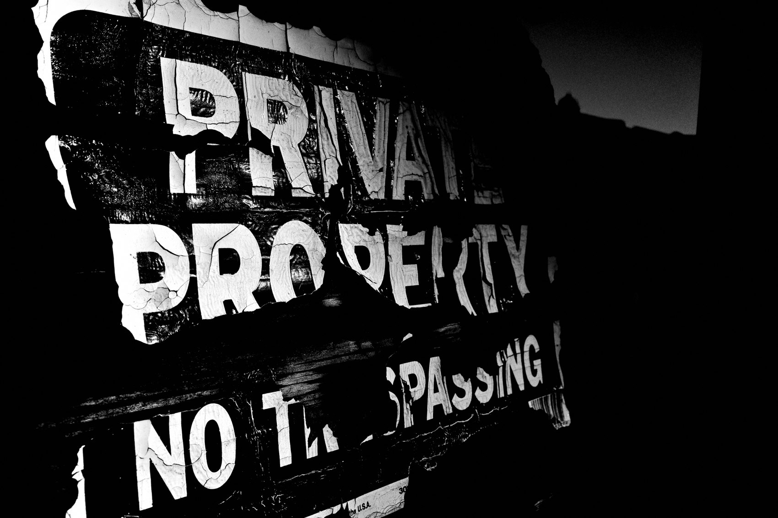
FLUX ACADEMY
BEAT 20 · COMMON MISTAKES
Shooting Only for Praise
— Waiting on fame kills the archive
— The value compounds quietly, over time
— Document now; meaning comes later
Notes:
The other trap: only shooting what you think will get praise right now. The archive doesn't pay off in likes today — it compounds quietly over years. Who cares about fame now? Document it anyway. The frames that feel ordinary today become the priceless record tomorrow.

Slide 22
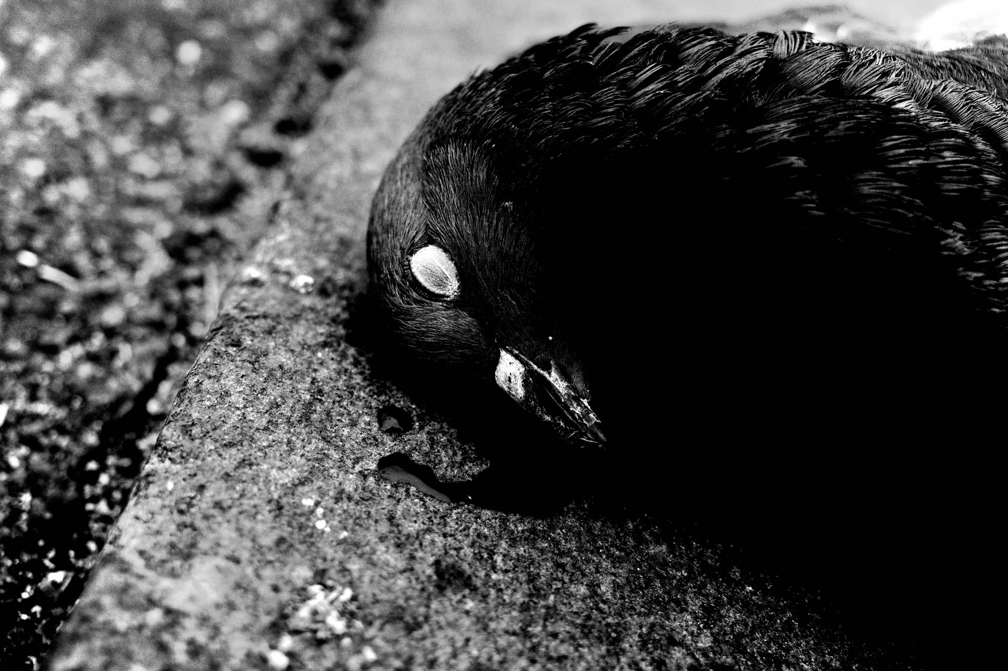
FLUX ACADEMY
BEAT 21 · RELATIONSHIP TO PREVIOUS
Openness Comes Home
— Builds on Lesson 014 — Juxtaposition & Serendipity
— Same openness, aimed at your own turf
— Receiving the street, where you live
Notes:
This lands right on top of Lesson 014, Juxtaposition & Serendipity. There you learned to stay open and receive what the street offers. Here you bring that same openness home — onto the most familiar ground you've got — and let your own neighborhood start handing you its gifts.

Slide 23
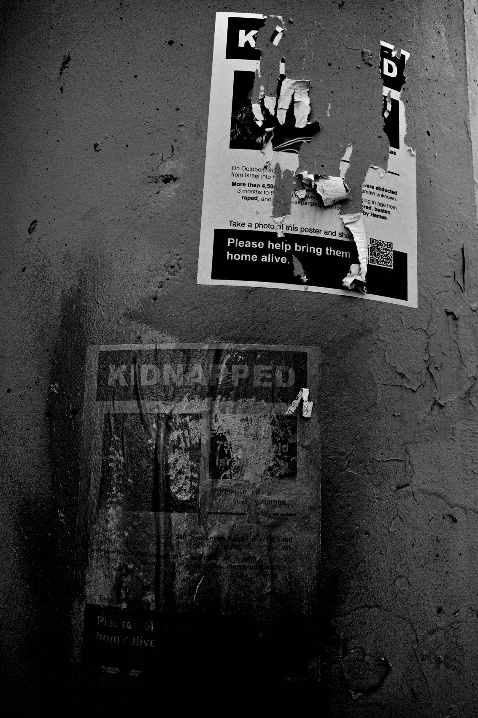
FLUX ACADEMY
BEAT 22 · RELATIONSHIP TO UPCOMING
Then We Look Closely
— Next: Breakdown I — Seeing (Lesson 016)
— We'll deconstruct real frames from Module 3
— Watch the seeing principles in action
Notes:
Next up is Lesson 016, Breakdown I — Seeing. We've spent this whole module learning to see — the mundane, the snapshot, the found moment, and now your own hometown. In the breakdown, I'll take real frames apart and show you exactly how all of it works on the street.

Slide 24
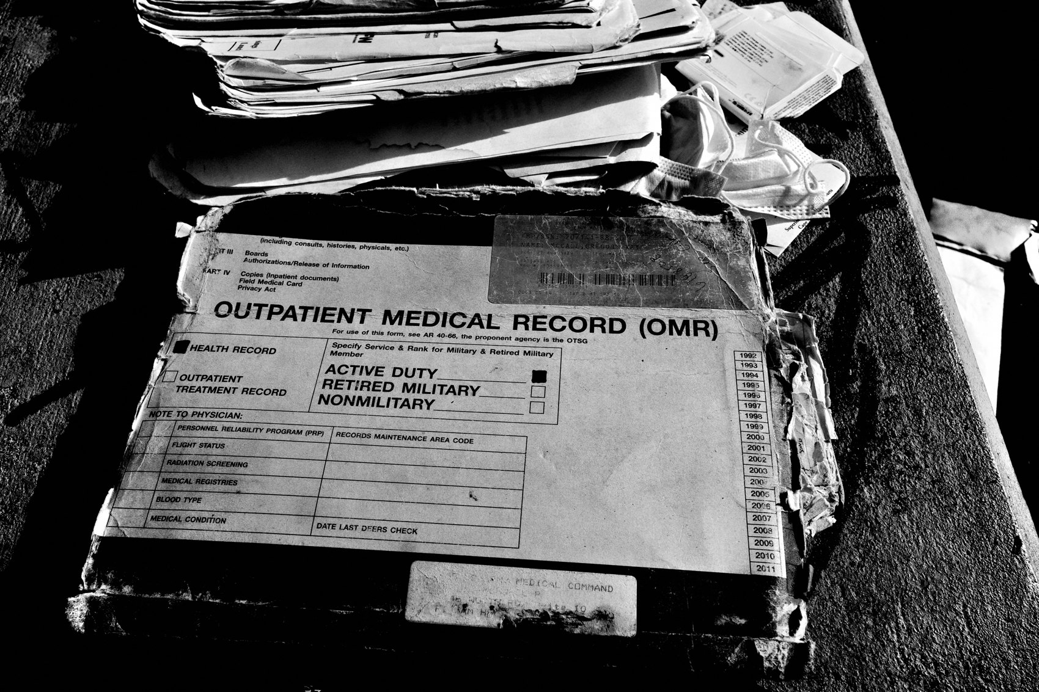
FLUX ACADEMY
BEAT 23 · SUMMARY / TAKEAWAY
Become the Camera
— Be the archivist of your hometown
— Photograph everything, fame or not
— Become the camera
Notes:
Last thing. You don't need a plane ticket to make meaningful work — you need fresh eyes on the place you already live. Be the archivist of your hometown. Photograph everything, with or without applause. Treat the camera as preservation, and become the camera. Catch you next lesson.

