Slide 1
FLUX ACADEMY · A SCHOOL FOR SEEING
MODULE 3 · LEARNING TO SEE
Juxtaposition & Serendipity
BY DANTE SISOFO

Slide 2
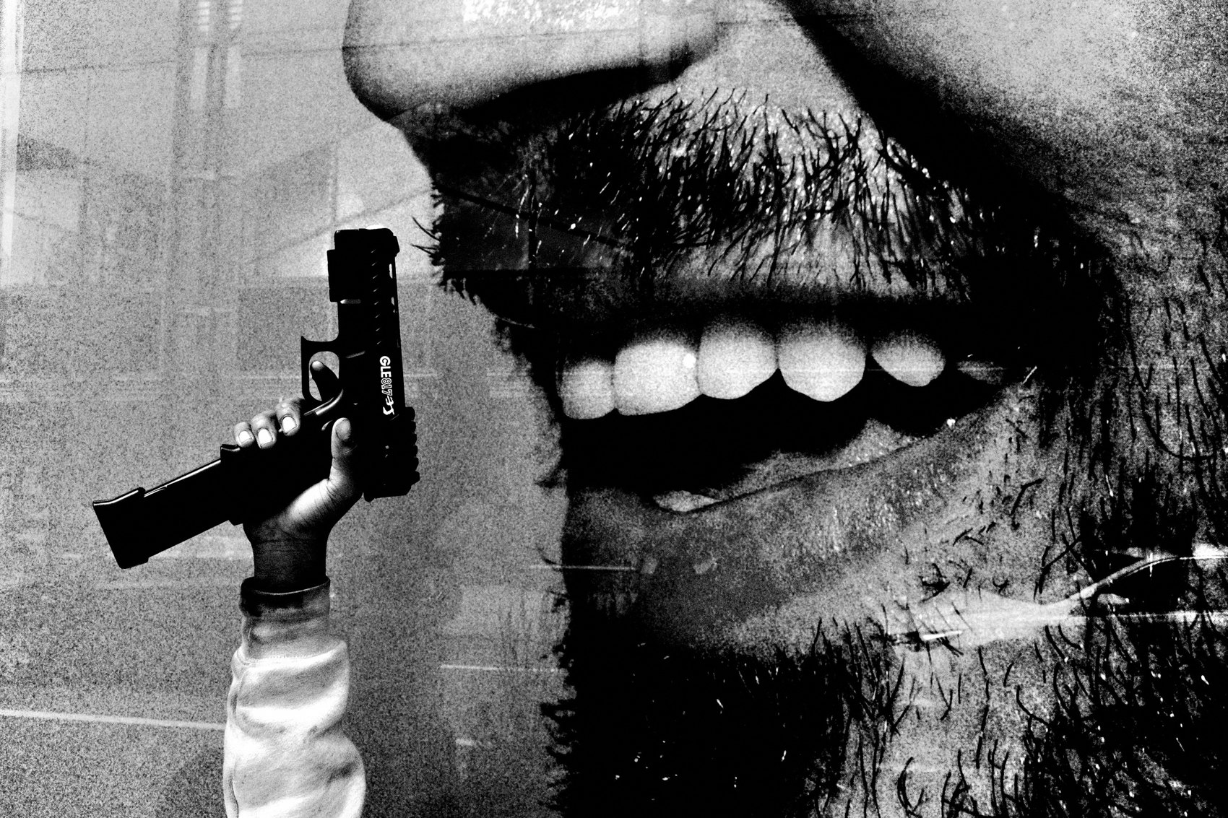
FLUX ACADEMY
BEAT 01 · CORE IDEA
Let Go and Find the Gold
— The decisive moment is a myth
— The magic starts when you let go
— Don't search — find
Notes:
What's popping, people — it's Dante. Today we talk about serendipity: letting go, flowing with the moment, and what that means on the street. Here's the heart of it — the decisive moment is a myth. The real magic doesn't come from hunting the perfect shot. It comes when you detach from the outcome and open yourself to the unknown. You don't search for the gold. You find it.

Slide 3
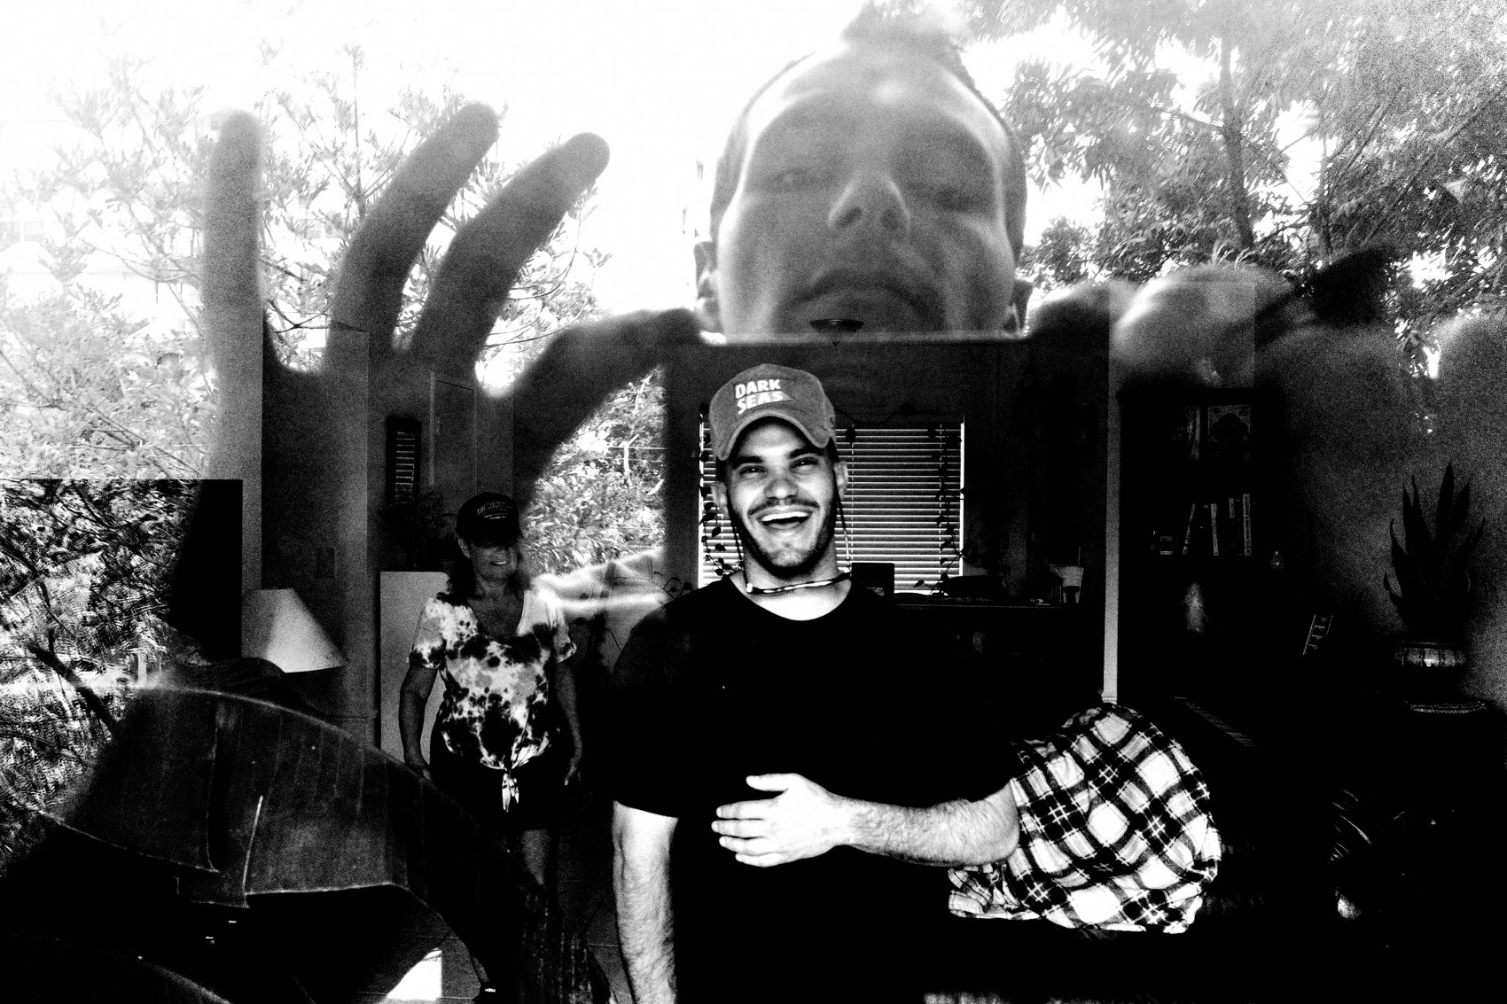
FLUX ACADEMY
BEAT 02 · LEARNING OBJECTIVE
Shoot From the Gut
— Stop hunting the "perfect" frame
— Respond to what feels right
— Be ready when chance aligns
Notes:
By the end of this lesson you'll know how to get out of your head and shoot from the gut. You'll stop white-knuckling the search for one perfect composition and start responding to what feels right — staying loose, staying open, and being ready in the split second when two unrelated things in the world fall into a relationship you never could've planned.

Slide 4
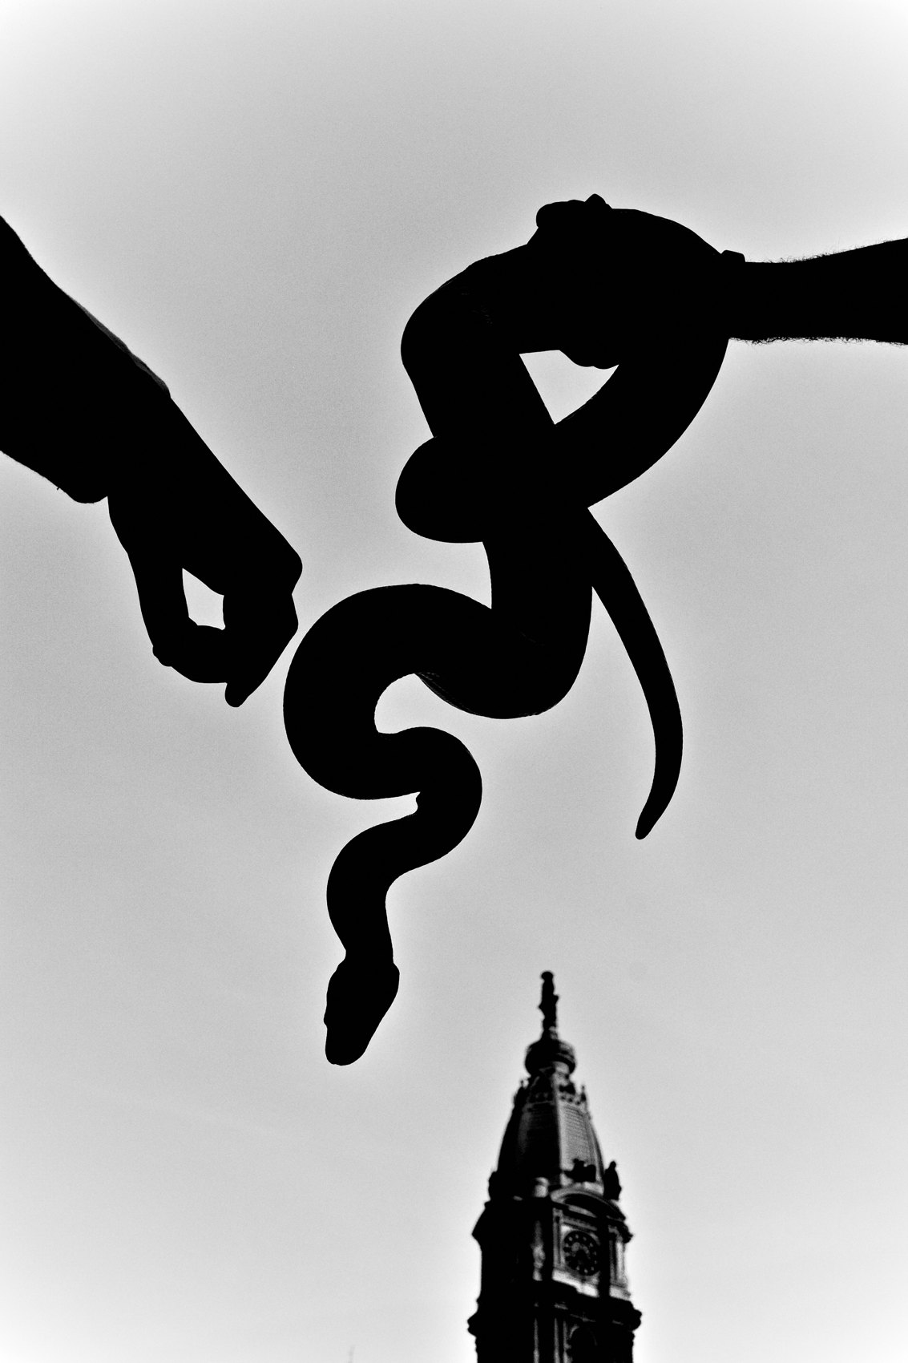
FLUX ACADEMY
BEAT 03 · WHY THIS MATTERS
The Decisive-Moment Trap
— Hunting "the perfect moment" makes you stuck
— Decision fatigue kills the day
— Stagnant is the enemy
Notes:
Here's why this matters. When you're out on the street it's easy to get caught hunting — looking for that one "perfect" decisive moment. But stay stuck in your head, convinced you need something specific, and decision fatigue sets in. That's what makes you stagnant. And stagnant is the one thing we can't be. We want to be moving, seeing, photographing.

Slide 5

FLUX ACADEMY
BEAT 04 · WHY THIS MATTERS
Serendipity Favors the Open
— Let go and yourself shines through
— The street hands you gifts you can't plan
— Open beats forced, every time
Notes:
And here's the payoff. When you let go, you let yourself shine through. You're not forcing a perfect composition — you're responding to what's real, and that's where the surprises live. The street hands you gifts you could never have scripted. But only if you're open enough to receive them. That openness is the whole skill we build today.

Slide 6
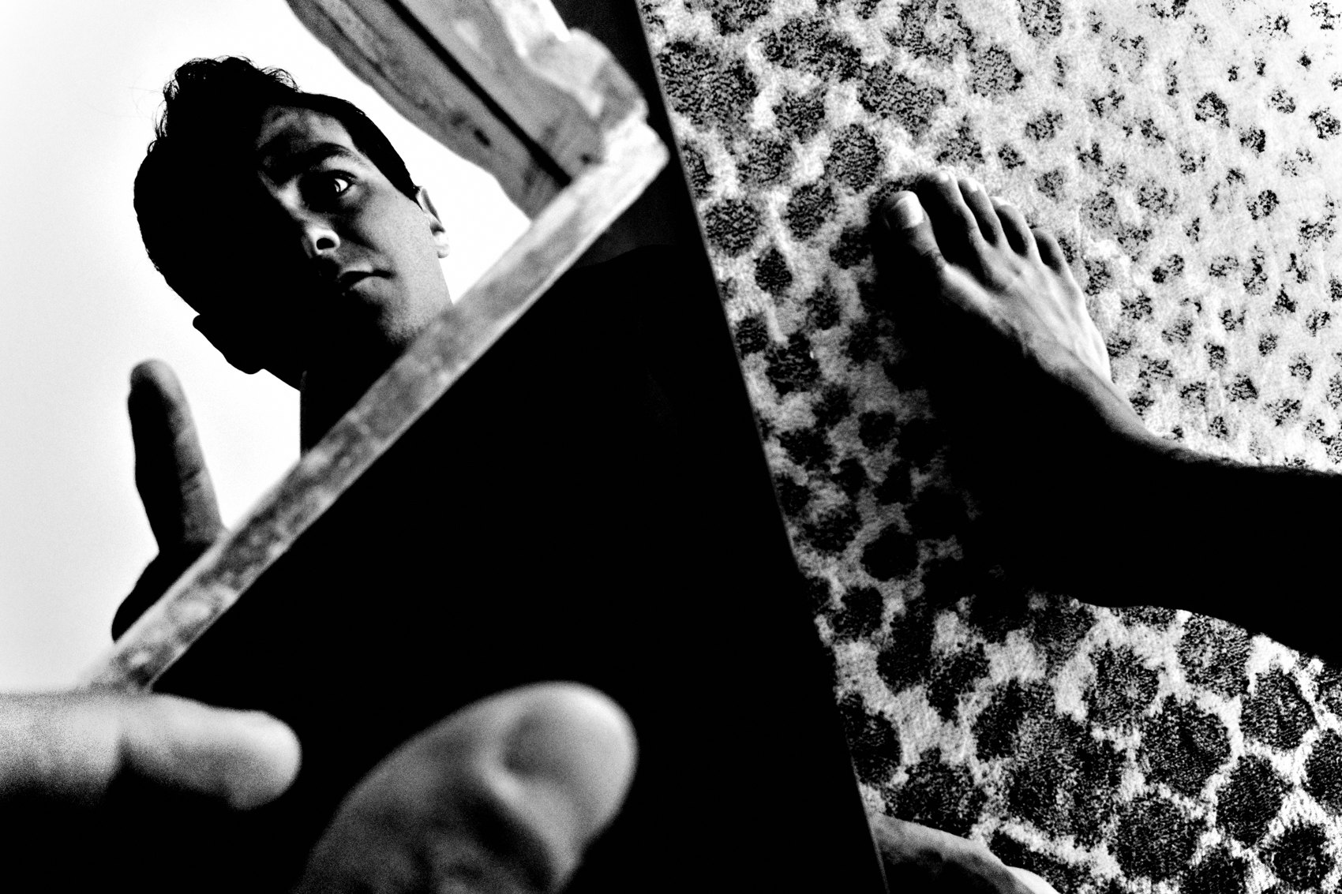
FLUX ACADEMY
BEAT 05 · MAIN TEACHING
The Decisive Moment Is a Myth
— Not every photo is an accident
— But the magic starts when you detach
— Open yourself to the unknown
Notes:
Let's say it plainly: the decisive moment is a myth. Now — I'm not saying every photo should be a pure accident. We still look around, we stay aware of what's happening. But the real magic starts when we let go, detach from the outcome, and open ourselves to the unknown. Stop gripping the moment so hard and the moments start coming to you.

Slide 7

FLUX ACADEMY
BEAT 06 · MAIN TEACHING
Follow the Light
— One rule: follow the light
— No plan, no map, no expectation
— Walk toward the sun
Notes:
When I go out to shoot, I have exactly one rule: follow the light. That's it. No plan, no map, no expectation. If the sun is shining, I walk toward it. Even when it's cloudy, I just move — follow my instincts and let the surprises come naturally. Sometimes that one simple rule walks me straight into something I never could've planned for.

Slide 8

FLUX ACADEMY
BEAT 07 · MAIN TEACHING
Get Out of Your Head
— Stuck in your head = decision fatigue
— Don't be stagnant — be moving
— Be moving, seeing, photographing
Notes:
Get out of your head. If you're locked in there thinking you need to find something specific, decision fatigue sets in and you freeze. That's what gets you stuck, standing in one spot grinding over nothing. We don't want to be stagnant. We want to be moving. We want to be seeing. We want to be photographing. Motion is the cure for the paralysis.

Slide 9

FLUX ACADEMY
BEAT 08 · MAIN TEACHING
Your Vision Is Your Vision
— Two shooters, same moment, different photos
— Your eye is your eye
— No copying when you're being real
Notes:
Here's something freeing. Two photographers can walk side by side and shoot the exact same moment — and the photos will be different. Your eye is your eye. Your vibe is your vibe. There's no copying when you're being real. So stop worrying about getting the shot everyone else would get. When you let go, you let yourself through, and that's the one thing nobody can take.

Slide 10

FLUX ACADEMY
BEAT 09 · MAIN TEACHING
Photograph From the Gut
— Not the rational mind — the gut, the heart
— No Fibonacci spiral in your head
— Things align when you're aligned
Notes:
Photograph from the gut. Not the rational mind — the gut, the heart. That's where the shutter comes from. You don't need a Fibonacci spiral or a rule-of-thirds grid floating in your head. Here's the line I live by: things align when you're aligned. Get yourself right, get loose and present, and the elements out there start clicking into place on their own.

Slide 11
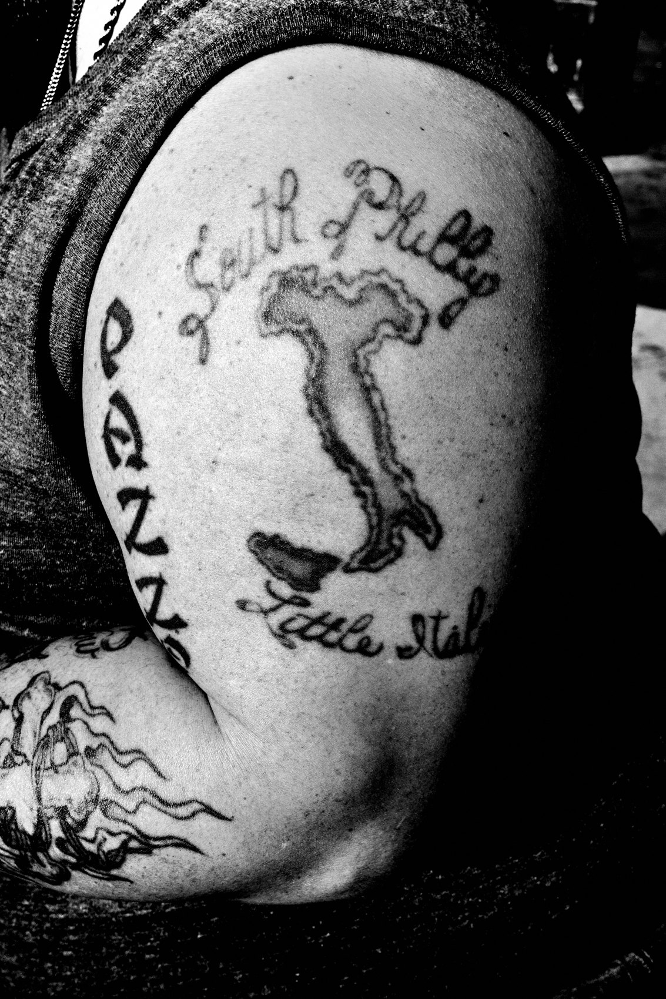
FLUX ACADEMY
BEAT 10 · MAIN TEACHING
The Art of Serendipity
— Create meaning without controlling every detail
— Let elements relate on their own
— Coincidence becomes composition
Notes:
This is the art of serendipity: creating something meaningful without trying to control every single detail. You loosen your grip, you stay present, and the street starts handing you relationships — a sign and a face, a shadow and a stride, two things that have nothing to do with each other suddenly meaning something together. You didn't force that. You were just open when it happened.

Slide 12
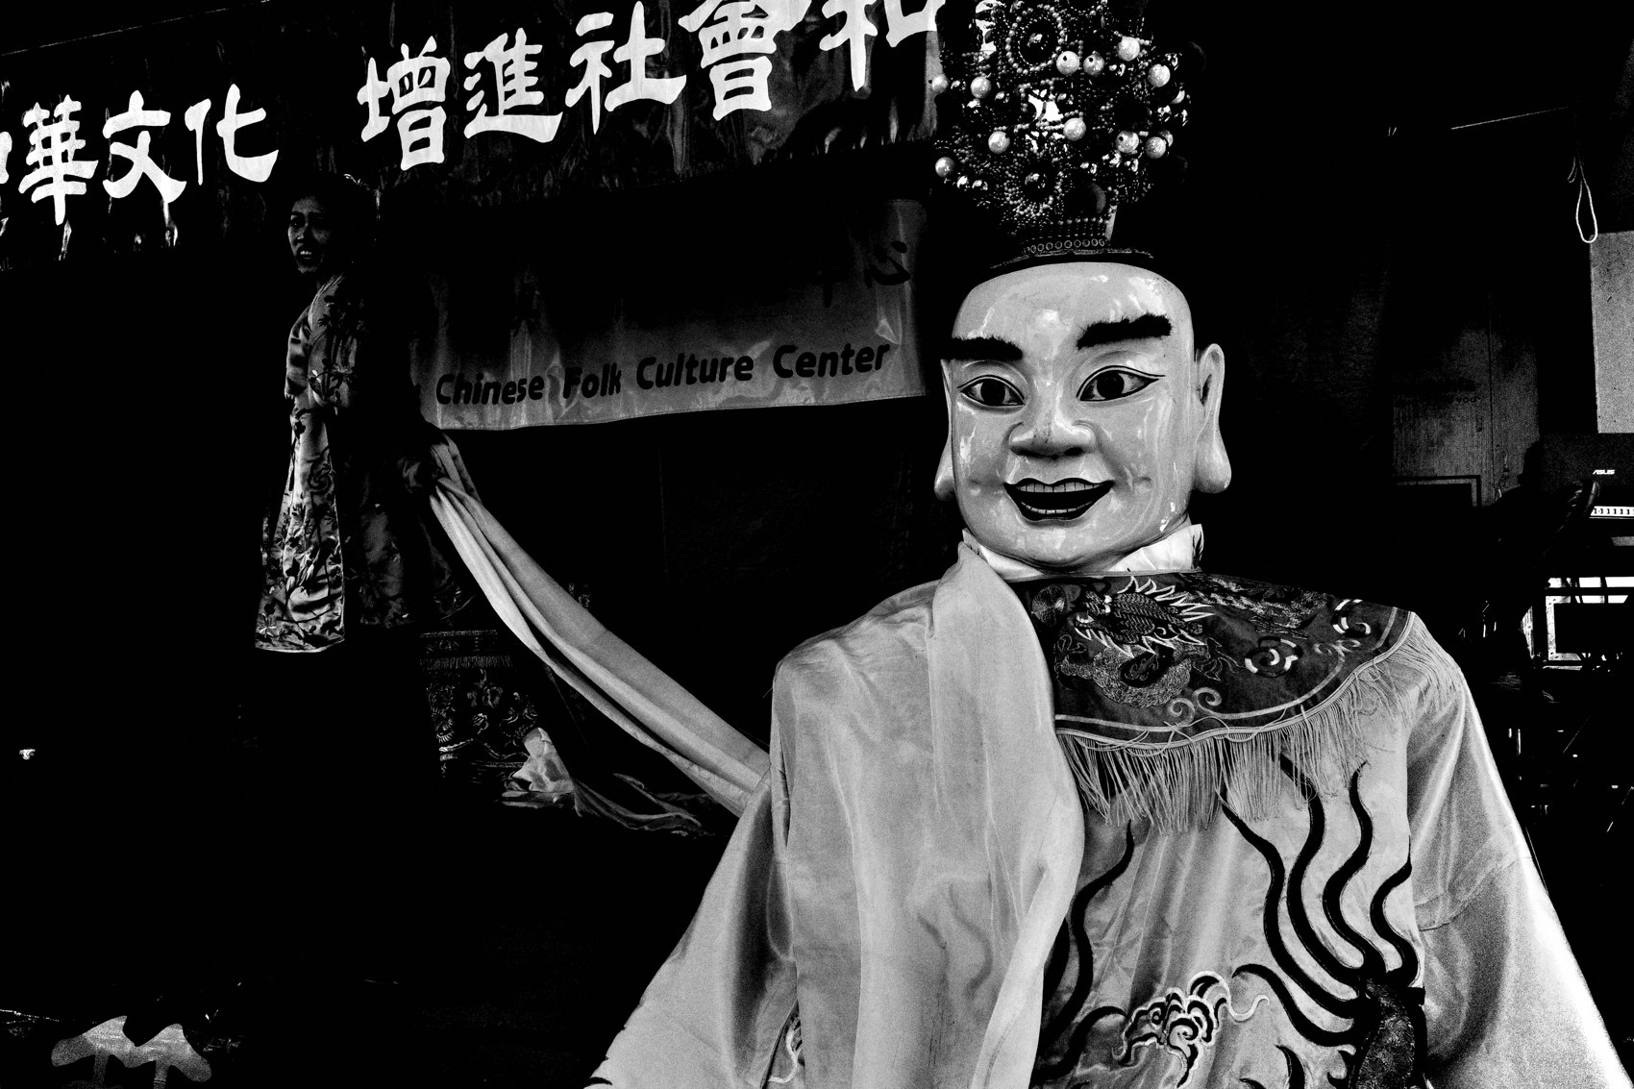
FLUX ACADEMY
BEAT 11 · MAIN TEACHING
The Legend of Serendip
— The word comes from a story
— Three princes of Serendip
— They made discoveries by accident
Notes:
Did you know "serendipity" comes from a story? There were three princes from Serendip — what's now Sri Lanka — who kept making discoveries by accident on their journey. One of them even discovered honey, randomly, just by being out in the world, moving through it with open eyes. That's not a fairy tale. That's a street photography manual.

Slide 13

FLUX ACADEMY
BEAT 12 · MAIN TEACHING
Finding the Honey
— One prince found honey by accident
— He wasn't searching for it
— Find that sweetness when you let go
Notes:
Let me sit on that honey a second, because it says everything. The prince wasn't searching for honey. He was just wandering, alive to the world, and the world handed it to him. That's exactly how the best frames arrive. You'll find that sweetness, that honey, that nectar — when you let go. Stop hunting the honey and you'll start tripping over it.

Slide 14
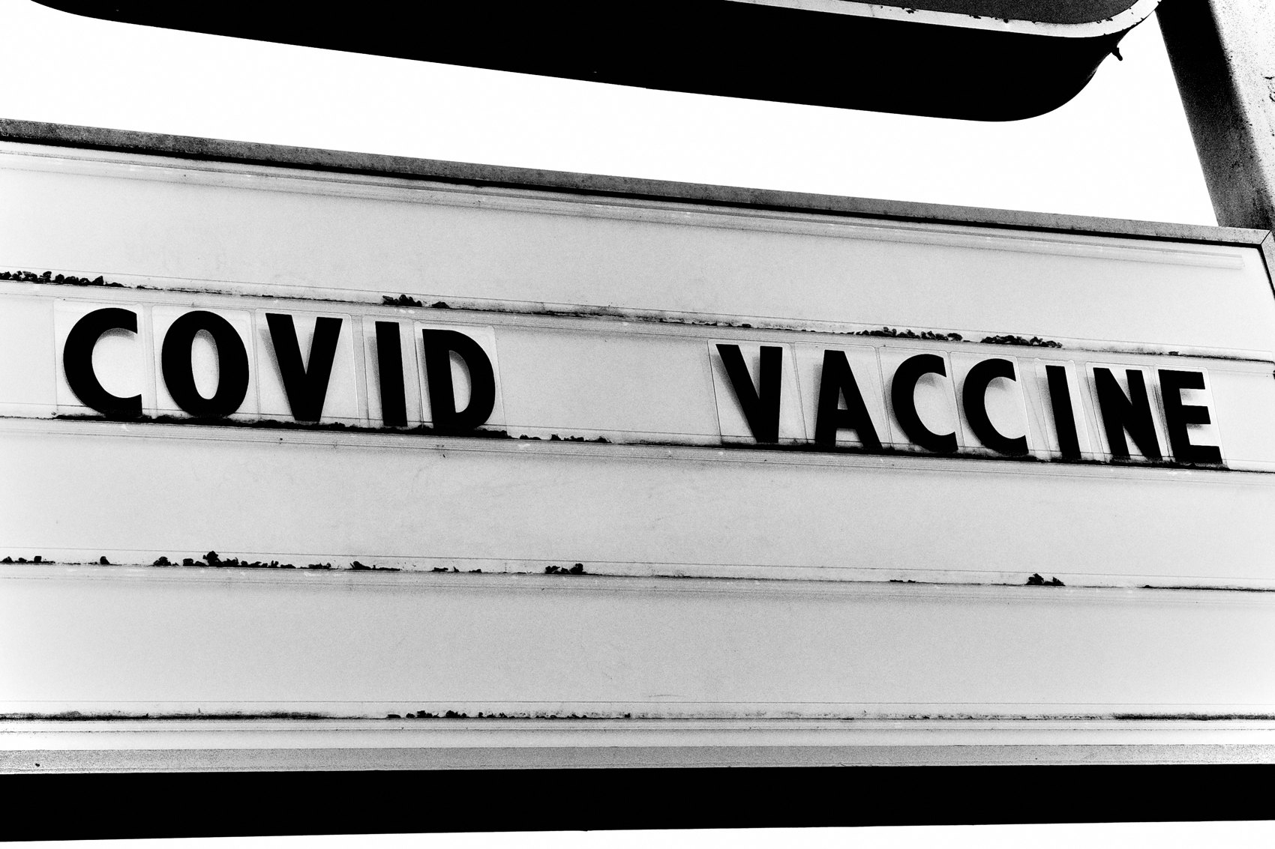
FLUX ACADEMY
BEAT 13 · MAIN TEACHING
Give a Place a Whole Day
— Spend hours immersed in one place
— Sun out or not — soak in it
— No agenda but to be present
Notes:
Here's what that looks like on the ground. Give a single place a whole day — hours in a park, a stretch of river, a corner of the city — just immersed in a beautiful space. It doesn't even matter if the sun isn't out. The joy of being there, present, is enough to put a smile on your face. No agenda, no shot list. Just letting go and flowing with the moment. That's the soil serendipity grows in.

Slide 15
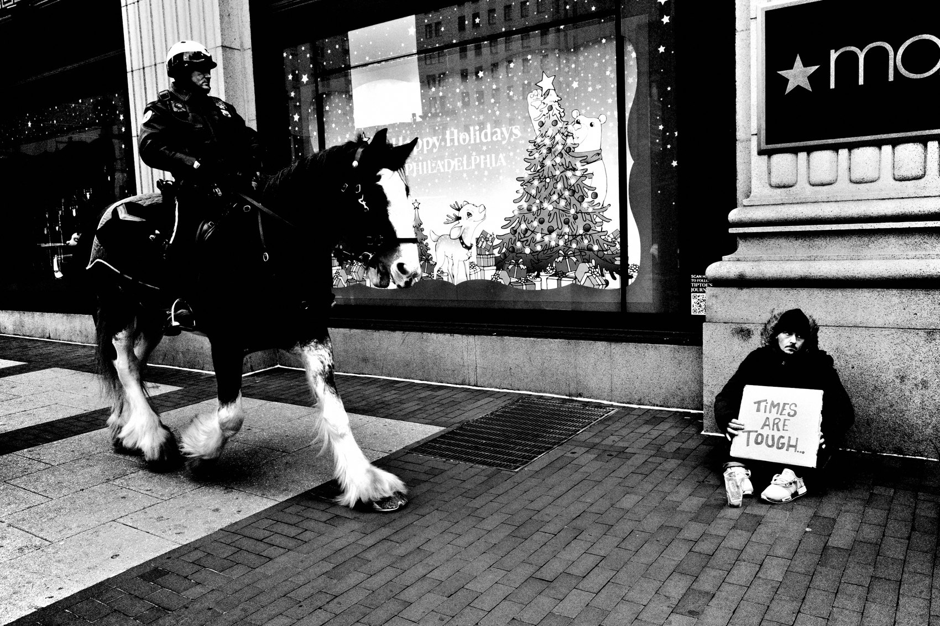
FLUX ACADEMY
BEAT 14 · MAIN TEACHING
The Princes' Gold
— They weren't looking for treasure
— Just living, wandering, moving
— In the movement, they found gold
Notes:
Here's the thread that ties it together. Those three princes from Serendip — they weren't looking for treasure. They were just living, wandering, moving. And in that movement, they found gold. That's the model for a day on the street. Don't march out demanding a masterpiece. Walk, observe, stay in motion — and trust that the gold shows up when you've stopped chasing it.

Slide 16
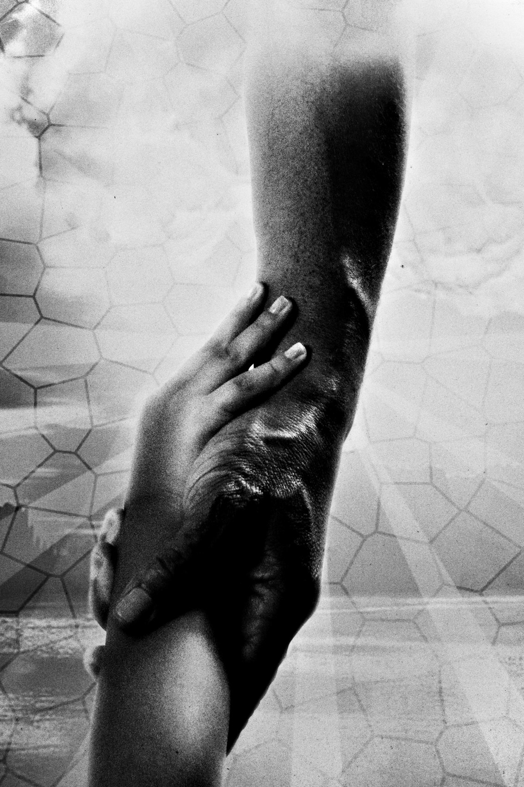
FLUX ACADEMY
BEAT 15 · MAIN TEACHING
Be Ready for the Moment
— Serendipity favors the prepared
— That flick of the wrist, that click
— The snap of the body — that's the magic
Notes:
Now the catch: serendipity isn't just chance. It favors the prepared. When that moment hits, you want to be ready — that quick flick of the wrist, that click of the shutter, that snap of the body's movement. That's the magic. Chance puts the gift in front of you, but readiness is what lets you actually take it home.

Slide 17
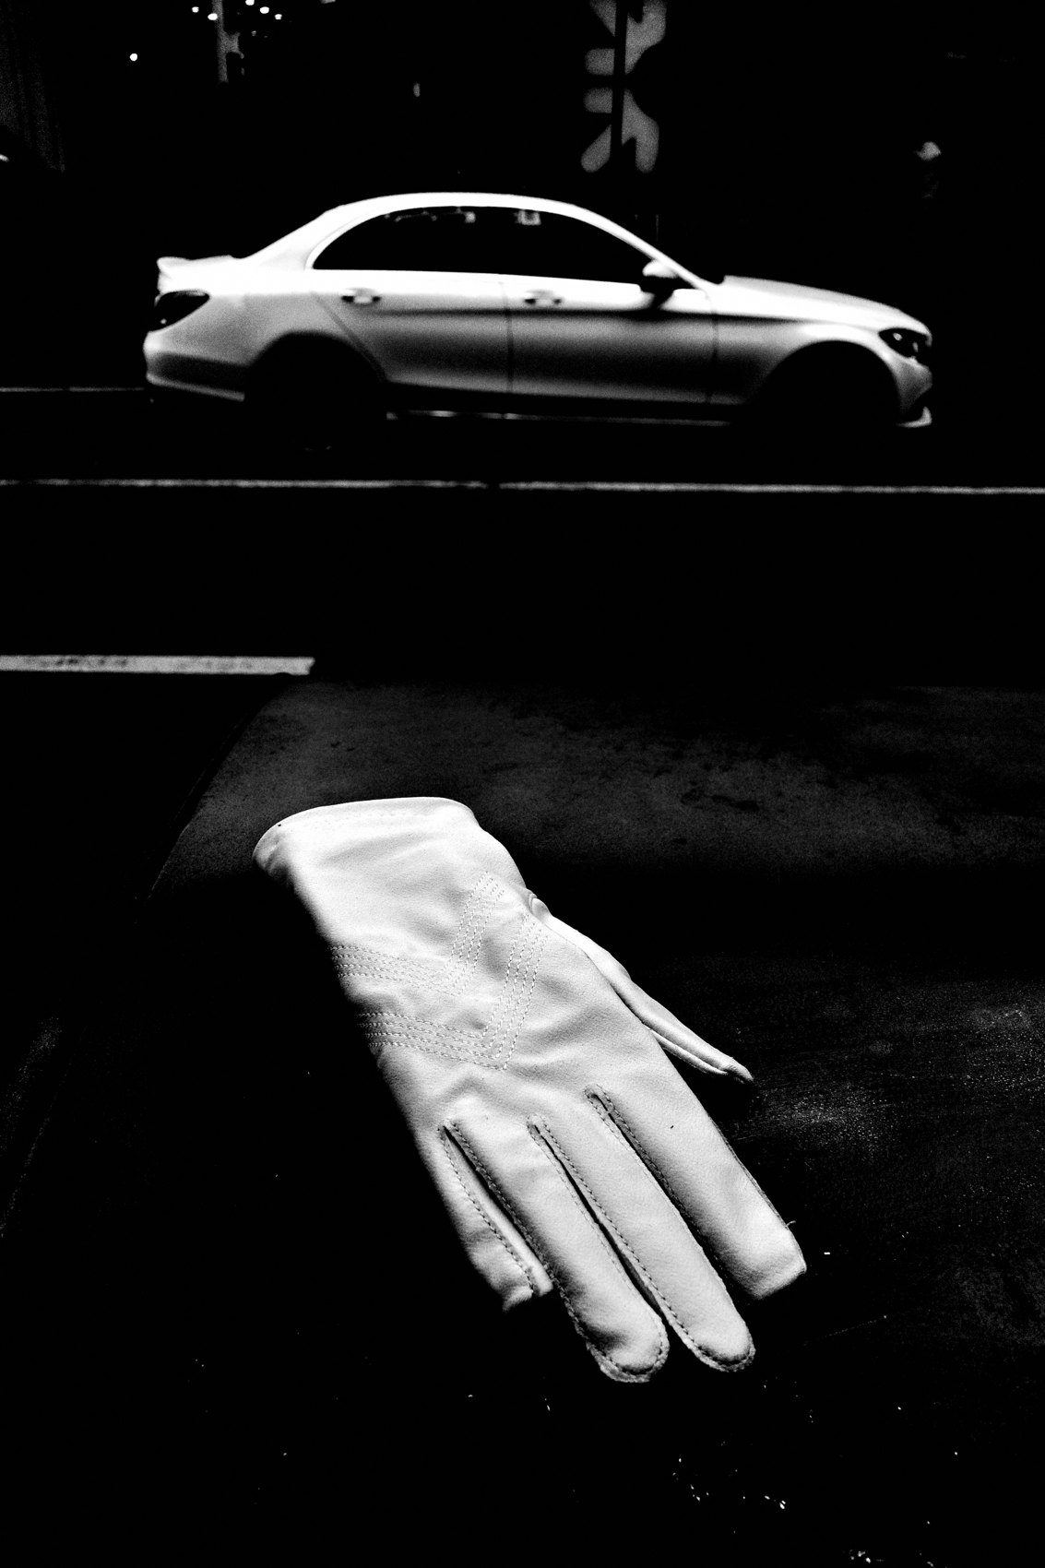
FLUX ACADEMY
BEAT 16 · MAIN TEACHING
Be Empty, Just Respond
— We're all in our heads when we shoot
— The best work happens when the mind goes blank
— Stop thinking, start being
Notes:
Here's the deepest part. We're all in our heads when we shoot — that's normal. But the most interesting photography happens when your mind goes blank. When you stop thinking and start being, that's when serendipity delivers. It's not about going out and searching. It's about accidentally finding. Empty the mind, and let the frame come find you.

Slide 18
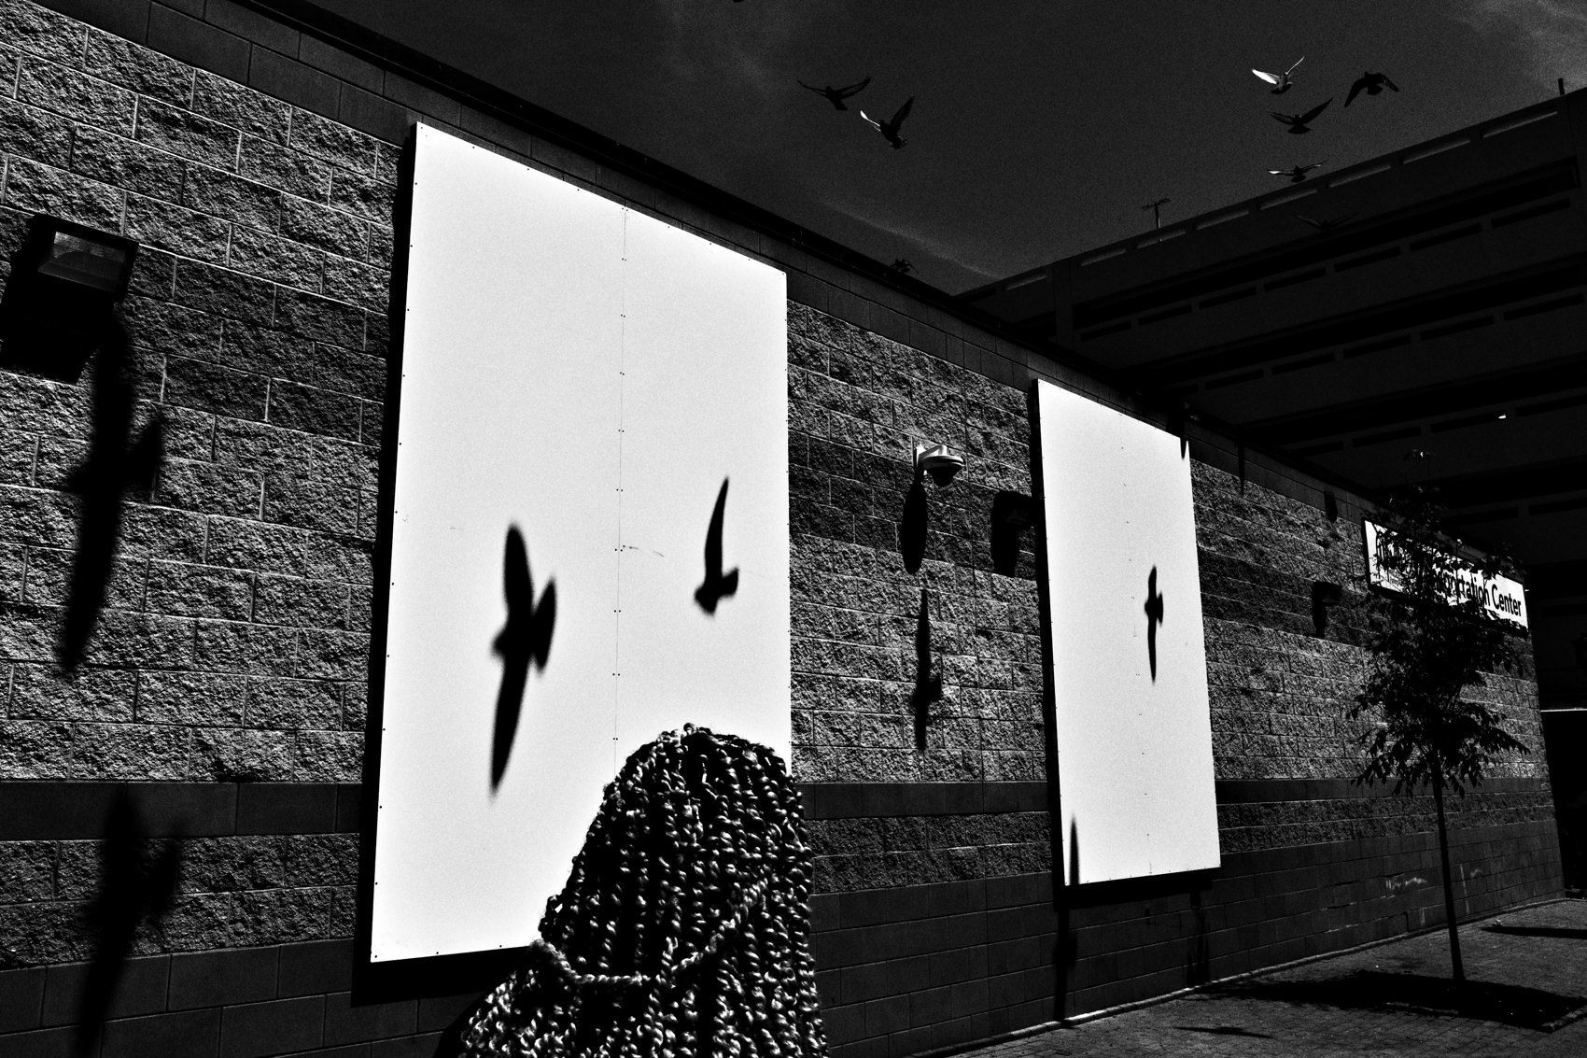
FLUX ACADEMY
BEAT 17 · PRACTICAL APPLICATION
Walk a Day With One Rule
— Go out with no plan, no map
— One rule: follow the light
— Photograph whatever's placed in front of you
Notes:
Here's your drill. Go out for a whole session with no plan and no map — just one rule: follow the light. When the sun shines, walk toward it; when it's cloudy, just move and trust your instincts. Don't hunt for "the shot." Photograph whatever the universe places in front of you. By the end you'll have frames you never could've planned — that's the proof serendipity is real.

Slide 19
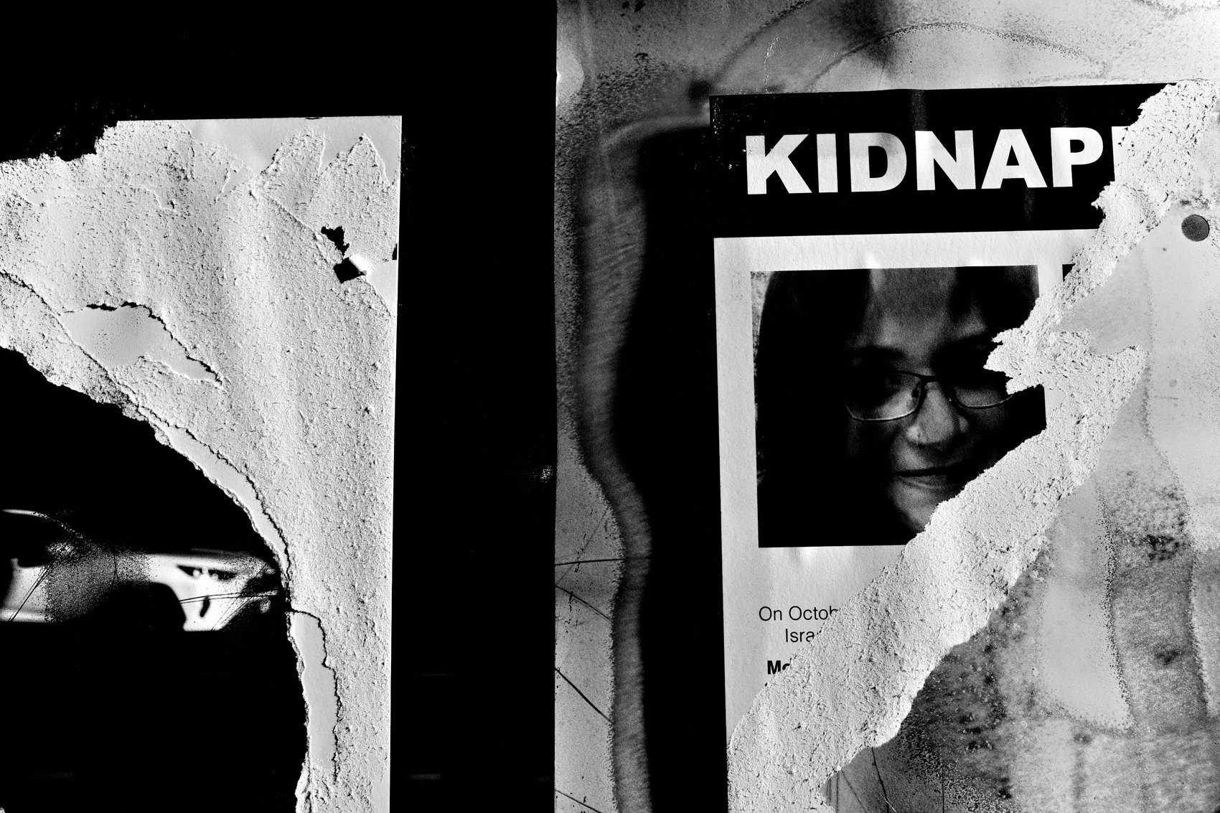
FLUX ACADEMY
BEAT 18 · PRACTICAL APPLICATION
Build the Foundation First
— Camera on you, batteries charged
— Be rested, sharp, present
— Clarity · energy · stillness · instinct
Notes:
Serendipity starts before you hit the street. If your work feels stuck, fix the foundation: have your camera on you, charge your batteries, be rested, be sharp, be present. I lean on clarity, energy, stillness, and sharp instincts — fasting helps me, rest helps me, getting out of the fog helps me. That's when your gut and brain sync up and you become a laser-focused, intuitive machine.

Slide 20
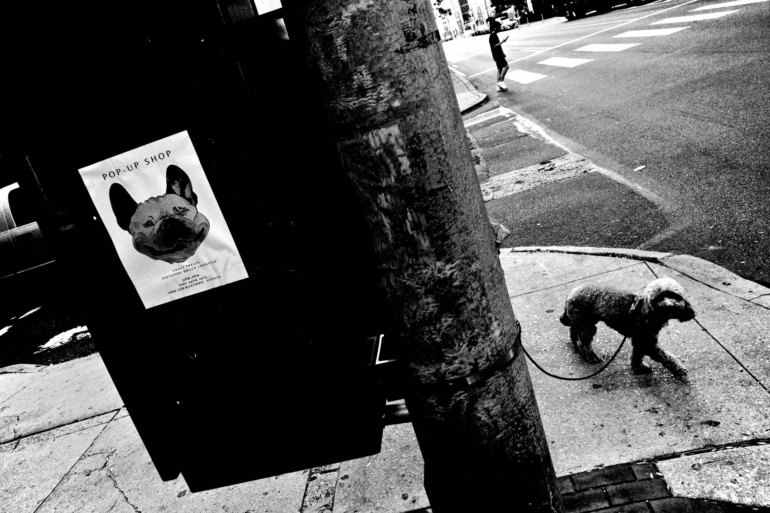
FLUX ACADEMY
BEAT 19 · COMMON MISTAKES
Hunting Instead of Finding
— Searching for a "perfect" shot
— White-knuckling the outcome
— That's decision fatigue, that's stuck
Notes:
The biggest mistake is hunting instead of finding. You go out searching for the perfect, decisive shot, white-knuckling the outcome — and that's exactly what triggers decision fatigue and freezes you in place. The fix isn't to try harder. It's to let go. Detach from the outcome, get moving, and let the photograph find you instead of the other way around.

Slide 21
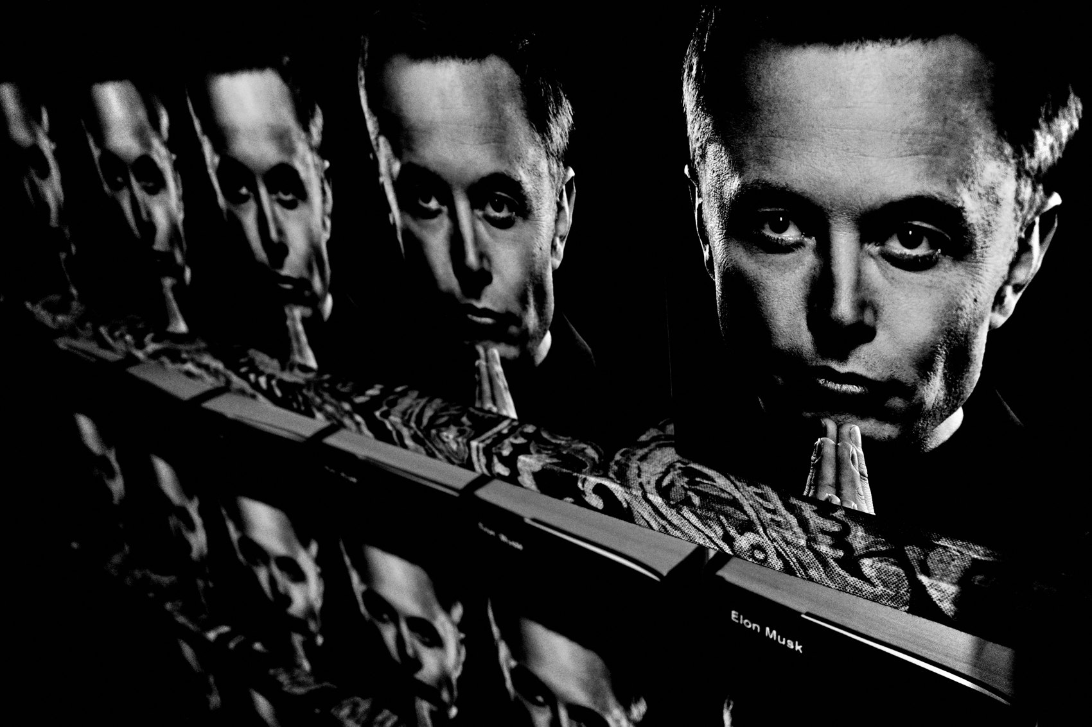
FLUX ACADEMY
BEAT 20 · COMMON MISTAKES
Shooting From the Head
— Forcing the composition
— Rule-of-thirds grid stuck in your mind
— Forgetting things align when you're aligned
Notes:
The other mistake: shooting purely from the head. Forcing the composition, running the rule-of-thirds grid on every frame, trying to control every detail. It makes the work stiff and lifeless. Remember — things align when you're aligned. Get yourself loose and present first, shoot from the gut, and let the alignment happen instead of manufacturing it.

Slide 22
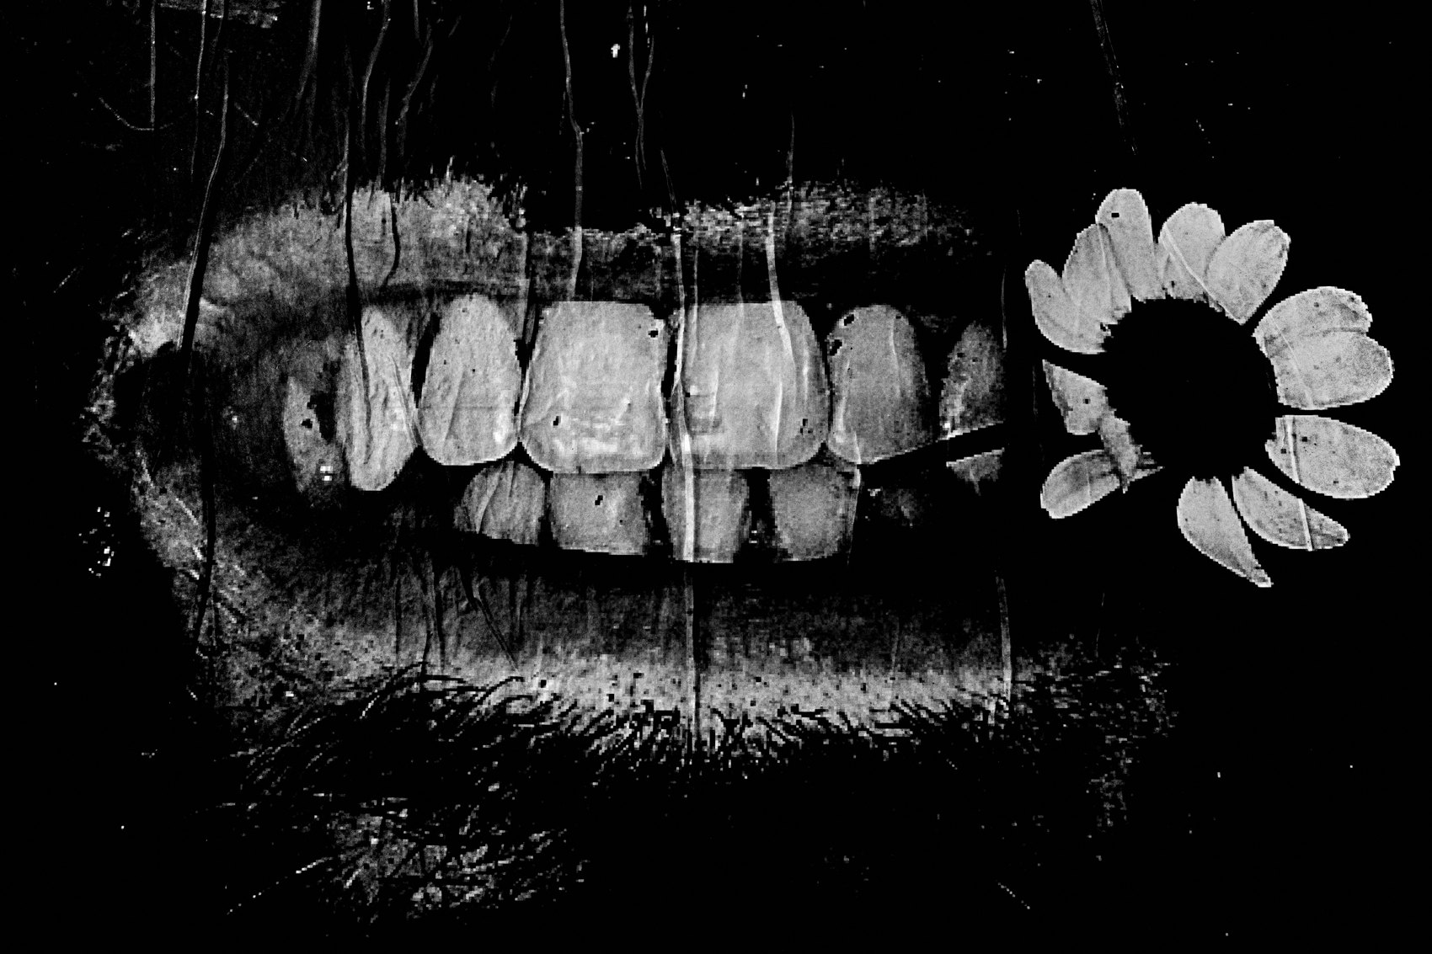
FLUX ACADEMY
BEAT 21 · RELATIONSHIP TO PREVIOUS
The Found Side of the Coin
— Lesson 013 was the made photograph
— This is the found photograph
— Prepared and open, together
Notes:
Last lesson — Lesson 013 — we worked the made photograph: patience, positioning, persistence, staying till the scene leaves you. Today is the other side of that coin: the found photograph, the gift the street hands you when you let go. These aren't opposites. The best photographers are prepared and open — they work the scene, and they stay ready for serendipity to drop something in.

Slide 23
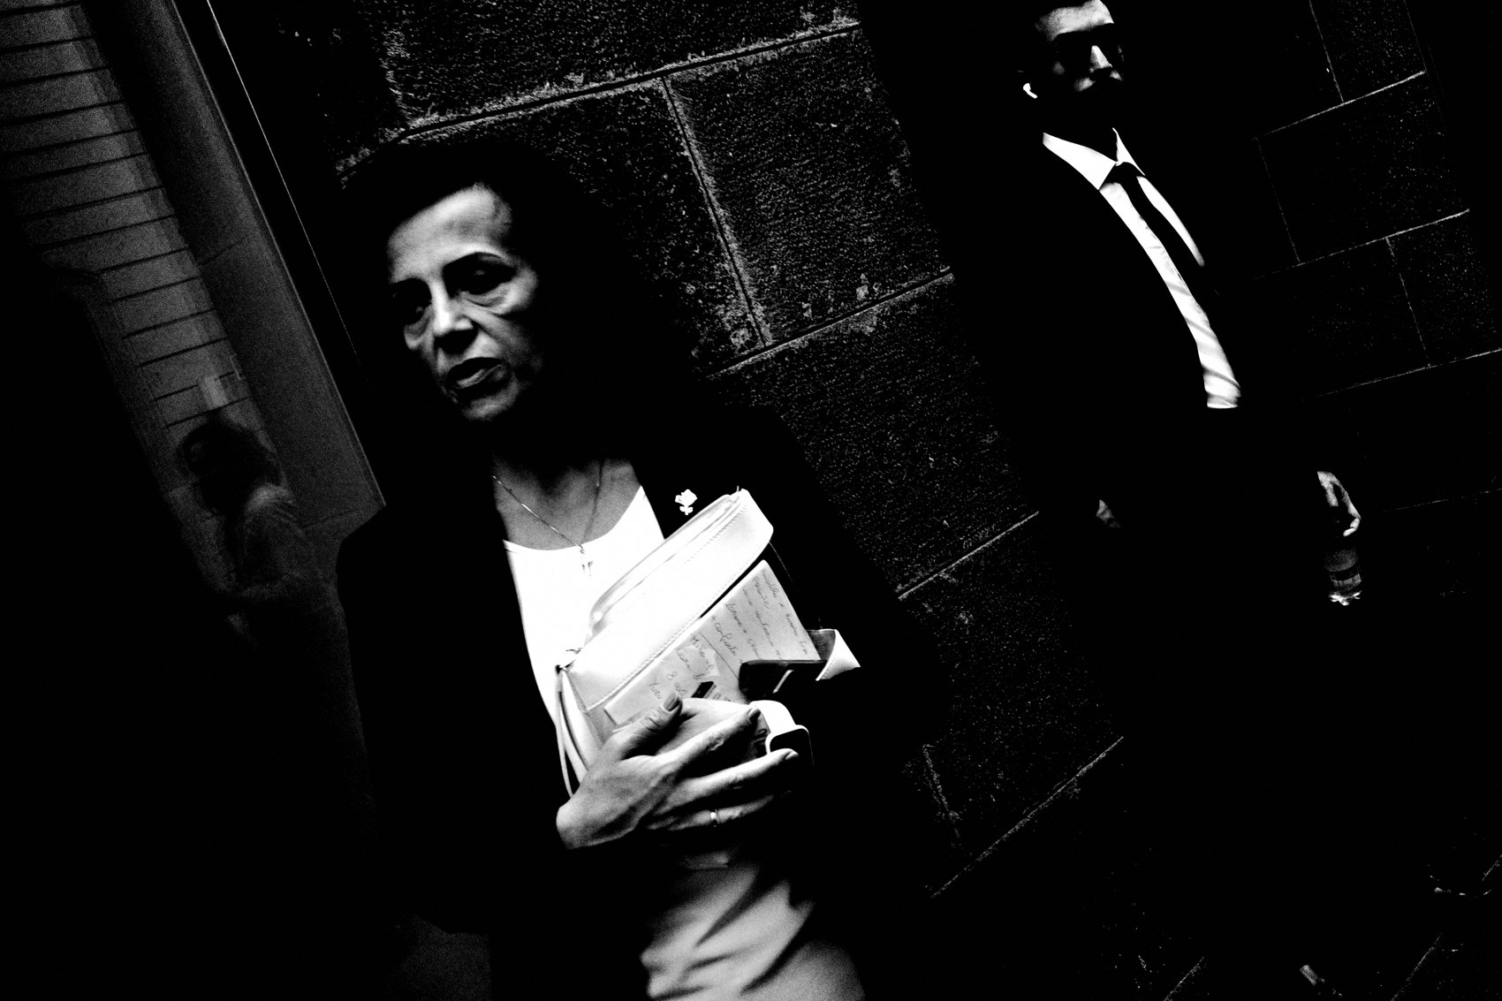
FLUX ACADEMY
BEAT 22 · RELATIONSHIP TO UPCOMING
Next: Be a Tourist at Home
— Next: Be a Tourist at Home (Lesson 015)
— Bring the open, wandering eye home
— Find honey on your own block
Notes:
Quick look ahead. In Lesson 015 — Be a Tourist at Home — we take this wandering, open, let-go eye and point it at the streets you think you already know. Serendipity isn't only for far-off parks and foreign cities. Walk your own block like one of those princes of Serendip, and you'll start finding honey right outside your door.

Slide 24
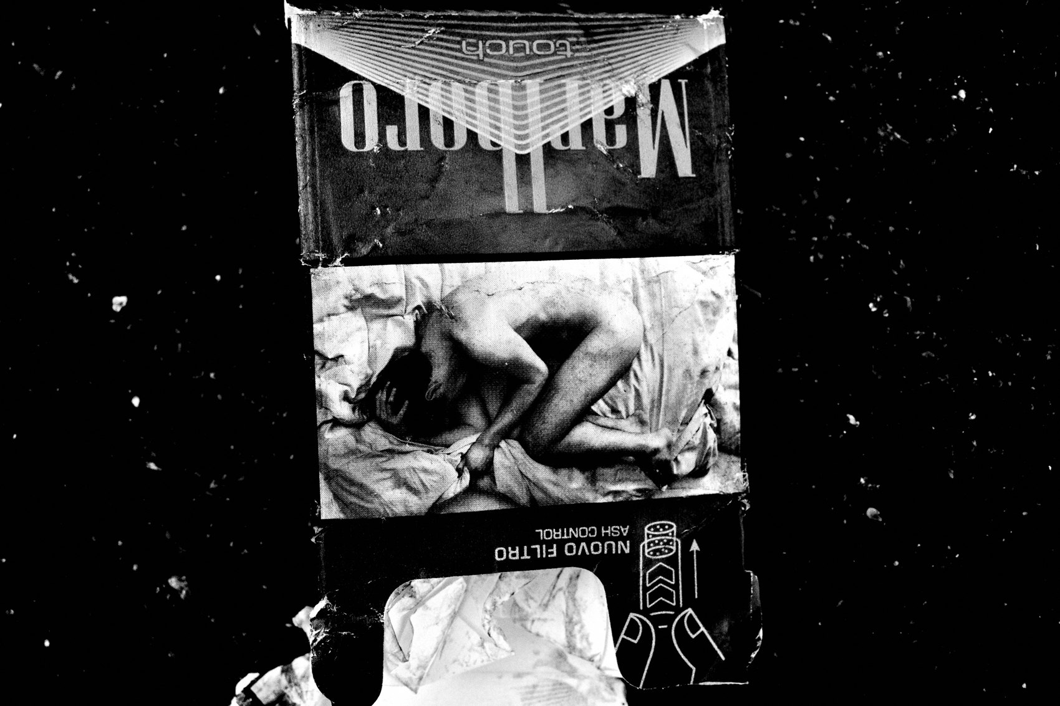
FLUX ACADEMY
BEAT 23 · SUMMARY / TAKEAWAY
Let Go, Walk, Find Gold
— The decisive moment is a myth
— Be prepared, then empty — and respond
— Let go · walk · observe · photograph
Notes:
Last thing. The decisive moment is a myth — the magic is in letting go. Build your foundation, be ready, then empty your mind and just respond. Like those three princes, don't go looking for treasure; just live, wander, move — and in the movement, you'll find gold. Let go. Walk. Observe. And photograph whatever the universe places in front of you. Catch you next lesson.

