Slide 1
FLUX ACADEMY · A SCHOOL FOR SEEING
MODULE 3 · LEARNING TO SEE
The Made vs the Found Photograph
BY DANTE SISOFO

Slide 2
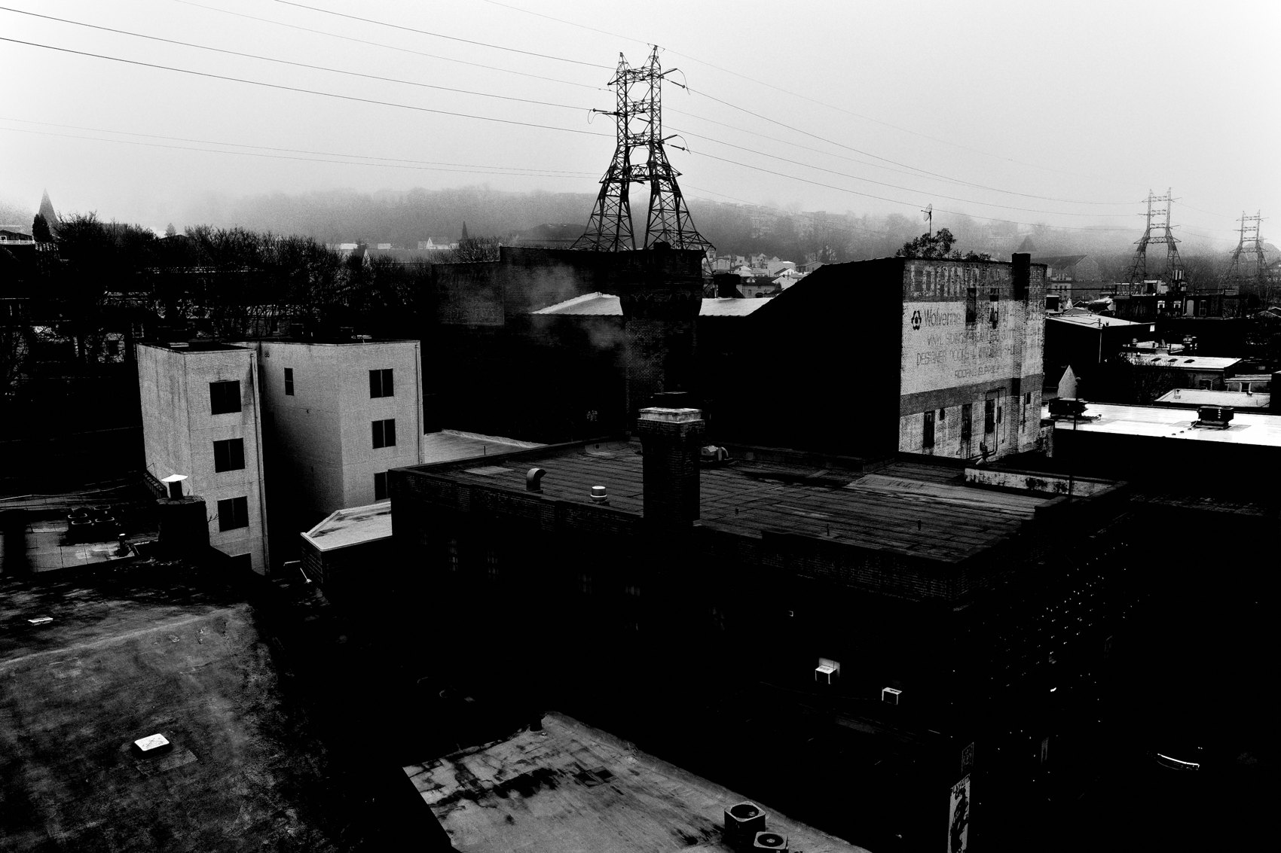
FLUX ACADEMY
BEAT 01 · CORE IDEA
You Make the Photo, You Don't Find It
— The single-click myth is wrong
— Strong frames are made, not stumbled on
— You stay until the scene gives
Notes:
What's popping, people — it's Dante. Today might be the most important thing I teach you: the difference between the found photograph and the made one. People think you click once and walk off. Nah. The photographs I'm proudest of came with lots of clicks, lots of time. I don't leave the scene until the scene leaves me.

Slide 3
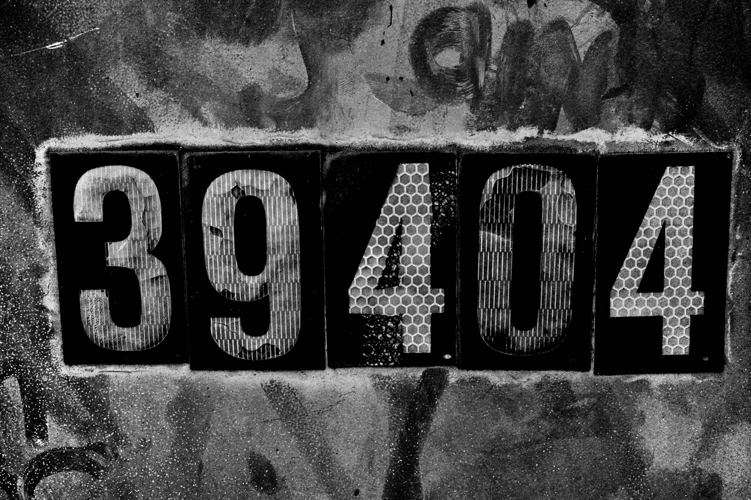
FLUX ACADEMY
BEAT 02 · LEARNING OBJECTIVE
Learn to Work a Scene
— Recognize a scene with potential
— Stay, move, and refine it into a frame
— Stop trusting the lucky single shot
Notes:
By the end of this lesson you'll know how to work the scene — how to spot the raw potential in front of you and then build it into a real photograph through patience, positioning, and persistence. You'll stop praying for one lucky click and start making the frame happen.

Slide 4
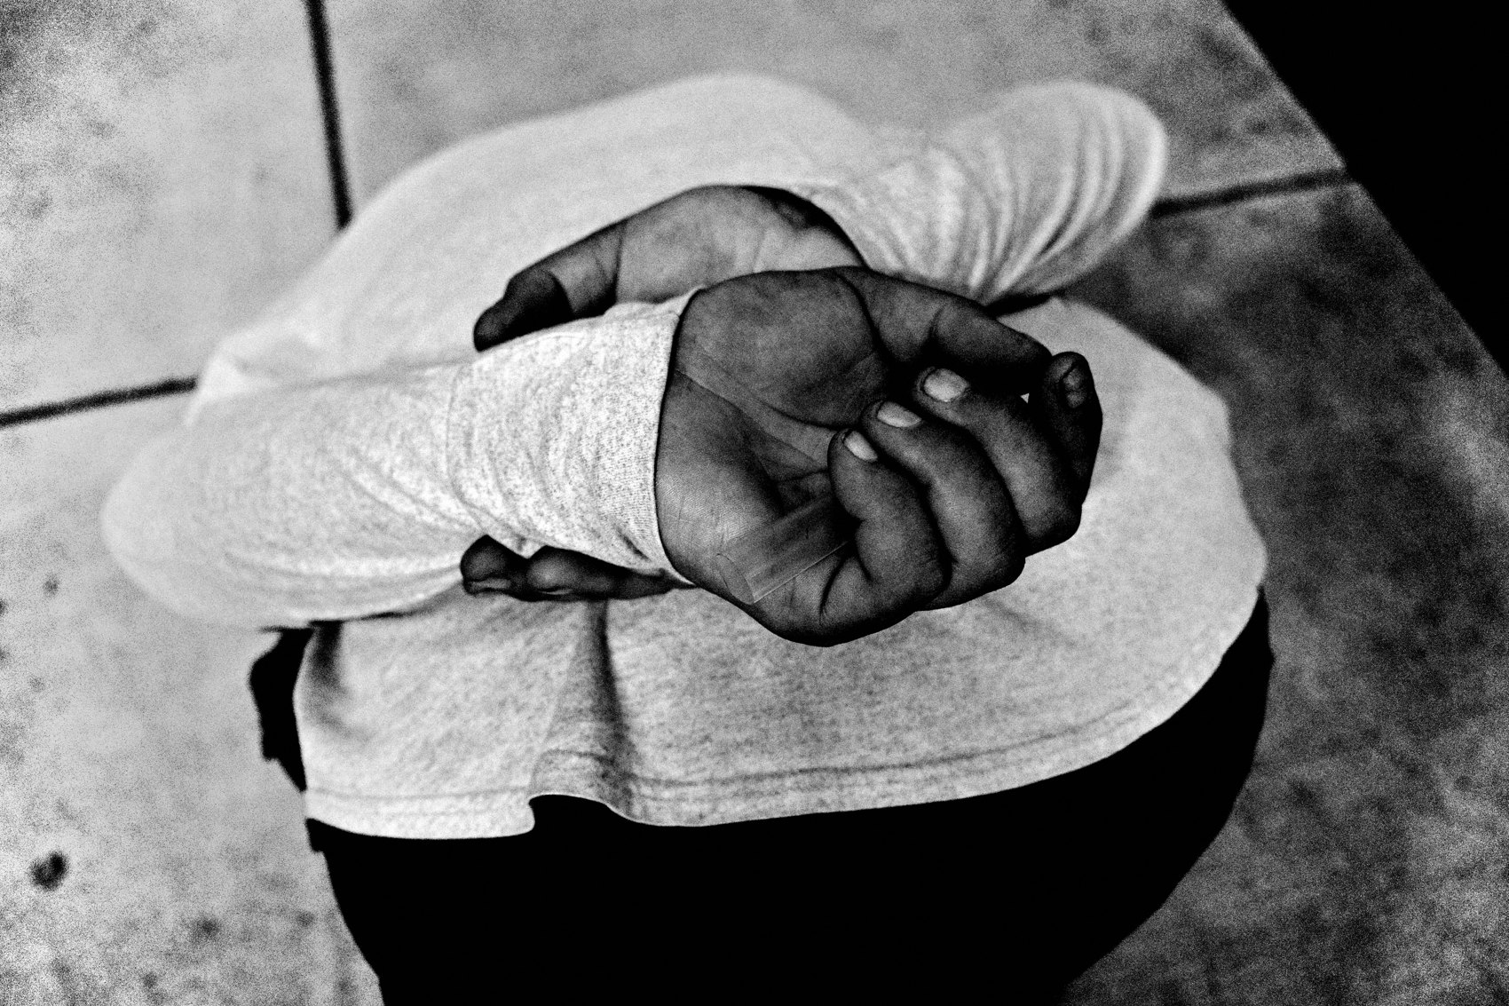
FLUX ACADEMY
BEAT 03 · WHY THIS MATTERS
The Decisive-Moment Myth
— The "one click and move on" idea is a myth
— It makes you leave too early
— The best moments come from staying
Notes:
Here's why this matters: there are huge misconceptions about the decisive moment. People picture a photographer clicking once and gliding away. I'm here to dispel that myth. Believe it and you'll quit on scenes right before they get good — you'll walk away from the photograph you came to make.

Slide 5

FLUX ACADEMY
BEAT 04 · WHY THIS MATTERS
Effort Is the Difference
— A found snapshot is a starting point
— A made photo is a refined one
— The work happens between the clicks
Notes:
And this is the difference between an okay snapshot and a frame that hits. The found moment is the seed; the made photograph is what you grow from it. The magic isn't in the one press of the shutter — it's in everything you do between the clicks to refine what's there.

Slide 6

FLUX ACADEMY
BEAT 05 · MAIN TEACHING
Don't Leave Till the Scene Leaves You
— Don't leave the scene until the scene leaves you
— Exhaust the possibilities first
— Lots of clicks, lots of time
Notes:
Let's state the core rule plainly: don't leave the scene until the scene leaves you. A lot of my photographs came with lots of shutter presses and a lot of time spent. You stay, you keep looking, you keep pressing — until the energy genuinely dies, not until you get bored or nervous.

Slide 7
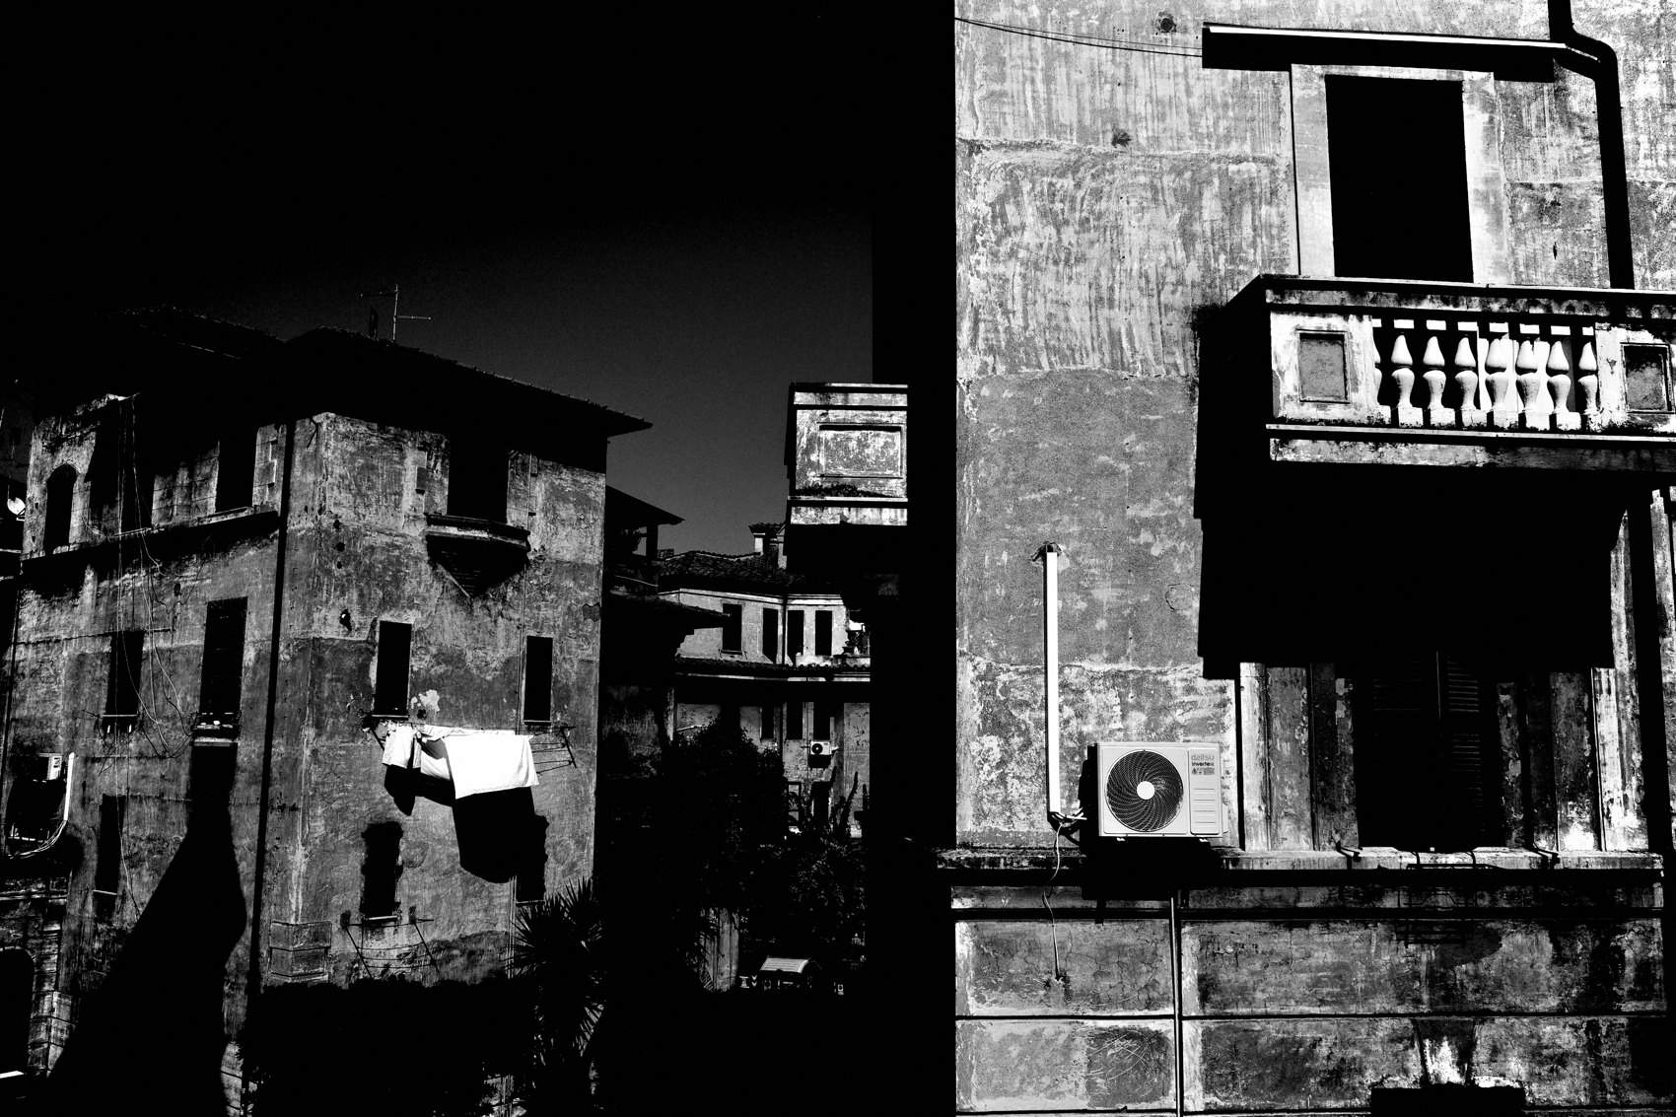
FLUX ACADEMY
BEAT 06 · MAIN TEACHING
Patience
— Sometimes you just wait
— The right moment arrives, doesn't announce itself
— Hold your position
Notes:
First of the three P's: patience. Sometimes you have to wait for the right moment. You set yourself up and you let the scene come to you. The picture doesn't show up on your schedule — so you hold, you watch, and you stay ready for the instant it finally aligns.

Slide 8
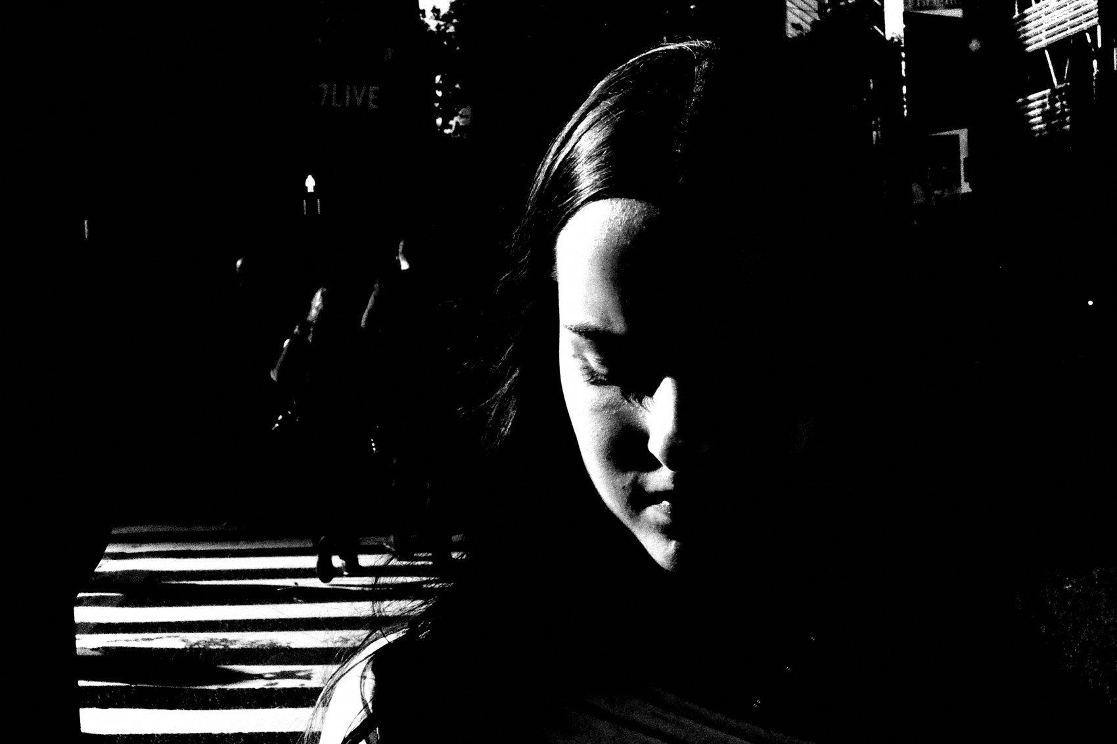
FLUX ACADEMY
BEAT 07 · MAIN TEACHING
Positioning
— Your body is the composition tool
— A few steps changes everything
— Drop low, step back, shift right
Notes:
Second P: positioning. Your physical relationship to the scene is everything. Photography is physical — move your body, drop low, step back, change your angle. Every small movement changes the composition drastically. The frame you want is often just two steps to the side of where you're standing.

Slide 9
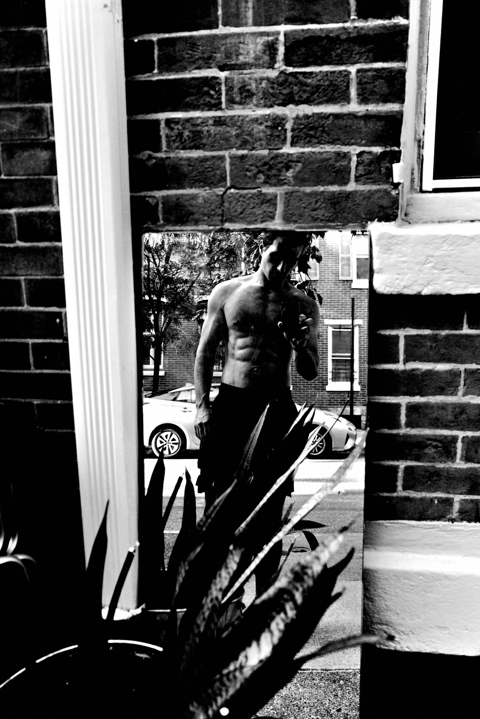
FLUX ACADEMY
BEAT 08 · MAIN TEACHING
Persistence
— Keep shooting, keep adjusting
— Come back again and again
— Refine, don't settle
Notes:
Third P: persistence. Keep shooting, keep adjusting, keep refining. Don't take one shot and move on — work the scene and find the best way to make the composition. Persistence isn't just one session, either. Sometimes you come back to a place week after week until it finally gives.

Slide 10
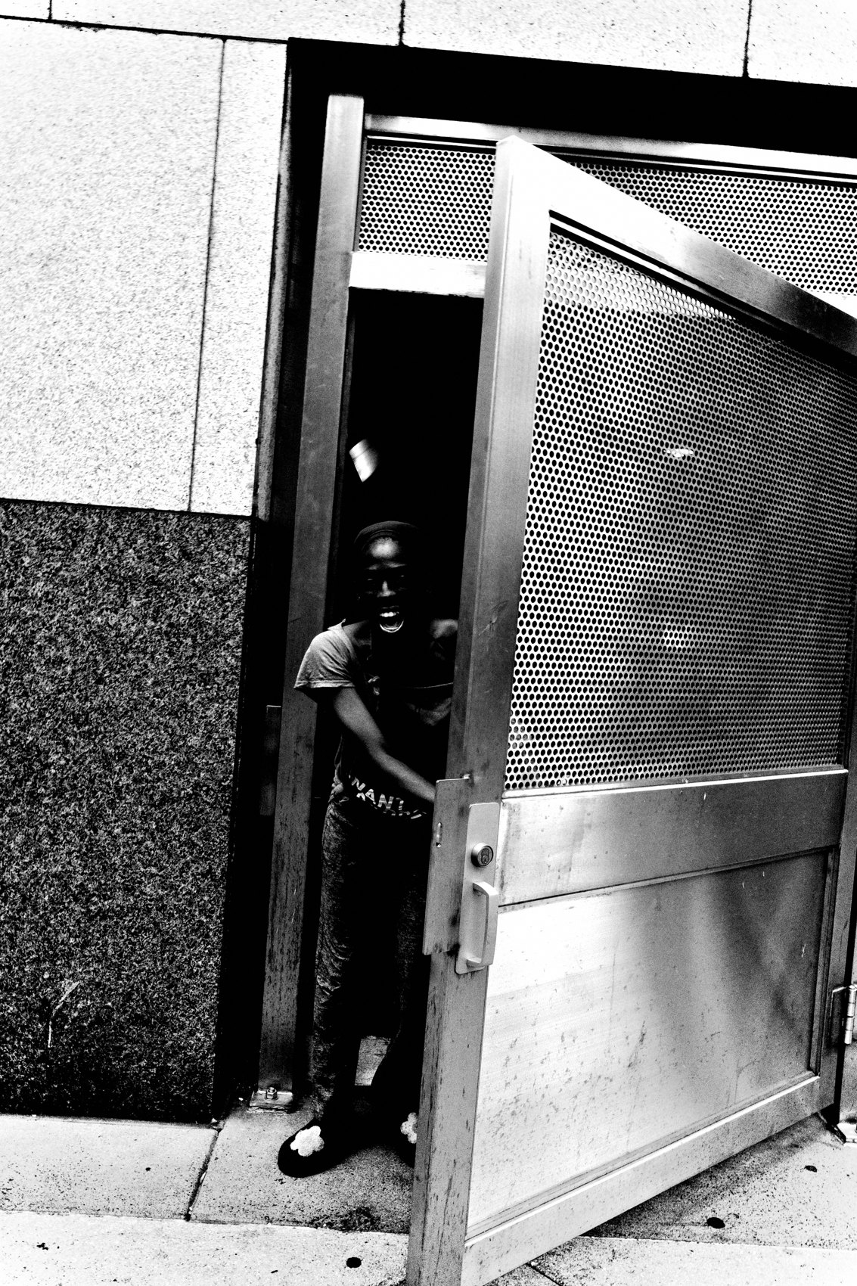
FLUX ACADEMY
BEAT 09 · MAIN TEACHING
The Visual Puzzle
— Photography is a visual puzzle
— Find the pieces, fit them together
— You're assembling, not just capturing
Notes:
Here's how I think about it: photography is a visual puzzle. Your job is to find the pieces and put them together. Light, a gesture, a shape, a background — they're all scattered in front of you. Working the scene is the act of arranging yourself until those pieces lock into one frame.

Slide 11
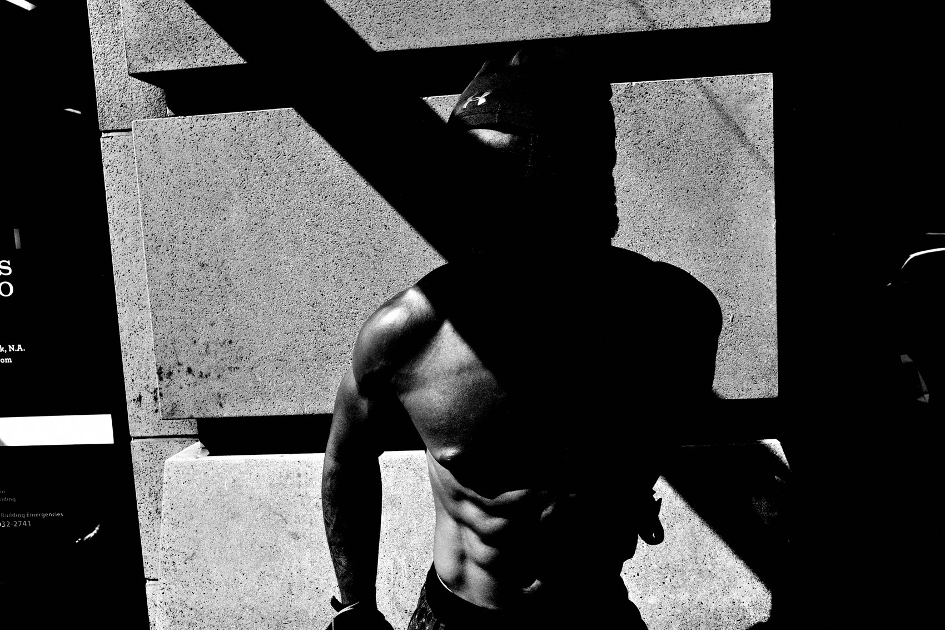
FLUX ACADEMY
BEAT 10 · MAIN TEACHING
Return Until It Gives
— Go back to a promising spot, again and again
— Most visits, nothing happens
— Courage, repetition, persistence
Notes:
Think about a place that keeps pulling you back — a spot you sense holds a photograph. You return time and time again, and most of the time nothing happens. It's empty, quiet, dead. Then, on some ordinary visit, the scene finally comes alive and hands you the frame. You get it through courage, repetition, and persistence. That kind of photograph is made over time, not found in a single moment.

Slide 12
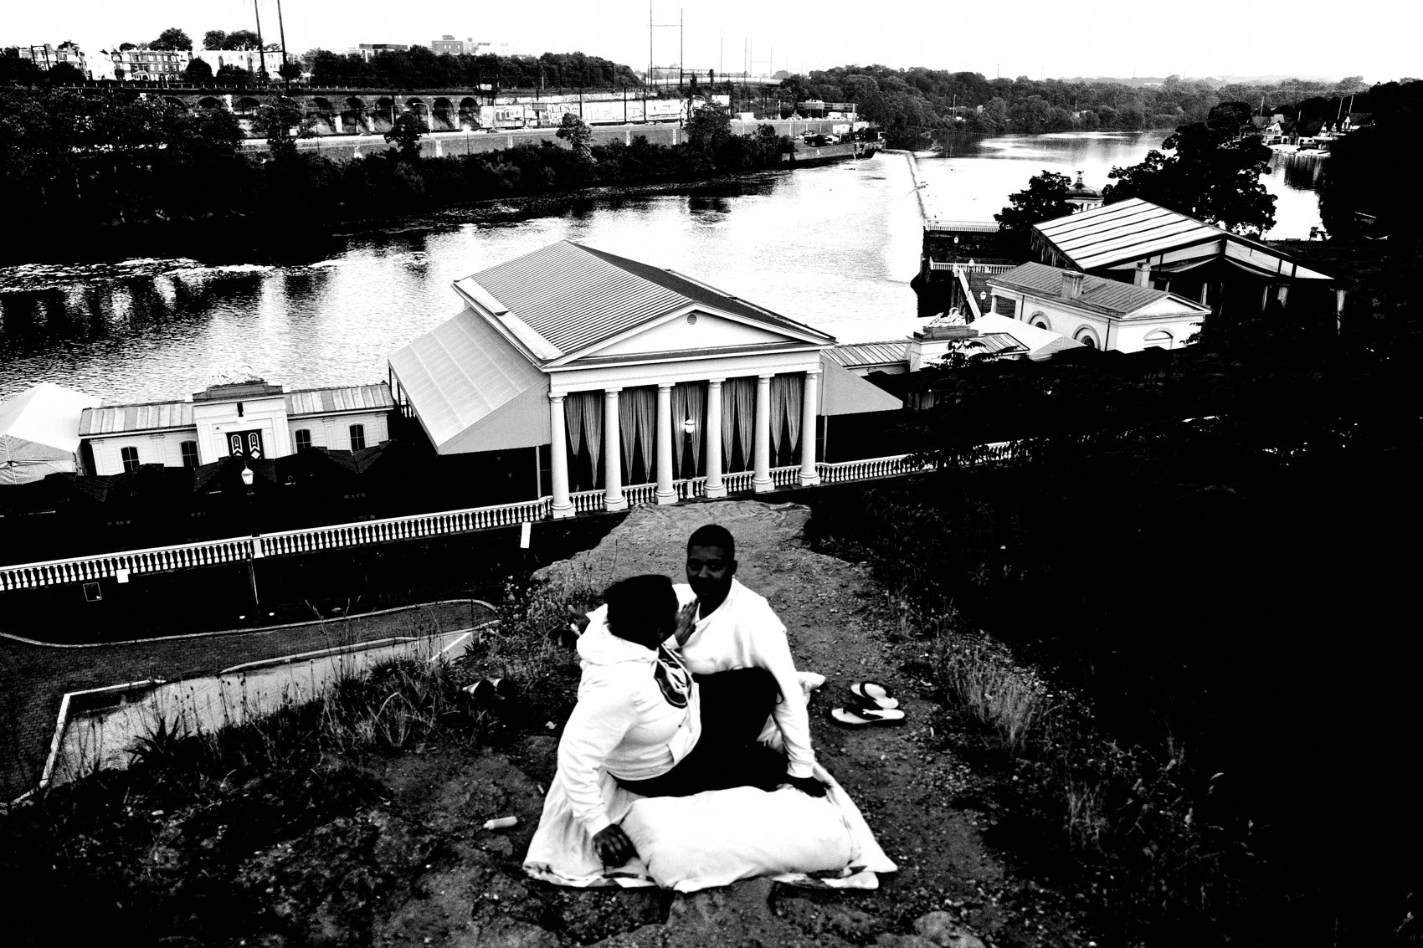
FLUX ACADEMY
BEAT 11 · MAIN TEACHING
The Contact Sheet Tells the Story
— First shots fall flat
— Reposition, change perspective
— The frame snaps into impact
Notes:
Lay out the full run from a scene you worked and you see the whole process. The early frames as you sense potential. The first shots that fall flat. Then you move a few steps to the side, change your perspective — and suddenly the elements line up and the frame carries real weight. Repositioning your body is how you turn a flat grab into a photograph with impact.

Slide 13
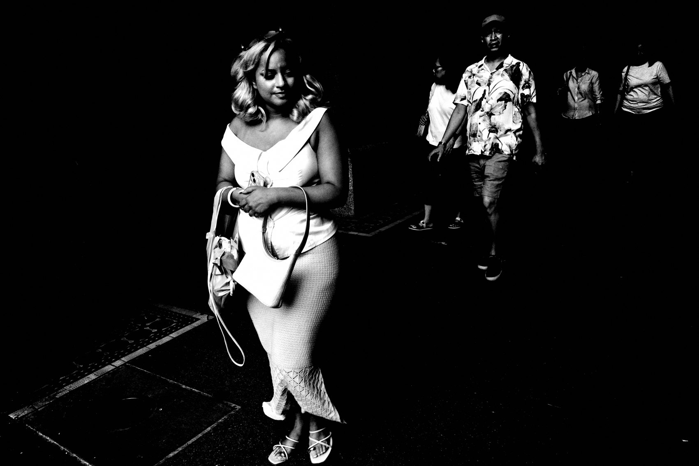
FLUX ACADEMY
BEAT 12 · MAIN TEACHING
Sense It, Then Wait
— A pop of color and striking light
— Position carefully, wait for the moment
— The gesture lands, framed by light and shadow
Notes:
Here's the pattern. You notice a beautiful pop of color and striking light at a market stall — you sense a potential photograph before anything has actually happened. So you position yourself carefully and you wait for the decisive moment. Then the vendor makes a gesture, a smile breaks, the human element lands right inside that light and shadow. That's the puzzle solved — you built the frame and waited for life to fill it.

Slide 14
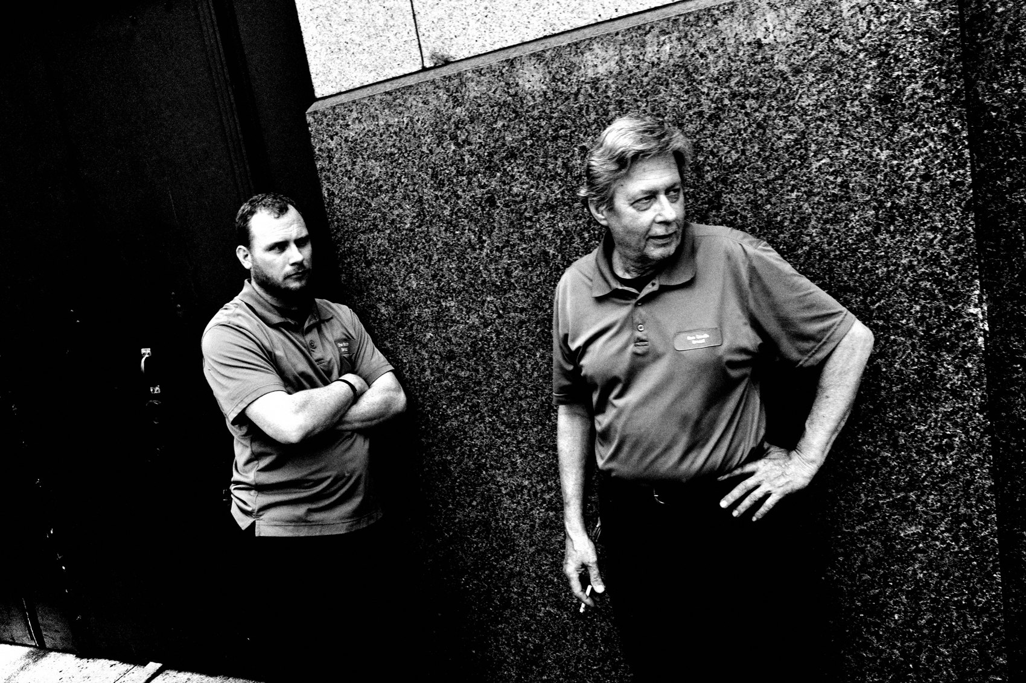
FLUX ACADEMY
BEAT 13 · MAIN TEACHING
Play Reveals the Frame
— Joke with your subject, build a connection
— Let the scene unfold naturally
— The best moment comes once they trust you
Notes:
Here's another way scenes get made. You come across someone in the middle of daily life, and instead of snapping a quick shot and leaving, you joke with them, build a connection, and let it unfold. By playing with the scene — being warm, being present, taking your time — you draw out a moment of real character and intrigue you never would've gotten with one rushed click. Connection opens frames that stealth never will.

Slide 15
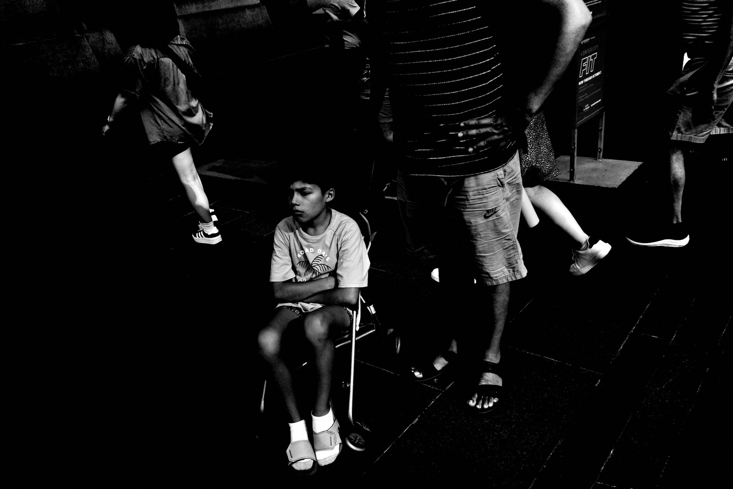
FLUX ACADEMY
BEAT 14 · MAIN TEACHING
Courage Comes From the Heart
— Courage comes from cor — heart
— We all feel the fear at the shutter
— Pushing through fear makes the photo
Notes:
Working the scene takes courage. The word comes from the Latin cor — heart. Photography is a reflection of your heart. We all feel fear pressing the shutter, we all feel awkward at times. But pushing through that fear is exactly what leads to the best photographs. The made photo is on the other side of the nerves.

Slide 16
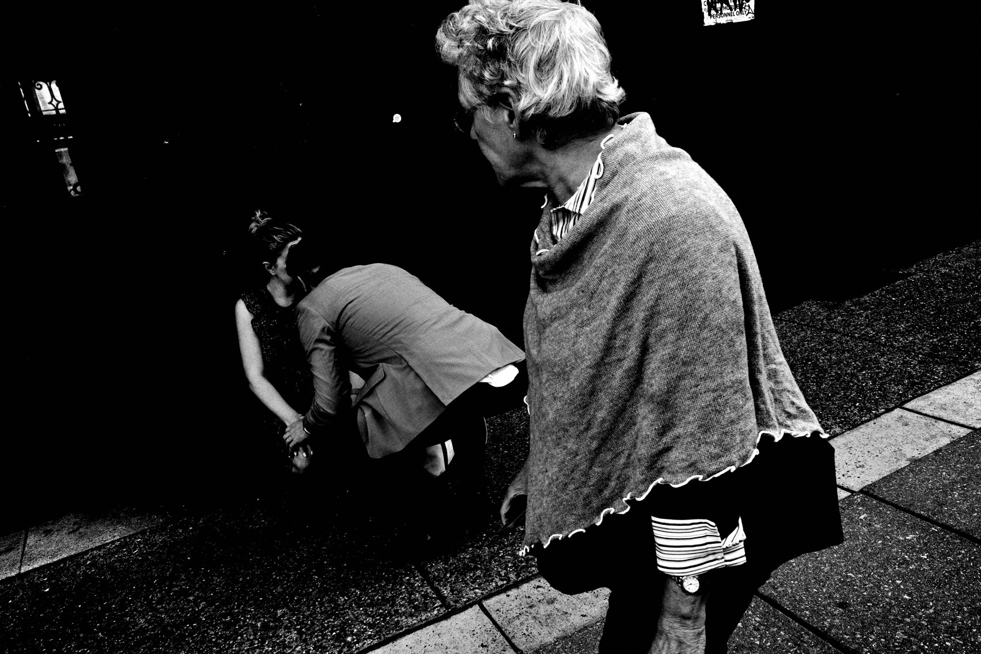
FLUX ACADEMY
BEAT 15 · MAIN TEACHING
Observe Before You Make
— Read light, human movement, patterns
— Anticipate where it's going
— Observe and react
Notes:
Before you can make a frame, you have to see the scene. Strong composition comes from understanding light, human movement, and patterns. Watch how the light falls, track a person's gestures, read where the emotion sits — then drop low, or shift your angle, to emphasize what matters. Observe, anticipate, then react. The watching is the work.

Slide 17

FLUX ACADEMY
BEAT 16 · MAIN TEACHING
Engage, Don't Just Document
— Photography is engaging with humanity, not just recording it
— Get close, interact openly
— Let scenes unfold naturally
Notes:
A made photograph often comes from engagement. Photography has nothing to do with photography — it has everything to do with how you engage with humanity. Even walking into a heavy, intimidating situation, you can set the fear aside and embrace play instead: interact openly, get close, and let scenes unfold. Connection makes the frame.

Slide 18
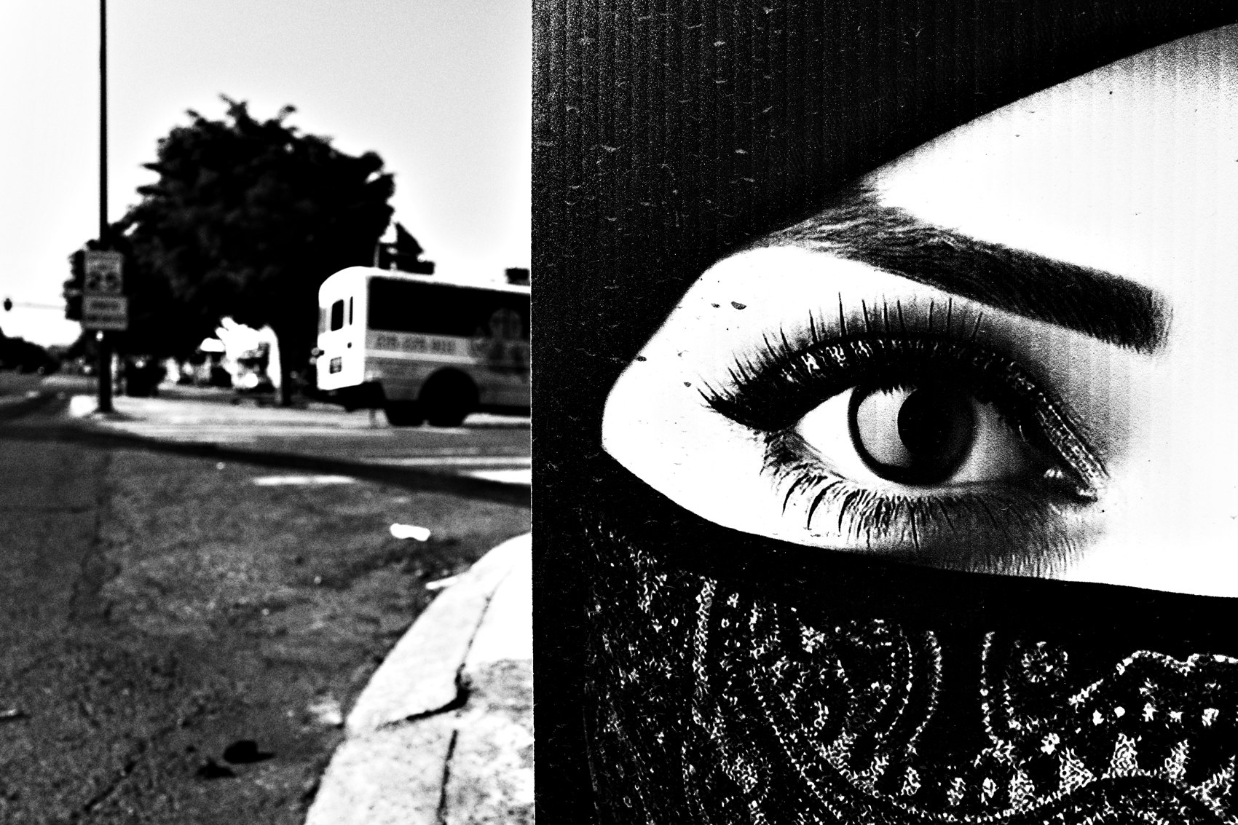
FLUX ACADEMY
BEAT 17 · PRACTICAL APPLICATION
Shoot One Scene Ten Ways
— Pick a scene with potential
— Shoot 15–20 frames, moving each time
— Compare: which position made it?
Notes:
Here's your drill. Next time something catches your eye, do not take one shot and leave. Stay and make fifteen, twenty frames — and move your body for every one. Step left, drop low, get closer, shift right. Later, lay them side by side and find which position made the photograph. That's working the scene.

Slide 19
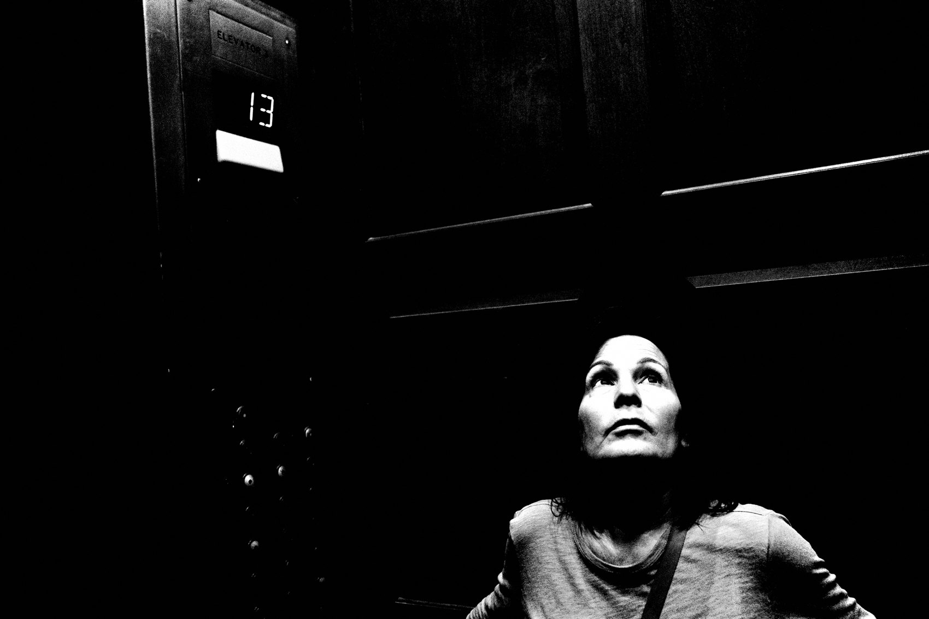
FLUX ACADEMY
BEAT 18 · PRACTICAL APPLICATION
Read Your Own Contact Sheet
— Review the whole run, not just the keeper
— Watch how it got stronger
— Learn what your moves did
Notes:
Then study it like I study mine. Look at the full run, not just the keeper. Watch the scene get stronger frame by frame — the flat early shots, the reposition, the moment it clicks. Reading your own contact sheet teaches you how you make a photo, so next time you get there faster.

Slide 20
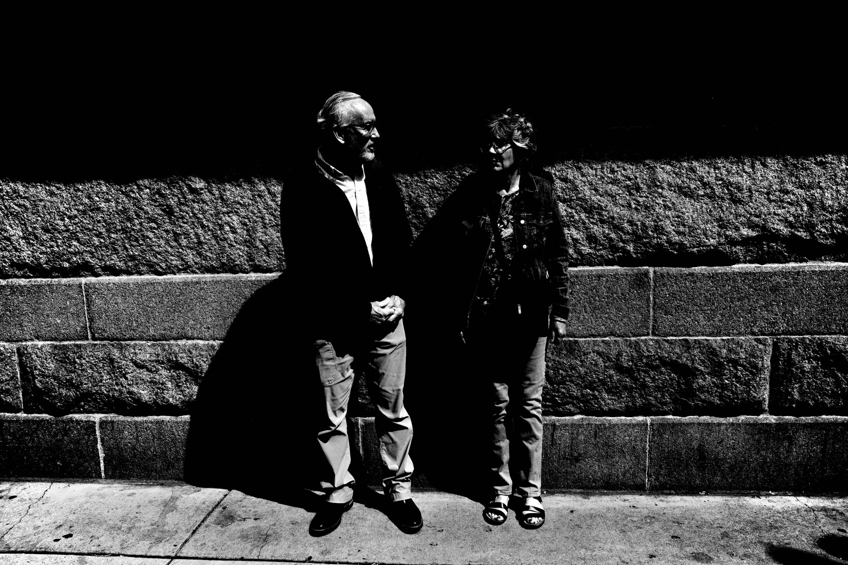
FLUX ACADEMY
BEAT 19 · PRACTICAL APPLICATION
Know When to Move On
— The energy dies, the light shifts
— Trust your gut
— Don't overstay — go find the next one
Notes:
One balance to learn: don't overstay either. Sometimes the energy of a scene dies down, the light shifts, the moment passes. Trust your gut. Don't cling to a dead scene out of stubbornness — work it fully, then move to the next opportunity. Staying and knowing when to leave are the same skill.

Slide 21
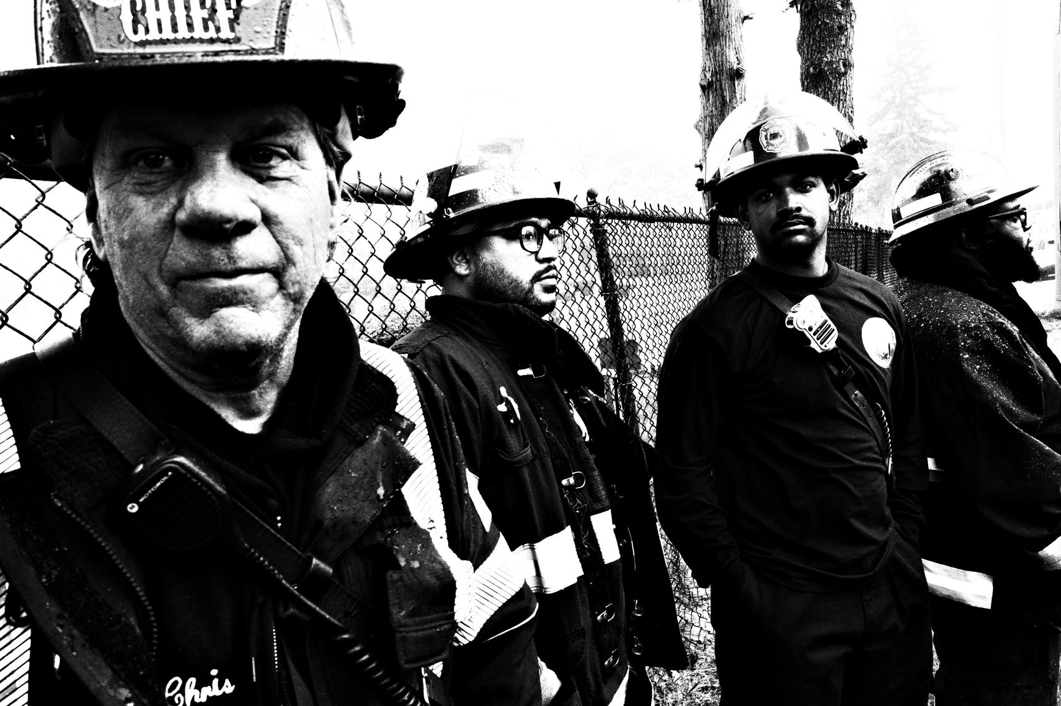
FLUX ACADEMY
BEAT 20 · COMMON MISTAKES
One Click, Then Stand Still
— Taking one shot and walking away
— Then shooting flat-footed, head-on
— Forgetting photography is physical
Notes:
The number-one mistake: one click and gone. You snap a quick grab shot and move on, leaving the real photograph behind — the one two minutes and three steps away. And its twin: standing flat-footed, shooting head-on from one spot. You forget photography is physical. If your first frames fall flat and you don't move, you've decided to settle.

Slide 22
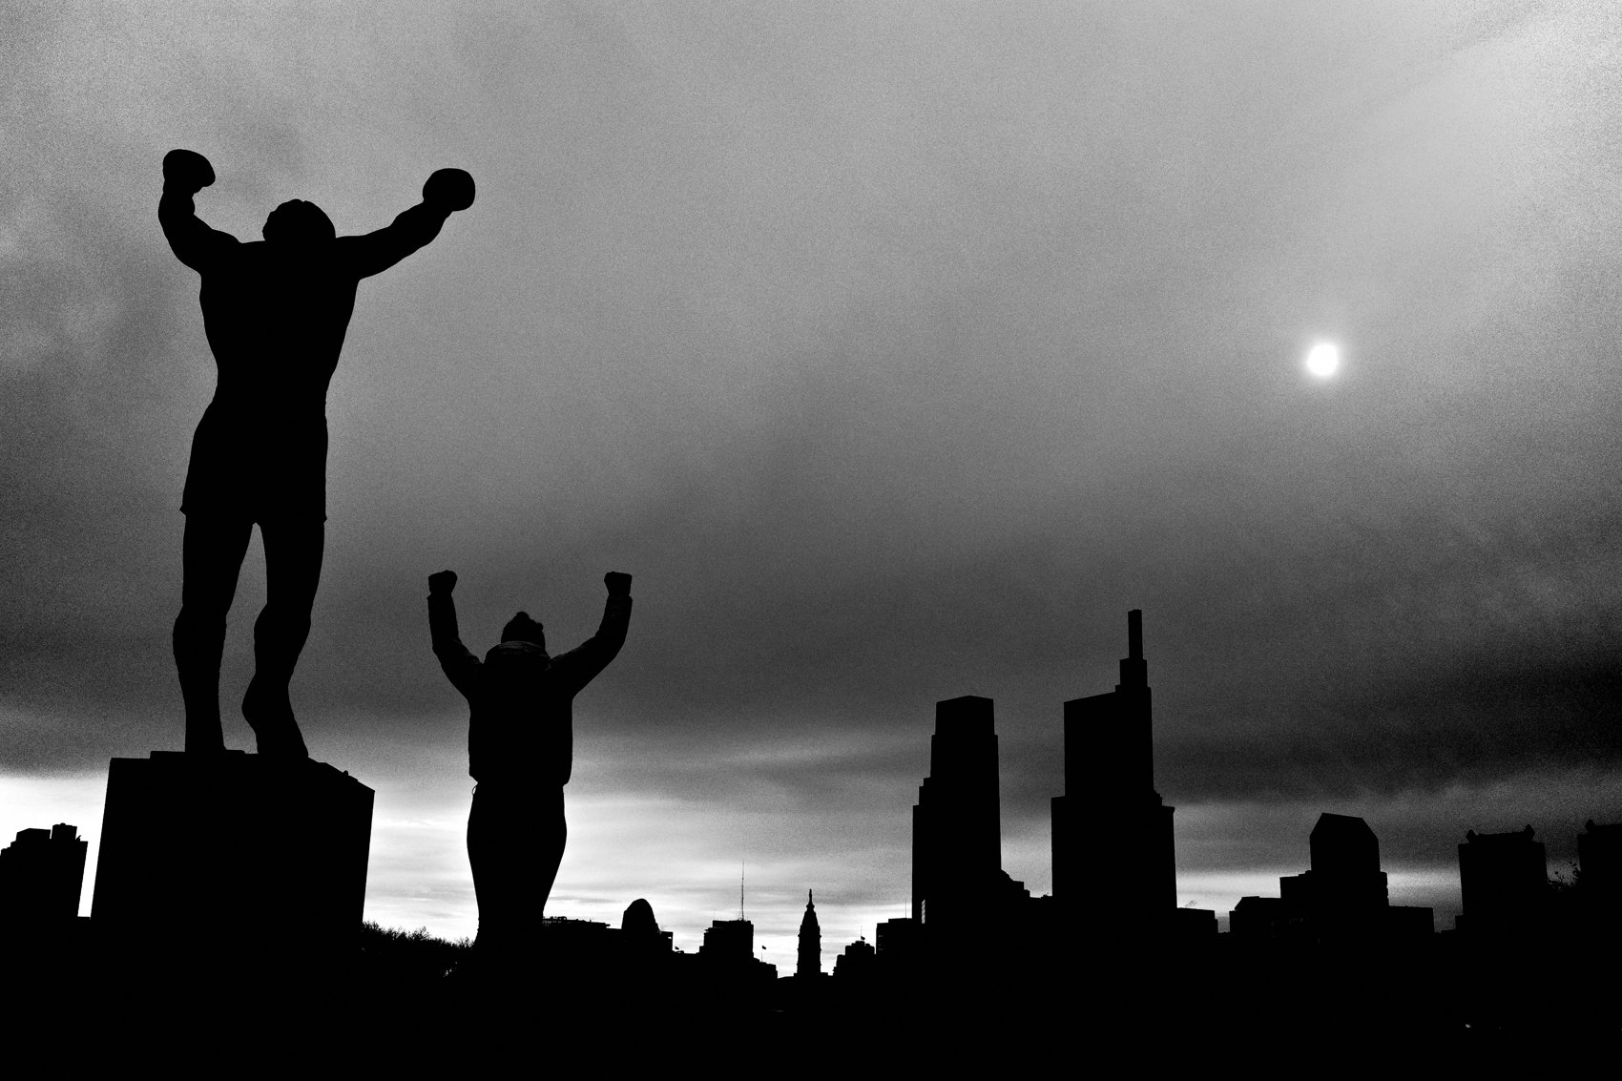
FLUX ACADEMY
BEAT 21 · RELATIONSHIP TO PREVIOUS
Beyond the Snapshot
— Lesson 012 taught the snapshot's honesty
— This lesson adds the work after the snapshot
— Found and made, together
Notes:
Last lesson — Lesson 012 — we honored the snapshot: loose, honest, unfiltered seeing. Keep that. But here we add the next move: once the snapshot shows you a scene worth having, you stay and work it. The found moment gives you the door; making the photograph is walking through it.

Slide 23
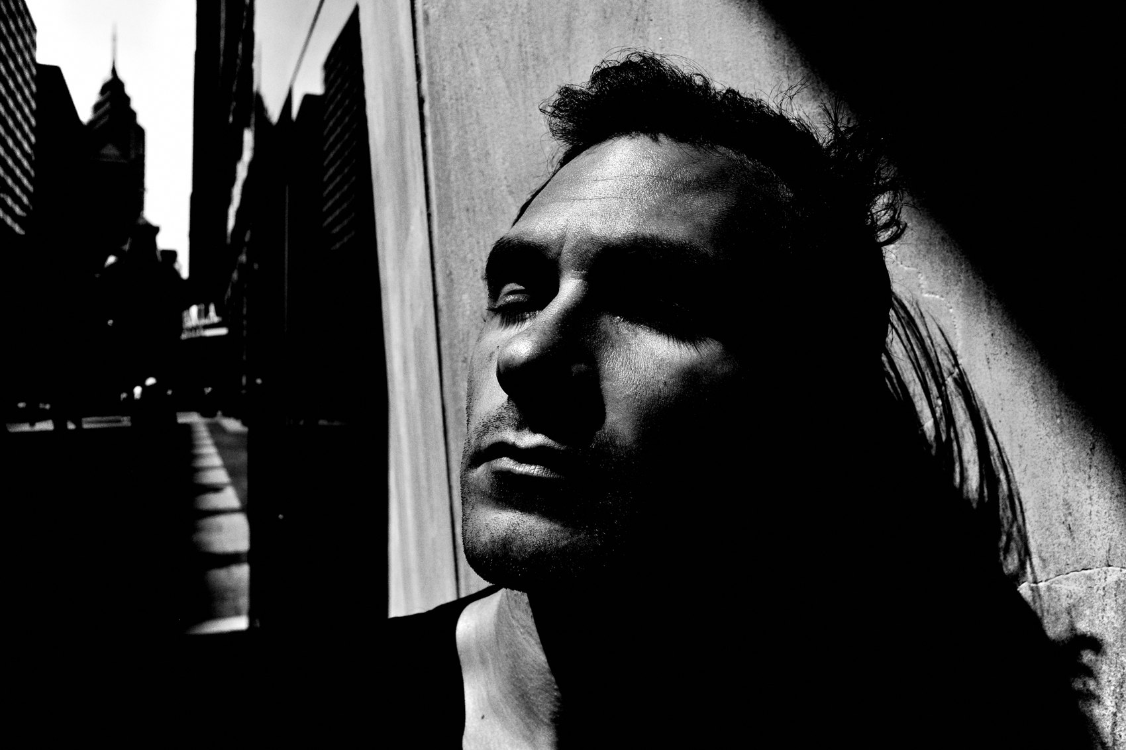
FLUX ACADEMY
BEAT 22 · RELATIONSHIP TO UPCOMING
Next: Juxtaposition & Serendipity
— Next: Juxtaposition & Serendipity (Lesson 014)
— Working the scene meets letting go
— Prepared and open to surprise
Notes:
Quick look ahead. In Lesson 014 we flip the coin: Juxtaposition & Serendipity. Working the scene is the made side — but the street also hands you gifts you couldn't plan. Next we learn to let go, follow the light, and be ready when the universe drops two unrelated things into perfect alignment.

Slide 24
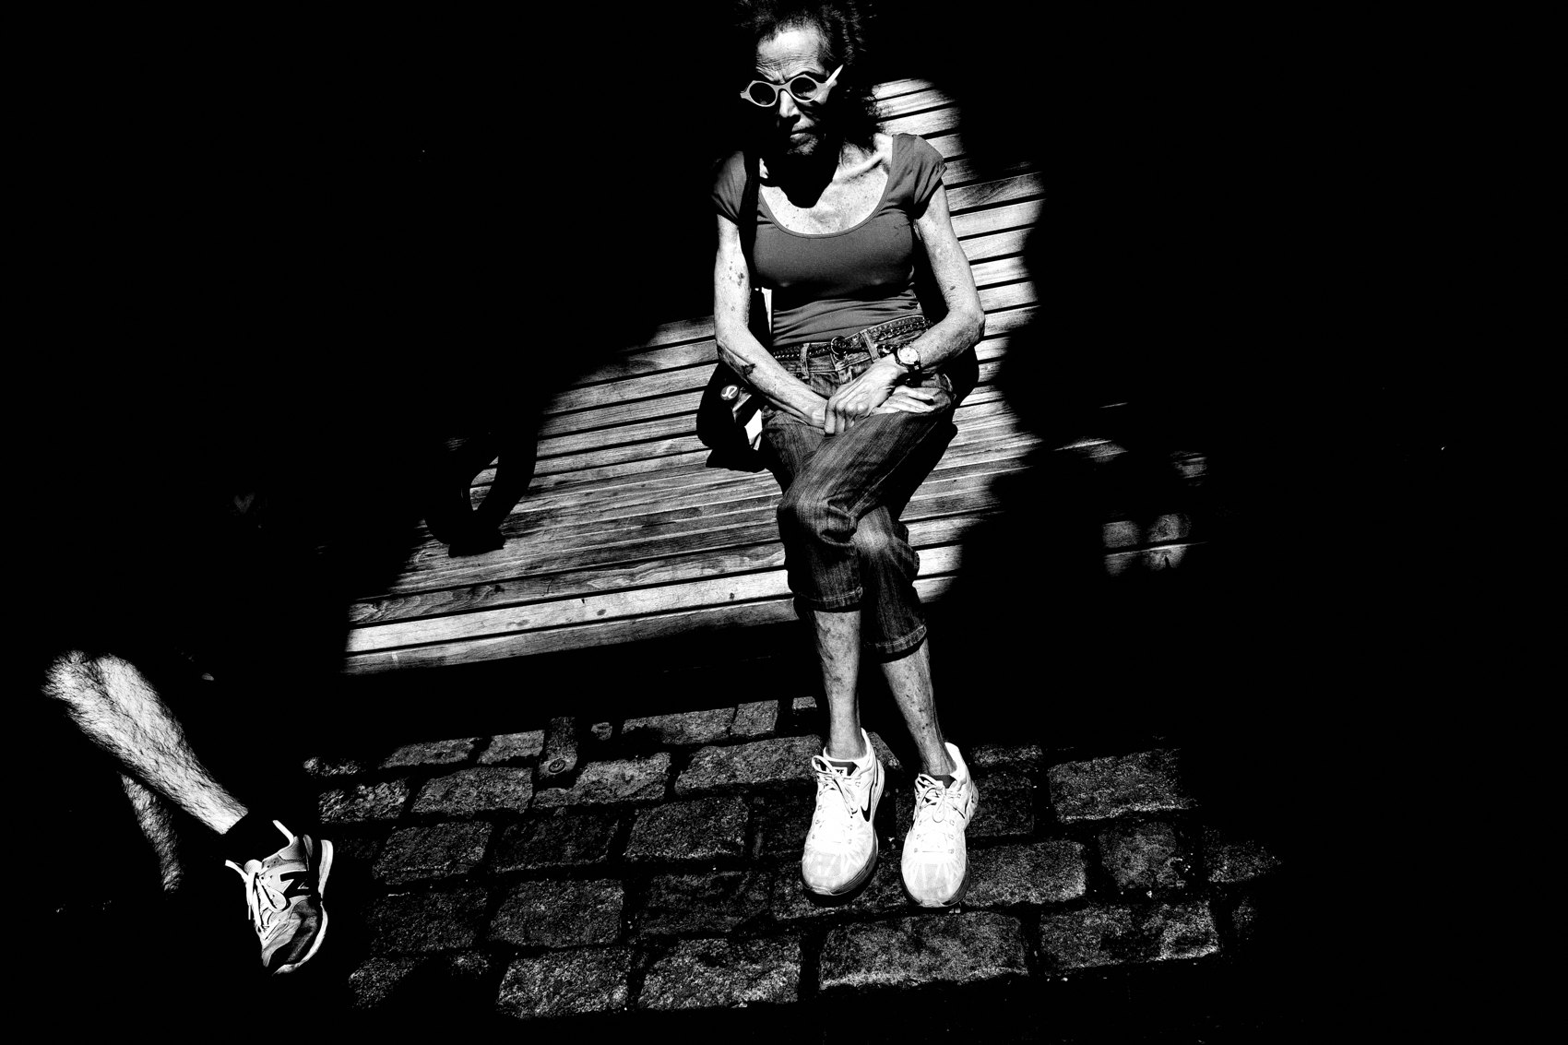
FLUX ACADEMY
BEAT 23 · SUMMARY / TAKEAWAY
Don't Leave Till the Scene Leaves You
— Strong photos are made, not found
— Patience · positioning · persistence
— Don't leave the scene until the scene leaves you
Notes:
Last thing. The great photograph isn't found in one lucky click — it's made through patience, positioning, and persistence. Stay. Move your body. Push through the fear. Work the puzzle until the pieces lock. And remember the one line that matters most: don't leave the scene until the scene leaves you. Catch you next lesson.

