Slide 1
FLUX ACADEMY · A SCHOOL FOR SEEING
MODULE 3 · LEARNING TO SEE
The Snapshot Aesthetic
BY DANTE SISOFO

Slide 2
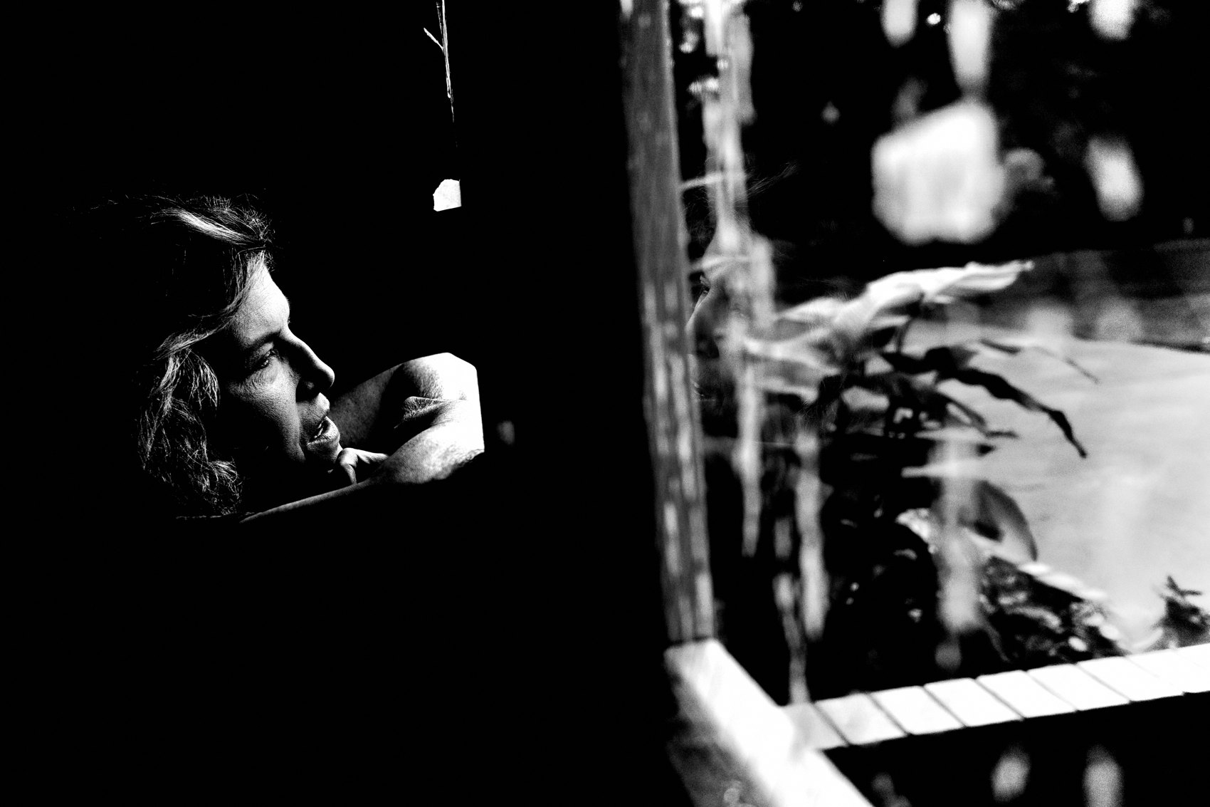
FLUX ACADEMY
BEAT 01 · CORE IDEA
The Snapshot Is the Point
— Not the careless photo — the honest one
— Immediate, embodied, instinctive
— The snapshot reveals you
Notes:
What's popping, people — it's Dante. Today we're talking about the snapshot aesthetic — and I want to flip your whole idea of it. The snapshot isn't the lazy photo, the throwaway photo. The snapshot is the honest photo. It's immediate, it's embodied, it's instinctive — and that's exactly why it matters.

Slide 3
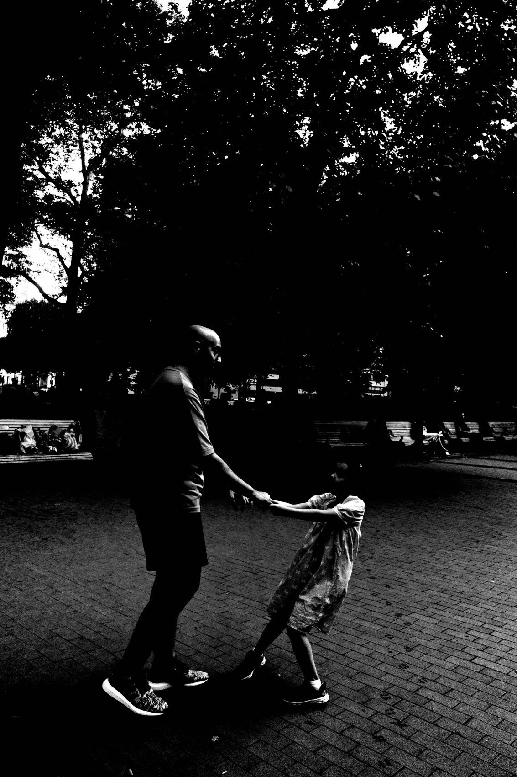
FLUX ACADEMY
BEAT 02 · LEARNING OBJECTIVE
What You'll Walk Away With
— Shoot fast, from the gut, no fuss
— Strip the friction out of your process
— Let casualness become honesty
Notes:
By the end of this lesson you'll know how to shoot like this on purpose — fast, loose, point-and-shoot, no fuss. You'll learn to strip the friction out of your process so instinct can take over. The casual snapshot isn't sloppy — it's a discipline. Let's get into it.

Slide 4
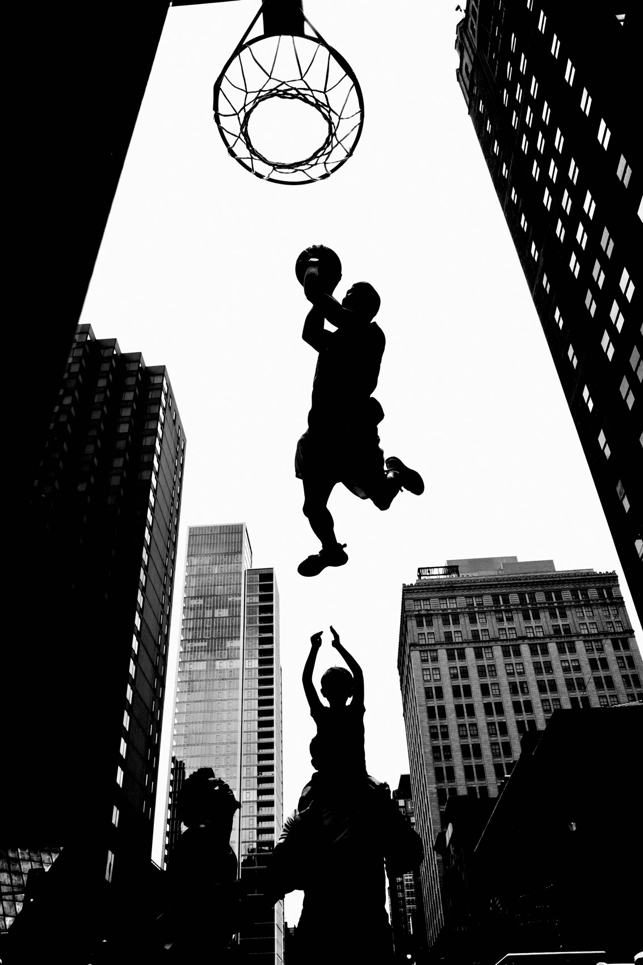
FLUX ACADEMY
BEAT 03 · WHY THIS MATTERS
Perfectionism Kills the Moment
— Overthinking causes delay
— Delay creates hesitation
— Hesitation kills instinct
Notes:
Here's why this matters. Overthinking causes delay. Delay creates hesitation. And hesitation kills instinct. The street moves at the speed of life — if you're standing there lining up perfection, the moment is already gone. The snapshot beats perfectionism because life doesn't wait.

Slide 5
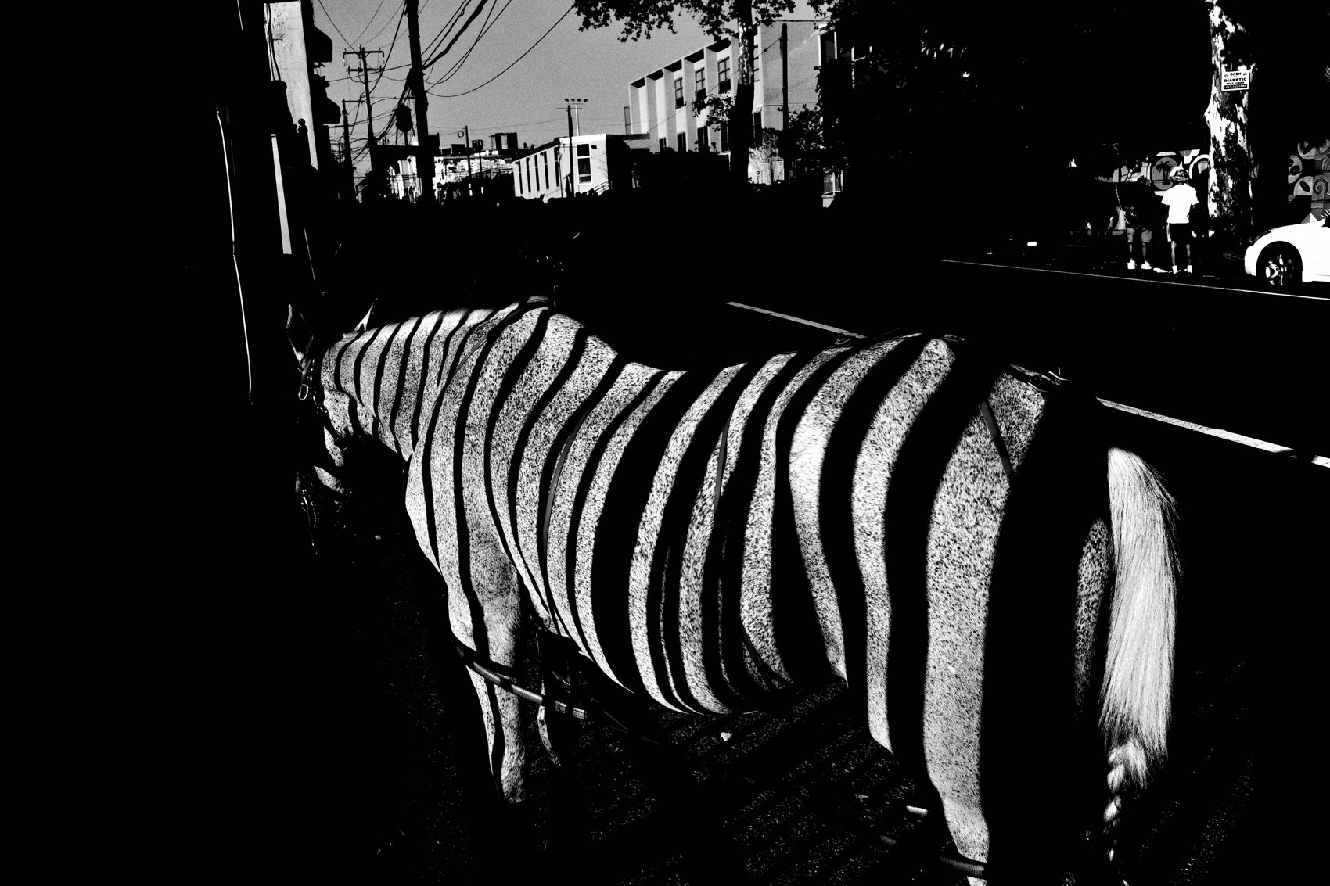
FLUX ACADEMY
BEAT 04 · WHY THIS MATTERS
Casual Is Honest
— Polish performs; the snapshot confesses
— Your subconscious surfaces in the click
— Honesty over impressiveness
Notes:
And here's the deeper reason. When you shoot from the gut, without constructing a narrative, you make the unconscious conscious. The image reflects your internal state, not your concept. Polished photos perform; snapshots confess. That honesty is worth more than any "impressive" frame you ever forced.

Slide 6
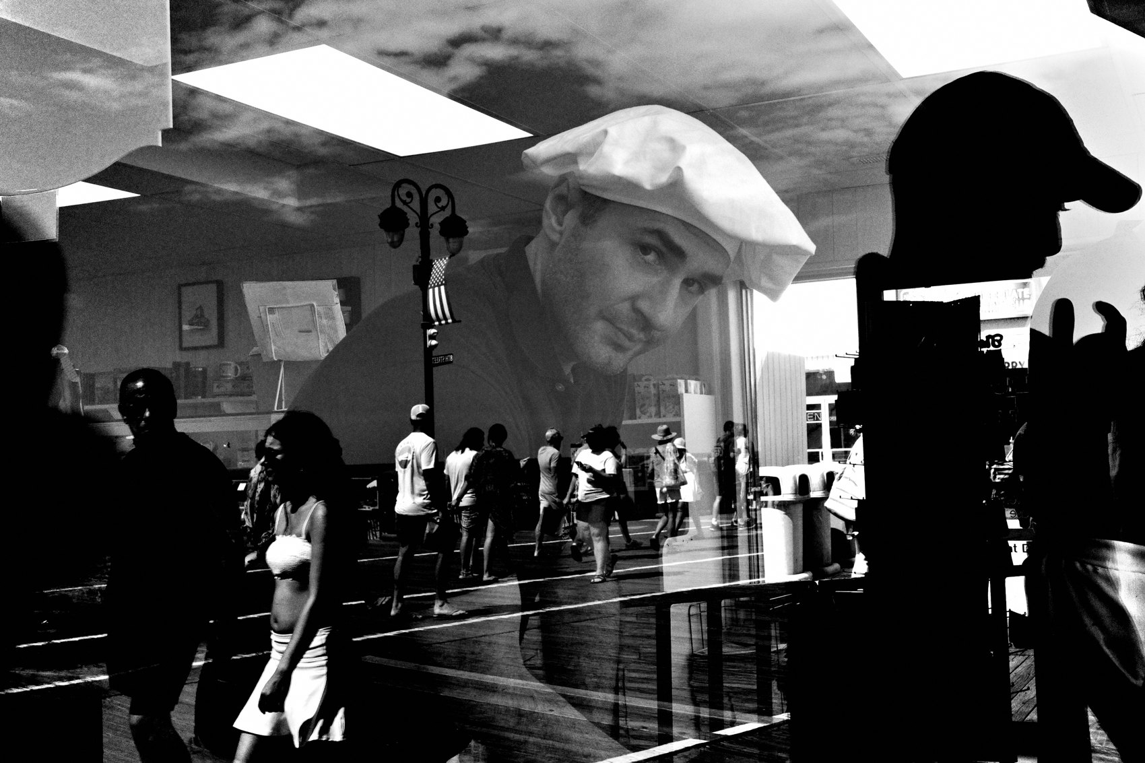
FLUX ACADEMY
BEAT 05 · MAIN TEACHING
Shoot First, Think Later
— Shoot first. Evaluate later.
— Don't narrate it in your head
— Click. Move on.
Notes:
So here's the first principle, plain as it gets: shoot first, think later. When you see something, don't narrate it in your head. Don't ask if it's good. Click. Move on. Let the chips fall as they may. The evaluating comes way later — out on the street, your only job is to respond.

Slide 7

FLUX ACADEMY
BEAT 06 · MAIN TEACHING
Strip the Practice Bare
— One camera, one lens, in your pocket
— Small JPEG, contrast cranked
— There is no going back
Notes:
The snapshot aesthetic starts with stripping the practice bare. For me that's a Ricoh GR in my pocket, a fixed lens, a small JPEG with the contrast cranked to the maximum. I've stripped photography down to black and white — there is no going back. When the practice is this simple, instinct develops much faster.

Slide 8
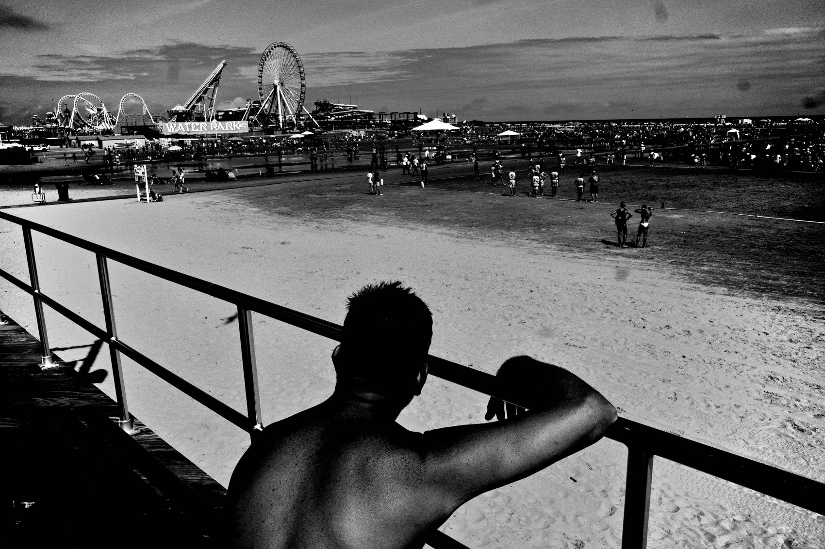
FLUX ACADEMY
BEAT 07 · MAIN TEACHING
Constraint Liberates Instinct
— Automatic mode, snap focus, no menu diving
— The less friction, the louder the gut
— Limits are permissions, not restrictions
Notes:
Counterintuitive truth: constraint liberates the instinct. Small camera, automatic mode, snap focus, no menu diving, no technical drama. The less friction in the way, the louder the gut gets. These limits aren't restrictions — they're permissions. When you remove the technical noise, instinct becomes inevitable.

Slide 9
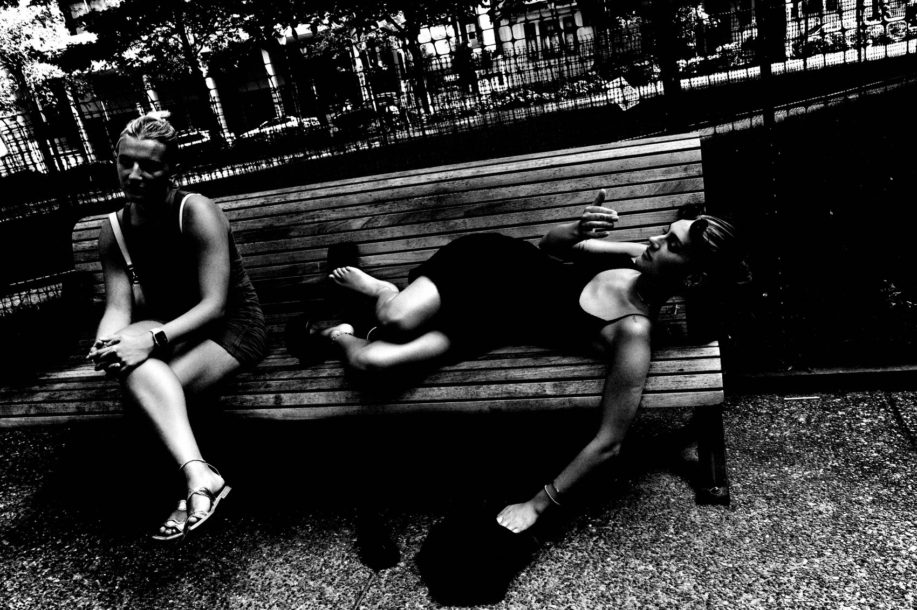
FLUX ACADEMY
BEAT 08 · MAIN TEACHING
Remove the Friction
— No post-processing, no fiddling
— Processing baked into the camera
— Raise the camera. Click. Move.
Notes:
Build a workflow around speed and simplicity. Processing baked into the camera. No post. No fiddling. Loose framing right off the LCD — point and shoot. The whole rhythm becomes: raise the camera, click, move. These creative constraints make photography inevitable. That's the engine of the snapshot.

Slide 10
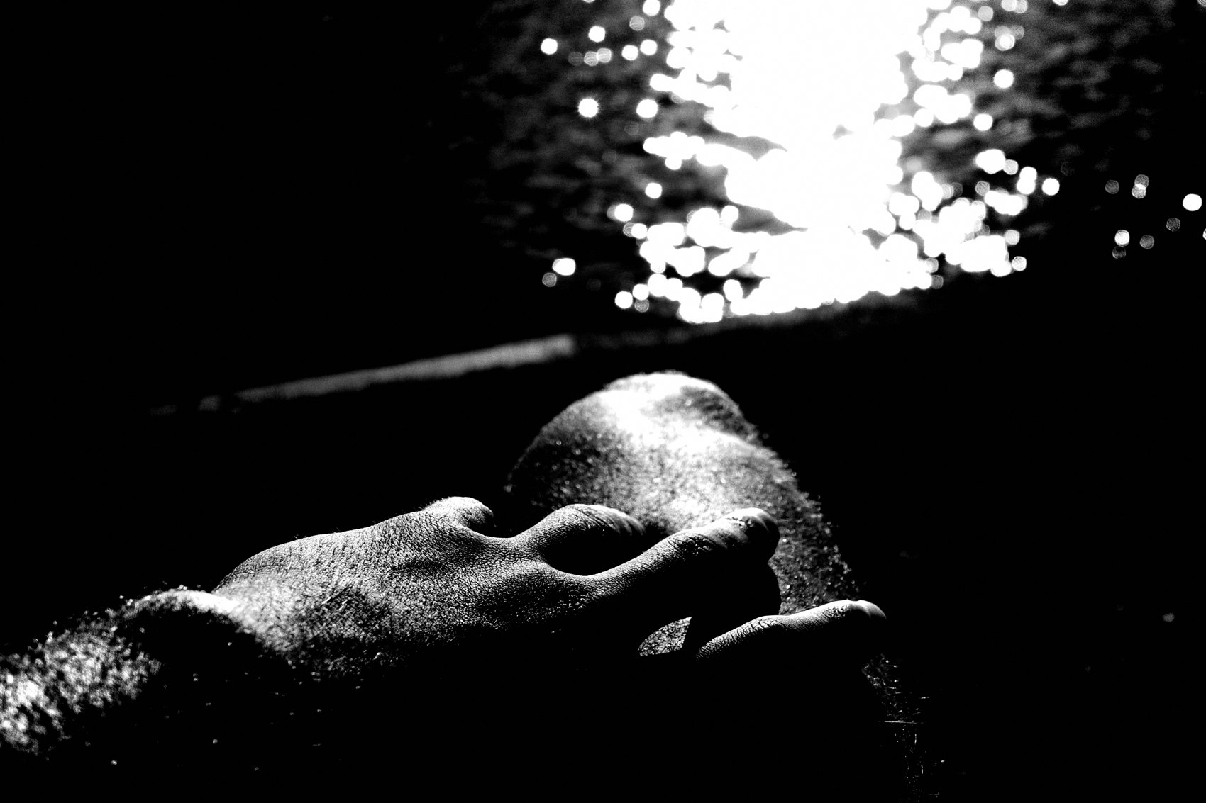
FLUX ACADEMY
BEAT 09 · MAIN TEACHING
Emotion Lives in the Click
— The image reflects your internal state
— Everything you've lived flows through the shutter
— It's immediate. It's embodied. It's honest.
Notes:
When you shoot from the gut, the image reflects your subconscious — everything you've lived flows through that split-second decision. That's why the snapshot matters: it's immediate, it's embodied, it's honest. You're not lining up a concept. You're letting your whole self answer in one click.

Slide 11
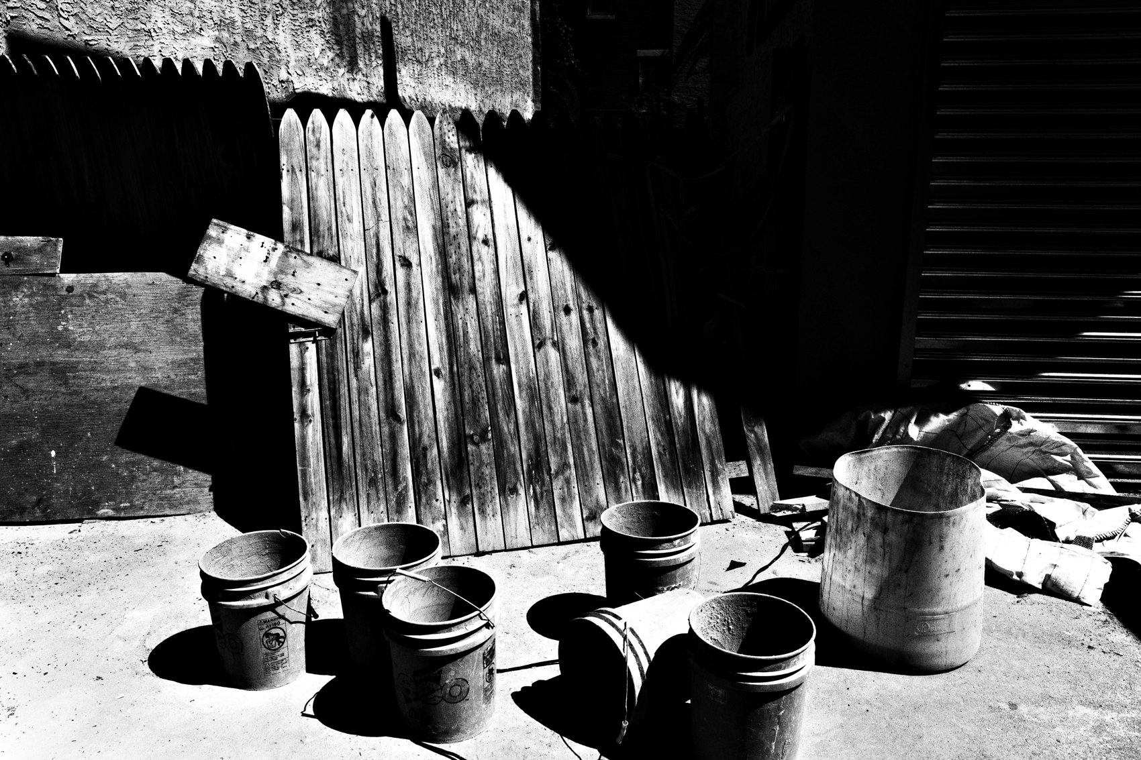
FLUX ACADEMY
BEAT 10 · MAIN TEACHING
The Camera as Extension
— You stop questioning the shutter
— You see, you position, you feel the frame
— The camera becomes part of you
Notes:
Do this long enough and the camera becomes an extension of your body and your eye. You no longer question why you're pressing the shutter — you simply know. You see something, you position your body, you feel how the photograph wants to live inside the four corners. That fluency is what the casual snapshot is really chasing.

Slide 12
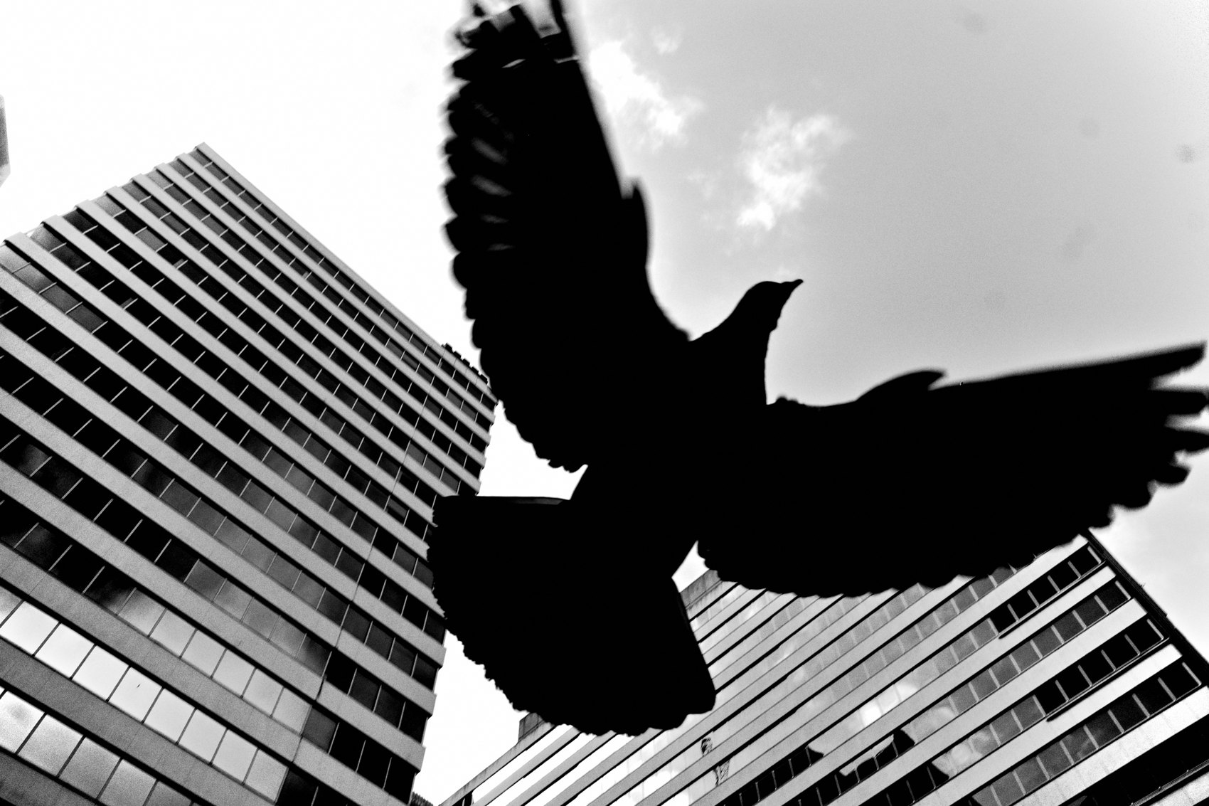
FLUX ACADEMY
BEAT 11 · MAIN TEACHING
Movement Creates the Moment
— Motivation = movere = to move
— Walk to feel instinct, don't stand and wait
— Nine times out of ten, the gut beats the brain
Notes:
Here's a word for you: motivation comes from movere — to move. If you want to feel instinct, walk. Don't stand there lining up perfection waiting for inspiration to strike. Nine times out of ten your gut beats your brain. So move your body, and when you feel the pull — click.

Slide 13
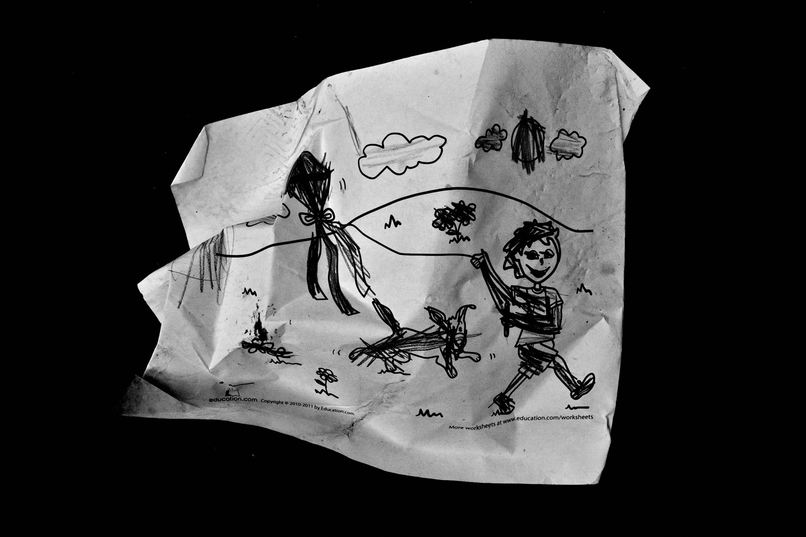
FLUX ACADEMY
BEAT 12 · MAIN TEACHING
The Casual Frame Finds More
— Same humble lane, every single day
— The challenge: uplift the mundane
— Casual approach, elevated result
Notes:
Here's what this looks like in practice. Take the same mundane lane near where you live — same boring street, every day. The challenge is to uplift that mundane into something greater. Stop meticulously composing. Let go, shoot it casual and fast — and the snapshot keeps finding things the careful frame would've walked right past.

Slide 14
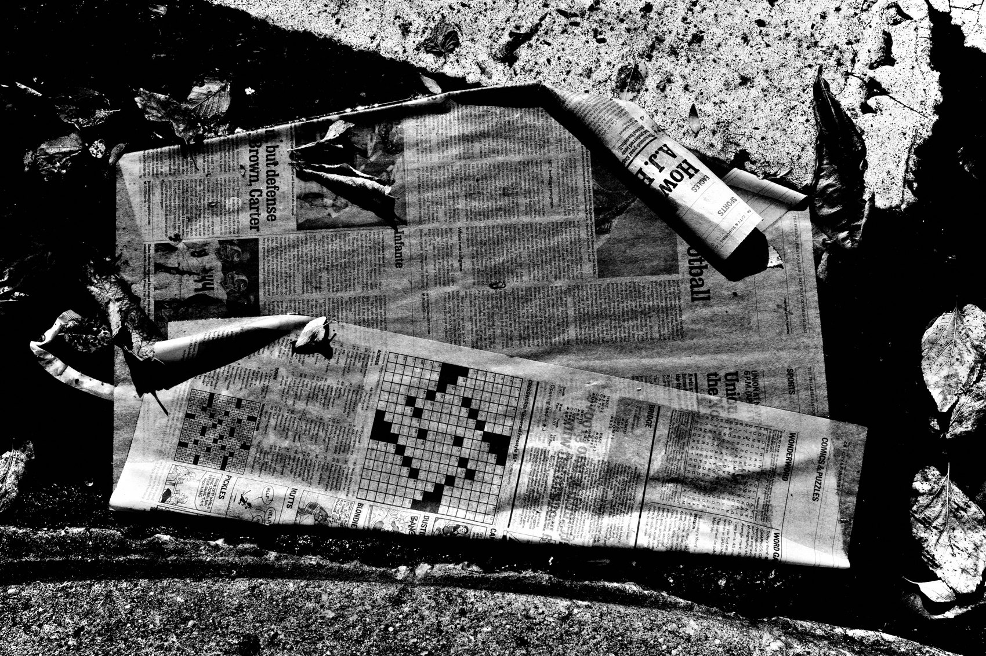
FLUX ACADEMY
BEAT 13 · MAIN TEACHING
Stripping to Black & White
— Switch to high-contrast B&W, small JPEGs
— Abstractions of reality through stripping down
— Speed, efficiency, longevity
Notes:
Take my own evolution. The switch to high-contrast black and white, the decision to shoot small JPEGs instead of RAW — that's all part of stripping down. By stripping to high-contrast black and white, you can create these abstractions of reality. It buys you speed and efficiency, which means you stay in the moment instead of obsessing over technical perfection.

Slide 15
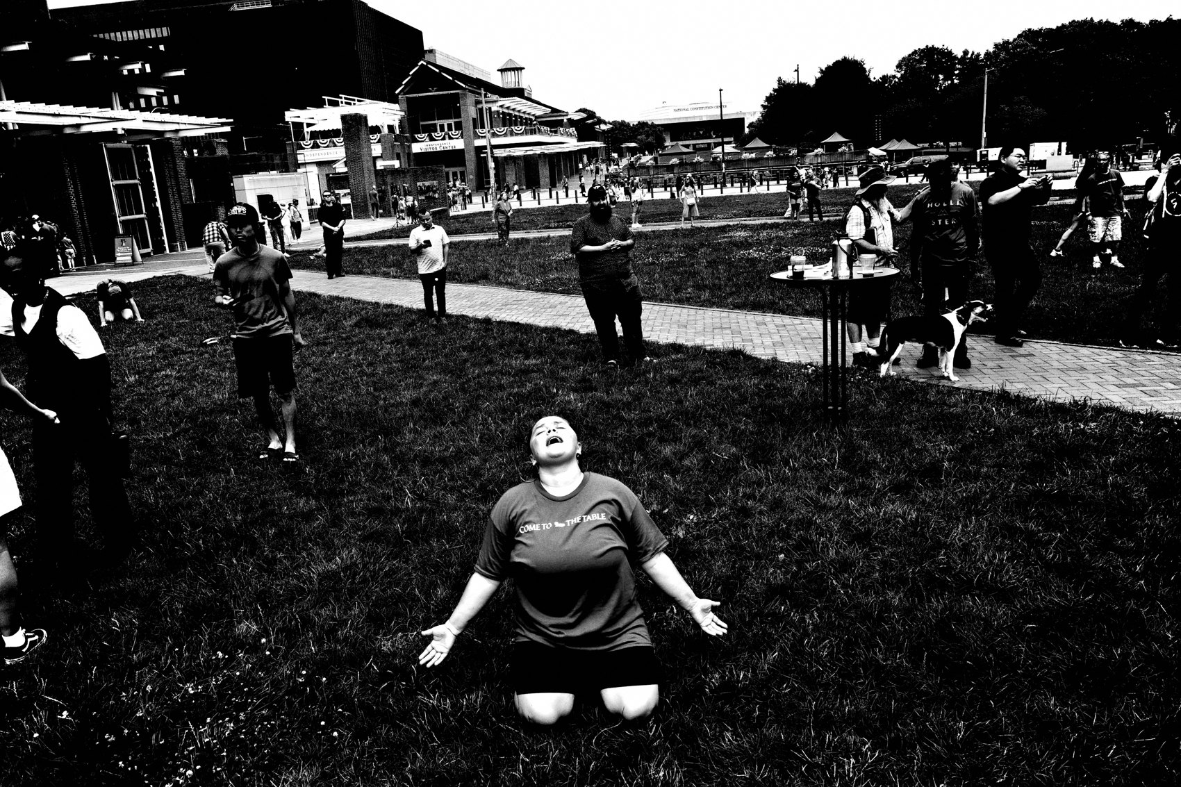
FLUX ACADEMY
BEAT 14 · MAIN TEACHING
Every Day Is Day One
— Every day is Day One
— Pick up the camera like an amateur
— No preconceived ideas about what's "good"
Notes:
My favorite reframe: every day is Day One. Each time you go out, feel like an amateur picking up the camera for the first time. No preconceived ideas about what makes or breaks a photograph. That child-like, casual energy is the snapshot aesthetic — it lets life flow toward you instead of you hunting for shots.

Slide 16
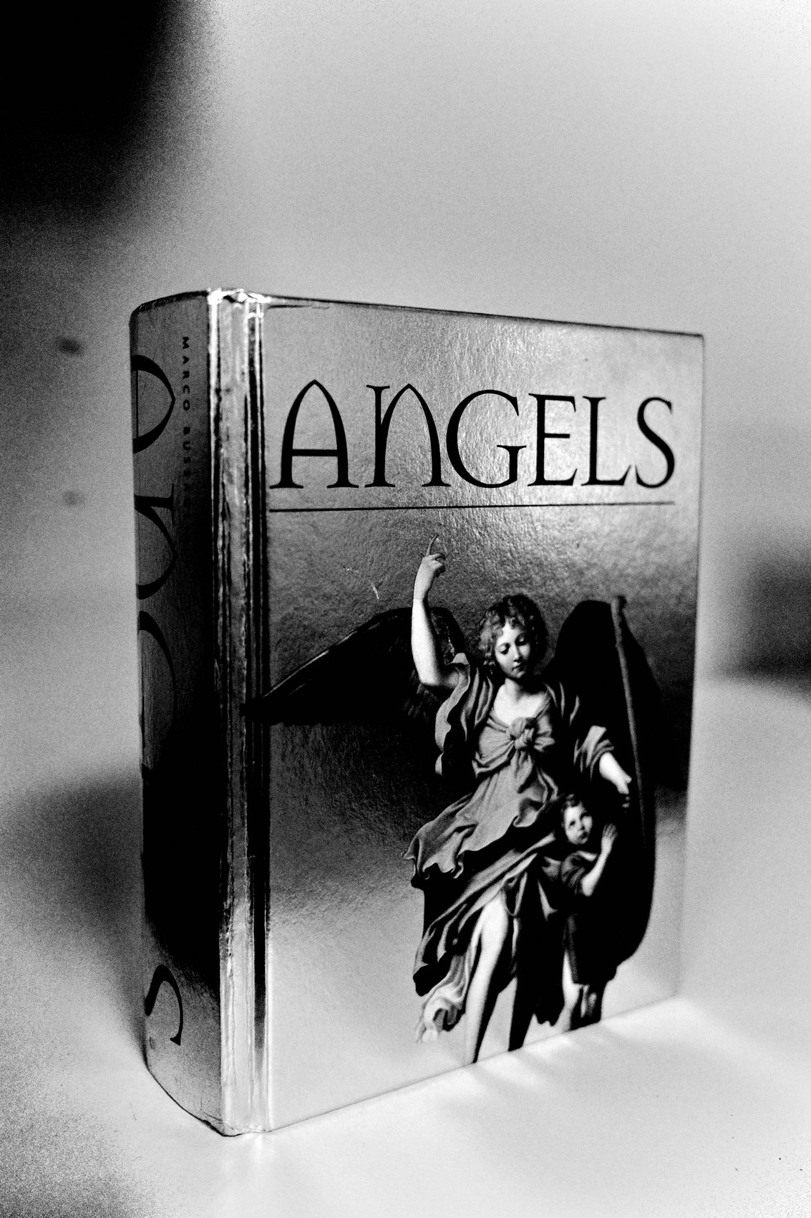
FLUX ACADEMY
BEAT 15 · MAIN TEACHING
Style Hides in the Snapshot
— The snapshot makes the unconscious conscious
— Repetition reveals the pattern — your voice
— You can't manufacture it
Notes:
And here's the payoff. Shooting this way isn't just fast — it's how your style actually emerges. When you press the shutter instinctively, your internal world surfaces. Over time, patterns appear, and that pattern is your voice. You can't manufacture it with an aesthetic trick. The snapshot reveals you, frame by frame.

Slide 17
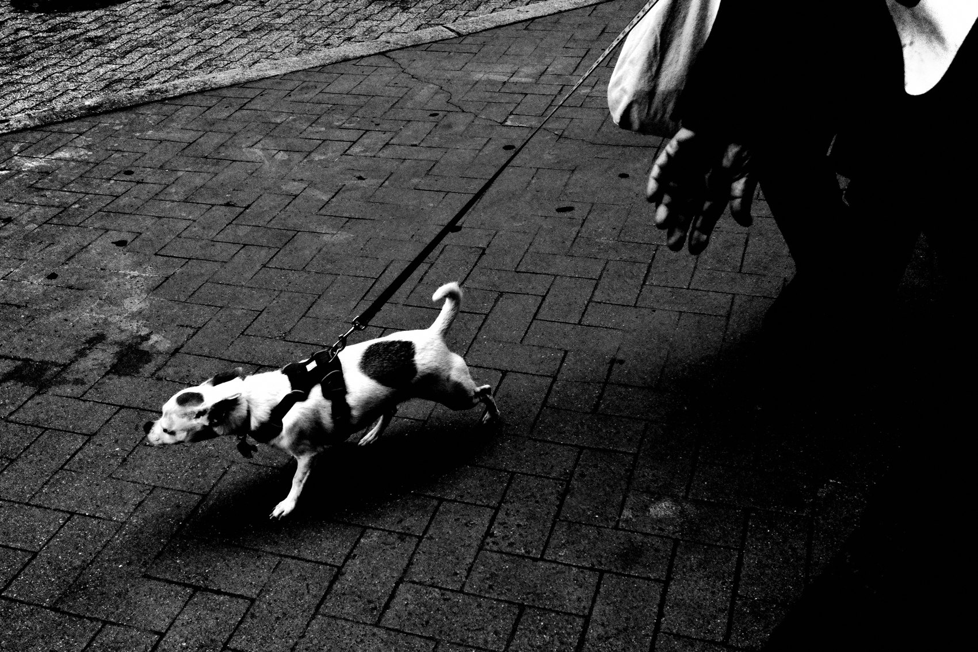
FLUX ACADEMY
BEAT 16 · MAIN TEACHING
Photography as a Visual Diary
— No longer seeking — flowing
— The camera comes along for the ride
— Not separate from life — woven into it
Notes:
This is why I now treat photography as a visual diary. It's no longer about seeking — it's about flowing. I'm not putting on my "photographer hat" and hunting a theme. I'm simply living, and taking the camera for the ride. The casual snapshot weaves photography into your everyday life instead of standing apart from it.

Slide 18
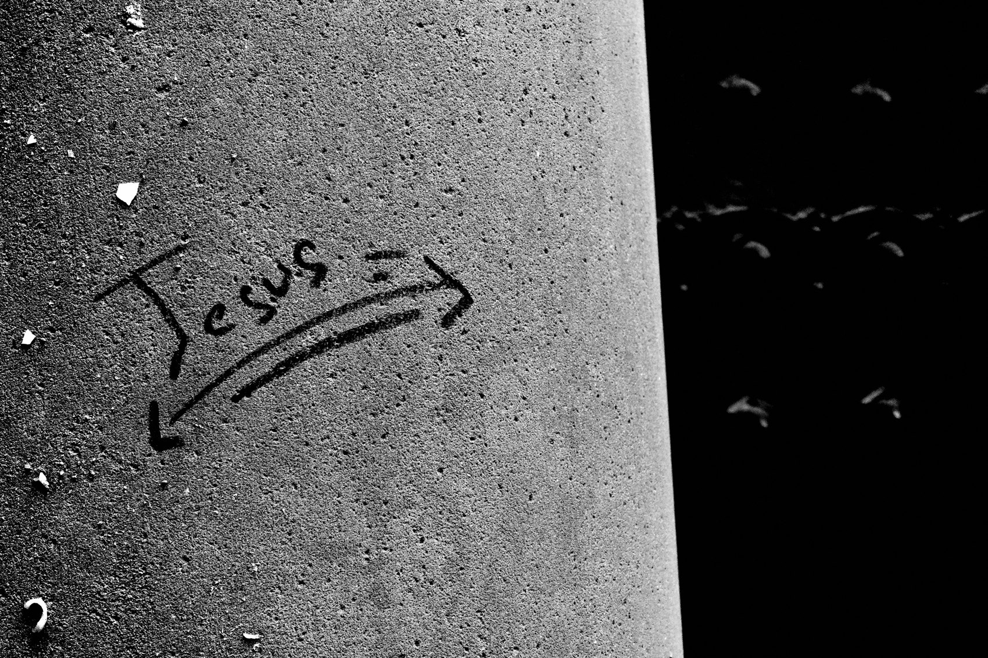
FLUX ACADEMY
BEAT 17 · PRACTICAL APPLICATION
The 7-Day Snapshot Install
— Go out with no plan, no theme, no shot list
— When you feel the pull, shoot immediately
— No checking, no mid-walk critique
Notes:
Here's your drill — run it for seven days. Go out with no plan. No theme, no project, no "today I'm looking for." When you feel the pull, press the shutter immediately. No checking the back of the camera. No mid-walk critique. No replaying it in your head. Click, move, repeat. Train the reflex.

Slide 19
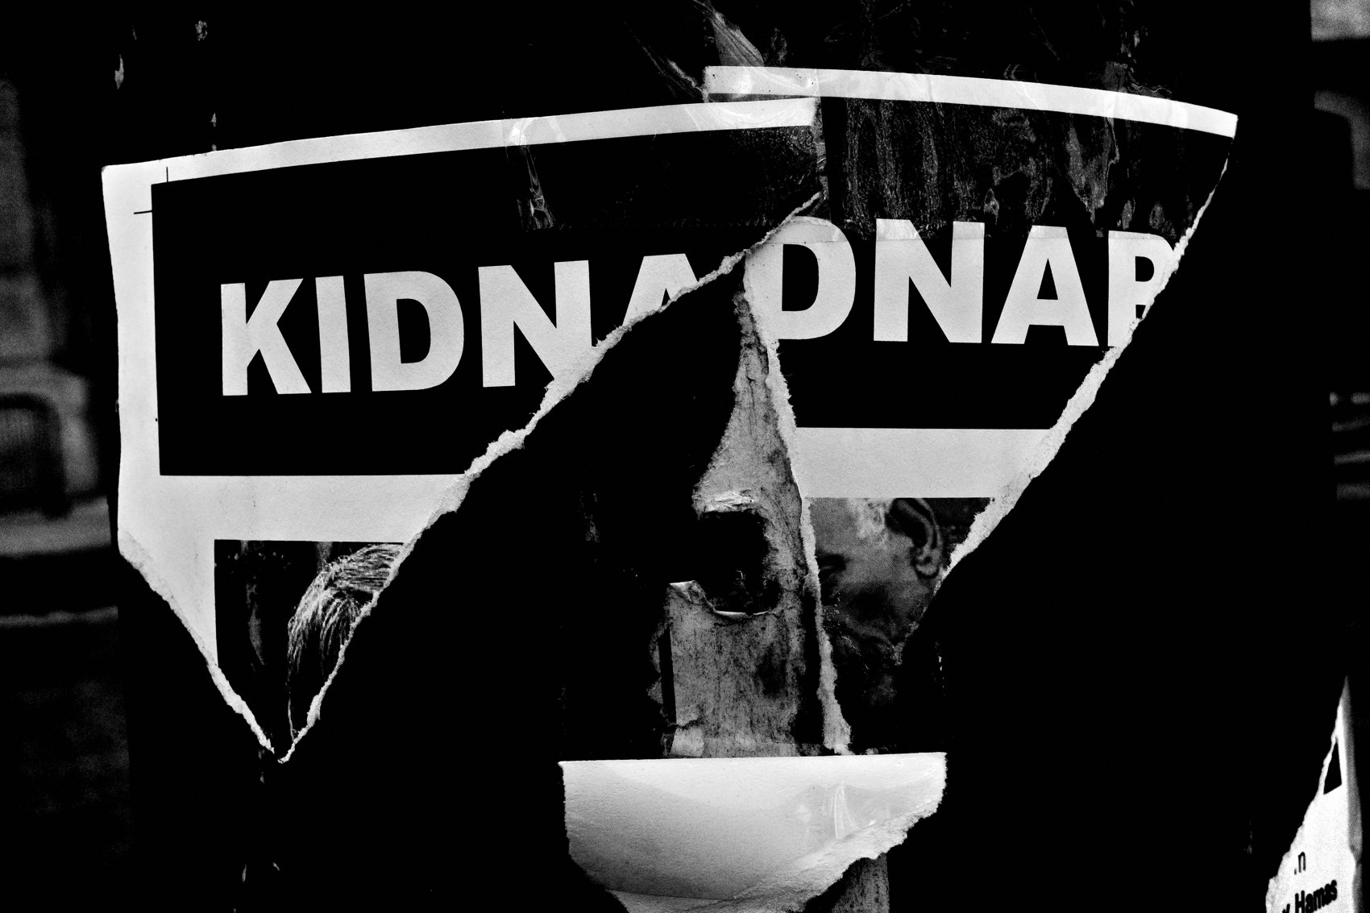
FLUX ACADEMY
BEAT 18 · PRACTICAL APPLICATION
Strip Your Setup Down
— One camera, one lens, automatic, snap focus
— Bake your look into the camera
— Kill every excuse to fiddle
Notes:
And set yourself up for it. Strip down: one camera, one lens, automatic mode, snap focus. Bake your contrast and your look into the camera so there's nothing to fix later. Kill every excuse to fiddle. The goal is a setup so frictionless that raising the camera and clicking is the only thing left to do.

Slide 20
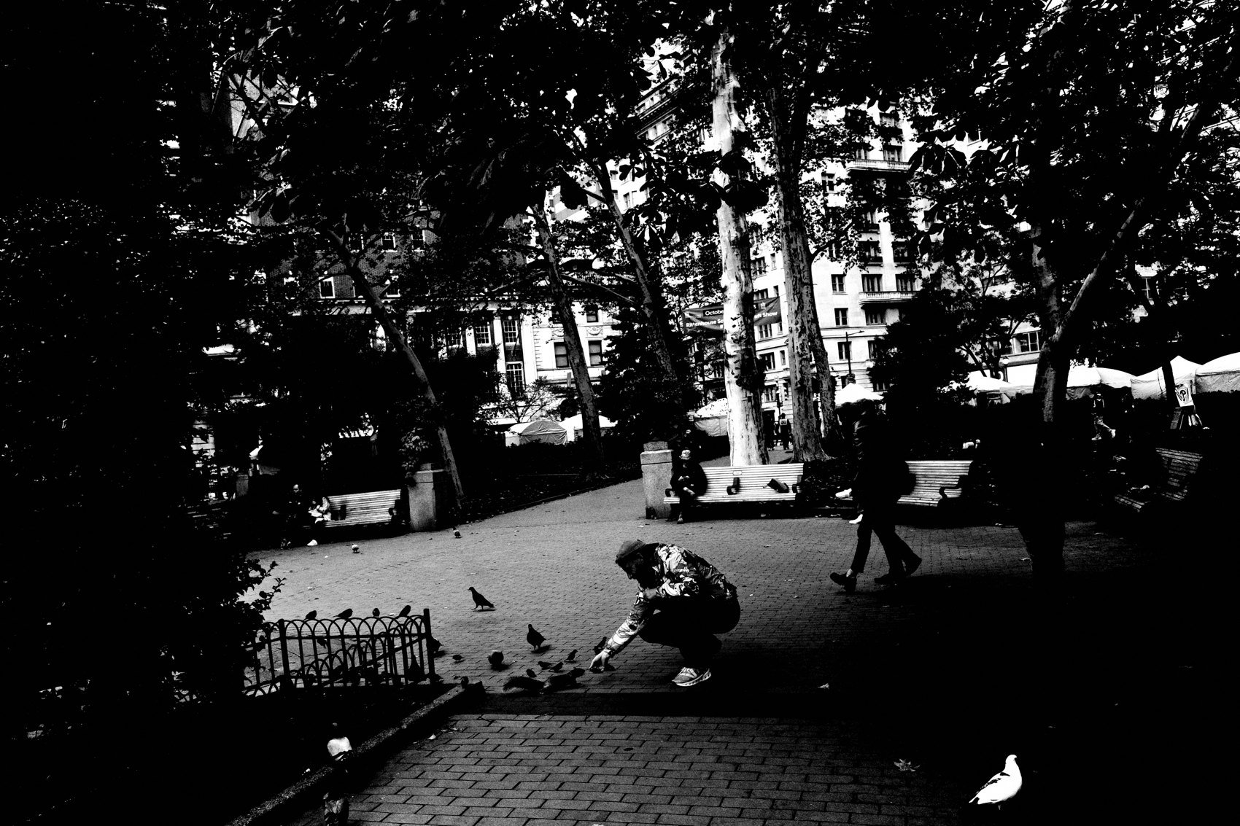
FLUX ACADEMY
BEAT 19 · COMMON MISTAKES
Chimping and Second-Guessing
— Don't check the LCD after every frame
— Second-guessing breaks the flow
— Trust the click, keep walking
Notes:
The biggest mistake: chimping — checking the screen after every single frame. The second you stop to second-guess, the flow breaks and the next moment passes you by. Trust the click and keep walking. You evaluate later, at home, never out on the street. Out there, you only respond.

Slide 21
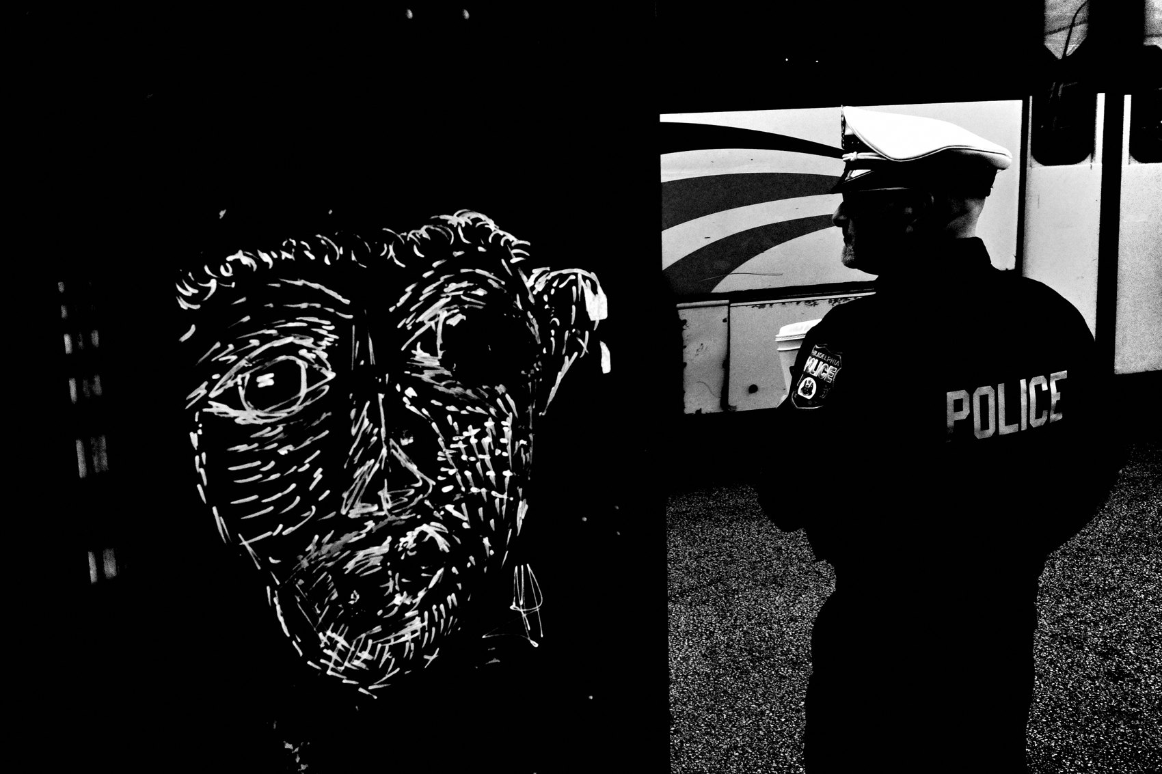
FLUX ACADEMY
BEAT 20 · COMMON MISTAKES
Mistaking Casual for Careless
— Casual ≠ random or sloppy
— Still see, still position your body, still feel the frame
— Looseness is trained, not lazy
Notes:
The other mistake — the opposite one: thinking casual means careless. This doesn't mean photograph randomly without understanding your gear. You still see, you still position your body, you still feel how the frame wants to exist. The looseness is trained. The snapshot is relaxed on the surface and razor-sharp underneath.

Slide 22
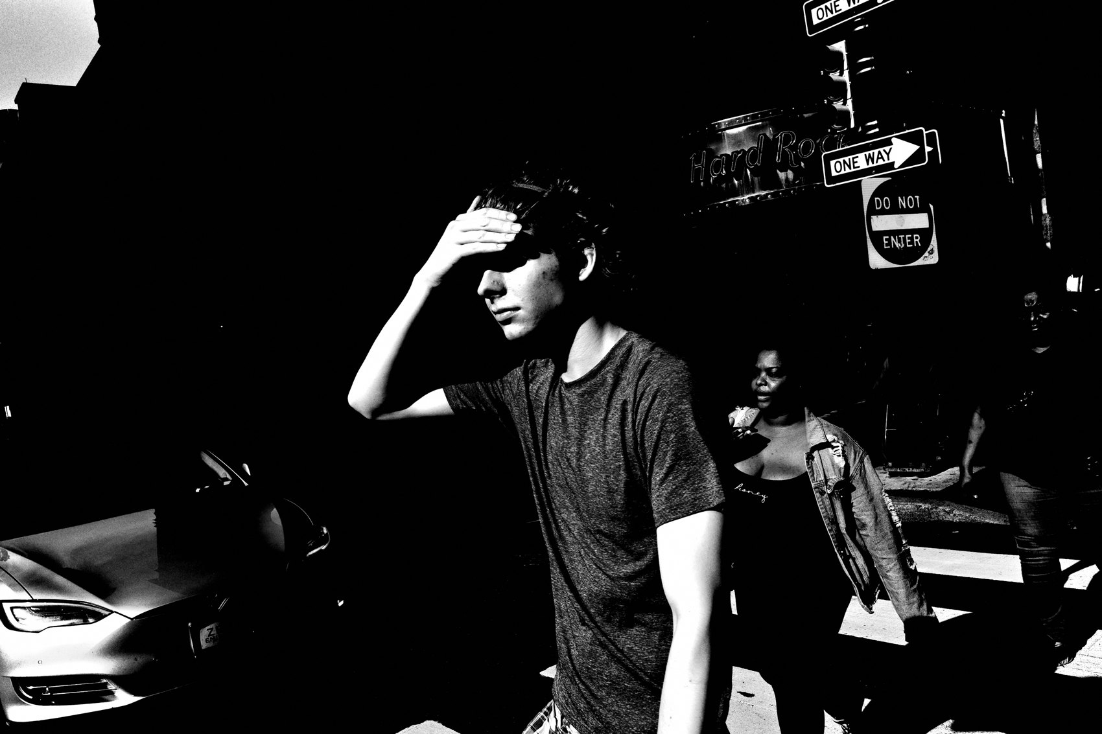
FLUX ACADEMY
BEAT 21 · RELATIONSHIP TO PREVIOUS
From the Mundane to the Snapshot
— Lesson 011 taught beauty in the mundane
— The snapshot is how you catch it
— Same humble subjects, faster hands
Notes:
This builds straight on Lesson 011, Finding Beauty in the Mundane. There we learned to see the overlooked everyday — to uplift that boring lane into something greater. The snapshot aesthetic is the how: the fast, frictionless, gut-led way you actually catch that mundane beauty before it slips by. Seeing it and grabbing it are two halves of one move.

Slide 23
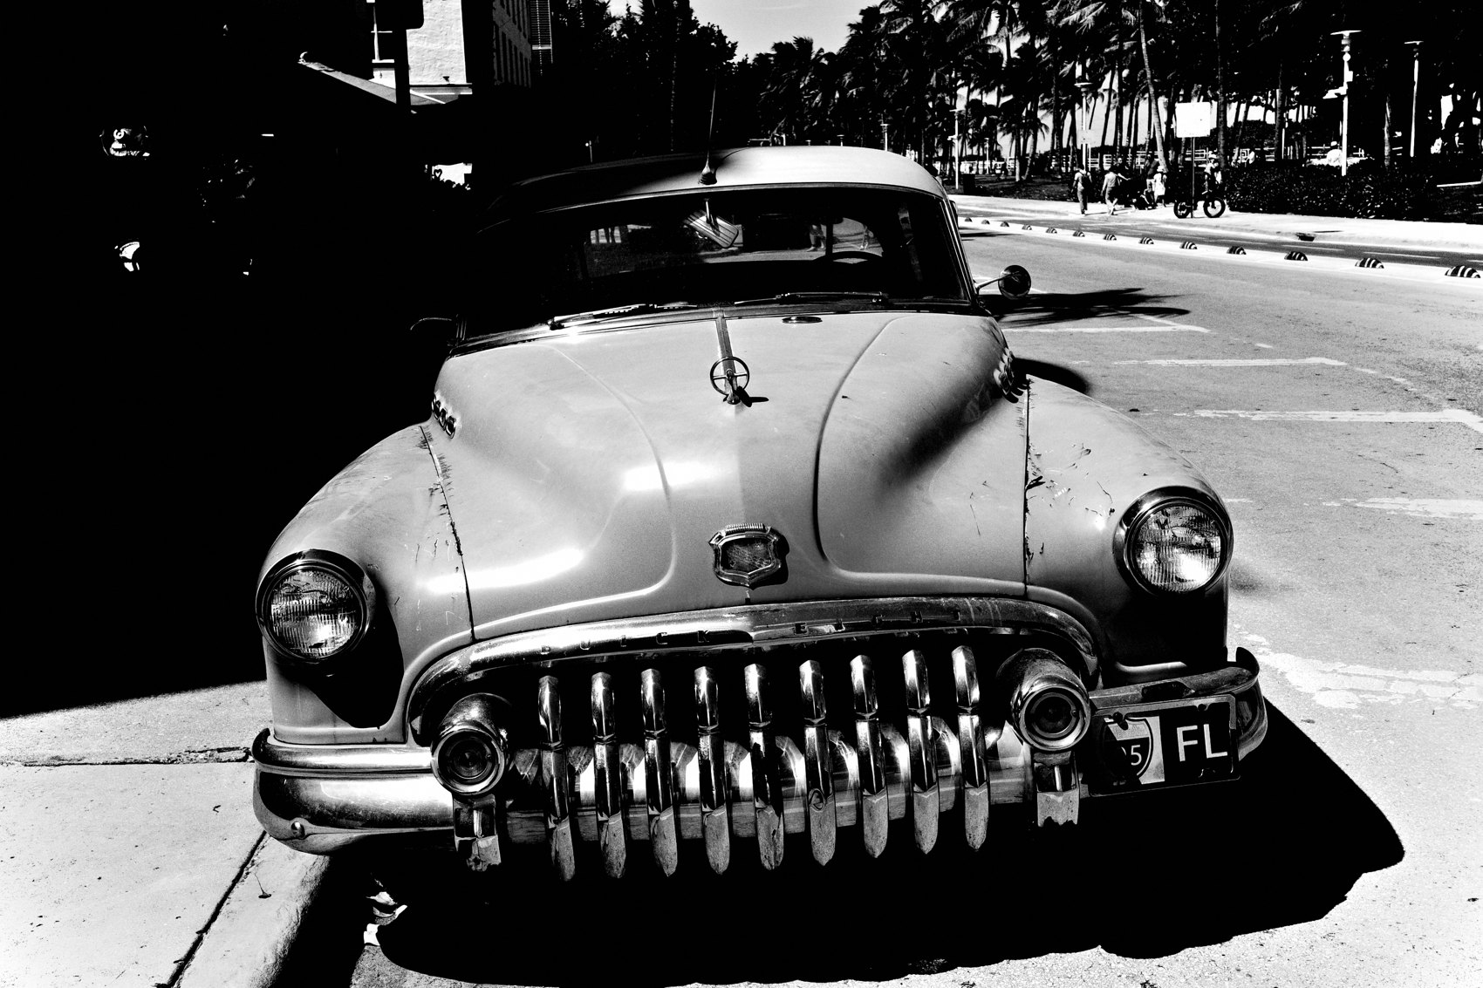
FLUX ACADEMY
BEAT 22 · RELATIONSHIP TO UPCOMING
Found vs Made
— Next: The Made vs the Found Photograph (Lesson 013)
— Snapshot = the found, instinctive frame
— Then: working a scene to make it
Notes:
Next up is Lesson 013, The Made vs the Found Photograph. Today's snapshot is the purest example of the found photo — instinctive, immediate, grabbed whole. Next lesson we'll set it against the made photo, where you work a scene and shape it over many frames. Two ways of shooting, both honest — and you'll need both.

Slide 24
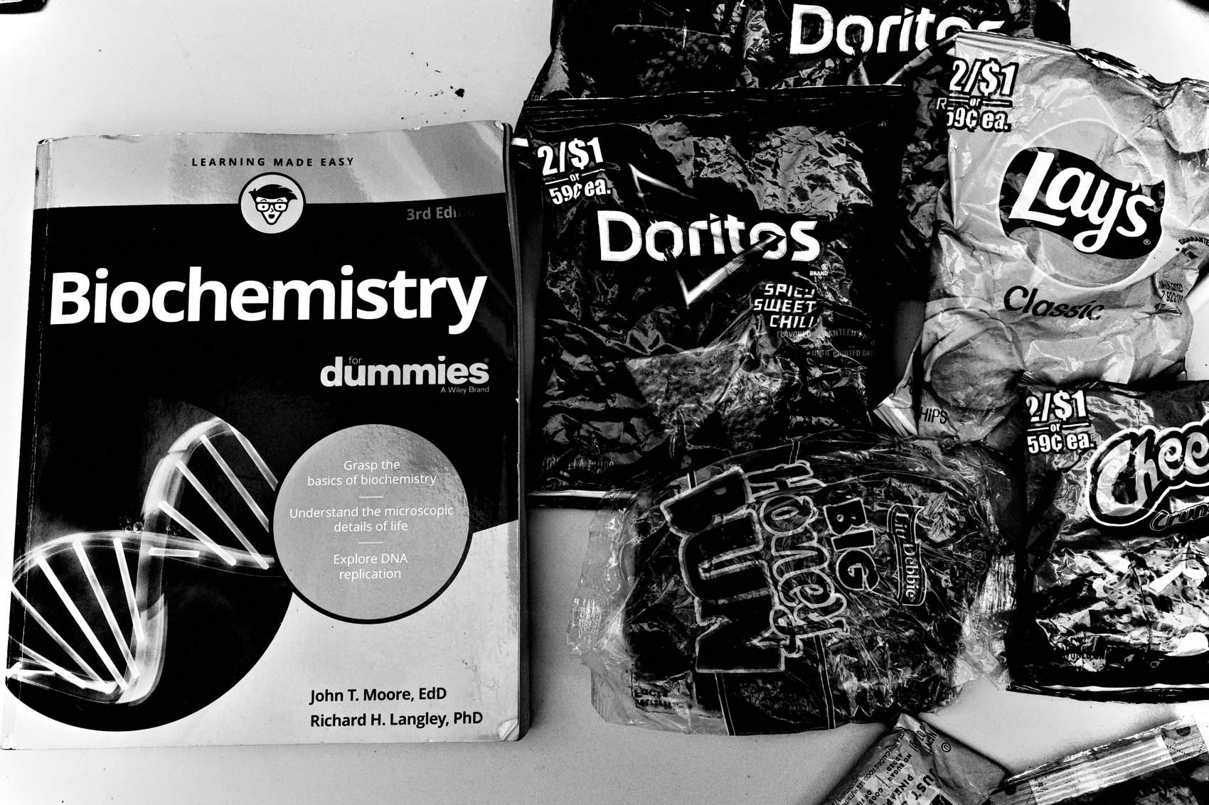
FLUX ACADEMY
BEAT 23 · SUMMARY / TAKEAWAY
Click, Move, Repeat
— Shoot first, think later
— Strip the friction, trust the gut
— The snapshot reveals you
Notes:
Last thing. The snapshot isn't the careless photo — it's the honest one. Strip your setup bare, kill the friction, shoot first and think later, and trust that the gut beats the brain. Click, move, repeat — and over time the snapshots reveal who you really are. That's the aesthetic. Catch you next lesson.

