Slide 1
FLUX ACADEMY · A SCHOOL FOR SEEING
MODULE 3 · LEARNING TO SEE
Finding Beauty in the Mundane
BY DANTE SISOFO

Slide 2

FLUX ACADEMY
BEAT 01 · CORE IDEA
The Ordinary Is the Subject
— The mundane isn't the obstacle
— It's the whole canvas
— The world around you is the canvas
Notes:
What's popping, people — it's Dante. Today we get to the heart of seeing. Most people wait for the extraordinary to show up. I'm telling you the opposite: the ordinary, the mundane, the overlooked — that is the subject. The world around you is the canvas. You don't need a better street. You need better eyes.

Slide 3

FLUX ACADEMY
BEAT 02 · LEARNING OBJECTIVE
What You'll Be Able to Do
— Walk a boring street and see
— Elevate the ordinary into meaning
— Stop waiting for "something to happen"
Notes:
By the end of this lesson, you'll be able to walk the same dull street you've walked a hundred times and actually find something to photograph. You'll stop waiting for a dramatic moment to land in your lap, and start making the moment out of whatever's already there.

Slide 4

FLUX ACADEMY
BEAT 03 · WHY THIS MATTERS
There's Always Something to Shoot
— The simplest moments can become the most beautiful
— Nowhere is "nothing to photograph"
— The challenge is the whole game
Notes:
Here's why this matters. Can you walk the same mundane street every day and still find something to capture? That's the challenge — and it never ends. The simplest moments can become the most beautiful. Whether it's a busy city or a sleepy village, there is always, always something to photograph.

Slide 5
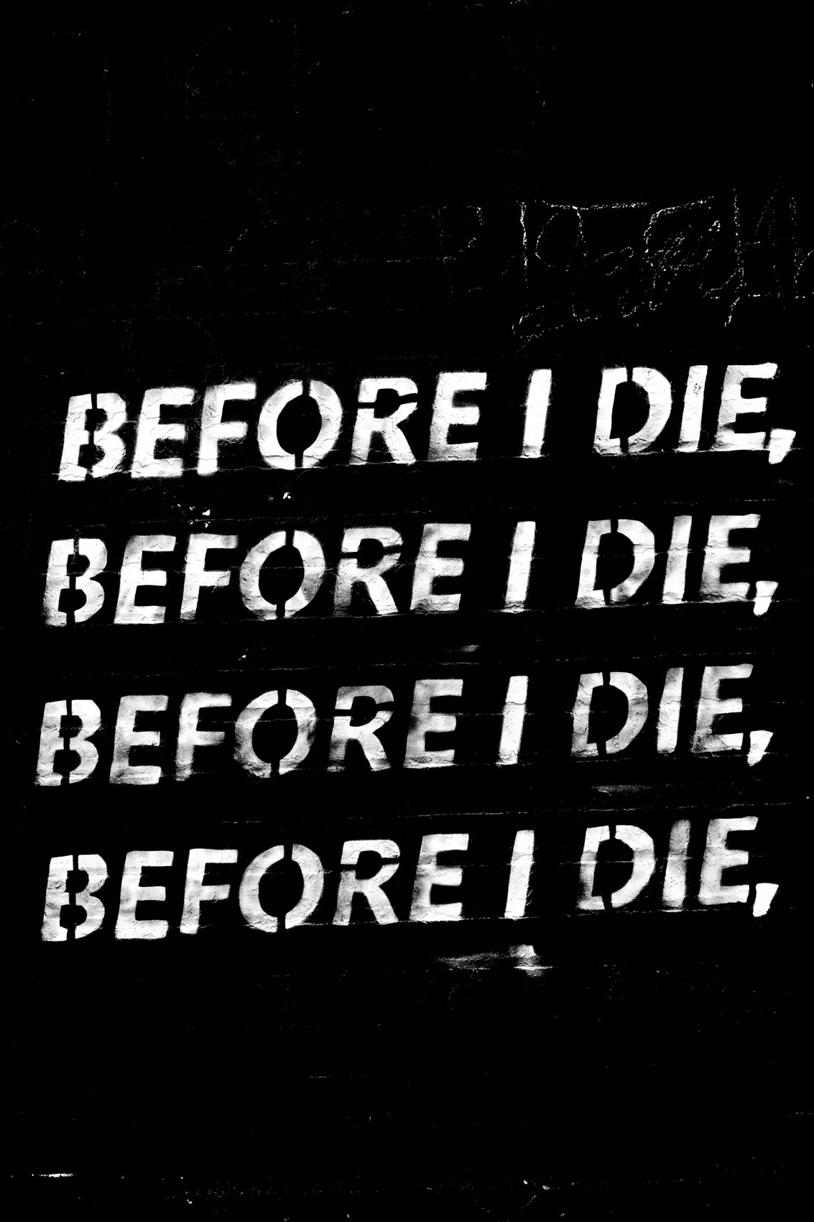
FLUX ACADEMY
BEAT 04 · WHY THIS MATTERS
Boredom Is a Perception Problem
— "Nothing here" is a you problem
— Change your view, not your location
— The street is never the issue
Notes:
And let me reframe the excuse. If you're out there thinking there's nothing interesting around you, maybe it's time to change your perspective on how you view the world. Boredom isn't a property of the street — it's a setting in your own eyes. Fix the eyes, and the "boring" street comes alive.

Slide 6

FLUX ACADEMY
BEAT 05 · MAIN TEACHING
Elevate and Transform
— Don't document the ordinary — elevate it
— Transform the ordinary into the extraordinary
— Your attention does the lifting
Notes:
So let's get into the work. The job is to elevate the mundane and find meaning in the overlooked — to transform the ordinary into the extraordinary. It's not documentation; it's creation. You're not just recording that the thing exists. You lift it, give it weight, make the viewer stop. The attention you pay is what turns nothing into something.

Slide 7

FLUX ACADEMY
BEAT 06 · MAIN TEACHING
The Magic Lives in the Ordinary
— Find extraordinary moments in the ordinary
— The magic isn't somewhere else
— It's already in front of you
Notes:
Here's the whole magic of photography to me: finding extraordinary moments in the ordinary. People think the magic lives in some far-off, dramatic place. It doesn't. It's right in front of you, in the plainest scene on your block — waiting for someone with the eyes to notice it and the nerve to frame it.

Slide 8
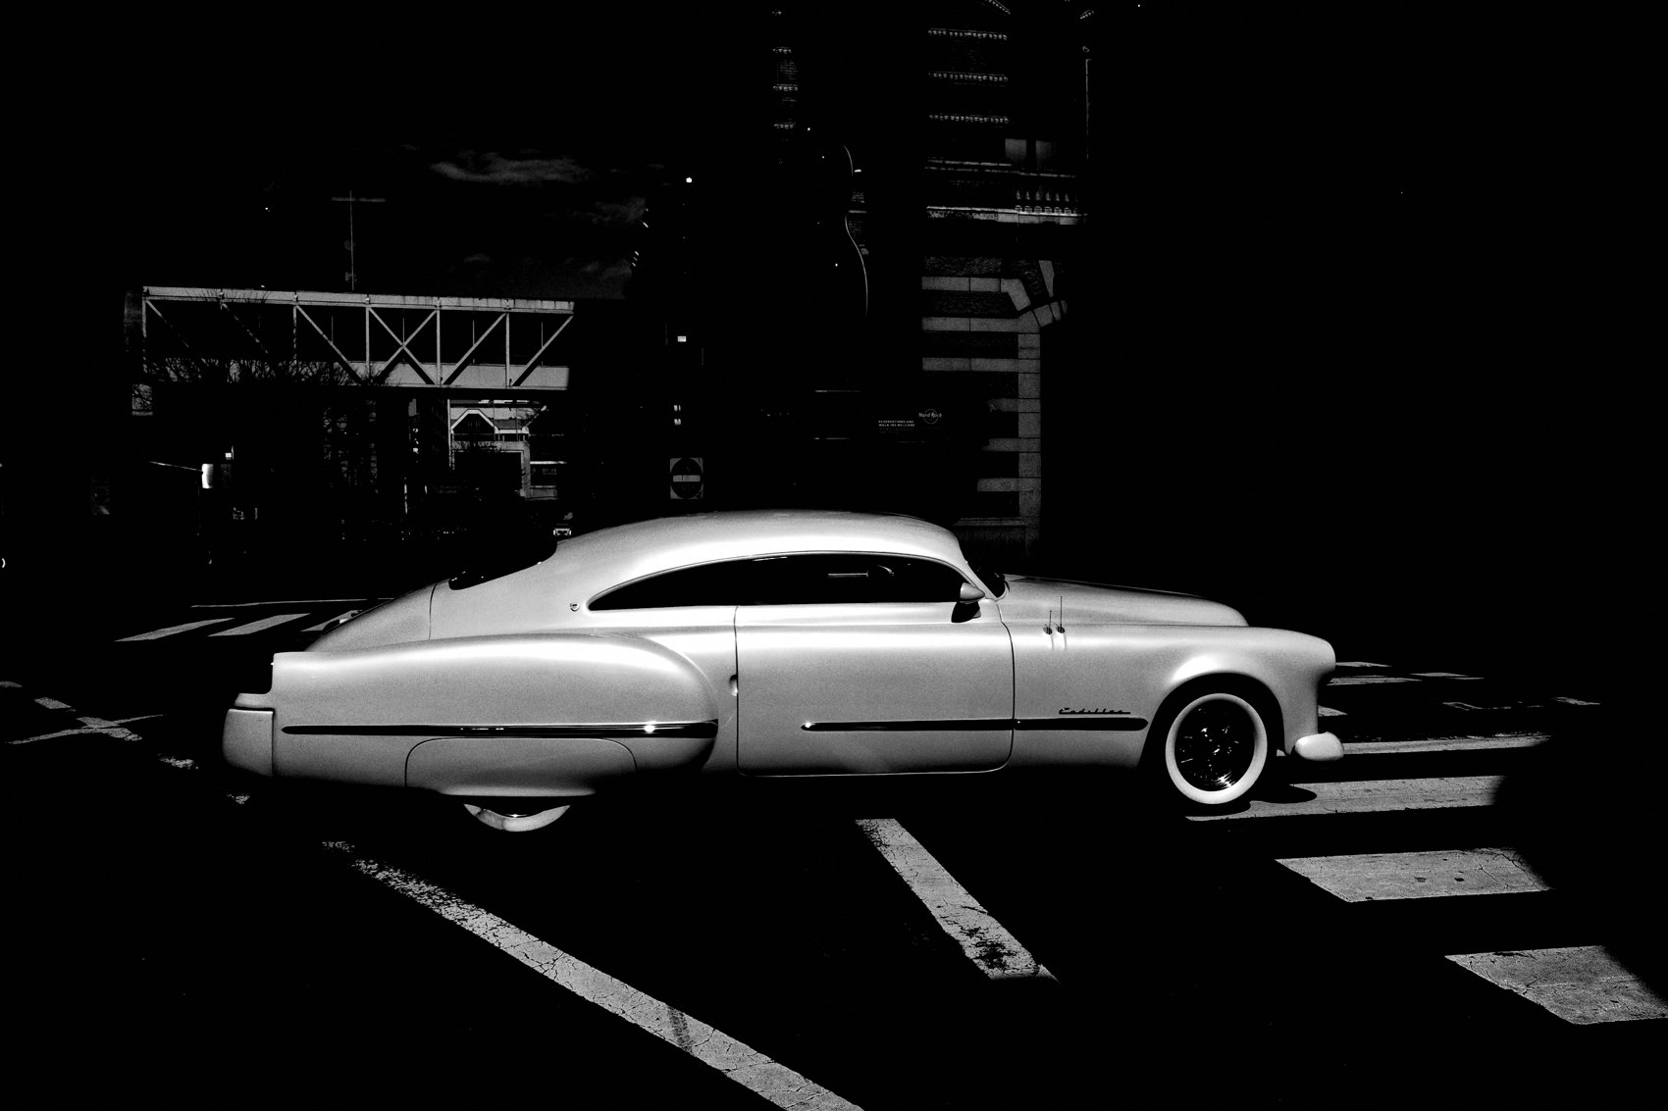
FLUX ACADEMY
BEAT 07 · MAIN TEACHING
Approach With No Preconceptions
— Arrive with no preconceived notions
— Then the mundane becomes fascinating
— Don't decide it's boring before you look
Notes:
Here's the mindset that unlocks it. When you approach the streets with no preconceived notions, the mundane becomes a source of endless fascination. The second you walk out already deciding "this neighborhood is boring," you've blinded yourself. Show up empty, curious, open — and the street fills back up.

Slide 9
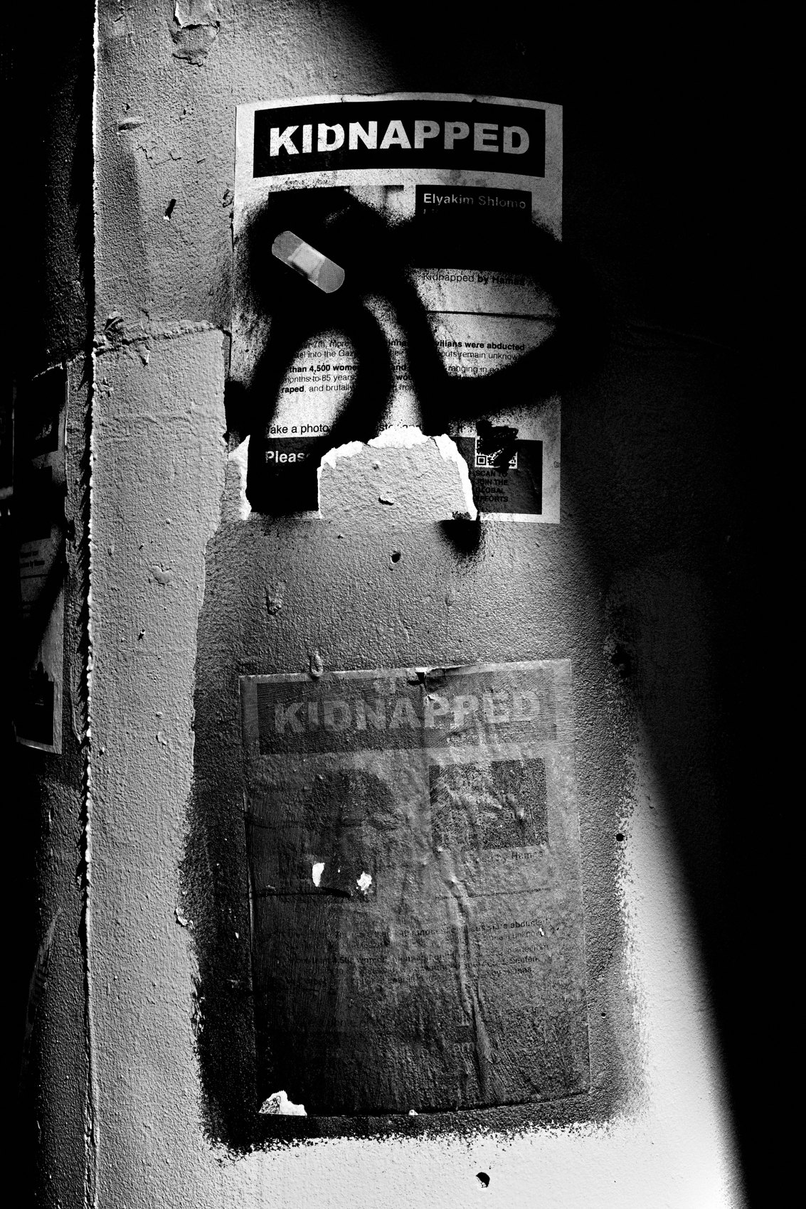
FLUX ACADEMY
BEAT 08 · MAIN TEACHING
Don't Wait for the Extraordinary
— Don't wait for extraordinary moments
— Make the moment from what's here
— Find beauty in the ordinary
Notes:
And kill the waiting game. Don't wait for extraordinary moments to arrive; instead, learn to find beauty in the ordinary. The extraordinary photographer isn't the one who stumbles onto crazy events — it's the one who can stand on the most ordinary corner and still come home with something.

Slide 10

FLUX ACADEMY
BEAT 09 · MAIN TEACHING
Curiosity Is the Transformer
— Curiosity transforms the mundane into the magical
— Wonder is the actual technique
— Let the world surprise you
Notes:
The engine under all of this is curiosity. Curiosity transforms the mundane into the magical, turning the chaos of the street into your personal canvas. This isn't a metaphor — it's the technique. Wonder is what lets you see the photograph everyone else walks straight past.

Slide 11
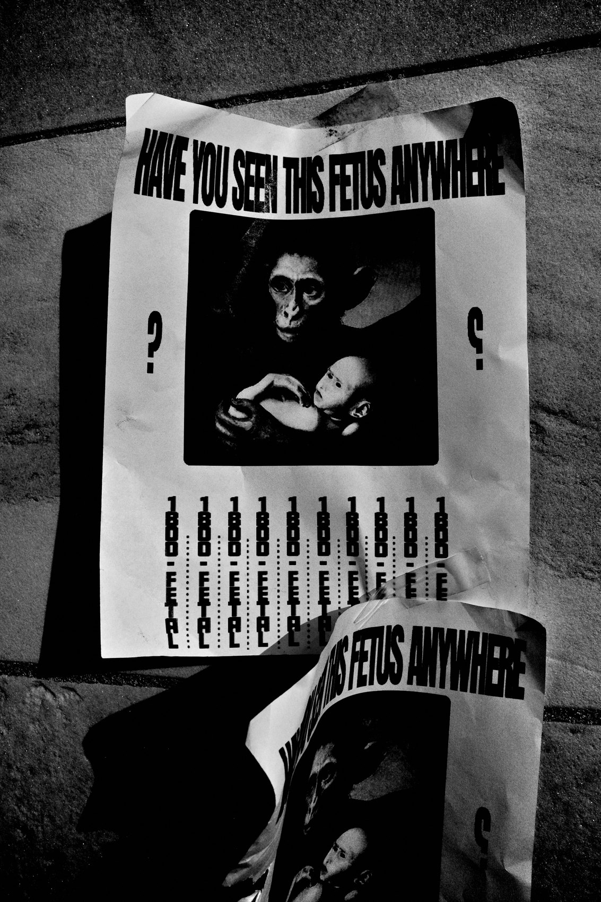
FLUX ACADEMY
BEAT 10 · MAIN TEACHING
Become a Flaneur
— Wander like a flaneur, observing
— Notice the overlooked details of daily life
— No destination, just attention
Notes:
One of my favorite frames of mind for this is the flaneur — the wanderer. Approaching life like a flaneur, I'm observing the overlooked details of everyday life. No destination, no agenda. Just drifting and paying attention. When you move through the world that way, the small stuff starts revealing itself.

Slide 12
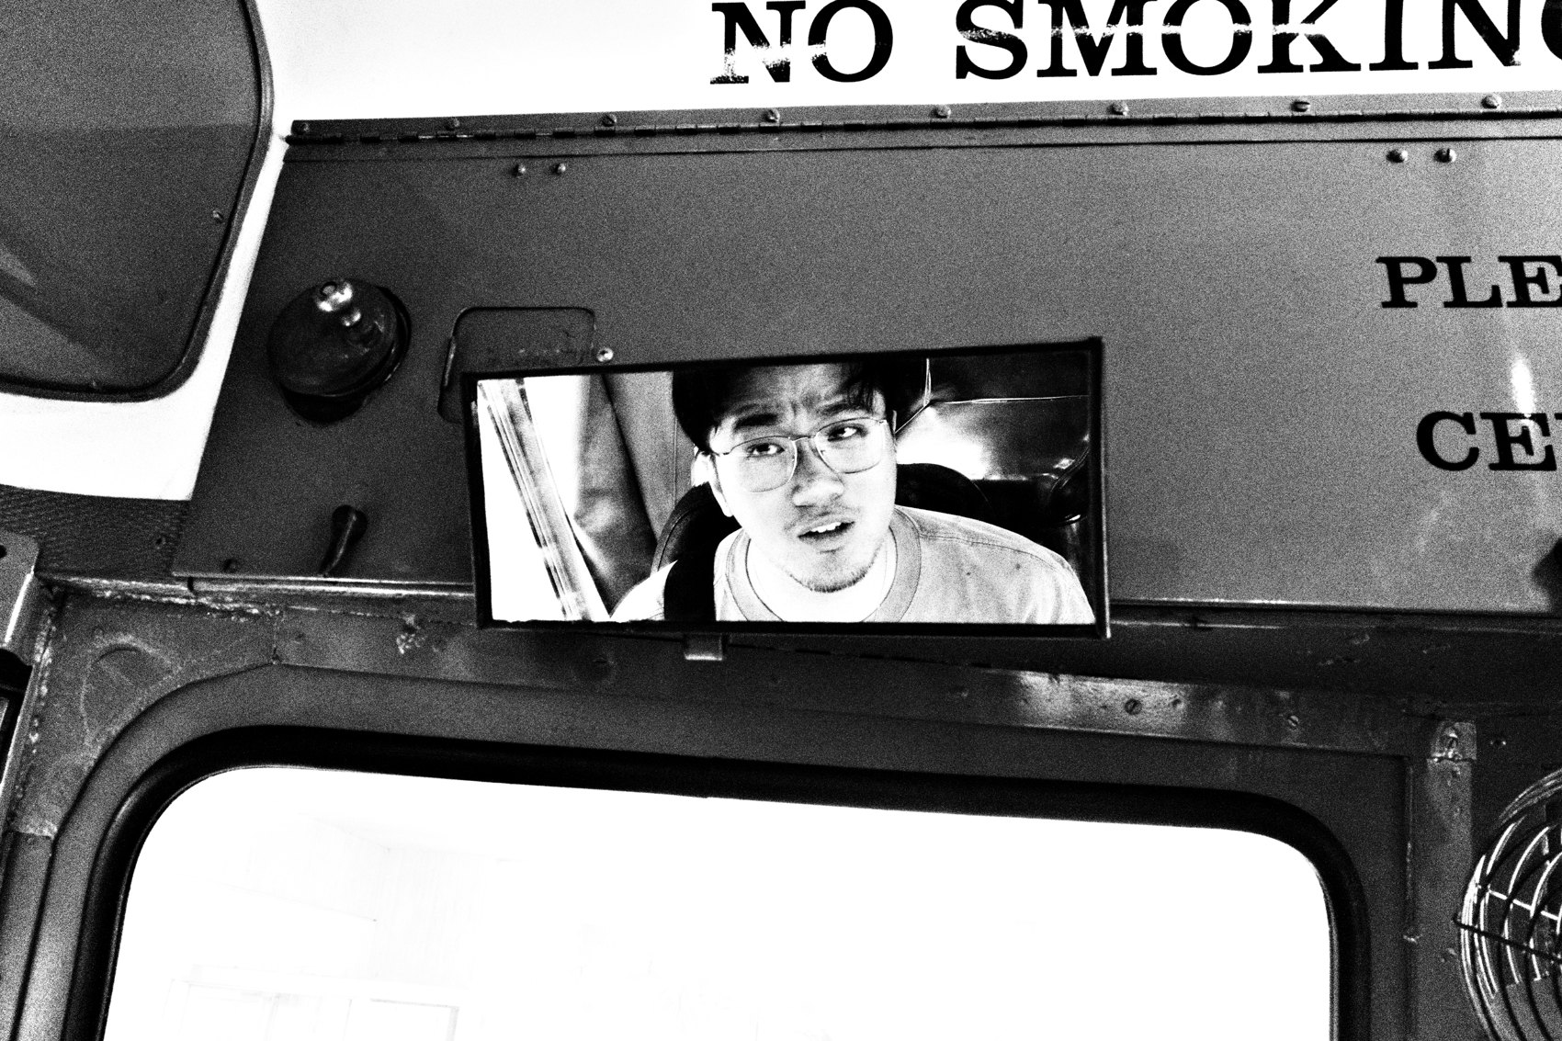
FLUX ACADEMY
BEAT 11 · MAIN TEACHING
Objects Left Behind
— Cigarette butts, found objects, a stray penny
— Textures on walls, things left behind
— Get close — use the macro
Notes:
Let me get concrete. You don't only photograph people. Capture the cigarette butts on the ground, the textures on walls, the random found objects — a discarded newspaper, a penny. Use the macro to get right in on the intricate details that would otherwise go completely unnoticed. Noticing the beauty in textures — that's mundane done right.

Slide 13

FLUX ACADEMY
BEAT 12 · MAIN TEACHING
Shoot the Same Lane Daily
— Return to one mundane lane, again and again
— The challenge: uplift it into something greater
— Repetition is the discipline
Notes:
Here's a practice worth building. Shoot the same mundane lane every day — but make the challenge to uplift that mundane into something greater. Same lane, same light most mornings, and yet the goal is to find a new photograph in it. That repetition isn't boring; it's the discipline that sharpens the seeing.

Slide 14

FLUX ACADEMY
BEAT 13 · MAIN TEACHING
Light on the Overlooked
— Underexpose a stop to isolate the moment
— Crush the unnecessary into shadow
— Let light pick the mundane subject
Notes:
Here's a technique for it. Underexpose by a stop and you can lift one quiet moment out of a busy scene while crushing everything around it into black. Light is how you point at the mundane. Drop the exposure, kill the clutter, and suddenly an ordinary riverbank, a plain wall, a bare corner carries mystery.

Slide 15

FLUX ACADEMY
BEAT 14 · MAIN TEACHING
Simplify to See
— Strip the frame down
— Put order to the chaos
— Simplicity reveals the overlooked
Notes:
A lot of mundane beauty only shows up once you simplify. My goal is to simplify — to hone in, isolate, and put order to the chaos through my frames. When you strip a frame down to one quiet element, the overlooked thing finally has room to speak. The mundane needs space to become beautiful.

Slide 16

FLUX ACADEMY
BEAT 15 · MAIN TEACHING
Follow Light, Build Your World
— I photograph the mundane. I follow the light
— With each click, I try to abstract reality
— Interpretation over recording — that's style
Notes:
When people ask what I shoot, my answer is simple: I photograph the mundane. I follow the light. Photography is drawing with light — phos, light; graphe, writing. But don't just record it — interpret it. With each click of the shutter, I try to abstract reality. I create my own world. The mundane is your raw material; bend it, make it yours. That's where personal style is born.

Slide 17

FLUX ACADEMY
BEAT 16 · PRACTICAL APPLICATION
The Same-Street Challenge
— Pick one boring block near home
— Shoot it daily for a week
— Force a new frame each day
Notes:
Here's the assignment, and it's the realest one I've got. Pick one mundane street near you — the most boring block you can think of. Shoot it every single day this week. Same street, no exceptions. Force yourself to find a new photograph each day. That constraint is how the seeing muscle grows.

Slide 18
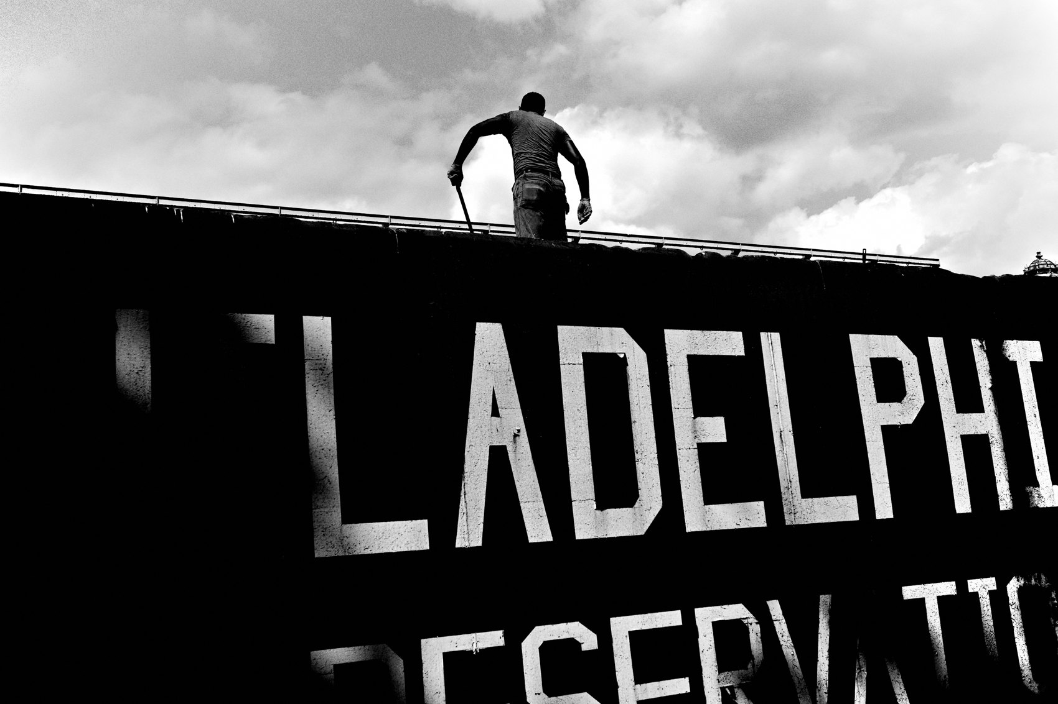
FLUX ACADEMY
BEAT 17 · PRACTICAL APPLICATION
Hunt the Small Stuff
— Shoot textures, found objects, shadows
— Get low, get close, use macro
— A whole walk with no people
Notes:
Second drill: spend a whole walk shooting no people. Only the small, overlooked stuff — textures, cracks, a discarded object, a shaft of light on a wall. Get low, get close, use the macro. You'll be shocked how much was there the whole time, sitting in plain sight, waiting.

Slide 19
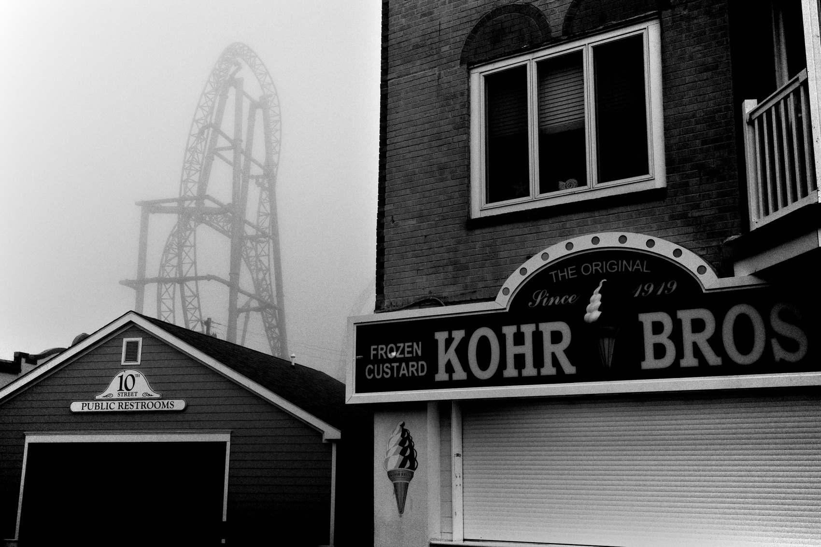
FLUX ACADEMY
BEAT 18 · PRACTICAL APPLICATION
Show Up and Just Shoot
— Carry the camera on every errand
— Stop overthinking and just shoot
— He who walks the most shall win
Notes:
Third: make it a habit, not an event. Carry your camera on errands, wake up early, and embrace every chance to press the shutter. Stop overthinking and just shoot. Treat it like a workout — the person who shows up consistently sees the most progress. He who walks the most, shall win.

Slide 20

FLUX ACADEMY
BEAT 19 · COMMON MISTAKES
Waiting for "Something Worthy"
— Don't postpone shooting until it's "interesting"
— The wait is the trap
— Change perspective, not location
Notes:
The number one mistake: standing around waiting for something worthy to happen. That's the trap. If you're not photographing because you think nothing's interesting, the problem isn't the street — it's the perspective. Don't go searching for a better location. Build a better way of seeing the one you're on.

Slide 21
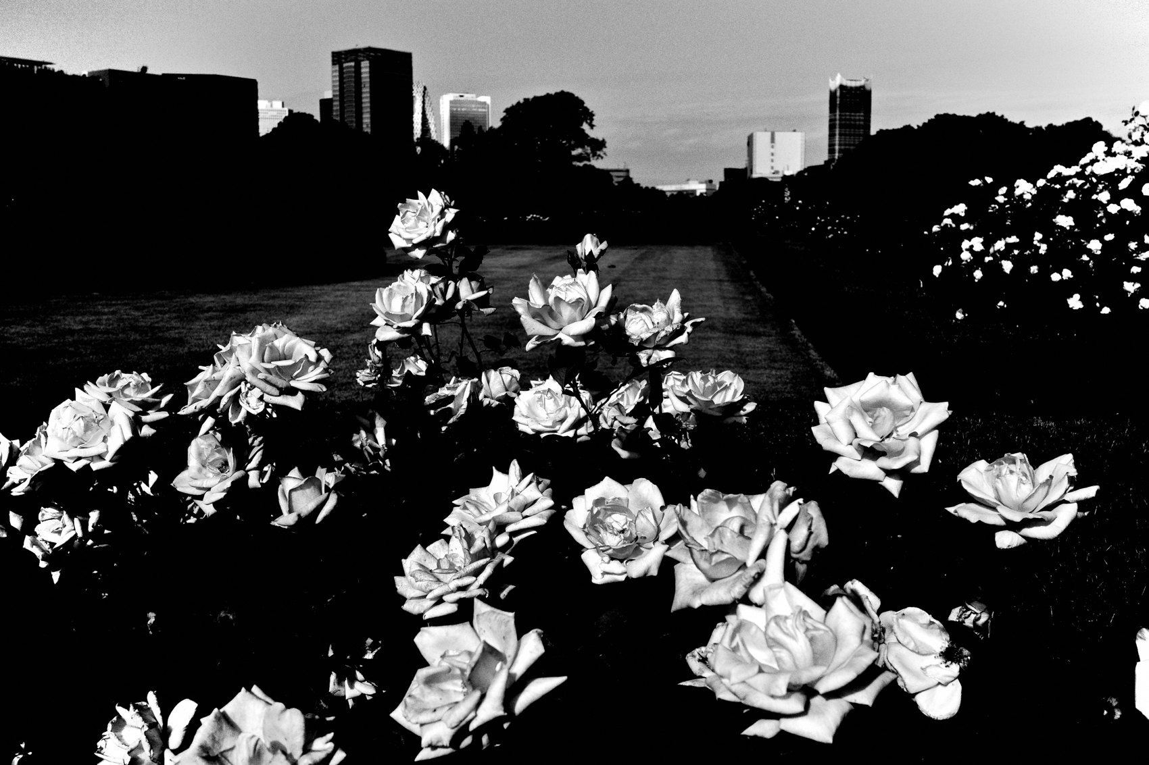
FLUX ACADEMY
BEAT 20 · COMMON MISTAKES
Over-Composing the Ordinary
— Don't strangle the frame meticulously composing
— Let go — react
— Perfectionism kills the mundane moment
Notes:
Second mistake, and I fall into it myself: over-thinking it. When you work that same mundane lane day after day, stop meticulously composing — let go. The mundane rewards looseness, not perfectionism. Strangle the frame chasing the "perfect" composition and you'll miss the quiet, alive thing that was actually there.

Slide 22
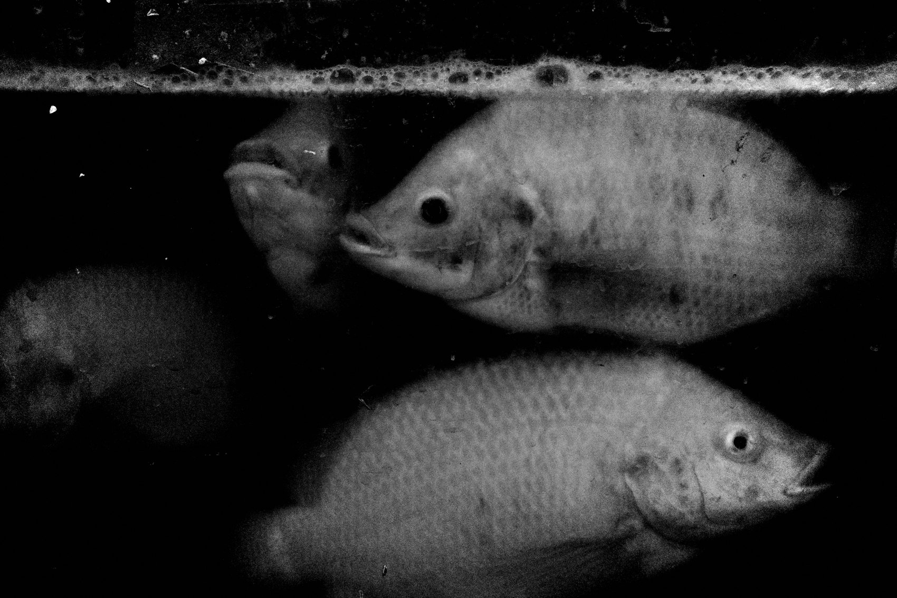
FLUX ACADEMY
BEAT 21 · RELATIONSHIP TO PREVIOUS
From Fear to Freedom
— Lesson 010 cleared the fear
— Calm eyes can finally see
— Now we point that freedom at the ordinary
Notes:
This builds straight on Lesson 010, where we conquered fear on the street. Once the fear of shooting strangers stops gripping you, your eyes relax — and relaxed eyes are seeing eyes. You can't notice the beauty in a cigarette butt or a shaft of light while your heart's pounding. We cleared the fear; now we point that freedom at the ordinary.

Slide 23

FLUX ACADEMY
BEAT 22 · RELATIONSHIP TO UPCOMING
Toward the Snapshot
— Next: The Snapshot Aesthetic (Lesson 012)
— The mundane begs for the loose, instinctive frame
— Seeing first, then letting go
Notes:
Coming up in Lesson 012, we take this seeing and lean all the way into the snapshot aesthetic — the loose, instinctive, un-fussy frame that the mundane practically begs for. Once you can see beauty in the ordinary, the snapshot is how you grab it without strangling it. Seeing first; then we learn to let go.

Slide 24

FLUX ACADEMY
BEAT 23 · SUMMARY / TAKEAWAY
The Canvas Is Everywhere
— The mundane is the subject, not the obstacle
— Curiosity transforms the mundane into the magical
— Change your eyes, not your street
Notes:
Last thing. The world around you is the canvas — the mundane isn't the obstacle, it's the subject. Don't wait for the extraordinary; curiosity transforms the mundane into the magical. The simplest moments can become the most beautiful. Change your eyes, not your street. See you next lesson.

