Slide 1
FLUX ACADEMY · A SCHOOL FOR SEEING
MODULE 2 · THE INNER GAME
Conquer Fear on the Street
BY DANTE SISOFO

Slide 2
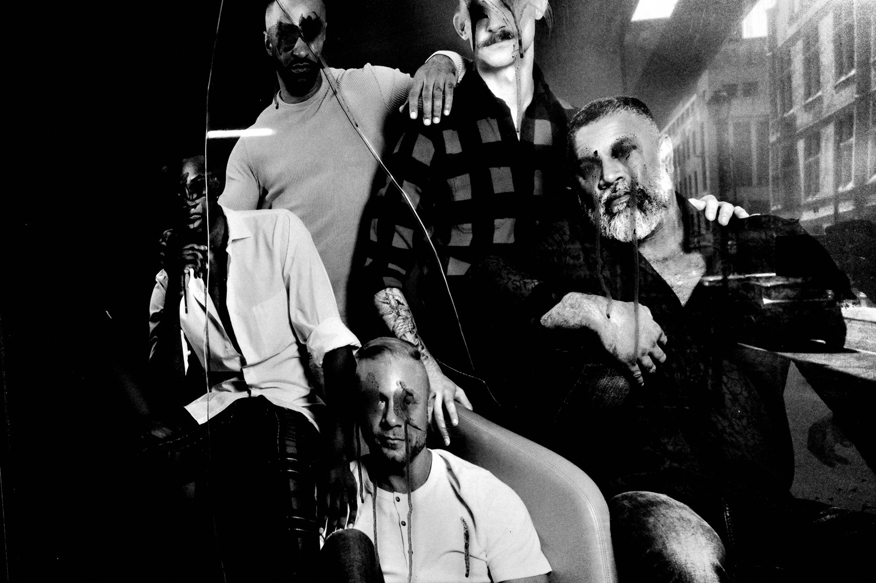
FLUX ACADEMY
BEAT 01 · CORE IDEA
Courage Makes the Photo
— The fear is real — and beatable
— Courage is a skill, not a gift
— The closer, the better
Notes:
What's popping, people — it's Dante. Today we go straight at the thing that holds almost everybody back: fear. Street photography is intimidating because it's candid — pointing a camera at strangers is scary, especially early on. But here's the core truth: the more courage you display on the streets, the more interesting your photos become. Courage isn't something you're born with. It's something you build.

Slide 3
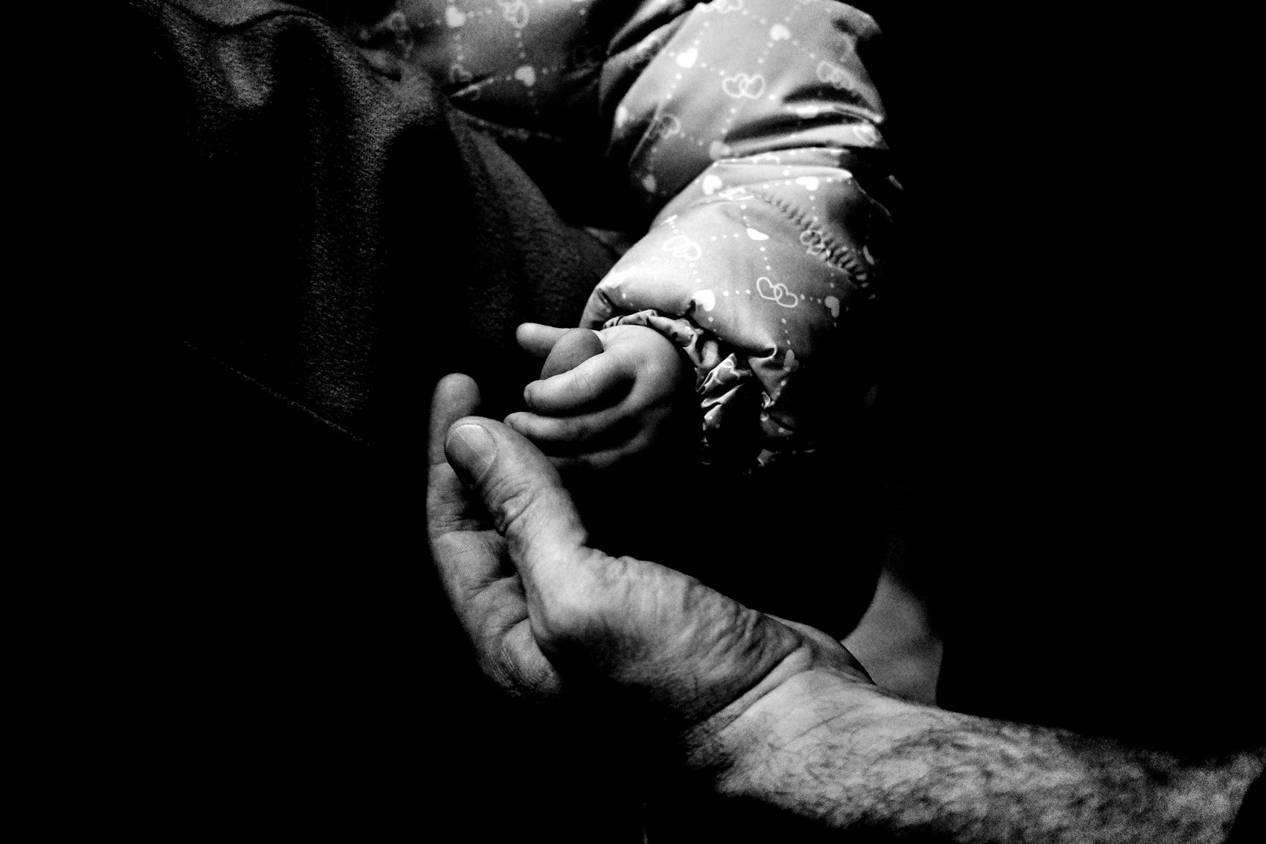
FLUX ACADEMY
BEAT 02 · LEARNING OBJECTIVE
What You'll Be Able to Do
— Press the shutter without freezing
— A ladder from self to stranger
— Handle confrontation calmly
Notes:
By the end of this lesson you'll have a real, step-by-step path out of the fear — not "just be brave," but an actual ladder you climb. You'll know how to warm up on yourself, ease in with portraits, go candid, stay stealthy when you need to, and stay calm if anyone ever questions you. The goal is simple: get you pressing that shutter button.

Slide 4
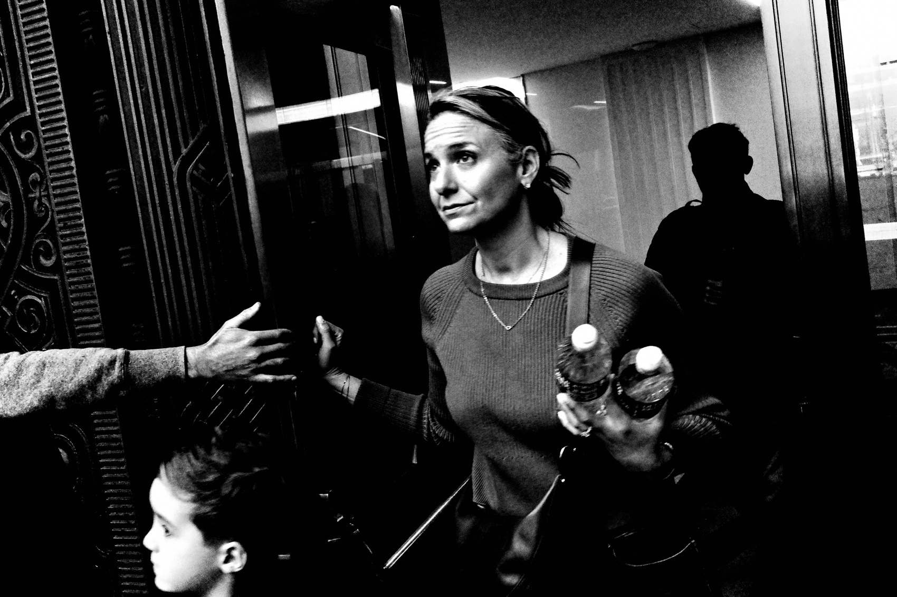
FLUX ACADEMY
BEAT 03 · WHY THIS MATTERS
Fear Holds You at the Edge
— The fear of rejection stops the shutter
— Hesitation kills the frame
— This is the gate to everything
Notes:
Why does this matter so much? Because the fear of confrontation or rejection is the single thing that holds you back from pressing the shutter. You can have the eye, the camera, the whole worldview — and still freeze at the decisive moment. Fear is the gate. Everything else in this course lives on the other side of it. So we deal with it now.

Slide 5
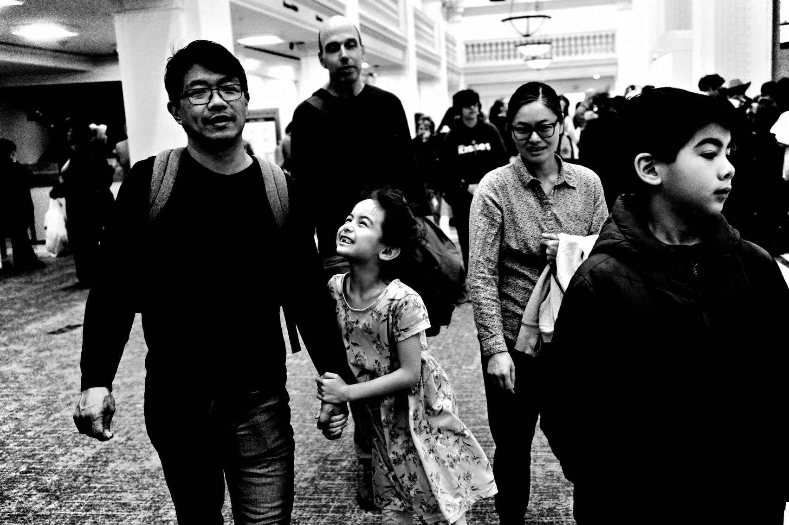
FLUX ACADEMY
BEAT 04 · WHY THIS MATTERS
Don't Let It Scare You Away
— Street photography shouldn't scare you off
— A few simple tips, real momentum
— Keep pushing forward
Notes:
And here's the encouraging part: street photography doesn't have to be the thing that scares you away. So many people quit before they ever really start, because that first wall of fear feels permanent. It isn't. With a few simple tips I'm about to give you, you keep pushing forward — and the wall gets lower every single time you walk out the door.

Slide 6
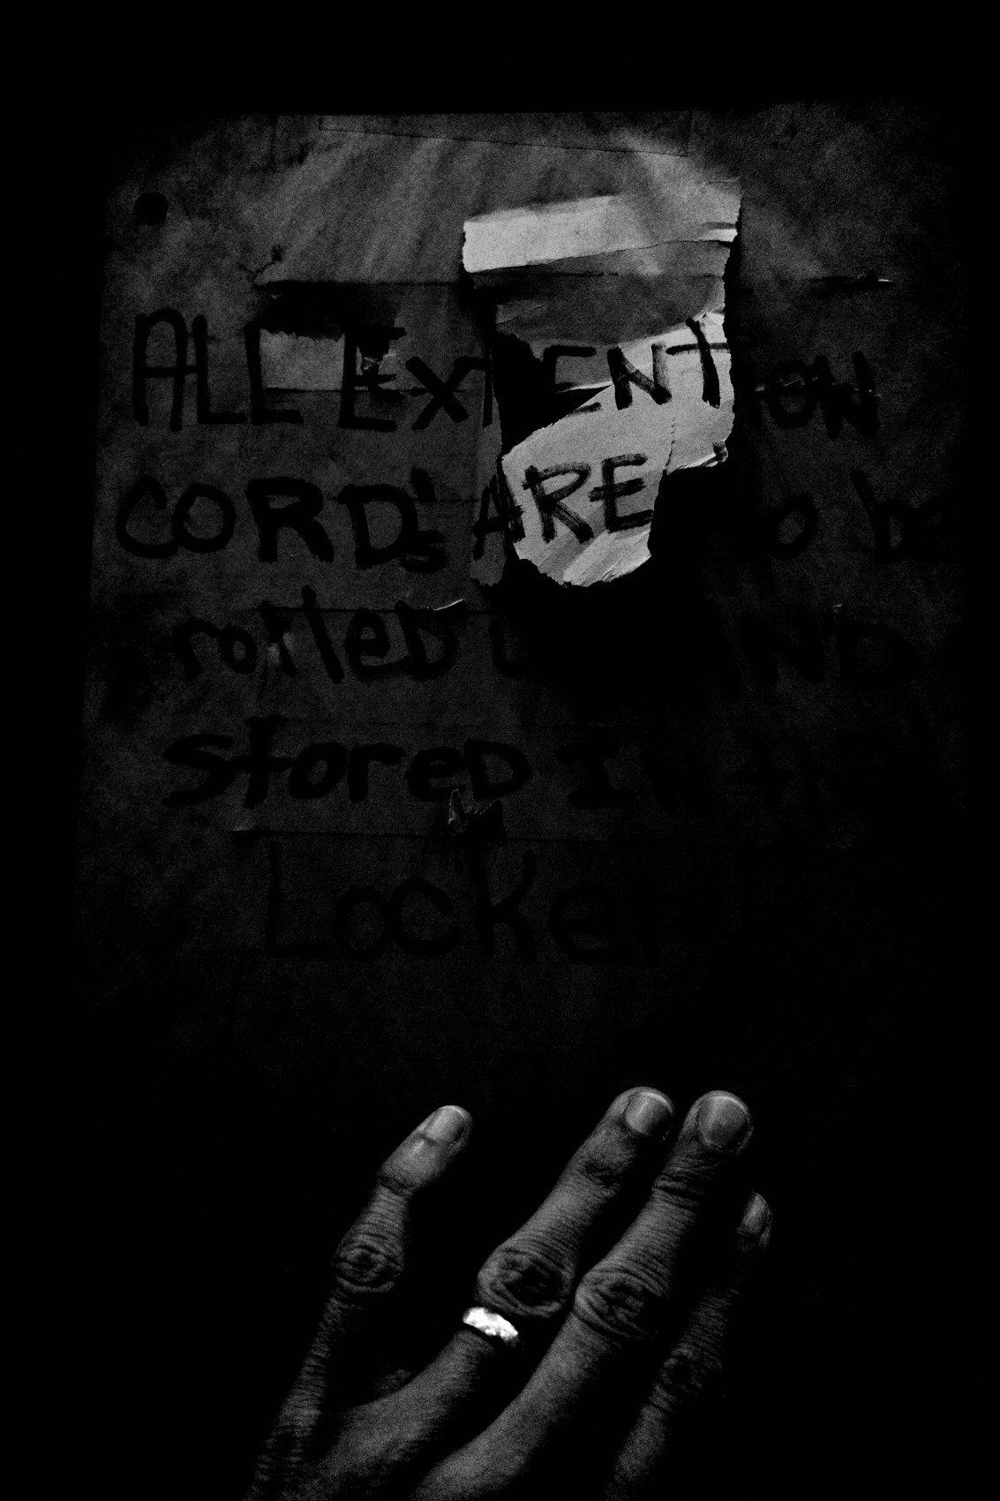
FLUX ACADEMY
BEAT 05 · MAIN TEACHING
Your Photography Matters
— Nothing wrong with what you're doing
— You're documenting the human experience
— Preserving history for the future
Notes:
First, the mindset that makes all of this possible: recognize there is nothing wrong with what you're doing. Street photography is documenting the human experience — capturing moments that preserve a piece of history for future generations. Remind yourself your work is valuable. When you understand the importance of what you're doing, you carry yourself differently. Every time you press the shutter, you're adding to a visual record of the world as you see it.

Slide 7
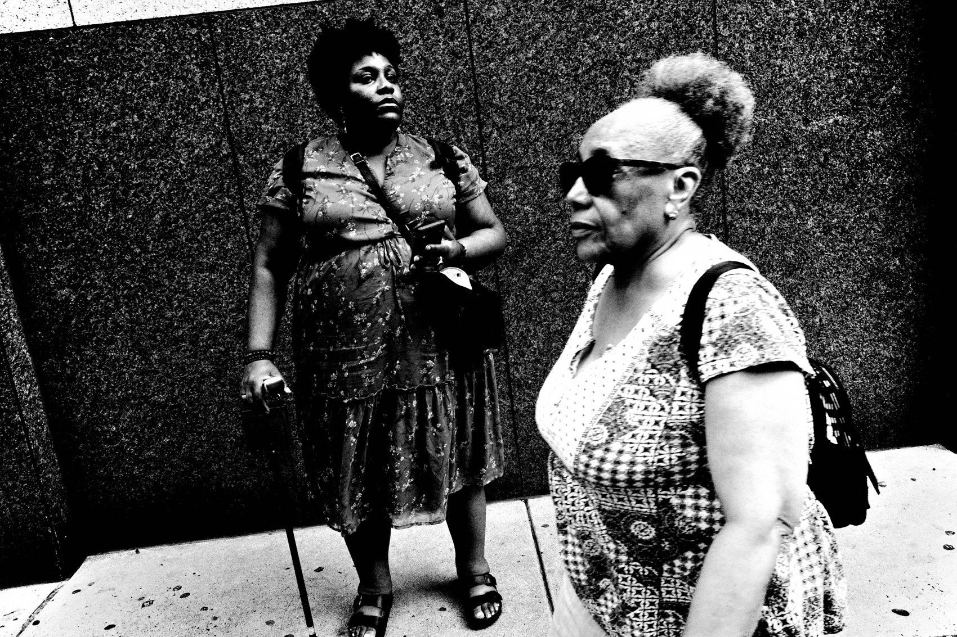
FLUX ACADEMY
BEAT 06 · MAIN TEACHING
Start With Self-Portraits
— Get comfortable with yourself first
— Know how it feels to be photographed
— You're beautiful — let that inspire you
Notes:
Step one on the ladder: make self-portraits. To get comfortable on the streets, get comfortable with yourself in front of the camera first. Put yourself in front of the lens and you'll understand what it actually feels like to be photographed. That's powerful. And honestly — it's a reminder that you're beautiful, which is inspiring all on its own. Start at home, with the easiest subject you've got: you.

Slide 8
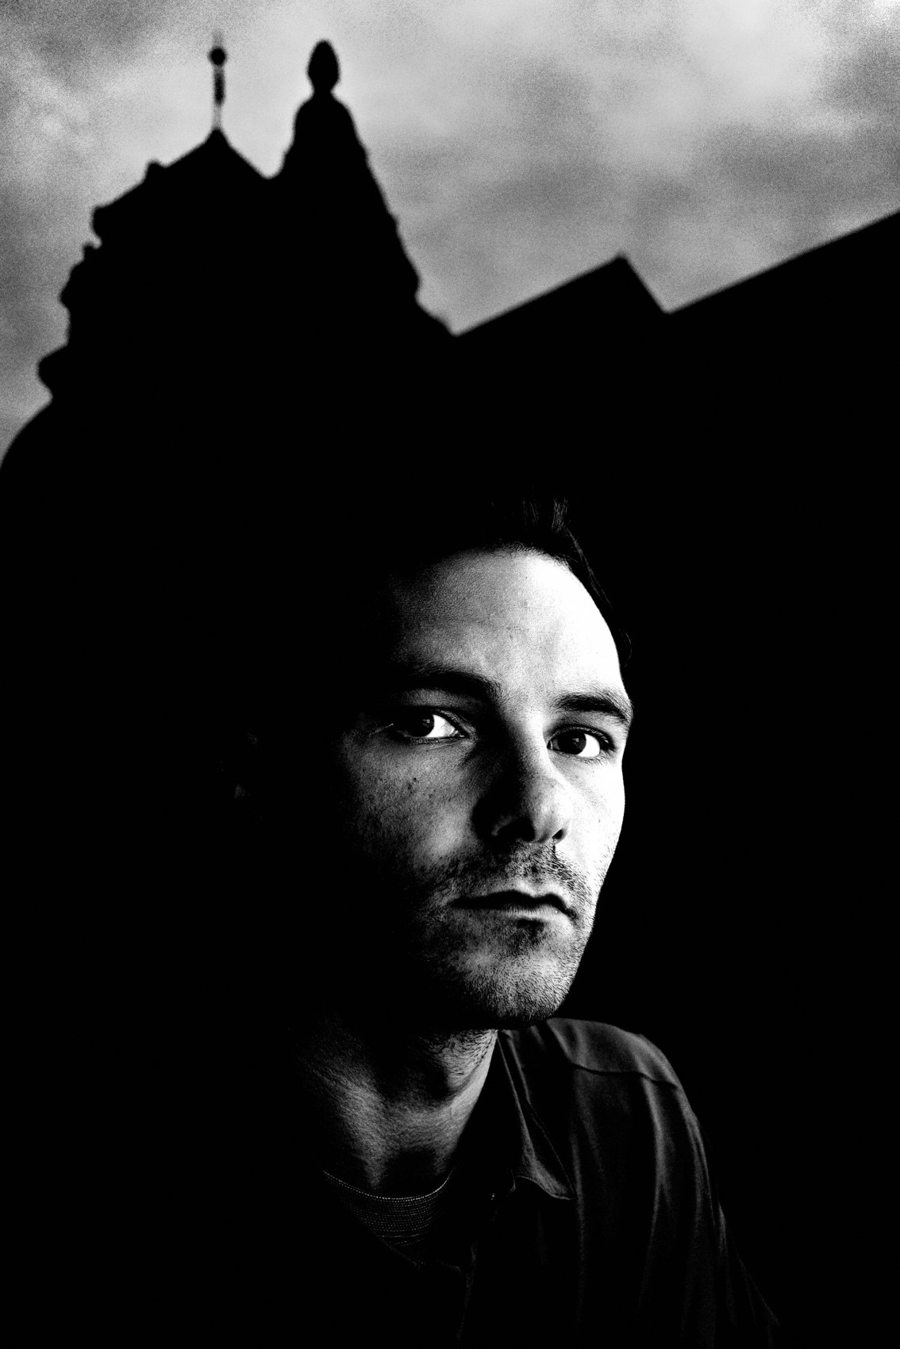
FLUX ACADEMY
BEAT 07 · MAIN TEACHING
Self-Portraits Build Empathy
— Confidence in front of the camera
— Empathy for your subjects
— Practice posing and seeing yourself
Notes:
Here's why self-portraits do more than build confidence — they build empathy. Once you know what it feels like to be on the other side of the lens, you approach strangers with more care, more warmth. You're not a sniper anymore; you're a fellow human who gets it. Confidence, empathy, and the practice of posing and seeing yourself through the lens — all of that flows straight into how you photograph other people.

Slide 9
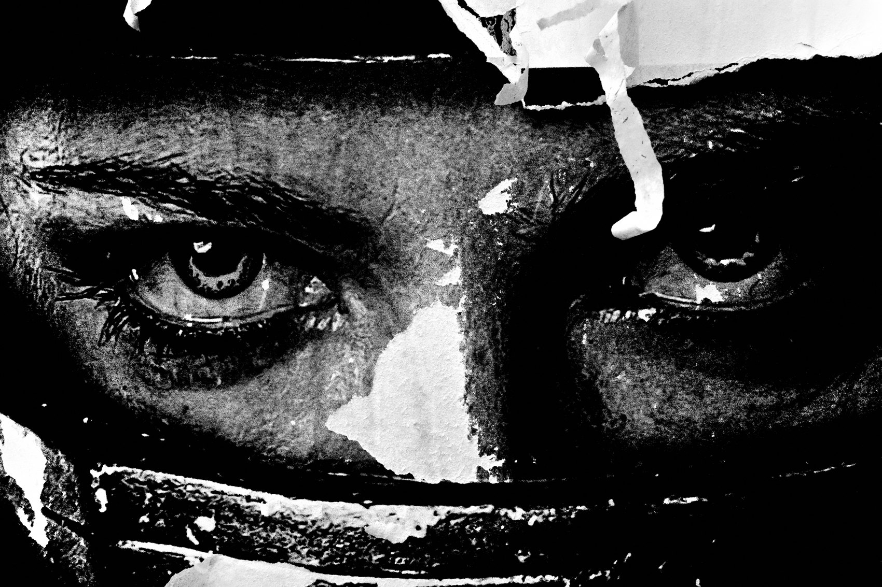
FLUX ACADEMY
BEAT 08 · MAIN TEACHING
Ease In With Street Portraits
— Street portraits are a great way to start
— Engage directly, learn to be told no
— Build social skills and courage
Notes:
Step two: street portraits. I believe making street portraits is one of the best ways to get started. You engage directly — you ask. And yes, sometimes people say no, but you'll be surprised how many say yes. This is where you learn to handle confrontation and rejection gracefully, where you build the social skills and the courage that candid work will later demand of you.

Slide 10
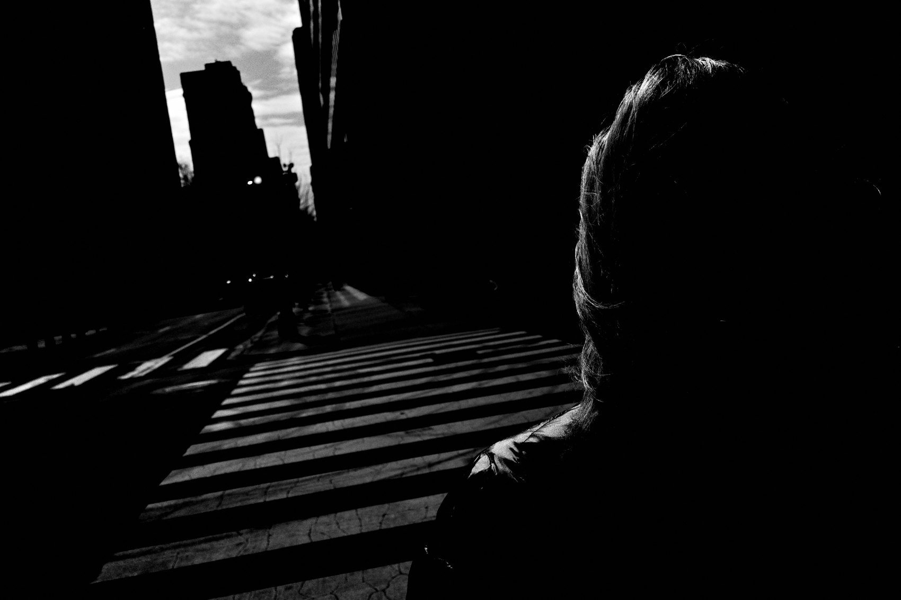
FLUX ACADEMY
BEAT 09 · MAIN TEACHING
The Instax Trick
— Carry an Instax your first few weeks
— Hand them a print on the spot
— A small gesture that builds trust
Notes:
Here's a move I swear by for those first few weeks: bring an Instax camera. After you make someone's portrait, you hand them a print right there on the spot. It completely changes the encounter — suddenly you're giving, not taking. That small gesture goes a long way toward building trust and confidence, both theirs and yours. It turns a scary ask into a gift.

Slide 11
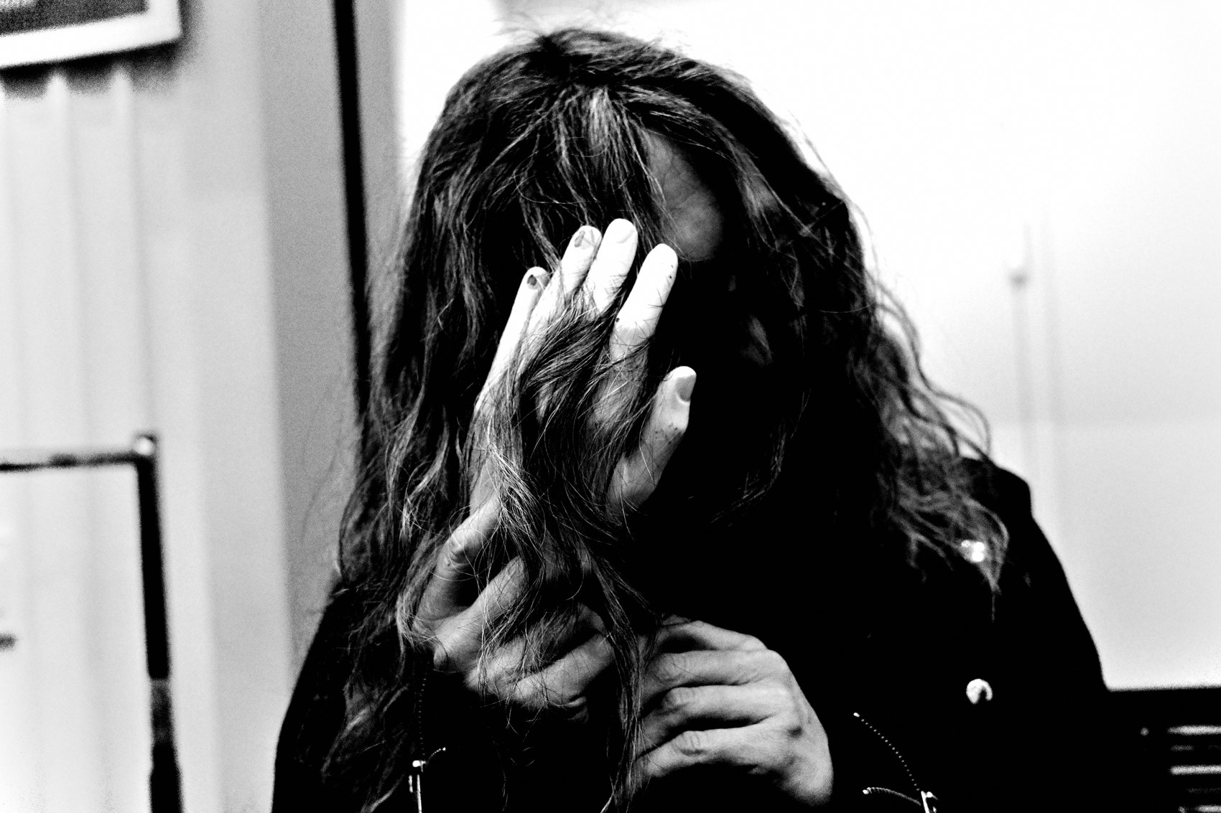
FLUX ACADEMY
BEAT 10 · MAIN TEACHING
Be a Tourist at Home
— Play the role of a tourist
— Wonder, curiosity, a real smile
— Relax, and you blend right in
Notes:
Step three, now we go candid. The trick I use: play the role of a tourist in your own hometown. Approach the streets with wonder and curiosity, wear a smile, enjoy your surroundings like you're seeing them for the first time. This mindset relaxes you — and when you're relaxed, you blend into the scene naturally and make candid images without drawing attention. Fear reads as suspicious; wonder reads as harmless.

Slide 12
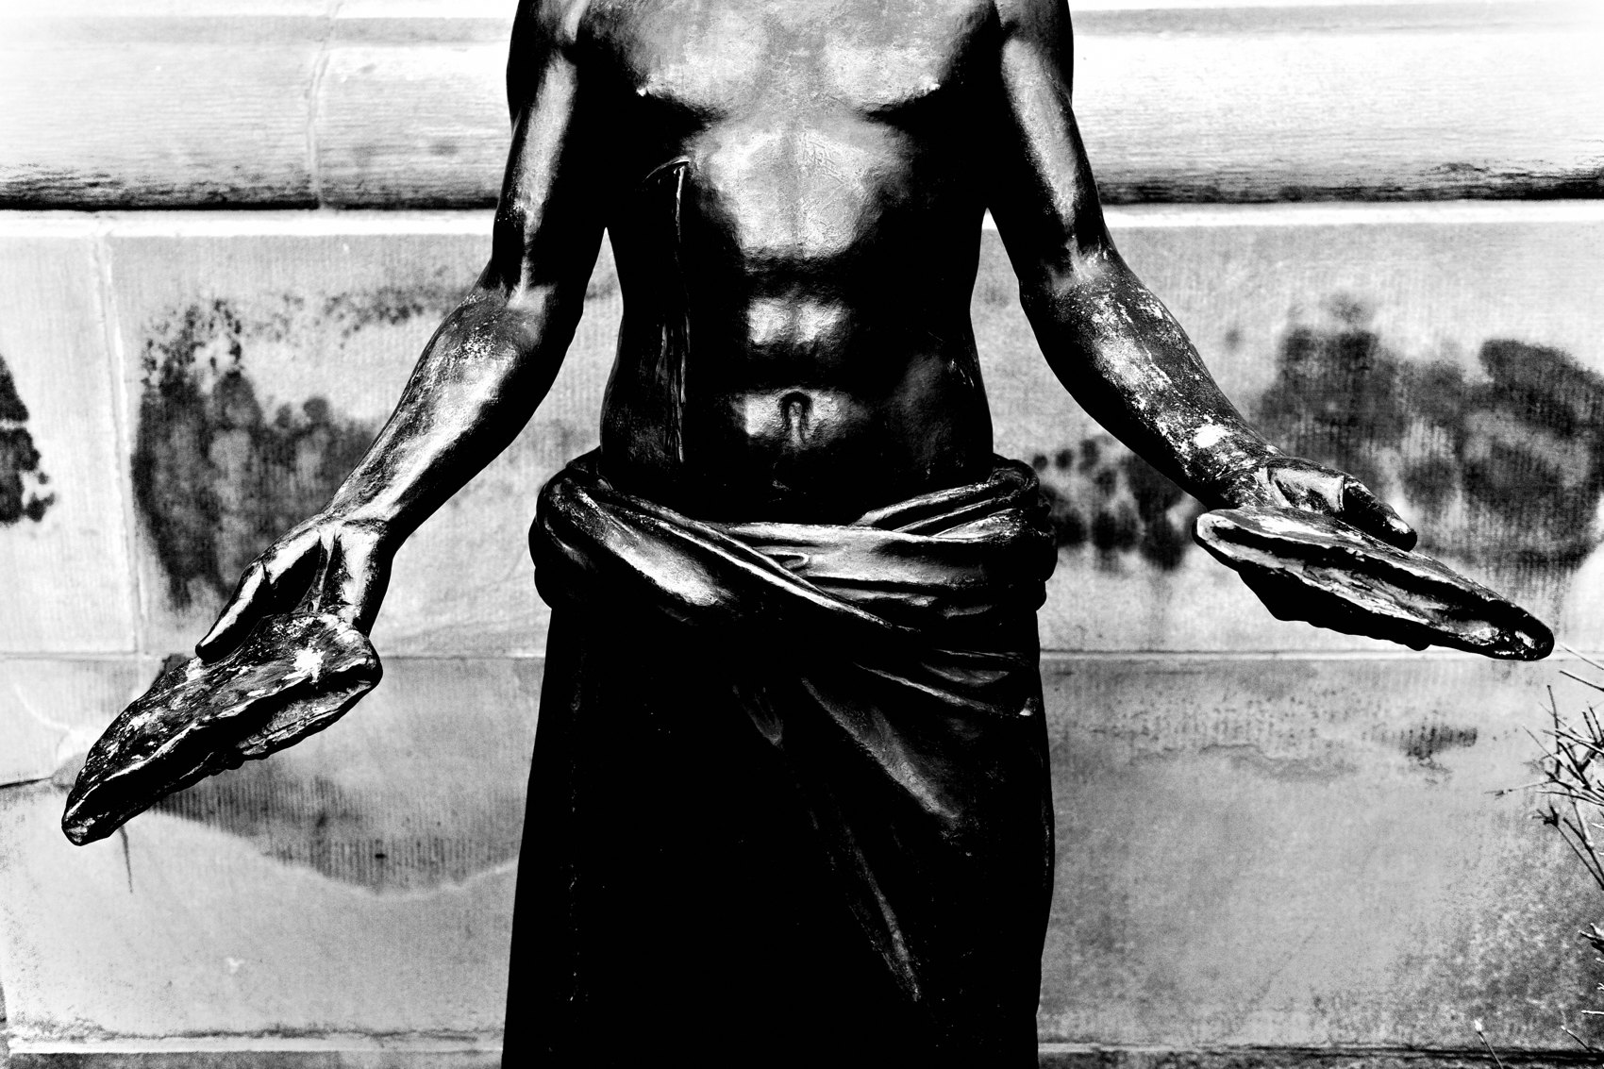
FLUX ACADEMY
BEAT 11 · MAIN TEACHING
How to Be Stealthy
— Use the LCD, not the viewfinder
— Look like you're shooting the background
— Avoid direct eye contact
Notes:
When you need to be invisible, stealth is an art. The simplest move: use the LCD screen on the back of your camera. Walk around looking at the screen like you're shooting video or fiddling with settings. Act as if you're photographing whatever is in the background of people on the street. Avoid direct eye contact. That little bit of misdirection lets you get close — and close is where the good frames live.

Slide 13
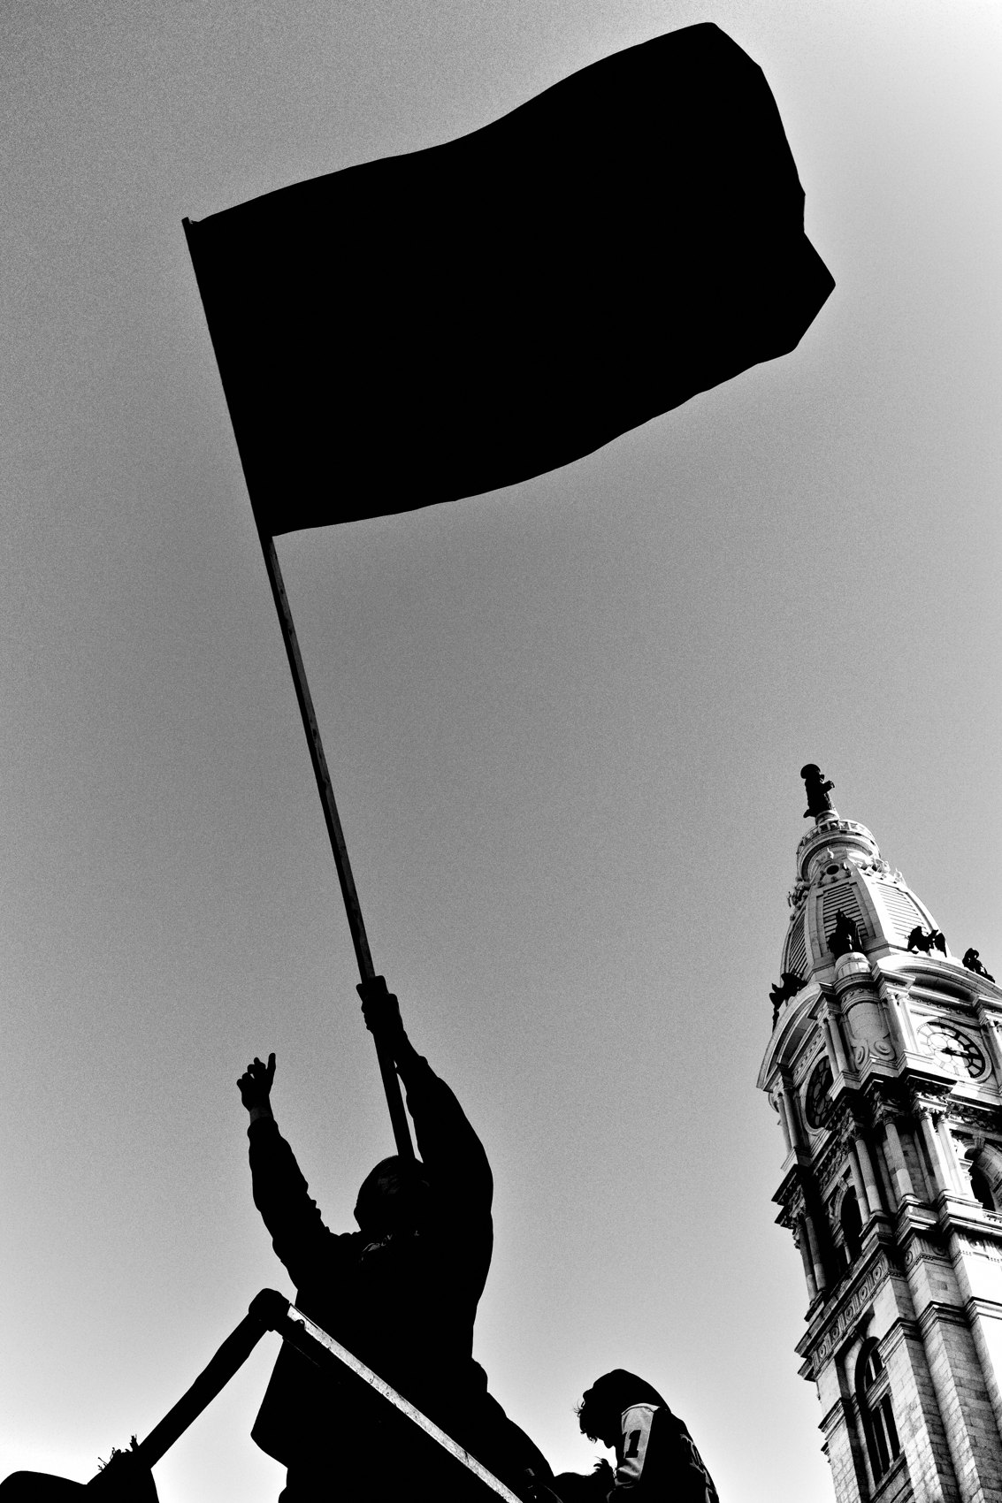
FLUX ACADEMY
BEAT 12 · MAIN TEACHING
A Compact Camera Disappears
— A small, quiet camera changes everything
— Confrontations grow rare
— Less gear, less suspicion
Notes:
The gear itself is part of the courage equation. Switch to a small, compact camera and shoot strictly off the LCD screen, and confrontations become genuinely rare. A stealthy camera simply doesn't read as a threat the way a big rig with a long lens does. The smaller and quieter your camera, the less fear you generate in the people around you — and the less you carry yourself.

Slide 14
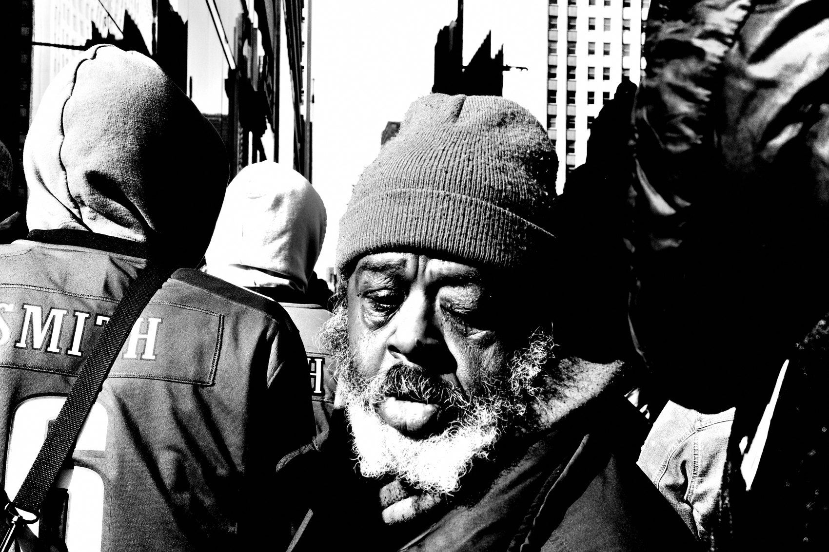
FLUX ACADEMY
BEAT 13 · MAIN TEACHING
If You Get Confronted
— Confrontation is rare — stay calm
— Be honest and polite, student or hobbyist
— Offer to delete; diffuse fast
Notes:
Now the fear underneath the fear: what if someone confronts me? First, it's rare. But if it happens, keep calm and have a quick, friendly conversation. Be honest and polite — tell them you're just taking photos as a student or a hobbyist, and offer to delete the picture if it makes them uncomfortable. The whole goal is to diffuse the situation quickly, no drama. Nine times out of ten, a calm and kind tone ends it right there.

Slide 15
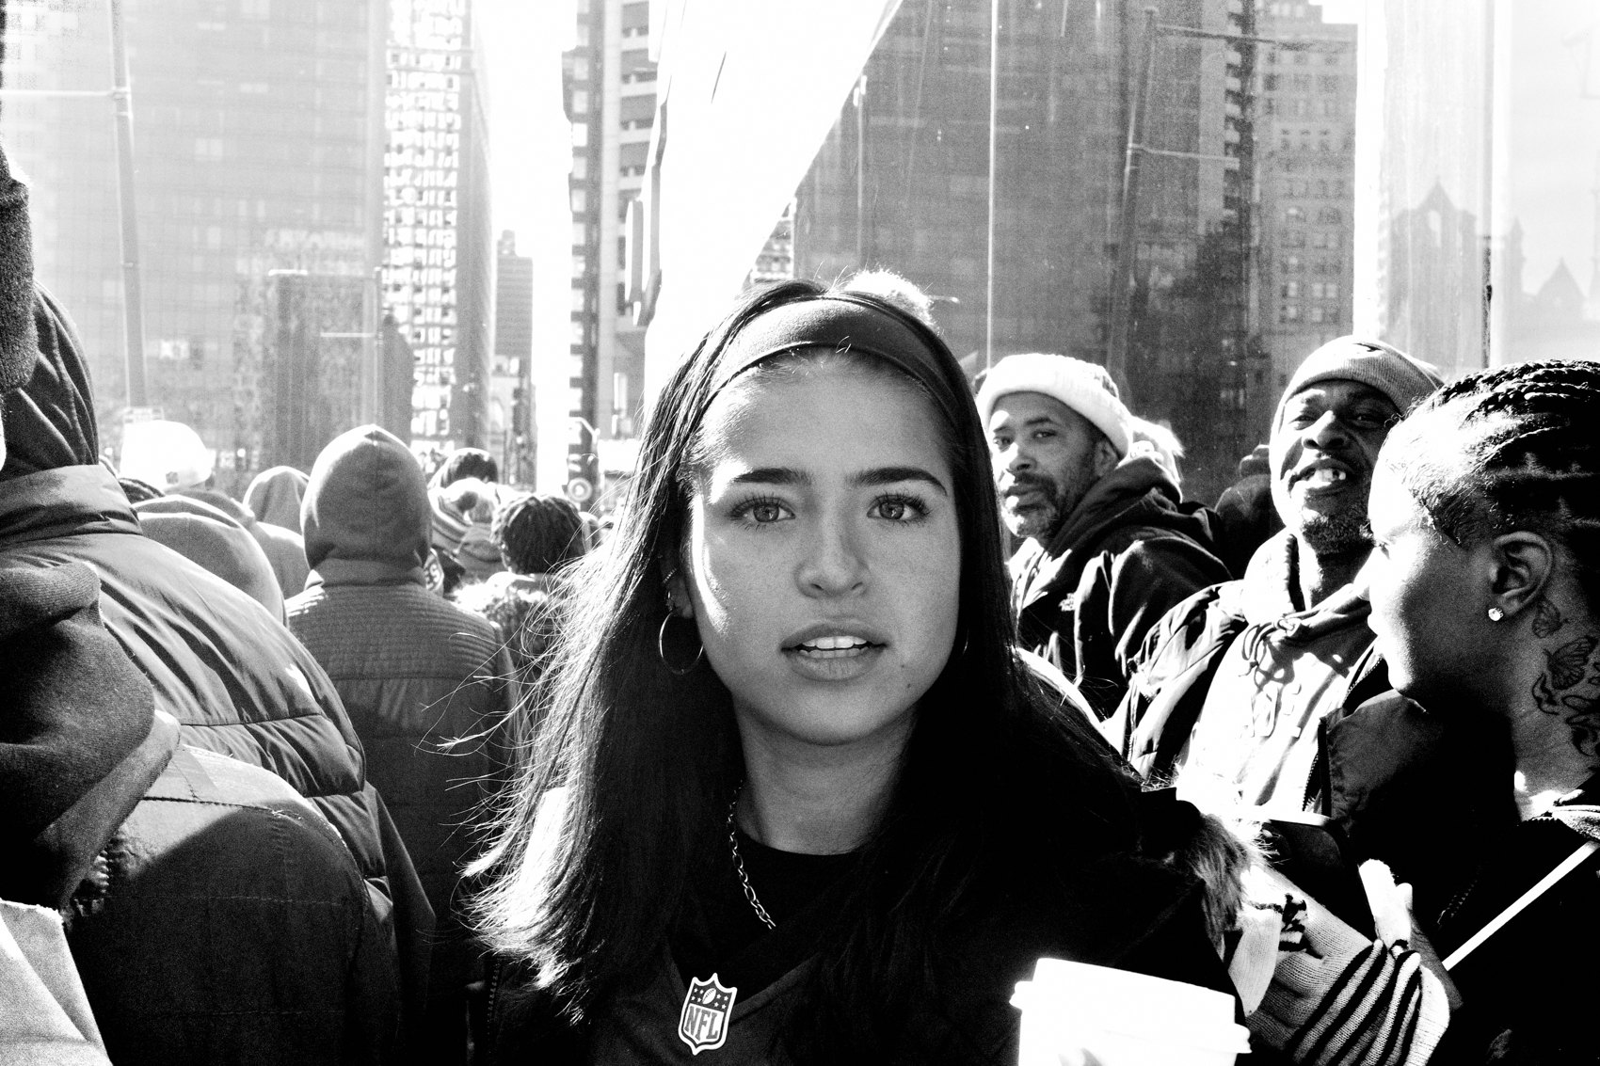
FLUX ACADEMY
BEAT 14 · MAIN TEACHING
Courage Is the Whole Game
— The more courage, the more interesting
— The closer, the better
— Proximity evokes the human experience
Notes:
Here's the heart of all of it: at its core, street photography requires courage. The most compelling images come from the moments you push past your comfort zone. The notion that "the closer, the better" holds true — proximity evokes a deeper sense of the human experience. Every great frame you'll ever make is sitting just past the spot where the fear told you to stop. Courage is literally how you get there.

Slide 16
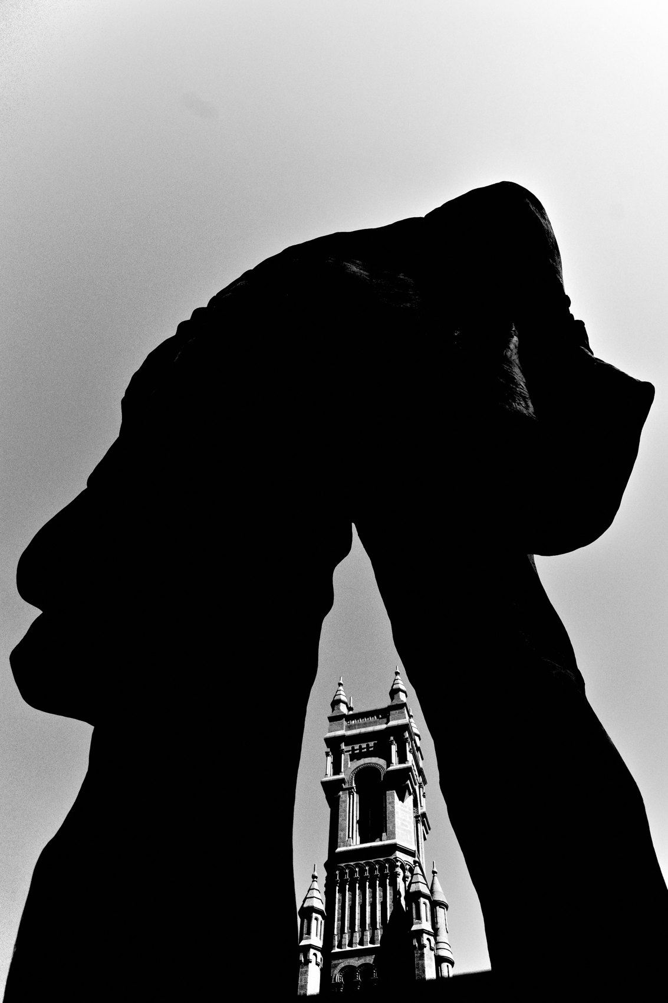
FLUX ACADEMY
BEAT 15 · MAIN TEACHING
Carry Yourself With Confidence
— Head held high, chest open, shoulders back
— Confidence and curiosity, together
— Your body teaches your mind
Notes:
And courage isn't only mental — it's physical. Walk the streets with your head held high, chest open, shoulders back. Carry yourself with confidence and curiosity. This isn't just posture for show; your body teaches your mind. Move like you belong there, and you start to feel like you belong there. People respond to that energy — and the images you create will reflect that boldness right back at you.

Slide 17
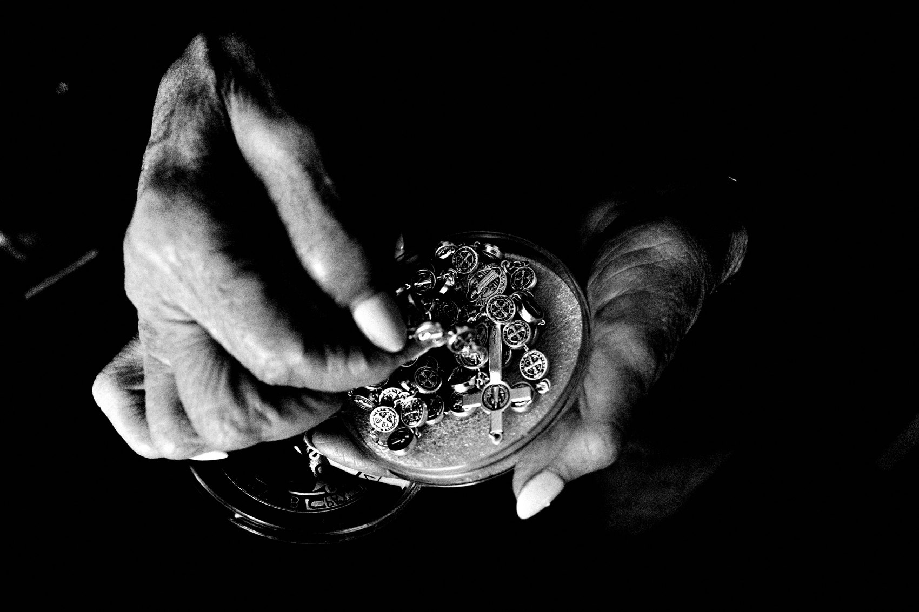
FLUX ACADEMY
BEAT 16 · MAIN TEACHING
Fear Shrinks With Reps
— Stay curious, embrace each encounter
— Every walk lowers the wall
— Positivity makes you approachable
Notes:
The thing nobody tells beginners: fear shrinks with reps. Stay curious and embrace each new encounter on the street. Confidence and positivity help you engage with your environment — and they make you approachable, which makes everything easier. You don't conquer fear in one heroic moment. You wear it down, walk by walk, frame by frame, until one day you realize the wall that stopped you is barely a curb.

Slide 18
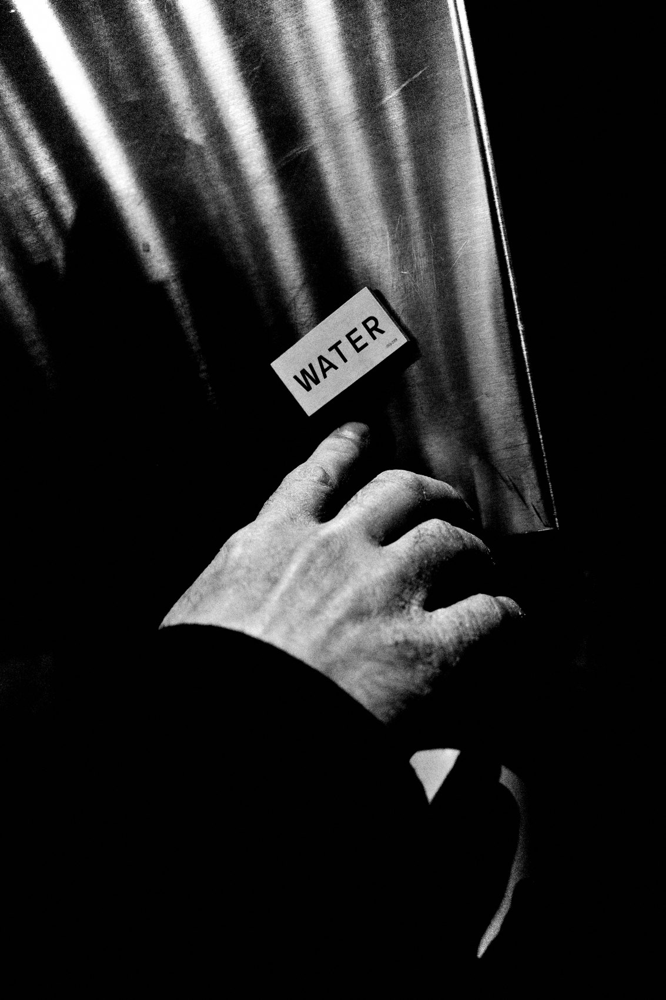
FLUX ACADEMY
BEAT 17 · PRACTICAL APPLICATION
Climb the Ladder in Order
— Week 1: self-portraits at home
— Then: street portraits with an Instax
— Then: candid as a relaxed tourist
Notes:
Here's your assignment, and it's a ladder — climb it in order. This week, make self-portraits at home until the camera feels normal. Next, go ask strangers for portraits — bring an Instax and hand out prints. Only then move to candid work, playing the tourist with a smile. Each rung makes the next one possible. Don't skip to candid before you've warmed up the courage muscle.

Slide 19
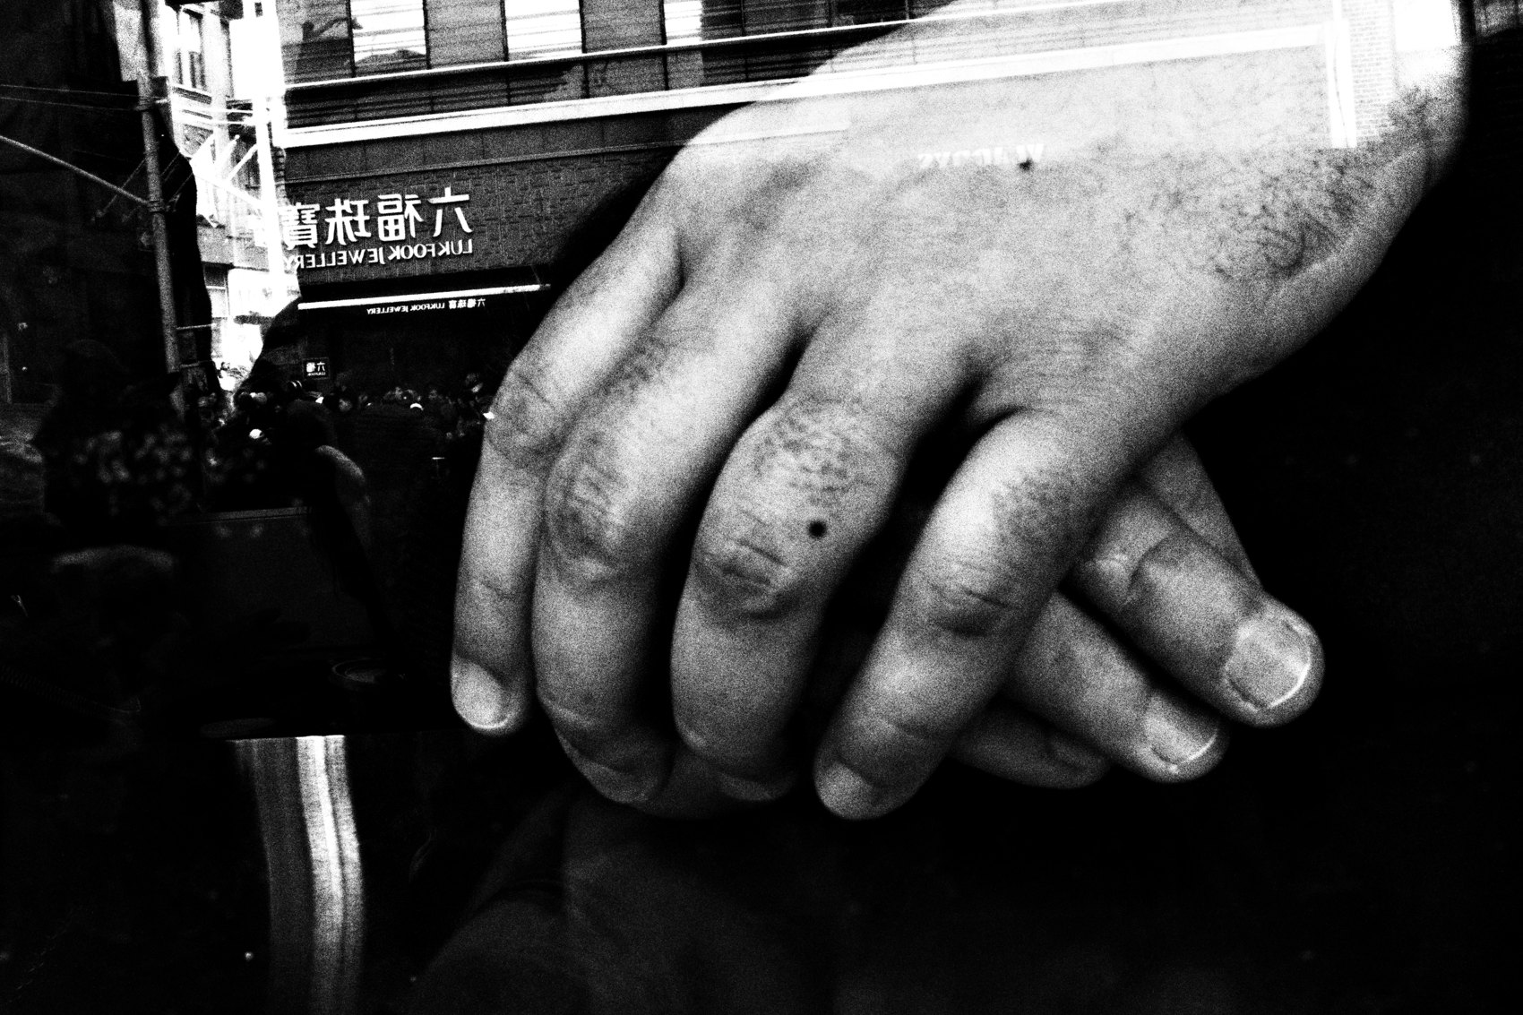
FLUX ACADEMY
BEAT 18 · PRACTICAL APPLICATION
The Stealth Drill
— Shoot a whole walk off the LCD
— "Aim" at the background, not the person
— Practice getting one step closer
Notes:
Second drill: a full walk shot entirely off the LCD screen, no viewfinder. Frame as if you're photographing whatever is behind your subject. The point isn't sneakiness for its own sake — it's lowering your own anxiety enough to get close. And push the proximity on purpose: each frame, take one step closer than feels comfortable. That single step is where the fear lives, and where the best photos are waiting.

Slide 20
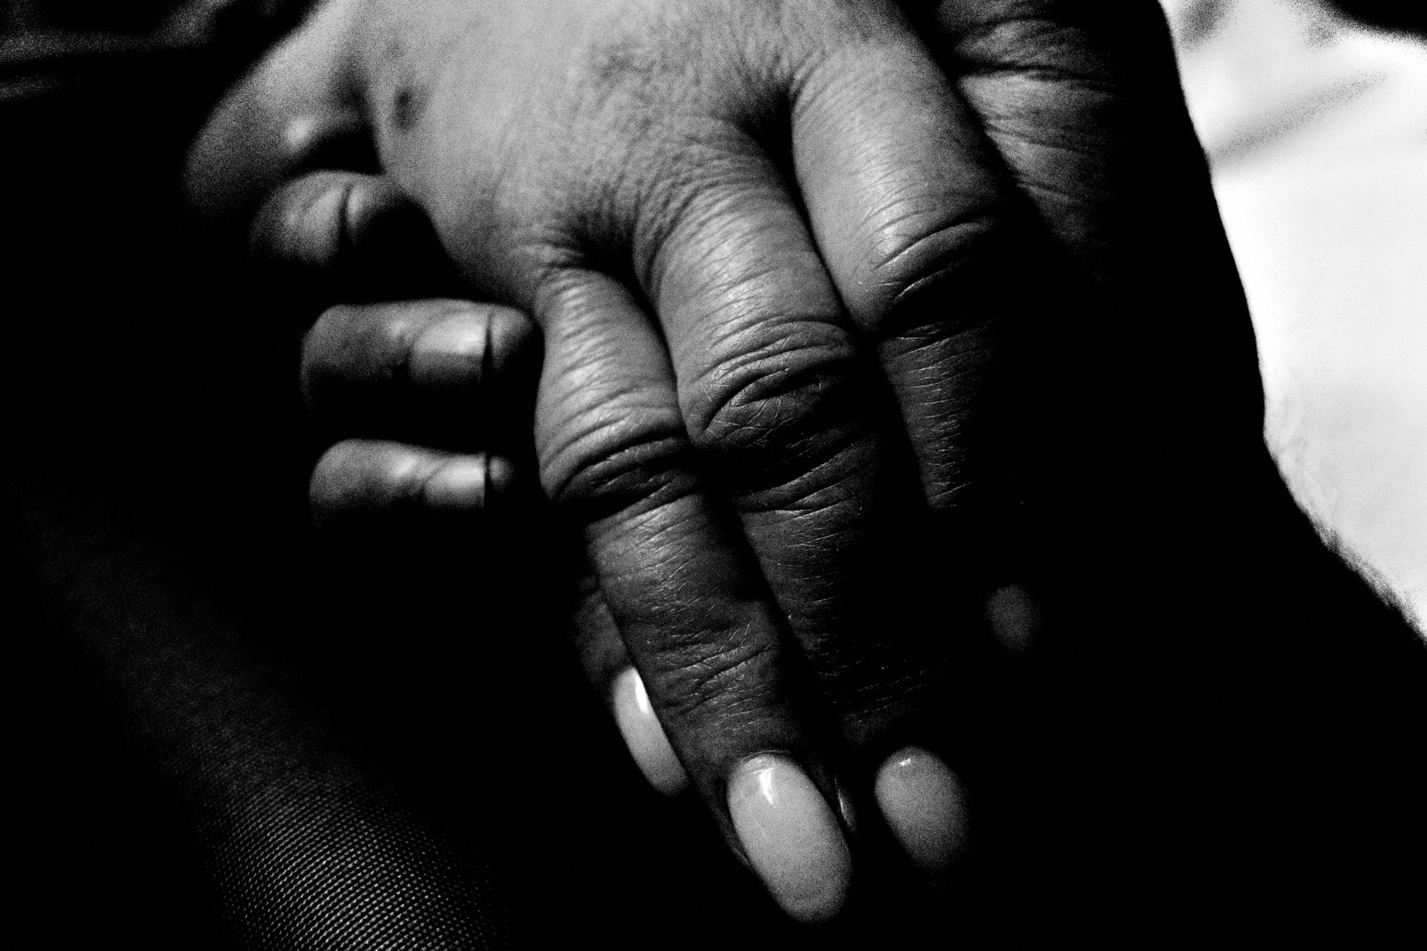
FLUX ACADEMY
BEAT 19 · COMMON MISTAKES
Shooting Scared and Far
— Long lens from across the street
— Tense body, darting eyes = suspicious
— Distance kills the human feeling
Notes:
The biggest mistake is shooting scared — hanging back across the street with a long lens, body tense, eyes darting. Ironically, that's what actually makes people suspicious of you. And worse, distance drains the human feeling right out of the frame. The photo of the fear is always a worse photo. Get closer, relax your body, and your work transforms.

Slide 21
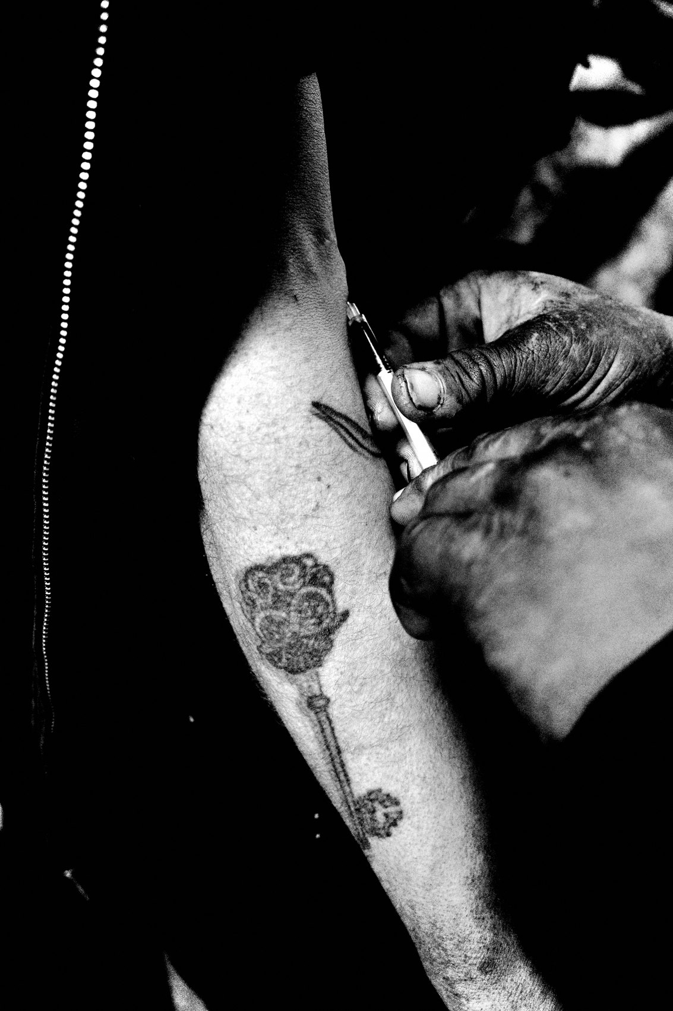
FLUX ACADEMY
BEAT 20 · COMMON MISTAKES
Letting One "No" Stop You
— Rejection is part of the practice
— One no isn't a verdict on you
— Let it go, keep walking, keep shooting
Notes:
The other mistake is treating rejection like a catastrophe. Someone says no, or someone confronts you, and you put the camera away for the day — or for good. Don't. Learning to handle rejection gracefully is the whole point of the early portrait work. A no isn't a judgment of you; it's just a no. Stay calm, be kind, let it go, and keep walking. Courage means continuing.

Slide 22
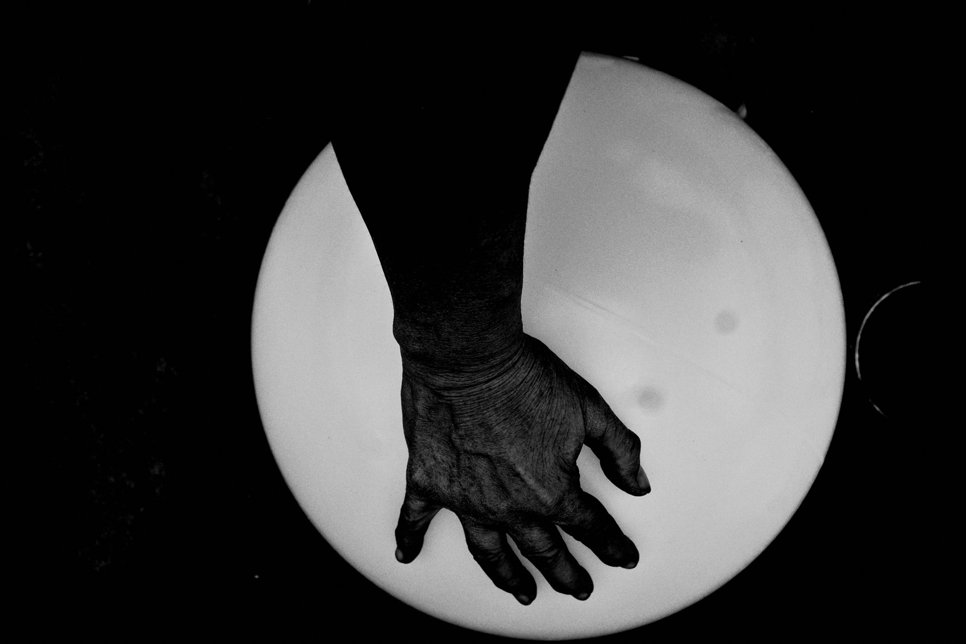
FLUX ACADEMY
BEAT 21 · RELATIONSHIP TO PREVIOUS
From Authenticity to Audacity
— Builds on Lesson 009 — Authenticity
— Shooting for yourself kills the fear of judgment
— Inner conviction becomes outer courage
Notes:
This lesson stands on the shoulders of Lesson 009, Authenticity: Shoot for Yourself. When you let go of validation — of likes, trends, and other people's approval — a huge chunk of the fear simply evaporates, because you stop performing for an audience. Authenticity is the inner conviction; courage is that same conviction made physical on the street. Be the master of your own self first, and audacity follows.

Slide 23
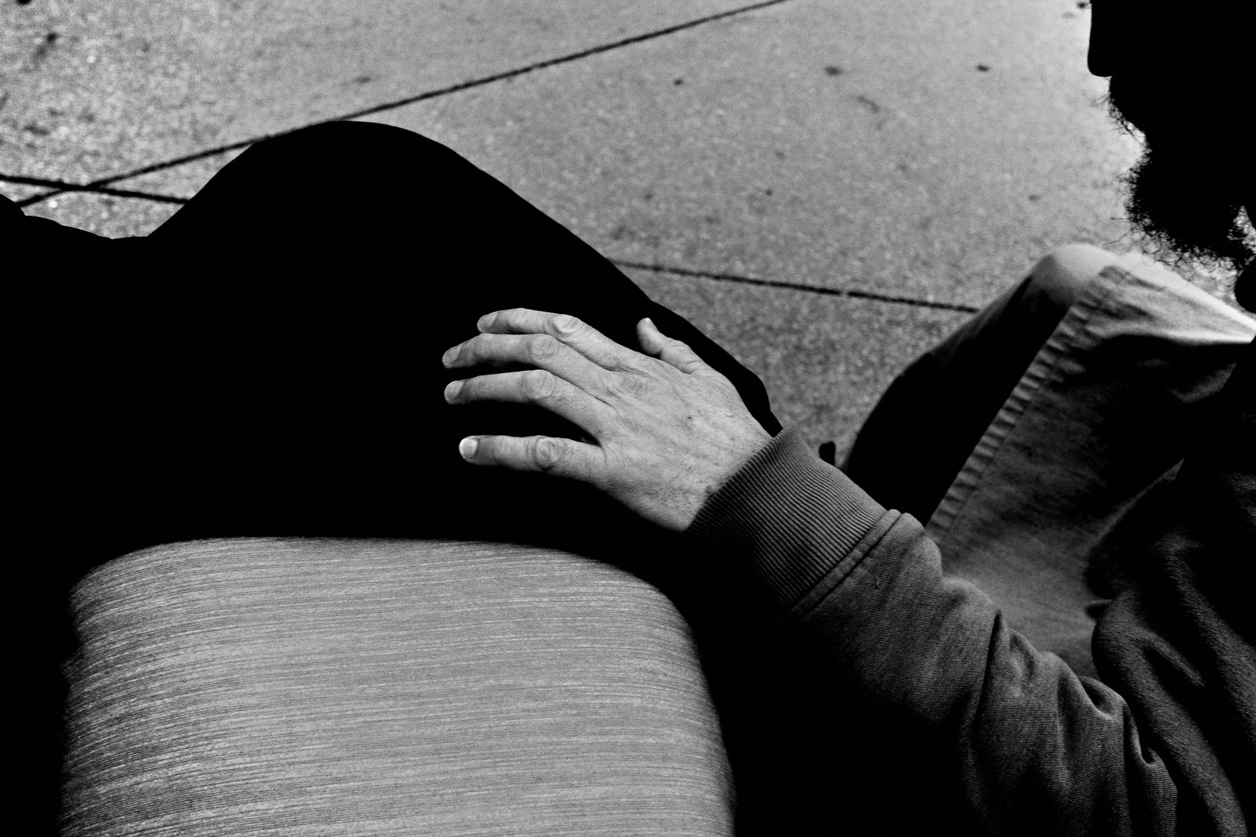
FLUX ACADEMY
BEAT 22 · RELATIONSHIP TO UPCOMING
Now Go Find the Magic
— Next: Finding Beauty in the Mundane (Lesson 011)
— Courage gets you close; vision finds the photo
— We leave the inner game for seeing
Notes:
With the fear handled, you're free to actually look. Next up, Lesson 011: Finding Beauty in the Mundane. Courage is what gets you close enough to the ordinary — now we train the eye to find the magic hiding in it. This is where we close out the inner game and start turning that newfound boldness into a way of seeing the everyday world.

Slide 24
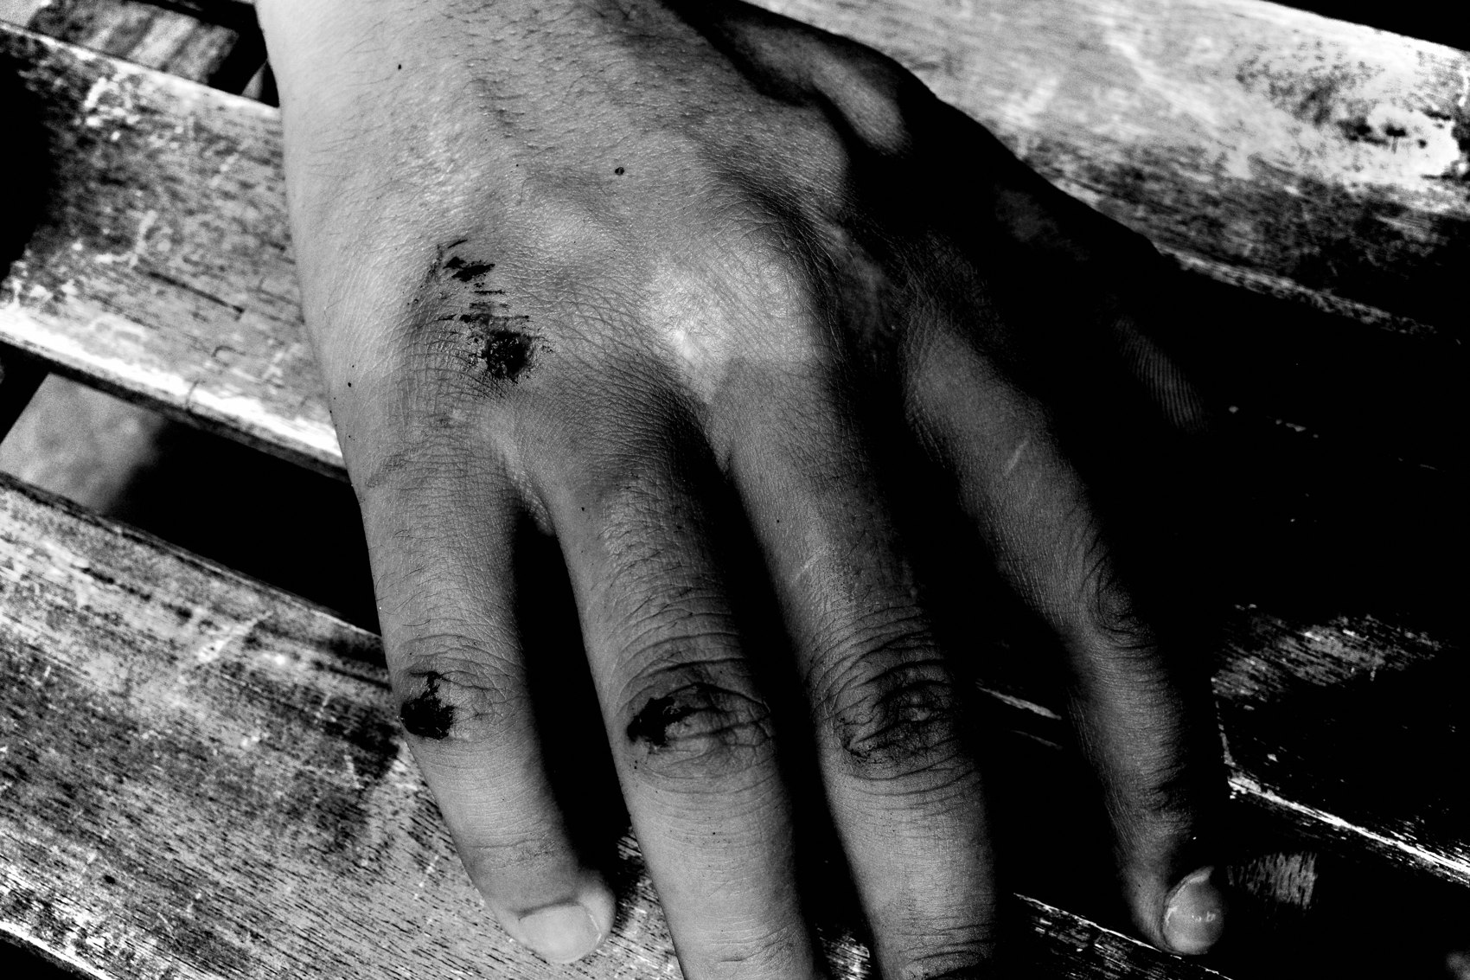
FLUX ACADEMY
BEAT 23 · SUMMARY / TAKEAWAY
Climb the Ladder, Get Close
— Your work matters — own it
— Self → portrait → candid → stealth → calm
— More courage, more interesting photos
Notes:
Last thing. Conquering fear isn't a personality trait you either have or don't — it's a ladder you climb. Remind yourself your work matters. Warm up on yourself, ease in with portraits, go candid as a curious tourist, stay stealthy, and stay calm if anyone asks. Walk with your head high and your chest open. Because the more courage you display on the streets, the more interesting your photos become. Get close. Catch you next lesson.

