Slide 1
FLUX ACADEMY · A SCHOOL FOR SEEING
MODULE 2 · THE INNER GAME
Authenticity: Shoot for Yourself
BY DANTE SISOFO

Slide 2

FLUX ACADEMY
BEAT 01 · CORE IDEA
Be the Master of Yourself
— Authentic = self + mastery
— Shoot the things that resonate with your soul
— Not for anyone else
Notes:
What's popping, people — it's Dante. Today we're talking about authenticity. Look at the word: autos, meaning self, and hentes, meaning to be the master of. To be authentic is to be the master of your own self — to make photos of the things that genuinely and deeply resonate with your soul. Not for likes. Not for a gallery. For you.

Slide 3

FLUX ACADEMY
BEAT 02 · LEARNING OBJECTIVE
What You'll Walk Away With
— Photograph from your own vision
— Detach from validation entirely
— Build a true visual diary
Notes:
By the end of this lesson you'll know how to shoot for yourself — to tune out the trends, the contests, the algorithm, and tune in to your own feeling. You'll learn to treat the camera as a visual diary and let your soul start reflecting itself back in your frames.

Slide 4
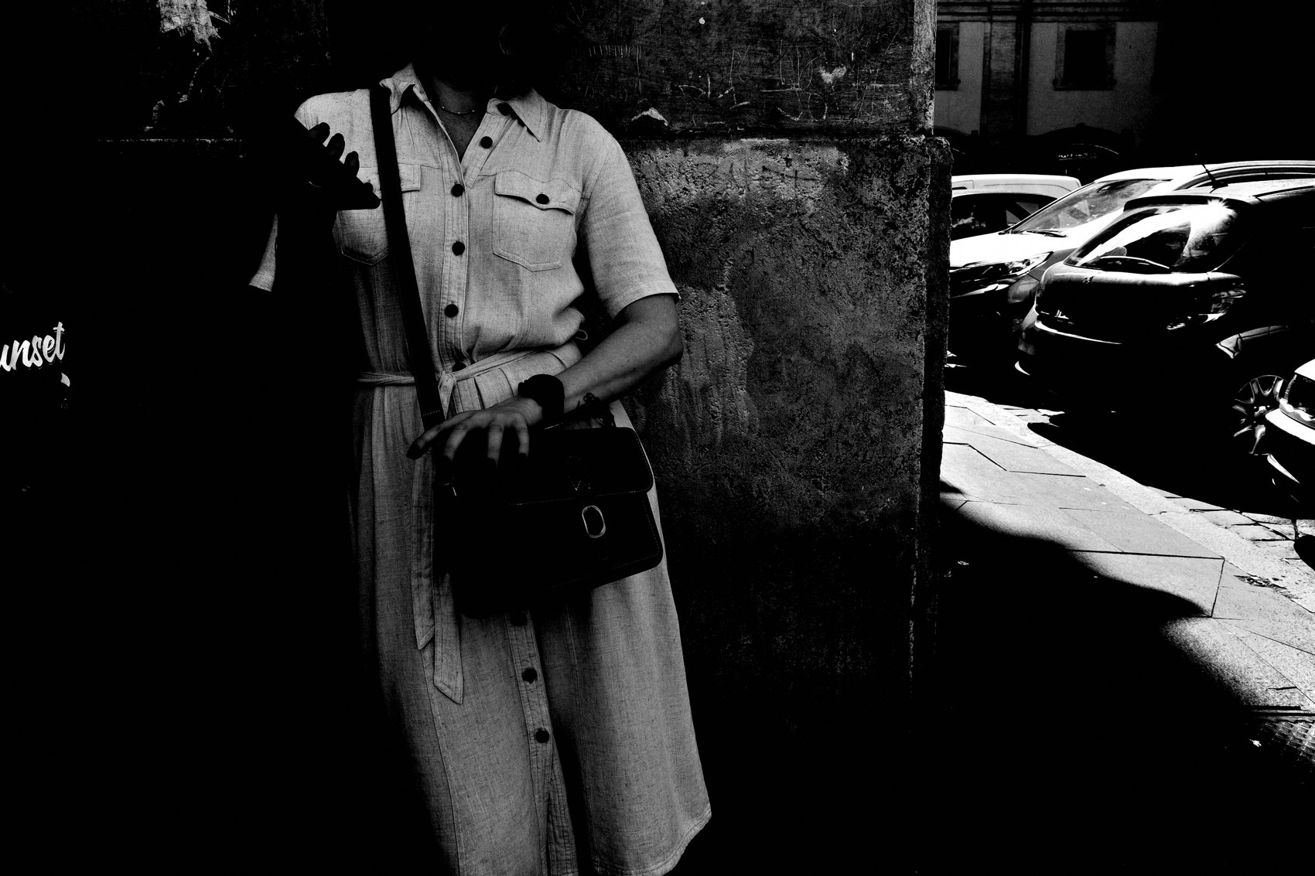
FLUX ACADEMY
BEAT 03 · WHY THIS MATTERS
Authenticity Is Rare Now
— News, noise, algorithms everywhere
— One photo trends, a thousand copy it
— Authenticity is needed more than ever
Notes:
Here's why this matters: we live in a world full of distractions, news, noise, and algorithms. One photograph gets attention, and suddenly a thousand more try to replicate it. It flattens everything into "good" versus "bad." In that flood of mimicry, authenticity is more needed than ever — and almost nobody's doing it.

Slide 5
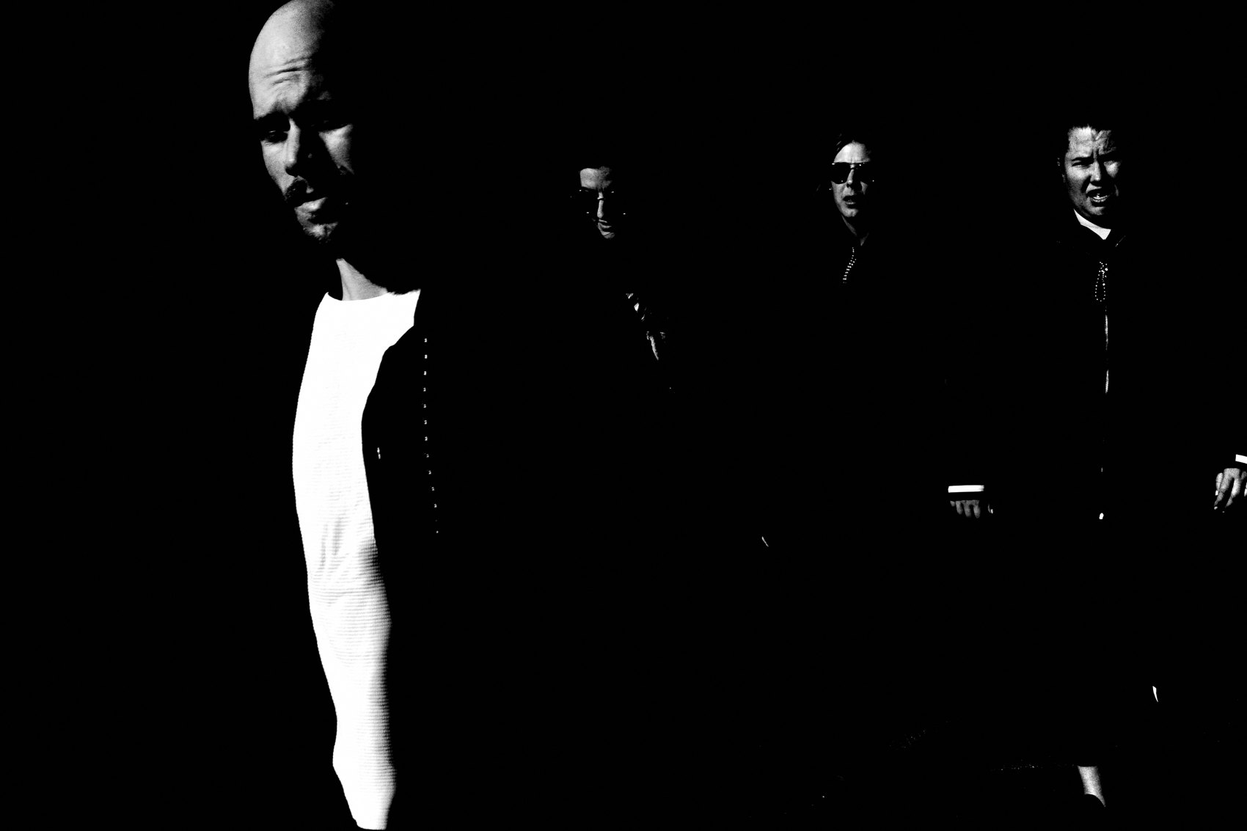
FLUX ACADEMY
BEAT 04 · WHY THIS MATTERS
Validation Runs Dry
— Trends, gear hype, likes — none of it is yours
— External validation never satisfies
— Your way of seeing is yours alone
Notes:
And here's the deeper stake. Chase trends, chase the gear everyone recommends, chase Instagram likes — and you're handing your eye over to other people. External validation never fills you up. But your way of seeing is yours. Mine is mine, yours is yours. That's the whole thing. That's authenticity.

Slide 6
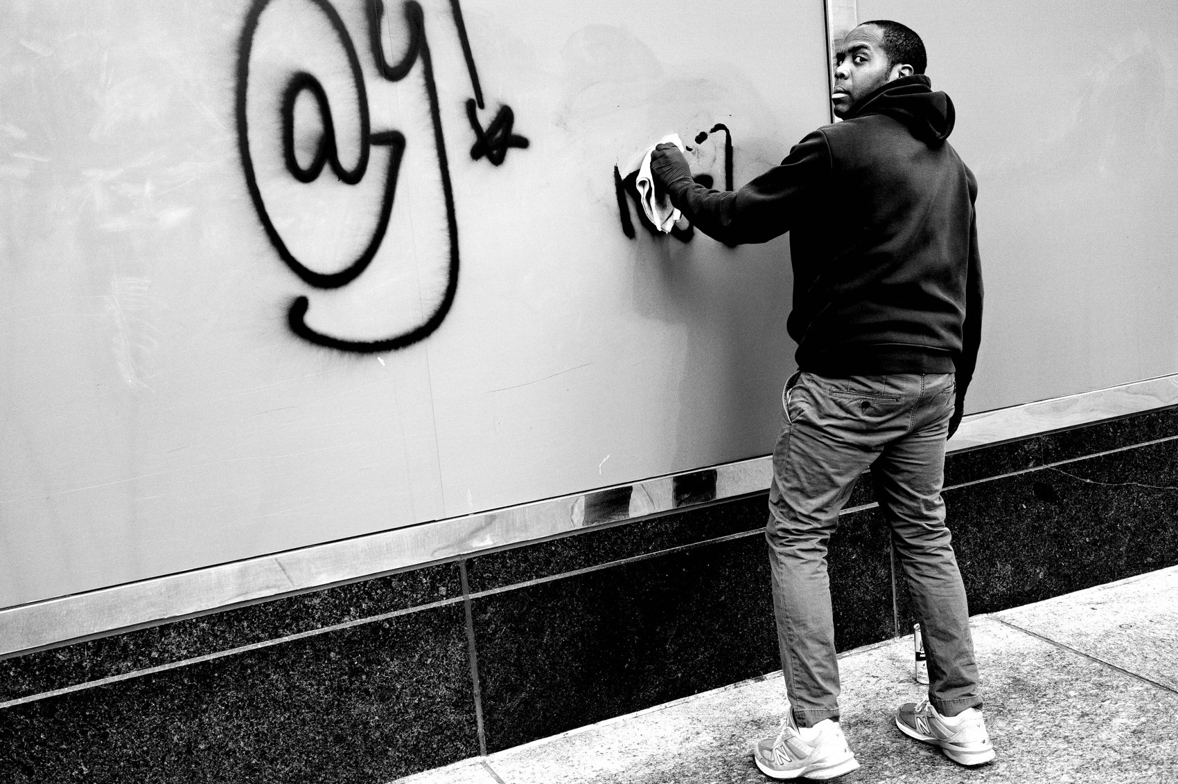
FLUX ACADEMY
BEAT 05 · MAIN TEACHING
Do It for the Act Itself
— Driven by the act, not the outcome
— No expectations, no hopes, no attachments
— The doing is the reward
Notes:
So let's get into it. Authenticity isn't about finding unique subjects. It's about doing something because you're driven by the act itself — no expectations, no hopes, no attachments. You press the shutter because the act of seeing and responding is already the reward. Everything else is noise.

Slide 7
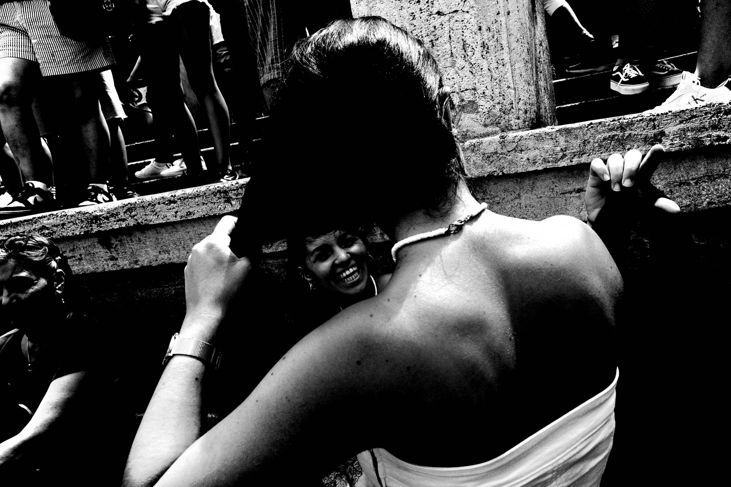
FLUX ACADEMY
BEAT 06 · MAIN TEACHING
Let Go of the Photograph
— Release the alchemy, the outcome, the image
— Stop hunting and desiring
— Let life flow toward you
Notes:
Most people are out there hunting — desiring, waiting for something to align. I say: let go. You have to release the photograph entirely — the alchemy, the outcome, the image. Stop hunting. Let life flow toward you. Be there, camera ready, and simply respond to what arrives.

Slide 8
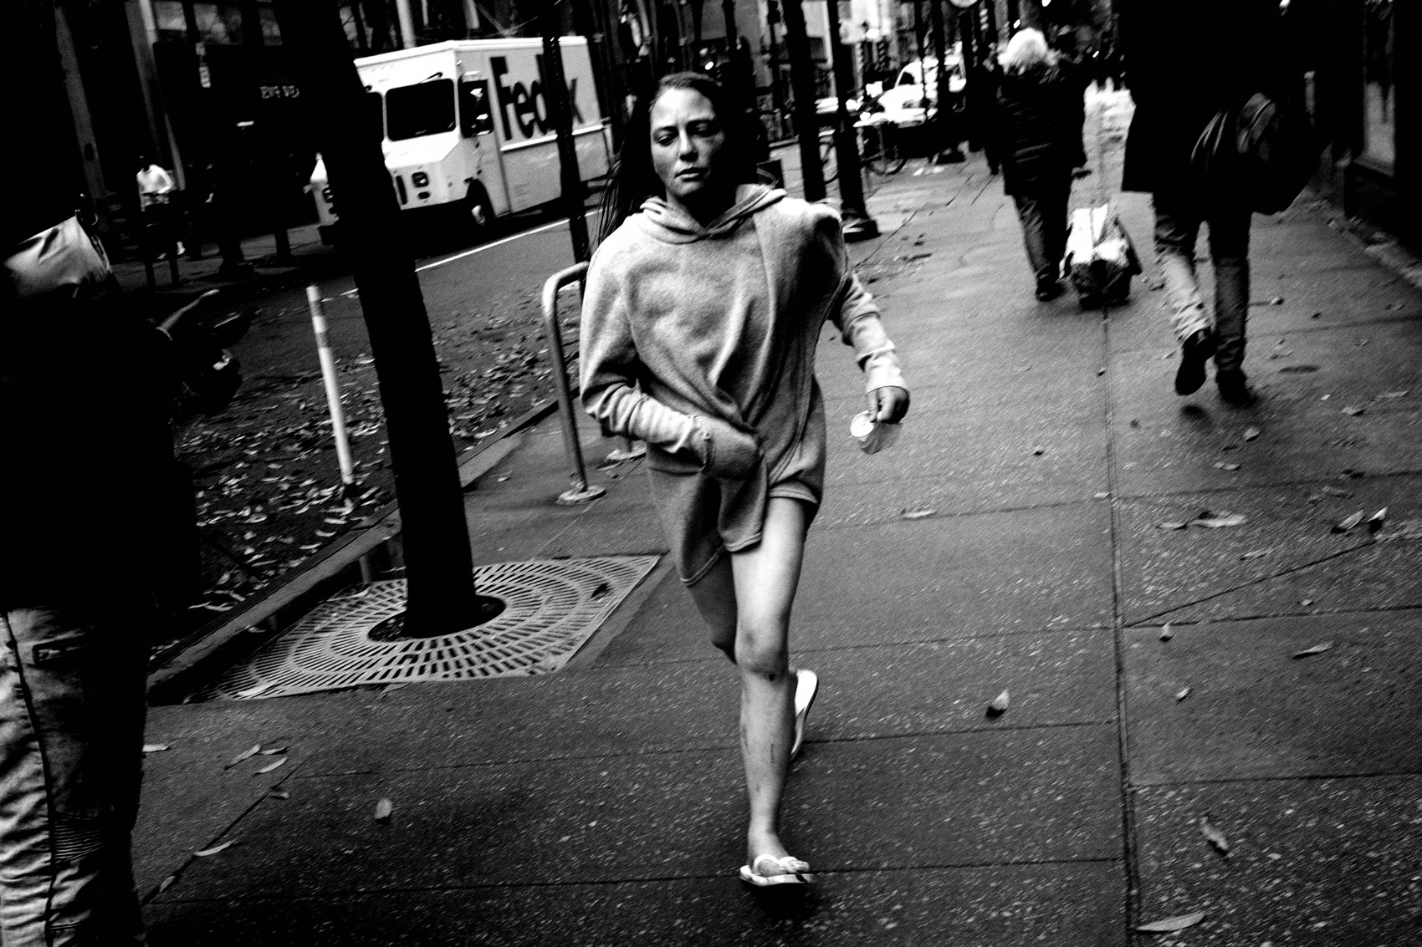
FLUX ACADEMY
BEAT 07 · MAIN TEACHING
The Visual Diary
— Photograph your way through life
— A simple diary of your day
— Honest documentation over masterpieces
Notes:
The frame I always come back to is the visual diary. I don't photograph because I'm attached to a subject or a theme. I just live my everyday life and bring the camera for the ride — photographing my way through the day like a simple diary. No groundbreaking work. Just honest documentation. That's the point.

Slide 9

FLUX ACADEMY
BEAT 08 · MAIN TEACHING
Let Go of Good and Bad
— Drop the binary of "good" vs "bad"
— The contests flatten everything
— Authenticity dissolves the judgment
Notes:
Here's a hard one. To be authentic is to let go of the very notion of what makes a photograph good or bad. That binary comes from the trends, the contests, the copycats. The moment you start grading every frame, you've left your own vision and adopted somebody else's scoreboard. Drop it.

Slide 10
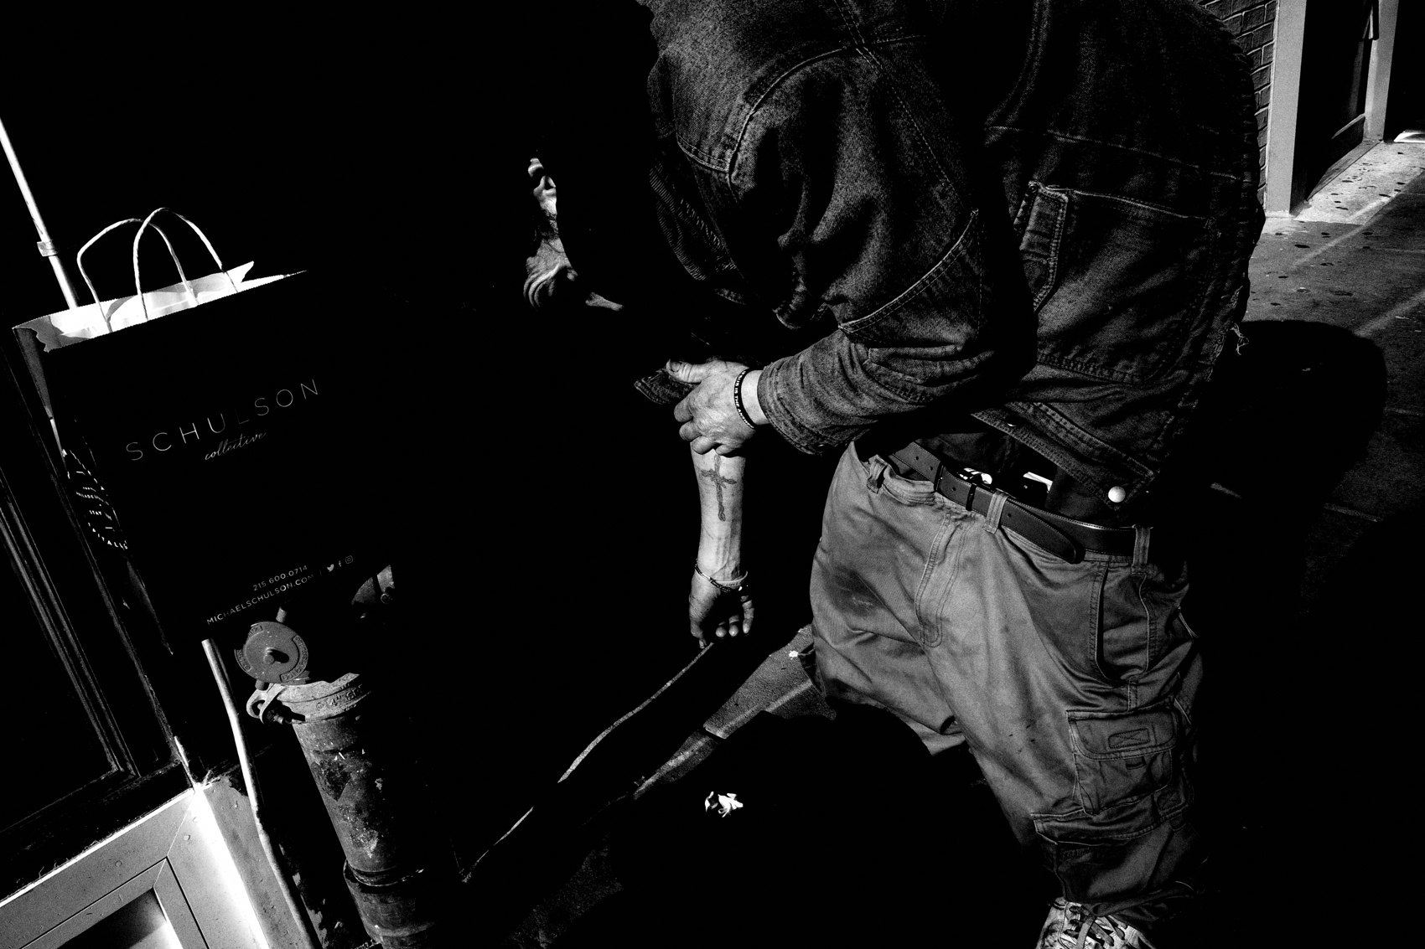
FLUX ACADEMY
BEAT 09 · MAIN TEACHING
Trust the Intuition
— Follow childlike curiosity
— Follow your gut, your intuitive eye
— Snap when it feels right
Notes:
So what do you follow instead? Your childlike curiosity. Your gut instinct. Your intuitive eye. Some days a certain quality of light pulls at you, some days a texture or a color — follow it, whatever it is. You don't always have to put four corners around it. You just press the shutter when it feels right.

Slide 11

FLUX ACADEMY
BEAT 10 · MAIN TEACHING
Shoot What Moves You
— Drawn by feeling, not by a "subject"
— Press the shutter because it stirs you
— Don't think about the result
Notes:
Here's what that looks like in practice. You step outside on an ordinary morning, camera in hand, and something pulls you — the way the sun sits on a surface, a horizon, a quiet stretch of street. You go toward it not because it's a "subject" but because it moves you. You press the shutter, you don't think about the result, you're just looking at life. That's authenticity in action.

Slide 12
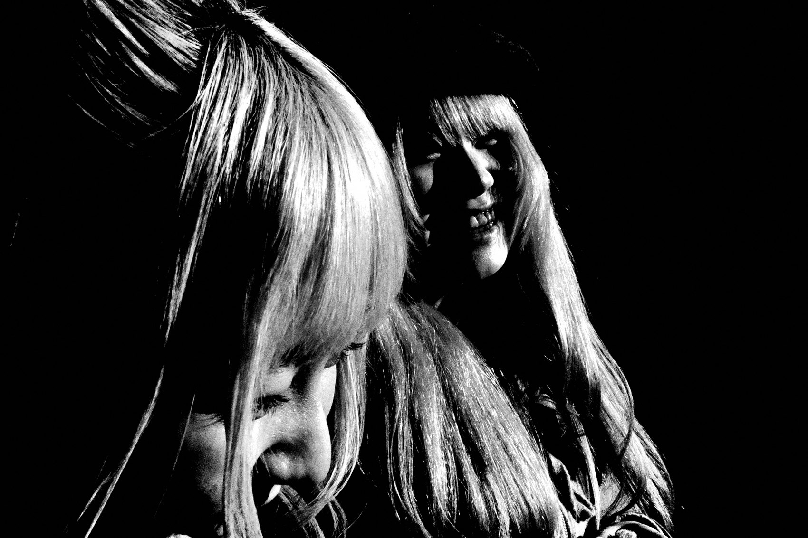
FLUX ACADEMY
BEAT 11 · MAIN TEACHING
Detach From Outcomes
— No book, zine, gallery in mind
— Not hunting decisive moments
— Improvement lives in the process
Notes:
It's easy to tie every frame to an outcome — a book, a zine, a gallery, a "great" photo. So detach. Stop chasing decisive moments and facial expressions. The only thing you truly control is whether you go out there with curiosity. Improvement isn't a checklist; it emerges from the process itself.

Slide 13
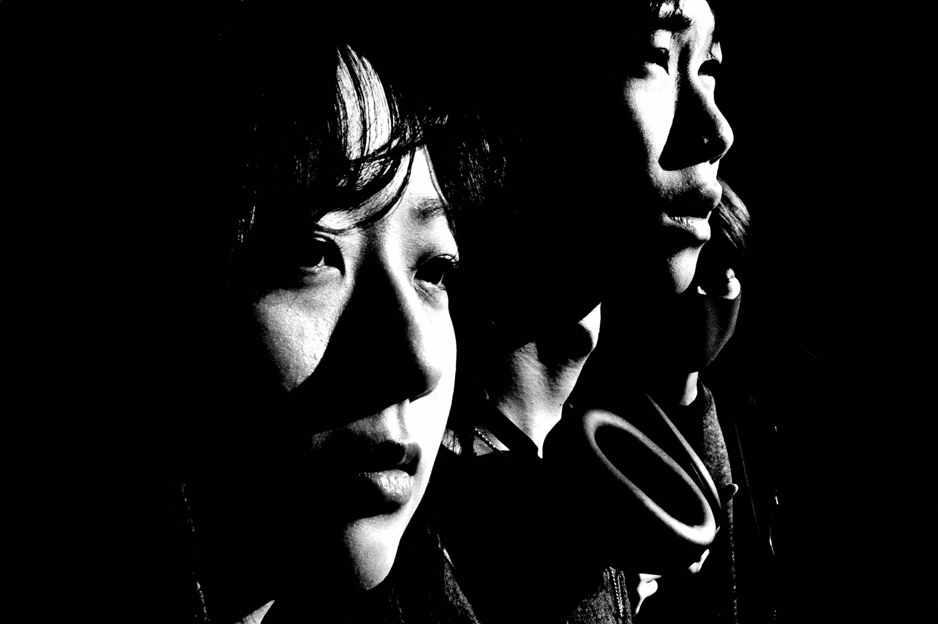
FLUX ACADEMY
BEAT 12 · MAIN TEACHING
Delete the Feed
— The contests and festivals? Junk
— "Delete your Instagram account"
— Photograph your way through the day
Notes:
Here's a blunt one. Look at all these contests and festivals — it's junk. Junk. My advice? Delete your Instagram account and just photograph your way through the day. Stop performing for an audience that was never the point. When you stop shooting for the masses, you start shooting for yourself.

Slide 14
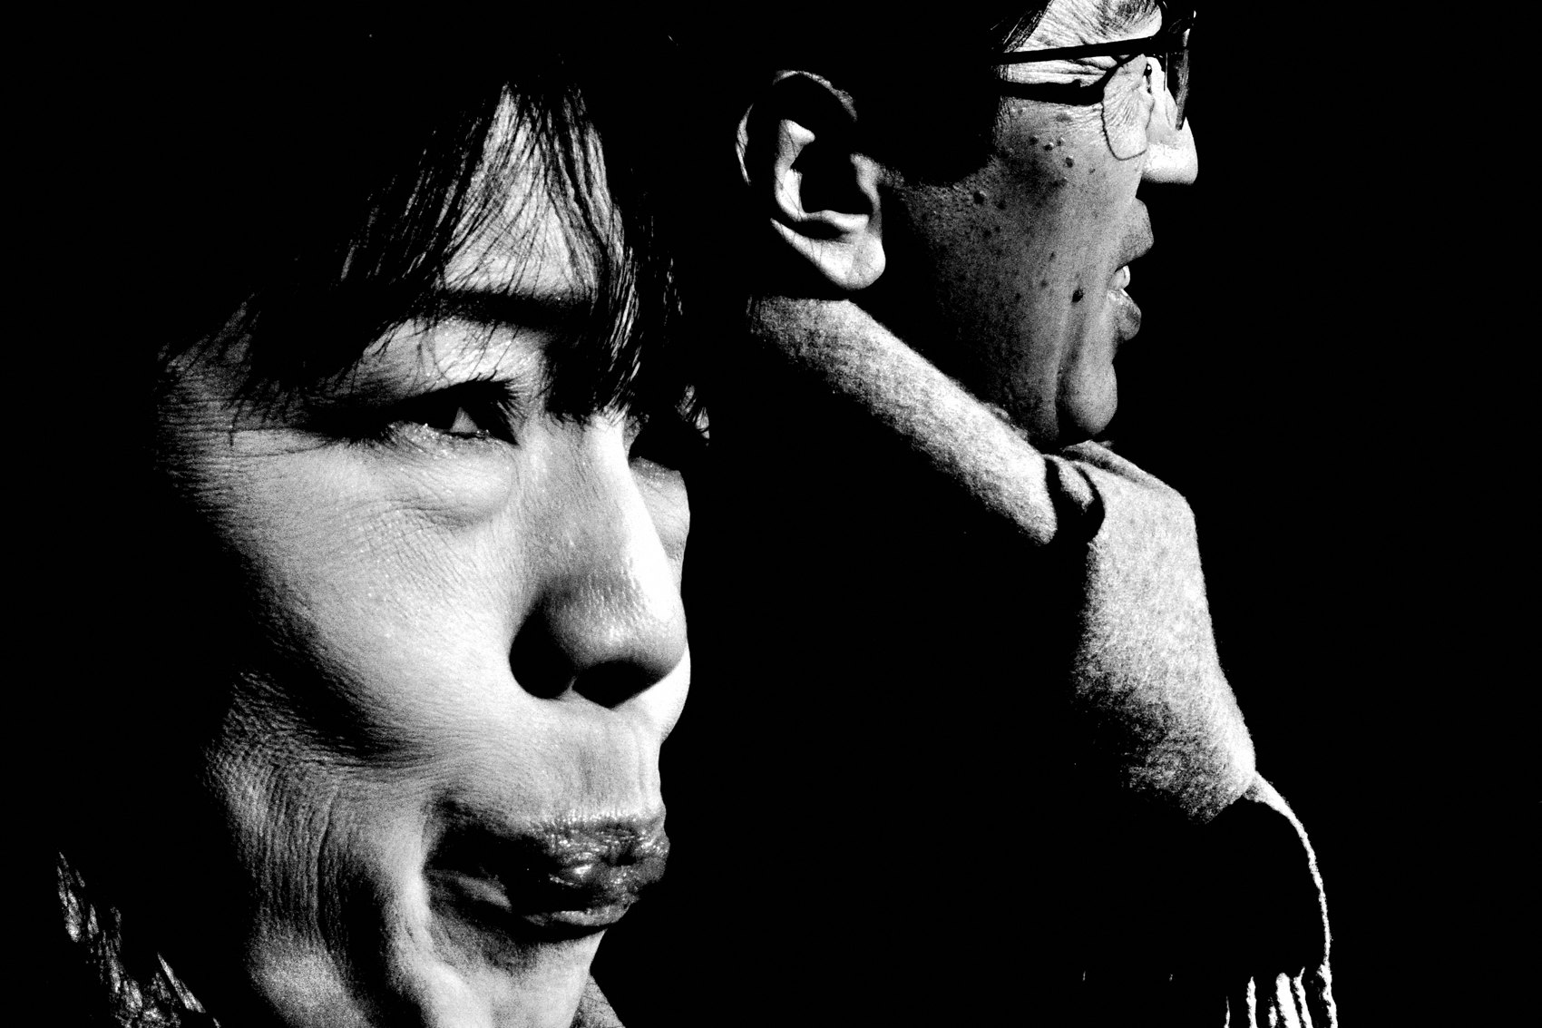
FLUX ACADEMY
BEAT 13 · MAIN TEACHING
Become Who You Are
— Nietzsche: "Become who you are"
— Found in silence, contemplation, solitude
— Walk, wander, read, think, create
Notes:
Nietzsche said it best: "Become who you are." But you only discover who you are in silence, contemplation, and solitude. Walking. Wandering. Enjoying the sun. Reading, writing, thinking, creating. That's the path to authenticity — and through that discovery, you photograph your way through it.

Slide 15
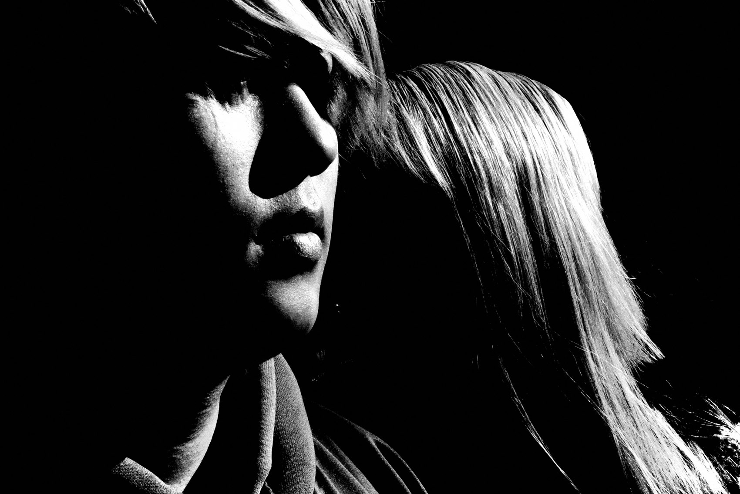
FLUX ACADEMY
BEAT 14 · MAIN TEACHING
Create Your Own World, Simply Be
— "I create my own world" — abstract reality each click
— Drawing with light — phos + graphe
— "Stop doing and simply be"
Notes:
Ultimately, that's my goal: I create my own world. With each click of the shutter, I try to abstract reality — photographing the mundane, following the light. Photography is literally drawing with light: phos means light, graphe means writing. And here's the heart of it: to be free, one must stop doing and simply be. No longer hunting — just allowing life to arrive, and responding.

Slide 16
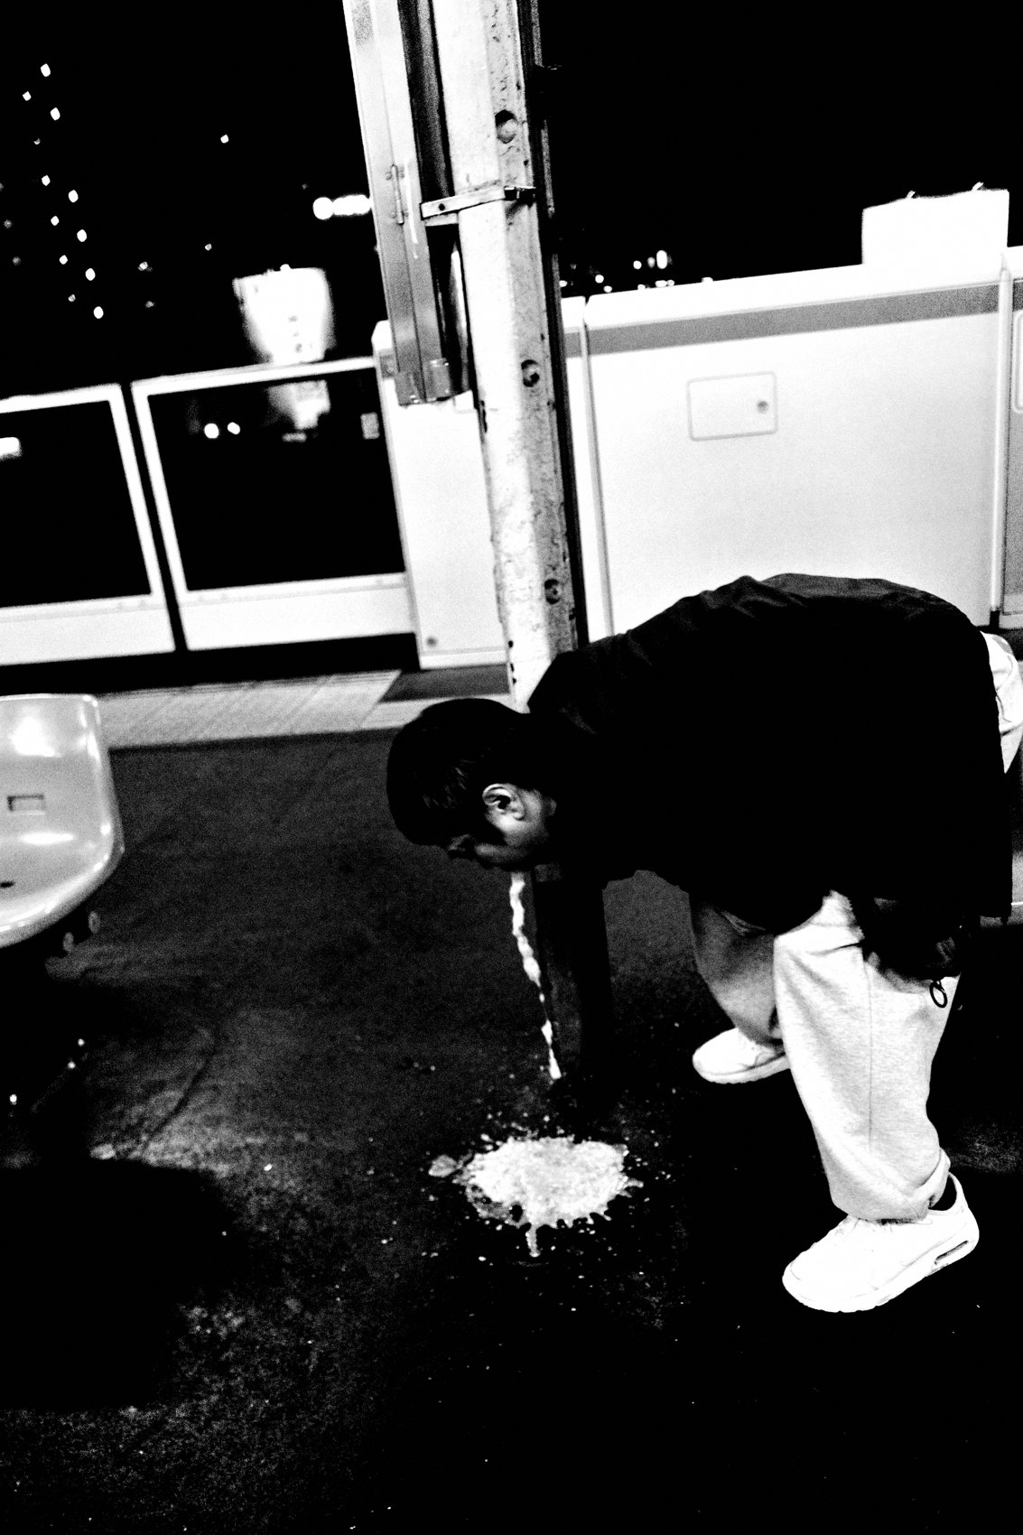
FLUX ACADEMY
BEAT 15 · MAIN TEACHING
Embrace the Rawness
— The raw, the visceral, the imperfect
— Perfection is somebody else's standard
— Your soul reflected back at you
Notes:
And don't sand it down. The beauty of street photography is the raw, the visceral, the imperfect. Perfection is a standard borrowed from the contests. Stop taking it all so seriously — and maybe, just maybe, your soul will start to reflect itself back in your photographs. That's the only "good" worth chasing.

Slide 17

FLUX ACADEMY
BEAT 16 · PRACTICAL APPLICATION
Shoot a Visual Diary
— Camera in your pocket, all day
— Photograph whatever unfolds
— No theme, no agenda — just your day
Notes:
Here's your assignment. For a full day, treat the camera as a visual diary. Keep it in your pocket and photograph whatever unfolds — no theme, no agenda, no "is this a keeper." Just snapshot your way through your actual day. At the end, you'll have an honest record of your life, seen your way.

Slide 18
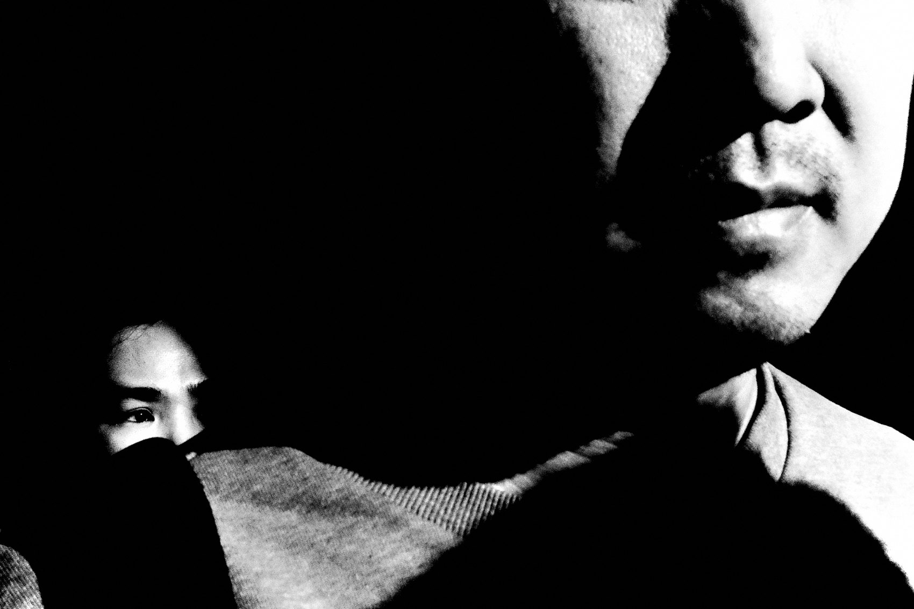
FLUX ACADEMY
BEAT 17 · PRACTICAL APPLICATION
The Validation Detox
— Don't post for a set stretch
— No likes, no metrics, no audience
— Notice what you are drawn to
Notes:
And do a validation detox. For a week — or delete the app entirely — don't post a single frame. No likes, no metrics, no audience in your head. Just shoot and notice what you are actually drawn to when nobody's watching. That pull is your authentic eye, and it's been buried under the algorithm.

Slide 19
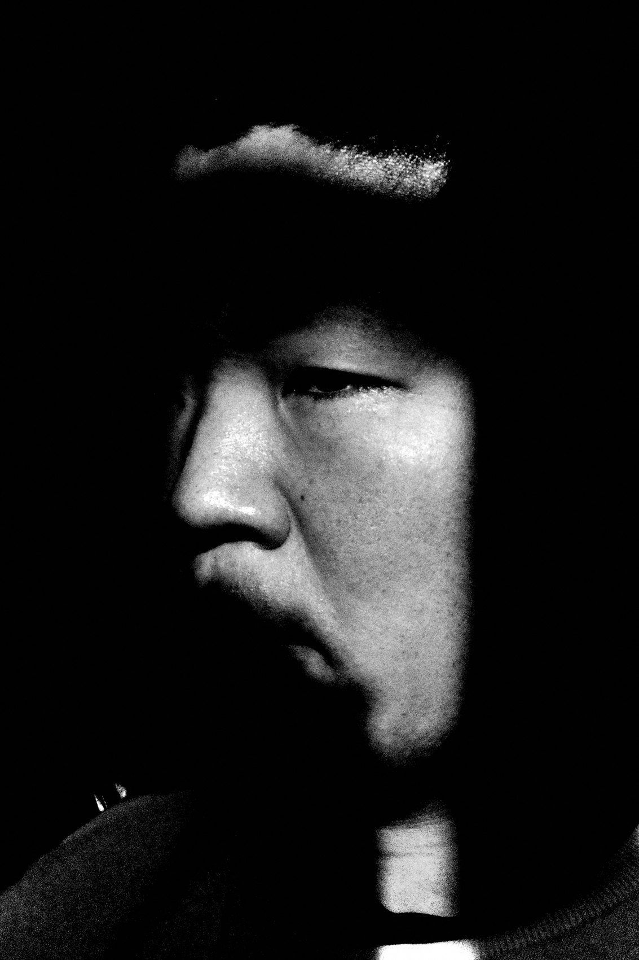
FLUX ACADEMY
BEAT 18 · PRACTICAL APPLICATION
Follow Your Intuition Out
— Let your gut choose the direction
— Go where you're drawn, not where's "good"
— Press the shutter when it feels right
Notes:
Third drill: let intuition lead the walk. Don't plan a "good" location. Just step outside and go where you feel pulled — toward the light, the water, the texture, whatever it is. Press the shutter only when it feels right, not when it looks impressive. Trust the gut. The eye follows the feeling.

Slide 20

FLUX ACADEMY
BEAT 19 · COMMON MISTAKES
Shooting for the Masses
— Copying what's trending
— Chasing contests, gear hype, likes
— It quietly erases your vision
Notes:
The biggest mistake is shooting for the masses. Copying what's trending, chasing the contests, buying the gear everyone recommends, making frames for the feed. It feels like progress, but it slowly erases your own vision until you're just one more copycat in the flood. Don't please the masses. Please yourself.

Slide 21

FLUX ACADEMY
BEAT 20 · COMMON MISTAKES
Clinging to the Outcome
— Attached to the book, the zine, the "great frame"
— Hunting kills the flow
— The grip strangles the joy
Notes:
The other mistake: clinging to the outcome. Tying every frame to a book, a zine, a gallery, a "great photo." That attachment turns you into a hunter, and hunting kills the flow. Let go of the result. The only thing you control is whether you show up curious — so control that, and release the rest.

Slide 22
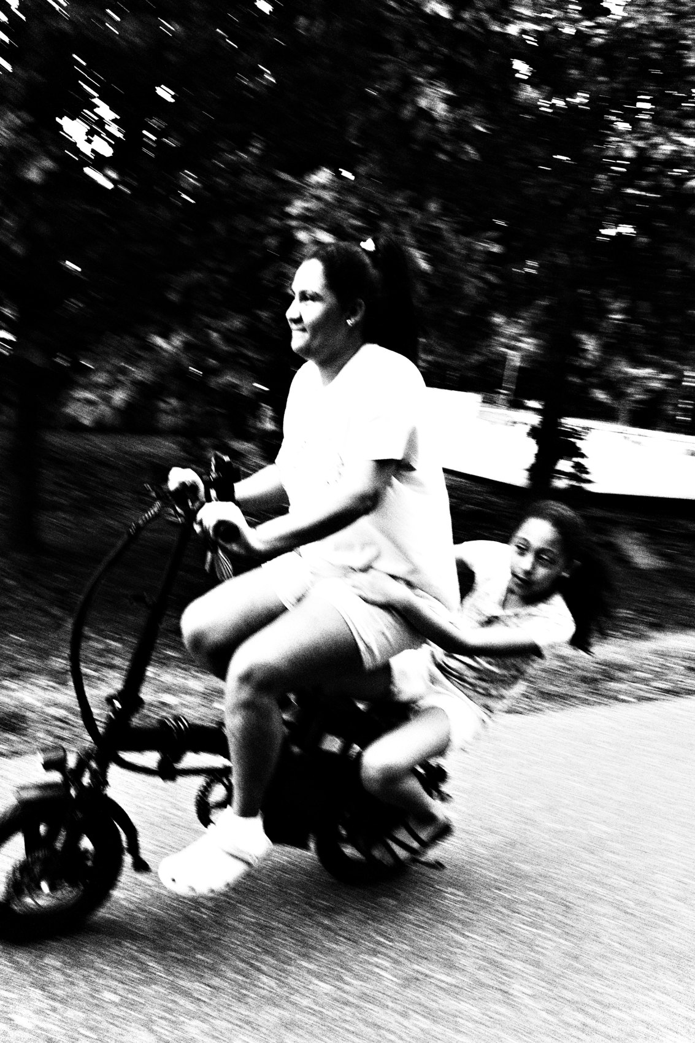
FLUX ACADEMY
BEAT 21 · RELATIONSHIP TO PREVIOUS
From Chaos to Self
— Lesson 008 taught surrender to chaos
— Same move, turned inward
— Let go outside and in
Notes:
This builds straight on Lesson 008, Embrace Chaos, where we learned to let go of control and surrender to the unpredictable street. Authenticity is that exact same move turned inward — letting go of validation, outcomes, and the masses. Surrender to the chaos outside, and surrender the need to impress inside.

Slide 23
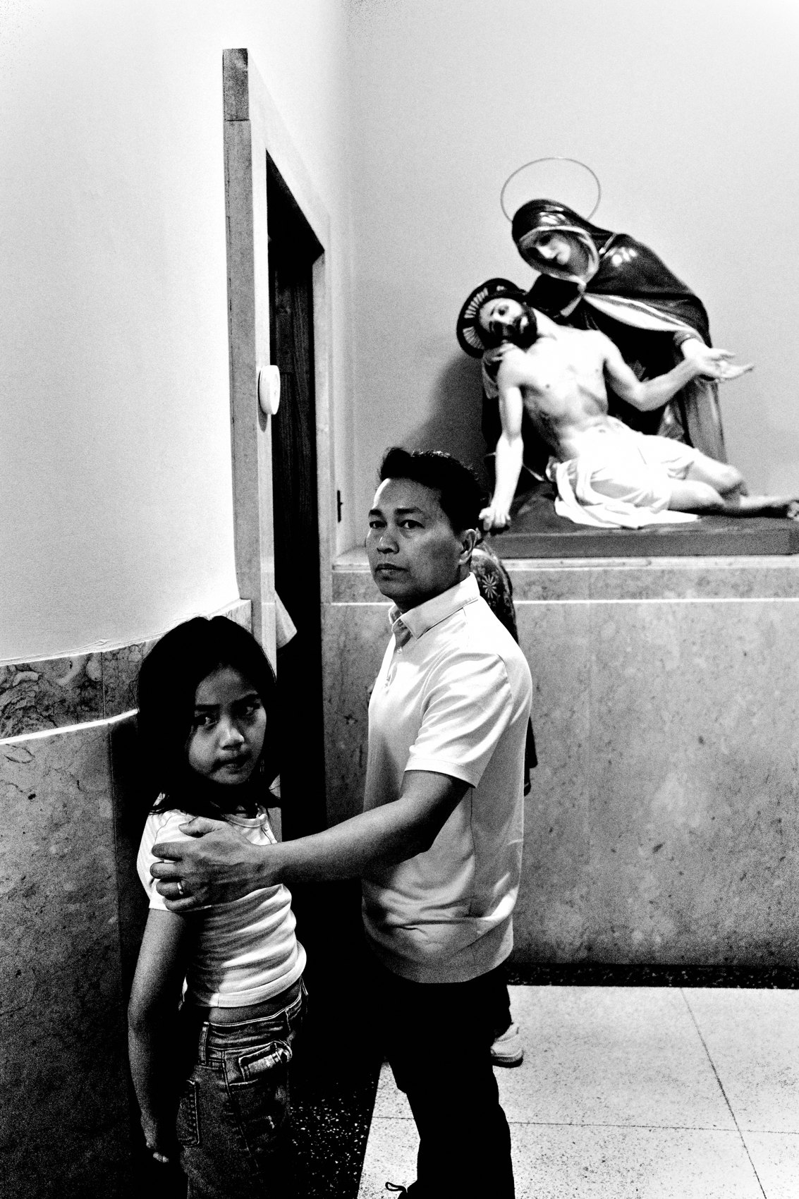
FLUX ACADEMY
BEAT 22 · RELATIONSHIP TO UPCOMING
Confidence Comes Next
— Next: Conquer Fear on the Street (Lesson 010)
— Shooting for yourself dissolves the fear
— Courage from authenticity
Notes:
Next up is Lesson 010, Conquer Fear on the Street. And here's the link: once you're shooting purely for yourself, the fear of what strangers think starts to dissolve. Authenticity is courage. When you stop performing for the world, the world stops having a vote — and you walk taller.

Slide 24

FLUX ACADEMY
BEAT 23 · SUMMARY / TAKEAWAY
Become Who You Are
— Be the master of yourself
— Shoot for you, not the masses
— Let go, simply be, become who you are
Notes:
Last thing. Authenticity means being the master of your own self — photographing what resonates with your soul, not what pleases the masses. Let go of validation, let go of the outcome, simply be, and photograph your way through life. Become who you are. Catch you next lesson — it's Dante.

