Slide 1
FLUX ACADEMY · A SCHOOL FOR SEEING
MODULE 2 · THE INNER GAME
Instinct Over Intellect
BY DANTE SISOFO

Slide 2
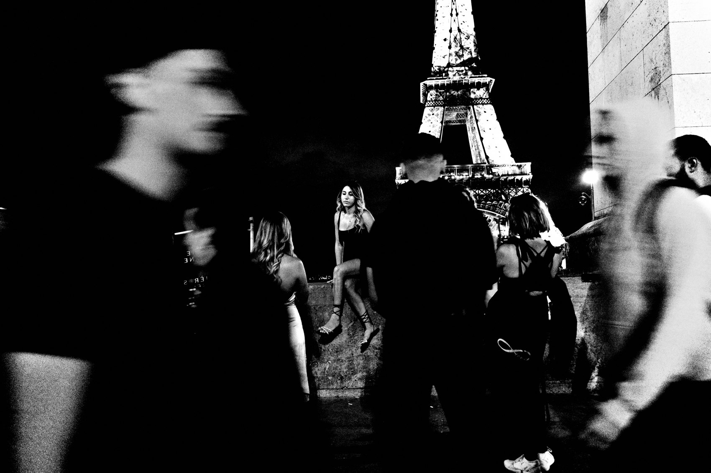
FLUX ACADEMY
BEAT 01 · CORE IDEA
Shoot From the Gut
— The photograph is born from instinct
— Think later — respond now
— The gut sees faster than the mind
Notes:
What's popping, people — it's Dante. Today we get to the heart of the inner game: instinct over intellect. The photograph is born from instinct. When you feel that physical pull and press the shutter, the subconscious becomes conscious — and that's the purest skill there is on the street.

Slide 3
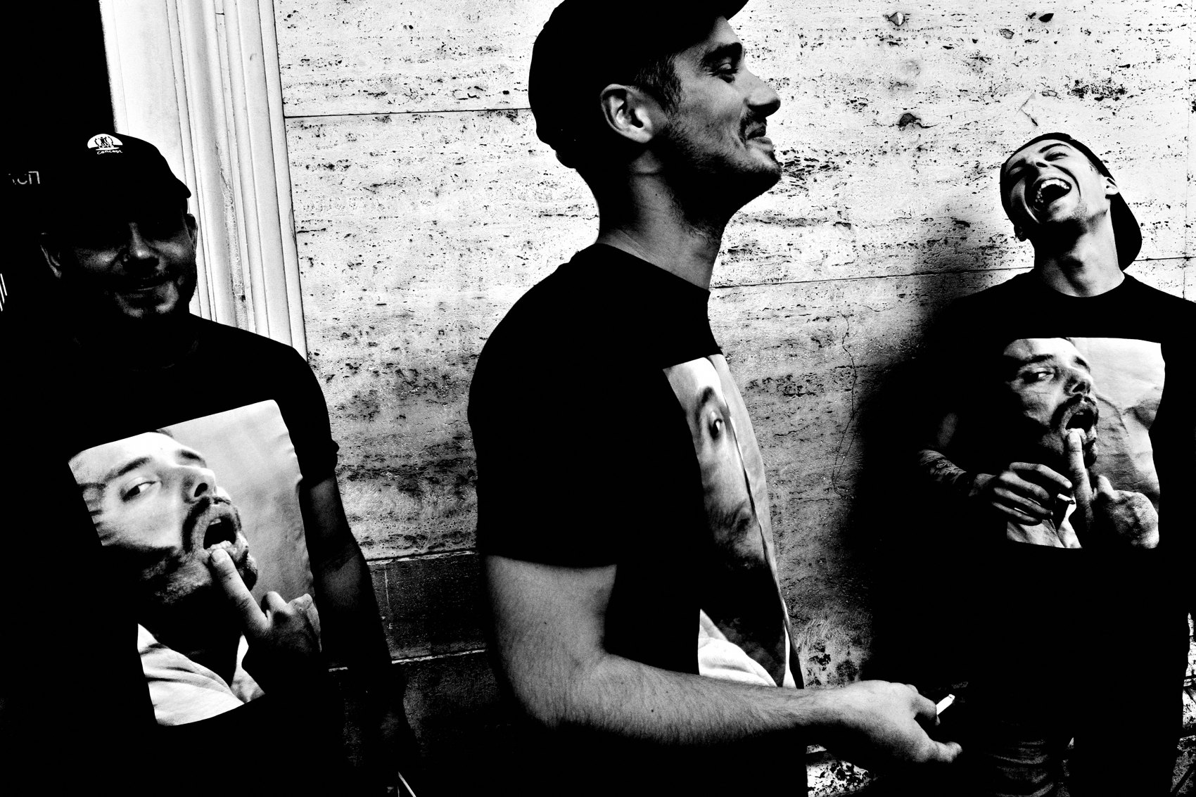
FLUX ACADEMY
BEAT 02 · LEARNING OBJECTIVE
What You'll Walk Away With
— Trust the gut at the shutter
— Move analysis off the street
— Respond instead of hunt
Notes:
By the end of this lesson you'll know how to get out of your own head and let your instincts run the show. You'll learn to push the thinking off the street — into the edit, where it belongs — so that in the moment, you respond instead of calculate.

Slide 4
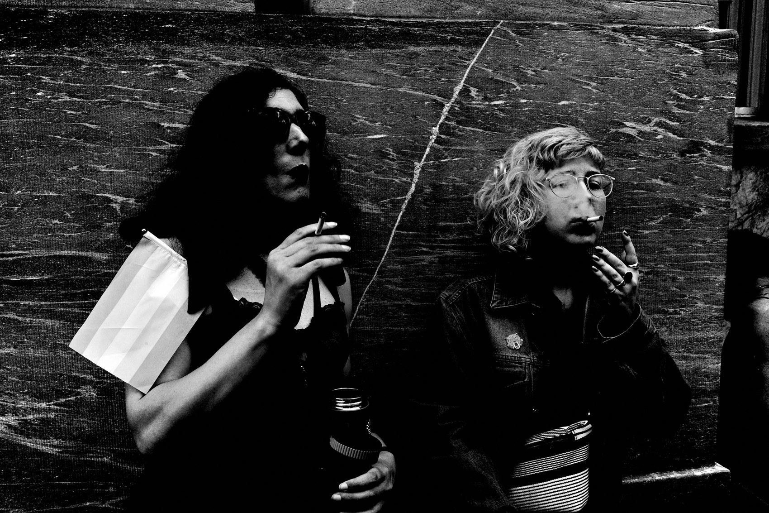
FLUX ACADEMY
BEAT 03 · WHY THIS MATTERS
Think Less, See More
— The more you think, the less you see
— Overthinking is hesitation
— The more you force, the less authentic
Notes:
Here's why this matters: the more you think, the less you see; the less you think, the more you photograph. The street moves faster than your analysis ever will — stand there solving the scene like a math problem and the moment is gone. And the same paradox runs deeper: the more you force, the less authentic the work; the less you try, the better the photographs get. Hesitation and striving are both the enemy.

Slide 5
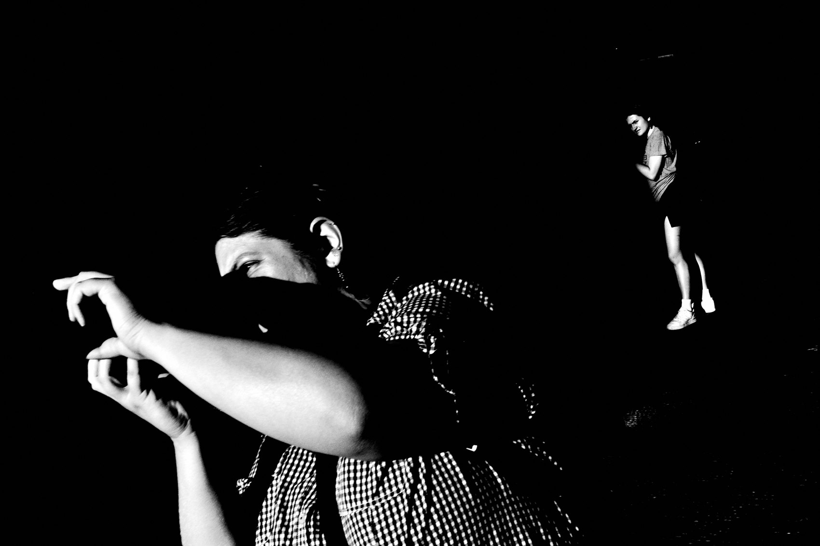
FLUX ACADEMY
BEAT 04 · MAIN TEACHING
Instinct, Not Analysis
— I photograph from instinct, not analysis
— Collect now, contemplate later
— No thinking at the shutter
Notes:
Let's state the principle plainly: I photograph from instinct, not analysis. In the moment, I just collect. Later — at home, in the edit — I can organize, think, and contemplate all I want. But when I see something? Boom. Camera on. Shutter pressed. No thinking. That's the whole move.

Slide 6
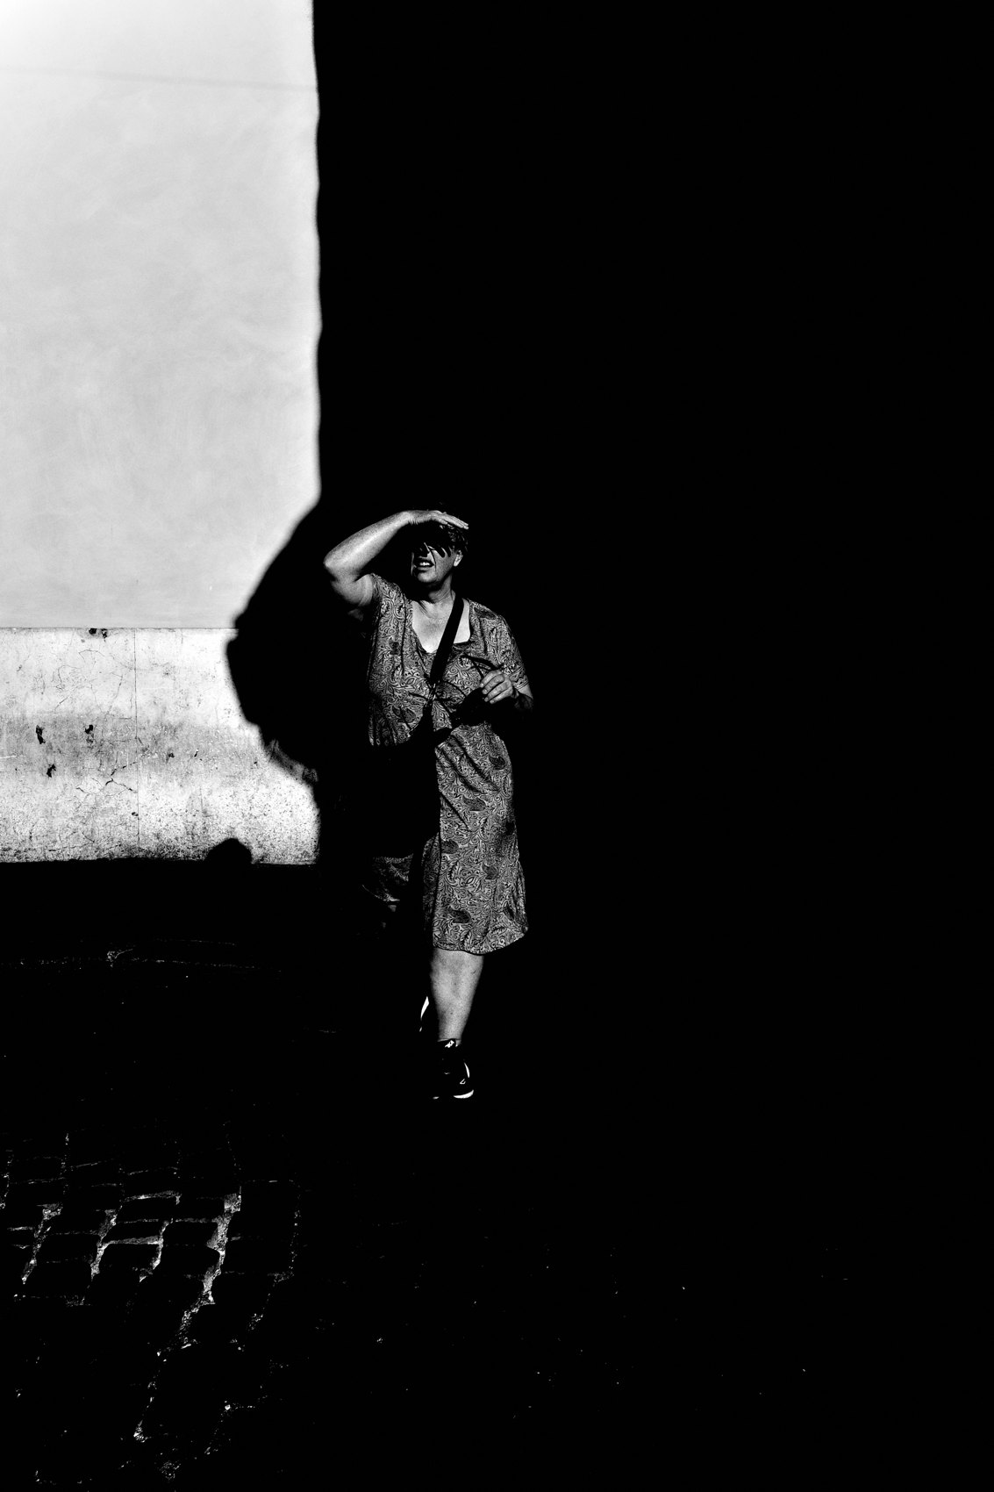
FLUX ACADEMY
BEAT 05 · MAIN TEACHING
Wu Wei: Effortless Action
— Wu wei = effortless action
— Don't fight the current — flow with it
— Respond as life unfolds
Notes:
The philosophy underneath this is wu wei — a Taoist idea meaning effortless action. Think about water: it flows one direction, and you don't fight the current, you move with it. I'm not running and gunning, not chasing. I'm just there, responding with my camera as life unfolds toward me.

Slide 7
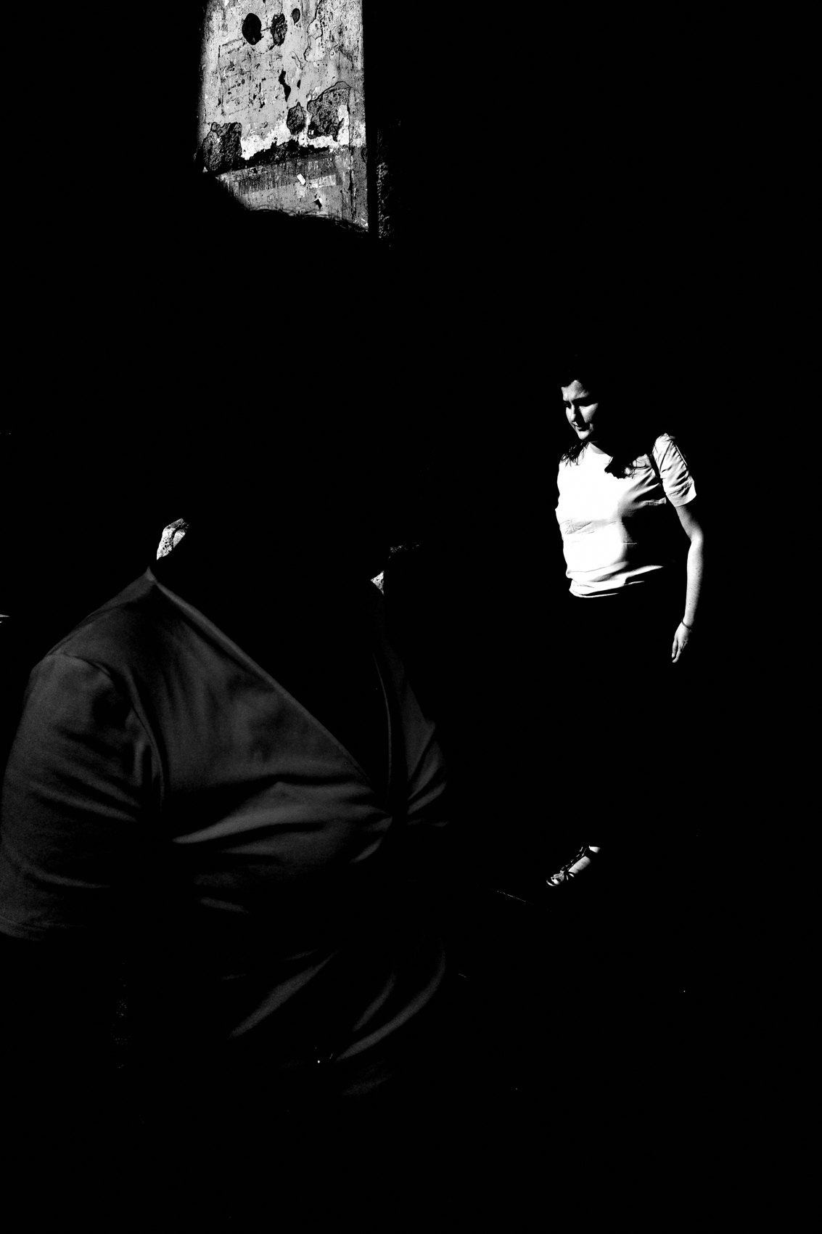
FLUX ACADEMY
BEAT 06 · MAIN TEACHING
Let Go of Control
— You don't control light, weather, moments
— Control only your presence
— Surrender is how flow opens
Notes:
Instinct only takes over once you let go of control. I'm not in control of the light, the weather, whether something interesting even happens. All I control is being there — present, prepared, ready. The instant you stop trying to control life and let it flow toward you, instinct gets the room it needs to work.

Slide 8
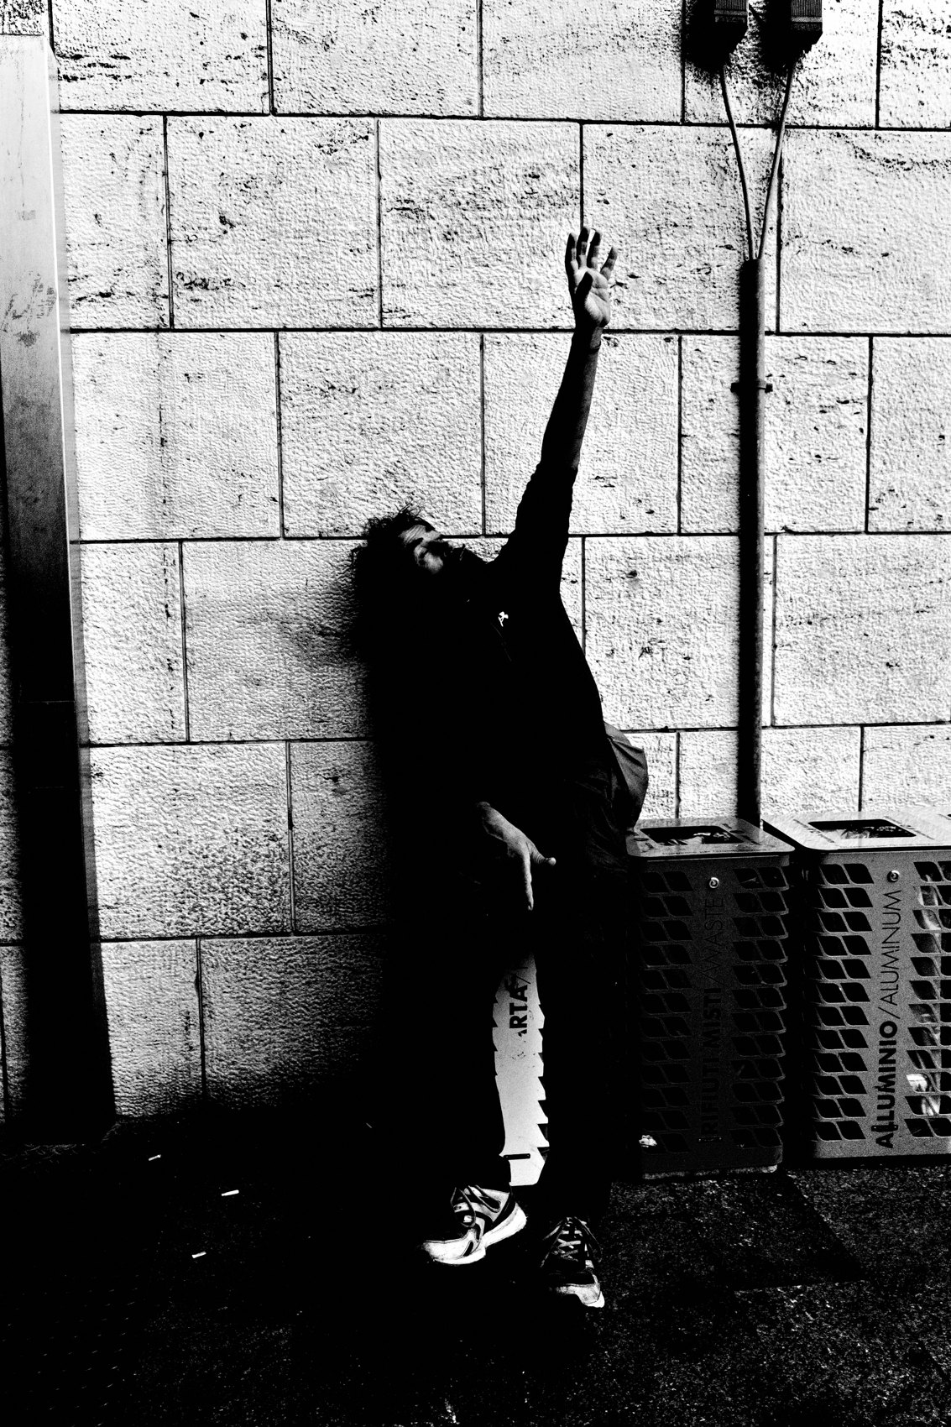
FLUX ACADEMY
BEAT 07 · MAIN TEACHING
Remove Technical Friction
— Auto or program mode — respond instantly
— Camera off until the moment
— Fewer decisions = faster instinct
Notes:
Now the practical key: remove the technical friction. I set the camera to automatic — aperture priority or program mode — so I can respond instantly. If you're thinking about settings and exposure, you're controlling too much, and the intellect creeps back in. Strip the decisions away so instinct has nothing standing in front of it.

Slide 9
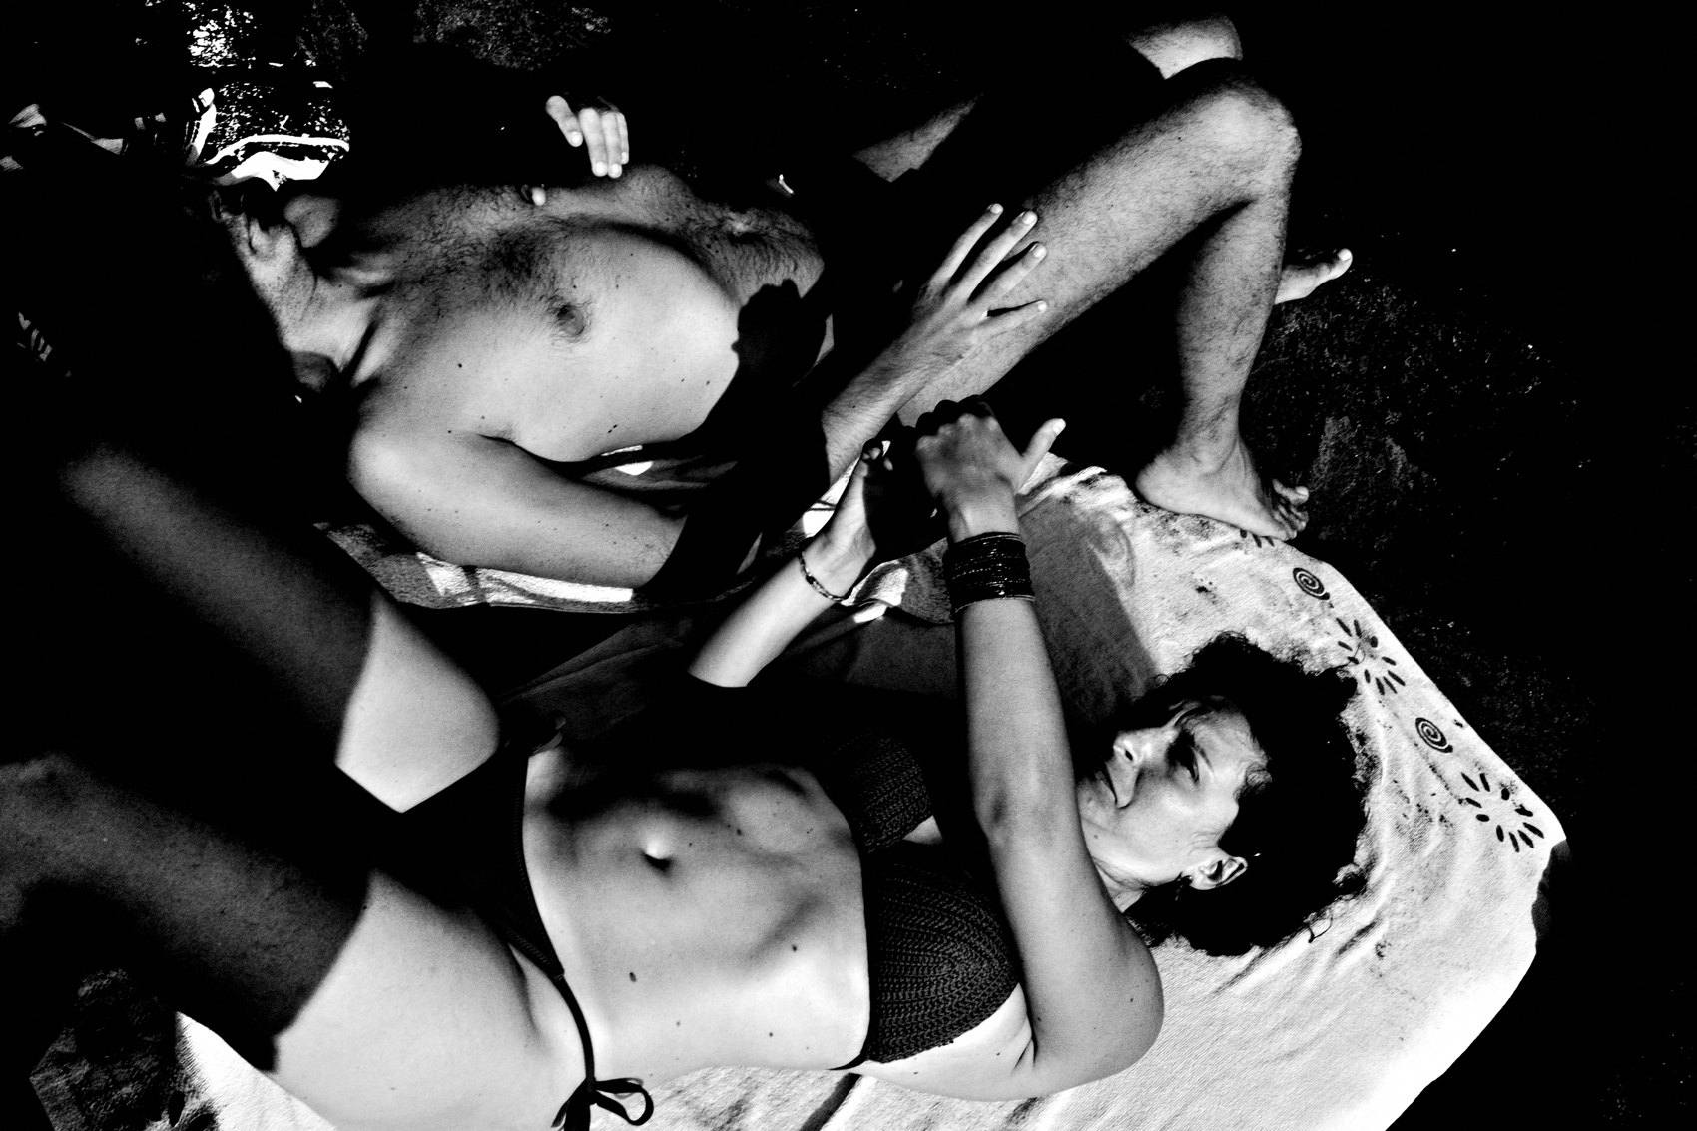
FLUX ACADEMY
BEAT 08 · MAIN TEACHING
The Knowledge Lives Underneath
— You do know composition, framing, light
— But you let go at the shutter
— Trained instinct, not blank guessing
Notes:
And let's be clear — this isn't ignorance. I have a rational understanding of composition, focal length, positioning, framing. That knowledge exists. But when I click the shutter, I let go and let the chips fall as they may. The craft gets absorbed into the body, then disappears into instinct. That's the goal: trained reflex, not random guessing.

Slide 10
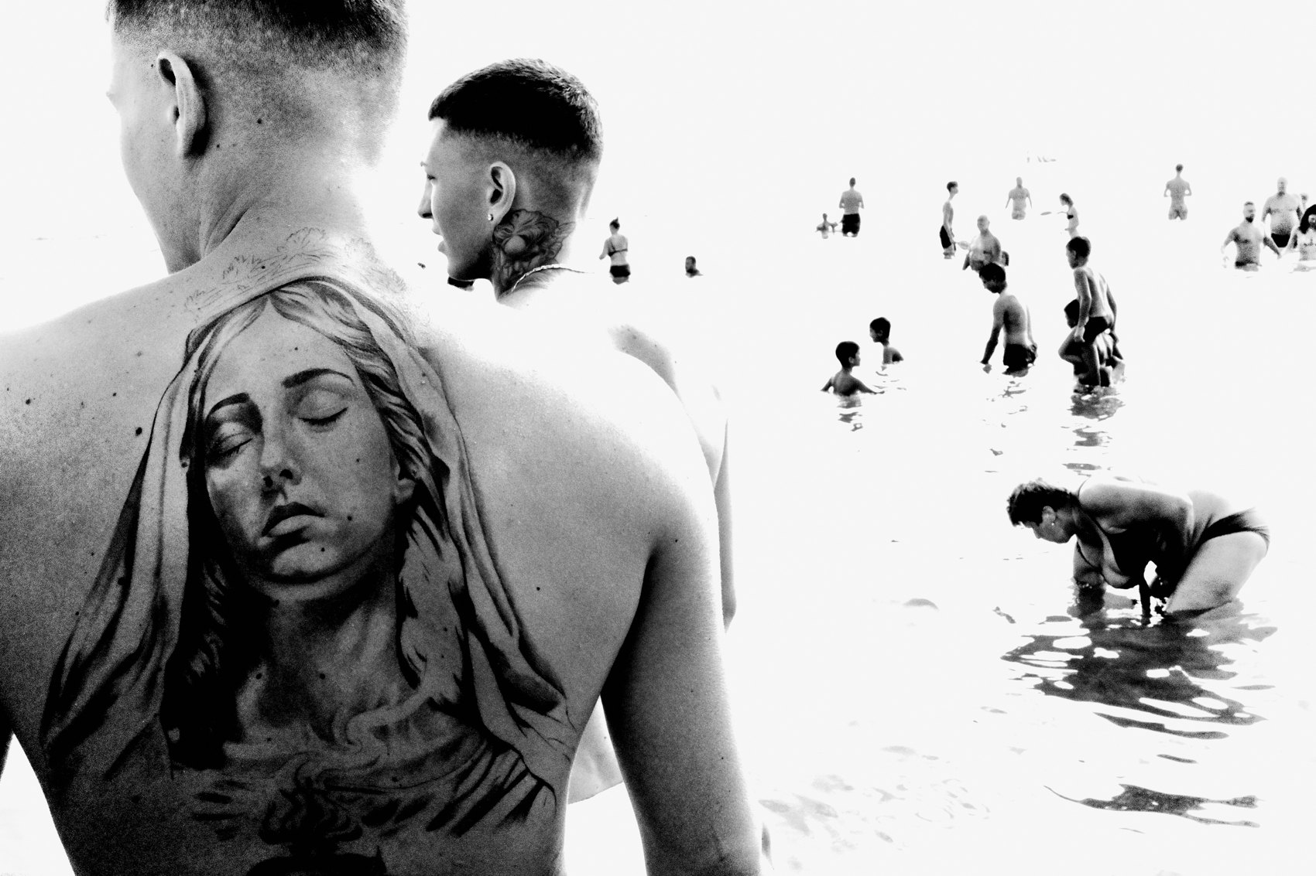
FLUX ACADEMY
BEAT 09 · MAIN TEACHING
The Subconscious Becomes Conscious
— A physical pull, then the shutter
— The subconscious speaks through the frame
— That's authentic expression
Notes:
Here's how it actually feels: you sense a physical pull, and you press. The subconscious becomes conscious through what you find. You weren't deciding — you were responding. That's what authentic expression is. The frame tells you what part of you noticed before your thinking mind ever caught up.

Slide 11
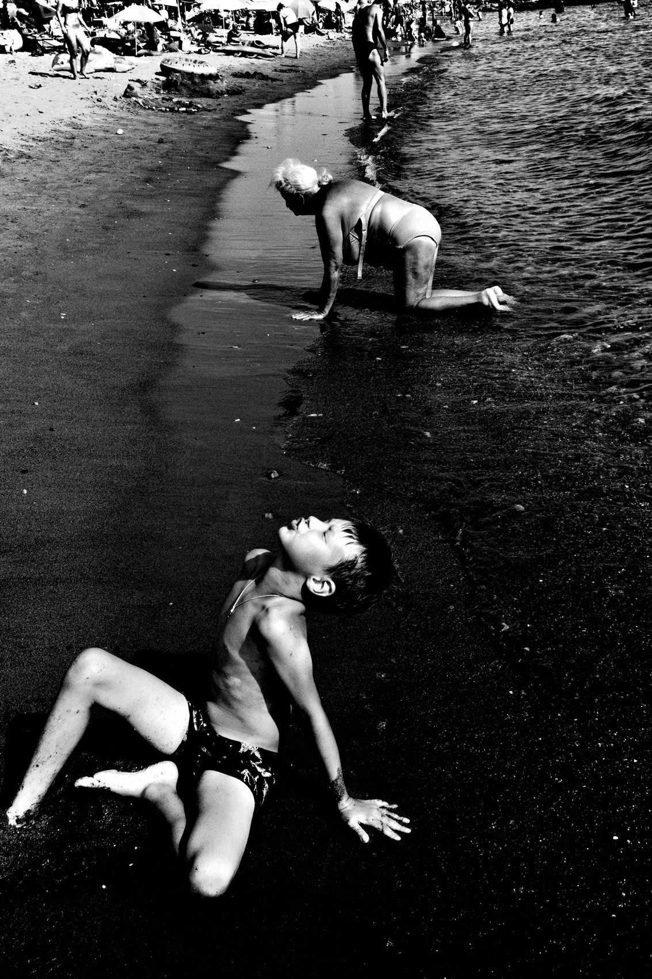
FLUX ACADEMY
BEAT 10 · MAIN TEACHING
Detach From the Outcome
— Detach from good photo / bad photo
— Outcomes are noise — ignore them
— The goal is to press the shutter
Notes:
Instinct can't breathe while you're chasing an outcome. So detach. I let go of the idea of good photos or bad photos. I'm not trying to make great photographs — I'm responding intuitively to what's in front of me. The moment you stop grading the result, the gut is free to react. The goal is simply to press the shutter.

Slide 12
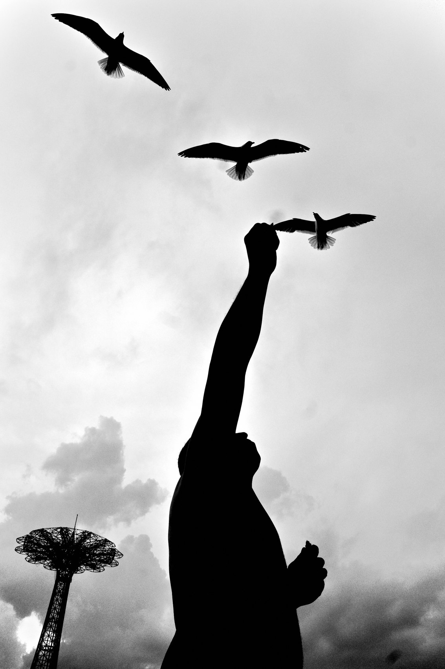
FLUX ACADEMY
BEAT 11 · MAIN TEACHING
The Moment Aligns Without Being Hunted
— Chaos around you, no hunting
— Someone glances, the background separates
— Not planned — pure instinct
Notes:
Here's what this looks like. Picture yourself in the middle of a loud, crowded scene — a festival, a celebration, noise and disorder everywhere. Someone standing beside you glances your way, the background falls open cleanly behind them, everything aligns for a fraction of a second, and you click. It wasn't hunted. It wasn't planned. That's instinct — you simply let life deliver the moment to you.

Slide 13
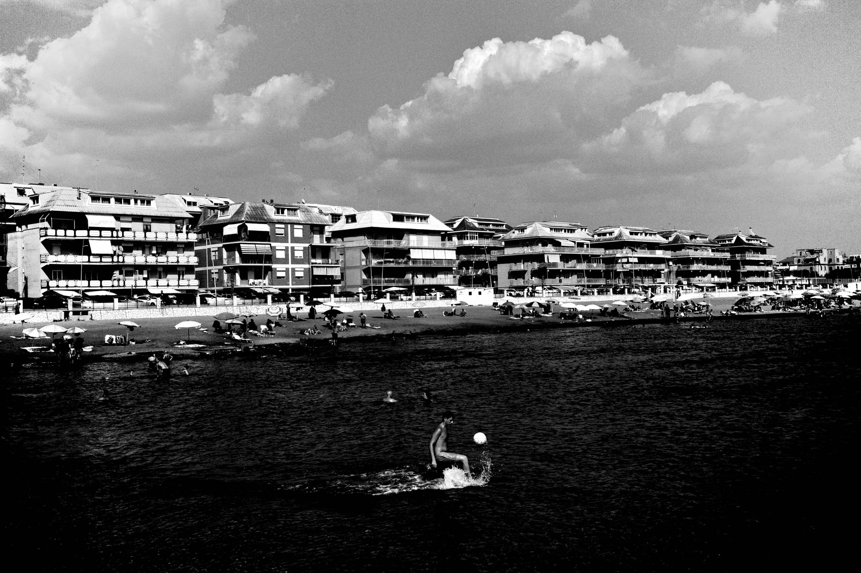
FLUX ACADEMY
BEAT 12 · MAIN TEACHING
The Best Frames Arrive Off-Duty
— No intention to shoot at all
— Hours of just being somewhere
— Ready because the camera is with you
Notes:
Another truth. Some of your favorite frames will happen when you had zero intention of photographing — lying by the water with someone you love, just resting, present, not working at all. After hours of simply being there, a scene unfolds on its own. You're ready only because the camera happens to be with you. No striving, no hunting — instinct catches what intention never would have.

Slide 14
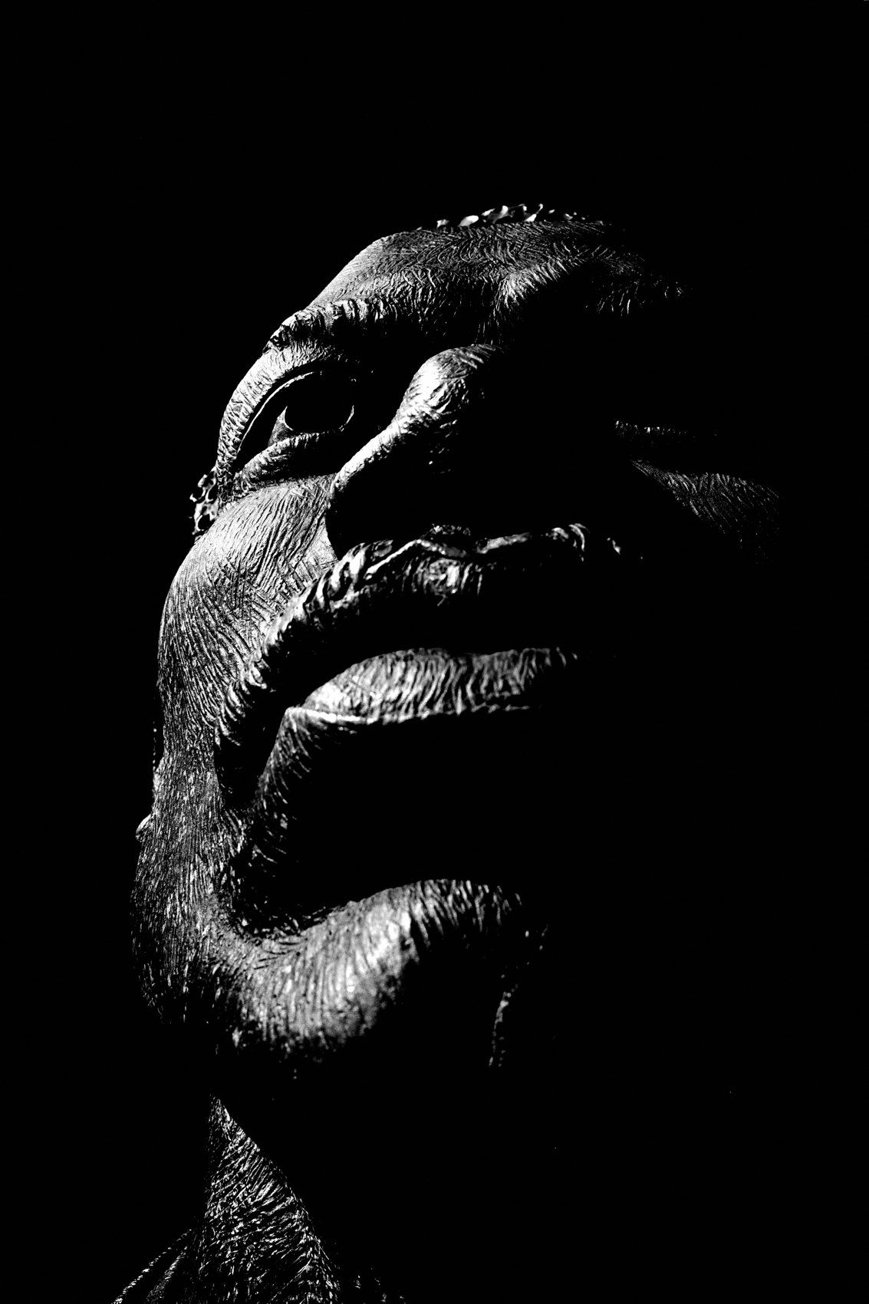
FLUX ACADEMY
BEAT 13 · MAIN TEACHING
React to Light, Don't Hunt Moments
— High-contrast B&W, baked in-camera
— Free to chase light, not "moments"
— Light never repeats — react to it
Notes:
Then there's light itself. I shoot small JPEGs, high-contrast black and white, highlights exposed, shadows crushed — all baked in. That frees me from hunting "interesting moments." Instead I'm just curious how light hits a surface, a body, a form. Light never repeats; you can't make the same photo twice. So you can only react to it — pure instinct.

Slide 15
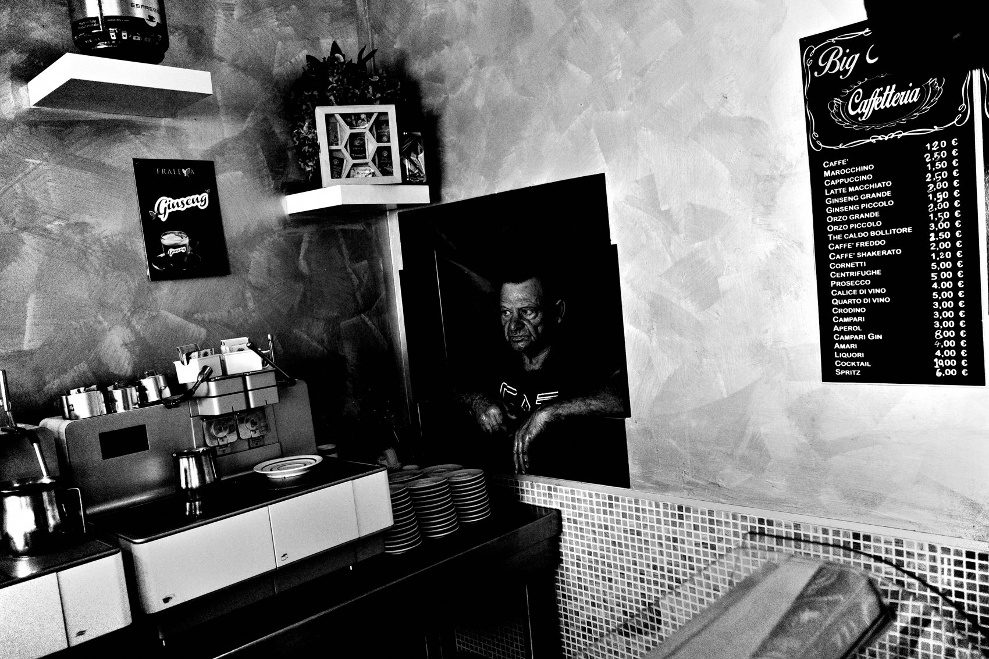
FLUX ACADEMY
BEAT 14 · MAIN TEACHING
Photography Becomes Meditative
— Phone off, mind quiet
— Body, mind, soul aligned at the shutter
— A walking meditation
Notes:
When the intellect goes quiet, photography becomes meditative. Phone off. Mind still. Body, mind, and soul aligned at the moment you press. It's almost a walking meditation — moving through the world, observing patterns of light and people and details, present enough that the right frame just arrives. Presence is what lets instinct speak.

Slide 16
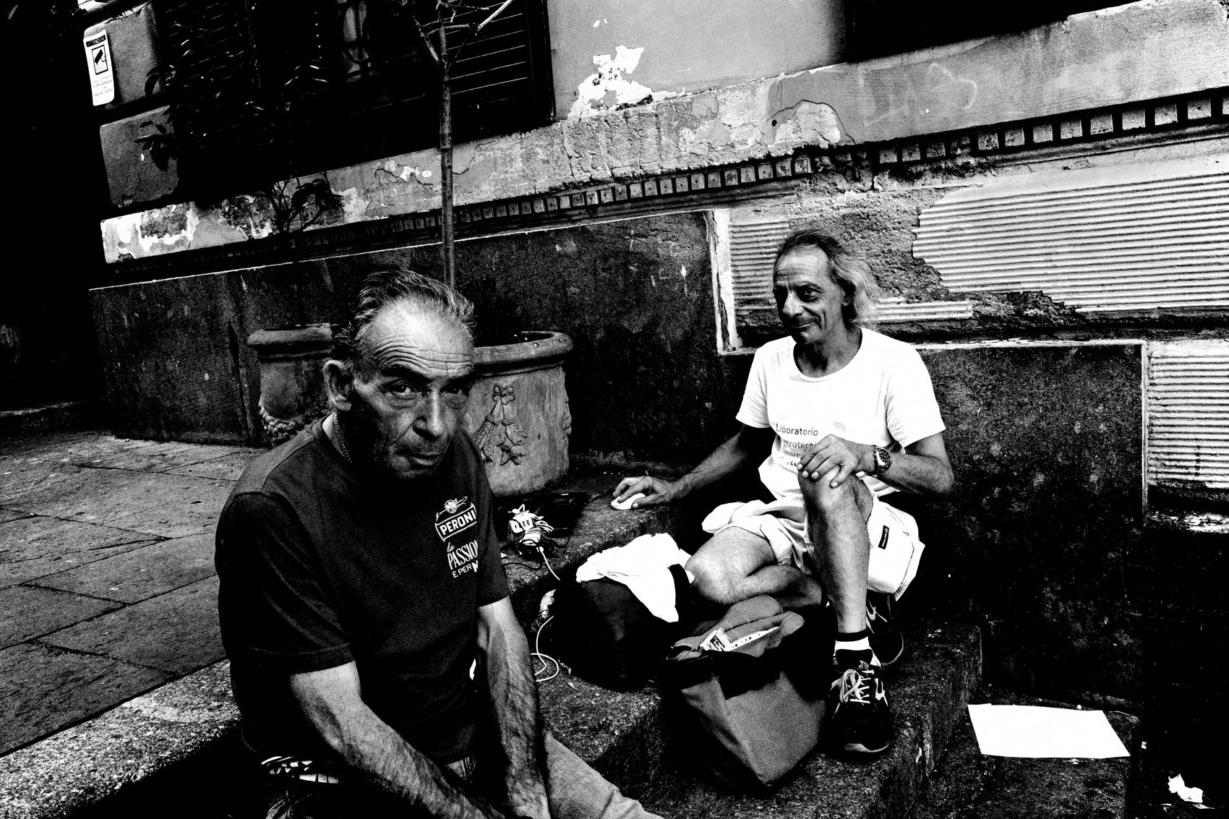
FLUX ACADEMY
BEAT 15 · MAIN TEACHING
Improvement Lives in the Doing
— You don't think your way to better
— Instinct sharpens through reps
— Perception shifts from doing the work
Notes:
And don't worry that instinct means you stop growing. You don't improve by thinking about improvement — you improve by doing the work. Walking more. Seeing more. Photographing more. Over time, your perception and your instincts sharpen on their own. The gut gets smarter the more you trust it. That's the only way it trains.

Slide 17
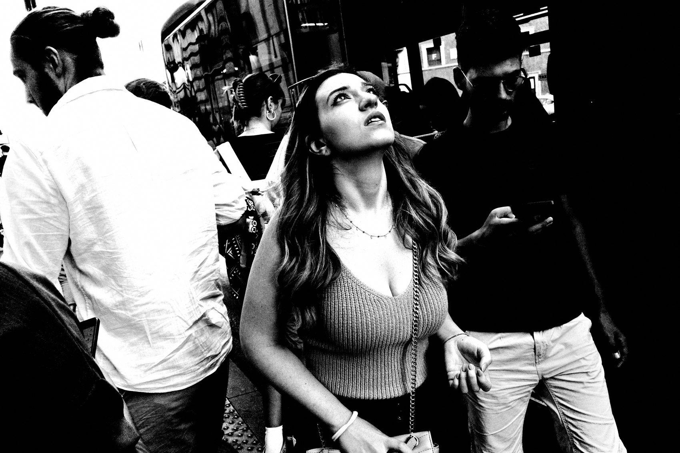
FLUX ACADEMY
BEAT 16 · PRACTICAL APPLICATION
Set It and Forget It
— Auto / program mode, camera off
— See it — on, shutter, move on
— Zero settings thinking on the street
Notes:
Here's your assignment. Set the camera to auto or program mode and leave it. Keep it off until you see something — then on, shutter, move on. No checking, no fiddling. Take every technical decision off the street so that the only thing left to do in the moment is react. Make instinct the only option you have.

Slide 18
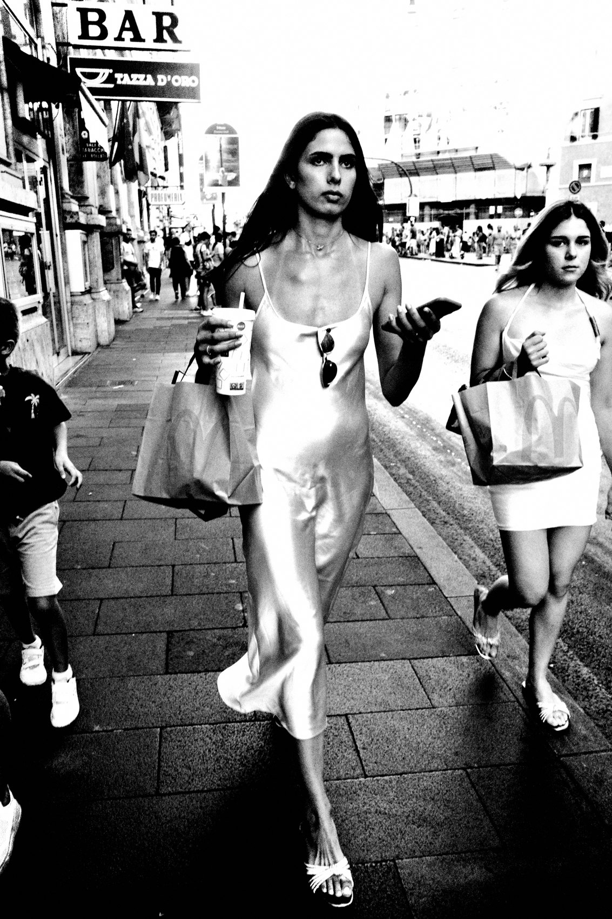
FLUX ACADEMY
BEAT 17 · PRACTICAL APPLICATION
The 0.001% Rule
— If it intrigues you even 0.001% — click
— Don't pre-judge, don't qualify it
— Shoot more, think less
Notes:
Then run the 0.001% rule. If something intrigues you even one-thousandth of a percent, just click the shutter. Don't stop to ask if it's worth it — that's the intellect trying to get a vote. Shoot more, think less. Let the gut twitch be the decision. You can sort out what mattered later.

Slide 19
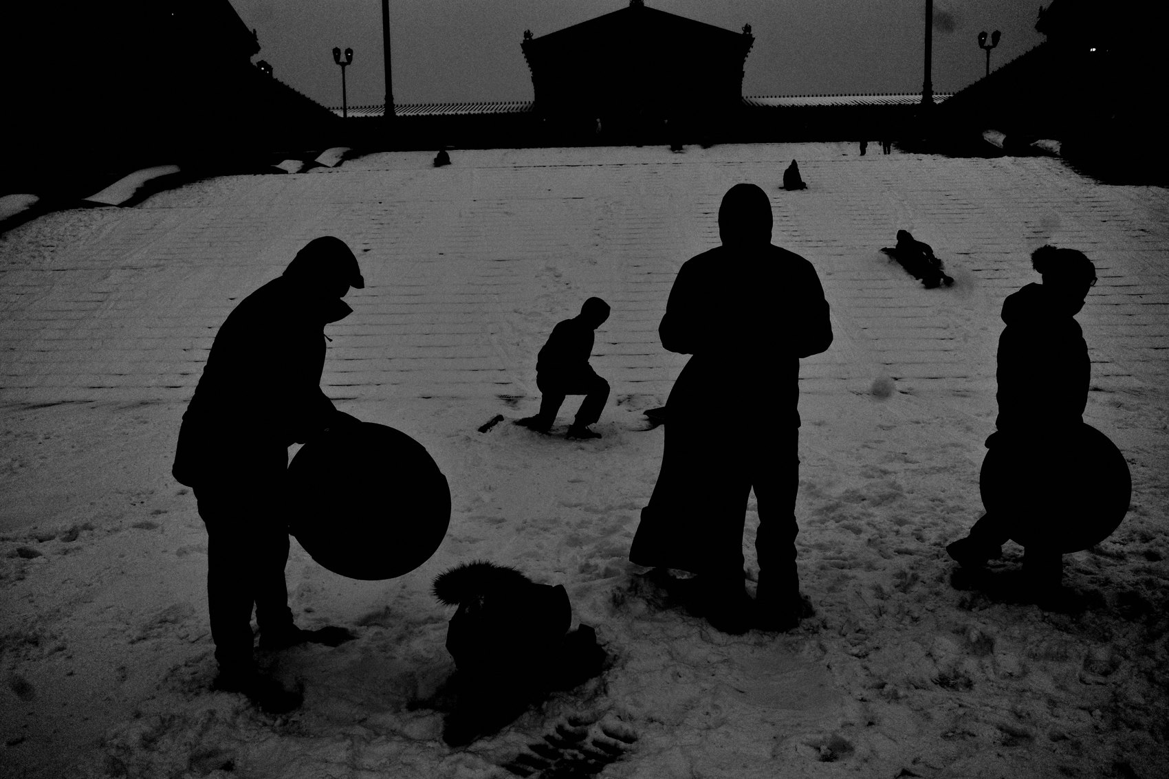
FLUX ACADEMY
BEAT 18 · PRACTICAL APPLICATION
Move Slower, React Faster
— The slower you walk, the more you see
— Slow body, quick instinct
— Notice the mundane, then react
Notes:
One more drill, and it sounds backwards: to react faster, move slower. The slower you walk, the more details you find and the more photographs you make. Slow the body down and you start noticing the way light hits a wall, the gestures people make. A calm body and a quiet mind are exactly what let instinct fire quickly.

Slide 20
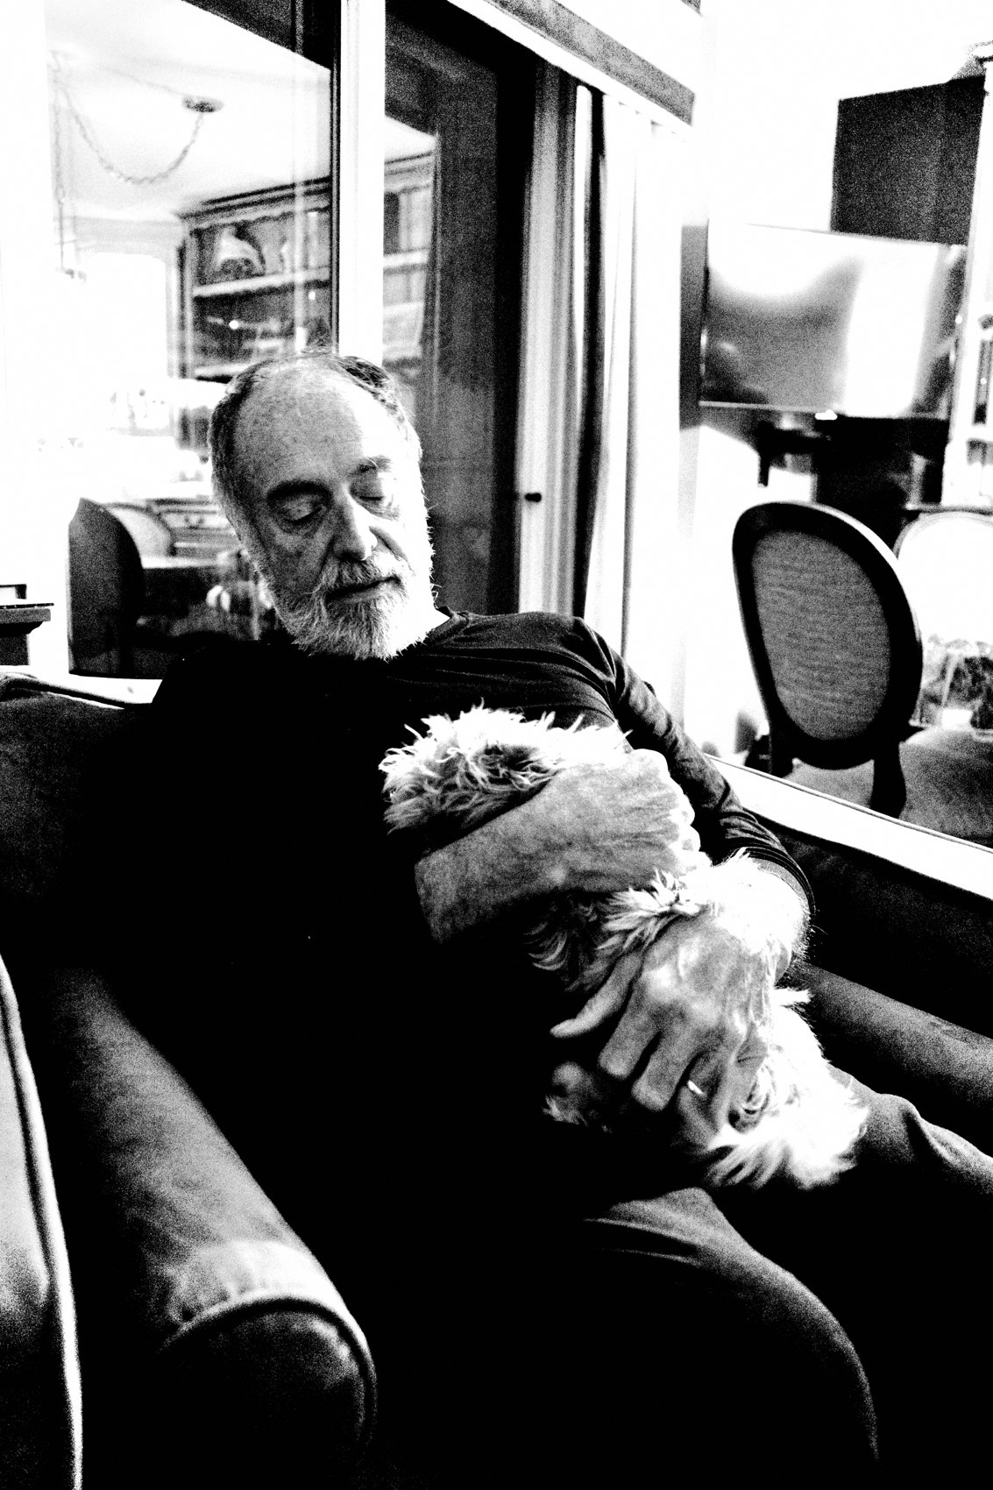
FLUX ACADEMY
BEAT 19 · COMMON MISTAKES
Thinking at the Shutter
— Analyzing in the moment = frozen
— "Is this good?" kills the frame
— Save the thinking for the edit
Notes:
The number-one mistake: thinking at the shutter. Standing there asking "is this good? is the composition right?" while the moment evaporates. Analysis belongs in the edit, never on the street. If you're calculating, you're already too late. Collect in the moment; contemplate at home. Never the other way around.

Slide 21
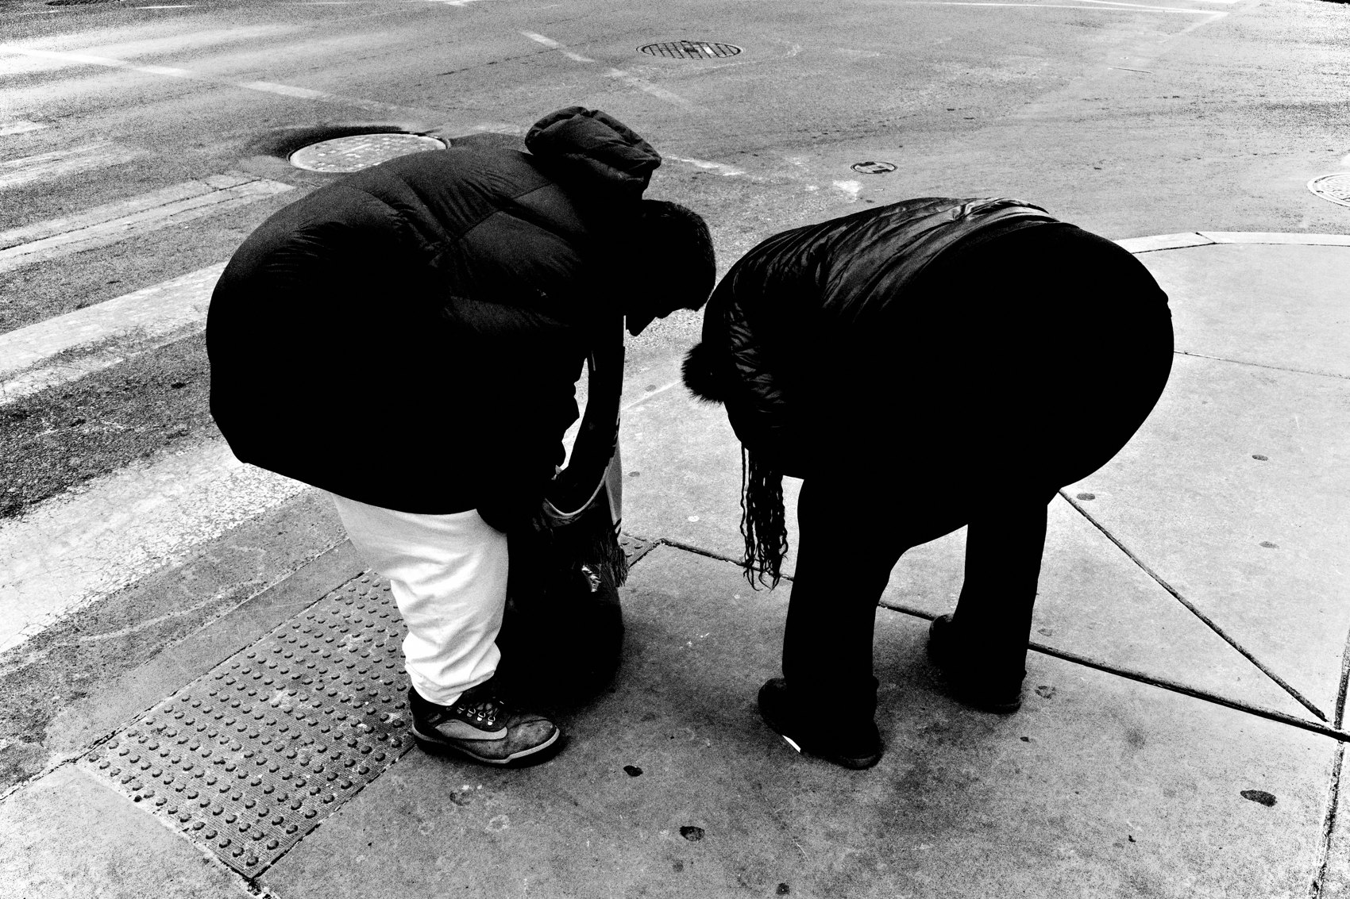
FLUX ACADEMY
BEAT 20 · COMMON MISTAKES
Forcing and Hunting
— Striving for impact burns you out
— Hunting overrides the gut
— Let life come to you instead
Notes:
The other mistake is forcing it — constructing photographs for impact, hunting moments, striving for hours. There's a season where that's sustainable, but it eventually burns you out and overrides your instincts. Stop hunting. Let life flow toward you, be there ready, and respond. The less you try, the better the work gets.

Slide 22
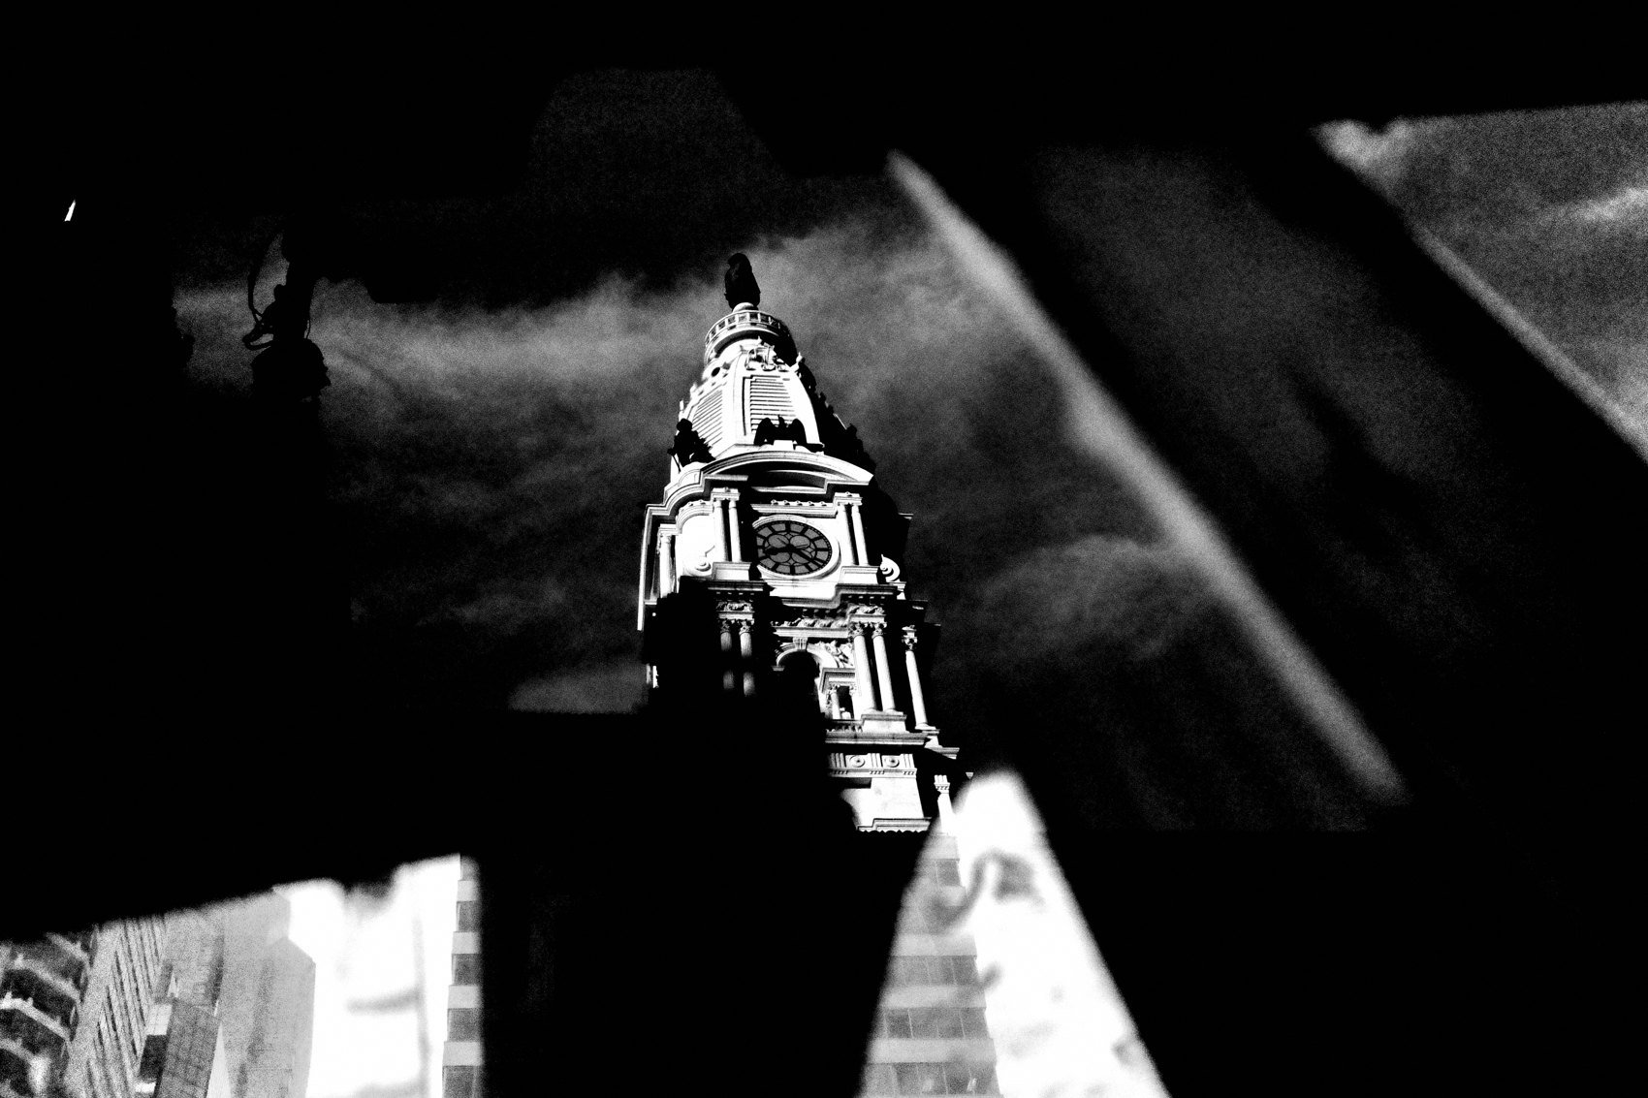
FLUX ACADEMY
BEAT 21 · RELATIONSHIP TO PREVIOUS
Built on the Flow State
— Lesson 006 opened the flow state
— Instinct is what flow runs on
— No flow, no trusting the gut
Notes:
This builds directly on Lesson 006, where we entered the flow state. Remember the line: the more you think, the less you see; the less you think, the more you photograph. Flow is the room — instinct is what moves inside it. You can't trust your gut while you're overthinking, so we had to find flow first. Now we put it to work.

Slide 23
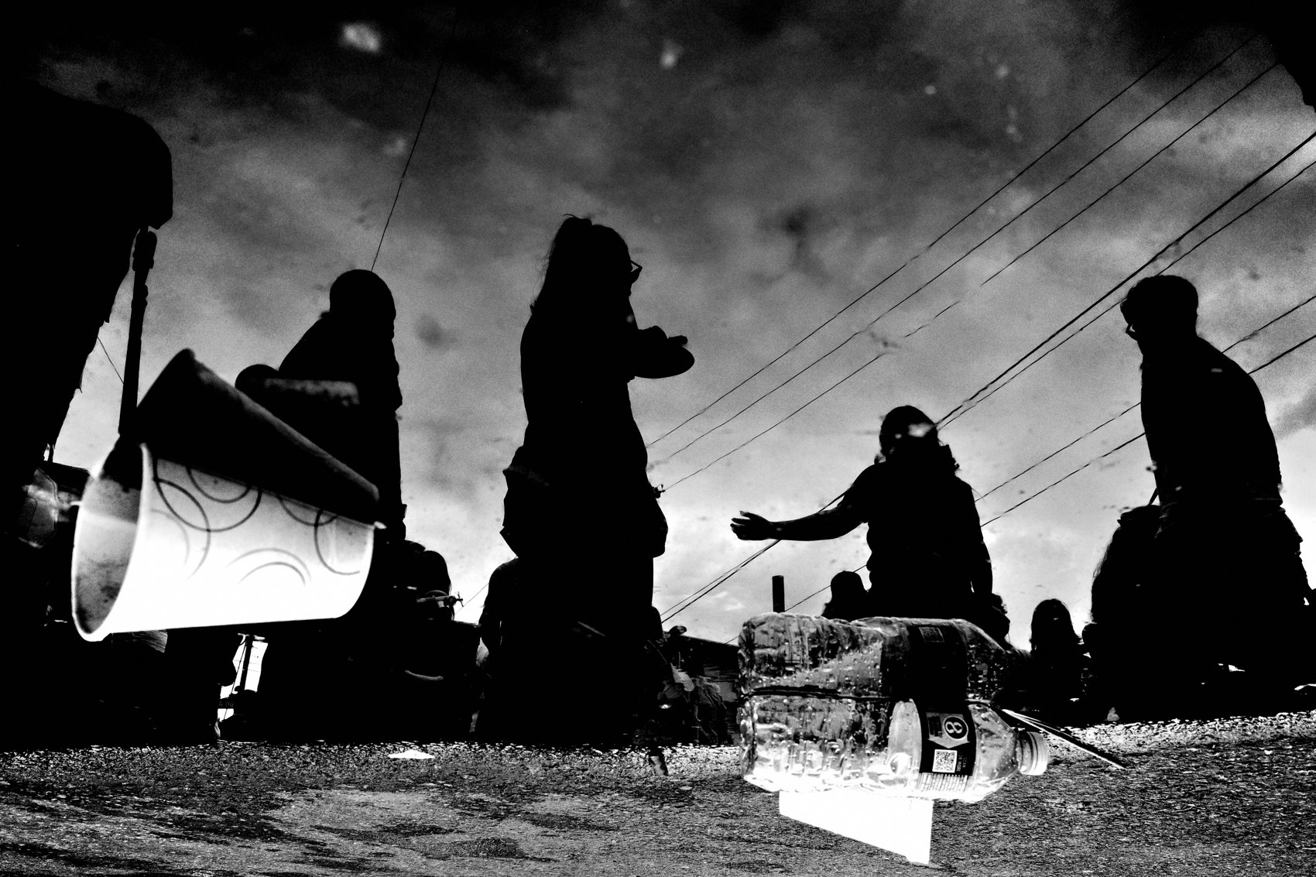
FLUX ACADEMY
BEAT 22 · RELATIONSHIP TO UPCOMING
Next: Embrace Chaos
— Next up: Lesson 008 — Embrace Chaos
— Chaos is where instinct gets tested
— Point, shoot, trust the gut
Notes:
Next, in Lesson 008, we take this trained instinct straight into the fire — Embrace Chaos. Crowds, markets, festivals, the lunch-rush whirlwind. Wherever there's chaos, you'll find me, throwing the camera into program mode to point, shoot, and pray. Chaos is the proving ground for everything we built today. Let's go test the gut.

Slide 24
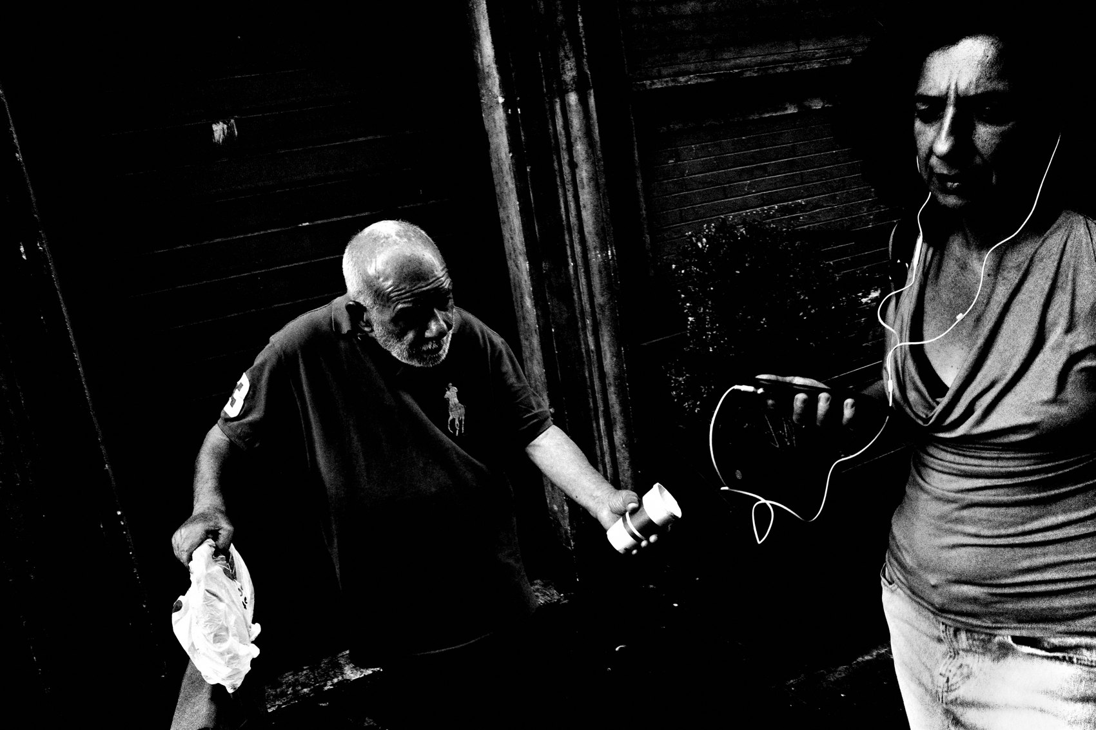
FLUX ACADEMY
BEAT 23 · SUMMARY / TAKEAWAY
Trust the Gut, Edit Later
— Instinct on the street, intellect in the edit
— Force less, flow more, trust the pull
— The subconscious becomes conscious
Notes:
Last thing. Instinct over intellect doesn't mean throwing your knowledge away — it means putting it in the right place. Intellect in the edit; instinct on the street. Let go of control, detach from the outcome, feel the pull, and press. The subconscious becomes conscious — and that's the purest skill you'll ever build. Catch you next lesson.

