Slide 1
FLUX ACADEMY · A SCHOOL FOR SEEING
MODULE 2 · THE INNER GAME
Entering the Flow State
BY DANTE SISOFO

Slide 2
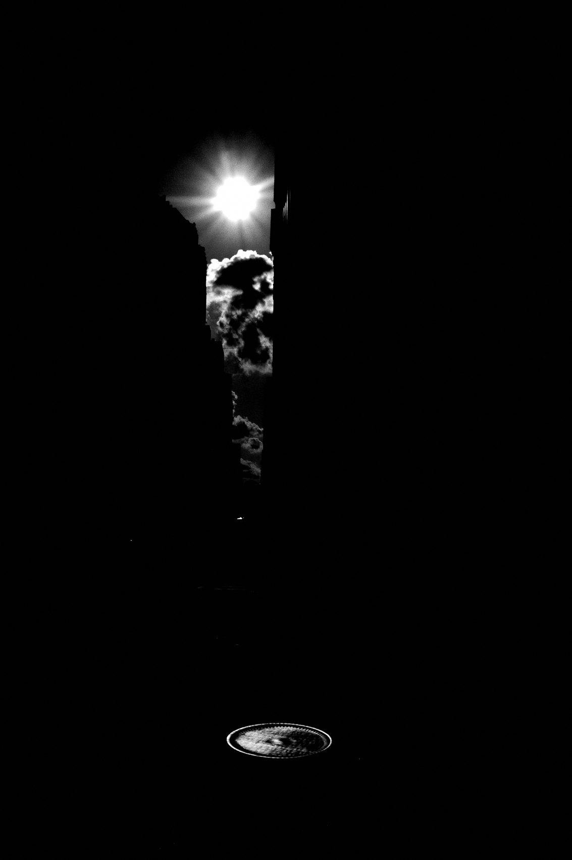
FLUX ACADEMY
BEAT 01 · CORE IDEA
The Less You Think, the More You See
— The more you think, the less you see
— Flow = effortless, hesitation-free seeing
— This state is where the best photos live
Notes:
What's popping, people — it's Dante. Today we're entering the flow state — the thing that gives this whole practice its meaning, purpose, and flavor. Here's the whole lesson in one line: the more you think, the less you see; the less you think, the more you photograph. Flow is where everything aligns and the camera disappears.

Slide 3
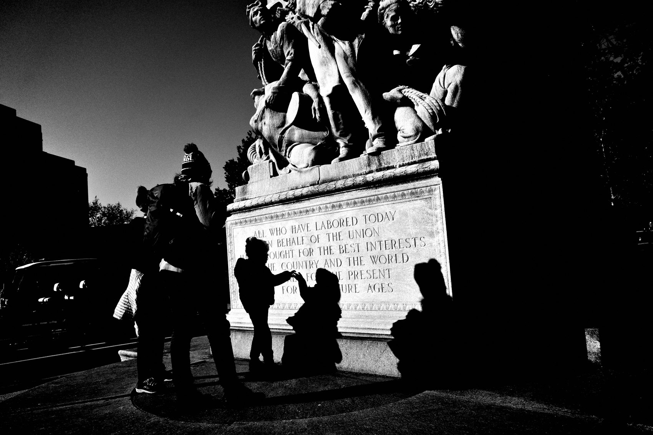
FLUX ACADEMY
BEAT 02 · LEARNING OBJECTIVE
What You'll Walk Away With
— How to enter flow on demand
— How to stay in it for hours
— A repeatable way to shoot without fear
Notes:
By the end of this lesson you'll know how to drop into flow on demand — and, more importantly, how to stay there. You'll learn the subtractions that get you in, the trifecta that keeps you in, and how to move through a city so that moments come to you instead of you chasing them.

Slide 4
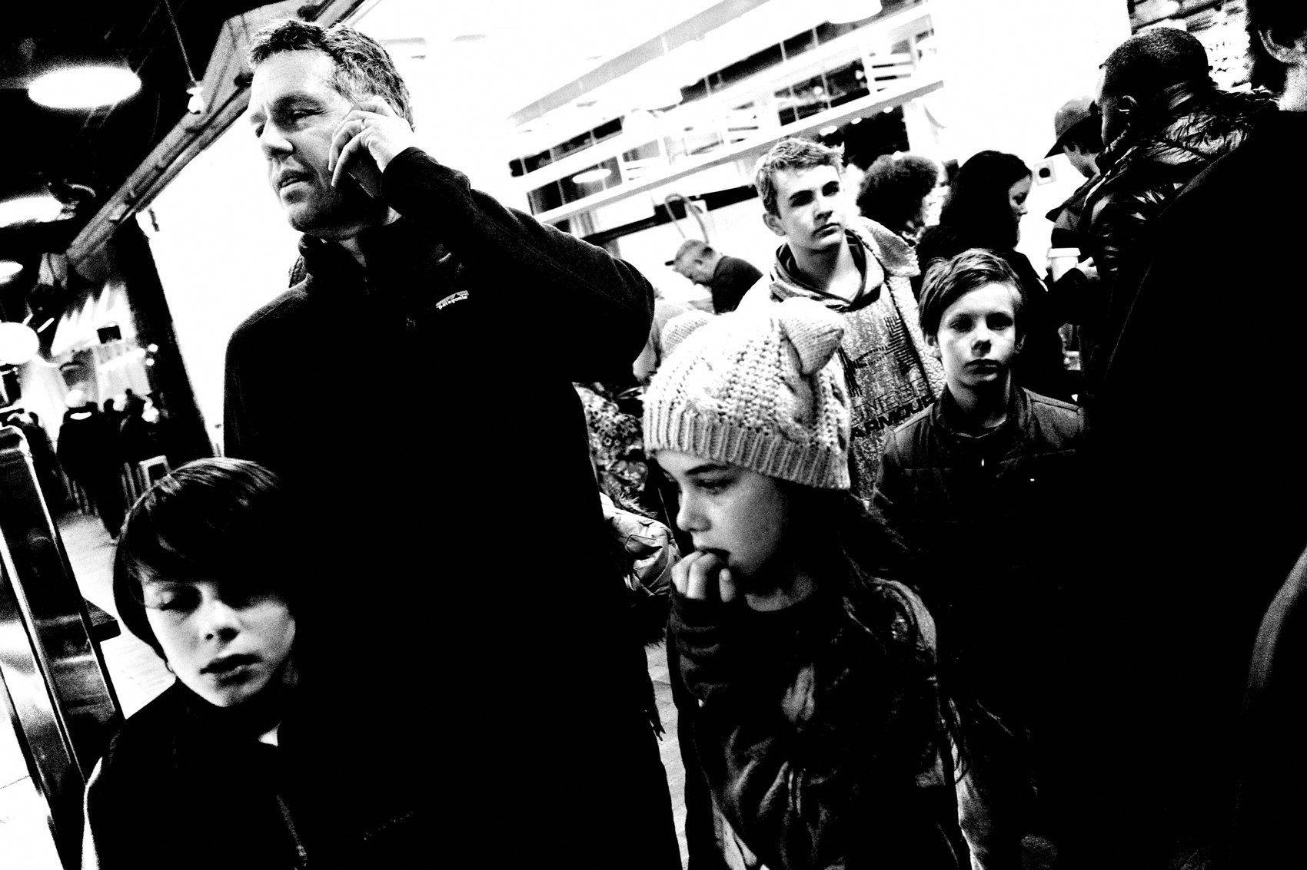
FLUX ACADEMY
BEAT 03 · WHY THIS MATTERS
Flow Is Where the Best Photos Happen
— Flow state is where all my best photos happen
— No overthinking, no hesitation, no fear
— Connected to the street, moving like water
Notes:
Here's why this matters: flow state is where all my best photos happen. When you're in it, photography feels effortless — no overthinking, no hesitation. You're just connected with the streets, moving like water, reacting and anticipating moments without fear. Miss the flow and you miss the work.

Slide 5
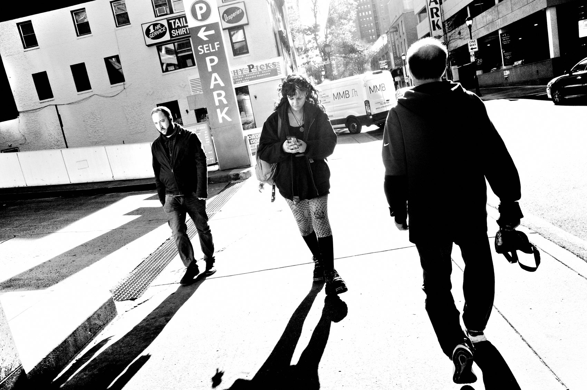
FLUX ACADEMY
BEAT 04 · WHY THIS MATTERS
Presence Is the Whole Gift
— Flow = full immersion in the present
— Not the past, not the future — now
— To enter flow is to enter the present moment
Notes:
And it goes deeper than pictures. Flow is full immersion — that space where time fades, distractions disappear, and intuition takes over. To enter the flow is to enter the present moment. That's the real gift: not the past, not the future, but right now. The photographs are just proof you were truly there.

Slide 6
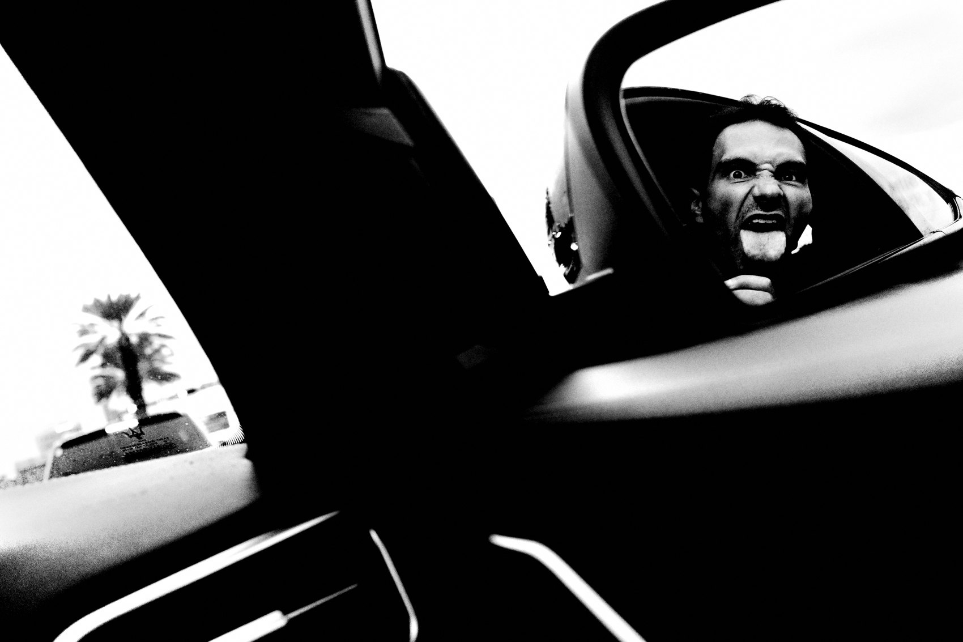
FLUX ACADEMY
BEAT 05 · MAIN TEACHING
A Meditative State of Observing
— Observe patterns in nature and human behavior
— Watch how light gives form to things
— Be in tune with the rhythm of the street
Notes:
So what is flow, really? When I'm out shooting I enter a meditative state of simply observing patterns — in nature and in human behavior. The way light casts onto surfaces, giving form to people, places, and things; the way people move and gesture. You're tuning into the rhythm and beat of the street, and that tuning is the doorway in.

Slide 7
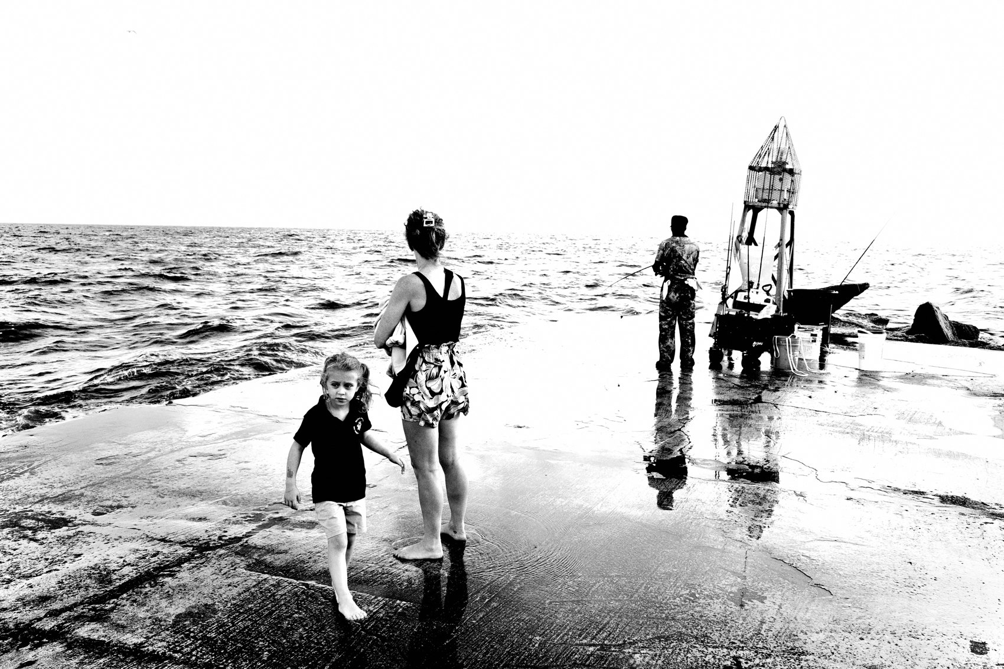
FLUX ACADEMY
BEAT 06 · MAIN TEACHING
Eliminate Distractions
— Put the phone away, kill notifications
— The phone is distraction's greatest weapon
— Immerse yourself in the present moment
Notes:
First move: eliminate distractions. Put your phone away. Turn off notifications. The phone is modern distraction's greatest weapon — people on their phones are players who hit pause on the game of life. Life isn't lived in notifications; it's lived out there, on the street. Flow begins by subtracting, not adding.

Slide 8
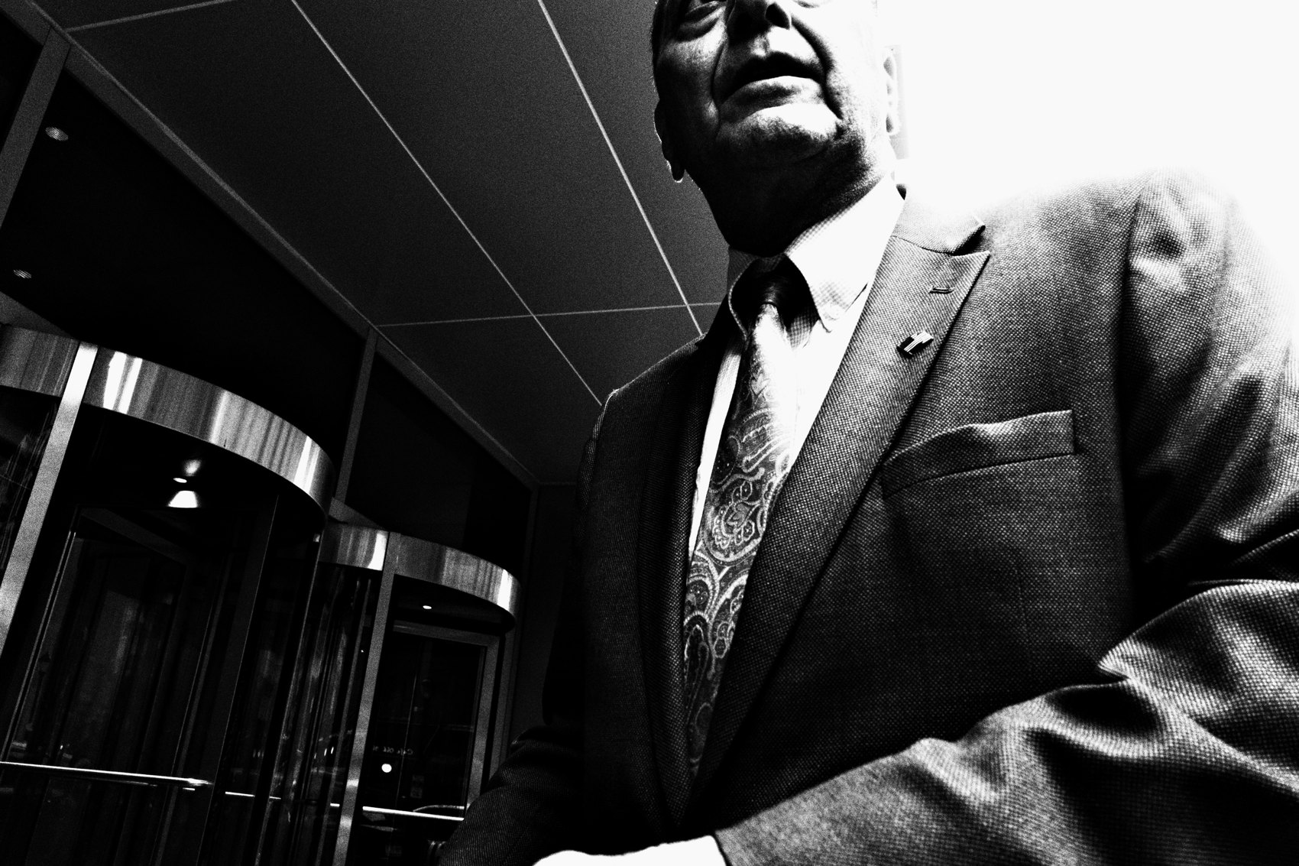
FLUX ACADEMY
BEAT 07 · MAIN TEACHING
Move Slower Than Everyone Else
— The slower you walk, the more you find
— Move at 75% of everyone else's speed
— Slowing the body wakes up the eye
Notes:
Next: move slower than everyone else. The slower you walk, the more details you'll find, and the more photographs you'll make. I move at about seventy-five percent of everyone else's speed. When you slow the body down, you start noticing the mundane moments — the way light hits a wall, the small gestures people make. Don't chase. Receive.

Slide 9
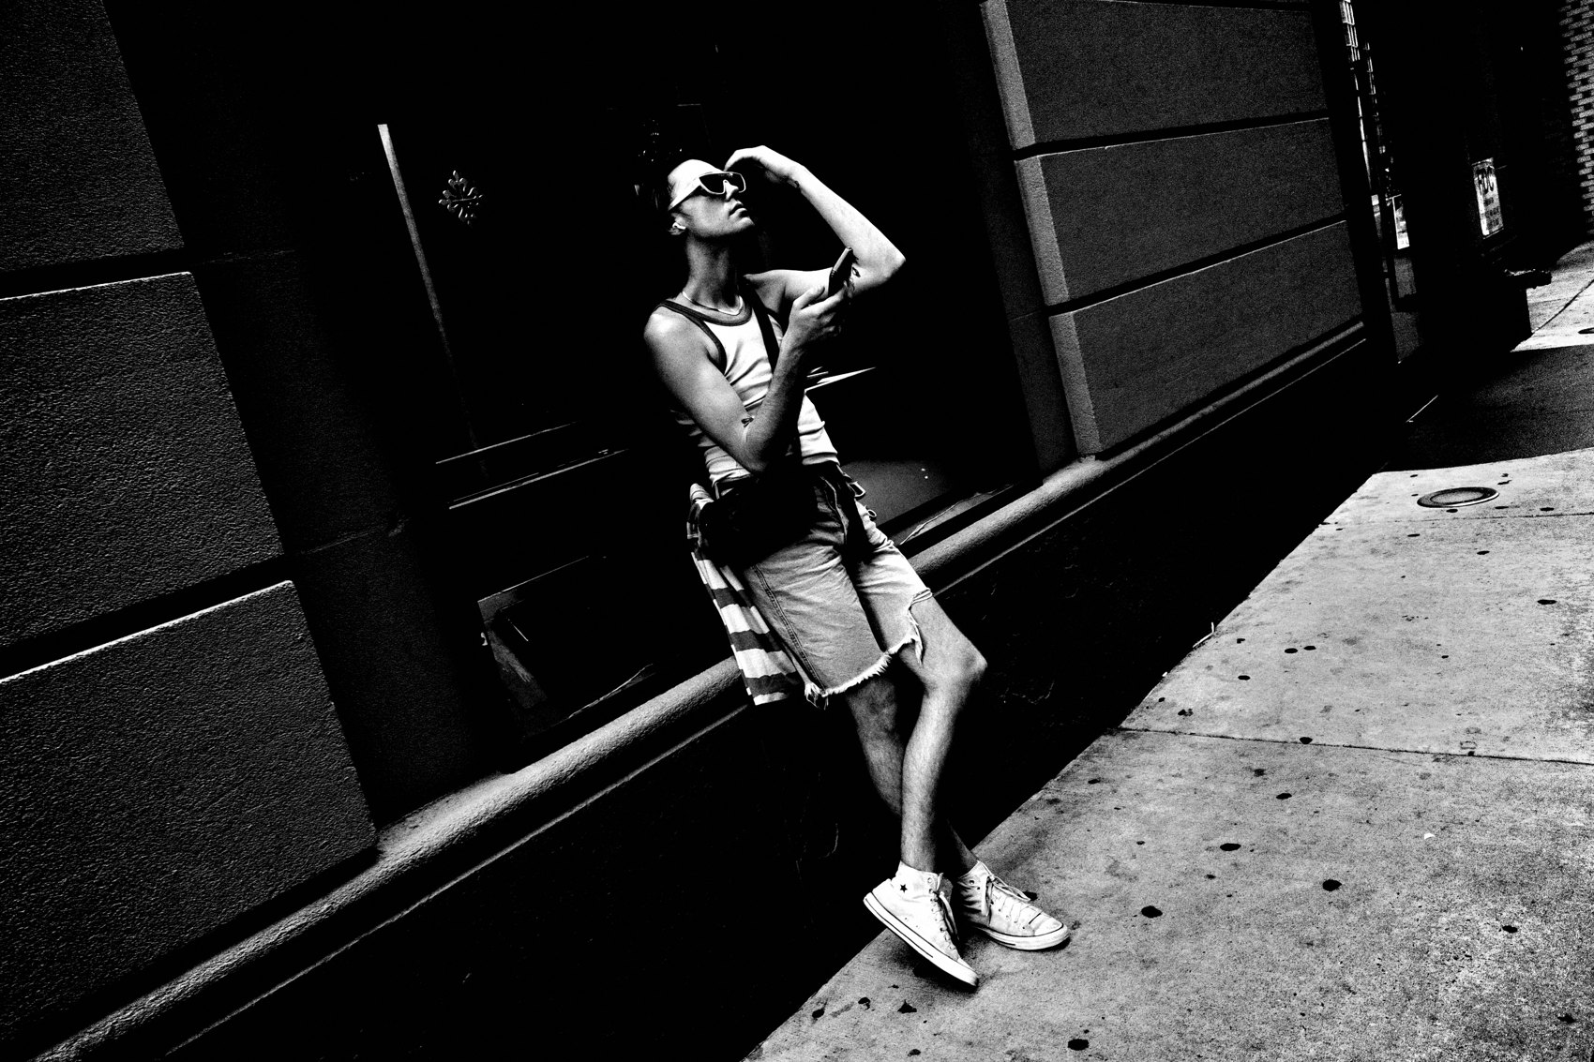
FLUX ACADEMY
BEAT 08 · MAIN TEACHING
Let Life Flow Toward You (Wu Wei)
— Wu wei — effortless action, no forcing
— Move with the current, like water
— Photography is receiving, not hunting
Notes:
This is wu wei — the Taoist idea of effortless action. I'm not running and gunning, not hunting moments. I'm there, responding as life unfolds in front of me. Think of water: you don't fight the current, you move with it. I don't go against the stream of life — I flow with it, and I let the moments that arrive be what I photograph.

Slide 10
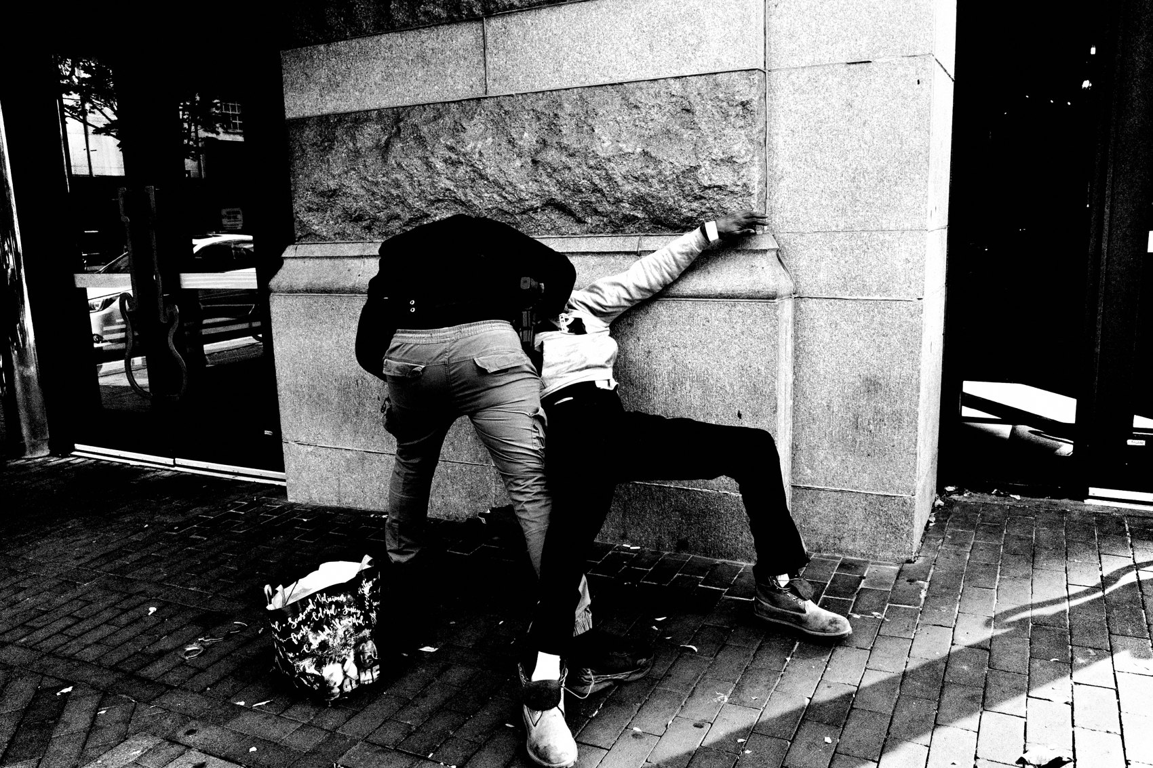
FLUX ACADEMY
BEAT 09 · MAIN TEACHING
Stay in a State of Play
— Go out in the spirit of play
— The best photos come from being a participant
— Engagement beats being a stealthy fly on the wall
Notes:
Now: stay in a state of play. Go out in the spirit of play — no agenda, just exploring. And flow doesn't mean being a stealthy fly on the wall all the time. The best photos come from being an active participant in the drama of the street — playing soccer with kids, a quick chat with a stranger, even just smiling. Presence creates richer photographs.

Slide 11

FLUX ACADEMY
BEAT 10 · MAIN TEACHING
Forget the Outcome
— No expectations, no over-analysis — just shoot
— Don't judge good vs. bad in the moment
— Follow curiosity, trust the process
Notes:
Then forget the outcome. Flow is about letting go — no expectations, no over-analysis. Don't judge your shots in the moment. Don't worry about good versus bad. Just follow your curiosity and trust the process. The instant you try to control the outcome, you lose the magic. Detach, and paradoxically you come home with better photographs.

Slide 12
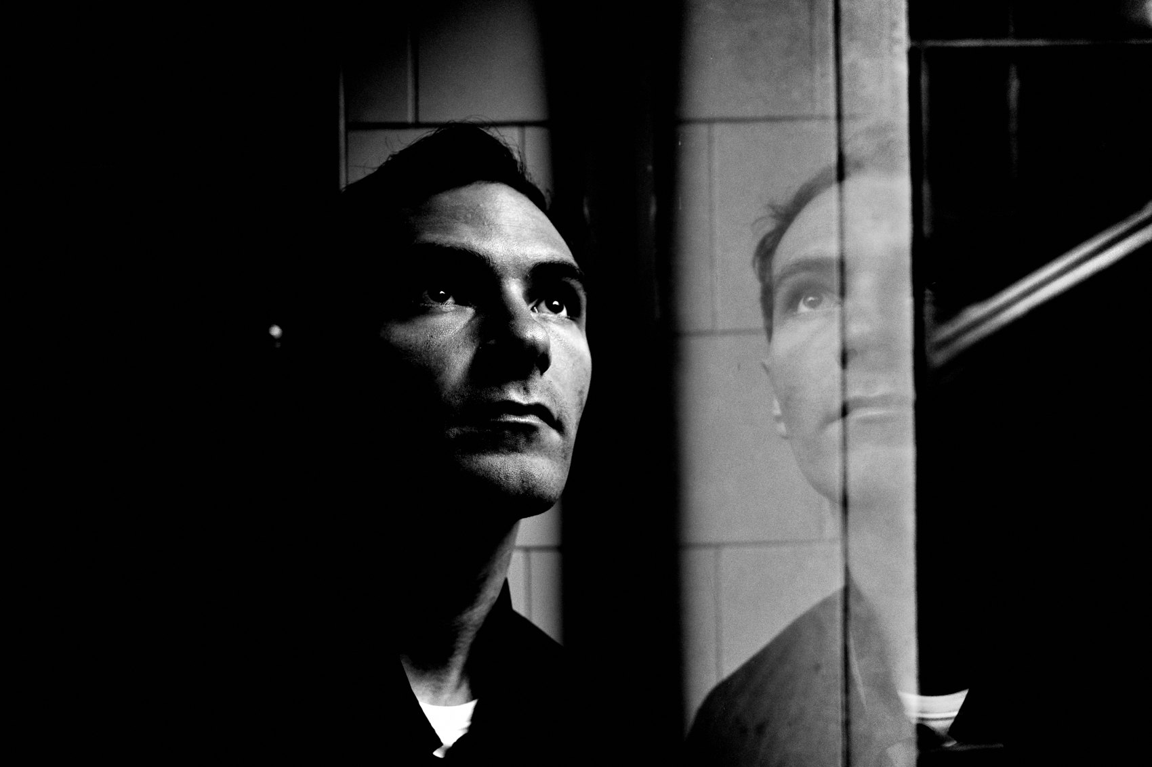
FLUX ACADEMY
BEAT 11 · MAIN TEACHING
The Trifecta: Courage, Curiosity, Intuition
— Courage — move, approach, press the shutter
— Curiosity — explore what's beyond the corner
— Intuition — trust your instincts on when
Notes:
Here's what keeps you in flow — the trifecta. Courage: the boldness to move, approach, and press the shutter without hesitation. Curiosity: the hunger to see what's beyond the corner. Intuition: the trust to know when to click. Together they heighten your awareness, and that heightened awareness is what ushers you into that effortless, alive rhythm.

Slide 13

FLUX ACADEMY
BEAT 12 · MAIN TEACHING
Flow Lives in the Body, in Motion
— Flow isn't found sitting still — it's in motion
— Motivation is movement; through movement, improvement
— Walk, breathe with the city, exist outside time
Notes:
Flow isn't found sitting still — it's found in motion. Motivation is movement; through movement comes improvement. When you move your body through the world — walking, breathing with the city — you step outside the passage of time. You stop overthinking and simply are. I ground myself in thin-soled shoes so I feel the street; flow emerges through the body first, then the mind.

Slide 14
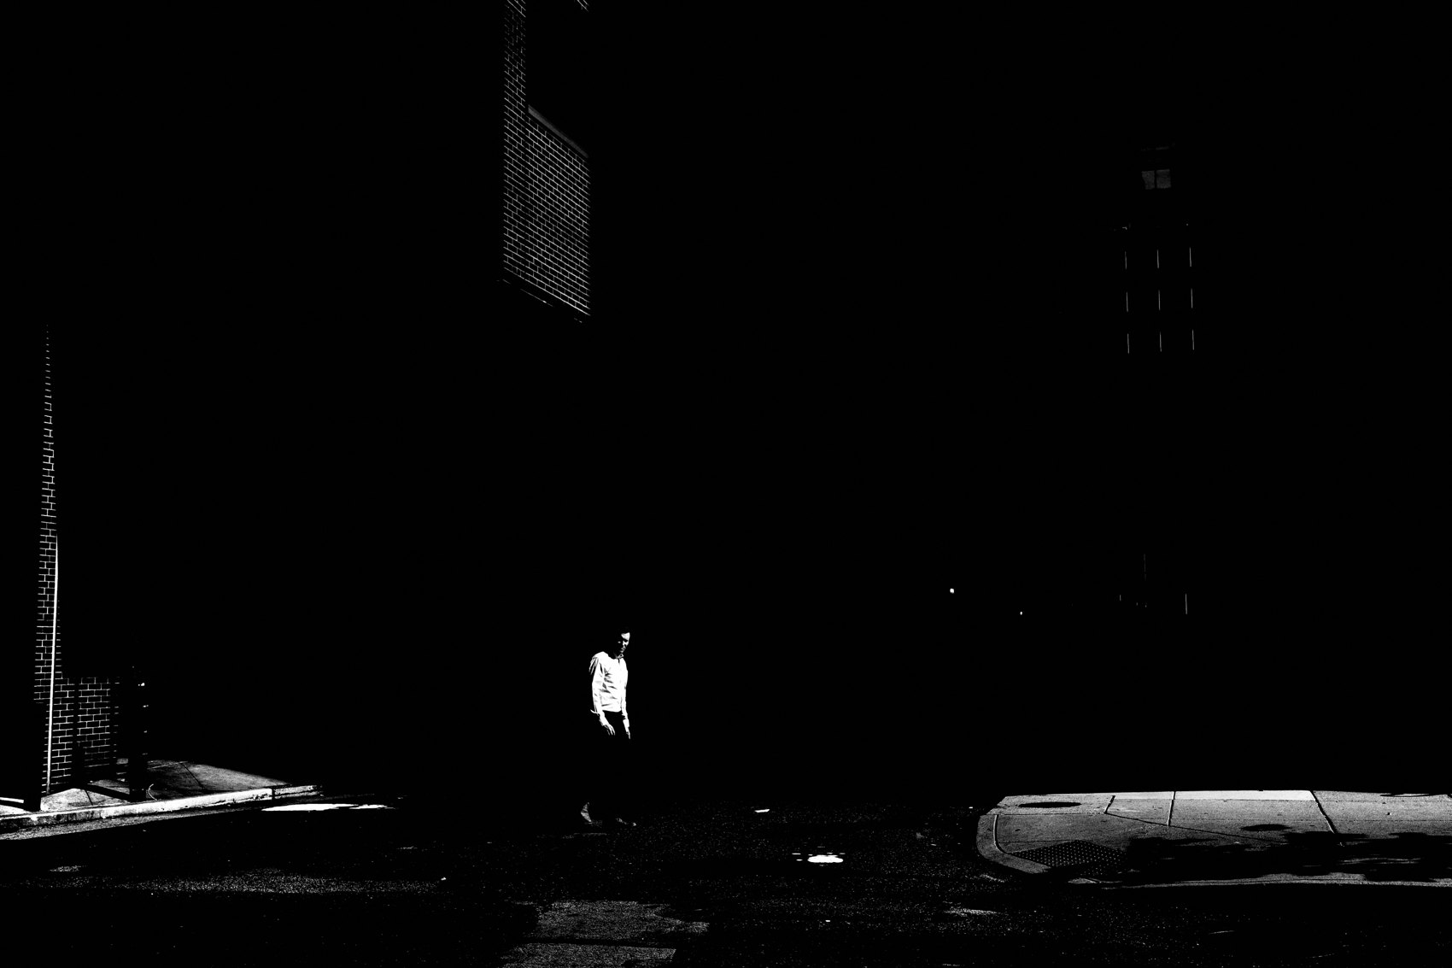
FLUX ACADEMY
BEAT 13 · MAIN TEACHING
Simplify the Gear, Subtract the Friction
— One camera, one lens; auto or semi-auto
— The fewer technical distractions, the better
— Use the LCD for fluid, hesitation-free framing
Notes:
Make it practical: simplify your gear. One camera, one lens. Auto or semi-auto modes — the fewer technical distractions, the better. The Ricoh GR is the closest thing to having no camera at all; pocketable, frictionless, set to auto and forgotten. I shoot off the LCD, not the viewfinder — it makes composition more fluid, with less movement and less hesitation.

Slide 15
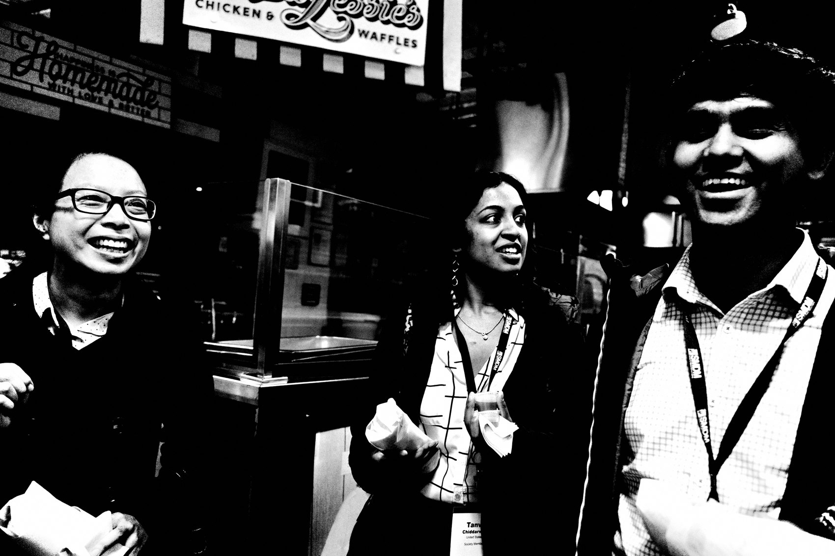
FLUX ACADEMY
BEAT 14 · MAIN TEACHING
Don't Leave the Scene Until It Leaves You
— A plain scene: mist, a passerby, a gesture
— Cliché at first — but don't think, just shoot
— Stay, and the ordinary turns abstract
Notes:
Here's flow in action. Picture something plain — mist or steam drifting off a fountain, someone stopping to take a selfie. Most would call it cliché and walk on. In flow, you don't think, you just shoot. And if you keep working the scene, it shifts: the person steps into the haze, back turned, framed in mystery, and suddenly a simple moment turns into something layered and alive. That's the rule — don't leave the scene until the scene leaves you.

Slide 16
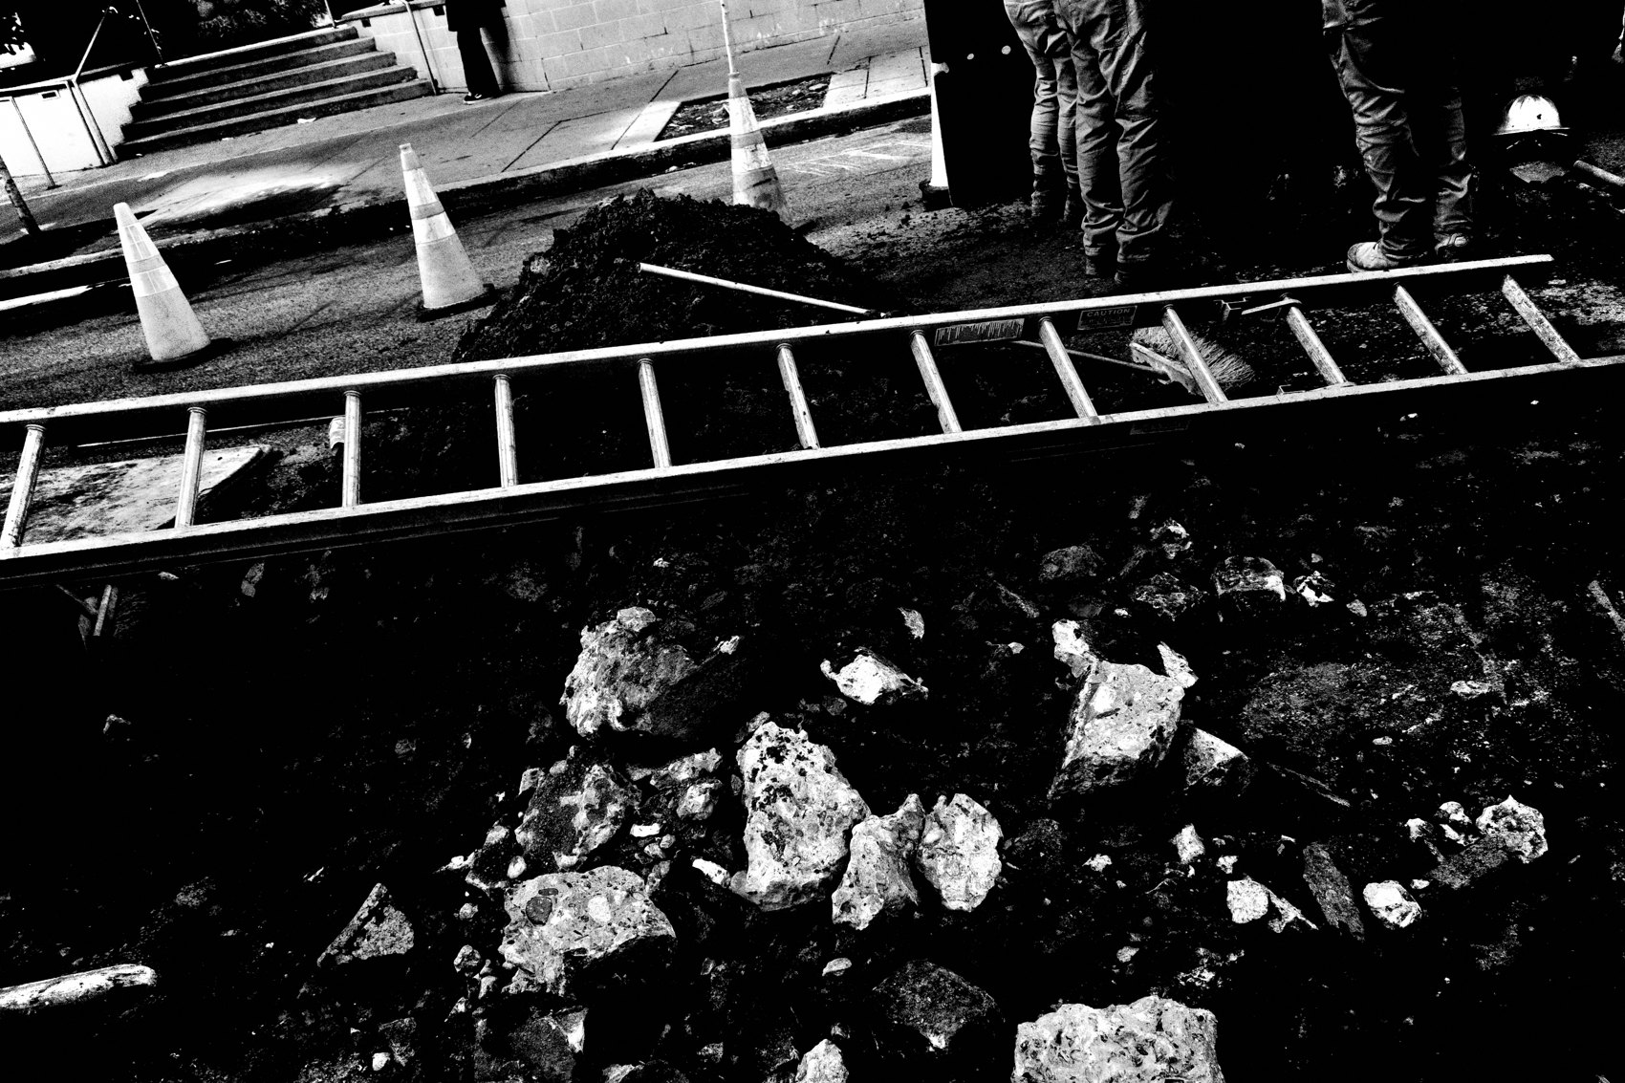
FLUX ACADEMY
BEAT 15 · MAIN TEACHING
Stay Attuned to the Micro-Moment
— Follow the light to a group of people
— Notice how it touches fabric, skin, form
— A small gesture arrives; reframe and click
Notes:
Another way it shows up. You follow the light and it leads you to a cluster of people — you notice the way it touches their clothing, the shapes it makes. Then, at the last instant, someone raises a hand, shifts a shoulder, turns a head. Instinctively you reframe and click. That one subtle gesture is what makes the frame. Flow means being attuned to these micro-moments, where instinct meets timing and awareness meets form.

Slide 17
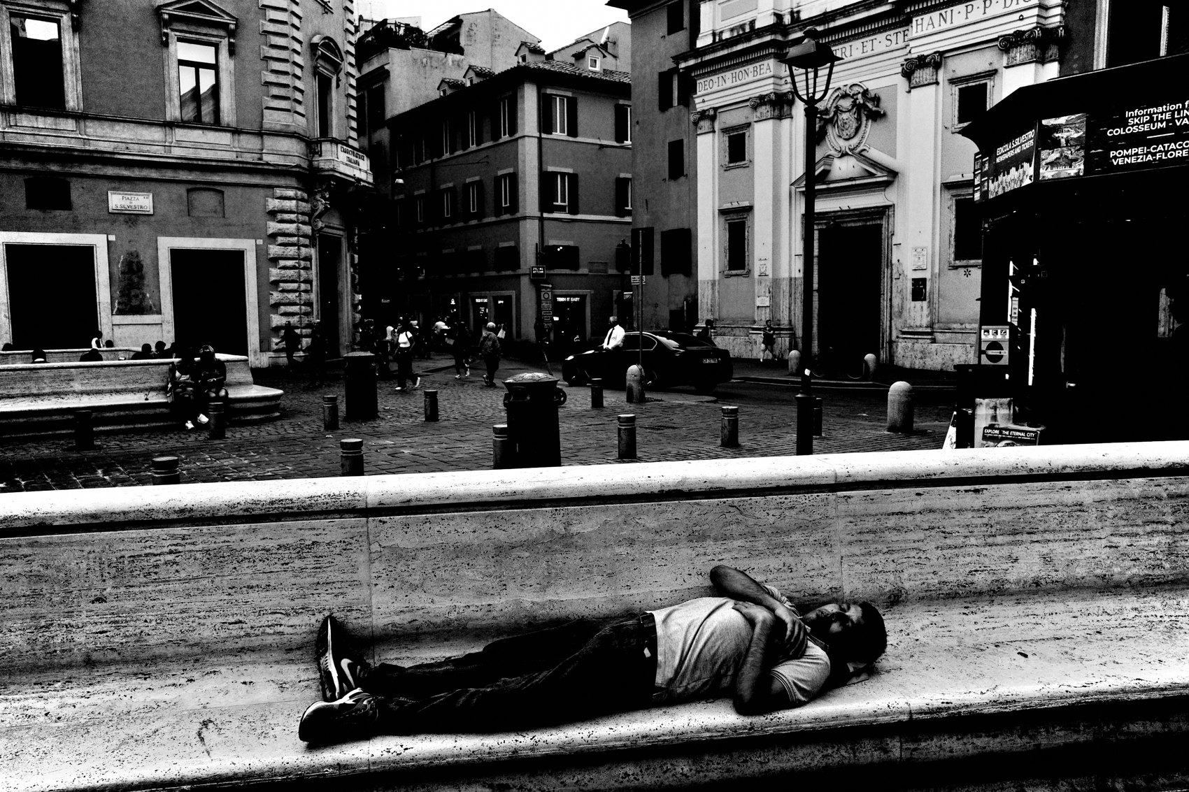
FLUX ACADEMY
BEAT 16 · MAIN TEACHING
Flow Rewards the Long Immersion
— A single place, hours in flow, not minutes
— Each frame comes through presence, not hunting
— The strongest image often comes late in the day
Notes:
And the big one — the long immersion. Give yourself hours in one place instead of minutes, and you drop into a perpetual flow state: people moving, light shifting, gestures aligning, each frame arriving naturally through presence rather than hunting. Often the strongest image comes late, as the light softens toward dusk, precisely because you stayed all day. Flow rewards persistence — it emerges through repetition, not randomness.

Slide 18
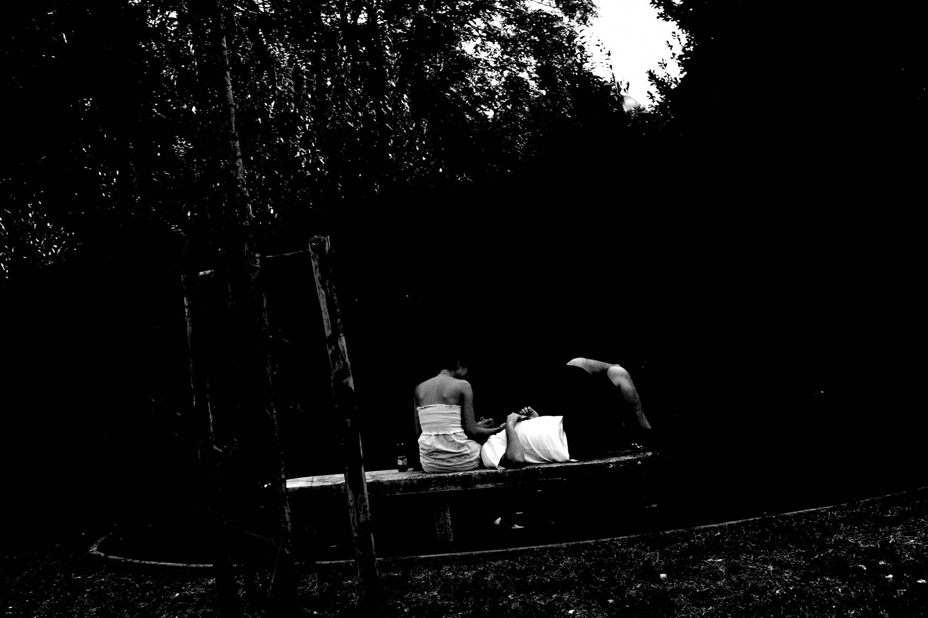
FLUX ACADEMY
BEAT 17 · MAIN TEACHING
Shoot More, Think Less
— If it intrigues you even 0.001%, click the shutter
— Volume comes from curiosity, not judgment
— My next photograph is my best photograph
Notes:
The simplest rule of all: shoot more, think less. If something intrigues you even 0.001 percent, just click the shutter. Don't dwell on yesterday's photos or tomorrow's shots — be here, now. My next photograph is my best photograph. That mindset keeps the channel open and keeps you moving frame to frame.

Slide 19
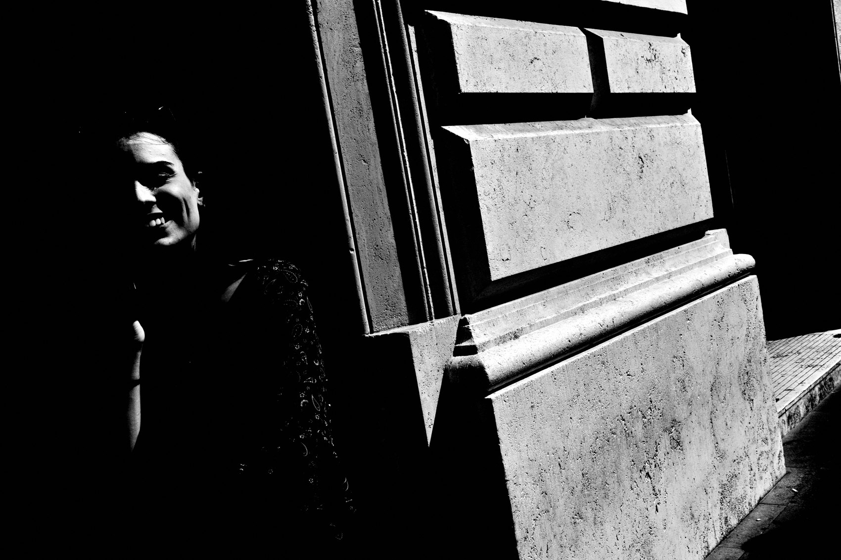
FLUX ACADEMY
BEAT 18 · PRACTICAL APPLICATION
Build Your Flow Ritual
— Phone off; one camera, one lens, on auto
— Walk slow — follow the light, not a map
— No planned route; let intuition pick left or right
Notes:
Here's how to actually do it. Before you walk: phone off, one camera, one lens, set to auto. Then move slow and follow the light, not a map — no planned routes. Let intuition decide whether you go left or right at the intersection. Some people fast to sharpen the mind; the point is to subtract anything between you and the street.

Slide 20
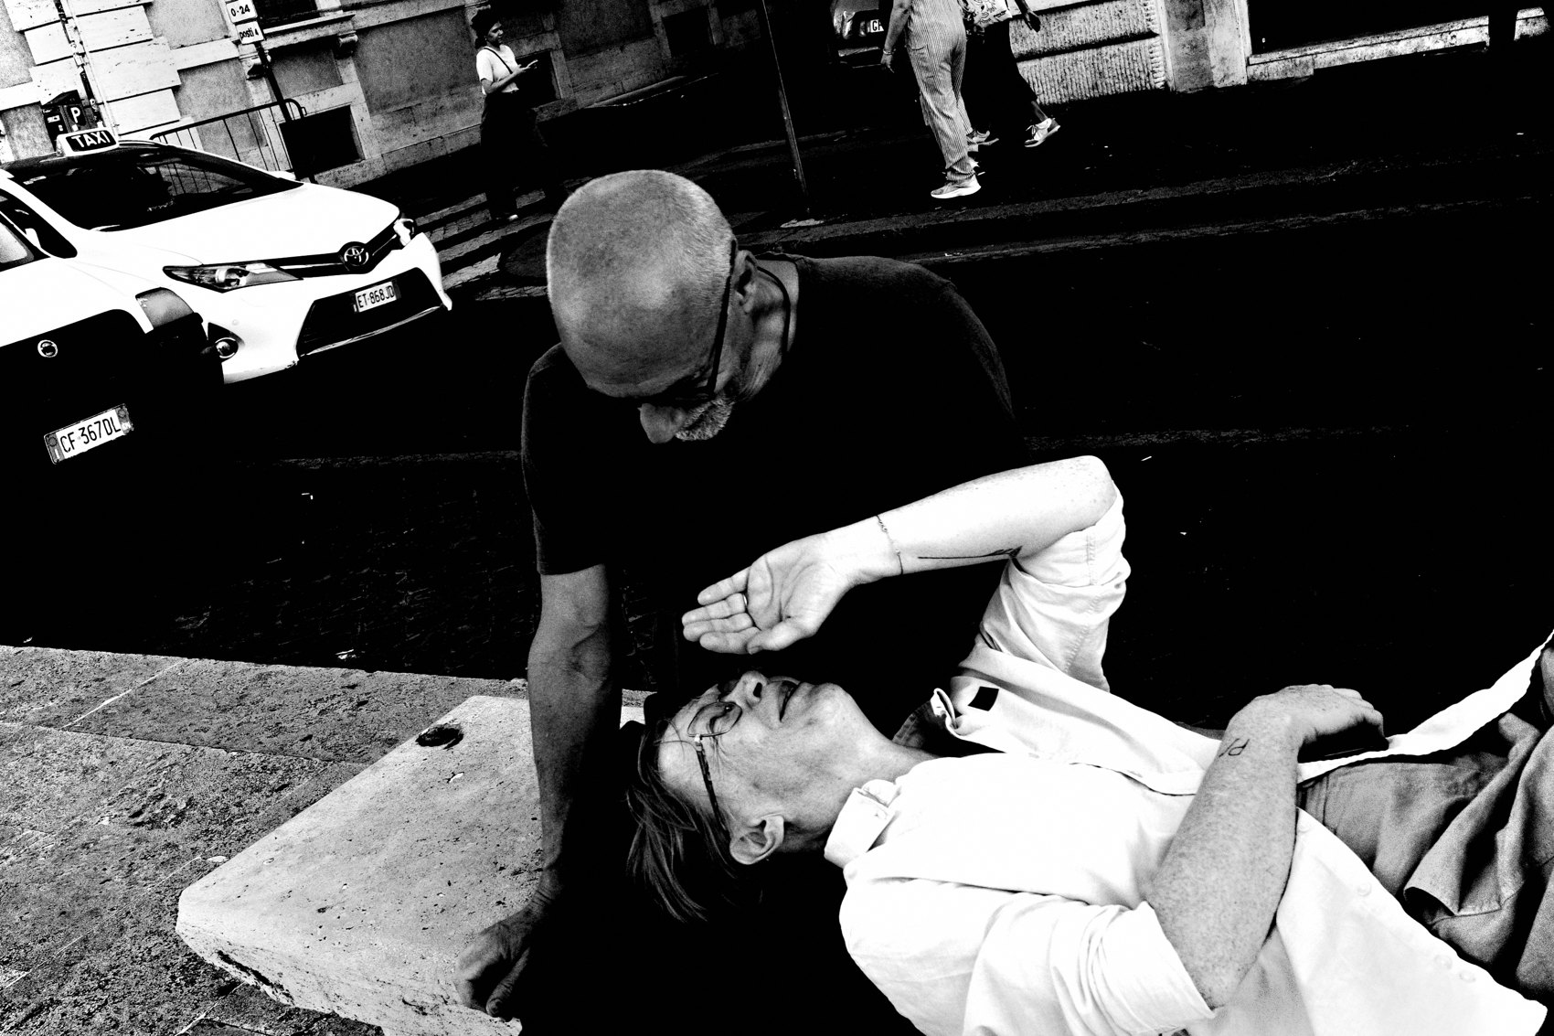
FLUX ACADEMY
BEAT 19 · PRACTICAL APPLICATION
The Eight-Hour Immersion Drill
— Pick one place; stay for hours, not minutes
— Work scenes; don't leave till the scene leaves you
— Let the day's repetition build the strongest frame
Notes:
Now a drill to feel it: pick one location and stay for hours, not minutes. Don't drift after one frame — work each scene until it leaves you. Watch the light change, let gestures align, keep responding. The strongest image often comes late, after the immersion has done its work. Flow is a muscle; this is how you train it.

Slide 21
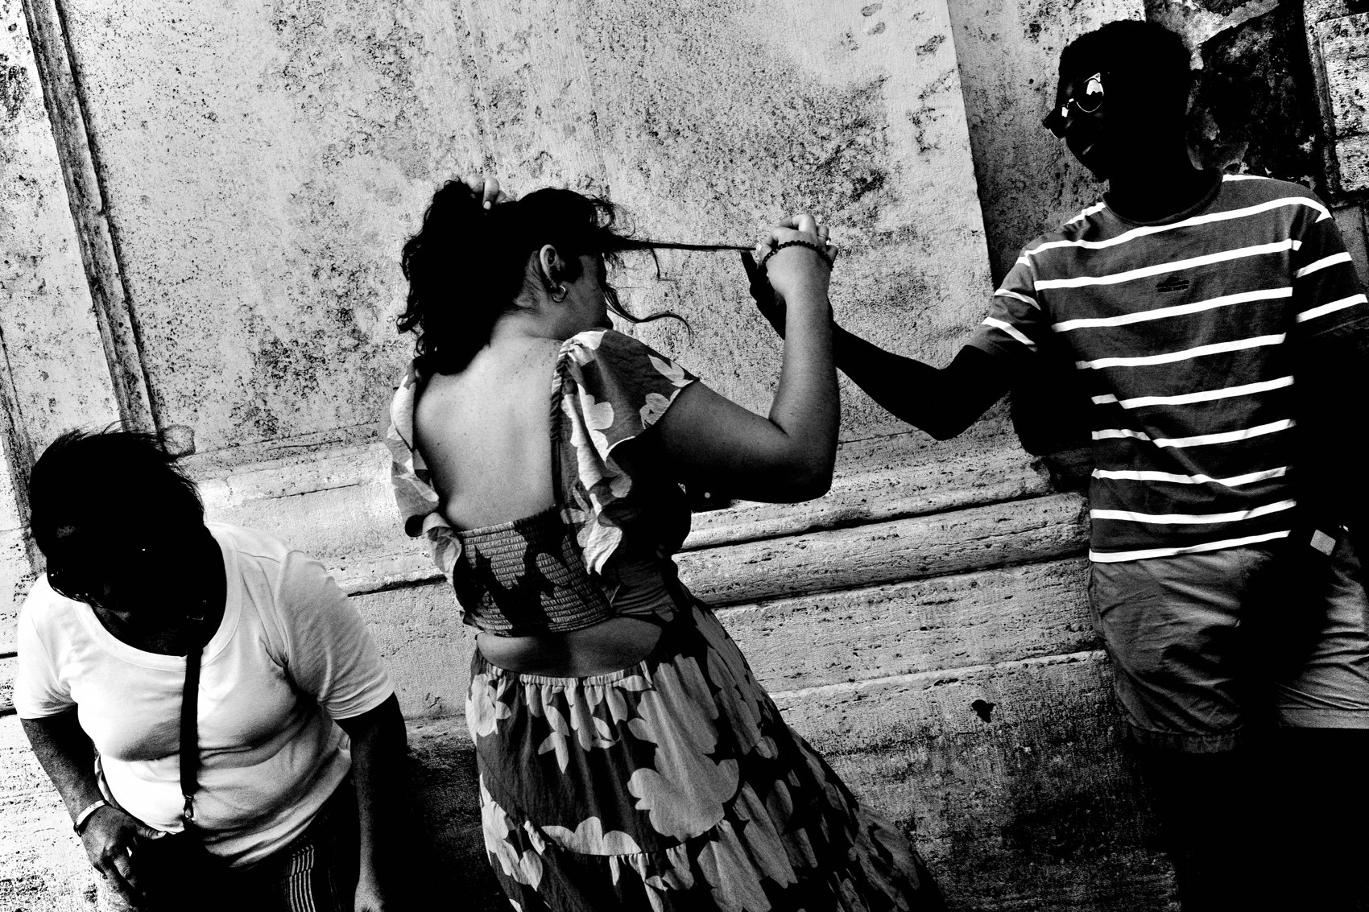
FLUX ACADEMY
BEAT 20 · COMMON MISTAKES
Hunting, Forcing, Judging
— Chasing the "decisive moment" breaks flow
— Forcing control kills the magic
— In-the-moment judging chokes your seeing
Notes:
The mistakes that kill flow are all the same mistake: trying to control. Hunting for a specific "decisive moment," forcing a great frame, judging good versus bad while you shoot — each one pulls you out of the present and back into your head. Remember: the more you think, the less you see. Stop hunting. Let life deliver the moments to you.

Slide 22
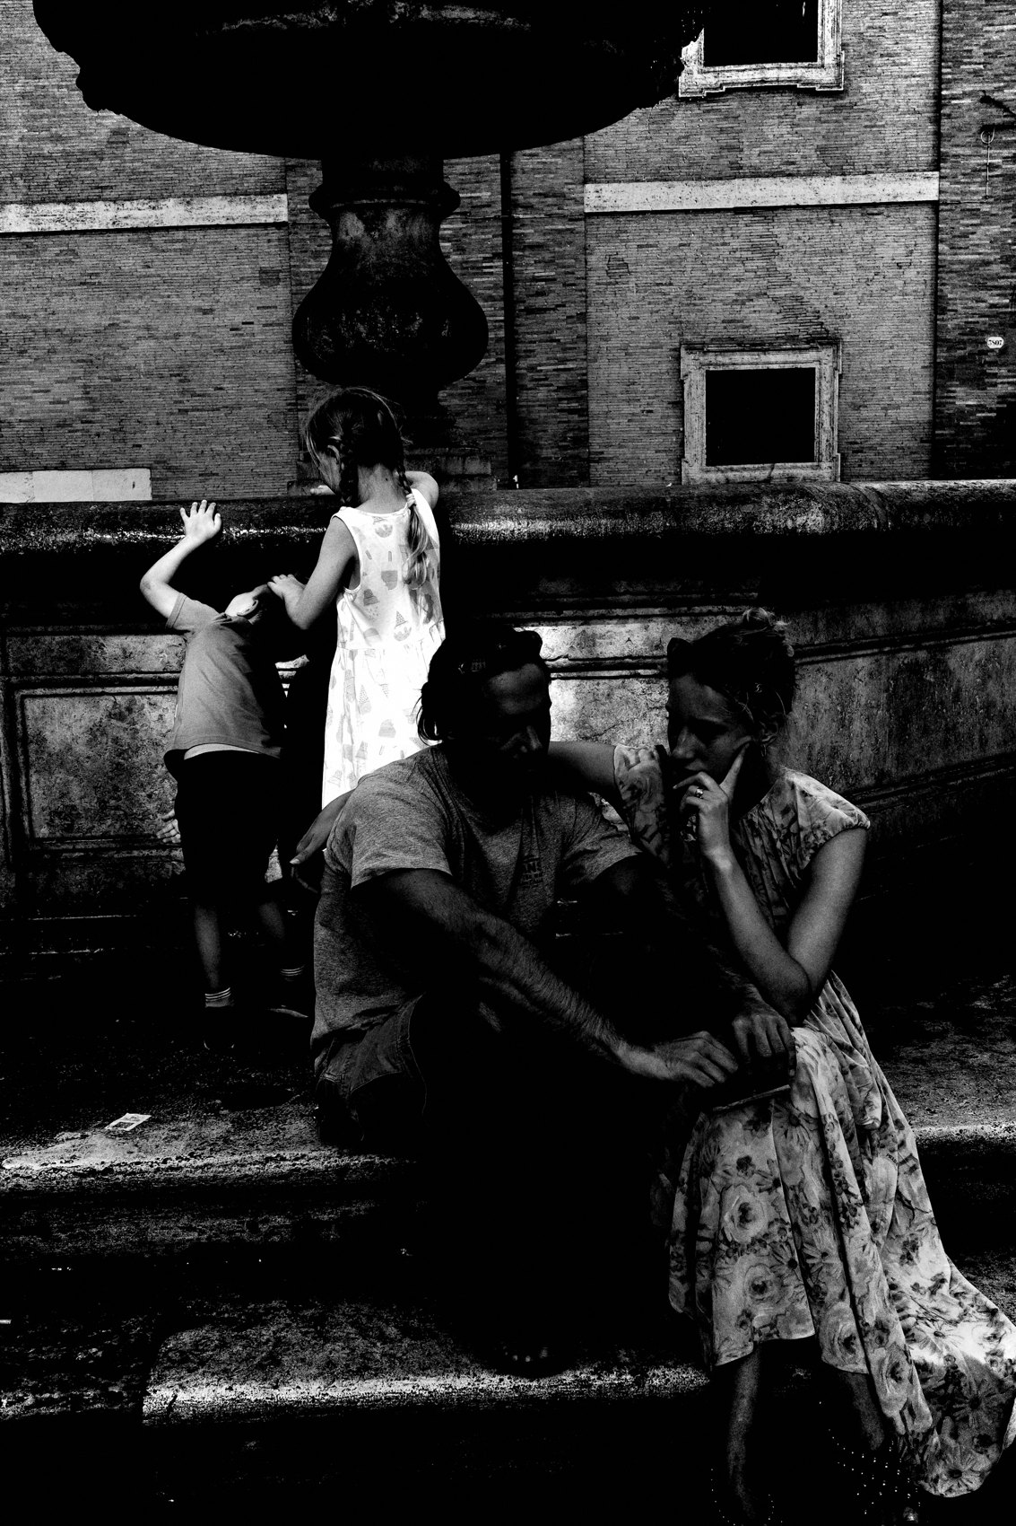
FLUX ACADEMY
BEAT 21 · RELATIONSHIP TO PREVIOUS
From Constraints to Flow
— Lesson 005 showed constraints create freedom
— One camera, one lens removes friction
— That simplicity is what lets flow happen
Notes:
This builds directly on Lesson 005, Constraints = Creative Freedom. The reason I can drop into flow is that I've already stripped everything down — one camera, one lens, auto settings, no project, no checklist. Those constraints aren't limits on flow; they're the runway for it. Subtract the friction first, and the present moment opens up.

Slide 23
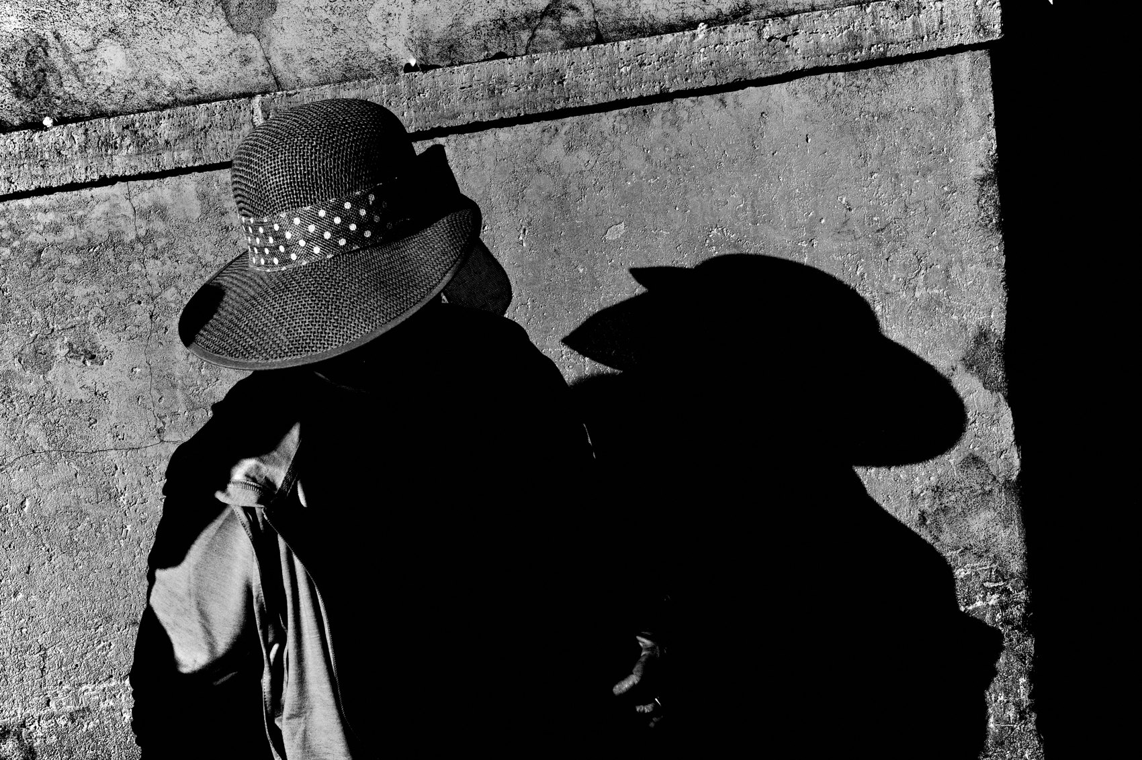
FLUX ACADEMY
BEAT 22 · RELATIONSHIP TO UPCOMING
Toward Instinct
— Next: Lesson 007, Instinct Over Intellect
— Flow hands the controls to your intuition
— Instinct is the trifecta's sharpest edge
Notes:
Flow naturally hands the controls over to your instincts — which is exactly where we go next. In Lesson 007, Instinct Over Intellect, we sharpen that third leg of the trifecta. Every frame we just talked about — the mist, the gesture, the late-day light — came the same way: I didn't think, I responded. That instinct is what the next lesson is all about.

Slide 24
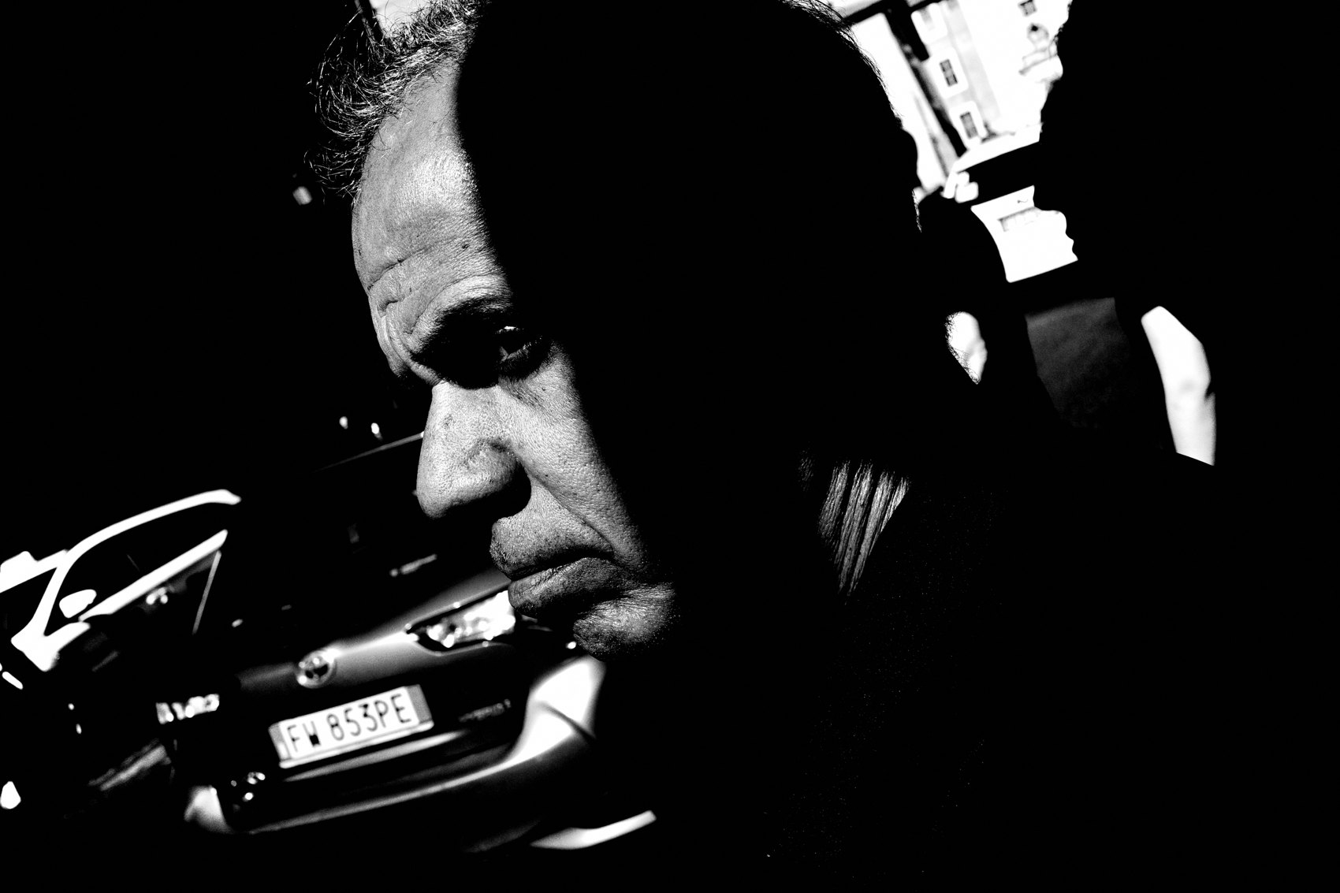
FLUX ACADEMY
BEAT 23 · SUMMARY / TAKEAWAY
Slow Down, Let Go, Flow
— Subtract distractions; move slow; play
— Detach from the outcome; trust intuition
— Slow down. Enter the flow. Make more photos.
Notes:
Last thing. Flow is where your best work is made — and you get there by subtracting, not adding. Put the phone away, walk slow, stay in play, and let go of the outcome so intuition can take over. Treat each photo like it could be your last and you'll photograph freely. Slow down. Enter the flow. Embrace play. Make more photos. Catch you next lesson — peace.

