Slide 1
FLUX ACADEMY · A SCHOOL FOR SEEING
MODULE 1 · FOUNDATIONS
Curiosity & Joy: The Engine
BY DANTE SISOFO

Slide 2
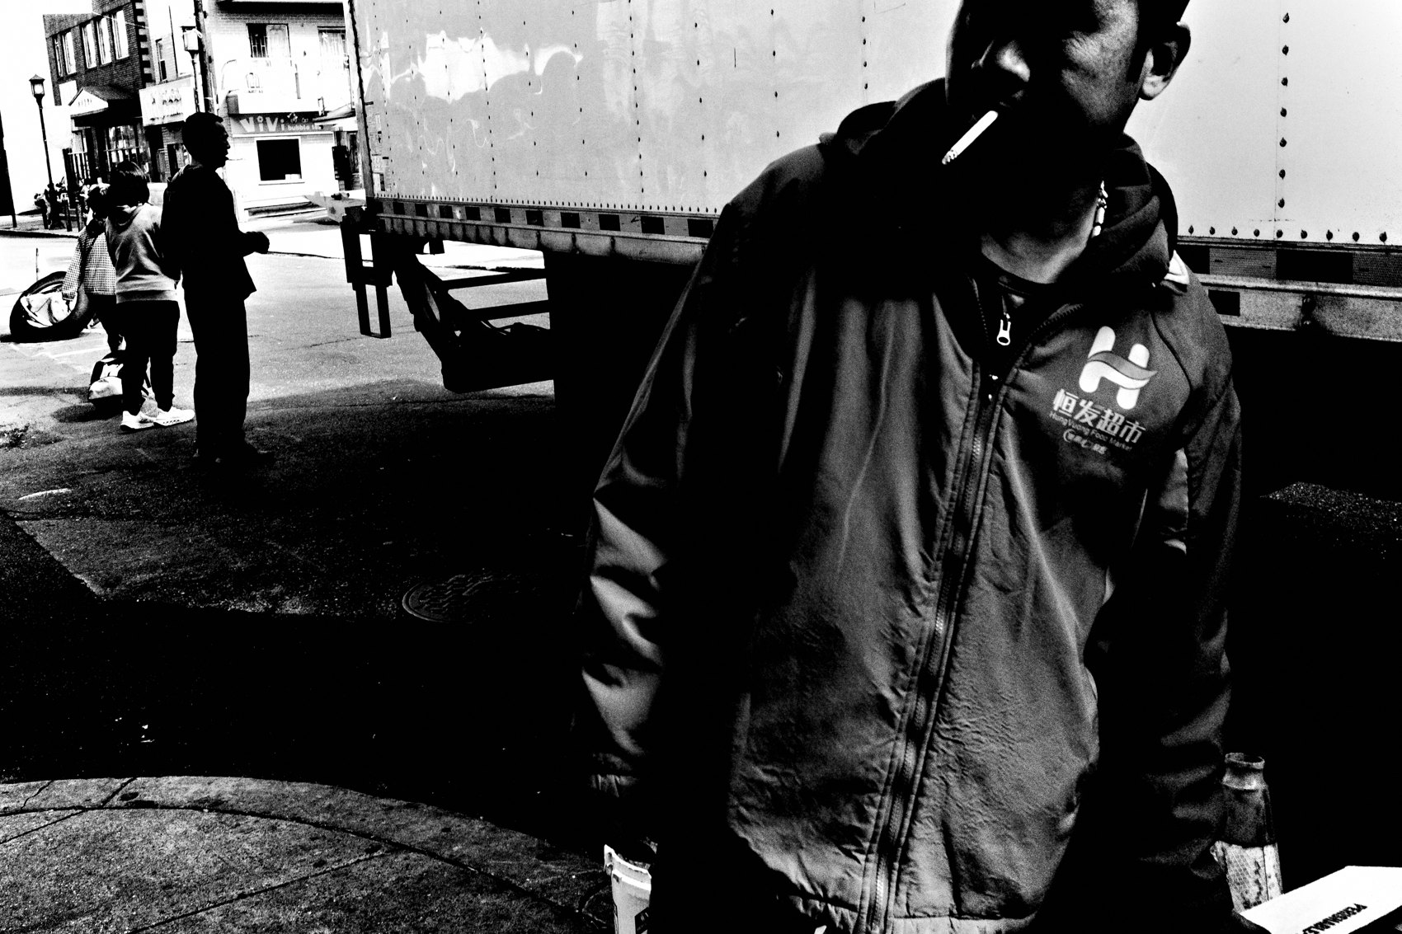
FLUX ACADEMY
BEAT 01 · CORE IDEA
Curiosity Is the Engine
— Curiosity is the key ingredient
— Joy is the fuel it runs on
— Everything else is downstream
Notes:
What's popping, people — it's Dante. Today we get to the thing underneath all of it: curiosity. I believe it's the single key ingredient in street photography. Curiosity is the engine, joy is the fuel it runs on, and every technique we'll ever learn is downstream of these two. Get this right and the work runs forever.

Slide 3

FLUX ACADEMY
BEAT 02 · LEARNING OBJECTIVE
What You'll Walk Away With
— How to run on curiosity, not results
— How to make play your method
— A practice that never runs dry
Notes:
By the end of this lesson you'll know how to power your photography from curiosity and joy instead of results and approval. You'll treat play as a method, not a mood. This is the difference between a practice you keep for life and one that quietly burns you out.

Slide 4
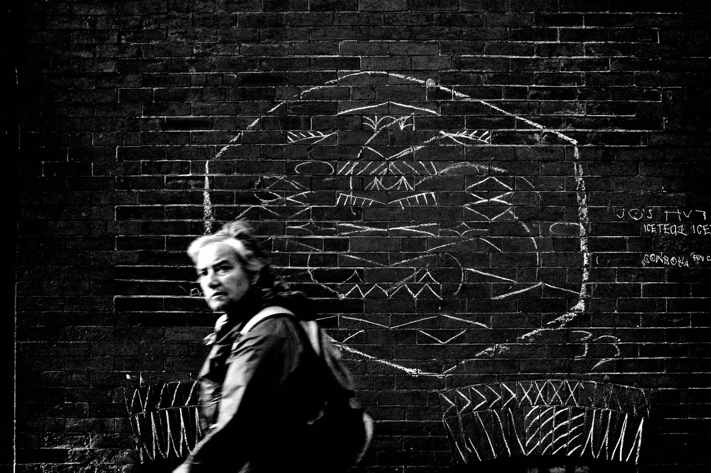
FLUX ACADEMY
BEAT 03 · WHY THIS MATTERS
Boredom Is a Perspective Problem
— Boredom is a perspective problem
— The world didn't get boring — you stopped looking
— Curiosity is the only cure
Notes:
Here's why this matters. Photographers tell me, "There's nothing interesting to shoot." I fall into it too — I'll look at my hometown with dull eyes. But boredom is a perspective problem. The world didn't become boring; you stopped being curious. The cure isn't a new city. It's a blank slate.

Slide 5
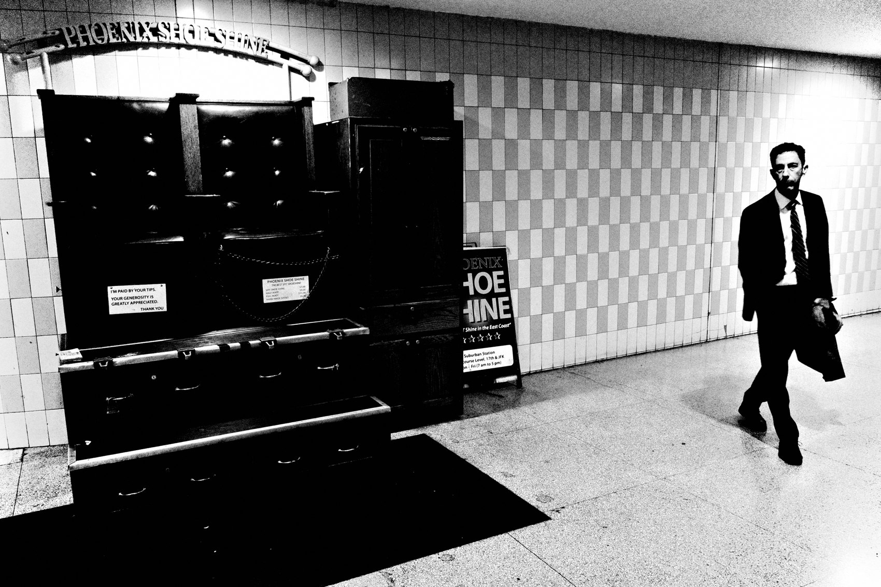
FLUX ACADEMY
BEAT 04 · WHY THIS MATTERS
Joy Is the Outcome
— Detach from results, joy flows in
— Joy makes photography inevitable
— The flow state becomes effortless
Notes:
And here's the payoff. When you detach from impact, audience, results — a deep joy starts flowing through you just from being out there. That joy fills you with energy. It makes photography inevitable, and the flow state becomes effortless. Joy isn't the reward at the end; joy is the outcome of the practice itself.

Slide 6
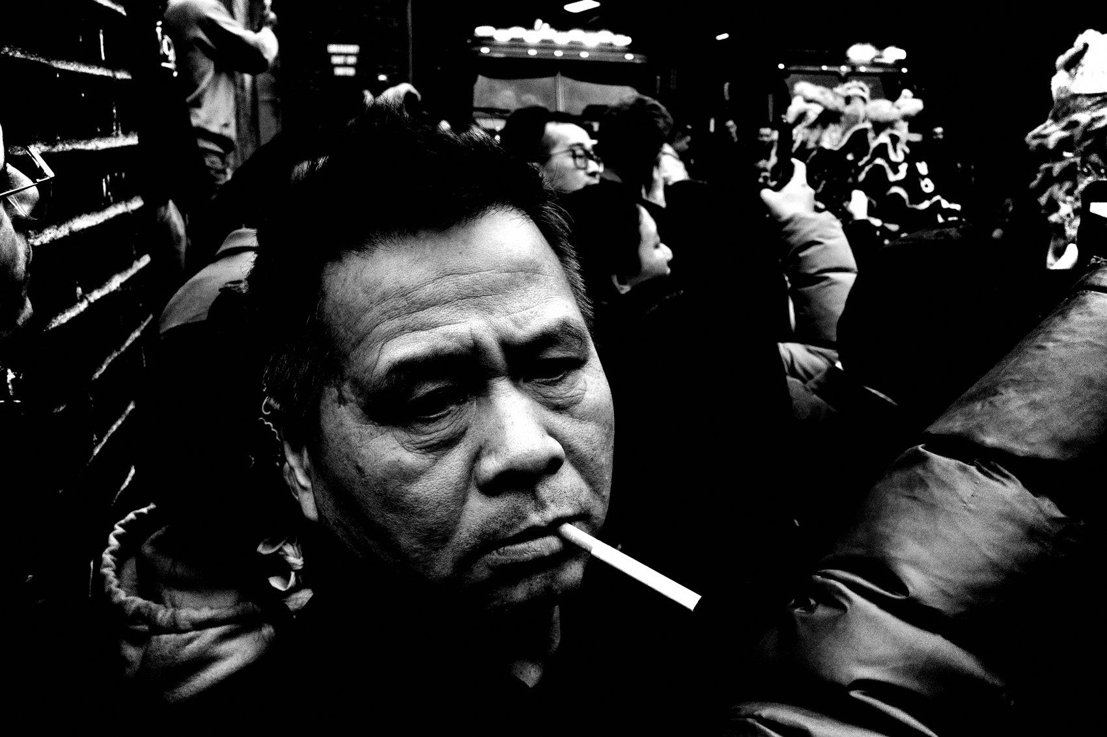
FLUX ACADEMY
BEAT 05 · MAIN TEACHING
Create Something From Nothing
— The goal is to create something from nothing
— The streets are your canvas
— Not the "best" photo — a genuine one
Notes:
So let's state the goal plainly. It isn't to make the "best" photograph or impress anyone. It's to create something from nothing, using the streets as your canvas. That frees you from everyone's expectations and opens the door to genuine, spontaneous art. You're not collecting trophies — you're conjuring something out of an ordinary moment.

Slide 7
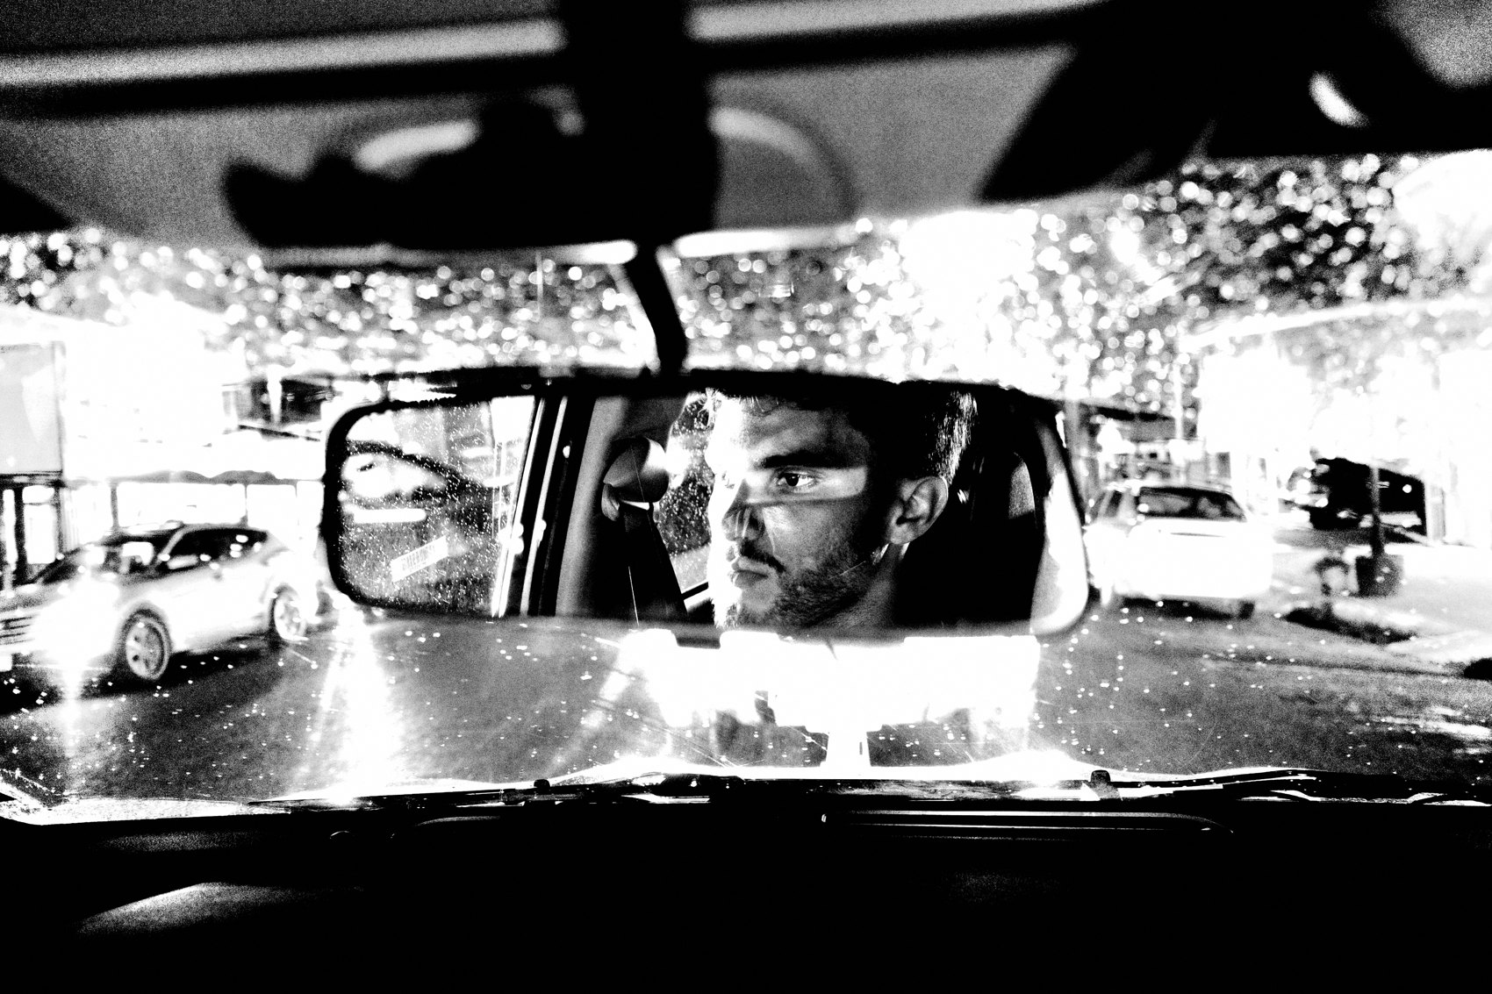
FLUX ACADEMY
BEAT 06 · MAIN TEACHING
Return to the Childlike Mind
— Return to the childlike mind
— Pick up leaves, touch concrete, look up
— The child is still within you
Notes:
To never be bored, you have to return to the childlike mind. Think of a kid picking up leaves, touching concrete, looking up at buildings — that child is still in all of us. Your job is to return to that state so you can look at the world with infinite possibility. That's where the photographs live.

Slide 8
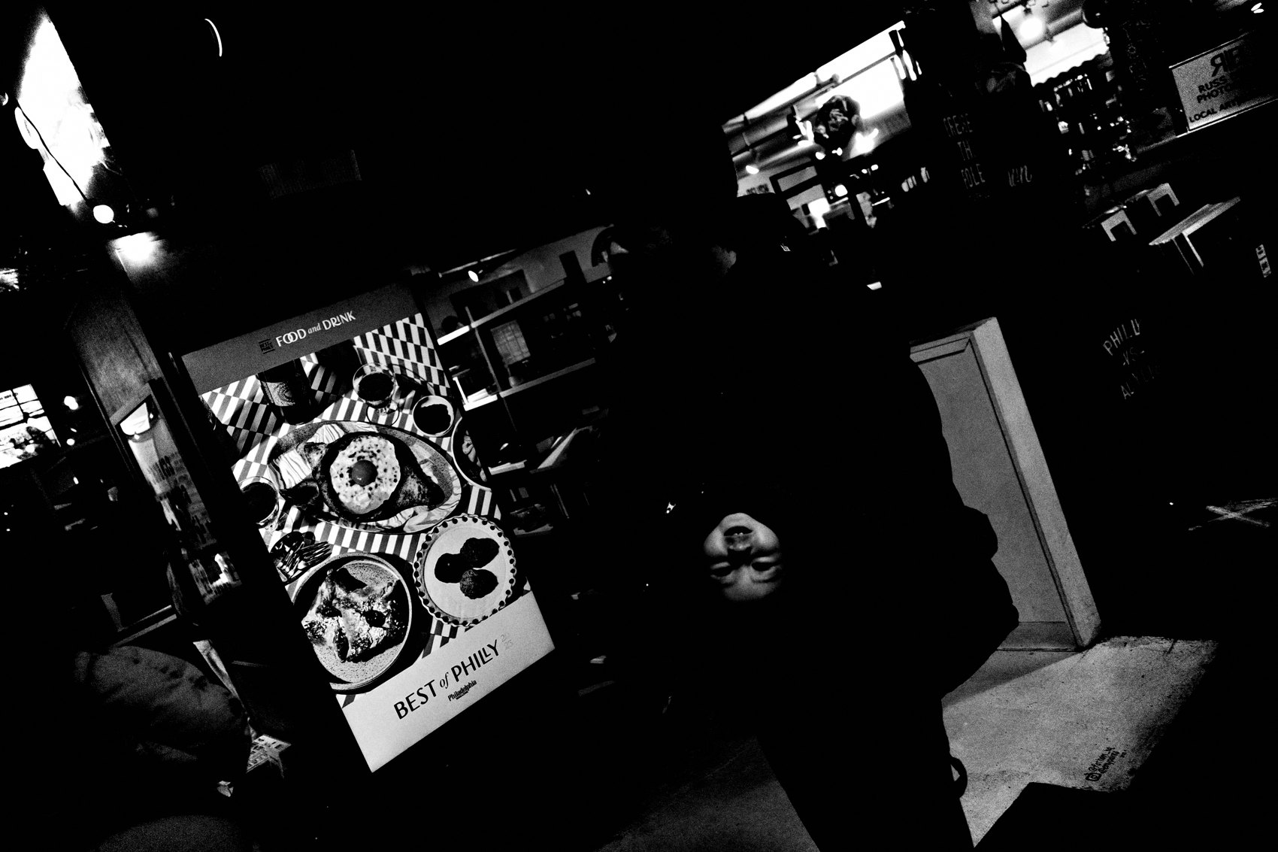
FLUX ACADEMY
BEAT 07 · MAIN TEACHING
Be Open Like a Child
— Be open like a child, with wide-eyed wonder
— No preconceived notions
— Wonder is the whole practice
Notes:
The instruction is simple: be open like a child, with wide-eyed wonder for the world around you. No assumptions. No preconceived notions of what you'll find. When you walk in with that openness, life surprises you with its gifts. Lose the wonder and you lose the work — it's that direct.

Slide 9
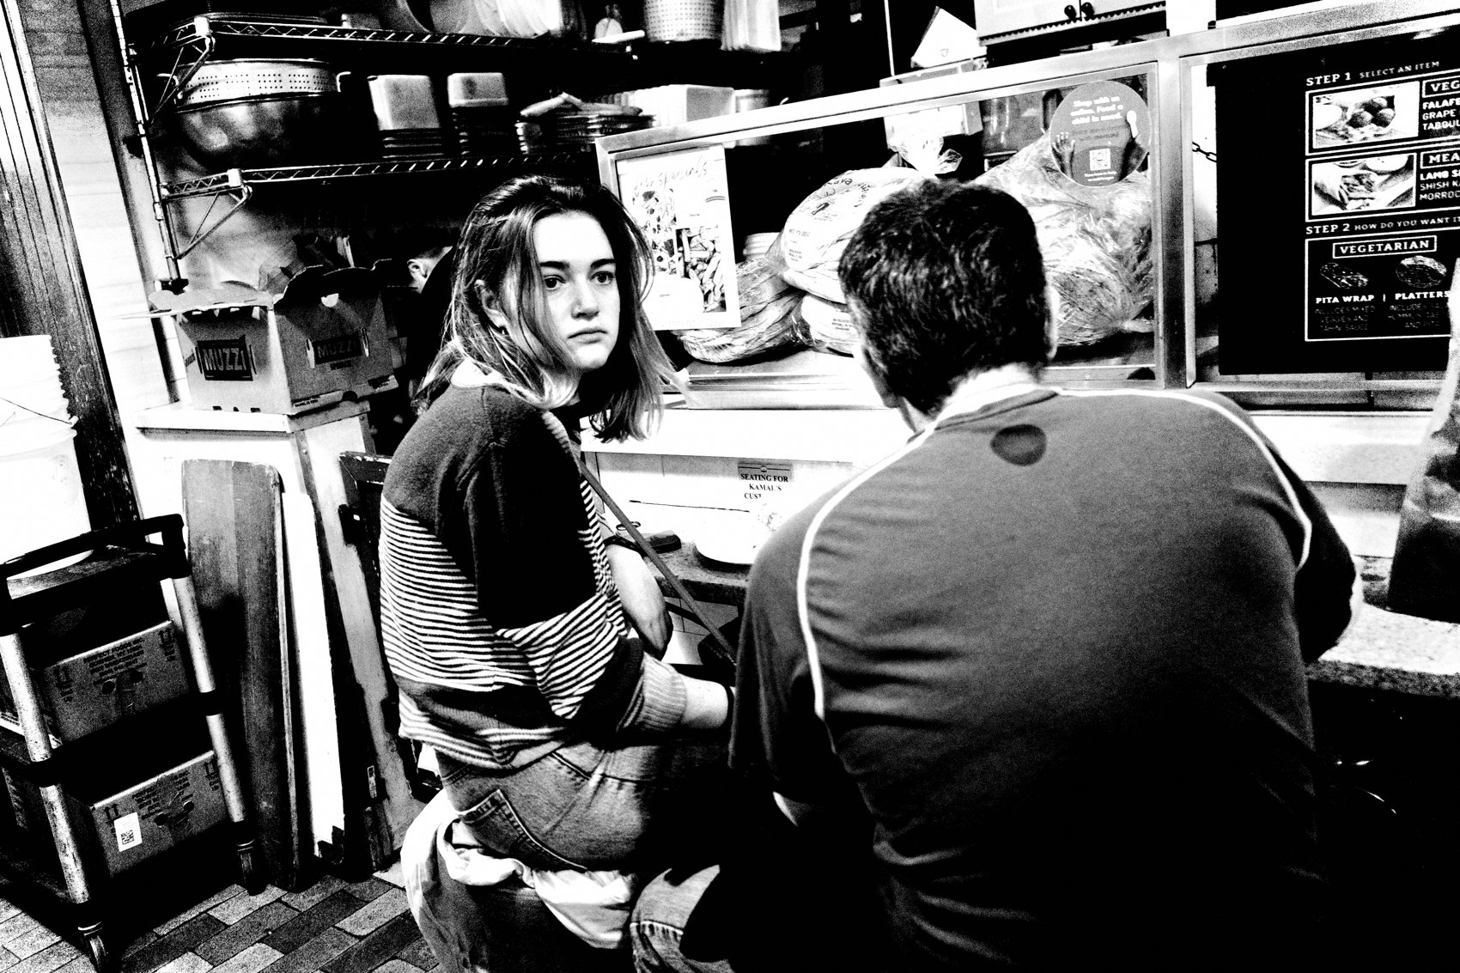
FLUX ACADEMY
BEAT 08 · MAIN TEACHING
Let Go of Preconceptions
— Don't lock into themes or tropes
— Anything and everything can be a photograph
— Drop the checklist
Notes:
Next principle: let go of preconceptions. Don't get confined by certain photographic tropes, specific places, or "the right" subjects. You shouldn't need a special location — anything and everything can be a photograph. The moment you box street photography into a narrow definition, you starve it. It's an attitude, not a checklist.

Slide 10
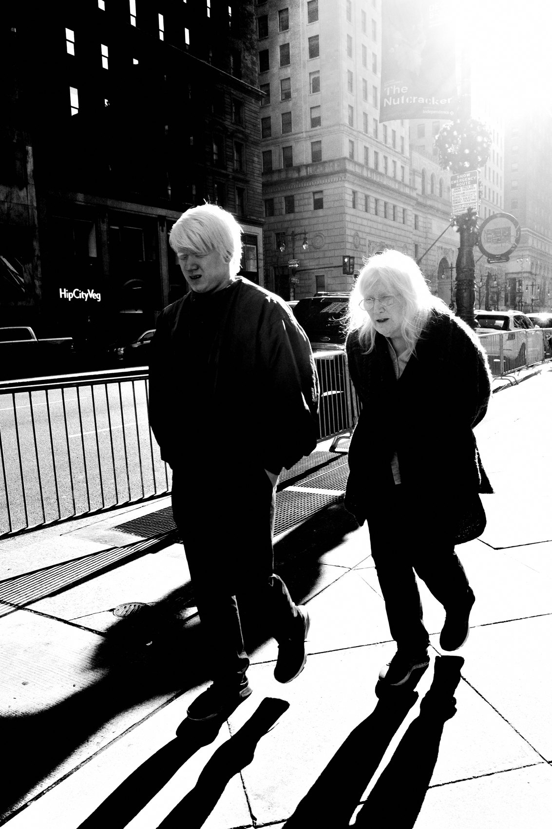
FLUX ACADEMY
BEAT 09 · MAIN TEACHING
Stay an Amateur Forever
— Return to the amateur state daily
— Never feel you've "mastered" it
— Infinite room to grow
Notes:
A goal I chase every single day: return to the amateur state. Back to the person I was walking through the woods with my first camera. I never want to feel I've mastered photography, seen it all, done it all. There's infinite potential to grow and transform — just like a child growing through life. Stay a beginner and you stay curious.

Slide 11
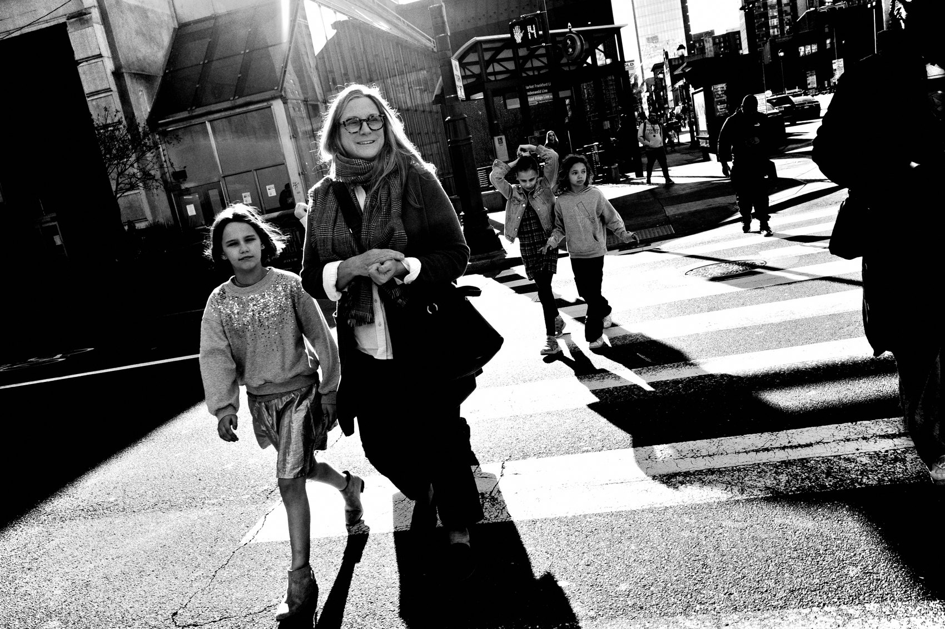
FLUX ACADEMY
BEAT 10 · MAIN TEACHING
Don't Seek — Allow
— Enter the Zen Zone
— Don't seek; allow life to flow toward you
— Camera always ready
Notes:
Now slow down and enter what I call the Zen Zone. You're not actively hunting subjects or stories — you're allowing life to unfold naturally. Don't seek; just let life flow toward you, and be ready to capture it. Camera always at hand. You make sense of the chaos by relaxing into it, not by chasing it down.

Slide 12
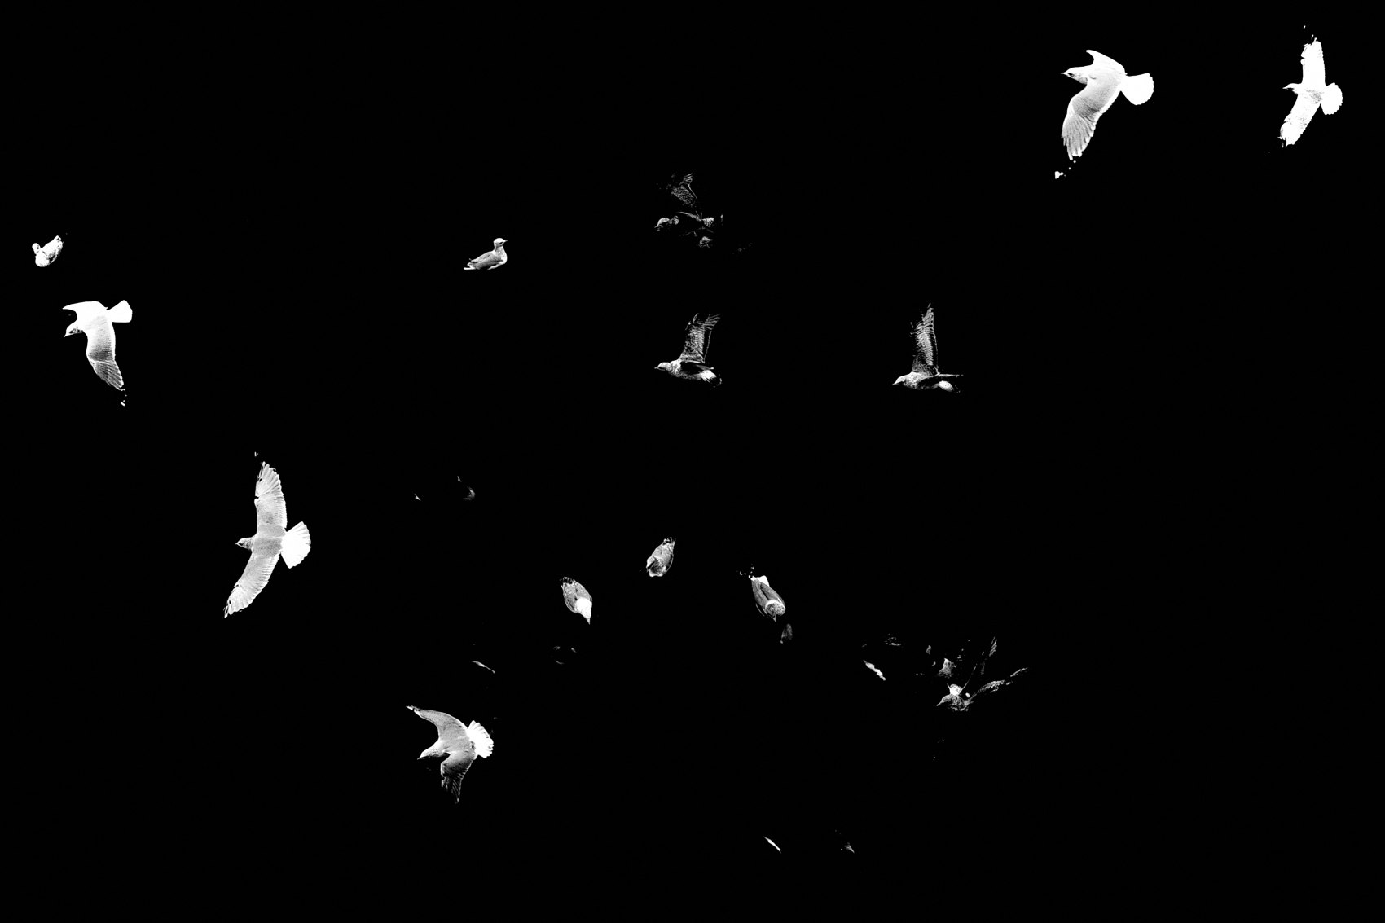
FLUX ACADEMY
BEAT 11 · MAIN TEACHING
Photography Is a State of Play
— Photography is a state of play
— Curiosity over gear, play over knowledge
— Seriousness kills curiosity
Notes:
Here's the heart of it: photography is a state of play. It's not elitist, it's not a costume, it's not technical perfection. Curiosity matters more than gear; play matters more than knowledge. And remember this one — seriousness kills curiosity. The world is serious enough already. Your photography should be fun.

Slide 13
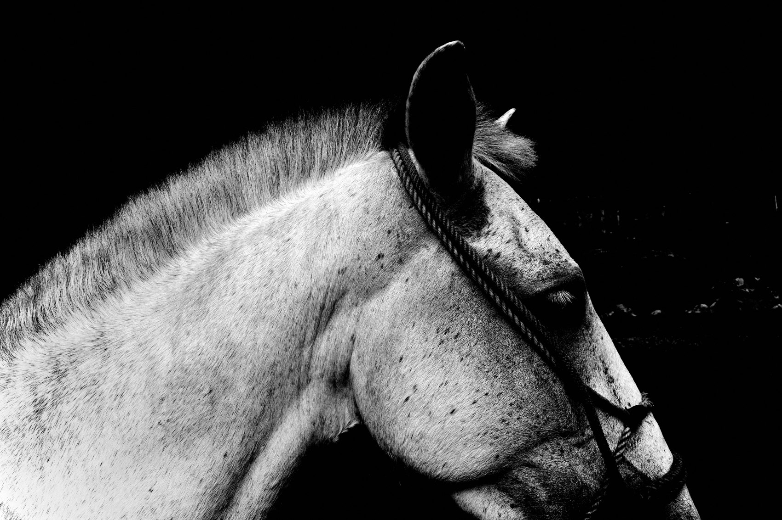
FLUX ACADEMY
BEAT 12 · MAIN TEACHING
Don't Take Yourself So Seriously
— You can play, experiment, fail, get back up
— Photography is really not that serious
— Don't put on the photography costume
Notes:
So don't take yourself so seriously — and don't take photography so seriously either. Go out and play. Experiment. Fail. Get back up. Make more photographs. Photography is really not that serious. The second you drop the heavy "serious artist" costume, you return to flow, you make more frames, and you stay alive to the world.

Slide 14
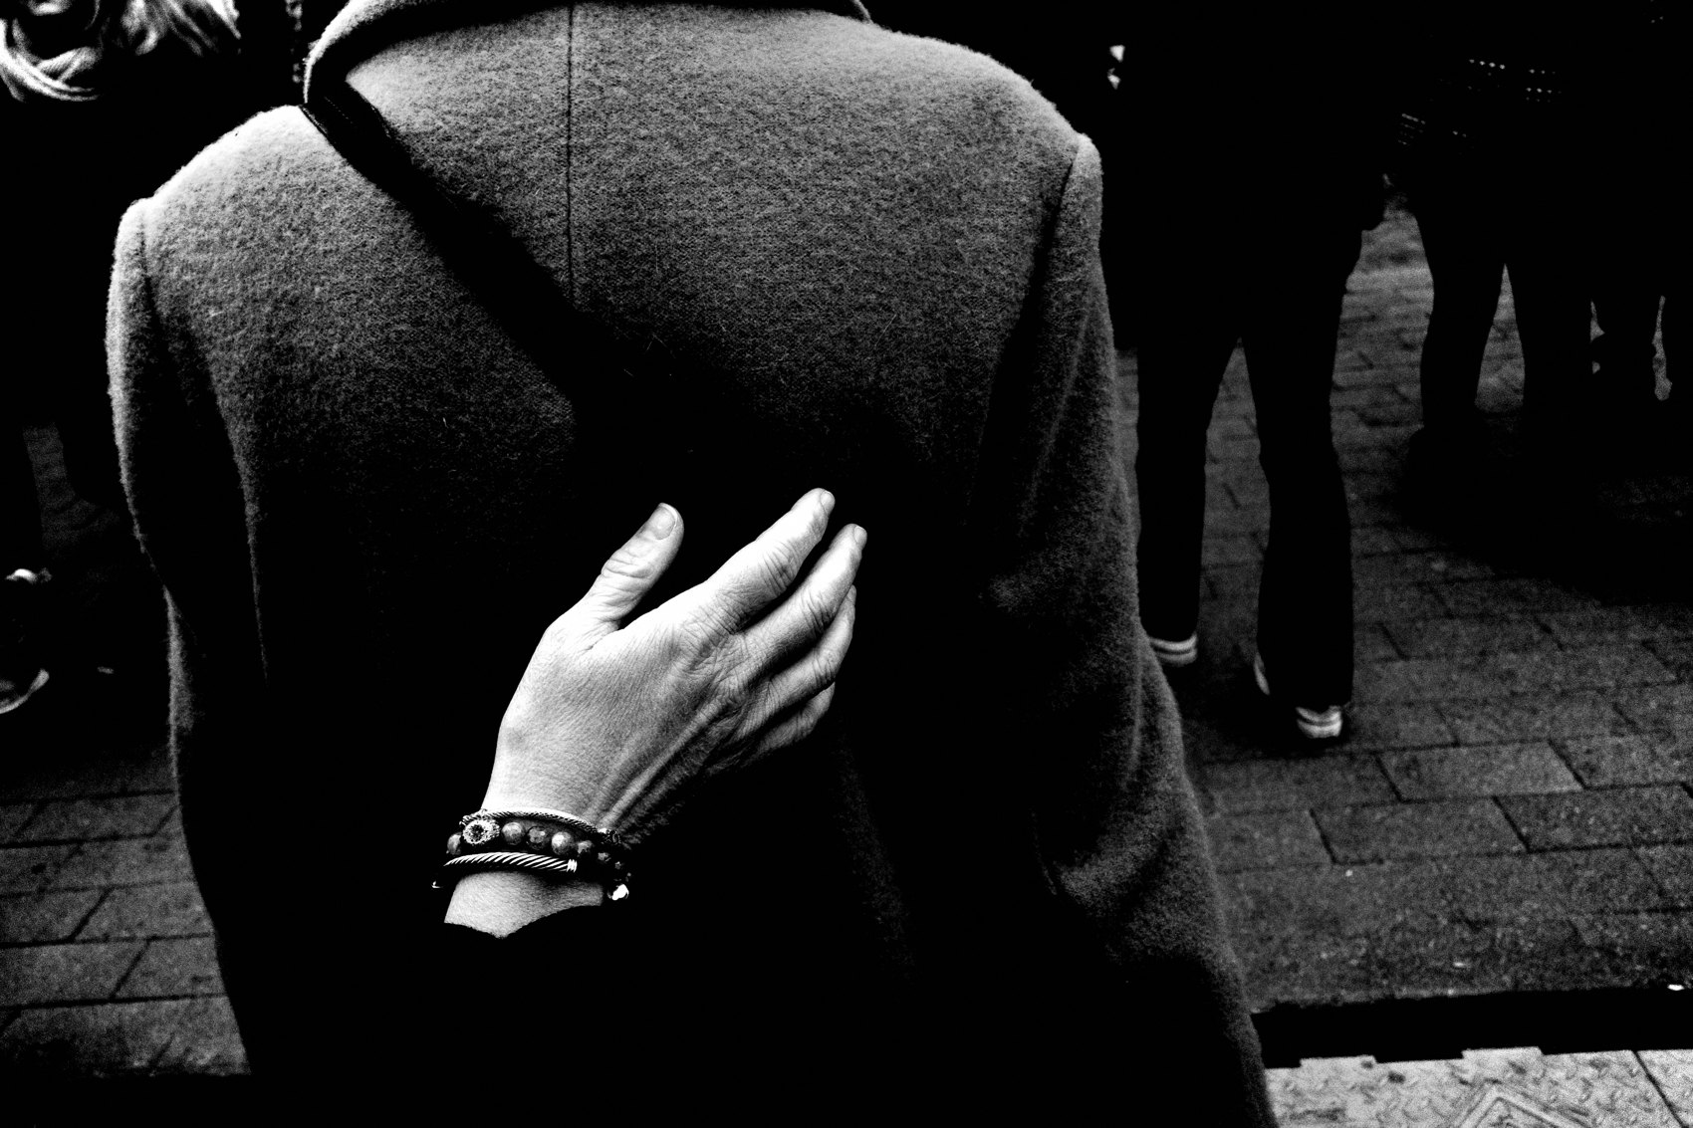
FLUX ACADEMY
BEAT 13 · MAIN TEACHING
Follow Your Joy
— Follow your joy, follow your inner childlike curiosity
— I'm joyful on the streets, not hunting
— That spirit reflects in the frames
Notes:
I'm not out there as a grim documentary photographer hunting the next shot. I love life. I love humanity. I'm joyful when I'm on the streets. So follow your joy, follow your inner childlike curiosity, and that spirit of play will reflect right back in your photographs. How you feel about life is exactly what shows up in the frame.

Slide 15

FLUX ACADEMY
BEAT 14 · MAIN TEACHING
Playfulness Disarms a Heavy Scene
— Even a tense place softens when you stay open
— Approach playfully and people play back
— No expectations, and it unfolds naturally
Notes:
Here's something to trust: even when the setting feels heavy — a tense street, wary faces, a place that puts you on edge — your own openness changes it. Walk in like a big kid with a camera, curious instead of guarded, and people feel it. Approach a group of working strangers playfully and, more often than not, they start playing back. You didn't force a thing. You stayed open, and it unfolded on its own.

Slide 16
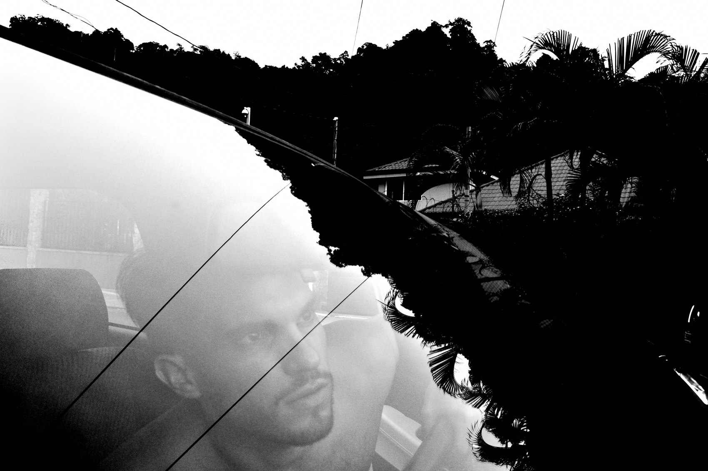
FLUX ACADEMY
BEAT 15 · MAIN TEACHING
Play Opens People Up
— A playful hello leads somewhere you didn't plan
— Hand the camera around — let people shoot you back
— Playfulness opens people up
Notes:
Carry this everywhere. A playful hello to someone working at their craft can lead you straight into a moment you'd never have set up. Come across a group of kids and hand the exchange back — let them take a few photos of you in return. When you embrace play, you're not just snapping pictures; you're engaging with people. Smile, use your body language, be open — and you'll be surprised how people respond.

Slide 17
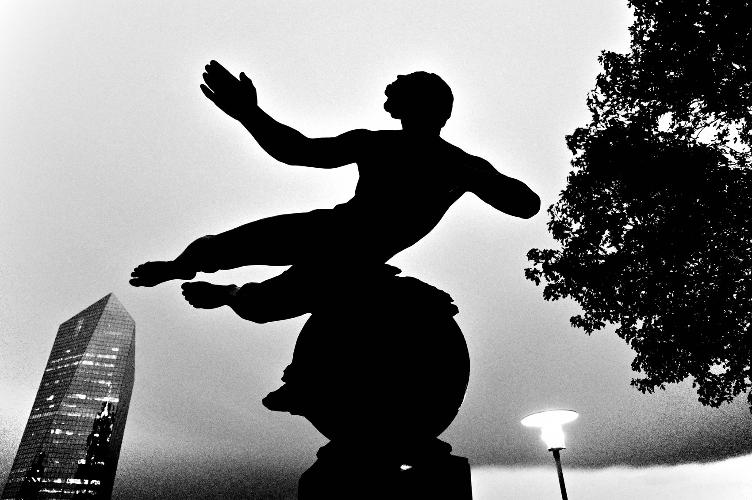
FLUX ACADEMY
BEAT 16 · MAIN TEACHING
Curiosity Goes Out First, Meaning Catches Up
— You're not thinking "meaning" in the moment — just curious
— Later you learn what you were actually looking at
— The camera teaches you, long after the shutter
Notes:
Here's a quiet gift of the practice. Often you'll shoot something purely because it pulls at your curiosity, with no idea what it means. Then, months or years later, you learn the story behind it — a custom, a symbol, a piece of history you had no clue you'd caught. That's the gift: photography teaches you things long after you've pressed the shutter. Curiosity goes out first; meaning catches up.

Slide 18
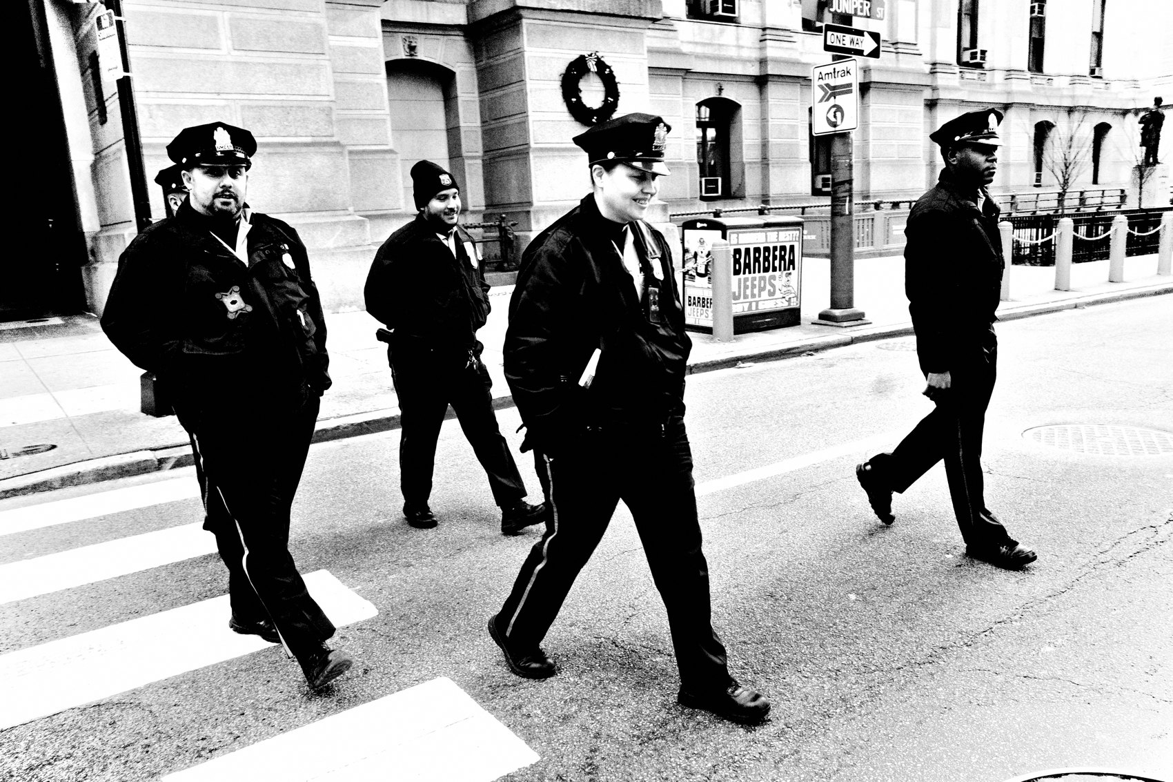
FLUX ACADEMY
BEAT 17 · MAIN TEACHING
Curiosity Over Results
— Orient everything toward curiosity
— Remove validation — you fall in love with life
— The more curious you get, the better the work
Notes:
So orient everything in your life toward curiosity — for curiosity's sake alone. Photograph because you love to photograph. Remove the validation, the gallery, the approval, and something strange happens: you start falling in love with life. And here's the kicker — the more curious you become about life, the more your photography improves on its own.

Slide 19
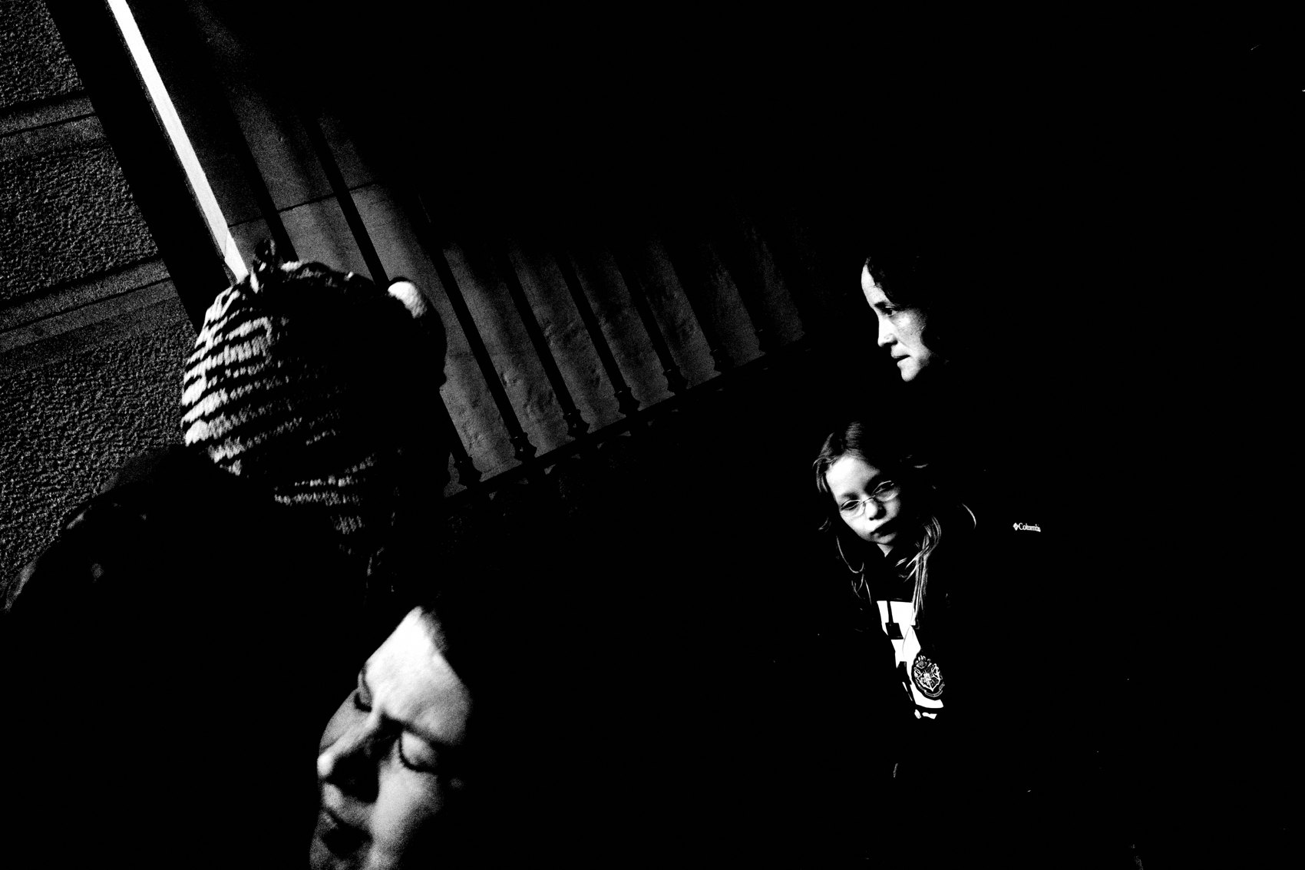
FLUX ACADEMY
BEAT 18 · PRACTICAL APPLICATION
Walk With a Blank Slate
— Go out with no assumptions, no theme
— Walk first, think later
— Respond to your gut, not a plan
Notes:
Your first drill: go out with a blank slate. No assumptions, no preconceived notions of what you'll shoot, no expectations of what you'll find. Walk first, think later. Don't rationalize every frame — respond to your gut, let your body guide you, move through the world and see what you find. The blank slate is the cure for boredom.

Slide 20
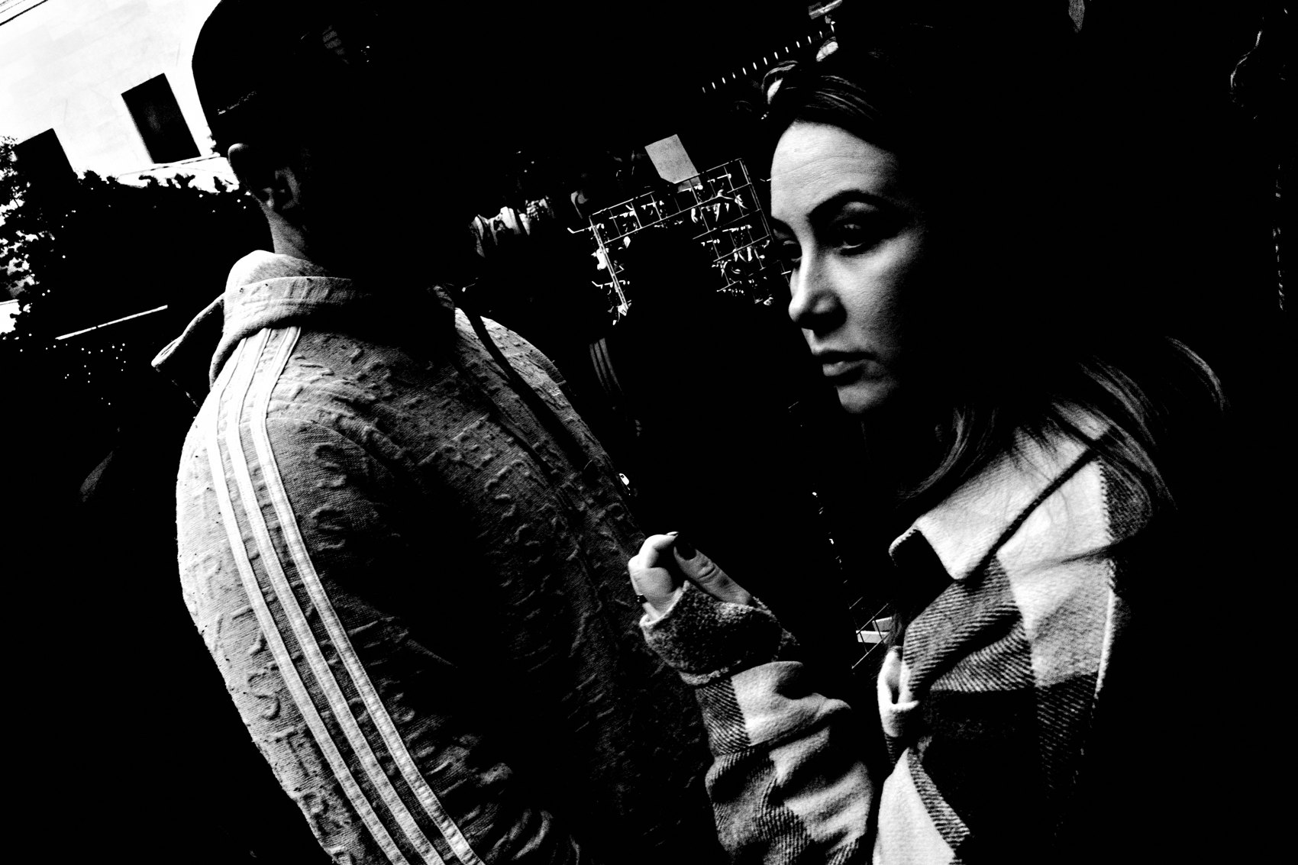
FLUX ACADEMY
BEAT 19 · PRACTICAL APPLICATION
Stay Ready, Play Openly
— Always have the camera, kept simple
— Forget themes — respond to life
— Smile, open your body language, engage
Notes:
Second drill, three parts. One: always have your camera — keep the gear simple and accessible. Two: forget themes — don't lock into specific ideas. Three: respond to life — let the world surprise you; your only job is to capture it. And when you meet people, play openly: smile, use body language, be open. Watch how the streets start handing you gifts.

Slide 21
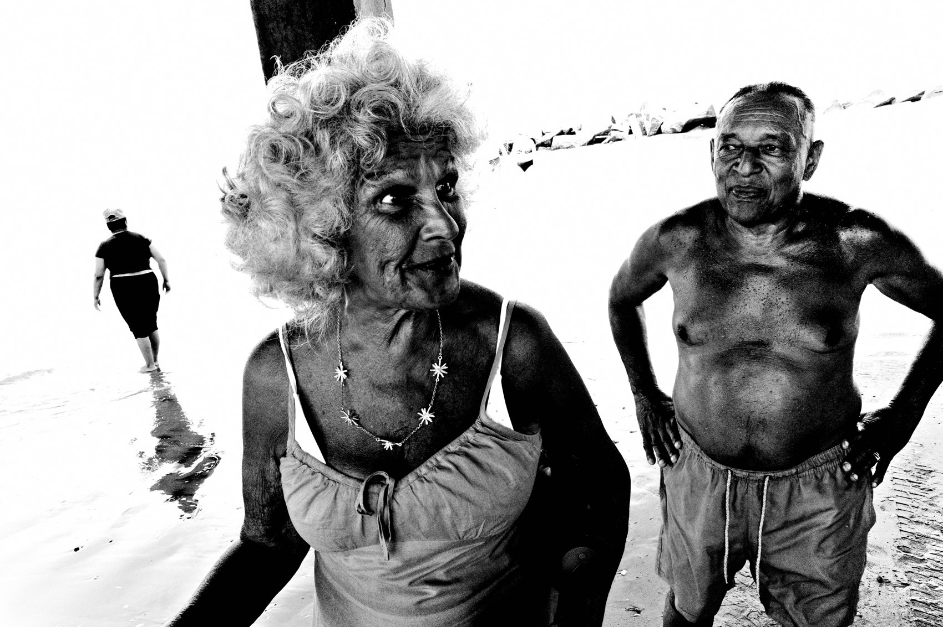
FLUX ACADEMY
BEAT 20 · COMMON MISTAKES
Chasing Results & Seriousness
— Don't shoot for validation or a "great frame"
— Seriousness kills curiosity
— Attachment to outcome distracts from practice
Notes:
The biggest mistake: chasing results. Being attached to making a great frame, finding something interesting, success, fame — it all distracts from the simple act of going out daily with curiosity. And turning it into a grim, serious pursuit? That's the silent killer, because seriousness kills curiosity. Take it seriously by keeping it joyful.

Slide 22
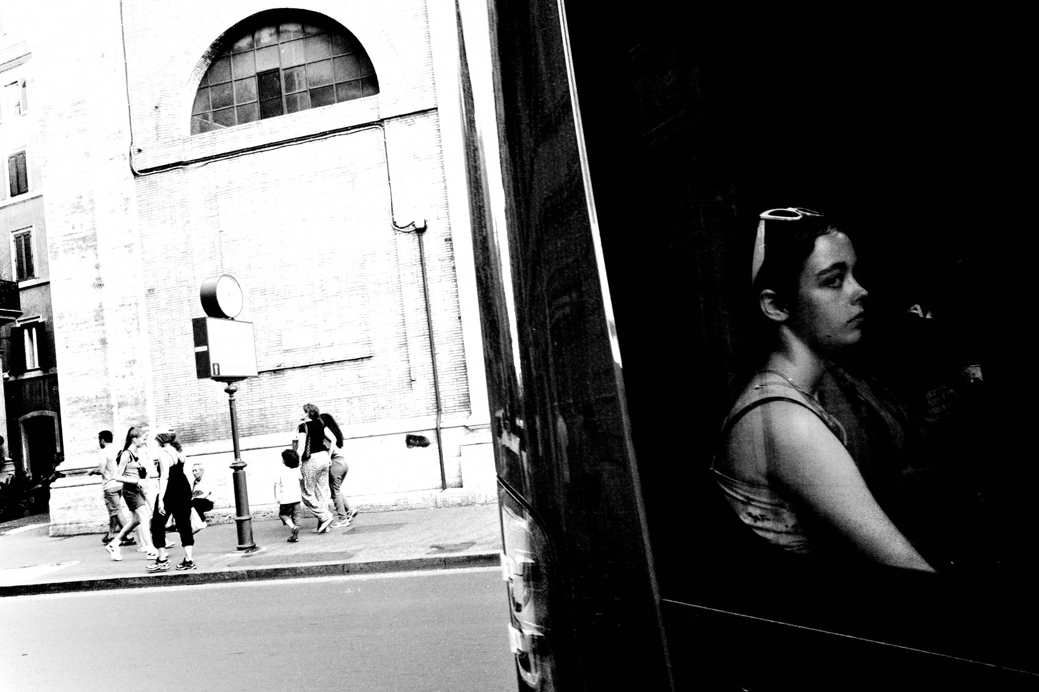
FLUX ACADEMY
BEAT 21 · RELATIONSHIP TO PREVIOUS
Now You Have a Reason
— Lesson 003 said: shoot everything, no limits
— Curiosity & joy are why you can
— The engine behind the permission
Notes:
In Lesson 003, Shoot Everything, No Limits, we tore down the filter that says only certain things "count." Today gives you the engine behind that permission. Curiosity is why anything and everything can be a photograph, and joy is what keeps you shooting it all. Lesson 003 gave you the freedom; this lesson gives you the fuel.

Slide 23
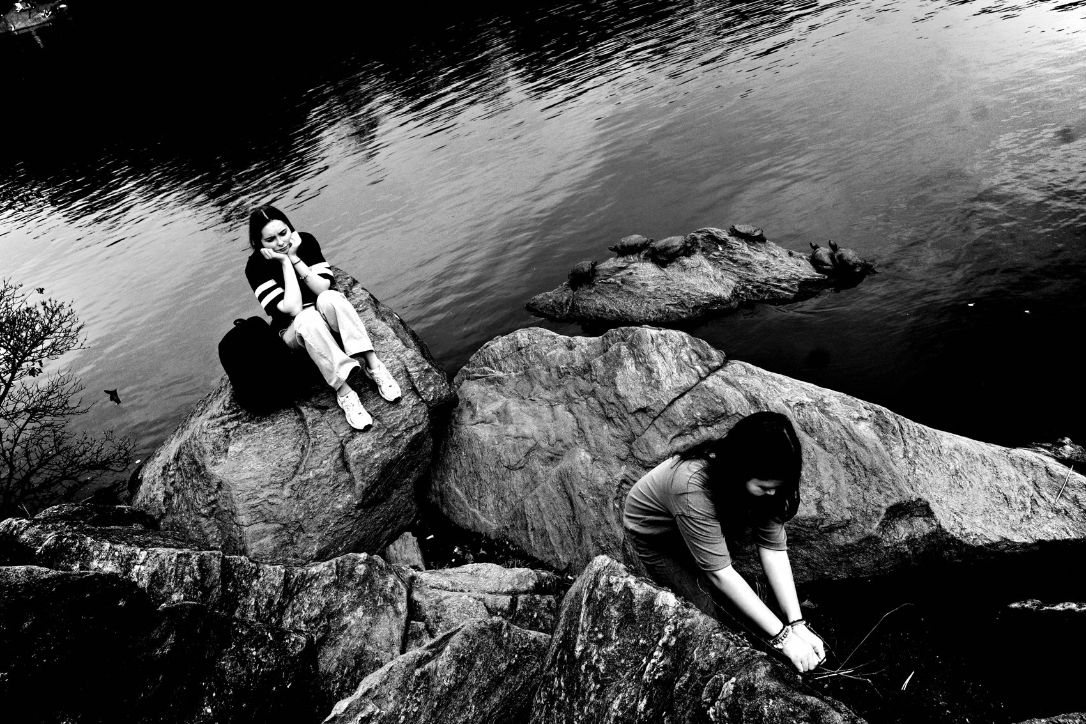
FLUX ACADEMY
BEAT 22 · RELATIONSHIP TO UPCOMING
From Freedom to Constraints
— Next: Constraints = Creative Freedom (Lesson 005)
— Curiosity gives you boundless options
— Constraints focus that energy
Notes:
Next up, Lesson 005, Constraints = Creative Freedom. It sounds like the opposite of today, but it isn't. Curiosity hands you boundless, infinite possibilities — and constraints are how you focus all that playful energy into work. Today opens the door wide; next lesson shows you why a smaller doorway can set you freer.

Slide 24
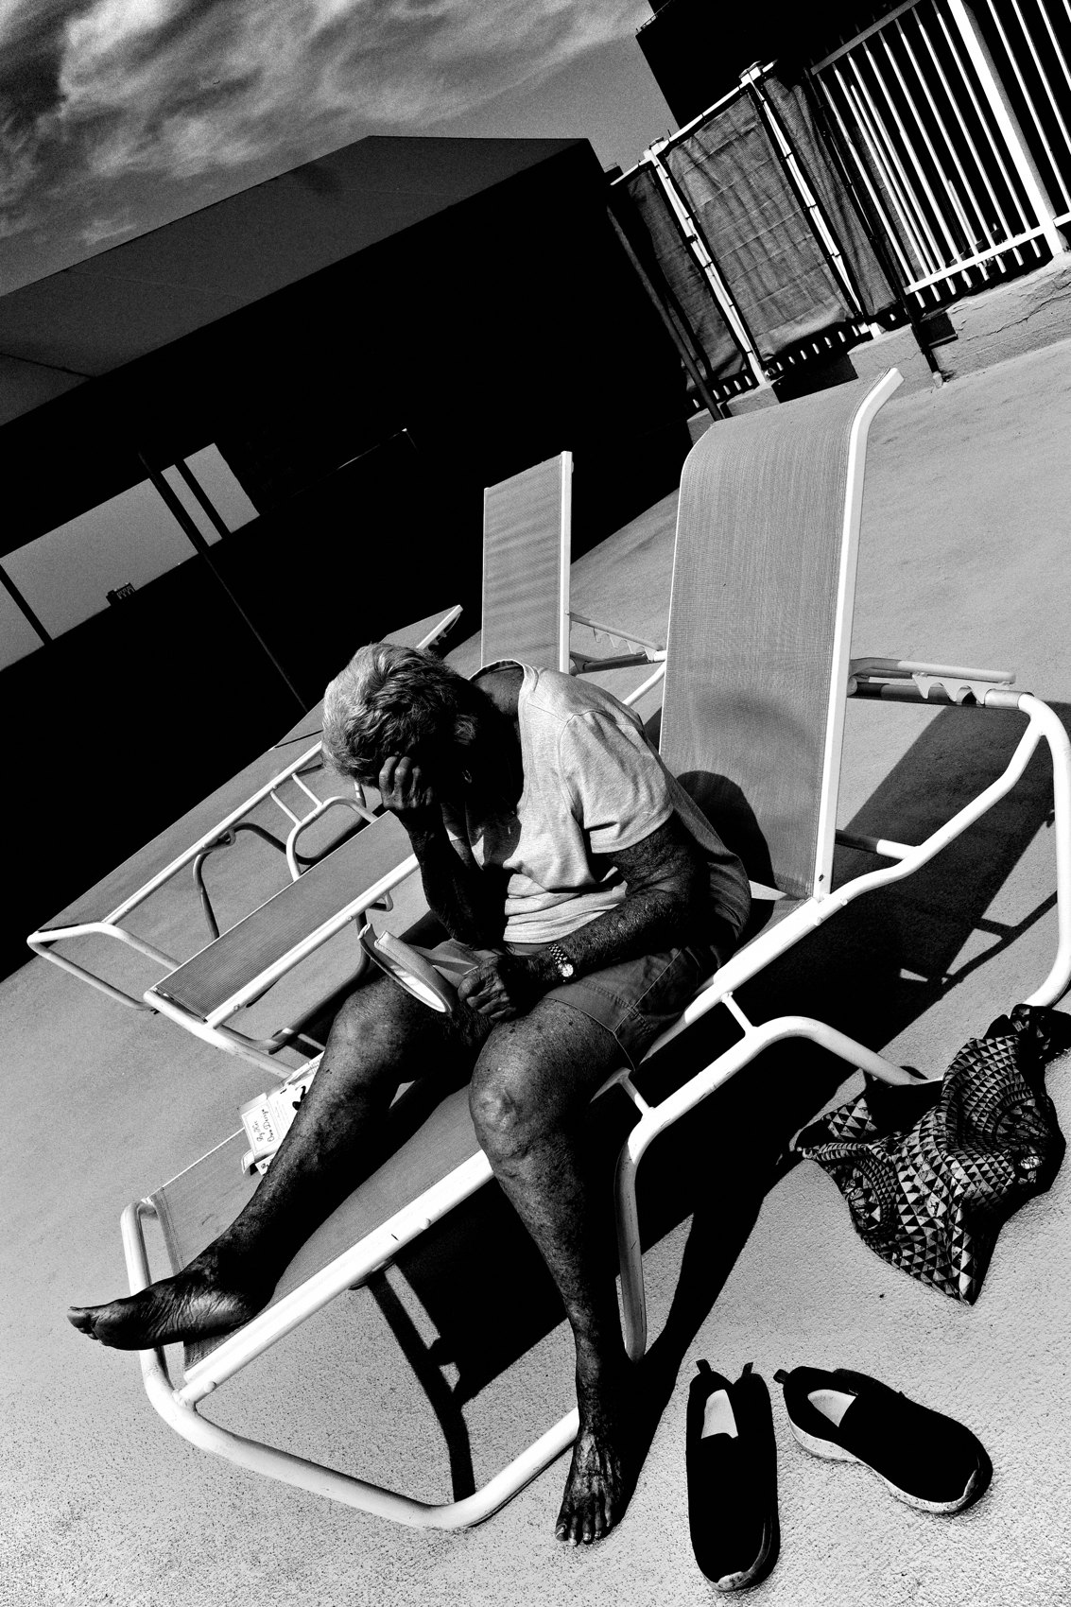
FLUX ACADEMY
BEAT 23 · SUMMARY / TAKEAWAY
Return to Wonder, Daily
— Curiosity is the engine, joy is the fuel
— Return to the childlike mind every day
— Walk. See. Play.
Notes:
Last thing. Curiosity is the engine and joy is the fuel. Boredom is just a perspective you can drop. Return to the childlike mind every single day, be open like a child with wide-eyed wonder, and follow your joy onto the streets. Orient everything toward curiosity, and the photographs — and the flow — become inevitable. Walk. See. Play. Catch you next lesson.

