Slide 1
FLUX ACADEMY · A SCHOOL FOR SEEING
MODULE 1 · FOUNDATIONS
Shoot Everything, No Limits
BY DANTE SISOFO

Slide 2
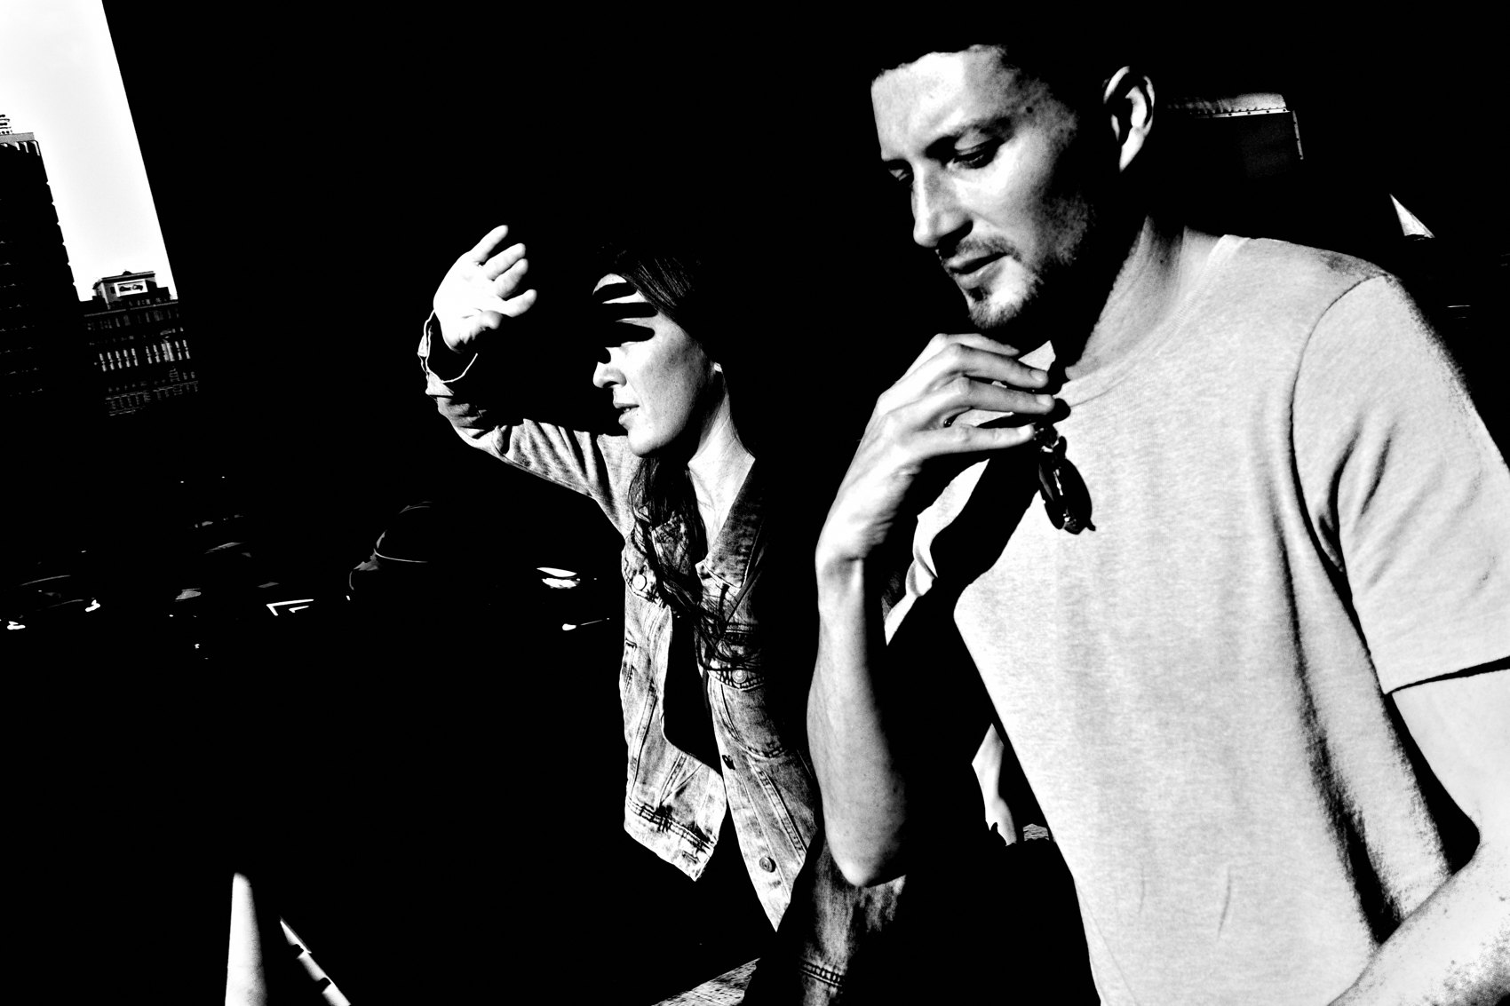
FLUX ACADEMY
BEAT 01 · CORE IDEA
Shoot Everything, No Limits
— Anything and everything is a photo
— No themes, no rules, no permission
— Volume is the practice
Notes:
What's popping, people — it's Dante. Today we break the last filter standing between you and the work: the idea that some things are "worth" a photo and some aren't. Throw it out. Anything and everything can be a photograph. Shoot everything. No limits.

Slide 3
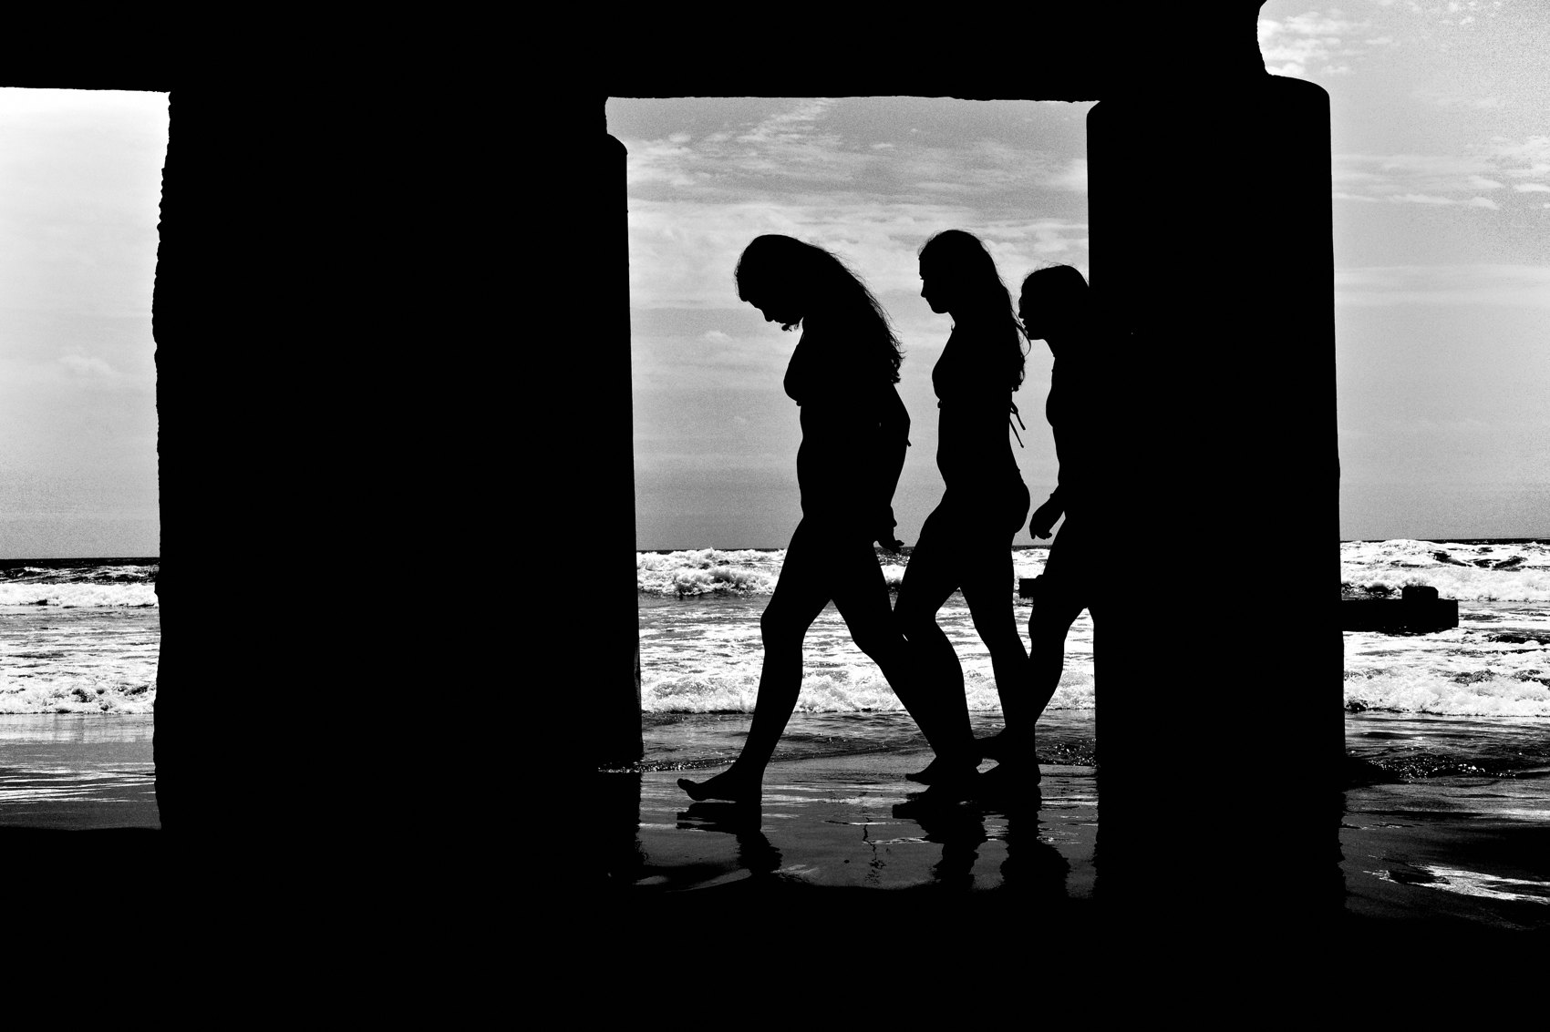
FLUX ACADEMY
BEAT 02 · LEARNING OBJECTIVE
What You'll Walk Away With
— Permission to shoot without filtering
— A volume habit you can keep
— Why "more" beats "perfect"
Notes:
By the end of this lesson you'll have permission — real permission — to go out and shoot freely, with nothing held back. You'll understand why making more photographs, not better-judged ones, is the engine of every skill you'll build this year.

Slide 4
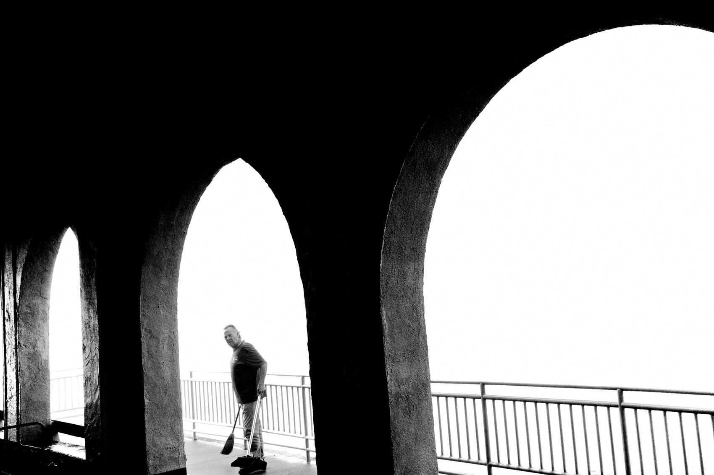
FLUX ACADEMY
BEAT 03 · WHY THIS MATTERS
Limiting Yourself Leads to Stagnation
— Strict themes narrow your eye
— You miss the beauty in everything else
— Selectivity early = stagnation
Notes:
Here's why this matters. Too often, street photographers limit themselves by sticking to strict themes, projects, or styles — and it narrows the creative possibilities until you stagnate. When you're only hunting one kind of shot, you're bound to miss the beauty in everything else.

Slide 5
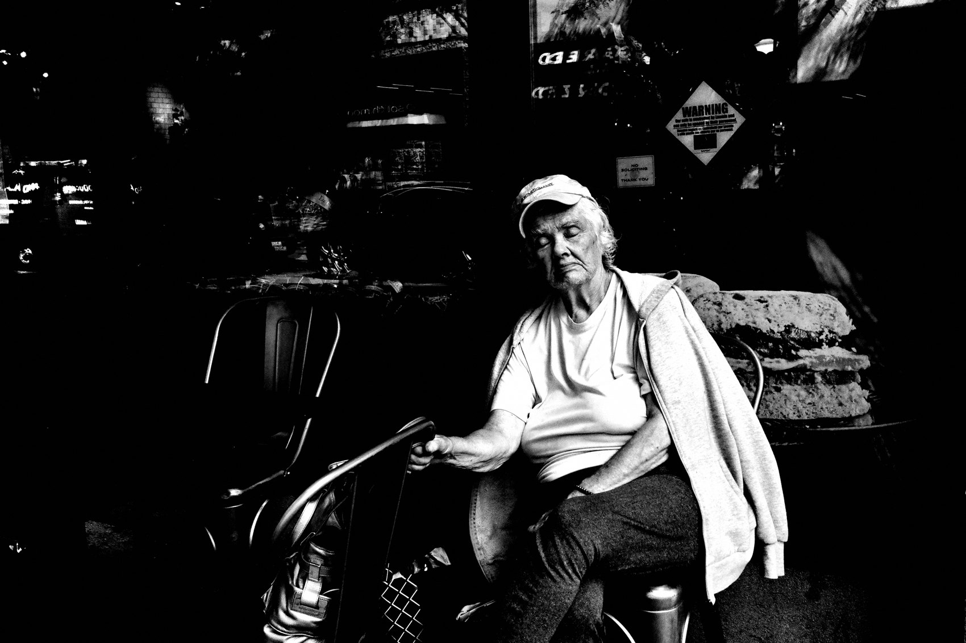
FLUX ACADEMY
BEAT 04 · WHY THIS MATTERS
A State of Production
— Success = simply making new pictures
— To be in a state of production
— Output now, opinions later
Notes:
And here's the upside. A successful street photographer is simply someone making new pictures — to be in a state of production is the ultimate goal. Not publications, not gallery shows. Output. Get into a state of production and everything else follows.

Slide 6

FLUX ACADEMY
BEAT 05 · MAIN TEACHING
Anything Can Be a Photo
— You shouldn't need specific places or subjects
— Drop the "is this worth it" filter
— The whole world qualifies
Notes:
First principle. You shouldn't need to resort to specific places or subjects — anything and everything can be a photograph. The minute you decide a scene isn't "good enough," you've started filtering reality before you've even seen it. Drop that filter. The whole world qualifies.

Slide 7
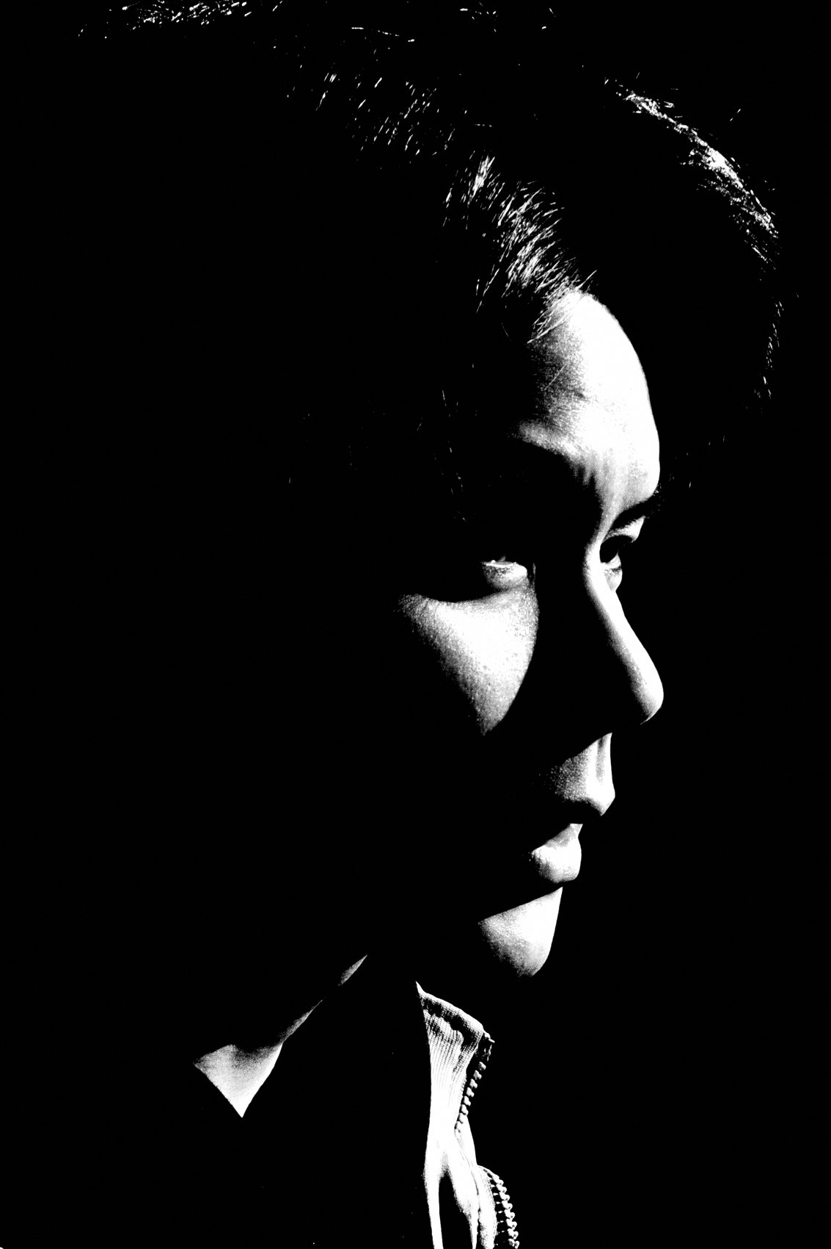
FLUX ACADEMY
BEAT 06 · MAIN TEACHING
Forget the Theme
— Don't go out with a theme in mind
— Shoot freely first
— Themes emerge later, on their own
Notes:
Second principle: forget themes. You don't have to go out with a theme in mind. Shoot freely, review your archive, and the themes will emerge naturally — poetic frames, geometry, humor, religion. They reveal themselves after you shoot, never before. Forcing a theme up front only shrinks what you'll see.

Slide 8
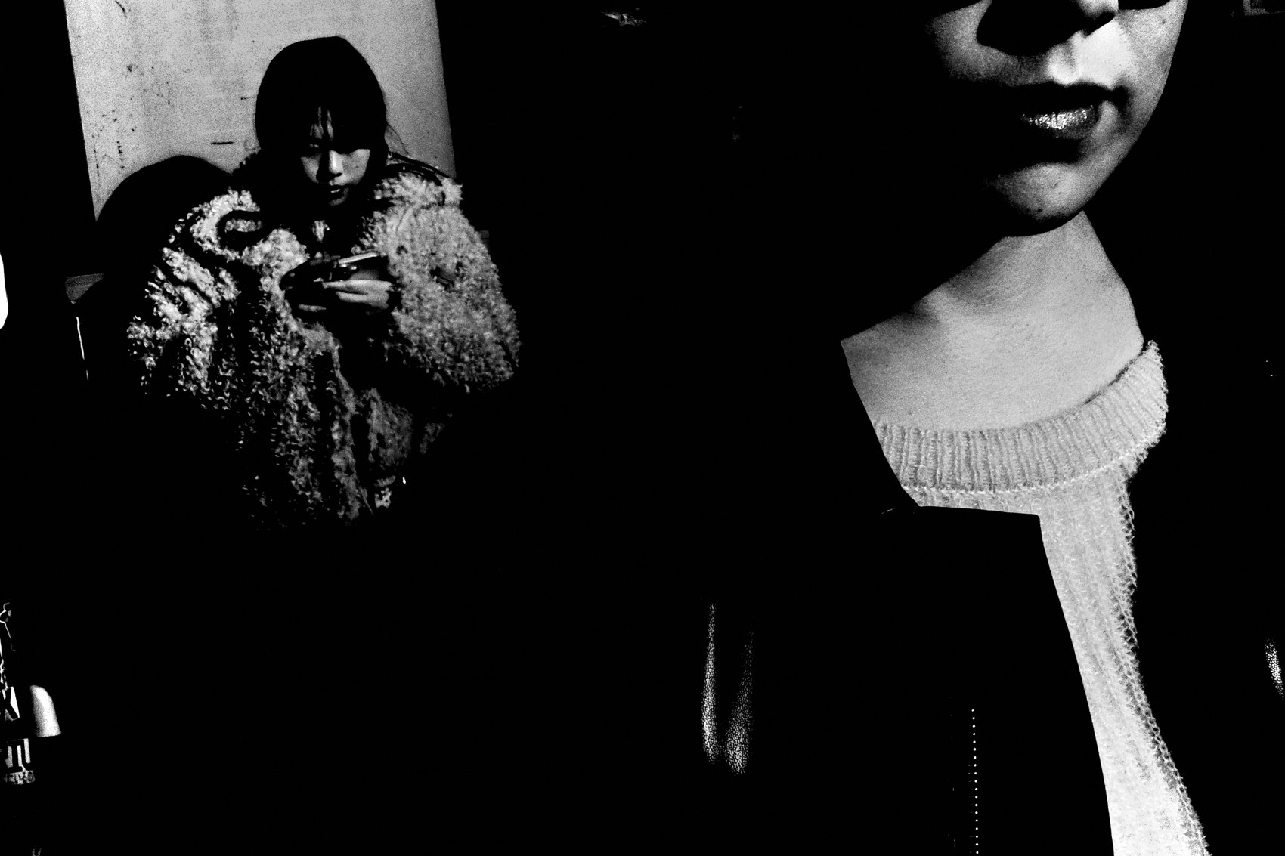
FLUX ACADEMY
BEAT 07 · MAIN TEACHING
More Photos, Better Photographer
— The secret is making more photos
— He who walks the most shall win
— Walk more → see more → shoot more
Notes:
Third principle, and it's almost too simple: the secret to improving is making more photos. The more you shoot, the better you become. And there's a loop underneath it — the more you walk, the more you see, and the more you see, the more you photograph. As I put it: he who walks the most, shall win. Put in the miles and the frames take care of themselves.

Slide 9
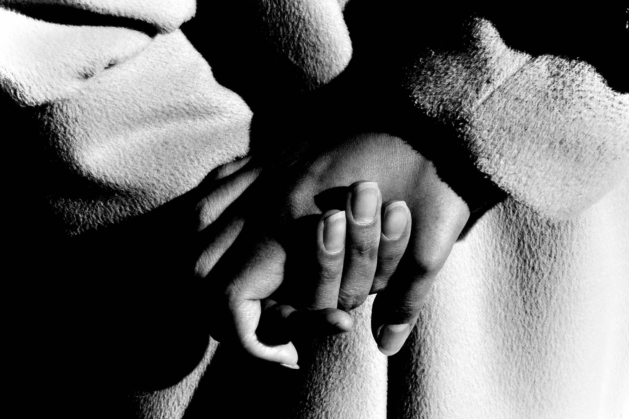
FLUX ACADEMY
BEAT 08 · MAIN TEACHING
Don't Think, Just Shoot
— Don't think. Just shoot.
— Judgment in the moment kills the moment
— Ask questions later
Notes:
Here's the discipline of shooting everything: don't think — just shoot. Let intuition guide you, ask questions later. The second you pause to grade a frame on the street, the moment is gone. Production mode means you press the shutter first and evaluate much, much later, if at all.

Slide 10
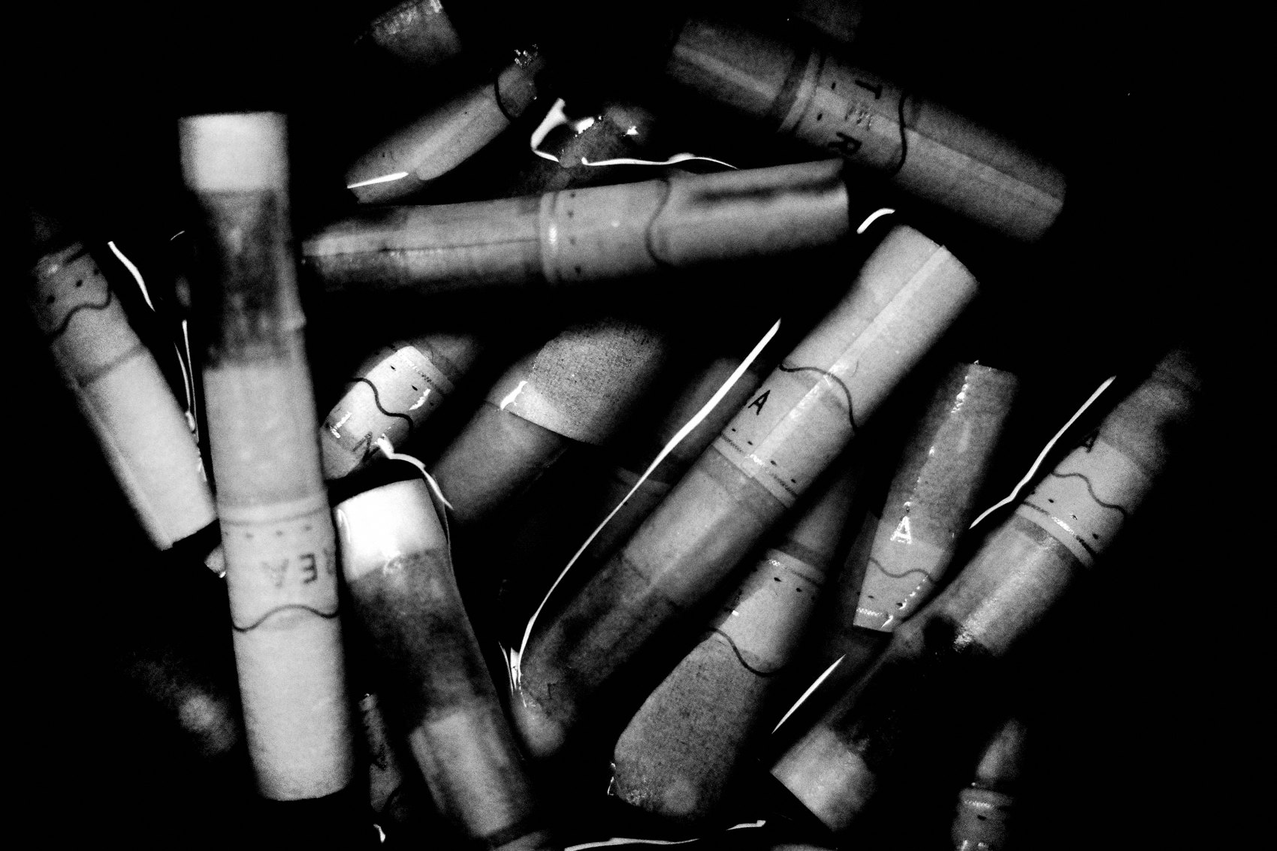
FLUX ACADEMY
BEAT 09 · MAIN TEACHING
The 1,000-Photo Day
— Goal: 1,000 photos in one day
— The more you photograph, the more you learn
— Saturate the habit, lose the preciousness
Notes:
Want a number to chase? Set a goal to take 1,000 photos in a single day. Sounds insane until you do it — and then something breaks open. You stop being precious with the shutter. You shoot the mundane, the half-chances, the maybes. The more you photograph, the more you learn.

Slide 11
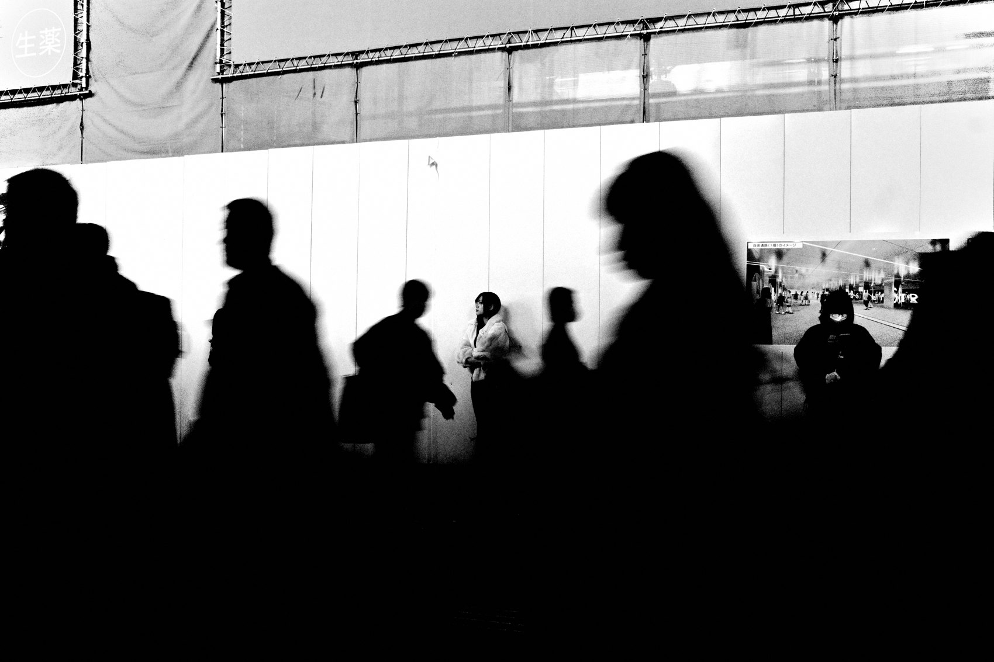
FLUX ACADEMY
BEAT 10 · MAIN TEACHING
Eliminate Excuses
— Always carry a camera
— A pocket camera kills "I didn't have it"
— There's always a reason to shoot
Notes:
If you're going to shoot everything, you have to be able to. Carry a compact camera at all times — it eliminates excuses. There's always a reason to photograph, and the world is full of endless scenes waiting to be captured. No camera, no frame. So the camera is always on you. Always.

Slide 12

FLUX ACADEMY
BEAT 11 · MAIN TEACHING
Shooting Everything Forces Your Luck
— Luck isn't waiting — it's repetition
— Put yourself in the situation, again and again
— Volume manufactures the decisive moment
Notes:
People think great frames are luck. They're not. You force your luck by putting yourself in the right situations repeatedly. Shooting everything is how you get enough at-bats for the magic to land. You don't wait for the moment — you make so many attempts that the moment has to show up.

Slide 13
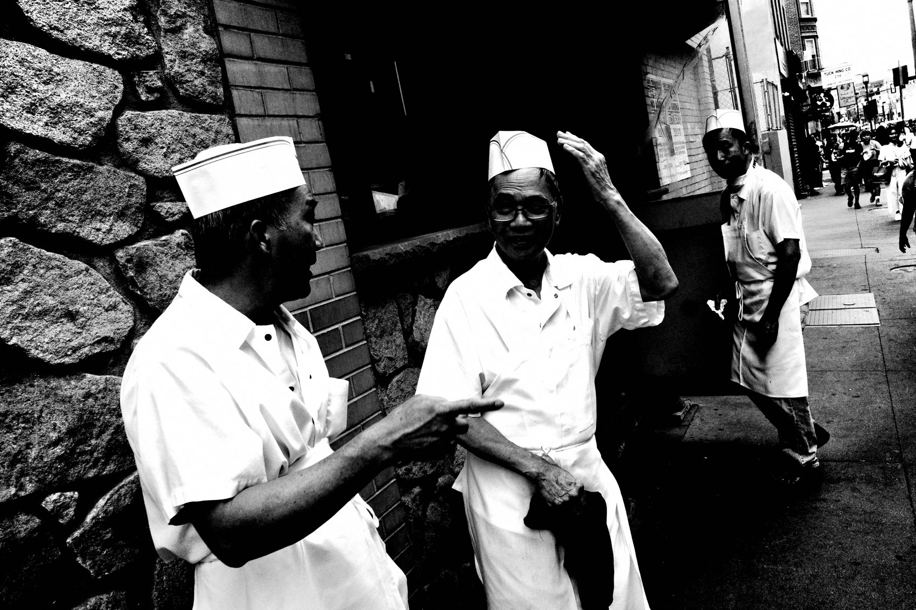
FLUX ACADEMY
BEAT 12 · MAIN TEACHING
Volume Puts You There Before the Moment
— Hours circling one spot pays off
— Read the light and the patterns
— Volume + presence = ready before it happens
Notes:
Think about a fountain throwing spray into the light. Circle it long enough — shooting the whole time — and you start to read the patterns: when the light catches the water, where you'd need to stand for a rainbow to appear. Then you position yourself and wait. The great frame that eventually arrives isn't luck. It's hours of shooting everything around that spot until the right instant shows up and finds you already in place.

Slide 14
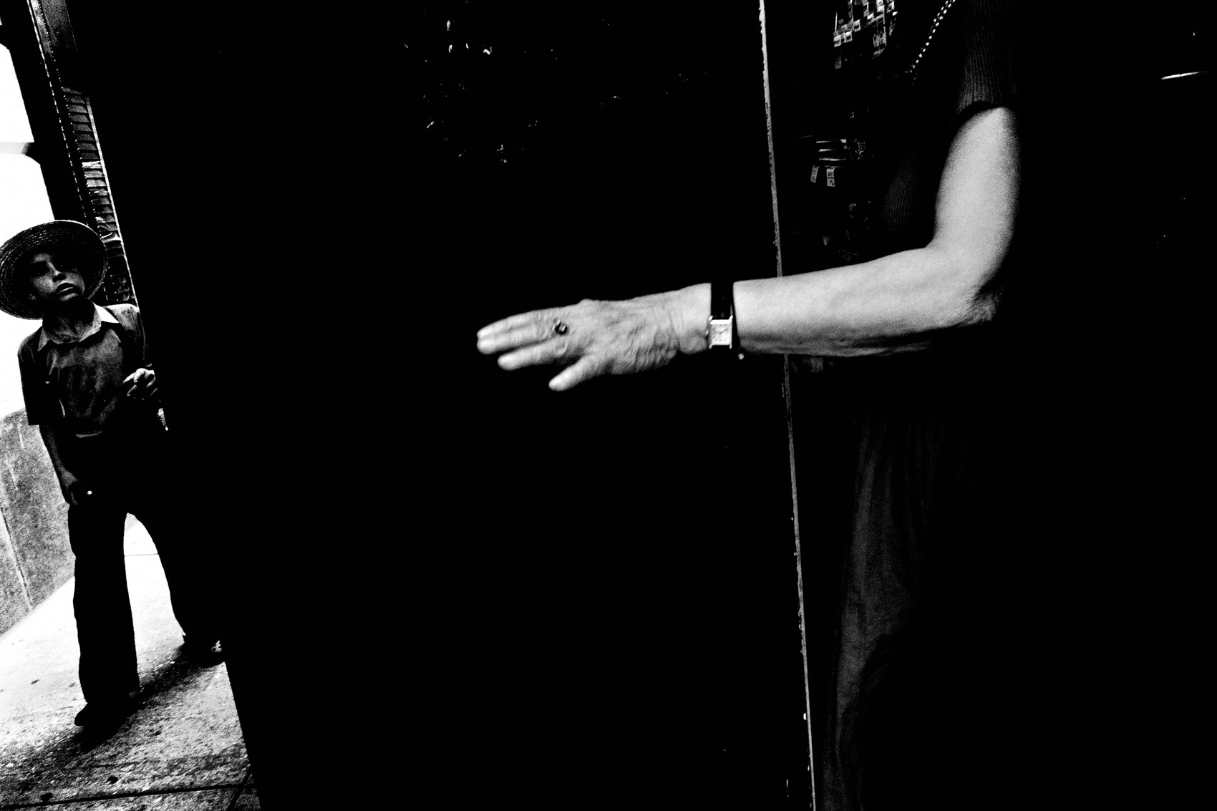
FLUX ACADEMY
BEAT 13 · MAIN TEACHING
The Frames Find You When You're Out There
— Just out moving, following curiosity
— Not "looking for" anything in particular
— The unexpected appears because you're out there
Notes:
The best scenes tend to arrive when you're not hunting them. You're just out moving through the day — riding, walking, following your curiosity — and suddenly something unfolds in front of you that you'd never have gone looking for. You weren't chasing a theme. You were simply out there, shooting. That's the whole secret: be present, be moving, and the frames find you.

Slide 15
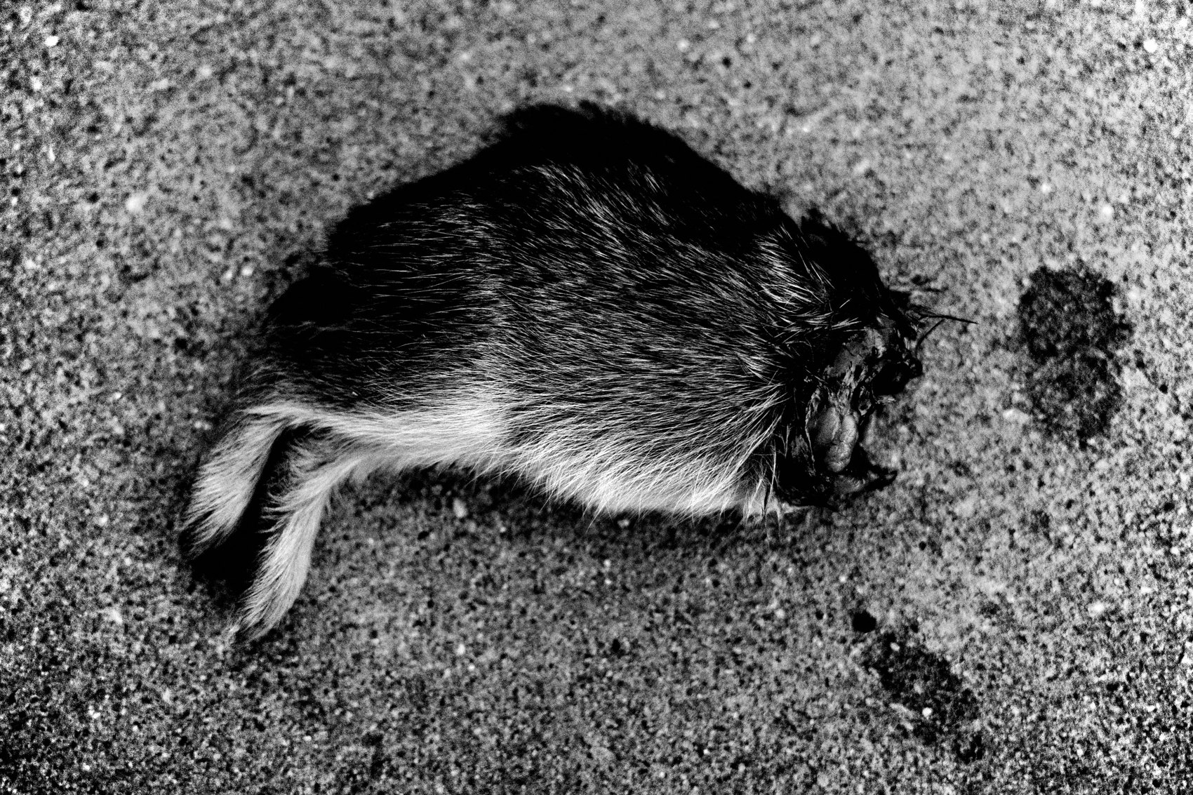
FLUX ACADEMY
BEAT 14 · MAIN TEACHING
The Mundane Scene, Shot Anyway
— A dull scene becomes a composition
— Foreground, mid-ground, background — layers
— An "ordinary" moment, shot instead of skipped
Notes:
Picture a broken-down car on the side of a road, people standing around it, open sky behind. About as mundane as it gets. But step into it and you can build layers — the car in the foreground, the people in the middle ground, the sky behind. A roadside nothing becomes a layered frame. It only happens because you shoot it, instead of deciding it isn't worth shooting.

Slide 16
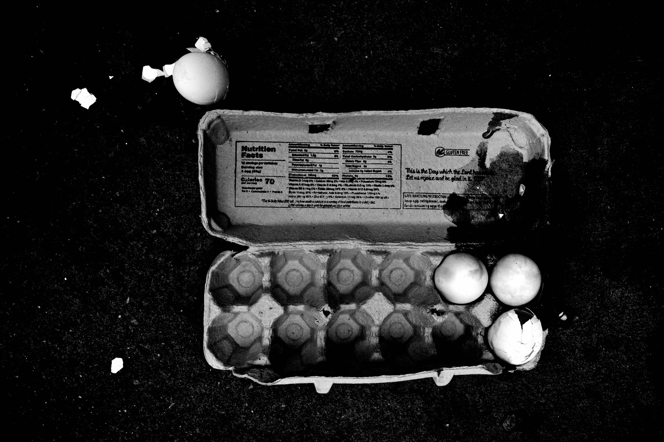
FLUX ACADEMY
BEAT 15 · MAIN TEACHING
Find Beauty in the Ordinary
— The mundane is endlessly fascinating
— Don't wait for extraordinary moments
— Change your view, not your location
Notes:
When you shoot everything, the mundane becomes a source of endless fascination. You stop waiting for some extraordinary moment to bless you. If you think there's nothing interesting around you, it's time to change your perspective on how you view the world — not your location. The ordinary was always enough.

Slide 17
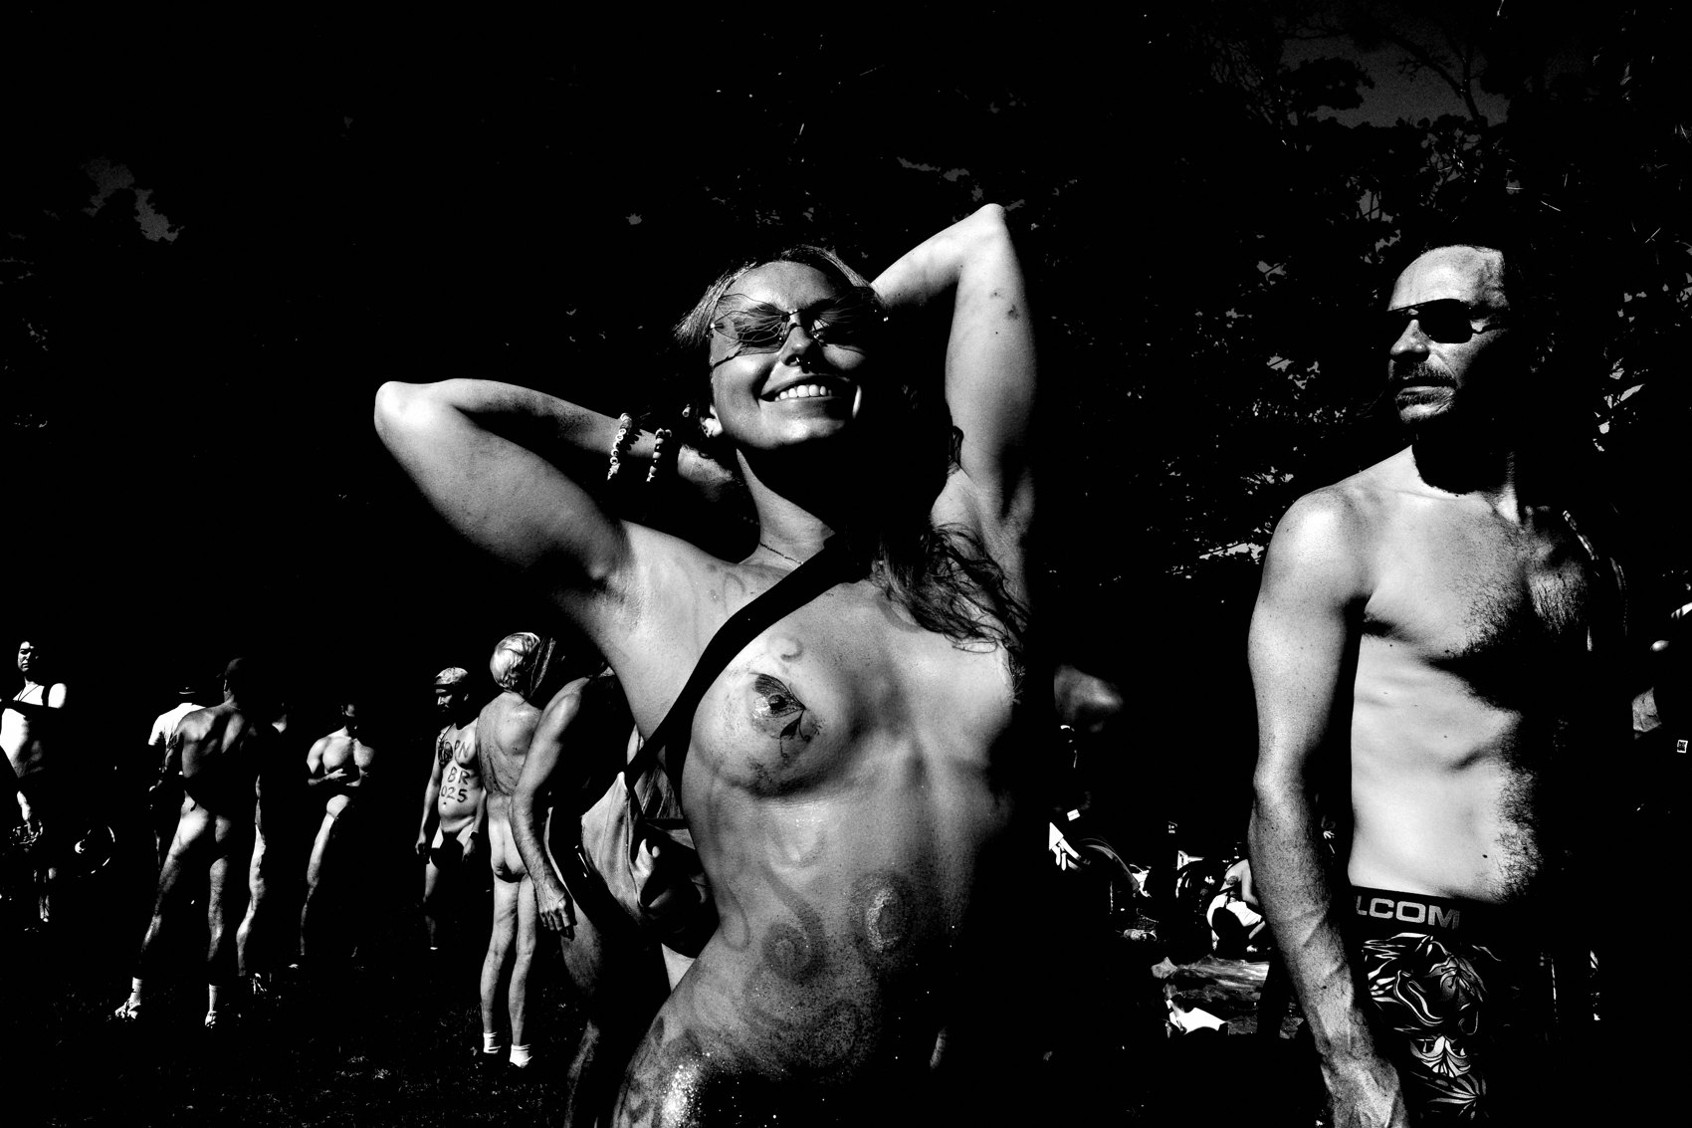
FLUX ACADEMY
BEAT 16 · MAIN TEACHING
Volume Builds the Flow State
— Shooting freely loosens you up
— Just shoot — no good vs. bad
— Production becomes effortless
Notes:
Here's the gift waiting on the other side of volume: flow. When you shoot everything with no judgment, you stop overthinking and start reacting to the world as it happens. No good-vs-bad in the moment. Just the next frame, then the next. Shooting everything is how you fall into the flow state.

Slide 18
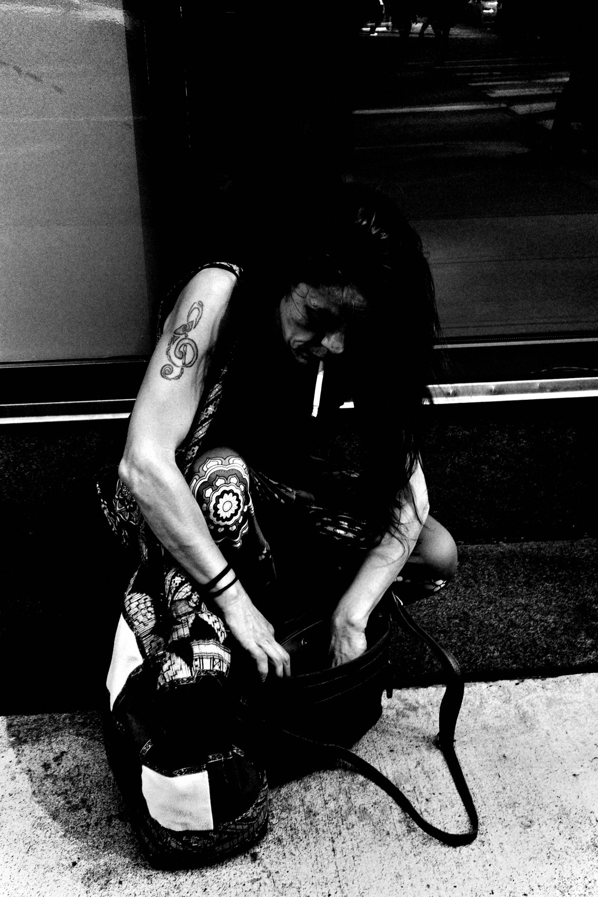
FLUX ACADEMY
BEAT 17 · PRACTICAL APPLICATION
The No-Limits Walk
— One walk, zero filtering
— Shoot the boring stuff on purpose
— Aim high on the count
Notes:
Here's your assignment. Go on one walk and shoot everything — no filtering, no "is this worth it." Shoot the boring stuff on purpose: the curb, the trash can, the shadow on a wall. Push the count high. The point isn't keepers — it's killing the filter that's been costing you frames.

Slide 19
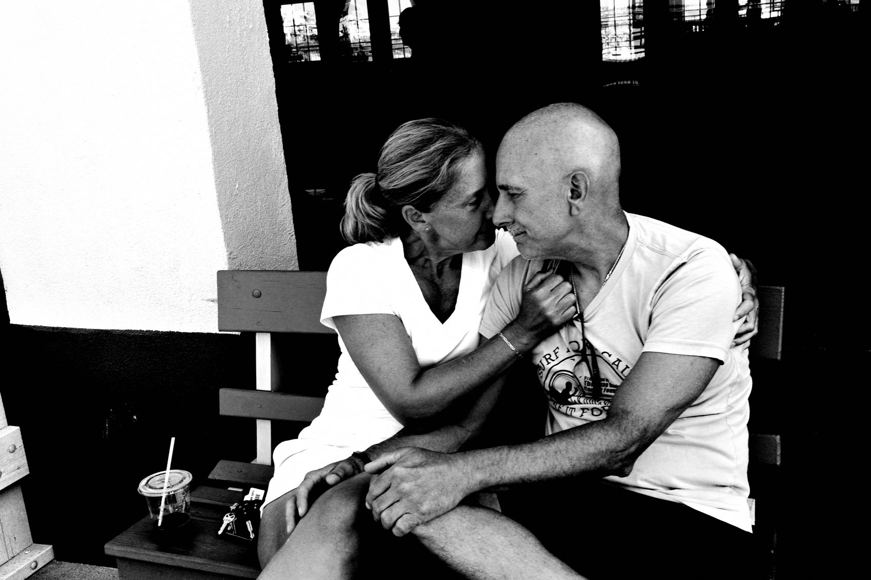
FLUX ACADEMY
BEAT 18 · PRACTICAL APPLICATION
The 1,000-Frame Challenge
— Pick a day, chase 1,000 frames
— Don't chimp, don't delete
— Review only after you're home
Notes:
Then level it up: pick a day and go for 1,000 frames. Don't chimp the screen, don't delete in the field — just keep walking and shooting. You'll burn through your preciousness fast, and what's left is a pure state of production. Review only once you're home, never on the street.

Slide 20
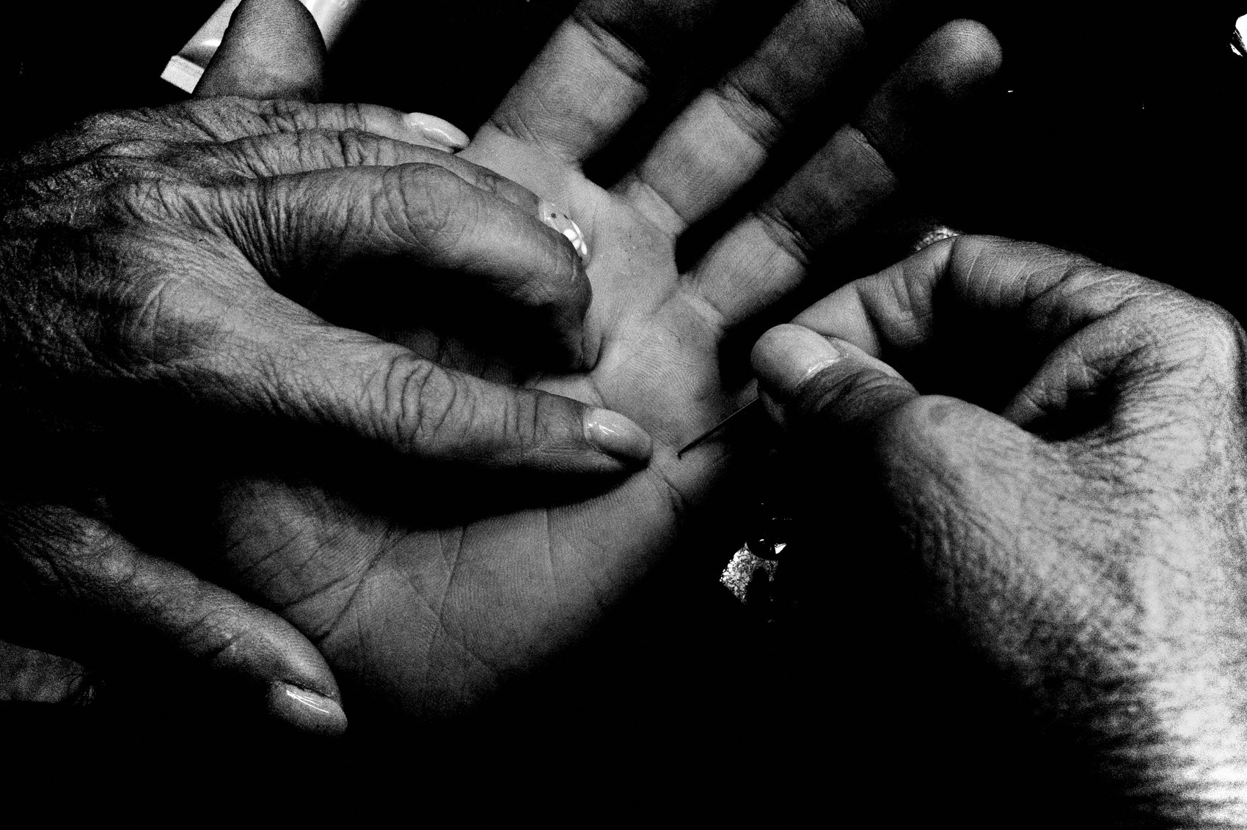
FLUX ACADEMY
BEAT 19 · COMMON MISTAKES
Waiting for the "Worthy" Shot
— Don't pre-judge what deserves a frame
— Don't wait for extraordinary moments
— Hesitation = the photo you never made
Notes:
The biggest mistake is standing there deciding whether a scene is "worthy" before you shoot it. That hesitation is the missed photo. Don't wait for extraordinary moments and don't pre-grade reality. If it catches your eye even a little — shoot it. You can sort it out later; you can never get it back.

Slide 21
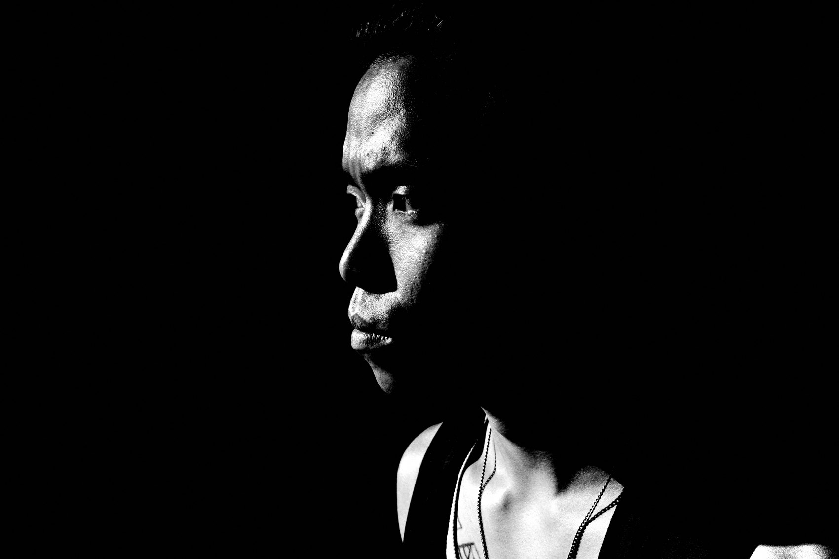
FLUX ACADEMY
BEAT 20 · COMMON MISTAKES
Caging Yourself in a Theme
— Rigid projects narrow your eye early
— You stop seeing everything else
— Let themes find you
Notes:
The other trap: locking into a strict theme or project too early. It feels disciplined, but it quietly narrows your eye until you only see one thing and miss the rest. Just shoot, and the themes will emerge naturally. Don't cage yourself before you've even learned to see widely.

Slide 22
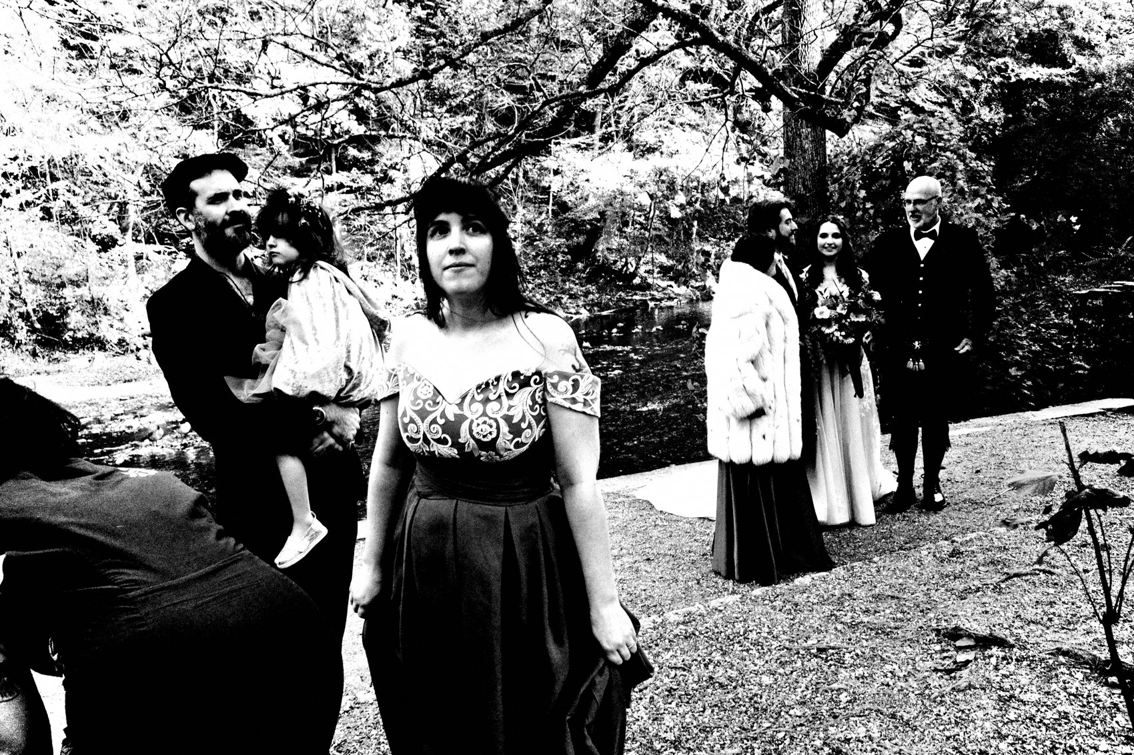
FLUX ACADEMY
BEAT 21 · RELATIONSHIP TO PREVIOUS
Building on a Way of Life
— Lesson 002 made it a way of life
— This is how you live it — shoot everything
— Always ready, always producing
Notes:
In Lesson 002 we made photography a way of life — camera always in your pocket, always ready. This lesson is the how of living that out: if it's a way of life, you shoot everything, all the time, no limits. The way of life and the volume habit are the same muscle.

Slide 23
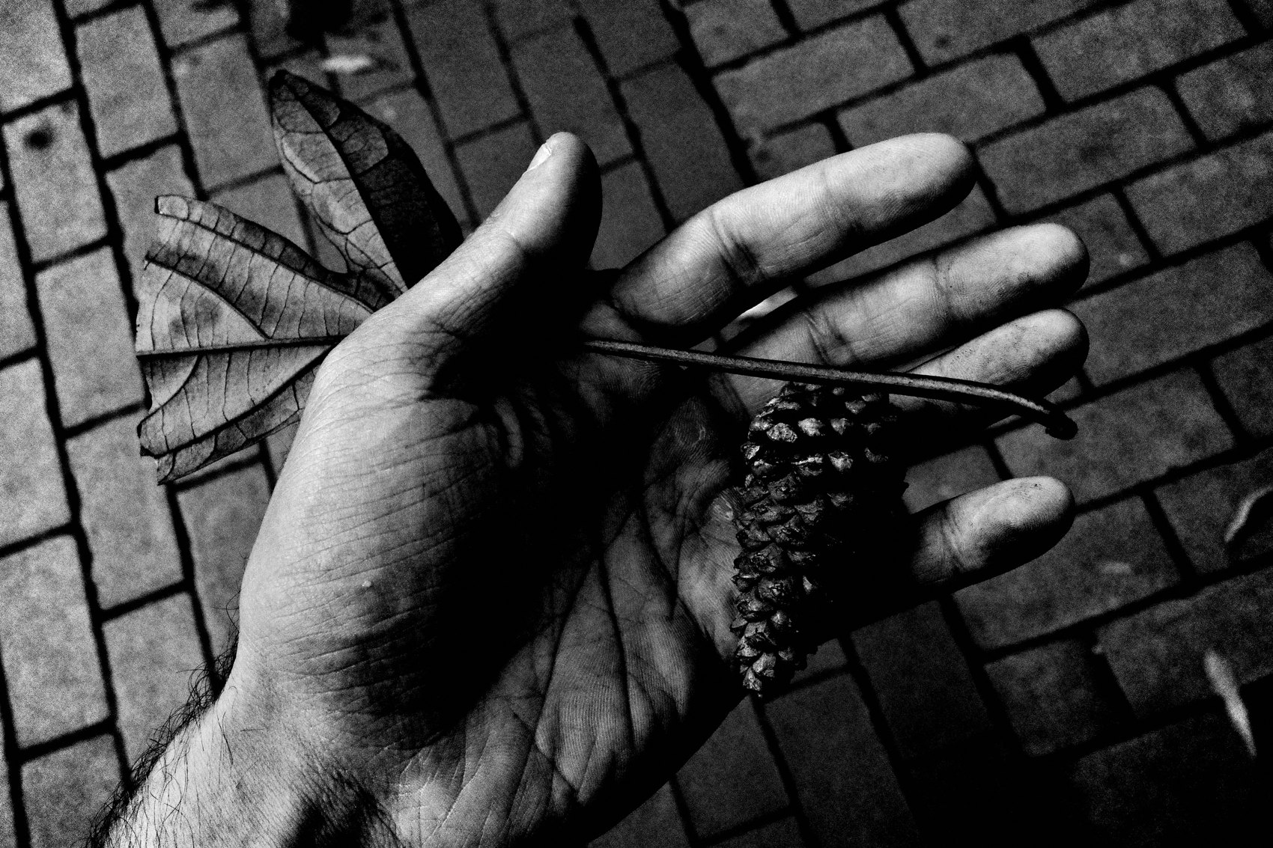
FLUX ACADEMY
BEAT 22 · RELATIONSHIP TO UPCOMING
Where We Go From Here
— Next: Curiosity & Joy (Lesson 004)
— The engine behind shooting everything
— Volume without joy burns out
Notes:
So if shooting everything is the practice, what powers it? That's next. In Lesson 004, Curiosity & Joy: The Engine, we get under the hood — because volume without curiosity is just a grind, and joy is the fuel that keeps you shooting everything for a lifetime.

Slide 24
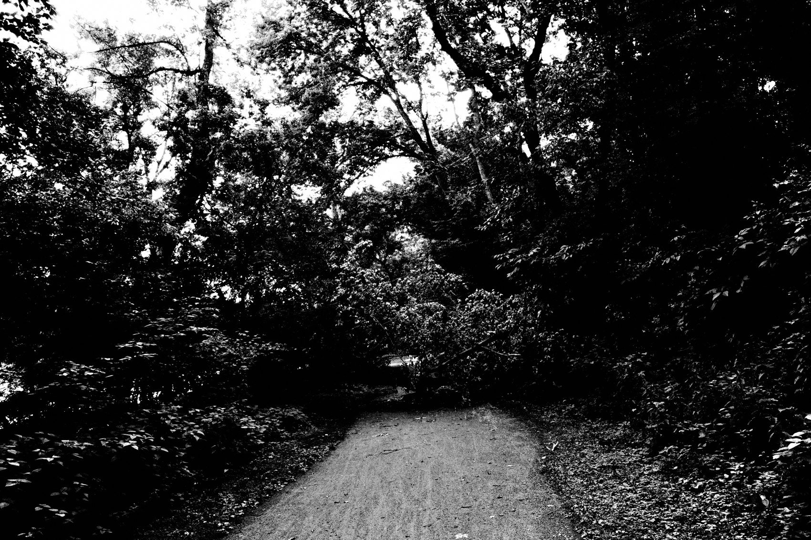
FLUX ACADEMY
BEAT 23 · SUMMARY / TAKEAWAY
Shoot Everything, Sort It Later
— Anything and everything is a photo
— More frames, fewer filters
— Walk more, judge less, shoot everything
Notes:
Last thing. Anything and everything can be a photograph. Forget the themes, forget "worthy," forget good-vs-bad on the street. Get into a state of production, force your luck with volume, and let the meaning emerge later. Walk more, judge less, shoot everything. Catch you next lesson.

