Slide 1
FLUX ACADEMY · A SCHOOL FOR SEEING
MODULE 1 · FOUNDATIONS
Photography as a Way of Life
BY DANTE SISOFO

Slide 2
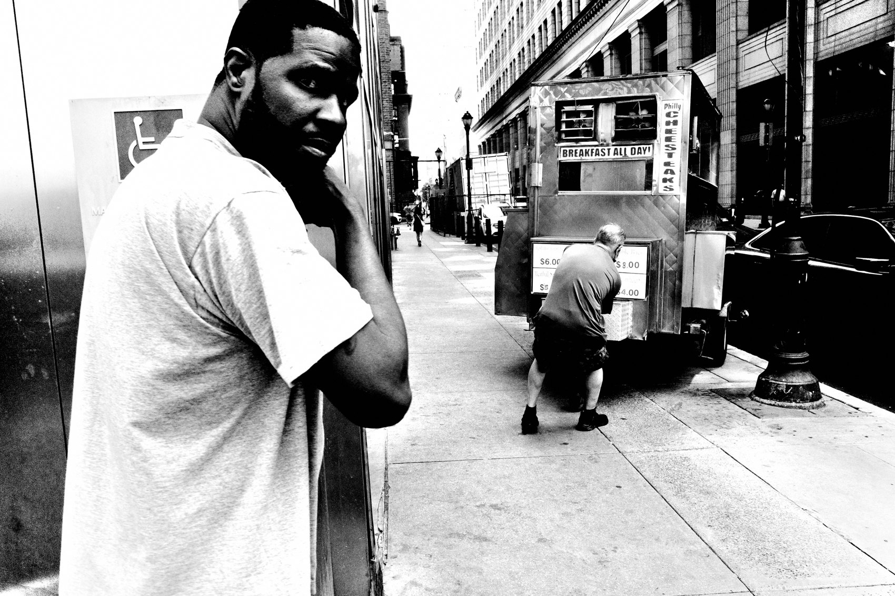
FLUX ACADEMY
BEAT 01 · CORE IDEA
Not a Hobby, a Life
— For the obsessed, it's not a hobby
— It's a way of life
— The camera becomes how you exist
Notes:
What's popping, people — it's Dante. Last lesson we set the goal. Today we go bigger: for those of us obsessed with street photography, it's not just a hobby — it's a way of life. The camera stops being a thing you pick up. It becomes how you move, how you see, how you exist.

Slide 3
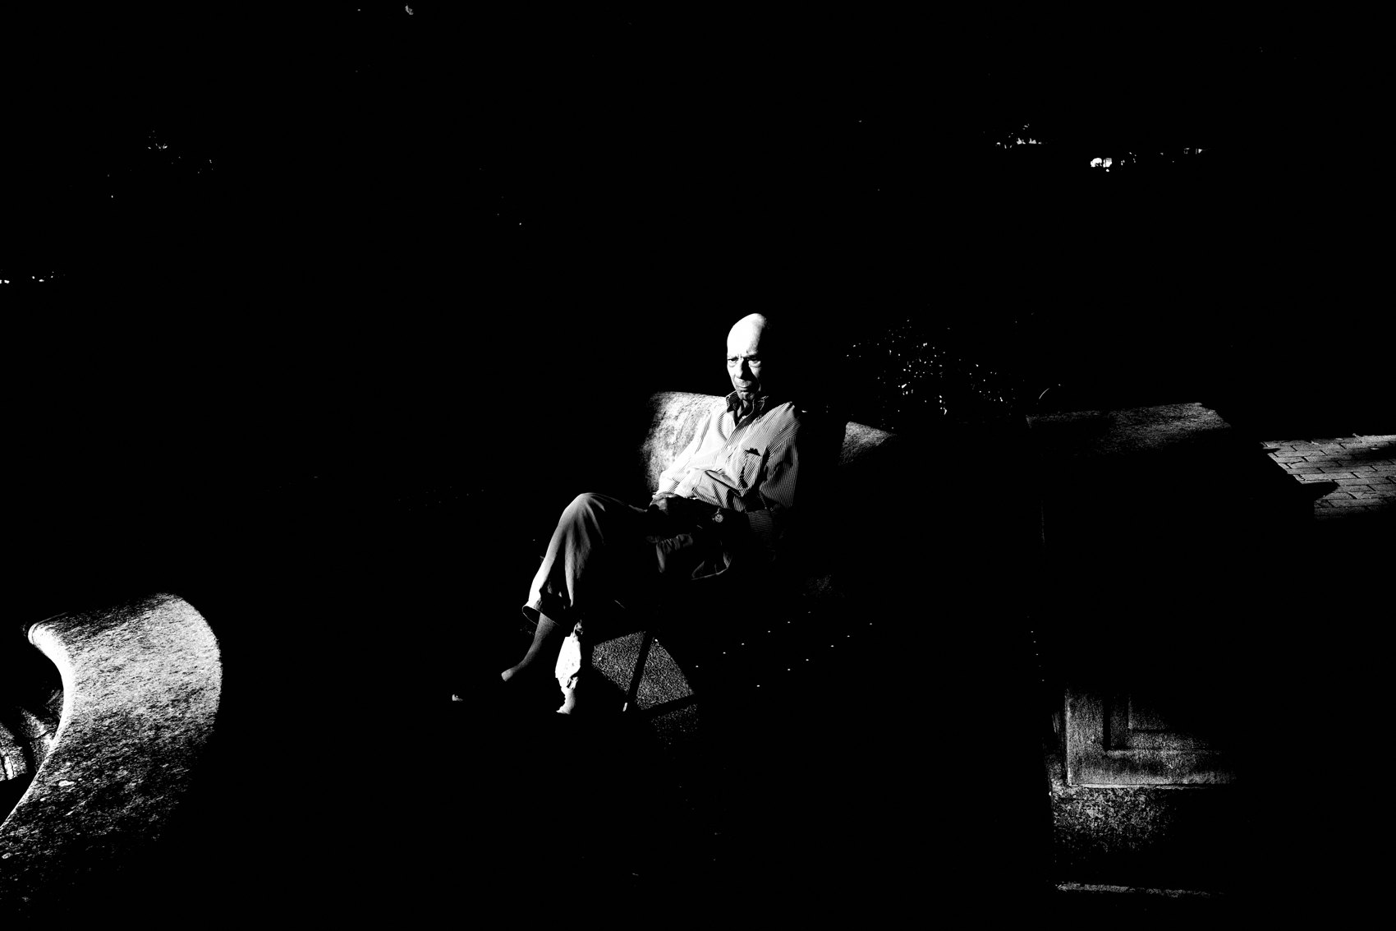
FLUX ACADEMY
BEAT 02 · LEARNING OBJECTIVE
Build It Into Your Existence
— Make photography a daily, seamless practice
— Let it flow from your life, not interrupt it
— Adopt the way-of-life mindset
Notes:
By the end of this lesson you'll know how to build photography into your existence — so it flows naturally from your day instead of interrupting it. Not a thing you schedule. A way you live.

Slide 4
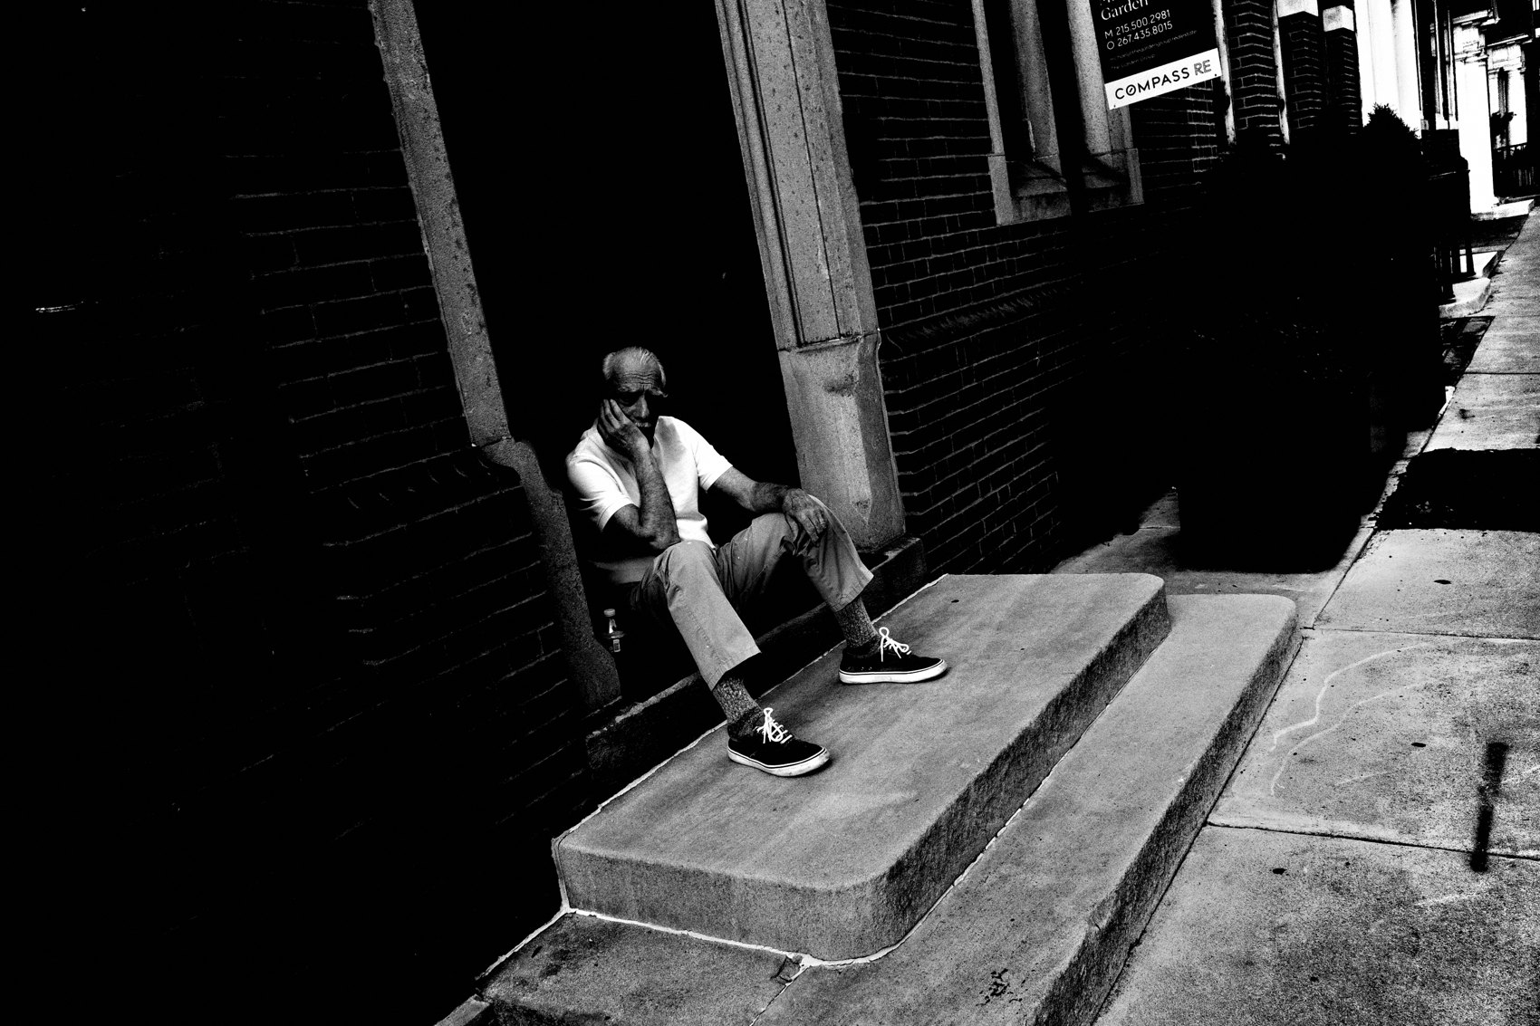
FLUX ACADEMY
BEAT 03 · WHY THIS MATTERS
Your Answer to "Why I Wake Up"
— He who has a why can bear any how
— Photography becomes your purpose
— It affirms your life every morning
Notes:
Here's why this matters. Answering why street photography? feels like answering why do I wake up in the morning? Nietzsche said he who has a why to live can bear almost any how. With the click of the shutter, I affirm my life. This is your why.

Slide 5
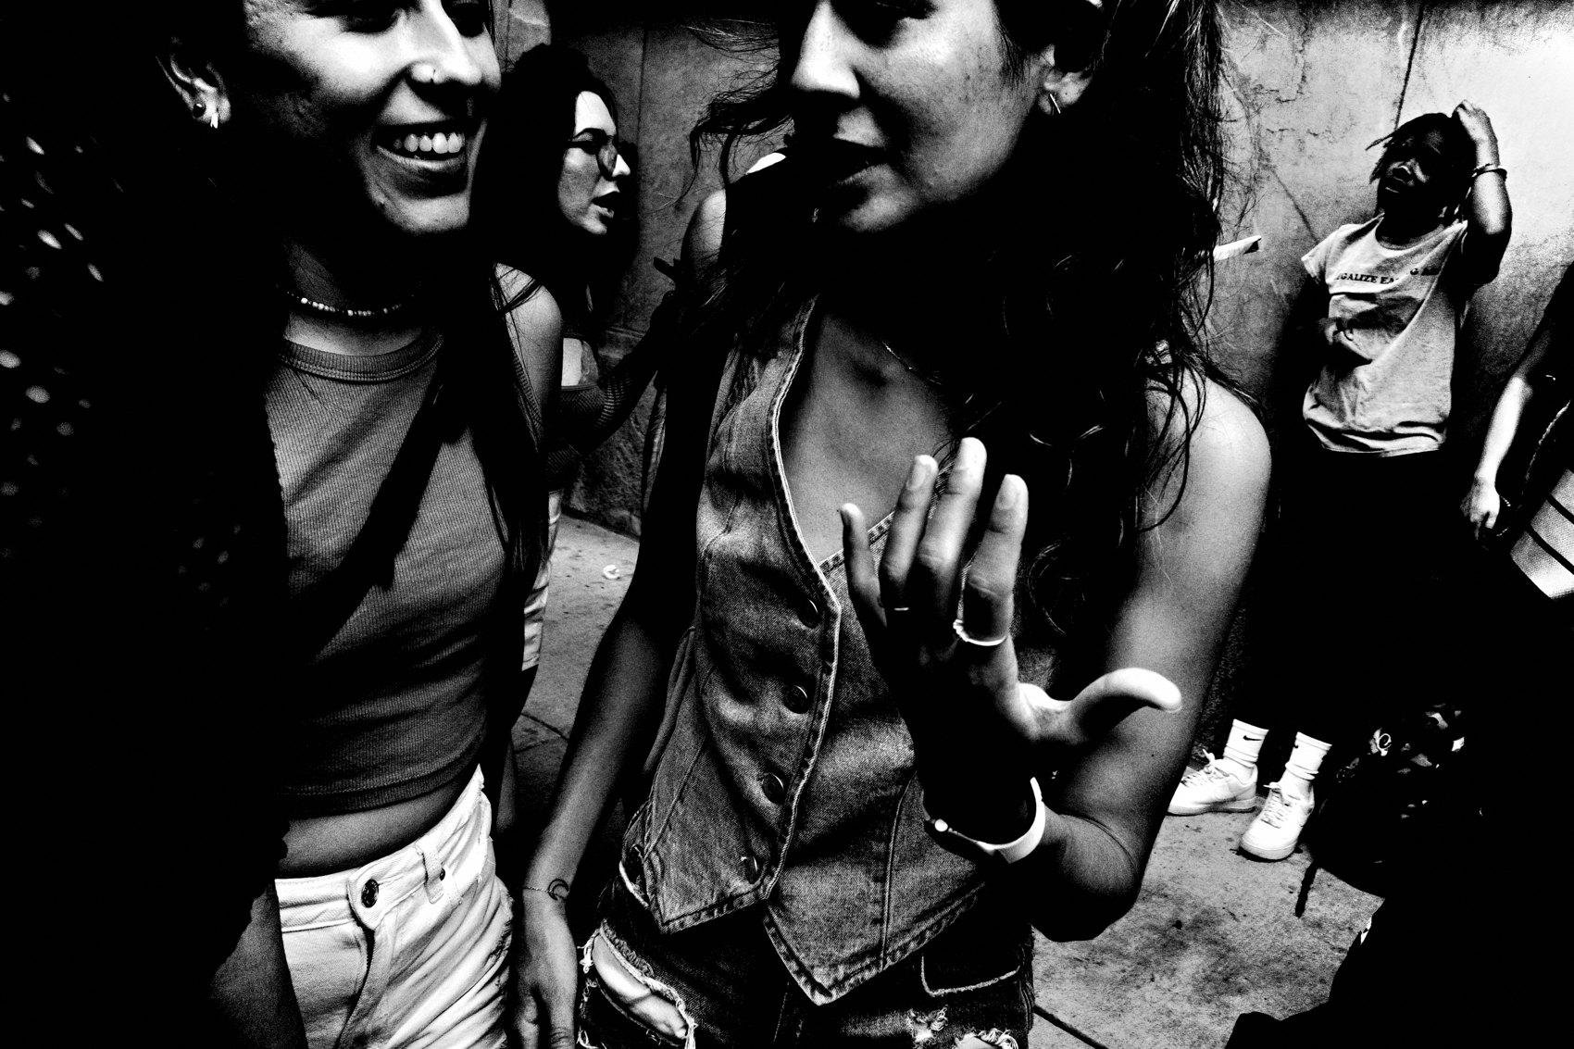
FLUX ACADEMY
BEAT 04 · WHY THIS MATTERS
Bliss No Matter the Circumstance
— Joy in creation, regardless of conditions
— Bliss comes from the inside
— Meaning you carry anywhere
Notes:
And here's the payoff: no matter where I am or how I feel — despite the weather, despite the external world — internally I find bliss through the creation of photographs. When photography is a way of life, the joy doesn't depend on circumstances. You carry it with you.

Slide 6
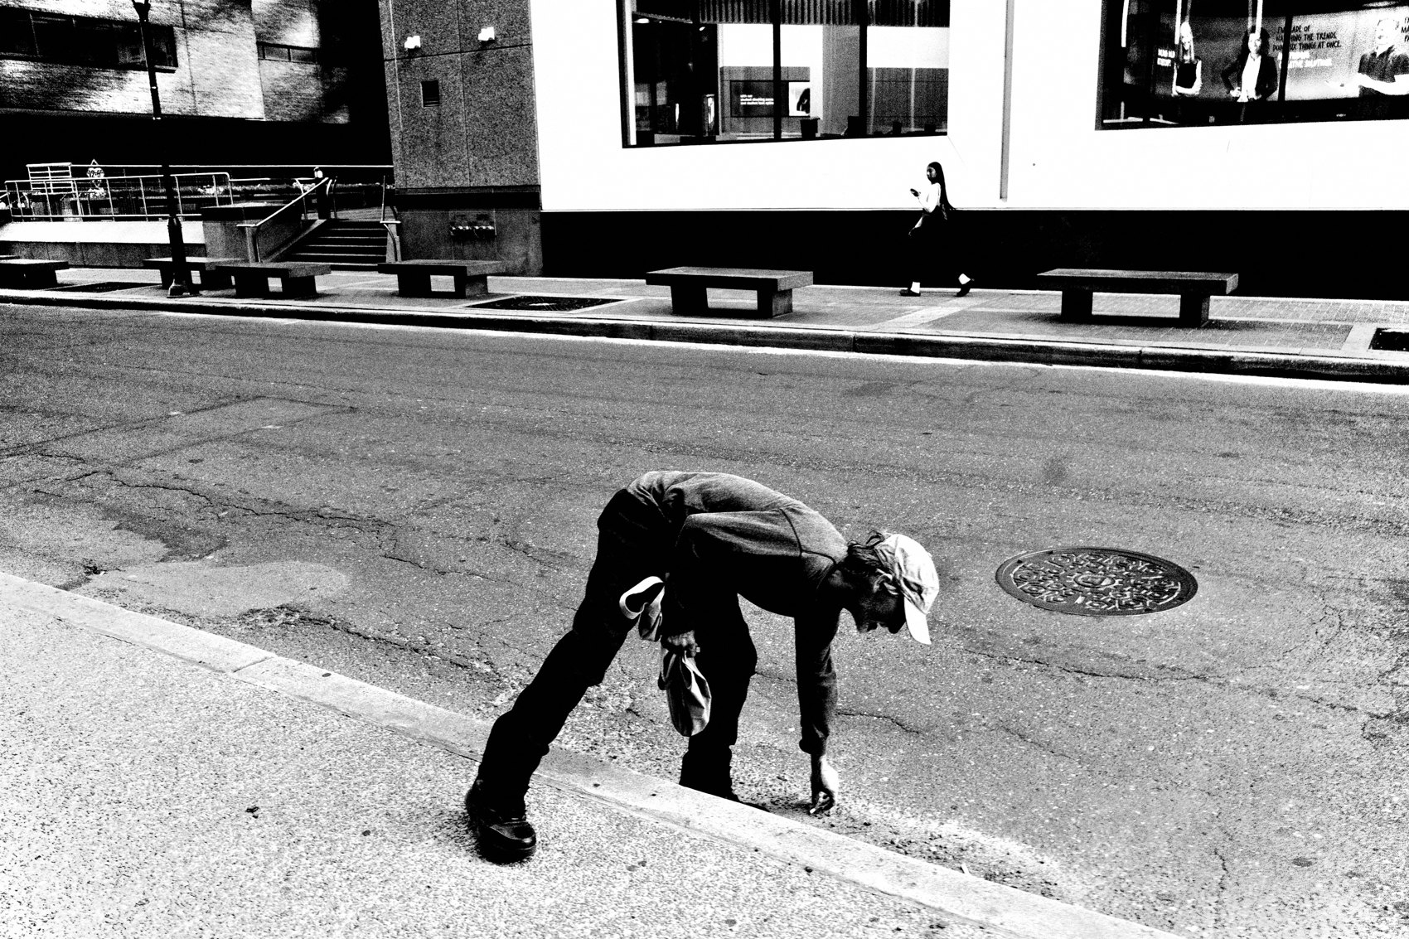
FLUX ACADEMY
BEAT 05 · MAIN TEACHING
Existing Outside of Time
— The closest thing to not existing
— Past and future fade — you're just being
— Immersed in the present
Notes:
Let's get into it. Street photography lets me exist outside the passage of time — it's the closest thing to not existing. When I photograph, the past and the future fade away. I'm simply being. You're immersed in the present, and life just flows toward you.

Slide 7
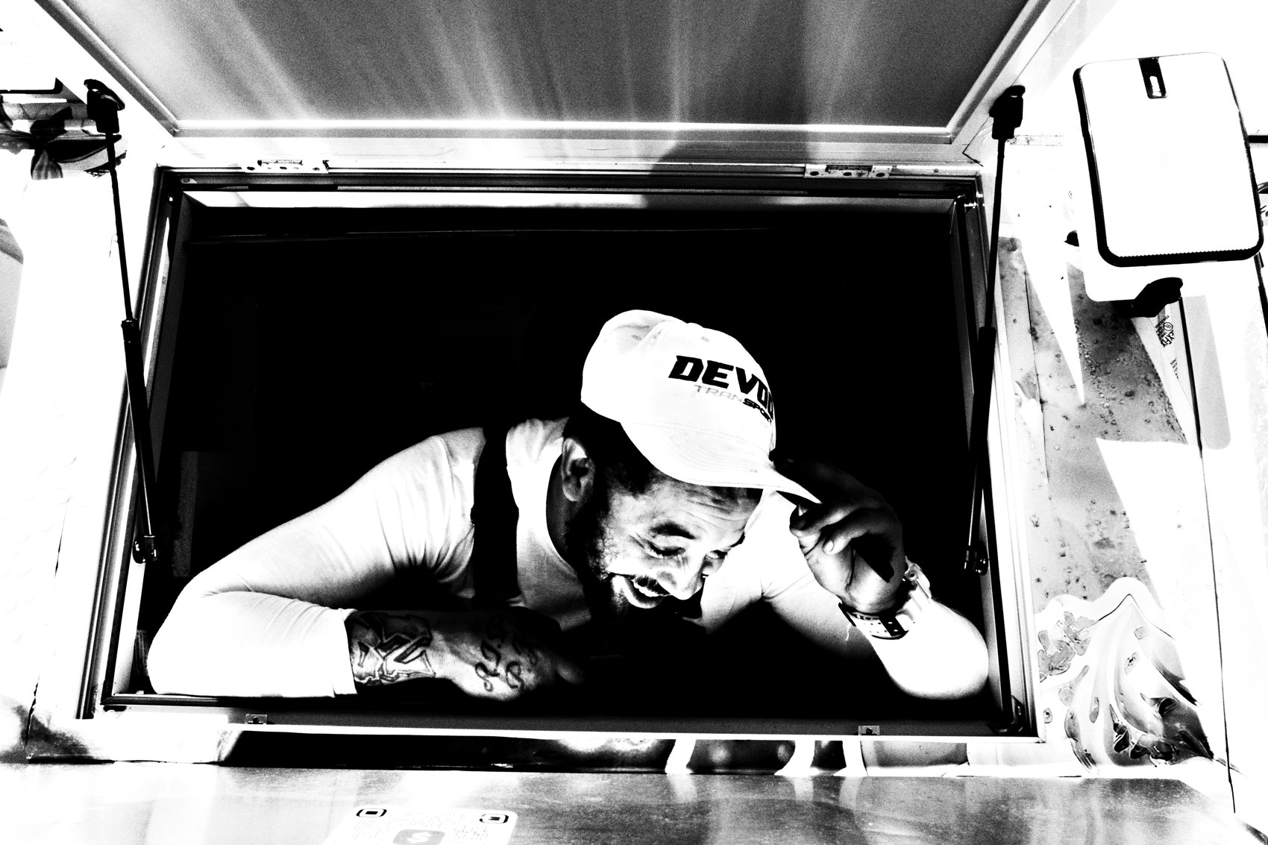
FLUX ACADEMY
BEAT 06 · MAIN TEACHING
Observe, Document, Cherish
— Your role: observe, document, cherish
— Life flows toward you
— Receive the moment, don't chase it
Notes:
When you're on the streets with the camera, your role is simple: observe, document, and cherish the fleeting beauty of everyday life. You don't force it. You stand in the flow and receive it. That's the whole posture of a life lived this way.

Slide 8
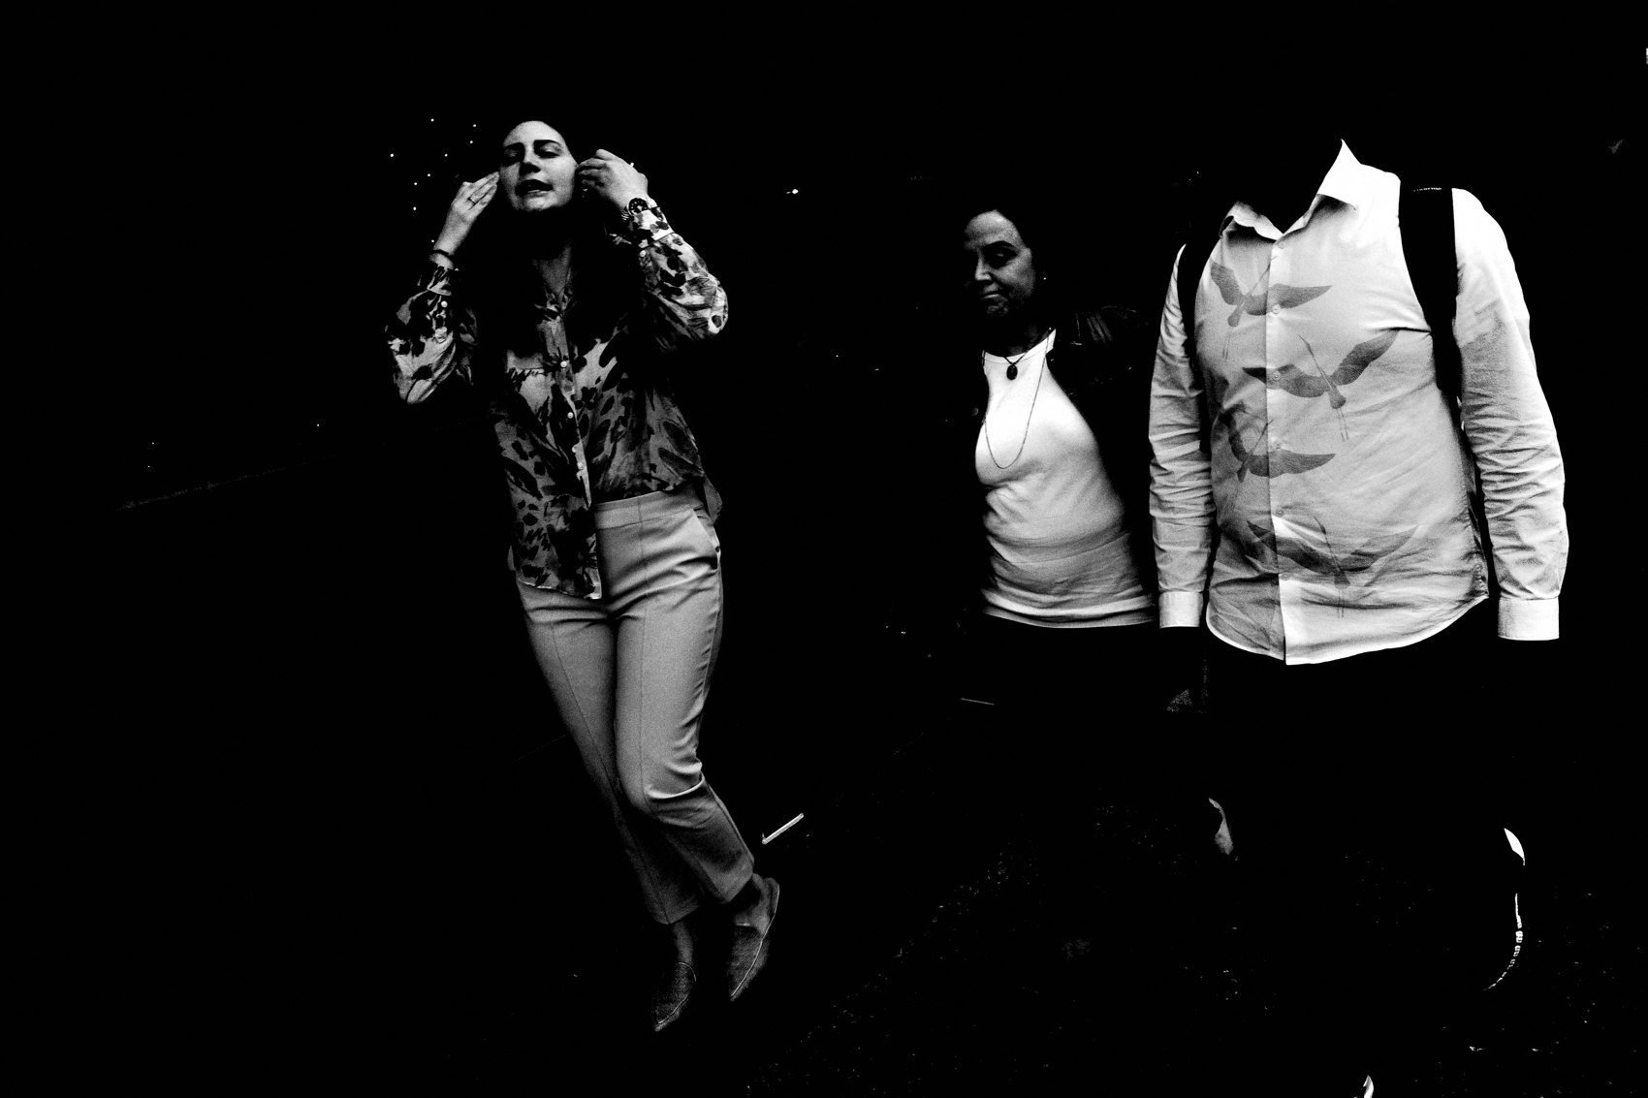
FLUX ACADEMY
BEAT 07 · MAIN TEACHING
The Camera as a Passport
— The camera is my passport to life
— It gets you out the door
— An excuse for endless exploration
Notes:
The camera is my passport to the complexities of life. It's my ultimate excuse. Without it I might never have knocked on the doors I've knocked on, sat with the people I've sat with, or wandered the streets I'd otherwise have walked right past. The camera is the reason I go out my door — it gets me out onto the front lines of life.

Slide 9
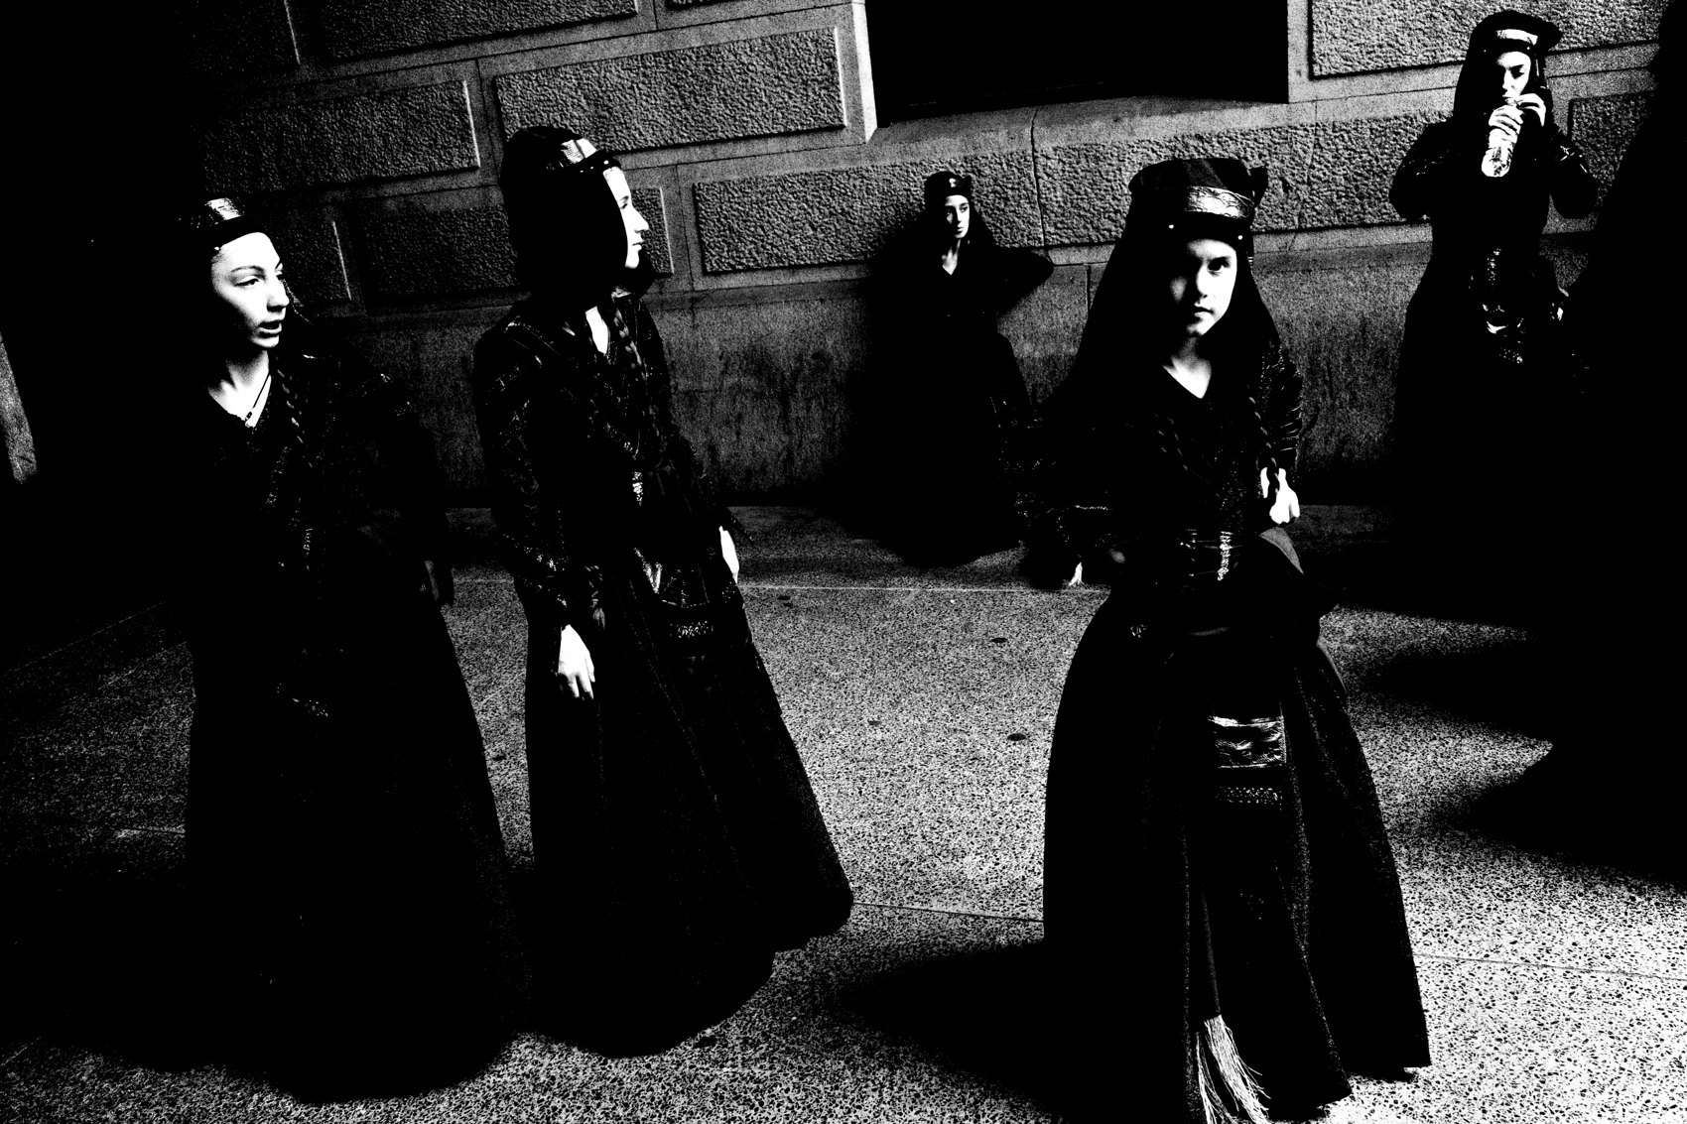
FLUX ACADEMY
BEAT 08 · MAIN TEACHING
Preserving the Soul of the City
— Not freezing time — preserving the soul
— Archive how the city felt
— Every frame is visual history
Notes:
This practice isn't about freezing time — it's about preserving the soul of the city. It's about archiving the life and rhythm of the place. Every photograph becomes part of its visual history — a way of remembering not just what the city looked like, but how it felt.

Slide 10
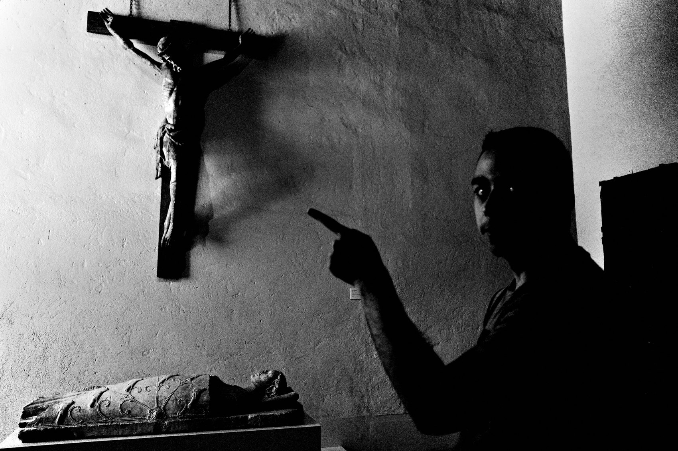
FLUX ACADEMY
BEAT 09 · MAIN TEACHING
Become the Eyes of Your City
— Observe everything. See it all.
— Become the eyes of your city
— A witness, a keeper of its memory
Notes:
And when you live this way, you become something to your city. You observe everything. You see it all. You become its eyes. That's not arrogance — it's a responsibility. You become the witness, the keeper of the everyday moments nobody else stops to notice.

Slide 11
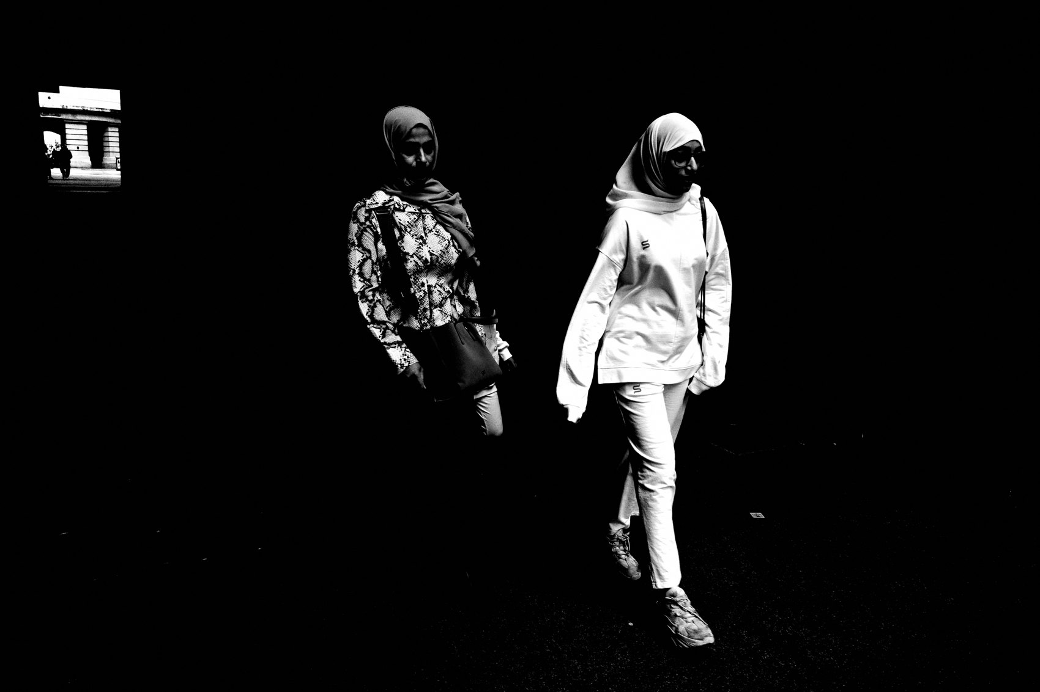
FLUX ACADEMY
BEAT 10 · MAIN TEACHING
Simplify the Process
— Ricoh GR III, pocket-sized
— High-contrast black & white, small JPEGs
— Simplicity serves longevity
Notes:
Now, the practical engine that makes a way of life possible: simplify the process. My setup is built for it — the Ricoh GR III, high-contrast black and white, small JPEG files. That's it. The simpler the process, the longer you can sustain it. Simplicity serves longevity.

Slide 12
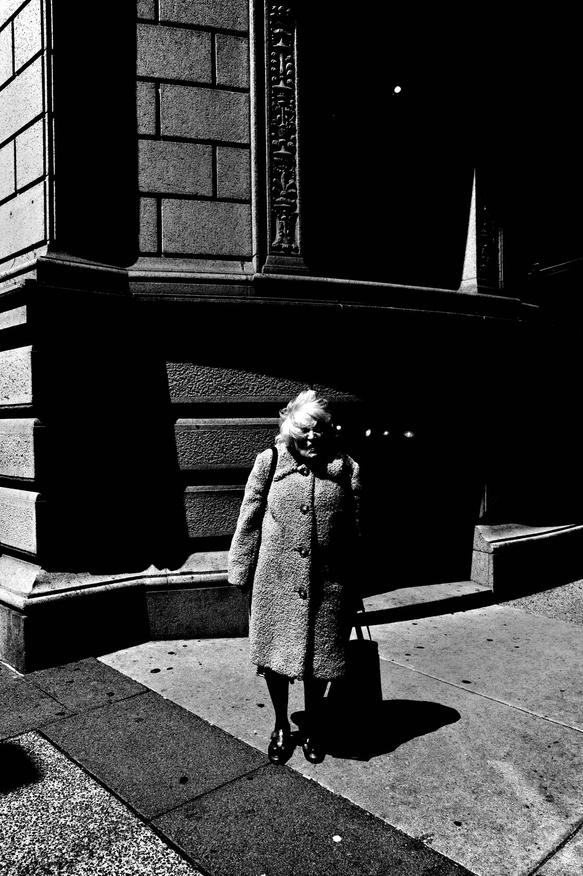
FLUX ACADEMY
BEAT 11 · MAIN TEACHING
Always Ready, Always Creating
— A camera small enough to live with you
— No bulky rig, no fiddling with settings
— Ready to shoot at any second
Notes:
A small, unobtrusive camera lets you live your life while staying ready to shoot. No bulky setup, no constantly adjusting manual settings. With a camera that fits in your pocket, photography becomes seamless — it integrates into daily life without disrupting it. Always ready. Always creating.

Slide 13
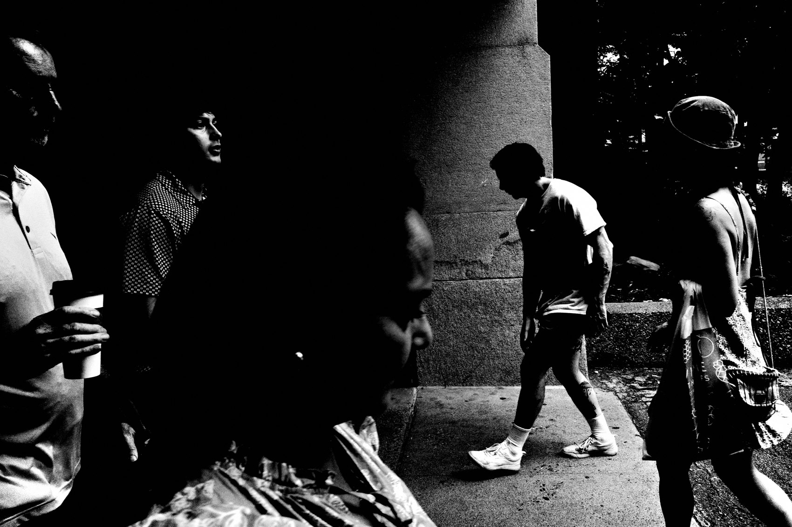
FLUX ACADEMY
BEAT 12 · MAIN TEACHING
Transcend the Photographer
— With a small device, you transcend being a photographer
— It's not about a camera around your neck
— Photography flows from your experiences
Notes:
Here's a subtle one. With a small device in your pocket, you transcend what it means to be a photographer. This isn't about looking the part — camera around the neck, gear on display. It's about living in a way where photography flows naturally out of your experiences.

Slide 14
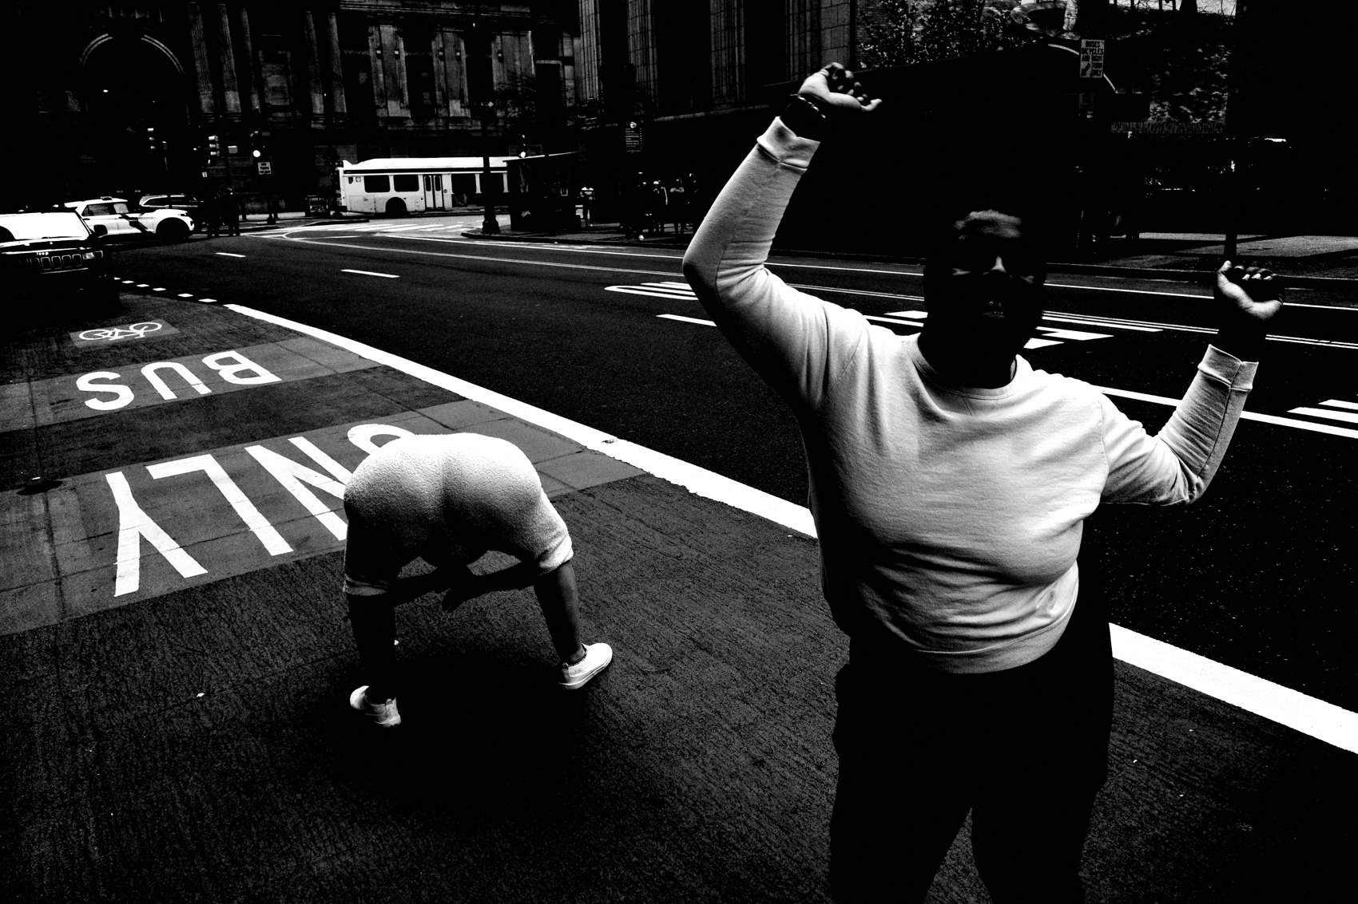
FLUX ACADEMY
BEAT 13 · MAIN TEACHING
Increase Curiosity 1% a Day
— Let the camera be your compass
— Increase curiosity by 1% each day
— Curiosity is the engine of the practice
Notes:
So what's the daily aim? Simple: increase my curiosity by 1% each day. Let the camera be your compass and let curiosity guide you. That's the engine of the whole life — not a big dramatic goal, just a little more wonder than yesterday, every single day.

Slide 15
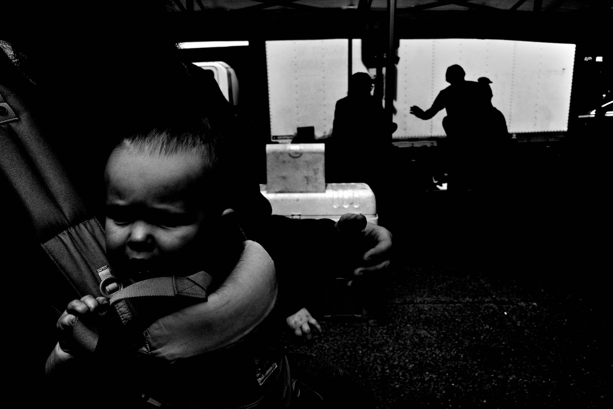
FLUX ACADEMY
BEAT 14 · MAIN TEACHING
Wake Up Reborn
— Treat sleep like a mini-death
— Treat each morning like a rebirth
— A big kid with a camera
Notes:
This is how I structure the day around it. I treat sleep like a mini-death, and each morning like a rebirth. I wake up eager to catch the sunrise, and I go out with the spirit of play — like a big kid with a camera. When photography is your life, the day itself reorganizes around it.

Slide 16
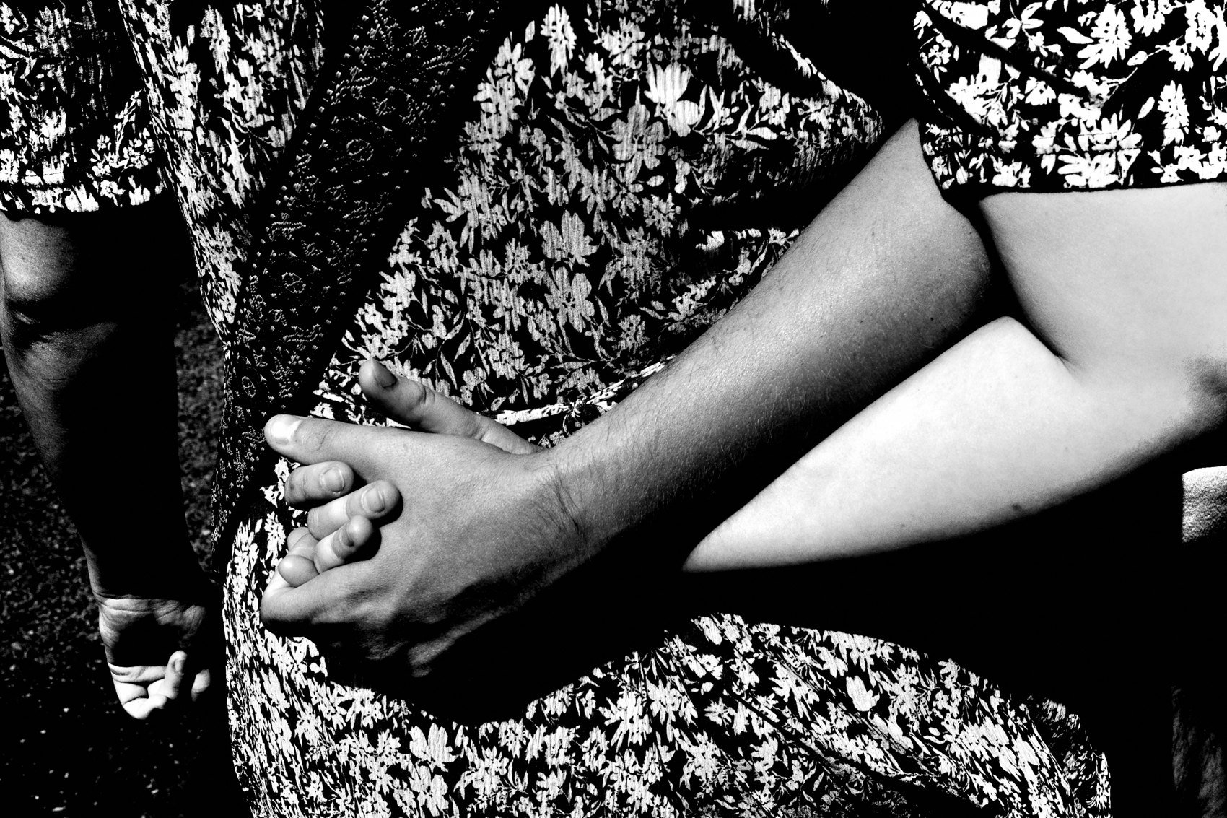
FLUX ACADEMY
BEAT 15 · MAIN TEACHING
Meaning in the Mundane
— A hand gesture, a fleeting glance — lifted
— Create something from nothing
— The ordinary becomes the extraordinary
Notes:
And the reward is everywhere, all the time. With a camera in hand, even the most ordinary moment — a hand gesture, a fleeting glance — can be uplifted to a new height. Through photography you create something from nothing. I can always find meaning in the mundane. That's life-affirming.

Slide 17
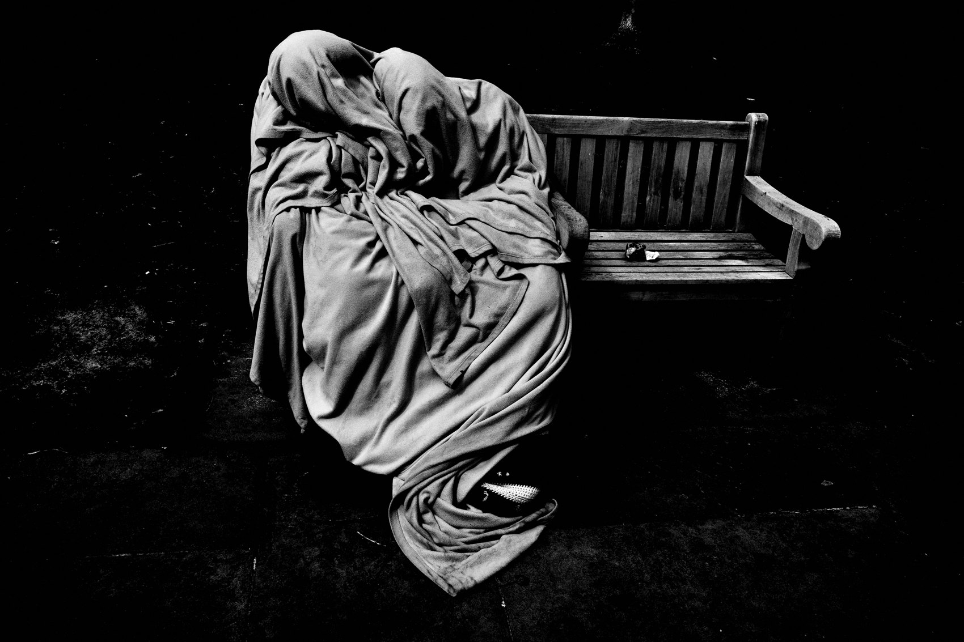
FLUX ACADEMY
BEAT 16 · MAIN TEACHING
Creating Your Own Reality
— Not capturing life realistically — creating my own reality
— From documentary toward artistic abstraction
— The frame becomes your world
Notes:
Here's what happens over time. You stop being interested in capturing life realistically, and you start creating your own reality. The focus shifts from documentary realism toward artistic abstractions of life. High-contrast black and white isn't an accident — it's a way of shaping the world into something uniquely yours. The way you render the world becomes your signature.

Slide 18
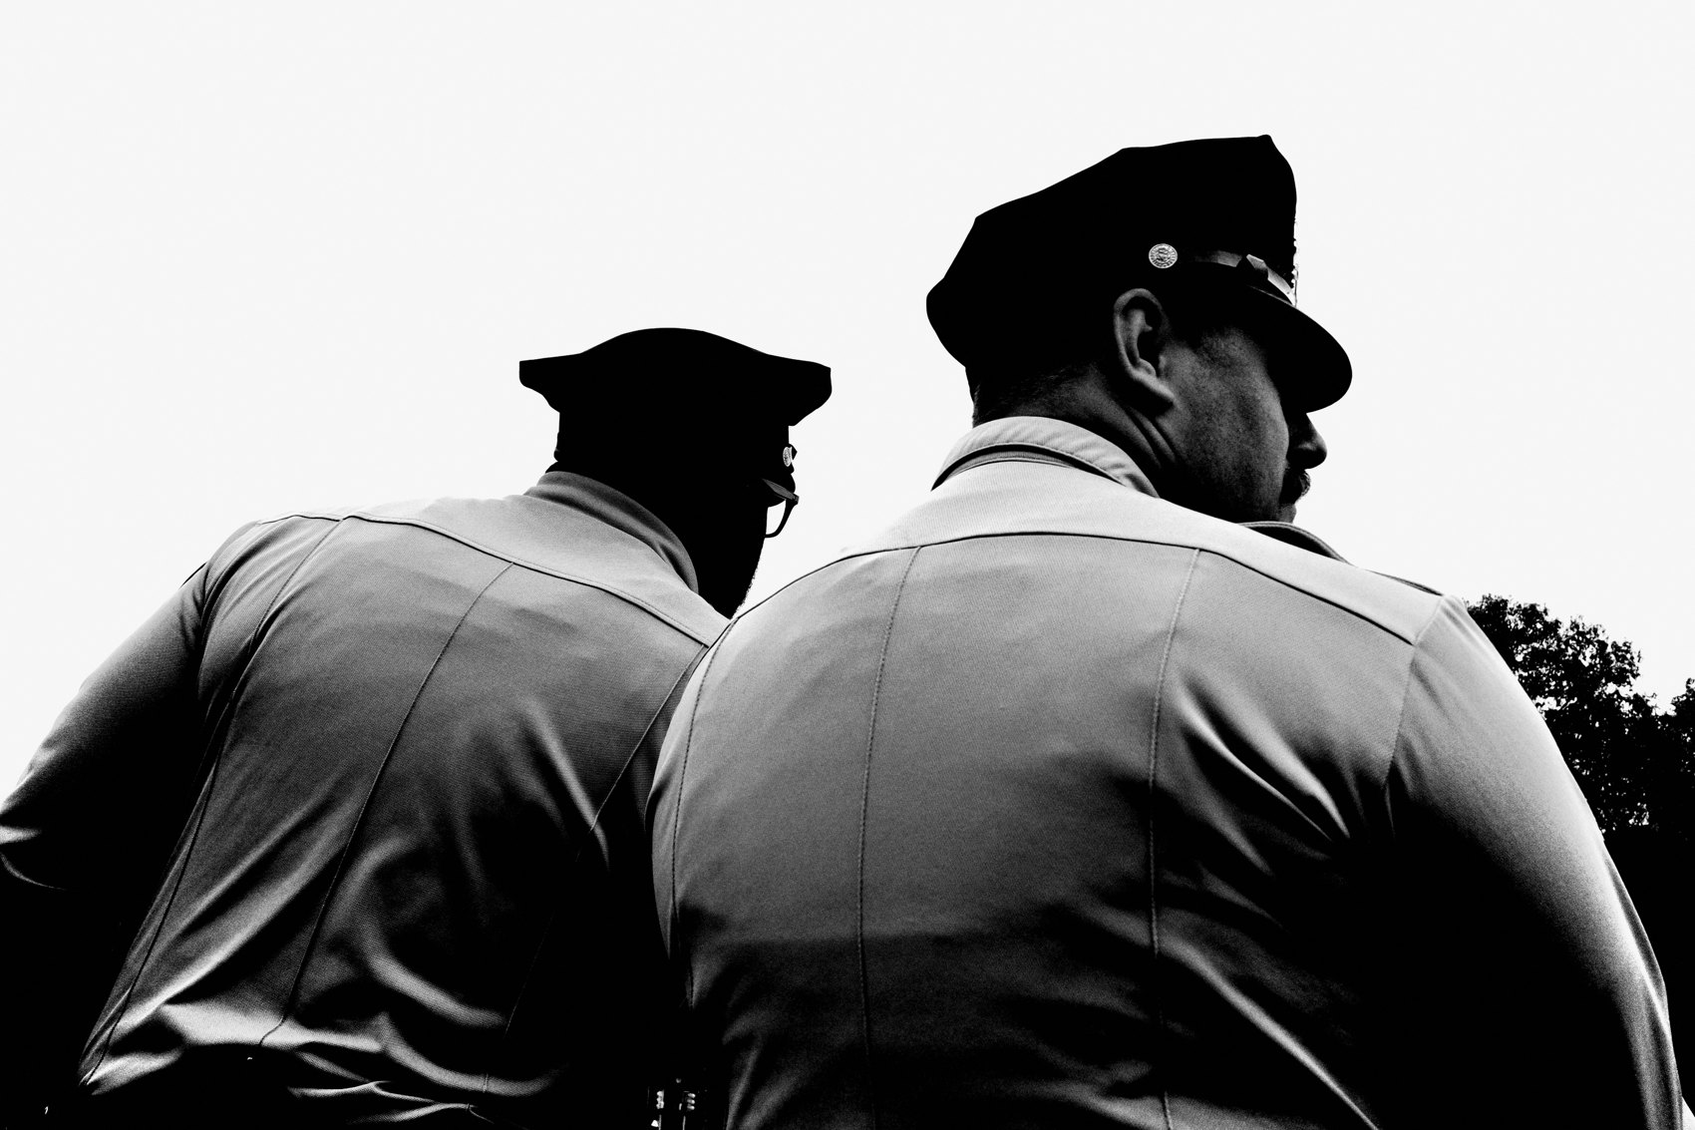
FLUX ACADEMY
BEAT 17 · MAIN TEACHING
Your Archive Is Your Autobiography
— Your photographs are extensions of your life
— They carry the energy of your streets, your way
— The archive becomes your autobiography
Notes:
Here's what your work becomes. Your photographs aren't just images; they're extensions of your life. They capture the energy of your streets, the rhythm of your city, the world as you see it. This is your life, your world, rendered your way. When photography is a way of life, the archive becomes your autobiography — a record of exactly how you moved through your days.

Slide 19
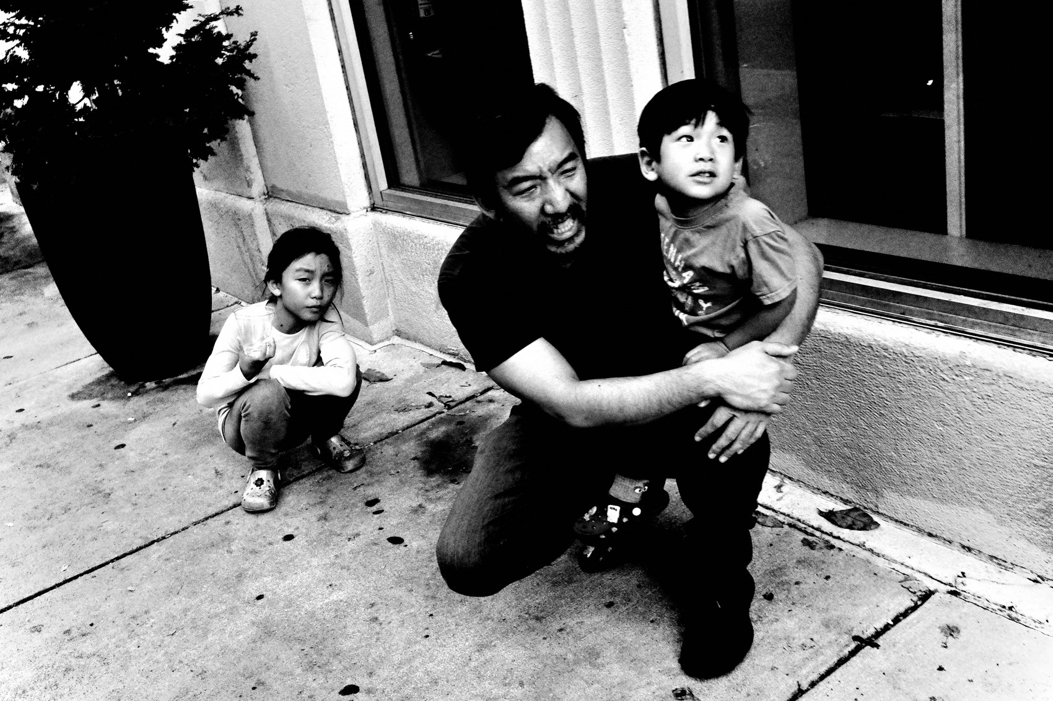
FLUX ACADEMY
BEAT 18 · PRACTICAL APPLICATION
Carry the Camera Everywhere
— One pocketable camera, on you always
— Lock simple settings, forget them
— Shoot on errands, commutes, walks
Notes:
Let's make it real. Pick one small camera you can carry every single day — pocketable, simple settings locked in so you never fiddle. Then bring it everywhere: the commute, the errand, the walk. Don't make a "photo trip." Let the photos happen inside your ordinary day.

Slide 20
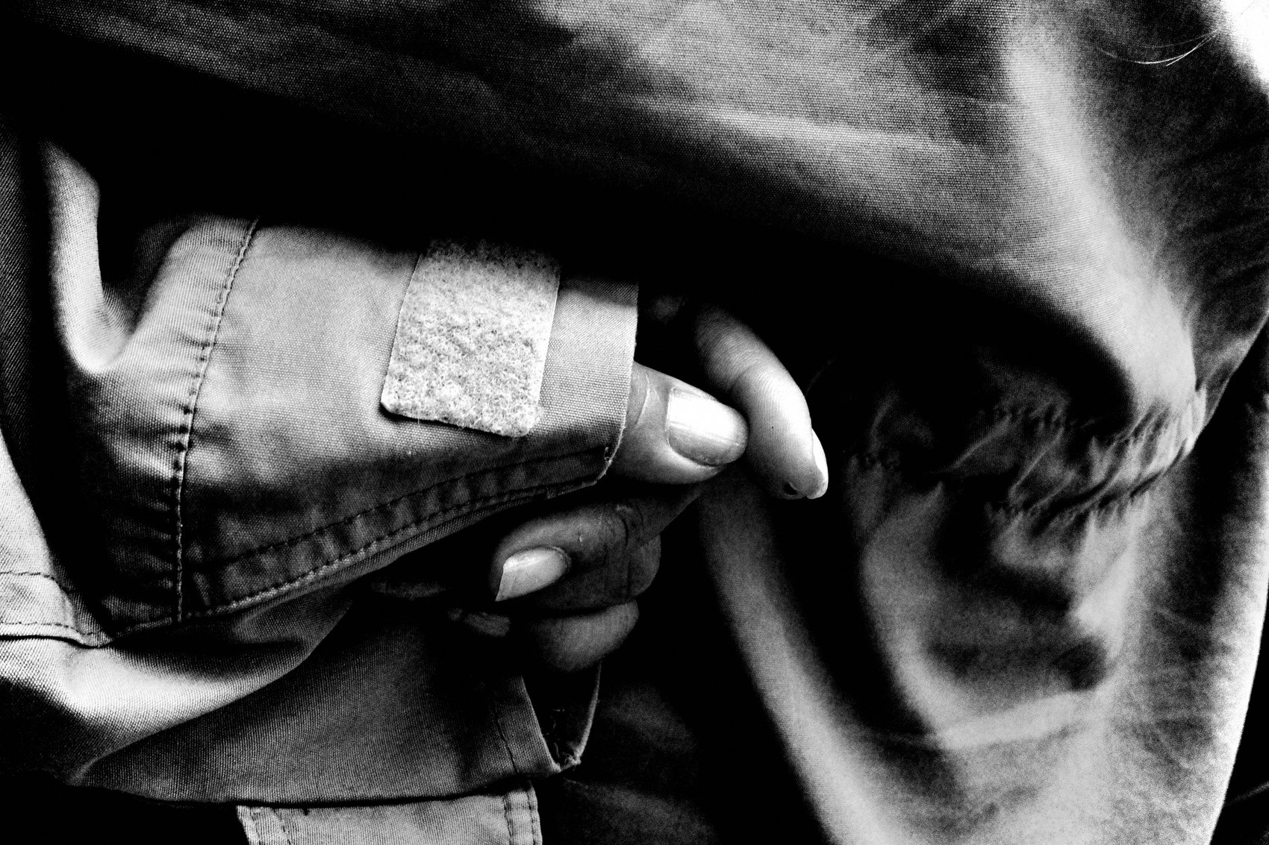
FLUX ACADEMY
BEAT 19 · PRACTICAL APPLICATION
The Daily Rebirth Ritual
— Each morning: born again, eyes open
— Aim to increase curiosity 1%
— Sleep = mini-death, morning = reset
Notes:
And build the ritual. Each morning, treat it like you were just born — eyes open to infinite possibilities. Each night, let it go like a mini-death. Your only daily target: be 1% more curious than yesterday. Do that long enough and photography stops being something you do — it's something you are.

Slide 21
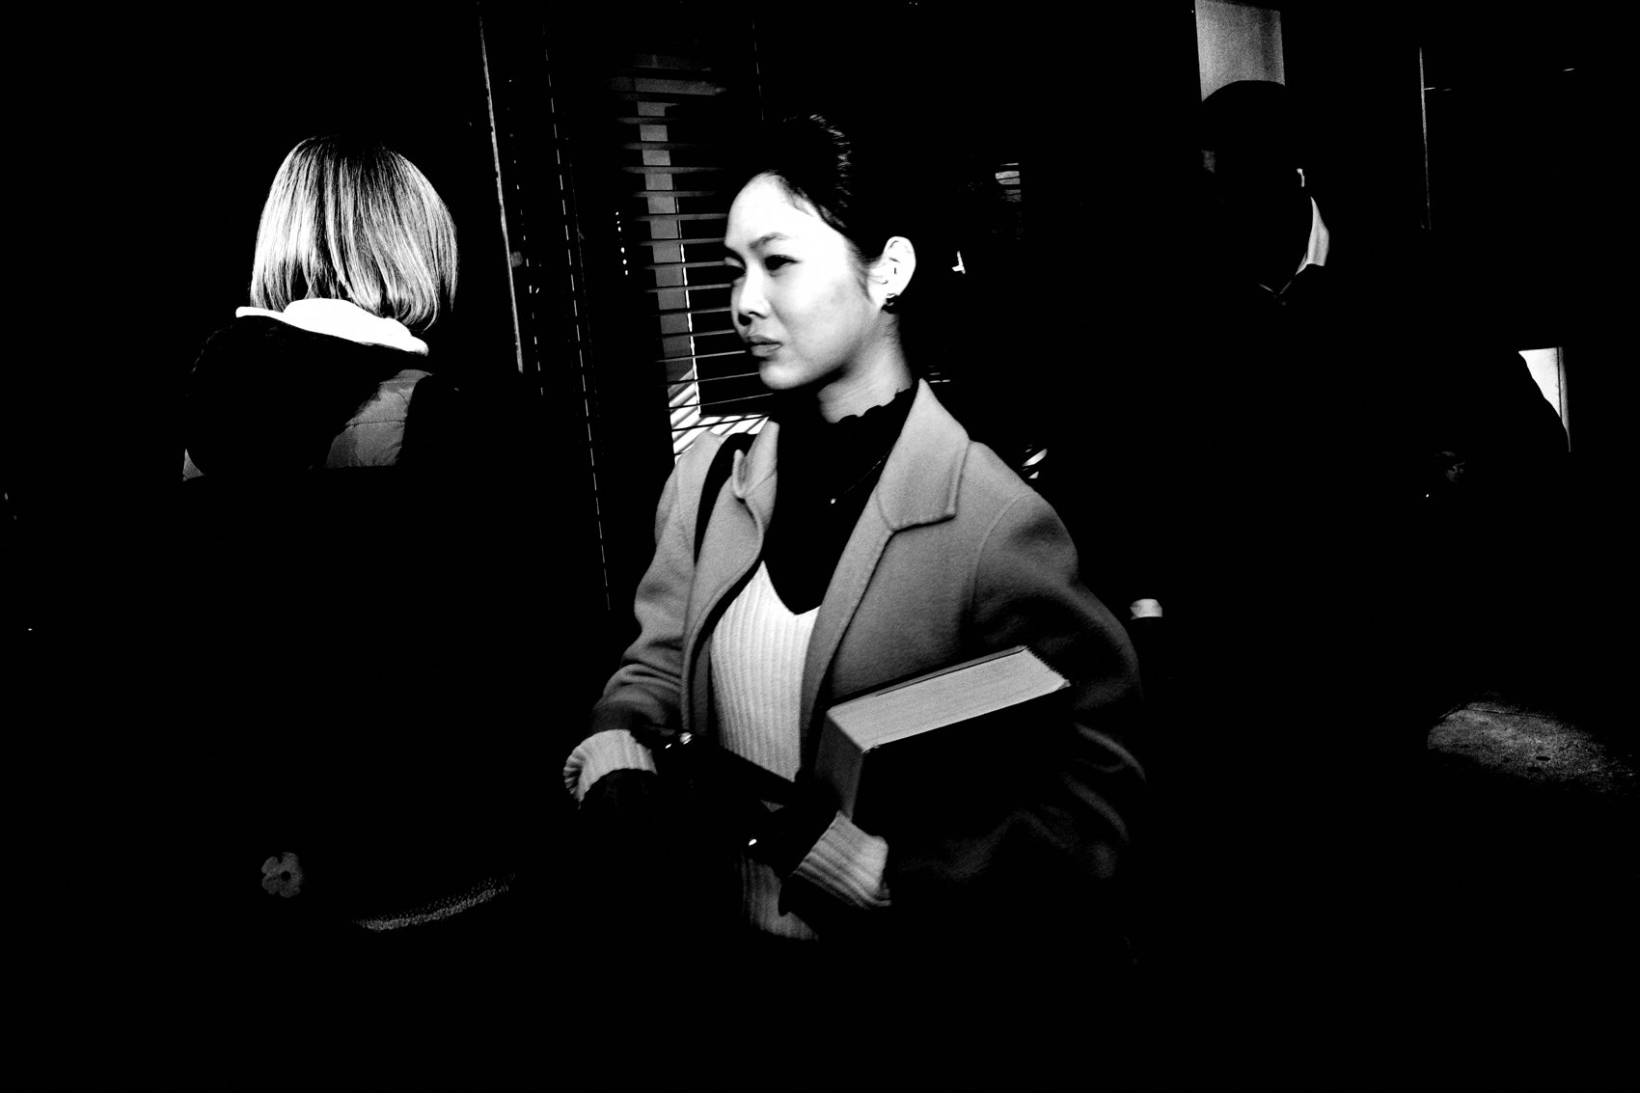
FLUX ACADEMY
BEAT 20 · COMMON MISTAKES
Treating It Like a Hobby
— A hobby gets put down; a way of life doesn't
— Don't wait for a "photo day"
— Sporadic shooting kills momentum
Notes:
Now the traps. The first mistake is treating it like a hobby — something you pick up on weekends, gear that lives on a shelf between "photo days." A way of life doesn't get put down. If you only shoot when you've scheduled it, you'll never reach the depth this practice offers.

Slide 22
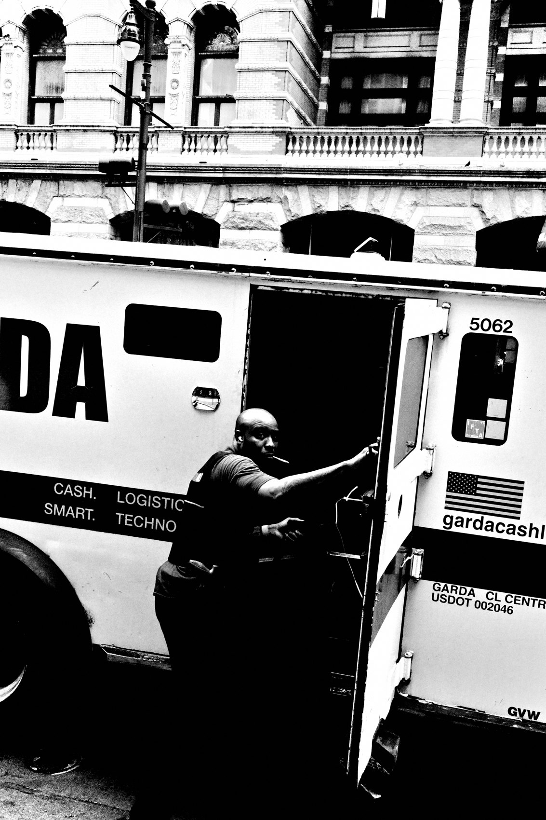
FLUX ACADEMY
BEAT 21 · COMMON MISTAKES
Over-Gearing the Process
— Bulky kit = friction = you leave it home
— Complexity is the enemy of longevity
— Heavy gear makes you look like a photographer
Notes:
The second mistake is over-gearing. A heavy, complicated rig adds friction, and friction means you leave it at home. Complexity is the enemy of longevity. Don't try to look like a photographer with a camera around your neck — keep it small, simple, and seamless so it can actually live alongside you.

Slide 23
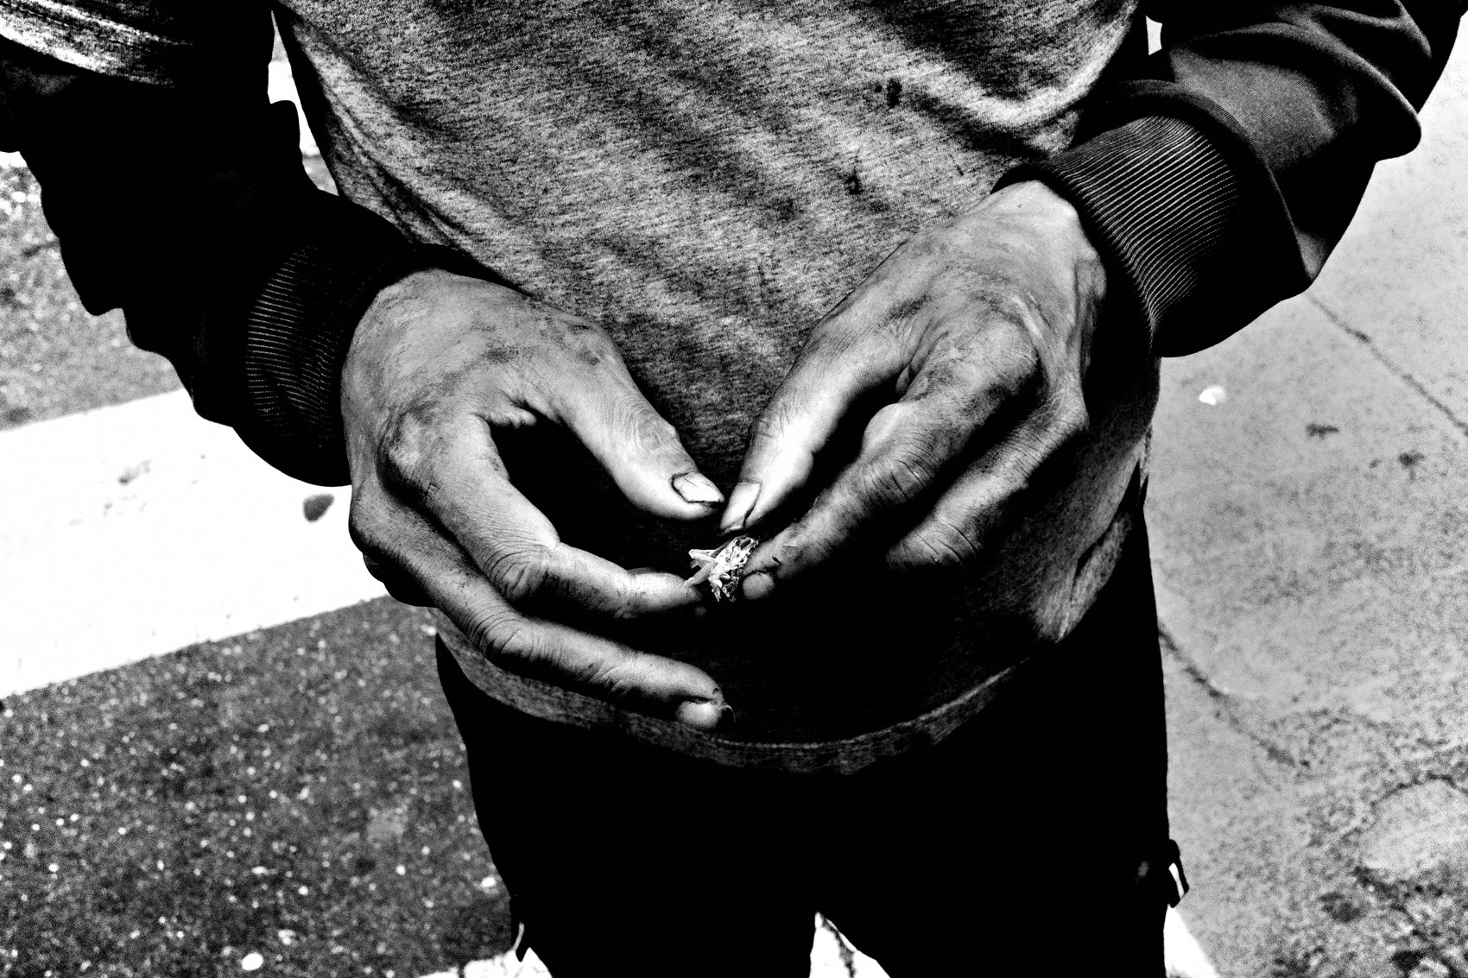
FLUX ACADEMY
BEAT 22 · RELATIONSHIP TO PREVIOUS
Built on the Goal
— Lesson 001 set the goal
— This turns that goal into a life
— Why → how you live
Notes:
This builds straight on Lesson 001. There we answered the goal — to reveal what reality could be, made from curiosity and joy. Today we took that goal and extended it into a whole way of living. The why from last lesson becomes the how you wake up in this one.

Slide 24
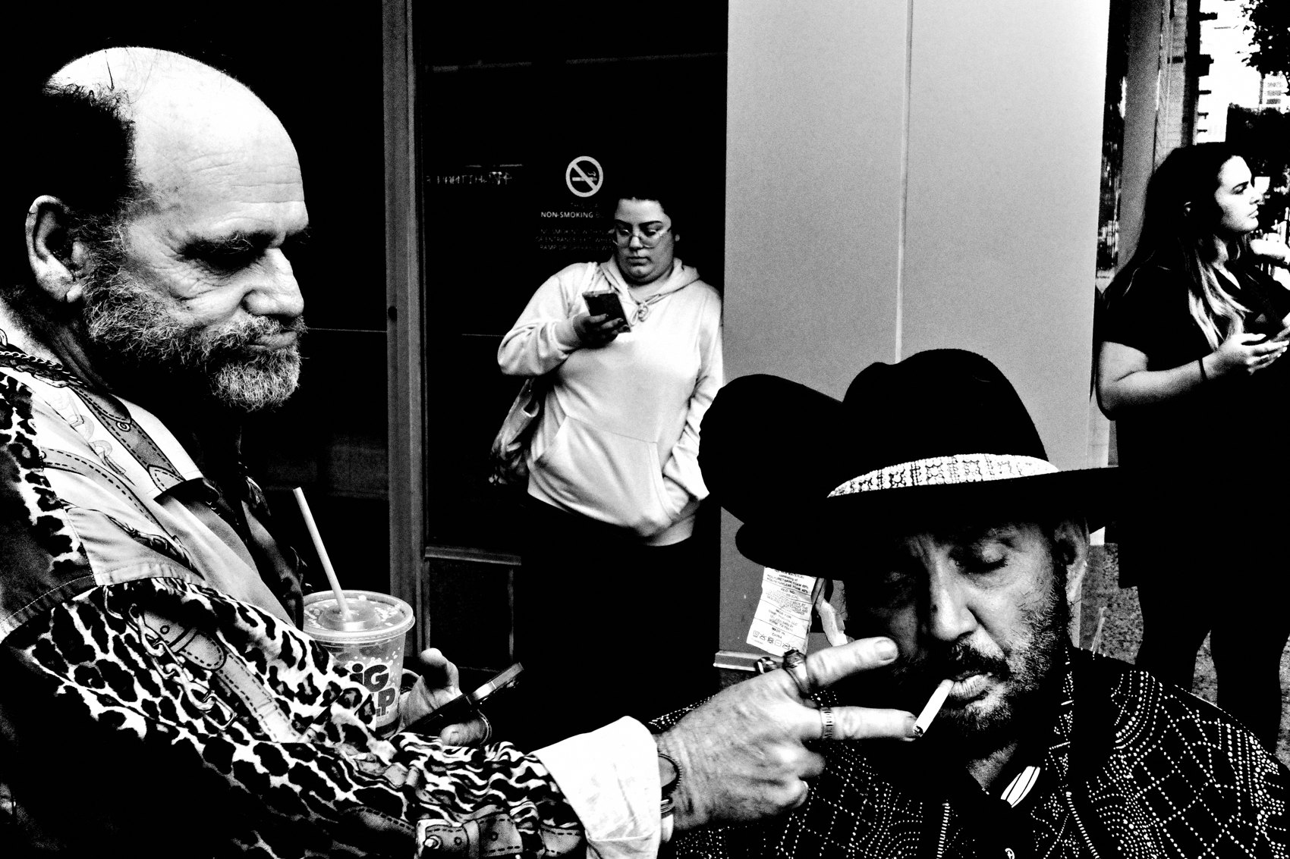
FLUX ACADEMY
BEAT 23 · RELATIONSHIP TO UPCOMING
Shoot Everything, No Limits
— Next: Shoot Everything, No Limits (Lesson 003)
— Then the rest of Module 1's worldview
— A way of life means nothing is off-limits
Notes:
Where do we go from here? Next is Lesson 003 — Shoot Everything, No Limits — and it follows naturally, because once photography is your life, nothing is off-limits. Lesson 003 and the rest of Module 1 keep building this FLUX worldview. So go out there, carry the camera, increase your curiosity by 1%, and make the world your own — one frame at a time. Catch you next lesson.

