Slide 1
FLUX ACADEMY · A SCHOOL FOR SEEING
MODULE 1 · FOUNDATIONS
What Is the Goal of Street Photography?
BY DANTE SISOFO

Slide 2

FLUX ACADEMY
BEAT 01 · CORE IDEA
The Goal Isn't Good Photos
— It's not about "impressive" images
— It's about what reality could be
— See, don't just document
Notes:
What's popping, people — it's Dante. Welcome to FLUX. Let's start with the only question that matters: why do we do this? And the answer is going to surprise you — the goal is not to make good photos. It's to capture what reality could be, not just what it is.

Slide 3

FLUX ACADEMY
BEAT 02 · LEARNING OBJECTIVE
What You'll Walk Away With
— A goal you can actually sustain
— Why "good" is the wrong target
— The mindset the whole year rests on
Notes:
By the end of this lesson you'll understand the real purpose behind street photography — a goal you can chase for the rest of your life without burning out. This is the foundation everything else stands on.

Slide 4

FLUX ACADEMY
BEAT 03 · WHY THIS MATTERS
Chasing "Impressive" Hollows You Out
— The more you chase impressive, the less fulfilling it gets
— External success runs dry
— The wrong goal quietly kills the joy
Notes:
Here's why this matters so much: the more you get caught up making an "impressive" photograph, the less fulfilling it becomes over time. Chase applause and you'll wake up empty. The wrong goal will quietly kill the very thing you love.

Slide 5

FLUX ACADEMY
BEAT 04 · WHY THIS MATTERS
A Goal You Can Keep for Life
— Right goal = lifelong fuel
— Not a finish line, a way of moving
— Sustainable beats impressive
Notes:
The right goal does the opposite — it fuels you for decades. It's not a finish line you cross; it's a way of moving through the world. Get this right and you'll never run out of reasons to pick up the camera.

Slide 6

FLUX ACADEMY
BEAT 05 · MAIN TEACHING
What Reality Could Be
— Not what reality is — what it could be
— Your lens interprets, not records
— Elevate the ordinary into meaning
Notes:
So here's the goal, stated plainly: not to record what reality is, but to reveal what reality could be. You're not a copy machine. You're an interpreter — taking an ordinary moment and lifting it into something that means something.

Slide 7

FLUX ACADEMY
BEAT 06 · MAIN TEACHING
Release Judgment of Quality
— Stop grading every frame "good/bad"
— Judgment chokes the flow
— Just make the next photo
Notes:
First principle: release the judgment of quality. The instant you label each frame good or bad, you choke. Stop grading. Just make new photographs — let the evaluating come much, much later, if at all.

Slide 8

FLUX ACADEMY
BEAT 07 · MAIN TEACHING
Just Make New Photos
— Volume over verdicts
— The next frame, then the next
— Quantity is permission
Notes:
The practice is almost dumb in its simplicity: just make new photos. Don't stop to judge — keep going. The next frame, and the next. That permission to keep shooting is the freedom.

Slide 9
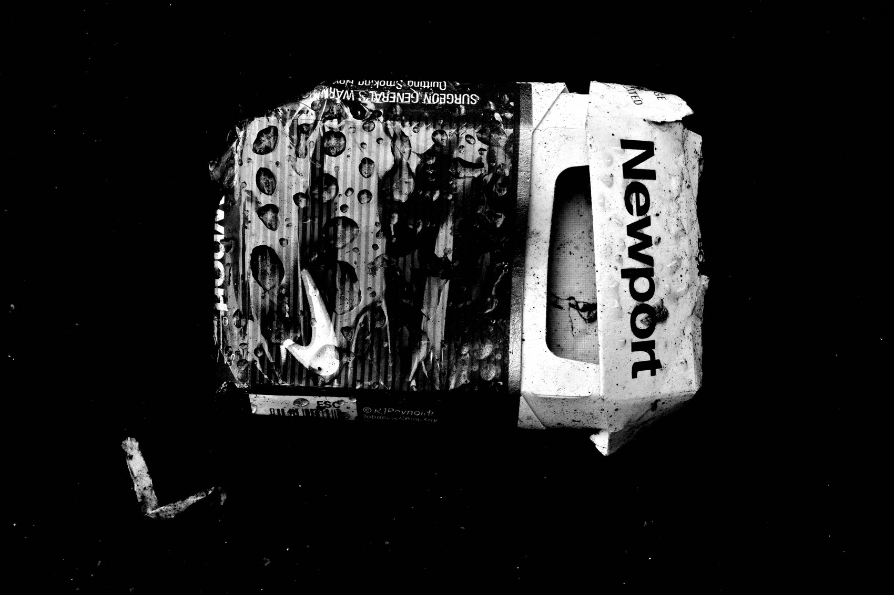
FLUX ACADEMY
BEAT 08 · MAIN TEACHING
Cultivate Curiosity
— Return to the child-like state every morning
— Eyes wide open to infinite possibility
— Curiosity is the heart of it
Notes:
The engine underneath all of it is curiosity. Return to the child-like state every morning and keep your eyes wide open to the infinite possibilities of the streets. Wonder is the whole practice. Lose the wonder, lose the work.

Slide 10

FLUX ACADEMY
BEAT 09 · MAIN TEACHING
The Cartier-Bresson Warning
— Cartier-Bresson modeled curiosity
— But he abandoned photography
— Keep the curiosity, avoid the burnout
Notes:
Cartier-Bresson modeled this curiosity better than anyone — and then he walked away from photography entirely. I take that as a warning: keep the curiosity and keep the love. The goal has to be one you don't outgrow.

Slide 11

FLUX ACADEMY
BEAT 10 · MAIN TEACHING
Embrace Play
— Photography is an excuse to be in a state of play
— Play unlocks freedom
— The camera is the permission slip
Notes:
Next principle: play. Think of photography as an excuse to go out there and be in a state of play. The camera is your permission slip to wander, to mess around, to be free. The play is the point.

Slide 12

FLUX ACADEMY
BEAT 11 · MAIN TEACHING
Adults Forgot How to Play
— Reclaim play as essential
— Seriousness drains fulfillment
— Joy is not a luxury here
Notes:
Somewhere along the way adults are told play is childish. Reclaim it. Treat photography as a serious career-building grind and the fulfillment drains right out. Joy isn't a luxury in this work — it's the fuel.

Slide 13

FLUX ACADEMY
BEAT 12 · MAIN TEACHING
Reframe the Purpose
— Ask: what will reality manifest to be?
— A question, not a checklist
— Interpretation over documentation
Notes:
So reframe the whole purpose into a question you carry: what will reality manifest to be in a photograph? That single question turns you from a documentarian into an interpreter — every time you raise the camera.

Slide 14

FLUX ACADEMY
BEAT 13 · MAIN TEACHING
Interpretation Over Documentation
— The same street, your vision
— Elevate, don't just capture
— The photograph adds something
Notes:
Two people stand on the same corner; one documents it, one elevates it. The difference is interpretation — what you bring. The photograph should add something that wasn't obviously there. That's the job.

Slide 15

FLUX ACADEMY
BEAT 14 · MAIN TEACHING
Photography as a Life Practice
— The camera deepens how you live
— Connection, attention, presence
— A practice, not a hobby
Notes:
Bigger than pictures: this is a life practice. The camera deepens how you move through the world — more connected, more attentive, more present. You're not collecting photos; you're practicing a way of being alive.

Slide 16

FLUX ACADEMY
BEAT 15 · MAIN TEACHING
Go Beyond This Earth
— Your goal isn't to get patted on the back
— It's to go beyond this Earth
— Meaning over validation
Notes:
And here's the deep end: your goal isn't to get patted on the back… it's to go beyond this Earth. Beyond likes, beyond approval — toward connection, meaning, something transcendent. Aim there and the small stuff stops mattering.

Slide 17

FLUX ACADEMY
BEAT 16 · MAIN TEACHING
Create from Curiosity and Joy
— Create from pure curiosity and joy
— Not from expectation
— The source decides the work
Notes:
If you take one line from today, take this: create from pure curiosity and joy — never from external expectation. Where the work comes from decides what it becomes. Start at joy and curiosity, always.

Slide 18
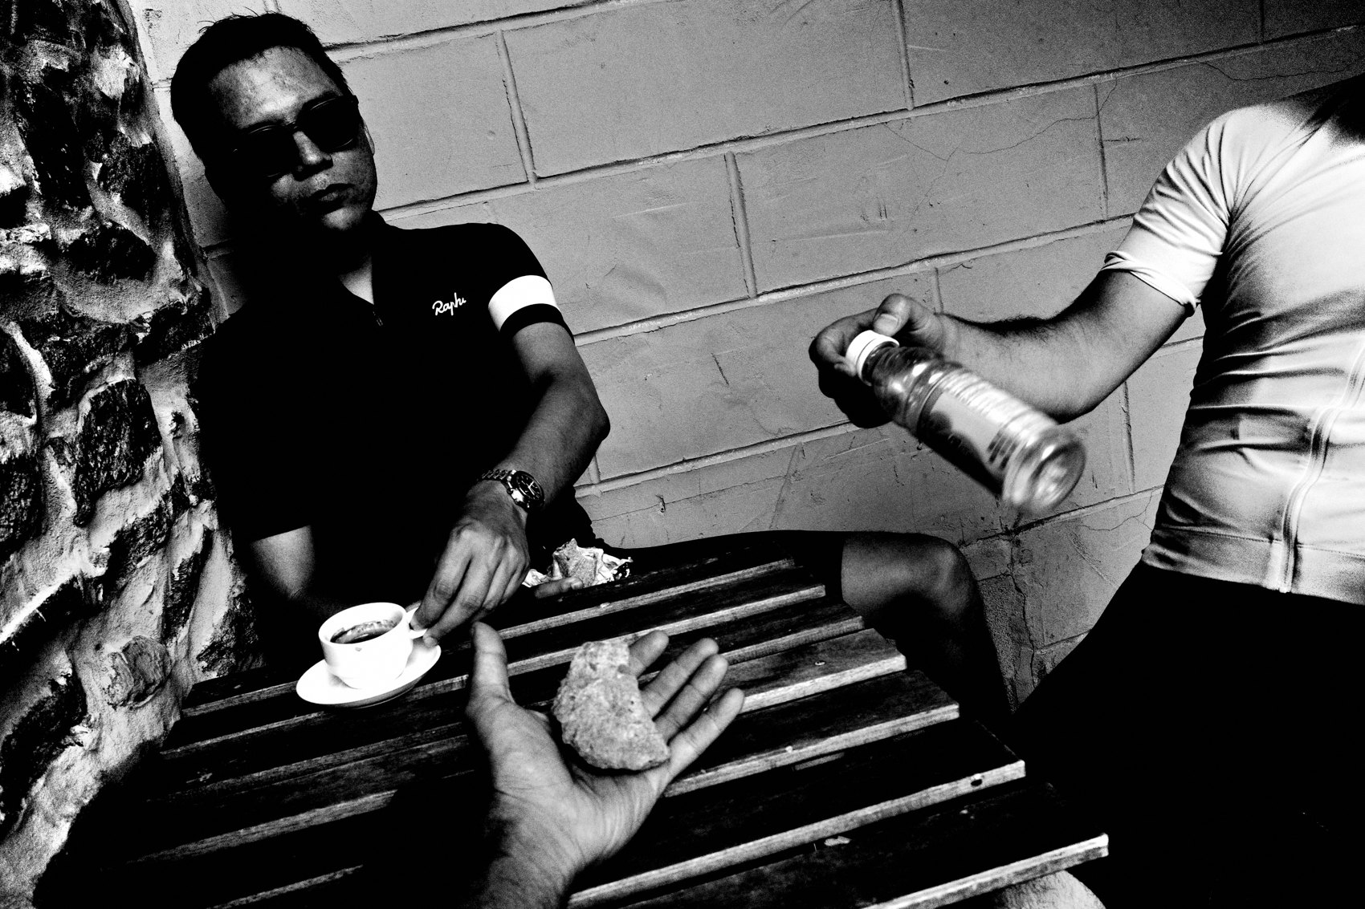
FLUX ACADEMY
BEAT 17 · PRACTICAL APPLICATION
Shoot With Zero Judgment
— Tomorrow: make photos, grade nothing
— No "keeper" thinking on the street
— Notice how much more you see
Notes:
Here's your assignment. Tomorrow, go out and make photographs with zero judgment. No "is this good," no keeper-thinking. Just curiosity and the next frame. Watch how much more you suddenly see.

Slide 19
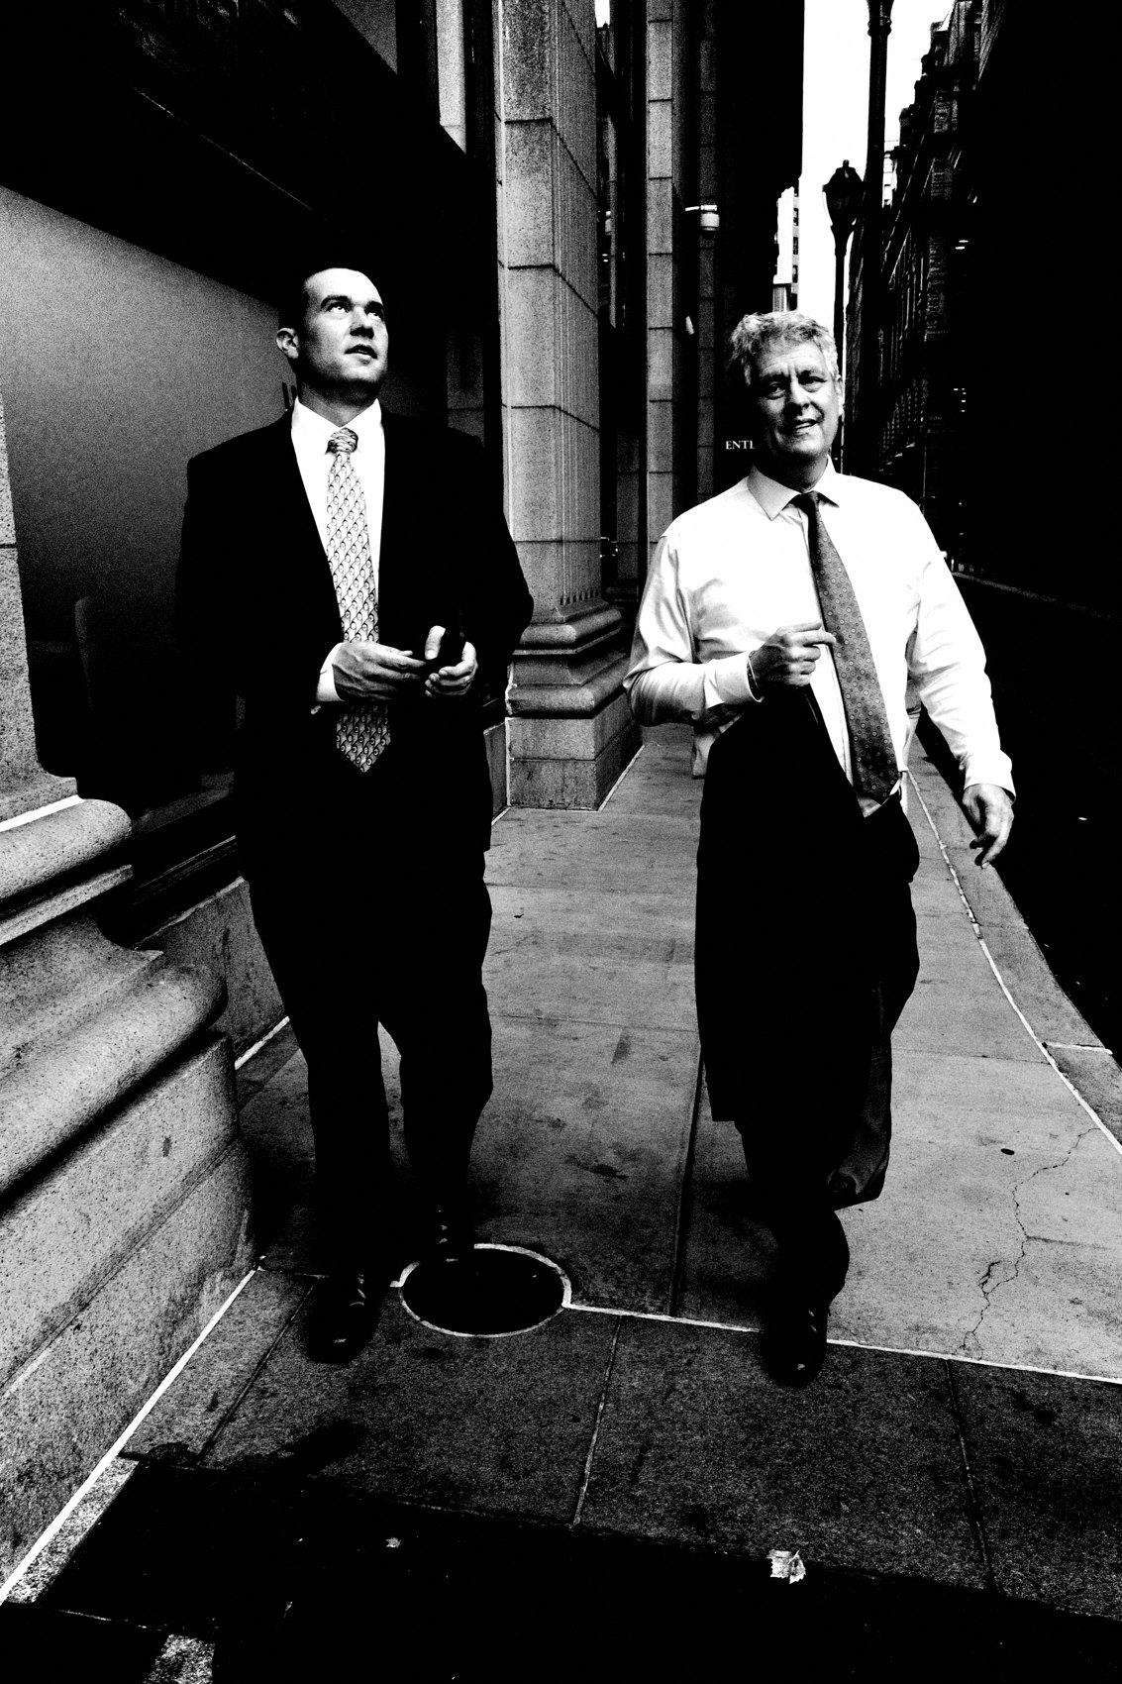
FLUX ACADEMY
BEAT 18 · PRACTICAL APPLICATION
The Curiosity Reset
— Each morning, child eyes back on
— Treat the known street as unknown
— Wonder is a daily choice
Notes:
And build a daily reset: each morning, put the child eyes back on. Walk your most familiar street like you've never seen it. Wonder isn't a personality trait — it's a choice you make every single day.

Slide 20

FLUX ACADEMY
BEAT 19 · COMMON MISTAKES
Shooting for Approval
— Don't shoot for likes or the algorithm
— Approval is a moving target
— It quietly distorts your eye
Notes:
The biggest mistake — and it's everywhere — is shooting for approval. For the feed, the likes, the algorithm. It's a moving target that never satisfies, and worse, it slowly bends your eye away from what's true to you.

Slide 21
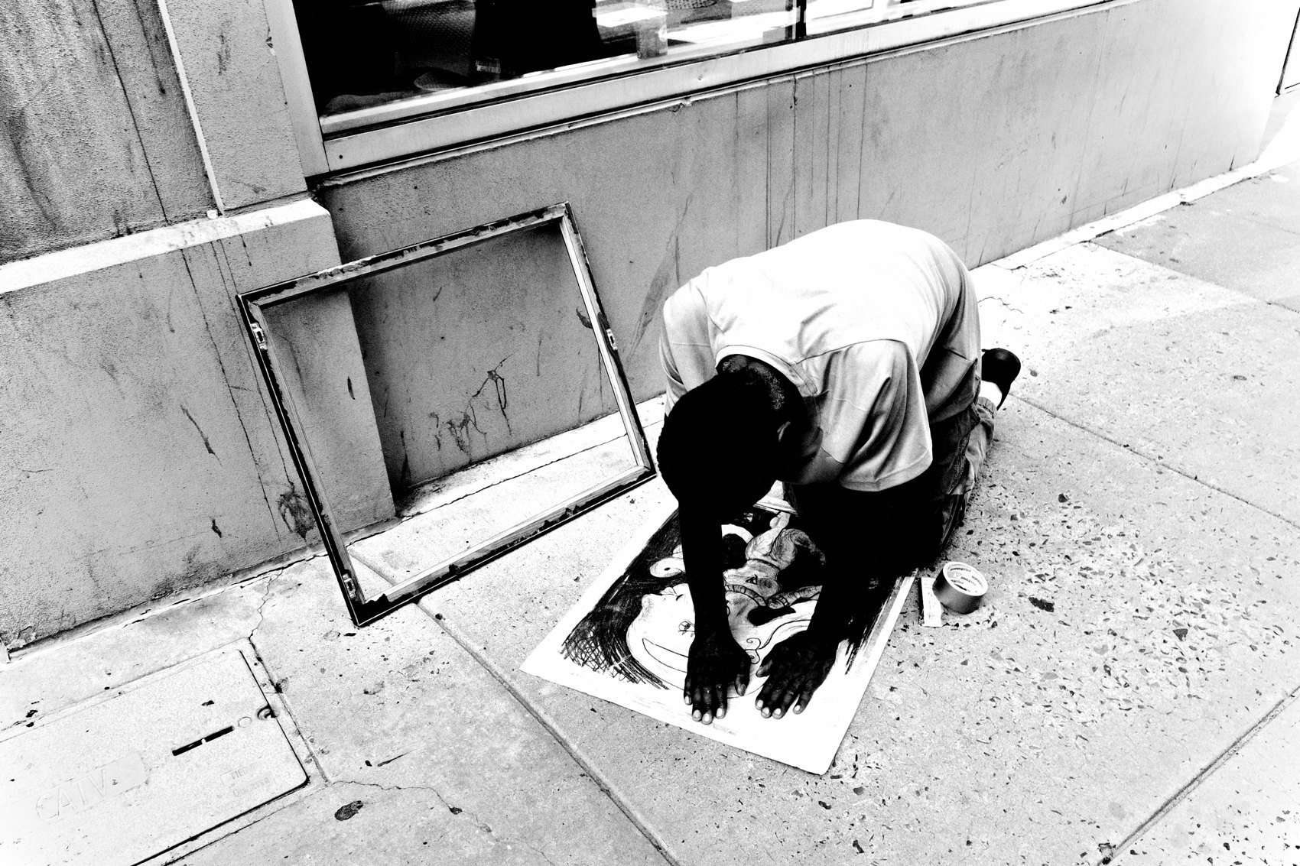
FLUX ACADEMY
BEAT 20 · COMMON MISTAKES
Making It a Grind
— Career-grind mindset drains it
— Pressure crowds out play
— Seriousness is the silent killer
Notes:
The other mistake: turning it into a serious, grinding pursuit of "making it." Pressure crowds out play, and play was the fuel. Take it seriously by keeping it joyful — that's not a contradiction, it's the whole secret.

Slide 22
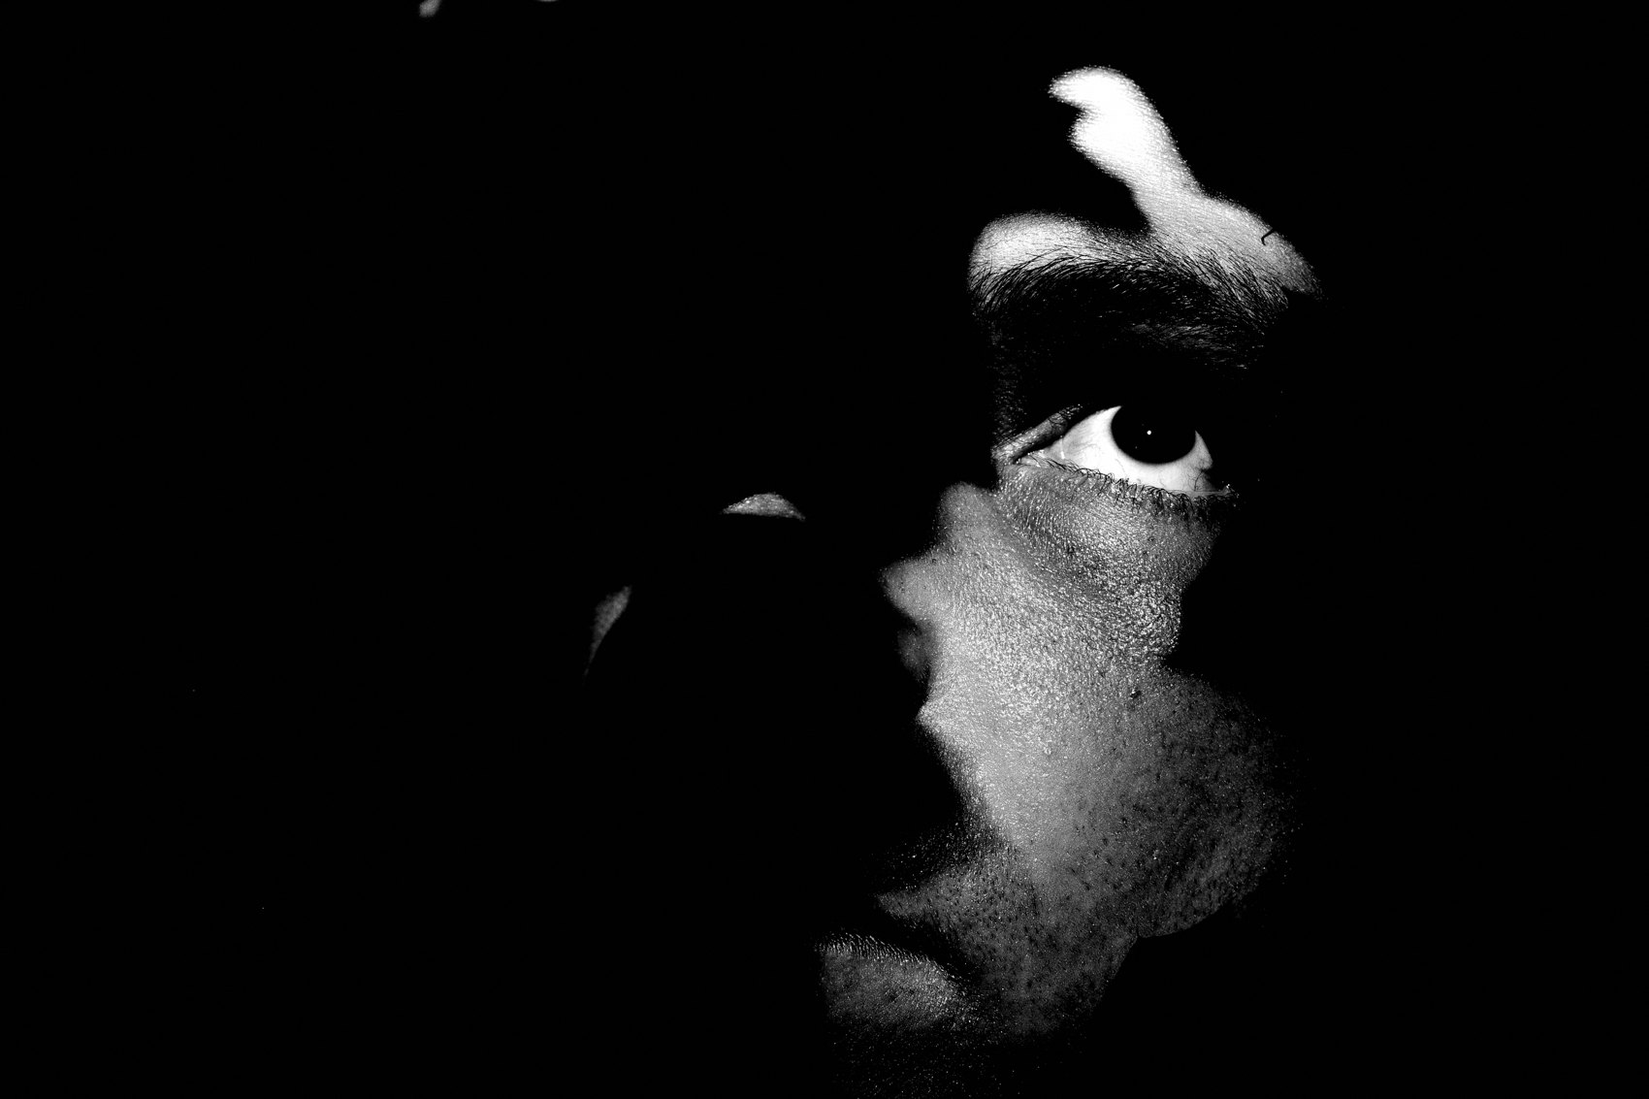
FLUX ACADEMY
BEAT 21 · RELATIONSHIP TO PREVIOUS
Where It All Begins
— This is Lesson 1 — the starting line
— Every later lesson leans on this
— The goal underwrites everything ahead
Notes:
There's nothing before this one — this is the starting line. Every technique, every craft lesson across the rest of the course leans back on the goal we set today. Get the why right and the how has somewhere to stand.

Slide 23

FLUX ACADEMY
BEAT 22 · RELATIONSHIP TO UPCOMING
Where We Go From Here
— Next: Photography as a Way of Life (Lesson 002)
— Then: Shoot Everything, No Limits (Lesson 003)
— Building the full FLUX worldview (Module 1)
Notes:
Next, we extend this goal into a whole way of living (Lesson 002), then break the last filter with Shoot Everything, No Limits (Lesson 003). These first five lessons build the FLUX worldview — and it all grows from today's answer.

Slide 24
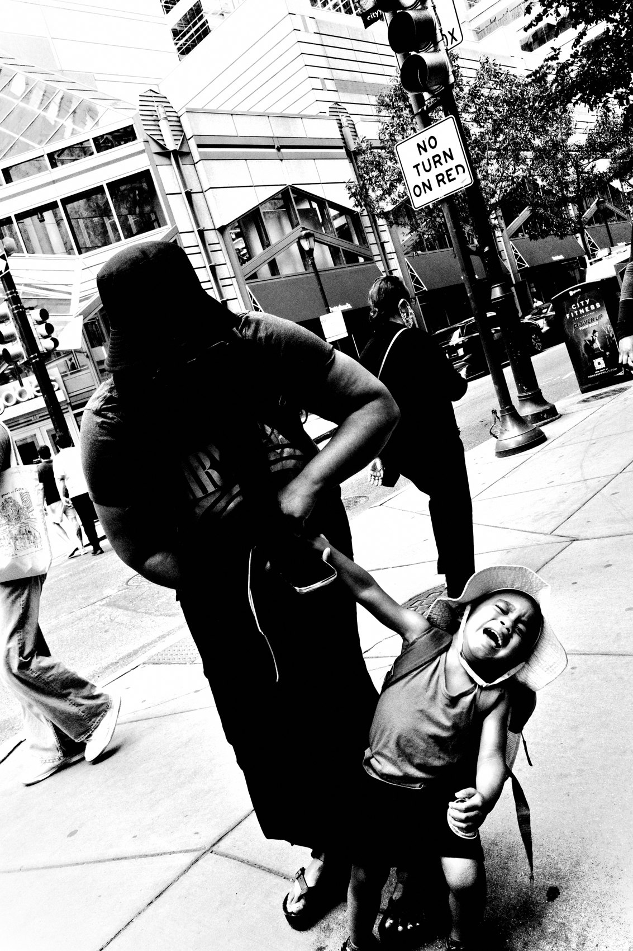
FLUX ACADEMY
BEAT 23 · SUMMARY / TAKEAWAY
See, Play, Go Beyond
— The goal: reveal what reality could be
— From curiosity and joy, never approval
— See. Play. Go beyond.
Notes:
Last thing. The goal of street photography isn't good photos — it's to reveal what reality could be, made from pure curiosity and joy, reaching for something beyond a pat on the back. See. Play. Go beyond. Welcome to FLUX — catch you next lesson.

